Slide 1
Site Selection Project
Part I: Selecting a Second Location for Prince George’s County Animal Shelter
Prepared by AnnaLinden Weller, Karin Flom, Sofie Rhoads, and Sarah Ingerson
URSP 688L – Planning Technologies – Fall 2017
Notes:
Sarah - Research Questions; Second 2 sites
AnnaLinden - Methodologies; Recommendations/Future Research
Karin - Background; First 2 sites

Slide 2
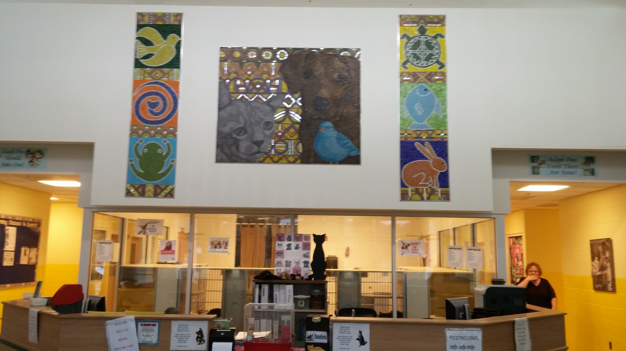
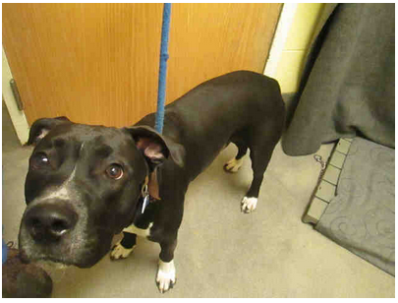
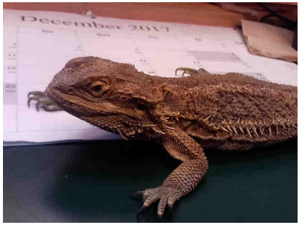
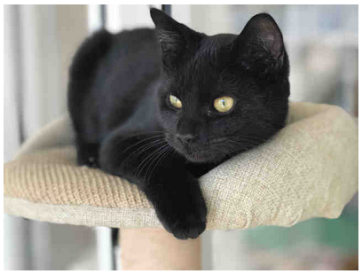
Introduction: A New Shelter
How can we utilize geospatial information, demographic data, and the existing feasibility study to determine optimal sites for a new animal shelter in northern Prince George’s County?
  Zoning
  Transportation
  Building and parking footprint
BEARDED DRAGON - ID#A468215
HUNTER -
ID#A437430
CHELSEA - ID#A466292

Slide 3
Background

Slide 4
Background: Why Do We Need a Second Shelter?
Existing facilities are out of the 15-30 minute drive shed residents prefer
Existing facilities are not readily accessible
Mismatch between population density and animal adoptions
Comparable counties in size to Prince George’s usually have more than one county animal shelter

Slide 5
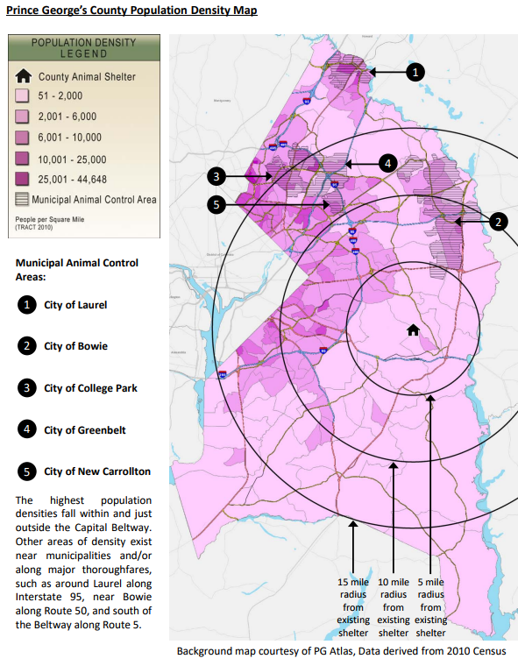
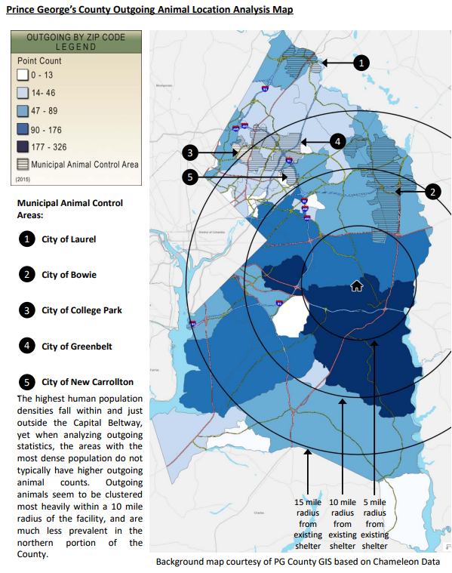
Background: Why Do We Need a Second Shelter?
Maps from the feasibility study for second animal shelter.
Left = population density
Right = animal adoptions

Slide 6
Background: What are the options?
Three options:
  Basic Adoption Center
  Adoption Center, limited intake
  Full Service Second Center
There is an optional vet module for each

Slide 7
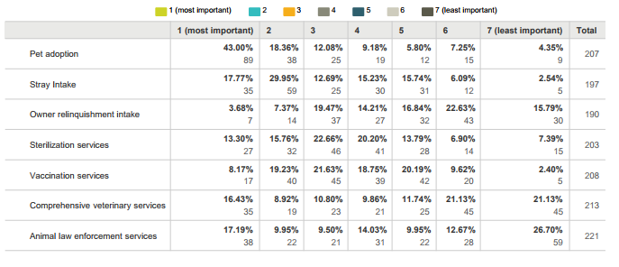
Background: Selection of options
After conversation with Chief Rodney Taylor, the team pursued site selection for Option 1.
Community wishes for a second shelter:
feasibility study

Slide 8
Methodologies & Processes

Slide 9
Methodologies & Processes
Developed a ranked list of criteria for potential sites:
County-owned land
Vacant land without existing structures
Correctly zoned land
Proper parcel size, including building footprint and parking
In the northern part of the County
Road access
In an attractive location
Transit access

Slide 10
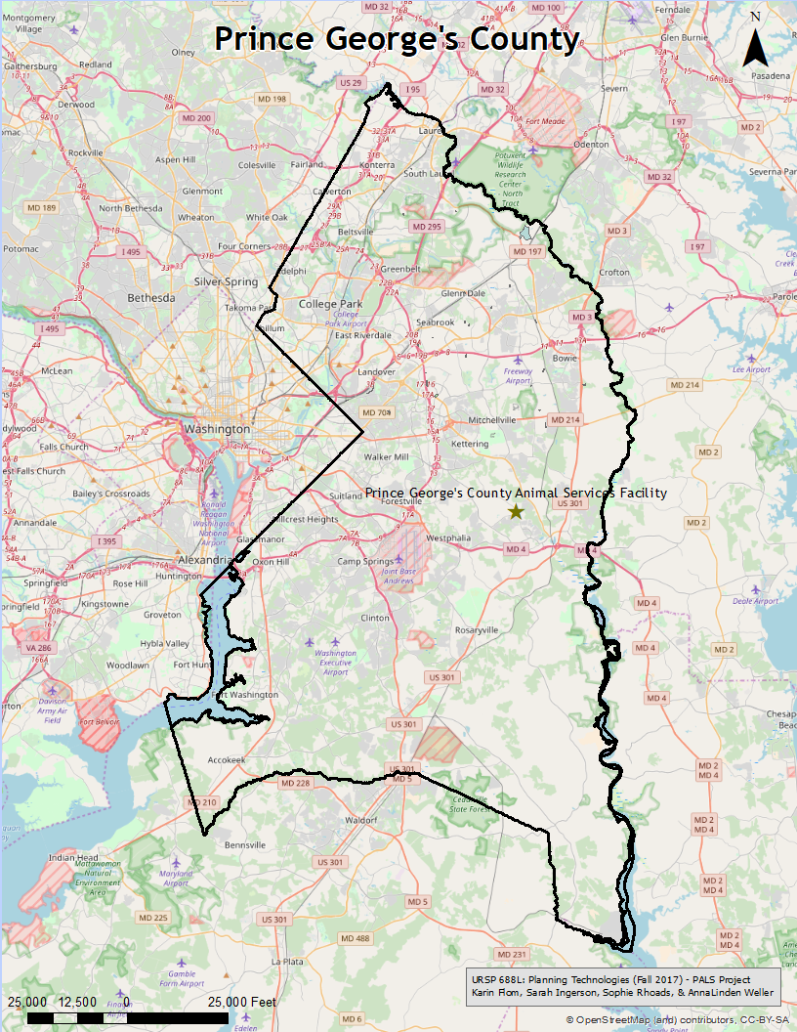
Prince George’s County
fifth largest in land area in Maryland
second in Maryland for population (890,000)
25% of residents live within one mile of a municipality
source: animal shelter feasibility study

Slide 11
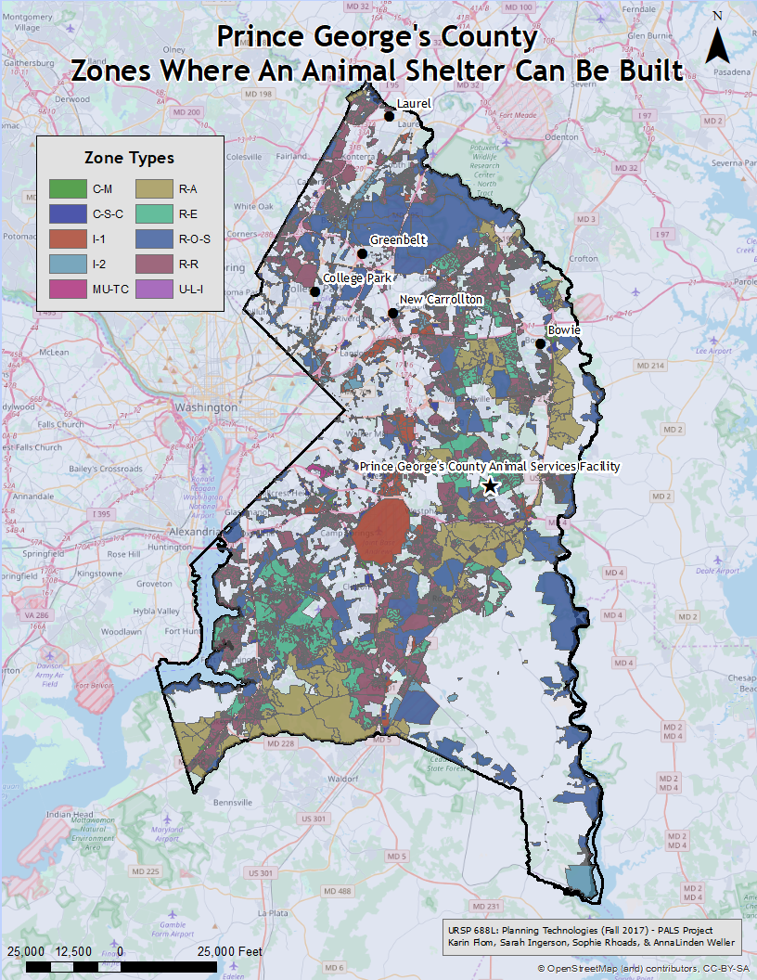
Zoning:
Where can a shelter be built?
Always:
I-1, light industrial
I-2, heavy industrial
U-L-I, urban light industrial
With Permit:
R-O-S, reserved open space
O-S, open space
R-A, residential agricultural
R-E, residential estate
R-R, residential rural
M-U-TC, mixed use town center
C-S-C, commercial shopping center
C-M, commercial miscellaneous

Slide 12
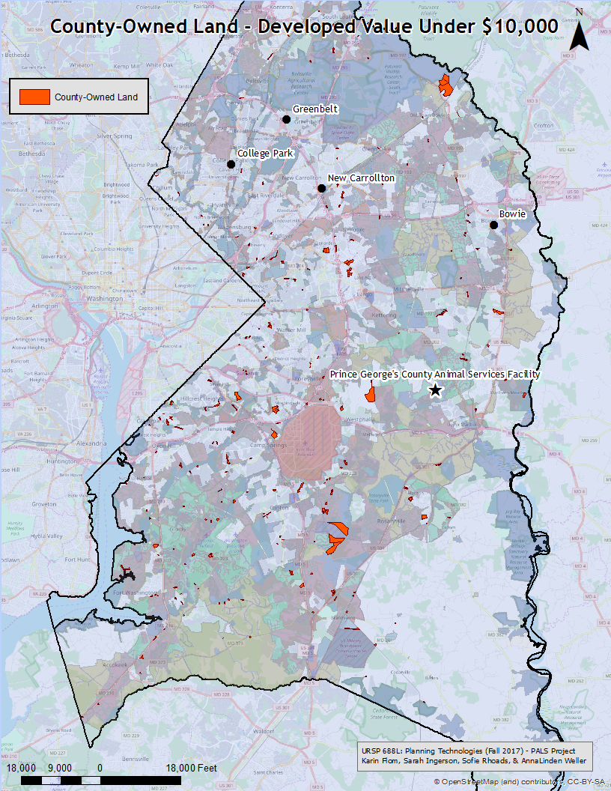
County-Owned Land
-developed value of less than $10,000
- at least 21,750 square feet
(includes for 11,840 sqft of parking)

Slide 13
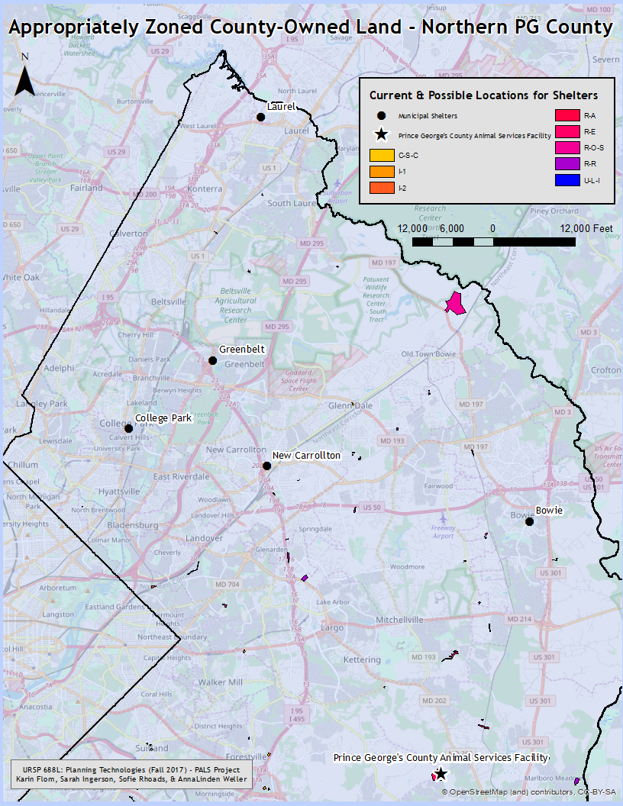
Possible sites
- in the north of the county
- considered in proximity to other shelters
- meeting all other requirements

Slide 14
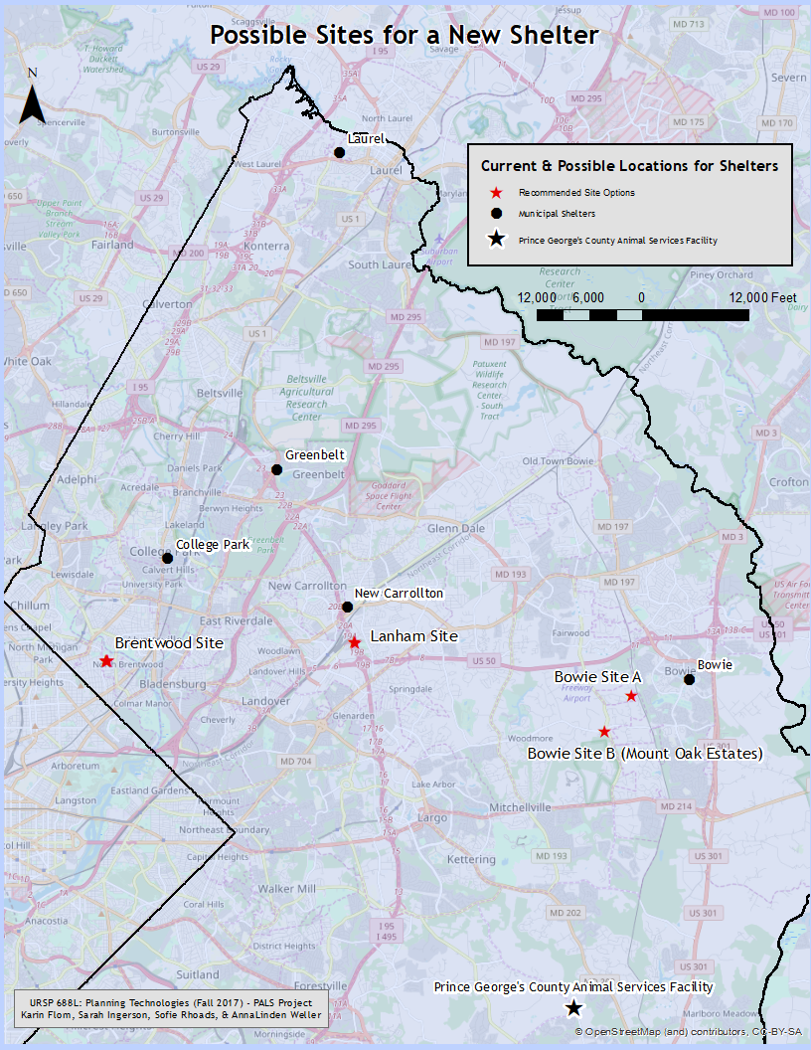
Recommended Sites
Lanham
Bowie-B
Brentwood
Bowie-A

Slide 15
Research Interpretations
(Survey of Potential Sites)

Slide 16
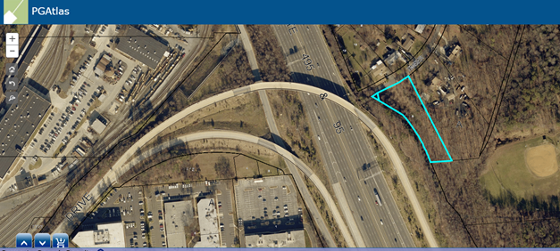
Research Interpretations
Potential Site #1 - 4603 Timber Lane
Lanham, MD
1 acre
By 495/95 and Route 50
Near the New Carrollton Metro

Slide 17
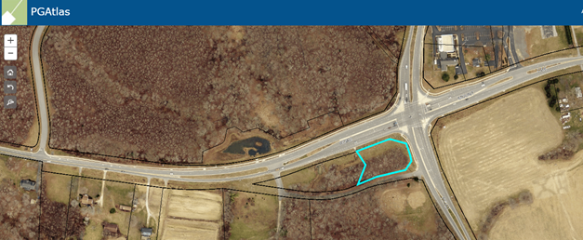
Research Interpretations
Potential Site #2 - Church Road and Mount Oak Road
Bowie, MD
1 acre
Accessible from Route 50 and Route 193
(Bowie B)

Slide 18
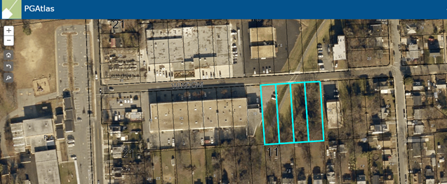
Research Interpretations
Potential Site #3 - Windom Road
Brentwood, MD
21,000 square feet
Commercial & residential area
Densely populated

Slide 19
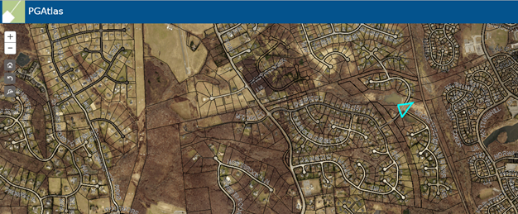
Research Interpretations
Potential Site #4 - Church Road Triangle
Bowie, MD
1.59 acres
In a residential subdivision
Triangular site may have some building disadvantages
(Bowie A)

Slide 20
Recommendations

Slide 21
Recommendations
Based on our mapping work, we have four recommended sites for a new adoption center.
While all of these sites have potential, the County might find sites closer to its initial specifications if it was willing to look at parcels not currently county-owned or with extant structures.
No matter what site is chosen, a marketing campaign advertising the location of the new shelter should be part of the operating budget for construction (40% of the survey respondents in the Feasibility Study were unaware of the location of the current facility).

Slide 22
Opportunities for Further Research

Slide 23
Opportunities for Further Research
New zoning maps for PG County may impact possible sites, opening up some new areas -- when these maps are available, the analysis of properly-zoned areas should be run again
Coordination with municipal shelters and the County’s key partners in animal welfare to maximize opportunity to get animals to new homes
  Is the new site geographically convenient to these partners?
  ‘Heat map’ of locations where animals need to be relocated from municipal shelters or areas without shelters would provide refinement of site selection to the optimal location for access.

