Slide 1
Minding the Gap:
Searching for Lost items in Offsite Storage
Arthur Natishan
Severn Library Supervisor
University of Maryland Libraries

Slide 2

A Little Background
In the summer of 2016 we moved 500,000 volumes from space we were renting inJohns Hopkins University’s Library Services Center to our brand new facility Severn Library.
This collection had been at the LSC since 2005.

Slide 3
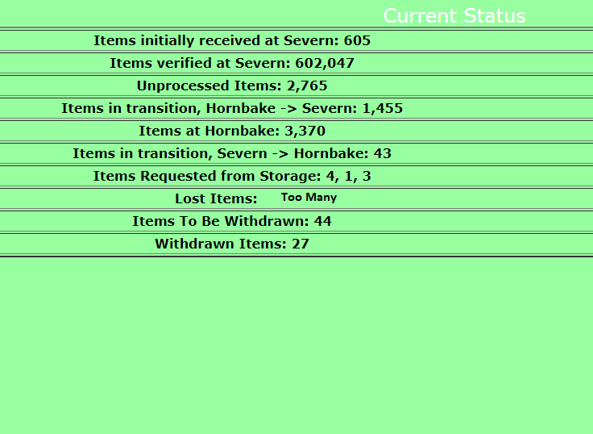
The Problem
Around 2500 items were missing.
When checking moving data from the move, these trays were not in the spreadsheets.
We had no idea where to begin looking.

Slide 4
What do you mean there are gaps?
Our Database Administrator gave us two lists to help us find lost items.
The first list was of gaps between trays on our shelves.
Second was of empty shelves, some of which, we found, should have had trays.

Slide 5
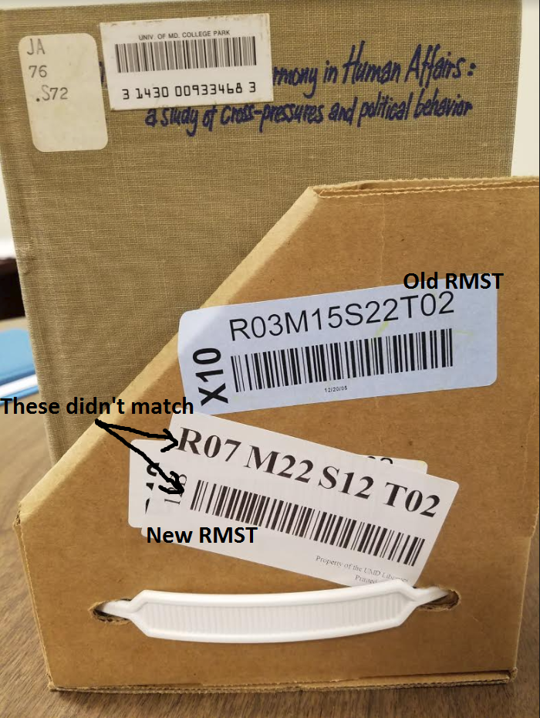
What we found
During the move there had been an issue with receiving trays.
When the RMST* barcodes were printed, the machine readable barcode never changed from the old barcode to the new one.
Once we identified the lost tray, we printed a new label and moved the items from the old RMST to the new one.
Thanks to this project we have found over 1,500 missing items.
We continue to search for missing items through an inventory project.
*RMST Stands for Row, Module Shelf, and Tray. This is the system we use to find items on our shelves.

Slide 6
Sources
Hackman, T. & Loebe, M. (2018). Accidental Project Management in a New Library Storage Facility. In Alice L. Daugherty (Ed.), Project Management in the Library Workplace (pp.) Bingley, U.K.: Emerald.

