Slide 1
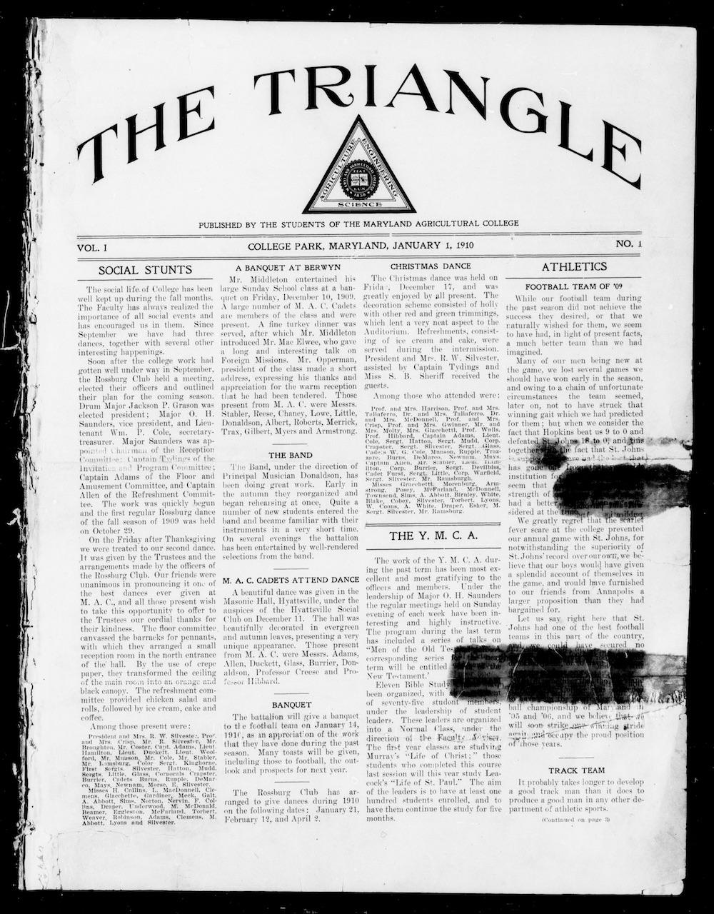

The Digital Diamondback:
Unfolding University History through Open Standards and Open Data
Kendall Aughenbaugh, Liz Caringola, Robin Pike, Joshua Westgard
Libraries Research and Innovative Practice Forum
June 14, 2018
Notes:
Welcome
Order:
Robin, Manager, DCMR
Liz, Archival Metadata Librarian
Josh, Systems Librarian
Kendall, Coordinator in University Archives

Slide 2
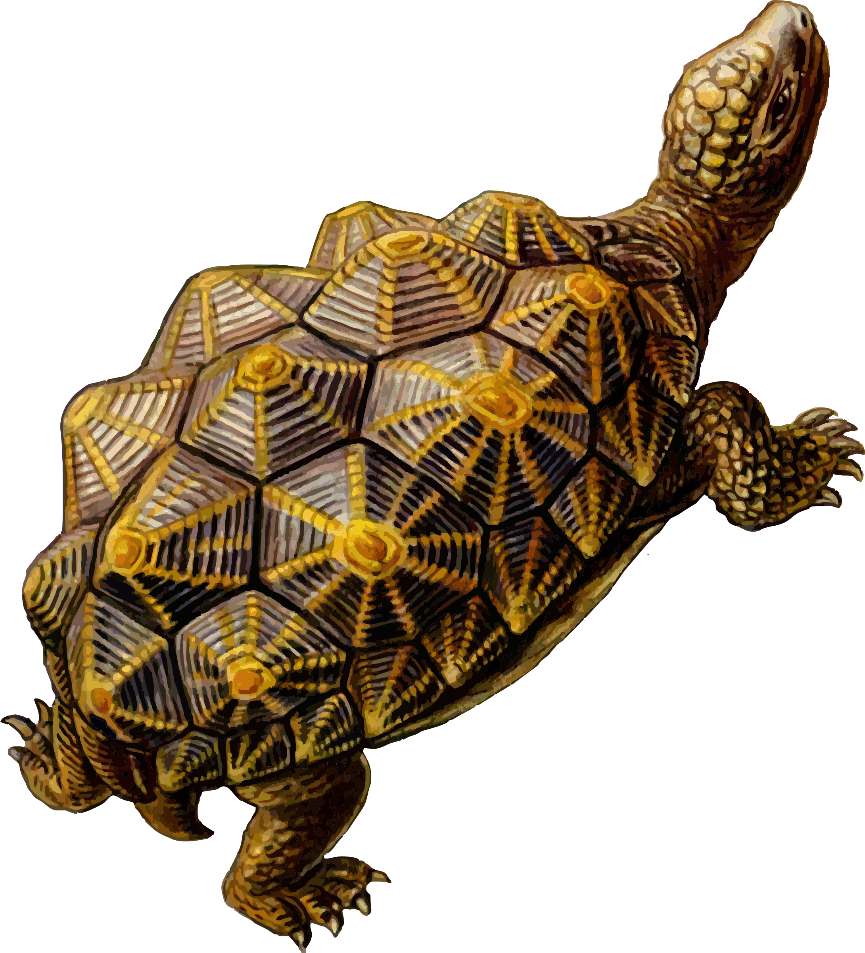
Project History
2012: NDNP, built internal expertise
2015: Crowd-funding campaign, $33,000+; selected standards
2015-2016: Phase 1, ~28,500 pages, 1910-1971
2016-2017: Phase 2, ~48,390 pages, 1971-1998
2017: Crowd-funding campaign, $26,000+
2017-2018: Phase 3: ~21,230 pages, 1998-2008
Total digitization cost: $102,995.78
2018-2019: Phase 4
Notes:
Starting in 2012, UMD Libraries began a complex, newspaper digitization effort as the Maryland state partner in the National Digital Newspaper Program (NDNP), a national collaboration with the Library of Congress, funded by the National Endowment for the Humanities. With the growing expertise in newspaper digitization and the METS-ALTO metadata standard promoted by NDNP, I was approached by University Archivist Anne Turkos to digitize The Diamondback, the student newspaper of record, and its earlier preceding titles, from 1910-present. Because there was no likely funding for this project, Anne created a crowd-funded campaign to raise money for an initial project phase, resulting in raising over $33,000.
Stakeholders in SCUA and DSS agreed that the project would primarily follow the NDNP standards with a few exceptions. In addition to the NDNP deliverables and UMD-unique metadata fields, Anne wanted patrons to have access to article-level segmentation, which would provide additional METS-ALTO files of text programmatically derived from scanned images (a process known as Optical Character Recognition, or OCR) to assist with searching and content indexing. The first phase was digitized from microfilm because it is more cost effective.
The Digitization Initiatives Committee approved the project to begin for the fiscal year 2016 project cycle. The first phase of the project was limited to approximately 28,500 pages, from 1910-1971 due to funding and also because publication and copyright was transferred from the University to Maryland Media, Inc., a private company, beginning in October 1971, and Anne was still in discussions to allow permission to digitize content after 1971.
The second phase was funded by a combination of a small grant from the Anacostia Trails Heritage Association, the remainder of crowd-sourced funding from the first round, and Libraries gift and operations funding. This phase conserved and digitized heavily damaged early issues from the paper, and microfilm through the end of 1998.
Anne Turkos led a second crowd-funding campaign for the third phase, which initially raised $21,000 but continues to bring in funds, getting us to more than $26,000 currently. This campaign facilitated the digitization of issues through the middle of 2008. The remaining papers will be digitized in FY19 in the fourth phase, again through donor funding.
This project has been so successful in finding donors because it has reached so many students, alumni, campus groups, and others in the UMD community, and because of Anne Turkos’s tireless efforts. To date, this project costs $102,995.78 in digitization, plus the cost of staff to design and scope the project, project manage, and refine metadata; students to perform metadata collation and quality control; and staff to develop the repository and ingest the collection. It is an exemplar of the wide-reaching complex projects that results from collaboration across divisions and with an external entity.

Slide 3
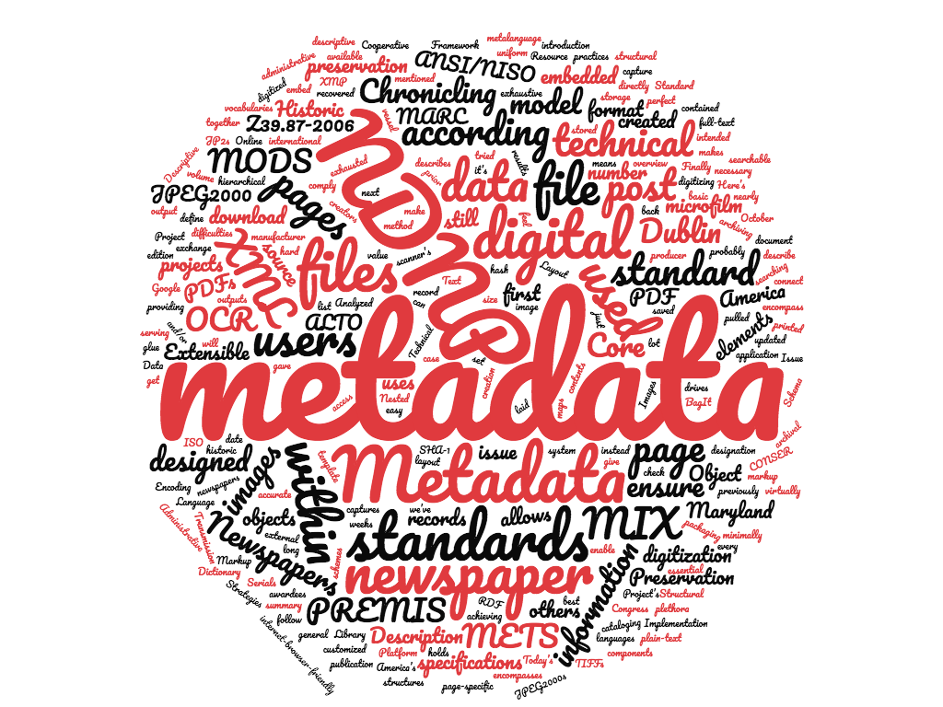
Metadata
“The NDNP specification was designed to use pre-existing, widely-used standards and to support the best practices of today’s digital library preservation needs.”
Nathan Yarasavage,
Library of Congress
Notes:
As Robin mentioned, one of the many advantages to participating in the NDNP is that the project team becomes experts on the robust metadata that the program requires for newspaper digitization. The NDNP metadata is the gold standard for newspaper digitization. As it says on the slide, “The NDNP specification was designed to use pre-existing, widely-used standards and to support the best practices of today’s digital library preservation needs.”
What metadata is required by the NDNP?
Descriptive metadata
Based on MARC records and encoded as MODS.
During metadata collation, we collection additional description information not found in the catalog record because of its granularity, such as, volume, issue, edition, date, and section information.
The descriptive metadata is contained in a METS file for each issue.
Some descriptive information is also directly embedded into the image files using Dublin Core.
Administrative metadata (includes technical and pres)
Tells us who about created the files, type of software used, etc.
PREMIS - preservation metadata, including checksums to ensure data integrity over time
MIX - technical information about the image file, such as the source of the digital images, image producer, the scanner manufacturer and model, and so on.
Structural metadata
Encoded in METS - wrapper for all of the metadata; uses XML format
Contains info about a batch (a.k.a. files that were digitized at the same time), reels, issues - how the files relate to each other and fit into the hierarchy of the batch
Full-text for the content of the newspapers is contained in separate METS/ALTO files
ALTO describes the layout and contents of OCR outputs.

Slide 4
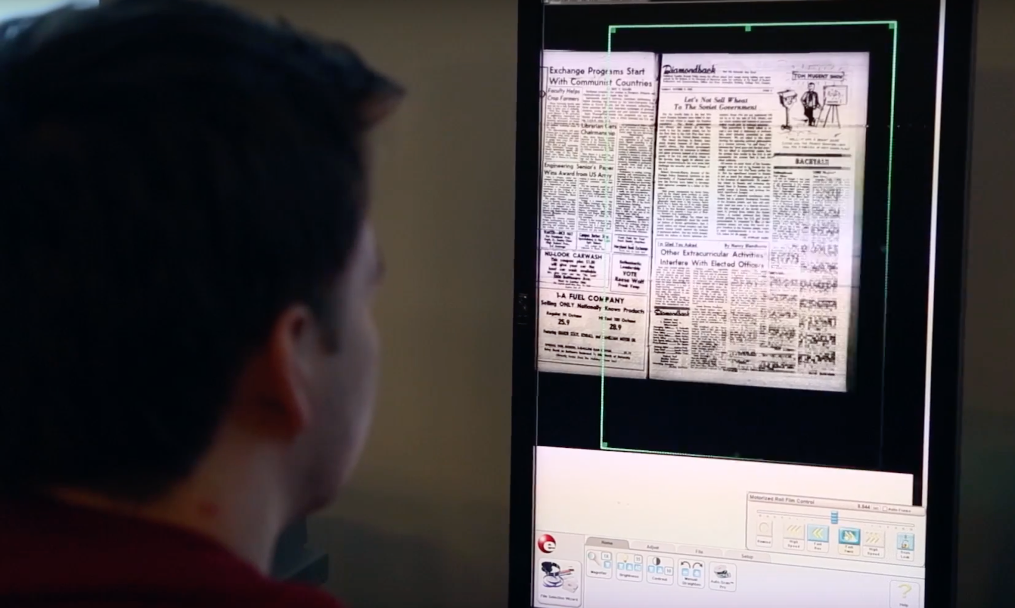
Metadata Collation
Notes:
Because we had in-house expertise with NDNP metadata, and we planned to eventually load all of the files from the Historic Maryland Newspapers Project to our own Digital Collections, it made sense to use NDNP metadata for the Diamondback. I was asked to consult during the planning of the project becaue I was the project librarian for the Maryland NDNP project, and I trained a SCUA student to do metadata collation for the Diamondback.
The process for data collation is not glamorous. It requires someone to look at each and every page that will be digitized (either in print or on microfilm) and to record information about each issue in the collation spreadsheet. We also look for anything odd in the microfilm that might require us to give special instructions to the digitization vendor.
Although the metadata created using NDNP standards is very robust, it does not include the inclusion of article-level metadata. We decided to use the Diamondback as a case study to see if creating article-level metadata was worth the extra cost. Luckily, this data is created by the vendor, so it did not add any additional steps to our metadata collation workflow.

Slide 5
Repository and Batchloading
Data stored in Fedora
“Fedora 4” is focused on web standards
LDP, WebAC, Memento, Activity Streams, HTTP headers
Loosely-coupled architecture
IIIF image viewer (Mirador)
IIIF image server (Loris)
Open Annotation OCR
Blacklight search
Batchloading with a locally-developed Plastron client
Notes:
Data stored in ‘Fedora 4’ - flexible and extensible digital object repository architecture
Fedora 4 should actually be called Fedora (and will soon be 5)
Efforts have focused on alignment with standards and creating a specification that details how Fedora aligns itself and integrates other standards
In adopting Fedora, we have focused our efforts on building a loosely coupled ecosystem
This will allow us to plug-and-play components as projects change and evolve
examples include viewer (integrated for F2) or triplestore
For batchloading we developed a python-based LDP client with data handler
this client is pluggable, can use plugins (data handler) that read various project data, and models it according to our needs
loader puts data into PCDM objects, and uses LDP API to deposit content into Fedora
deposit causes messages to be emitted which in turn trigger indexing, fixity checking, and other data enhancements

Slide 6
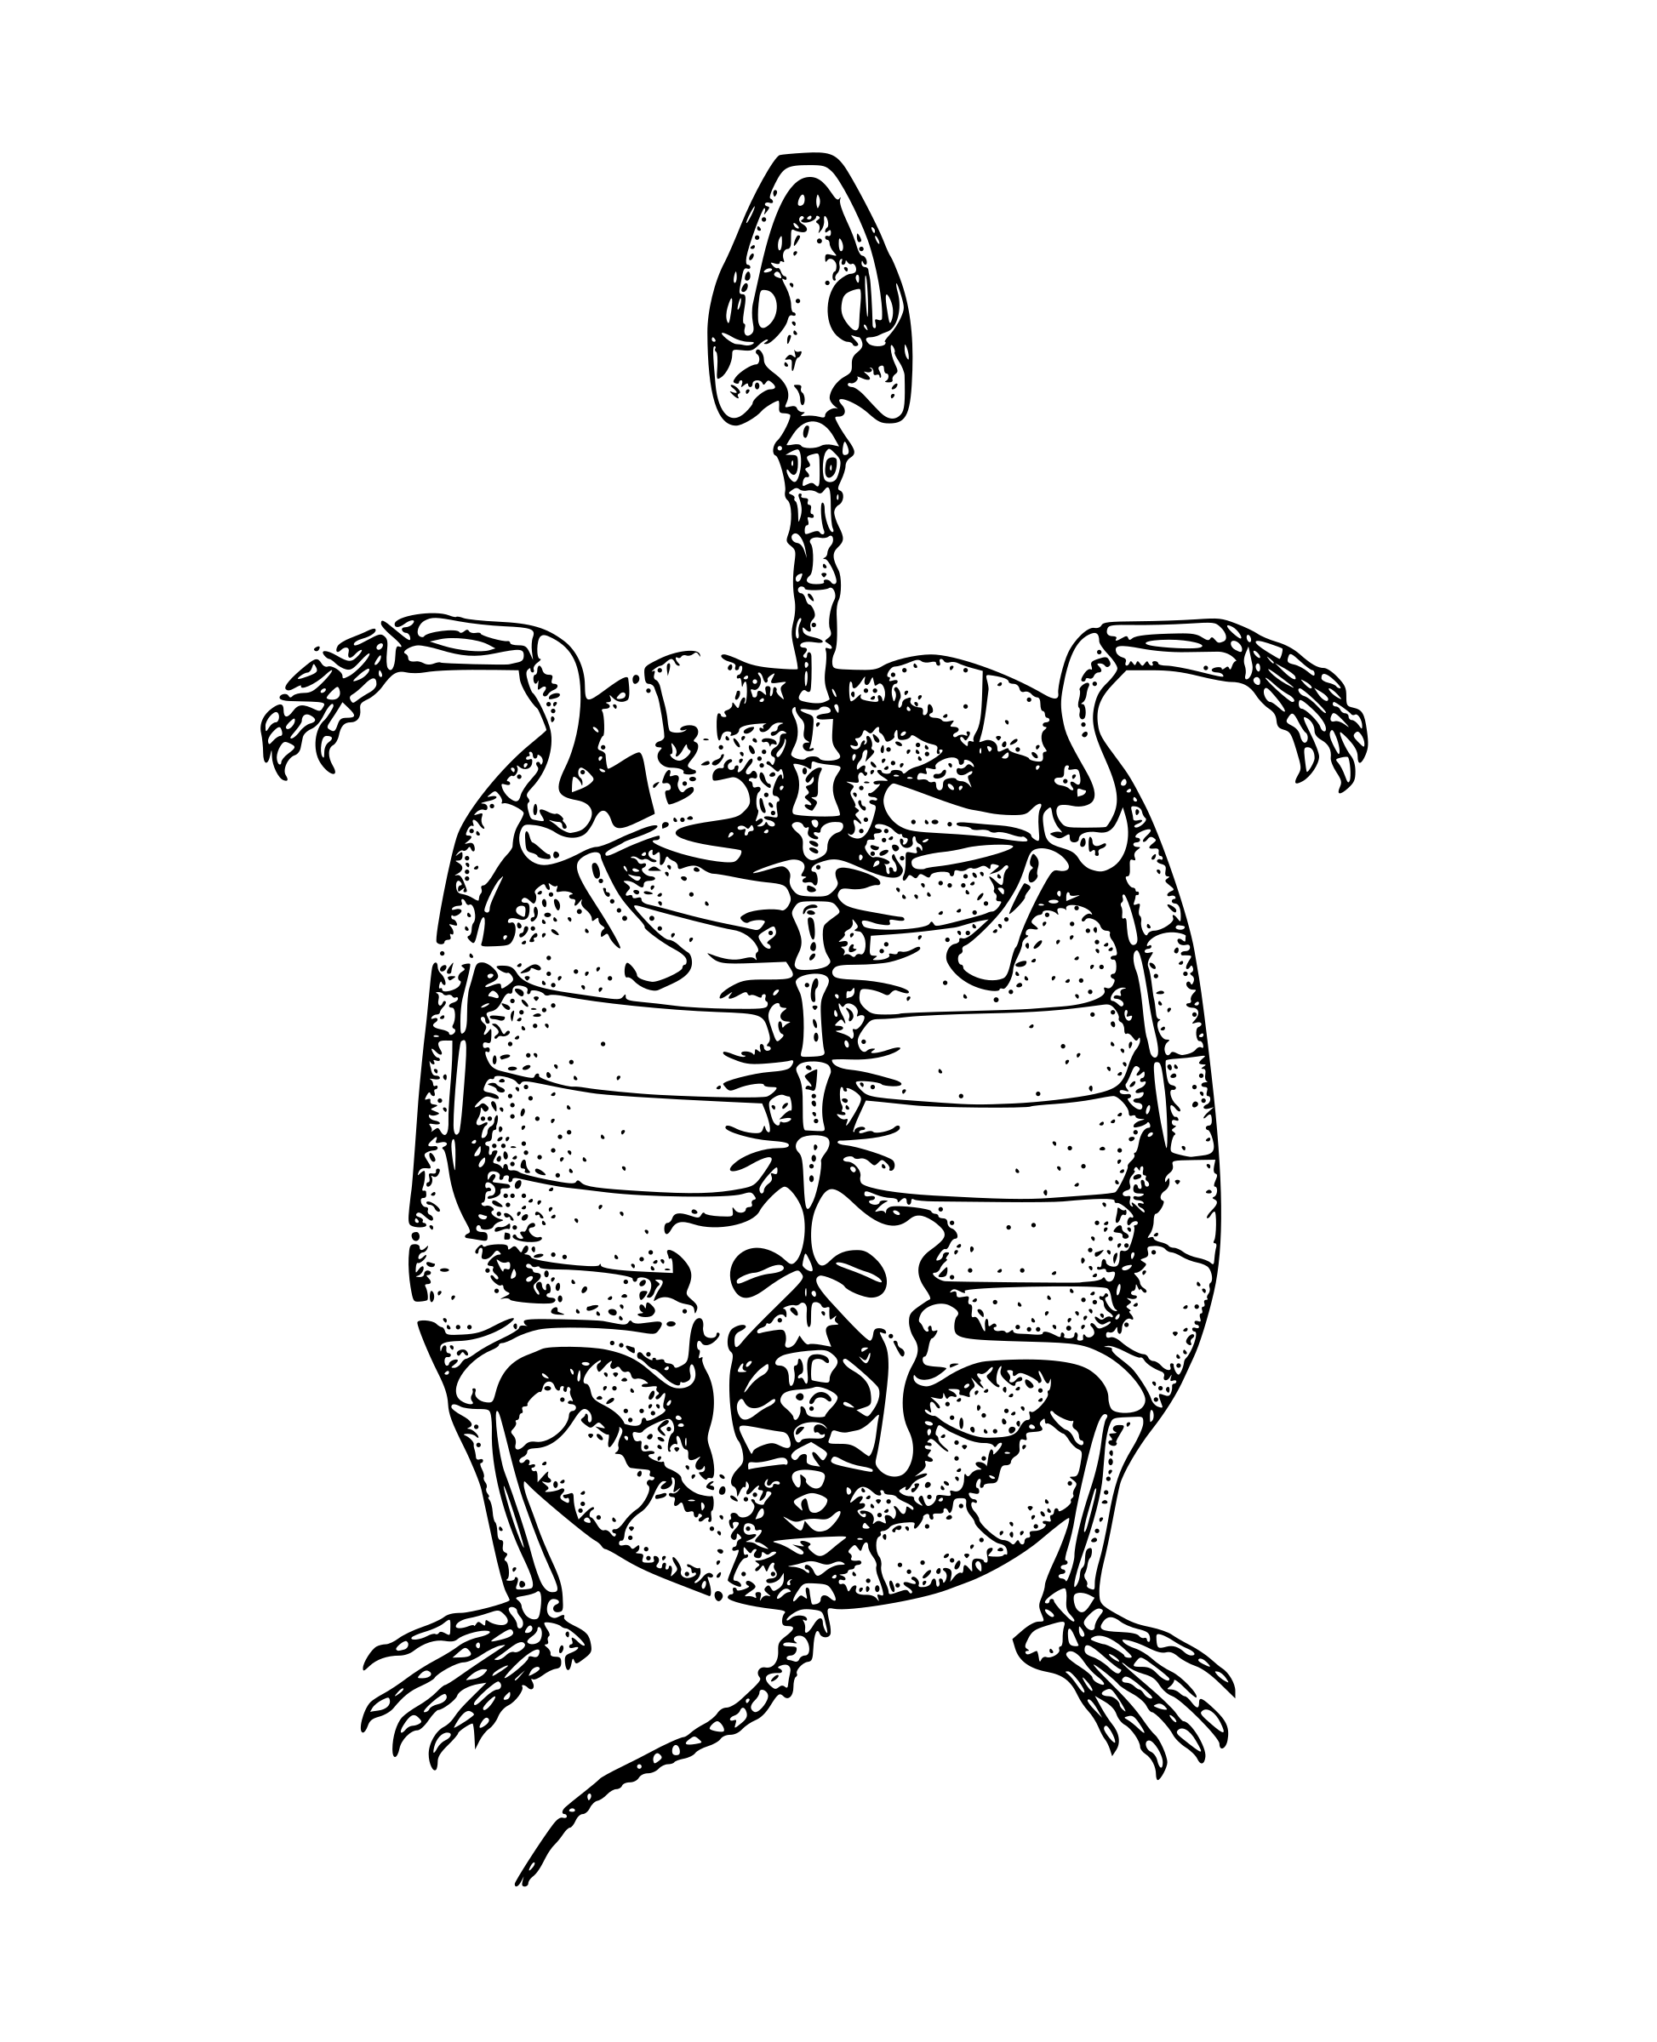
Content Modeling
LDP resources (RDFsource and nonRDFsource)
Why RDF is so hard
Local vs. global scope
Triplestore and SPARQL
Portland Common Data Model
National Digital Newspaper Program XML
Why standards are good
Notes:
Resource Description Framework
Linked Data Platform: two types of resources metadata and binaries
contrary to what is sometimes believe this does not mean everything needs to be converted to RDF and all other serializations are out
Why does this need to be so hard?
At its core, RDF is simple (triples, text based)
RDF does enforce a good degree of rigor on the adopter, though. Each predicate has a definition and can be difficult to find the right one.
Can be difficult because there is no hierarchy or ordering -- this is good for big data but makes certain things harder
Local vs. global
In theory our collection could be queried with others directly
PCDM
Goal is interoperability, but remains to be proven
NDNP
This has made our task much easier -- vendor has a spec to prepare against and we know precisely what we are getting.
Contrast with other projects where each year the data are different

Slide 7
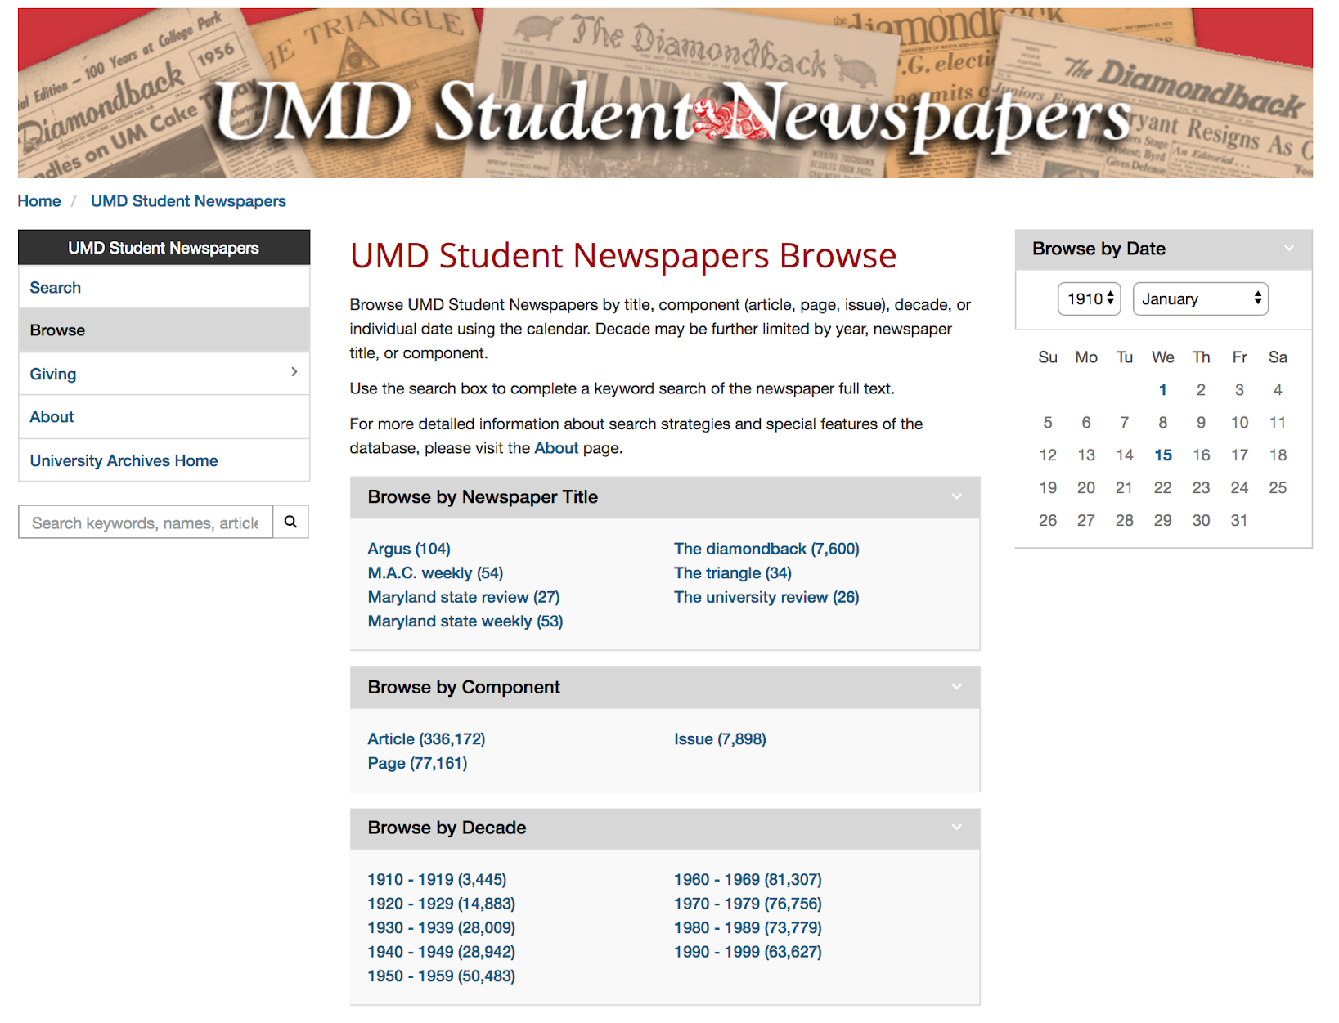
Impact
Response time for reference queries cut from days to minutes
Easy-to-use interface allows nearly all patrons to search easily
Excellent tool for development, alumni and campus outreach
Makes purpose of University Archives clear and visible
Notes:
DBK is the first stop for a lot of our incoming reference. Before the student newspapers database, responding to reference needs that required the Diamondback typically look at least 3 business days. After initial contact from the patron, we would have to exchange several messages about specifics to narrow date the date range where we would be likely to find the relevant article(s). After coming away with that information, we would attempt to reference any headline indexes that existed for that date range to see if we could get the date even more specific. This was sometimes helpful, but not always. We then asked a student (often me) to sit in the Maryland Room and review microfilm, looking for anything related to the patron’s request. If we knew exactly what we were looking for, this process could still take a few hours. If we were going in blind, that took even longer.
Now that the database is keyword searchable and extremely user-friendly and easy-to-use, it takes barely a couple of hours to respond to patron requests. Often, we can simply respond with a quick and easy “how-to” email to the patron alongside a link to the database so they can search on their own.
Search full-text of articles (uncorrected) and article titles (corrected) using the search box
After searching, you can use faceting to further narrow your search by type of result (issue, page, or article), title, and date
Browse by title, date, or newspaper component (issue, page, or article level)
When you select a page/issue/article to view, you can see the plain text in a pane to left while also looking at the page
Additionally, the database has served as an excellent outreach tool and an easy way to showcase what University Archives is doing -- with one of our most important collections. We send a link to the database to nearly anyone (alum, current students, academic departments, etc.) who asks a question about university history, even if it’s just as an aside to say, “If you’re curious about anything else in the future, try searching here first!” We were also able to have the database available for use on laptops and computers at a fundraising event for the second Diamondback campaign, which I think was (and will be) extremely effective in encouraging further contributions to help us finish the project.

Slide 8
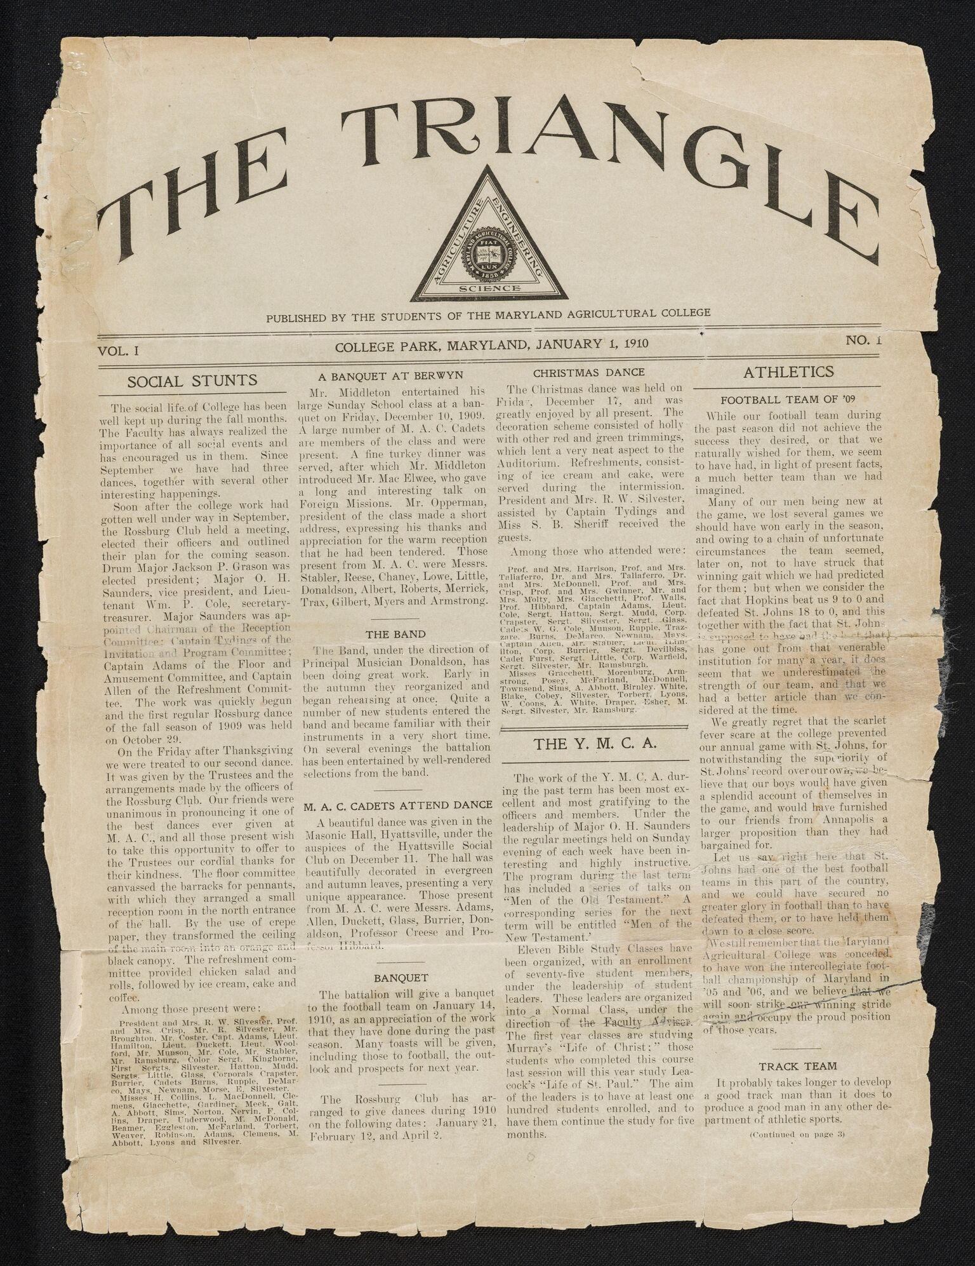
Future Plans
Future of Student Newspapers
Black Explosion
Mitzpeh and Eclipse
Future of the repository
Correspondence
Audio/Video
Migration of Fedora 2 content
Born digital archives
Research Data
Future of our data
Notes:
Future of Student Newspapers
Black Explosion is in process -- data are on the dev server now
Mitzpeh and Eclipse-- FY19
Future of the repo
We have plans for other content types and additional data to be added to the repository
We also need a CRUD interface
Some of these will happen this year, others almost certainly will not
Future of our data
“Data ages like wine, software ages like fish”
Most exciting things about where the repository is heading is what is happening to our data
Gone are the days of proprietary and one-off application-specific data formats (at least we hope)

Slide 9
Questions?
Notes:
If no questions, can demo

Slide 10
Resources
NDNP metadata
Blog post from DigiStew, https://dssumd.wordpress.com/2013/10/30/ingredients-of-the-ndnp-metadata-stew/
Video tutorials on NDNP metadata from University of Kentucky Libraries
Part 1, https://www.youtube.com/watch?v=04poLAu4QLA
Part 2, https://www.youtube.com/watch?v=2KBHepoV6hA
2018 NDNP Technical Guidelines, https://www.loc.gov/ndnp/guidelines/NDNP_201820TechNotes.pdf
Web Standards and Links
Fedora API Specification
Linked Data Platform
Memento
PCDM
RDF
SPARQL
WebAC

Slide 11
Thank you!
Kendall Aughenbaugh
kaughenb@umd.edu
Robin Pike
rpike@umd.edu
Liz Caringola
ecaringo@umd.edu
Joshua Westgard
westgard@umd.edu

