Slide 1
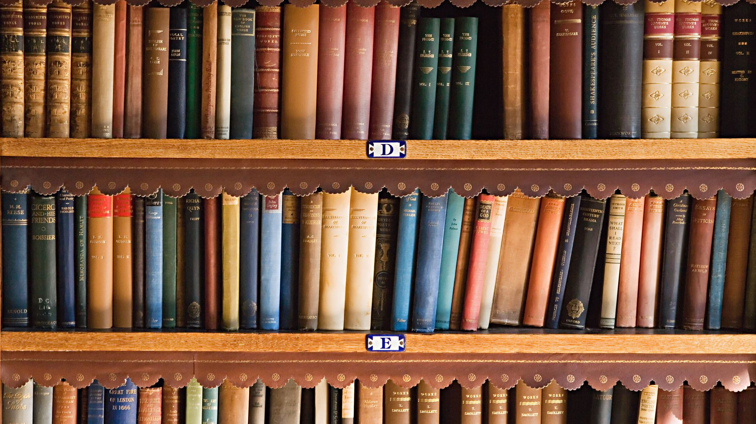
A Brief History of STEM Libraries at UMD
Leah DiCiesare, STEM and Open Science Librarian

Slide 2
Timeline
1949
A new temporary Engineering Library opens on the second floor of the engineering classroom building
1953
Chemistry Library Opened
Materials for the College of Engineering and the Institute of Fluid Dynamics and Applied Mathematics moved to their new quarters in the Mathematics Building
1958
McKeldin Library opens in May
1968
Larger library for engineering opens and is 2.5 times larger than it was before

Slide 3
Timeline
1975
Chemistry Library moved into the White Memorial Chemistry Library in the Chemistry Building
1980
New Library wing opened and EPSL was renovated
2018
EPSL and White Memorial Chemistry Library merged into the STEM Library

Slide 4
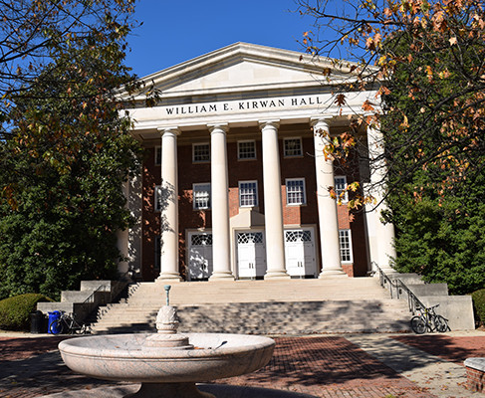
The Current Mystery
EPSL’s space in the Mathematics Building was cut in about half sometime between 1968 and 1980ish
Maybe during the construction and renovation of the new library wing

Slide 5
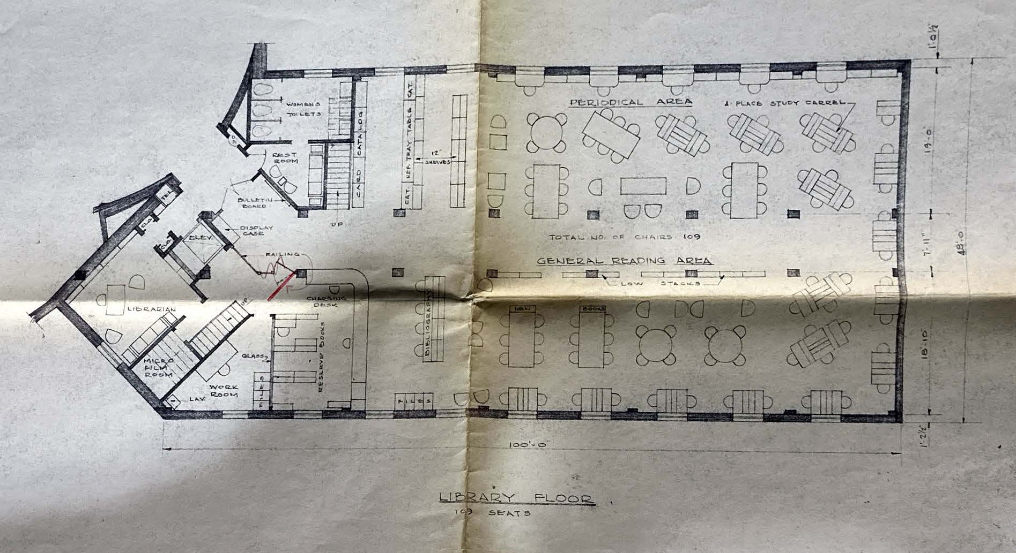
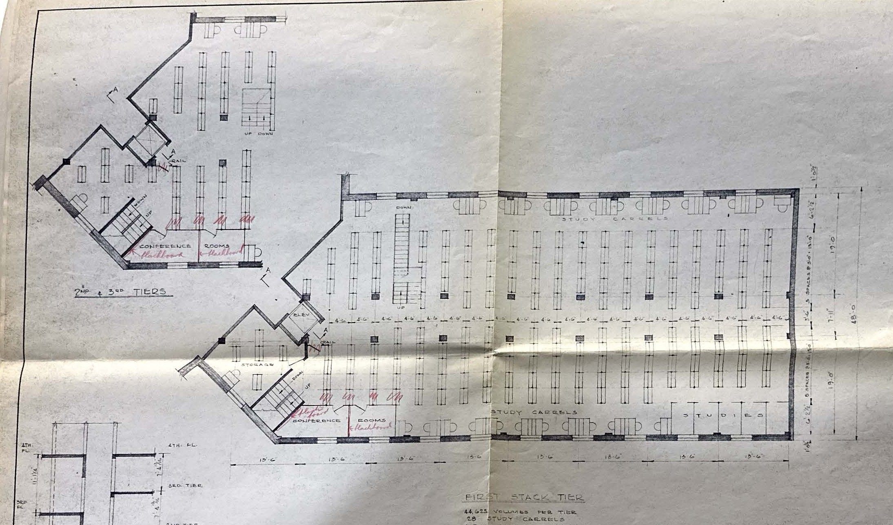
1951 Floorplan for EPSL
EPSL Library Plan Layout (Acc 2013-31 Libraries – Engineering and Physical Sciences Library - Map Folder 1). (1951). University of Maryland College Park.

Slide 6
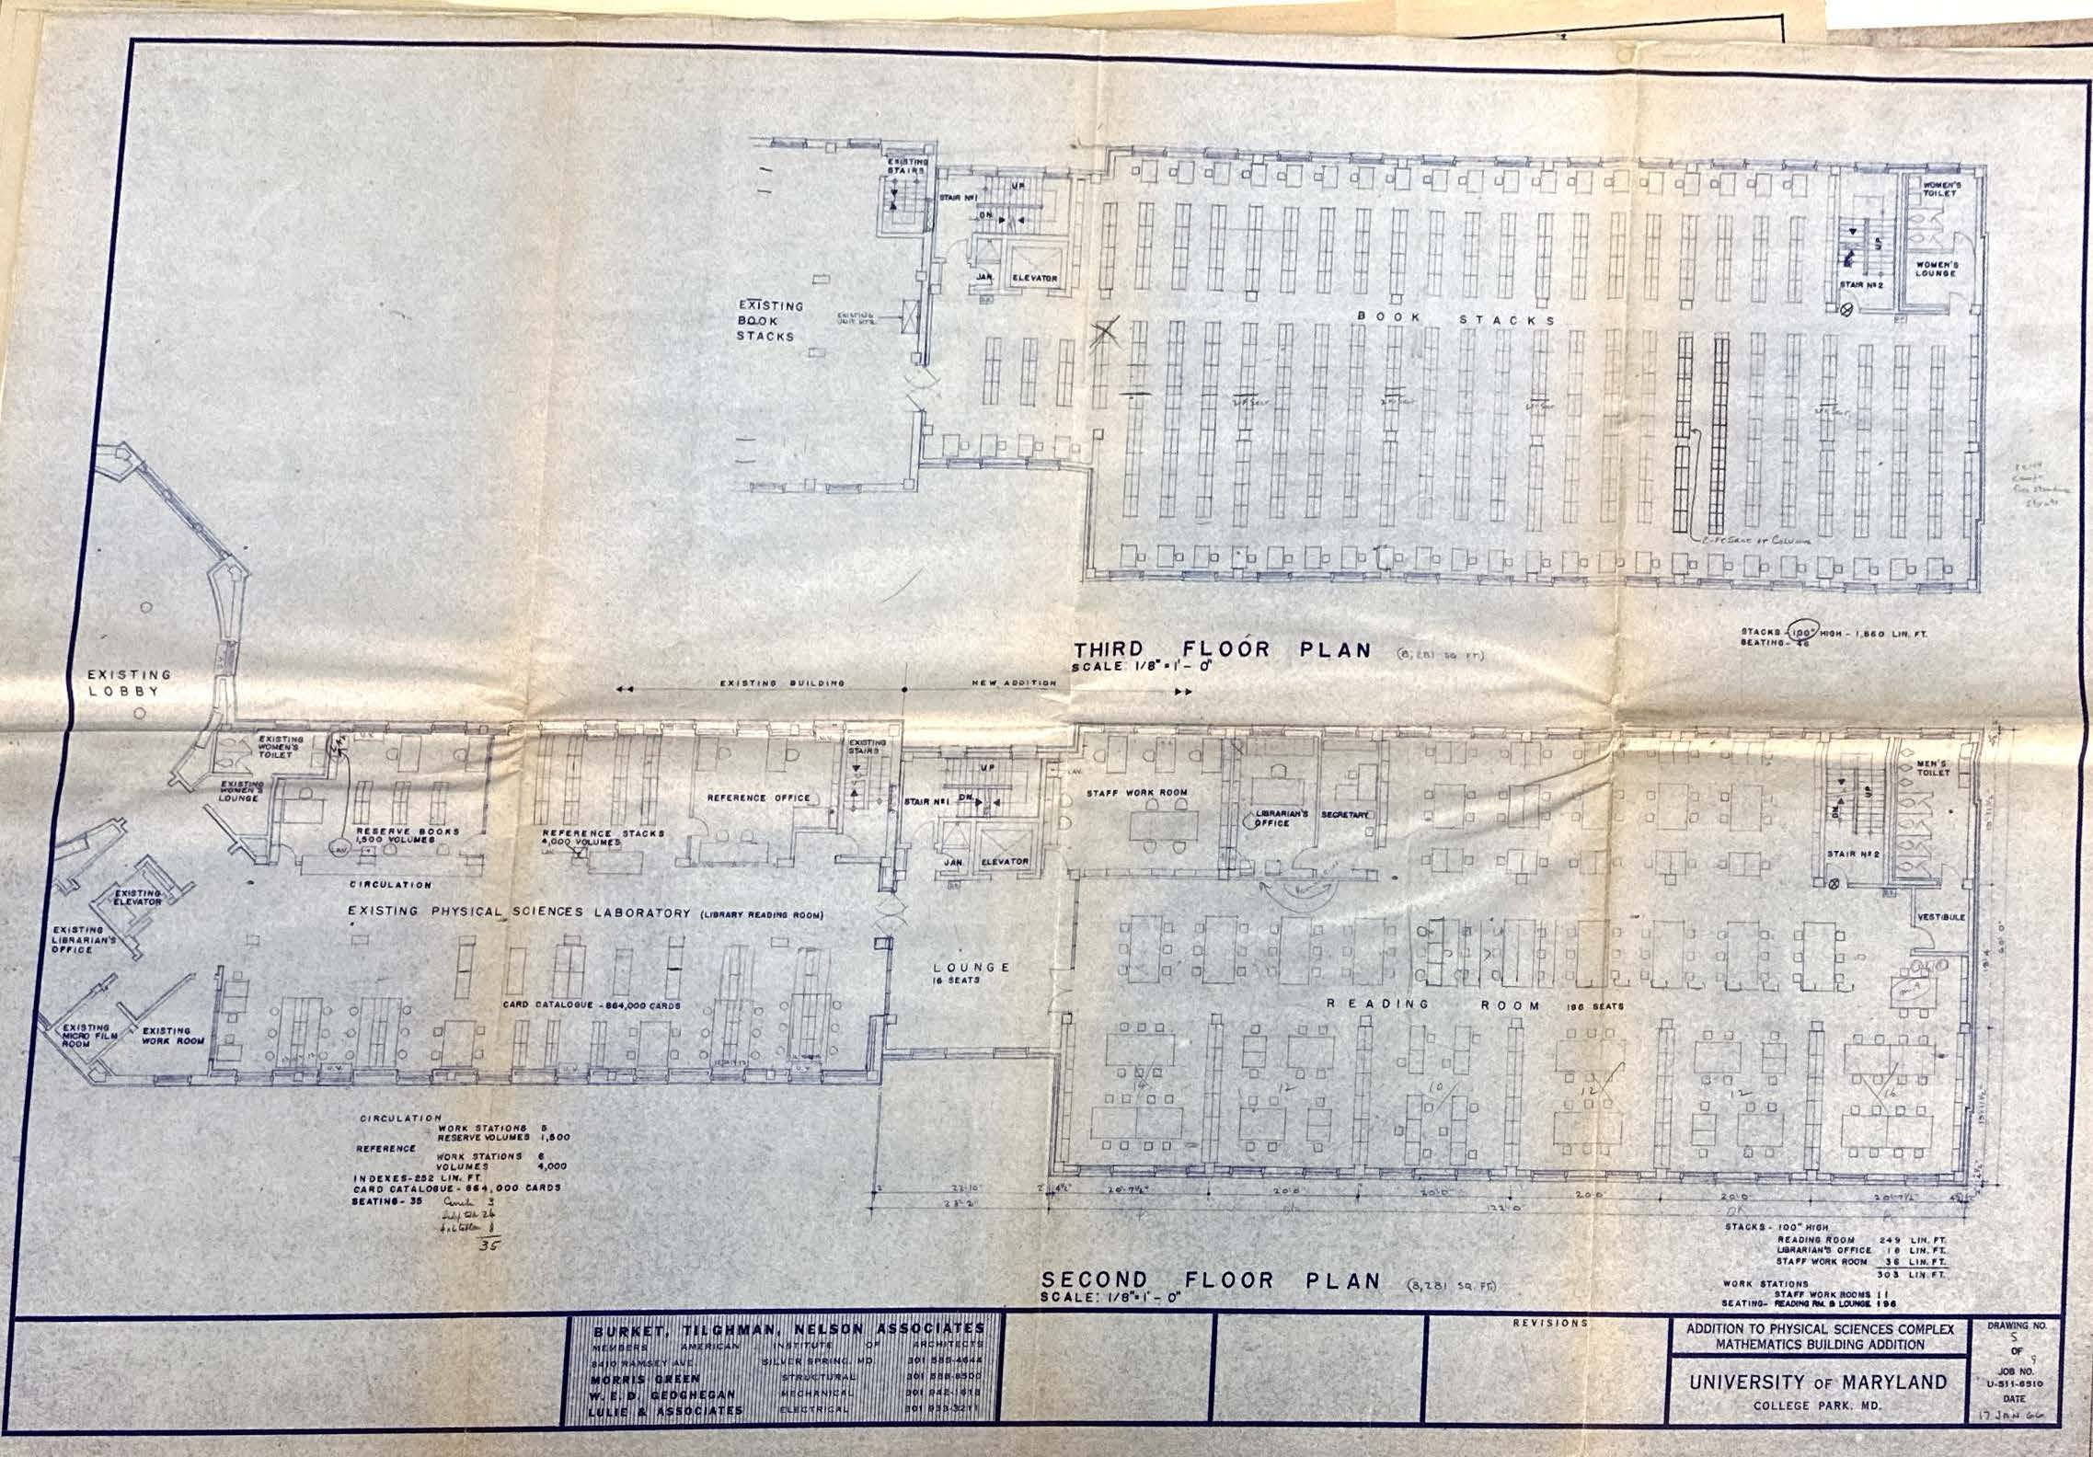
Blueprint for Math Building Addition 1/17/66
Addition to the Physical Sciences Complex: Mathematics Building Addition (Acc 2013-31 Libraries – Engineering and Physical Sciences Library - Map Folder 2). (1966). University of Maryland College Park.

Slide 7
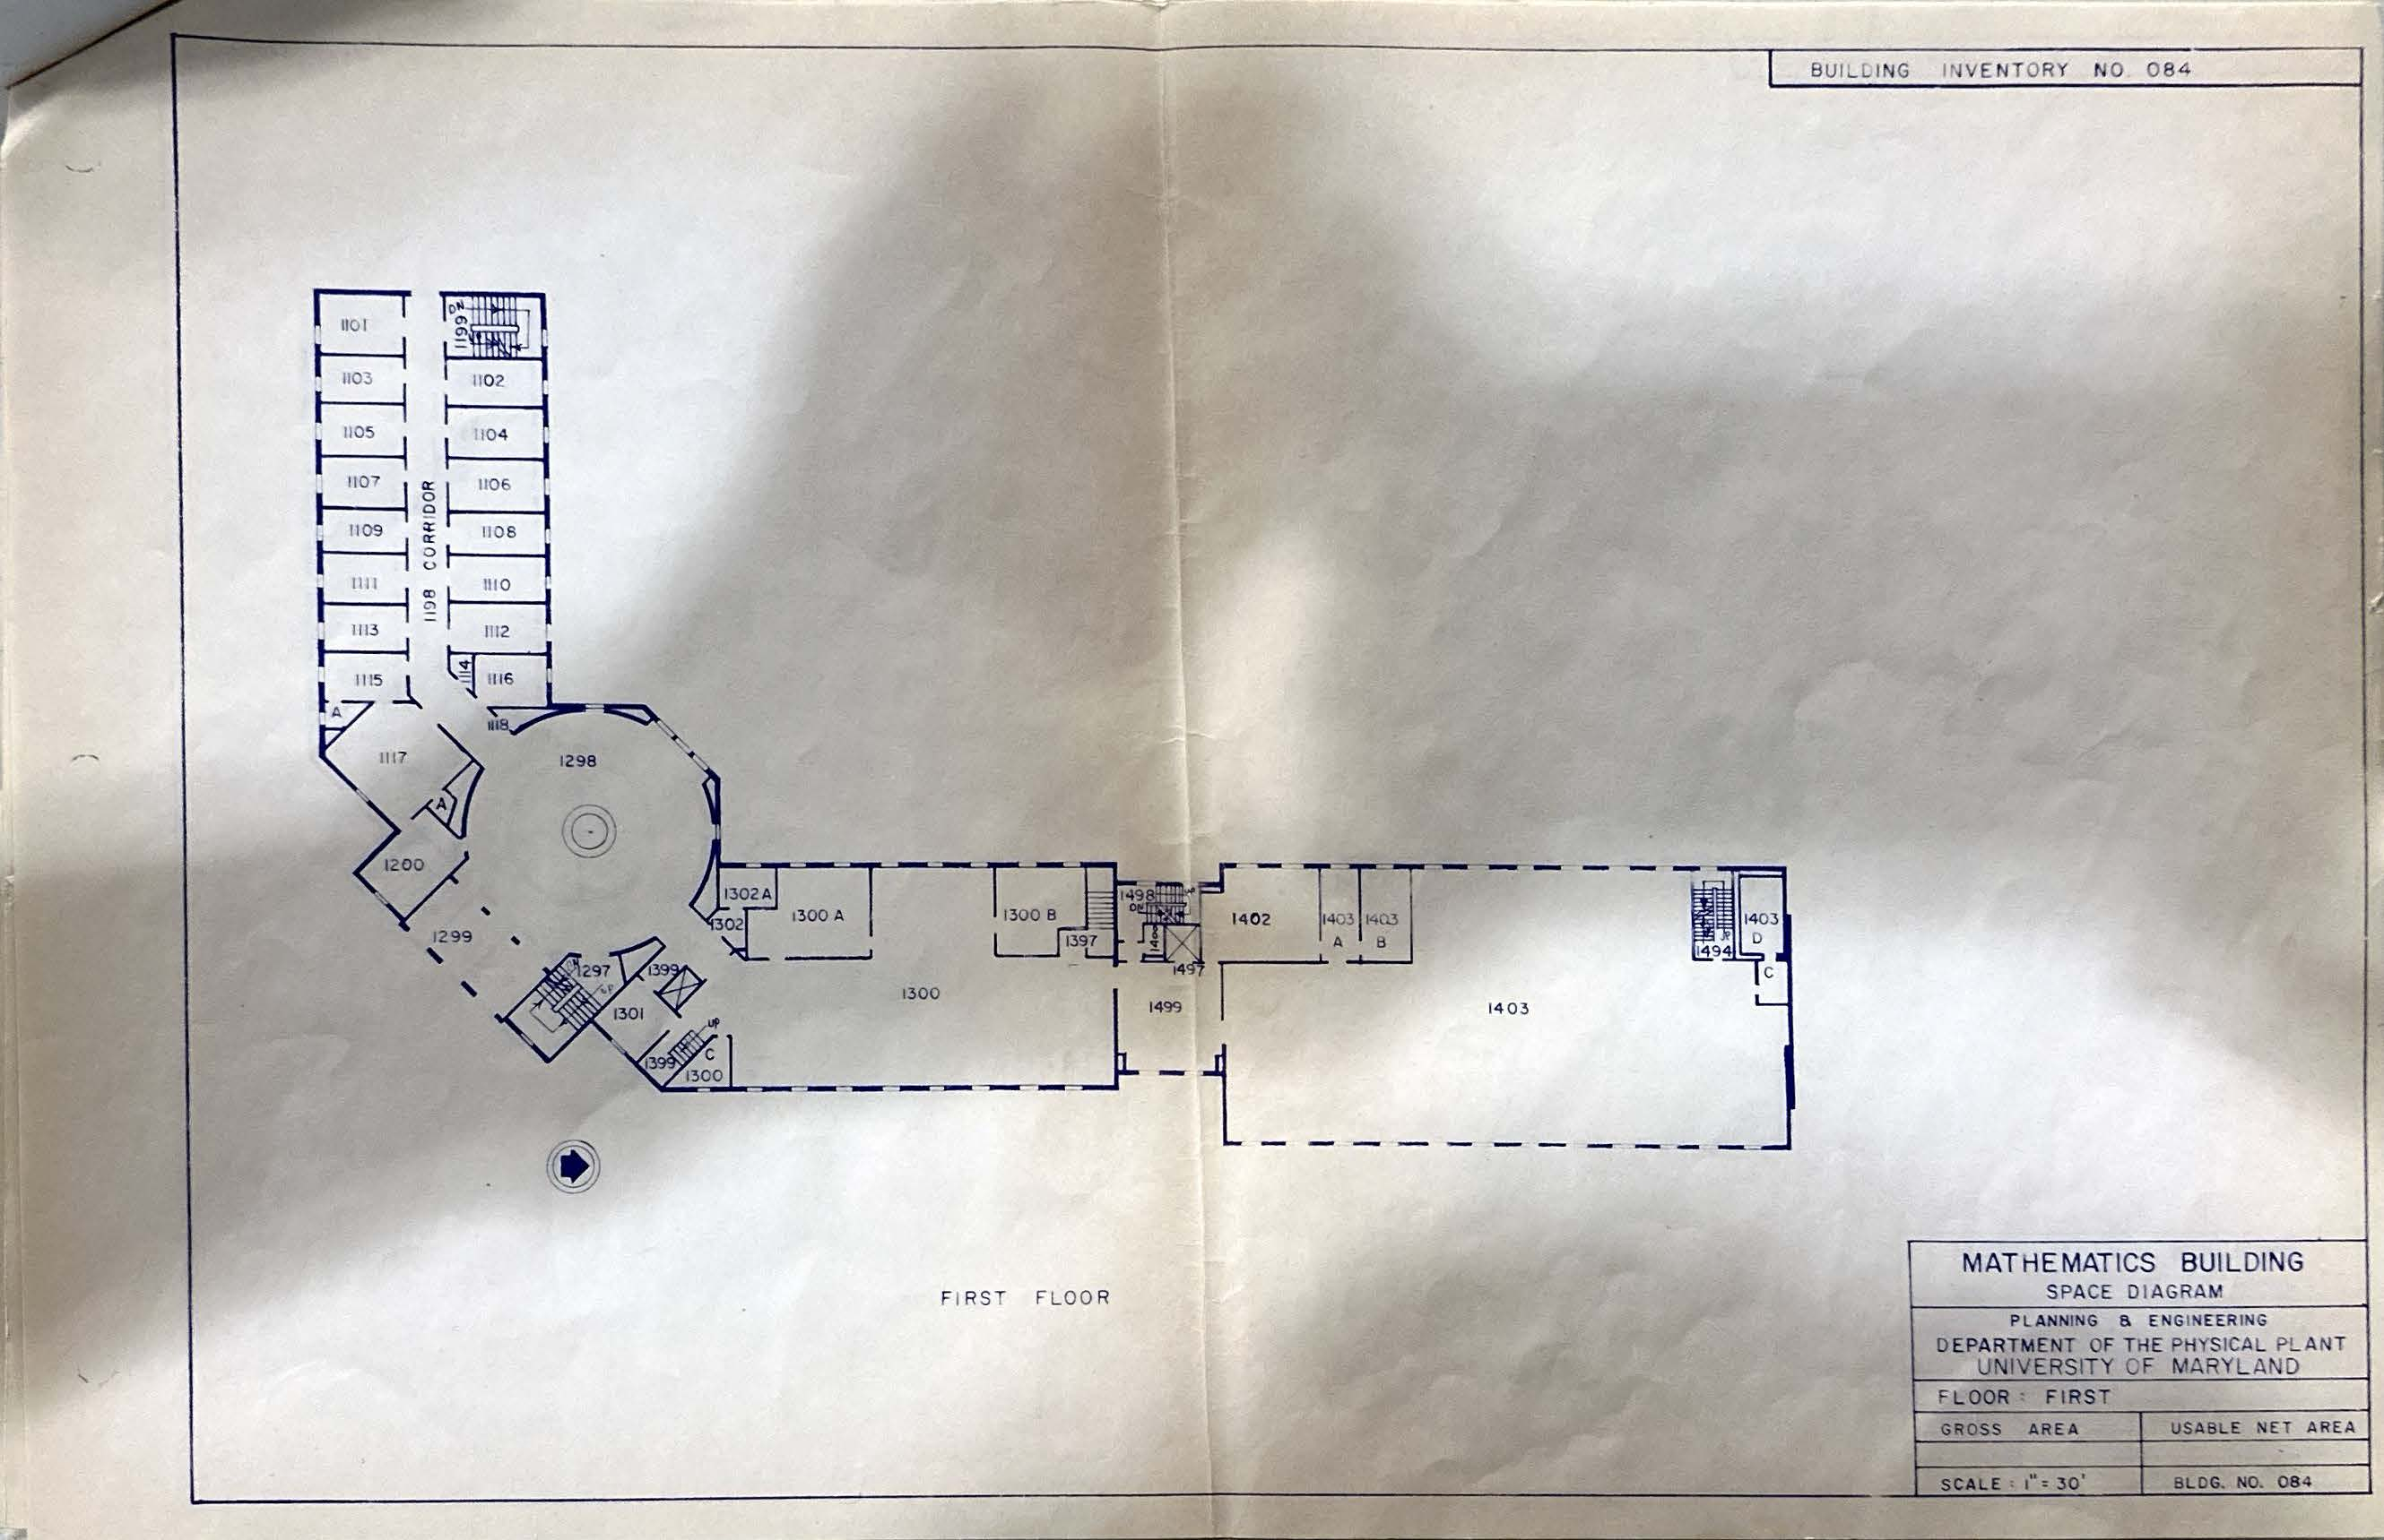
Plan for Building Extension – est. between 1965-68
Math Building Space Diagram (Acc 2013-31 Libraries – Engineering and Physical Sciences Library - Map Folder 1). (n.d.). University of Maryland College Park.

Slide 8
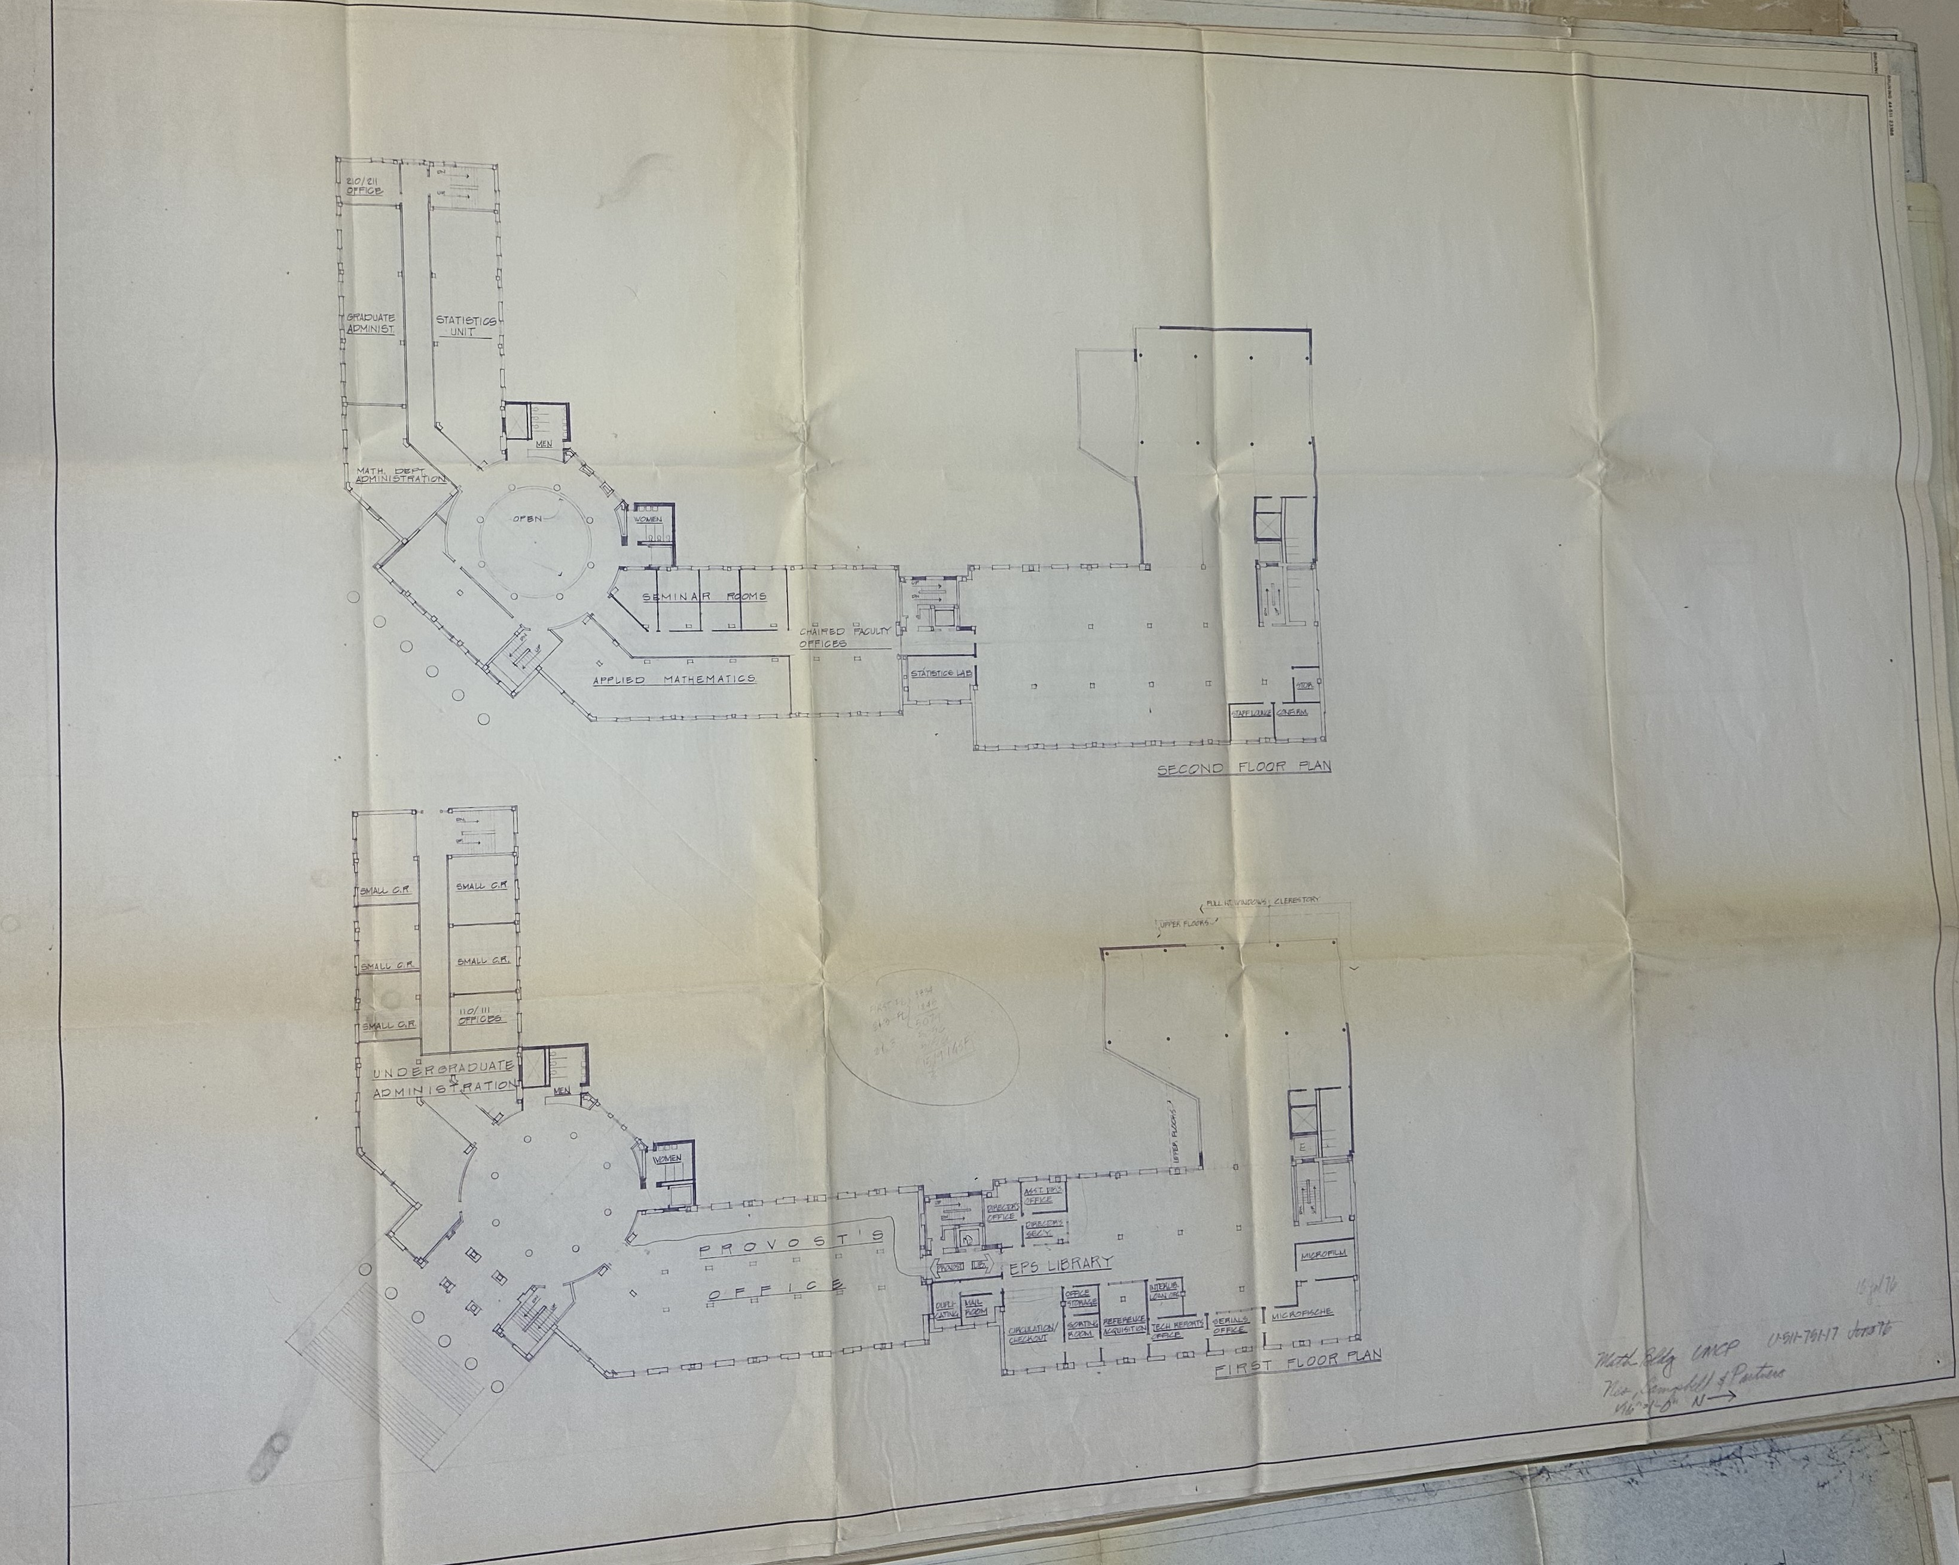
Math Building Plan 07/16/76
Math Building UMCP (Acc 2013-31 Libraries – Engineering and Physical Sciences Library - Map Folder 3). (1976). University of Maryland College Park.

Slide 9
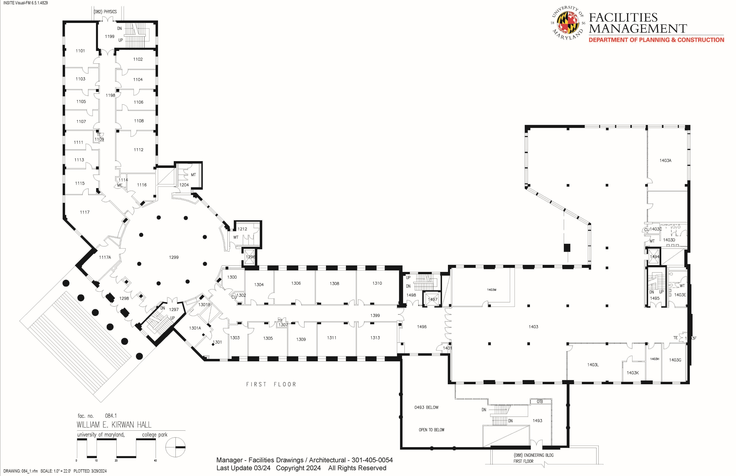
Current Kirwan Hall Floorplan
University of Maryland Facilities Planning. (2024). William E. Kirwan Hall.

Slide 10
Next Steps
Finish going through physical materials in boxes in Hornbake – finishing up the last box from White Memorial Chemistry Library
Go through digital materials such as student newspapers, photos, and yearbooks
Continue secondary source reading to put information into context
Put together a comprehensive timeline
Present and publish more on the STEM Libraries’ history at UMD

