Slide 1
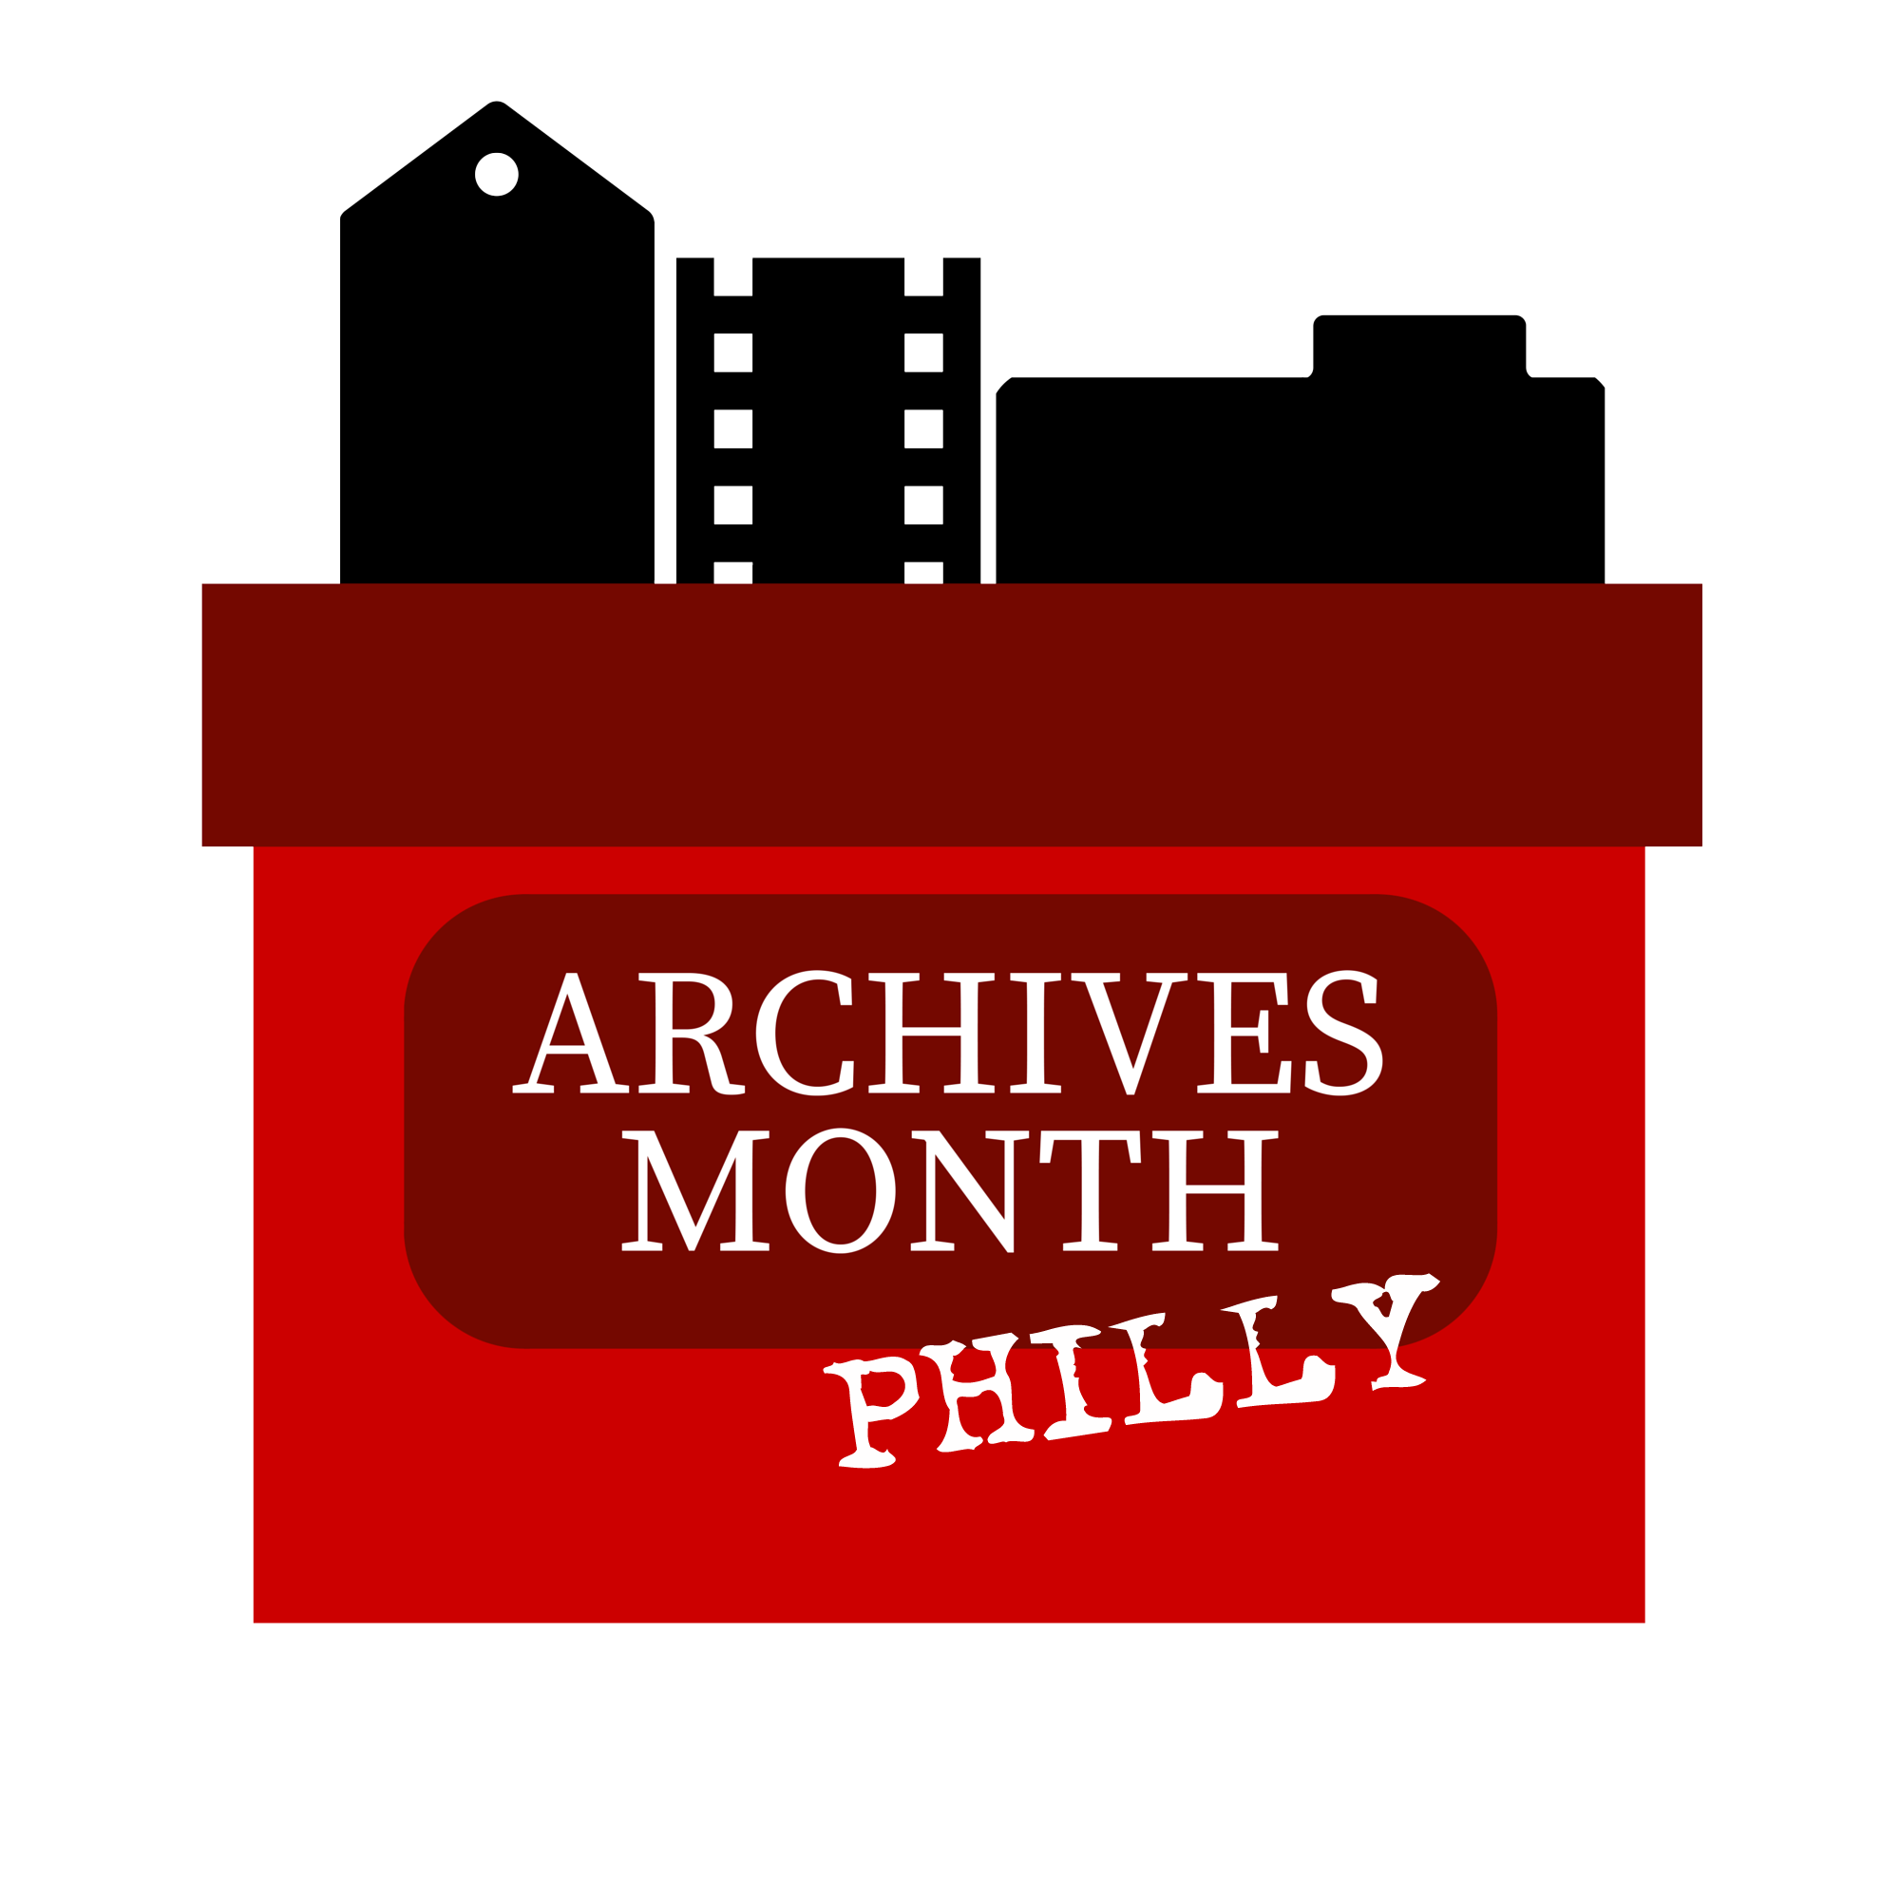
IF YOU PLAN IT, THEY WILL COME: ARCHIVES MONTH EVENT INCUBATOR
Mid-Atlantic Regional Archives Conference
Spring 2018 - Hershey, PA
Tweet with #maracspring18, #s17, #archivesPHL
Notes:
Presenters: Hillary S. Kativa (Science History Institute); Celia Caust-Ellenbogen (Swarthmore College); Kelsey Duinkerken (Thomas Jefferson University); Bayard Miller (American Philosophical Society); Chrissie Perella (College of Physicians of Philadelphia).

Slide 2
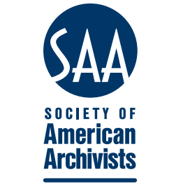
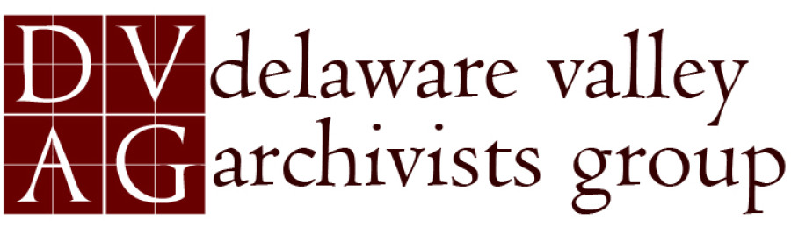
ABOUT ARCHIVES MONTH PHILLY
Tweet with #maracspring18, #s17, #archivesPHL
Organized by the Delaware Valley Archivists Group (DVAG), but anyone can volunteer.
Revitalized in 2013.
Notes:
Local instantiation of American Archives Month held annually in October; Archives Month spearheaded by SAA as an opportunity for archives and archivists to raise public awareness about their collections and the work that they do.
Local effort organized by the Delaware Valley Archivists Group (DVAG) in conjunction with participating institutions; effort initiated in the 1990s, revived in 2013 under AMP brand.
In contrast to archives’ crawls and bazaars in other cities, AMP is a month-long event at institutions throughout Philadelphia and parts of New Jersey and Delaware.
Volunteer-run, from event-planning to website and social media.

Slide 3
2017 AT-A-GLANCE
Tweet with #maracspring18, #s17, #archivesPHL
21 special events and 8 ongoing exhibitions across the Delaware Valley region.
More 500 event attendees throughout October.
Storify: https://storify.com/ArchMonthPhilly/archives-month-philly-2017
Notes:
Over 21 special events and 8 ongoing exhibitions across Delaware Valley region, which include Delaware and New Jersey.
500 attendees at events throughout October; included mix of behind-the-scenes tours, workshops, lectures, exhibits, and much more.

Slide 4
EVENT TYPES
Tweet with #maracspring18, #s17, #archivesPHL
Centerpiece events
Multi-institution events intended to stand out as highlights of the month-long calendar.
Independent, Coordinated Events
Developed independently at local institutions and submitted for inclusion on AMP calendar.
Notes:
Centerpiece events: 3 to 5 featured, multi-institutional events developed as a collaboration between AMP Planning Team and participating institution(s); intended to stand out as highlights of the month-long calendar.
Independent, coordinated events: Majority of calendar made up of events developed independently at local institutions and submitted for inclusion on AMP calendar.
All events promoted on AMP website, social media channels, and other publicity materials.

Slide 5
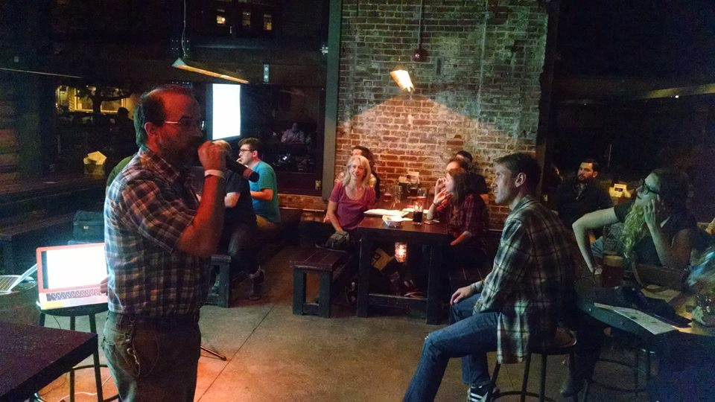
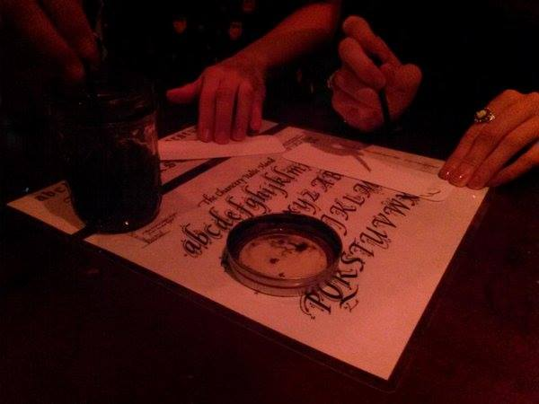
Centerpiece Event:
Nerd Nite: Archives Take-Over
Notes:
Archivists take over the popular bar-based monthly lecture series, Nerd Nite Philly.

Slide 6
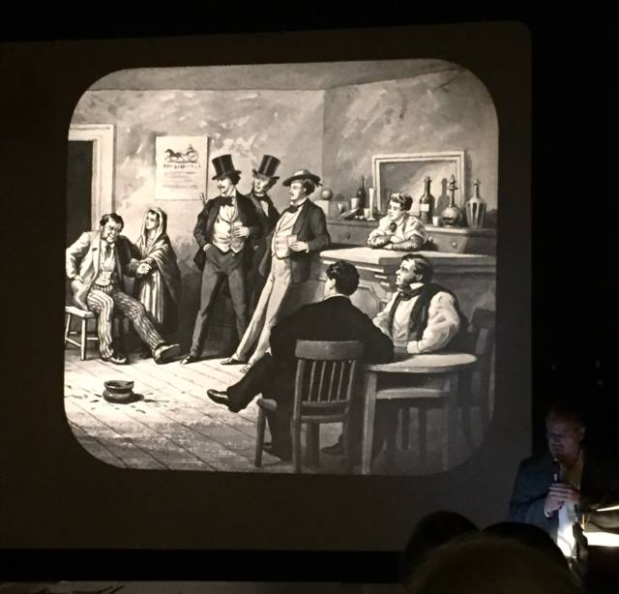
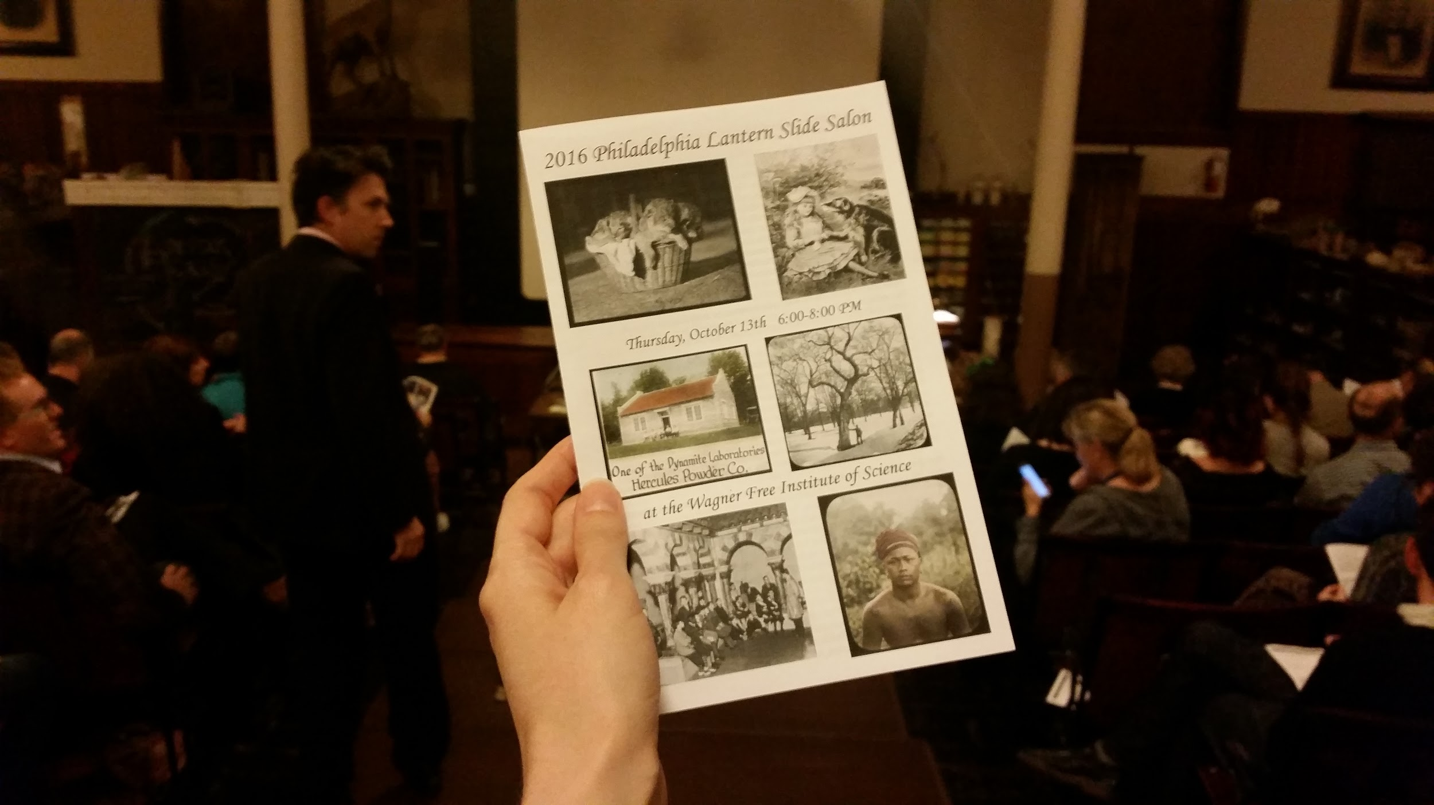
Centerpiece Event:
Philadelphia Lantern Slide Salon
Notes:
Our oldest centerpiece event, held annually since 2013. 6-8 participating institutions present lantern slides from their collections in the Wagner Free Institute of Science’s Victorian-era lecture hall using an historic lantern projector.

Slide 7
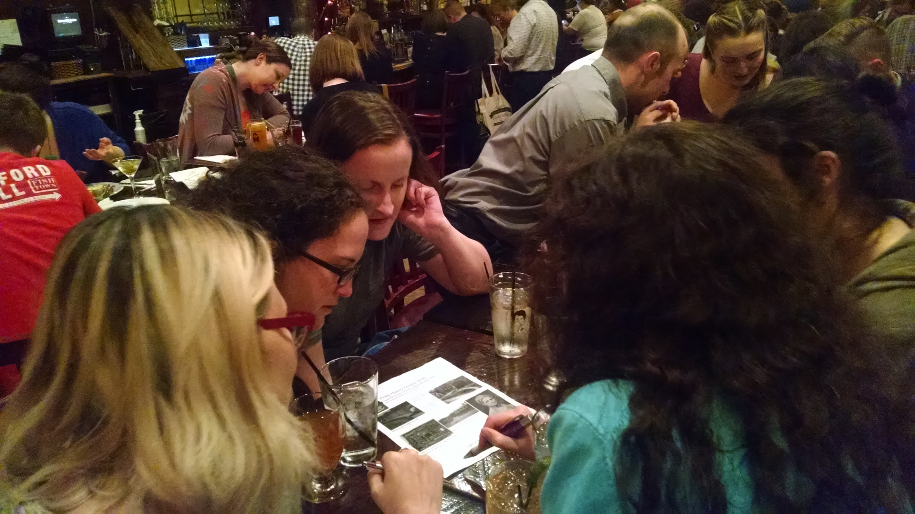
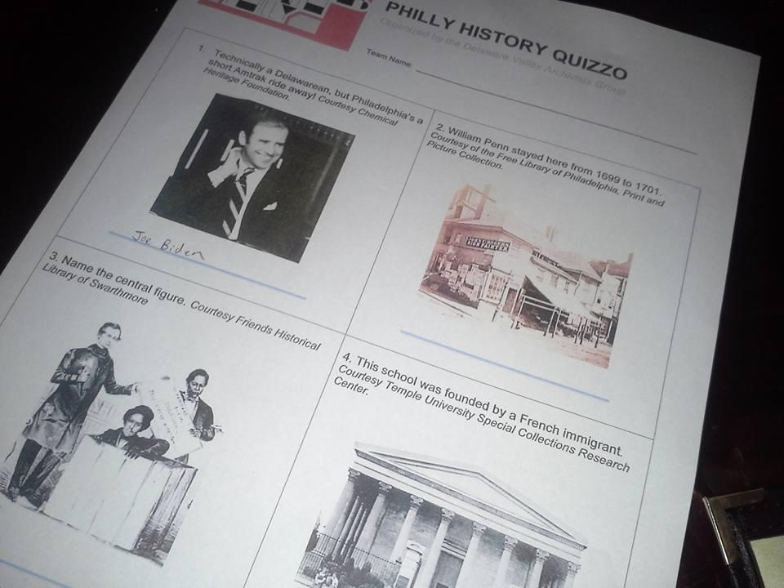
Centerpiece Event:
Philly History Quizzo
Notes:
Special pub quiz coordinated with local partners such as the Philadelphia History Museum.

Slide 8
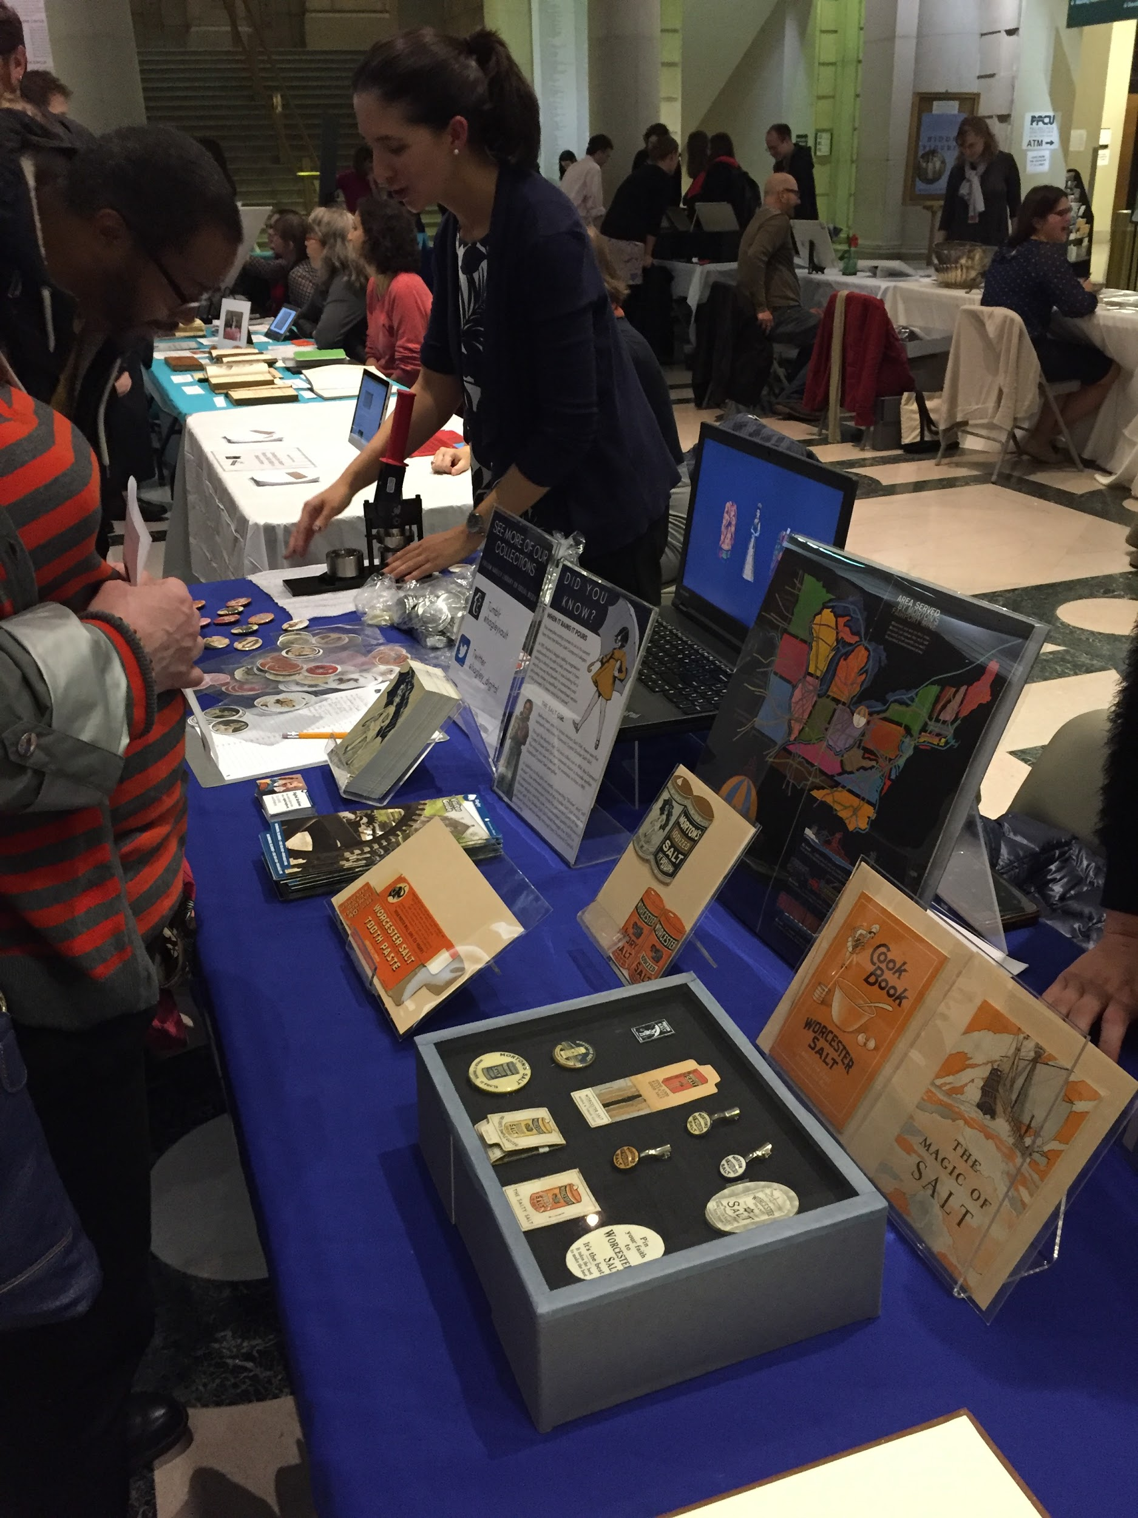
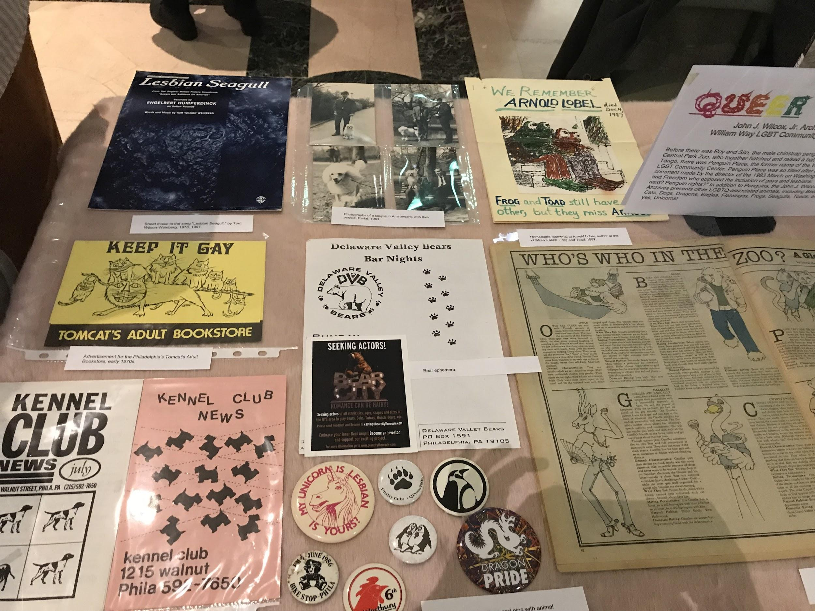
Centerpiece Event:
Food/Animals in the Archives
Notes:
Archives-bazaar showcasing collections around a particular theme with 12-15 participating institutions; currently held at the Free Library of Philadelphia.

Slide 9
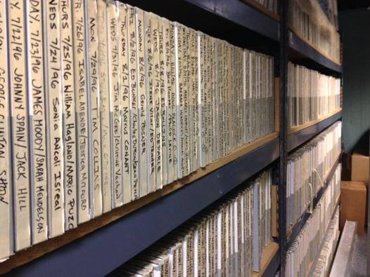
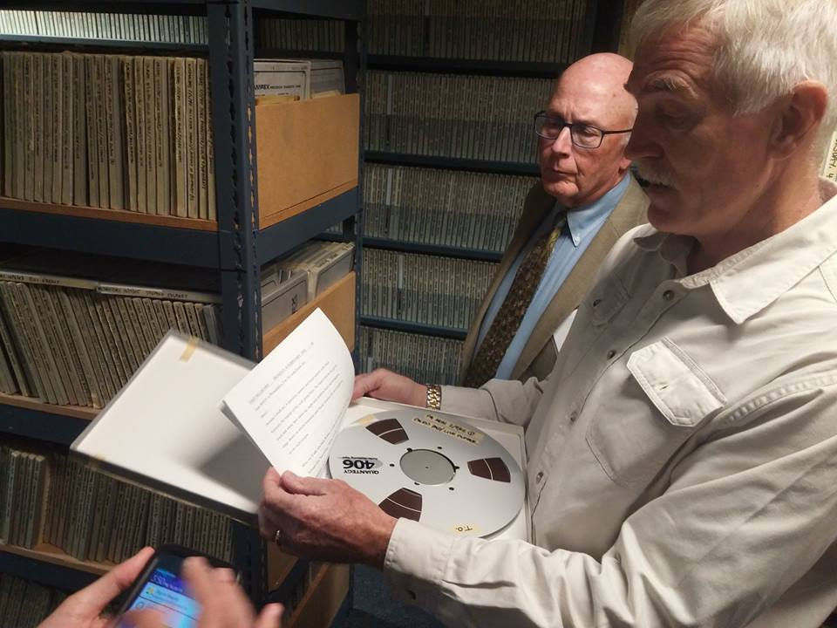
Coordinated, Independent Event:
Fresh Air Archives Behind-the-Scenes

Slide 10
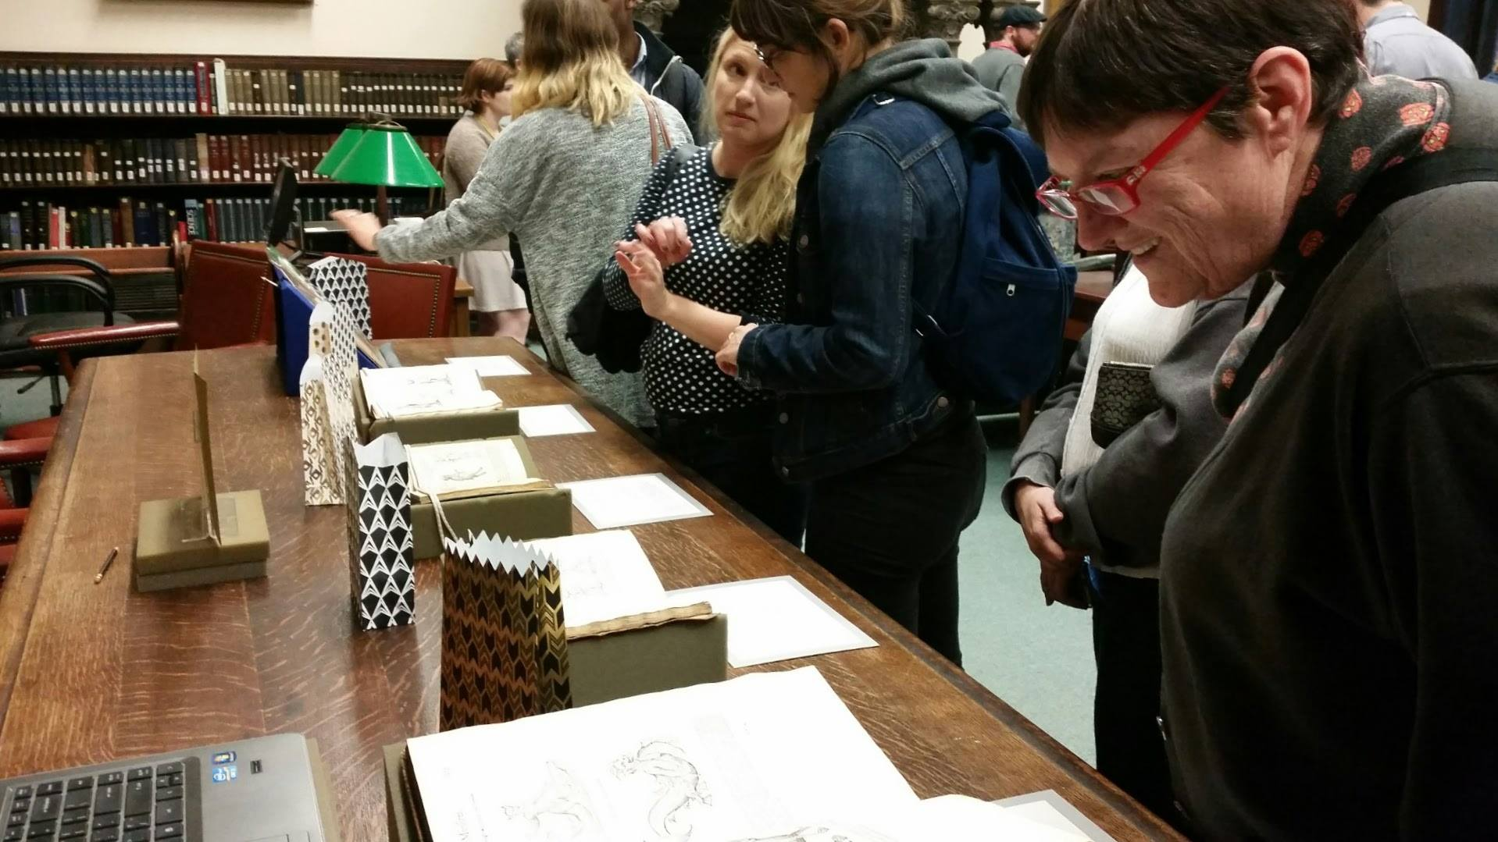
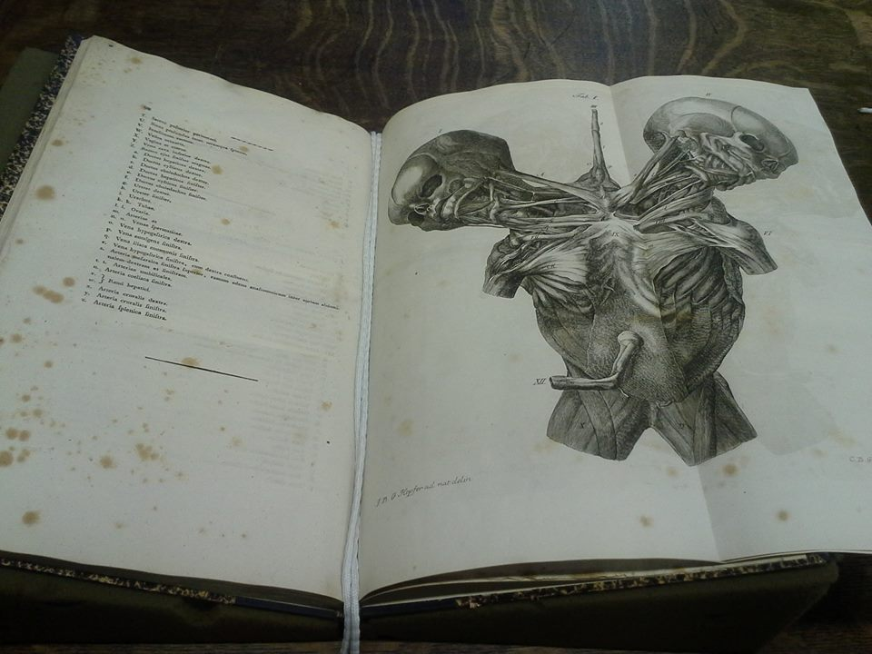
Coordinated, Independent Event:
College of Physicians Pop-Up Exhibits

Slide 11
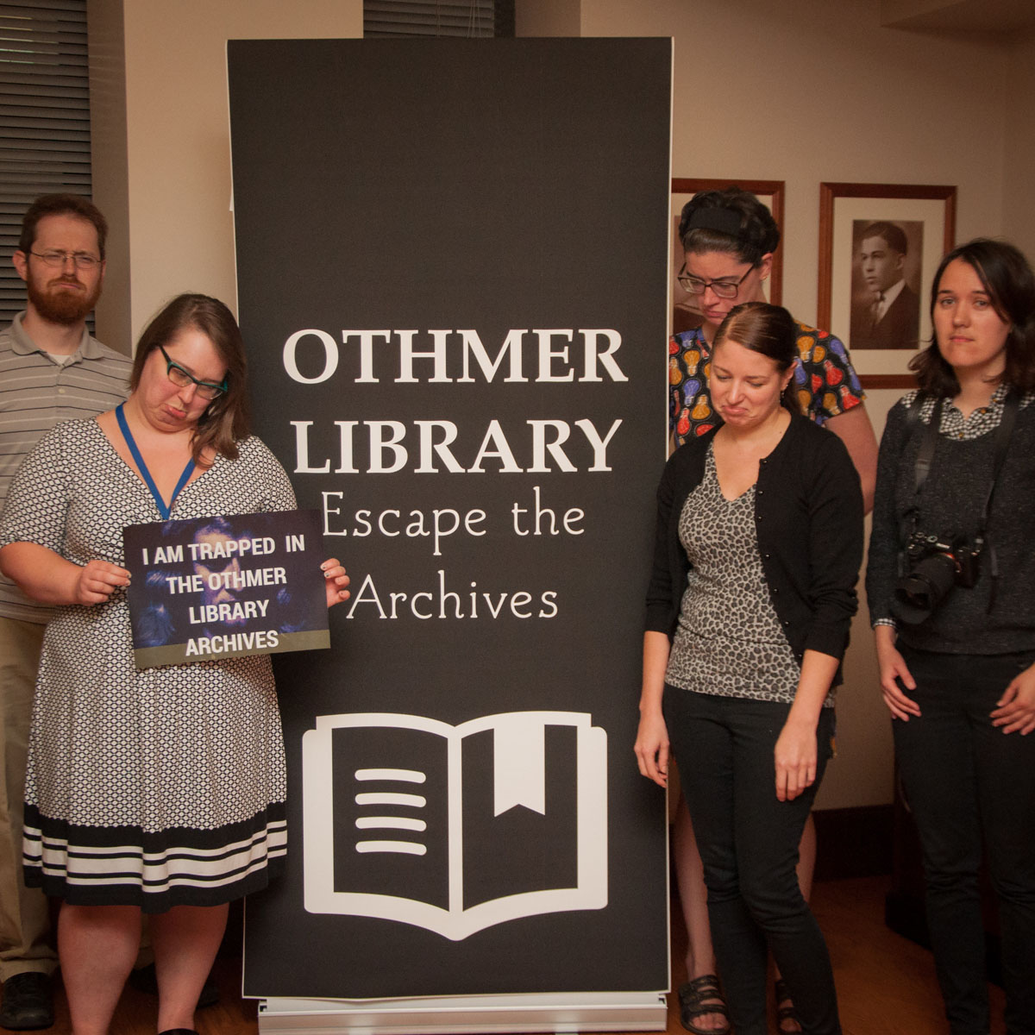
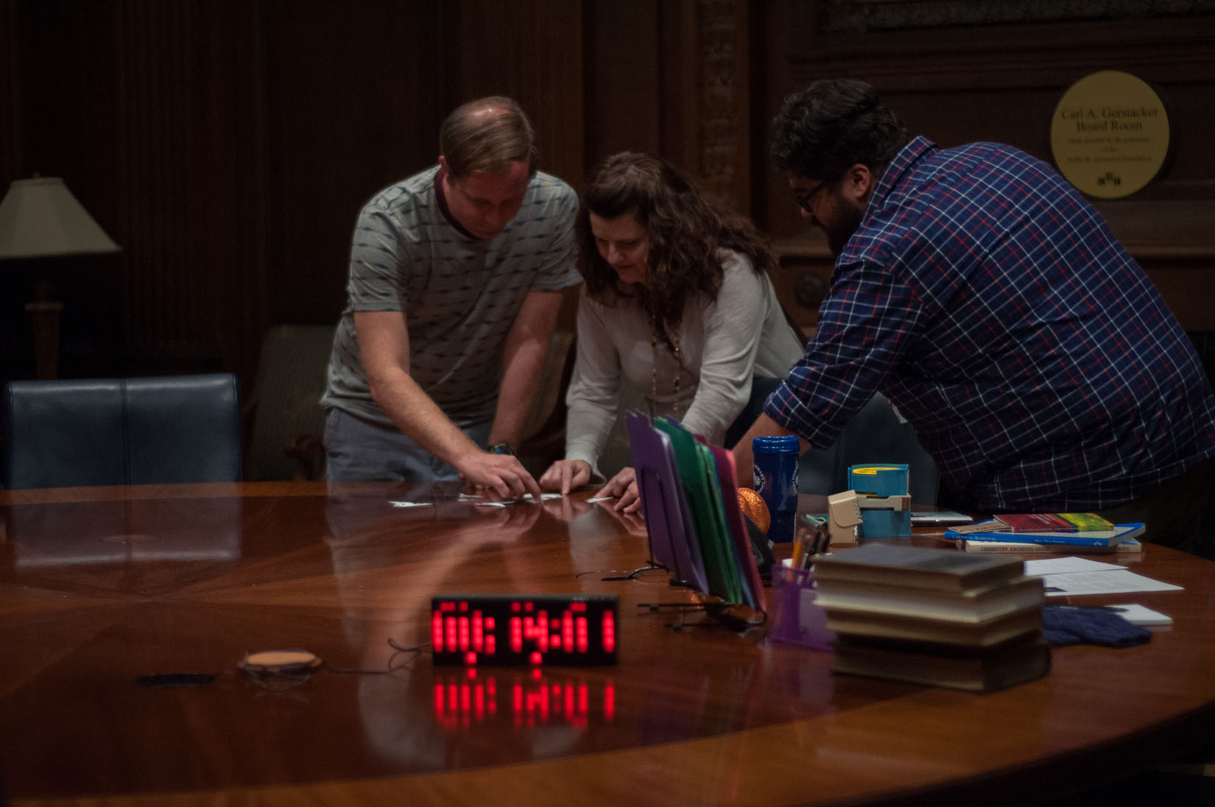
Coordinated, Independent Event:
Othmer Library Escape the Archives

Slide 12
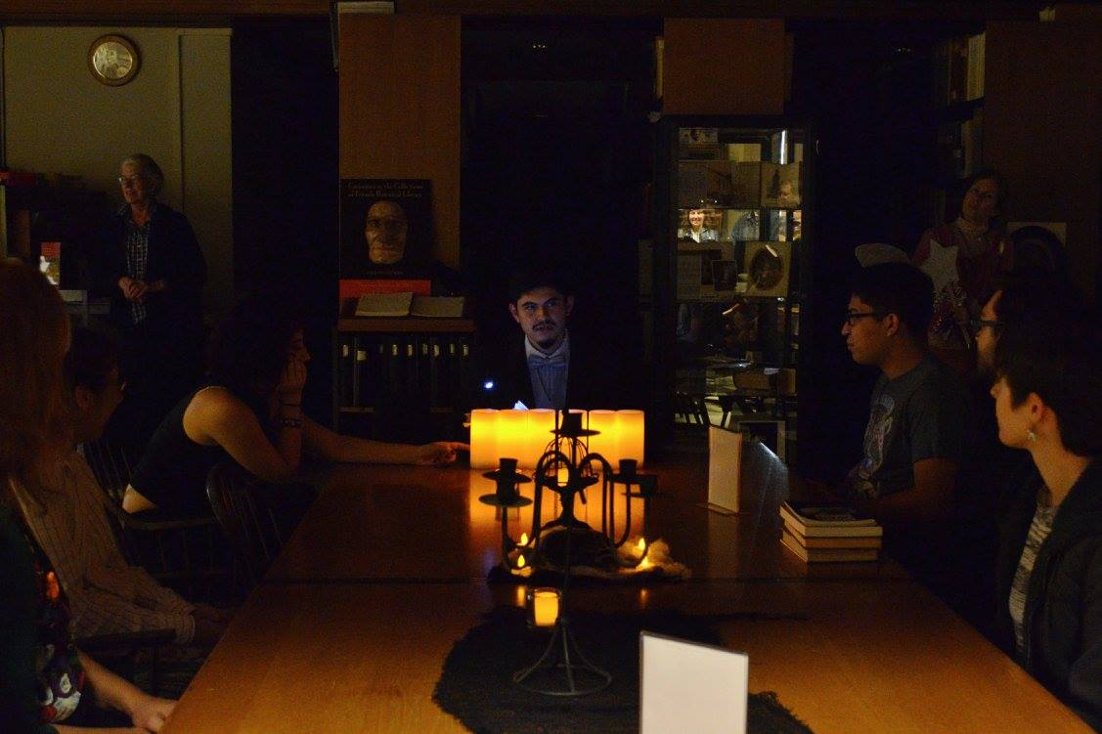
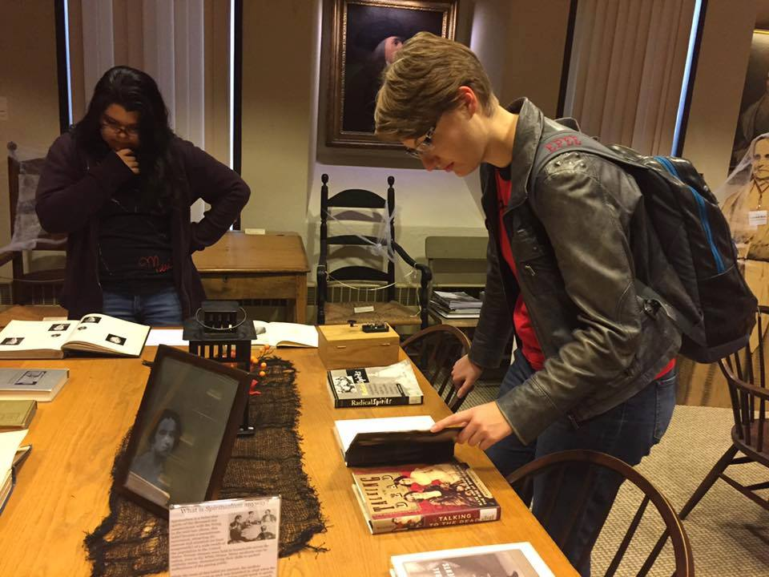
Coordinated, Independent Event:
Friends Historical Library Séance

Slide 13
OUR “PHILLY-OSOPHY”
Tweet with #maracspring18, #s17, #archivesPHL
October is for outreach.
Location matters.
Event planning = Skill-building.
People personalize the festival.
Notes:
October is for outreach (11 months out of the year, DVAG focuses on programming for archivists; in October, we focus on programming for the general public); Location matters (having an event at your institution gets people in the door who might not otherwise visit; we also try to meet people where at are, at bars, public libraries, etc.); Event planning = skill-building (Even if no one attends your event, planning an event can help raise your profile, both within your institution and beyond); People personalize the festival (we use a core of volunteers to document each event and spread the word about Archives Month Philly; volunteers also help the range of events feel like a cohesive festival.

Slide 14
TIPS FOR SUCCESS
Tweet with #maracspring18, #s17, #archivesPHL
Start planning early.
You’re only as strong as your planning team.
Mobilize your community.
Keep it fun.
Notes:
Start planning early (planning takes time and many institutions need a cushion to get stakeholders thinking about hosting an event, get approvals, etc.); Mobilize your community (spread the word about Archives Month through local listservs, blogs, etc.).

Slide 15
LEARN MORE
Tweet with #maracspring18, #s17, #archivesPHL
Website: archivesmonthphilly.com
Facebook: Archives Month Philly
Twitter: @ArchMonthPhilly
Storify: https://storify.com/ArchMonthPhilly/archives-month-philly-2017

Slide 16
INCUBATOR GROUPS
Tweet with #maracspring18, #s17, #archivesPHL
Session 1 (15 mins): Brainstorming Event Ideas
#1: College/University (Celia)
#2: Special Library (Chrissie and Hillary)
#3: Multi-Institutional Events (Bayard and Kelsey)

Slide 17
INCUBATOR GROUPS
Tweet with #maracspring18, #s17, #archivesPHL
Session 2 (15 mins): Event Logistics
#1: Planning an Event (Chrissie and Kelsey)
#2: Building and Sustaining a Planning Committee (Bayard, Celia, and Hillary)

