Slide 1
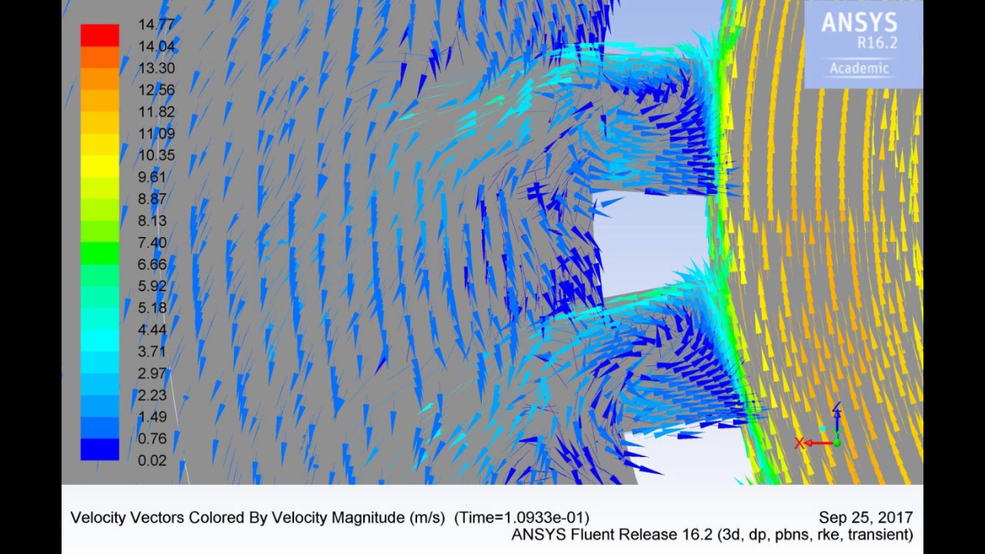
Animation 1 – The Silverson L4R inline mixer with the standard shear gap - mean velocity field colored by velocity magnitude in the XZ plane, y = 130 mm. Showing the center plane of rotor and stator. Skipped every other arrows (8000 RPM, pressure inlet, pressure outlet, 7.8M cells, RANS simulations)

Slide 2
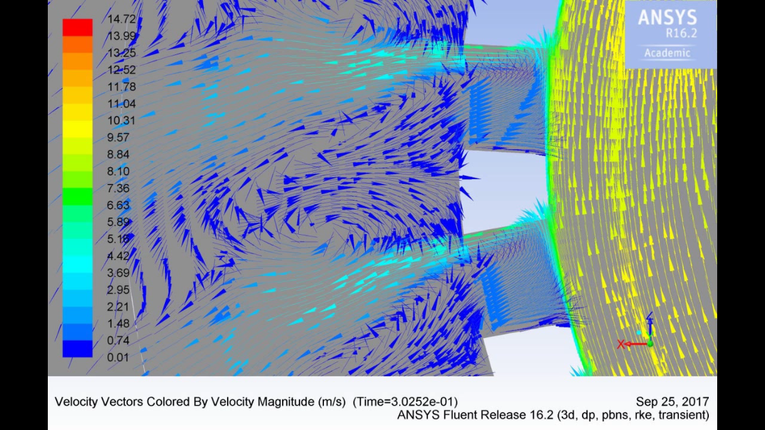
Animation 2 – The Silverson L4R inline mixer with the enlarged shear gap - mean velocity field colored by velocity magnitude in the XZ plane, y = 130 mm. Showing the center plane of rotor and stator. Skipped every other arrows (8000 RPM, pressure inlet, pressure outlet, 7.8M cells, RANS simulations)

