Slide 1
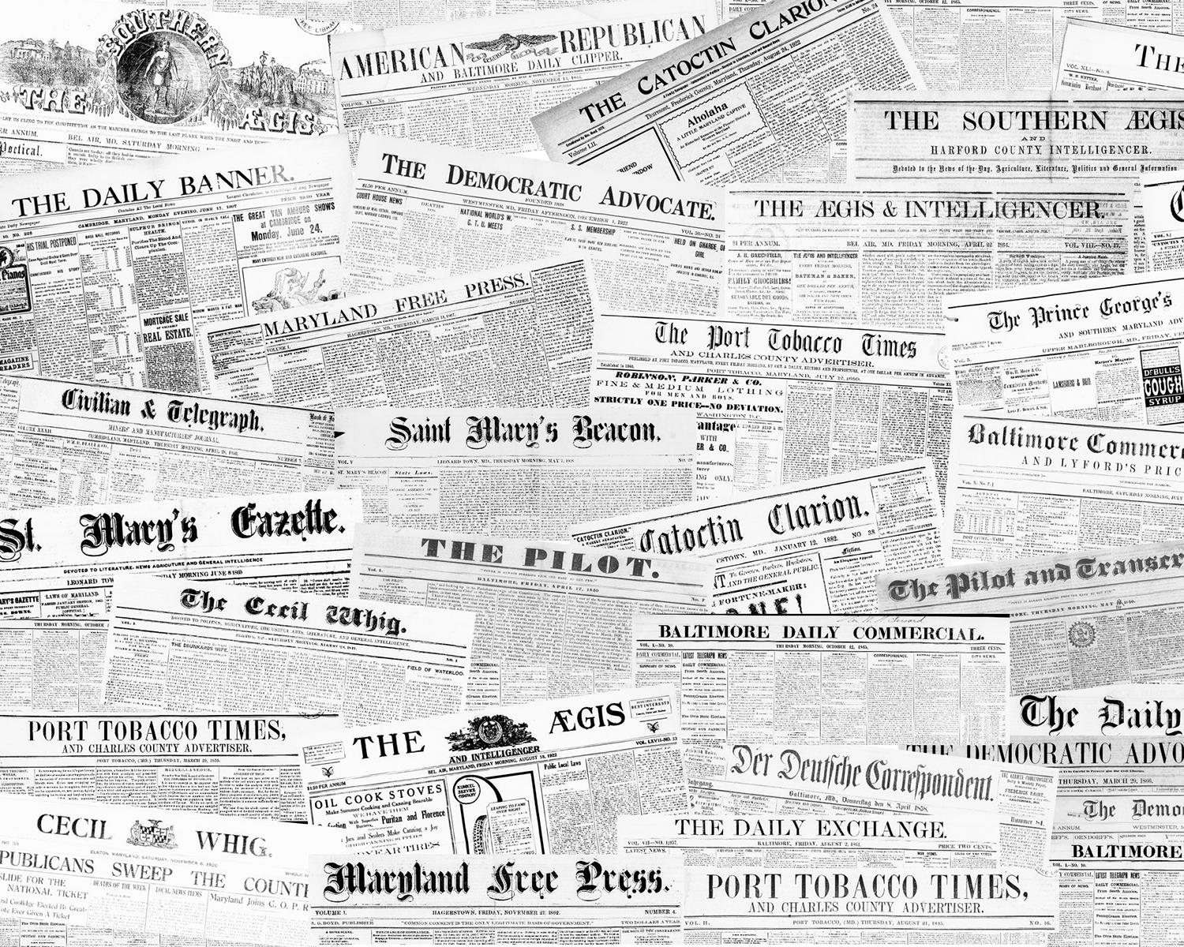


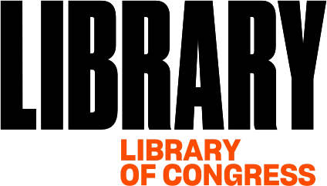
Historic Maryland
Newspapers Project
Advisory Board
Meeting Fall 2020
HMNP Advisory Board Meeting - virtual
October 28, 2020 | 1:00-3:00pm
Notes:
Historic Maryland Newspapers Project (HMNP) Advisory Board Meeting Fall 2020
October 28, 2020 | 1:00-3:00pm | Virtual via Zoom
Hosted by HMNP Team at University of Maryland Libraries:
Douglas McElrath, Co-Director
Robin C. Pike, Co-Director
Pamela A. McClanahan, Project Manager
HMNP is made possible by funding received from the National Digital Newspaper Program (NDNP), a partnership between National Endowment for the Humanities and Library of Congress.

Slide 2
Welcome
and
Introductions
Notes:
Welcome and Introductions - Doug (5 mins)
-This meeting will be recorded
-Welcome
-Intro (Attendee List)

Slide 3
HMNP
Project
Update
Notes:
HMNP Project Update - Pam (10 mins)

Slide 4
Background
US Newspaper Program (USNP), 1982 - 2001
  Locate, catalog, and microfilm newspapers published in U.S.
National Digital Newspaper Program (NDNP), 2005 - Present
  Digitize select newspapers to be made freely accessible in Chronicling America
Notes:
I’m going to go over the different phases of the Historic Maryland Newspapers Project (or HMNP).
I’ll start by sharing a little background of what led to HMNP to put my updates in context.
I’m going to go over the two partnerships of National Endowment for the Humanities and Library of Congress related to newspapers -
the US Newspaper Program and the National Digital Newspaper Program.

Slide 5
U.S. Newspaper Program (USNP)
1982-2001
Enhance access to historic American newspapers
Locate, catalog, and preserve on microfilm newspapers published in the United States
Established the USNP Preservation Microfilming Standards
All 50 states participated
Notes:
Starting with the US Newspaper Program or USNP:
This program first brought NEH and LC together to enhance access to historic American newspapers.
The goal of this program was to locate, catalog, and to preserve on microfilm newspapers published in the United States.
USNP established standards for microfilming newspapers that are still used today. And all 50 states participated in this program.
In Maryland, the state archives was the designated repository for the microfilm produced under the grant.
University of Maryland Libraries participated in the cataloging portion of this project,
which resulted in the publication of ‘A Guide to Newspapers and Newspaper Holdings in Maryland.’
That you might be familiar with.

Slide 6
National Digital Newspaper Program (NDNP)
2005-Present
Project publication date range: 1690-1963
One award per state/territory
  Multiple content partners
~100,000 pages per award
  Multiple award opportunities
Title selection criteria
Microfilm selection criteria
Other deliverables: title essays, survey data
Notes:
The National Digital Newspaper Program or NDNP, brought together NEH and LC again to offer grants to states to further enhance access to historic American newspapers by digitizing select titles that had been microfilmed during the USNP.
Then these titles would be made freely available in a database of digitized newspapers.
Each state has the opportunity to apply to the program through one organization who collaborates with relevant state partners for content.
If awarded, the state receives a two year grant to digitize 100,000 pages.
States can apply for multiple phases depending on funding availability.
States have been encouraged to complete three phases and have approximately 300,000 digitized newspaper pages available in Chronicling America, and in some cases states are able to go beyond three phases.
And we have been fortunate enough to be one of those states.
With only being able to digitize a small portion of what was microfilmed as part of the USNP,
NDNP has very specific criteria that must be met to make a newspaper title eligible for digitization.
We’ll review those criteria this afternoon before our Phase 5 title discussion.
While most digitization happens from microfilm, we are permitted to digitize from print when microfilm is not available,
And we have done that in this current phase, and have a couple of possible titles for Phase 5 that are in print as well.
In addition to digitizing 100,000 newspaper pages, state awardees are responsible for providing title essays for each newspaper title they digitize that are then displayed on the title view in Chronicling America
and conducting a state-wide survey of other digitized newspapers,
such as the Google mass digitization project,
and then we make that data searchable on our HMNP website and provide links to those other sources.

Slide 7
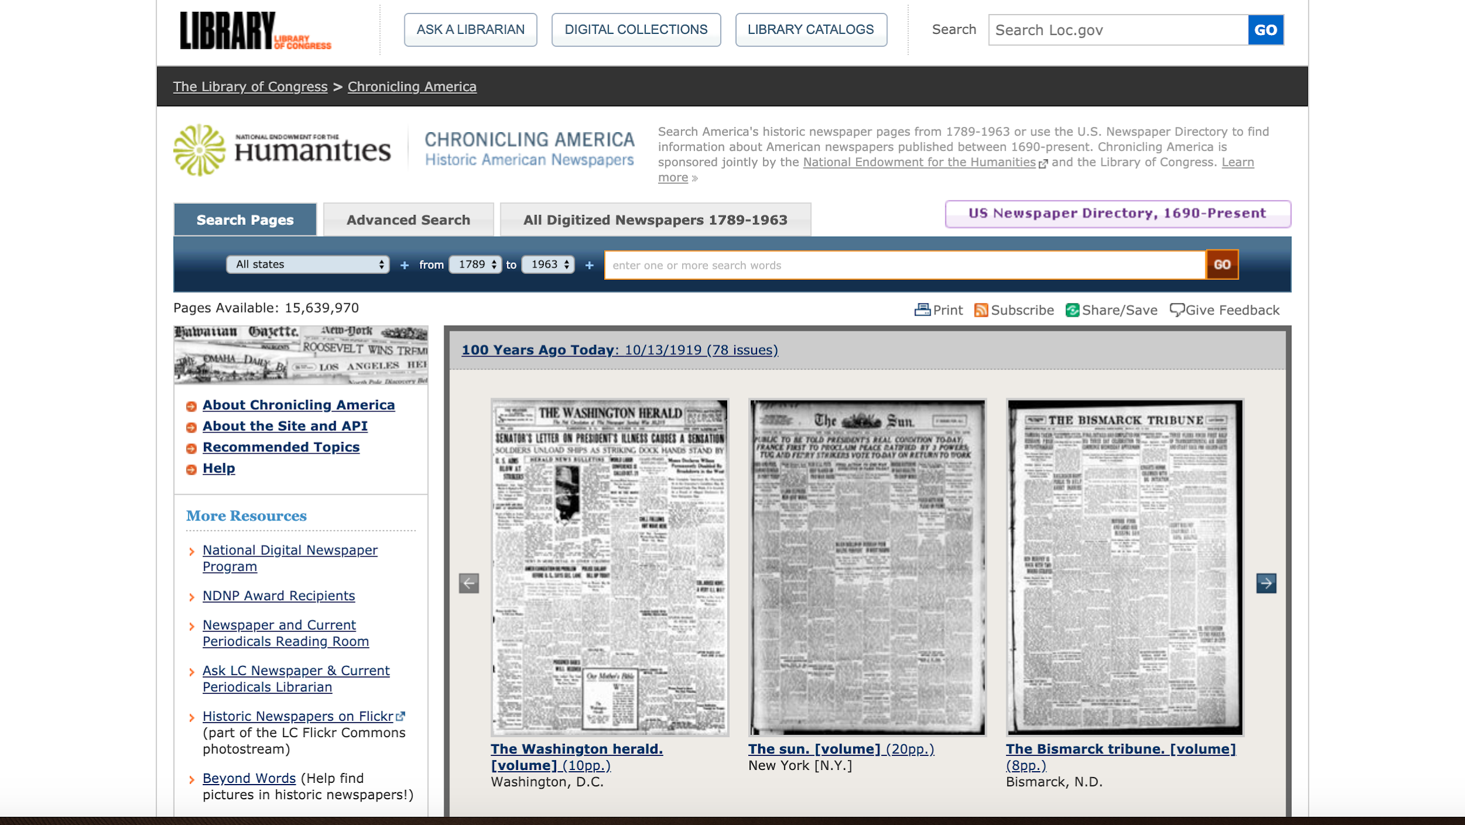
Chronicling America
https://chroniclingamerica.loc.gov/
Notes:
Chronicling America is the digitized newspaper database created out of the NDNP.
It is freely accessible on the Library of Congress website.
And offers simple and advanced searches, and a feature to browse all of the titles for each state.
Chronicling America also provides access to the US Newspaper Directory,
which was first established from the cataloging portion of the USNP
and is now offered in a searchable format to view bibliographic information about all newspaper titles identified during the USNP,
not just those digitized and made available in Chronicling America.
Some changes are coming to Chronicling America, so it will look different likely sometime next year,
but will offer the same search options, as well as some enhanced features.
Robin will go over more about that when she talks about NDNP conference updates.
https://chroniclingamerica.loc.gov/

Slide 8
Maryland Content in Chronicling America
Years participating: 2012-present
Total MD News pages: 316,168
Total MD issues: 58,664
Total MD titles: 46
Languages: 5 (English, German, Polish, Italian, Czech)
Notes:
Maryland content in Chronicling America:
University of Maryland Libraries applied to NDNP working closely with other stakeholders from throughout the state.
And the Historic Maryland Newspapers Project received their first grant in 2012.
Through the first three grant rounds, 316,168 Maryland Newspaper pages were added.
This represents 58,664 issues from 46 titles.
These titles are in three different languages - English, German, and Polish.
Phase 4 will add another 100,000 pages, as well as titles in Italian and Czech.
I want to thank our advisory board members
who have helped us select a wide range of content for the state throughout the grant rounds.
We have Maryland newspaper titles from the different geographic regions of the state
representing different social and political views including papers of record for the state.
We also have titles representing diverse communities
including political minority groups, labor groups, and immigrant communities in Baltimore.
I will talk more about the Maryland newspapers that have been digitized a little later this afternoon.

Slide 9
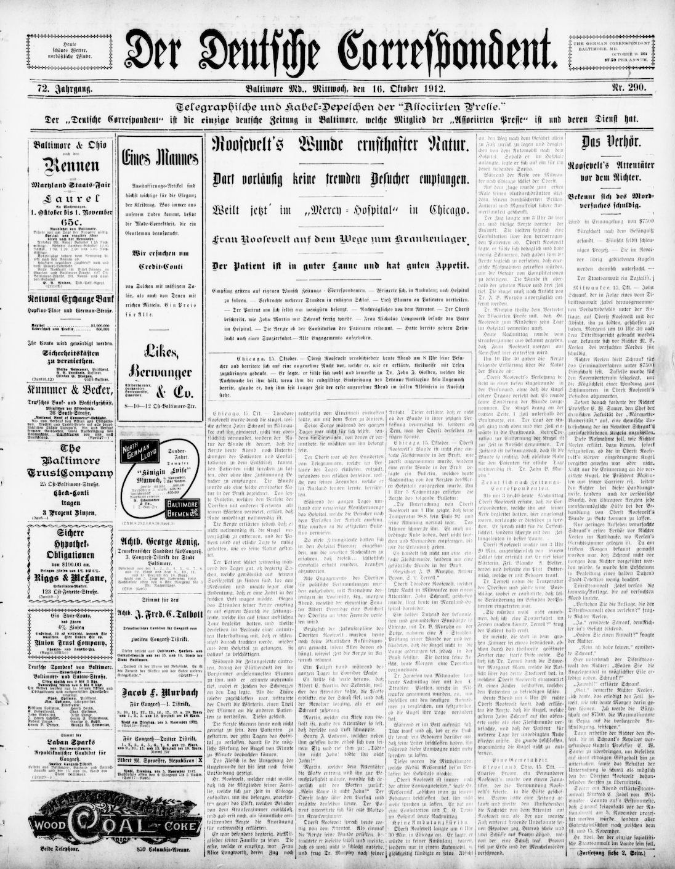
HMNP Phase 1
(2012-2014)
Beginning of project - determining workflows and selecting vendors who could meet standards
Primarily digitized the prominent German title, Der Deutsche Correspondent
Included some English-language issues from a Hagerstown title and a Cumberland title
Notes:
Now, I’ll share about the different grant phases.
During the first phase, a lot of time was spent learning the process and developing workflows,
as well as selecting digitization vendors who could meet the NDNP Technical Standards.
There was a lot of troubleshooting in the first phase to establish the workflows and ensure quality images.
Digitization efforts were focused primarily on the important German language title published in Baltimore, Der Deutsche Correspondent.
There were a few English-language issues from a Hagerstown title and a Cumberland title as well,
but the majority of pages submitted were from Der Deutsche Correspondent.

Slide 10
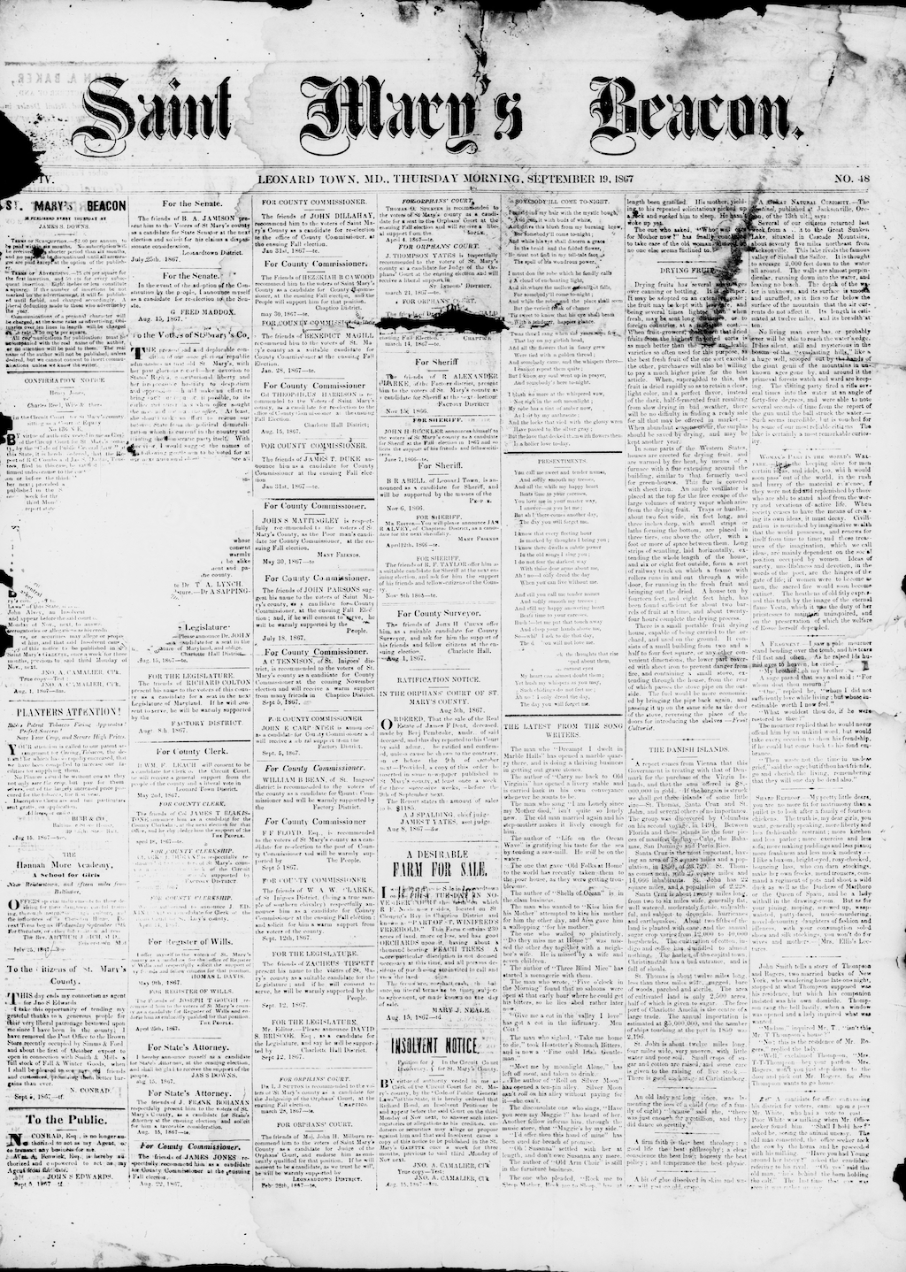
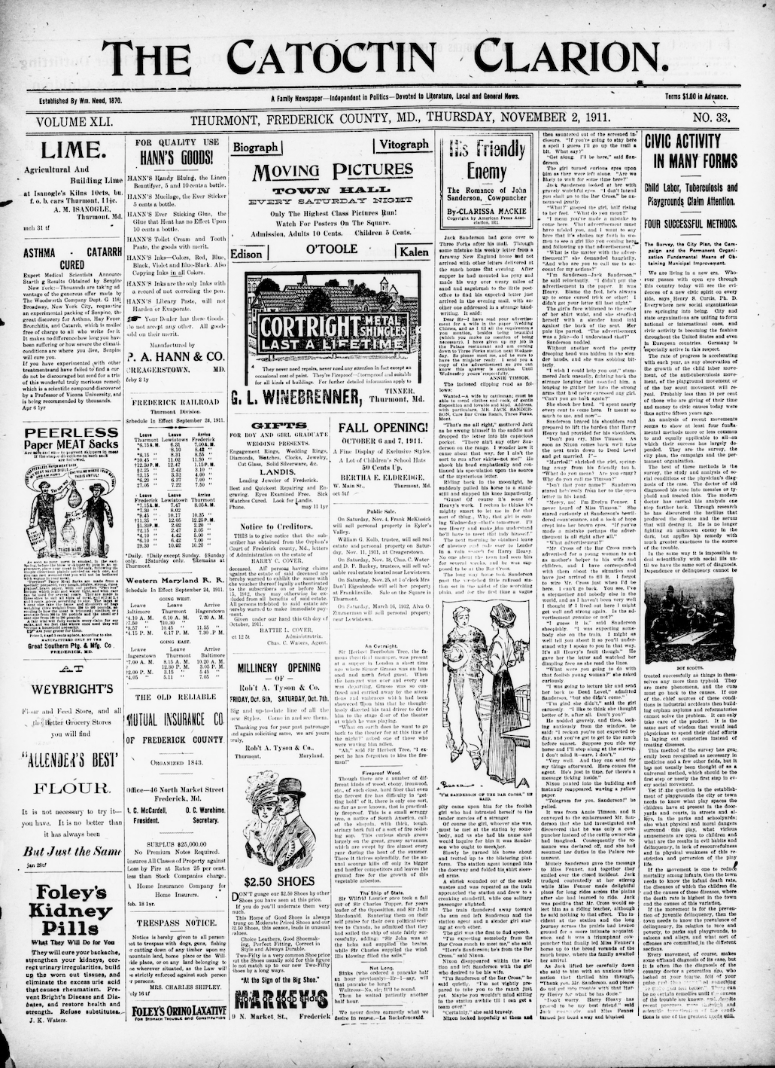
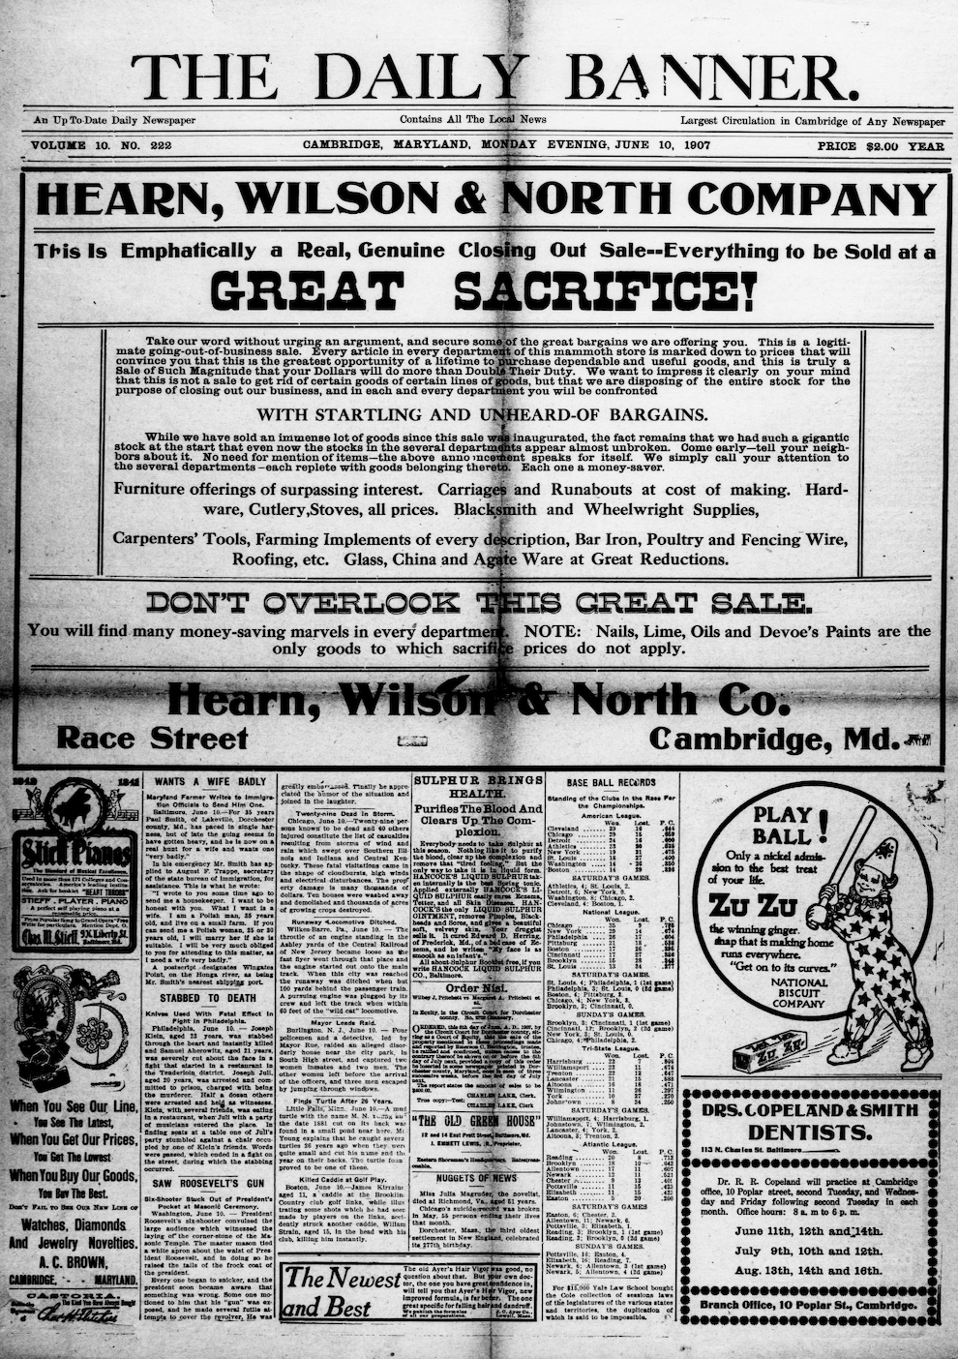
HMNP Phase 2
(2014-2016)
Increased number of English-language pages
Broader geographic representation - titles from Western Maryland, Southern Maryland, and the Eastern Shore
Increased temporal coverage, especially Civil War years and beyond
Notes:
In the next phase, the number of English-language pages was increased.
There was a goal to broaden the geographic representation
and this phase included titles from Western Maryland, Southern Maryland, and the Eastern Shore.
The temporal coverage of English-language titles was increased as well, particularly for the Civil War years and beyond.
NDNP has increased the date range of newspaper titles they will accept for the project starting with just 1900-1910,
And gradually extended decade by decade, to cover the historic period 1836-1922.
The project now accepts newspapers from 1690-1963, as long as the title is in the public domain.
As NDNP added more years, HMNP found titles from different eras to include as well.

Slide 11
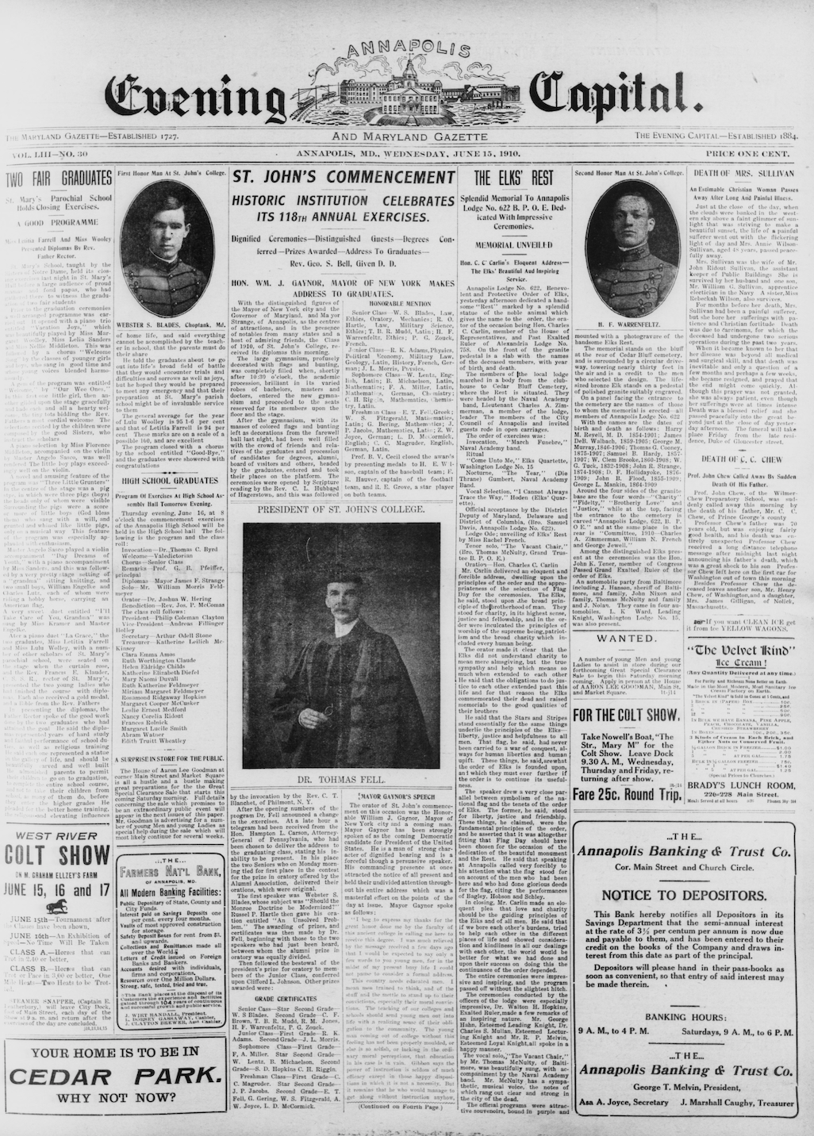
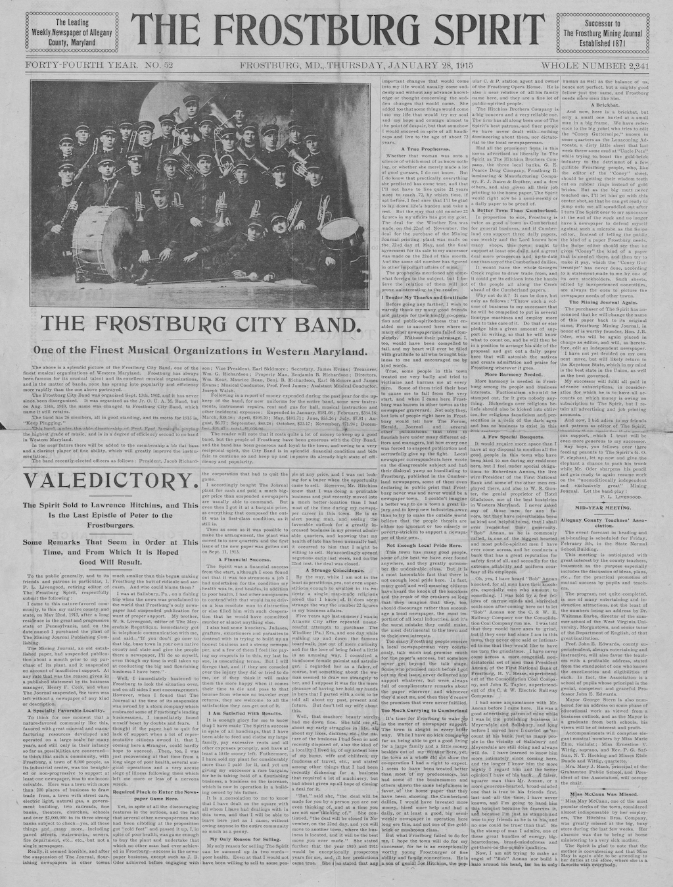
HMNP Phase 3
(2016-2018)
Continued to increase the geographic and temporal coverage of MD newspapers
Broadened the representation of diverse opinions
Included a Polish language title from Baltimore
Notes:
During Phase 3, HMNP continued to increase the geographic and temporal coverage of Maryland newspapers in Chronicling America.
With Maryland’s historic position as a border state, titles were chosen to offer contrasting viewpoints to previously digitized titles to broaden the representation of diverse opinions.
Another goal during this round was to represent additional diverse communities including labor groups and the Polish community in Baltimore.

Slide 12
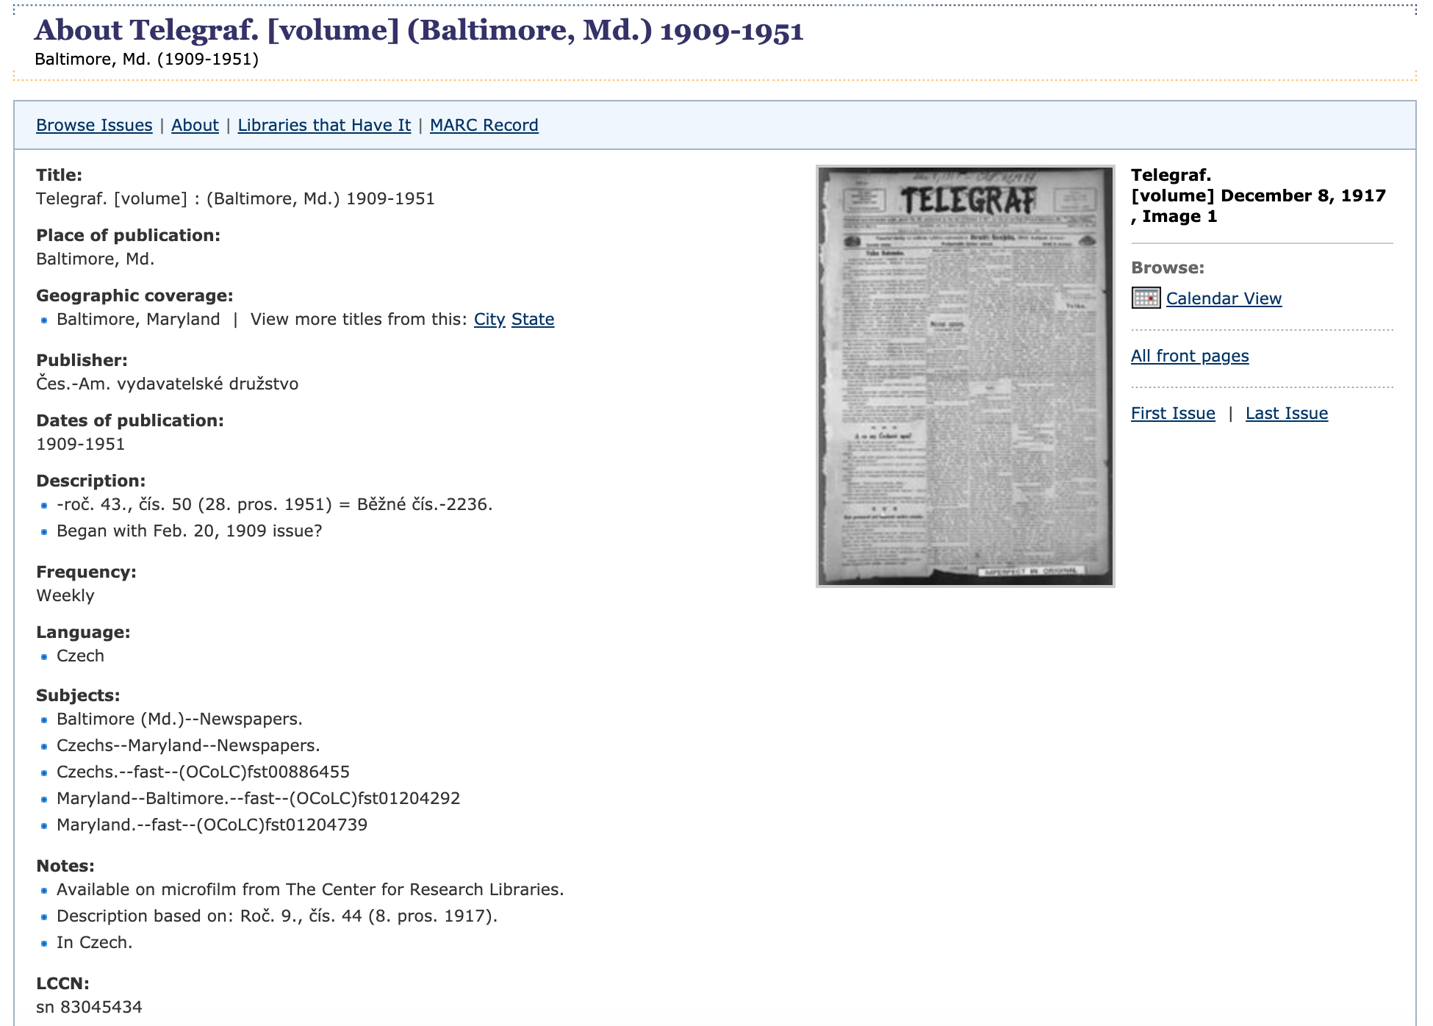
HMNP Phase 4
(2018-2020)
Documenting underrepresented communities
Post-1922 content (1923-1963)
Completing titles previously selected for digitization
Notes:
Now we’re finishing up Phase 4. Things slowed down this year when our vendor had to close down temporarily due to Covid. This phase was originally supposed to end in August, but we requested and received a no cost extension from NEH to extend the project through the end of the calendar year.
In Phase 4, about 50% of titles are documenting underrepresented communities. Newspapers are often one of the only primary sources for these communities’ activities. We have diverse titles from the Italian, German, and Czech communities of Baltimore. We also have the Maryland Suffrage News, a paper written by and for women advocating for suffrage, and its subsequent title the Maryland Women’s News after women got the vote.
The other half of the content is focused on post-1922, now that the copyright year has moved forward. With some copyright research, we also can include content up until 1963 as set by the grant.
Within that, we have been able to include a couple of titles that had been selected for digitization in previous phases, but did not work out for inclusion earlier, including the Montgomery County Sentinel and The Republican from Garrett County. We have been able to include a wider date range for those titles than we would have been able to in a previous phase.
From Phase 4, we currently have one title that has been added to Chronicling America: The Telegraf,
which you can see the title record from Chronicling America here.
The Telegraf is our Czech title, and we have digitized 1917-1951.
We have a couple of more batches at Library of Congress now, and then a couple more ready to go.
So we should have more titles from Phase 4 online very soon.
Telegraf: https://chroniclingamerica.loc.gov/lccn/sn83045434/

Slide 13

Content Partners
Maryland State Archives
Enoch Pratt State Library
Center for Research Libraries
National Woman’s Party Museum
Montgomery County
Historical Society
Prince George’s County Memorial Library System
St. Mary’s College of Maryland
Greenbelt News Review
Greenbelt Museum
Maryland Historical Society
Frostburg State University
Library of Congress
Notes:
HMNP is very much a collaboration.
We have partnered with organizations throughout the state during all of the grant phases, and their names are listed here.
We’re grateful for these organizations who have become content partners on the project.

Slide 14
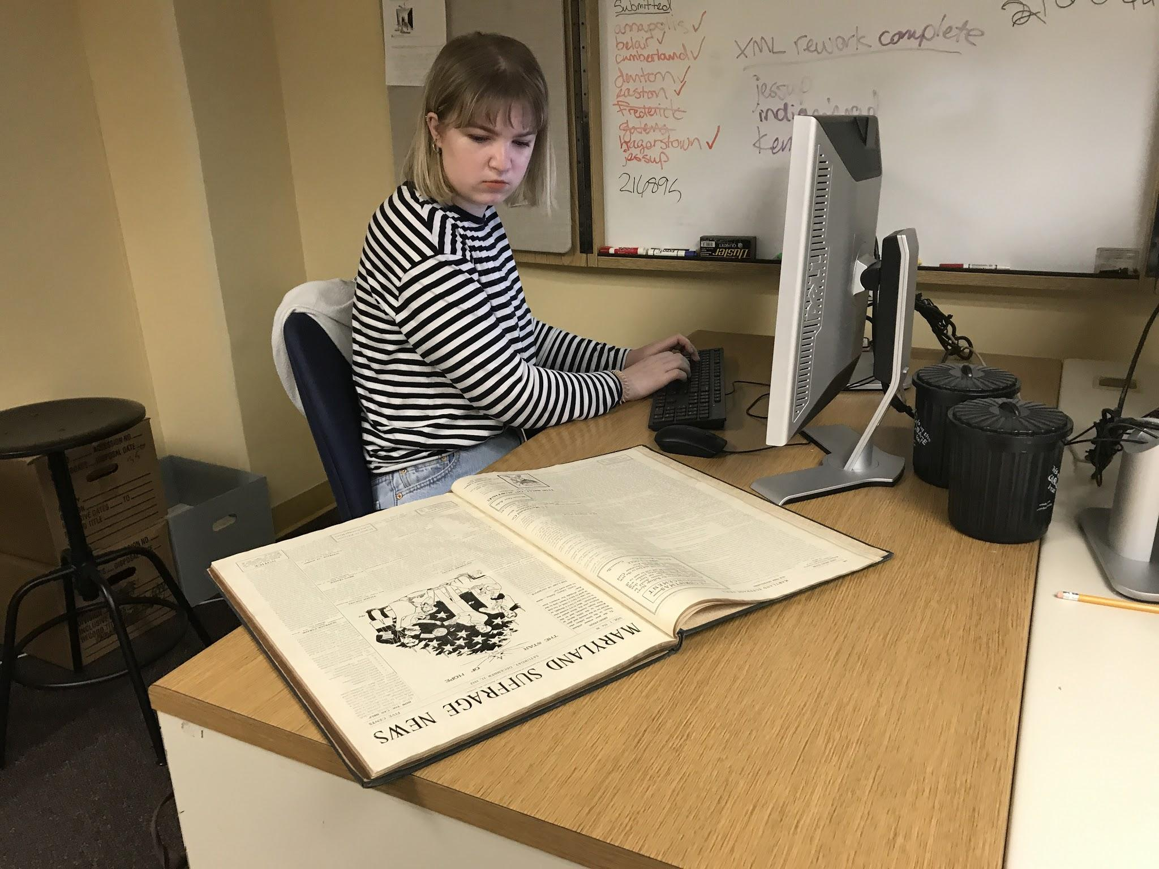
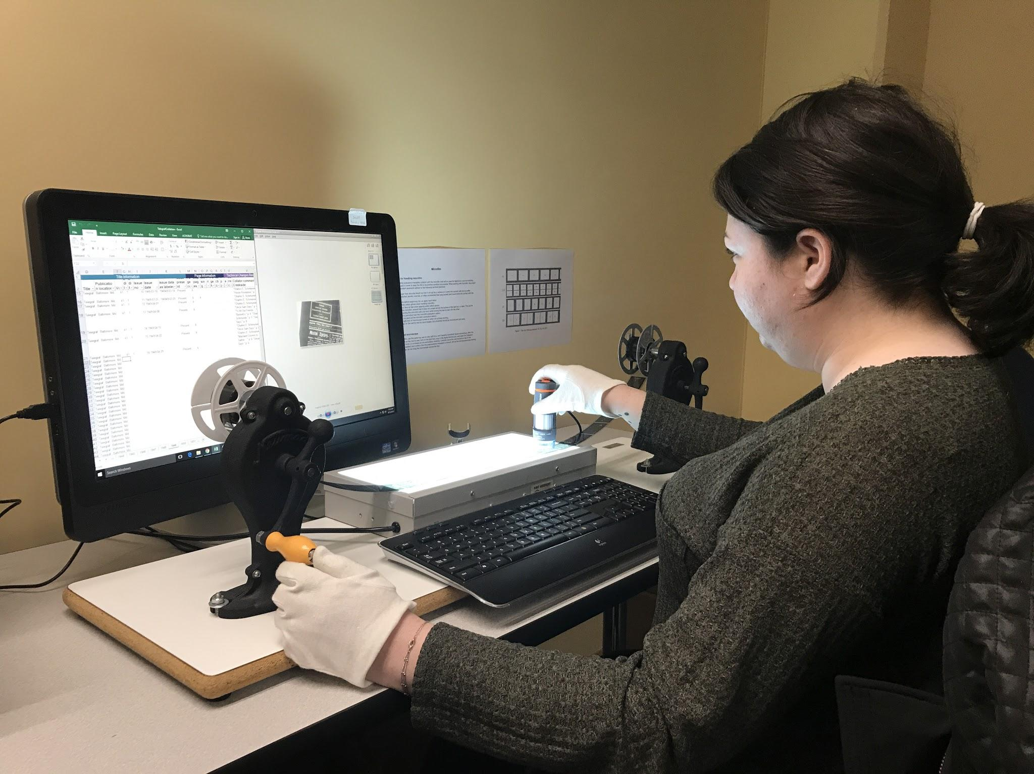
Project
Workflow
Finalize title selection
Obtain original content
Send microfilm for duplication
Complete metadata collation
Send duplicated microfilm reels for imaging along with metadata to be embedded in images
Conduct quality review on digitized files
Submit approved files to LC for inclusion in Chronicling America
Notes:
This is an overview of the project workflow for digitization during a grant phase.
First, title selection is finalized and we work with content partners that I just mentioned to obtain the original content.
We send the microfilm reels to the vendor for duplication.
Then metadata collation is completed for each title.
The duplicated microfilm reels are sent to the vendor for imaging along with the metadata in batches of 10,000 pages.
As we receive batches of digital files back from the vendor, we complete quality control on the images and metadata.
Next they are submitted to Library of Congress,
and once they are approved by LC, the pages go online in Chronicling America by batch.
In the photos here, two of our previous student assistants are working on metadata collation. Jane in the top photo is working from a bound volume of newsprint. In the bottom photo, Sydney is working from a duplicated microfilm reel with a digital microscope. Our student assistants help with various aspects of the project including metadata collation of titles, quality review of images and metadata, copyright research, blog posts, wikipedia entries, social media, and other outreach.

Slide 15
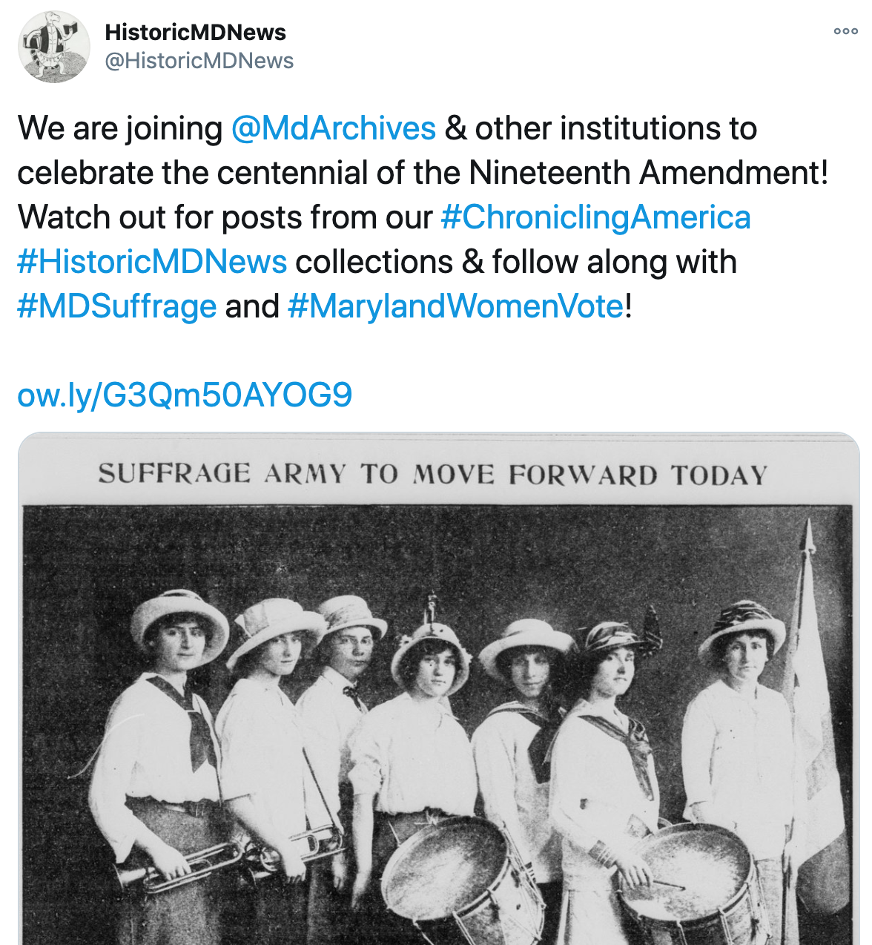
Outreach
Wikipedian-in-Residence and Wikipedia Edit-a-Thon
Digital Maryland presentations at public libraries
Genealogical research brochure
Maryland Newspaper Conference, partnering with Digital Maryland
UMD Social Justice Day poster on women in historic newspapers
Social Media - @HistoricMDNews
Presentations to genealogy groups
Assignments using historic newspapers in UMD courses
Notes:
Here are some highlights of HMNP outreach activities.
After more English-language content was added in Phases 2 and 3, more general outreach programs could be done.
The first HMNP Project Manager, Liz Caringola, had a wikipedia edit a thon for the Maryland newspaper content
And there was a Wikipedian in Residence on the project
In Phase 2, HMNP partnered with Linda Tompkins-Baldwin of Digital Maryland
to present at 5 public library programs across central Maryland.
In Phase 3, Robin and Doug developed a genealogical research brochure,
and again partnered with Digital Maryland and Linda to create a Maryland Newspaper Conference.
My predecessor, Rebecca Wack, created social media accounts for HMNP,
and developed a monthly hashtag party with the other state newspaper projects.
A different theme is chosen each month, and all the states find content related to the theme in their titles
and post with the same hashtag on Twitter on the third Tuesday of the month.
which generates more interest and engagement with the digitized newspapers.
Throughout the project, we have given presentations at public libraries and to genealogy groups, as well as in the classroom for various courses on campus on how to do research with historic newspapers.
Not being able to travel this year, I have focused more on online outreach. The students have helped increase our social media content, and we shared Chronicling America as resource for distance learning.
Also this year I partnered with our board member, Maria Day of Maryland State Archives to organize a week long social media hashtag campaign in August to share content related to women’s suffrage coinciding with the centennial of the 19th amendment. I know many of you attending today participated in that campaign, so thank you, that was a great way to connect with other Maryland historical organizations and for us all to share our Maryland content. Ian’s going to share about how the Nabb Center used the resources from that social media event at Salisbury a little later too.
Now, Robin is going to give an update from the NDNP conference.

Slide 16
NDNP Annual Conference Update, 2019-2020
Notes:
NDNP Annual Conference Update - Robin (10 mins)

Slide 17
Chronicling America Statistics
Over 17M pages
Over 2.3M issues
3,862 titles
1,586 newspaper essays
States Added: Alabama and Wyoming, also US Virgin Islands
  48 states, 2 territories, DC
Date Range: 1789-1963, bulk 1835-1924 (public domain)
New Languages: Hungarian, Tagalog
https://www.loc.gov/ndnp/data-visualizations/
Notes:
As a whole, the Chronicling America corpus represents:
over 17M pages, 2,300,000 issues, 3862 titles, 1,586 newspaper essays
States added: Alabama and Wyoming, also US Virgin Islands; 48 states, 2 territories, DC
date range: 1789-1963, bulk 1835-1924 (public domain)
more languages: new--Hungarian and Tagalog
You can check out LoC’s data visualizations to see how the data is represented at https://www.loc.gov/ndnp/data-visualizations/

Slide 18
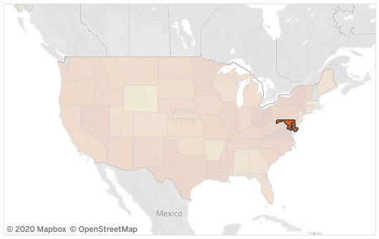
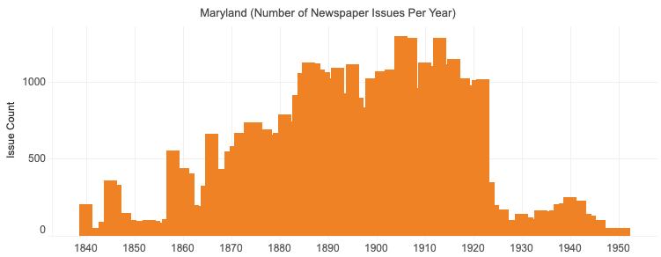
Notes:
These visualizations are taken from the interactive temporal map which allows you to click on each state or territory and see the temporal representation from that state. The temporal chart is not quite accurate as LoC generated it in June and we will be adding several titles that range into the 20th century including the Sentinel and Republican as we conclude Phase 4.

Slide 19
New Digital Strategy for LoC
Strategic plan: https://www.loc.gov/strategic-plan/
Digital strategy: https://www.loc.gov/digital-strategy/
Teachers resources online: https://www.loc.gov/programs/teachers/professional-development/online-office-hours/
Research guide conversion: https://guides.loc.gov/
  Over 359 so far!
Notes:
As part of new digital direction for the 2019-2020 Strategic Plan of the Library and as a result of the Covid closures, LC staff worked to develop new teaching resources for their collections which are freely available to the public. Though these sessions which ran from March through August are completed now, the recordings and resources are linked for current use.
https://www.loc.gov/programs/teachers/professional-development/online-office-hours/
A massive project to convert research guides from old web pages to Libguides began last year as part of the digital strategy but was expanded during Covid-19 closures as work that could be done from home: https://guides.loc.gov/. LOC staff have migrated 359 research guides so far and will continue with the migration as well as will update with new online resources.
Feel free to share these resources with your user communities.

Slide 20
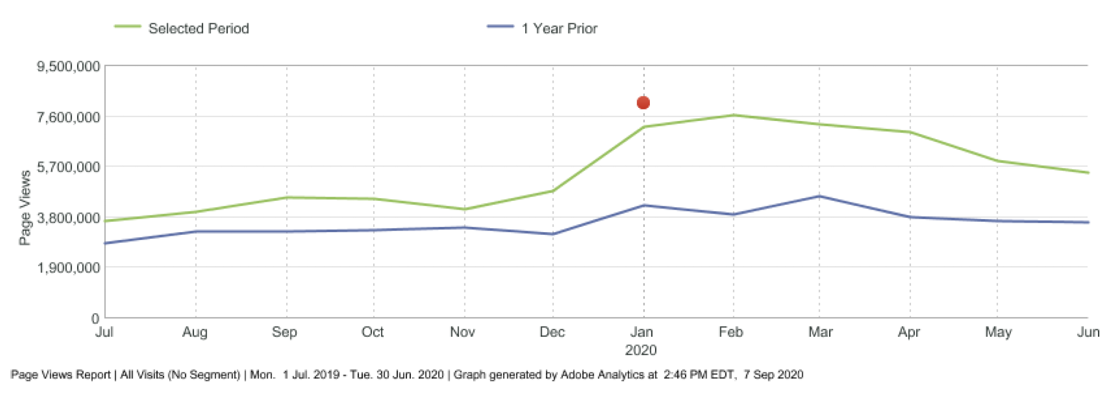
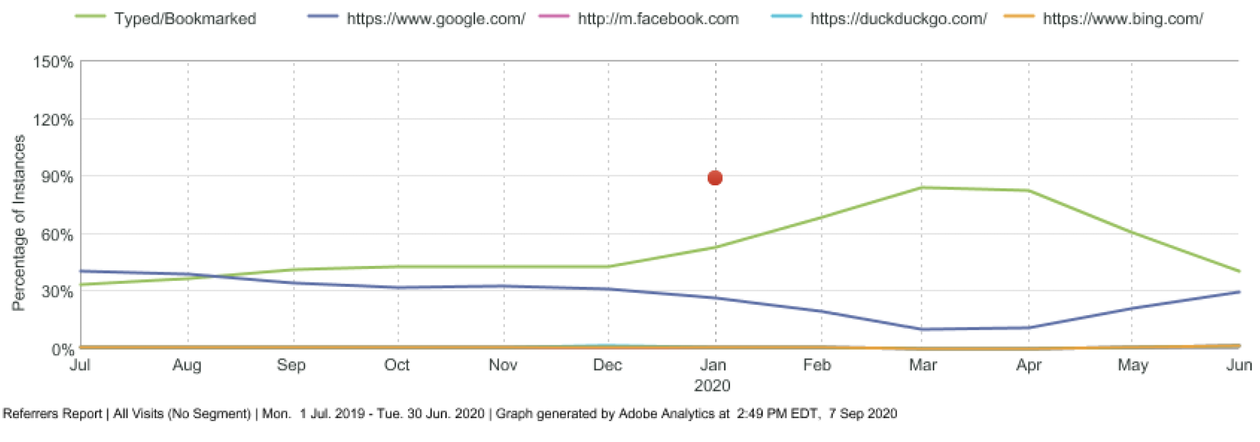
Statistics
Notes:
Due to outreach during Covid-19 closures, usage of LoC digital collections, including Chronicling America, more than doubled from the end of March to beginning of May, and were consistently higher from the January through the end of May. At the meeting, LoC didn't have statistics to share from September, but they were anticipating a similar spike as many schools again used the free, public content. (include image from LC)
More people are accessing content directly typed in or bookmarked rather than searches, which makes it seem likely that people are being linked from promoted resources or saved bookmarks. (include image from LC)

Slide 21
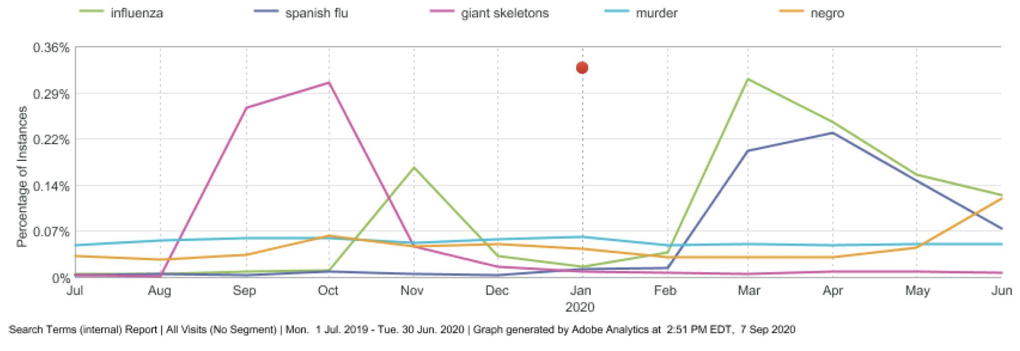
Statistics
Notes:
For searches in Chronicling America, there were two very large spikes in November and from March to present for "influenza", as well as similar spikes for “spanish flu”. There was also a spike for "negro" from May into present, showing the increase in people's research into historic African American life in the US, for a variety of reasons tied to current social movements. (include image from LC)
This underscores the need to digitize content from underrepresented communities.

Slide 22
Beyond NDNP
Beyond Words
  About: https://blogs.loc.gov/thesignal/2017/09/introducing-beyond-words/
  Came to close in June 2020
Newspaper Navigator
  About: https://blogs.loc.gov/headlinesandheroes/2020/09/newspaper-navigator-search-application-now-live/
  Project: https://labs.loc.gov/work/experiments/newspaper-navigator/
Notes:
Projects that were highlighted that were built using the Chronicling America corpus included Beyond Words and Newspaper Navigator.
Beyond Words identified images and the option of amending captions to photos via crowdsourcing
https://blogs.loc.gov/thesignal/2017/09/introducing-beyond-words/. Beyond Words came to a close in June 2020.
Building from Beyond Words, LOC Labs Innovator-In-Residence Benjamin Charles Germain Lee created the Newspaper Navigator, an algorithm to recognize and extract images from text to extract meaning from images and how they were used across the ChronAm corpus. The example in the post tracks a portrait image of W.E.B.Dubois and through that image, you can find the articles. (https://blogs.loc.gov/headlinesandheroes/2020/09/newspaper-navigator-search-application-now-live/)
This may prove another interesting way to search across the corpus for specific people or images related to specific events, such as suffrage, 19th amendment, The Great War, etc.

Slide 23
Future of Chronicling America
Decommissioning https://chroniclingamerica.loc.gov/ because it’s old tech
Moving to https://www.loc.gov/collections/chronicling-america/
New interface will facilitate
  Faceted browsing within a search
  Image manipulation
  Saving clips
  View OCR with image
  IIIF image sharing
Need to figure out how to migrate US Newspaper Directory Data before decommission ChronAm
Future
  Exploring a map interface to search ChronAm.
Notes:
LoC also announced major changes to come to the Chronicling America infrastructure.
LoC will be decommissioning the old Chronicling America soon in favor of the whole LOC search and a separate collections page for ChronAm under their collections because the underlying technology is old and not as flexible as newer technology that already exists and they have implemented for their other digital collections. The old site will be available for at least 3 months after the migration is completed. LoC is re-indexing all ChronAm batch by batch in new repository.
www.loc.gov/collections/chronicling-america
The new site will facilitate more dynamic faceted browsing and searching and will allow a user to do a lot more image manipulation in their browser, which will be better for saving clips and metadata, and will allow users to view the OCR alongside an image. The viewer is based on IIIF (the International Image Interoperability Framework) which will allow for better linking and sharing online, as well. (show screenshots on how to browse, if doing search, can refine further).
In the future, LoC is exploring a map interface to ChronAm, as well.
They will be migrating US Newspaper Directory once they figure out where it will live. This directory is useful to search the newspapers cataloged in the USNP and the ones cataloged since.

Slide 24
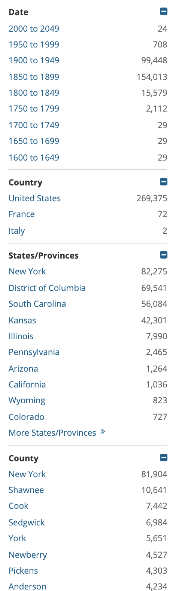
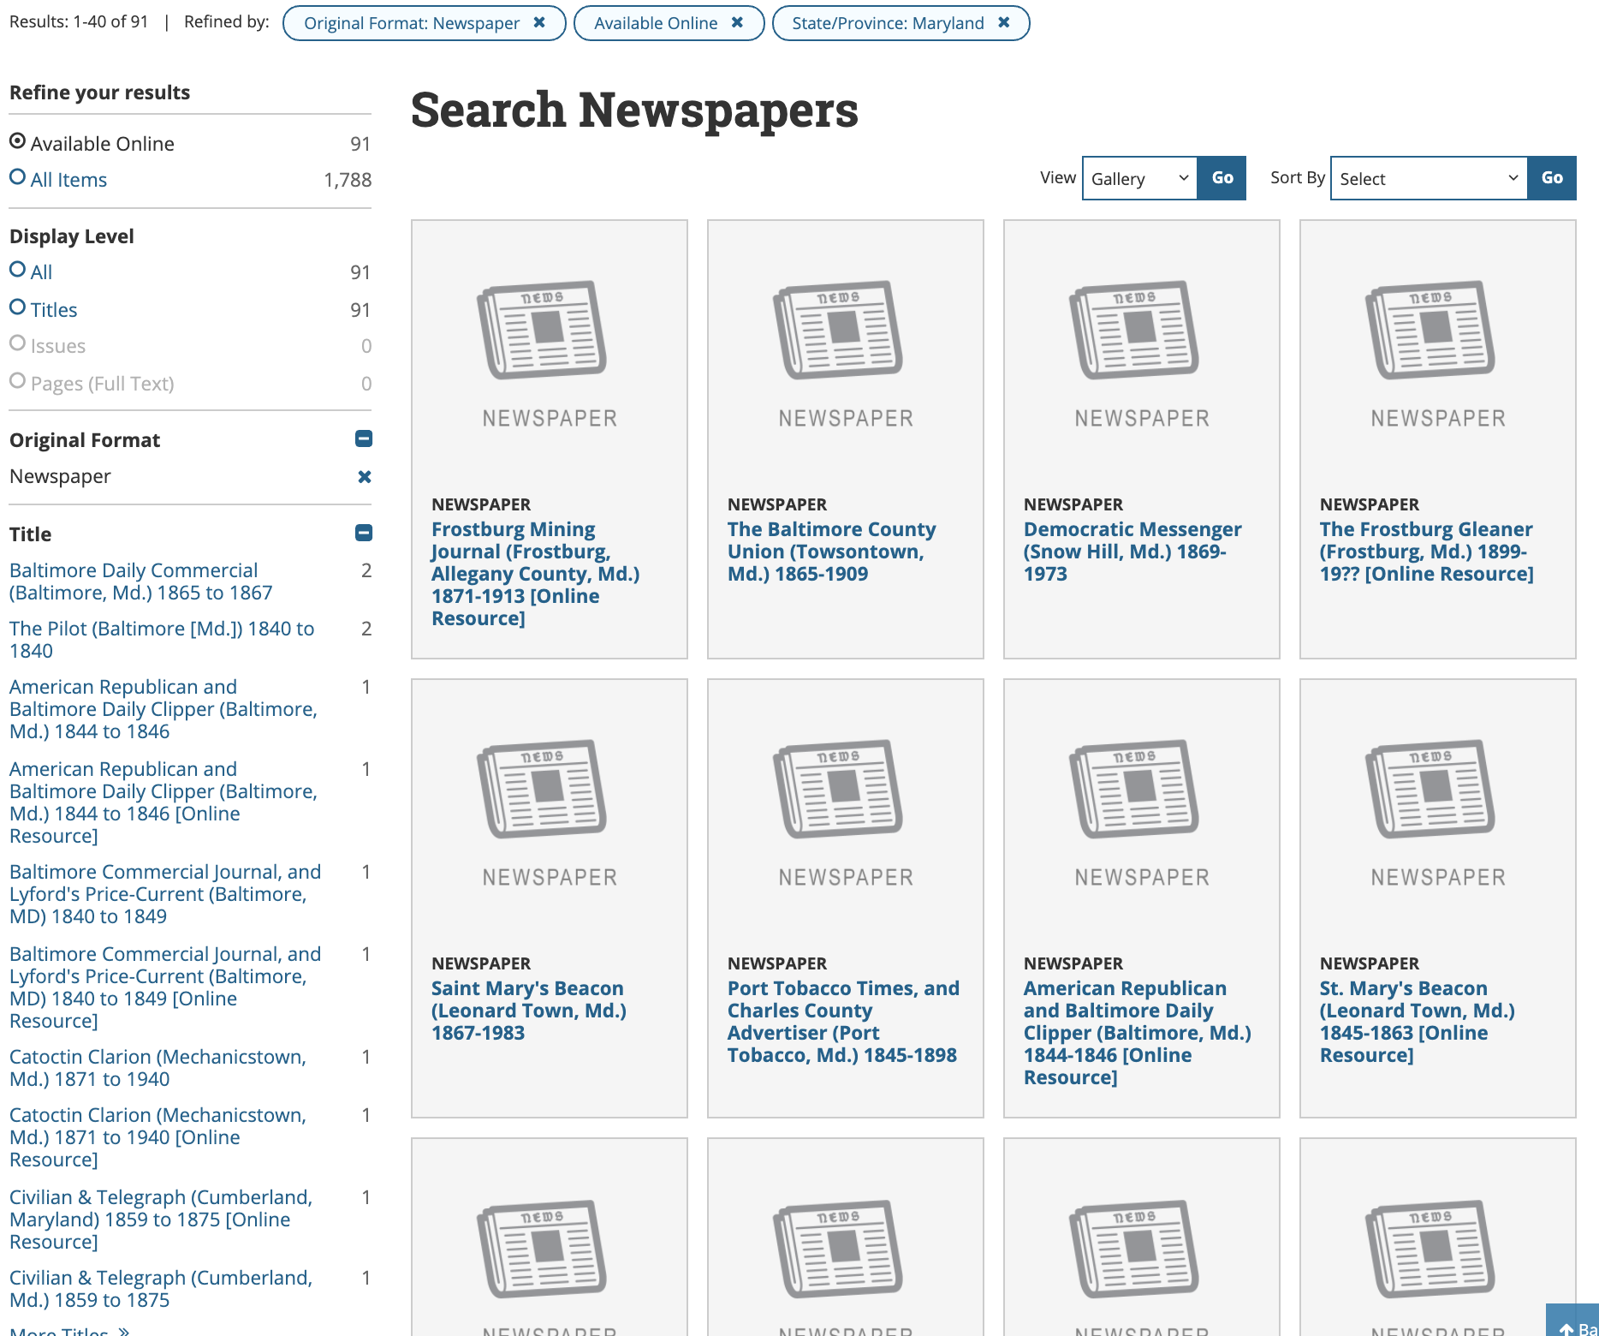
Notes:
Here are two views of the facet and search results in the new interface

Slide 25
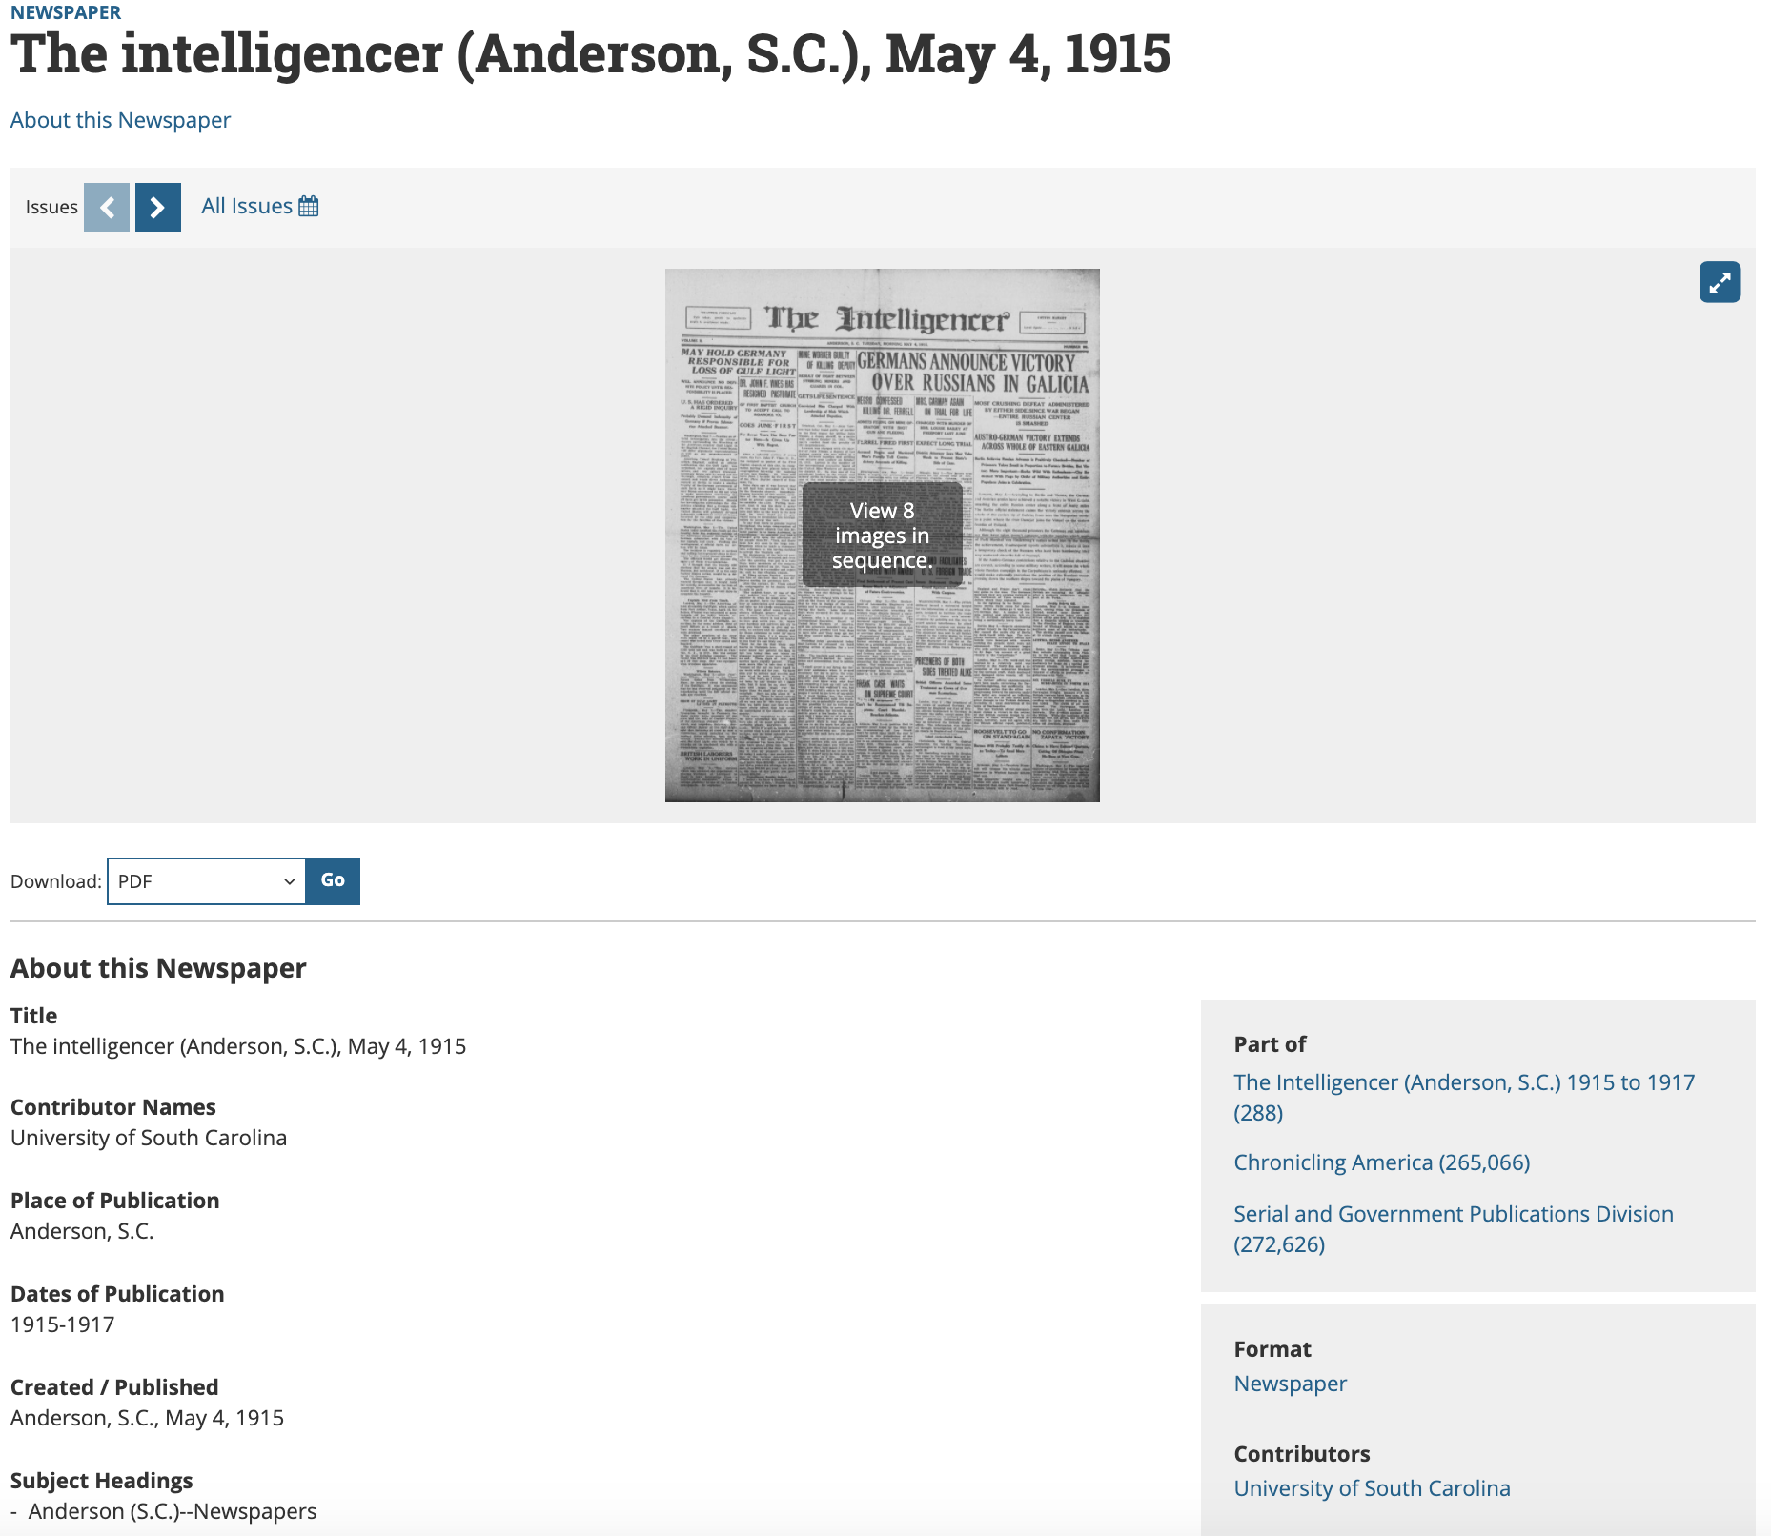
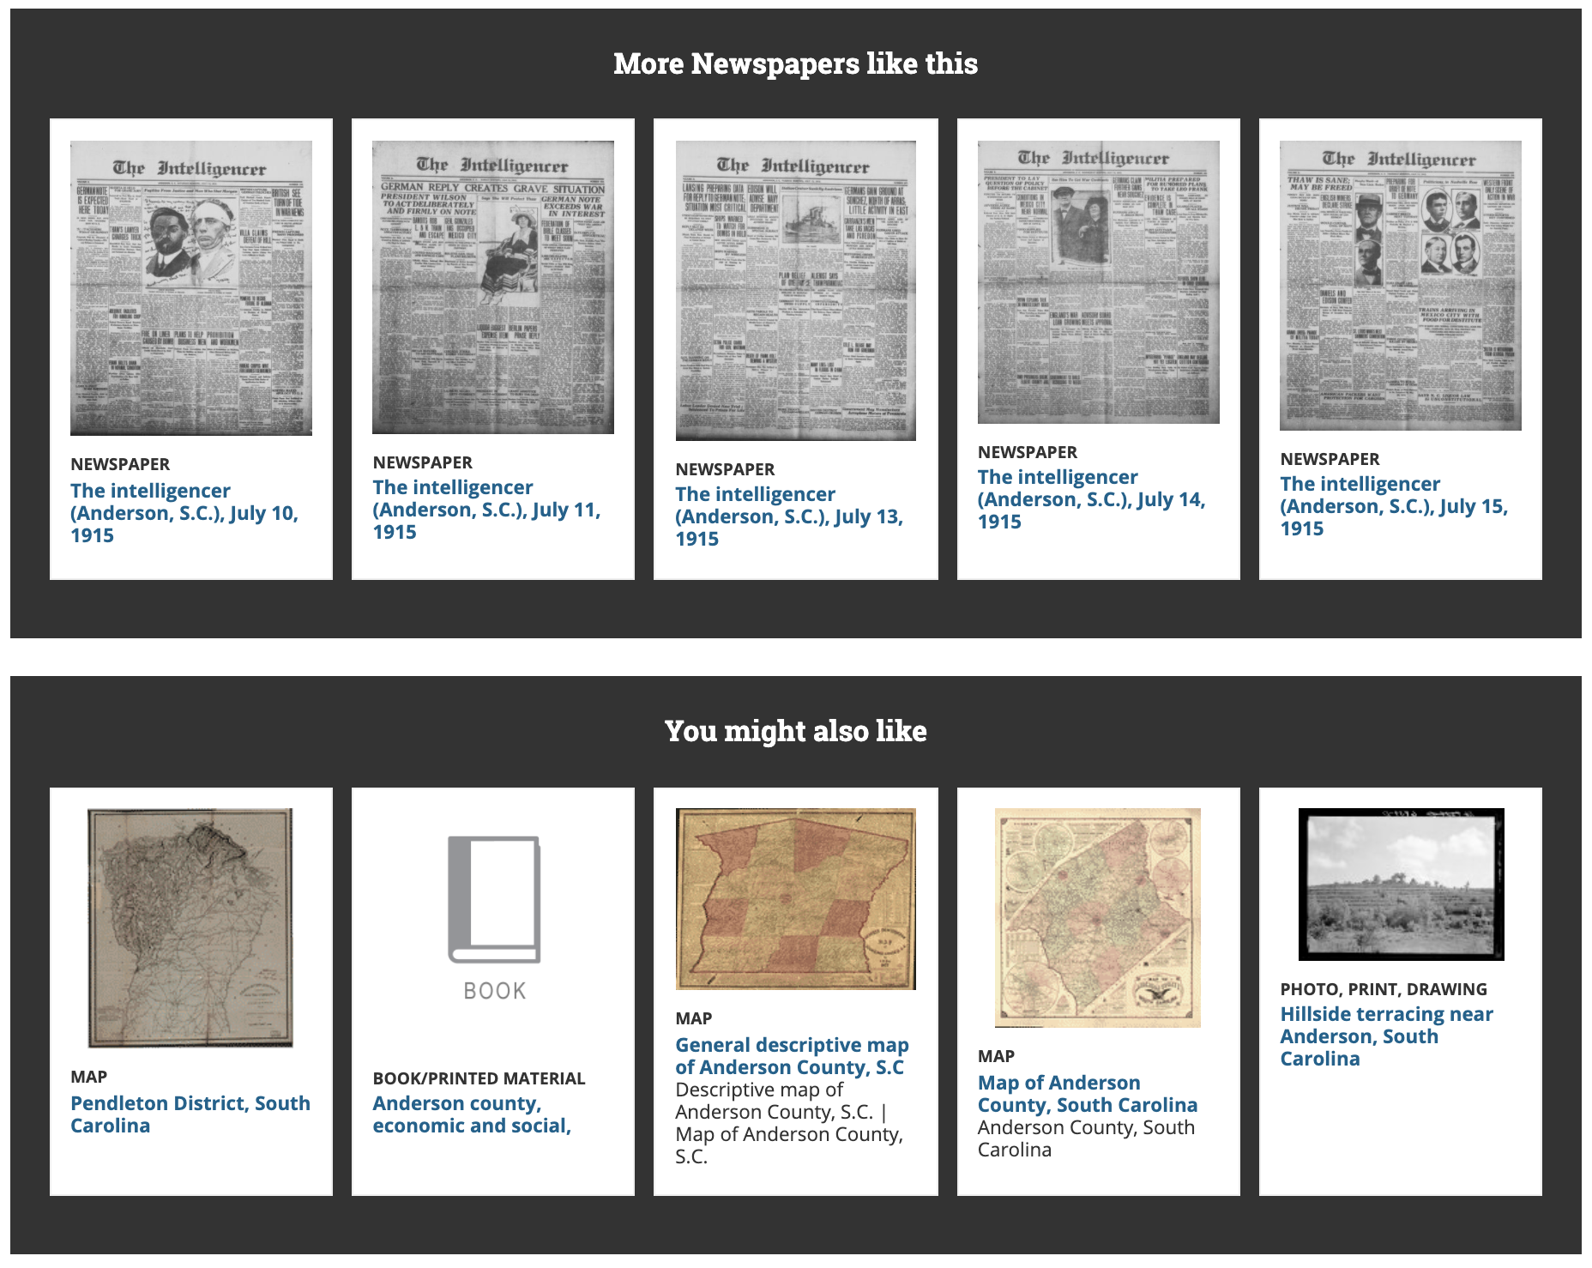
Notes:
Maryland newspapers haven’t been loaded yet since LOC is starting to load the earliest batches first, but here are two views of the top and bottom of how an issue will look.
I’ve cropped the metadata that appears in the middle of the page.
In addition to viewing the newspaper issue, a user will also be shown similar newspaper issues and titles and other digital collections from LOC.

Slide 26
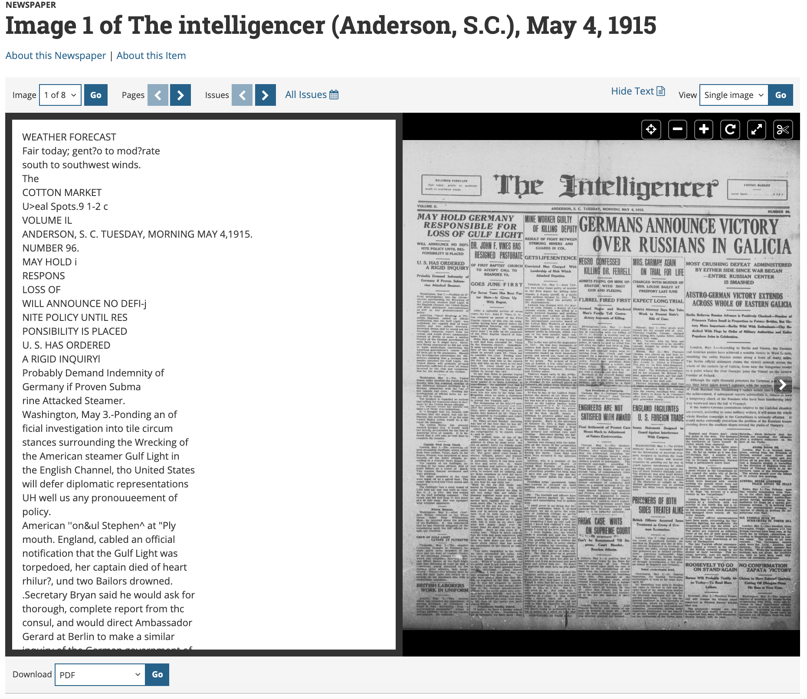
Notes:
And here is a screenshot of the page viewer with the OCR view turned on (notice the Hide Text at the top toolbar).

Slide 27
NEH Funding
FY18: 95% of applications
FY19: 85%
FY20: 38%
Notes:
NEH also gave an update at the meeting this year, which wasn’t great.
In past years, and even until FY18, NEH was able to fund 95% of applications submitted to the National Digital Newspaper Program. With more applicants and with less money, in FY19 they funded 85% and this year in FY20, with even fewer funds available, they funded 38%. The NDNP grant is becoming very competitive and we need to make plans the next year to either submit a very competitive 6th grant application or look to find other funding sources for digitization and infrastructure in Maryland.

Slide 28
New NDNP Application Guidelines
New Application Guidelines
  Representation requirements for Phases 4-6
  More partnerships
  More innovative projects
    Documenting use in current projects
    Book chapter
    Multi-institution collaborative social media campaign
Potential Cap
Notes:
NEH has also updated their guidelines for applicants in rounds 4-6, now putting a major focus on selecting titles that provide underrepresented perspectives and histories. Our application was strong for Phase 5 because we located so many immigrant community and non-English language newspaper titles. This is also why we need to search harder for African American titles, looking into black towns and black presses. We can still make the case for military, labor, and similar special interest papers that can provide wider representation. Another state participant mentioned they found and were digitizing prison newspapers!
There is no official cap, but no states have been awarded applications past a Phase 6 and very few states have received a 6th grant. We should be prepared to accept we might not have our Phase 6 application accepted for the first time and have to reapply, and that we need to make a hard case for the content in the newspapers.
NEH has also decided that for applications beyond a third phase, they are rewarding states that partner more, and that show evidence of innovative projects, such as digital humanities projects or creative outreach and scholarship, in addition to the digitization project. We don’t necessarily have to do these things at our institutions, but we need to make sure our users are doing these things with Maryland newspapers, that we know about their projects, and we can report those projects to LC and NEH in our progress reports. For example, documenting if and how the MSA Legacy of Slavery project used ChronAm. Or how Doug, Anna Kephart, and I (Robin) wrote a chapter in a book on teaching librarianship on teaching genealogists and students how to use Chronicling America and other online newspaper databases to do research. The recent multi-institution collaborative social media campaign on suffrage that combine ChronAm with so many of our other collections was thought highly of, so if we can do more outreach like that, that will be well-received in an application.

Slide 29
Advisory Board Member Panel:
Community Building and
ChronAm Use Cases
Maria Day - Maryland State Archives
Mary Mannix - C. Burr Artz Public Library, FCPL
Ian Post - Nabb Research Center, Salisbury University
Notes:
Advisory Board Member Panel: Community Building and ChronAm Use Cases (20 min)
-Maria Day
-Mary Mannix
-Ian Post

Slide 30
BREAK
Notes:
BREAK (10 mins)
Announce that will follow up with survey to rank proposed titles or add potential other titles after the meeting (for those who can’t attend second half)

Slide 31
Maryland Newspaper Data Analysis
and
NDNP Title Criteria
Notes:
Maryland Newspaper Data Analysis and NDNP Title Criteria - Pam (5 mins)
I’m going to go over the NDNP selection criteria requirements for newspaper titles,
As well as some data analysis of the Maryland content

Slide 32
Title
Selection
Criteria
Current NDNP selection criteria include:
content must be published in state between 1690-1963 and be in the public domain;
with significant research value (papers of record for the state and good geographic, temporal, social, and political coverage of the state, as well as prioritizing content from diverse and underrepresented groups);
good image quality, preferably from the master negative microfilm (but can consider positive microfilm and print);
with as complete a run as possible - long runs, continuity, few to no gaps; and
has not already been digitized elsewhere.
https://www.loc.gov/ndnp/guidelines/selection.html
Notes:
NDNP has selection criteria requirements that must be met related to research significance and microfilm quality.
For the current selection criteria:
-content must be published in state between 1690-1963 and be in the public domain;
-it must have significant research value including papers of record for the state
and good geographic, temporal, social, and political coverage of the state,
as well as prioritizing content from diverse and underrepresented groups;
-the microfilm must have a good image quality, preferably from the master negative microfilm
but we can consider positive microfilm and print that are in good condition.
-Titles should be as complete as possible with preference given to long runs, continuity, and few to no gaps in coverage.
-The content should not already be digitized elsewhere unless there is a strong case for it to also be in Chronicling America.
https://www.loc.gov/ndnp/guidelines/selection.html

Slide 33
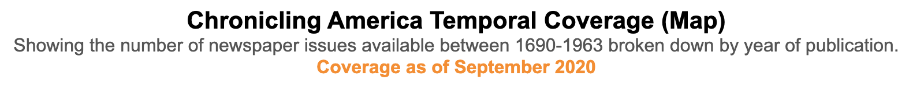
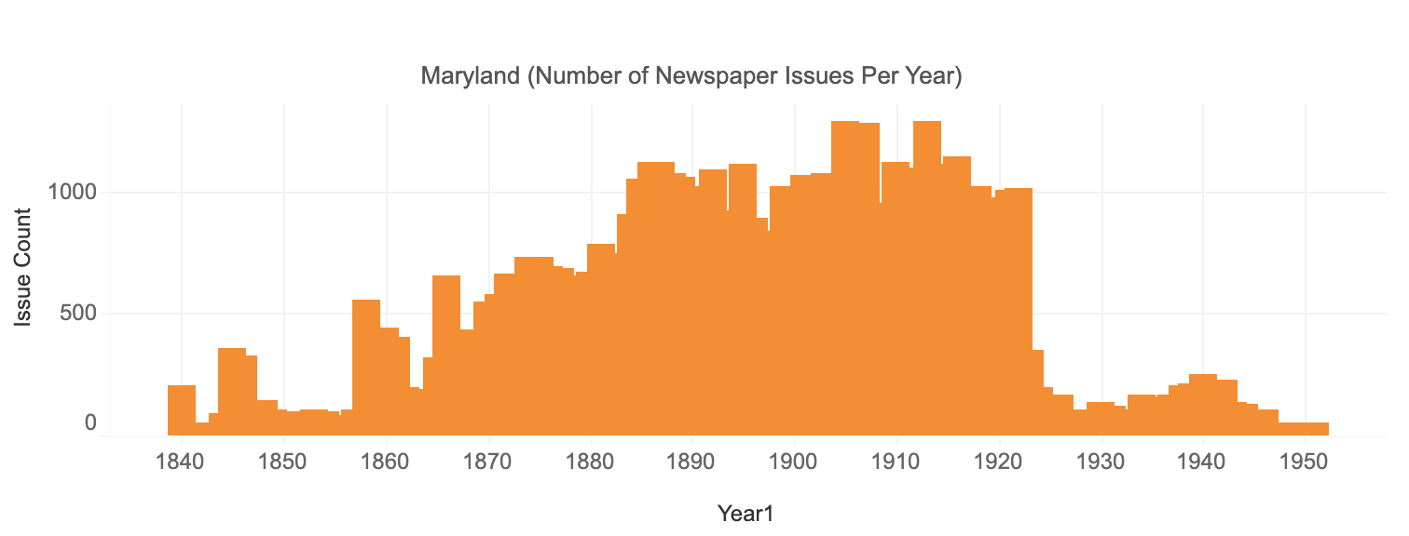
https://www.loc.gov/ndnp/data-visualizations
Notes:
To help us get started thinking about title selection, I have some data analysis to share for the Maryland newspapers.
This data visualization is made available by Library of Congress on Tableau Public.
The graph shows temporal coverage of Maryland titles in Chronicling America.
Maryland currently has titles from 1840 to 1951,
with the majority of content between 1885 and 1922.
In Phase 4, we’re expanding on this and will be adding titles all the way to 1963,
Which you can see does not have nearly as much coverage currently.
1922-Present is a gap in our coverage, though it is a gap for Chronicling America overall
since these dates were just recently allowed to be added
-------------
Data Visualization provided by Library of Congress.
Data used in this visualization is from https://chroniclingamerica.loc.gov as of 9/12/2020.
More info at: https://www.loc.gov/ndnp/data-visualizations.

Slide 34
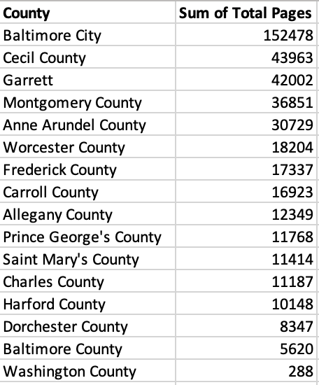
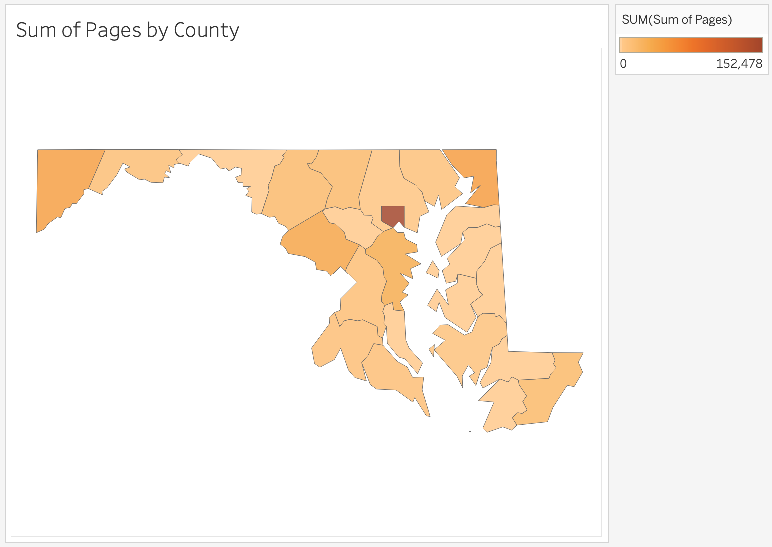
Pages by County
Notes:
I wanted to look at our distribution of newspapers geographically as well,
so I used Tableau to display our data on a Maryland map by county.
This is not to say that there should be equal geographic distribution by county or region,
but just to get an idea of where gaps might be.
The more populated areas of the state are going to have more newspapers.
Baltimore City is always going to be our highest count,
but that is the most populated area of the state with the most surviving newspapers.
This includes Phase 4 data, so it’s an estimate and not our final numbers. But it’s very close to where we’re at.
I also want to note that I did include all of the Republican through 1963 in these numbers,
but we’ll only be able to do about 20,000 pages of the Republican in this Phase.
To finish it through 1963, we will need to do the remaining 20,000 pages in Phase 5.
There are several counties that we don’t have newspapers from at all:
-there are 6 counties on the Eastern Shore (Kent, Queen Anne’s, Talbot, Caroline, Wicomico, and Somerset)
-Calvert and Howard don’t have any at all either
-and Washington has a very low count
Then we have four counties with 30,000+ pages:
Anne Arundel, Montgomery, Garrett, and Cecil
Again, I don’t think we necessarily will have a newspaper for every county or equal page counts per region,
but this does make me think we might have somewhat of a gap on the Eastern shore.
At the same time, while Anne Arundel is one of the counties with the highest page count,
we only went up to 1923 with the Evening Capital, but could digitize all the way to 1963.
Perhaps that would be considered a high research value with it being a paper of record in the state capital.

Slide 35
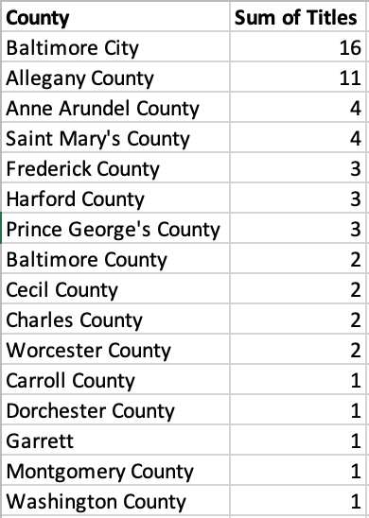
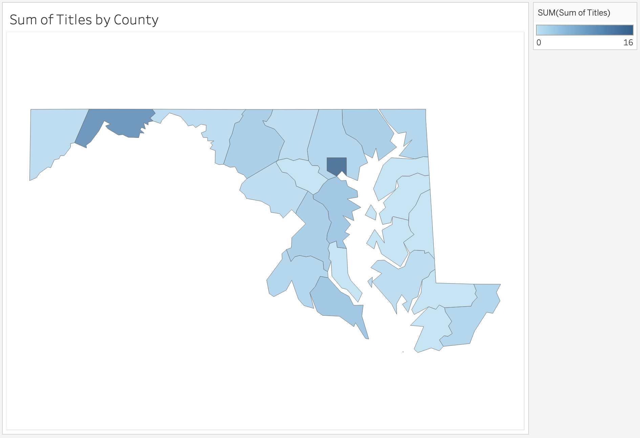
Titles by County
Notes:
It is also interesting to look at title by county as well.
For example, Garrett County, which was in our top 3 for page counts, is all from one title - The Republican.
Baltimore City of course has most the titles. Alleghany County is deceptively high. There are several Frostburg titles (some with only 2 issues per title) that are really all part of the same family of titles or closely related.
The other counties are all fairly evenly dispersed with none of over 4 titles.

Slide 36
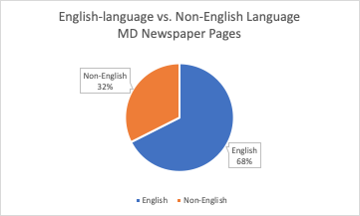
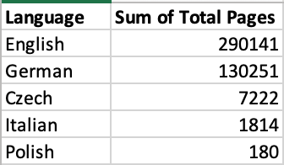
Language Page Counts
Notes:
This is a quick look at the number of pages by language.
The pie chart shows that 68% of newspaper pages are English and 32% are Non-English.
Of the 32% Non-English, 30% are German newspaper pages.
In comparison, we have a small amount of Czech and Italian, and very small amount, just 180 pages of Polish.

Slide 37
Themes for
Phase 5 and
Title Discussion
Notes:
Themes for Phase 5 and Title Discussion - Doug (30 mins)
With the selection criteria in mind now and some more details about the Maryland newspaper pages, Doug is going to go over themes for Phase 5 and start our discussion on title selection.

Slide 38
Themes for Phase 5
(2020-2022)
Titles from culturally and ethnically diverse populations (e.g. non-English language titles from immigrant groups, and titles in English from diverse and typically underrepresented groups such as African-Americans and / or Jewish-Americans);
Titles from early in Maryland’s founding to support the 400th anniversary of Maryland and the 250th anniversary of the United States; and
Titles from 1923-1963 to expand Chronicling America into more recent date ranges to support research in the 20th century
Notes:
In Phase Five, the Historic Maryland Newspapers Project will align its goals with the Library of Congress and the National Endowment for the Humanities and the Maryland 400th anniversary projects and aim to digitize content from:
1) culturally and ethnically diverse populations (e.g. non-English language titles from immigrant groups, and titles in English from diverse and typically underrepresented groups such as African-Americans and / or Jewish-Americans);
2) early in Maryland’s founding to support the 400th anniversary of Maryland and the 250th anniversary of the United States; and
3) 1923-1963 to expand Chronicling America into more recent date ranges to support research in the 20th century.

Slide 39
Phase 5 Title Discussion
Are genealogy researchers more often interested in English or non-English titles from the immigrant communities in their ancestry? Are there groups or time periods requested more than others?
How often do researchers request: 1) military base titles; and 2) labor history titles?
In what ways can we reach out to African American communities in Maryland to research titles published by their communities or identify titles that share the perspective of their community?
Notes:
Focus on communities traditionally underrepresented in archives.
Questions for consideration.

Slide 40
Future of
Newspaper Digitization in Maryland
Notes:
Future of Newspaper Digitization in Maryland - Robin and Doug (10 mins)
Robin:
- NEH funding and applying for 6th phase
- beginning to think now about titles for Phase 6 application
- with current funding it seems like Phase 6 would be final phase (no other state has gone beyond a Phase 6)
Doug:
- Is there interest in a statewide newspaper conference?
- are there ways we could partner to continue newspaper digitization beyond NDNP?
- are there funding opportunities? A grant for a joint proposal? (newspapers.com?)

Slide 41
Conclusion
Notes:
Conclusion (5 mins)
Thanks everyone for coming today and participating in the discussion around Phase 5 title selection. We’ll give everyone a chance to review our discussion, and we’ll follow up via email to finalize our 100,000 page selection. Then, we will start reaching out to content contributors. We are looking forward to continuing discussions on newspaper digitization beyond NDNP as well.

Slide 42

Thank You!
https://www.lib.umd.edu/digital/newspapers/home
@HistoricMDNews
Historic Maryland Newspapers Project
Notes:
Thanks again!
If you have any questions or follow up comments / suggestions, please follow up with Pam.

