Slide 1
Users Expectations for ILL requesting of Textbooks, results of two surveys
Kurt Munson,
Northwestern University Library
October 22, 2015

Slide 2
Starting Points
With unmediated borrowing, you can’t stop users from requesting certain types of materials.
If those users can place those requests, it’s best to understand their motivation and figure out the best way to meet their expectations.
Manage expectations rather than control.
A quarter systems requires students purchase 33% more textbooks or other course materials.

Slide 3
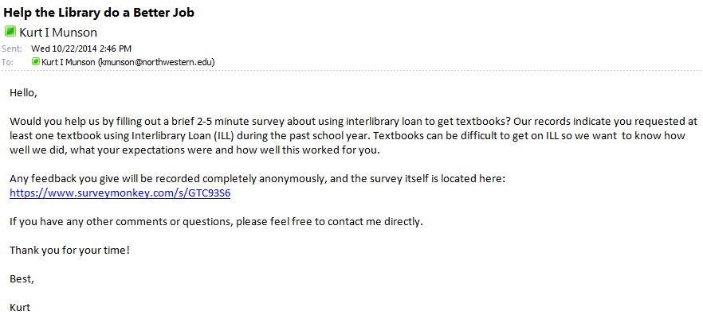

Slide 4
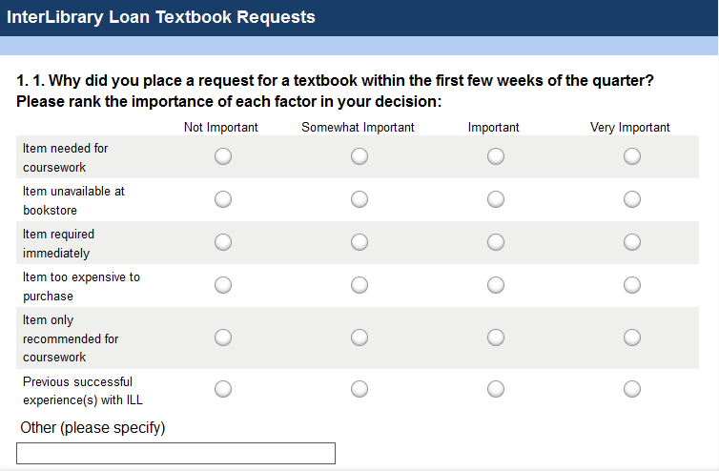
The Survey

Slide 5
Results or what motivates the patrons

Slide 6
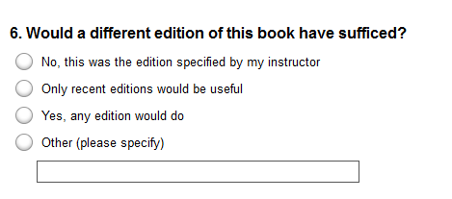
Alternate addition OK?

Slide 7
Will patrons accept an alternate addition? ILLiad Data says:
86% of the respondents unchecked the Accept Alternate Edition box in ILLiad. Doh!

Slide 8
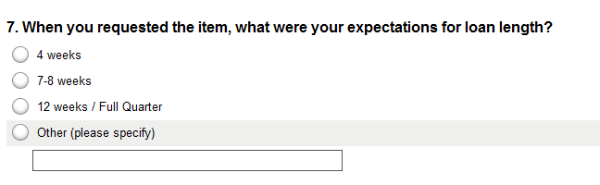
How long do they expect to keep a book? Can they?
I think the 12 week loan period in UBorrow is influencing patron expectations.

Slide 9
Do they get the loan period they want?
16% have a loan of 12 weeks or longer
45% had a loan period between 7 and 12 weeks
22% had a loan period between 4 and 7 weeks
17% had a loan period less than 4 weeks

Slide 10
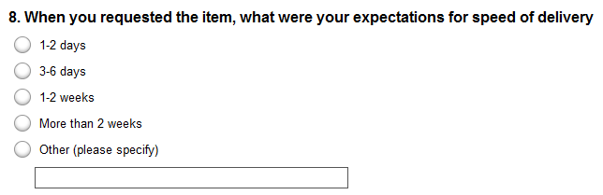
Delivery speed meets their needs.

Slide 11

The $64,000 question
How many Textbook requests actually were filled?
62% of the request were filled (All ILL is 87%)
56% for Introduction to …. 10 ed. textbooks
82% for other required readings
Two surveys done in two different years had remarkably consistent results both in patrons expectations and in our ability to provide items.
https://s3.amazonaws.com/hobsons-ccinfo-prod/admit/uploads/2010/12/pt1490.jpg

Slide 12
What did we learn?
Even if ILL is not the best way for students to acquire their textbooks, it works well enough for them that they continue to use it. It meets their expectations.
Recognizing how important this service is to undergraduates, we made the following changes to our processes:
distribute a list of textbooks we cannot order to the service desks at the beginning of each quarter.
take more latitude with editions when ordering.
have a special cancelation email for textbooks.

Slide 13
Questions?
Kurt Munson
kmunson@northwestern.edu
@KurtMunson

