Slide 1
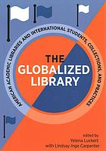
The globalized library : American academic libraries and international students, collections, and practices
Luckert, Yelena, with Lindsay Inge Carpenter, editors.
Association of College and Research Libraries, 2019.
AJL Author Event, March 14, 2021
Notes:
== I would like to start by thanking Michelle and AJL for giving me this opportunity. I am very excited to be here today.
== ACRL approached and convinced me to do a book on international librarianship in 2018. I was very concerned because I was not sure if my English was good enough to do it.
== Thus choosing a co-editor became very important. Lindsay and I ended up strongly complimenting each other. We both grew from the process, I for one became a really good editor even in English.
== We sent out the call for participation to any reflector we could think of, including AJL
== Our rejection rate was around 25%
== It took about 1&½ years to put together a volume consisting of 33 chapters and Introduction

Slide 2
Introduction. The Globalized Library: American Academic Libraries and International Students, Collections, and Practices
“When reflecting on libraries in the United States, we almost never think of them as being international in nature. We view them as “American” institutions, serving our “American” patrons and our “American” organizations. But academic libraries, like institutions of higher education at large, are key players in the effort to educate a diverse student body to be globally conscious members of our communities. In this volume, practitioners from America and Canada reflect on how their work is globalized, addressing themes including collection practices, professional development opportunities, outreach efforts, instructional strategies, and international partnerships.” (from the Introduction).
Notes:
It was important for us to include an introduction that frames the entire volume. This Introduction is a historical reflection on American libraries and how truly international in nature they have been from the very beginning. Today we see globalization of libraries both traditional and emerging: our collections, library employees for whom English is a second language, reference and instructional services for diverse student and faculty body, digitization and preservation efforts of primary sources in non-western languages, in supporting international programs such as Study Abroad, and more recently global efforts in building satellite libraries abroad.

Slide 3

Some fun facts
The federal government and many state governments have directly or indirectly supported acquisitions of foreign materials at colleges and universities, particularly after the passing of the Higher Education Act of 1965 (Title VI), which transformed academic institutions by allowing international studies to grow.
For some countries of the world, materials held in US libraries surpass what might be available to their citizens in their own libraries due to hostile governments, censorship, wars, economic hardships, or natural disasters.
The 2020 Open Doors® Report on International Educational Exchange, reveals that for the fifth consecutive year the United States hosted more than one million international students (1,075,496) during the 2019/2020 academic year, https://www.iie.org/en/Why-IIE/Announcements/2020/11/2020-Open-Doors-Report.
American higher education is highly prized around the world for its academic rigor, diversity of majors, use of emerging technology, flexibility, independent thinking, problem-solving, and the abundance of schools and programs to choose from in different geographic locations and with a range of tuition levels.
Notes:
Here are some of fun facts from the Introduction.
The 2020 Open Doors Report details that not much have changed since the stats we reported in this volume.
It is easy to see that globalization impacts our campuses, alters institutional priorities, and thus influences libraries’ collections and operations, propelling us to change what we do and how we do things. Of course there are other factors that play a role here too. Among them are budgets, technology, storage, need for physical spaces, strategic goals and priorities of our institutions, changes in pedagogue, and shifts in research.

Slide 4

Book breakdown
Introduction
SECTION I: INFORMATION LITERACY
7 chapters
SECTION II: OUTREACH & INCLUSION
6 chapters
SECTION III: COLLECTIONS & DIGITAL HUMANITIES
8 chapters
SECTION IV: ESTABLISHING LIBRARIES & SERVICES
6 chapters
SECTION V: CAREER & PROFESSIONAL DEVELOPMENT
6 chapters
Notes:
The chapters in the book detail how our work has changed and became globalized. They demonstrate new ways to address language and cultural differences, handling collections in non-western alphabets, challenges with international purchase and processing of materials, information literacy needs of students world apart, and professional ties with librarians across the Globe. It explores the use of campus and library partnerships to create specially designed programs and learning opportunities for international students, providing support to American students studying abroad, creating online teaching tools, and establishing American-style libraries at satellite campuses in countries where access to information is highly restricted.

Slide 5
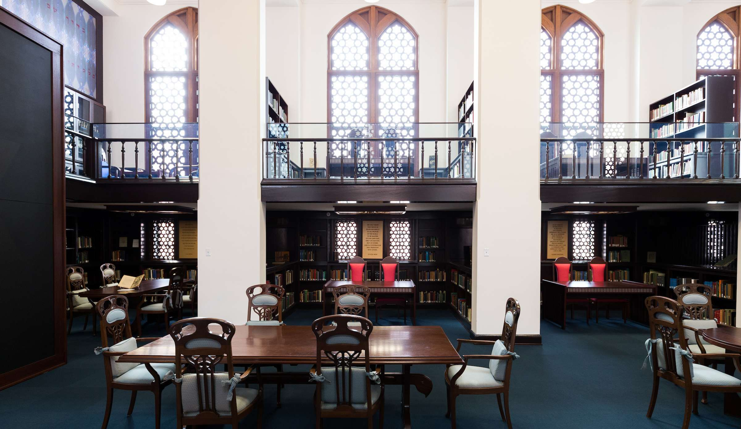

SECTION III: COLLECTIONS & DIGITAL HUMANITIES
Chapter 18: Shared Global Heritage in Research Libraries
Margarita Vargas-Betancourt, E. Haven Hawley, and Rebecca J.W. Jefferson
Chapter 19: Leveraging Connections to Build and Promote International Special Collections: A Case Study
Mary Jo Zeter and Deborah J. Margolis
Notes:
There are two chapters in the book that detail work specifically with Judaica collections at two major research universities. They are examples of intertwining between collections, digitization and user services and provide interesting perspective on how things are merging together.
-- Chapter 18 offers an overview of selected programs and projects that articulate the intersection of the three collections, offering specific models for multi-institutional activities. The Latin American and Caribbean Collection, the Isser and Rae Price Library of Judaica, and the Panama Canal Museum Collection are central to digital library projects and innovative instruction at the University of Florida .
-- Chapter 19 provides another example of an innovative instructional program developed for students at the Michigan State University based on the Hebrew popular culture collection, specifically Hebrew graphic novels, housed in the Special Collections of the university.

Slide 6
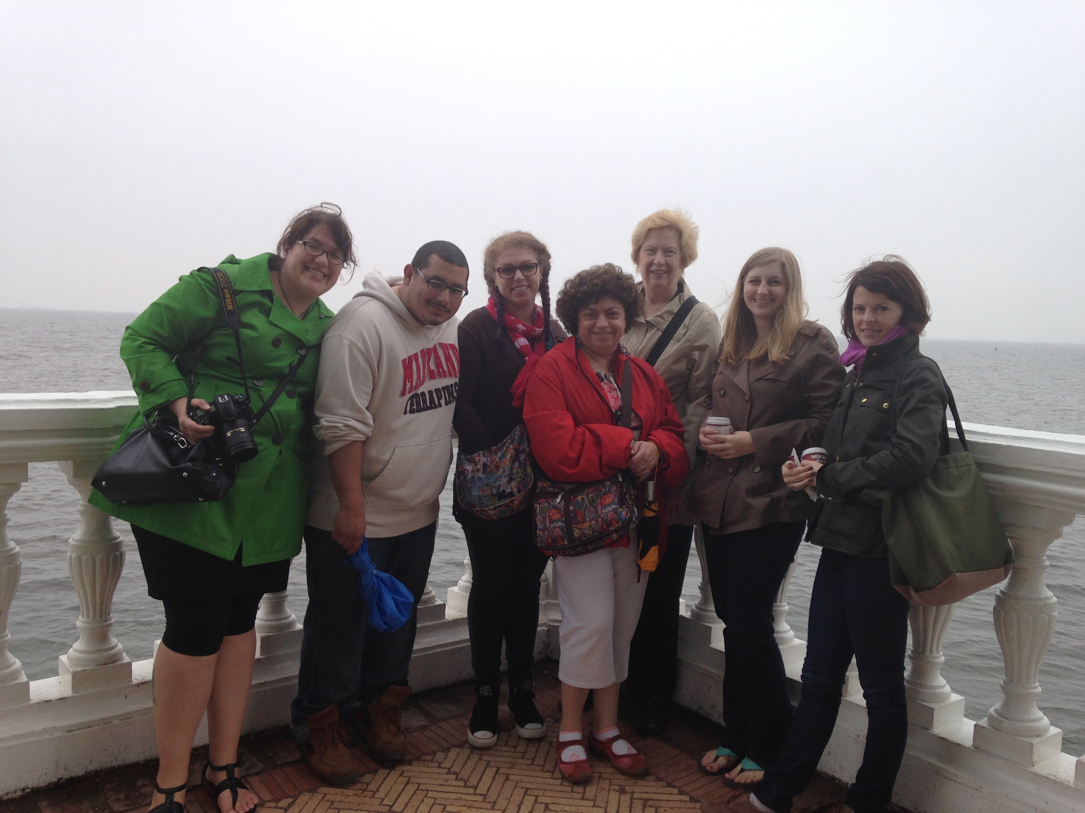
Chapter 25: Successful American-Russian Partnership Through Education Abroad
Yelena Luckert
and Lindsay Inge Carpenter
Notes:
This article is of personal importance to me. The University of Maryland Libraries have been developing a four-way partnership among the University of Maryland Libraries, the University of Maryland College of Information Science, the Library of Russian Academy of Sciences, and the St. Petersburg State University of Culture and Arts. It began with the development of a single Study Abroad course, LBSC 729R:: International Opportunities in Information
Studies: Libraries and Cultural Heritage Institutions of St. Petersburg, Russia.
Lindsay, the co-editor of this book (the blond woman second on the right), was a student in this class in the 2014. This article consists of two parts: 1) detailing experiences of the instructor and the framework of the course from instructor’s perspective, and 2) experience of a student from a student’s perspective. I believe this is a very unique perspective.

Slide 7
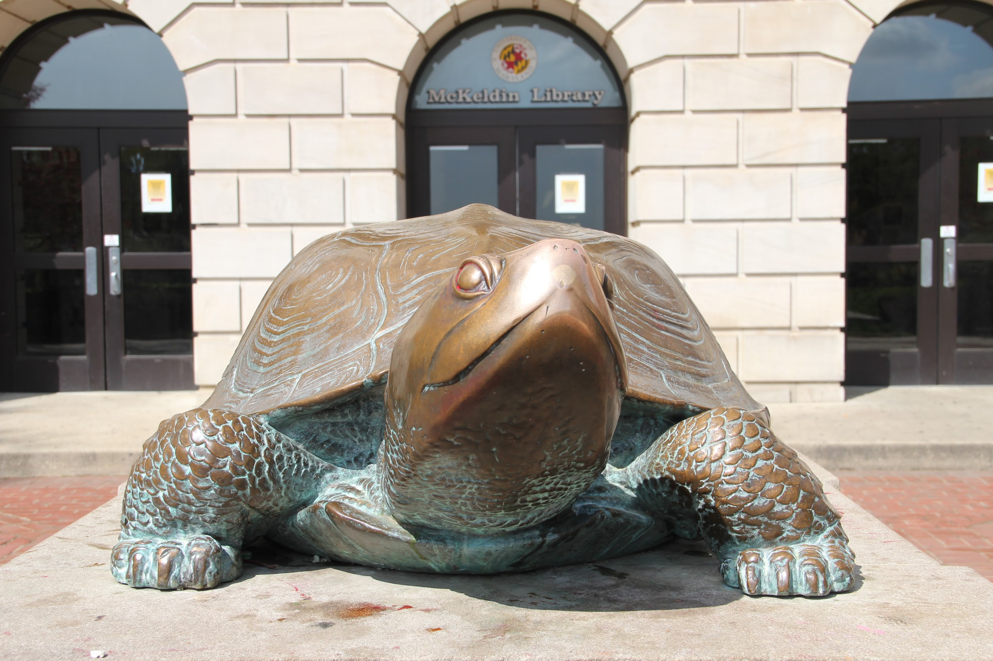
Questions?
THANK YOU
Yelena Luckert
yluckert@umd.edu

