Slide 1
How to catalog 100,000 playbills
(give or take a few thousand)
Sarah Hovde
Digital & Archival Approaches to Theater History
January 18, 2019

Slide 2
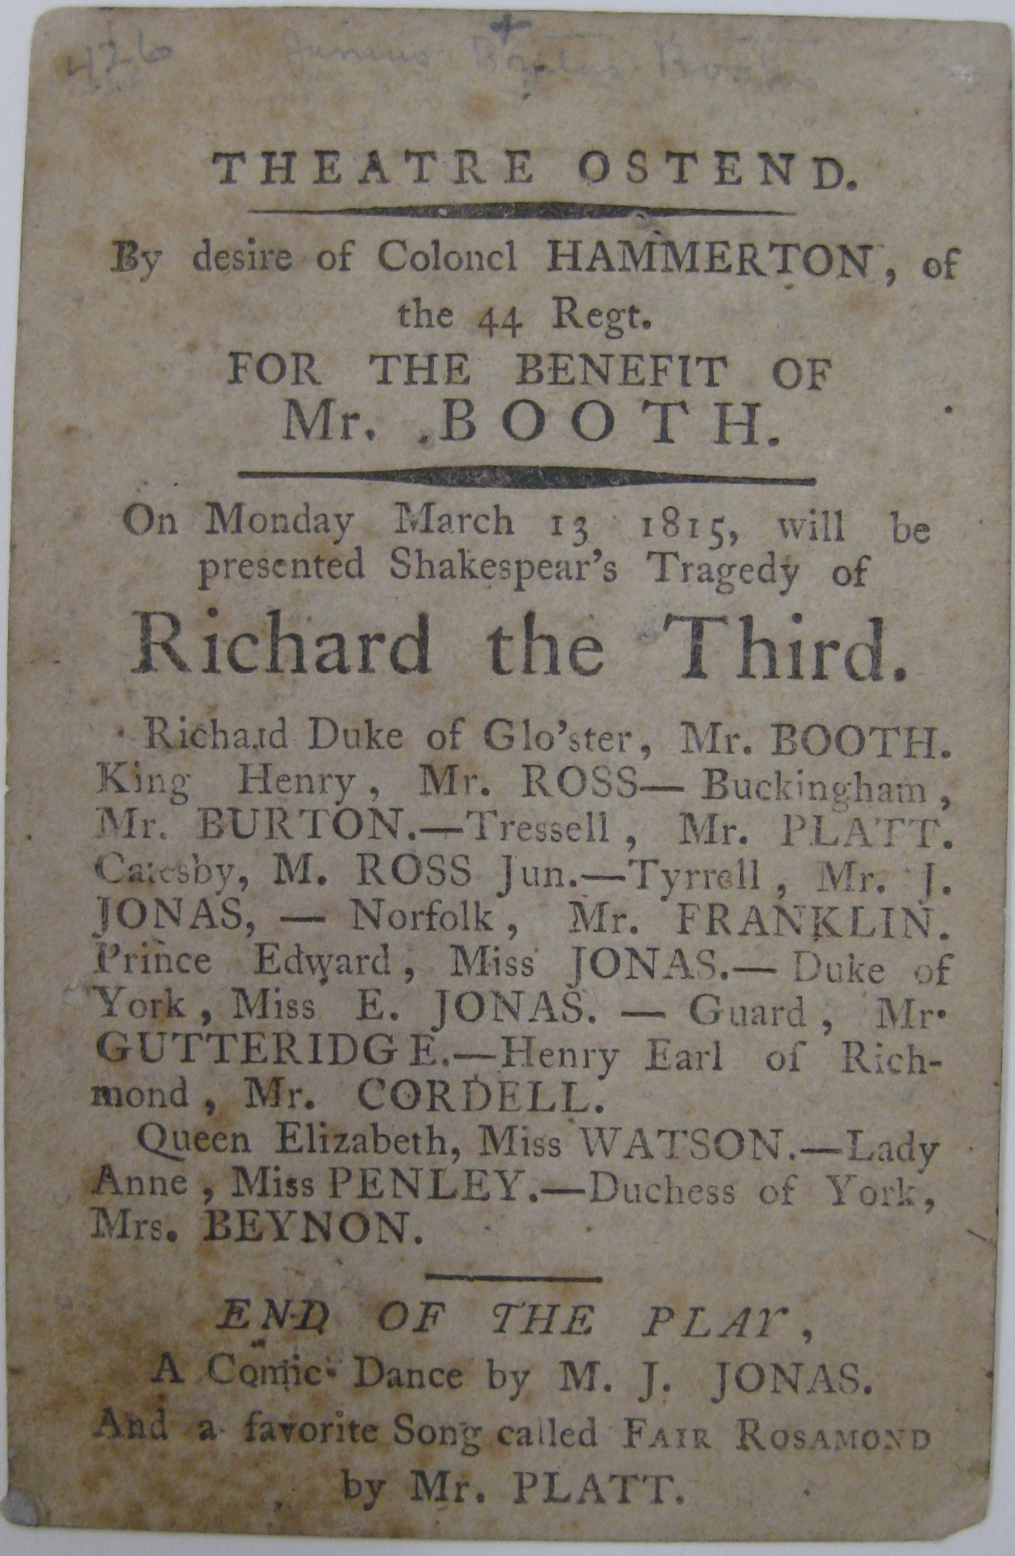
Playbills (AAT)
Programs or posters announcing a theatrical performance.
Playbills (RBMS)
Use for single-sheet items advertising plays, usually announcing the cast.
Playbill from the Theatre Ostend, Belgium
(BILL Box Z5 O3to 1815)

Slide 3
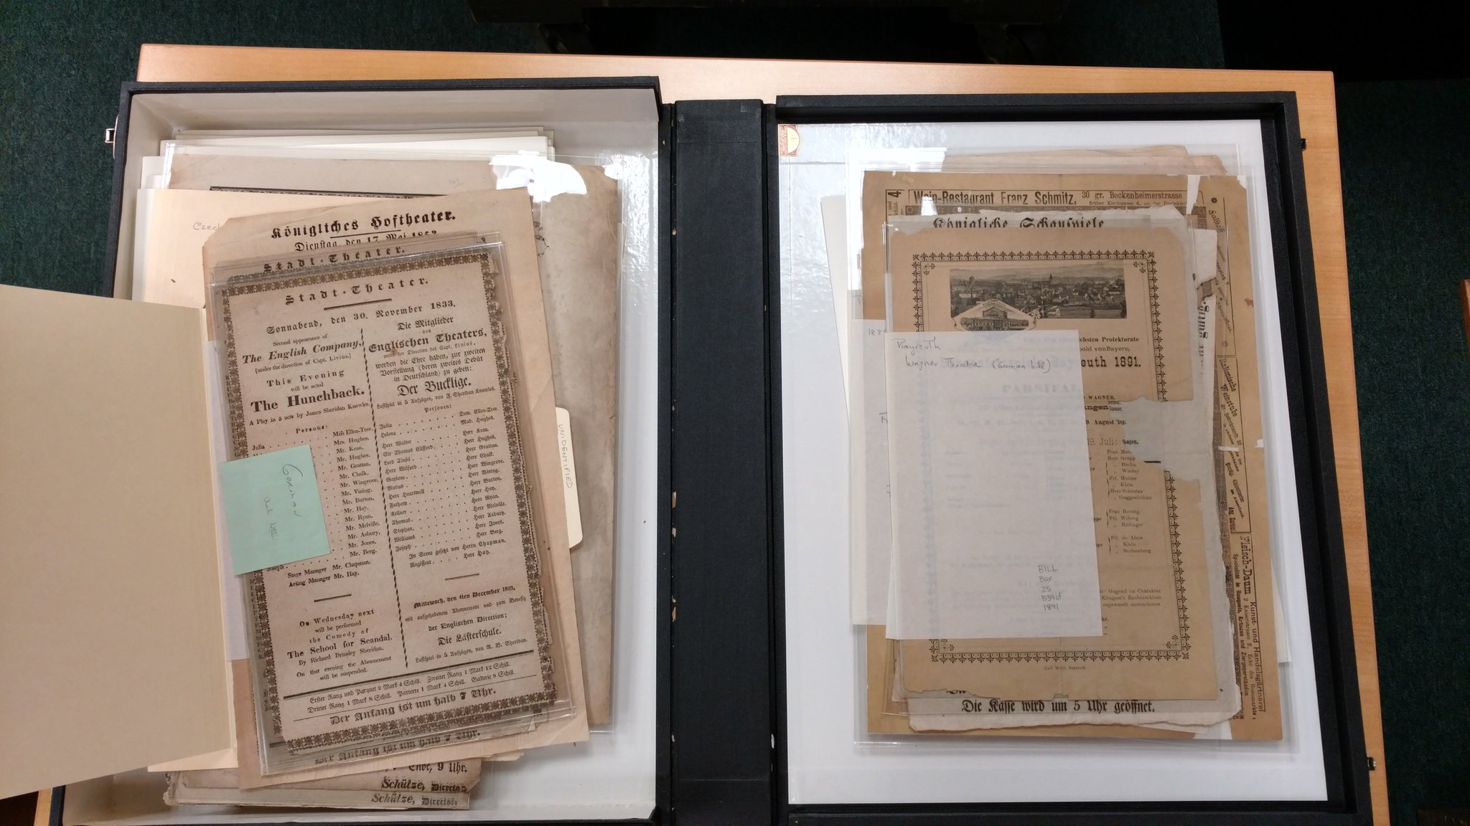
German playbills (BILL Box Z5)

Slide 4
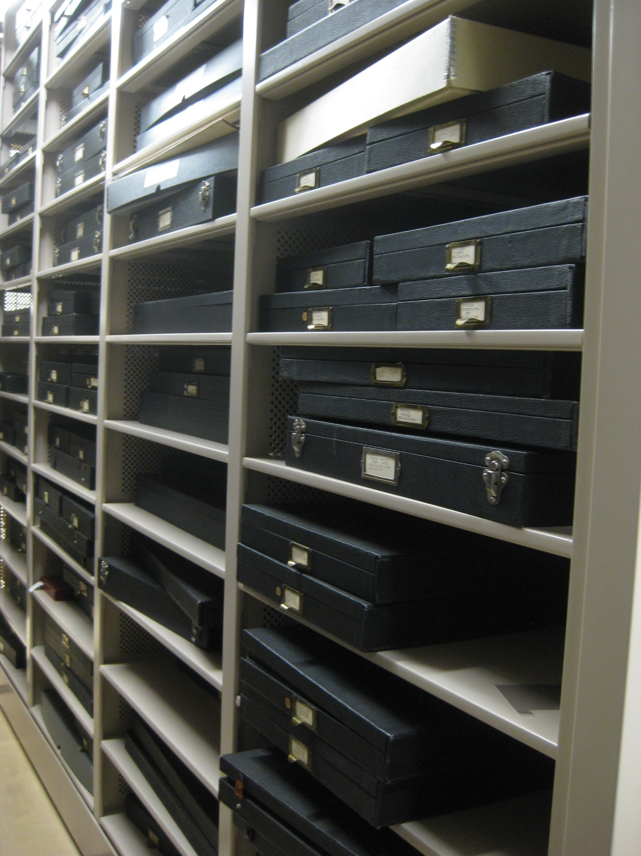
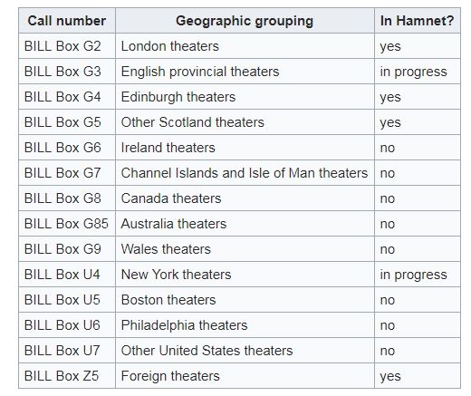

Slide 5
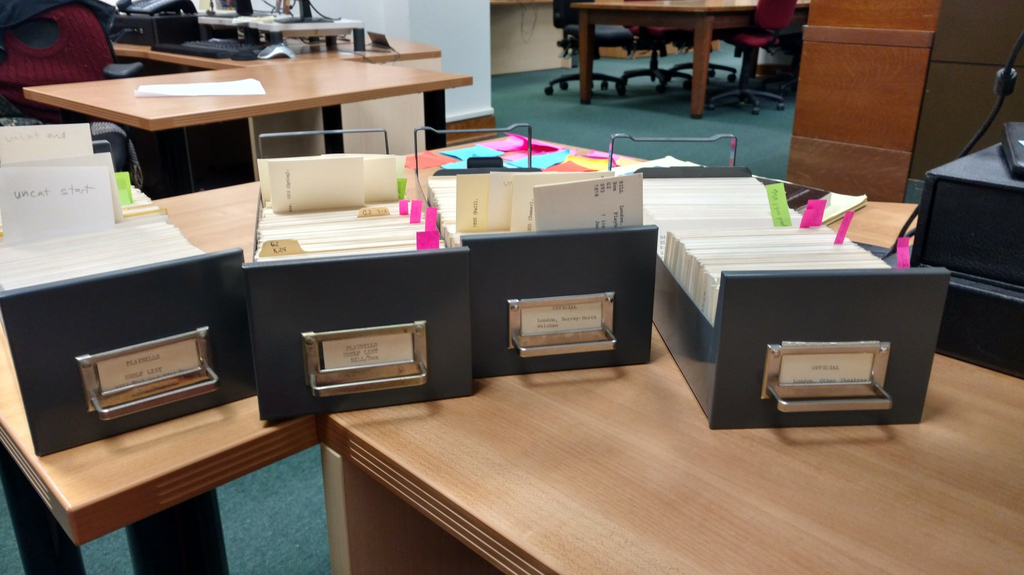

Slide 6
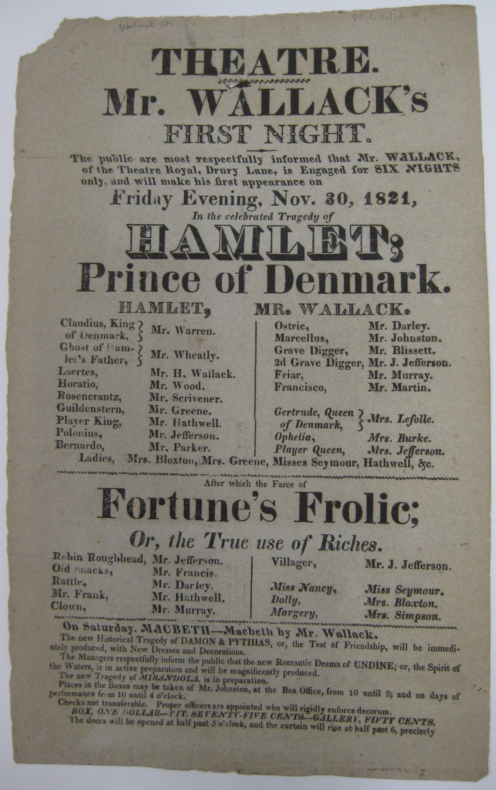
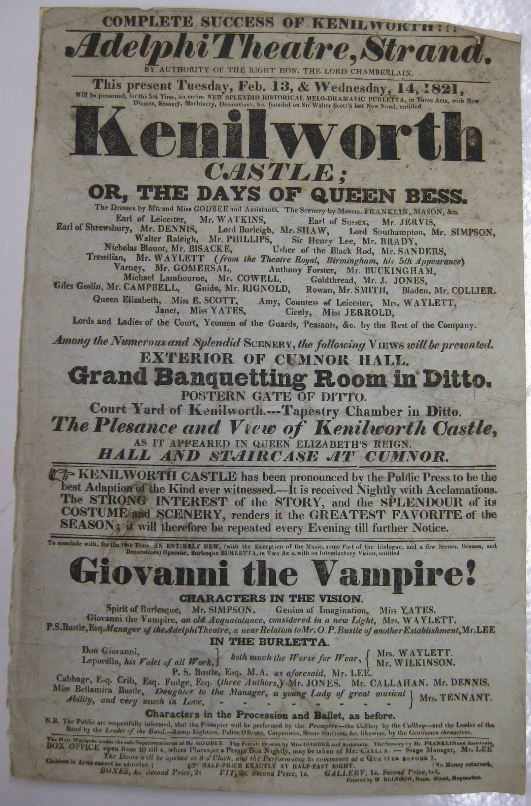
Playbill from the Walnut Street Theatre
(BILL Box U6 W16 1821)
Playbill from the Adelphi Theatre
(BILL Box G2 A23 1821)

Slide 7
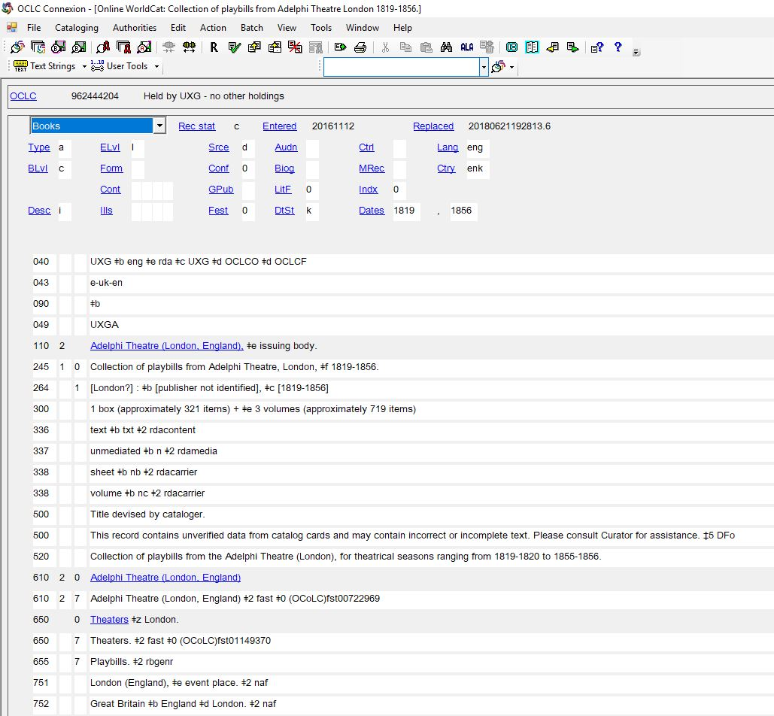

Slide 8
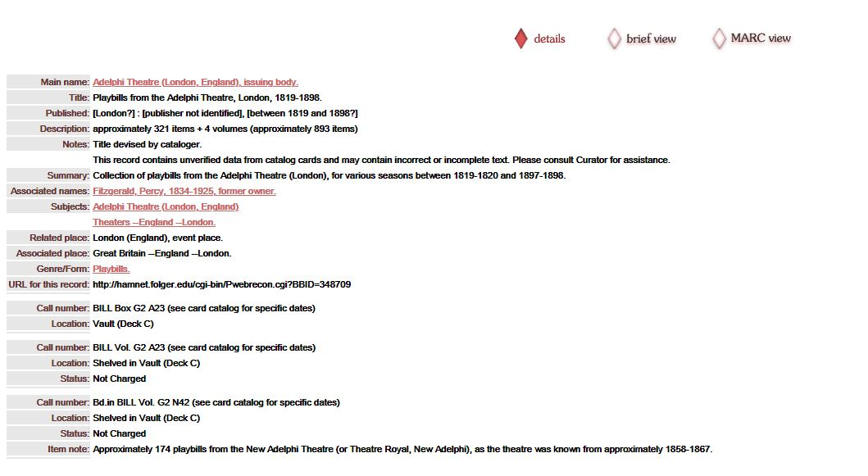

Slide 9
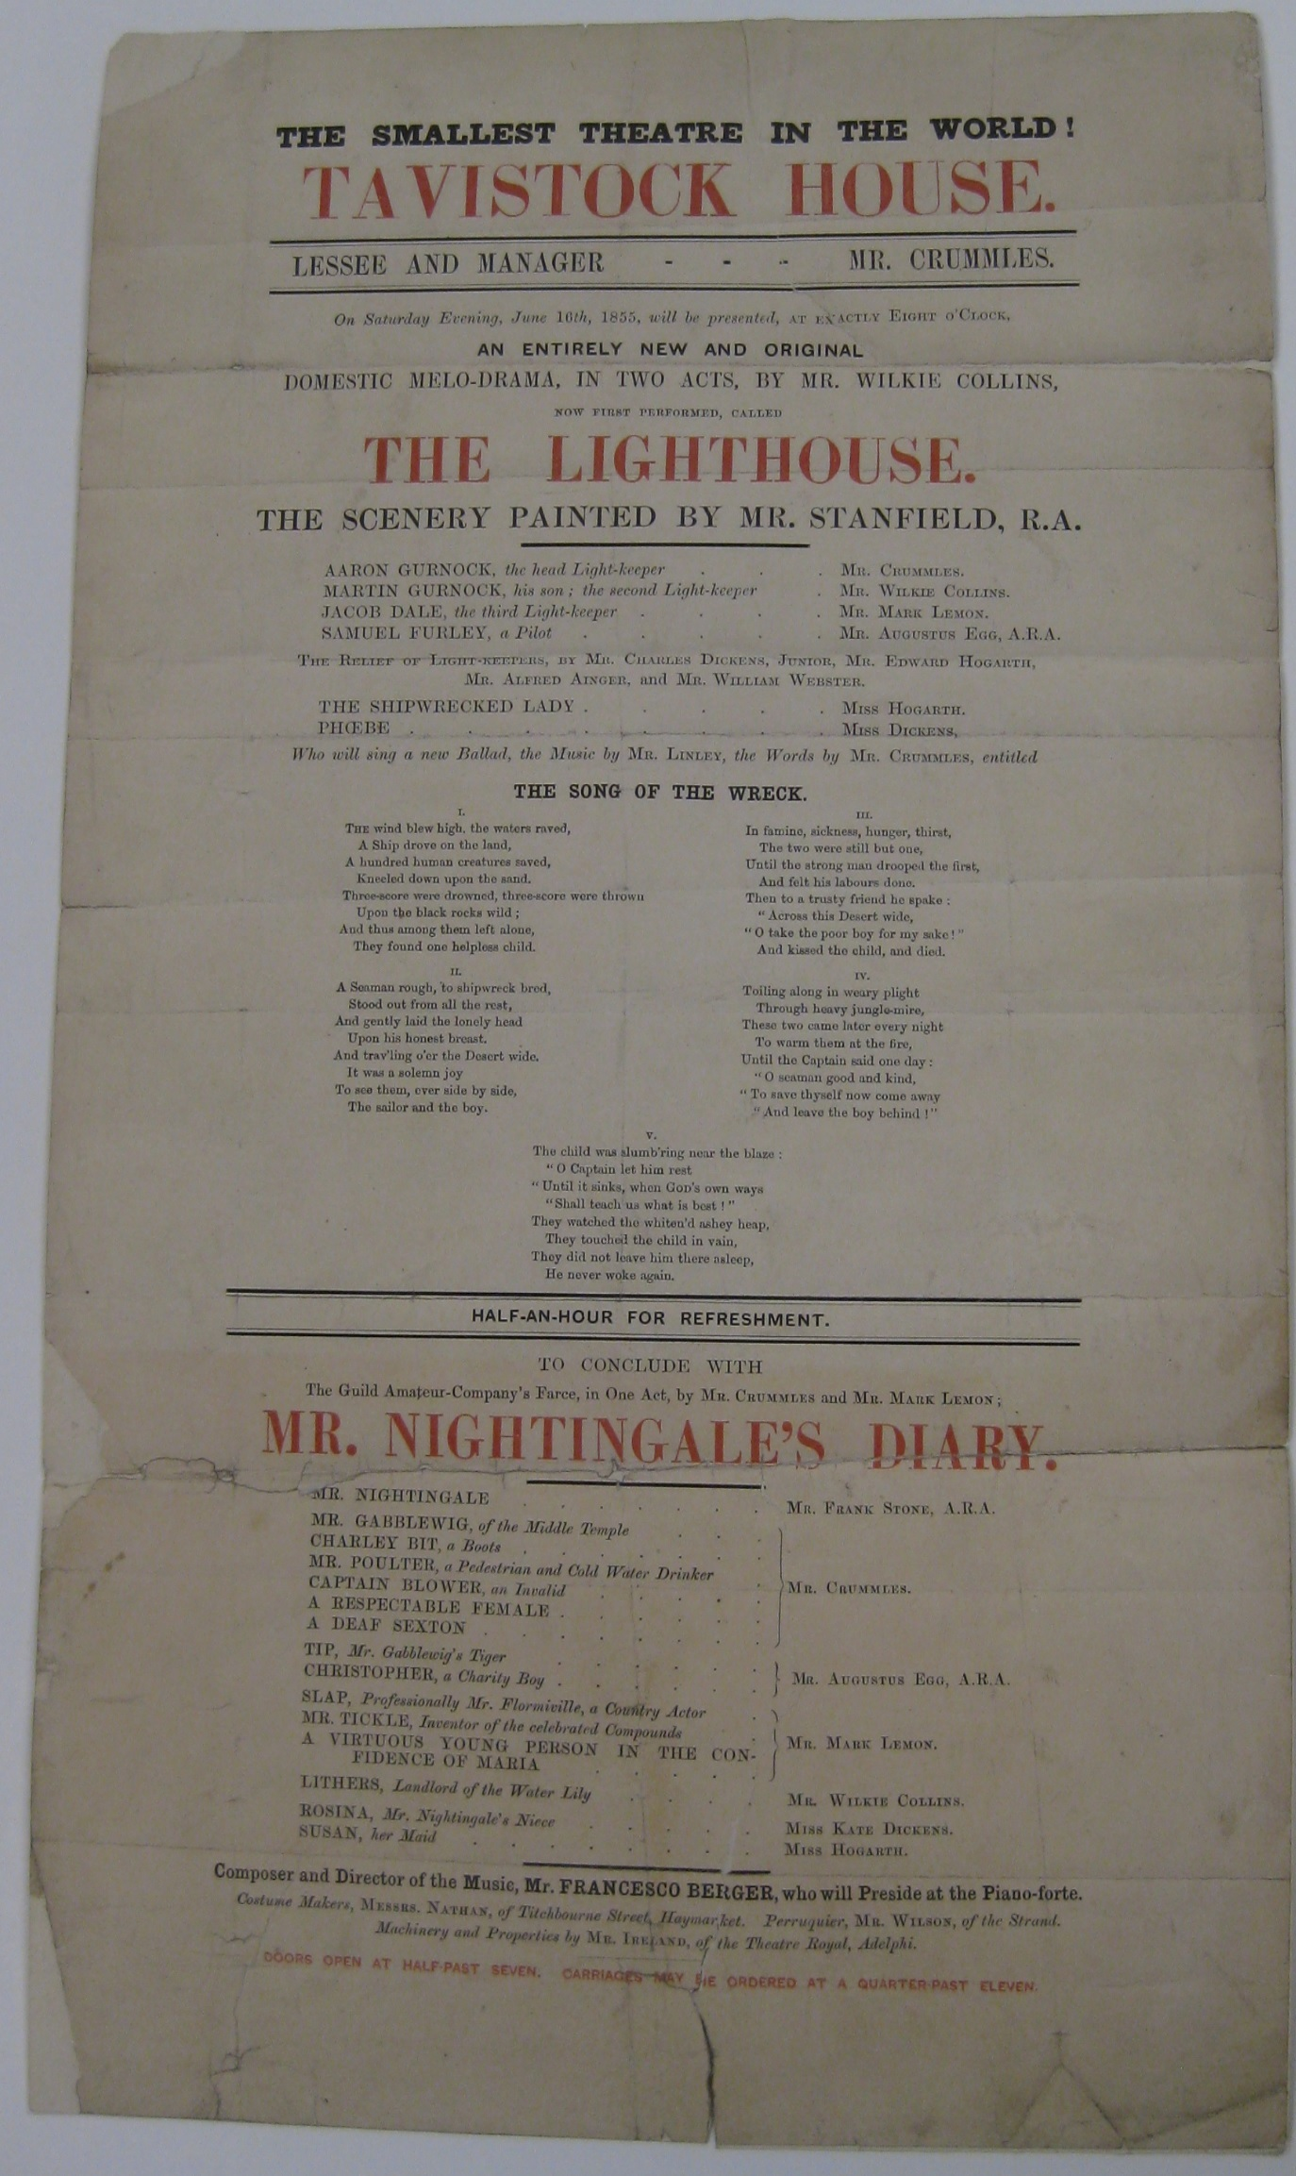
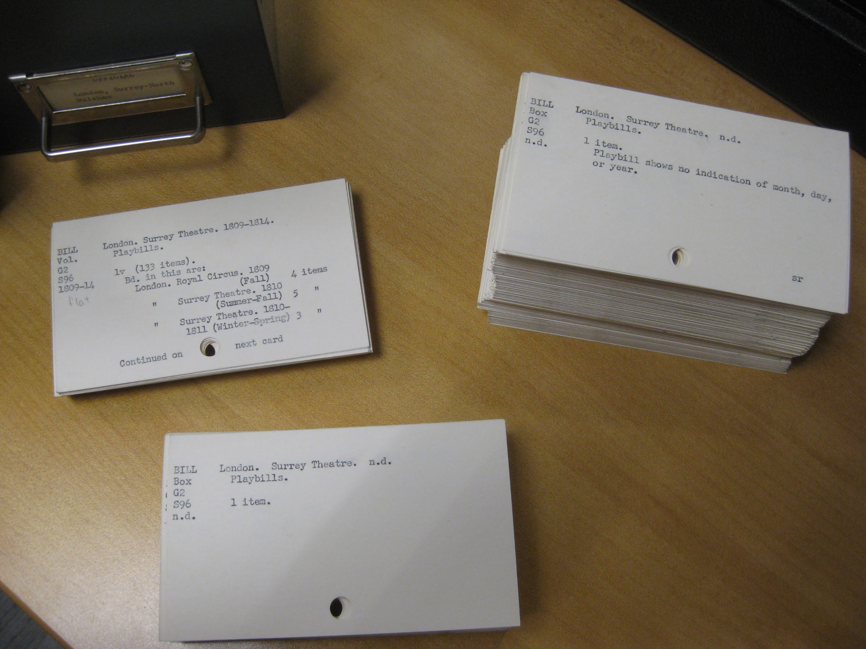
cards for Surrey Theatre (BILL Box G2 S96 and BILL Vol. G2 S96)
playbill from Tavistock House (BILL Box G2 T19 1855)

Slide 10
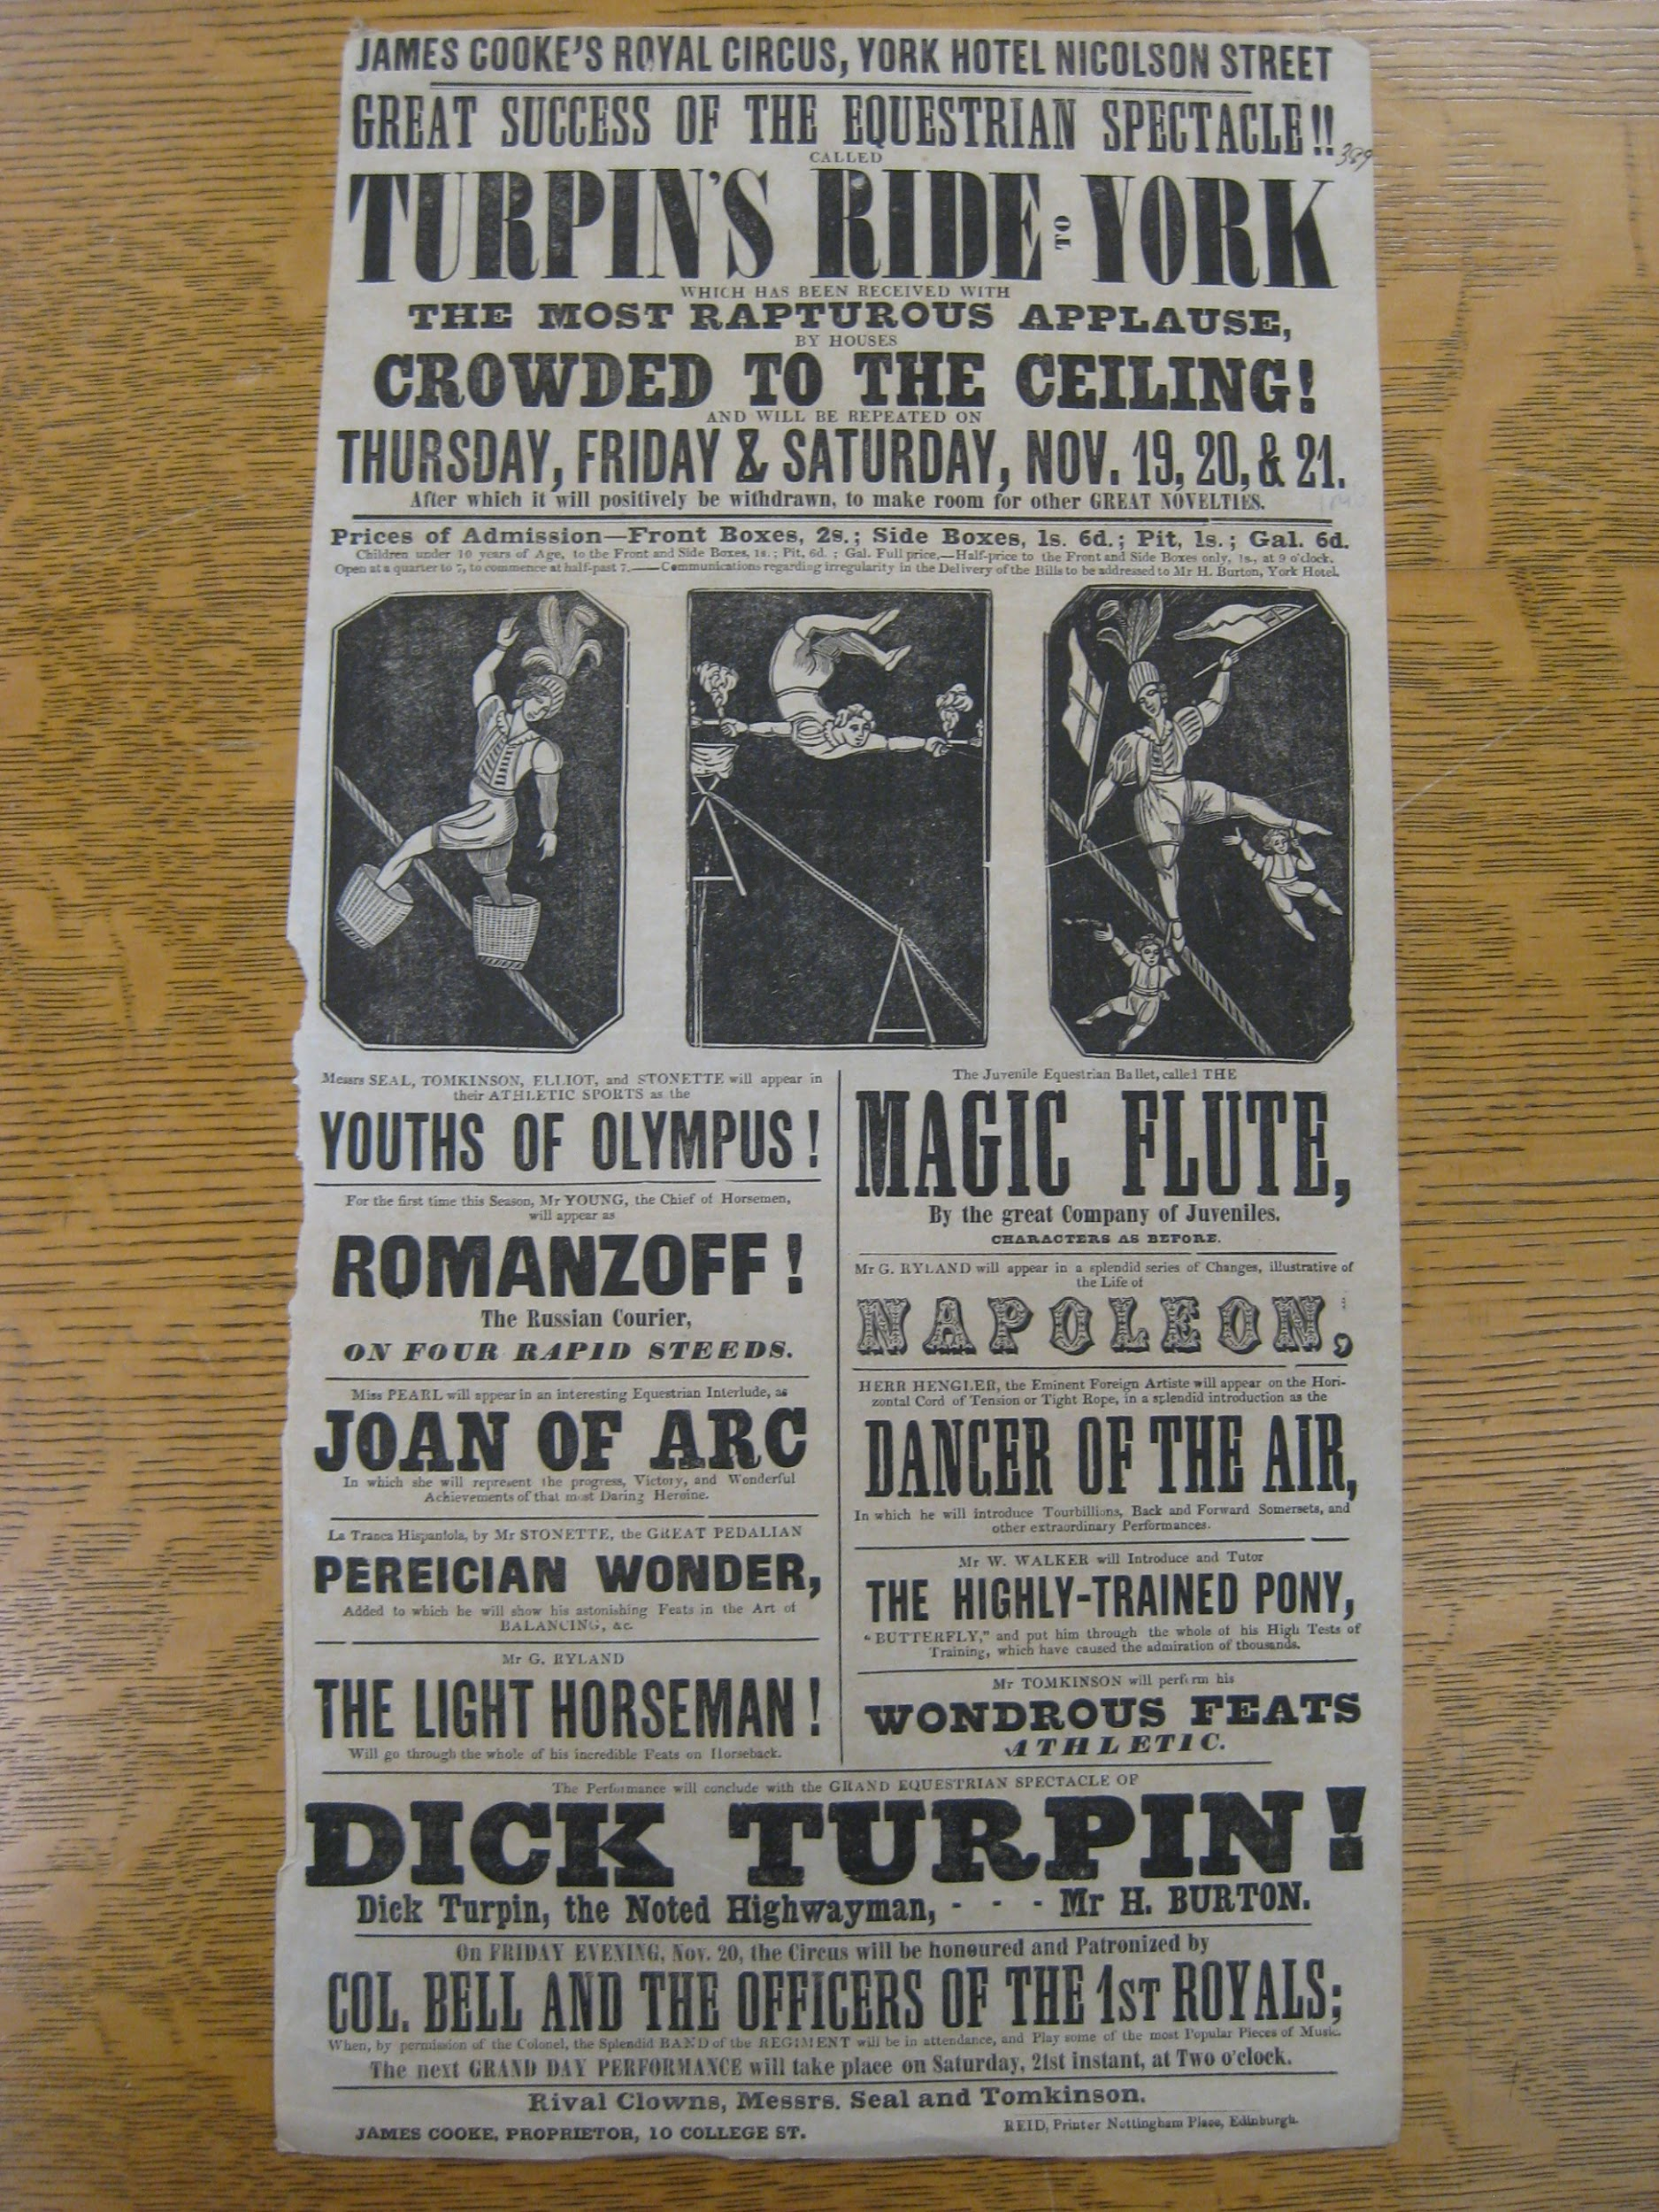
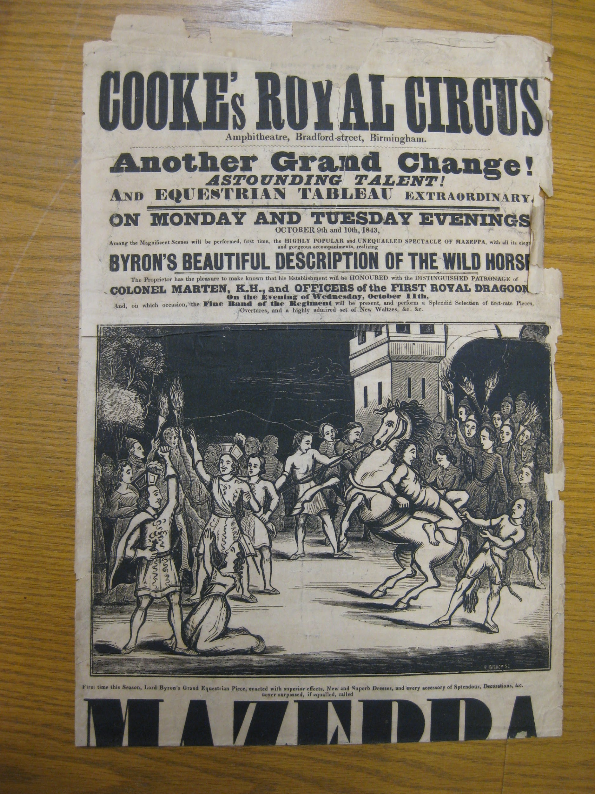
Playbill from Cooke's Royal Circus, Edinburgh (BILL Box G4 C77 1846)
Playbill from Cooke's Royal Circus,
Birmingham (BILL Box G3 B53cc 1843)

Slide 11
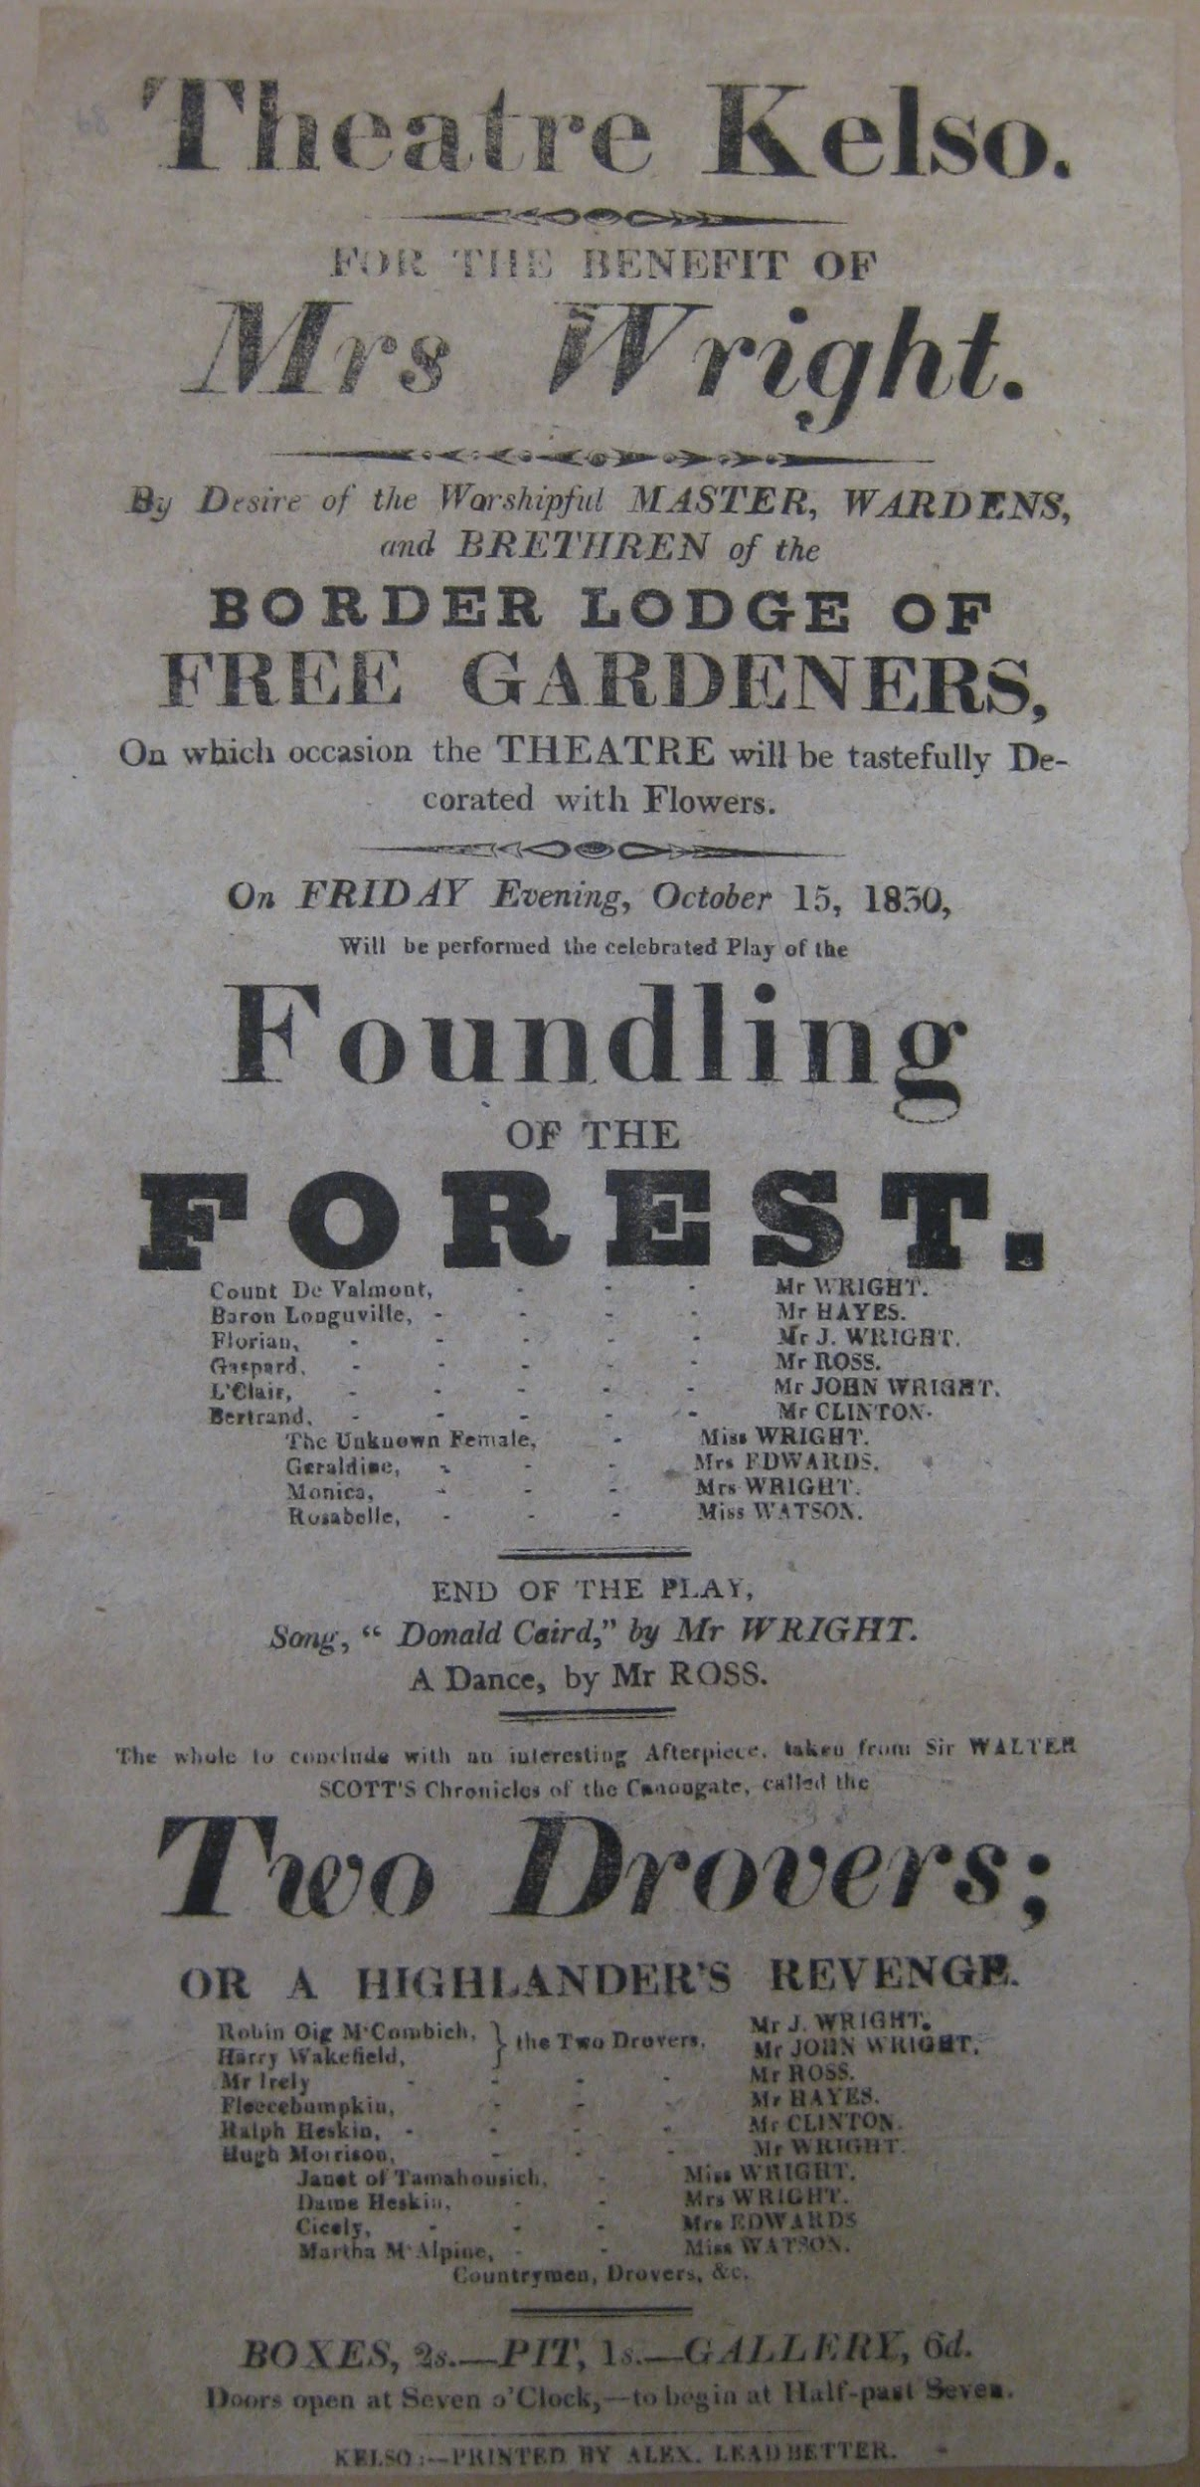
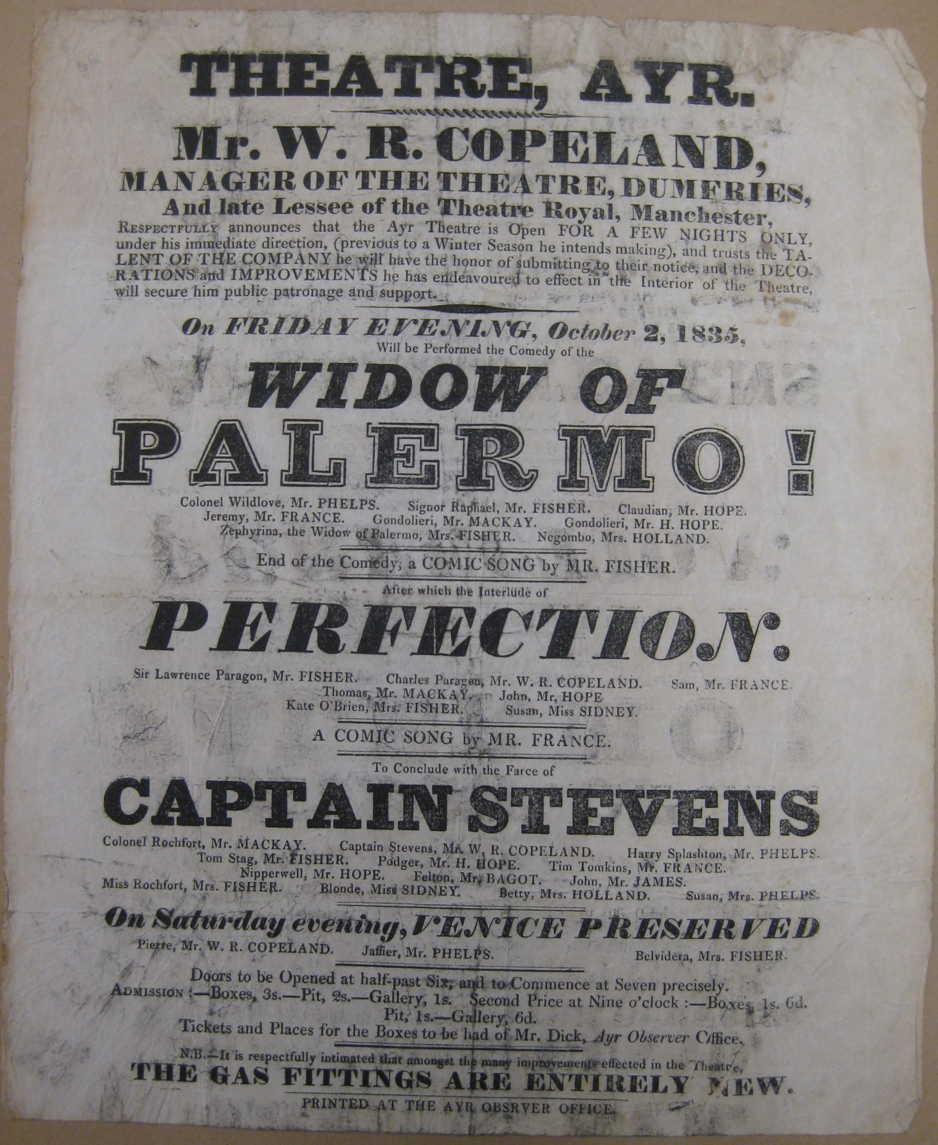
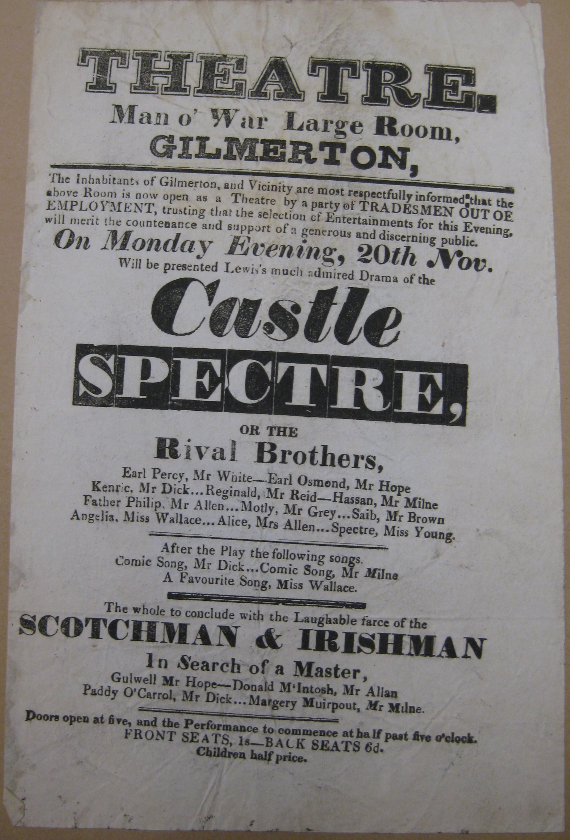
BILL Box G5 K29kt 1830
BILL Box G5 A98at 1834
BILL Box G5 G42gt

Slide 12
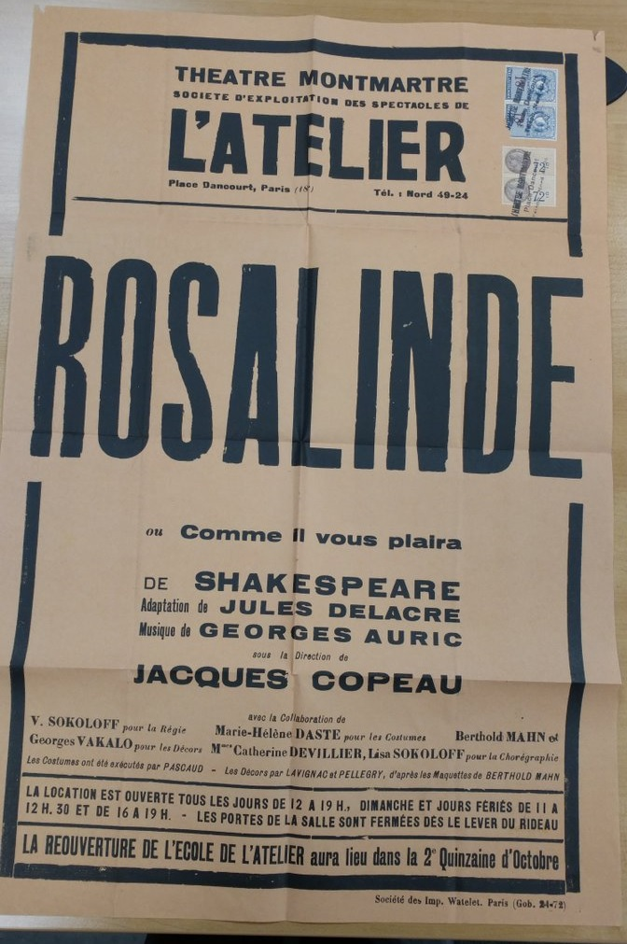
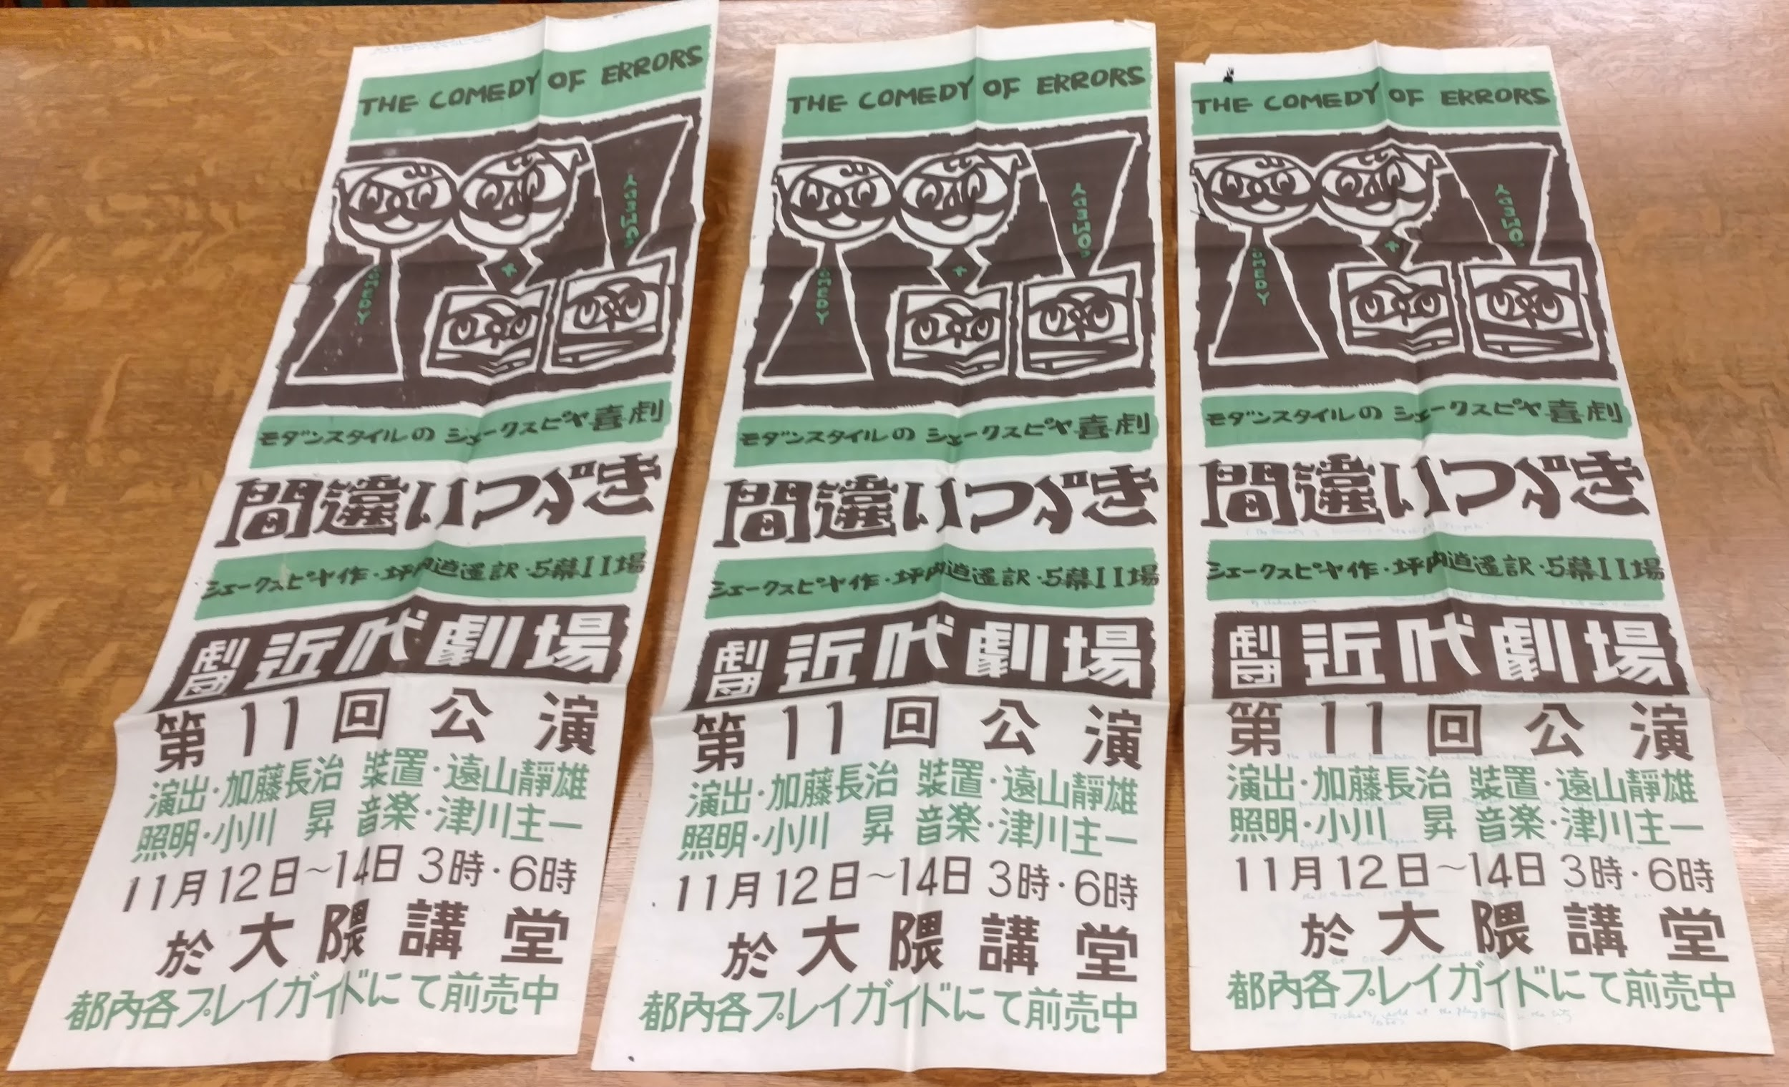
Playbills from Okuma Memorial Hall (BILL Box Z5 T7oh 1954)
Playbill from the Theatre d'Atelier (BILL Box Z5 P3tm 1934)

Slide 13
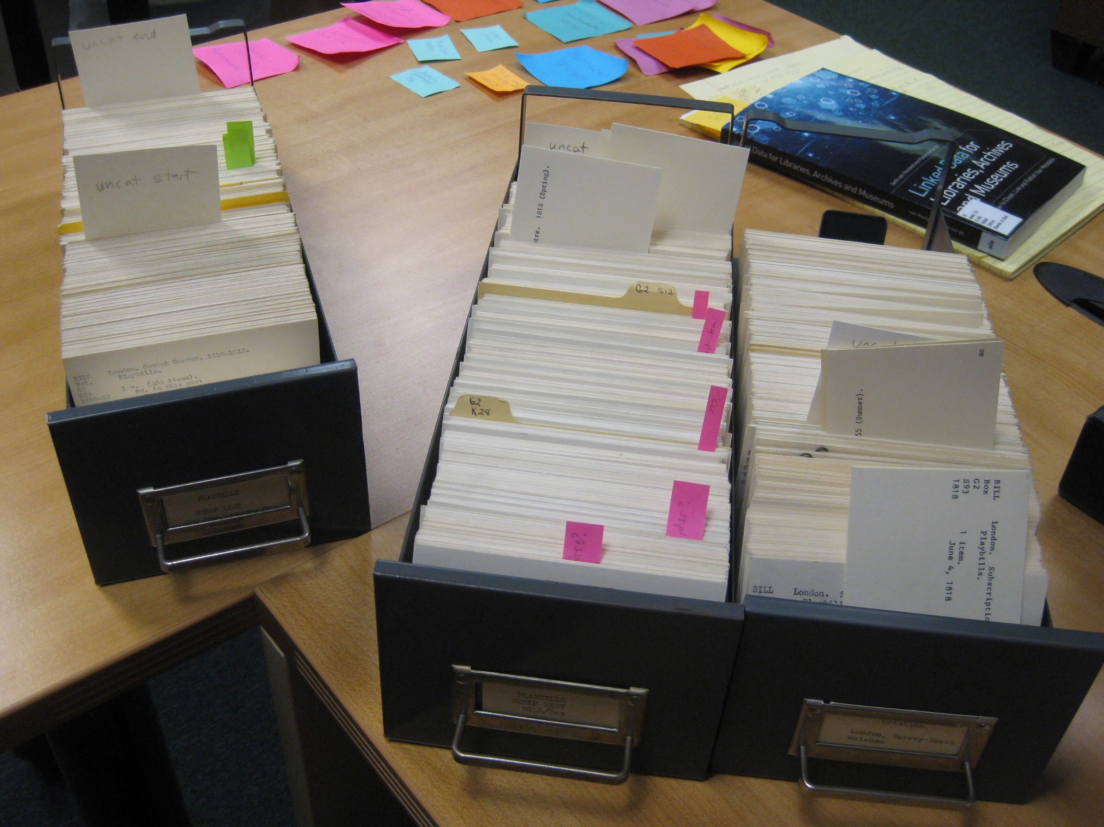
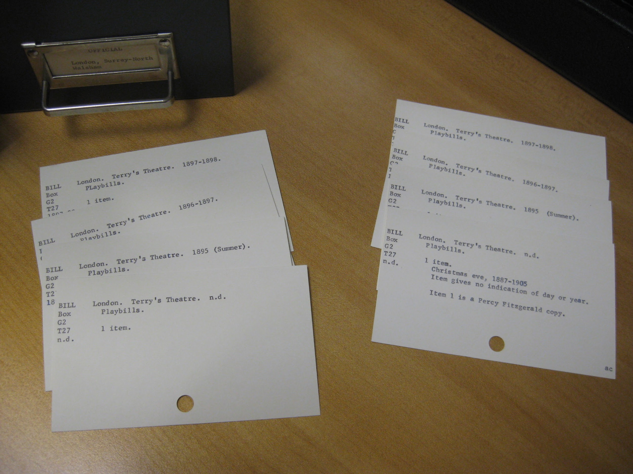

Slide 14
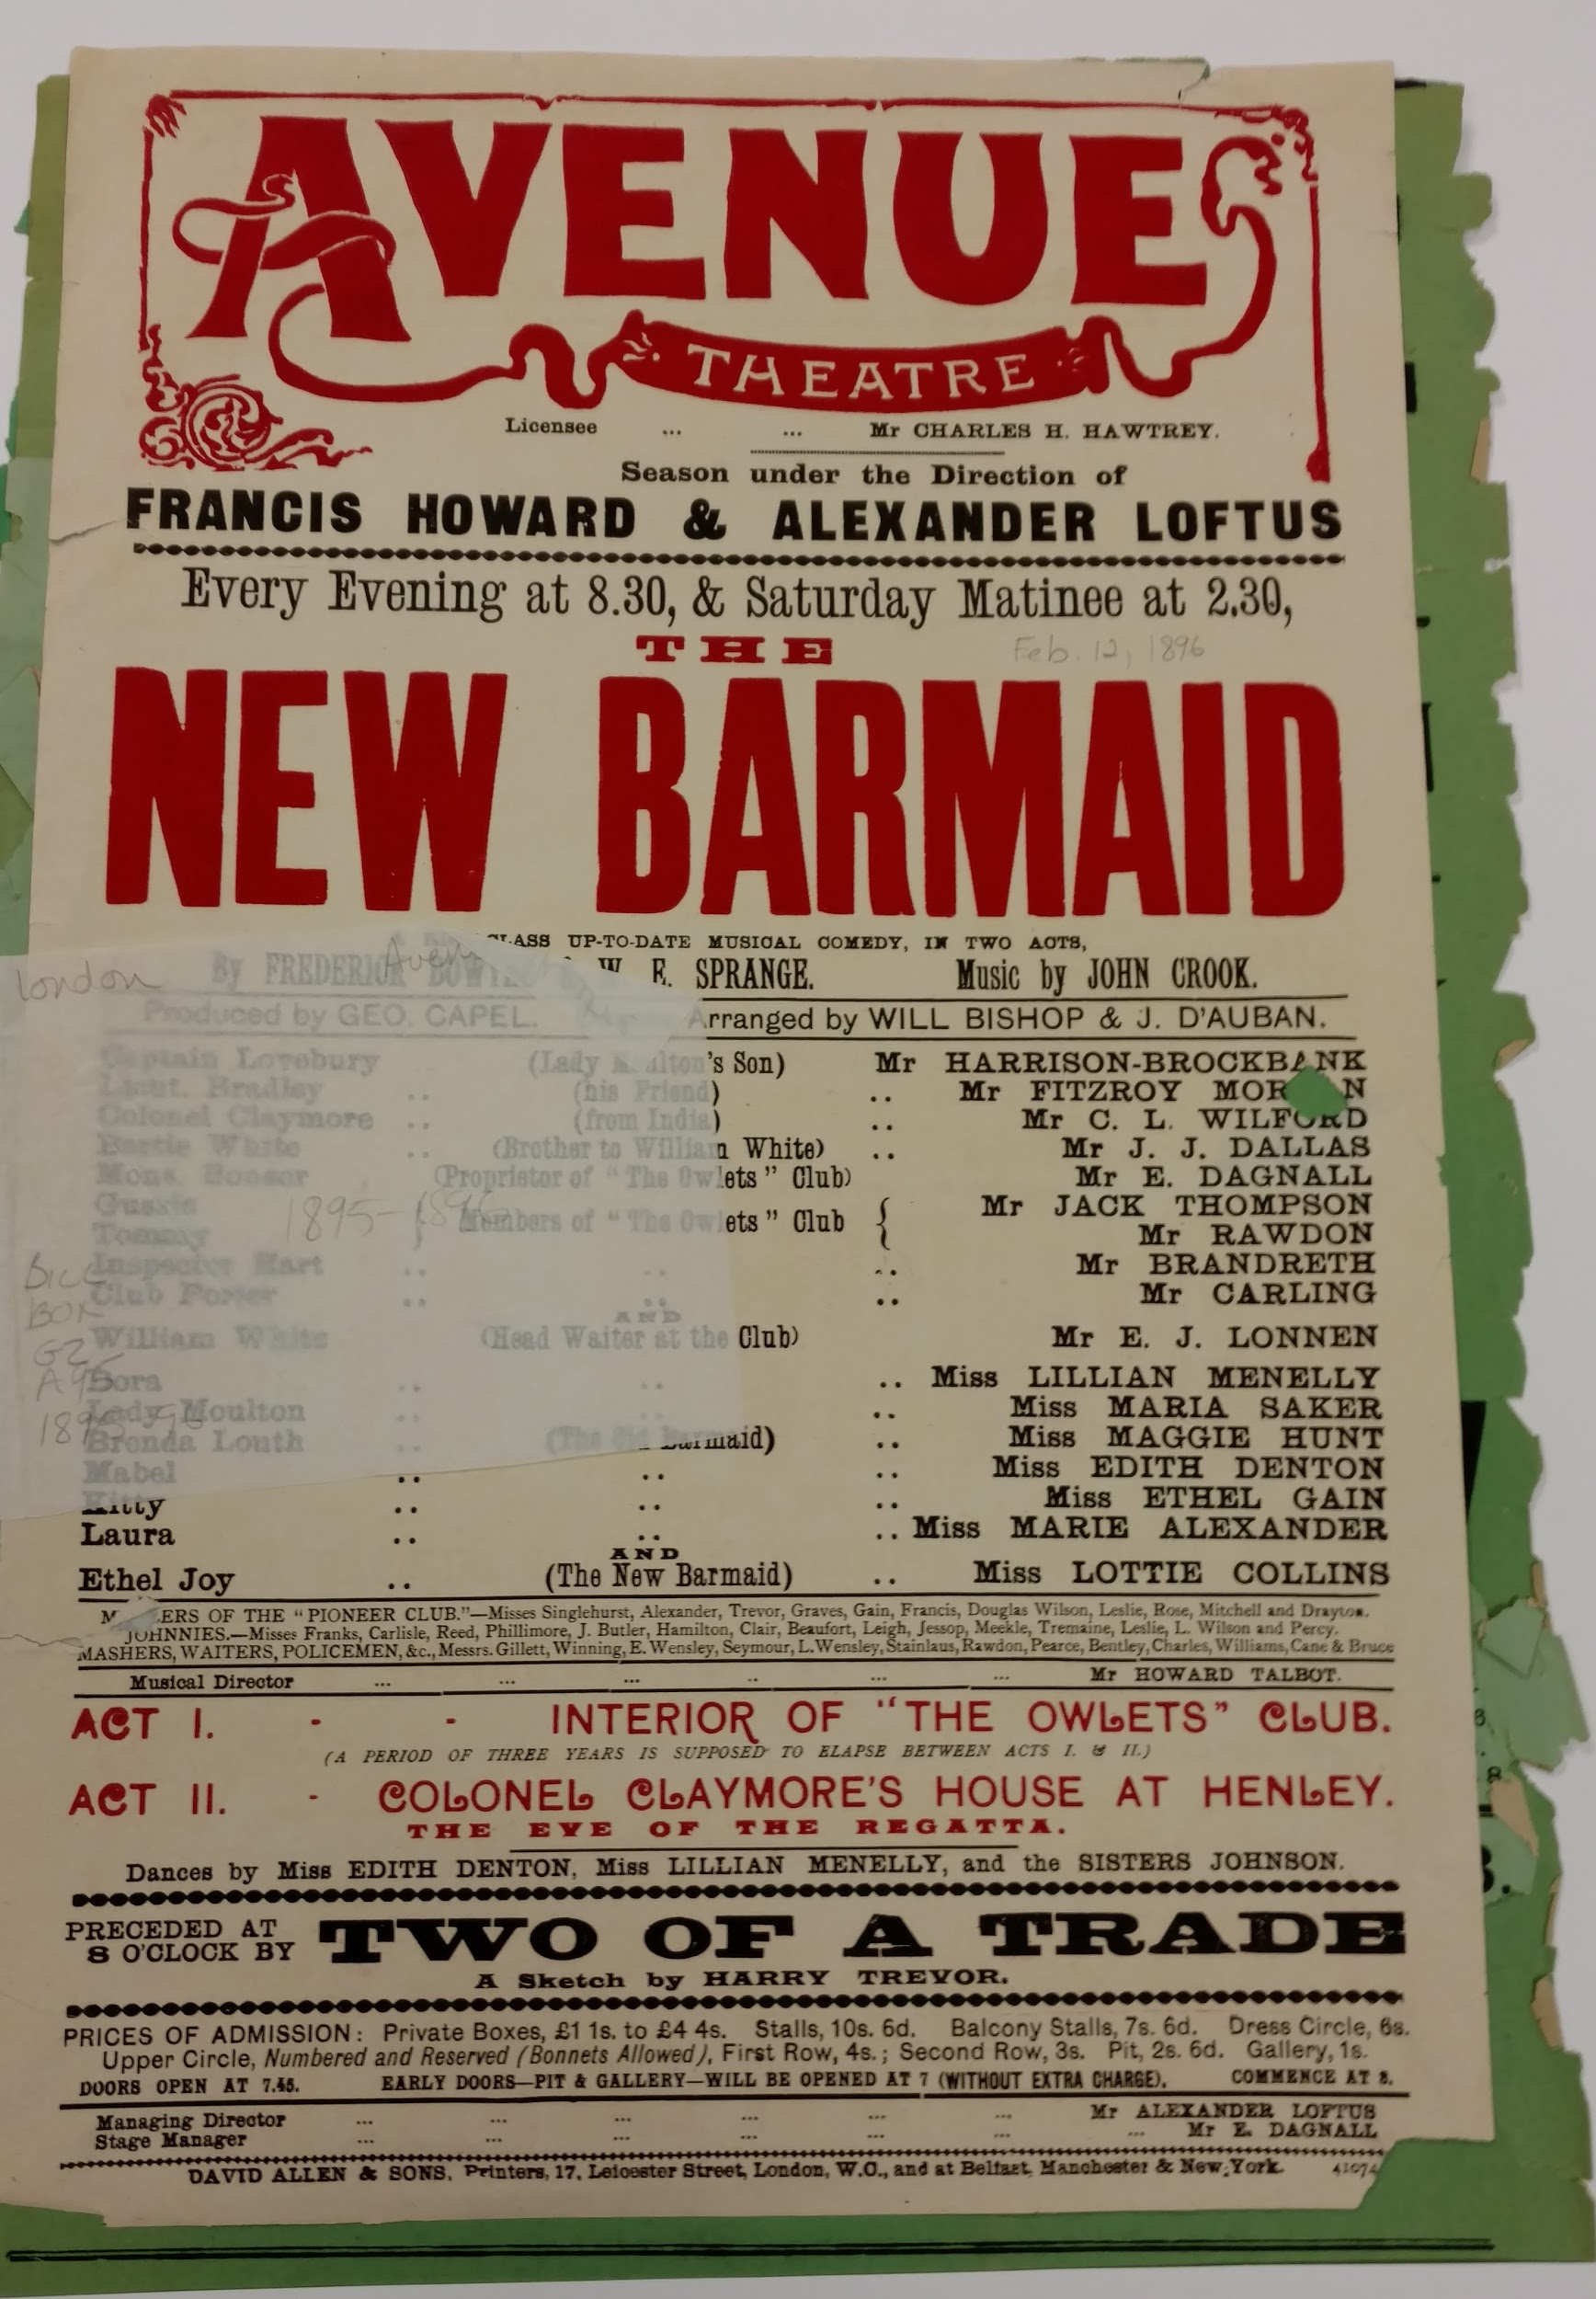
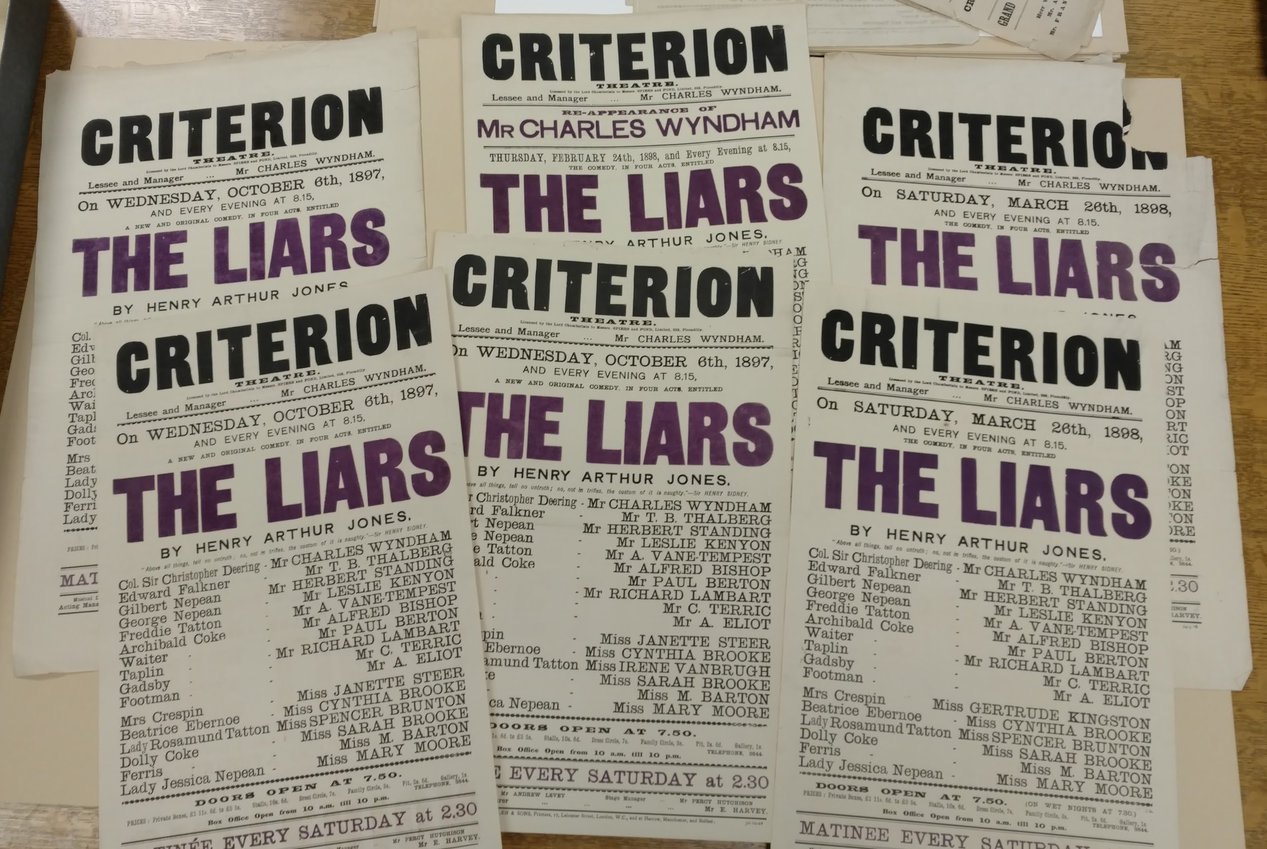
playbill from the Avenue Theatre (BILL Box G2 A95 [1896?])
playbills from the Criterion Theatre (BILL Box G2 C87 1897)

Slide 15
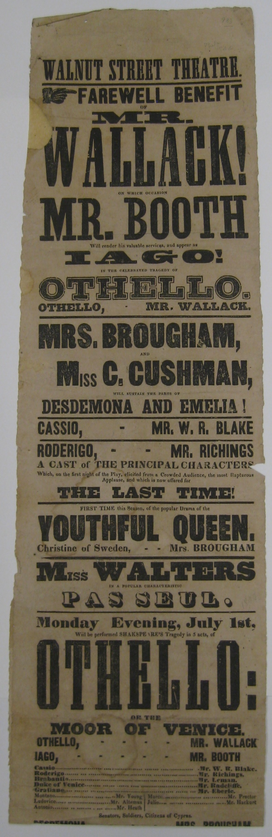
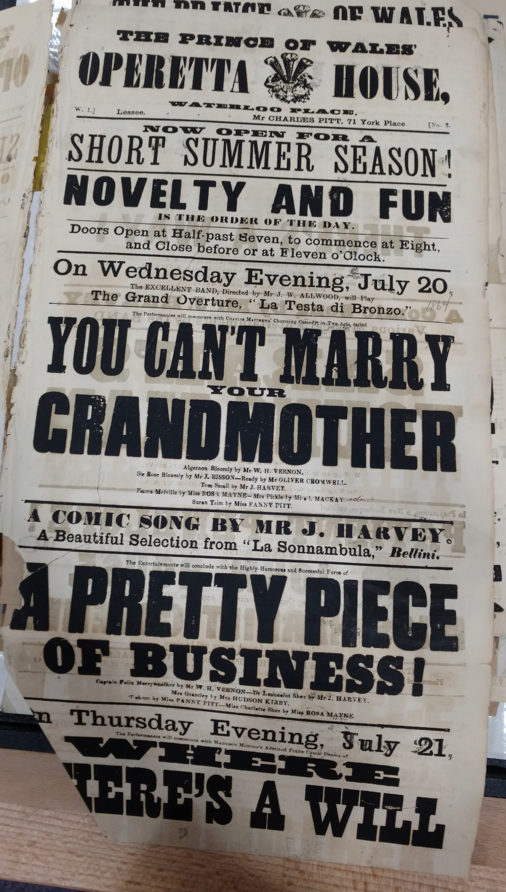
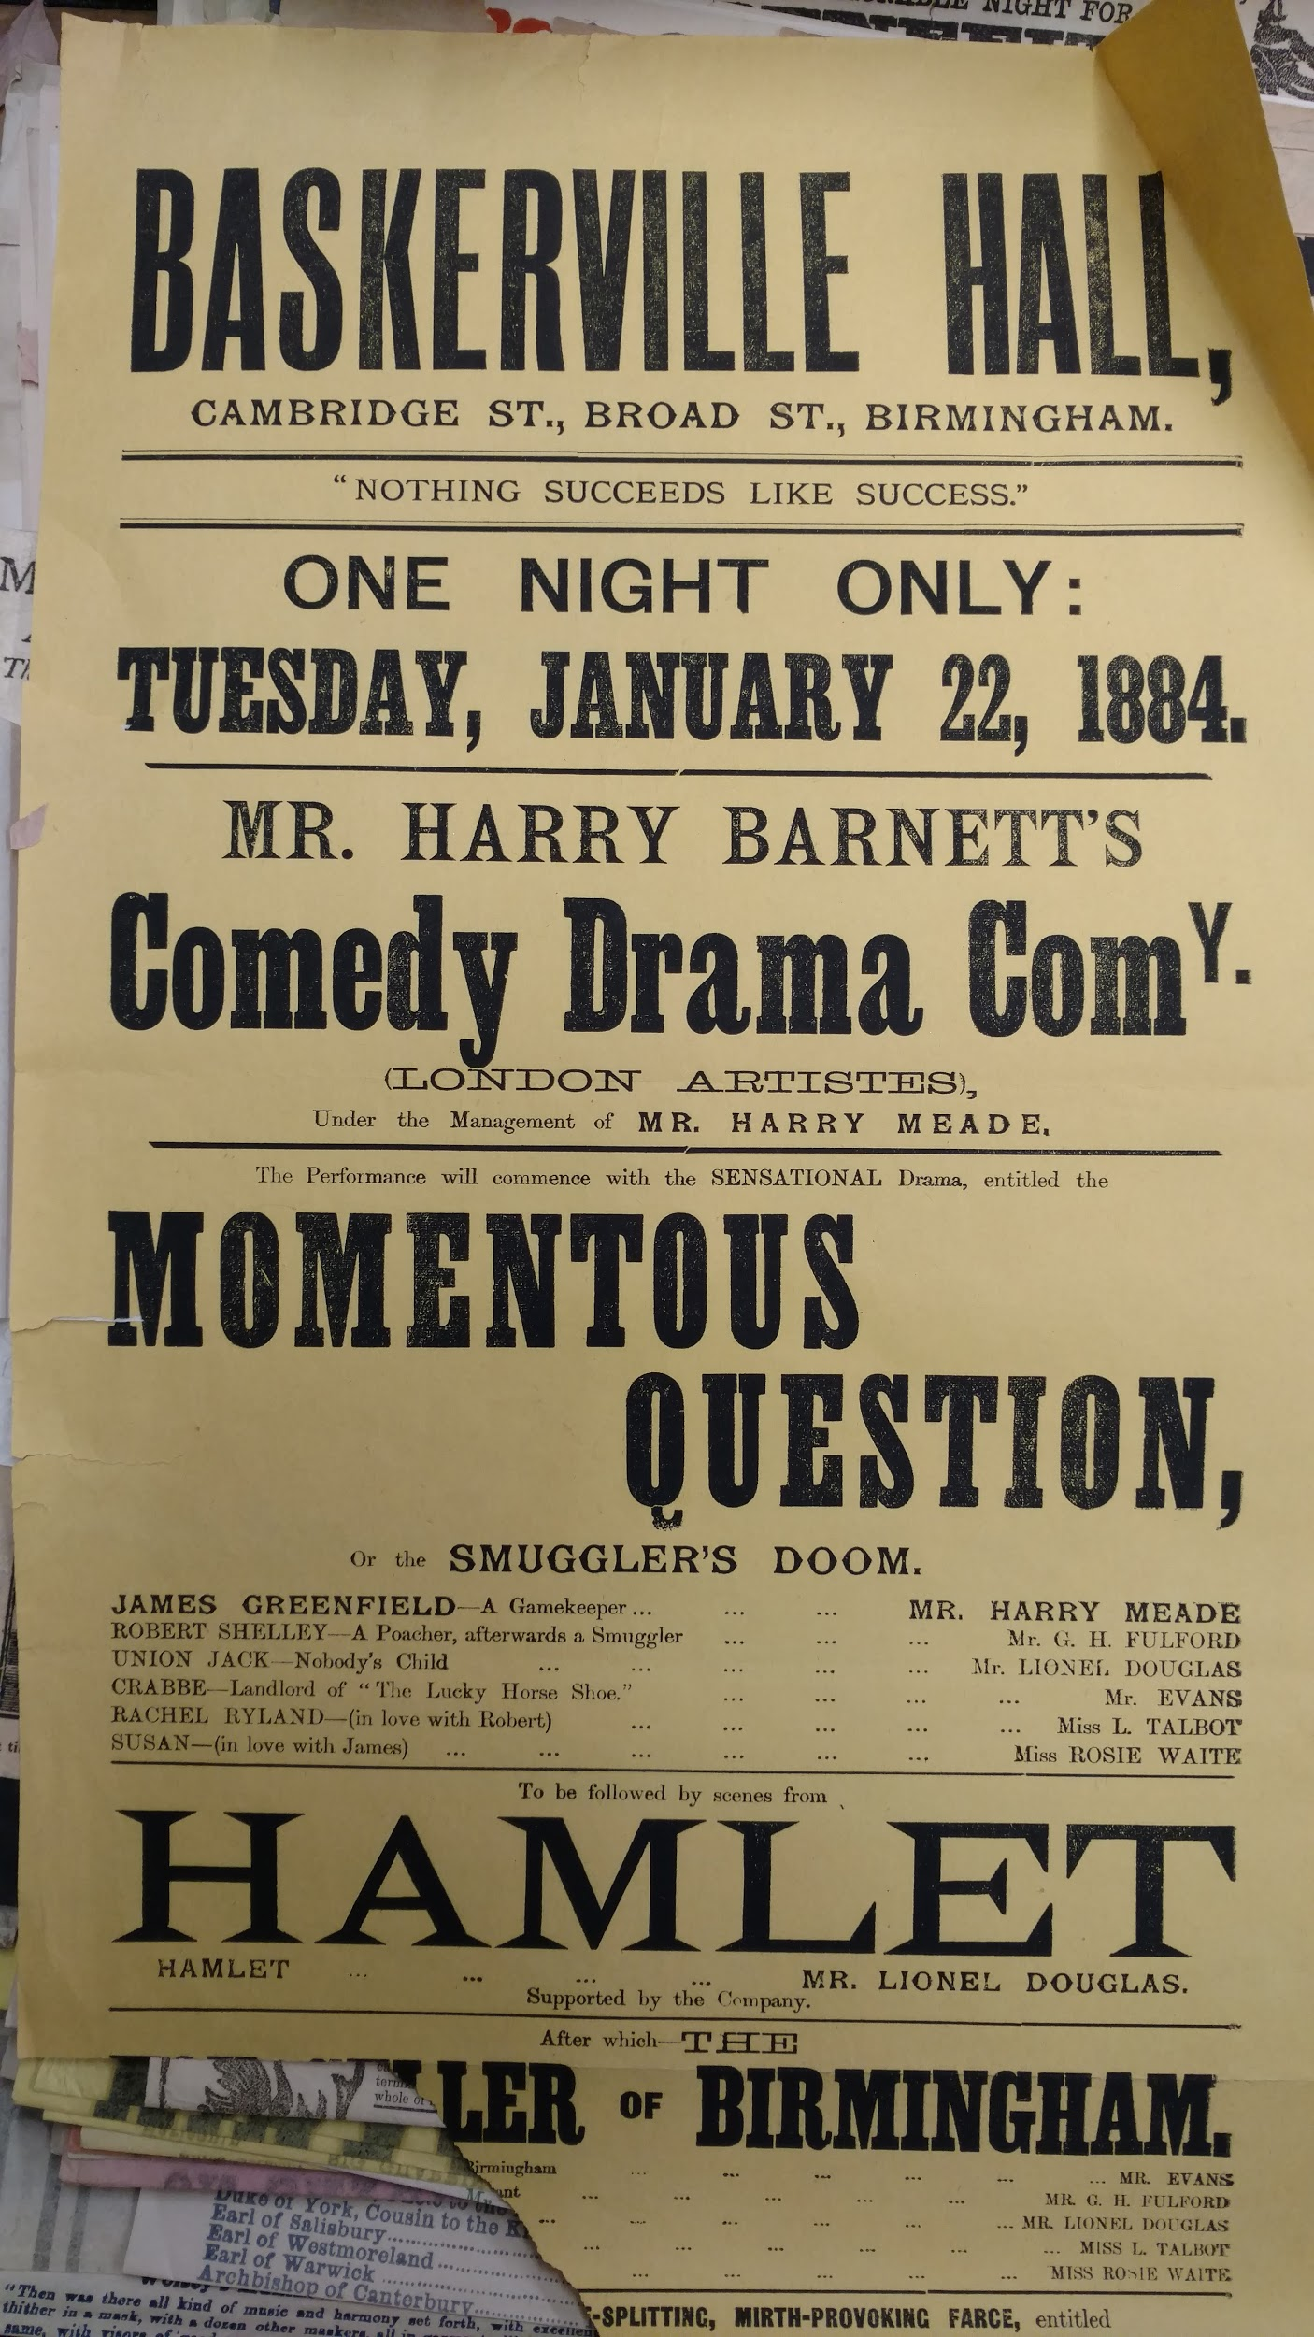
BILL Box U6 W16
BILL Box G2 P95
BILL Box G3 B53bh 1884

Slide 16
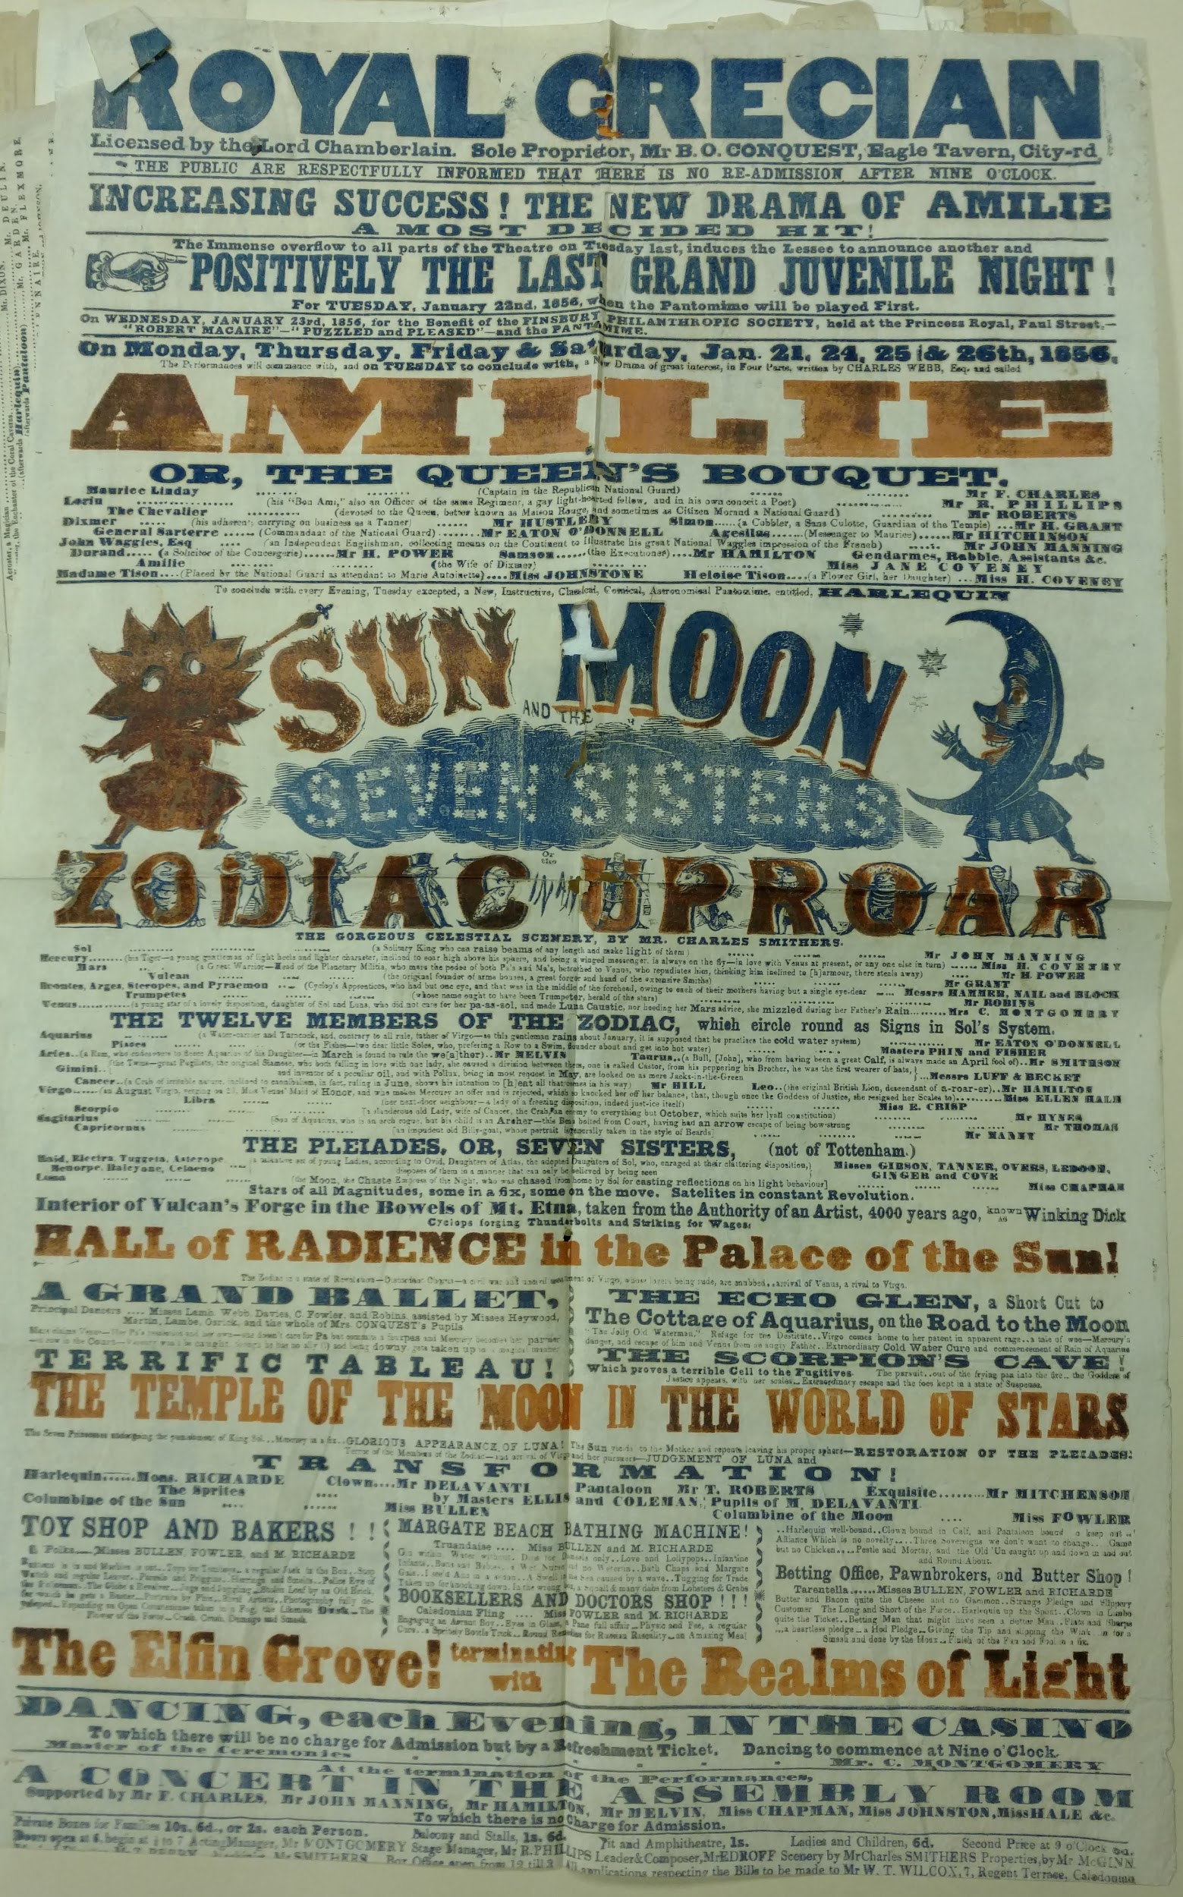
Thank you!
twitter: @sehovde
email: shovde@folger.edu
Playbill from the Grecian Theatre
(BILL Box G2 G81 1856)

