Slide 1

Structured Study Breaks in the TLC as a Model for Developing New Library Services
Andy Horbal & Aaron Ginoza

Slide 2
Origins
“I’m wondering if, say, two nights per week (Tues/Thurs, for example) we might offer students a break in their studies from 930 to 10pm when they could participate in yoga or doing stretches or drawing or moving to music or making music, or on learning to snack healthily while they study?”
-From an email by former Libraries staff member Michael Zeliff
Notes:
Goals identified by Michael, all of which fall under the general heading of “wellness”:
Stress Reduction
“To provide a more rounded experience in the Libraries”
Building community among students
Michael’s email led to a meeting in October, 2018 attended by him, Eric Bartheld, Tim Hackman, Yelena Luckert, Gary White, Aaron, and myself where we decided that the TLC would be the best host for programming along these lines, and that the ideal next step would be to survey our users about what sorts of activities they would be most likely to attend

Slide 3
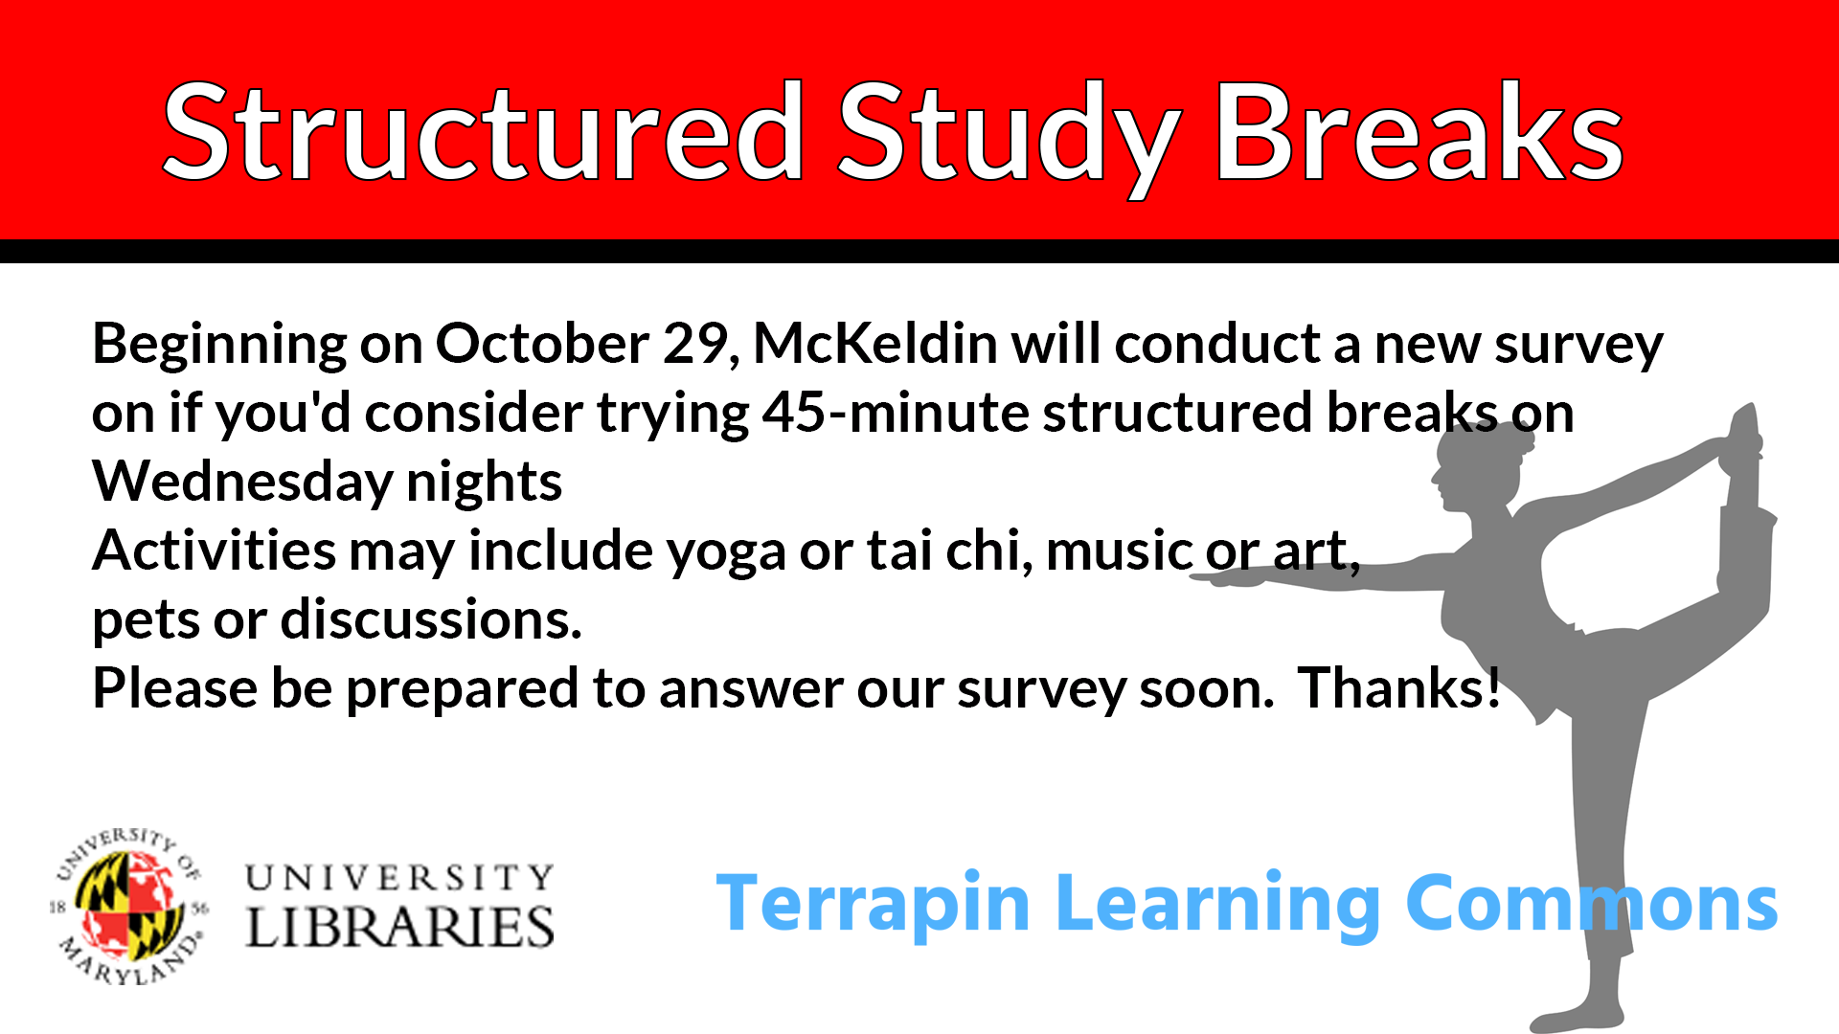

Slide 4
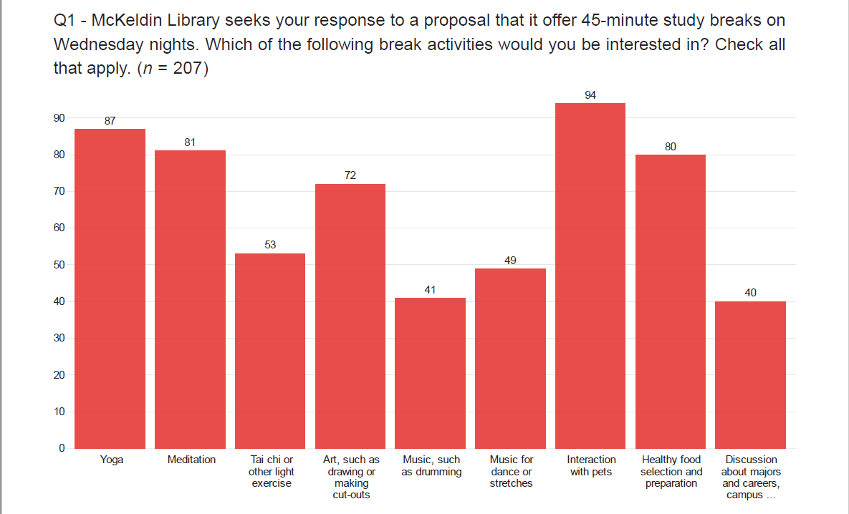

Slide 5
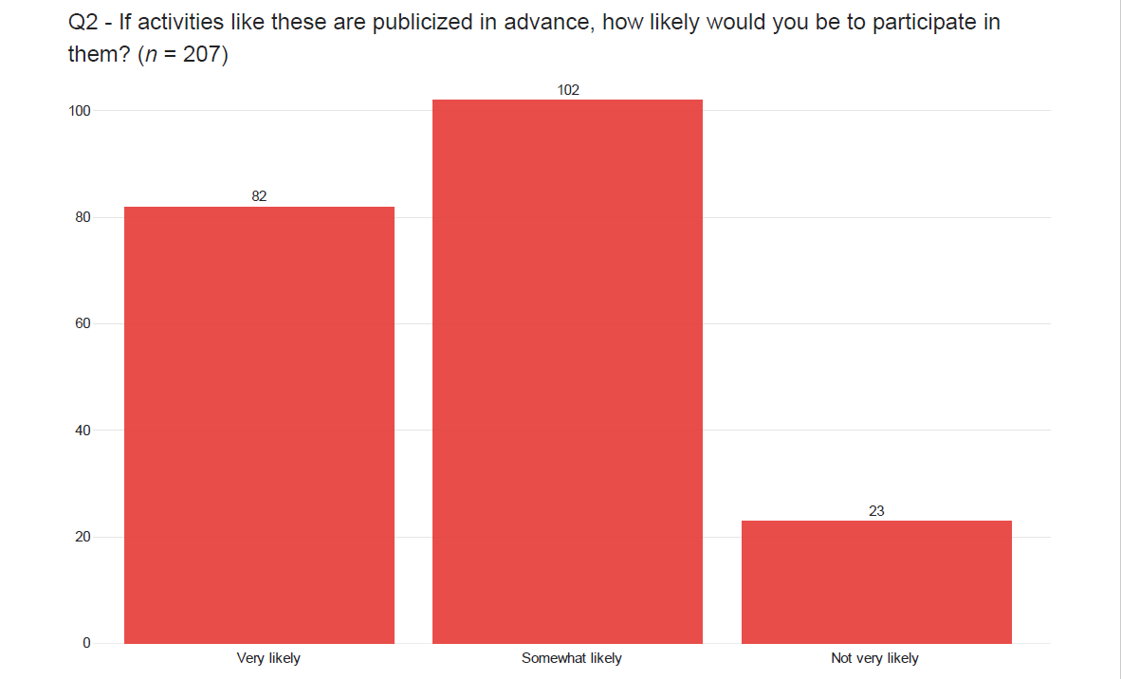

Slide 6
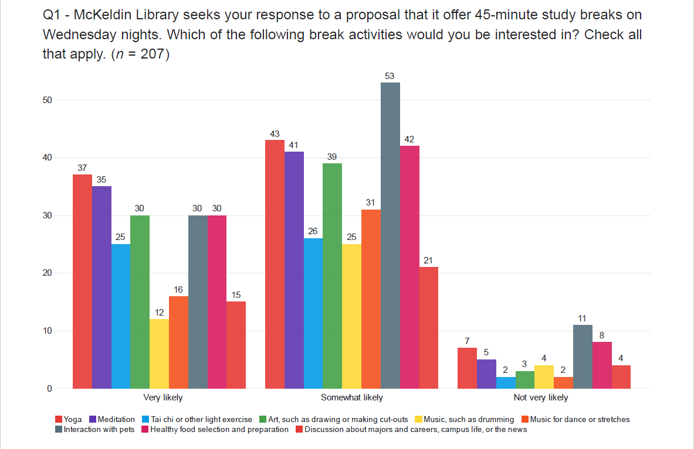
Notes:
Discussed survey results at a TLC staff meeting attended by Michael Zeliff and decided to move forward with one to two pilots each in five areas:
Yoga
Meditation
Art, such as drawing or making cut-outs
Interaction with pets
Healthy food selection and preparation

Slide 7
Building the Team
Started by assembling a coalition of people from the Libraries, including Michael Zeliff, the TLC staff, the Communication Department, and the Student Outreach Team
Researched relevant precedents, such as yoga sessions offered during finals week from 2015-2017
Reached out to existing partners for referrals
Notes:
Michael also obtained a modest ($71) grant from the Pepsi Enhancement Fund, and Chris Davis in PSD helped us order supplies.

Slide 8
Partners
RecWell (Yoga)
Studio A (Art)
University Health Center (Healthy Snacks, Pets)
Notes:
We identified our most logical partner for meditation as the Health Center as well, but unfortunately our contact retired in December before we were able to plan any events.
RecWell + UHC = new versions of existing partnerships; Studio A = new partner

Slide 9
Evolution of an Idea, Example #1
Cooking demonstration
“Build Your Own Trail Mix” activity where students make their own trail mix using items representing all five food groups
+
=
Peer educators answering questions about nutrition
Notes:
Compromise between our original idea and our partner’s original idea, resulting in something that worked better for everyone.

Slide 10
Evolution of an Idea, Example #1
Cooking demonstration
“Build Your Own Trail Mix” activity where students make their own trail mix using items representing all five food groups
+
=
Peer educators answering questions about nutrition
Notes:
Compromise between our original idea and our partner’s original idea, resulting in something that worked better for everyone.

Slide 11
Evolution of an Idea, Example #1
Cooking demonstration
“Build Your Own Trail Mix” activity where students make their own trail mix using items representing all five food groups
+
=
Peer educators answering questions about nutrition
Notes:
Compromise between our original idea and our partner’s original idea, resulting in something that worked better for everyone.

Slide 12
Evolution of an Idea, Example #2
"Some ideas I have for next time is having them include the times of the classes with the 30 minute increments because people were coming in and out in the middle of classes and it was distracting. I also think they should put my name on the poster so people know who is leading the class!"
-From an email by instructor Jemma L.
Notes:
Evolution of the idea based on feedback from partners:

Slide 13
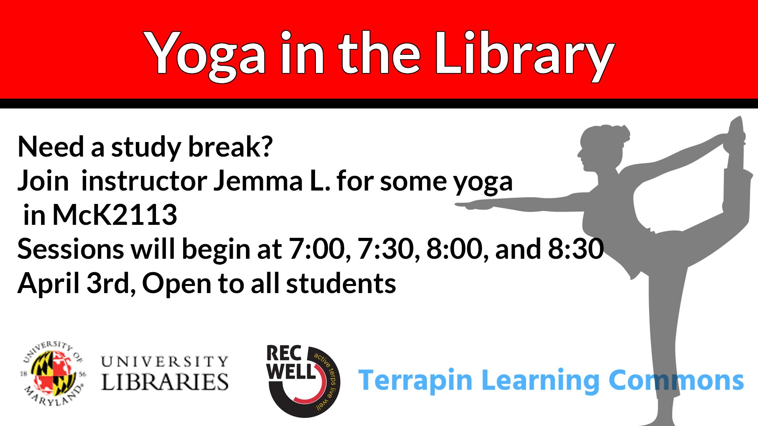

Slide 14
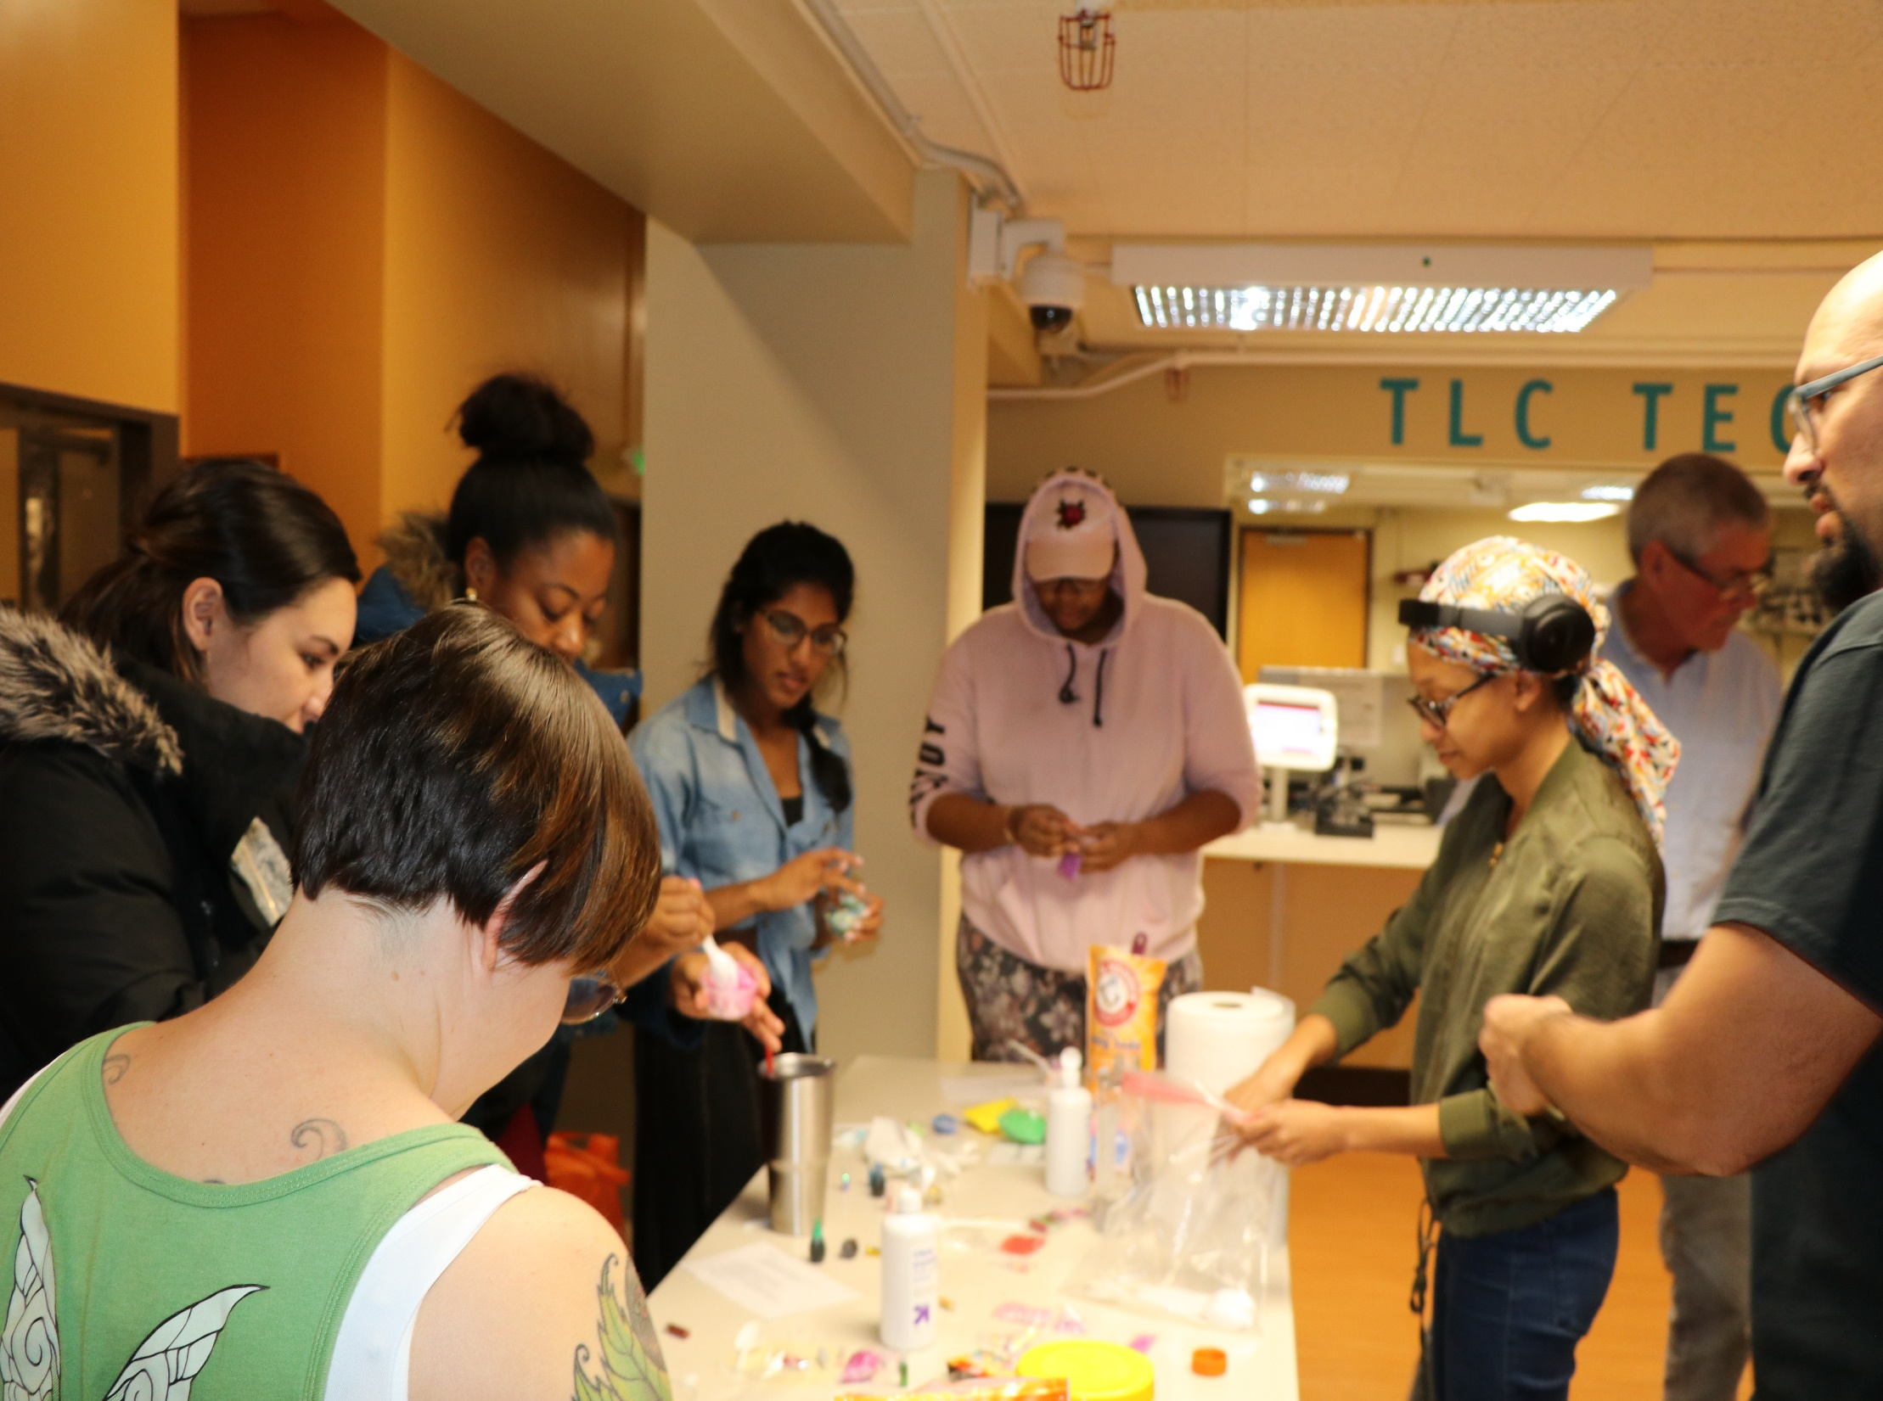
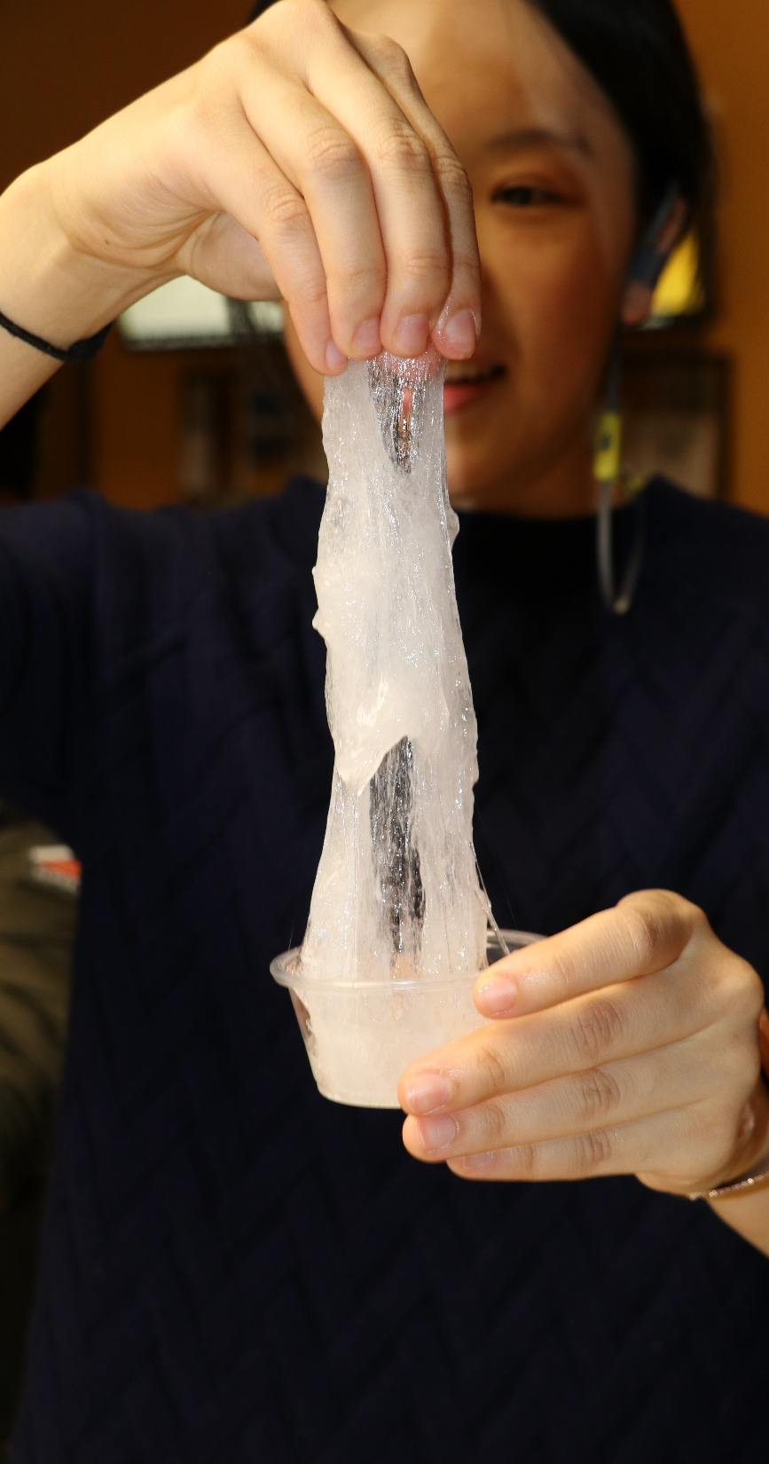
Notes:
Marketing and outreach strategy consisted of promoting events online in as many forums as possible, creating both digital and physical signage in the Libraries, telling people studying in the TLC that an event was about to start, and positioning events in highly visible locations.

Slide 15
Assessment
100+ students reached (average of about 18/session)
Survey respondents overwhelmingly indicated that they would be extremely likely to participate in each event again, and that they night it took place worked well for them
Partners + Libraries staff also provided anecdotal evidence that students appreciated all of the events
Notes:
Ultimately hosted six pilots, two each in the areas of yoga, healthy snacks preparation and selection, and art, such as drawing or making cut-outs. As mentioned previously, the person who would have ideally conducted our meditation pilots retired in December, and we weren’t successful at identifying a replacement. We also weren’t ever able to coordinate with our partner in the Health Center regarding an evening Wags for Wellness session. It’s actually unclear how much we would have learned from the latter in particular, though, since we have been hosting them once a month or more during the daytime for quite awhile, and there is obvious interest in programming on both areas, so we don’t consider this to be a great loss.
Survey responses weren’t necessarily super helpful for planning purposes, but do clearly indicate that the pilots were successful. More importantly, we confirmed our theory that access to the students studying in the TLC was considered valuable enough that partners would be willing to provide free workshops for us in exchange for it. We also learned more about the logistical challenges inherent in providing programming like this, especially during the event.

Slide 16
Future Directions
Requested new student supervisor positions/reclassifications for TLC to free Coordinator of TLC Operations up to focus more on partner relations
Planning to build on relationships we established by offering more events next year
Big leap forward = creation of specific wellness goals + assessment of effectiveness of events in reaching them

Slide 17
Our Process
User Analysis
Team Building
Partnerships
Service Refinement
Promotion
Assessment
Notes:
1. User Analysis: To measure interest in TLC-hosted study breaks, TLC staff conducted student surveys focused on potential participation levels, interest in specific activities, and scheduling preferences.
2. Team Building: After confirming student interest, TLC staff assembled a team that could advance the project. Team members included TLC staff, Michael Zeliff, and Aaron Ginoza. The Libraries Student Outreach Team, a group of student workers supervised by the communications office, would also serve as a resource for developing the study breaks.
3. Partnerships: With team roles and responsibilities mapped out internally, TLC staff reached out to campus departments that could facilitate the specific types of study breaks students highlighted in surveys.
4. Service Refinement: With partners in place, TLC staff initiated a conversation about structuring and staffing the service. That conversation included input from the Libraries Student Outreach Team and benefited from research on study break projects run at peer institutions.
5. Promotion: Once the service had an implementation plan that utilized the strengths of our partners, we promoted the study breaks using physical signs, infoscreens, and Instagram Stories.
6. Assessment: At the study breaks, we collected assessment data via iPad survey so we would have a basis to evaluate our efforts and be more informed executing future projects.

Slide 18
What We Did Right
Integrated user input
Recognized the importance of partners
Built on existing relationships
Leveraged our location
Notes:
Integrating user input: Throughout the planning process, we looked for ways to integrate user input into the development of the new service. This helped us move the service forward while staying connected to the population it would engage.
Importance of partners: Pulling in partners helped us expand the quality of the study breaks without a lot of additional staffing from the Libraries.
Building on existing relationships: Having a working relationship with two of our three partnering organizations made it easy piloting a study break service with their direct support.
Leveraging our location: We found our partners are interested in working with us in part because of our location and the access to students it provides. The Health Center in particular, which is not an ideal location for hosting events, has expressed the benefits of having a programming presence in McKeldin.

