Slide 1



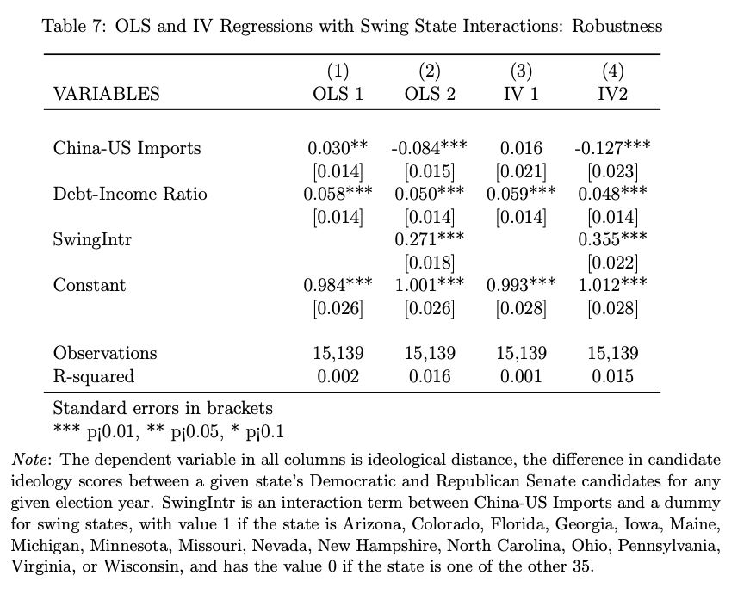
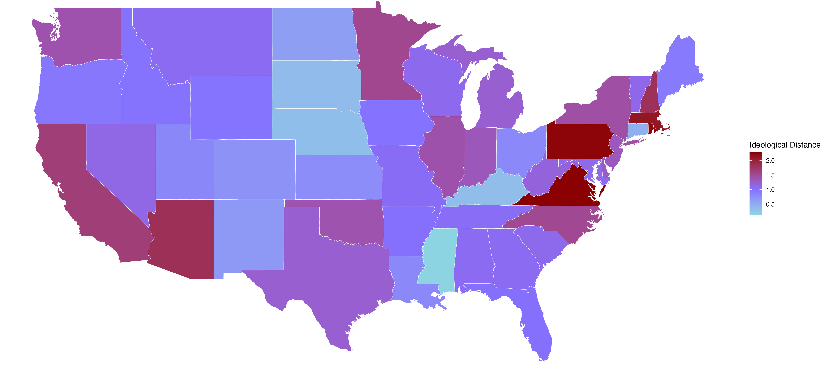
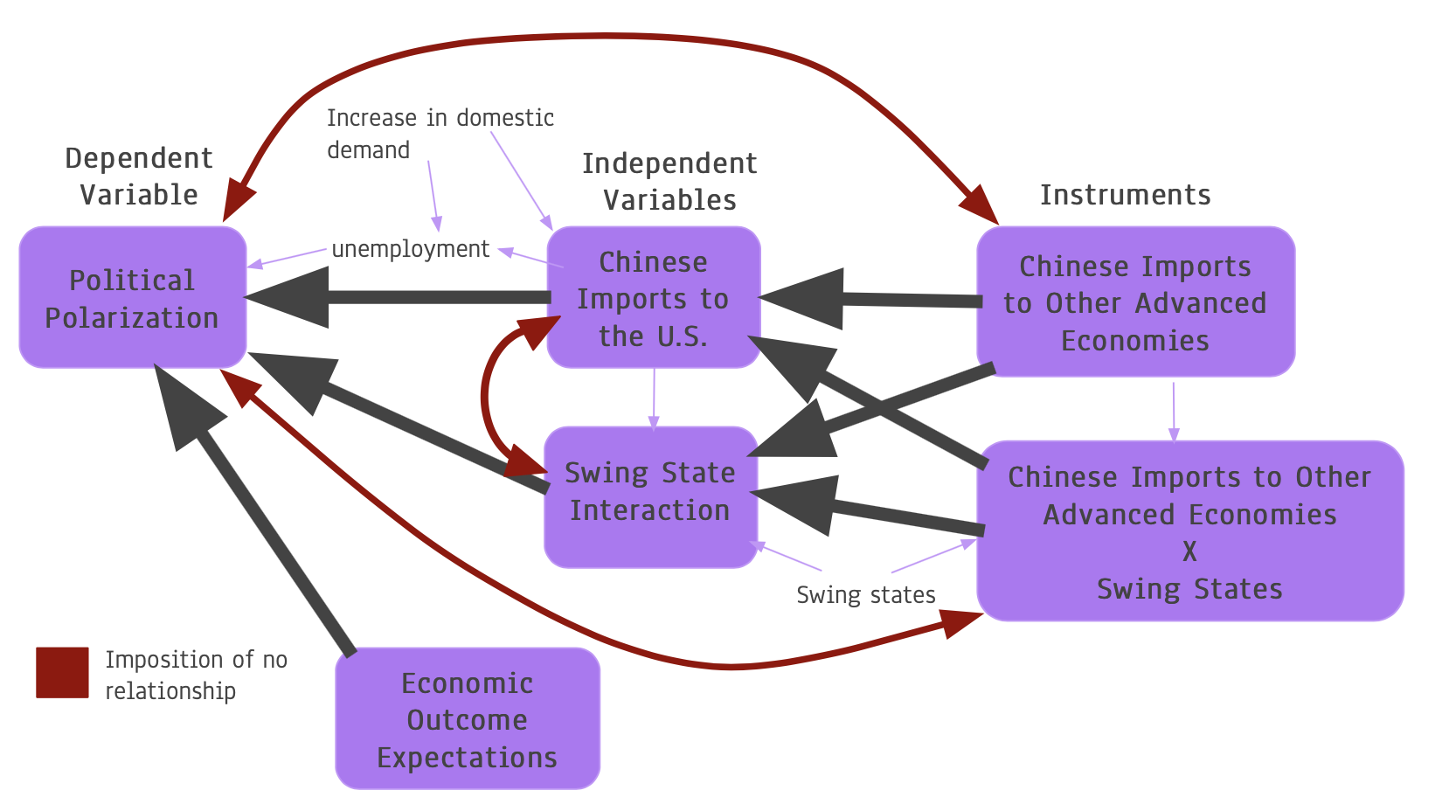

Economic Outlook and Political Polarization in Trade Impacted American Labor
Department of Economics Honors Thesis
Jessica Ye
Abstract
Data
Results/Data Analysis
Discussion and Conclusion
Since the start of China’s WTO membership in 2001, there has been a decline of over one million U.S. manufacturing jobs. This process has been linked to an increase in U.S. political polarization. This project explores the relationship between local labor market trade exposure and Senate candidate ideological realignment. To this end, I exploit exogenous variation from economic outcome perceptions. The analysis combines multiple sources of information. The empirical strategy implements an IV method, in which Chinese import penetration in the U.S. is instrumented with Chinese import penetration in other advanced economies. Accounting for the presence of swing states, I find a significant impact on Senate polarization from increases in import penetration and household debt to income. These results support pre-existing literature and offer insight into the importance of economic optimism in widening political cleavages from trade.
I use manufacturing sector import penetration data between the U.S., China, and other countries from the UN Comtrade and U.S. Census. This data has been broken down to commuting zone granularity by Autor et. Al 2020. My polarization measure is constructed from candidate ideology data from Adam Bonica’s Database on Ideology, Money in Politics, and Elections (DIME). My economic outlook data comes from FRBNY’s Equifax credit data.
Measure of polarization:
Public perception of a candidate may be different than their voting record and their donor list.
Some interests may be perceived centrist in one area but be extreme in another. For example, environmental donors may make a Maine Republican appear more centrist than environmental donors to a West Virginia Republican.
Trade exposure:
In non-swing states, increased trade causes a modest decrease in polarization.
However, in more politically influential swing states, more trade causes a large increase in polarization.
Increases in polarization occur across states, not within districts.
Economic outcomes sentiment:
Higher average debt to income increases polarization modestly in all locations
Negative sentiment makes voters more vulnerable to polarizing forces.
Swing states:
Swing states tend to have more competitive elections as there is “more to lose”
Fear of loss drives increases in donations, causing polarization
Policy Implications to reverse trend:
Campaign finance reform
Messages of hope in campaigns
Trade adjustment insurance or other social benefits may not be enough to reverse the “feeling” of hopelessness
Polarization in the United States 2000 - 2016
Main (column 4):
The default difference between candidates is 1.012, which is 75% of the difference between Joe Biden in 2002 and Rand Paul in 2016.
For every county’s average income level increase in average debt to income, the distance between Senate candidates grows by 0.048, which is four times the difference between John Thune (conservative Republican) in 2010 and Susan Collins (centrist Republican) in 2002.
In all states, there is a decrease in polarization of 0.127 for every 100% increase in commuting zone import penetration. This is comparable to slightly more than the difference between Joe Biden in 2002 and Dianne Feinstein in 2006.
In swing states, there is an increase in polarization three times that of the decrease in all states.
Robustness:
The default candidate ideology difference remains similar across all specifications.
The effect of debt to income remains similar across all specifications.
In aggregate, there is a slight increase in polarization from trade.
The inclusion of a swing state interaction clarifies a modest decrease in polarization for all states and a large increase in swing states.
Motivation
There has been a trend of rising political polarization over the past few decades.
This trend coincides with rising import exposure from China
Most measures of political polarization focus on vote shares or percentages of parliament.
  There is less focus on the ideological options presented to voters prior to elections’ conclusion
The role of economic expectation sentiment is not well explored
  Republicans tend to be more pessimistic than Democrats on a range of social factors except for racial equity.
Swing states have outsized political impact
Methodology
My measure of polarization is ideological distance, which is constructed as the difference between DIME candidate ideology scores for each election.
I use a causal two stage instrumental variable method with two first stages:
Trade exposure is instrumented by imports from China to other countries to avoid global demand shocks:
swingIntr is an interaction term between a swing state dummy variable and trade exposure:
Citations
I need two first stages to ensure exogeneity and exclusion.
Autor, D., Dorn, D., Hanson, G., and Majlesi, K. (2020). Importing political polarization? The electoral consequences of rising trade exposure.
Bonica, A. (2019). Are Donation-Based Measures of Ideology Valid Predictors of Individual-Level Policy Preferences?
Keese, M. (2012). Who feels constrained by high debt burdens? Subjective vs. objective
measures of household debt.
McLaren, J. and Ma, X. (2018). A swing-state theorem, with evidence.
Acknowledgements
I am extremely grateful to my advisor Professor Sergio Urzua for his guidance as well as Professor Nolan Pope, Professor Ethan Kaplan, Sebastian Montano Correa, Shirley Redroban, and the other students in the 2024 University of Maryland Economics Honors Thesis Cohort for their support. All errors are my own

