Slide 1
Integrating Aeon and Interlibrary Loan
Joanne Archer
University of Maryland Libraries
jarcher@umd.edu

Slide 2
What is Aeon?
“Automated request and workflow management software”
Special Collections management
  Tracking of activities (e.g. exhibits, class instruction, digitization)
  Increased capability for statistics
Researcher registration and request system
  Tracking of special collections circulation
  Increased remote options for patrons

Slide 3
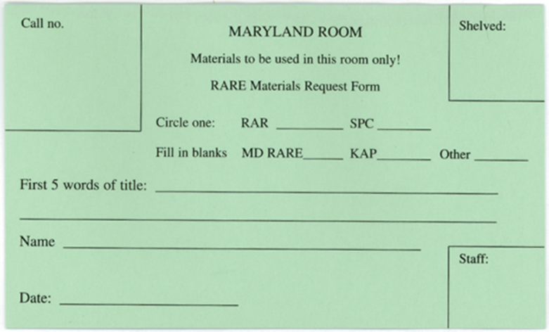
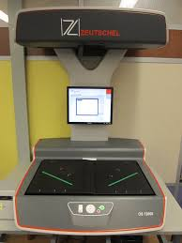
Special Collections and ILL
Long wait times for retrievals
Little communication between ILL and SCUA
No statistics/data about ILL requests

Slide 4
Workflows
Illiad communicates directly with Aeon
Requests for materials appear in the Aeon staff client in Interlibrary Loan queue.

Slide 5
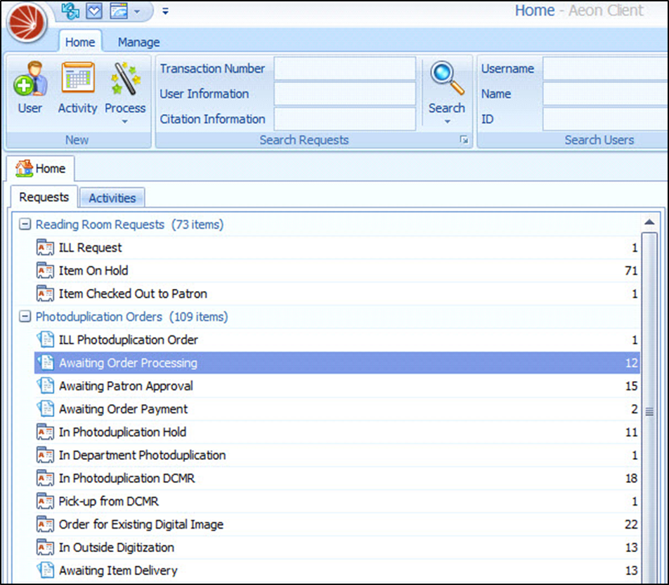
Workflows

Slide 6
Workflows
Illiad communicates directly with Aeon
Requests for materials appear in the Aeon staff client in Interlibrary Loan queue.
ILL student workers scan materials in the Maryland Room
Pre-1923 material uploaded to Internet Archive

Slide 7
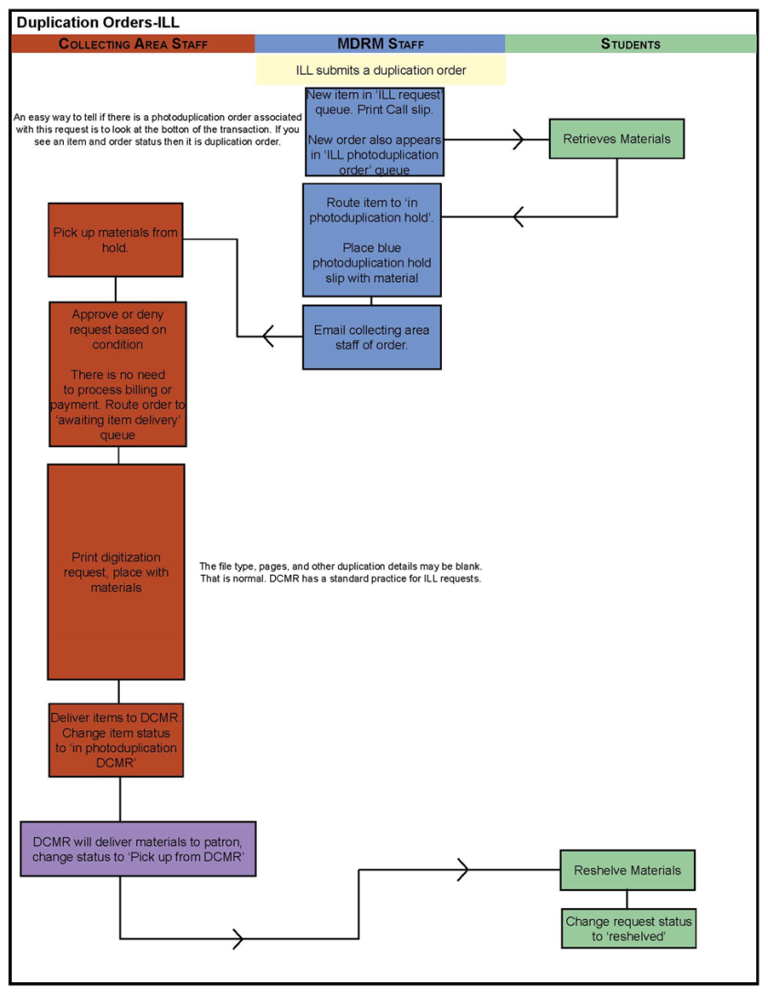
Workflows

Slide 8
Issues
Technical Issues
  Mapping site name in Illiad
  Normal debugging in Aeon
Policies and Procedures
  Development of new procedures for ILL and SCUA staff
  Establishing shared expectations
  Workflows and Documentation
  Training/Troubleshooting
  Refining in response to issues
    New queues
    Better understanding of ILL workflows

Slide 9
Hornbake Requests

Slide 10
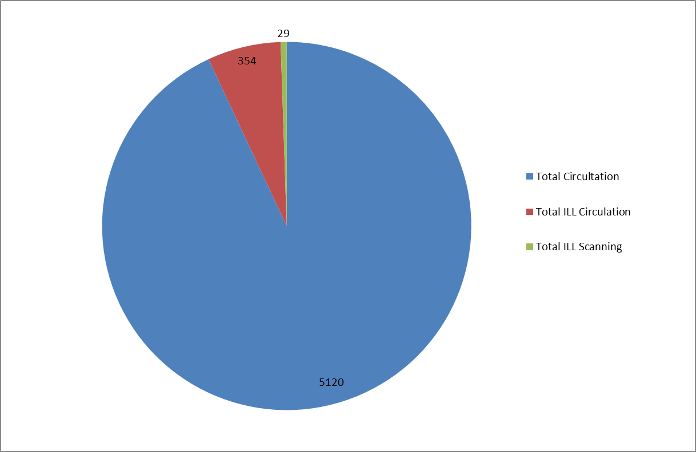
ILL Use
August 2014-October 2015
Notes:
7% of total circulation in the Maryland Room

Slide 11
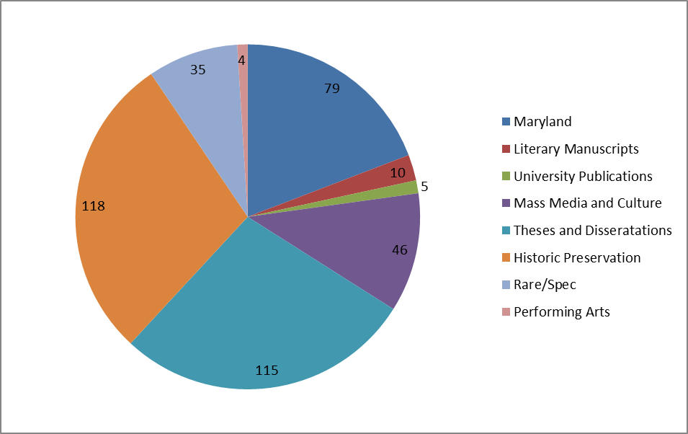
ILL Use
August 2014-October 2015

Slide 12
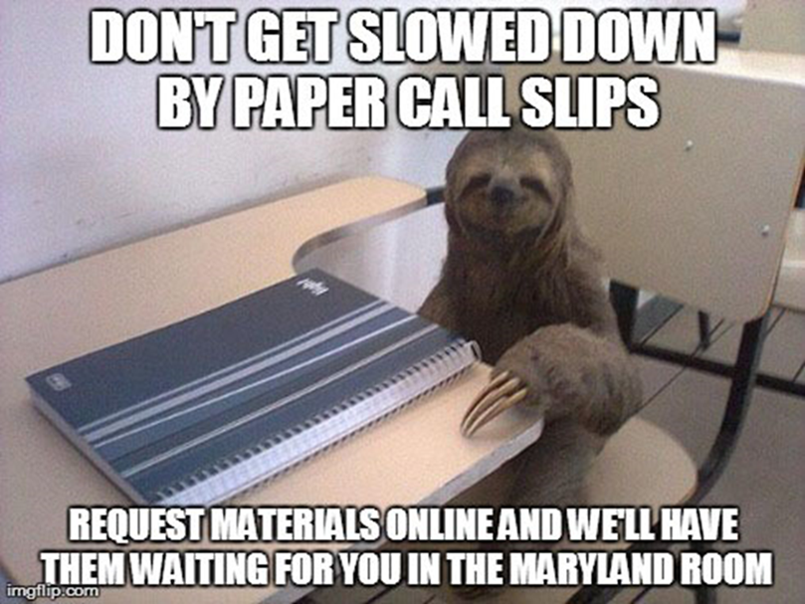
Impact
More streamlined process for ILL
More use of special collections by ILL
Improved relationship and collaboration with ILL staff

