Slide 1
Data, Data, Everywhere...
Future of Research Library Series
University of Maryland College Park
April 5, 2018
Sayeed Choudhury

Slide 2
The Rime of the Ancient Mariner
Water, water, every where,
And all the boards did shrink;
Water, water, every where,
Nor any drop to drink.
-- Samuel Taylor Coleridge
We are awash in data but we can’t drink...or can we?

Slide 3
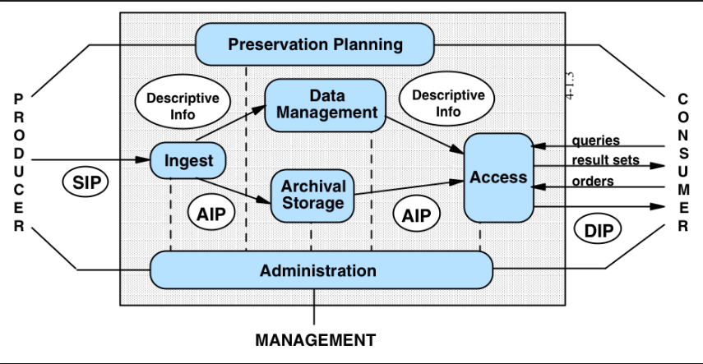
OAIS Functional Entities

Slide 4
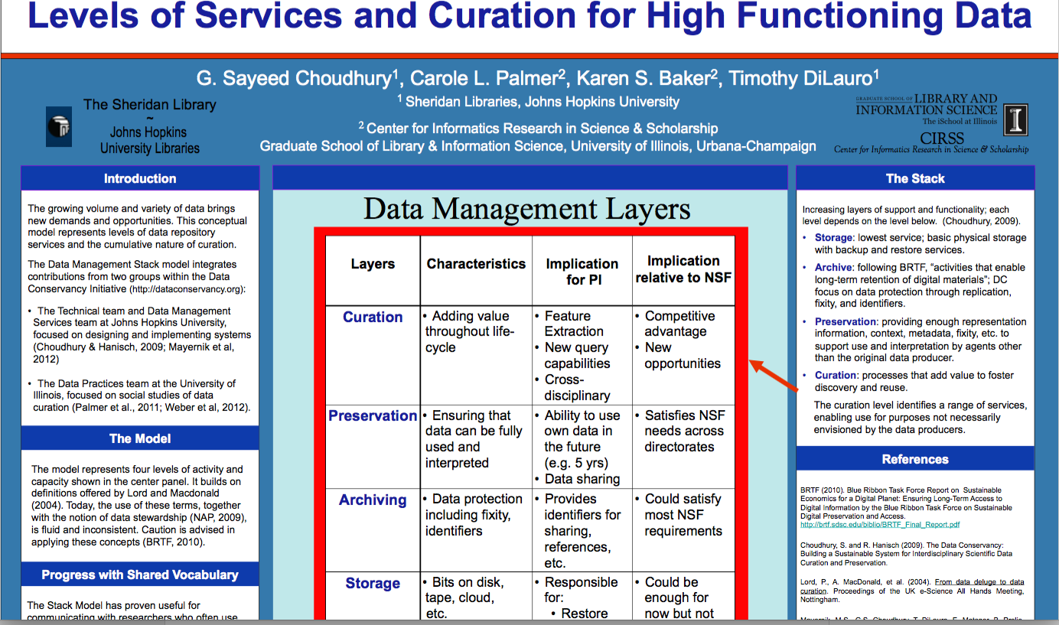
Data Management Layer or “Stack” Model

Slide 5
Definition of Big Data
Often defined in terms of “V’s” such as volume, velocity, viscosity, veracity, variety…
This definition is content based or focused
Alternate definition based on methods…that is, data become “big” when existing analytical methods are no longer efficient or effective
Key breakthrough for methods is machine learning in the form of deep networks combined with annotated big data and GPUs

Slide 6
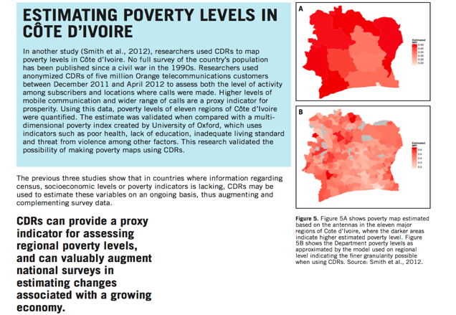
Methods -- Government/NGO

Slide 7
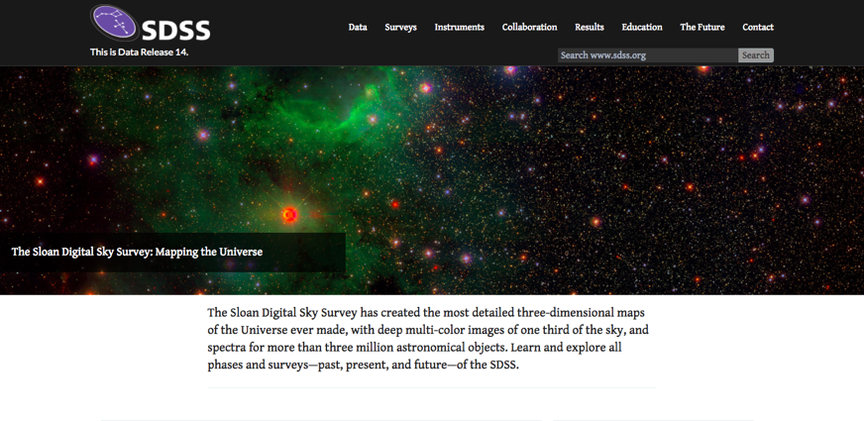
Methods -- Academic

Slide 8
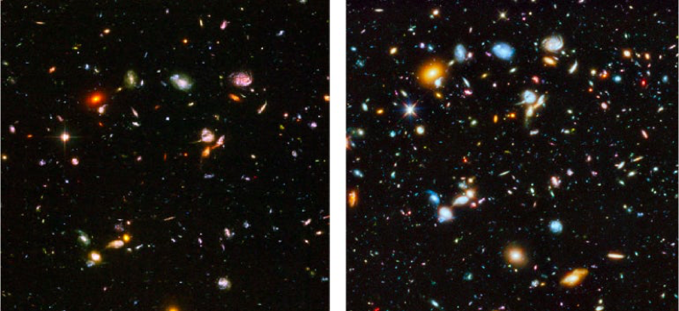
Astronomy Image from Hubble Space Telescope

Slide 9
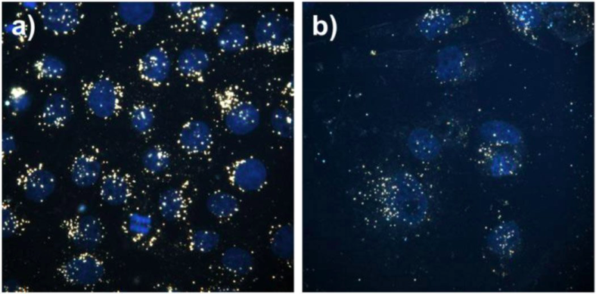
Image of Cancer Cells

Slide 10
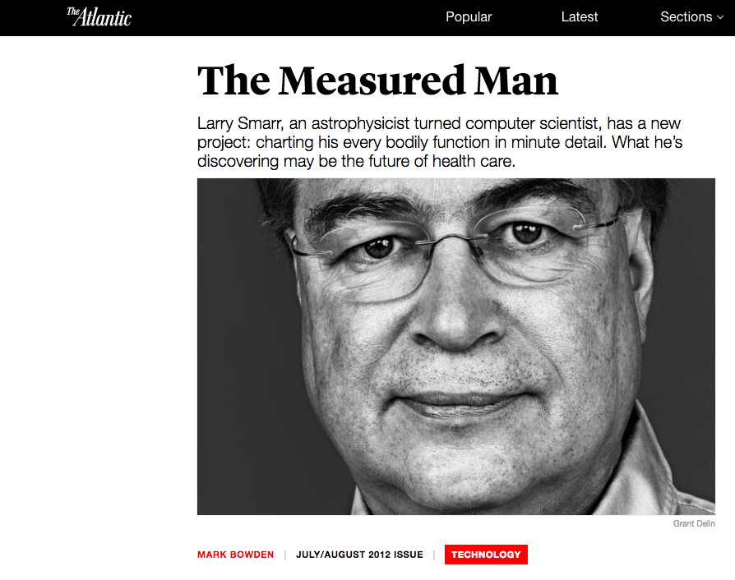

Slide 11


Methods -- Corporate

Slide 12
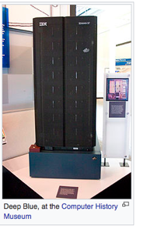
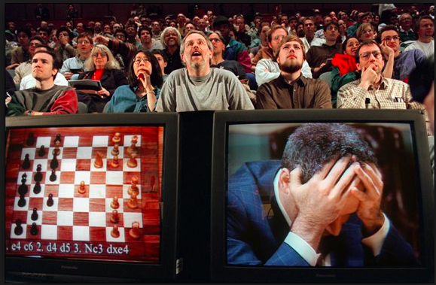
IBM Deep Blue vs. Kasparov

Slide 13

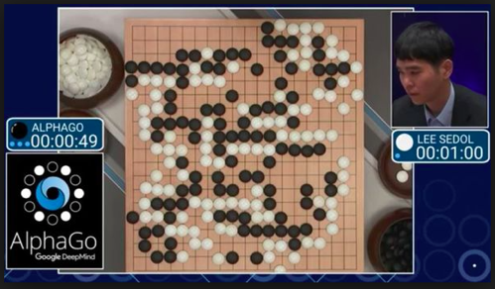
AlphaGo vs. Sedol

Slide 14
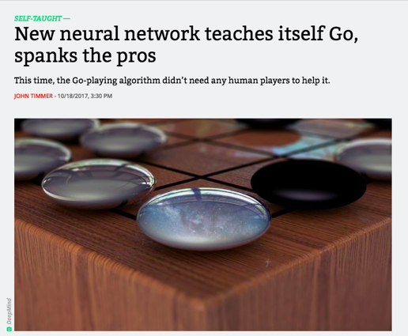
AlphaGo Zero vs. AlphaGo

Slide 15
OAIS Functional Entities

Slide 16
Data Management Layer or “Stack” Model

Slide 17
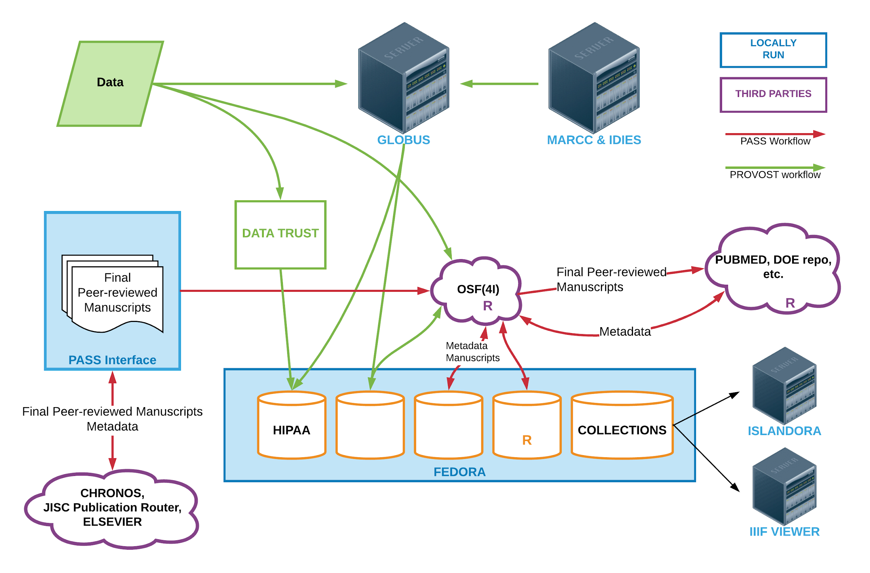

Slide 18
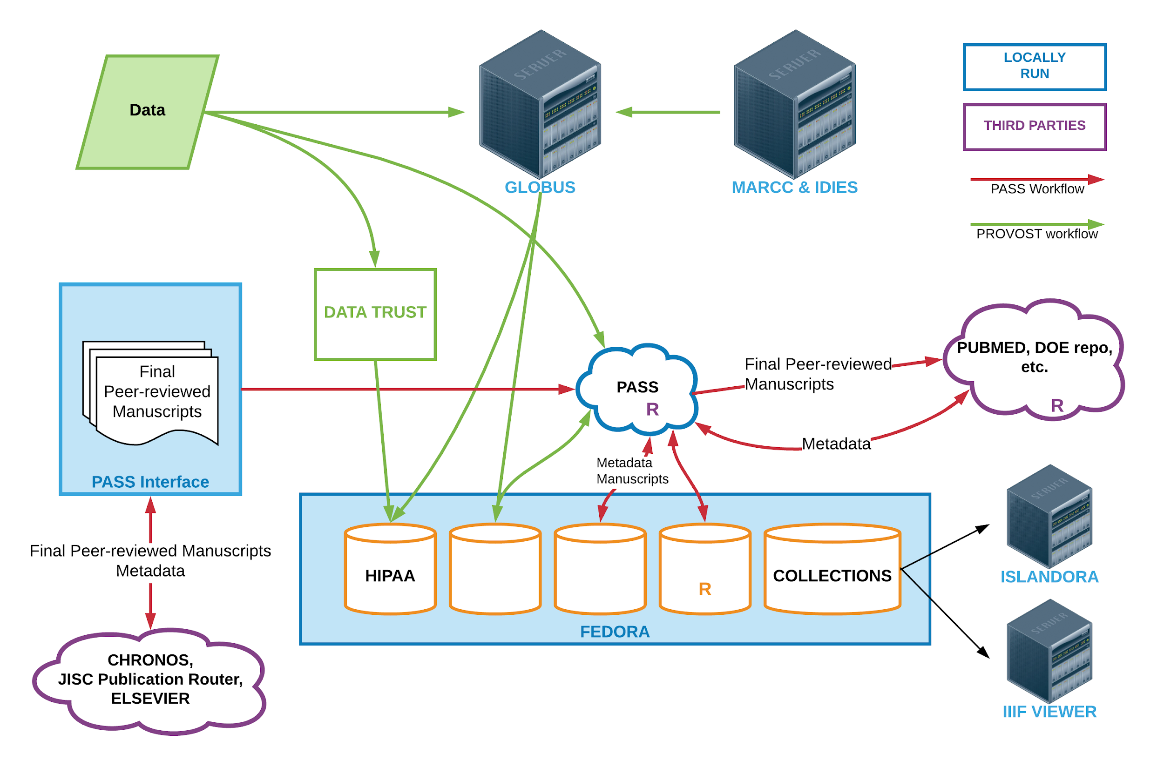

Slide 19
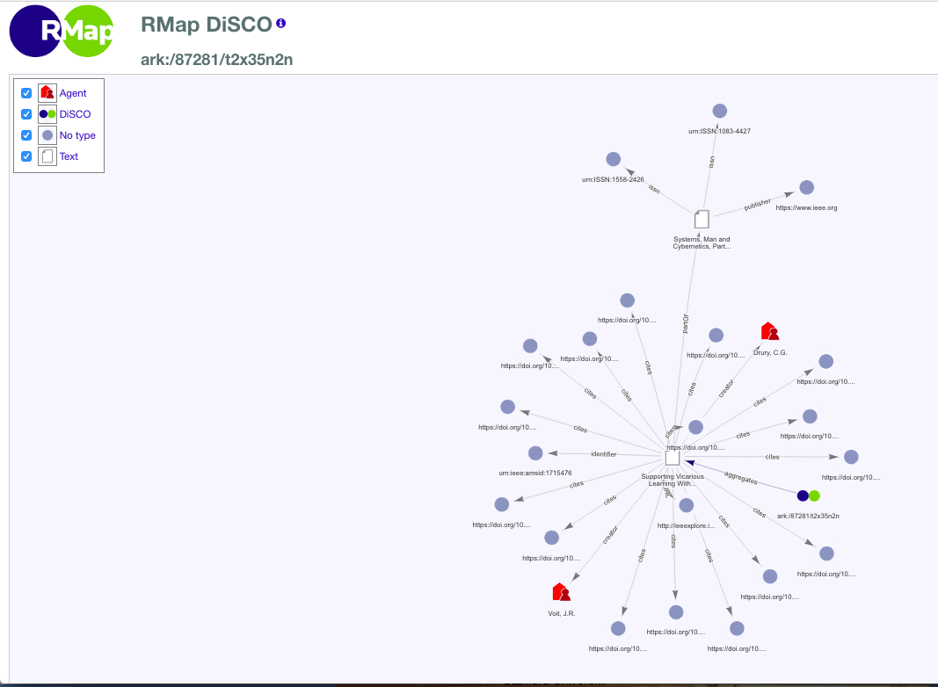
RMap -- Linked Data Protocol and Service

Slide 20
Questions? Comments? Reactions?

