Slide 1
HMNP Advisory Board Meeting
Thursday, November 17, 2016
Hornbake Library North 3210

Slide 2
Agenda
Welcome
Grant 1 and 2
NDNP Conference
Grant 3
Maryland Newspaper Repository
BREAK
Future Opportunities Brainstorming

Slide 3
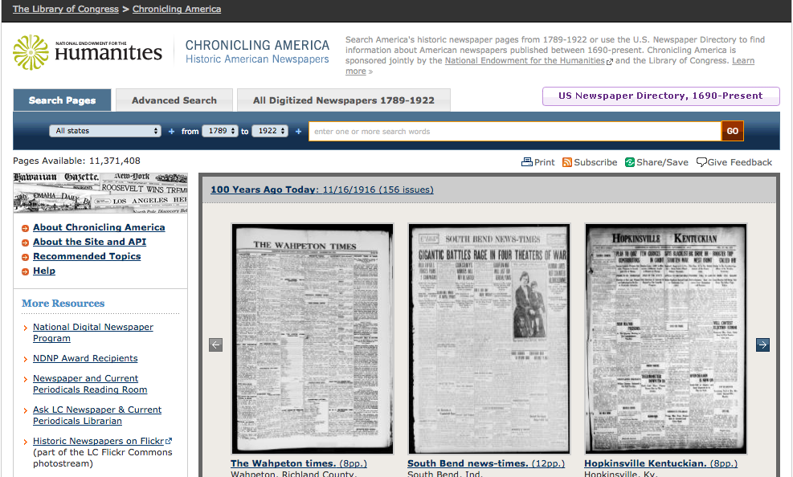
Chronicling America http://chroniclingamerica.loc.gov/

Slide 4
Grants 1 and 2 Updates
2012-2014, 2014-2016
~210,000 pages digitized
1840-1922
Content Partners
Library of Congress (1)
Maryland State Archives (2)
Maryland Historical Society (2)
Focus: geographic and temporal representation
11 cities
16 titles

Slide 5
Grants 1 and 2 Updates
Other Project Deliverables
Microfilm duplicates to LC
Newspaper Survey Data
Gateway to Digitized Maryland Newspapers
http://www.lib.umd.edu/newspapergateway
Essays
Short (250-500)
Publication history
Publishers/editors
Events or themes covered
Example: Cecil Whig http://chroniclingamerica.loc.gov/lccn/sn83016348/
Wikipedia entries; Edit-a-thons
Pinterest: https://www.pinterest.com/MDnewspapers/

Slide 6
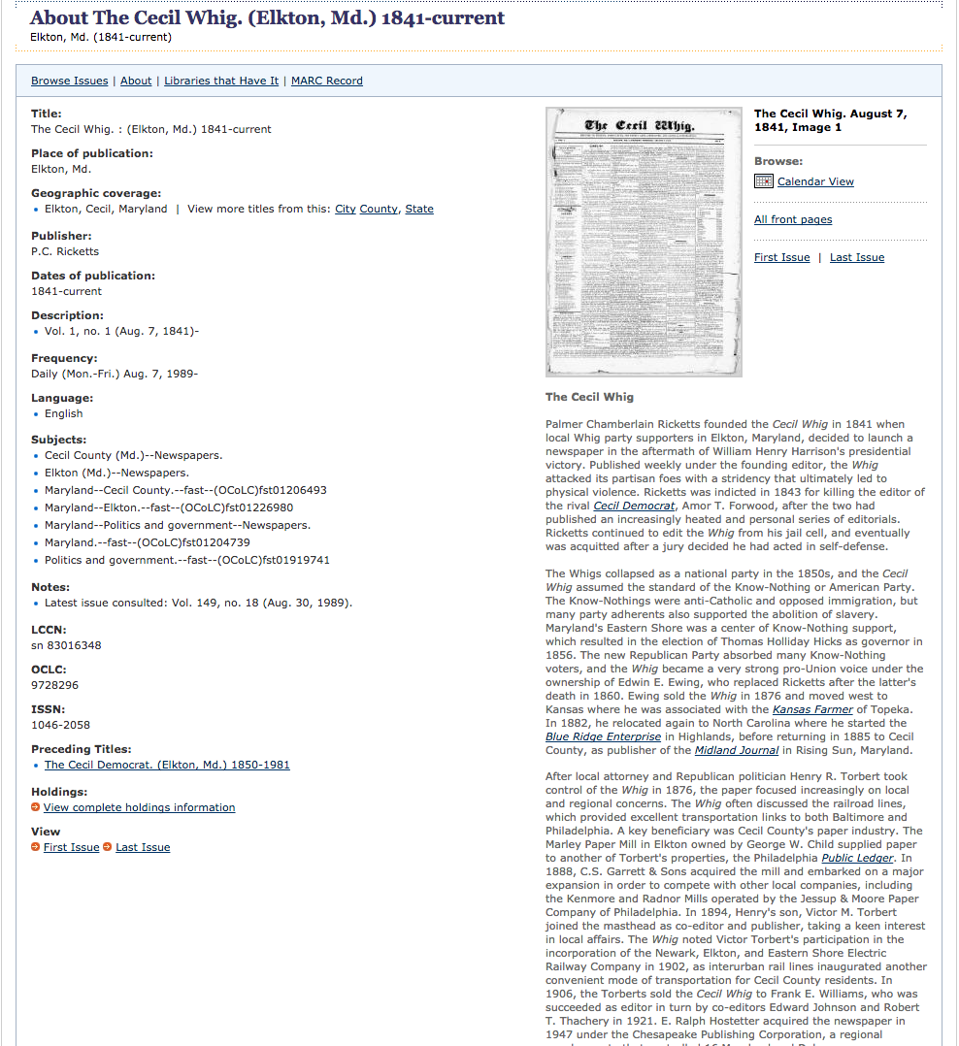
Cecil Whig (Essay)

Slide 7
Grant 1 and 2 Updates
Title | Publication Location | Years Digitized
The Aegis & Intelligencer | Bel Air | 1864-1922
American Republican and Baltimore Daily Clipper | Baltimore | 1844-1846
Baltimore Commercial Journal, and Lyford's Price-Current | Baltimore | 1847-1849
Baltimore Daily Commercial | Baltimore | 1865-1866
Catoctin Clarion | Mechanicsville | 1871-1922
Cecil Whig | Elkton | 1841-1922
Civilian & Telegraph | Cumberland | 1859-1865
The Daily Banner | Cambridge | 1902-1922
The Daily Exchange | Baltimore | 1858-1861
Democratic Advocate | Westminster | 1865-1922
Der Deutsche Correspondent | Baltimore | 1858-1918
Maryland Free Press | Hagerstown | 1862-1868
The Pilot / The Pilot and Transcript | Baltimore | 1840-1841
Port Tobacco Times, and Charles County Advertiser | Port Tobacco | 1845-1898
Prince George’s Enquirer and Southern Maryland Advertiser | Upper Marlboro | 1882-1922
Saint Mary's Gazette / Saint Mary’s Beacon | Leonardtown | 1845-1922

Slide 8
NDNP Conference Updates
9/14/2016
Data Challenge Award Projects
Purpose: A contest to challenge members of the public to produce creative web-based projects using data pulled from Chronicling America, the digital repository of historic U.S. newspapers.
Examples of Data Challenge Winners:
America’s Public Bible http://americaspublicbible.org/
USNewsMap.com http://usnewsmap.com/

Slide 9
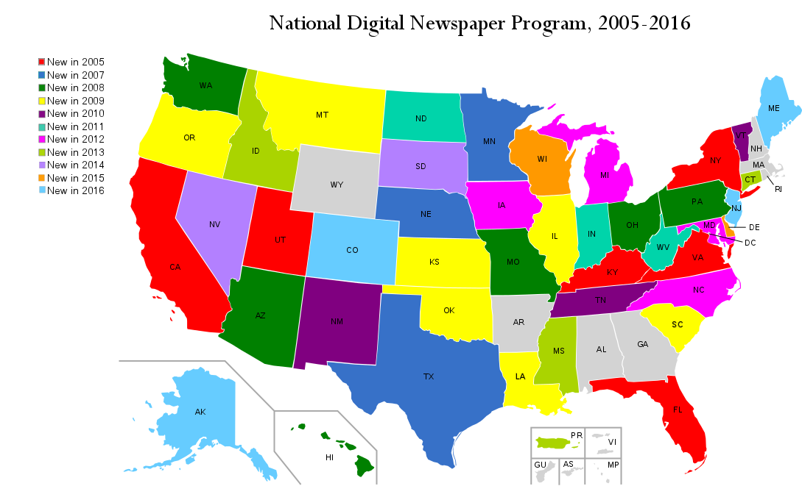
NDNP Conference Updates

Slide 10
NDNP Conference Updates
9/15/2016
Multilingual content (ChronAm software dev)
Copyright expansion and research (changes in cooperative agreements)
K-12 outreach
CT: http://ctdigitalnewspaperproject.org/resources/, presented at state council for Social Studies conference
OH: http://www.ohiohistoryhost.org/ohiomemory/resources, Teaching American History grants, activities, state level History Day award, Humanities Council Education Partnerships and Outreach
Projects beyond NDNP
Portal to Texas History: https://texashistory.unt.edu/, state challenge grants
Virginia Memory: http://www.virginiamemory.com/collections/virginia_newspapers; Virginia Untold: http://www.virginiamemory.com/collections/aan/, part of state budget

Slide 11
NDNP Conference Updates
9/16/2016
Twitter:
#ChronAm #ChroniclingAmerica
@paperbot, automated feed pulls headlines from 100 years ago today.
@TrendingHx, trending history bot
Outreach and marketing
TX: http://education.texashistory.unt.edu/
Teaching with the Library of Congress, https://blogs.loc.gov/teachers/
NDNP Extras: https://www.loc.gov/ndnp/extras/
State digital projects/exhibits: http://mthistoryrevealed.blogspot.com/2015/12/fiction-in-montanas-historic-newspapers.html
API and data toolkit
http://chroniclingamerica.loc.gov/about/api/
Harvest data, if know scripting, can run scripts on data

Slide 12
Grant 3 Updates
Project staff changes
Theme: Documenting Under-represented Communities
Copyright research
Goals:
Establish when or if the publisher registered the copyright between 1923 and 1963, and if so,
Establish whether the publisher renewed the copyright 28 years after initial publication. Since failure to renew is key, this is the most critical fact to establish.
Tools for copyright research
Online=Catalog of Copyright Entries (CCE) volumes for “Periodicals” https://archive.org/details/copyrightrecords&tab=collection
University of Pennsylvania’s “First Copyright Renewals for Periodicals” site: http://onlinebooks.library.upenn.edu/cce/firstperiod.html
Copyright Office Database 1978-Present: Renewals for original publication dates of 1950-1963 http://cocatalog.loc.gov/cgi-bin/Pwebrecon.cgi?DB=local&PAGE=First

Slide 13
Titles Selected
Title | Publication Location | Years
The Baltimore County Union | Towsontown | 1865-1909
Catoctin Clarion | Mechanicstown | 1923
The Citizen | Frederick | 1895-1922
Czas Baltimorski | Baltimore | 1940-1941
Democratic Messenger | Snow Hill | 1881-1922
Evening Capital and Maryland Gazette | Annapolis | 1884-1922
Frostburg Mining Journal | Frostburg | 1871-1917
The Frostburg Forum | Frostburg | 1897-19??
The Frostburg Gleaner | Frostburg | 1899-19??
The Frostburg Herald | Frostburg | 1903-19??
The Frostburg News | Frostburg | 1897-18??
The Frostburg Spirit | Frostburg | 1913-1915
Greenbelt Cooperator | Greenbelt | 1937-1943
Maryland Independent | Port Tobacco | 1874-1934
The Midland Journal | Rising Sun | 1885-1946
Voice of Labor | Cumberland | 1938-1942
Worcester Democrat and Ledger-Enterprise | Pocomoke City | 1921-1953

Slide 14
Maryland Newspaper Repository
Purpose
Development progress
Partners
Content
Student Newspapers
Questions:
What digitized student newspapers already are available?
Would colleges/universities be interested in making their student newspapers available on a Maryland statewide newspaper repository site?
Example: McDaniel University
http://lib.hoover.mcdaniel.edu/archives/newspapers

Slide 15
BREAK

Slide 16
Future Opportunities Brainstorming

Slide 17
Grant 4 Theme and Research
Under-represented communities
Investigation and research
Cultural, ethnic minorities (esp. Af. Am.)
LGBT
Trade newspapers
Alternate newspapers
Paper v. microfilm costs

Slide 18
Educational Programming Brainstorming
National History Day local coordinators
K-12 lesson plans
Higher Ed opportunities (university, community college classroom use)
Internship via UMD CP College of Ed or ARHU
NEH education grants (teachers institute)
Lesson plans? Who is best placed to lead and organize?
Genealogical research tutorials
Digital humanities/scholarly use

Slide 19
Outreach/Promotion Brainstorming
Wikipedia Edit-a-thons
Social Media campaigns
Partnering with Digital Maryland, MD Genealogical Soc., Bmore Historic Unconference
Promotion at local insts. (bookmarks)—Can Advisory Board/content partners help?
Maryland History and Culture Collaborative: Managers of collections with significant MD content
Maryland Genealogical Society (tutorial)
What meetings are current in your regions?

Slide 20
Funding for Secondary Projects
IMLS state regrant program
NEH Summer Programs in the Humanities for School and College Educators
NEH Data Challenge Awards
Maryland Humanities Council (educational)
Newspaper publishers
Private foundations/sources

Slide 21
NEH Data Challenge Awards
MD Insts. are using data from MD or other states
Show NDNP data challenge projects
Higher ed
K-12
Other campus interest? External interest?
Future of Information Alliance?
MITH Fellows?

Slide 22
Future Events
Maryland’s Historic Newspapers – June 2017 Symposium. Goucher College, Towson.
Organizers: Linda Tompkins-Baldwin (Digital Maryland); Doug McElrath (UM)
Goal: Bring together stakeholders and potential participants in project that expands beyond the scope of Chronicling America.
Tentative Agenda:
Keynote – Call for Institutional Cooperation. Tim Baker (State Archives)
Status Report on NDNP/Chronicling America Project in Maryland (UM Project Staff)
Roll-Out of Maryland Newspaper Repository (UM Project Staff)
How to Participate – Copyright Research. Michael Johnson (Enoch Pratt Library)
How to Participate – Standards for Metadata & Formats. Corey Lewis (State Archives)
Why Newspapers Matter – Exciting Projects & Potential Research Opportunities. Doug McElrath (UM)

