Slide 1

Revisiting Subdivisions for Databases
CONSER Cataloging Forum, November 5, 2024
Beth Guay, M.L.S. (she/her)
Continuing Resources Librarian
University of Maryland Libraries

Slide 2

Today’s presentation:
Revisit the April 2021 CONSER Webinar session, “Problematic subdivisions that need attention and clarity: --Databases”
PCC catalog records for online databases:
Findings
Discovery services and linked data systems in context.
Recommendations.
Notes:
(Link to the agenda of the April 2021 CONSER Webinar - https://www.loc.gov/aba/pcc/conser/meetings/documents/Ad-Hoc-2021-04-23.pdf)

Slide 3
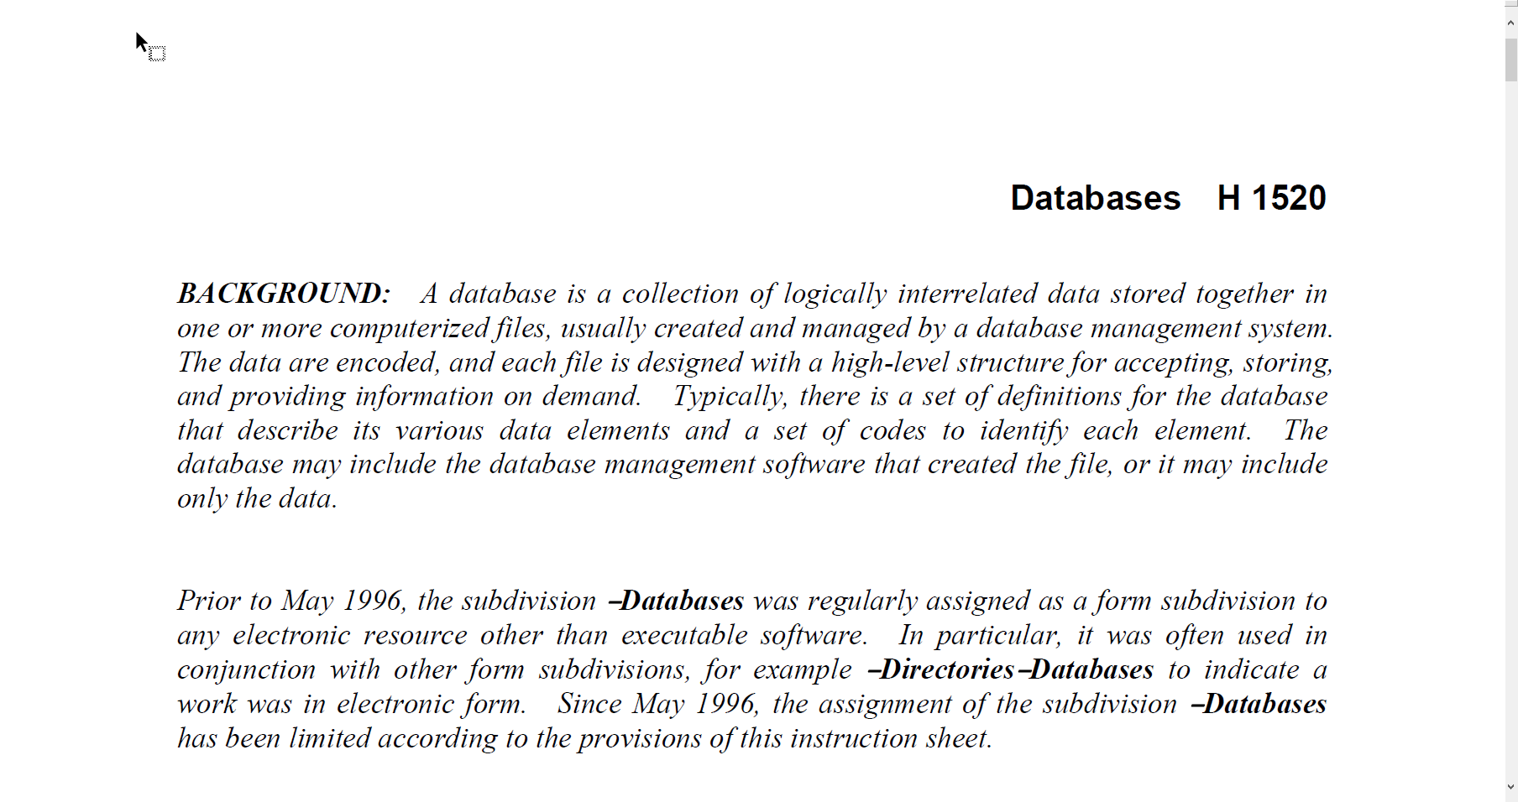
SHM H 1520 –Databases, and related cataloging documents:
SHM H 1095, Free floating Subdivisions, Databases;
LCGFT, Databases;
CCM Module 35: Integrating Resources, IR7.10 008: Type of continuing resource;
MARC 21 Bibliographic 008 – Continuing Resources, 008/21 – Type of continuing resource.
Notes:
In my 2021 presentation, I asserted that guidance in SHM H 1520 –Databases, in conjunction with the cataloging documents listed here, collectively caused cataloger confusion, leading to inconsistent practice. My ongoing experience cataloging databases led me to want to revisit the issues and the questions I asked in 2021. I believe that most of the “problems” with this June 2013 instruction sheet have been resolved. I believe that catalogers are no longer agonizing over the H 1520 definition of databases shown here.
As a reminder, CCM Module 35: Integrating Resources is also Appendix A to the BIBCO Participants’ Manual, and BIBCO and CONSER members share in the responsibility of authenticating integrating resource records.

Slide 4

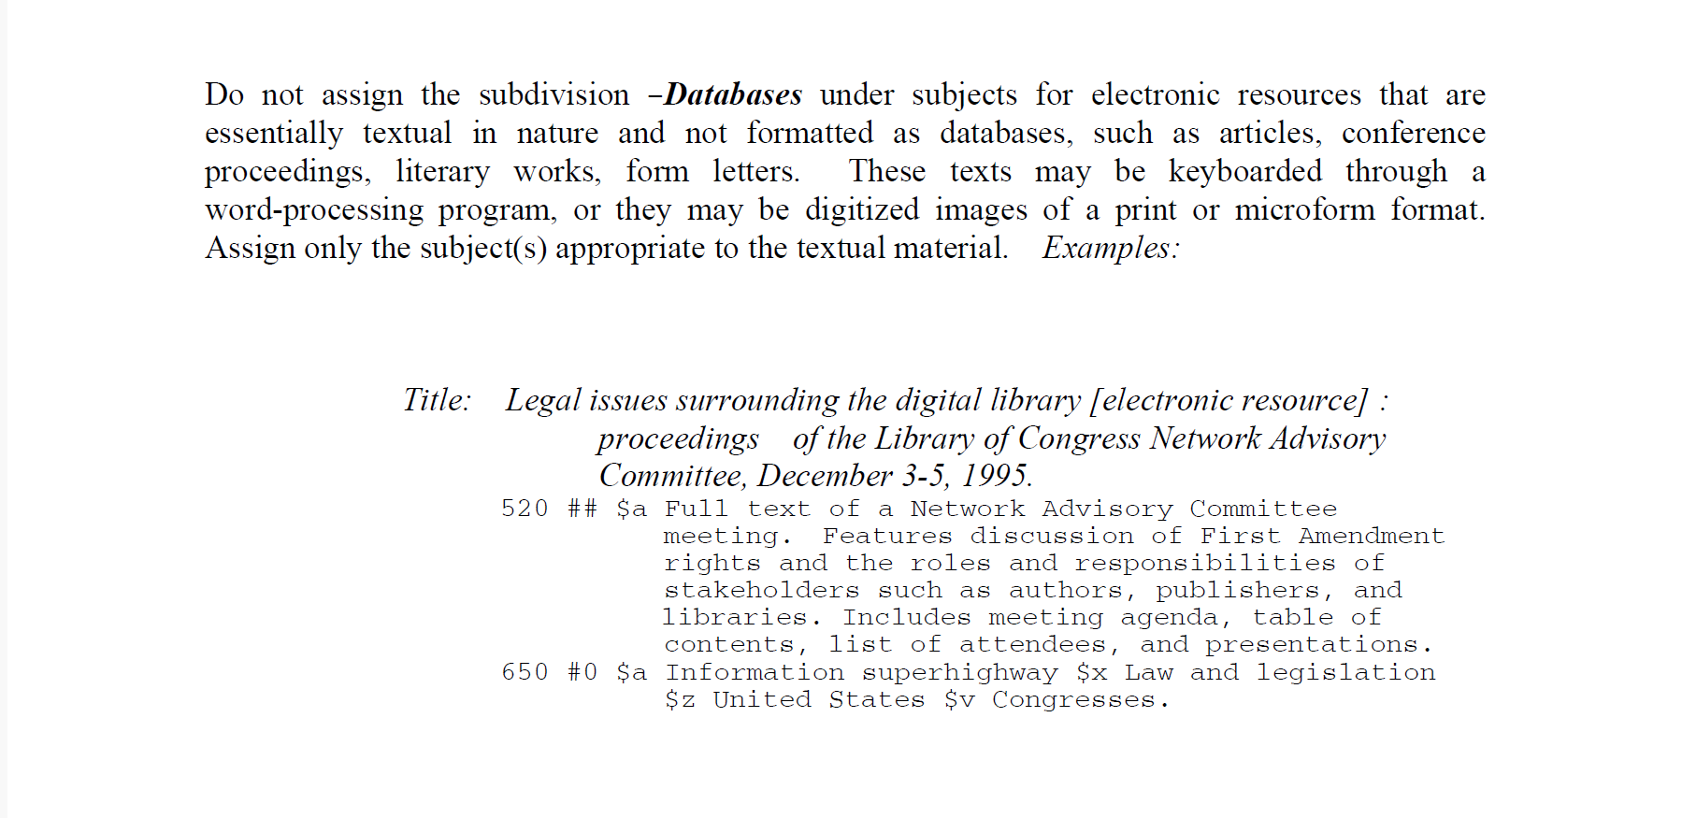
Notes:
I believe catalogers understand that H 1520’s guidance and examples reflect a period in which the cataloging of databases was somewhat new. For example, catalogers know that the subdivision --Databases should not be assigned to electronic versions of individual articles, individual conference proceedings, individual literary works, and so on.

Slide 5
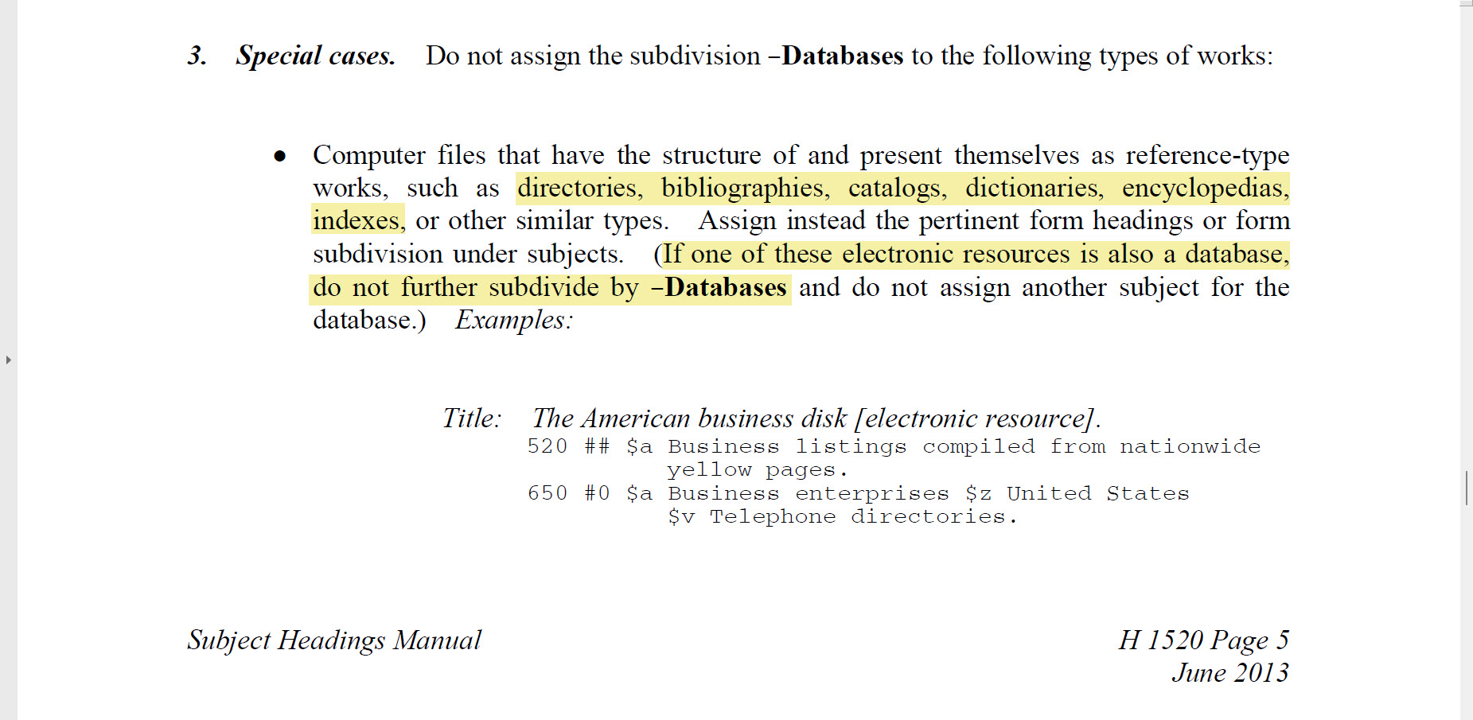
Notes:
I believe that H 1520 instruction 3, Special cases, remains a problem.
Its examples of subdivisions that “have the structure of and present themselves as reference-type works” is helpful. The guidance regarding these reference type works is clear: if one of them is also a database, do not further subdivide by –Databases.

Slide 6
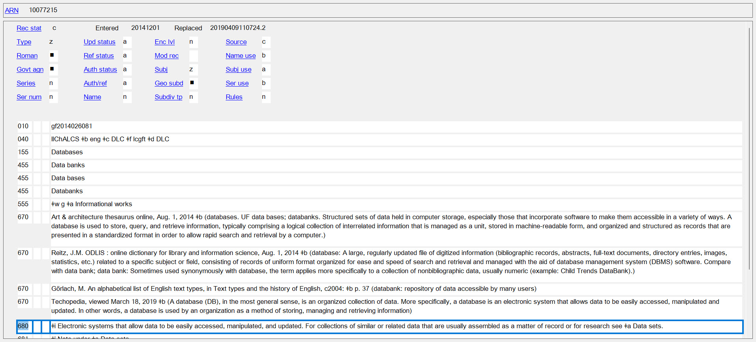
Source: OCLC Connexion Client viewed October 28, 2024
Notes:
The 2013 instruction sheet was followed by publication of the LCGFT “Databases” in 2014. This was revised in 2019 with new information and a short, straightforward definition in the public note field (680). In 2021 I asked if it was “generally understood that use of this LCGFT is not appropriate in records for resources described by subject headings that are not to be further subdivided by the free-floating form subdivision $v Databases, but are instead to be assigned ‘reference type’ form subdivisions?”

Slide 7
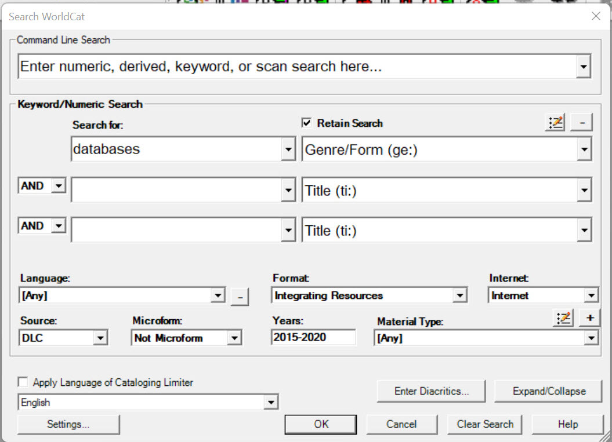
Current findings on PCC records for online databases -- Methodology.
Notes:
On September 26, 2024, I performed 2 WorldCat searches using Connexion Client criteria shown here, thus limiting the result sets to records having form/genre terms “Databases”; Material type Integrating Resource; Material type Internet (records with field 856 and second indicator <blank>, 0, or 1); Not Microform; Source DLC, and Year(s) of publication, in this first search, 2015-2020. In the second search I changed only the date ranges to 2021-2024.
Source: https://help.oclc.org/Metadata_Services/Connexion/Connexion_client/Reference/Quick_reference_Searching_WorldCat_in_Connexion_client

Slide 8

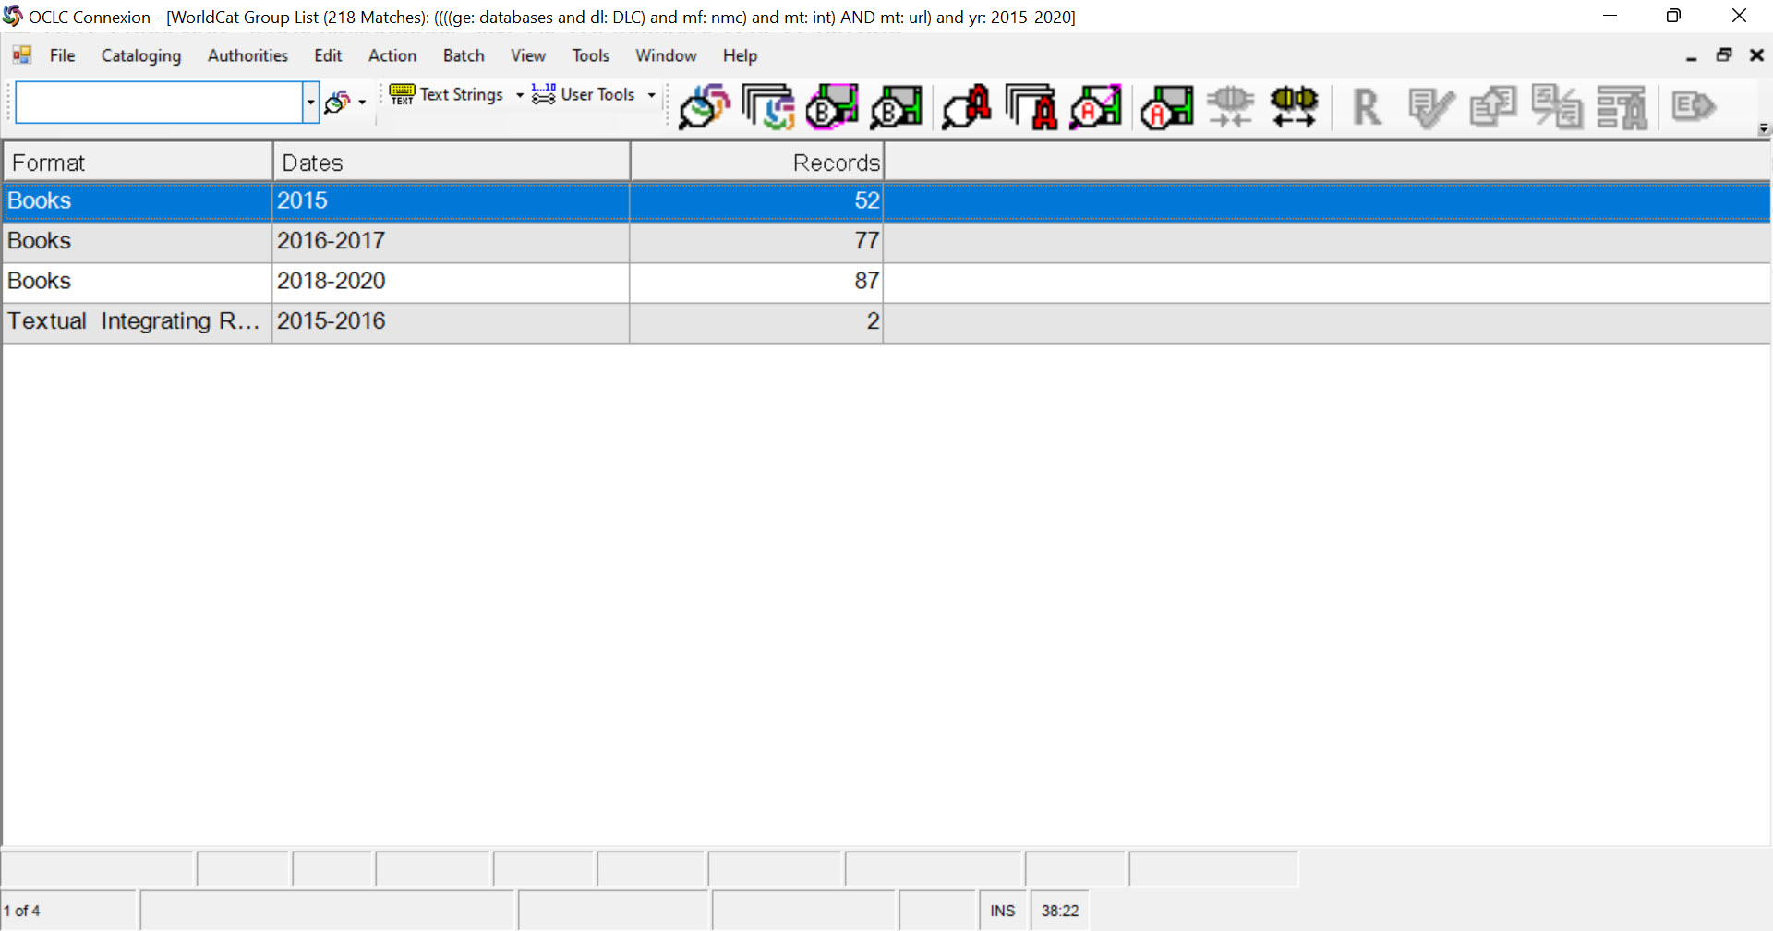
Notes:
The first search resulted in 218 records which I exported to a spreadsheet. I sorted the records on the DLC/PCC column and deleted the DLC records, leaving 148 records, which I batch searched in Connexion, then manually deleted the records that had “Replaced” dates after 2020. This left me with 39 PCC records which I exported to a file, and using MarcEdit, converted to Binary MARC/MARC text files. The second search using publication years 2021-2024 resulted in a set of 55 records. After sorting on the DLC/PCC column and deleting the DLC records, 22 PCC records remained.
https://www.oclc.org/bibformats/en/fixedfield/replaced.htmlhttps://www.oclc.org/bibformats/en/fixedfield/replaced.html

Slide 9
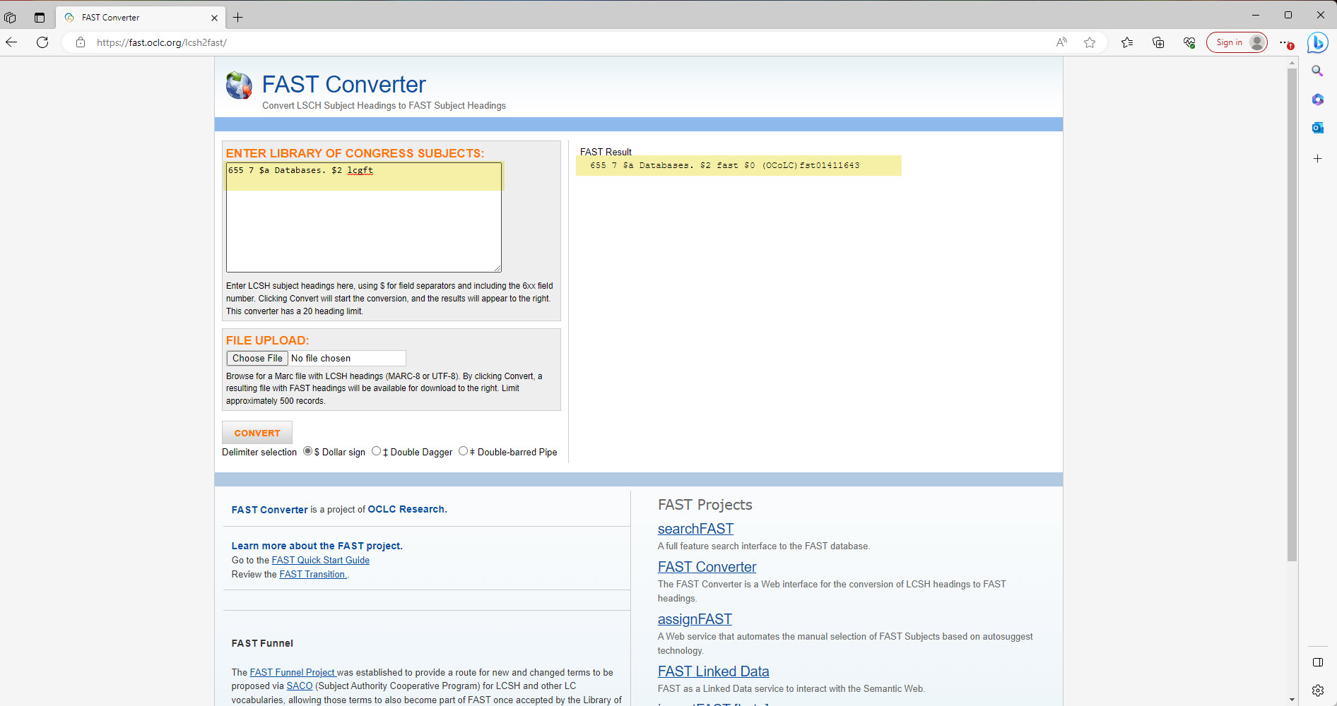
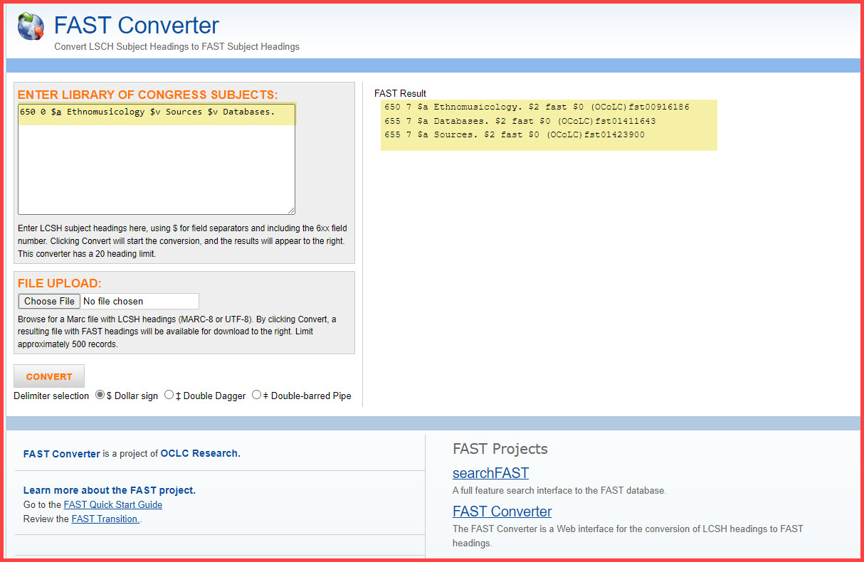
Notes:
Before looking at specific findings, I want to point out that FAST headings positively impacted my search result sets. OCLC‘s FAQ webpage tells us that, “OCLC adds FAST headings to WorldCat bibliographic records that have no current FAST headings based on the Library of Congress subject headings present in the record. After the initial loading of FAST headings to the record, the FAST headings are treated as an independent subject heading set ...”
(https://help.oclc.org/WorldCat/Metadata_Quality/Frequently_asked_questions/Bibliographic_records/If_a_change_is_made_to_a_Library_of_Congress_subject_heading_in_a_bibliographic_record_will_the_corresponding_FAST_heading_be_corrected_via_automation?sl=en, viewed October 30, 2024) ,

Slide 10
PCC 2015-2020: 39 records
PCC 2021-2024: 22 records
4 records contained one or more of the following subdivision strings:
$v Statistics $v Databases. ;
$v Periodicals $v Databases. ;
$v Sources $v Databases.;
$v Excerpts $v Databases. ;
$v Newspapers $v Databases.
Records having form subdivisions not further subdivided:
$v Sources. (3 records)
$v Statistics. (1 record)
$v Periodicals. (1 record)
$v Catalogs. (8 records)
2 records contained one or both of the following subdivision strings:
$v Archives $v Databases. ;
$v Sources $v Databases.;
Records having form subdivisions not further subdivided:
$v Sources. (4 records)
$v Archives. (1 record)
$v Newspapers. (1 record)
$v Bibliography. (1 record)
Notes:
Full disclosure: My institution’s symbol, UMC, is in 3 of the records in the 2015-2020 set, and 7 of the records from the 2021-2024 set.
While a small sample size can’t assure qualitative research outcomes, we can observe across these 2 record sets that confusion may remain regarding the “Special cases,” instruction. For example, are resources that are “Sources,” “Computer files that have the structure of and present themselves as reference-type works” that should not be “further subdivided by –Databases” or are they not?
We can also observe that given the terms listed in the instruction sheet and highlighted here, catalogers may be following the “Special cases” guidance and not further subdividing these by –Databases.

Slide 11
PCC 2015-2020: 39 records
PCC 2021-2024: 22 records
$v Catalogs. (8 records)
All 8 contain other LCSH with the form subdivision, Databases, e.g.,
650 $a Bronzes, Ancient $z Middle East $v Databases.
All contain the FAST heading, Databases; none contain the LCGFT.
$v Bibliography. (1 record)
Does not contain other LCSH subdivided by Databases.
Does not contain the FAST heading, Databases, but contains the LCGFT.
Notes:
In 2021 I also asked, “Is it generally understood” that use of the LCGFT, Databases, is not appropriate in records for resources described by subject headings that are not to be further subdivided by the free-floating form subdivision $v Databases. I don’t think that the records retrieved can answer this question. However, I believe that whether the form/genre headings in these cases are FAST or LCGFT, they will enhance catalog record “discoverability.”

Slide 12
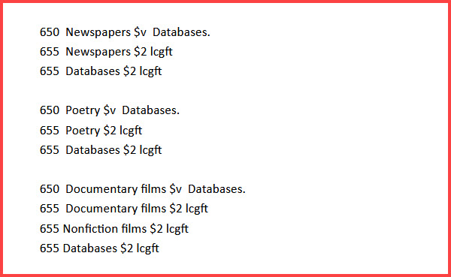
PCC 2021-2024
If you have what librarians call a "database" of something that has its own genre/form, what is the best practice? When should you use the form subdivision? Do you use the LCGFT term for Databases, for the genre/form of the content or both? -- Kelley McGrath
OCLC #1376377504
650 African Americans $x History $y19th century $v Sources.
...
650 African American newspapers $v Databases.
...
655 Databases.$2fast
655 Sources.$2fast
655 Databases.$2lcgft
Notes:
The OCLC record (given on the left side of the screen), from the 2021-2024 set contains: headings subdivided by Sources; a heading subdivided by Databases; FAST headings for both; but the LCGFT for Databases only.
The right side of the screen shows Kelley McGrath’s September 23, 2024 question on the PCC listserv. “If you have what librarians call a "database" of something that has its own genre/form, what is the best practice? When should you use the form subdivision? Do you use the LCGFT term for Databases, for the genre/form of the content or both?” Kelley’s examples are shown in the box beneath her questions. Adam Schiff responded, “it would be appropriate to include both LCGFT terms.”

Slide 13
PCC 2015-2020: 39 records
PCC 2021-2024: 22 records
LCGFT, Databases (5 records → 12.82 %))
FAST, Databases (39, although 3 are formatted incorrectly, “655 $a Databases $2 fast” with no full stop preceding $2)
LCGFT Databases (16 records → 72.72 %)
FAST Databases (19 records)
Notes:
I did find for records retrieved based on my search criteria, that catalogers added the LCGFT, Databases, at a greater rate after 2020 than they did before 2021. New question: Do faceted subject headings inform discovery services?

Slide 14
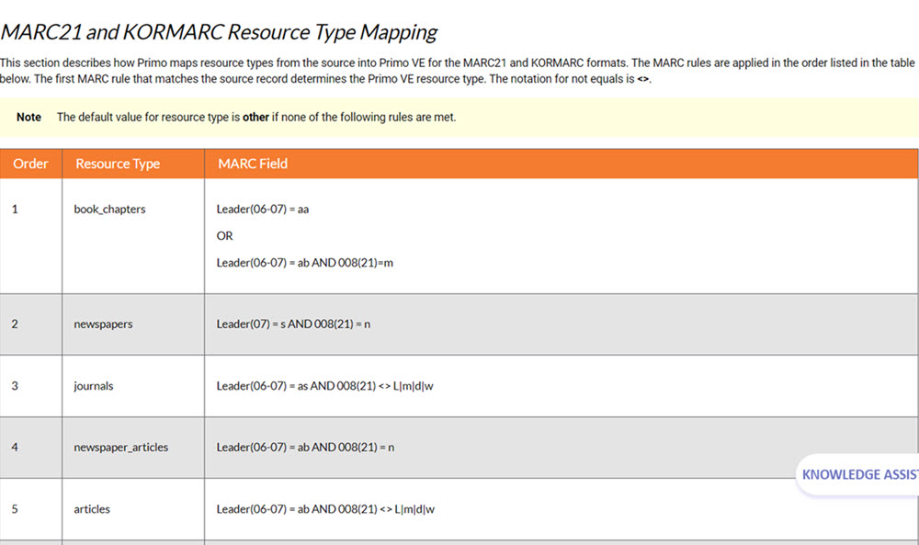
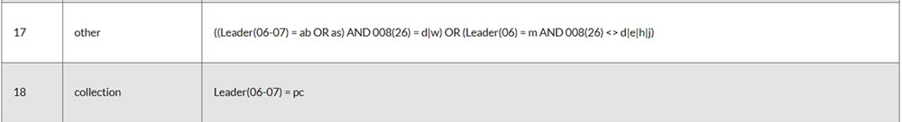
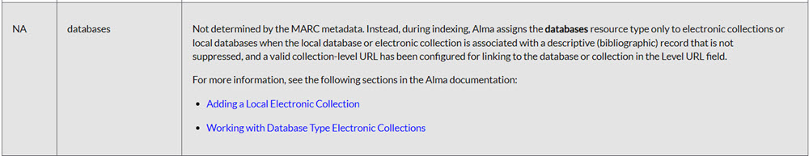
Notes:
Faceted subject headings apparently do not inform the UMD Libraries’ new Discovery Service’s “Resource Type” facets.
These snippets of images from this Ex Libris’ web page tell us how Ex Libris maps resource types from MARC records to Primo VE. It tells us that the MARC rules are applied in the order listed in the table and that the first MARC rule that matches the source record determines the Primo VE resource type.
It tells us that catalog records with Type of record = Computer file AND Type of computer file not equal to: document, bibliographic data, sound, or online system or service, are placed in the facet category “other”!
That’s unless Ex Libris decides the resources described are “electronic collections” or a library’s added local databases with a “valid collection-level URL … configured for linking to the database or collection in the Level URL field.” In other words, MARC record metadata has much to do with preventing and nothing to do with granting access to the exclusive Ex Libris “databases” facet.
Source:
https://knowledge.exlibrisgroup.com/Primo/Product_Documentation/020Primo_VE/Primo_VE_(English)/120Other_Configurations/Mapping_to_the_Display%2C_Facets%2C_and_Search_Sections_in_the_Primo_VE_Record#, viewed November 1, 2024

Slide 15
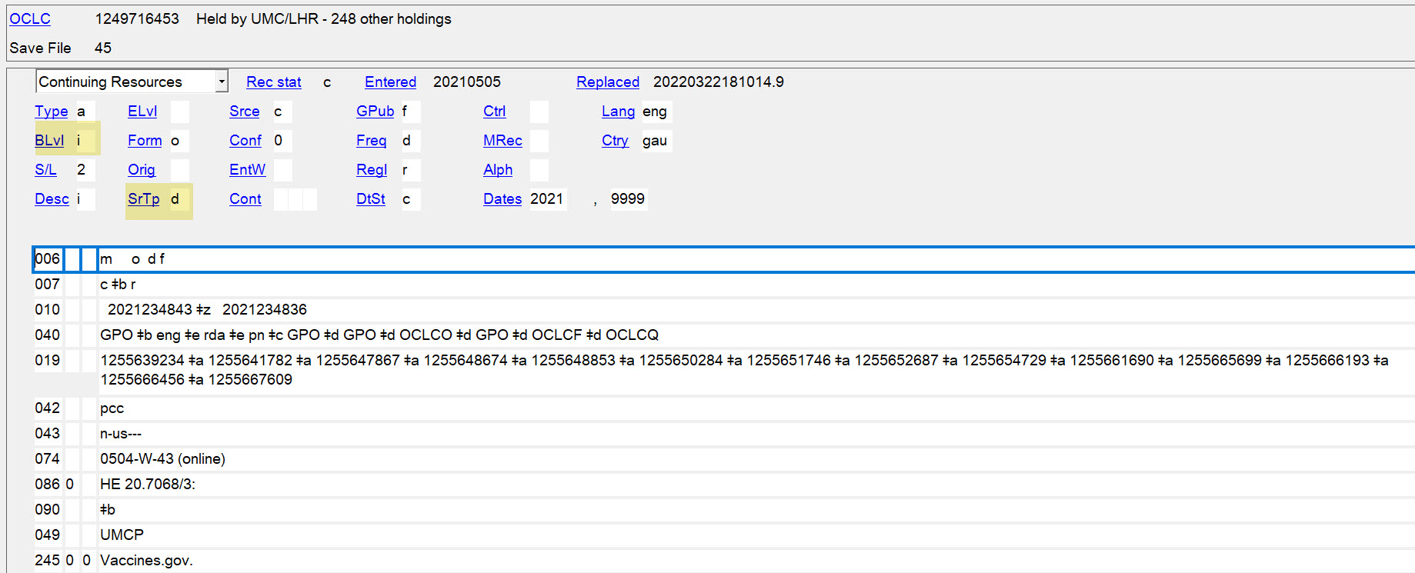
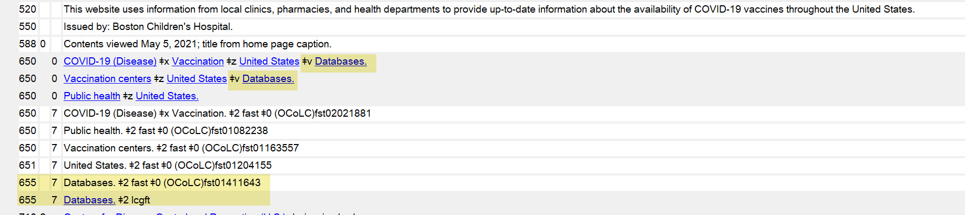
Notes:
This OCLC record from the 2021-2024 set identifies the resource as a database. The word “Covid” is seen several times in this view of the record; the word “vaccines” is seen in the 520 field.

Slide 16
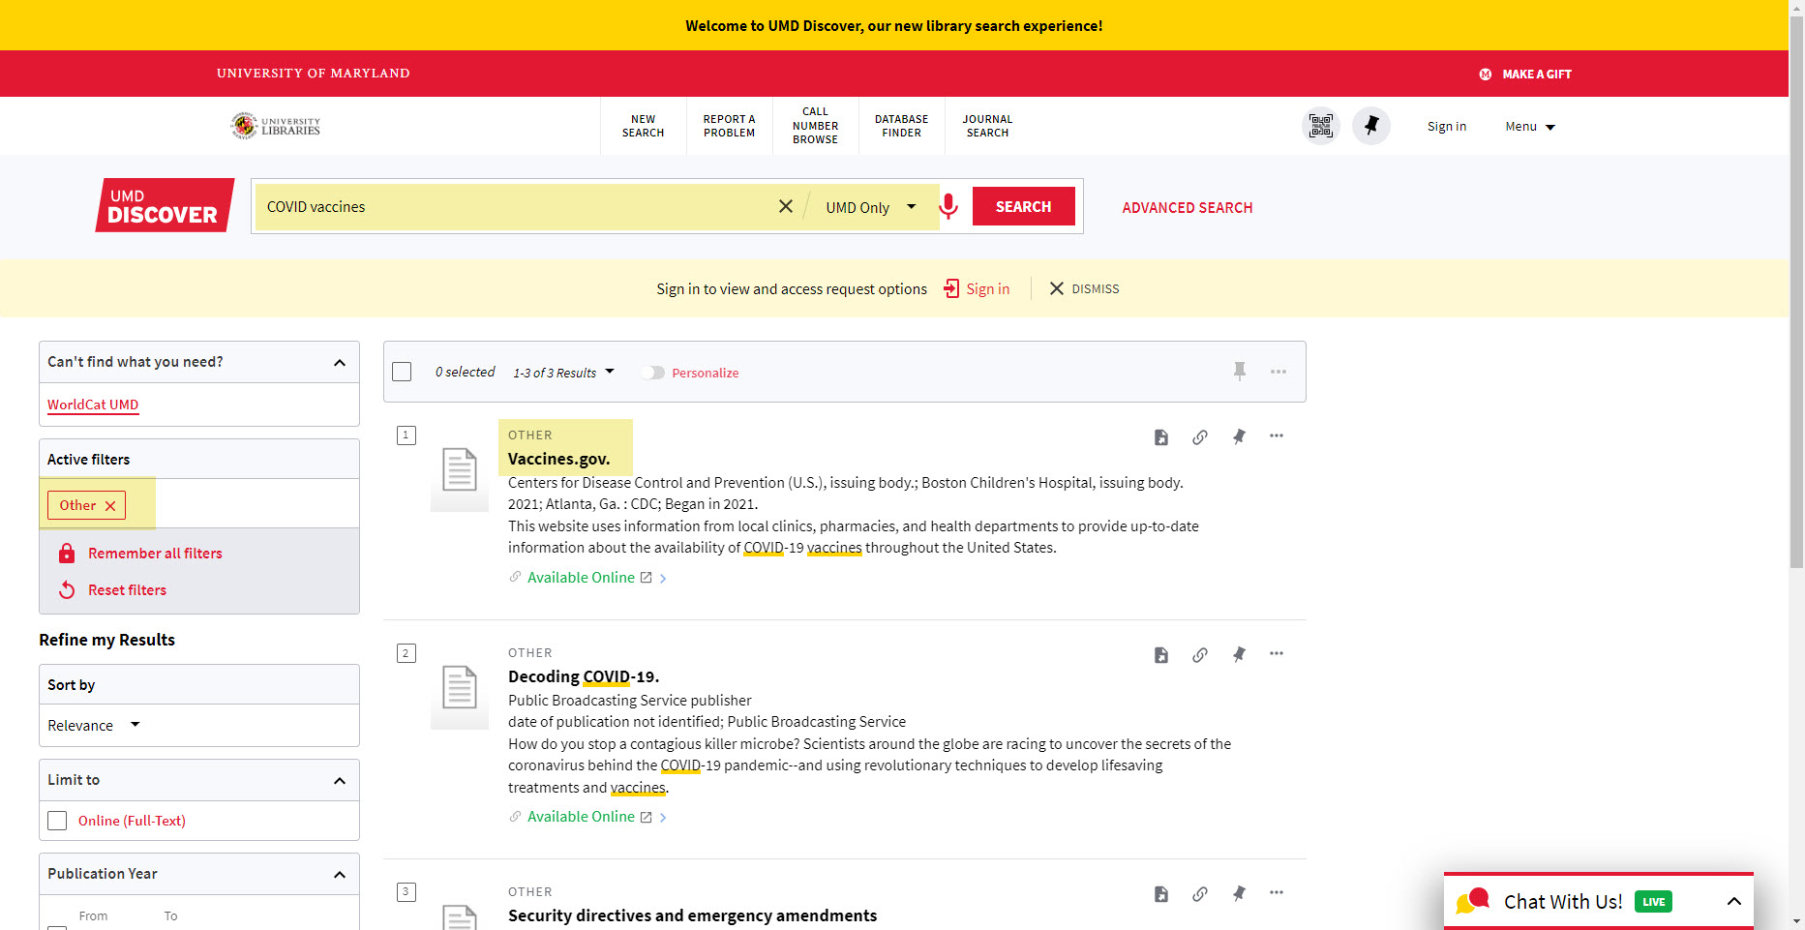
Notes:
In my local Discovery Service, acting as a library user, I entered “COVID vaccines” in the single search box, limiting to my campus only. Based on Ex Libris’ mapping, Vaccines.gov showed up in the “Resource type” “Other”. I doubt that anyone knows what “other” is, and that among numerous results and resource types, that anyone would want to explore the category “other.”

Slide 17
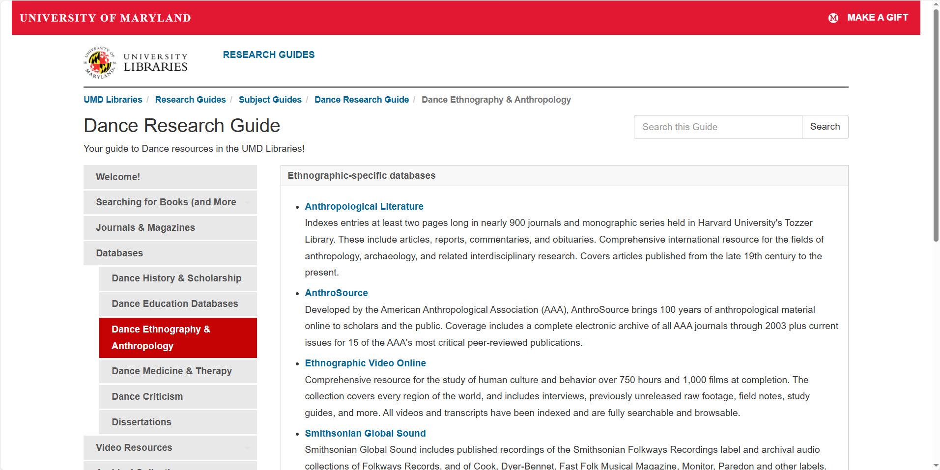
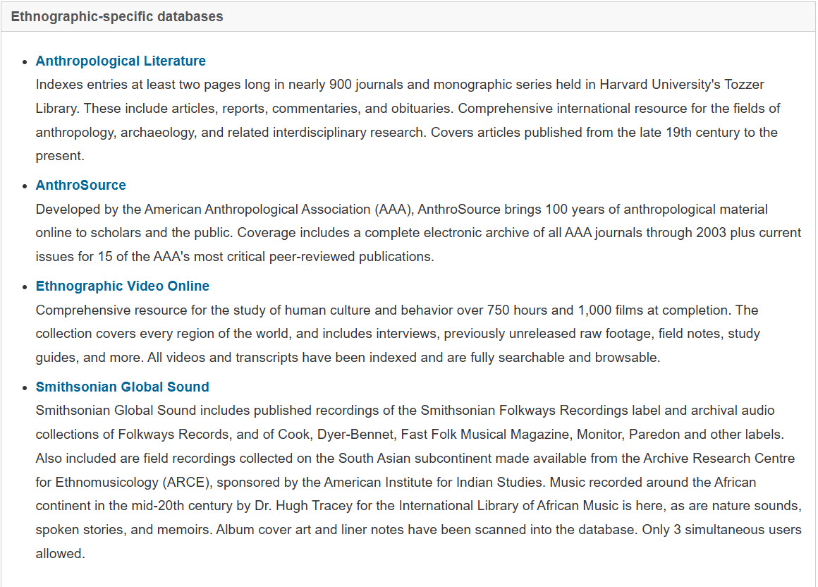
Source: https://lib.guides.umd.edu/dance, viewed October 25, 2024. Attribution: Drew Barker
Notes:
We know that thanks to library instruction, library users know what databases are. We also know that catalog records offer discovery not matched by library “database finders,” or A to Z lists of databases that live outside of the discovery service.

Slide 18
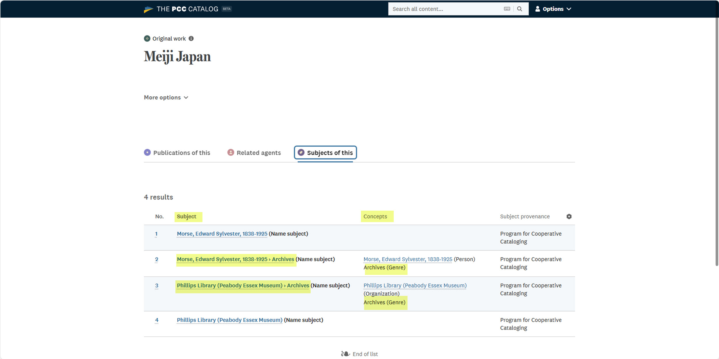
OCLC #227911132
Notes:
In late 2022, I participated in the Share-VDE PCC Data Pool review process. I looked at this record in Share-VDE a “discovery environment based on linked data.” (Sources: Share-VDE. About Share VDE, https://www.svde.org/about/about-share-vde, viewed November 5, 2024; Meiji Japan (https://pcc-lod.org/opuses/1501658944924606, viewed October 31, 2024).
I believe that removal of the form/genre subdivisions from the subject strings would add semantic clarity about the subject of the work. I agree with Nancy Cooey and Amy Phillips, who wrote in their 2023 article, Library of Congress Subject Headings: A Post-Coordinated Future, “With the advent of LCGFT, it is no longer necessary to append $v at the end of a pre-coordinated subject string to indicate the form of a resource.”

Slide 19
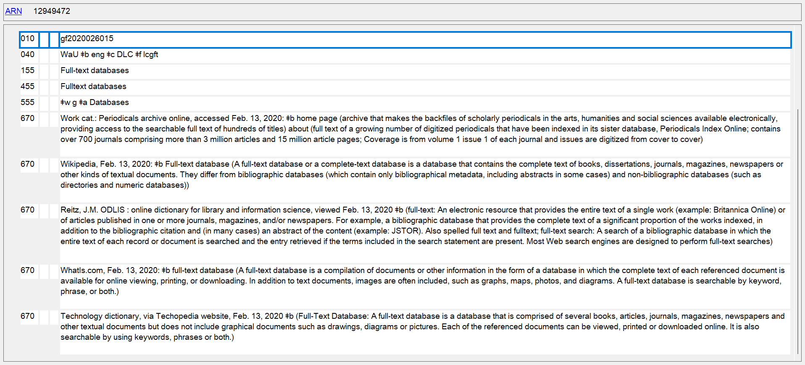
Notes:
New question: what will be the impact of the “new” LCGFT, “Full-text databases” on cataloging practice and resource discovery? We should talk about this question.

Slide 20
Recommendations
Harmonize H 1520 and the LCGFT, Databases.
Remove H 1520’s outdated instructions and examples (relegate to historical notes?).
Revise H 1520 instruction 3, Special cases.
If you haven’t done so already, review your discovery service’s faceted mappings for resource types. Work with your discovery librarian if the mappings should and can be modified. Complain to your discovery service provider if they can not.
Continue preparing for a post-coordinated future.
Notes:
Here are some recommendations.

Slide 21
Selected Bibliography
ALA Core Subject Analysis Committee. Retrospective Implementation of Library of Congress Faceted Vocabularies, (Version 1.1) https://hdl.handle.net/11213/22720
Breeding, Marshall. ALA TechSource 2014, no. 1, chap. 1, “Discovery Product Functionality” https://journals.ala.org/index.php/ltr/issue/view/195
Cooey, Nancy, and Amy Phillips. "Library of Congress Subject Headings: A Post-Coordinated Future." Cataloging & Classification Quarterly 61, no. 5-6 (2023): 491-505.
McGrath, Kelley, and Lesley Lowery. "Getting More out of MARC with Primo: Strategies for Display, Search and Faceting." Code4Lib Journal 41 (2018).
McGrath, Kelley. "Musings on Faceted Search, Metadata, and Library Discovery Interfaces." Cataloging & Classification Quarterly 61, no. 5-6 (2023): 439-490.
Nelson, David, and Linda Turney. "What’s in a word?: Rethinking facet headings in a discovery service." Information Technology and Libraries 34, no. 2 (2015): 76-91.
O'Neill, Edward T., and Lois Mai Chan. "FAST (Faceted Application of Subject Terminology): a simplified vocabulary based on the Library of Congress Subject Headings." IFLA journal 29, no. 4 (2003): 336-342.
Share-VDE. About Share-VDE. https://www.svde.org/about/about-share-vde, viewed November 5, 2024
Smith-Yoshimura, Karen. “Faceted vocabularies.” Hanging Together: the OCLC Research Blog, October 31, 2016. https://hangingtogether.org/faceted-vocabularies/
Notes:
Thank you.
(I’ll be depositing this PowerPoint presentation, along with the 2 MARC files I examined, in my institutional repository.)

