Slide 1
The Interactive Experience: Exploring Technologies for Creating Touchscreen Exhibits
Deena Sasser, Curator/Historian
Virginia Museum of Transportation, Roanoke, VA
MARAC Fall Conference 2015

Slide 2

Who are we?
The Virginia Museum of Transportation’s mission is to advance all modes of transportation across the Commonwealth, to celebrate and preserve the hard work and ingenuity of generations past, and to inspire current and future generations to value this industry which is essential to Virginia’s history, culture, and economic growth.

Slide 3
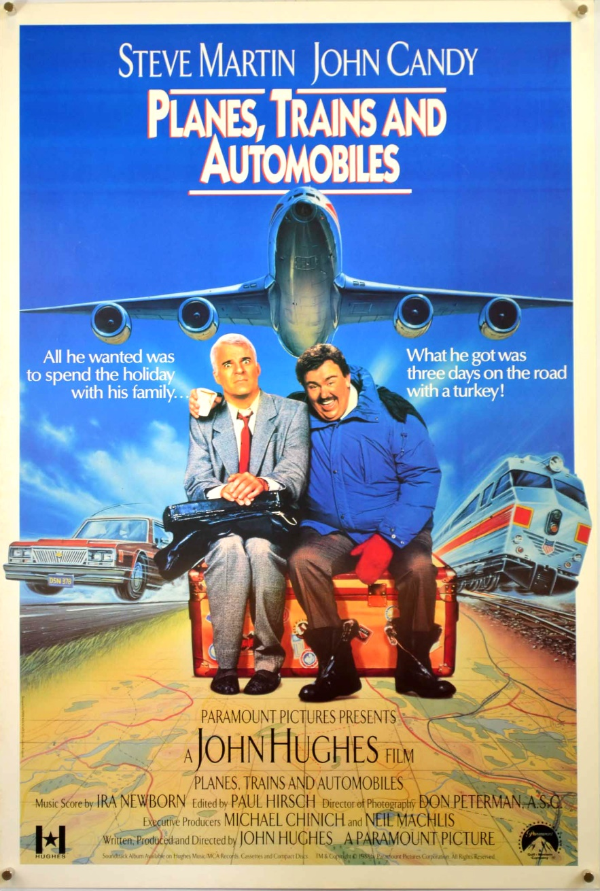
To put it simply…

Slide 4

What is a Touchscreen Exhibit?

Slide 5
What is a touchscreen exhibit?
Touchscreens are a way to allow your museum guests to directly interact with their environment. They bring an added level of information that is not reliant on artifacts or interpreters.

Slide 6





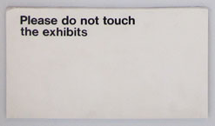

Slide 7

What’s so great about touchscreens??
Touch screen exhibits allow your visitors to do the one thing they want to do more than any other:

Slide 8
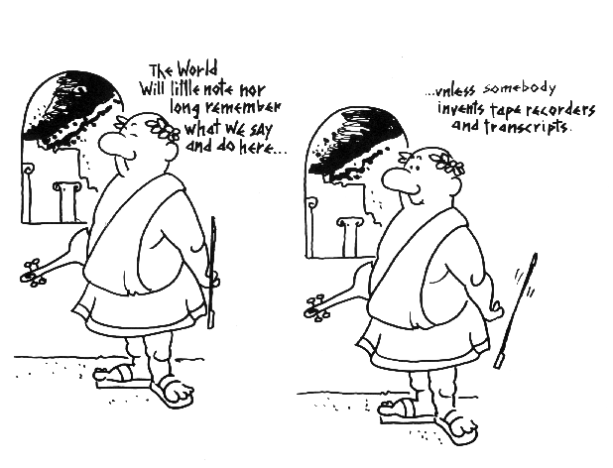
Oral History on Display

Slide 9

Who is your target audience
Consider your demographics
  Touchscreens appeal to younger generations, but not exclusively
    Smartphones, tablets, e-readers—the people who use these will use your kiosk
SOLs?
  Does the content meet or assist Standards of Learning requirements
    Work with your Education department

Slide 10
What do you want them to learn?
What kinds of stories do you tell?
  How do you determine what parts of stories will be most appealing to your audience?
    8 seconds to grab someone’s attention
  Additional content
    Where do you host it?
      Transcriptions
      Further video
    How do you make people aware of additional content?

Slide 11
Where do you put the kiosks?
Are they exhibit specific?
  Are they better suited at a certain place within that exhibit? First thing? Last?
Are they visible?
  Can patrons find them or are they in a remote area?
Accessibility
  Mobility
  Visual impairment
  Hearing impairment

Slide 12
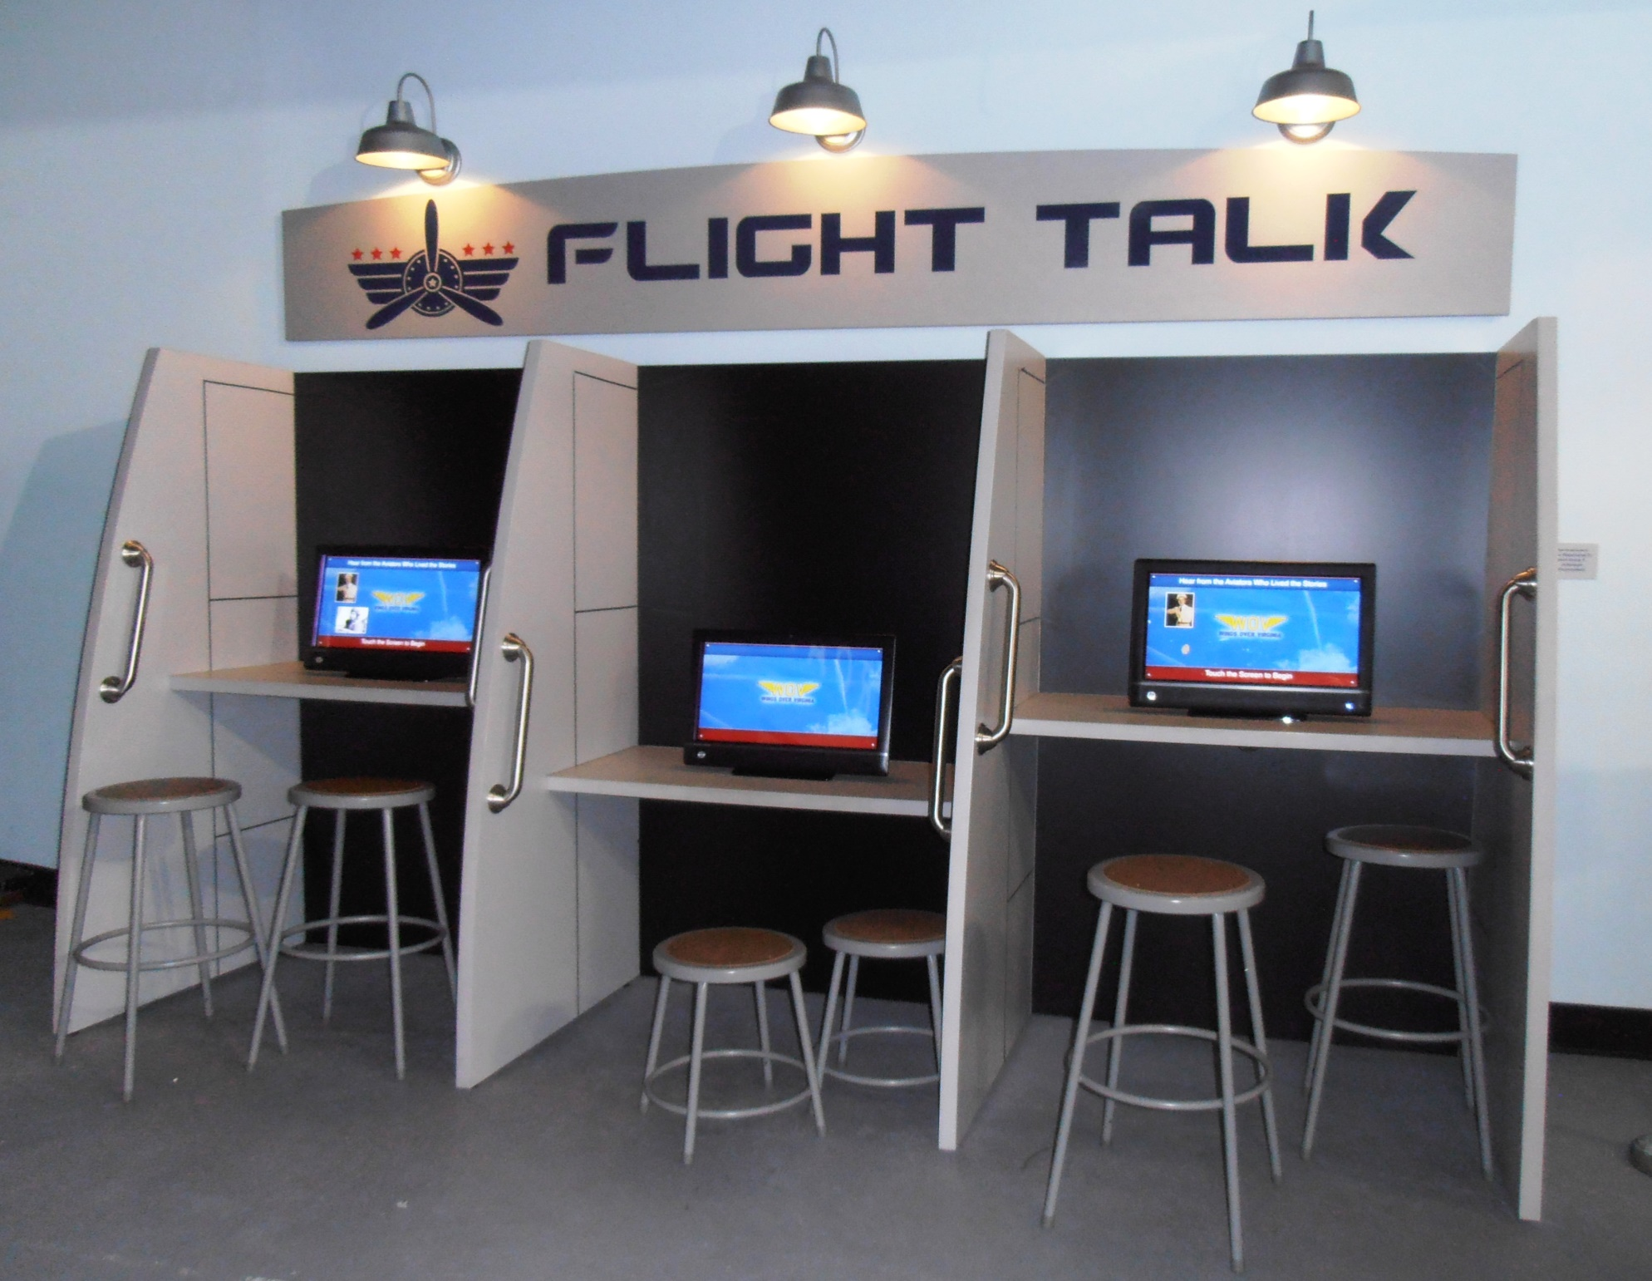
Individual lighting for each terminal
Grab bars for assistance in sitting and standing at kiosks.
Lower level seating to accommodate wheelchairs and small children.

Slide 13

Aesthetics
Consider having your kiosk(s) add to the exhibit rather than looking different
  Tailor appearance to fit with the overall design

Slide 14
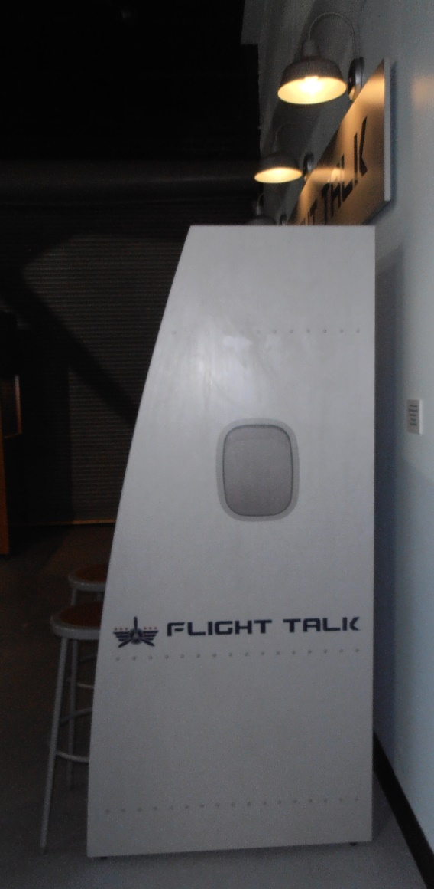
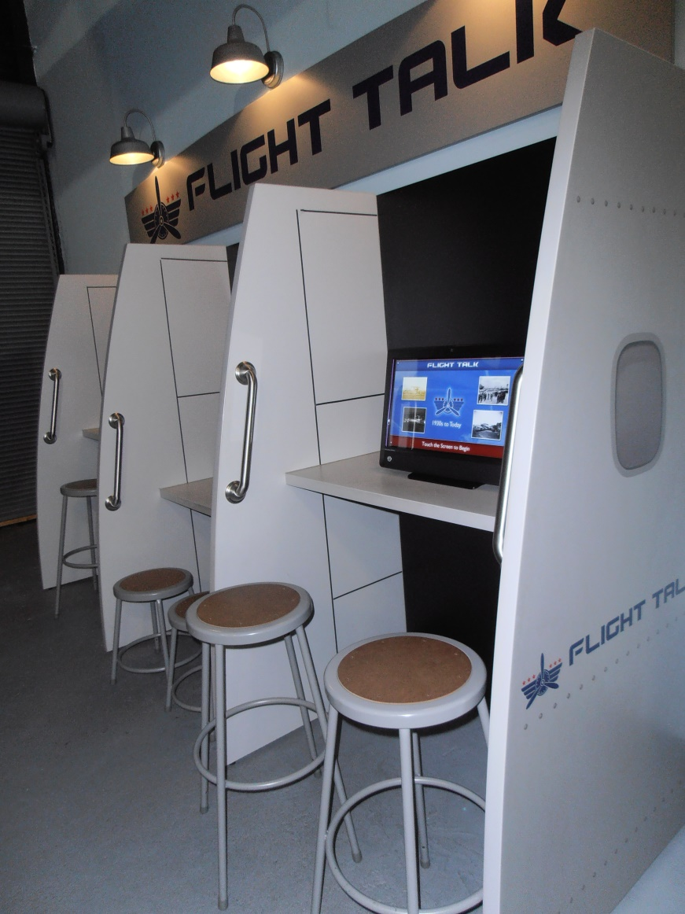
Aviation theme

Slide 15
Why should you incorporate interactive kiosks into your exhibit?
How does this enhance visitor experience?
  Is it just a “thing” to have or does it enrich the exhibit?
  Oral history tells a human story
    Individual experience rather than the overview of a period of history
    Visual storytelling
Does it educate?
  Is your audience learning or merely distracted by moving pictures
Does it tie directly to the primary exhibit or is it the primary exhibit?

Slide 16

Technology
Interactive Design and Development, Inc. (IDD) is a full-service IT firm specializing in custom software solutions, web design, mobile apps, content management systems (CMS), media services, graphic design, and digital and print marketing.
  Based in Blacksburg
  Iddnet.com/kiosks-interactive

Slide 17
Statistical data
What are your visitors viewing?
  Also shows where there is a lack if you have empty categories
How long are they spending at a kiosk?
  Which stories are popular?
What days see the most traffic?
  School group days? Weekends?

Slide 18
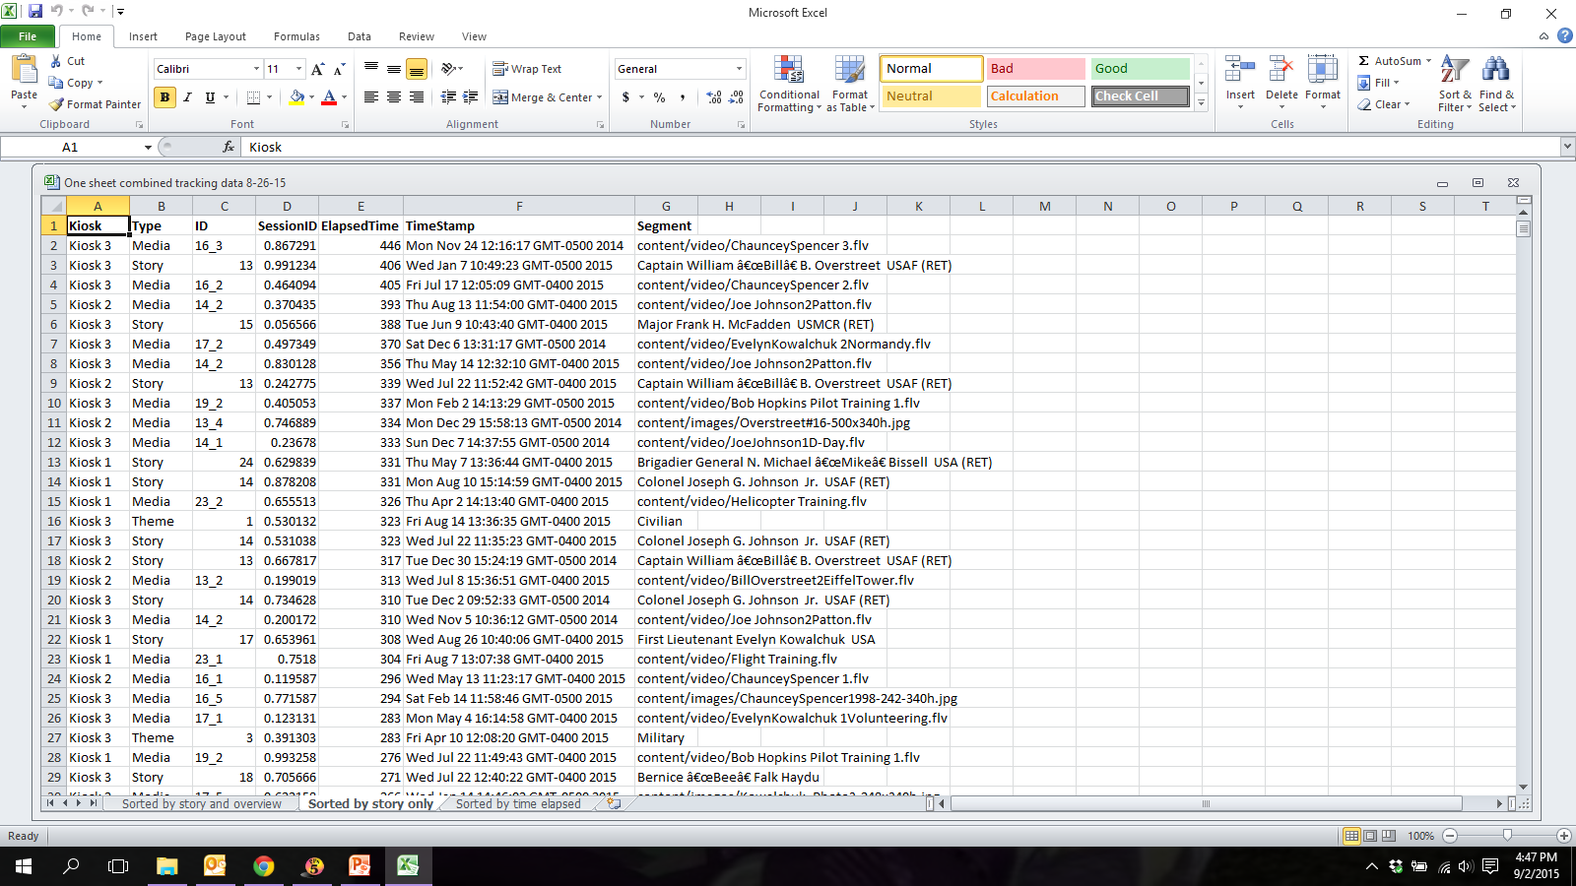

Slide 19
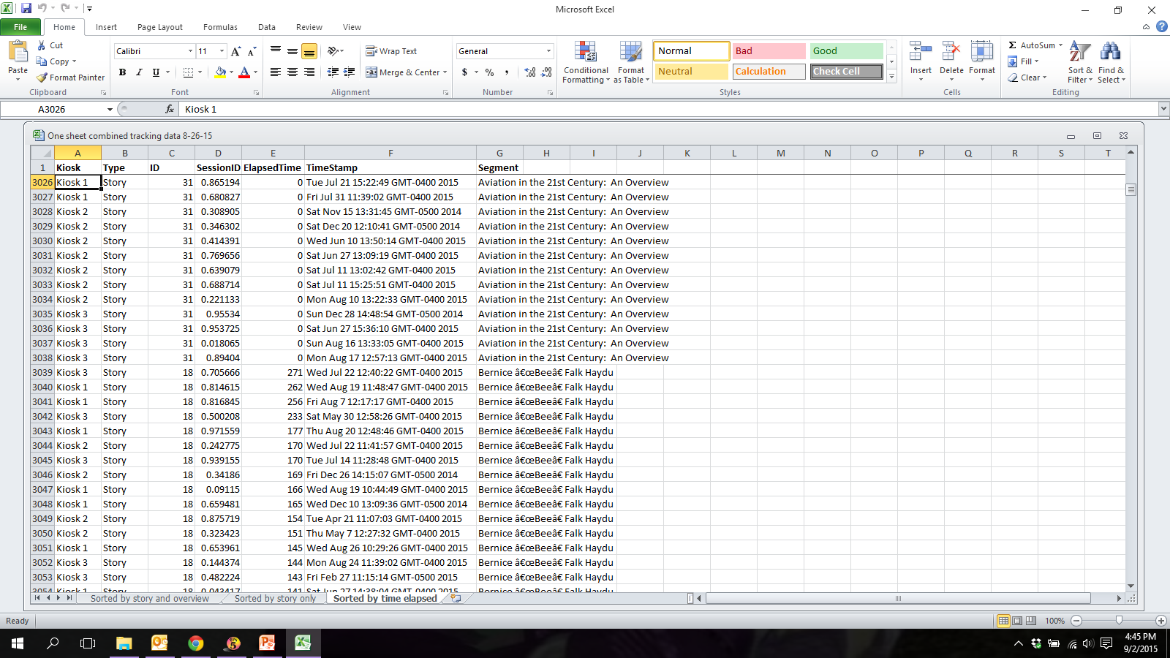

Slide 20
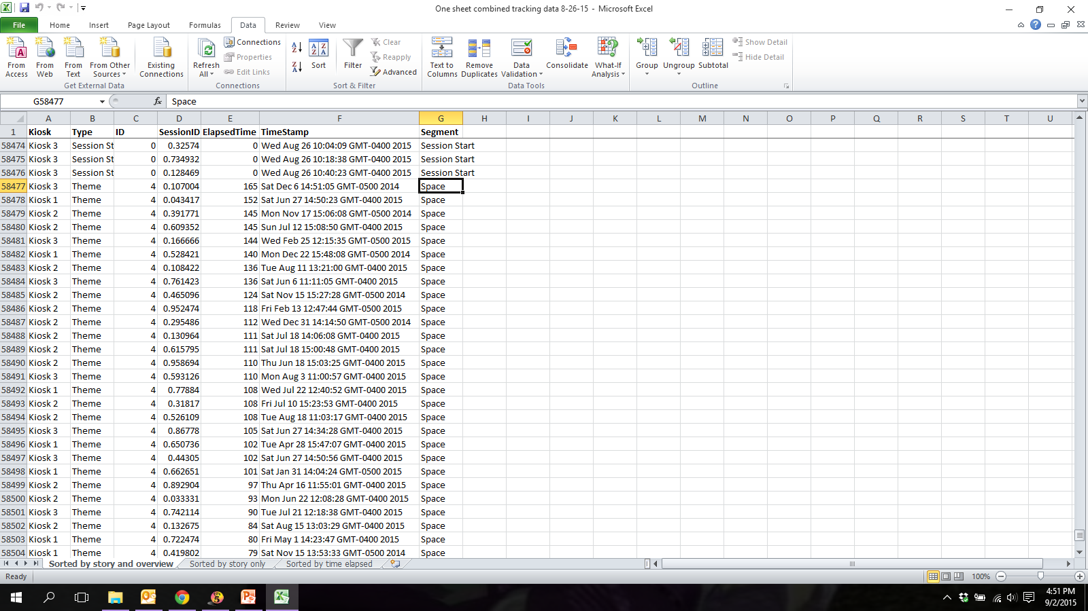

Slide 21
What does this data tell us?
Allows your fundraiser(s) to seek additional funding for stories
Helps your educator(s) tailor their lessons to be more inclusive of all stories

Slide 22
Longevity and security
How secure is your location?
  Mounting your kiosk screens for safety and security
  Restricting access
    Hidden quit
    Disabled ports
    Auto start/shut down
Updating software
Adding new stories

Slide 23
Does this work for your institution?
Considerations
  Cost
  Internal updating
    Someone designated to add/maintain content in order to draw visitors
  Traffic

Slide 24
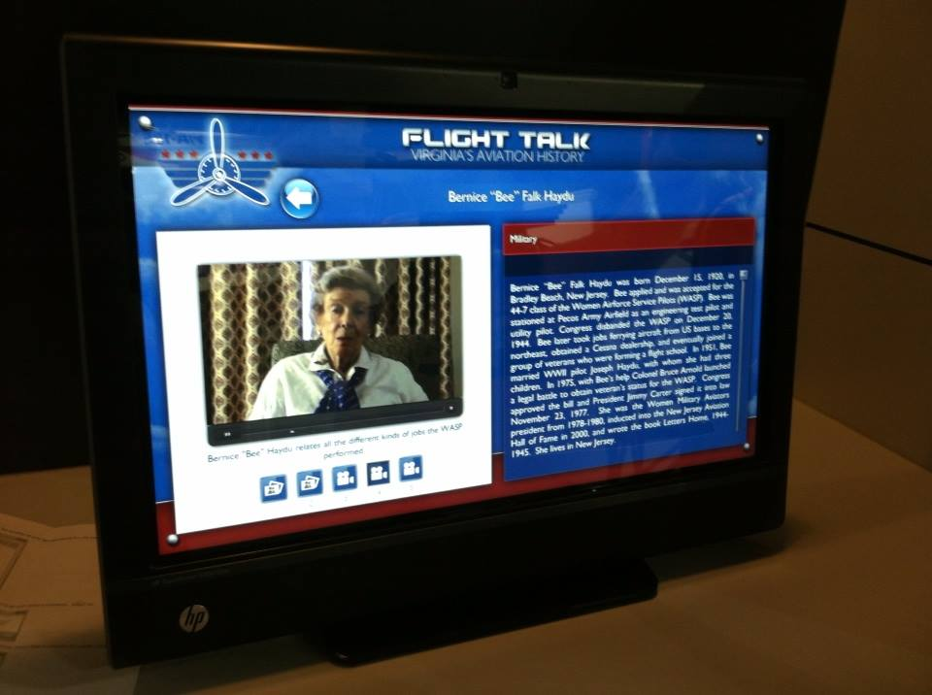

Slide 25

Cost factor
Varies from institution to institution
Dependent upon various factors
  Number of terminals
  Is the design new or from an existing one?
    We used the Department of Defense’s existing template
  Initial costs include hardware as well as programming
    Additional stories can be added for a fee
  New Cloud-based technology changing this template

Slide 26

Questions?

Slide 27


