Slide 1
The Alchemy of Tumblr Gold: Uses of Social Media at the Chemical Heritage Foundation
Megan Miller
Chemical Heritage Foundation
MARAC Newark Meeting
April 21, 2017
Notes:
Today I’m going to talk a bit about the Chemical Heritage Foundation’s social media presence, with a specific focus on the library’s use of Tumblr. But before I get to social media, I’m going to talk about context and institutional organization a bit. And because you’re all archivists you’re going to love it.

Slide 2
What is the Chemical Heritage Foundation?
“CHF is a library, a center for scholars, and a museum and an archives. We preserve, study, and interpret the history of chemistry, chemical engineering, and the life sciences. Our staff and fellows study the past in order to understand the present and inform the future.”
Notes:
To quote from the website, the Chemical Heritage Foundation “is a library, a center for scholars, and a museum and an archives. We preserve, study, and interpret the history of chemistry, chemical engineering, and the life sciences. Our staff and fellows study the past in order to understand the present and inform the future.”

Slide 3
Fascinating! Tell me more about CHF.
Founded in 1982
Merged with the Life Sciences Foundation in 2015
In the process of rebranding
Recently expanded staff positions
Notes:
CHF has been around since 1982. In 2015, it merged with the Life Sciences Foundation. Rebranding, in conjunction with the merger, has been an ongoing project. CHF has also expanded recently and one of the new positions is that of Social Media Specialist. There has also been a lot of internal discussion about siloing and means of encouraging cross-departmental communication and collaboration.
So what we have is an organization serving many constituencies with multiple public-facing departments, all of which have their own particular identities, messages, and needs.

Slide 4
I take it by your presence on this panel that
CHF has a social media presence…?
Institutional accounts on various platforms
Recently hired Social Media Specialist
Efforts to coordinate messages, encourage outside engagement, and offer staff a platform to talk about their work
Notes:
The Social Media Specialist, Hillary Mohaupt, has to balance different institutional needs. Sometimes that means soliciting content from different departments, or repurposing material that has already been used. Sometimes that means sending out promotional tweets that won’t do anything to help her engagement numbers, creating Facebook ads for an upcoming event, or writing a promotional plan for CHF’s Museum Dance-Off video. There’s some effort to take advantage of events and themes--the release of the film Hidden Figures, recurring “Museum Mondays,” or highlighting one scientific instrument per month.
Takeovers of CHF social media accounts have proven popular. They allow people across the organization to talk about what they do. Fellows have discussed their research, museum staff highlighted some pieces in our art collection, conference center staff wrote about the facilities and hospitality, the Editor in Chief of Distillations wrote about the process of putting together the magazine, and last summer I wrote about digitization.
Last week was National Library Week and librarians took over CHF’s Twitter and Instagram. The Twitter takeover highlighted CHF’s World War I materials. The Instagram takeover was mostly rare books and advertisements--subject matter that is visually appealing, generally popular, and not quite as heavy as chemical warfare.

Slide 5
So does CHF really have a top-down social media strategy?
Social media use predates the Specialist position
Departmental support for social media use
Moral, scheduling, and financial support
Current and former staff and fellows encouraged to use their personal accounts
Notes:
Social media use predates the Social Media Specialist position and newly drafted requirements for creating new institutional accounts on social media platforms. Top-down messaging does happen, but a chunk of social media outreach has developed organically out of existing relationships and internal departmental efforts.
CHF encourages staff to use social media to talk about work and share collection materials. Since we have a rotating crop of Research Fellows, we also have a number of former fellows who are now at different institutions but still engaged with CHF.

Slide 6
So what is this Tumblr of which you speak?
Highlights “intriguing, quirky and often fun images and items in our books and archives”
Collaborative work of librarians and archivists: Elsa Atson, Ashley Augustyniak, Hillary S. Kativa, Andrew Mangravite, Megan Miller, Sarah Newhouse, Victoria Orzechowski, and Andrea Tomlinson
Notes:
I want to spend most of my time talking about the library Tumblr and its workflow. Othmeralia highlights “intriguing, quirky and often fun images and items in our books and archives.” It’s a collaborative effort. Tumblr-worthy materials are selected by a team of librarians and archivists.

Slide 7
Othmeralia by the numbers
First post January 22, 2014
2,480 posts
14,461 followers
Includes 289 institutions
Average of 20-30 notes per post
Most popular post: 6,302 notes
Following 1,891 Tumblrs
Liked 63,786 posts
Notes:
Othmeralia has been around since January 2014 and we’ve posted almost 2,500 times. We have over 14,000 followers and nearly 300 of them are other institutions. The most popular post has collected more than 6,000 notes.

Slide 8
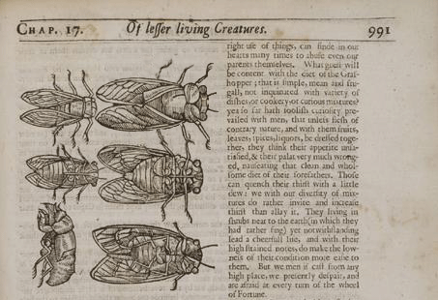
What is “Tumblr gold”? Bugs, apparently.
Yep, Tumblr
loves bugs.
(Also mint and
the periodic table,
our second and
third most liked
posts.)
Notes:
And here’s the image that appears in our most popular post.

Slide 9
What happens behind the scenes?
Monthly status/planning meetings
Trello board to manage the workflow
Drafts and queue visible to all
Statistics tracked with Tumblr’s dashboard and Google Analytics
Coordination with other CHF social media efforts
Promotion, outreach, professional presentations
Victoria does a lot
No, really, that part is super important
Notes:
I think it’s important to emphasize that social media work is work. It takes time and effort to do well. Having departmental buy-in facilitates the consistency and quality of the product. So does having a Victoria, who took on a project management role.
How does Othmeralia work? Generally, there are two posts per day: original content at 10:00 AM, and a reblog at 10:00 PM. By reblogging material from other accounts, we reduce our own work, but also make other institutions’ work more visible and enmesh ourselves a little more in the Tumblr community. Othmeralia posts are not attributed and we all share one log-in. All the drafts are together, so everyone can see what’s being worked on. Posts that aren’t specific to a certain day can sit there for days or months before being dropped into the publication queue.
For over a year, we’ve been using Trello to maintain a calendar, highlighting days that are historically significant, birthdays of influential chemists, or whimsical “fun days,” like International Bagpipe Day or National Ice Cream Day. This lets us assign posts to individuals, create cards for potential posts, and suggest collection materials appropriate to a certain theme. It also makes it easy to see what’s been done in previous years, so we have handy material to reblog and can avoid retreading the same ground.

Slide 10
What are the posts like?
Breezy, informal tone
Links to library resources
Hashtags
#othmeralia goes on everything
#reblog, #beckmanlegacy, #advertising, #OTD, #scientificillustration frequently appear
Some are whimsical, silly, one-use
Posts usually highlight an image
Quality and type of photograph varies
Notes:
The voice of the posts tends to be a bit breezy--they’re supposed to be fun and accessible. (I tend to be a bit wordy, and my posts are rarely more than a couple paragraphs.) There’s no editing for style or attempt at uniformity. We have a short list of consistently used hashtags and beyond that we try to pick things that may be useful search or classification terms. We don’t typically include full citation information, but will link to a volume, journal, or collection in the Othmer Library’s catalog. When our digital repository launches, we’ll be able to link to that resource as well.

Slide 11
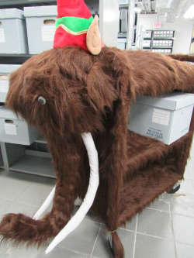
DSLR images
This photograph of Oloch, our woolly mammoth library cart, is very relevant because Victoria took it using a Canon PowerShot SXS530 HS.
Notes:
The type and quality of the images varies. Some photos were taken with a DSLR camera.

Slide 12
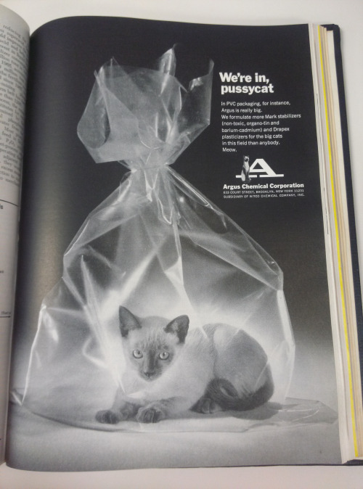
Smartphone images
Because the best camera is the one you have in your pocket.
(Don’t worry. Cats were an ongoing theme in Argus advertising. I’m sure they didn’t actually let a cat suffocate.)
Notes:
Some were taken with smartphones.

Slide 13
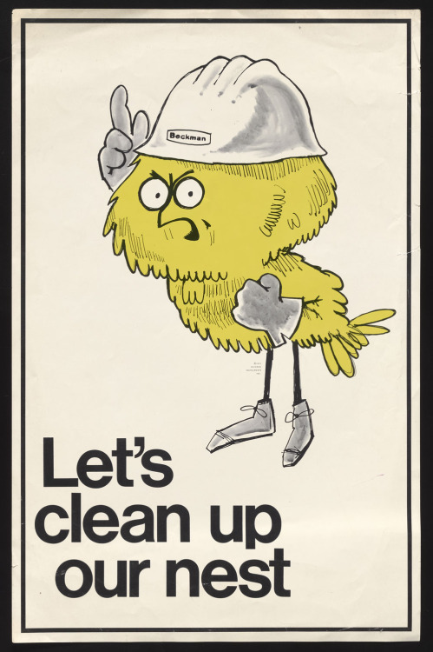
Digitization suite images
These images were shot using an 80 megapixel PhaseOne IQ3 digital back.
TIFFs will be part of our digital repository (coming soon!) but downsized JPGs are used on Tumblr.
Notes:
Some were shot with an 80 megapixel digital back and are downsized JPG versions of a TIFF that will be part of our digital repository.

Slide 14
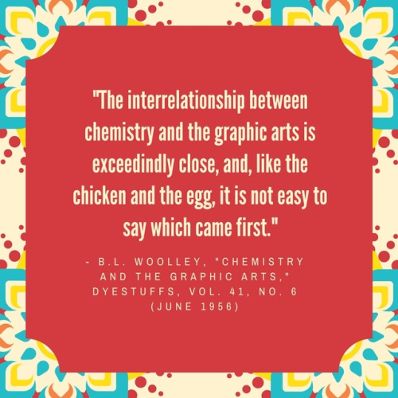
Quotations
Quotations are mocked up in a visually pleasing manner using Canva.
The same software is also used to produce promotional material, like recipe cards.
Notes:
We have quotations mocked up in a visually pleasing manner using Canva.

Slide 15
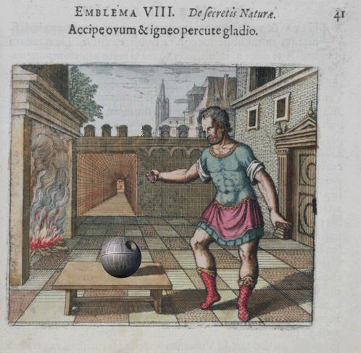
Animated GIFs
Animation is an excellent way to present alchemical subject matter to an interested public. If the technology had been available to Michael Maier (1568?-1622), I’m sure he’d have agreed.
Notes:
We have animated GIFs, because what is the point of having rare alchemical books if you can’t add light sabers?

Slide 16
Sidebar: accessibility
Deserves a full presentation, not just a sidebar
Accessibility issues should be considered when choosing a social media platform and evaluated periodically
Multiple social media platforms allow different entry points for different audiences, including those with particular accessibility issues
Notes:
Now that I’ve shown you some fun visuals from an image-intensive Tumblr, I need to talk about accessibility, or lack thereof, based on my admittedly limited experience. Do you want to make posts more accessible to visually impaired users by including descriptions of images in alt tags that have been around since the mid-90s? As far as I can tell, with Tumblr you’re out of luck. Other platforms do better there: Twitter recently implemented an image description option, and Instagram at least doesn’t do the Tumblr trick of indiscriminately plunking the first chunk of your text into the image’s alt attribute.
There is a tension between meeting users where they are and working around the limitations of those platforms. Using multiple platforms is one way to mitigate accessibility problems, even if it’s not a particularly satisfying solution.

Slide 17
Starting conversations and sharing resources
Social media can be a good way to converse with colleagues
Including colleagues at the same institution, who may be geographically dispersed or organizationally separated
Othmeralia posts have the potential to lead to increased visibility and use of materials
Tiny Science
Twitter crosstalk
Notes:
I’ve mostly talked about outreach that targets audiences outside the organization. But Othmeralia content has been a way to do internal outreach, highlighting collections material to other people in the organization and encouraging creative re-use.

Slide 18
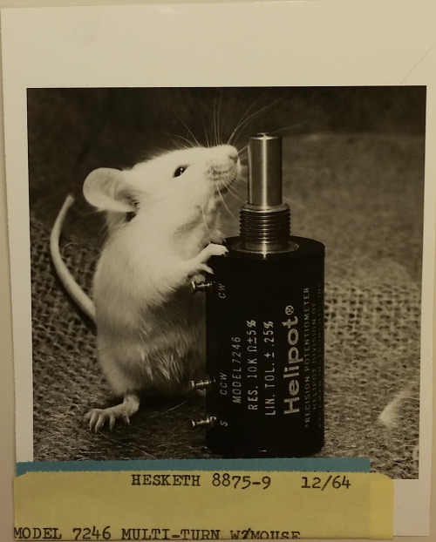
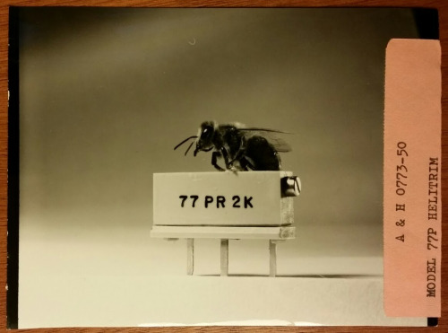
Great Moments in Tiny Science
The bee garnered 675 notes.
(Tumblr loves bugs.)
The mouse may become
part of our décor.
Notes:
Sarah has done a series of “Great Moments in Tiny Science” posts, highlighting photographs of electronic components juxtaposed with small objects. These are fantastic images, and the mouse is a particular in-house favorite. Some of you may remember it from last summer’s Animals in the Archives contest (in round three, the mouse was eliminated by an admittedly adorable fawn). It’s possible that the mouse will be one of the images to adorn our lobby in a forthcoming redesign.
The library Tumblr isn’t driving interior design, but does help raise awareness of material in the collection, including images that are cute, striking, unusual...
[See http://archivesnext.com/?cat=76 for Animals in the Archives.]

Slide 19
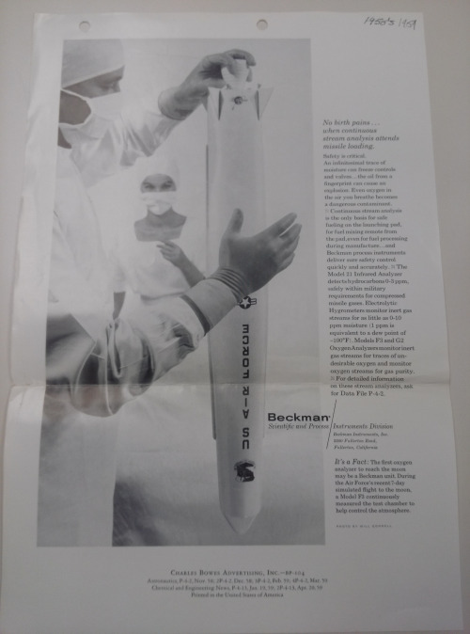
Sharing links
Posts make material easy to share with colleagues.
They may not always thank you for that.
(Why yes, that does appear to be a doctor delivering a missile.)
Notes:
...and, sometimes, horrifying. The print is tiny and this is not a very good shot, but the ad’s text begins “No birth pains…” So, yes, that is supposed to be a doctor delivering a missile. Having seen Missile Baby, I’m on a mission to share the image and spread the horror. (It’s kind of like Mad Men meets The Ring.) A research fellow made a comment on Twitter about military language used to discuss birth control, so naturally I tweeted a link to this post. She was suitably horrified--and expressed interest in writing about the image at length. So Missile Baby might soon be horrifying readers of Distillations. Best of all, her interest gave me an excuse to put Missile Baby in our digitization queue, and I’m going to have a lot of fun with subject headings.
Neither the mouse nor Missile Baby were “hidden.” But formal and informal social media use increased the discoverability of both images.

Slide 20
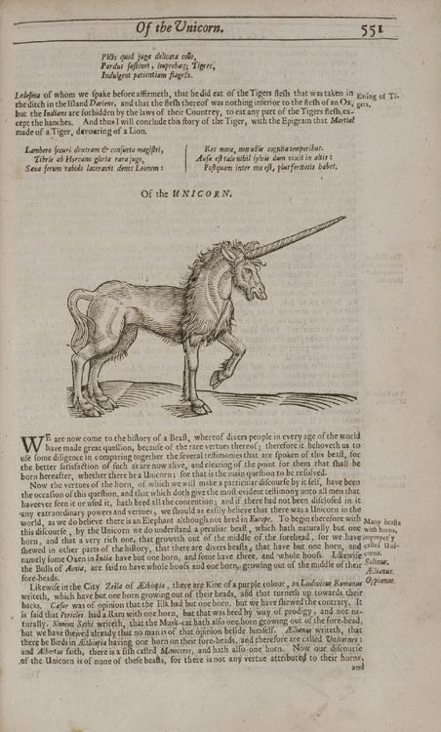
Sorry. Here’s a unicorn chaser.
While there is disturbing material in our collection, and we sometimes discuss serious issues in our posts, we’ve never taken a post down or been asked to remove or edit anything.
Notes:
It’s important to note that this presentation is a case study rather than a set of concrete instructions. Outreach strategies will differ from one organization to another. Sometimes it’s appropriate to widely share and publicize collection materials, sometimes it’s legally and ethically inappropriate. Management may offer support or pushback. My anecdata comes from one institution which was already using various social media strategies before I started my job a little more than a year ago. Othmeralia was an established, departmentally supported effort with a competent team already in place, and it was easy to jump in.

Slide 21
Resources and links
LibGuide: guides.othmerlibrary.chemheritage.org/tumblr
othmeralia.tumblr.com
othmeralia@chemheritage.org
instagram.com/chemheritage/
twitter.com/chemheritage
storify.com/chemheritage
More CHF social media:
chemheritage.org/follow-us-on-social-media
Contact me:
mmiller@chemheritage.org or @mhpmiller
Notes:
And this is where I sign off. If you’d like more information about CHF’s varied social media platforms and efforts, feel free to check them out. You’re welcome to get in touch with me later on, too. Thank you all very much.

