Slide 1
Breaking Down Barriers:
Co-Managing and Transforming Public Services
Timothy Hackman & Yelena Luckert
University of Maryland Libraries
Re-Think It! 2018
January 9, 2018, Austin, TX
Notes:
TH
Welcome and thank you for attending! Introductions - names and titles

Slide 2
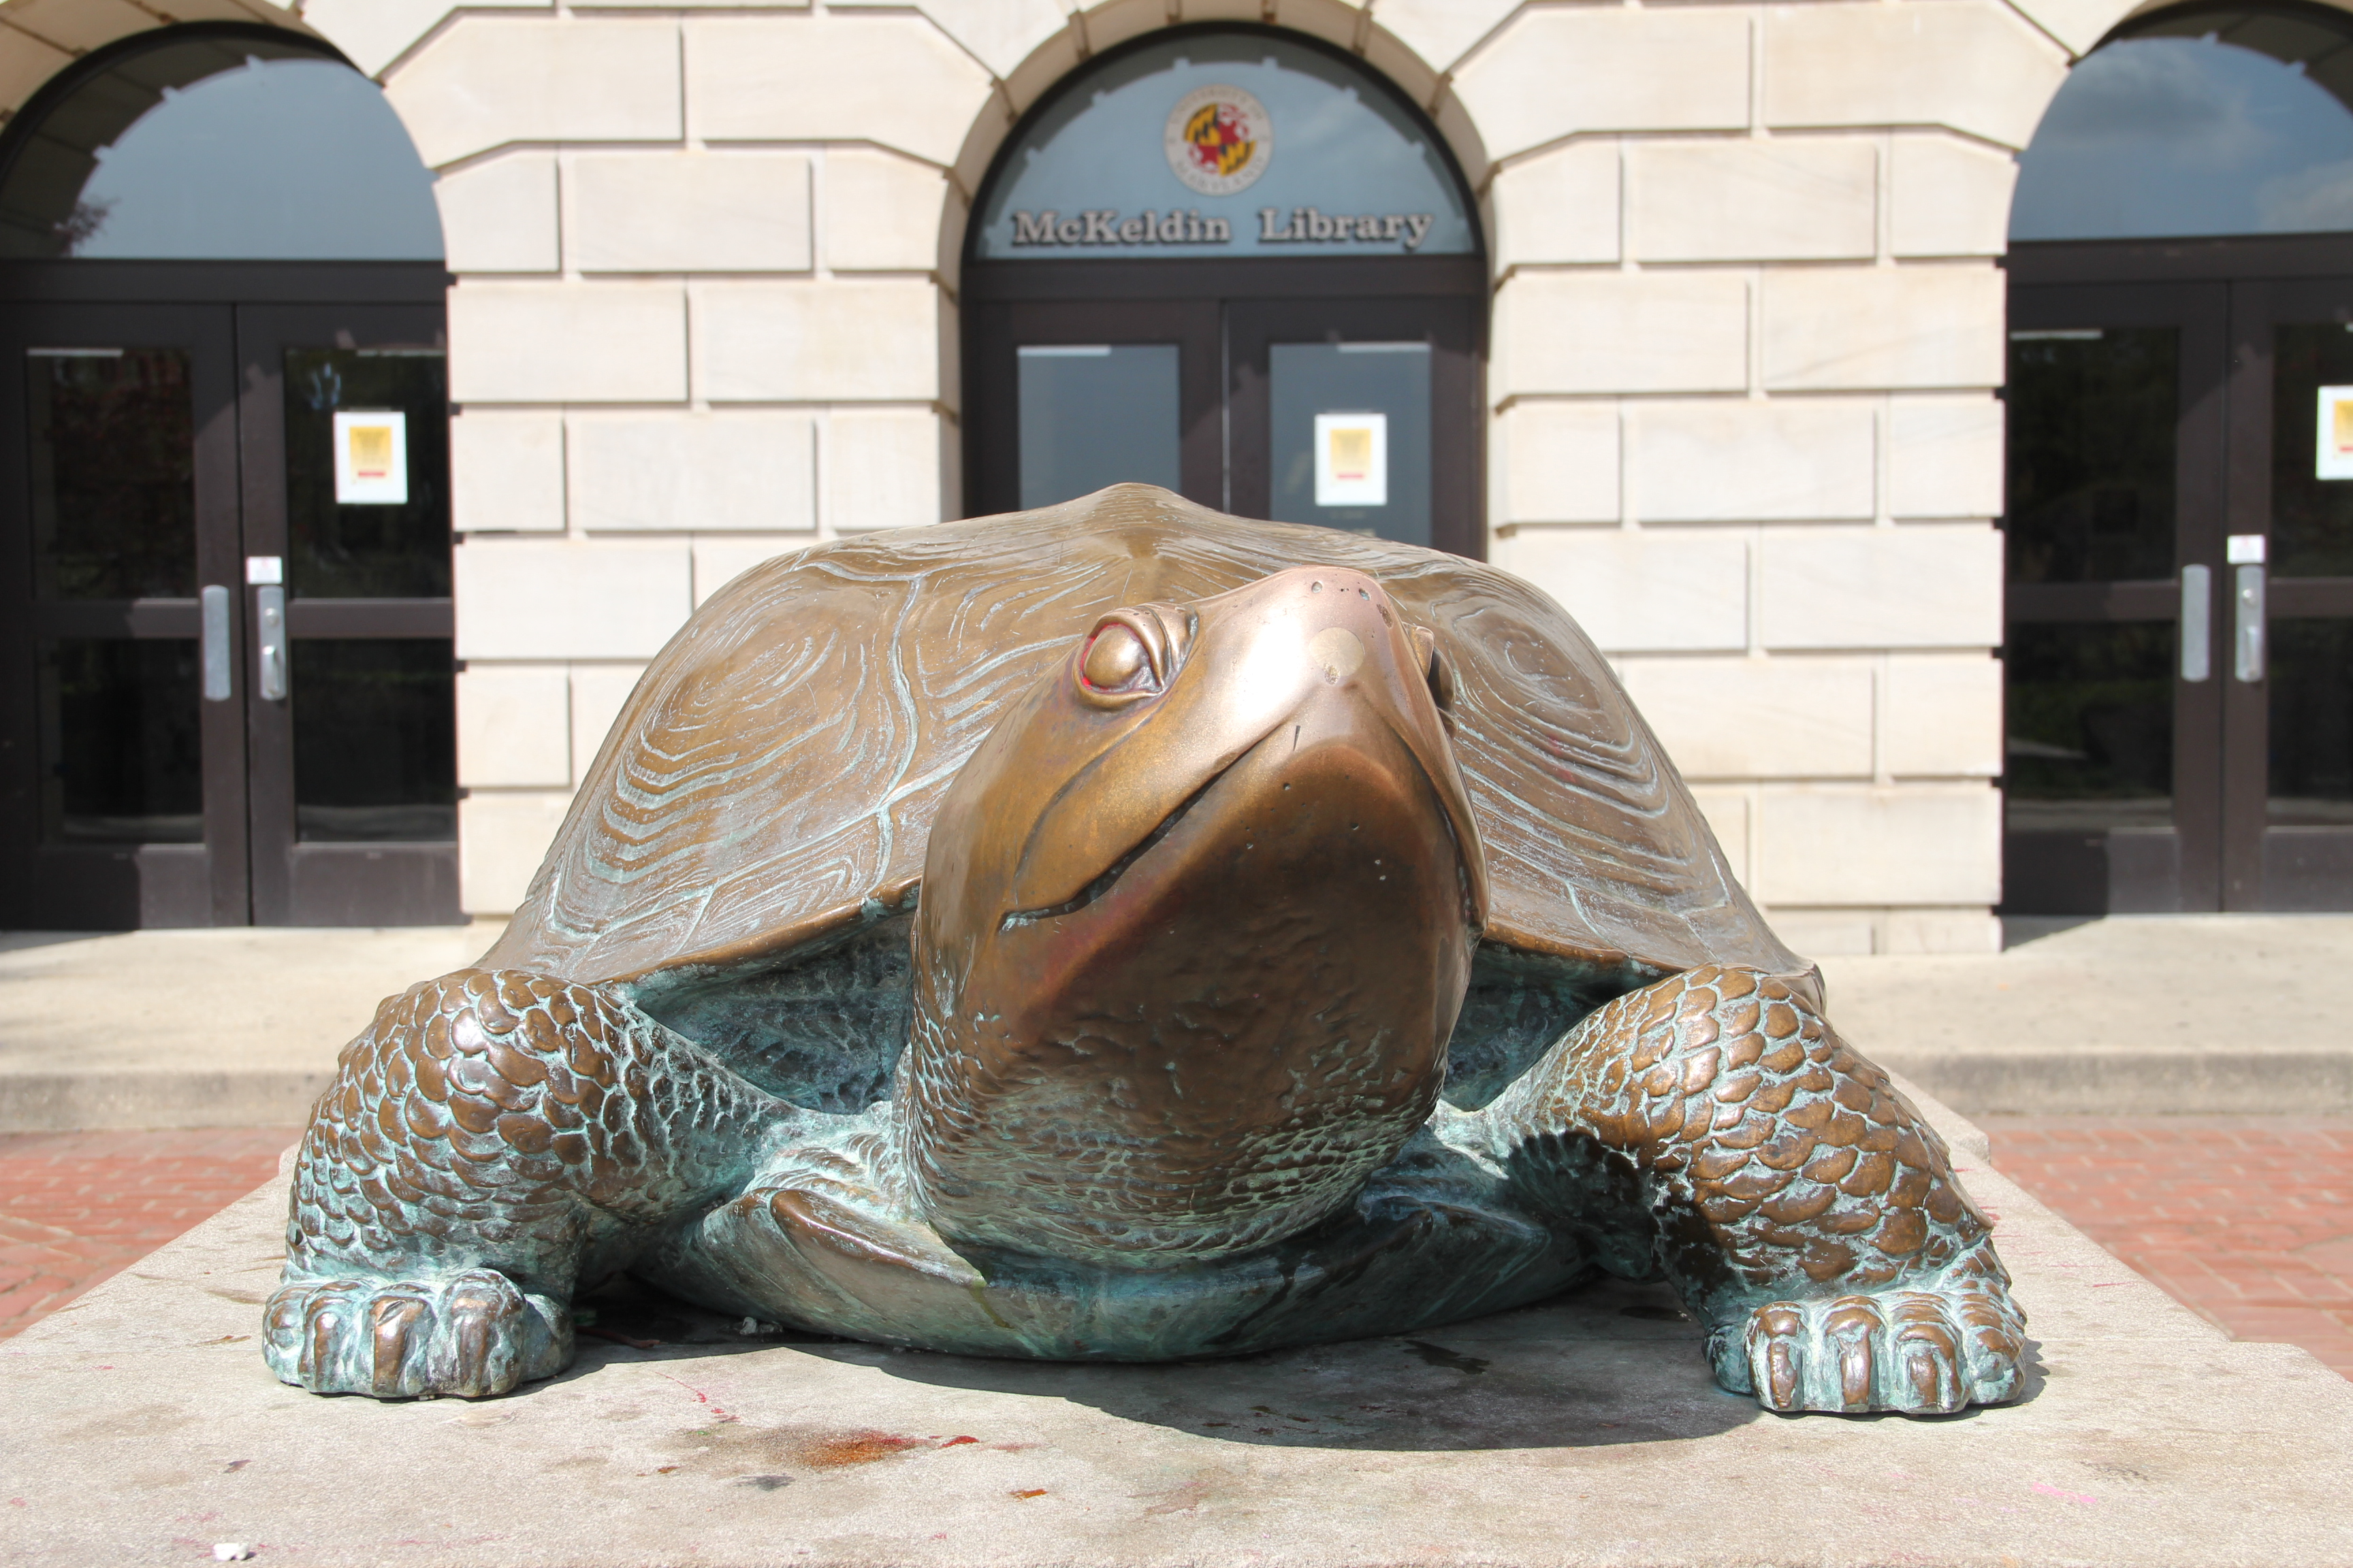
Breaking Down Barriers: Co-Managing and Transforming Public Services
About UMD’s Public Services Division
Reorganization of staffing and services
Staff support
Co-managing staff and services
Outcomes
Notes:
TH
Just to briefly outline what we’ll discuss today...

Slide 3
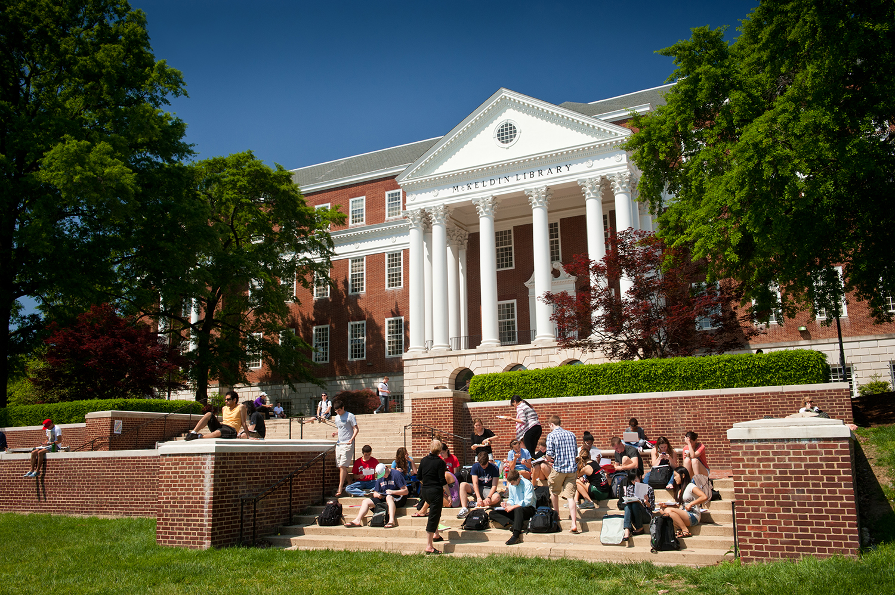
Public Services Division, UMD Libraries
About PSD (https://www.lib.umd.edu/services/psdhome)
  Mission, Vision, Strategic Priorities
  4 Units: USRS, R&LS, LMS, USG
Major services/programs we manage
Billing & Fines, Branch Libraries, Circulation, Collection Development, Collection Maintenance, Equipment Loan, Interlibrary Loan, Learning Commons, Makerspace, Offsite Storage, Reference (virtual and in-person), Research Commons, Reserves, User Accounts, and more
Notes:
TH
PSD is one of 4 major divisions in the UMD Libraries, reporting to Associate Dean (AUL), Gary White
Stated mission is to “provide exceptional research, teaching, and collection services to support the research, teaching, and outreach needs of all students and faculty of the University and other members of the University community.” Read more about our vision, values, and strategic priorities at the website.
PSD is organized into 4 departments
User Services & Resource Sharing
Research & Learning Services
Library Media Services (formerly Nonprint)
Universities at Shady Grove Library (unique service center for 8 consortium sites)
# staff
USRS: 3 faculty librarians, 30 staff, 1 GA
R&L: 43 permanent (27 faculty librarians, 12 staff, and 4 GAs)
Some of the services we manage include...
Toss to Yelena to talk about changes in our services and spaces…

Slide 4
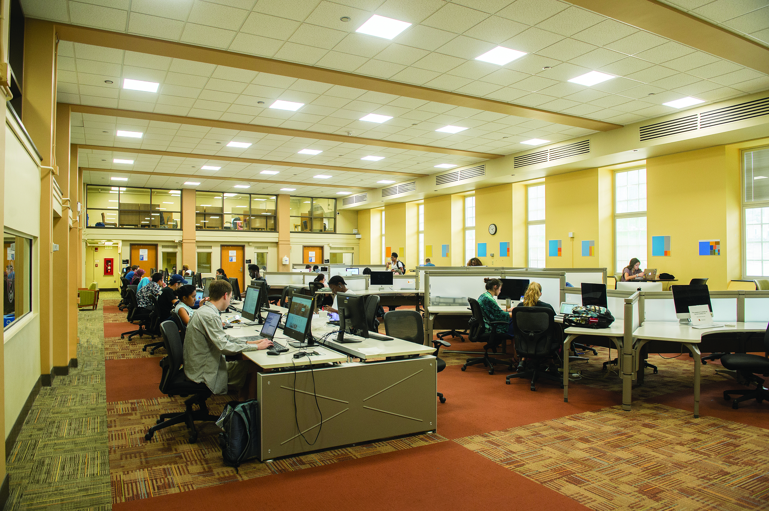
From Collection-Centric to Service-Centric
  Public Services librarians
  Increasing staff responsibilities traditionally covered by librarians
  Collection realignment
  Reimagining spaces
Notes:
YL
●Since 2013 we moved from a reference/subject librarian model to Liaison Librarians model.
●Changes in daily duties of librarians created some work power deficit in providing some of our core Libraries functions and services. Thus non-librarian staff had to step in to perform duties traditionally designated as professional librarianship.
●Collections
○ Like all other institutions we are re-considering how we do collection development and management, to e-formats when possible, removing duplicates and sometimes superseded materials, moving things to storage.
○ Our budget shortfalls are pushing us to cancel lesser used journals and databases.
○ We are moving towards access vs ownership, and reliance on consortial agreements and ILL.
●Changes in how we develop and manage collections provide us with opportunities and lead to changes how we use our spaces

Slide 5
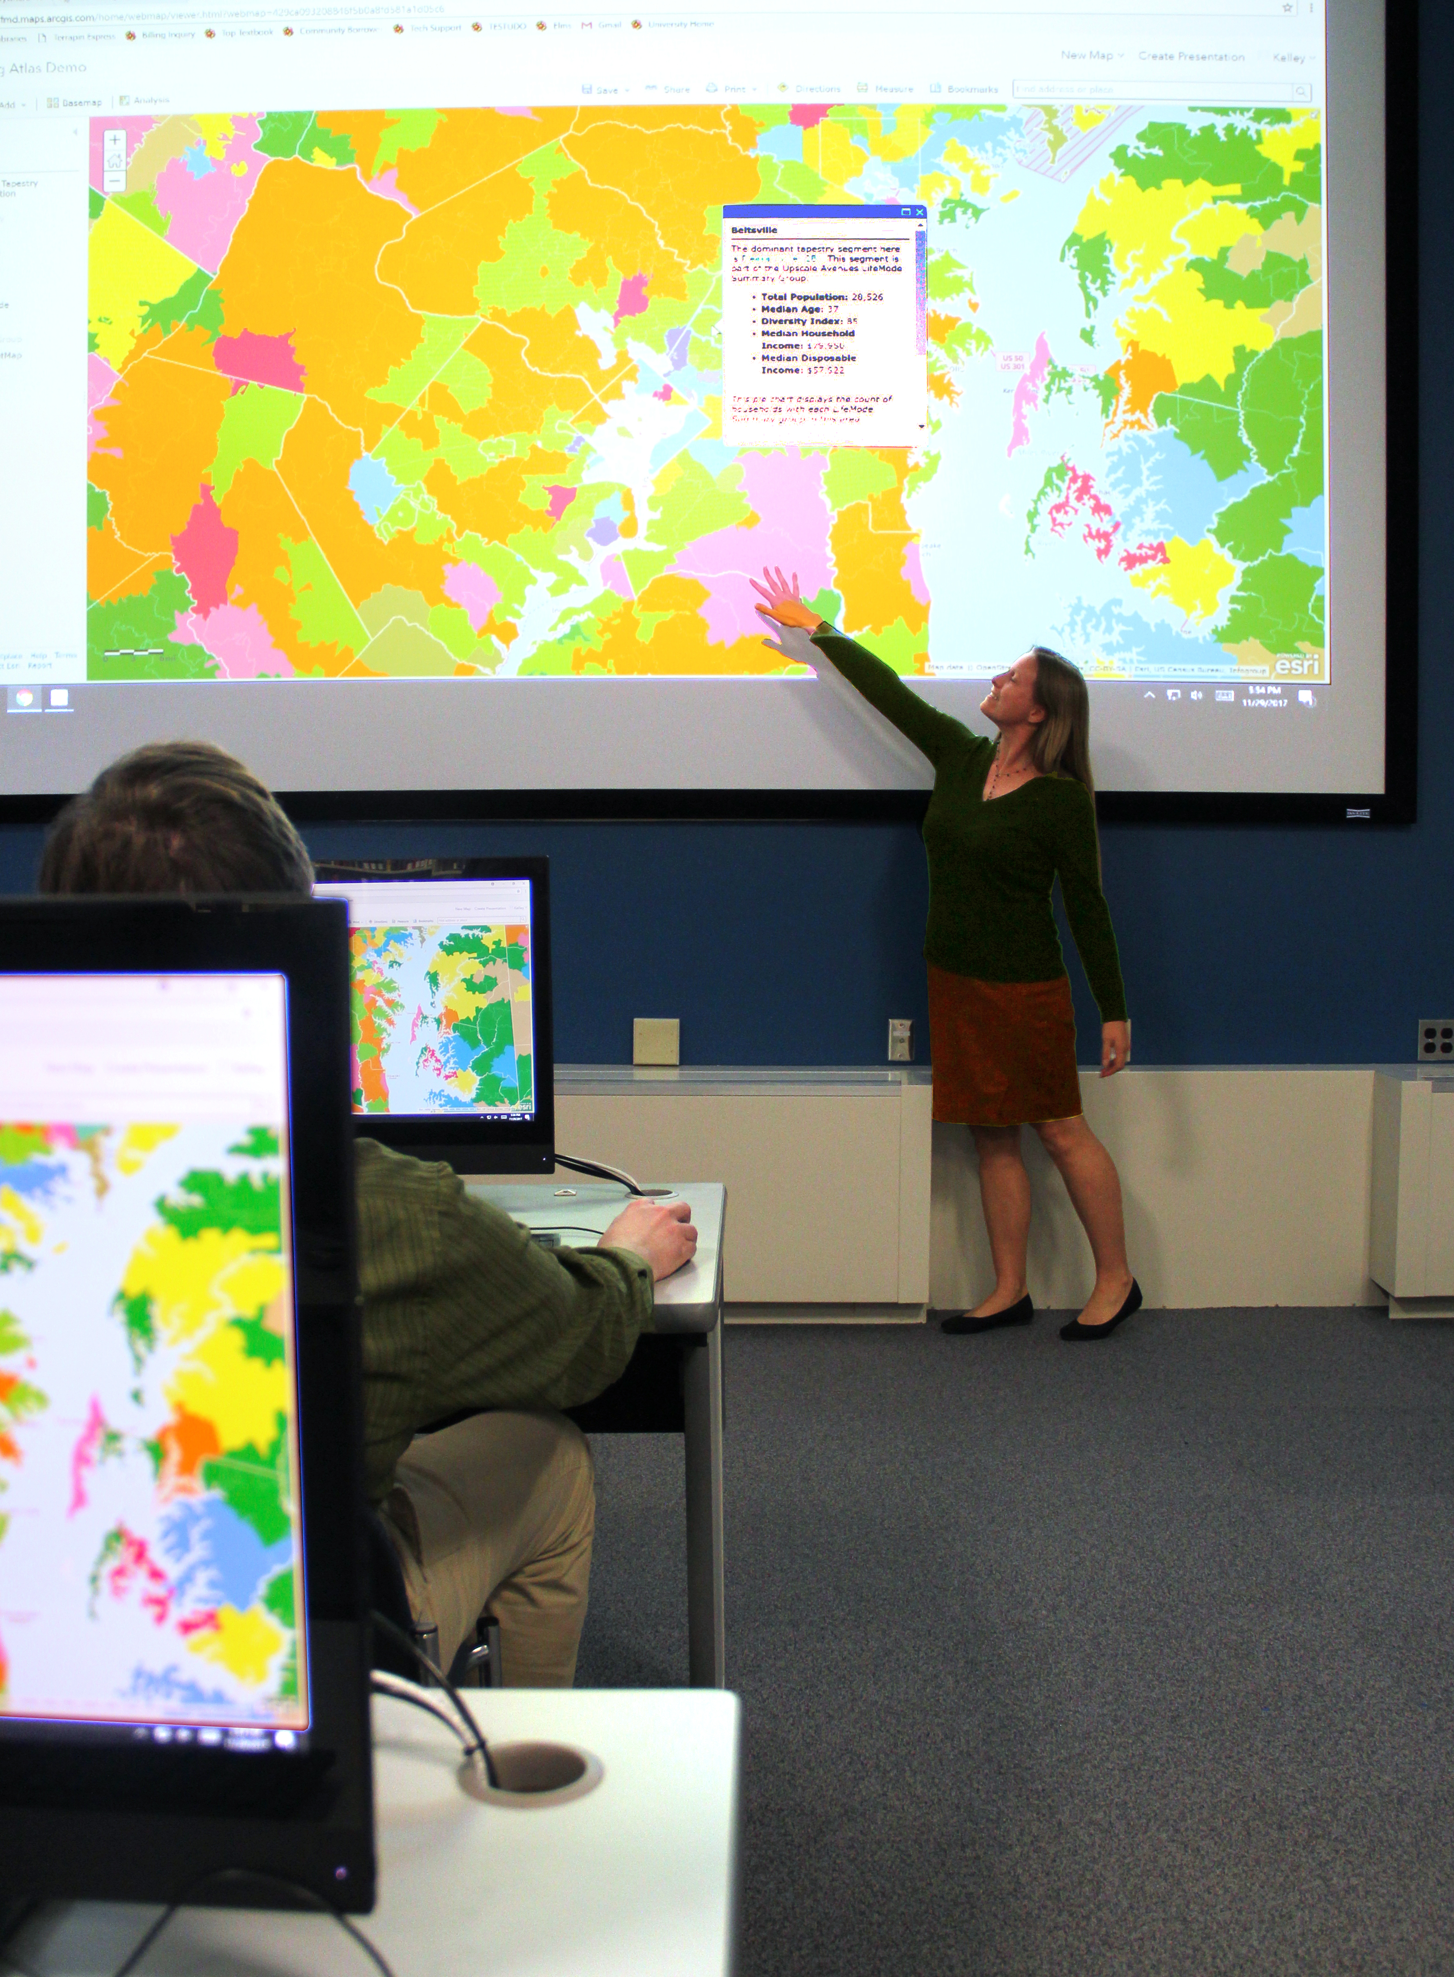
From Reference Librarians to Liaisons
Liaison Librarianship model
New expectations
How do we train librarians to fill new roles?
Notes:
YL
To become liaison librarians we had to:
Create a vision of what liaison librarianship means to us, (Liaison Report came out in 2013), which changed expectations for librarians who work with academic departments
Collectively created CORE competences
Developed new Annual Review processes with emphasis on impact and personal/professional development
Re-thought daily activities for librarians
Developed new strategic goals
So what are the new expectations of librarians and where is the give and take?:
more emphasis on outreach and engagement with their departments and embeddedment, not necessarily physical
Increased emphasis on instruction, including a newly developed LOA program and Peer Observation program
Emphasis on partnerships with faculty and departments
Holistic approach to patrons’ needs, including non-traditional services – copyright, statistics, bibliographic management software, data research
Some things we stopped doing: reference shifts at a physical service desks, more automation in collection development, re-scaling instructional programs moving some large programs to online environment
We spend a lot of time and energy on training
Internal Training
Checklist for new librarians
R&L Forums (day to day work sharing)
Multigenerational Workplace
Kick Ass workshop (improv)
Library groups like Emerging Technologies, Coding workshops
Very supportive learning environment, where people help each other
Library supports
conference attendances
Sending out to classes (computer languages, visualization, instructional activities)
Internal and external leadership programs
Webinars
We allow for experimentation, and do not frown on failures, creating a truly learning organization
But we can’t do it without support and re-deployment of our staff

Slide 6
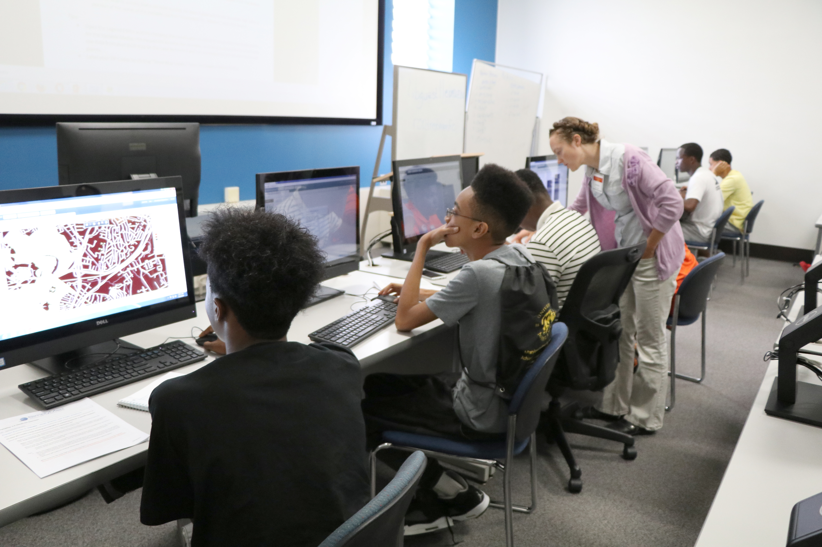
Increasing Staff Responsibilities
Evolving staff roles as librarians move to new responsibilities
How do we train staff to fill new roles?
Examples:
  Reference/circulation merger
  Co-managed virtual reference
Notes:
TH
As we reshape our services, the expectations for all staff have evolved. My department differs from Yelena’s in that I have mostly exempt and non-exempt staff while she has mostly faculty.
Depending on your environment, you may have more or less leeway to adjust staff and faculty duties BUT the key is building a culture of trust, where employees know you’re making changes for the greater good, not just to make their lives difficult.
Tying changes to the larger mission of the Division and of the Libraries is one way to accomplish this. My department has created 2 Strategic Plans since I started in 2012; each time we’ve started with the larger Library goals and worked as a group to find the ways we can contribute
Successful example: merger of reference and circulation desks, summer 2014, into one shared Library Services Desk. Required an enormous amount of coordination. We created cross-department teams to figure out issues related to space, technology, communication, services, and training.
The training group in particular came up with a model that we’ve used every subsequent summer: start with a list of tasks we need done at the desk; survey staff on how comfortable they are with each; look at the results and recruit staff and librarian experts to design and deliver training wherever the gaps are; use staff feedback to improve the training each time
As part of the merger we moved to all on-call shifts for librarians, so they no longer have regular desk hours. This was an adjustment for some of the librarians, who viewed their professional identity as bound up with the reference desk, as well as for the staff, who needed serious training on when to refer questions to on-call librarians. [Data re: on-call referrals?]
Another successful example is the co-management of virtual reference services (“chat”) This was originally a librarian task, with 40 assigned hours each week. By looking at data we realized the vast majority are informational, not reference questions, and could be answered by staff (or even, in some cases, students.) The service is now managed by a staff member from USRS and a librarian from R&L, who share the responsibility for the technology, scheduling, follow up on questions, maintaining the knowledge base, and more. We have established a schedule whereby each branch is responsible for a certain number of hours each day, based on the branches’ busy and slow times. [avg completed chat transactions per month]

Slide 7
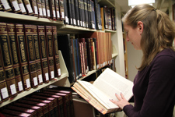
Realigning Collections
Sharing decision-making and co-managing projects
Examples:
  Reference collection
  STEM Library merger
Notes:
TH
Another area where we have significant collaboration, cooperation, and coordination is in the huge task of weeding collections to make room for new learning spaces and services. Whether you call this “right sizing” or “realignment” of collections, there’s a tremendous amount of intellectual and physical work to do.
In our case, Yelena’s unit includes the subject librarians who purchase and manage collections for specific disciplines, while my group includes the collection maintenance staff who take care of the physical books day to day. In addition, two different divisions also need to be involved -- Collection Strategies and Services includes the staff and librarians who manage electronic resources and maintain catalog data, while Digital Systems & Stewardship create any reports we need on holdings, loans, etc.
Two major projects in the past year: weeding the reference collection by 75% and relocating it from the 1st to the 4th floor; weeding the EPSL and Chemistry libraries and merging them into a combined STEM library
How did we do it?
USRS works with IT to get data, shelf lists, loan counts, etc.
R&L librarians do the intellectual work of making decisions on individual volumes - withdrawal, transfer, keep
USRS works with CSS and IT to change catalog records as needed
USRS does physical work of relocating collections to 4th floor, updating signage, etc.

Slide 8

Reimagining Spaces
Realigning collections → Reimagining spaces
Sharing decision-making and co-managing projects
Examples:
  McKeldin Library Research Commons
  McKeldin Library 1st floor
Notes:
YL
As we remove collections from the libraries, we open up space for study, collaboration, partnerships, and more. Over just few years, we created designated spaces for undergraduate and graduate students, adjunct faculty, maker spaces, new labs and events venues that can be easily converted to multifunctional spaces and serve many purposes. As in the previous slide, we take a collaborative approach, in which we share decision-making and co-manage projects as they evolve. Examples:
YL:
The second floor of the Main, McKeldin, Library, has long been designated as a Terrapin Learning Commons, an expansive and very popular space for the undergraduate commons. And in 2014 we began working on developing our Research Commons, both physical and virtual space to address needs of those who are involved in research process, from upper levels of undergraduates to faculty and visiting scholars. 4th floor of McKeldin was designated as the physical space for Research Commons, to house a grand reading room, Reference collections, silent reading room, GeoSpecial Lab, Statistical help, Research Commons staff and some of our subject librarians. Both Tim’s and my department have been deeply involved in the remodel of the fourth floor.
●Most vivid example of our cooperation: moving or our reference collection from the 1st floor of McKeldin to the 4th floor, from a huge space into a much smaller one.
○ Tim and I jointly agreed on the new location for it, designed it, agreed on carpets, paints and furniture.
○ We had downsize the moved collection from about 50,000 volumes to about 3,000 to fit the space. Subject librarians were doing all the intellectual work of what should stay in reference, be moved to the circulating stacks, or to stacks in other branches, or be withdrawn
○ Tim’s staff took care of actual move of materials to the new location, stacks, storage or out.
○ The librarians still purchase materials for reference (although now mostly in e-format), but Tim’s staff maintains shelves, re-shelving books, moving furniture displaced by students.
○ At the same time I help with re-envisioning of the former Reference Collection space and of the entire 1st floor.
TH:
McKeldin Library’s 1st floor is a busy hub most hours of the day. Students come and go for the public computers and printers, to visit the technology store and help desk run by the central Division of IT, to find their way to group or quiet study spaces, and of course to pick up course reserves, interlibrary loan, and book holds. Since 2013 Yelena and I have been working with architects, campus facilities, and others in the library to redesign the space. It’s an ongoing, iterative process, constantly beset by budget delays, and the lack of progress can be frustrating. Instead of despairing, though, we have collaborated to transform the floor bit by bit. Together we created a popular reading nook in the main entrance, relocated hold shelves and made the hold process self-service, added bookeye scanners, relocated reference collection and put group study tables in its place, and, as mentioned, combined the reference and circulation service points into a combined library services desk, turning the old reference desk into a laptop bar. We don’t know when or if the larger renovation of the 1st floor will ever happen, but we can say that, by working together on one piece at a time,, we’ve made it a more attractive, useful space for our users.

Slide 9
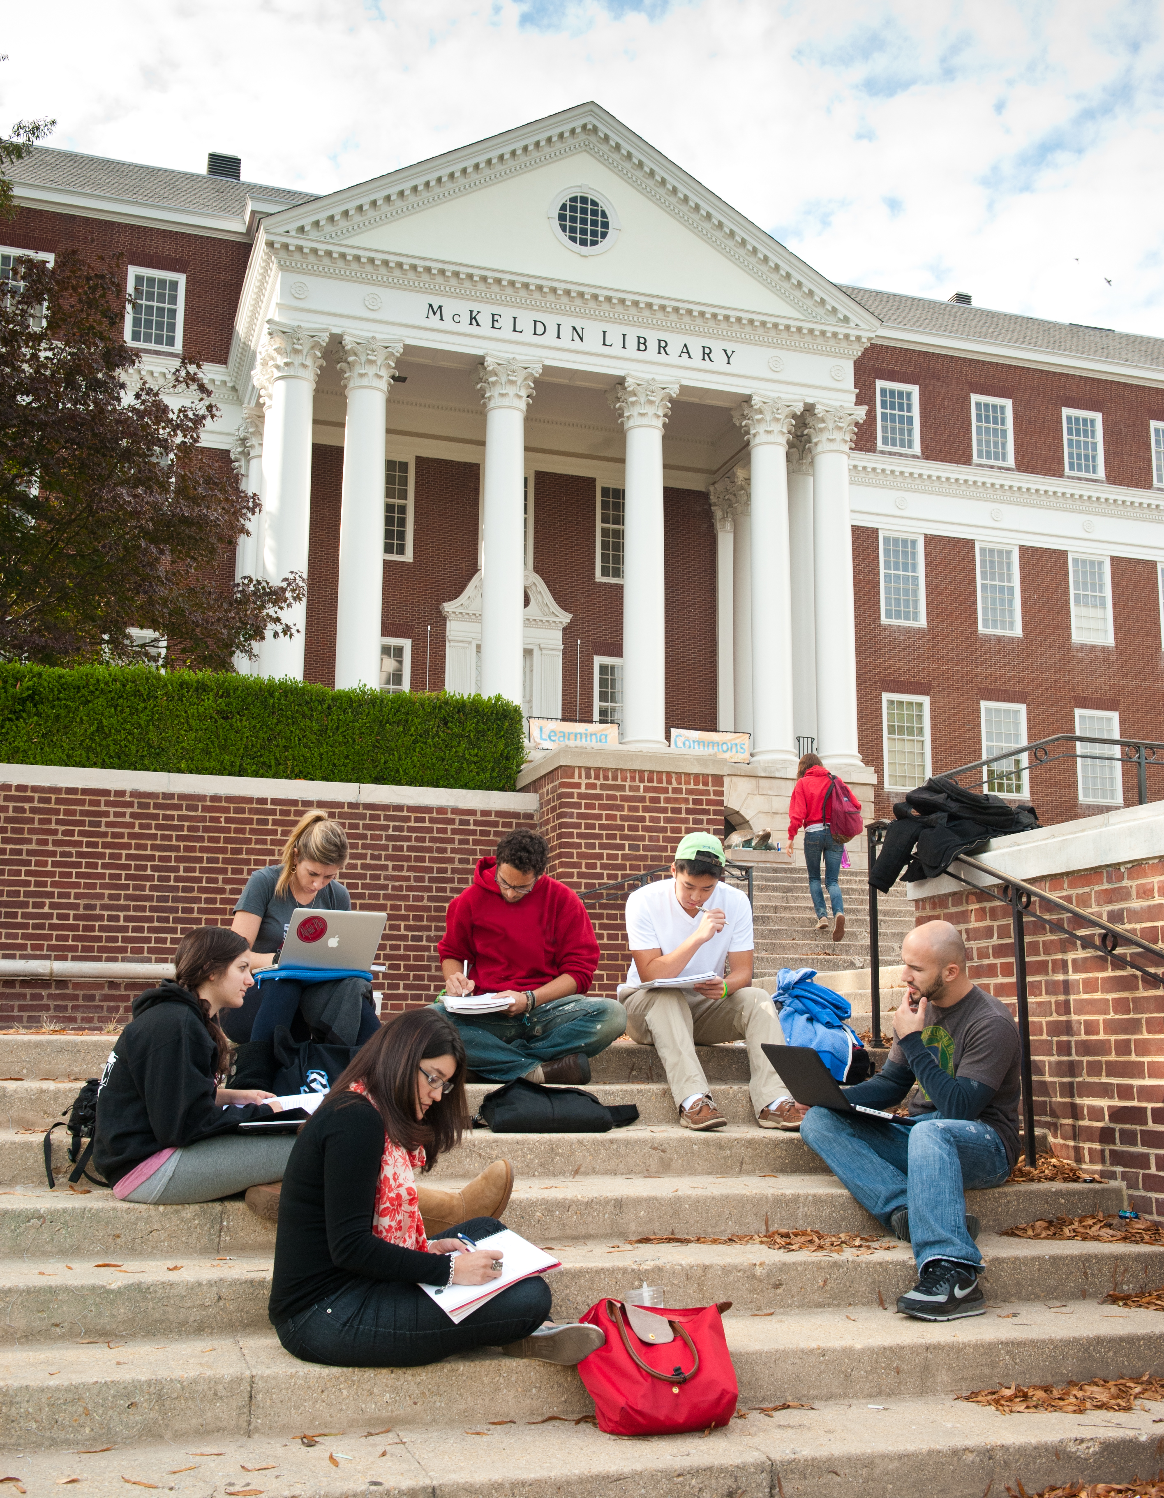
Co-managing Programs and Services
  Constant, open communication
  Focus on Libraries/user needs within PSD SP context
  Large changes are incremental, within environment of continuous assessment and improvement and staff engagement
  Examples:
    Head of Terrapin Learning Commons departure
    Cross-divisional teams
    Coordination of messaging
Notes:
TH
As you might expect, constant and honest communication is key to how we work together well. We have scheduled weekly lunch meetings but have drop in, phone, or chat conversations more often.
Above all I think we’ve been able to put aside our egos and work together toward the Libraries’ goals, as defined by the PSD Strategic Plan. That’s not to say that we always agree, or that the process is always 100% ego-free, but overall we think about what’s best for the Libraries rather than what’s most convenient, what’s more or less work for me, etc. Key is keeping common goals in mind and working towards them
Example: TLC Head Departure. Originally 3 heads -- Learning Commons and User Instruction under a colleague, head of Teaching & Learning. When she left for another university, we took a good look at her portfolio and divided it among ourselves. Not because we couldn’t have asked for her position to be replaced, but because we thought we could handle the extra work and that salary would do more good dispersed to hire staff in some key areas, including a Teaching & Learning Services librarian in Yelena’s group; the move also led to better management of TLC operations by moving a librarian in from another unit to provide planning and oversight
Example: Yelena has already discussed our collaboration on the Research Commons. My head of Learning Commons coordinates with the head of Research commons and heads of developing commons in the branch libraries
We both embrace ethics of assessment, continuous improvement, and staff engagement, and work to instill those ethics in our departments -- no service or program is a finished project or the property of just 1 person. There are lots of pilot projects, and lots of openings for staff and user feedback. Example: for desk merger already mentioned we formed cross-department teams to come up with solutions to issues of communications, space planning, training, etc. Librarians and staff worked together; everyone had an equal voice and was part of the process, THEY are responsible for coming up with solutions, which others can evaluate and help improve
Communication and messaging is another area of frequent overlap. When we create or change services we rely on subject librarians, who have those liaison contacts with the departments. We provide information content they can share, and count on them to share it.

Slide 10
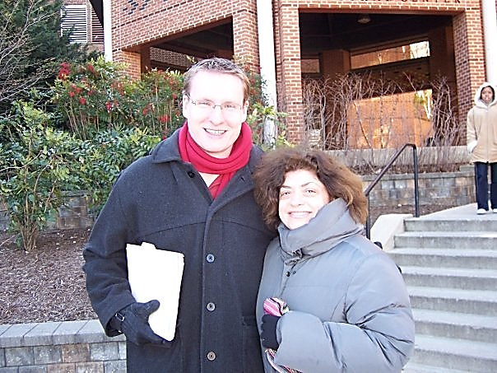
Results
Benefits
  Teamwork and morale
  Greater integration, holistic approach
  Personal & professional growth
Challenges
  Takes work, engagement
  “Ours” not “mine”
What Helps
Notes:
YL
● We feel that we are in step with the profession. Many of traditional library functions are evolving, merging, changing, and new are coming in. In this environment functions blurry and often require multiple people with multiple skills.
In doing this work we found
○Overall better services with more flexibility and holistic approach
○more comradery and teamwork;
○better understanding of what others do and less of “what do they do all day?”
○personal and professional growth for staff, librarians and ourselves
●Challenges:
○We, as organization, have to work at this all the time
○Making sure that everyone is always on the same page is time and energy consuming and require consistency and constant work at it
○It requires a high level of engagement on everyone’s part, and Tim and I push for it
○Importance of learning to see things as “ours” and not as “mine.” That is true for staff, librarians, but more importantly for Tim and I.
●What helps us:
○Personal friendship
○Deep respect and concern for each other and our careers
○Weekly lunches and outings with families
○Love for dogs

Slide 11
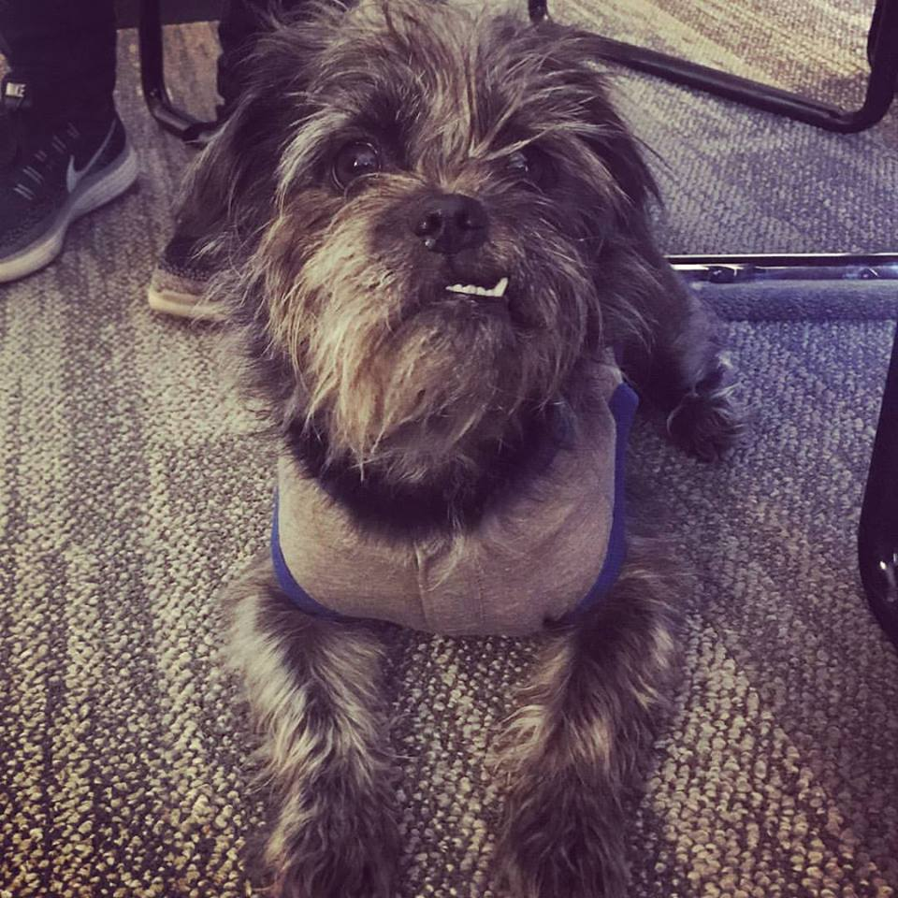
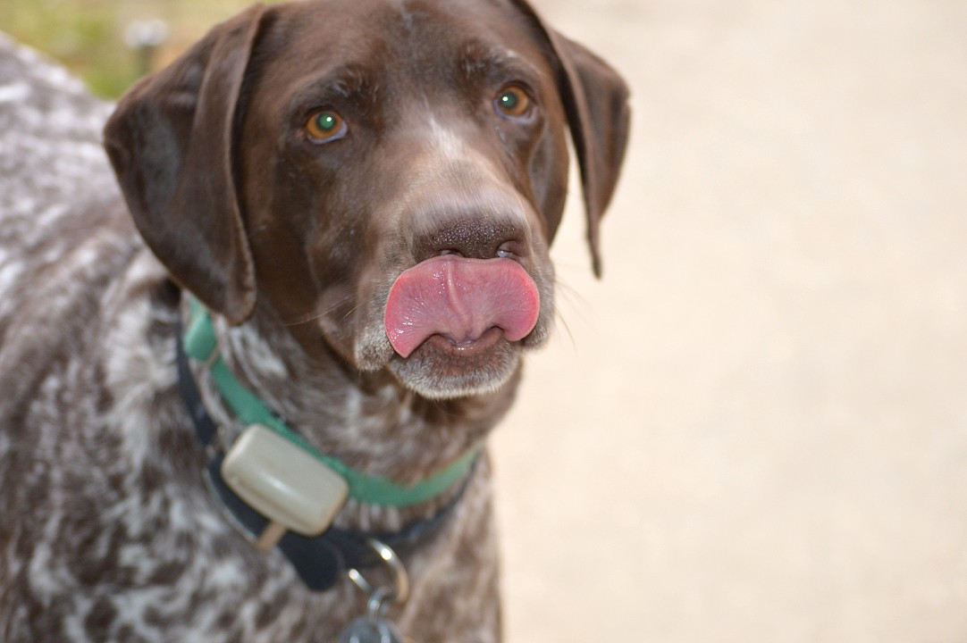
Thank You!
Timothy Hackman
Director of User Services & Resource Sharing
thackman@umd.edu
Yelena Luckert
Director of Research & Learning Services
yluckert@umd.edu
Notes:
TH
Questions?

