Slide 1
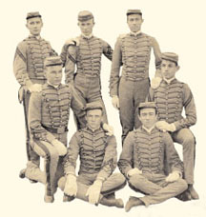
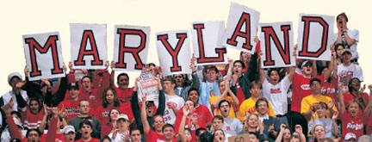
Tending The Front Porch: Athletics & The University Archives
Jason G. Speck, Asst. University Archivist, University of Maryland
Notes:
ATHLETICS AT THE UNIVERSITY OF MARYLAND HAVE PROVIDED SOME OF THE INSTITUTION’S GREATEST TRIUMPHS, AND SOME OF ITS DARKEST MOMENTS. FROM THE NUMEROUS NATIONAL CHAMPIONSHIPS, TO THE SCANDALS OF 1953 AND 1986, ATHLETICS HAS BEEN INTERWOVEN IRREPARABLY WITH THE HISTORY OF BOTH MAC AND MARYLAND. TODAY WE’LL LOOK AT AN OVERVIEW OF THE SPORTS HISTORY OF THE UNIVERSITY, BOTH ON THE FIELD AND OFF.

Slide 2
The Role of Intercollegiate Athletics at Maryland
“Intercollegiate athletics is integral to the lives and education of our student-athletes. It is an integral part of the mission of the University of Maryland to support our student-athletes so that they succeed in the classroom, in their sport, and in the game of life…The core of a university’s house is education, research, and the arts, and its front porch is intercollegiate athletics.”
--UMD President Dr. Wallace Loh, November 21, 2011, “Response to the Report of the President’s Commission on Intercollegiate Athletics.”
Notes:
As everyone knows, the front porch is not the most important part of the house. "But, because it's the front porch, it's the most visible part of the house," he said. And so it must be tended to.
For University Archives, athletics is also a front porch—it is not all that we are by a long shot, but it is one of our most highly visible collecting areas, one that often demands the most resources, and one that has the potential to raise our visibility almost like no other.

Slide 3
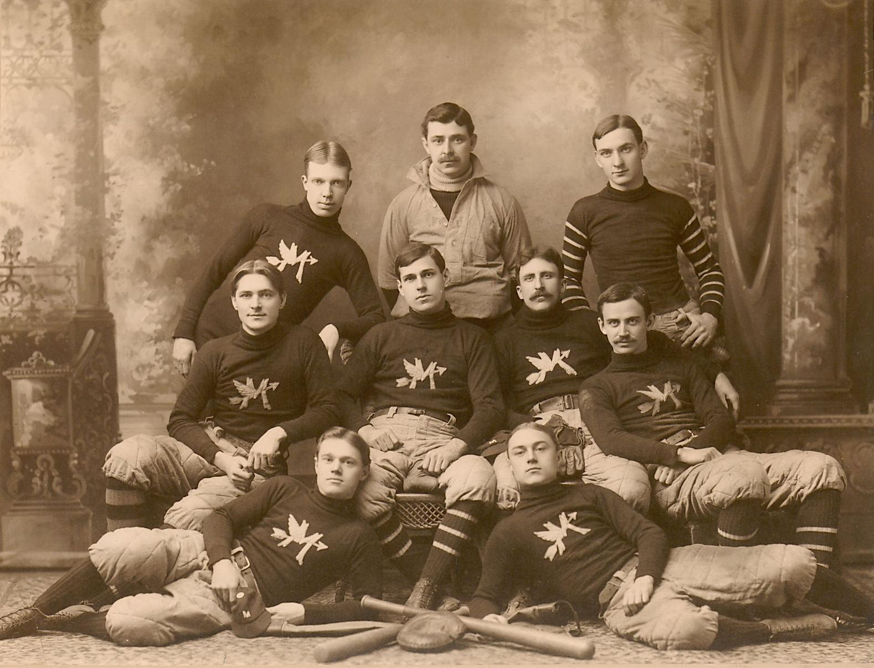
Athletic Origins--Baseball
Maryland Agricultural College baseball team, c.1890s
Notes:
IN THE EARLIEST DAYS OF THE CAMPUS, ATHLETICS WERE A RECREATIONAL ACTIVITY. ACCORDING TO MARYLAND HISTORIAN GEORGE CALLCOTT, BASEBALL PLAYED FOR FUN IN THE EARLY DAYS OF MAC WAS “A FRIVOLITY FROWNED UPON BY OFFICIALS.” BASEBALL WOULD BECOME THE EARLIEST SPORT PLAYED INTERCOLLEGIATELY AT MARYLAND—WE RECENTLY UNCOVERED NEWSPAPER ACCOUNTS OF GAMES AS FAR BACK AS 1869. UNFORTUNATELY MAC’S EARLY FORAYS INTO INTERCOLLEGIATE ATHLETICS WERE NOT TERRIBLY SUCCESSFUL. THE BASEBALL TEAM LOST TO ST. JOHN’S COLLEGE IN 1869 BY THE INGLORIOUS SCORE OF 34-4.

Slide 4
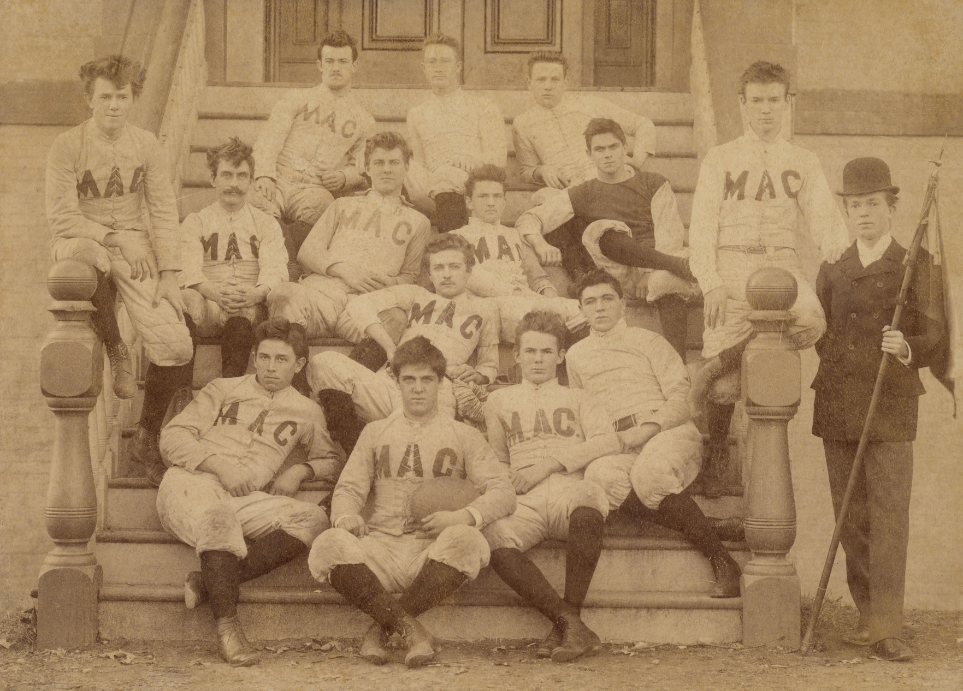
Athletic Origins-Football
First MAC football squad, 1892
Notes:
THE FOOTBALL TEAM, IN ITS FIRST ORGANIZED SEASON OF 1892, LOST ALL THREE OF ITS GAMES BY A COMBINED SCORE OF 128-0, INCLUDING A SEASON-ENDING SHUTOUT LOSS TO EPISCOPAL HIGH SCHOOL. THE FOOTBALL TEAM WOULD REBOUND IN 1893 BY GOING UNDEFEATED, ALTHOUGH IT WOULDN’T BE UNTIL A CERTAIN HARRY CLIFTON BYRD RETURNED TO COACH THE FOOTBALL TEAM IN 1912 THAT THEY WOULD BEGIN TO ACHIEVE CONSISTENT RESULTS ON THE FIELD.

Slide 5
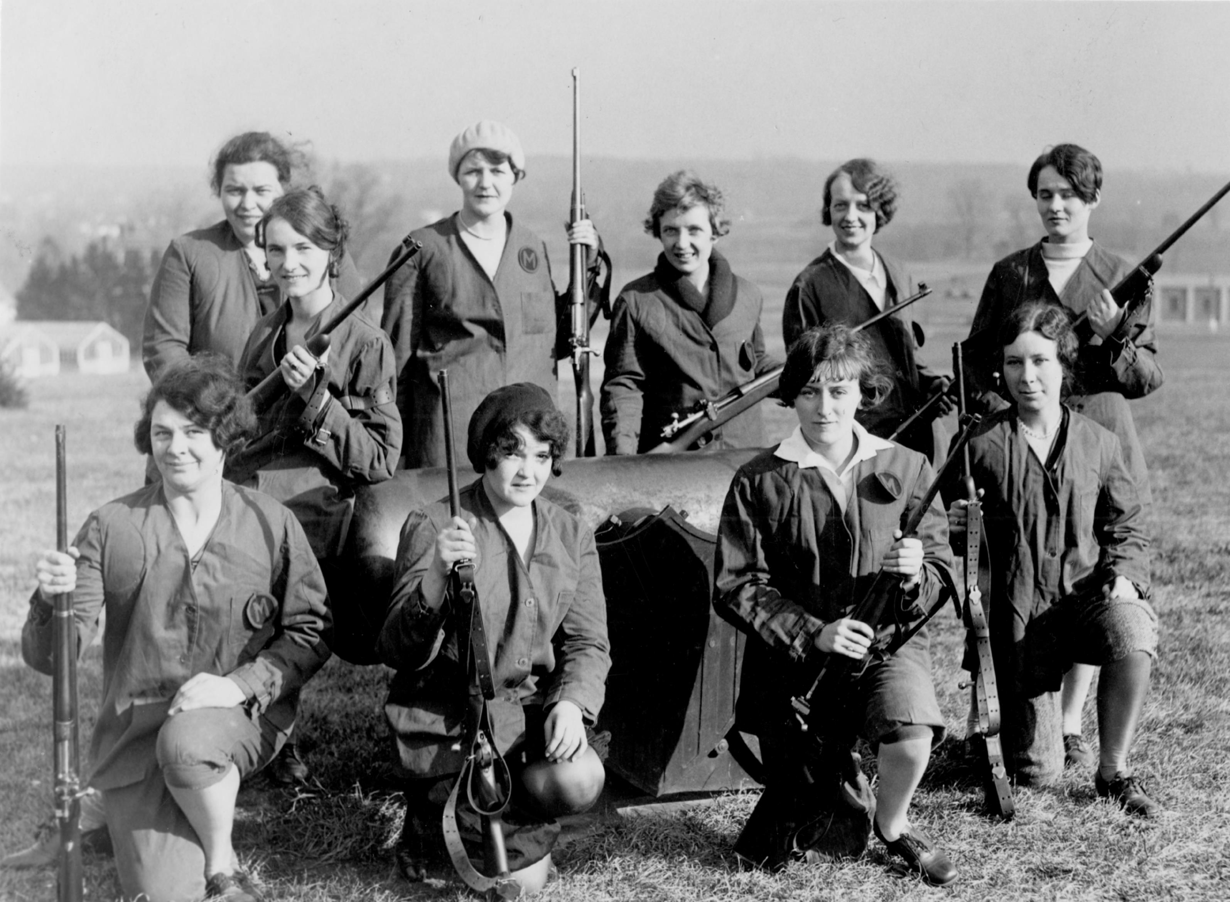
Early UMD Athletics—Women’s Rifle
c.1920s
Notes:
MARYLAND’S TEAMS WOULD ACHIEVE SUCCESS IN SOME OF THESE EARLY 20TH-CENTURY SPORTS. LACROSSE FINISHED SECOND NATIONALLY IN 1929 AND WON ITS FIRST NATIONAL TITLE IN 1936. WOMEN’S RIFLE WAS ONE OF THE EARLY POWERHOUSE TEAMS IN UMD ATHLETICS—THE LADIES WON INDIVIDUAL AND TEAM NATIONAL TITLES BETWEEN 1924 AND 1941, WITH STARS LIKE MARGARET MITCHELL, A BACK-TO-BACK INDIVIDUAL NATIONAL CHAMPION. RIFLE TEAM MEMBERS WERE ALSO THE FIRST WOMEN WHO EARNED VARSITY LETTERS FROM THE NEWLY FORMED “M” CLUB, THE UNIVERSITY’S LETTER-WINNER’S CLUB, WHICH WAS CREATED IN 1923. THESE FEMALE ATHLETES WOULD PAVE THE WAY FOR WOMEN’S SPORTS AT MARYLAND.

Slide 6
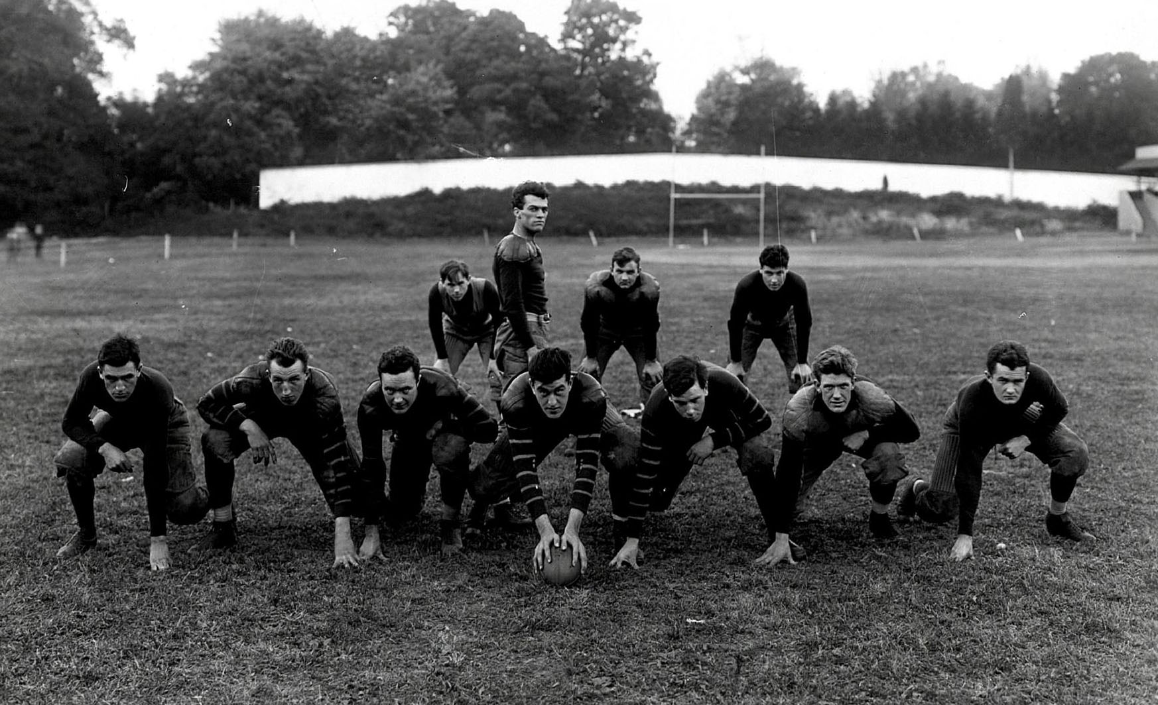
The Rise of Curley Byrd
Harry Clifton Byrd (standing) and his players, c.1910s
Notes:
HARRY CLIFTON BYRD, ABOUT WHOM WE HAVE TALKED PREVIOUSLY, WAS A LARGER-THAN-LIFE FIGURE WHOSE LIFE WAS SHAPED IN PART BY HIS ATHLETIC ACHIEVEMENTS. A STAR ATHLETE IN BASEBALL AND FOOTBALL WHILE A STUDENT AT MAC, HE PLAYED SEMI-PRO BASEBALL FOR A YEAR BEFORE RETURNING TO MARYLAND IN 1912 TO COACH THE FOOTBALL TEAM, ADDING THE POSITION OF DIRECTOR OF ATHLETICS IN 1915. FROM THAT TIME UNTIL HE RELINQUISHED THE PRESIDENCY OF THE UNIVERSITY IN 1954, BYRD WOULD REMAIN HEAVILY INVOLVED IN INTERCOLLEGIATE ATHLETICS.

Slide 7
The Impact of Curley Byrd
Byrd openly bucked national trends on financial aid to student-athletes, preferring now-common ‘full ride’ scholarships
Byrd funneled previously unheard of amounts of money into recruiting, financial aid, new arenas, etc.—often at the expense of academic needs
Byrd micromanaged athletics and allowed little to no outside oversight
Maryland and six other schools, including Virginia, narrowly miss getting expelled by the NCAA in 1950 for student aid violations
By 1953, Maryland is at risk of losing its accreditation, just as it wins the national football title
Notes:
BYRD ALSO WAS A STRONG PROPONENT OF FINANCIAL AID FOR ATHLETES, REGARDLESS OF NEED. IN THIS HE WAS AHEAD OF HIS TIME, BUT IN THE MINORITY. MANY OF THE NCAA’S MEMBERS IN THE YEARS BYRD WAS PRESIDENT (PARTICULARLY THOSE IN THE MIDWEST AND EAST) ATTEMPTED TO UPHOLD THE ALREADY FADING IDEAL OF THE AMATEUR ATHLETE, LEADING TO THE PASSAGE OF BYLAWS IN THE LATE 1940S REQUIRING THAT AID TO ATHLETES BE NEED-BASED AND BASED ON JOBS PROVIDED BY THE SCHOOL, AS WELL AS SETTING LIMITS ON AID FOR TUITION AND SOME SMALL EXPENSES. THE NCAA ATEMPTED TO REINFORCE THESE NEW BYLAWS BY CREATING ADDITIONAL REGULATIONS THAT WOULD EXPEL MEMBERS IN VIOLATION OF THESE RULES VIA A TWO-THIRDS VOTE. MANY SOUTHERN SCHOOLS WERE NOT IN FAVOR OF THE NEW BYLAWS, WHETHER BECAUSE THEY ALREADY PRACTICED MORE LIBERAL AID PROGRAMS, OR THEY WERE LOCATED IN RURAL COMMUNITIES WHERE FINDING JOBS FOR ALL OF THE ATHLETES WASN’T FEASIBLE. MILITARY ACADEMIES OBJECTED TO THE NEW CODE, BECAUSE THEIR MILITARY DRILL PRACTICES MEANT THAT HOLDING DOWN A JOB TO EARN FINANCIAL AID WAS SIMPLY IMPOSSIBLE. SCHOOLS LIKE MARYLAND AND VIRGINIA, WHICH HAD ALREADY MADE THE NOW COMMONPLACE SHIFT TO ‘FULL RIDE’ SCHOLARSHIPS, OPENLY STATED THAT THEY HAD NO INTENTION OF COMPLYING WITH THE NEW BYLAWS, OPENLY DARING THE NCAA TO DO ITS WORST. IN 1949-1950, BYRD LED A SMALL GROUP OF SCHOOLS, KNOWN AS THE ‘SINFUL SEVEN,’ TO CHALLENGE THE NCAA’S GUIDELINES, CALLING THEIR BLUFF ON WHETHER THEIR SUBSIDIZATION OF ATHLETES WOULD IN FACT GET THEM EXPELLED. NEEDING A TWO-THIRDS VOTE, THE MOTION TO EXPEL THE SEVEN FAILED, 111-93, ONE OF THE FINAL NAILS IN THE COFFIN FOR RESTRICTING THE PRACTICE OF OPEN SUBSIDIZATION OF ATHLETES.

Slide 8
The Rise and Fall of UMD Athletics After Byrd
24 NCAA national championships, 13 other national titles (AIAW, USILA)
Dozens of conference championships, athletic and academic All-Americans
Integrating the ACC in 4 sports
Long losing periods in football and basketball after significant scandals
Len Bias’ death in 1986
NCAA sanctions in 1990s
Cutting seven varsity sports in 2012
Joining the B1G Ten in 2014

Slide 9
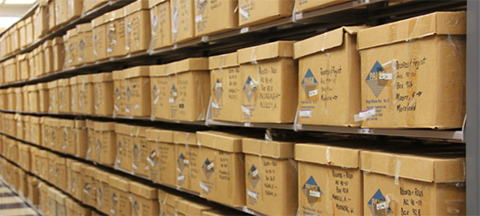
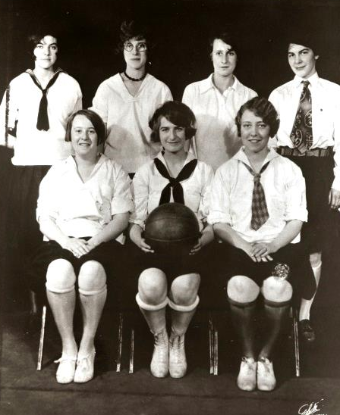
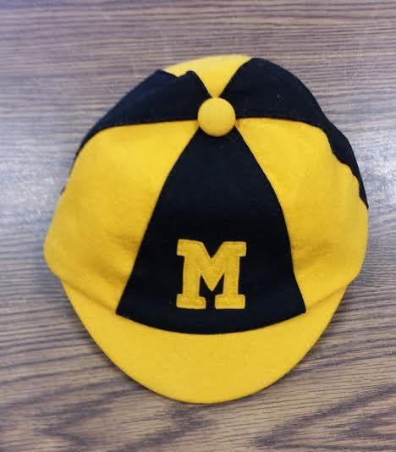
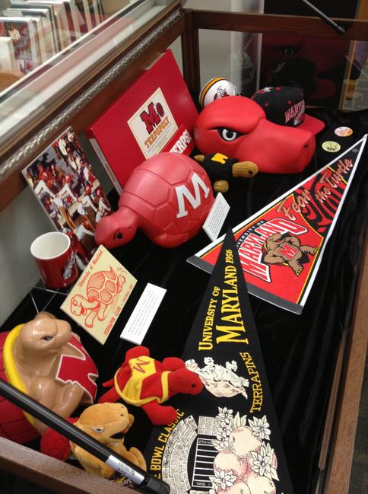
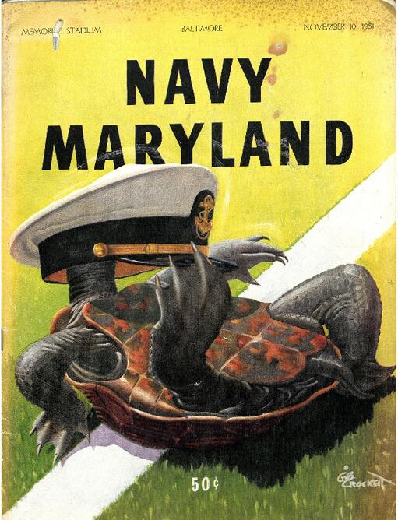
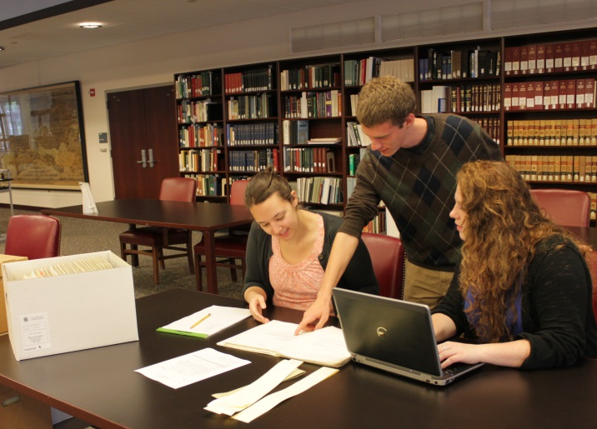
Enter…The University Archives!
Notes:
Created in 1972.
Early holdings contain athletics materials—mostly photos and documents, but very little is from athletics itself. Much is from President’s Office, Campus Photo Services, etc.
This changes when athletics begins moving from its longtime home, Cole Field House, and starts moving into what is now the Xfinity Center, in 2002. The Univ. Archivist reaches out to the athletic director and offers the archives as a way to preserve and maintain the historical records of intercollegiate athletics. As a result, the archives gets approx. 1000 linear feet of materials in an extremely compressed time frame.
Since then the Archives has been back to both Cole and Xfinity on numerous occasions to pick up even more materials that were held onto by athletics during and after the move. We now get donations of materials from them (mostly film and video, but some documents and publications and memorabilia) as they run out of space.
Currently we have approximately 1,450 linear feet of athletics materials, and approximately 750 memorabilia items. This is just accessions of materials directly from athletics. It does not cover athletics photographs or documents in other collections, or memorabilia. We also have yearbooks, gameday programs, media guides, trophies. In terms of audiovisual materials, we have 16mm film for basketball and football going back to the 1940s, and every conceivable format of videotape known to man.

Slide 10
Whom Do We Serve?
Athletics
Media (Newspapers, ESPN, BTN, TT)
Other schools, athletic conferences
Former athletes & their families
Halls of Fame & Museums
Students
Alumni
General Public (including local businesses)
Professional projects (books, movies)
University Communications/Publications
Ourselves (education & outreach)
Notes:
Mention volume of requests and time spent on them.
Since we began tracking stats, the highest number of requests to date was in 2005 (spent the equivalent of 13 person weeks on 399 queries). Lowest amount of time was 6 weeks.

Slide 11
Benefits and Challenges
Increased visibility, but increased workload
Athletics hasn’t always recognized our value (and certainly hasn’t paid for it)
Getting Athletics to recognize the importance of our heritage
UMD Libraries often questioned our relationship with Athletics
Now a recognized authority by Athletics, as well as a place to send important materials
Notes:
Our visibility with both Athletics and the larger population has increased over the years, but so has our workload. Increased visibility means we get more materials, but more queries as well. This is not a bad problem to have, but it often made us feel like we had little time for other projects.

Slide 12
Benefits and Challenges. Cont’d.
Oh, the formats…
Significant re-organization & re-housing issues still remain from 2002
Tracking materials borrowed by Athletics
The problems with digital materials (images, media guides, footage)
Visibility has aided our desire to get certain materials digitized
Notes:
Betacam
Betacam SP
DVCAM
Mini DV
VHS (standard play, long play, extended play)

Slide 13
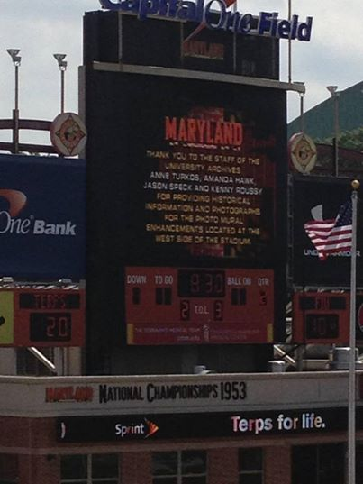
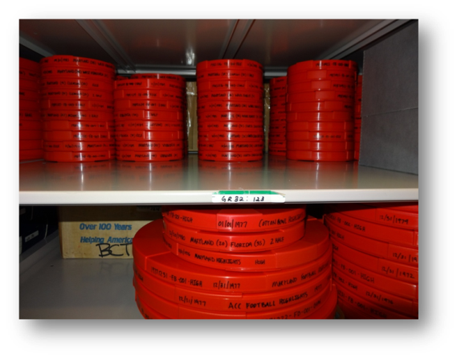
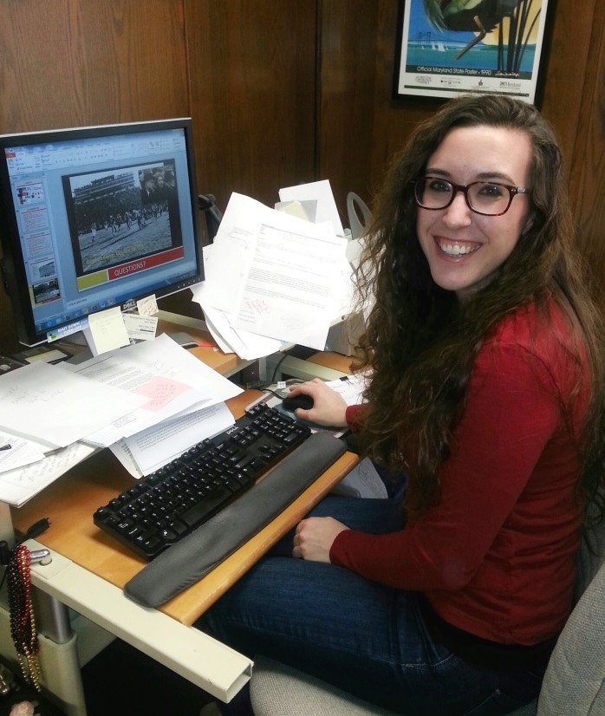
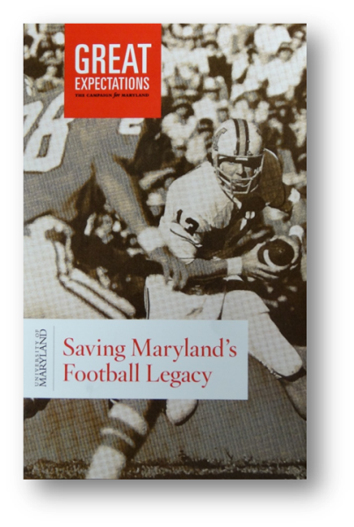
Recent Successes

Slide 14
Future Challenges
Maintaining & strengthening relationships
Solving the digital problem—getting Athletics’ digital files
Solving the format conundrum—can we use what we have?
Digitizing basketball film
Keeping our Athletics Archivist

Slide 15
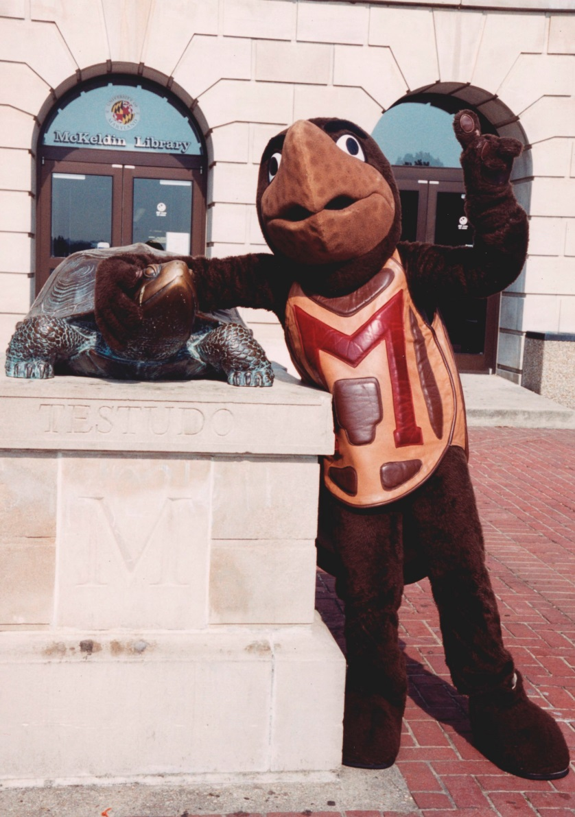
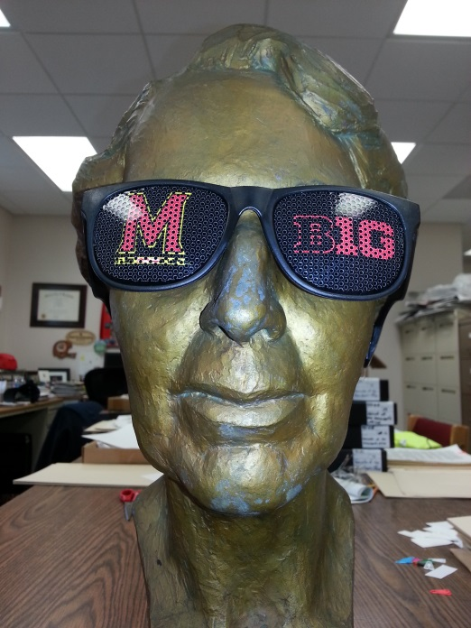
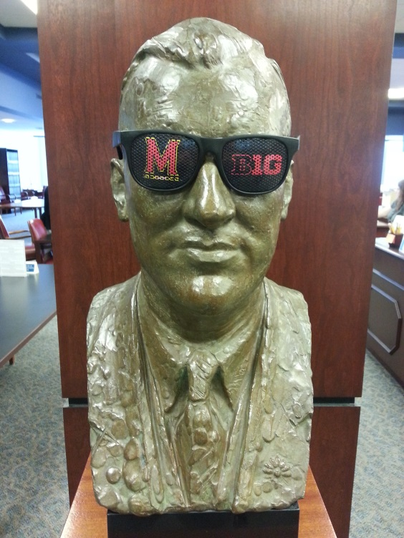
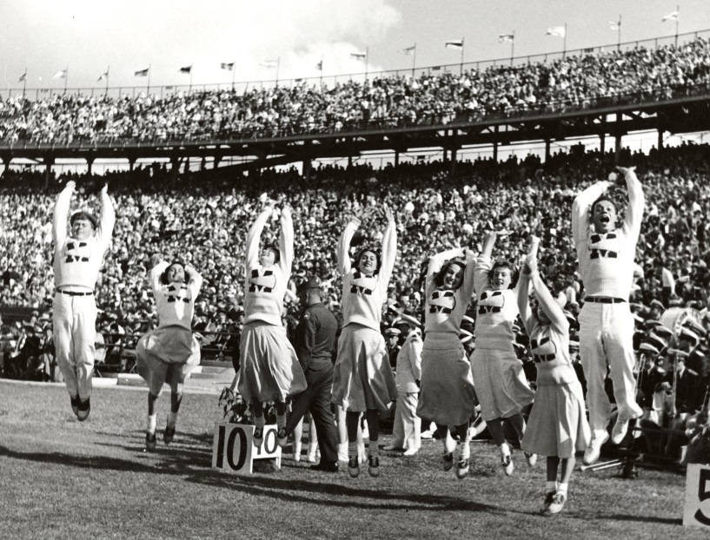
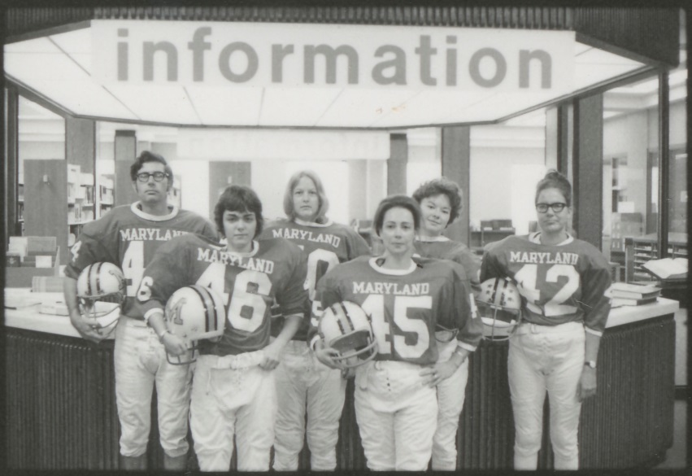
Thank You!!

