Slide 1


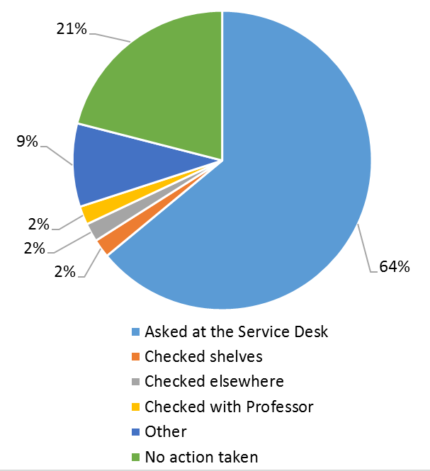
Reserves UNreserved
Madhu Singh, Toni Negro, Emily Spangler
Priddy Library, Universities at Shady Grove
Objectives
User Survey Results
Feedback Survey Results
Negative Outcomes
To replace the library’s current model with an open course reserves system providing students direct access to the material, eliminate storage space and reduce staff workload. Pilot started in summer 2016.
Ninety-seven people responded to the survey:
    55% found item on shelf
    45% did not find item on shelf
Follow up action for items not found
Sixty-seven people responded to the survey:
    “I like the concept of the open course reserves, unfortunately whenever I am looking for the course reserve that my professor requested, a student already has it. I would really like to take advantage of the service.”
    “It has been extremely convenient and helpful for me as a student.”
    “I waited for the book all day, but did not get to use it. I am very disappointed.”
    Daily Inventory
    Loss/Theft
    Faculty Concerns
    Limited User Data
    Replacement Costs
    High Demand Titles Competition
    Misplaced Items
Implementation
Initial steps included relocation of course reserves from the Service Desk to open stacks. This required retraining staff and relabeling of each item. Subject liaisons reached out to faculty via email. Marketing to students included new print and digital signage in the library.
To assess implementation of the service users responded to a voluntary survey. The survey asked students to identify course number, item title, and if able to find the title on the shelf and if not found, what follow up action was taken.
In spring 2017 a feedback survey to elicit student comments on the program was initiated.
Conclusion
The Library has determined the next steps to improve the project should include better instructional signage, expanding marketing beyond the library and continuous assessment.
Positive Outcomes
    Fewer Service Desk Transactions
    Accessible Location
    Fine Elimination
    Reduced Storage Shelves
    Increased Service Desk Efficiency
Contacts
Madhu Singh
    madhus@umd.edu
Toni Negro
    anegro@umd.edu
Emily Spangler
    espangle1@umd.edu

