Slide 1

New Wine in Old Bottles: “Films without Celluloid” + Making the Most of the Spaces You’ve Got
Andy Horbal
University of Maryland
The Innovative Library Classroom
May 12, 2015

Slide 2
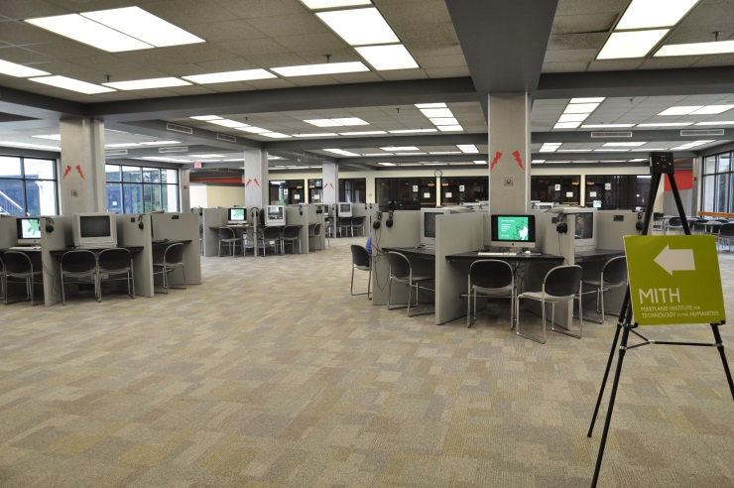
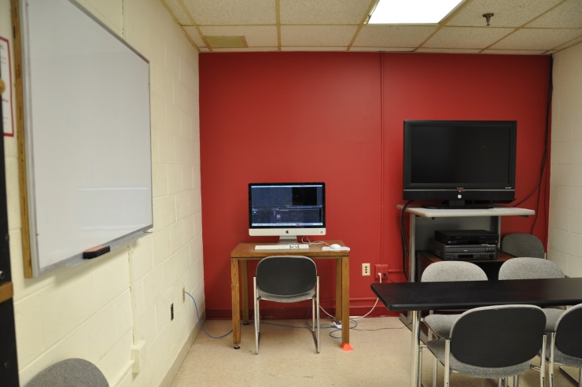
A Brief History of Library Media Services

Slide 3
The Problems
Current spaces not ideal for multimedia production instruction
  Designed for media consumption, not production
  No instruction lab
  Not enough cameras to go around
No money for new equipment or construction

Slide 4
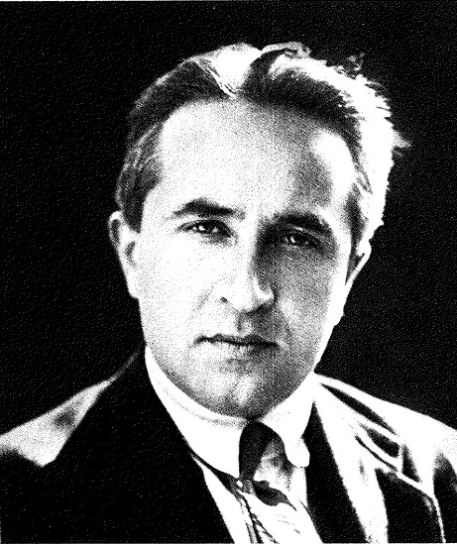
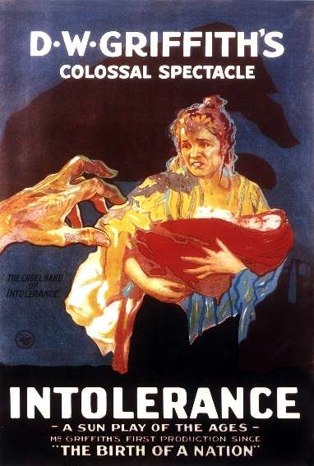

“Films without Celluloid”
Movie poster for Intolerance (1916) in public domain. Picture of scissors retrieved from http://pixabay.com/en/scissors-isolated-white-background-213700/ + used according to the terms of a CC0 (public domain) license. Picture of Lev Kuleshov (1925) found on p.81 of Lev Kuleshov: Fifty Years in Film (Raduga Publishers, 1987) + used according to 17 USC § 107.

Slide 5
Lessons
You don’t need a camera to plan a film shoot
You don’t need a camera to experiment with filmmaking
Experimentation is the key to media literacy

Slide 6
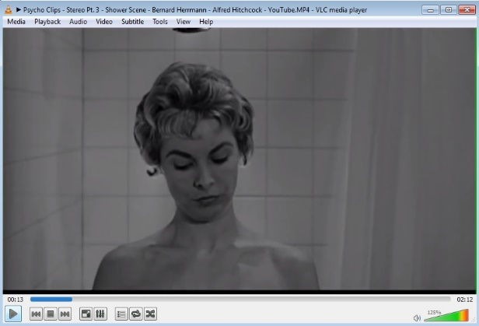
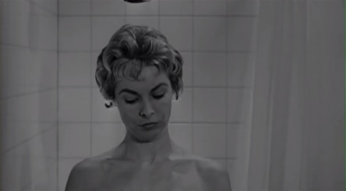
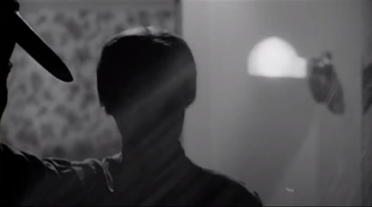
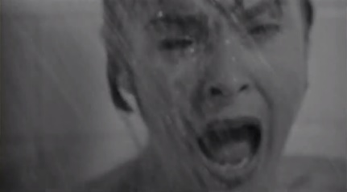
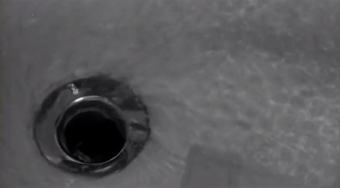
What We Did
1
2
3
4

Slide 7
Benefits
Active learning!
Shifts focus to core media literacy concepts
  Less pressure to produce a polished finished product
  Production software = means to an end

Slide 8
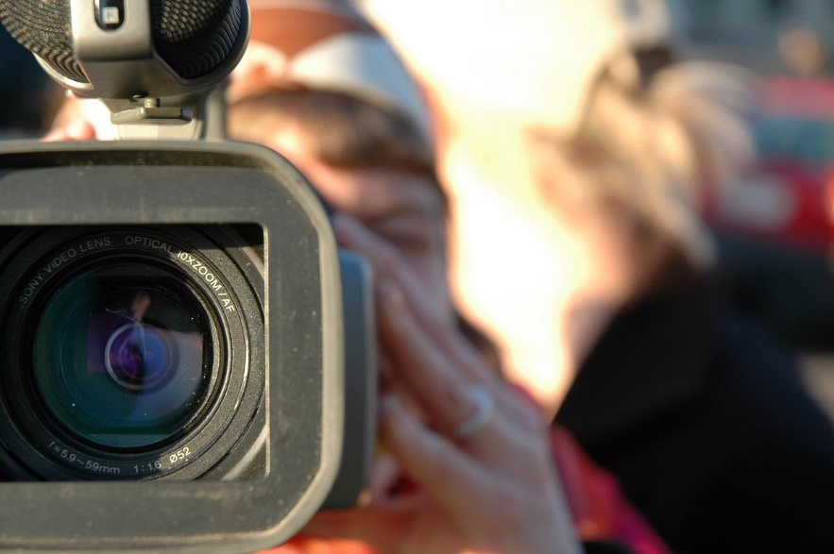
Applications
Imaged retrieved from http://commons.wikimedia.org/wiki/File:Video_Camera.JPG + used according to the terms of a CC0 (public domain) license
Notes:
What’s your “camera”?

Slide 9
Contact
Andy Horbal
Head of Learning Commons
1101 McKeldin Library
University of Maryland
College Park, MD 20742
(301) 405-9227
ahorbal@umd.edu
http://www.slideshare.net/horbal125/new-wine-in-old-bottles

