Slide 1
“There is a Question of trust:”
Punk rock, word of mouth, and donor relations
John Davis - Performing Arts Metadata Archivist - University of Maryland
April 12, 2019 - MARAC Spring Conference - Morgantown, WV.
Notes:
Today, I’ll be talking about my experiences in the Washington, DC punk rock community and how they have served me in creating relationships with donors who might not have normally considered institutional archives as a home for their materials. While the situations I’m talking about are unique to me, I hope that some of my experiences will be applicable to any archivist looking to build reciprocal relationships with donors from communities that are underrepresented in archives or are skeptical of working with traditional institutions.
I had the good fortune of growing up in the Washington, DC area, which has been the home of an influential punk rock scene since the genre emerged in the mid-1970s

Slide 2
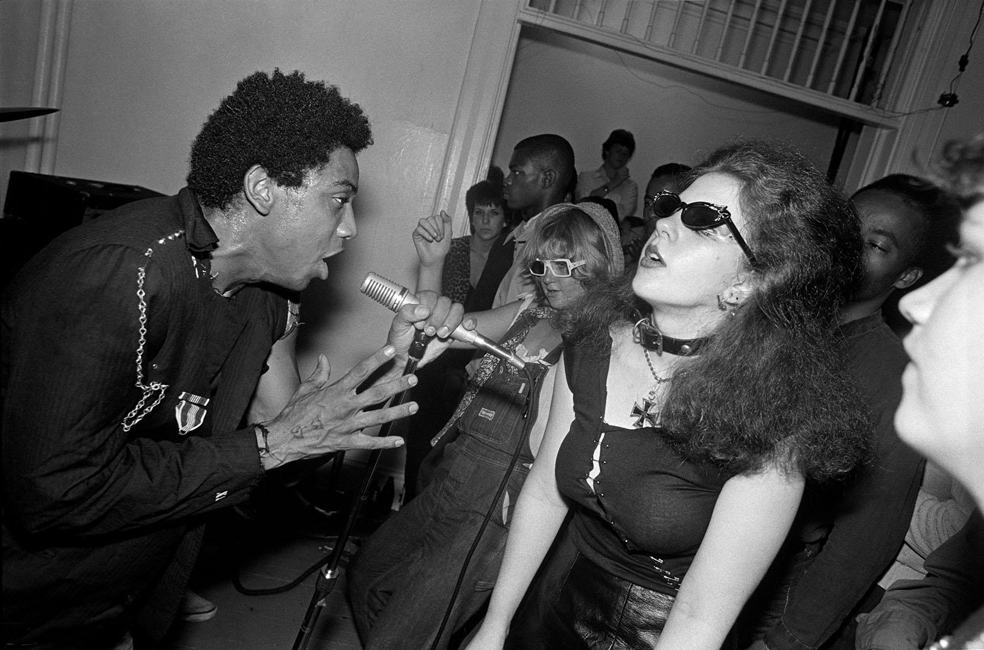
Photo: Lucian Perkins
Notes:
Early DC punk bands like Bad Brains

Slide 3
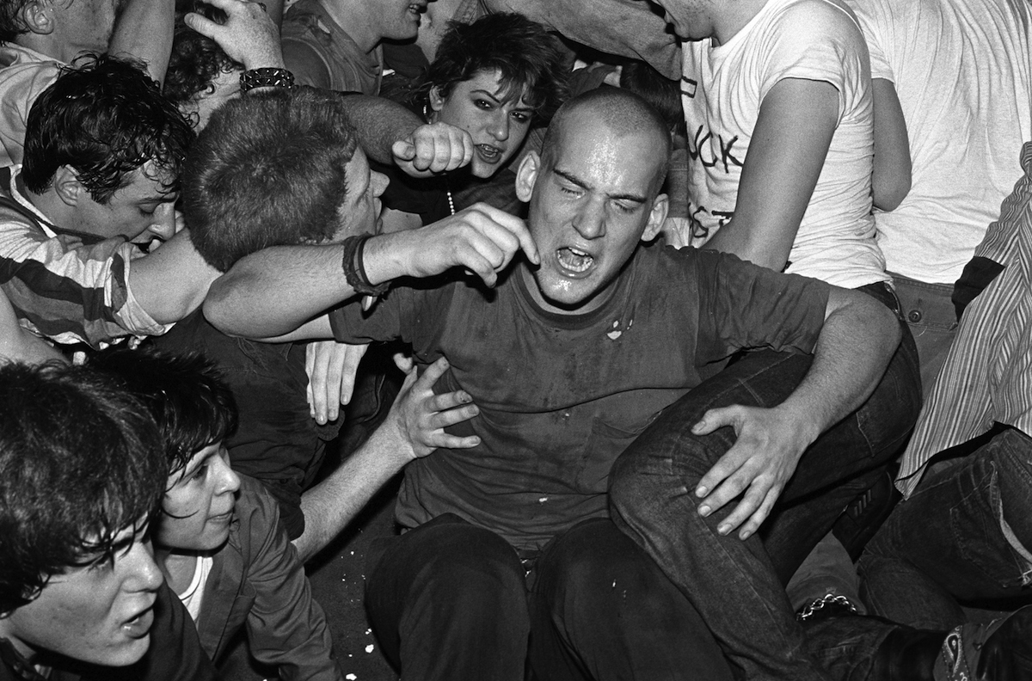
Photo: Jim Saah
Notes:
and Minor Threat have become punk icons and helped lay the foundation for a community that is still going strong today.

Slide 4
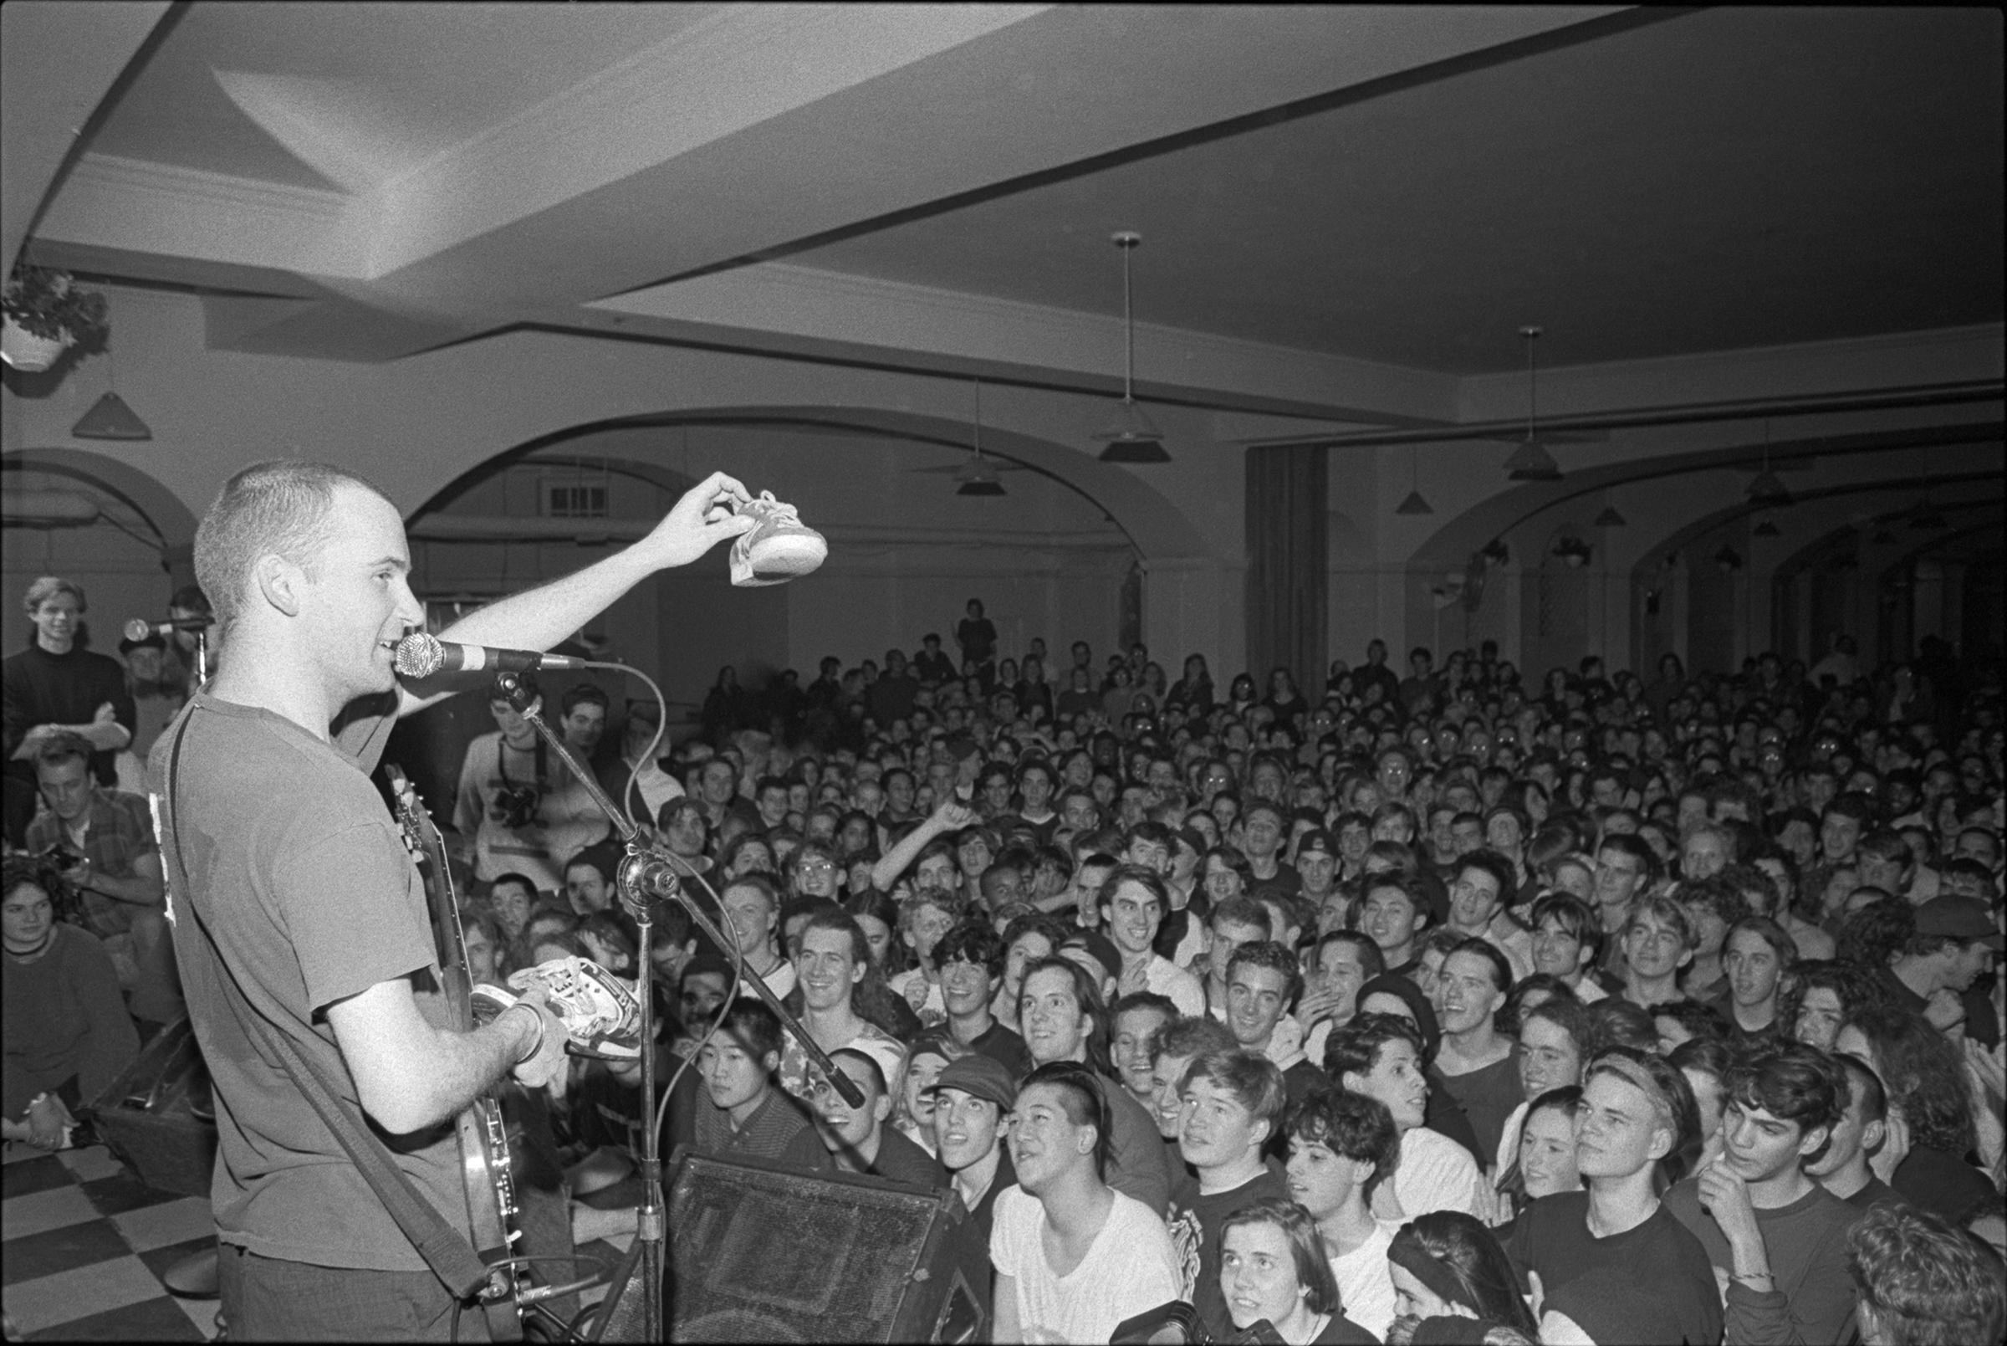
Photo : Bert Queiroz
Notes:
Punk grabbed a hold of me as a young teenager, back in the early 1990s when bands like Fugazi were leading the scene. Punk fans at my high school traded mix tapes and sported homemade t-shirts emblazoned with band names like Bikini Kill and Nation of Ulysses. This is how I first knew that something was really happening. When I heard all of these bands for the first time, the music spoke to me in a way that I had long been waiting for. Here was this new thing that was immediate, energetic, confrontational, and righteous.

Slide 5
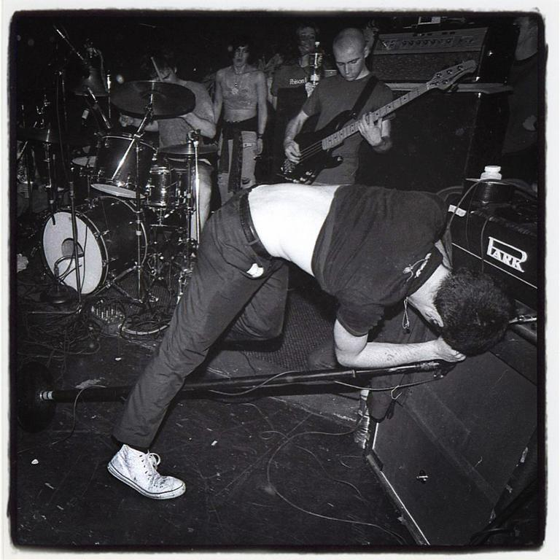
Photo: John Falls
Notes:
On April 4, 1992, I went to my first punk concert. As seen here, Fugazi played at the Sanctuary Theatre in Washington, D.C. The venue was packed and hot and smelled weird. I was genuinely afraid walking through the hallway that led to the performance space, as everything was so different and intimidating. Quickly, though, it felt like a place I knew I wanted to stay. The music was life-affirming and the merchandise tables were blanketed with activist literature that sought to make the world a better place, which was vastly different than the $50 t-shirts I was used to seeing for sale at the arena rock concerts I had previously attended.

Slide 6
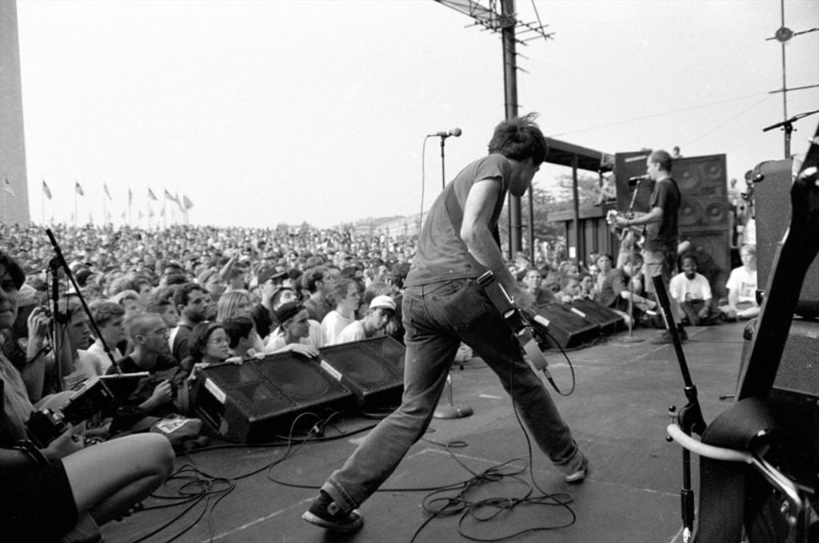
Photo: Bryan Whitson
Notes:
I started going to see Fugazi and other D.C. punk bands play in unconventional venues like community centers, church halls, outdoor parks, basements, and anywhere else punks could set up a concert. Before punk, going to a concert, to me, used to mean that I’d be seated in some stadium about a mile away from the action. So, it was no wonder that seeing a band as powerful and exciting as Fugazi in person from just a few feet away had a major impact on me. This photo is from the summer of 1993 when Fugazi played to thousands at the Washington Monument, one of their defining moments. That’s me sitting cross-legged on the ground to the furthest right in the photograph.

Slide 7
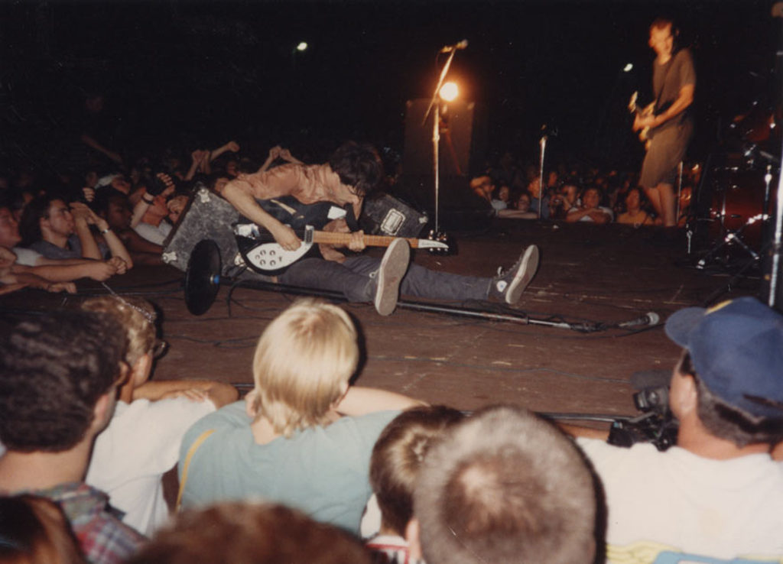
Photo: Unknown
Notes:
I saw them again, two days later at Fort Reno Park in DC. That’s me hanging on the stage in the middle of the picture with the green shirt.
Before long, my own punk band was playing concerts in those same unconventional venues, I was putting out records on my own record label, I was taking photographs of bands at shows, and I was publishing my own punk fanzine.

Slide 8
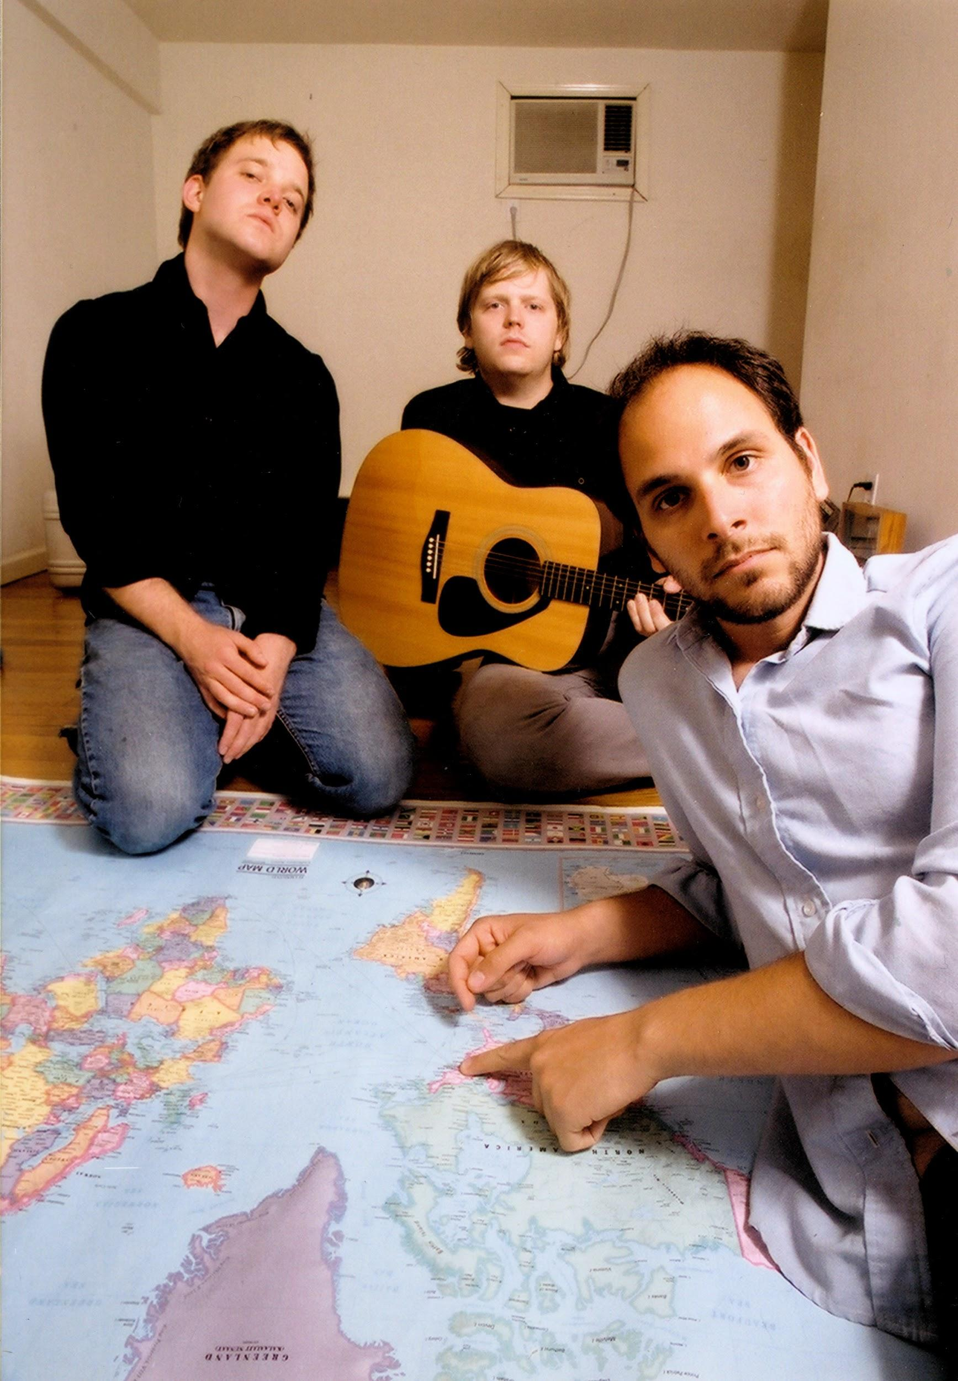
Notes:
I went on to play music in a bunch of bands over the years and was even able to make a living just putting out records and touring for a while. Eventually, though, it became clear that I couldn’t afford to live that way much longer, so I thought about what I could do next that might strike the same chord in me that playing music did.

Slide 9
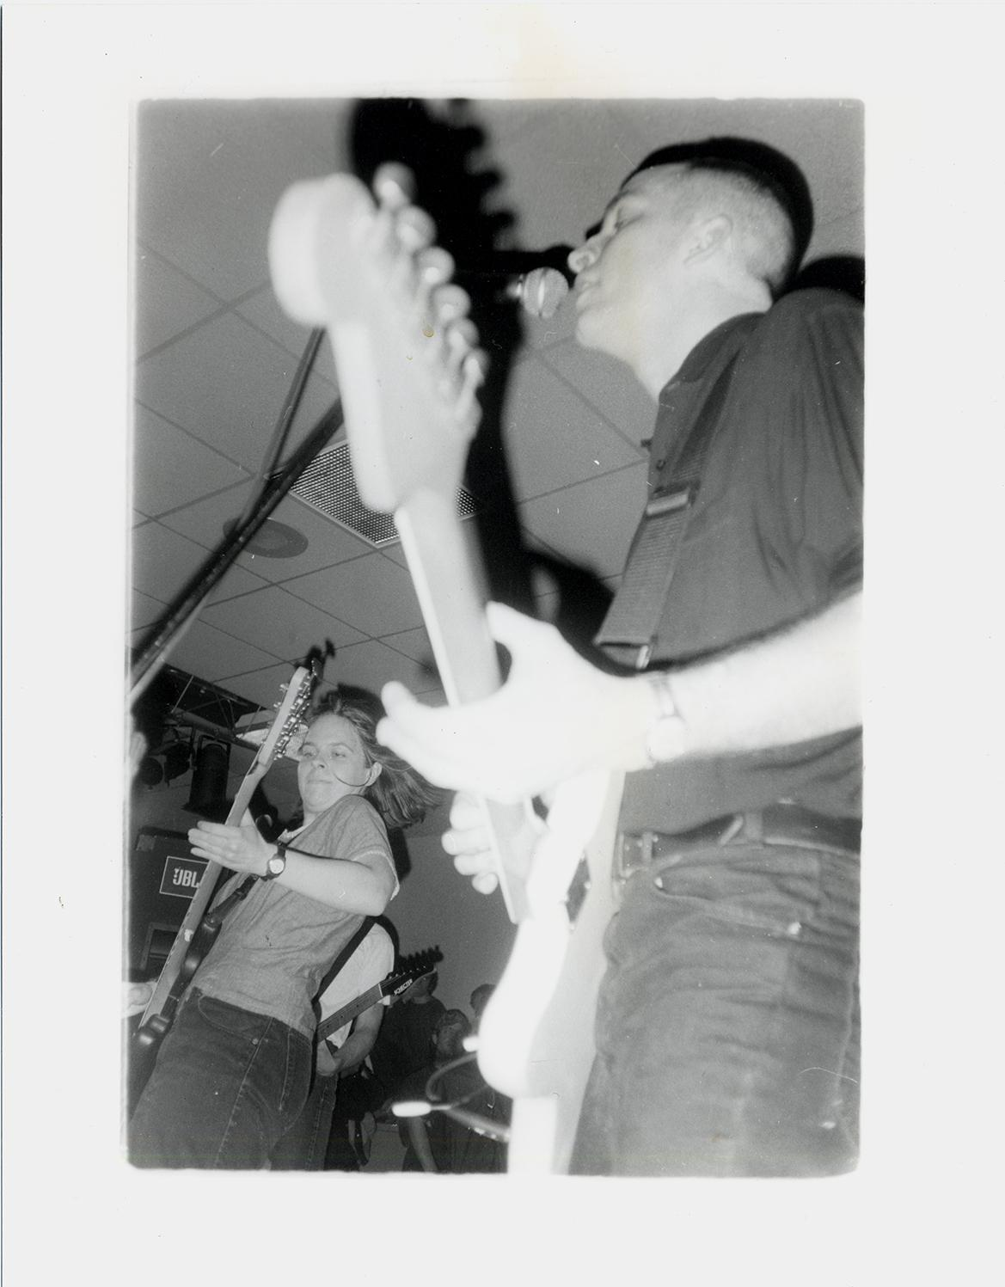
Notes:
Several punk musicians I’d met and respected were immersed in the world of libraries and archives. Kim Coletta of the DC band Jawbox had gone on to library school after her band broke up.

Slide 10
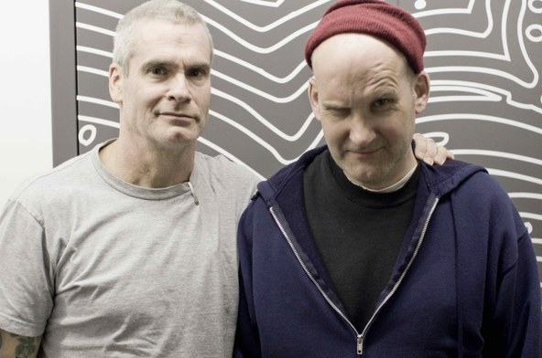
Photo: KCRW
Notes:
Others, like Ian MacKaye of Fugazi or Henry Rollins of Black Flag, were self-taught archivists, building extraordinary collections around their own materials without any institutional assistance. Just like their music had inspired me, those musicians helped to illuminate another world that I would become immersed in: Libraries and Archives.

Slide 11

Located in the Michelle Smith Performing Arts Library at the University of Maryland, Special Collections in Performing Arts (SCPA) collects, serves, and preserves performing arts materials that document performance practice, instruction, and scholarship.
Notes:
By 2013, I had gotten my MLIS and was working at Special Collections in Performing Arts, also known as SCPA, at the University of Maryland. SCPA is located in UMD’s Michelle Smith Performing Arts Library (MSPAL), a branch library located in the Clarice Smith Performing Arts Center. SCPA’s mission is to collect, serve, and preserve performing arts materials that document performance practice, instruction, and scholarship.

Slide 12
Special Collections in Performing Arts (SCPA)
Materials at SCPA include:
65,000+ scores
35,000 recordings
20,000 photographic items
A print collection of more than 15,000 titles
Notes:
Materials at SCPA include more than 65,000 scores, 35,000 recordings, 20,000 photographic items, a print collection of more than 15,000 titles,

Slide 13
Special Collections in Performing Arts (SCPA)
E. Collections related to:
Dance
Theatre
Popular music
Composers
Bands
Music education
Official records of performing arts organizations
Notes:
and numerous collections related to dance, theatre, popular music, composers, bands, music education, and the official records of performing arts organizations.

Slide 14
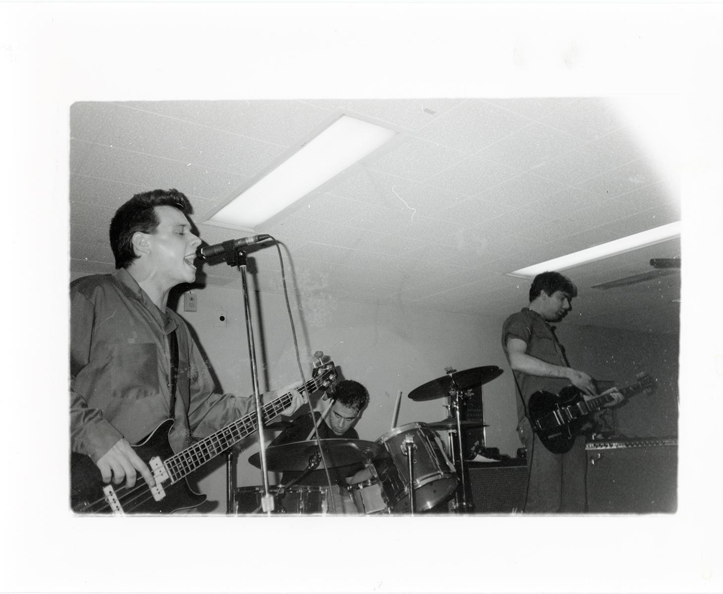
Notes:
Shortly after I joined the staff at SCPA, I proposed an idea to the curator, Vincent Novara. Vin is also a longtime participant in the DC punk scene—as seen in this 1995 photo I took of his band, the Crownhate Ruin—so I hoped he might be receptive to the idea of a punk collection coming to SCPA. I was inspired by punk collections like the Riot Grrrl Collection at New York University’s Fales Library and the University of Iowa’s Sarah and Jen Wolfe Collection of Riot Grrrl and Underground Zines. Also, around that same time, our colleagues at the DC Public Library launched the DC Punk Archive, a collection that broadly documented DC punk culture. With all of this in mind, I thought SCPA might start at a more granular level and initially build a collection that focused solely on punk fanzines created in the DC area

Slide 15
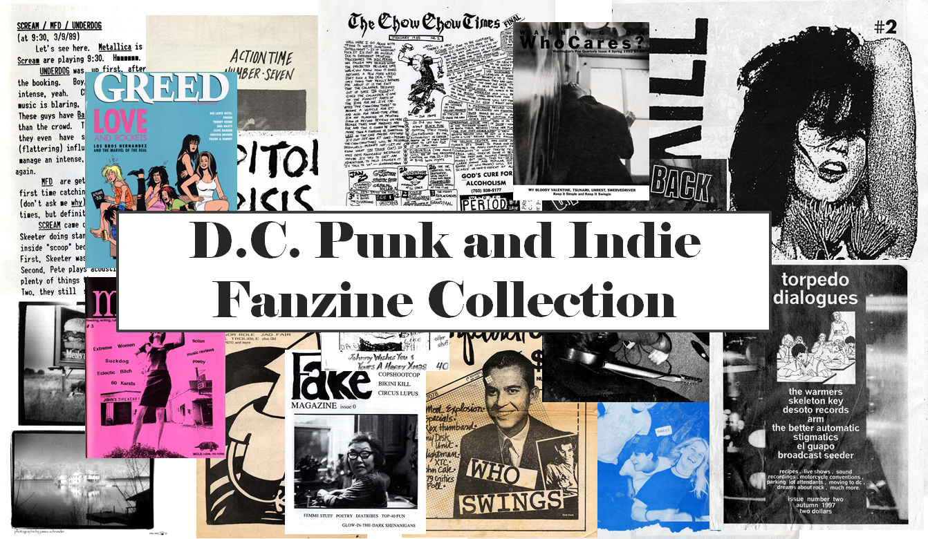
Notes:
Vin agreed and SCPA’s first punk collection, the DC Punk and Indie Fanzine collection was born.

Slide 16
Fanzines are publications produced by enthusiasts of an aspect of popular culture, usually in small runs and geared toward fellow fans.
Notes:
If you’re wondering what fanzines are, one definition could be: Fanzines are publications produced by enthusiasts of an aspect of popular culture, usually in small runs and geared toward fellow fans.

Slide 17
Notes:
I used the network of people that I knew from within the DC punk scene to build this collection in its entirety. Some donations came in through social media but nearly everything in the collection arrived through people I knew or through friends of people I knew. This was sort of the beginning of this idea that SCPA’s punk collections have tapped into, with donors within a subculture being gatekeepers to new materials and collections that might have been left to sit in a basement somewhere. It also introduced me to the skepticism that some members of the punk community held toward major institutions like the University of Maryland. As one potential donor said to me when I asked about his materials coming to SCPA:

Slide 18
“Those institutions never cared about us before. Why should we trust them with what we’ve already taken care of for ourselves?"
Notes:
“Those institutions never cared about us before. Why should we trust them with what we’ve already taken care of for ourselves?" This is a fair question.
Punk is a subculture and, like many groups of people outside of the majority, its members are often left out of the narrative—in this case, institutional archives--by either oversight or active rejection. Members of these groups long had to tell their own stories and preserve their own histories. It is natural, then, that when someone from a major academic institution comes and asks for them to donate their materials, that they might resist. For me, when communicating with potential donors of punk materials, it was important to establish that I had the same reverence for their materials as they did. Expressing passion and expertise in the subject has gone a long way toward building the necessary trust. I can offer potential donors a way to give these materials purpose again by helping to preserve them and by making them available to researchers, giving them a second life.

Slide 19
“Those institutions never cared about us before. Why should we trust them with what we’ve already taken care of for ourselves?"
Notes:
People have deep emotional connections to these materials, both positive and negative, and part of successful donor relations can entail knowing how to be considerate of those emotions and helping potential donors to understand how their connections to the materials don’t end just because they aren’t sitting in their house anymore. Interestingly, several potential donors spoke of their materials with some resentment, describing their collections of zines, fliers, photographs, and other ephemera as fragments of the past that they drag from home to home, unsure of why they even keep them.
There have been times where I felt like what I was doing was therapeutic for the donor, helping them see the value in their pasts and the materials they’ve collected and preserved for so many years or even reconnecting them with the long dormant emotions or aspirations that were inextricable from the items they had collected. These materials represent people’s lives and legacies, so it’s important that we convey our respect for the collections and make it clear that we will be capable stewards.

Slide 20
“Those institutions never cared about us before. Why should we trust them with what we’ve already taken care of for ourselves?"
Notes:
As iconoclastic as some punks might be, all of the donors who have given materials to SCPA have expressed gratification and gratitude at the knowledge that their collection—which they have sometimes doubted the value and purpose of—was worthy of preservation and research. It can be enormously validating to people to know that the materials they made or protected are things that other people could find use in.

Slide 21
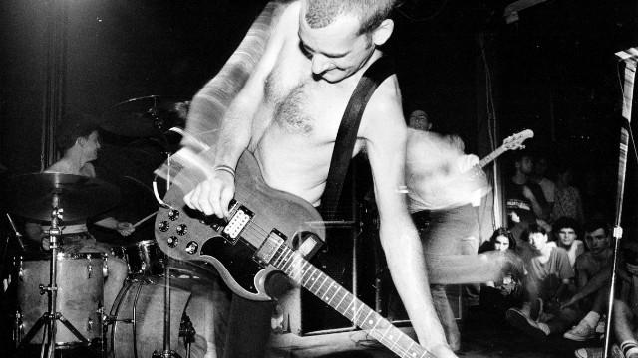
Photo: Jim Saah
Notes:
Just like I was brought into punk through the word of mouth network at my high school, one donor’s positive experience with us can lead to them sharing their experiences with others and bringing in new donors. If there’s a case study of this for SCPA, I’d say it’s Ian MacKaye. He and I had a friendship already from years of interaction in the DC punk scene, but I have definitely had to prove myself as an archivist to him. I proposed an idea of digitizing his personal fanzine collection--consisting of more than 1700 zines--to post online to UMD’s Digital Collections website for anyone to see, which he ultimately agreed to. That project is still in progress--the first part of it should be accessible later this year--but this new working relationship with Ian has been a good one and he wound up helping us bring another important punk collection to SCPA.

Slide 22
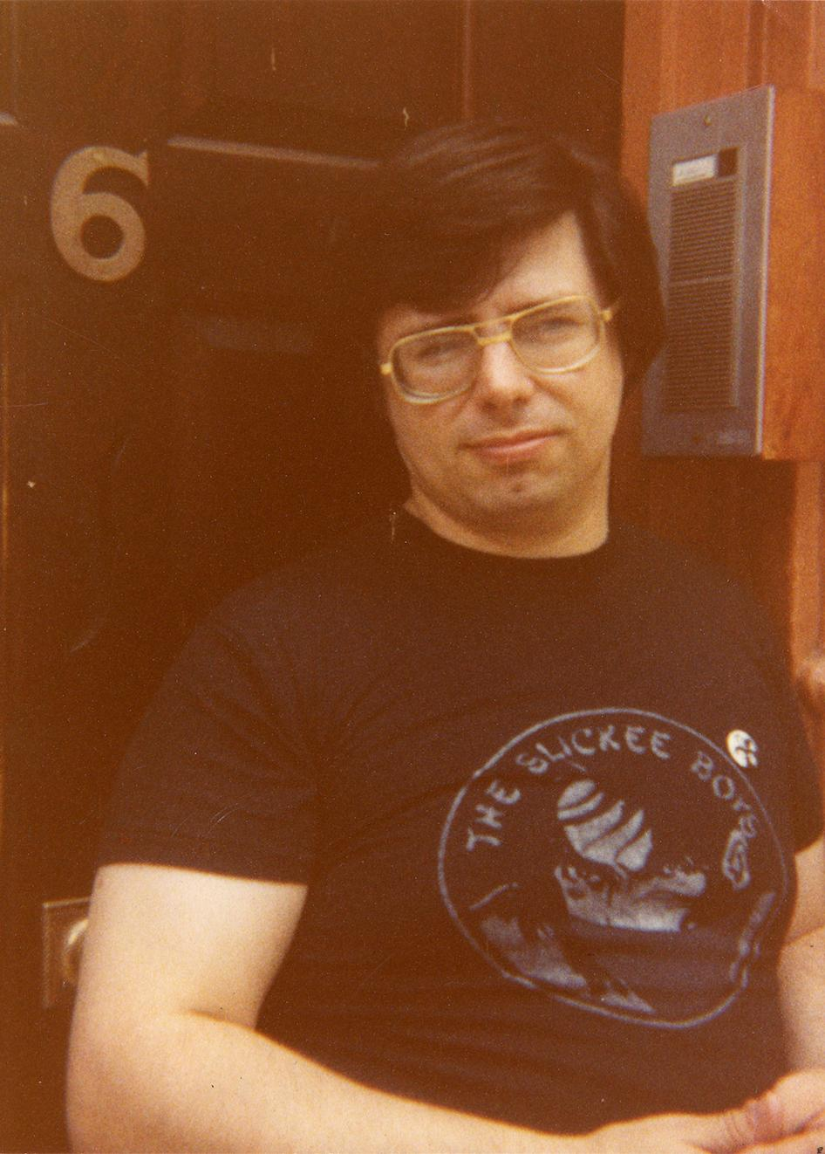
Notes:
Skip Groff, one of the founding figures of the DC punk scene through his work as a record producer and record store owner, as well as an important mentor to Ian, wound up donating a collection of photographs, recordings and correspondence in 2017. Ian very much served as an agent for us, vouching for me, Vin, and SCPA and even helping me with some archival pre-processing on site at Skip’s house when we determined which materials would come to SCPA. Skip passed away earlier this year and I am so glad that we were able to establish this relationship while he was still alive and he could understand just how important his legacy to music is.

Slide 23
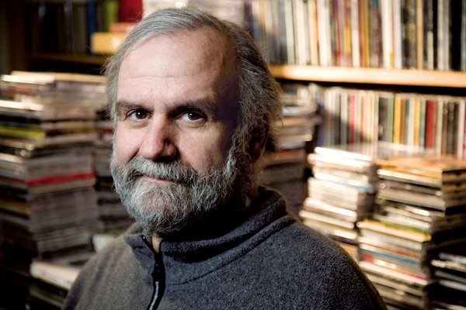
Photo via Washington Post
Notes:
There have been other similar gatekeeper situations with SCPA, too. Our positive donor relationship with longtime DC music journalist Richard Harrington led to the acquisition of the papers of his close friend Mike Schreibman, one of DC’s most influential music promoters from the late 1960s into the 21st century. When Mike was looking for a place to donate some of his papers, Richard recommended SCPA as the right place for them based on the trust that had grown through the donations he had previously made.

Slide 24
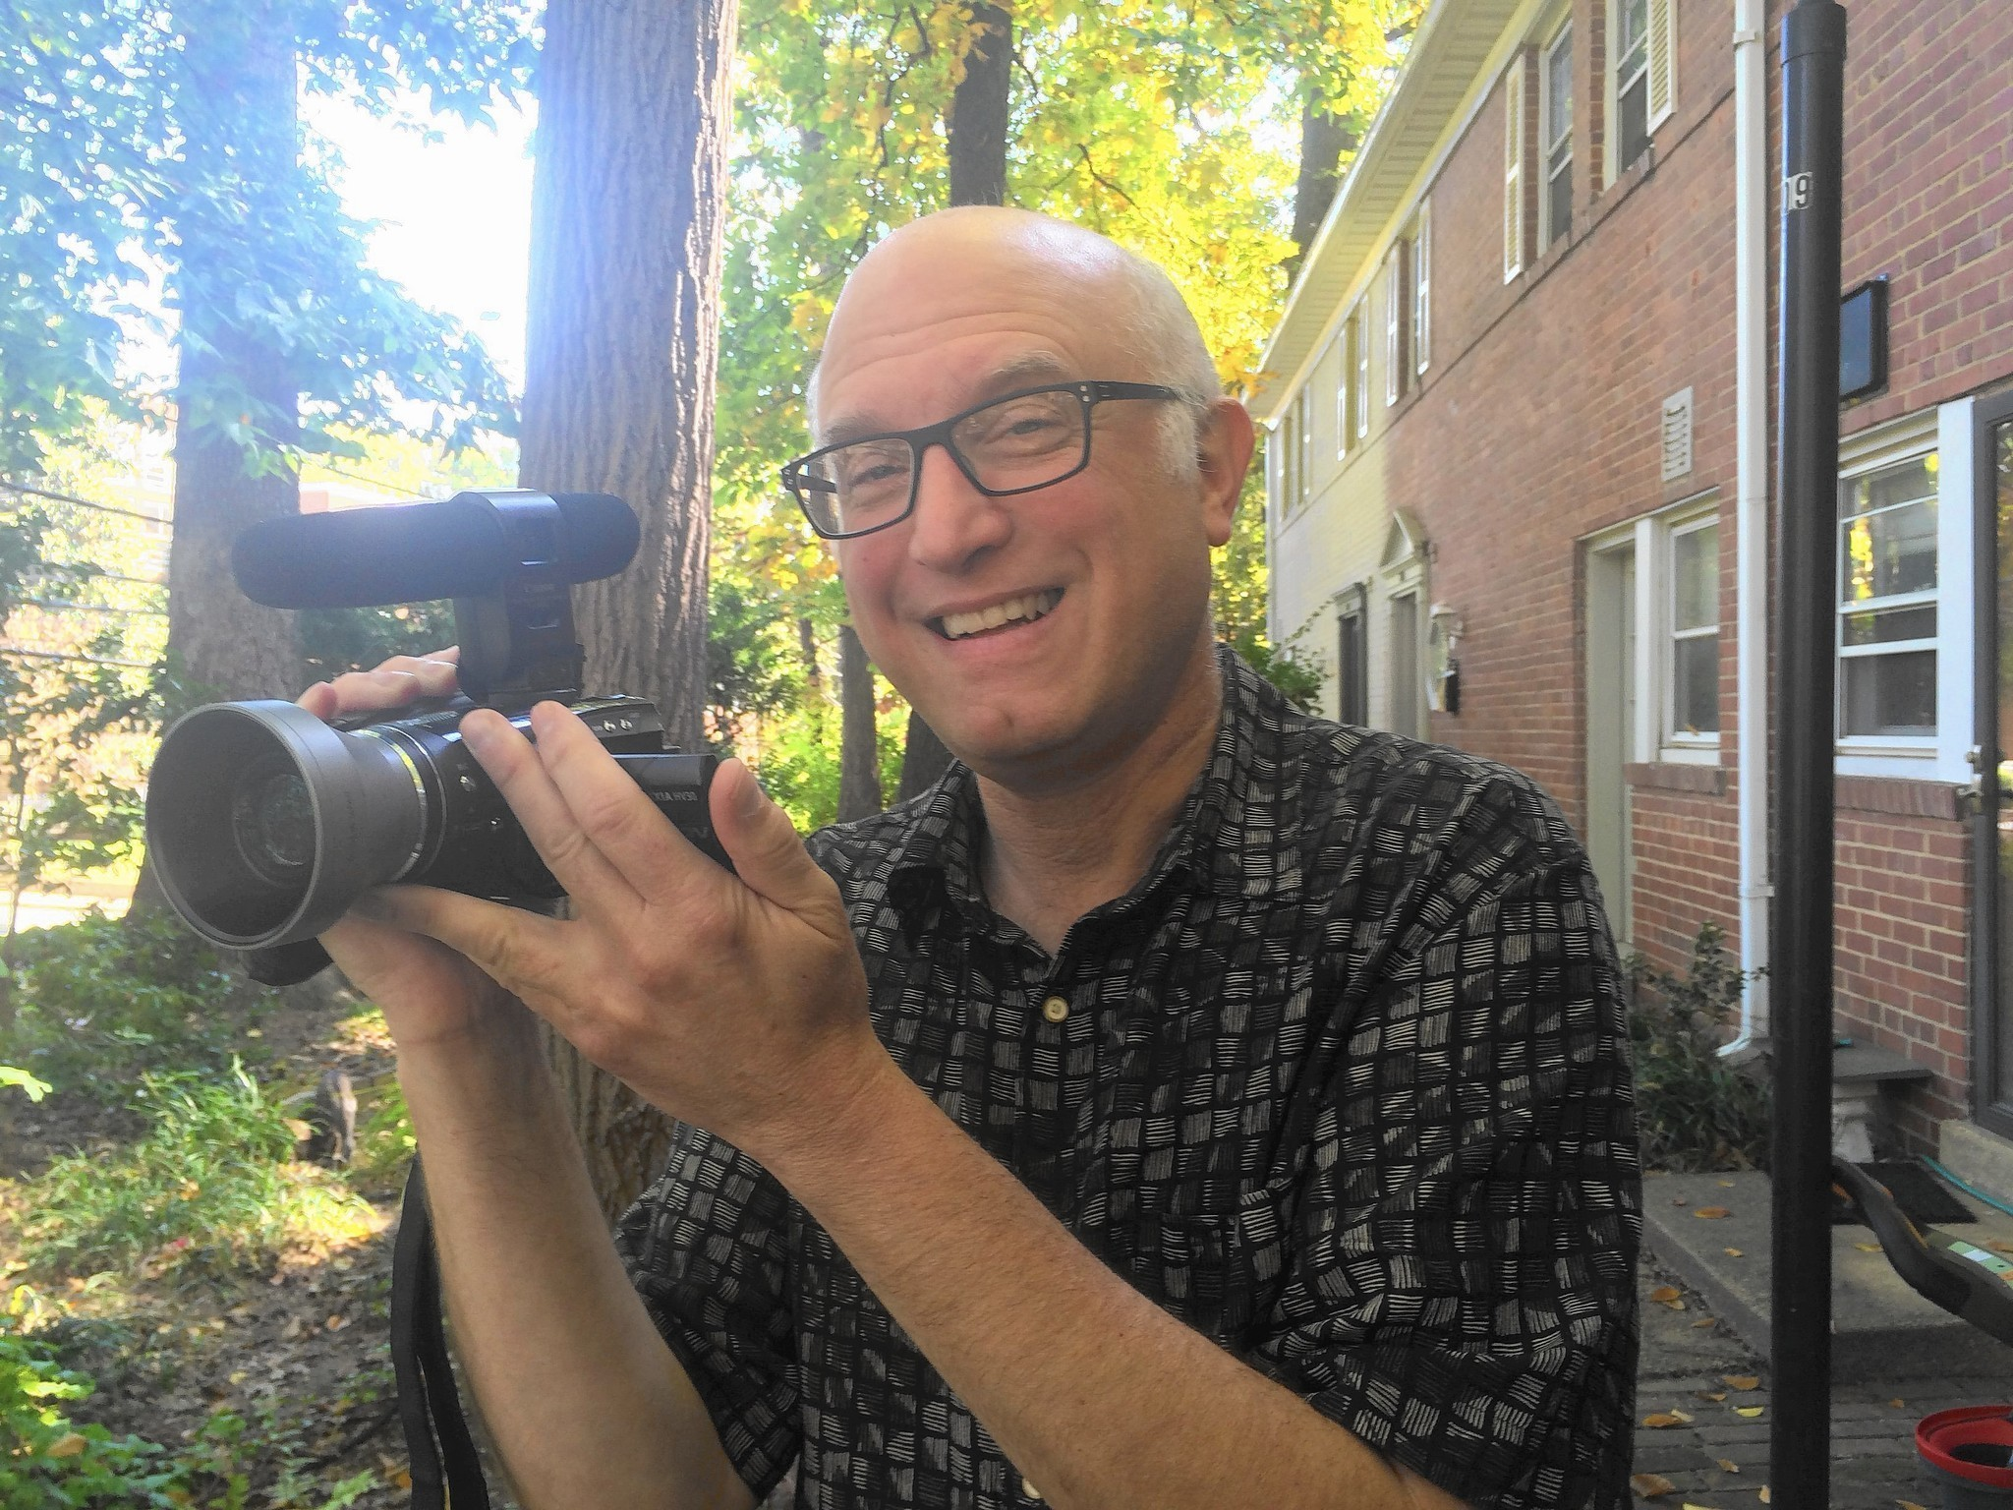
Photo via Capital Gazette
Notes:
Another example is the filmmaker Jeff Krulik, best known for his cult classic documentary

Slide 25
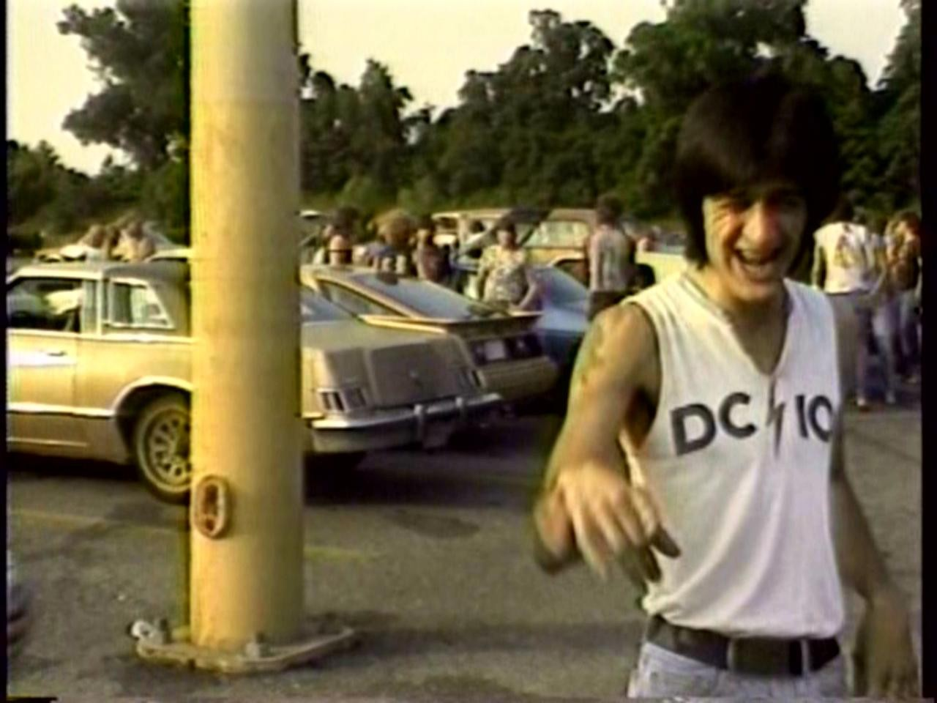
Notes:
Heavy Metal Parking Lot. Jeff has collaborated with SCPA and was so pleased with his experience that he frequently advocates on our behalf with friends of his from the DC music community to donate their materials to UMD. As a collecting area grows, you build momentum.

Slide 26
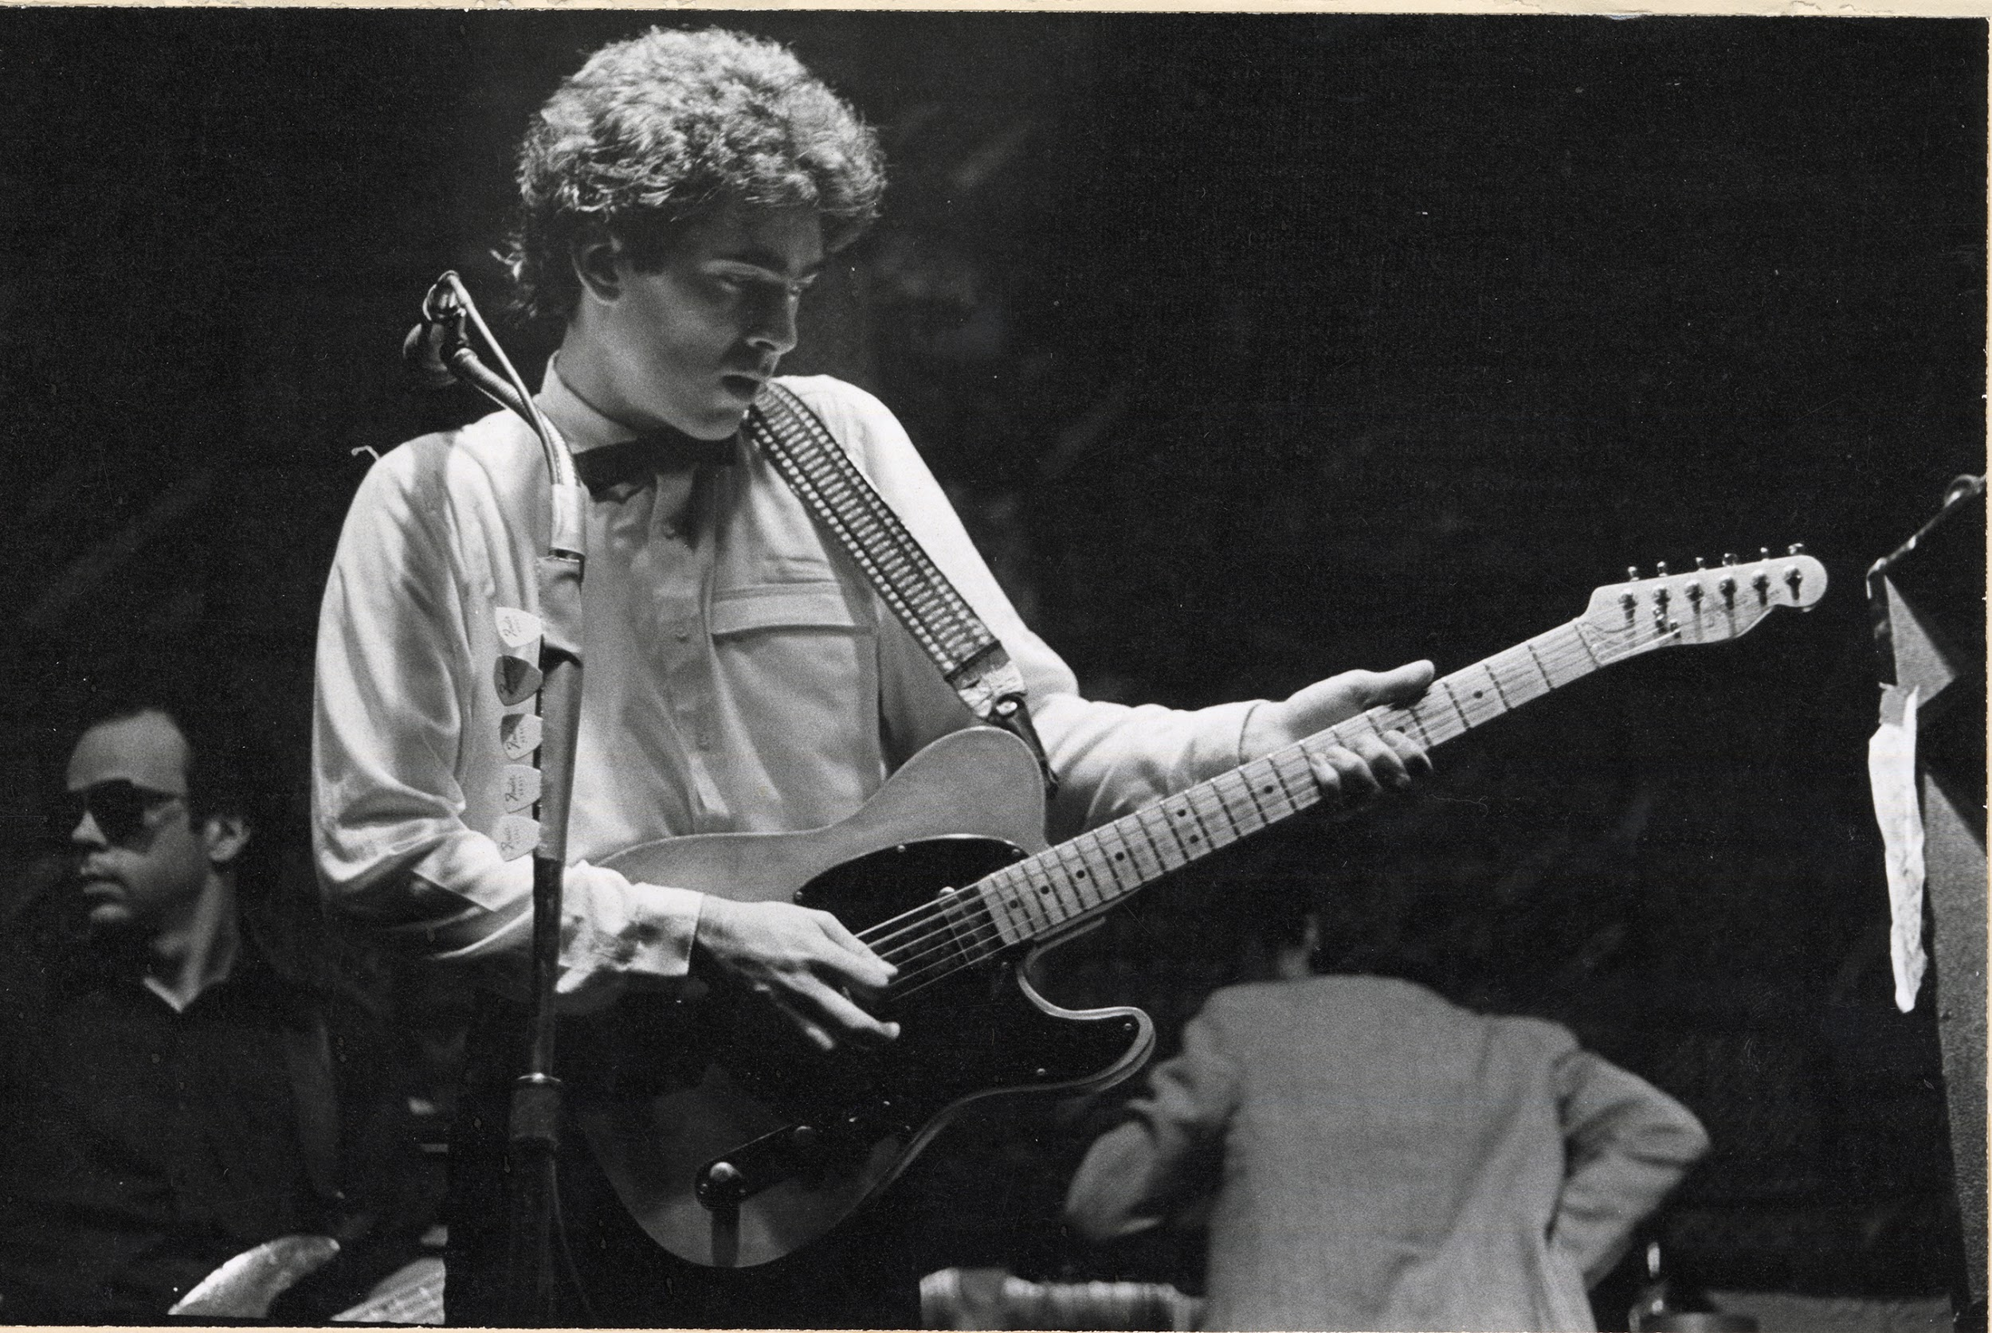
Notes:
When the DC musician Tommy Keene passed away unexpectedly in 2017, his brother Bobby came across an appreciation of Tommy that I had written for the Washington Post and he passed along his thanks to me. This led to us talking about the idea of a collection of Tommy’s materials coming to UMD, something that might never have crossed Bobby’s mind if we did not already have collections from Tommy’s peers like Skip Groff, Ian MacKaye, Sharon Cheslow, and others. In summer 2018, the Tommy Keene collection was established at SCPA.

Slide 27
Notes:
Donor relations within a subculture can be a challenge, for ideological, emotional, and practical reasons. I feel that, at SCPA, we’ve been able to build connections with these donors by showing that our relationship can be the latest link in the chain of their stories. When it comes to strong relations with donors, as Fugazi once sang, “there is a question of trust.” Punk has always been about building communities where people could come together to express themselves creatively, politically, aesthetically, and even physically while finding some form of acceptance. It’s about community and trust. It’s about relationships, to each other and to these materials. And it’s demonstrating that this is a passion for us, the archivists, just like it has been for them.

Slide 28
THANK YOU

