Slide 1
Project Academic Knowledge
Using the Microsoft Academic API to evaluate institutional repository impact
Joseph Koivisto

Slide 2
https://go.umd.edu/LRIPF-MA

Slide 3
What is Microsoft Academic?
Notes:
To begin, what is Microsoft Academic?

Slide 4
What is Microsoft Academic?
Commercial discovery interface
Publicly accessible
Semantic search vs. keyword search
“employs advances in machine learning, semantic inference and knowledge discovery”
https://academic.microsoft.com/faq
Notes:
Microsoft Academic is a commercial discovery interface developed and maintained by Microsoft.
It is publically accessible via the web and provides search and access (in some cases) to millions of research publications from around the world.
Perhaps most notable is the fact that MA uses some fairly advanced semantic evaluation of search terms, going beyond basic keyword searching that can sometimes encounter issues with natural-language search behaviors
But that’s not the focus of this talk

Slide 5
What isn’t Microsoft Academic?
Notes:
Also important to note what MA isn’t

Slide 6
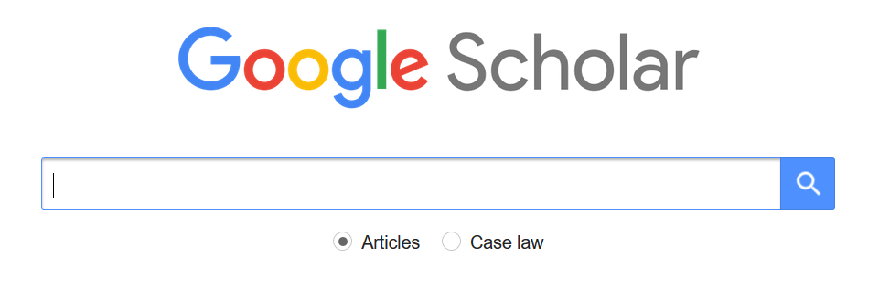
Notes:
*cough cough*

Slide 7
Why it matters that it isn’t Google Scholar...
An alternative to Google hegemony
Discovery not limited to publisher outlets and interfaces (includes open access resources*)
Pathways for systematic access and reuse of data
Notes:
While Microsoft Academic is a product of perhaps one of the most monolithic corporate entities in the history of the world, there is an argument that MA represents a challenge to the all-but-complete primacy of Google Scholar as the ‘not library discovery interface’ of choice. There are many issues wrapped up in this (scholarly communication, corporatization of knowledge, privacy, equity), the fact that another commercial publically available interface exists should be worth the looking at.
MA is not only limited to resources published by scholarly journal publishers and includes open access resources. While this isn’t exactly unique, it is important when viewed in the context of the next point…
MA provides pathways for systematic access and evaluation of their data. This is a HUGE improvement over Google Scholar, which does not allow you to harvest their data and, as I inadvertently found out earlier this year, will ban a whole institutional IP range from accessing GS if they find your traffic to be beyond their acceptable limits. (Ask me about it if you want a funny story).

Slide 8
What is Project Academic Knowledge?
Notes:
So, there’s Microsoft Academic, but what is Project Academic Knowledge?

Slide 9
What is Project Academic Knowledge?
“With [the Project Academic Knowledge] service, you will be able to interpret user queries for academic intent and retrieve rich information from the Microsoft Academic Graph (MAG). The MAG knowledge base is a web-scale heterogeneous entity graph comprised of entities that model scholarly activities: field of study, author, institution, paper, venue, and event.”
https://docs.microsoft.com/en-us/academic-services/project-academic-knowledge/introduction
Notes:
Project Academic Knowledge is a application programming interface that allows users to query the Microsoft Academic Graph -- the underlying data structure that drives the MA interface -- without having to go through the traditional GUI. This is an API if that sounds familiar to any of you. Access to this platform is freely available to any interested person and only requires that you sign up for an account and subscribe (not unique for APIs, serves to better administer use).

Slide 10
What is Project Academic Knowledge?
Four related REST API methods:
Interpret: Interprets a natural language user query string.
Evaluate: Evaluates a query expression and returns Academic Knowledge entity results
Calchistogram: Calculates a histogram of the distribution of attribute values for the academic entities returned by a query expression
Similarity: Calculates the cosine similarity between two strings
https://docs.microsoft.com/en-us/academic-services/project-academic-knowledge/introduction
Notes:
Users can interact with Project Academic Knowledge using REST API methods. What is most interesting here is that you can do so much more than just query their resources (which, admittedly, is most of what I’m interested in doing). You can also query the MA Graph to investigate how query strings are interpreted by their semantic evaluation algorithms, see distribution of resource attributes over time, and more. It’s quite powerful, actually.

Slide 11
What is Project Academic Knowledge?
Four related REST API methods:
Interpret: Interprets a natural language user query string.
Evaluate: Evaluates a query expression and returns Academic Knowledge entity results
Calchistogram: Calculates a histogram of the distribution of attribute values for the academic entities returned by a query expression
Similarity: Calculates the cosine similarity between two strings
https://docs.microsoft.com/en-us/academic-services/project-academic-knowledge/introduction
Notes:
However, of primary interest to the general audience will be the evaluate method, which allows users to search Microsoft Academic resources based on query expressions that they have crafted.
Think of it as search on steroids with the help of a computer.
Computer steroids? Is this hacking? Insert johnny mnemonic gif

Slide 12
Limitations Project Academic Knowledge?
Not everything is indexed
Still a commercial scholarly portal
Requires some technical knowledge (not a lot, but more than zero)
Other limitations (Hug, Ochsner & Brändle, 2017)
Does not provide the publication document type
“Fields of study” are dynamic, too specific & field hierarchies incoherent
Some publications assigned to incorrect years
Metadata of some publications did not include all authors
Notes:
Now, as awesome as all this sounds, there are limitations
Not everything is indexed, so don’t be shocked it you look for something and it’s not there.
It is still first and foremost a commercial tool. Microsoft is extracting value out of scholarly research and publication, so let your conscience be your guide on that one.
Does require some technical skills. Their interface portal is very nice and does do some hand holding, but you need to be comfortable with working with data structures like JSON rather than human-readable plain text.
Hug, Ochsner & Brandle also note some other limitations

Slide 13
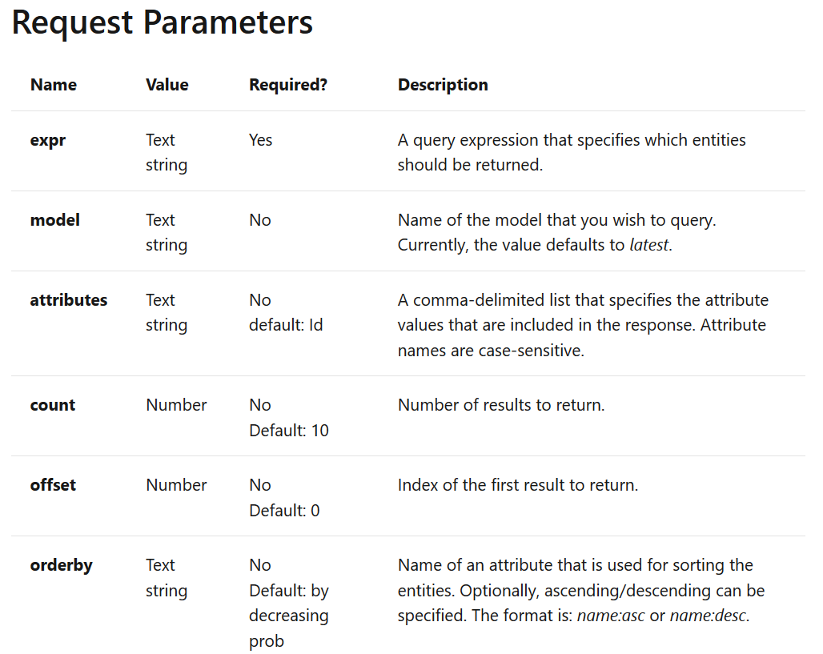
Project Academic Knowledge - Evaluate
https://docs.microsoft.com/en-us/academic-services/project-academic-knowledge/reference-evaluate-method
Notes:
To search PAK, it is important to understand the search structure it is expecting. Your query can include a number of parameters, shown here. The interface that I will link to later in the presentation will provide you with a field for each of these parameters, but they are important to know about if you want to craft your own requests.

Slide 14
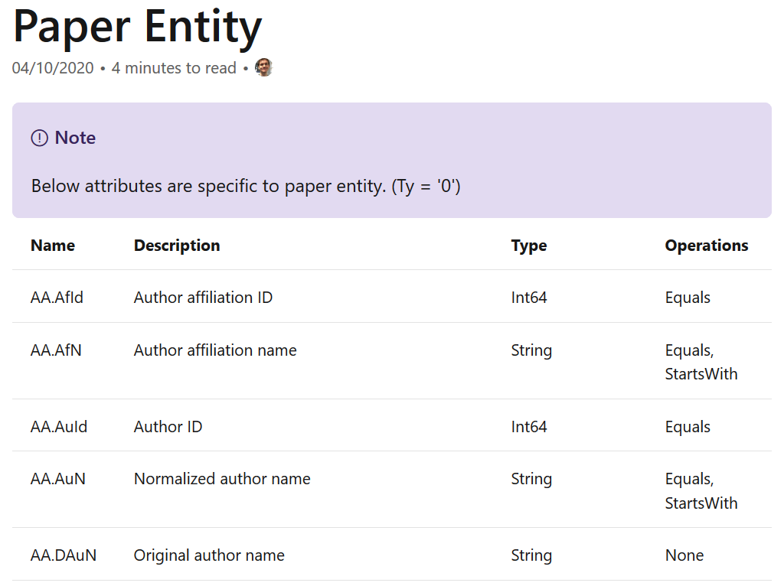
Project Academic Knowledge - Evaluate
https://docs.microsoft.com/en-us/academic-services/project-academic-knowledge/reference-paper-entity-attributes
Notes:
Your query -- the expression parameter from the previous slide -- will query different entities, including papers, authors, institutions, field of study, &c. There is a great deal of documentation on the PAK website, so you can find out exactly what type of entity you would like to search and what attribute to use.

Slide 15
Use Case Scenario
Notes:
Sounds cool right? So what’s an example of its usefulness?

Slide 16

How to get citation counts for 13,000+ records?
Notes:
As a part of the MD-SOAR renewal project, I wanted to collect as much statistical data about the platform to make a case for its continued support. It was suggested that citation counts would be especially impactful, but this data isn’t by default captured in DSpace. So, after crushing failure using Google Scholar, I decided to try MA.

Slide 17
Project Academic Knowledge - Evaluate
Project Academic Knowledge
List of DOIs from MD-SOAR
Extracted data per request
Python Script
Notes:
Workflow was relatively simple, extract DOIs from MDSOAR, run them through a Python script that creates Project Academic Knowledge requests and extract the citation counts as a CSV

Slide 18
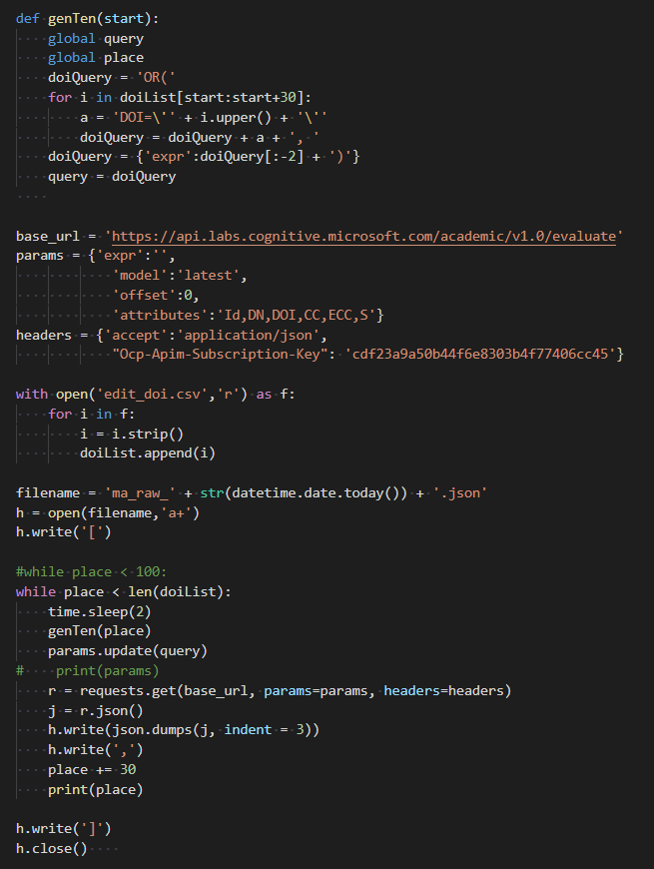
Project Academic Knowledge - Evaluate
See the code on GitHub at https://gist.github.com/23koivisto/994063d4c1d8f9d30a49797e58553935
SECRET, SHHH!!!!!!!!
Notes:
Here’s the code I used. It is available on GitHub should you be interested.

Slide 19
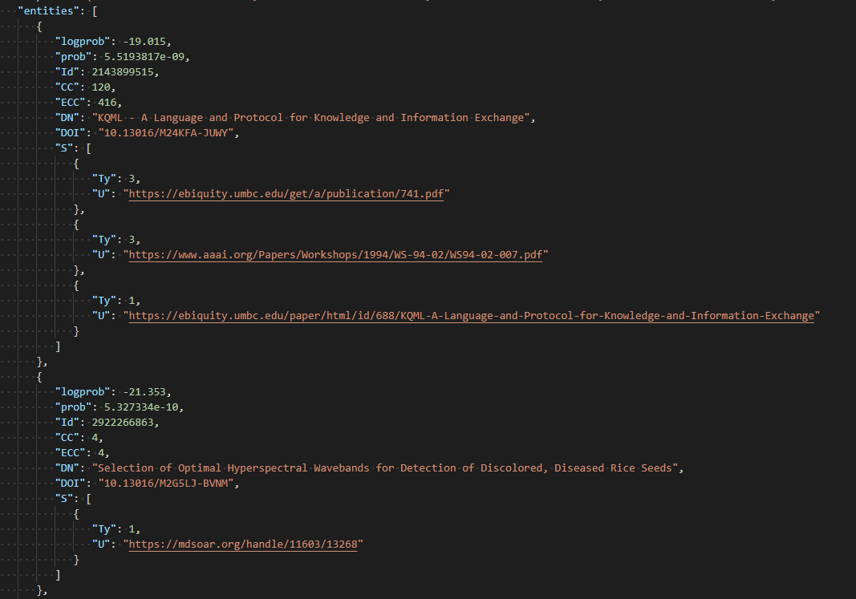
Notes:
Returned data comes in as JSON by default. You can see it here.

Slide 20
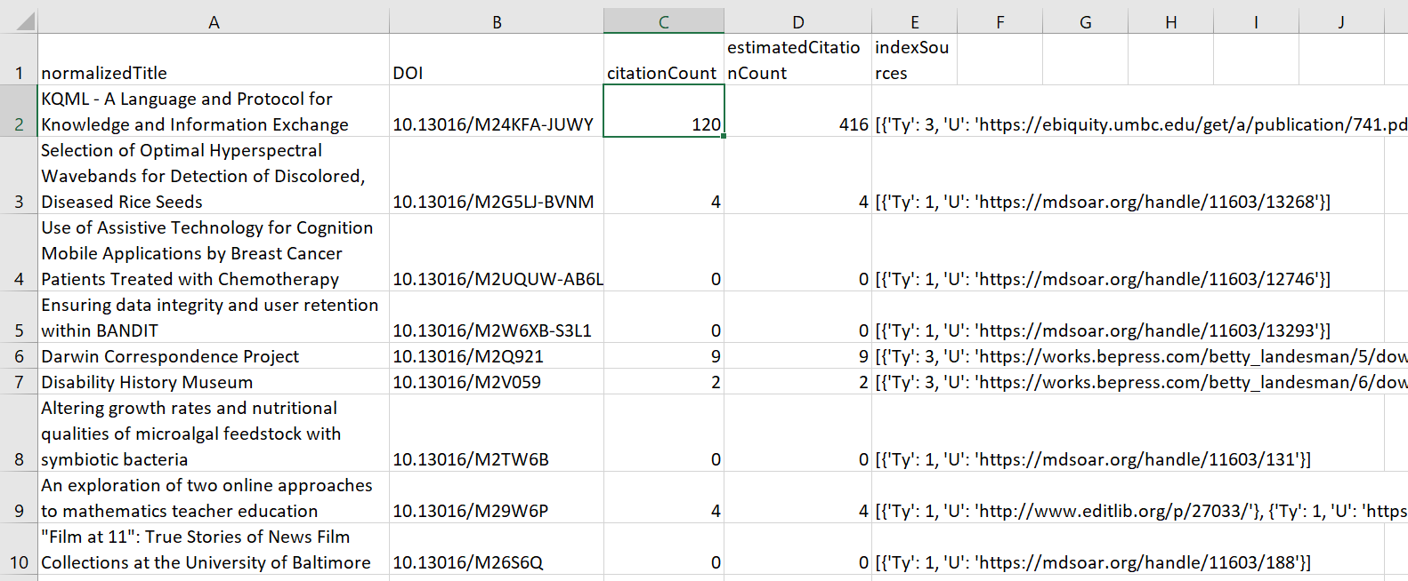
Project Academic Knowledge - Evaluate
Notes:
And, voila! After a little python trickery, you have an easy-to-use spreadsheet of citation counts per indexed title. Like I said, not everything is indexed, so it doesn’t capture everything, everything, but it does give you a good picture.

Slide 21
2,235 records indexed
Notes:
Results? MA has indexed 2,235 records based on MDSOAR generated DOIs (roughly 17%)

Slide 22
5,189 citations recorded
Notes:
And of those, there were 5,189 citations recorded on MA. Pretty substantial. Now, those aren’t evenly distributed, some are cited more than others, but from a sheer n-value perspective, it is worthwhile data to have.

Slide 23
How to get started

Slide 24
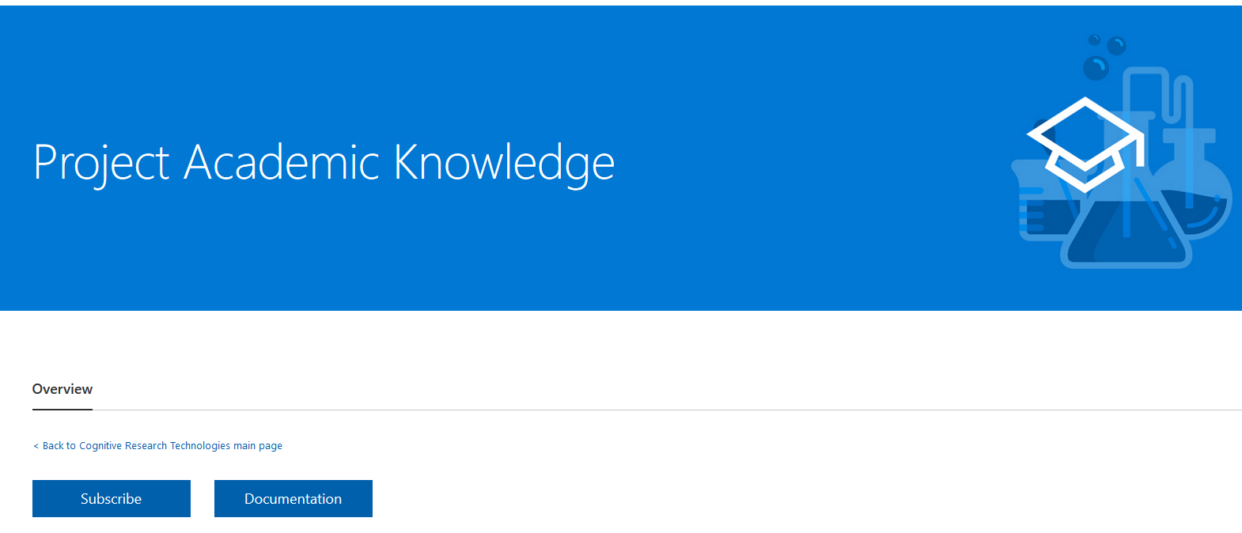
How to get started
Visit https://www.microsoft.com/en-us/research/project/academic-knowledge/ and subscribe
Notes:
First things first, you need to subscribe to Project Academic Knowledge. The link in this slide will take you to the site where you can elect to do so.

Slide 25
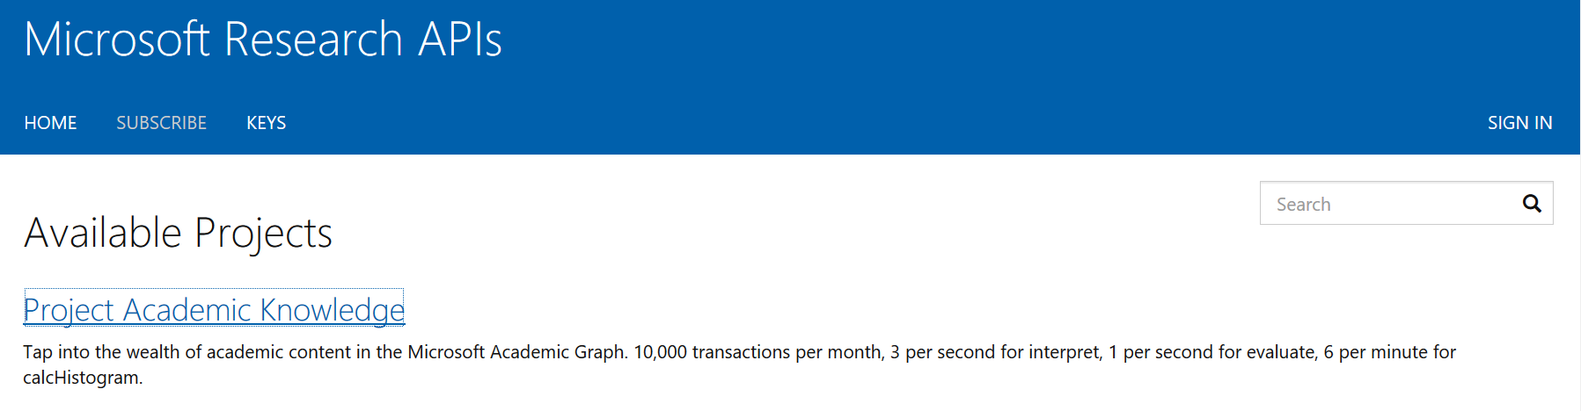
How to get started
Notes:
Select the Project Academic Knowledge project

Slide 26
How to get started
Create a Microsoft API Management account if you don’t already have one
Notes:
You’ll be asked to login, so make an account if you don’t have one (super easy)

Slide 27
How to get started
You’ll get a couple emails, be sure to check your spam folder if you don’t see them

Slide 28
How to get started
You’ll receive a subscription key
Notes:
An email will be sent that includes a link to the subscription key. If you are going to use the web interface for experimenting, you won’t need to save it as the key will be associated with your login.

Slide 29
How to get started
Navigate to https://msr-apis.portal.azure-api.net/docs/services/academic-search-api
Notes:
Once you have an account and a subscription, you can navigate to the Academic Search API where you can try your hand at querying the MA graph.

Slide 30
How to get started
Experiment!
(Suggest starting with GET Evaluate)
Notes:
And you’re all set! Go experiment. I do suggest starting out with the evaluate method as it will likely be what you’re most interested in.

Slide 31
How to get started
Important note
Expression (expr) is where you enter your search query
Attributes is where you will specify what fields you would like returned
Notes:
Don’t forget, your search really relies on two key parts: the expression and the attributes

Slide 32
How to get started
Example
expr: DOI=’10.1145/2983270’
Searches for resources identified by this DOI
Attributes: Id, DN, CC, ECC,AA.AuN
Will return the resource ID, normalized name, citation count, estimated citation count, and normalized author’s name
Notes:
Here’s an example of a search expression and the attributes you may want to include

Slide 33
How to get started
Documentation on the evaluate method is available at https://docs.microsoft.com/en-us/academic-services/project-academic-knowledge/reference-evaluate-method
Notes:
There is a lot of documentation available, so no need to worry!

Slide 34
Keep in touch
Let me know what you’re working on
Let me know if you need help on a problem
Come to UMD Libraries Coding Workshop

Slide 35
Citations
How is MA different from other academic search engines? (ND). https://academic.microsoft.com/faq
Project Academic Knowledge (2020). https://docs.microsoft.com/en-us/academic-services/project-academic-knowledge/introduction
Hug, S.E., Ochsner, M. & Brändle, M.P. (2017). Citation analysis with microsoft academic. Scientometrics 111. P 371–378. https://doi-org.proxy-um.researchport.umd.edu/10.1007/s11192-017-2247-8
Evaluate method (2020). https://docs.microsoft.com/en-us/academic-services/project-academic-knowledge/reference-evaluate-method
Paper entity (2020). https://docs.microsoft.com/en-us/academic-services/project-academic-knowledge/reference-paper-entity-attributes

