Slide 1


Thesis Defense
High Efficiency Megawatt Class Constant Impedance Tunable Power Extraction Circuits for Mobile Ionospheric Heaters
Amith Hulikal Narayan
Department of Electrical & Computer Engineering,
University of Maryland
Advisor:
Professor Thomas M Antonsen Jr.
,
Thesis Defense Committee:
Professor Thomas M Antonsen Jr. (Chair)
Professor Edward Ott
Professor Neil Goldsman
Professor Adil Hassam
Dr. Brian L Beaudoin, Dr. Antonio C Ting & Dr. Gregory S Nusinovich
AFOSR GRANT NO - FA9550-14-1-0019

Slide 2
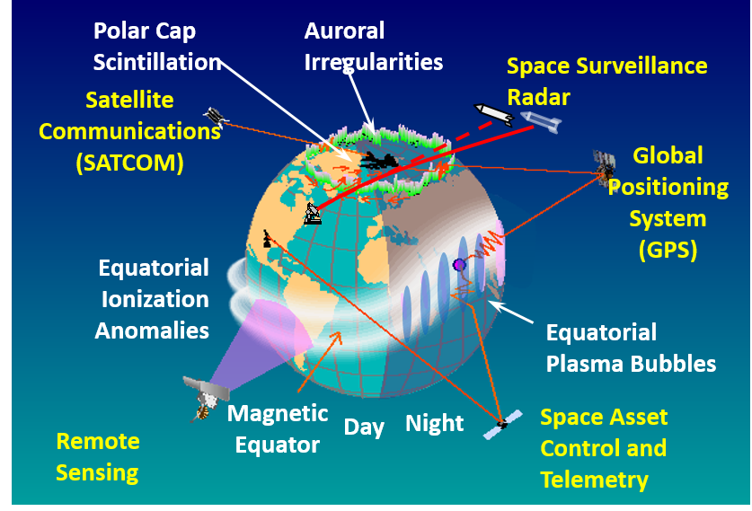
Ionospheric Modification: Relevance & the role of High Frequency Heaters
Ionosphere - Ionized part of Earth's upper atmosphere, from about 60km - 1000km altitude.
It controls the performance of critical DoD and civilian communications and navigation systems.
Ionospheric modification refers to changes in the ambient properties of the ionosphere that are produced by humans.
High Frequency Heaters broadcast high power radio waves typically in the RF band to modify the ionosphere in a controlled manner.
AFOSR MURI
UMCP, Texas Tech, UCLA
Notes:
The MOSC experiment was designed to provide an opportunity for the first comprehensive diagnosis of an artificially plasma cloud generated by the release of Sm vapor in the upper atmosphere. Of primary interest was an examination of the extent to which a tailored radio frequency (RF) propagation environment could be generated through artificial ionospheric modification. This included an investigation into the potential use of this technology for suppression of scintillation caused by ionospheric irregularities driven by the Rayleigh‐Taylor instability (RTI) in the nighttime equatorial region [Kelley et al., 2011; Makela et al., 2006]. Amongst other requirements, site selection called for a low‐latitude release close to an incoherent scatter radar facility capable of tracking the resulting plasma clouds.
The ionosphere (/aɪˈɒnəˌsfɪər/^{[1][2]}) is the ionized part of Earth's upper atmosphere, from about 60 km (37 mi) to 1,000 km (620 mi) altitude. It is above the Troposphere, Stratosphere, Mesosphere,
Navigation Satellites are at about 20,000 kms.
Ionospheric modification refers to changes in the ambient properties of the ionosphere that are produced by humans. Ionospheric Heaters broadcast high power radio waves typically in the RF band to modify the ionosphere in a controlled manner.

Slide 3
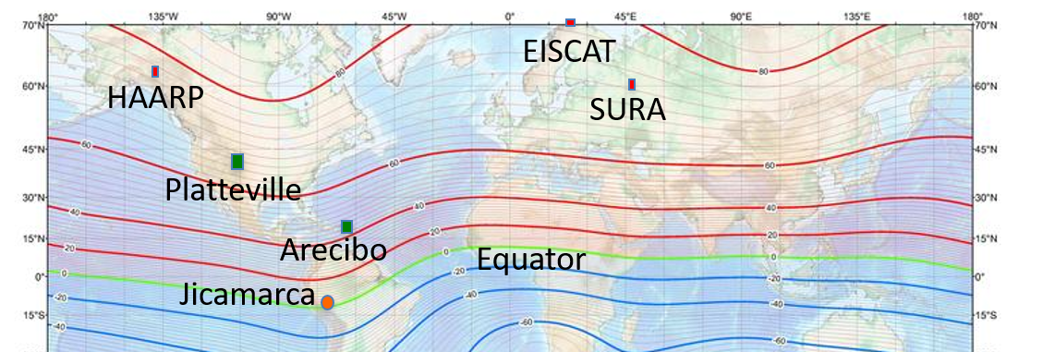
Mobile Ionospheric Heaters: Need & Impact
Past IM experiments, conducted at high latitudes indicate strong dependence of ionospheric processes on geomagnetic latitude.
Transportable heaters will allow for the first time a quantitative exploration of the IM requirements vs. geomagnetic latitude without expensive ground installations. Research capability to explore latitudes different than high latitudes currently explored.
Heater | Frequency (MHz) | Power (MW)
HAARP | 2.7-10.0 | 3.6
EISCAT | 3.9-8.0 | 1.2
SURA | 4.5-9.0 | 0.75
PLAT | 2.7-10.0 | 1.4
Arecibo | 5.125 or 8.125 | 0.6
Notes:
Effective Radiated Power is the total power in watts that would have to be radiated by a half-wave dipole antenna to give the same radiation intensity (signal strength in watts per square meter) as the actual source at a distant receiver located in the direction of the antenna's strongest beam (main lobe).
Jicamarca Radio Observatory – Lima, Peru.
Platteville Atmospheric Observatory - Platteville, Colorado
Arecibo Observatory - Arecibo, Puerto Rico was the largest telescope until 2016
EISCAT - Tromsø, Norway

Slide 4

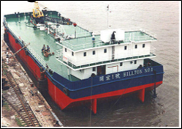
Mobile Ionospheric Heaters: Technological Challenge
HAARP size 300 m by 400 m
Area 1/16
Transportable-Array size 110 m by 70 m
Power consumption/Efficiency
RF tubes in present heater facilities -10 kW. We need megawatt class RF tubes for mobile heaters.
Frequency Tuning, f = 3 - 10 MHz
1/16

Slide 5
Research Summary
Our research group is working on the development of High Efficiency RF Sources for transportable heaters: Grid-less Tetrode (RF sources & power extraction circuit)
My research is focused on development of a highly efficient megawatt class power extraction circuit.
Proposed a single stage power extraction circuit and tested it at lower power levels. Discuss the design restrictions imposed.
A new method to approach the design of high Q inductors in MHz frequencies. Discuss the measurement issues.
Proposed a two-stage power extraction circuit to overcome the limitations of the single stage circuit & measurement issues. Discuss simulation results.

Slide 6
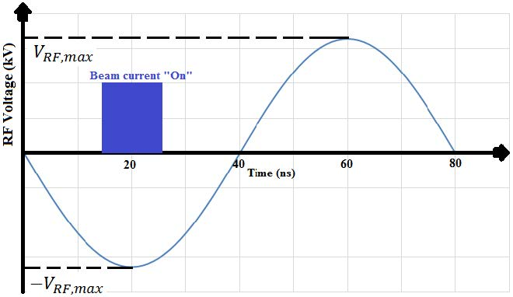
Class D Grid-less Tetrode for High Efficiency
Class D mode can achieve very high efficiencies (>90%). Beam current pulse is a square waveform. “On” phase < π/2.
Grid-less tetrode is a variation of Inductive Output Tube (IOT). IOTs typically operate in the frequency range of 200 MHz-1300 MHz, and offer efficiencies ranging from 60-80%.
We need lower frequencies (3 - 10 MHz) and higher efficiencies.
Beam peak power should be a few MWs. We consider 70kV-30A beams (2 MW peak power – 0.5 MW average power).
70kV
30 A
For a beam current of 30 A square pulse, a decelerating voltage of V_{RF} = 70 kV needs to be presented at the gap to sufficiently stop the electrons (70keV energy) before hitting collector.

Slide 7
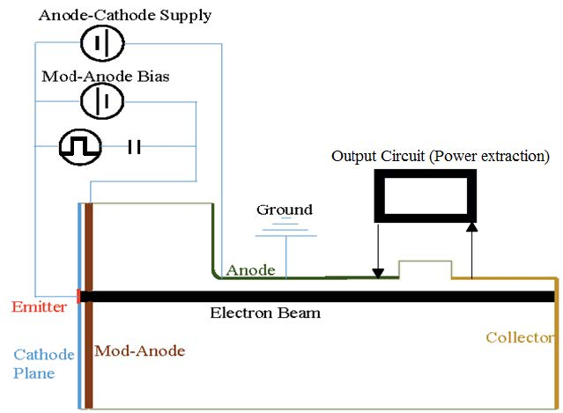
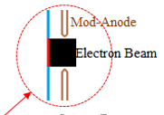
Grid-less Tetrode: Device Basics
My Research
-70kV
-71.25kV
RF Source
0 - 2.5 kV
V_{RF}
Decelerating gap extracts the kinetic energy using a power extraction circuit (My Focus Area)
High Efficiency RF source design, specifically the grid-less tetrode is dealt by my colleague, Jaykrishnan Karakkad in his paper, “Physics of Efficient Gridless Tetrodes with Intense Electron Beams” (Physics of Plasmas 26.9 (2019): 093101)
Decelerating Gap
Modulating anode gates the beam on and off (No Grid).
Beam is annular and thin – electrons experience nearly same accelerating & decelerating fields.
Notes:
Electrons pass through a decelerating gap (RF field), collected at collector, returns to ground through the power extraction circuit
Electrons emitted from a cathode held at a potential –V_{AK} and accelerated towards a grounded anode.

Slide 8
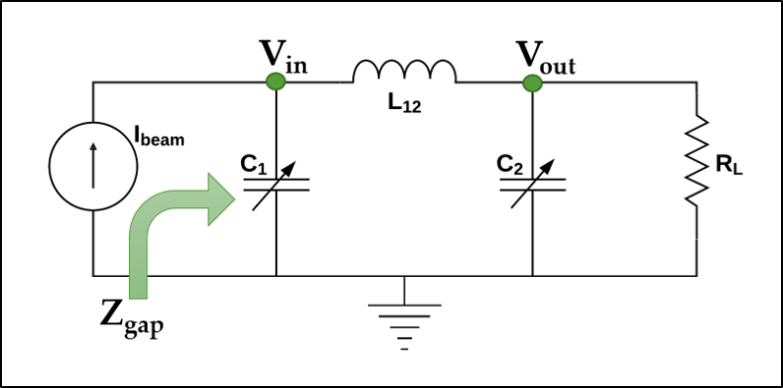
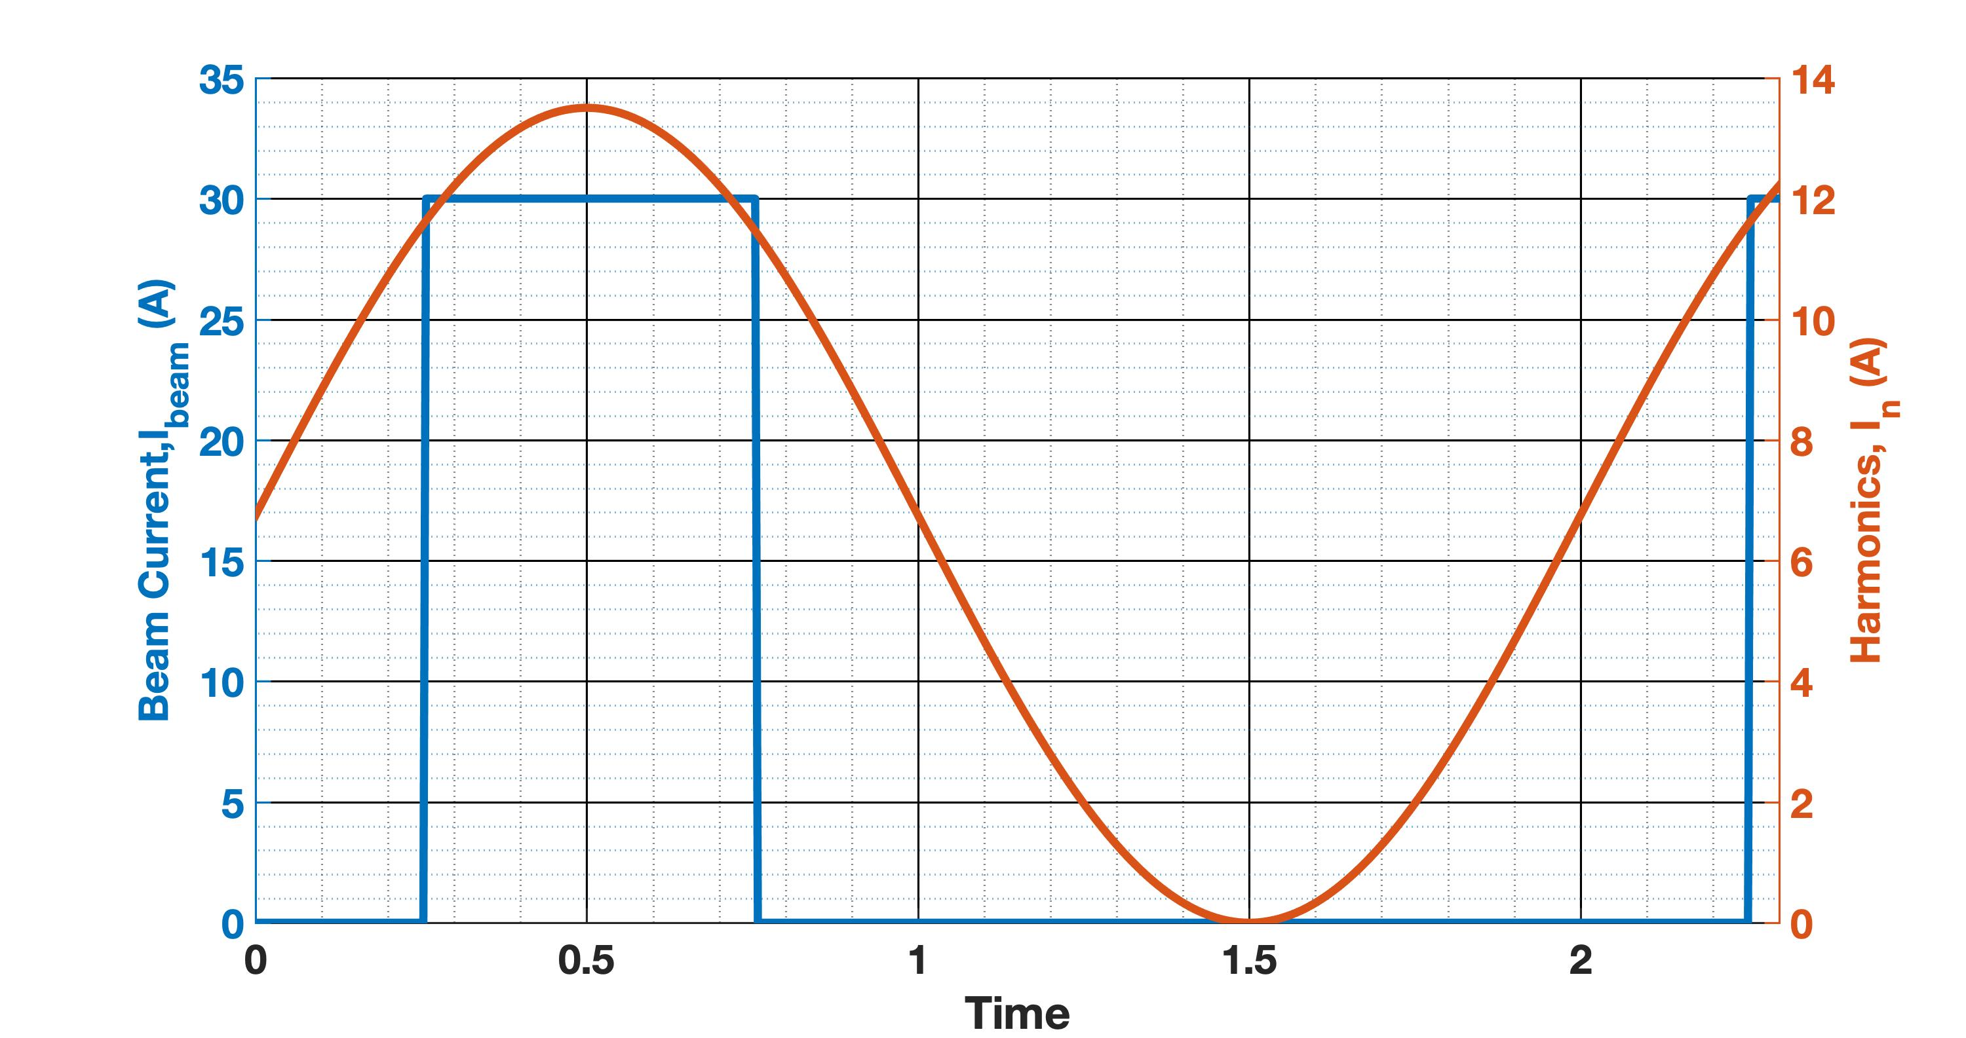
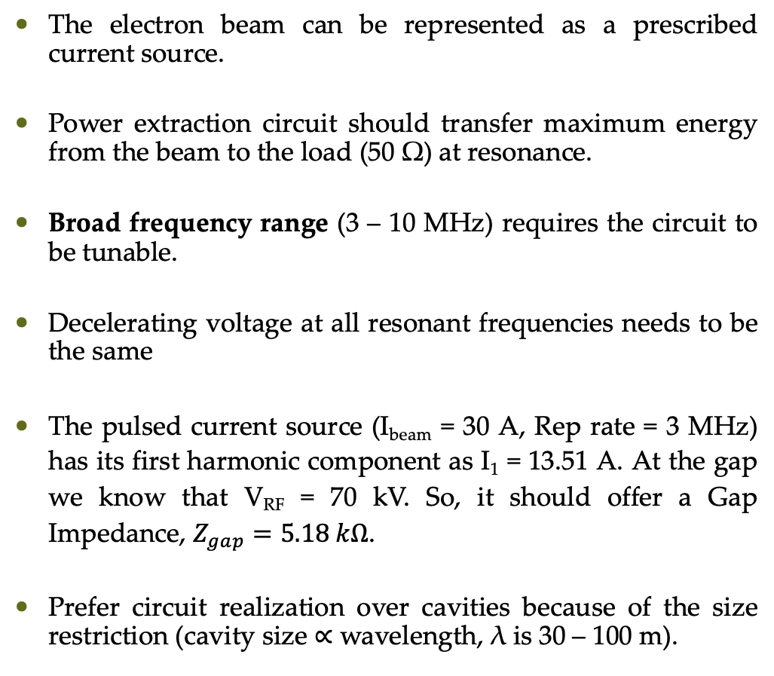
Features of a Power Extraction Circuit
The electron beam can be represented as a prescribed current source.
Power extraction circuit should transfer maximum energy from the beam to the load (50 Ω) at resonance.
Broad frequency range (3 – 10 MHz) requires the circuit to be tunable.
Decelerating voltage at all resonant frequencies needs to be the same
The pulsed current source (I_{beam} = 30 A, Rep rate = 3 MHz) has its first harmonic component as I₁ = 13.51 A. At the gap we know that V_{RF} = 70 kV. So, it should offer a Gap Impedance, $Z_{gap}=5.18 kΩ$.
Prefer circuit realization over cavities because of the size restriction (cavity size ∝ wavelength, λ is 30 – 100 m).
Source
Power Extraction Circuit
Antenna
I₁ – First Harmonic
T_{ON}
T_{OFF}
I_{beam} – Beam Pulse
Notes:
70 kV

Slide 9
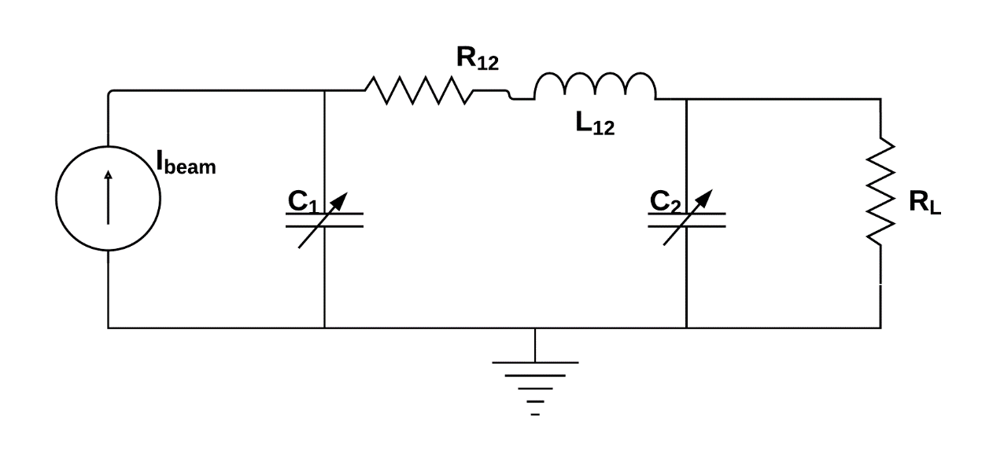
π-Circuit as a Power Extraction Circuit
A π-circuit consisting of appropriate capacitors and inductors can serve as a resonant circuit used for power extraction in RF source (We initially considered a transformer – Losses were too high!).
Decelerating voltage at all resonant frequencies should be the same. Circuit should present same gap impedance at all resonant frequencies.
Two parameters (resonant frequency & gap impedance) to manipulate.
Resonant Frequency is largely controlled by C₁ & L₁₂. Resonant Gap Impedance (peak value) is largely controlled by C₂ and L₁₂. We use tunable capacitors and fixed inductors.
My research studies and models the inductor resistance (in picture).
V_{RF}
V_{o}
Z_{gap}
R_{L}, Output Load (Antenna)
I_{beam}, Beam - Current Source,
Z_{gap}, Resonant Gap Impedance

Slide 10
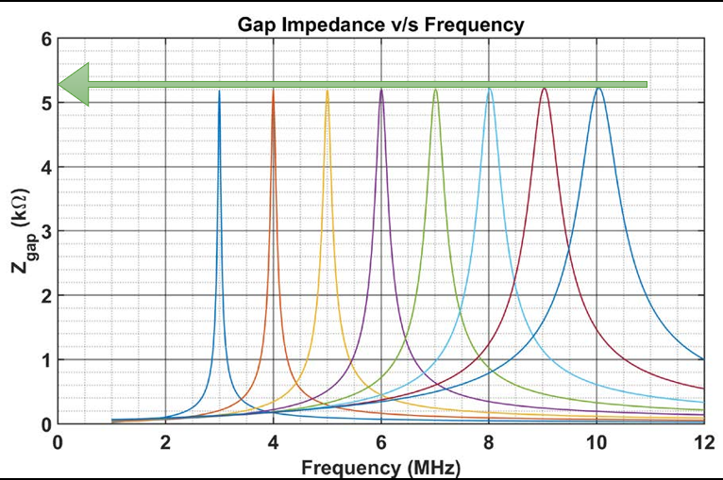
Tuned π-Circuits: Impedance plots for Initial Design
70 kV - 30 A Configuration
Resonant Gap Impedance: Z_{gap} = 5.18 kΩ.
C₁ & C₂ are varied to achieve the requisite peak gap impedance at a given resonant frequency.
Same Gap Impedances for varying resonant frequencies.
Quality Factor decreases as Frequency increases.
In reality, the device parasitics prevent such ideal behavior.

Slide 11
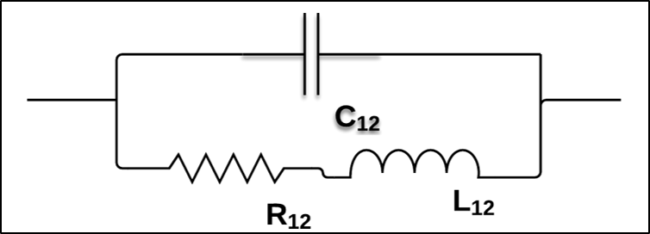
π-Circuit Design Problems: Inductor Parasitics
Inductor parasitics harm highly efficient circuit design: Winding resistance & Shunt Capacitance
Skin Effect- Current density is largest near the surface of the conductor and decreases with greater depths in the conductor.
Proximity Effect - Current distribution is further constrained by the presence of adjacent current carrying conductors, further enhancing the resistance.
Self Resonance - Inductors self resonate due to its self-capacitance at high frequencies.
L₁₂, Inductor
R₁₂, Intrinsic Resistance of the Inductor
C₁₂, Self–Capacitance of the Inductor
For a given resonant frequency, gap impedance & load – Set Upper limit on the winding resistance of coil.

Slide 12
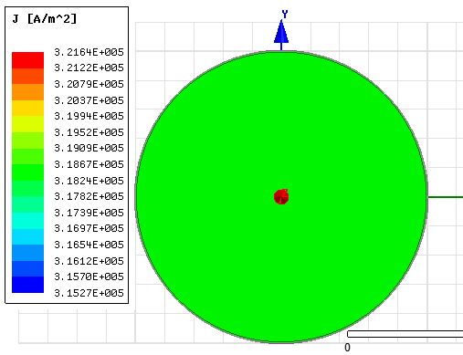
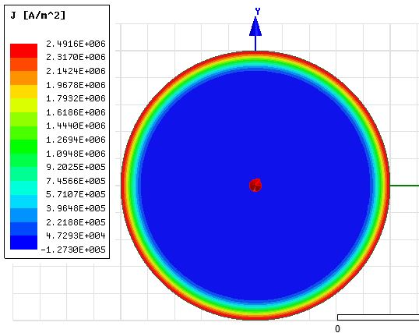
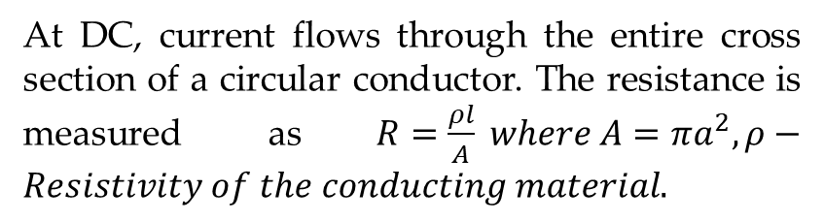

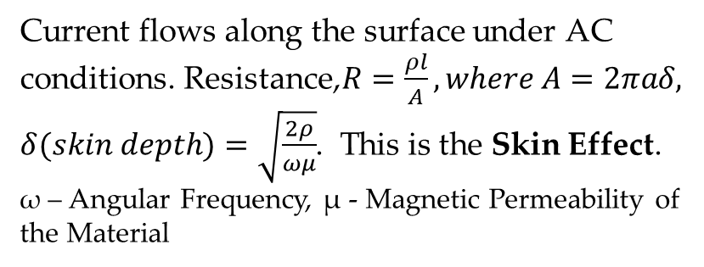
Skin Effect Enhances Resistance in Conductors
Direct Current
Alternating Current (Skin Effect)
a – Wire Radius = 1 mm
a – Wire Radius = 1 mm
R = 84.5 mΩ/m
R = 5.49 mΩ/m
$$δ_{4MHz}=33.04 μm$$
At DC, current flows through the entire cross section of a circular conductor. The resistance is measured as$R=\frac{ρl}{A} where A=πa^{2}, ρ−Resistivity of the conducting material.$
Current flows along the surface under AC conditions. Resistance,$R=\frac{ρl}{A}, where A=2πaδ, δ(skin depth)=\sqrt{\frac{2ρ}{ωμ}}$. This is the Skin Effect.
ω – Angular Frequency, µ - Magnetic Permeability of the Material

Slide 13
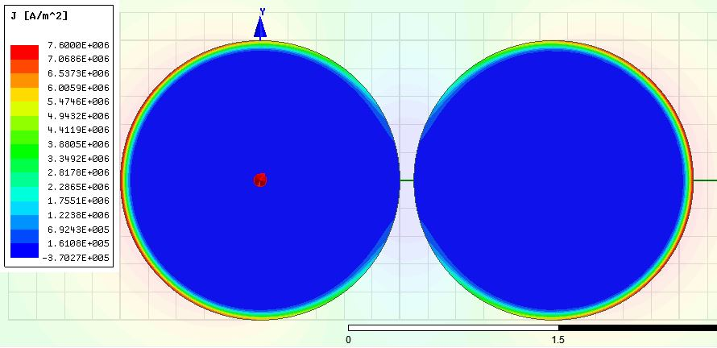
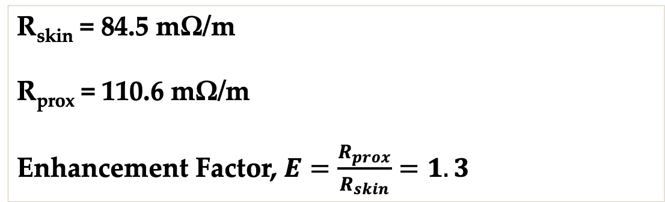
Proximity Effect Enhances Skin Resistance
4 MHz
1 mm
R = 110.6 mΩ/m
Current flows along the surface under AC conditions. It redistributes based on the adjacent conductors.
Current is the same within a conductor. Hence, current densities change.
Concentration of current occurs in the more remote parts of the conductors.
This is Proximity Effect.
R = 110.6 mΩ/m
0.1 mm
R_{skin} = 84.5 mΩ/m
R_{prox} = 110.6 mΩ/m
Enhancement Factor, $E=\frac{R_{prox}}{R_{skin}}=1.3$
Notes:
Tangential magnetic field strength is maximum at the outer edges of the surface when current flows in same direction.

Slide 14
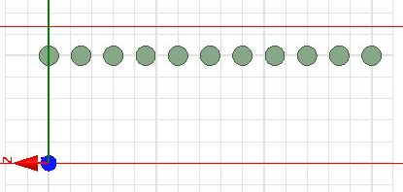
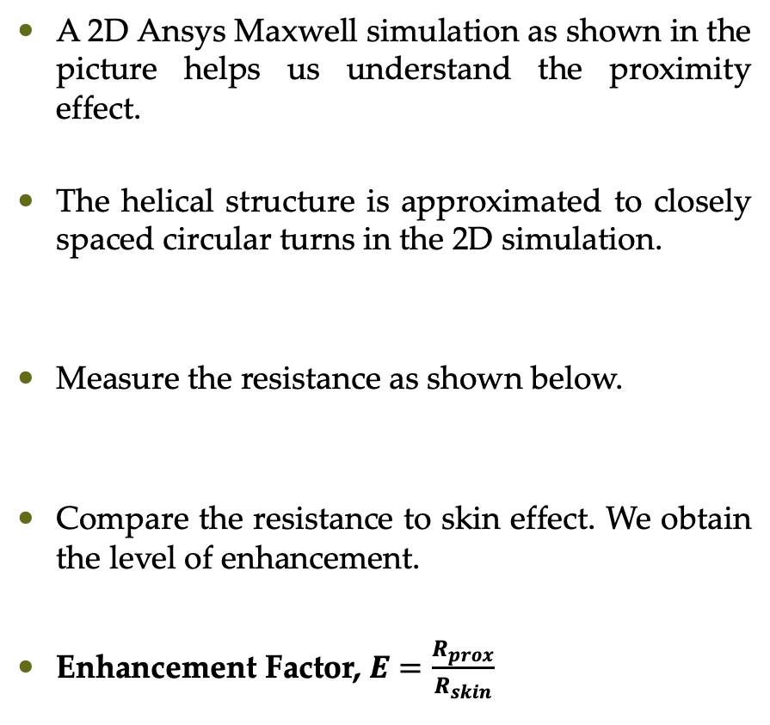
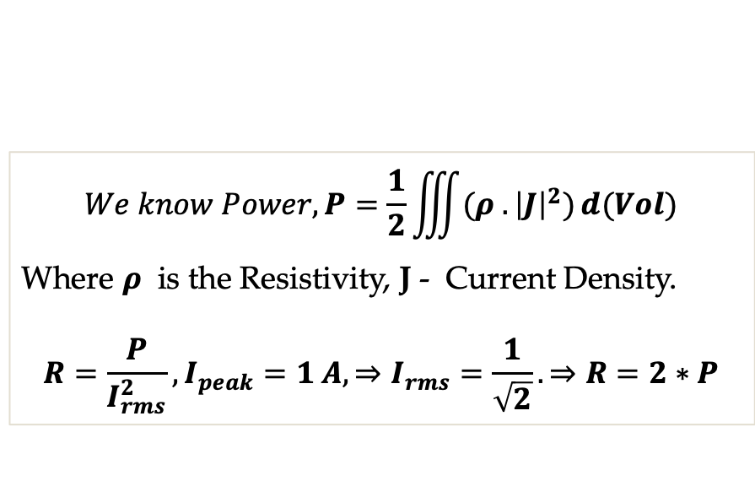
Modelling Proximity Effect in Inductors
Solenoid Length (SL)
A 2D Ansys Maxwell simulation as shown in the picture helps us understand the proximity effect.
The helical structure is approximated to closely spaced circular turns in the 2D simulation.
Measure the resistance as shown below.
Compare the resistance to skin effect. We obtain the level of enhancement.
Enhancement Factor, $E=\frac{R_{prox}}{R_{skin}}$
Solenoid Radius (SR)
Pitch
Wire Radius (WR)
Axis of Symmetry
$$We know Power, P=\frac{1}{2}\iiint{(ρ .{\left|J\right|}^{2})ⅆ(Vol)}$$
Where $ρ$ is the Resistivity, J - Current Density.
$$R=\frac{P}{I_{rms}^{2}}, I_{peak}=1 A, ⇒I_{rms}=\frac{1}{\sqrt{2}}. ⇒R=2∗P$$

Slide 15
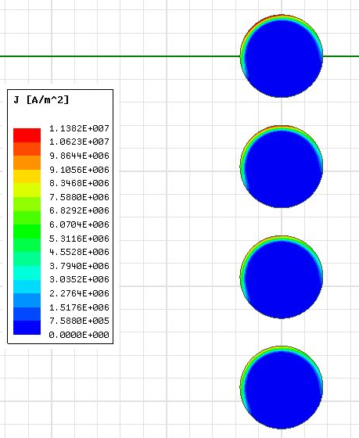
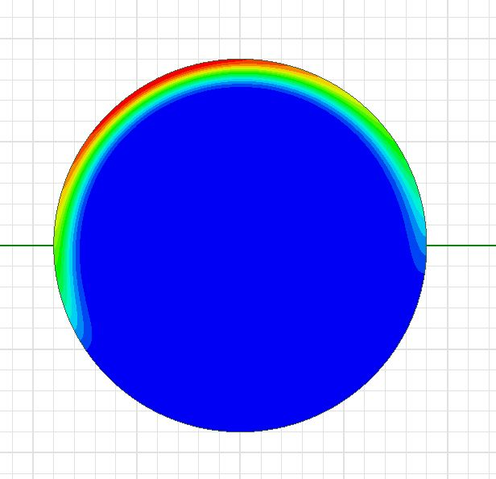
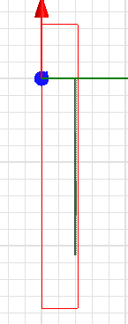
Current Density is Non-Uniform at the Edge of the Coil
Solenoid Length, SL = 24 cm, Solenoid Radius, SR = 8 cm, Wire Radius, WR = 0.9 mm
Frequency, f = 4 MHz, Turns, N = 101, Pitch = 2.4 mm
Current density is high at the outer edge compared to elsewhere.
Current flows through a very small area.
Resistance increases in edge turns of solenoid coil.
Uneven current distribution

Slide 16
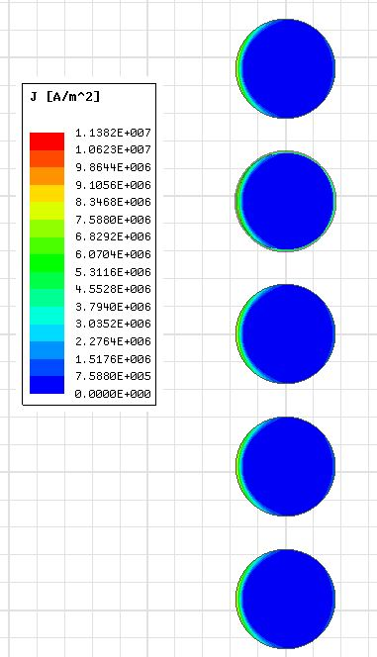
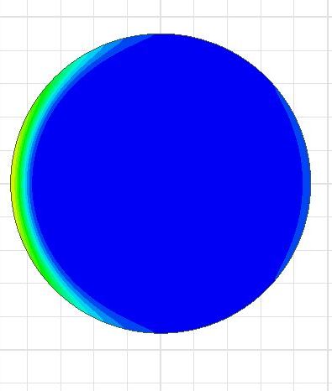
Current Density is Relatively Uniform at the Center
Solenoid Length, SL = 24 cm, Solenoid Radius, SR = 8 cm, Wire Radius, WR = 0.9 mm, Frequency, f = 4 MHz, Turns, N = 101, Pitch = 2.4 mm
Current density is relatively uniform at the center of the coil.
Current flows through a most of the outer surface.
Resistance decreases in center turns of solenoid coil.
Uniform Current Distribution
Notes:
Don’t use the word much when describing the current distribution. Just say current distribution is uniform compared to edge conductors.

Slide 17
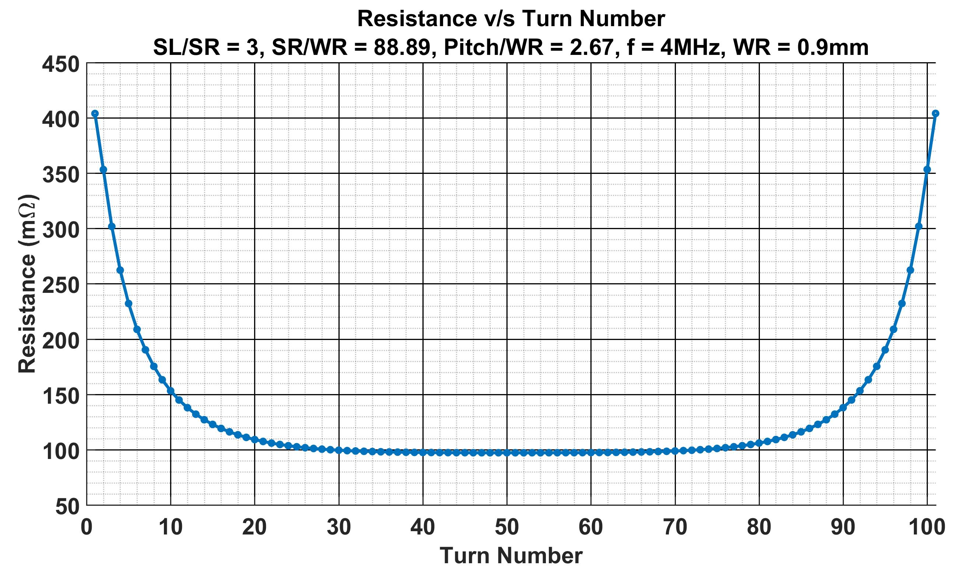
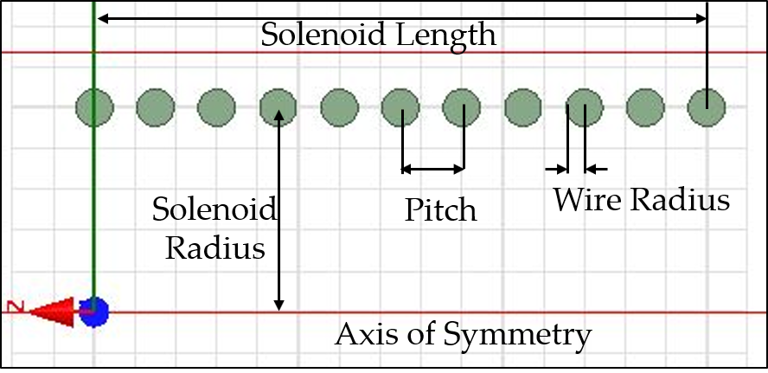
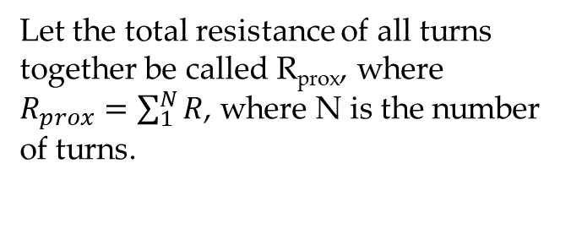
Resistance v/s Turn Number
Solenoid Length, SL = 24 cm
Solenoid Radius, SR = 8 cm
Wire Radius, WR = 0.9 mm
Frequency, f = 4 MHz
Turns, N = 101
Pitch = SL/ N = 2.4 mm
R_{skin}= 92 m𝛀
Let the total resistance of all turns together be called R_{prox}, where $R_{prox}=\sum_{1}^{N}{R}$, where N is the number of turns.
Proximity Effect is mostly enhanced by the Pitch/WR . The smaller the Pitch/WR, greater the Enhancement

Slide 18
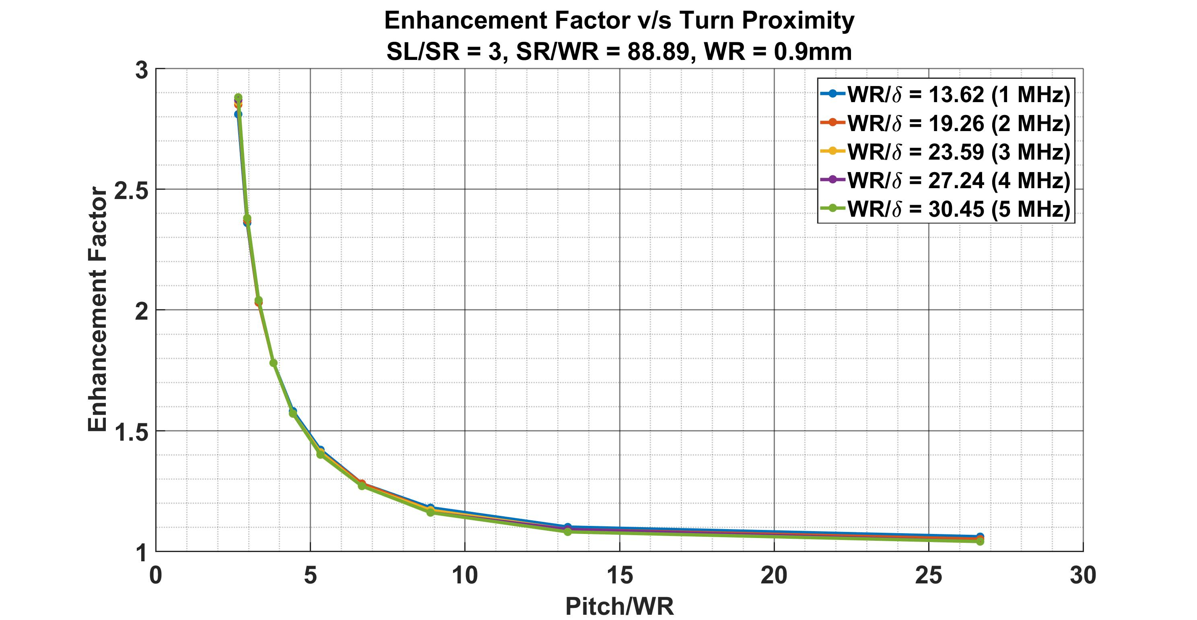
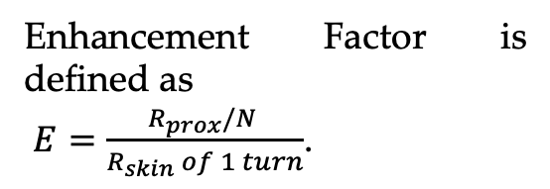

Enhancement Factor is Insensitive to Frequency
Enhancement Factor is defined as
$E=\frac{R_{prox}/N }{R_{skin} of 1 turn}$.
At Pitch/WR ~ 5,
50% Enhancement
N – Number of Turns,
SR – Solenoid Radius,
SL – Solenoid Length,
WR – Wire Radius,
δ – Skin Depth,
Turn Proximity – Pitch/WR
Skin Resistance, $R_{skin}=\frac{ρl}{2πrδ}$
When turns are closely spaced (Pitch/WR is small), Enhancement is High.
Change in frequency doesn’t have noticeable impact on the Enhancement Factor.

Slide 19
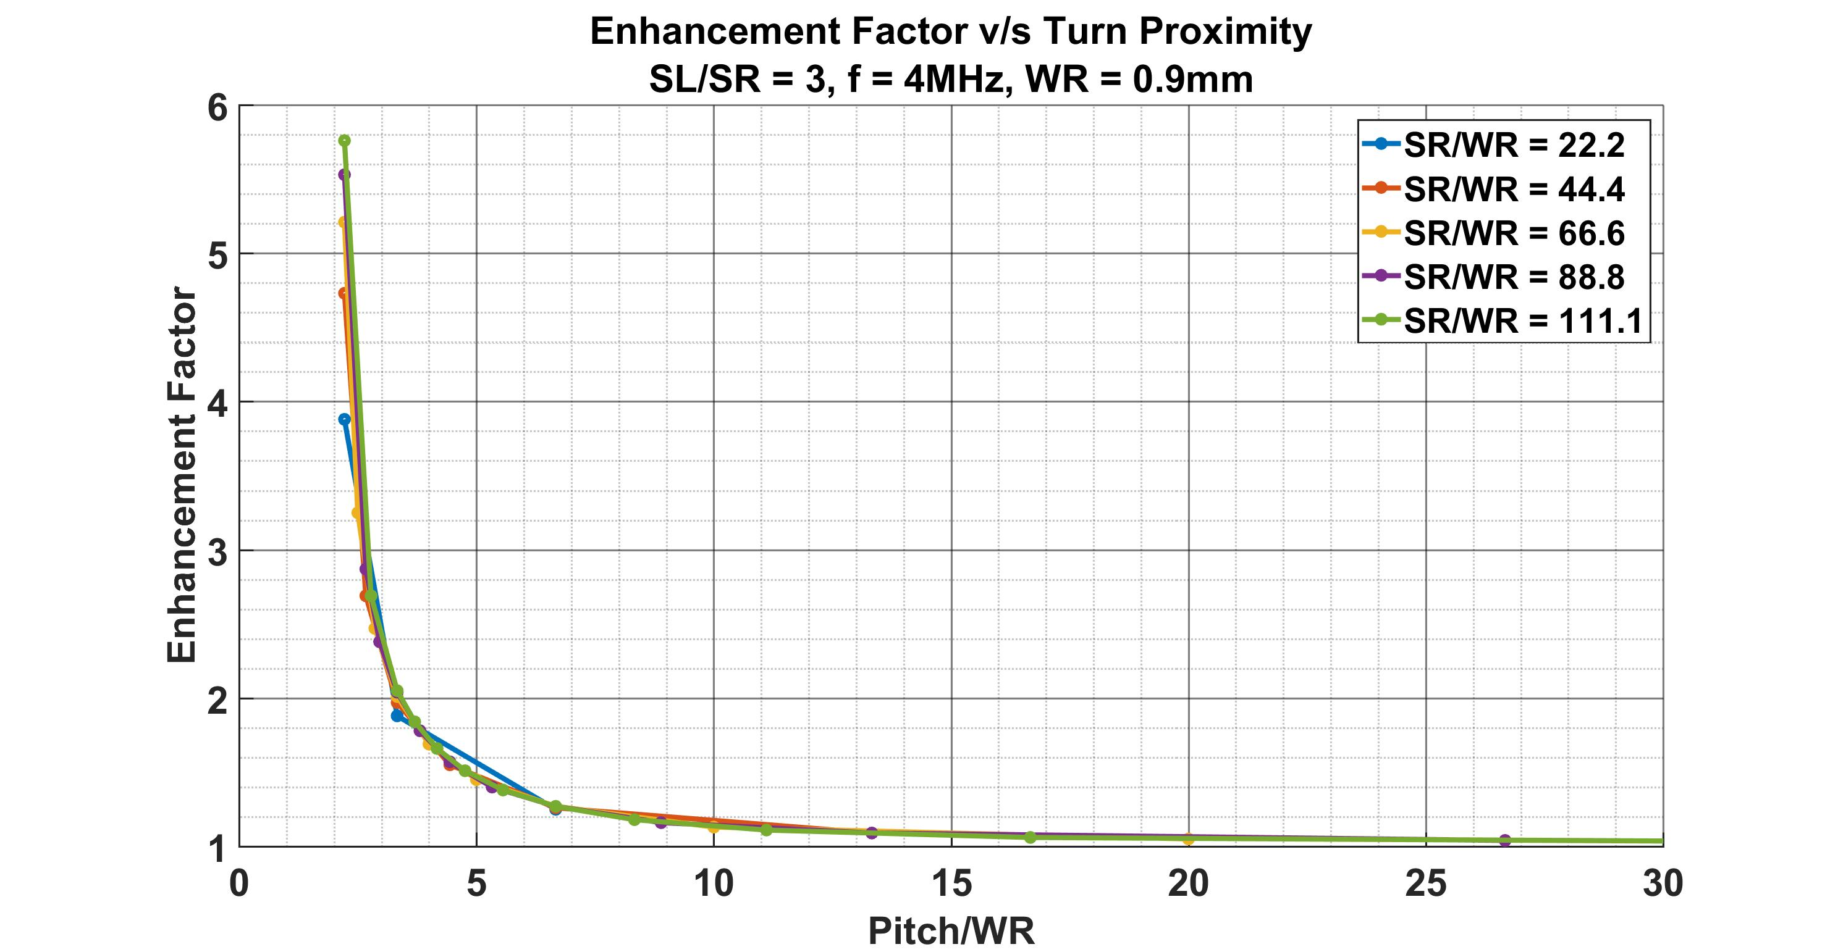
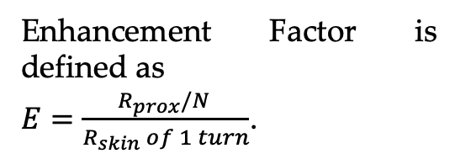

Enhancement v/s Turn Proximity for Varying Radii Ratios (SR/WR)
Enhancement Factor is defined as
$E=\frac{R_{prox}/N }{R_{skin} of 1 turn}$.
N – Number of Turns,
SR – Solenoid Radius,
SL – Solenoid Length,
WR – Wire Radius,
δ – Skin Depth,
Turn Proximity – Pitch/WR
Skin Resistance, $R_{skin}=\frac{ρl}{2πrδ}$
Enhancement is high when SR/WR is high – Only when turns are closely spaced.
Generally, they have no significant effect on the enhancement when turns are far apart..

Slide 20
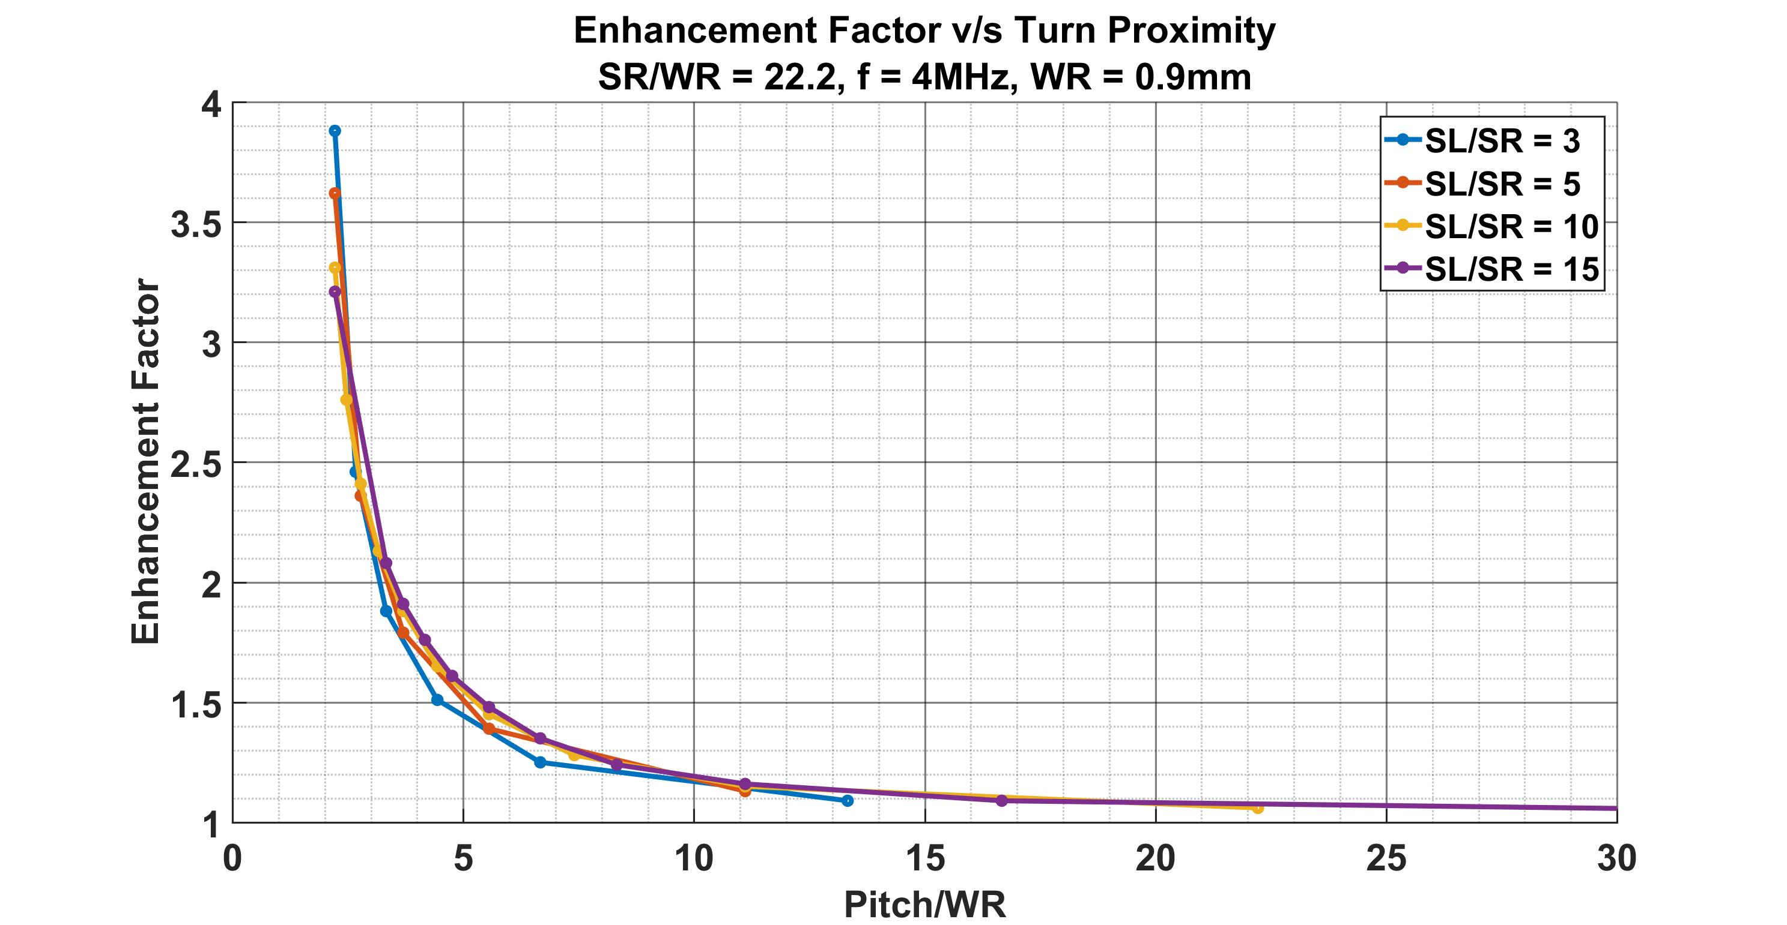
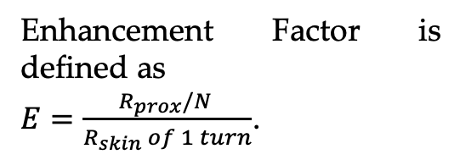

Enhancement v/s Turn Proximity for Varying Aspect Ratios (SL/SR)
Enhancement Factor is defined as
$E=\frac{R_{prox}/N }{R_{skin} of 1 turn}$.
At Pitch/WR ~ 5,
50% Enhancement
N – Number of Turns,
SR – Solenoid Radius,
SL – Solenoid Length,
WR – Wire Radius,
δ – Skin Depth,
Turn Proximity – Pitch/WR
Skin Resistance, $R_{skin}=\frac{ρl}{2πrδ}$
Enhancement is marginally higher when SL/WR is low – Only when turns are closely spaced. But no significant impact otherwise.
If we want low resistance, we should operate around the Pitch/WR~10.

Slide 21
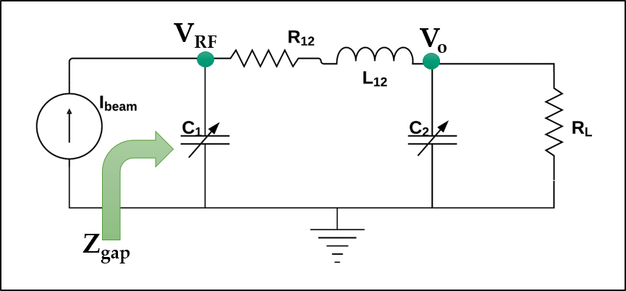
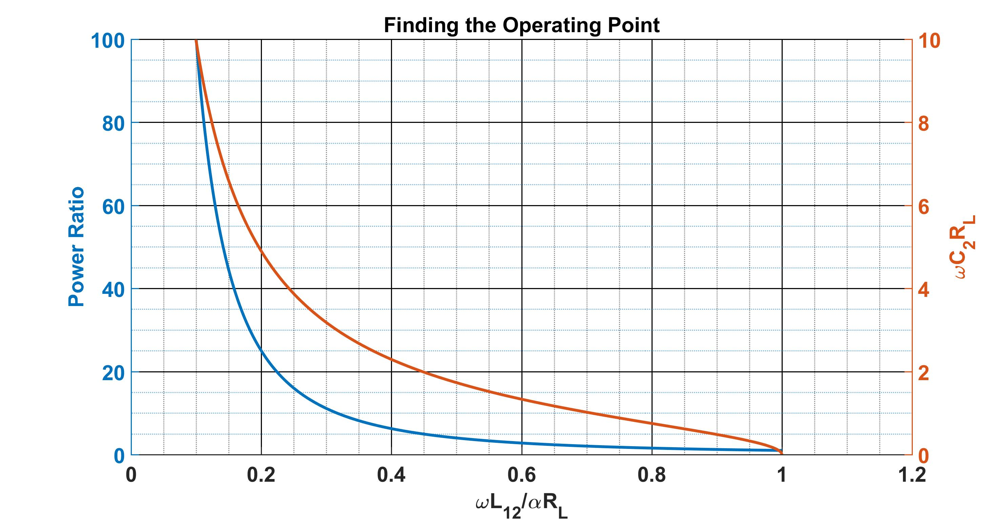
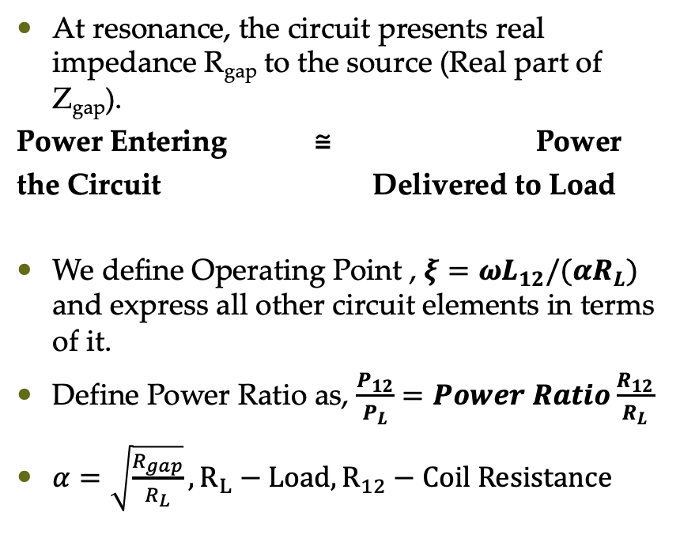
Design: Finding the Operating Point
ξ = 0.4 , Power Ratio = 6.25, $ωC_{2}R_{L}$ = 2.29
At resonance, the circuit presents real impedance R_{gap} to the source (Real part of Z_{gap}).
Power Entering ≅ Power
the Circuit Delivered to Load
We define Operating Point , $ξ=ωL_{12}/({αR}_{L})$ and express all other circuit elements in terms of it.
Define Power Ratio as, $\frac{P_{12}}{P_{L}}=Power Ratio\frac{R_{12}}{R_{L}}$
$α=\sqrt{\frac{R_{gap}}{R_{L}}}, R_{L}−Load, R_{12}−Coil Resistance$
Operating Range
If ξ is too low, Power Ratio shoots up & the power lost in R₁₂. This sets a lower limit
If ξ is too high, C₂ becomes very low. This sets an upper limit.
ξ – 0.4 to 0.8 is reasonable
Consequently, a single inductor cannot be used for the entire range.

Slide 22
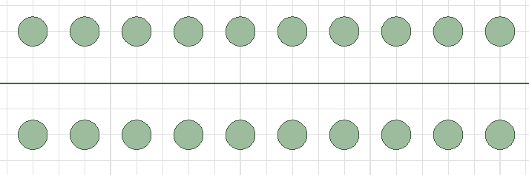
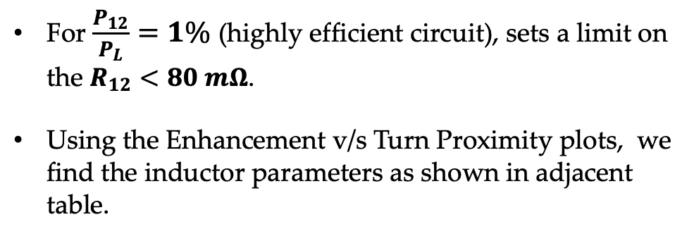
Inductor Design for 70 kV – 30 A Configuration
Length, ₤
Let us choose
V_{RF} | 70 kV | R_{gap} | 5.18 k𝞨
I_{beam} , I₁ | 30 A, 13.5A | R_{L} | 50 𝞨
f | 3 MHz | 𝛂 | 10.18
Wire Radius, a
Radius, R
Pitch, t
Turns, N
Solving all related equations and using the plots, we find,
Wire Length, ℓ = 2πRN, t = ₤ / N = ₤ 2πR / ℓ
L₁₂ | 10.8 µH
C₂ | 2.43 nF
C₁ | 259 pF
Coil Length, ₤ | 1.44 m | Pitch, t | 13.5 cm
Wire Length, ℓ | 12.5 m | Coil Radius, R | 18.65 cm
Wire Radius, a | 1.5 cm | Turns, N | 11
Inductance, L₁₂ | 10.8 µH | R₁₂ | 71.7 mΩ
For $\frac{P_{12}}{P_{L}}=1\%$ (highly efficient circuit), sets a limit on the $R_{12}<80 mΩ$.
Using the Enhancement v/s Turn Proximity plots, we find the inductor parameters as shown in adjacent table.

Slide 23
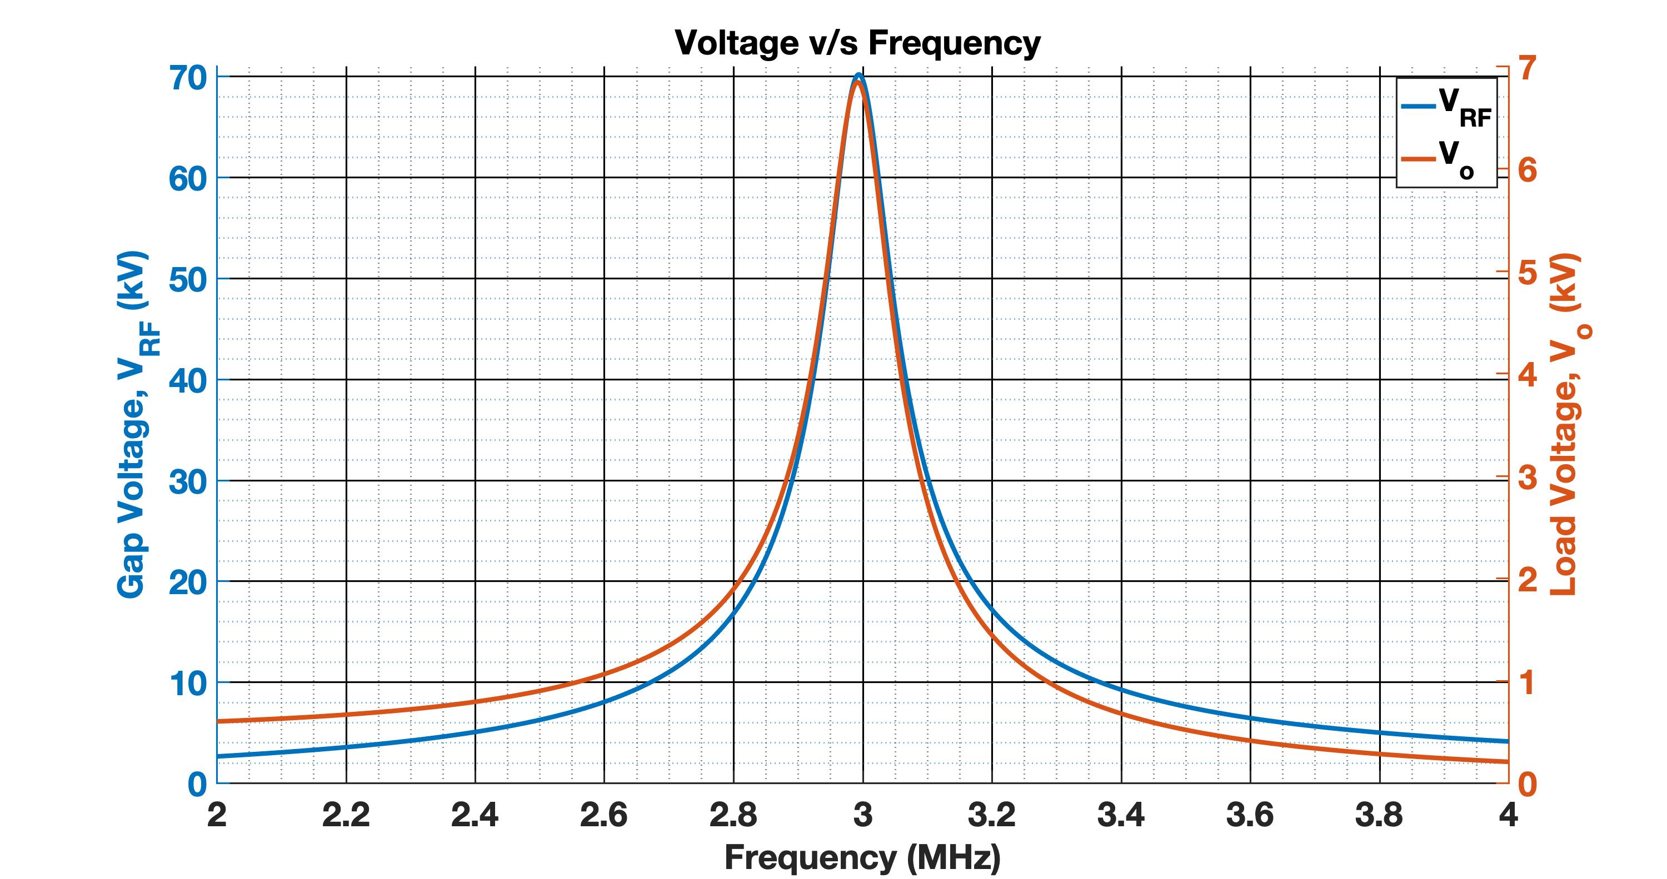
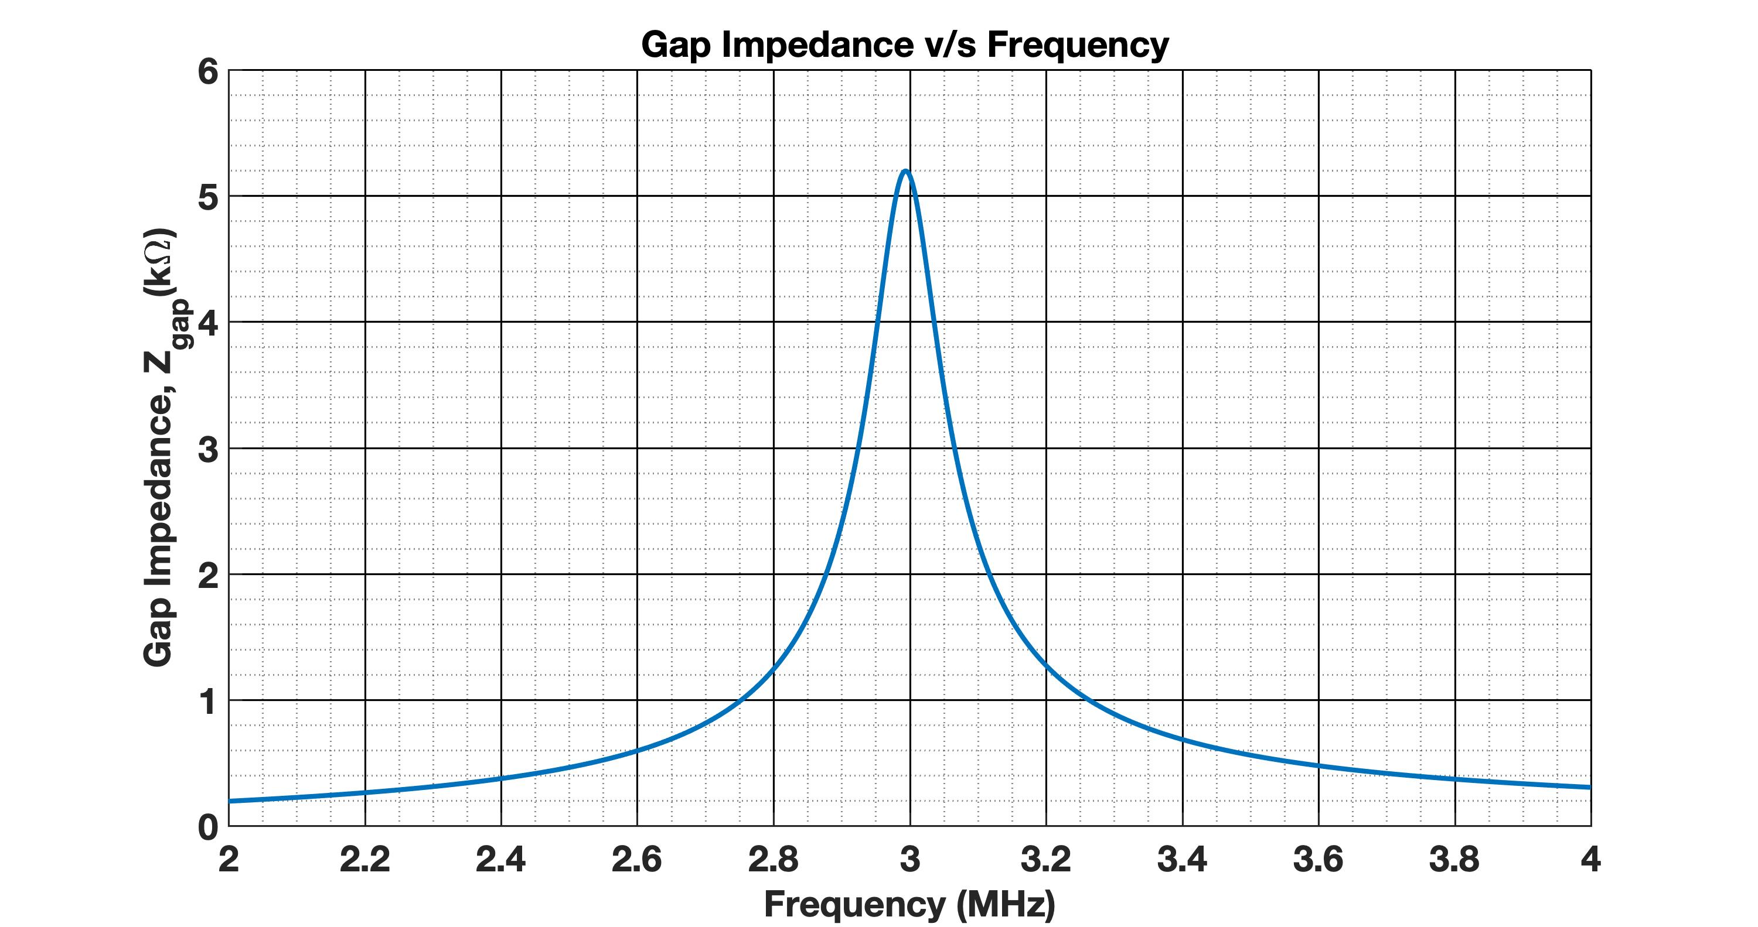

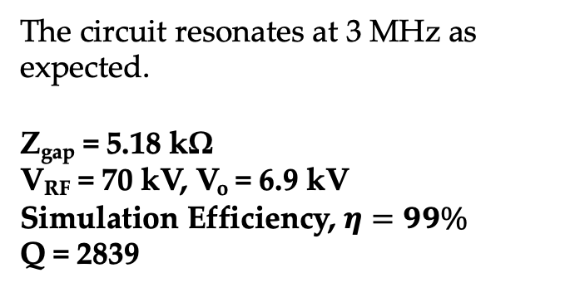
Plots from PSPICE Simulation
L₁₂ | 10.8 µH
R₁₂ | 71.7 mΩ
C₂ | 2.43 nF
C₁ | 259 pF
R_{L} | 50 Ω
The circuit resonates at 3 MHz as expected.
Z_{gap} = 5.18 kΩ
V_{RF} = 70 kV, V_{o} = 6.9 kV
Simulation Efficiency, $η=99\%$
Q = 2839

Slide 24
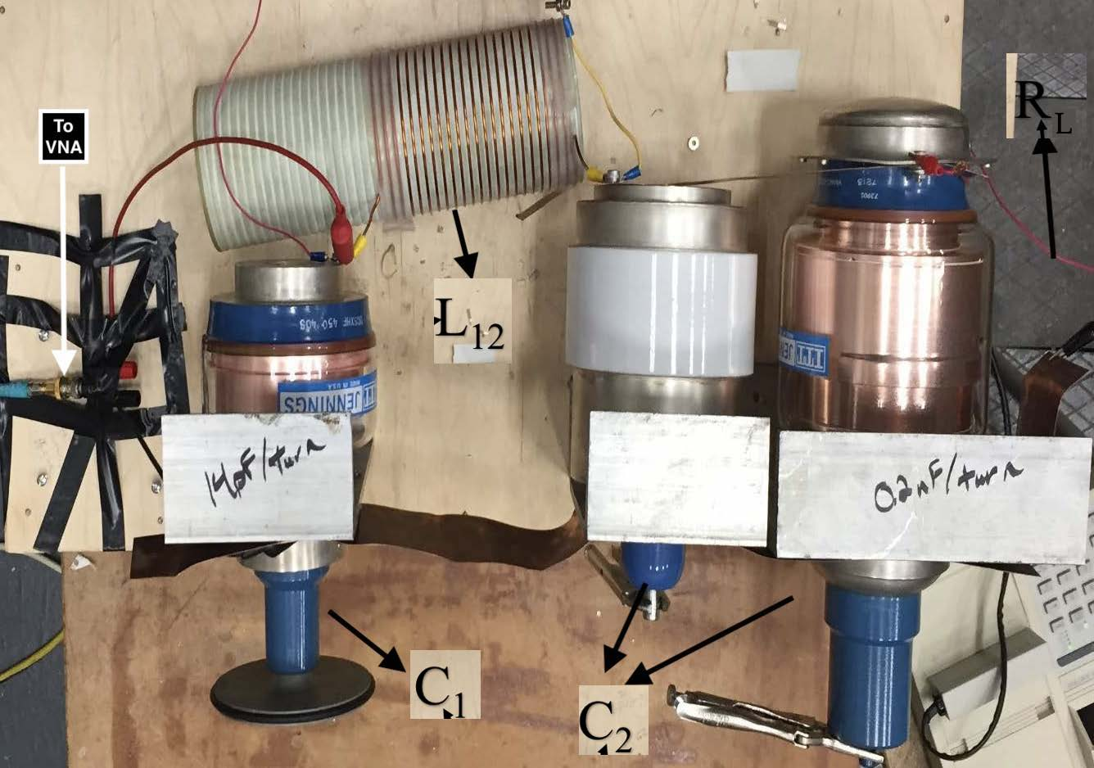
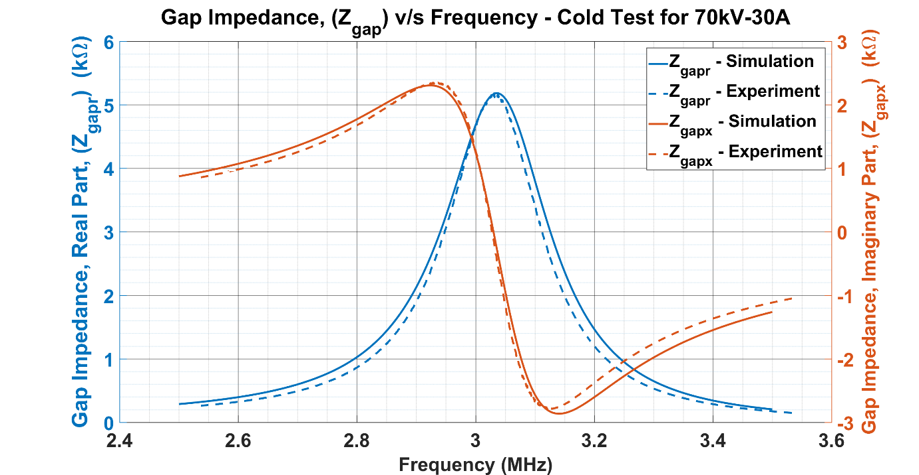
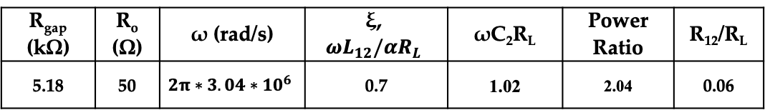
Cold Test for 70 kV - 30 A Design
R_{gap} (kΩ) | R_{o} (Ω) | ω (rad/s) | ξ, $$ωL_{12}/{αR}_{L}$$ | ωC₂R_{L} | Power Ratio | R₁₂/R_{L}
5.18 | 50 | $$2π∗3.04∗{10}^{6}$$ | 0.7 | 1.02 | 2.04 | 0.06
L
70kV-30A Case | C₁ (pF) | R­₁₂ (Z_{r}) (Ω) | L₁₂ (μH) | C₂ (nF) | R_{L} (Ω)
Simulation | 137.4 | 3 | 21.3 | 1.07 | 50
Experiment | 137 ± 1 | 3.1 ± 0.2 | 21.3 ± 0.5 | 1.04 ± 0.03 | 51.5 ± 0.2
Observed Data | Resonant Frequency, f | Z_{gap} (Real Part) | Efficiency, η
Simulation | 3.04 MHz | 5.28 kΩ | 89.9 %
Experiment | 3.03 MHz | 5.16 kΩ | 89.3 %

Slide 25
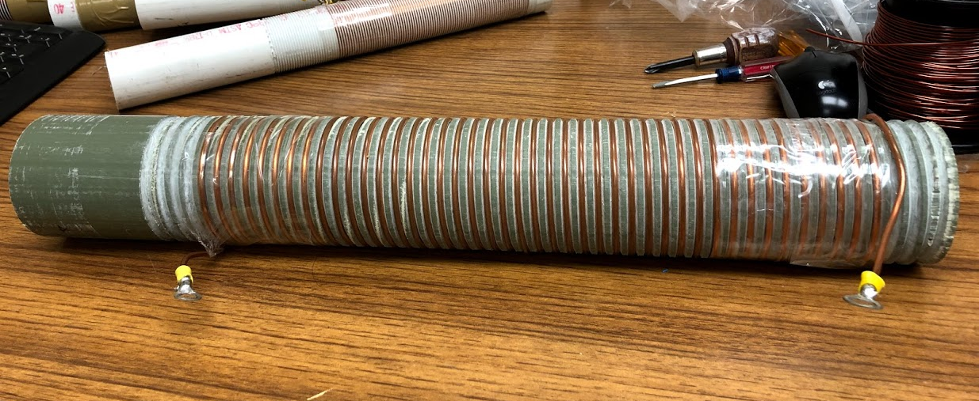
Inductor Design: Measurements
Coil Parameters | Value
Coil Diameter, D | 7.3 cm
Coil Length, L | 36.5 cm
Wire Diameter, a | 3.15 mm
Wire Wall Thickness, t | 0.762 mm
Turns, N | 43.5
Wire Length, ℓ | 9.97 m
Pitch, p | 8.39 mm/turn
Inductance, L_{coil} | 27.26 µH
Other Parameters | Value
Pitch/WR (Wire Radius) | 5.3
SR/WR (Solenoid Radius/ Wire Radius) | 23.17
SL/WR (Solenoid Length/ Wire Radius) | 10
Proximity Factor (from table) | 1.5

Slide 26
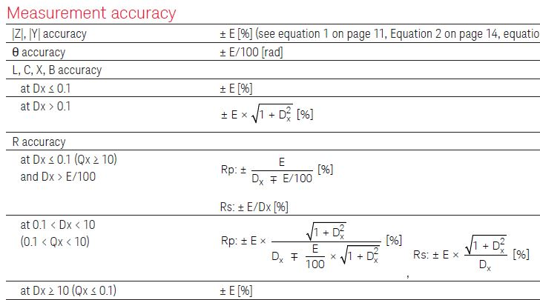
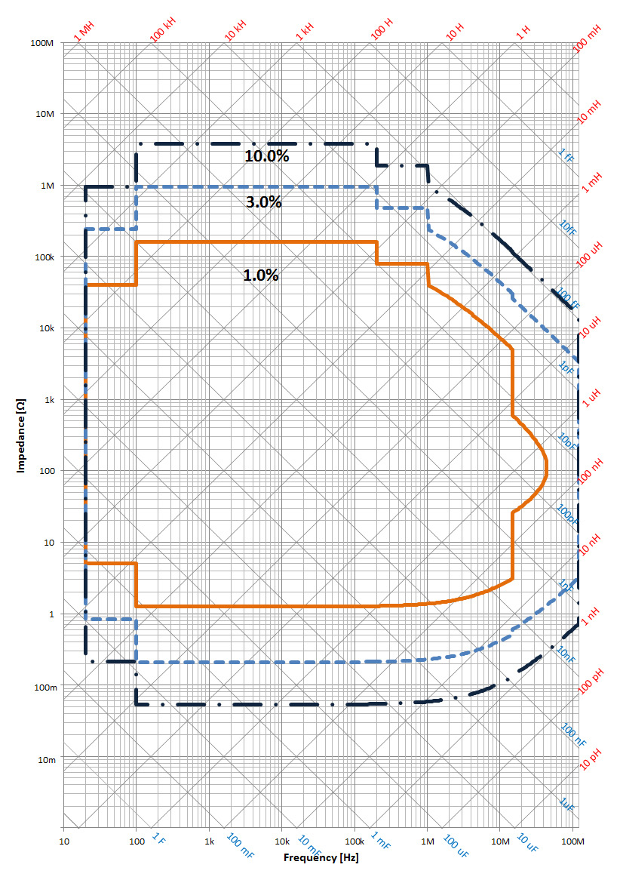
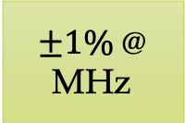

Impedance Analyzer Measurement Accuracy
$±1\%$@ MHz
For example,
Freq (kHz) | Z_{r} (mΩ) | Z_{x} (mΩ) | Dx = Zr/Zx | |Z| (mΩ) | Error, E | Z_{r} Accuracy | Z_{x} Accuracy
1 | 36.8 | 163 | 0.22 | 167.1 | 10 % | 45.4 % | 10 %
Measurements with appropriate error bars:
Z_{r} = 36.8 ± 16.7 mΩ
Z_{x} = 163 ± 16.7 mΩ
$±10\%$@ kHz

Slide 27


Resistance Measurements are inaccurate due to device limitations for high Q inductors
Z_{x} for Inductor A
Z_{r} for Inductor A
Z_{x} measurements are in line with predicted values. Error levels are about 1%.
Z_{r} measurements sharply diverge at higher frequencies.
Error is 1% of the total magnitude. At 4 MHz, 1% is 7Ω >> 0.78 Ω . This is the device limitation.

Slide 28


NRL Gun Experiments
We used a low power gridded gun from the Naval Research Laboratory (NRL) to :
  Test class D operation.
  Test the viability of pi circuits as a power extraction circuits.
The gun was originally designed to operate at 500 MHz - 1.5 GHz range. We used it to operate at 4 MHz.
Cathode Anode voltage designed to operate from 20-35kV range.
  Observed I_{beam,max} of 0.98 A (indirect measurement).
  Observed V_{RF, max} ~ 4.5kV
Circuit offered gap impedance of ~16 k𝛀 @ resonance, Expected Efficiency ~ 58 % (using our operating point graph for the above circuit parameters).

Slide 29
Power & Efficiency Measurements
Efficiency was measured to be 58% for the design parameters.
Input power reduces with reduced C₂. This is because,
  When C₂ ↓ , Z_{gap} ↓⟹ V_{RF} ↓
To achieve higher efficiency we needed very high Q inductors (Q~5k for 99%).

Slide 30
Limitations of Single Stage Power Extraction Circuit
Tuning range is limited because of a single inductor coil.
Design requires very high Q inductors for high efficiency.
Difficulties in measurement of inductor coils with such high-quality factor. 1% error on |Z| translates to large errors on the resistances
Impedance transformation from 50 Ω to 5 k Ω – two orders of change in a single stage
Tunability is provided by the same set of elements. Adding more elements gives more flexibility.
A multistage circuit has more elements and provides much more flexibility.

Slide 31

Two Stage Circuit is Tunable & Less Restrictive (Q requirements)
L_{s,1}
C_{s,2}
C_{p,1} – Parallel Capacitor
L_{s,1} – Series Inductor
L_{p,2} – Parallel Inductor
C_{s,2} – Series Capacitor
C_{p,1}
L_{p,2}
A Two Stage Circuit provides - two stages for impedance transformation.
Reduces the high Q requirements on individual circuit elements.
Provides for tunability. The C_{s,2} capacitor also blocks the DC current going into the load.

Slide 32


Operating Range provides for Tunability & Low Loss
At resonance, the circuit presents real impedance R_{gap} to the source (Real part of Z_{gap}).
Power Entering ≅ Power
the Circuit Delivered to Load
We define Operating Point , $ωL_{s,1}/({αR}_{L})$ and express all other circuit elements in terms of it.
Define Power Ratio as,
$$\frac{P_{diss}}{P_{L}}=Power Ratio\frac{ωL_{s,1}Q^{−1}}{R_{L}}$$
Let $\frac{P_{diss}}{P_{L}}=1\%$ (High Efficiency).
Operating Range
We assume that the Q for both the inductors are the same. Pick the operating point for which the power ratio is low.
Power Ratio is lower for higher L_{s,1}/L_{p,2} ratios.
$\frac{ωL_{s,1}}{{αR}_{L}}=0.5$, $Power Ratio=1.85, ωC_{s,2}R_{L}=1.43$

Slide 33


Simulations of Two Stage Circuit provides
The Decelerating Voltage at resonance for High Efficiency (99%)
L_{s,1} | 13.5 µH
L_{p,2} | 1.5 µH
C_{s,2} | 1.5 nF
C_{p,1} | 185.6 pF
Rs,1 | 270 m𝞨
Rp,2 | 30 m𝞨
Q | 939.1
V_{RF} | 70 kV | R_{gap} | 5.18 k𝞨
I_{beam} , I₁ | 30 A, 13.5A | R_{L} | 50 𝞨
f | 3 MHz | 𝛂 | 10.18
Q for the inductor is down from 2839(single stage) to 939 (two stage).

Slide 34


Two stage circuits are tunable from 3-10 MHz for High Efficiency (99%)
L_{s,1} | 13.5 µH
L_{p,2} | 1.5 µH
C_{s,2} | 169.12 pF
C_{p,1} | 16.31 pF
Rs,1 | 3.1 𝞨
Rp,2 | 340 m𝞨
Q | 271.7
V_{RF} | 70 kV | R_{gap} | 5.18 k𝞨
I_{beam} , I₁ | 30 A, 13.5A | R_{L} | 50 𝞨
f | 10 MHz | 𝛂 | 10.18
Q is further down to 271 (two stage).

Slide 35
Two Stage Circuit is relatively better than Single Stage Circuit
Single Stage Circuit for 70 kV -30A | Two Stage Circuitfor 70 kV -30A
Simple pi circuit – Fixed Inductor, Two Variable Capacitors: To adjust Resonant Frequency & Gap Impedance. | Two Fixed Inductors, Two Variable Capacitors: To adjust Resonant Frequency & Gap Impedance.
Frequency Range: 3-6 MHz/ 4-8 MHz/5-10MHz | Frequency Range: 3-10 MHz
C₁ Range: 259 pF – 68.7 pF (3- 6 MHz) | C_{p,1} Range: 185.6 pF – 16.31 pF
C₂ Range: 2.43 nF - 424 pF (3-6 MHz) | C_{s,2} Range: 1.51 nF – 169.1 pF (3-10 MHz)
Q Factor of Inductor @ 3 MHz for 99% Efficiency ~ 2839 | Q Factor of Inductors @ 3 MHz for 99% Efficiency ~ 939
Q Factor of Inductor @ 3 MHz for 95% Efficiency ~ 508 | Q Factor of Inductors @ 3 MHz for 95% Efficiency ~ 188

Slide 36
Conclusion
A single stage circuit designed for impedance ratio of 5.18 kΩ (beam) to 50 Ω (load) requires inductor of Q = 2839 for Efficiency = 99%. Tunability is restricted (3-6 MHz or 4-8 MHz etc, but not the entire range from 3 – 10 MHz)
Calculated Q for single stage inductor including parasitics indicates this is possible.
However, this Q value is too high to be reliably measured using impedance analyzer. (Probably, one would have to immerse the inductor in fluid and measure the temperature rise, but this is cumbersome).
The gun experiments showed the viability of the pi circuit as an extraction circuit. Demonstrated class D operation is feasible.
A two-stage circuit designed for impedance ratio of 5.18 kΩ (beam) to 50 Ω (load) requires inductor of Q = 939 for Efficiency = 99%. Q = 188 for Efficiency = 95%.
Two-stage circuit reduces the restriction on the inductor Qs. This is measurable. They provide for tunability from 3 to 10 MHz.

Slide 37
Conference Papers & Publications
A. H. Narayan, B. L. Beaudoin, C. Turner, N. Goyal and T. M. Antonsen, "Constant impedance tunable IOT power extraction circuit," 2016 IEEE International Vacuum Electronics Conference (IVEC), Monterey, CA, 2016, pp. 1-2, doi: 10.1109/IVEC.2016.7561771.
A. H. Narayan et al., "Simulations Of Power Extraction Circuits For Mobile Ionospheric Heating*," 2017 IEEE International Conference on Plasma Science (ICOPS), Atlantic City, NJ, 2017, pp. 1-1, doi: 10.1109/PLASMA.2017.8496150.
Beaudoin, B. L., Ting, A., Gold, S., Narayan, A. H., Fischer, R., Karakkad, J. A., ... & Antonsen Jr, T. M. (2018). Experimental studies on radio frequency sources for ionospheric heaters. Physics of Plasmas, 25(10), 103116.
Beaudoin, B., Koeth, T., Nusinovich, G., Narayan, A., Haber, I., Rodgers, J., ... & Antonsen, T. (2015). Novel high power sources for the physics of ionospheric modification.
Beaudoin, B. L., Karakkad, J. A., Narayan, A. H., Nusinovich, G. S., Ting, A., Turner, C., & Antonsen, T. M. (2017, April). Progress in developing a high efficiency IOT for ionospheric heating. In 2017 Eighteenth International Vacuum Electronics Conference (IVEC) (pp. 1-2). IEEE.
B. L. Beaudoin ., Ting, A., Gold, S., Narayan, A. H., et al., "Scaled experimental studies on radio frequency source for megawatt-class ionospheric heaters," 2018 IEEE International Vacuum Electronics Conference (IVEC), Monterey, CA, 2018, pp. 21-21, doi: 10.1109/IVEC.2018.8391532.

Slide 38
Thank You
Possible Future Work
Implement and Test Two Stage Power Extraction Circuit on the actual gun.
Variable Pitch Inductors for better power management could be an area worth exploring.
Develop a robust method to test high Q inductors at MHz frequencies.

