Slide 1
Drawing the Circle Wider
Employing Individuals on the Autism Spectrum in the Archives
Matthew R. Beland
April 13, 2019
Notes:
The title of my presentation is a reference to a relatively recent hymn in the Anglican and United Methodist Church tradition, “Draw the Circle Wide”. It came to me as I was thinking about my subtitle and the theme of our conference: labor in the archives. What does it mean to employ individuals with autism in the archives? What should we expect that to look like?

Slide 2
Our questions
1. What is autism spectrum disorder (ASD)?
2. How do people with ASD work in
other workplaces?
3. What is it like to work in an
archives?
4. People with ASD working in an archives:
What to expect?
Notes:
To that end, in the next 15 minutes or so I will ask and give some answers to several questions. First, What is our subject? What is autism spectrum disorder, or ASD? People with ASD work in other occupations. What does that look like? Next, I review something familiar to most of us-aspects of working in an archives, with an emphasis on how that connects to the labor that people with ASD already do. I end with a sense at least of my original goal – what does employing a person with ASD in an archives look like? What should we expect if we are the ones who supervise them?

Slide 3
What is autism?
Defined, yet ambiguous
A spectrum disorder
Challenges and strengths
An adult disability
Notes:
According to one source I looked at, autism is the fastest growing disability in the United States. In 2013, the American Psychological Association defined autism as “a complex neurodevelopmental disorder that is characterized by impairments in social communication and interaction and restricted, repetitive patterns of behavior and interests.”
This definition can tell us what is going on, but it cannot tell us the degree or magnitude of impairment. It has been said that “if you have met one person with autism, you’ve met one person with autism.” The disorder or impairment in communication and/or behavior may be severe or relatively mild. For this reason, it is referred to as a spectrum disorder. There is a spectrum of observable behaviors within this diagnosis. Because the impairment may be mild, ASD is often characterized as an invisible disorder. You would probably have to converse with someone with ASD before you could determine that they had some sort of irregular behavior.
Because social interactions can be a challenge for people with ASD, traditional job interviews or meetings may be difficult if not impossible to carry out. People with ASD often struggle in environments that are not structured or predictable. They may, however, exhibit some strengths that are valuable for any kind of employment. Because they often thrive in a structured environment, they may be quite disciplined and good at following rules or guidelines. They may also have excellent knowledge of specialized topics and display great attention to detail.
ASD is typically diagnosed within the first few years of life, and I would say most of the literature is on children with ASD in schools and their education. However, given the growing prevalence of ASD, more and more of these individuals are “aging out” – growing out of the school system. It is estimated that 500,000 teens over the next decade will become adults – that’s roughly 50,000 with ASD per year. They will be leaving the highly structured environment of the school. Some of these individuals will be candidates for employment, and it is in this setting that you may encounter them.

Slide 4
How do people with ASD
work in other workplaces?
Industry: Greenvision, Inc.
Non-profits: Goodwill
Writers and the “gig economy”
Libraries: Project A+/Florida State
& Institute of Museum and Library
Services (IMLS)
Notes:
People with ASD are already working in other occupations. I asked a special education teacher at my son’s school for some companies she knows that hire people with ASD. One of them was semi-industrial: Greenvision, Incorporated.

Slide 5
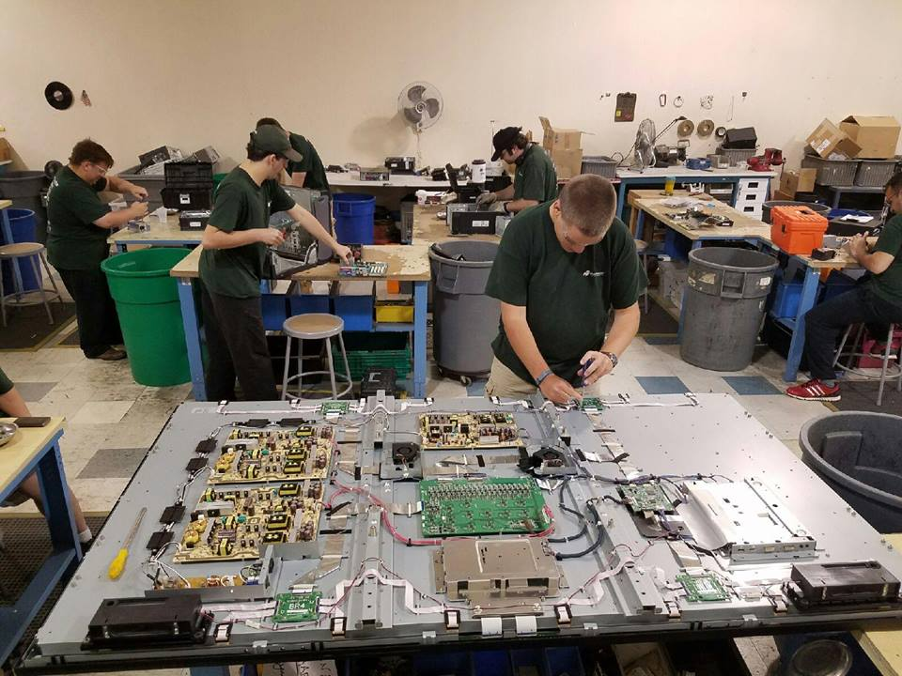
Notes:
This is photograph of their facility in Randolph, NJ. This company deals with discarded electronic equipment, or e-waste. You can imagine there is a lot of it out there, and before it can be properly recycled, it must be stripped down. That’s what these guys and girls do. This is the kind of job that some people with ASD really gravitate to. It’s hands-on and lots of repetitive, discrete tasks. On their testimonial page, one employee says that she’s always loved to take things apart. What better kind of job could you have, and what a service to the community!

Slide 6
How do people with ASD
work in other workplaces?
Industry: Greenvision, Inc.
Non-profits: Goodwill
Writers and the “gig economy”
Libraries: Project A+/Florida State
& Institute of Museum and Library
Services (IMLS) https://aplus.cci.fsu.edu/
Notes:
There is also a place for people with ASD to work in non-profits, in places like Goodwill, for example. I had always thought of Goodwill as a thrift store company, but they are much more than that. Much of their work involves providing people – not just those with disabilities – with employment services. Think coaches who help you gain employment. This is often critical for the people with ASD. I recently read a blog post at the Goodwill website where high school students with ASD in Tulsa, Oklahoma are transitioning from school to work. They gather together to take part in role playing certain situations at work. This helps them learn to read social cues, again something that can often be difficult for people “on the spectrum.” Goodwill also funnels some of these people into their own workforce. A little more than a quarter of Goodwill’s 113,000 employees have a disability. I am certain some of those individuals are people with ASD. While some individuals with ASD struggle with interpersonal communication, they may still be highly intelligent and communicative via the written word. [Hold up book] A recent college graduate with ASD wrote this book of life lessons for teenagers with autism. It’s not that bad. Last I heard she was writing pieces for an autism blog. All the advantages of the “gig economy” that individuals without ASD experience also apply to those with ASD. Finally there is the library, one of the closest analogues to an archives. I was fortunate early in my research for this presentation to encounter the Project A+ report which came out of Florida State University just last year. The authors of the report have themselves presented at a recent American Colleges and Research Library (ACRL) conference and I read a summary of their report in ACRL News.

Slide 7
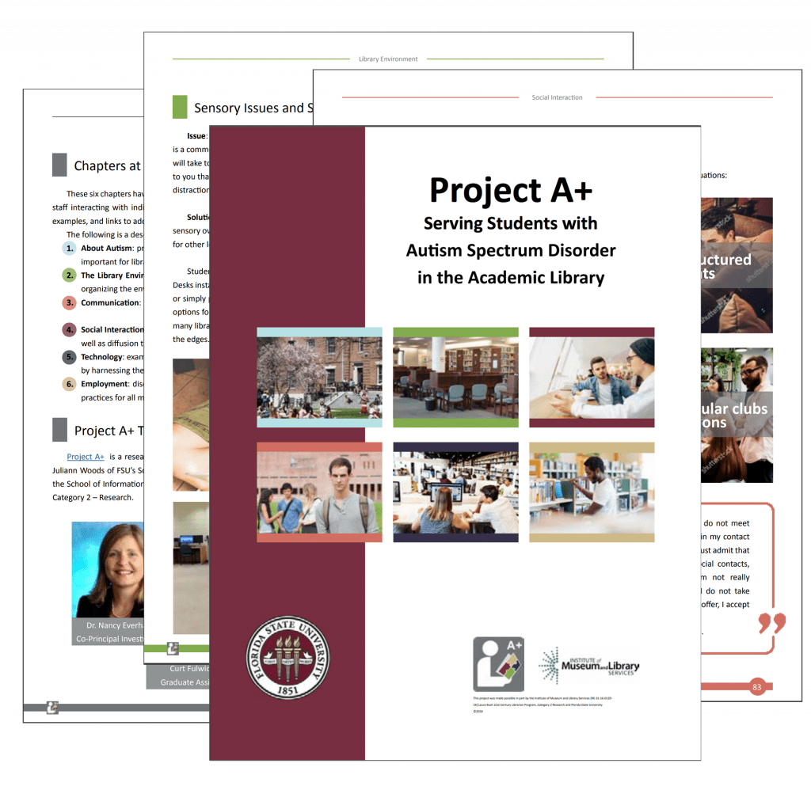
Notes:
The report itself is 132 pages and is the perfect place to start for further investigation into this topic. The report examines the library environment and how that can support students with ASD, how people with ASD commonly communicate and what libraries can do to improve social interaction, the role technology plays in empowering individuals with ASD, and finally employing individuals with ASD in the library. It is comprehensive and I recommend it highly.

Slide 8
What is it like to work in an
archives?
Intense focus, discrete tasks
Order/Structure
Repetitive, sequential work
Solitary, quiet
Some physical labor (Accommodations)
Notes:
So much for people with ASD working in other occupations. What is it like to work in an archives? In some ways, it is no different than what we’ve just covered. There is often an intense focus, on discrete tasks.
There is an order and structure to our work.
Like those workers at Greenvision with their electronics, our work can be sequential and repetitive. I’m particularly thinking of going through collections and sorting out series, or even more so creating folders and labels for those items.
At times it can be solitary and quiet, much like the kind of work a writer does on her own.
Of course, there is also physical labor in the archives. I know that most of the job applications I have seen discuss the need to lift boxes of a certain weight, and this may be an area where one might need to introduce some reasonable accommodations for people with ASD or other disabilities. Rather than having them pull items from high up on the shelves, perhaps items can be brought to them. Other accommodations might include flexible hours or regular meal breaks.

Slide 9
People with ASD working in an
archives: Expectations?
A timely concern in our profession
Case study: Inventory work
Potential rewards – for everyone
Being realistic and flexible
Notes:
So, what kinds of things should we expect to encounter when people with ASD work in an archives?

Slide 10
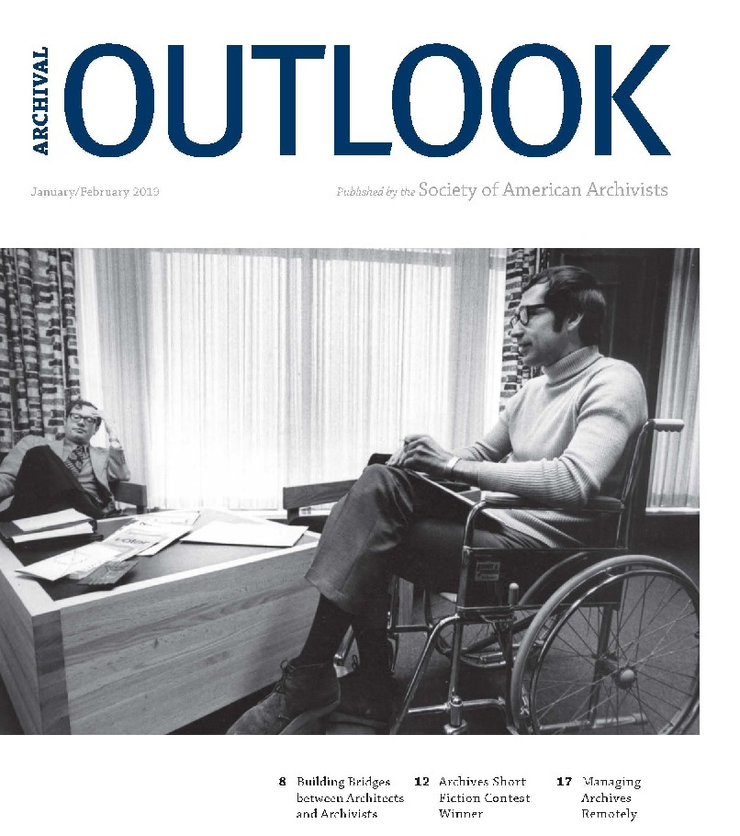
Notes:
Perhaps this is a digression, but I think we can expect to see more people with ASD in archives, in part because the topic is timely. [slide] This is cover of the January/February 2019 issue of the SAA Outlook magazine. As soon as a I saw the cover, I hoped I would find an article about archives and disabilities, and I was not disappointed. Part of the article discusses the most recent efforts of the SAA Task Force on Accessibility to formulate [hold up the report] Guidelines for Accessible Archives for People with Disabilities.

Slide 11
People with ASD working in an
archives: Expectations?
A timely concern in our profession
Case study: Inventory work
Potential rewards – for everyone
Being realistic and flexible
Notes:
At my own institution we have had the opportunity to work with people on the spectrum. We recently hired a student with ASD. We were initially approached by representatives from our disability services department and a faculty member (who also happened to be the student’s father). That is significant – I think it quite likely that any individuals on with ASD you encounter will probably have coaching or some sort of guidance. In our case, the student was only mildly impaired. We determined that she was capable of doing inventory work on a collection of pamphlets that had languished. She struggled with spatial directions (finding her way about) so the collection she was brought to her (this was the main accommodation) but most of the time she did fine. She was capable to entering data into a spreadsheet.
The literature I read on this topic also describes a potential reward. Improving services for people with ASD, indeed for people with any disability, makes services better for all.
I close with this – nothing Earth shattering but it is honest: it is incredibly helpful to be both realistic and flexible. In the case of our student worker mentioned above, there were a few times when she was having a really bad day. We were lucky that some of her fellow student workers had experience people with ASD. One of them offered to take her out of the building for a walk around campus, which totally defused the situation. We must also be realistic – sometimes it won’t work out. That same student eventually left the school for another. I don’t think it was because of us, but you never know. Sometimes jobs don’t work out for employees without disabilities; no one wants that to happen, but it does; the same is true for people with ASD.

Slide 12
Closing:
Your questions/observations
Encounters with people with ASD?
Experience with ASD (or other disabilities) in the archives?
Notes:
During the question and answer period, I welcome any of you to share your encounters with people on the spectrum and your experience with ASD (or other disabilities) in the archives.

Slide 13
Thank You!
Dr. Matthew R. Beland
mbeland@drew.edu
Notes:
Thank you very much!

