Slide 1
RDA Beta Toolkit Workshop:
From overview to creating linked data
Kathy Glennan
Chair, RDA Steering Committee Head, Original & Special Collections Cataloging, University of Maryland

Slide 2
Today’s agenda
Background
Short topics followed by Q&A exercises
Break
Overview of RIMMF4
Hands-on data entry
Wrap-up

Slide 3
Thanks to…
Kristi Bergland & Mary Huismann
Who helped with the planning, etc., and will be assisting you today
Deborah & Richard Fritz
RIMMF developers
RSC and/or NARDAC members who presented at the 2020 ALA Midwinter RDA preconference
Kate James (past RDA Examples Editor), Honor Moody (current RDA Examples Editor, Thomas Brenndorfer (NARDAC representative to the RSC), Dominique Bourassa (NARDAC Chair), and Melanie Polutta (LC, NARDAC member)
Their presentations helped inform today’s content

Slide 4
Background Beta RDA Toolkit

Slide 5
What is RDA?
The standard itself
A package of data elements, guidelines, and instructions for creating library and cultural heritage metadata that are well-formed according to international models. These metadata are intended to support the discovery and identification of resources in library and other cultural heritage collections.
The RDA Toolkit
An integrated, browser-based, online product
Includes RDA, and other cataloging-related documents and resources
The RDA Registry
Provides documentation about the RDA entities, elements, and vocabulary encoding schemes for application developers and linked data communities .

Slide 6
Scope of RDA
In scope
“Things” of bibliographic interest
Data and functionality required by end-users to meet their information needs
Out of scope
Administrative metadata
Resource management metadata (e.g., acquisitions, preservation, circulation)
Rights management metadata
Subject access beyond RDA entities

Slide 7
The 3R Project – Why?
IFLA consolidated and updated RDA’s underlying functional requirements models (FRBR, FRAD, and FRSAD) and created the new IFLA Library Reference Model (LRM)
Introduced new entities
Greater emphasis on relationships rather than attributes
Settled on a model for aggregates
A chance to improve the functionality both within and behind the original RDA Toolkit
An opportunity to better align RDA with linked data principles and to expand its reach internationally

Slide 8
3R Project – Decisions
Retain current RDA elements unless they conflict with LRM
Redundant elements will be removed sometime after 3R Project ends
Unstructured description of an element (e.g., type of recording) preferred over old “details of” approach (e.g., details of type of recording)
Generalize the instructions
Move away from organizing instructions and guidelines in the form of a cataloging manual
Recast “relationship designators” as relationship elements
Offer more flexibility in choosing how to record a piece of information

Slide 9
Beta RDA Toolkit Status
English text “stabilized” in April 2019
Work underway on policy statements, application profiles, and translations
But certain changes still permitted
Those that do not have an impact on the outcome of applying the instructions
Correction of errors, improving consistency, and other modifications that will not have a significant impact on the policy statement writers and translators
Addition/revision of examples
Expect to add some samples of policy statements by April 2020
Still considered “beta” until …

Slide 10
The Switchover Date
On Dec. 15, 2020, the beta RDA Toolkit will become the official version of RDA
beta.rdatoolkit.org → access.rdatoolkit.org
Original Toolkit will become available at: original.rdatoolkit.org
The year-long countdown clock for bringing down the original Toolkit will not start on this date
Instead, this will be announced at a later time, after the RSC and the RDA Board agree on a specific date
Catalogers are not expected to start using the new RDA on this date
When will catalogers start using the new RDA?
That’s up to you – and LC/PCC, MLA, etc.

Slide 11
Beta RDA Toolkit Basics

Slide 12

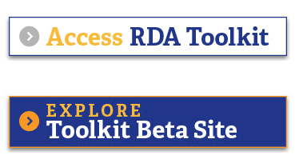
Accessing the new Toolkit
Must have a current subscription to RDA
Several choices
Directly at beta.rdatoolkit.org
Via a link in the original Toolkit
From a link on the RDA Toolkit homepage https://www.rdatoolkit.org/

Slide 13
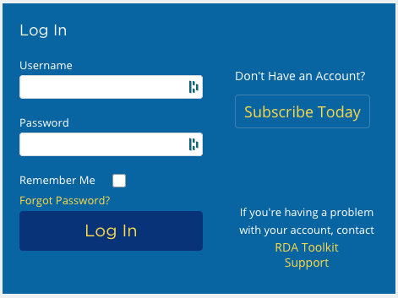


Logging in
IP Authenticated?
No extra login required for basic use
Institution name in top left
But profile not logged in – see top right
Need personal profile login for
Bookmarks and notes
Documents
Custom views
No IP authentication?
Single institution/profile login, gives access to everything
Institution name in top left
Your name in top right
MLA RDA Preconference – February 26, 2020

Slide 14
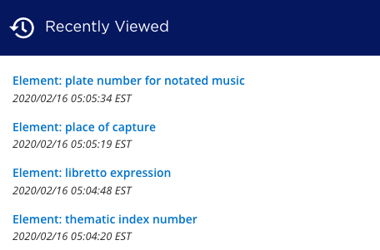
Navigating
Drop down menus from each content tab
Available everywhere
Recently viewed list on home page

Slide 15
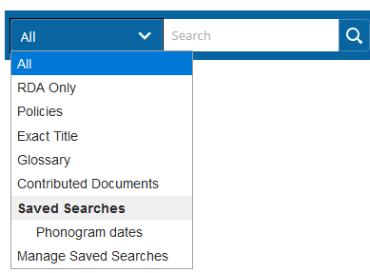
Searching
Several choices
All: searches everything in the Toolkit
Except for AACR2
RDA Only: searches Guidance, Entities, Elements, Glossary, and the top two sections in Resources
Exact title: a left-anchored search of “RDA Only” content
Useful if you know the exact page name you want
Glossary: limits the search to Glossary entries
Contributed documents: searches globally and locally shared documents
Saved searches: You may save any of the above searches for later use

Slide 16
Searching tips
Toolkit does not use Boolean operators
“and” is assumed between terms
Searching is not case sensitive or punctuation sensitive
Use quotation marks when searching for an exact phrase
Unless you’re using Exact Title – then omit them
Good way to search for former element names
Use an asterisk (*) as a wildcard for one or more letters
number* retrieves: number, numbers, numbering
Use a percentage sign (%) as wildcard for a single letter
short-cut retrieves: nothing
short*cut retrieves: shortcut

Slide 17
Special searches
MARC 21
Search by combining MARC field, indicator values, and subfield; can specify “authority” or “bibliographic” for greater precision
RDA only search, using quotation marks for precision: “264 *1 $b”
RDA only search, using quotation marks: “authority 400 1* $a”
Original Toolkit instruction numbers
Some available – at a high level
Search “6.15”, not “6.15.1.6.1”
No links back to AACR2

Slide 18
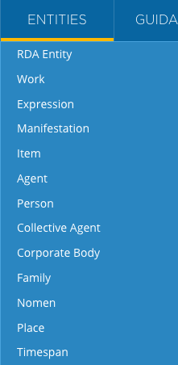
Toolkit structure – Entities
Drop down menu for the 13 RDA entities
“Things” that are of interest to library users
Each entity page has the following sections
Definition and scope
Prerecording
Is this the entity to use for my data?
Recording
What data do I record?
Elements
What elements are in scope for this entity?
Can scroll through the list or use the type ahead search

Slide 19
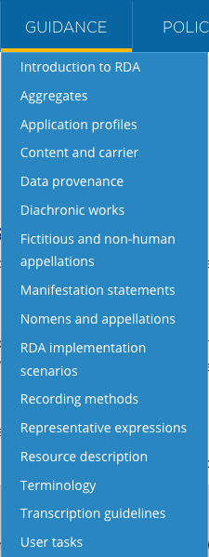
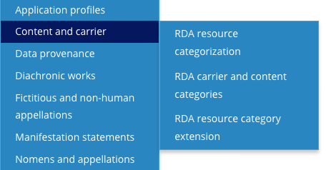
Toolkit structure – Guidance
Contains
Background information about RDA and RDA Toolkit
Instructions that apply to multiple elements
Some chapters have a popout menu with subtopics

Slide 20
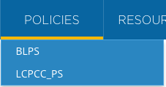
Toolkit structure – Policies
Under construction
Expect to see sample content in April 2020 release
Where MLA Best Practices will appear (eventually)

Slide 21
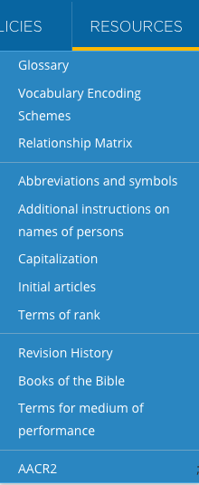
Toolkit structure – Resources
In four sections
RDA reference material
Glossary
Vocabulary Encoding Schemes
Relationship Matrix [under construction!]
Original Toolkit appendices which are still applicable
Including Capitalization and Initial articles
Content that is relevant to RDA, but not officially part of it
Including the medium of performance terms originally in AACR2
AACR2

Slide 22
Toolkit structure – Elements
Not directly available through the dropdown menus
More than 3000!
Each element page has the following sections
Definition and scope
Element Reference
Prerecording
Recording
Recording Methods
Related Elements
May have View as Relationship & View in Context examples

Slide 23
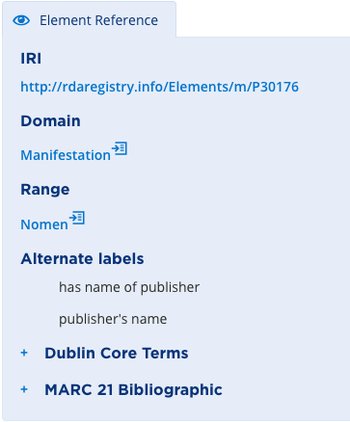
Element Reference
Collapsible box
Contains
Link to RDA Registry (external site)
Domain
Range
Alternate labels
Mapping to other standards, such as MARC 21
Expandable by clicking on “+”
Links to entity pages

Slide 24
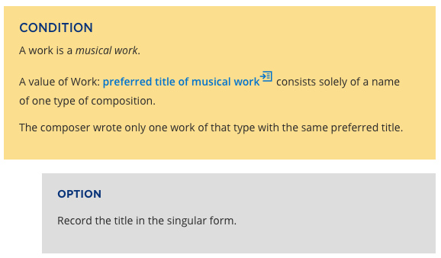
Condition/Option boxes
Replaces the variety of options and exceptions in the original Toolkit
Condition = situation
If the box contains multiple conditions, they all must apply
Options = what to do
A condition box may or may not have multiple separate option boxes, which may or may not be mutually exclusive

Slide 25
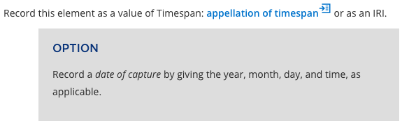
Option box alone
Option boxes may appear without condition boxes

Slide 26
Other kinds of options
Recording any element is optional, except as specified in
Coherent description of an information resource (Guidance chapter)
Must include a description of at least one of the resource’s entities
Minimum description of a resource entity (Guidance chapter)
Record a value for at least one appellation element of the entity, using an applicable recording method
Relate entities by recording a value for a relationship element
Effective description of an information resource (Guidance chapter)
Conforms to coherent and minimum descriptions
Adds other entities and/or elements deemed useful for identification or access
From application profiles, policy statements, cataloger’s judgment, and/or information availability

Slide 27
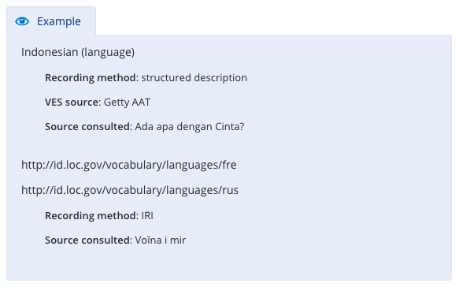
Examples
Collapsible boxes
Instructions may have many or none
Different types
With the instruction
[on this slide]
View in context
View as relationship

Slide 28
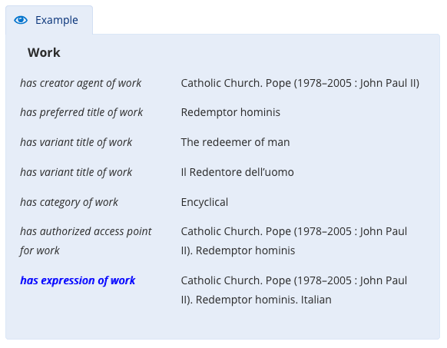
Example – View in context
Shows other elements that could be used in describing the entity
The element in focus is in blue italics

Slide 29
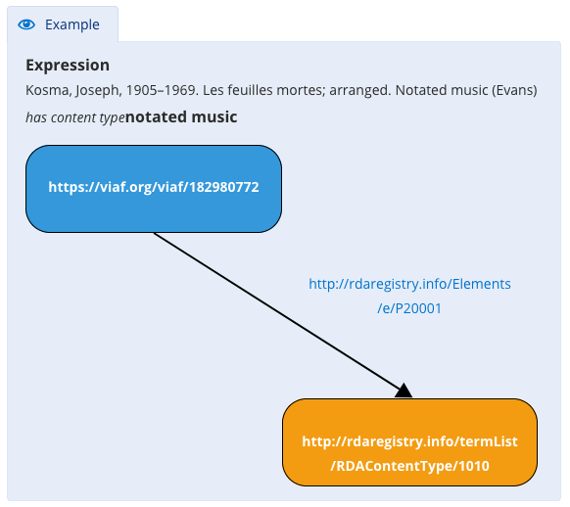
Example – View as Relationship
A linked data visualization of the relationship
With the relevant IRIs

Slide 30
More Toolkit orientation
Available on RDA Toolkit’s YouTube channel
https://www.youtube.com/channel/UCd5pa3AoQIr17wESE9YHcnw
Logging In
RDA Beta Site Demo from July 24, 2019
Linking Tool
To insert bookmarks and notes
Revision History

Slide 31
Exercise Set #1

Slide 32
Question 1
Q: Do an Exact Title search for copyright date. Do not include quotation marks in your search. What happens?
A: You go directly to the copyright date element page

Slide 33
Question 2
Q: Do a RDA Only search for copyright date. Use quotation marks around the phrase. How many results do you get?
A: 14
Includes results from the following categories: elements, glossary terms, relationship matrix, and entity

Slide 34
Question 3
Q: Where is information about user tasks located in the Toolkit?
A: Guidance > User tasks

Slide 35
Question 4
Q: What is the new name for the original RDA element “form of work?” How did you find this information?
A: category of work
1: RDA Only search: “form of work”
Select Glossary hit
Has see reference for category of work
2: Search directly in Glossary

Slide 36
Question 5
Q: What is the inverse element for derivative work? Where did you find the answer?
A: based on work
1: Exact title search: derivative work
Scroll down to bottom of page
Last line (under Related Elements) gives inverse
2: Search directly in Glossary
Inverse given after definition

Slide 37
Question 6
Q: Can you find the three places where the term “vocal score” is defined in Toolkit?
A:
In the Glossary
In the Vocabulary Encoding Schemes
Resources > Vocabulary Encoding Schemes > RDA Format of Notated Music
In the element page format of notated music
As a mouseover on the term

Slide 38
Quick Guide to:
Entities & Elements
String Encoding Schemes
Vocabulary Encoding Schemes

Slide 39
Entities & Elements

Slide 40
Definition: Entity
An abstract class of key conceptual objects in the universe of human discourse that is a focus of interest to users of RDA metadata in a system for resource discovery

Slide 41
13 RDA entities
RDA entity – at the top
Work
Expression
Manifestation
Item
Agent
Collective agent
Family
Corporate body
Person
Nomen
Place
Timespan

Slide 42
Definition: Element
A specific aspect, characteristic, attribute, or relationship used to describe an RDA entity

Slide 43
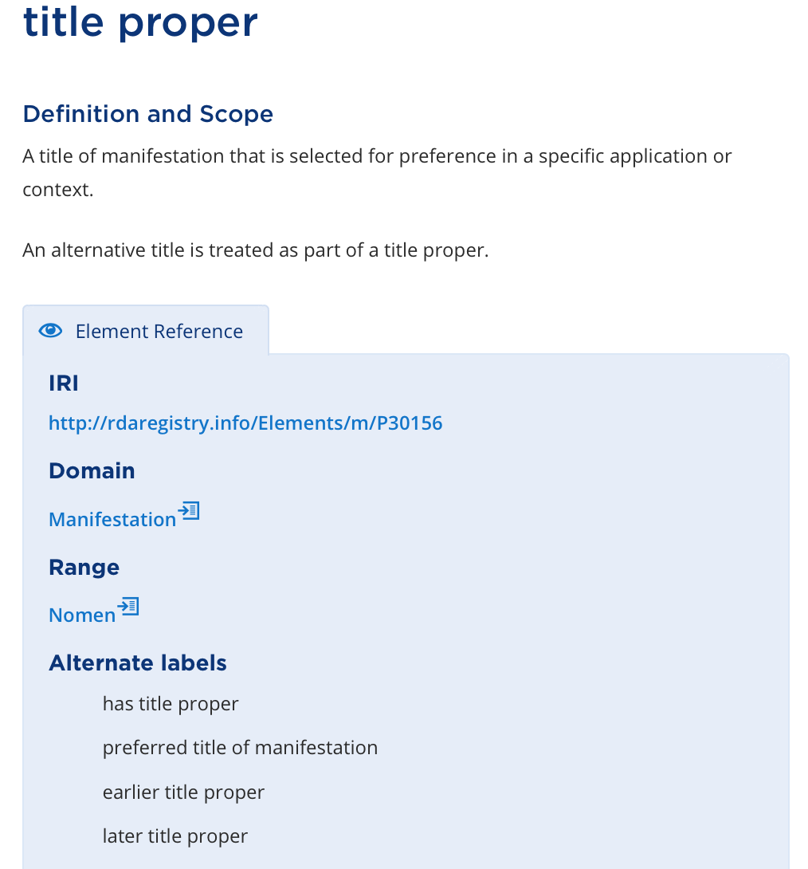
unique label
unique definition
Each element is unique
unique IRI
unique identifier
43

Slide 44
Each element can only describe one entity
The element “title proper” always describes a manifestation
44

Slide 45
Each element has one or more alternate labels
Verbalized label (RDA Registry label)
45
Previous element names

Slide 46
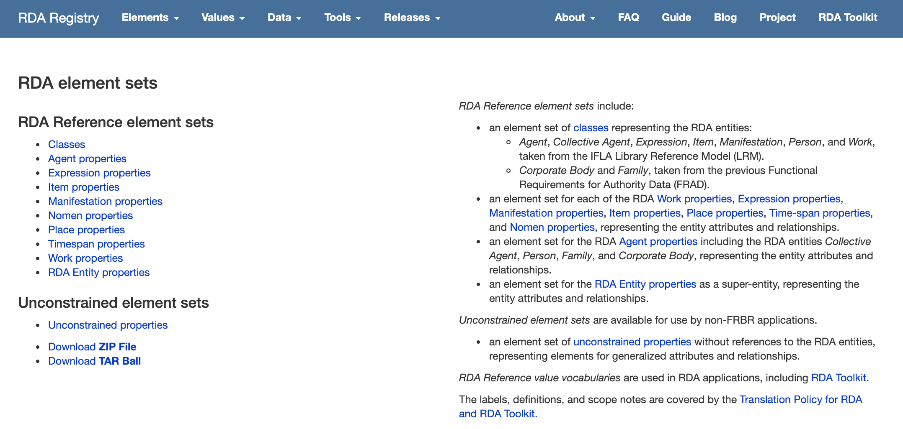
Elements are “stored” in the RDA Registry
constrained elements
unconstrained elements
https://www.rdaregistry.info/Elements/

Slide 47
Definition: Relationship element
An element that relates two RDA entities Use for: relationship designator

Slide 48
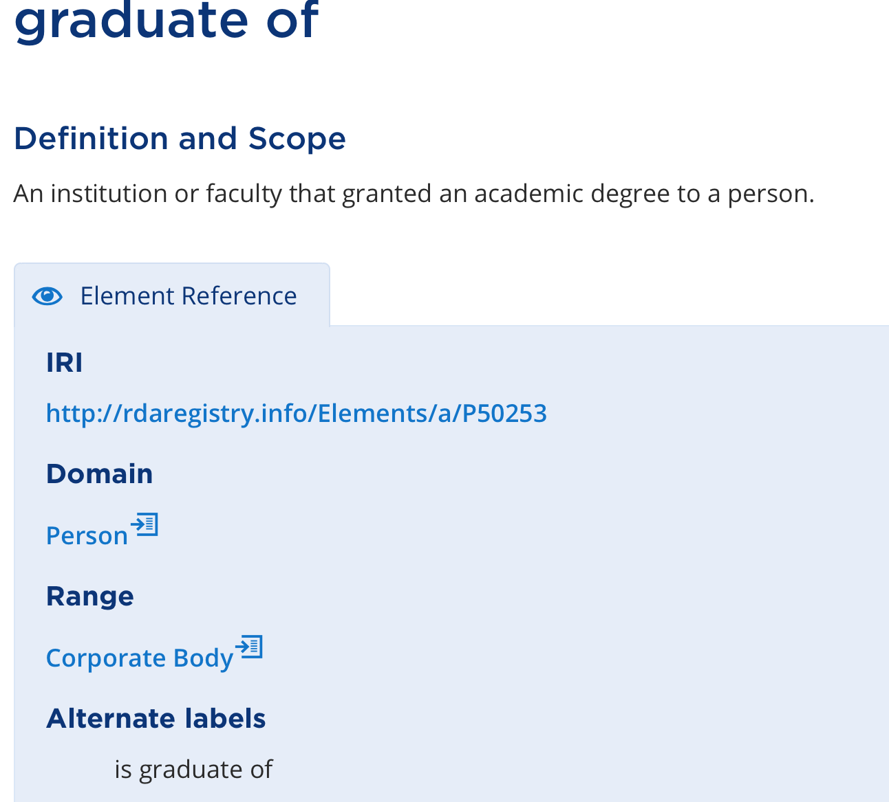
Relationship elements have a domain and a range
RDA Entity that is described by an element
RDA Entity that is the value of a relationship element

Slide 49
The element
relates a
How to read this information
to a
that is

Slide 50
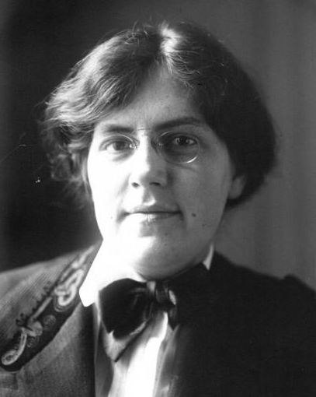
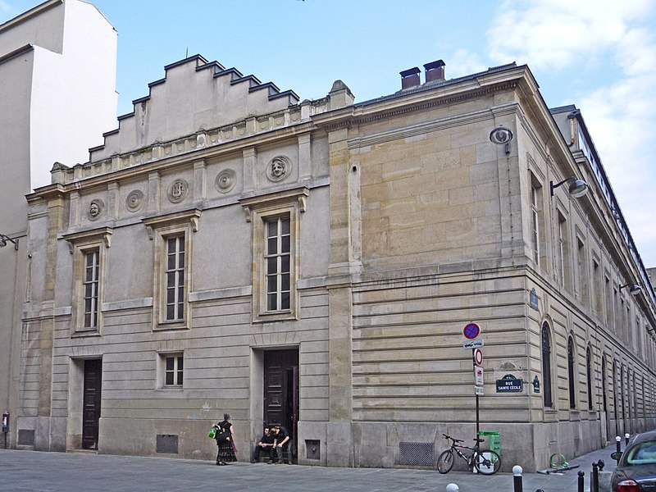
Example with a relationship element
Domain: Person
Range: Corporate Body
Nadia Boulanger
record
an element
Conservatoire de Paris
is graduate of
is graduate of
The verbalized label helps understand the essence of the relationship
record a value
for the element

Slide 51
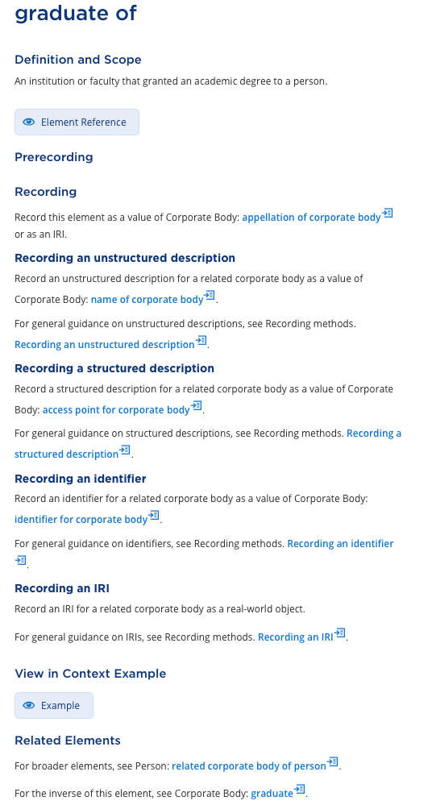
Relationship elements are reciprocal
One way to find the inverse of an element is to scroll to the bottom of the element page

Slide 52
Relationship elements are reciprocal
The inverse of
the element
graduate of
is
graduate

Slide 53
Reciprocal example
Domain: Person
Range: Corporate Body
Nadia Boulanger
Conservatoire de Paris
is graduate of
has graduate
Range: Person
Domain: Corporate Body

Slide 54
Definition: Attribute element
An element that is an inherent or externally imputed characteristic of an RDA entity

Slide 55
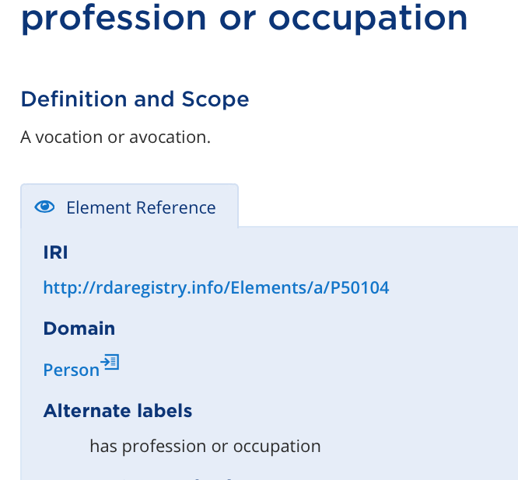
Attribute elements have a domain but no range
RDA Entity that is described by an element
No Range!

Slide 56
Example with an attribute element
Domain: Person
Range: None
not an RDA entity
Nadia Boulanger
has profession
or occupation
composer

Slide 57
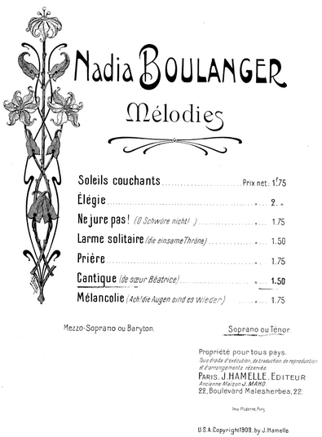
Some original RDA Toolkit attributes have become relationship elements
Domain: Manifestation
Range: Nomen
has title proper
Cantique
Range: Place
has place of publication
Paris
Range: Timespan
has copyright date
1909

Slide 58
Definitions
element super-type
A broader category or type of an element
element sub-type
A narrower category or type of an element

Slide 59
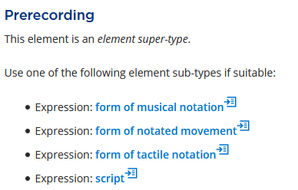
Example: Form of notation

Slide 60
Element names
Some unchanged, such as
title proper
place of publication
content type
date of birth
Some with minor changes
based on (work) → based on work
place of residence, etc. → place of residence

Slide 61
Agent elements separated
Original Toolkit
author
Beta Toolkit
author agent
author collective agent
author corporate body
author family
author person

Slide 62
A more drastic transformation
Original Toolkit
illustrator
Beta Toolkit
contributor agent of still image
contributor collective agent of still image
contributor corporate body of still image
contributor family of still image
contributor person of still image
element broken down into separate elements
label modified
relationship moved from expression to manifestation

Slide 63
New elements created
Original Toolkit
[no equivalent]
Beta Toolkit
appellation of person
transformation by extension plan
identifier for nomen
language of representative expression

Slide 64
Those crazy element names…
Complaints about baffling and/or intimidating element labels, such as
contributor person of still image
contributor agent to amalgamation
medium of performance of choreographic content of representative expression

Slide 65

Facts
Element labels are not intended for “human consumption”
700 1- $a Anderson, Leroy, $d 1908-1975, $e arranger person of music
Element labels and definitions are grounded in linked data principles
Elements are designed to be meaningful to machines

Slide 66
User-friendly labels?
The RSC has charged the North American RDA Committee to create user-friendly display labels
These will have to be community specific; they cannot work for all RDA users worldwide
Communities will be able to develop their own labels

Slide 67
String Encoding Schemes, or SES

Slide 68
Definition: String encoding scheme
A set of string values and an associated set of rules that describe a mapping between that set of strings and a value of an element

Slide 69
What is an SES?
“Rules” that explain how to put together a string, such as an access point for a person
Instructions may include:
Components of the string
The order of the data
Punctuation or other delimiters
Examples
Lennon, John, 1940-1980 [LC/NACO Authority File]
Lennon, John‏ (1940-1980)‏ [National Library of Poland]
John Lennon [Wikidata]

Slide 70
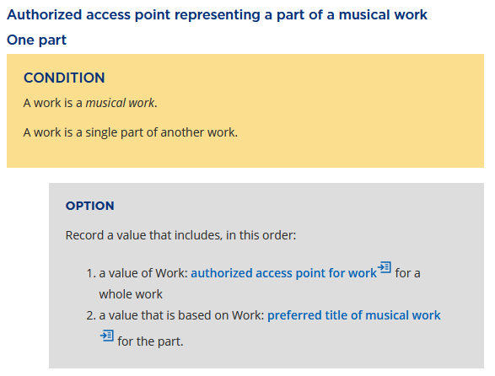
SES future in RDA instructions
Plan to move SESs out of element pages
Currently

Slide 71
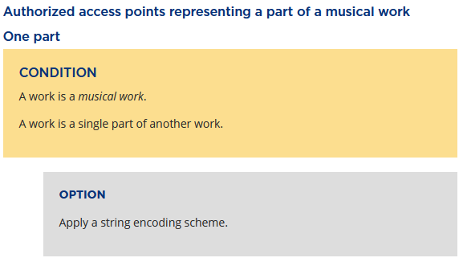
SES future in RDA instructions
Planned
Will require creating specific guidance in policy statements

Slide 72
Vocabulary Encoding Schemes, or VES

Slide 73
Definition: Vocabulary encoding scheme
A named structured list of representations of controlled values for elements

Slide 74
What is a VES?
A list of controlled terms
VESs include:
RDA lists of terms (ex.: RDA content type)
ISO code lists (ex.: ISO 639-2 language code list)
Standard terminology (ex.: Terms for medium of performance)
Authority control systems (ex.: name authority records, LCGFT)
VESs do not include simple keyword indexes

Slide 75
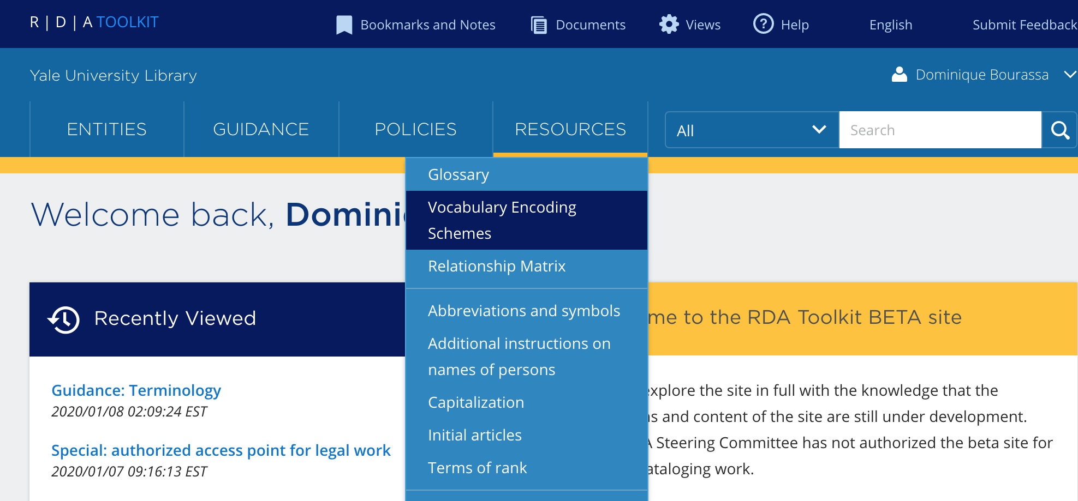
Accessing the list of RDA VESs

Slide 76
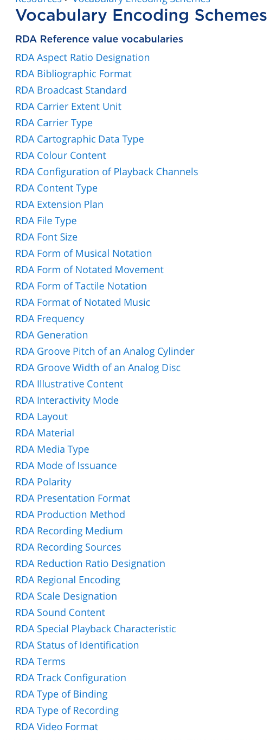
List of RDA VESs
Click on a link to retrieve the complete list of RDA terms for a given VES

Slide 77
List of RDA VESs
Click on a link to retrieve the complete list of RDA terms for a given VES

Slide 78
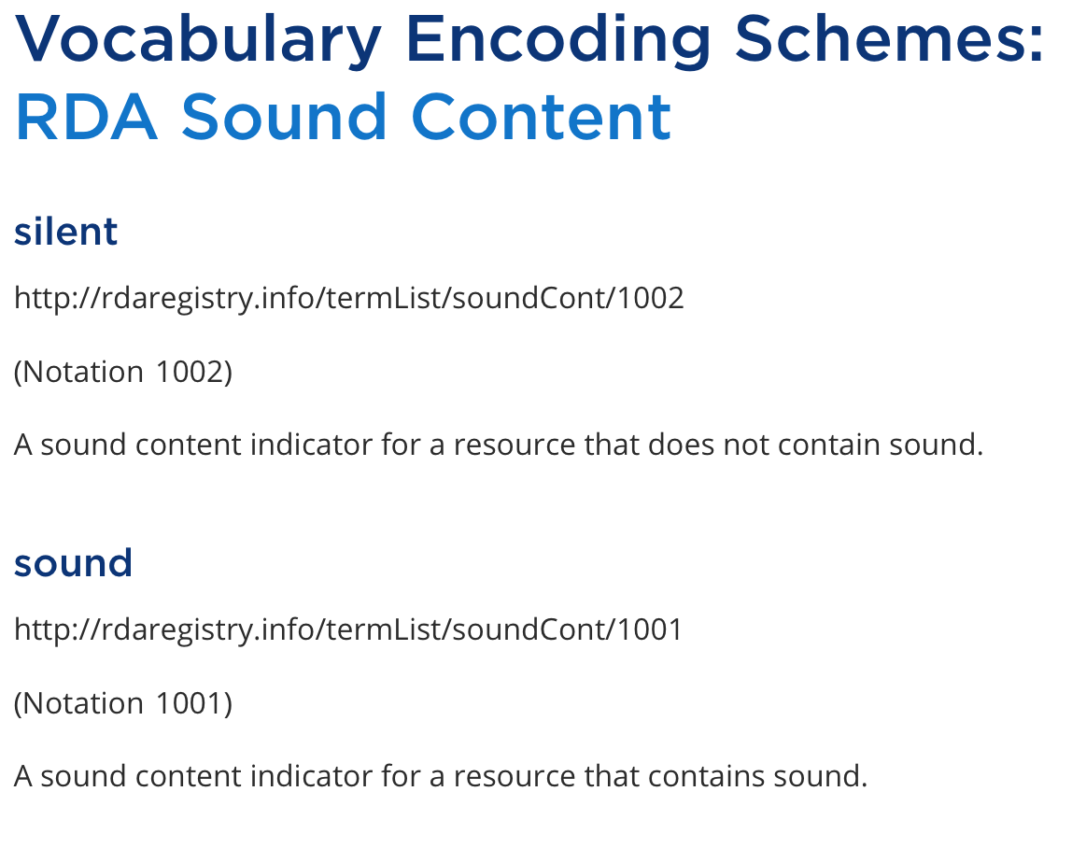
unique label
unique IRI
unique identifier
unique definition

Slide 79
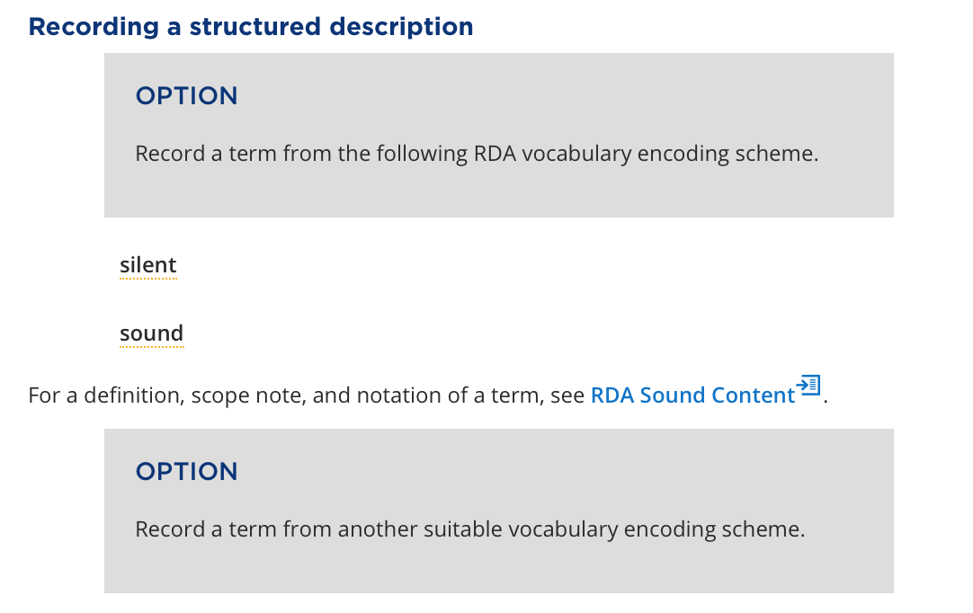
Example of options to use VESs for sound content

Slide 80
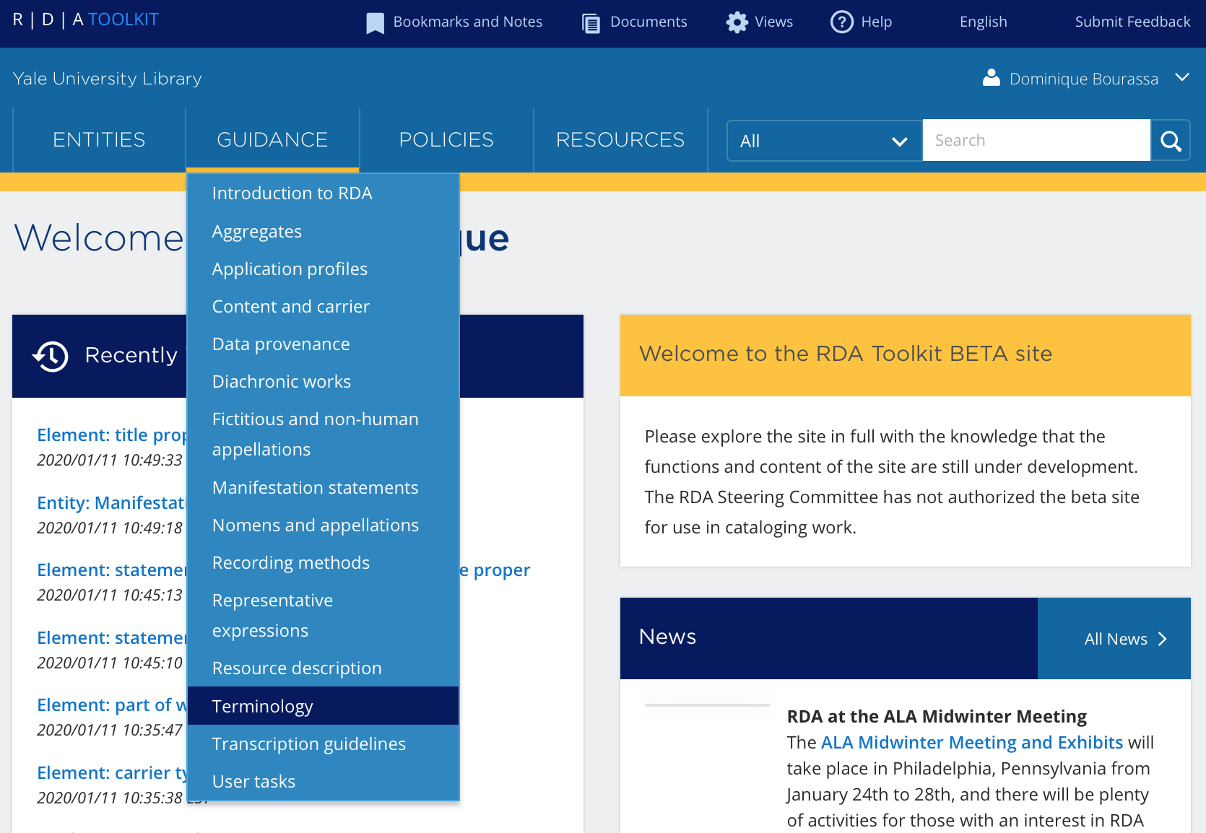
See Guidance > Terminology for details

Slide 81
Exercise Set #2

Slide 82
Question 1
Q: What is the beta Toolkit label for the element writer of preface?
A: contributor agent of text
1: RDA Only search: “writer of preface”
Select Glossary hit
Has see reference for contributor agent of text
2: Search directly in Glossary
Note: there are also more specific labels:
contributor collective agent of text
contributor corporate body of text
contributor family of text
contributor person of text

Slide 83
Question 2
Q: What is the domain and range of the element date of capture? Where did you find this answer?
A: Domain = Expression; Range = Timespan
Exact title search: date of capture
Open element reference

Slide 84
Question 3
Q: What is the inverse element for content type?
A: trick question!
Content type is an attribute element, not a relationship element
No inverse
Open element reference

Slide 85
Question 4
Q: Can you find at least one broader and one narrower relationship for performer agent?
A:
Do exact title search: performer agent
Scroll down to the bottom of the page
Broader: contributor agent to performance
Narrower: conductor person [one of 47 choices!]

Slide 86
Question 5
Q: Make two metadata statements about yourself using RDA elements
A: Sample!
[Me] has given name → Kathy
[Me] is person member of corporate body of → RSC

Slide 87
Everything Old is New Again:
Recording Methods
Appellation Elements

Slide 88
Recording Methods

Slide 89
Recording instructions
Original Toolkit – 3 terms
“Record”
Capture the information
Includes using terms from a list
May include guidance about order, e.g. extent statements
Also applies to relationships
“Transcribe”
Generally, record what you see
“Construct”
Instructions for structuring data, like in access points
Beta Toolkit – 4 methods
Unstructured description
Manifestation statement & Transcription
Unstructured note & Uncontrolled term
Structured description
Access point & Structured note
Controlled vocabulary terms, etc.
Identifier
Assigned by either a local or external agent
IRI
Actionable identifier used in linked data

Slide 90
Beta Toolkit
Four recording methods

Slide 91
Unstructured description
Uses include
Uncontrolled notes, terms, etc.
Transcription of information from the manifestation (i.e., manifestation statements)
Three choices for transcription guidelines
RDA Guidelines on basic transcription
RDA Guidelines on normalized transcription
Any other transcription guidelines of your choice
Supports the user tasks: identify and find

Slide 92
Basic transcription
Generally, “take what you see” or WSYWYG
Preserve capitalization, punctuation, numerals, and diacritics as they appear
Omit symbols or images intended to be interpreted as text if you cannot reproduce them
Transcribe the components in the order in which they appear
Use “\\” to delimit the separate components of a statement
Use “…” to indicate the omission of text within a statement
Collapse “white space” to a single space
Multiple spaces, new lines, indentation, tabs and block alignments, etc.
De-duplicate
Contiguous marks of omission
Contiguous delimiters
Strings in a manifestation statement

Slide 93
Normalized transcription
Based on what we do now
Transcribe and/or transliterate
Add missing diacritics
Apply capitalization guidelines
Omit, modify, or add punctuation for clarity
Repeat letters or words intended to be read more than once
Follow instructions about using abbreviations and symbols, including
Numbers expressed as words
Ordinal numbers

Slide 94
Definition: Manifestation statement
A statement appearing in a manifestation and deemed to be significant for users to understand how the manifestation represents itself

Slide 95
Manifestation statements
Designed for
Machine transcription
Simplified decision making (less parsing required)
Broad categories of information
13 sub-elements, including
manifestation publication statement
manifestation title and responsibility statement
Not required – can use the more granular elements, like
title proper
statement of responsibility relating to title proper

Slide 96
Structured description
May be a single term or a combination of values of elements associated with the entity or element
May have an associated string encoding scheme
Surname, Given name. Preferred title (Instructions give order and punctuation conventions)
May be represented in a vocabulary encoding scheme
The 1XX in a MARC 21 name authority record, or a term from LCSH
For RDA entities, the structured description is a nomen entity
Supports the user tasks: find, identify, and explore

Slide 97
Identifier
Kinds of identifier include:
Those assigned by an independent, external agent
ISBN, ISSN, music publisher number
Those assigned by a local agent
System number
Notation for a concept taken from a controlled vocabulary
sh 85029403 – LCSH for Composition (Music)
Only meaningful when associated with the assigning agency or source vocabulary
Data provenance!
Supports the user tasks: find, identify, and explore

Slide 98
IRI
Internationalized Resource Identifier
Based on Semantic Web technologies
Used as the referent of an entity or controlled term in linked open data using Resource Description Framework
Globally unique
For RDA entities, the IRI is not treated as a kind of nomen entity
It’s the “thing”, not the “string”
Supports the user tasks: find, identify, and explore

Slide 99
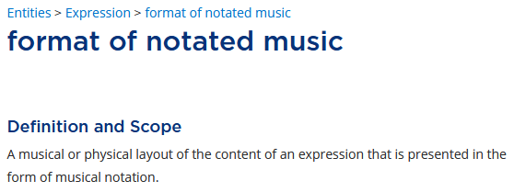
Recording “chorus score”
All four recording methods available

Slide 100
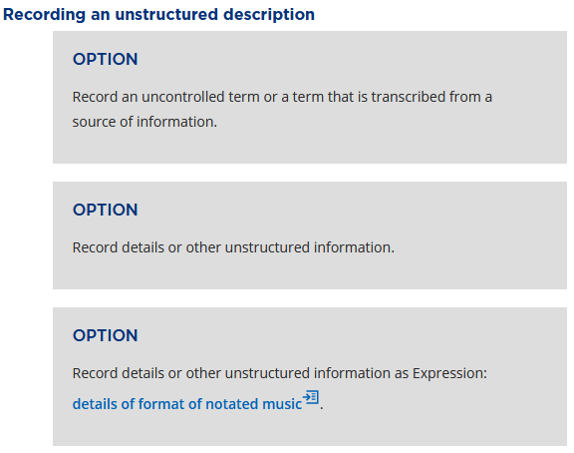
Chorus score – unstructured
Redundant element; temporarily kept

Slide 101
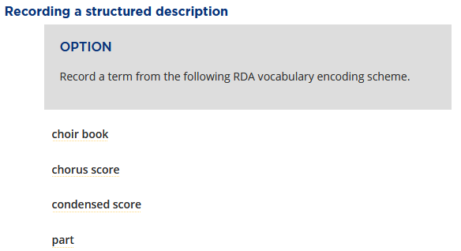
Chorus score – structured
…

Slide 102
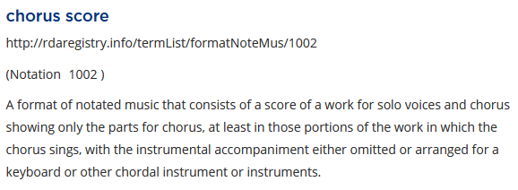
Chorus score – identifier & IRI
IRI
identifier

Slide 103
Appellation Elements:
Names, Titles, Identifiers, and Access Points

Slide 104
Identifying Persons
Original Toolkit – Chapter 9
Starts with instructions about recording attributes
date associated with person
language of person
Followed by instructions to create access points, incorporating
fuller form of name
profession or occupation
Most data recorded with creating access points in mind
Much of the core element guidance
Placing surname first in preferred name
Beta Toolkit – appellation elements
Appellation of person
A nomen that is used within a given scheme or context to refer to a person
Unstructured = name of person
Structured = access point for person
Identifier = identifier for person
IRI – not applicable
A hierarchy of elements – for example
Appellation of person →
Name of person →
Preferred name of person
Variant name of person

Slide 105
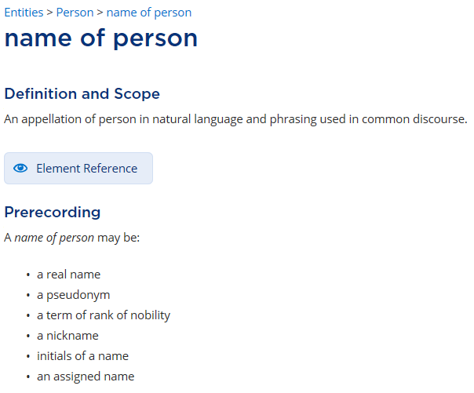
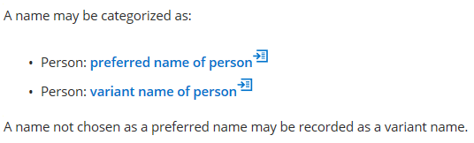

Slide 106
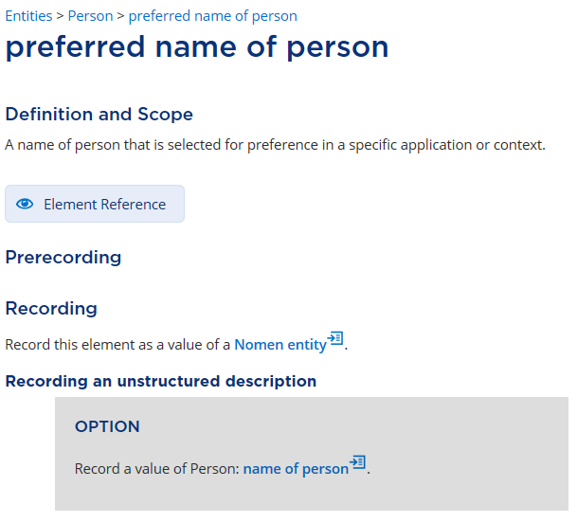
No instructions here about manipulating data elements for an access point

Slide 108
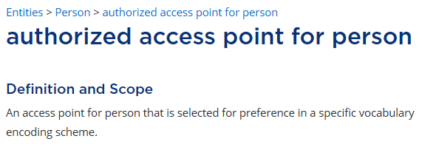
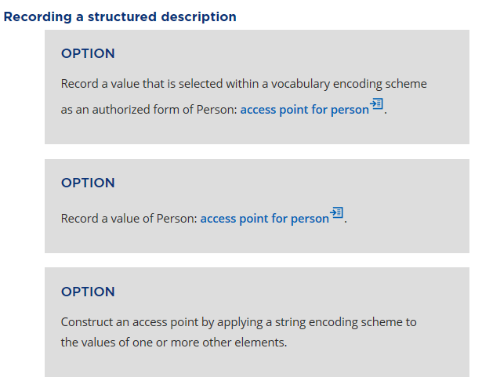

Slide 109
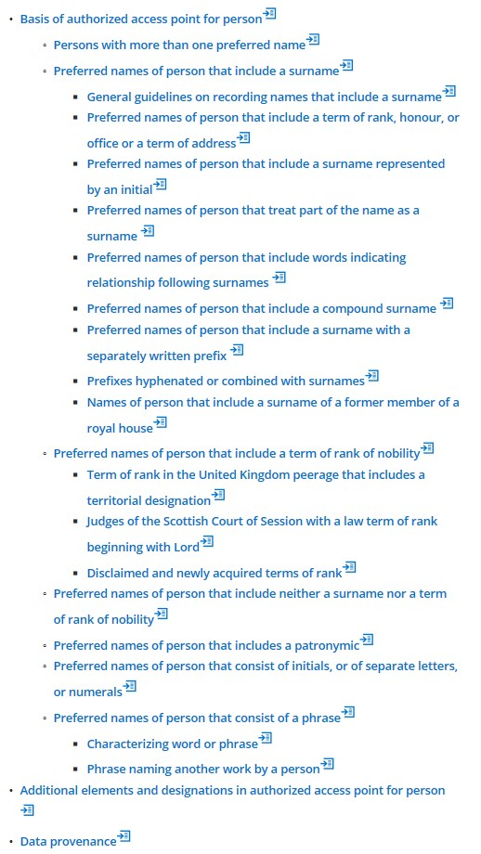
Authorized access point for person
Specific instructions, including data manipulation

Slide 110
Authorized access point for person
Specific instructions, including data manipulation

Slide 111
Other entities are similar
Only exception: nomen
Appellation of work
Unstructured = title of work
Structured = access point for work
Identifier = identifier for work
Appellation of manifestation
Unstructured = title of manifestation
Structured = access point for manifestation
Identifier = identifier for manifestation

Slide 112

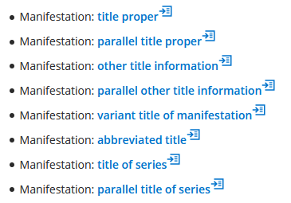
Title of manifestation
Covers all types of manifestation titles

Slide 113
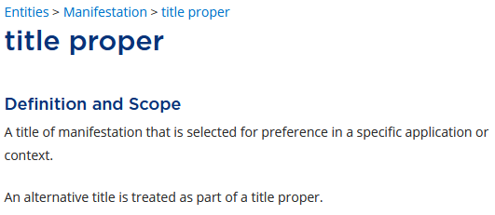
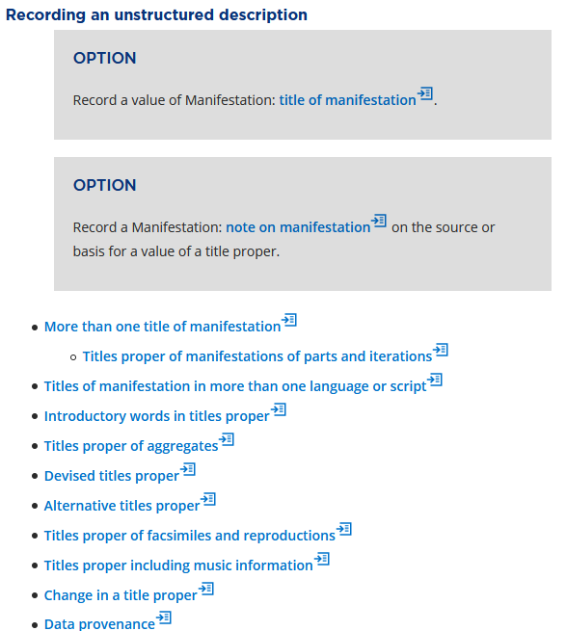
But where is source of title?
Under data provenance
(More on that in the next section)

Slide 114
Exercise Set #3

Slide 115
Question 1
Q: What recording method(s) can be used for plate number for notated music?
A: Exact title search: plate number for notated music
Identifier
IRI

Slide 116
Question 2
Q: Can you rearrange title page elements in a manifestation title and responsibility statement? Does it matter which transcription method you use?
A: See Guidance > Transcription guidelines
No; that’s the point
No

Slide 117
Question 3
Q: Where can you find instructions for putting surname before given name?
A: RDA Only search: surname and look at the relevant element pages
Authorized access point for person
Variant access point for person

Slide 118
Question 4
Q: What are the related elements for title of work?
A: Exact title search: title of work and scroll down
Broader
appellation of work
name of RDA entity
Narrower
key title
preferred title of work
variant title of work

Slide 119
Whatever happened to…?
Core instructions
Instruction numbers
Sources of information

Slide 120
Core Instructions

Slide 121

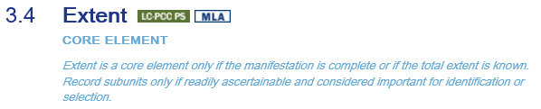
Original Toolkit
Identification at the element level
Applies to all Toolkit users
Sometimes “core if”

Slide 122
Beta Toolkit
Minimal guidance
Remember the guidance chapters
Coherent description of an information resource
Include a description of at least one of the resource’s entities
Minimum description of a resource entity
Record a value for at least one appellation element of the entity
Effective description of an information resource
Add other entities and/or elements deemed useful for identification or access
So many options, so little guidance in RDA instructions – What’s a cataloger to do?
Use an application profile

Slide 123
Definition: Application profile
Specifies the entities, elements, and vocabulary encoding schemes that are expected in a set of metadata that meets the functions and requirements of an application that uses the metadata
May include the minimum and maximum number of times an element may be used
Minimum = 1: Mandatory
Minimum = 0: Optional
Maximum > 1: Repeatable

Slide 124
Application profiles
Developed by communities
Specific to their needs
May publish a very basic application profile in the “official” part of RDA
Would have to apply to all users
Individual application profiles can be integrated into the Toolkit, or can be external
Option to not “live” behind the Toolkit paywall
May take the form of a spreadsheet
May be designed to interoperate with policy statements, best practices, etc.
A cataloging agency might nest them
RDA → LC/PCC → MLA → local

Slide 125
Using Application profiles + …
Example
title proper
RDA defines this element and presents options on what data to record, and how it may be captured
Application profile declares that title proper is mandatory
Policy statement clarifies which options within this element may or may not be used
Perhaps even cataloger’s judgment?
Application profile or other documentation specifies the recording method(s) for title proper
Tied to your agency’s encoding standard

Slide 126
Goodbye, Instruction Numbers
Hello, Citation Numbers!

Slide 127
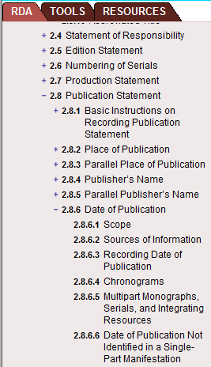
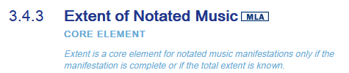
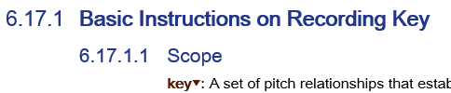
Original Toolkit: Instruction #s

Slide 128
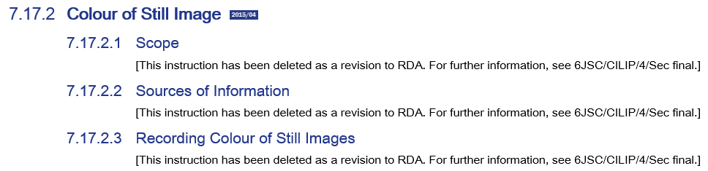
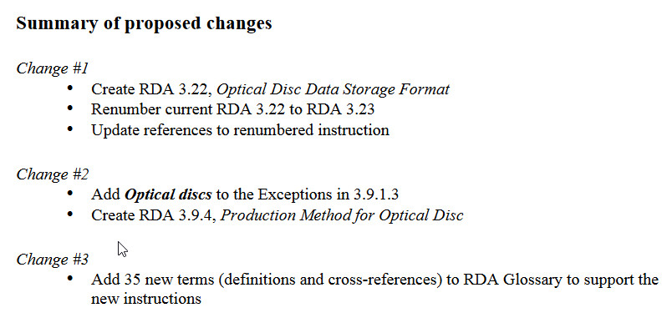
Maintenance nightmare

Slide 129
Beta Toolkit: Instruction # alternatives
Citation numbers
Shorthand reference to instructions
Designed for use when linking is not practical (like print)
Reference discrete portions of RDA content
Appear in entity, element, and guidance pages
Associated with headers, condition/option boxes, and solo option boxes
Formatted as ##.##.##.## and assigned randomly
Searchable, using any of the RDA search parameters
Do not automatically display
URLs
Links with the same granularity as citation numbers
Designed for online use (links in email, Word docs, etc.)

Slide 130

How do you find these?
bookmark
Highlight text
Click on appropriate symbol in popup box
note
link
citation number

Slide 131


Popup boxes

Slide 132

#s for phonogram copyright
Citation number: 62.89.16.04
Result highlighted:

Slide 133

#s for phonogram copyright
Link: https://beta.rdatoolkit.org/en-US_ala-452cb3af-3c8e-3c20-8d59-2362ad325a09/div_bmv_tzx_dfb
Result not highlighted:

Slide 134
Sources of Information

Slide 135

Original Toolkit

Slide 136

Beta Toolkit: Sources of information
Part of the Guidance chapter on Data provenance
Guidance > Data provenance
With guidance for …
Find Sources of information here

Slide 137
Definition: Data provenance
Provides information about the metadata recorded in an element or set of elements, which can be used to infer the context and quality of the metadata
The metadata being described by data provenance are treated as a metadata work that consists of a metadata statement or a metadata description set

Slide 138
Definitions
metadata statement
A piece of metadata that assigns a value to an RDA element that describes an individual instance of an RDA entity
metadata description set
One or more metadata statements that describe and relate an individual instance of one or more entities

Slide 139

Sources: Title page, etc.
Some familiar guidance at Recording a source of metadata that is a manifestation that is being described
Including this condition/option (09.53.46.48)

Slide 140
Exercise Set #4

Slide 141
Question 1
Q: Find the citation number for the option that instructs you to “Abridge a statement of responsibility only if this can be done without loss of essential information.”
A: 00.14.22.81
RDA Only search on the phrase (in quotes)
Browser search in page for: Abridge
Highlight text, select caption option
Alternative A: If you highlight the section name instead of the option, the citation number is: 88.60.88.63

Slide 142
Question 2
Q: Find the URL for the Prerecording section under preferred title of work.
A: https://beta.rdatoolkit.org/en-US_ala-f21836a5-7397-341a-bd4c-bd641e765511/f2201bd2-48e0-481d-9e6f-537a50ecffc4
Exact title search: preferred title of work
Highlight text, select link option

Slide 143
Question 3
Q: Where do you find the first condition/option(s) for the source of information for a moving image resource? Describe it with a citation number; URL; or element page, section title, and condition number (by counting).
A:
Citation: 59.02.67.78
URL: https://beta.rdatoolkit.org/en-US_ala-cfa18e03-17f2-378a-874c-86515bf7e0ac/div_ms2_1cr_vfb
Guidance > Data provenance
Recording a source of metadata that is a manifestation that is being described
6th condition/option

Slide 144
Question 4
Q: Find the page with instructions for navigating RDA Toolkit. Where is it? Provide a citation number or URL.
A: Semi-trick question
RDA only search: navigating rda toolkit
Lives in the help files – no citation number
URL: https://beta.rdatoolkit.org/Resource/Index?externalId=en-US_topic_lnb_qmy_x3b

Slide 145
New Concepts
Representative Expressions
Aggregates
Diachronic Works

Slide 146
Representative Expressions

Slide 147
Definition: Representative expression
Provides the values of specific elements used to identify a work and distinguish it from other works
Any expression can be used as a representative expression
With the relevant representative expression element values coming from there
There may be more than one expression that can be treated as a representative expression
With different representative expression element values coming from different expressions

Slide 148
Representative Expression Elements
Characteristics that
Originally “live” at the Expression level in the LRM model
Become identified as Work attributes because they best represent the intention of the creator(s)
17 such elements added to RDA, including:
language of representative expression
medium of performance of musical content of representative expression
key of representative expression
duration of representative expression
date of representative expression
date of capture of representative expression
place of capture of representative expression

Slide 149
Example
has language of representative expression: German
has medium of performance of musical content of representative expression: soprano orchestra
has key of representative expression: G major
has date of representative expression: 1892
Work
Mahler Symphony no. 4
Main utility:
construction of access points
distinct description of similar works
Notes:
Depending on how this is used, it could distinguish the original expression from any others.

Slide 150
Aggregates

Slide 151
Definition: Aggregate manifestation
A manifestation that embodies two or more expressions
Those expressions may realize one or more works
The manifestation may be issued in one or more units
Three types
Collection aggregate
Example: compact disc with more than one musical work
Augmentation aggregate
Example: cantata with critical notes
Parallel aggregate
Example: opera vocal score in two languages

Slide 152
Definitions
aggregating work
A plan to select and arrange one or more expressions of one or more works, and embody them in an aggregate [manifestation]
aggregating expression
The realization of an aggregating work’s plan

Slide 153
Characteristics of aggregates
Aggregating works and expressions are plans
Not the content
The creator = the agent who came up with the plan
Not a whole/part relationship
The relationship between individual expressions in an aggregate are not an inherent feature of the works they realize
A given audio track can appear on different CD compilations
The same expression of a novel may be published with and without an introduction

Slide 154
Work-Expression (WE) Lock
An aggregating expression realizes one and only one aggregating work
If two aggregate manifestations have similar but not identical content, there are two different aggregating works/expressions
A Shakespeare play with a new preface
UK and US releases of the Beatles’ Rubber Soul
Some of the tracks are the same, some are different
But the same aggregating expression can be issued on different carriers
Print and microfilm
Study score and full score

Slide 155

LRM model for aggregates
The dotted lines represent shortcut relationships Aggregating Expression [has] manifestation of expression Aggregate Manifestation Aggregate Manifestation [has] expression manifested Expression 1 Aggregate Manifestation [has] expression manifested Expression 2

Slide 156
Describing an aggregate
Choices, choices!
Record all of the works/expressions embodied in the manifestation
CD that contains two symphonies by different composers
Describe them both, and create separate access points
Urtext score with scholarly preface
Describe the musical work in detail, and make a note about the textual content
Record some of the works/expressions embodied in the manifestation
But not all of them; some may not be important enough to mention
Simply relate the aggregate manifestation to the aggregating work/expression
Encyclopedia
Shel Silverstein’s Falling up [144 poems!]

Slide 157
Specific aggregate elements
Includes the following (and their inverses)
Aggregates
An expression that is chosen as part of the plan of an aggregating expression
manifestation of expression
A physical embodiment of an expression
collective title
contributor agent to aggregate
An agent who creates an expression of a work that is embodied by an aggregate
contributor agent of music
contributor agent of still image
contributor agent of text

Slide 158
Diachronic Works

Slide 159
Definition: Diachronic work
A work that is planned to be embodied over time, rather than as a single “act of publication”
Content changes over time – by design
We can’t predict the future, but our cataloging may give some clues
Which may or may not prove true!
More than just serials
Includes multipart monographs issued over time

Slide 160
Characteristics of diachronic works
Has an extension plan
Extension requirement: Is the addition of content required to sustain the integrity of the work?
Extension mode: How will the content be extended through time?
Accumulation / succession
Supplements, new issues of journals, additional volumes, etc.
Replacement / integration
Loose leaf for updating, dynamic web resources, etc.
Extension termination: May or may not have an anticipated ending date

Slide 161
Work-Expression-Manifestation (WEM) Lock
A diachronic work is realized by one and only one expression and embodied by one and only one manifestation
If the diachronic work plan changes, you have a new work
Such changes may include differences in
scope or editorial policy, genre or literary form, target audience, style
The online and print versions of a serial may be identical so far, but may diverge in the future – thus they are separate works from the outset
Enter the “work group” concept:
A group of two or more works that have a common appellation assigned from a vocabulary encoding scheme
Not an element itself; but some work group elements exist, including
authorized access point for work group

Slide 162
Specific diachronic elements
Includes the following (and their inverses)
editorial director agent
An agent who has legal or intellectual responsibility, but not creative responsibility, for the editorial policy and content of a diachronic work
founder agent of work
An agent who is responsible for initiating a diachronic work
integrating work
A diachronic work that is planned to be realized in a single expression
successive work
A diachronic work that is planned to be realized in multiple distinct expressions

Slide 163
Questions for discussion

Slide 164
Question 1
Q: True or false: You can declare the medium of performance of musical content of representative expression for Brahms’ Zwei Sonaten für Clarinette (oder Bratsche) und Pianoforte, op. 120 Why or why not?
A: No, because neither instrumental version is considered an arrangement of the other

Slide 165
Question 2
Q: True or false: Including a contents note (say as a note on manifestation) for the 25 tracks on the CD “Hits of '21 : ain't we got fun?” is sufficient for describing the expressions that are aggregated.
A: Yes, although there are other choices available
Remember that RDA doesn’t *require* this, so you could even omit this information entirely

Slide 166
Question 3
Q: True or false: A re-released CD compilation will always be associated with the same aggregating expression as the original release
A: No, not always; you need to compare the content
Remember the WE lock!

Slide 167
Question 4
Q: True or false: The score volumes comprising The complete works of Carl Philipp Emanuel Bach, published by Packard Humanities Institution starting in 2005 is not a diachronic work
A: It *is* a diachronic work because it is issued over time, even though it will come to a planned end eventually

Slide 168
An Example Using RIMMF4

Slide 169


Cataloging this Score
Cover
Title page
©2019
Staff notation
16 [numbered] pages
30 cm
ISMN: M-2223-0818-3
UPC: 9790222308183
T.p. verso has:
bio of composer poem by composer

Slide 170
RIMMF steps
Create Manifestation record (or “metadata description set”)
Create Work record
Create Agent record (in this case, person)
Create Expression record
Make final link back to Manifestation record

Slide 171

RIMMF step #1
Create manifestation record

Slide 172

RIMMF step #1.1
Select basic elements template

Slide 173

RIMMF step #1.2
Resize window, fill out details
Title proper
Statement of responsibility
Place of publication
Publisher
Mode of issuance (dropdown)
Media type (dropdown)
Carrier type (dropdown)
Identifier for manifestation

Slide 174

Result after step #1.2

Slide 175
RIMMF step #1.3
Add missing elements of the same type
Find Identifier for manifestation
Put your cursor there and duplicate the item using <F2>
Enter the UPC

Slide 176
RIMMF step #1.4
Add other missing elements at bottom (new element, <F4>)
Other title information
Copyright date (Shift + F1)
Extent of manifestation (not fully built out – just enter string)
Dimensions
Plate number for notated music

Slide 177

Result after step #1.4

Slide 178

RIMMF step #1.5
Create Authorized access point for manifestation
Note the formatting options at the end of the field
Choose the numbered list and select the elements you want
Click on + if you want to use an additional element
My result

Slide 179

RIMMF step #2
Create work record

Slide 180

RIMMF step #2.1
Select basic elements template

Slide 181

RIMMF step #2.2
Resize window, fill out details
Preferred title of work
Category of work
Extension plan (dropdown)

Slide 182

Result after step #2.2

Slide 183

RIMMF step #2.3
Add missing element for composer (new element, F4)

Slide 184

RIMMF step #2.3 continued
Add missing element for composer
Set up record for composer’s name
In blank text line, use <F5> and pick Create new … Person

Slide 185
RIMMF step #2 paused …
… while you move to step #3
Things to know about Thorogood
Born 1927
Composer, author, poet

Slide 186

RIMMF step #3.1
Select TMQ.person template

Slide 187

RIMMF step #3.2
Resize window, fill out details
Date of birth
Profession or occupation (dropdown)
Preferred name of person
Note that RIMMF automatically supplies a link back to the work

Slide 188

RIMMF step #3.4
Create Authorized access point for person
Note the formatting options at the end of the field
Choose the numbered list and select the elements you want – results:
Peter Thorogood|1927
But wait, I want the name inverted, and I want different punctuation
Just edit it
Thorogood, Peter, 1927-

Slide 189
RIMMF step #3.3
Add missing elements
Additional profession or occupation terms, each on a separate line (use <F2>)

Slide 190

Result after step #3
(With empty fields removed)

Slide 191


Back to RIMMF step #2.4
Go back to work record
Add representative expression elements
Apply a new template <Ctrl+T>

Slide 192
RIMMF step #2.4 continued
Add representative expression elements (continued)
Resize the window & scroll down
Enter
Duration of representative expression
Medium of performance of musical content of representative expression

Slide 193

RIMMF step #2.5
Add contents as “Part work”
Apply a new template <Ctrl+T>

Slide 194
RIMMF step #2.5 continued
Add contents as “Part work”
(continued)
Resize the window & scroll down
Enter the movement titles as a string
I chose to use ISBD punctuation

Slide 195
RIMMF step #2.6
Create Authorized access point for work
Note the formatting options at the end of the field
Choose the numbered list and select the elements you want
Adjust punctuation if you want
My result
Thorogood, Peter, 1927- Halcyon days

Slide 196

Result after step #2
(With empty fields removed)

Slide 197
Because it’s linked data…
The access point for the work changed in the Person record after I improved the authorized access point
Was:
Now:

Slide 198

RIMMF step #4
Create expression record
In blank line for Expression of work
Use <F5> and pick Create new … Expression

Slide 199

RIMMF step #4.1
Select basic elements template

Slide 200

RIMMF step #4.2
Resize window, fill out details
Preferred title of expression
Content type (dropdown)

Slide 201

RIMMF step #4.3
Add music elements
Apply a new template <Ctrl+T>

Slide 202
RIMMF step #4.3 continued
Add music elements (continued)
Resize the window & scroll down
Enter
Medium of performance of musical content
Format of musical notation (dropdown)
Format of notated music (dropdown)

Slide 203
RIMMF step #4.4
Add other missing elements
(using <F4>)
Duration
Supplementary content
For biographical note
For poem of the same title by the composer (duplicate element name with <F2>)
Illustrative content

Slide 204
RIMMF step #4.5
Create Authorized access point for expression
Note the formatting options at the end of the field
Choose the numbered list and select the elements you want
Edit the punctuation if desired
My result
Thorogood, Peter, 1927- Halcyon days. Notated music

Slide 205

Result after step #4.5

Slide 206

RIMMF step #5
From the expression record, link back to the manifestation
Find Manifestation of expression
Use <F5> and pick Link to (Open)
Select the manifestation

Slide 207

We’re Done!
From the work record, click on R-Tree
Click on the plus signs to see all of the relationships

Slide 208
Now It’s Your Turn
Have Fun!

Slide 209
More Information
RSC website: http://rda-rsc.org/
RSC presentations (by year):
http://www.rda-rsc.org/rscpresentations
ALA Midwinter preconference handouts, etc.
https://www.rdatoolkit.org/RDAWorkshop_1.20
RDA Toolkit website
https://www.rdatoolkit.org/
RDA Toolkit YouTube channel
https://www.youtube.com/channel/UCd5pa3AoQIr17wESE9YHcnw

Slide 210
Wrap-Up
Questions? Ask now, or email me at:
RSCChair@rdatoolkit.org

