Slide 1
There and Back Again:
Integrating Special Collections Into Offsite Storage
Charlotte M. Johnson
University of Maryland Libraries

Slide 2
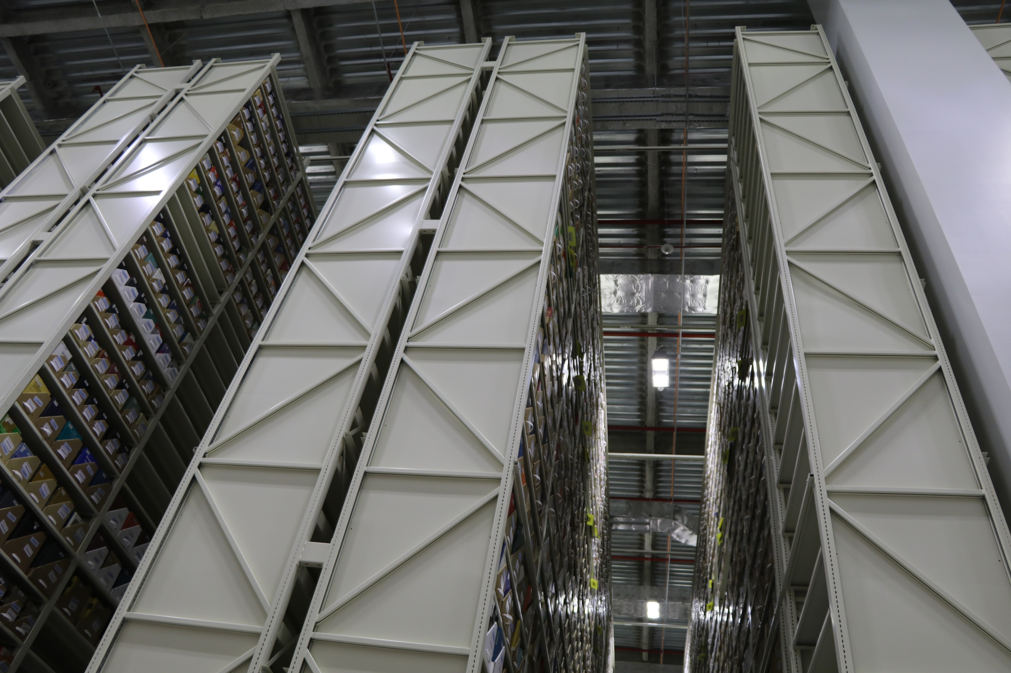
On the Severn End

Slide 3
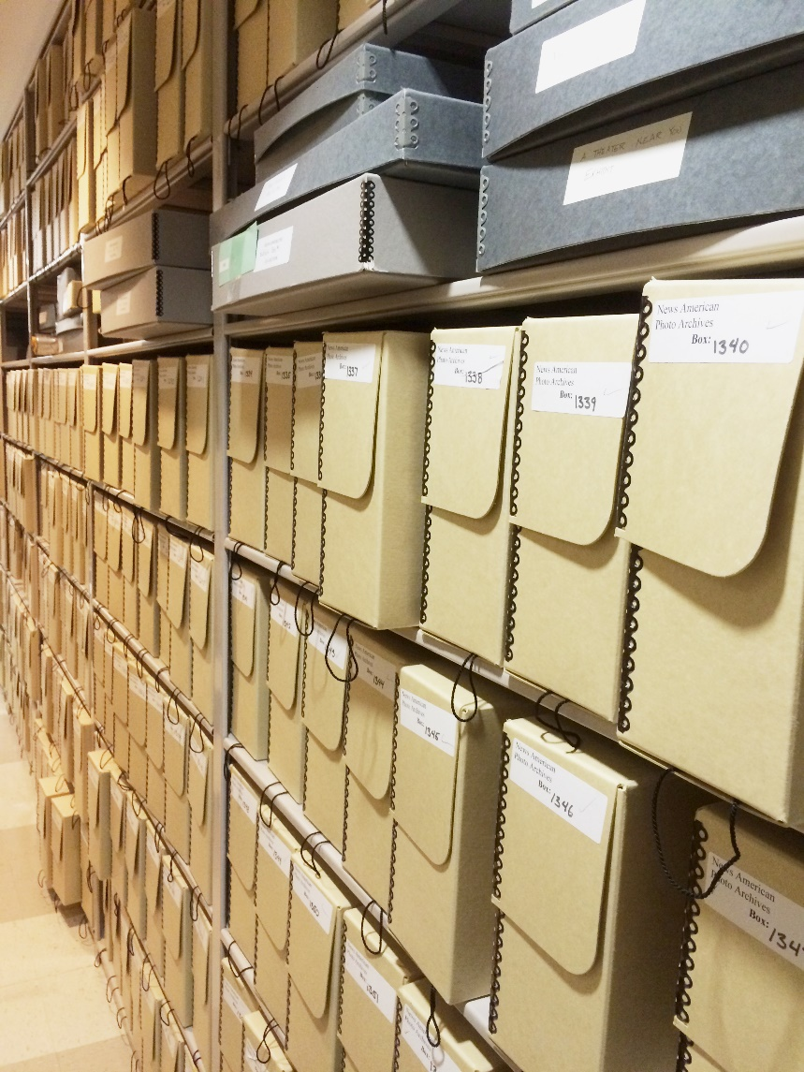
On the SCUA End

Slide 4
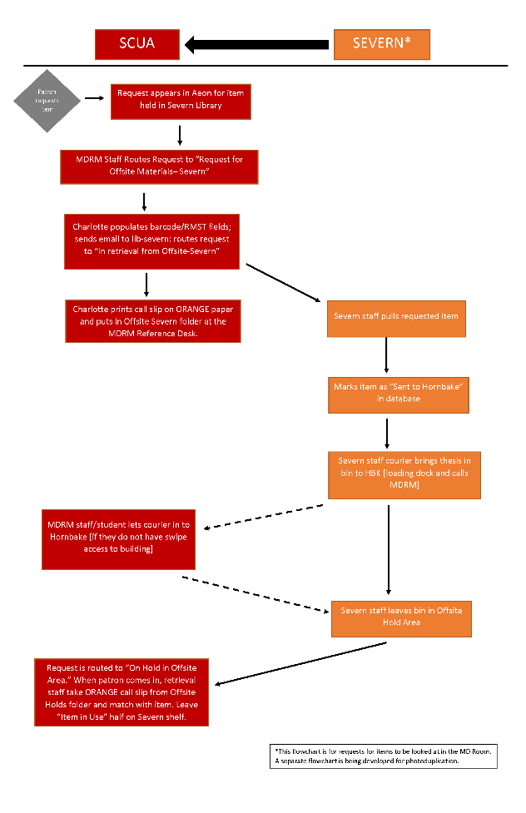
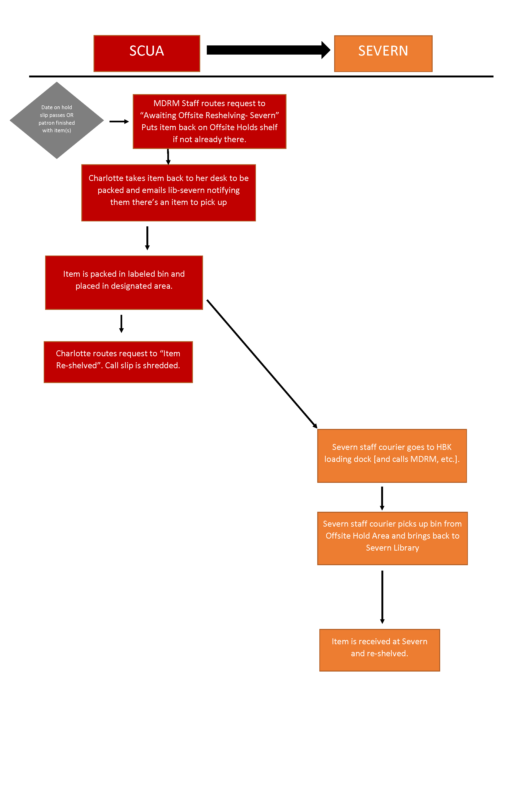

Slide 5
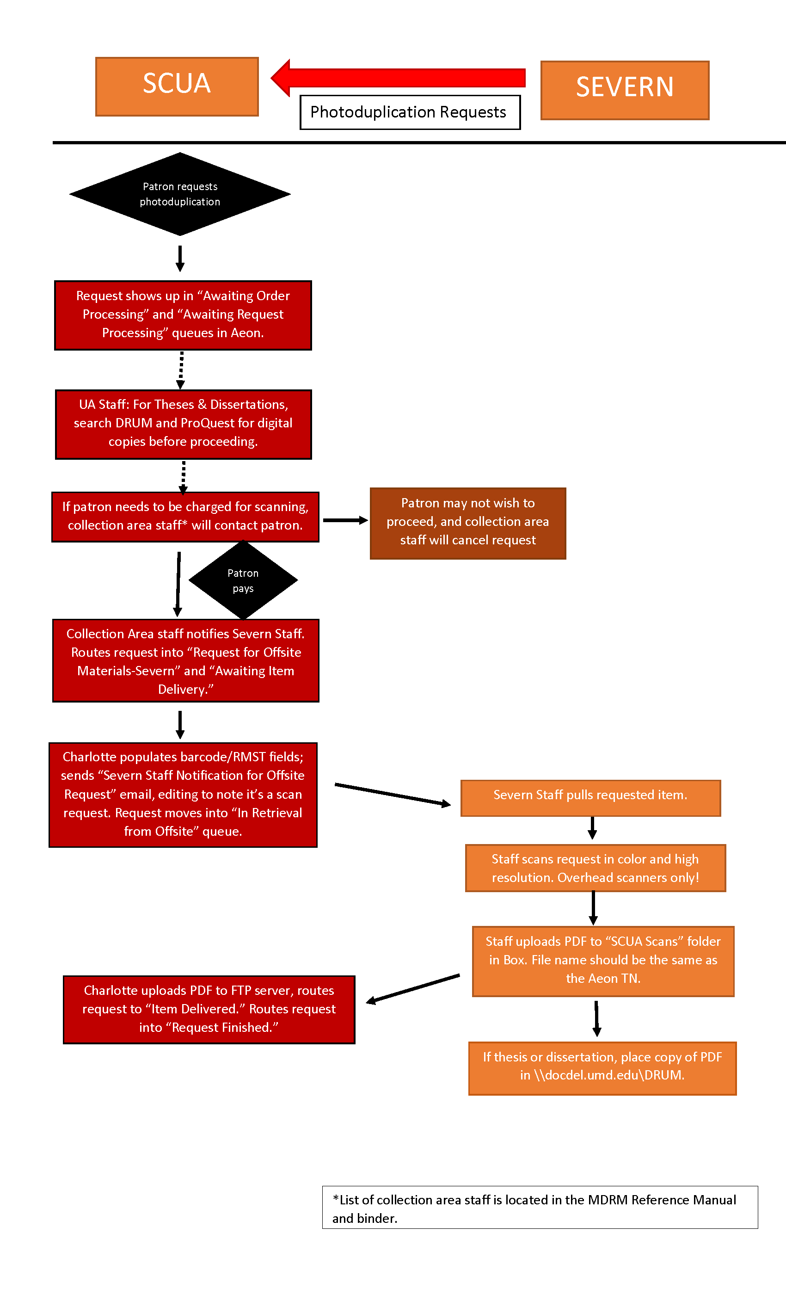

Slide 6
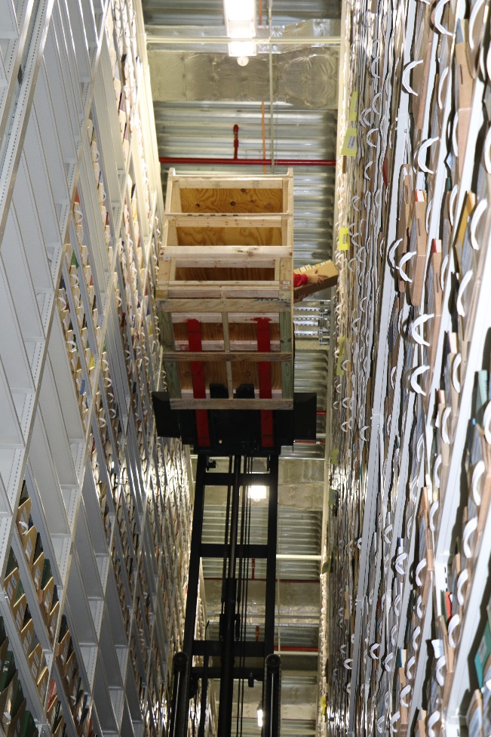
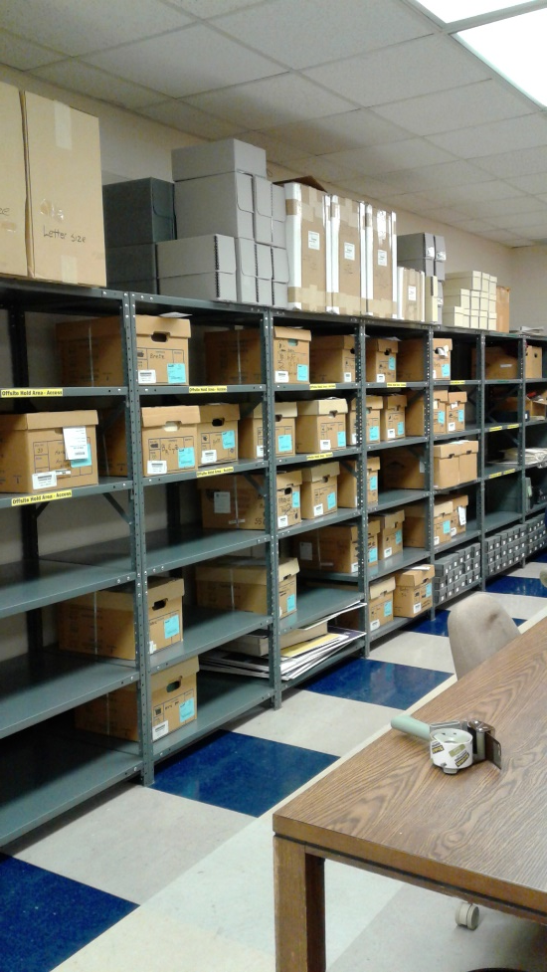
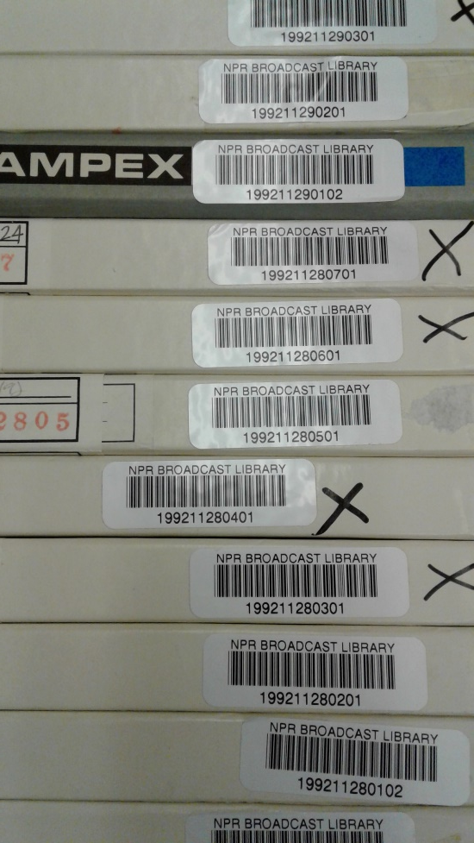
What to Consider If You’re Planning to Store Special Collections

