Slide 1
P2E IN A CONSORTIUM
ONE SIMPLE TRICK TO REMOVE UNWANTED ELECTRONIC PORTFOLIOS!
ELUNA, JUNE 19, 2025
LINDA SEGUIN, SYSTEMS LIBRARIAN
UNIVERSITY SYSTEM OF MARYLAND & AFFILIATED INSTITUTIONS (USMAI)

Slide 2
About Us

Slide 3
USMAI Member Institutions
Bowie State University
Coppin State University
Frostburg State University
Loyola Notre Dame Library
Morgan State University
St. Mary's College of Maryland
Salisbury University
Towson University
University of Baltimore
University of Baltimore Law Library
University of Maryland, Baltimore Health Sciences and Human Services Library
University of Maryland, Baltimore Law Library
University of Maryland, Baltimore County (UMBC)
University of Maryland Center for Environmental Science
University of Maryland, College Park
University of Maryland, Eastern Shore
University of Maryland Global Campus

Slide 4
USMAI Member Institutions
17 members across the State of Maryland
  14 within University System of Maryland
Public and Private Academic Institutions
Serving over 190,000 students
4 HBCUs
1 Medical Library (Regional Med Library, Region 1)
2 Law Libraries
3 Universities with Research 1 designation

Slide 5
Alma Migration
After over twenty years on Ex Libris’ Aleph, USMAI migrated to Alma with
seventeen Institution Zones (IZ) and a Network Zone (NZ).
April 2023 - Onboarding began
August 2023 - Implementation began
October 2023 - Test Load
May 2024 - Go Live

Slide 6
Aleph Environment

Slide 7
Aleph Architecture
Single Bibliographic (BIB) Library - MAI01
shared bibliographic records (~4.2 million)
Single Administrative (ADM) Library - MAI50
separate items, orders, subscriptions, vendors
Single Holdings (HOL) Library - MAI60
separate holdings

Slide 8
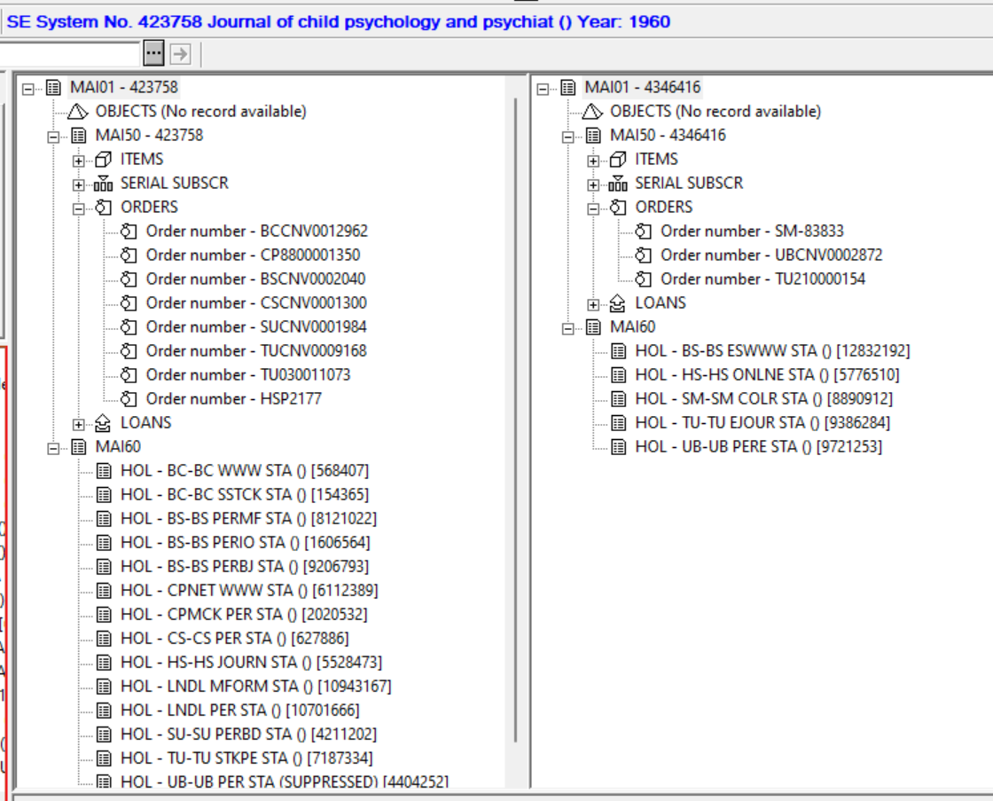
E-Resources in Aleph
Mixed single- and separate-record approach:
some e-holdings on print BIB records; some on separate e-BIB records
Linking via 856/956 fields in BIBs and SFX link resolver
Anticipated single-record approach would be problematic in migration to any new system
Difficult to move e-holdings to e-BIB in Aleph, due to order, subscription linking relationships
PRINT
ELECTRONIC

Slide 9
Alma Physical to Electronic (P2E) Processing

Slide 10
Why P2E Processing?
“Most legacy ILS systems have a single format for resources, and for migration purposes, we treat incoming inventory from the ILS as physical. In Alma, electronic resources have a different database structure than physical resources. In order for the migration programs to change physical resources into electronic resources, you have to indicate which resources to change from physical to electronic (P2E).”
Source: Physical to Electronic (P2E) processing
Simplified Diagram of Physical to Electronic
*Not all, but most e-resources become portfolios
MARC BIB
MARC BIB
MARC Holdings
“Standalone” Electronic Portfolio*
Item

Slide 11
Customer Inputs to P2E Process
P2E Input File
CSV file listing BIB numbers of records that are to undergo P2E processing
Migration Form
MARC field/subfield mapping to portfolio URL, Public Note, Provider fields
Locations that are to be considered electronic
(Optional) Material types of items within those locations that are to be considered electronic

Slide 12
General Overview of P2E Process
“The migration programs create at least one electronic resource for each BIB identifier in the p2e file, unless the bib is rejected. If the bib is suppressed, an e-resource is generated but it is inactive.”
“If there are items/holdings in a location which was specified as electronic, then the items and/or holdings are transformed from Physical to Electronic.”
“If no holdings/items are present or if all holdings/items are physical (i.e. not marked as electronic), the migration program still creates an electronic resource based on information in the bibliographic record only.”
“The p2e process also transforms each electronic record’s associated order, if present, to an electronic type order rather than physical type order.”
Source: https://knowledge.exlibrisgroup.com/Alma/Implementation_and_Migration/Migration_Guides_and_Tutorials/Physical_to_Electronic_(P2E)_processing

Slide 13
The Problem

Slide 14
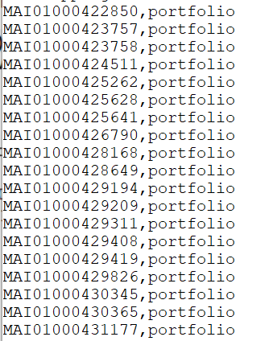
One P2E Input File for the Whole Consortium
This one list determines the BIBs that will undergo P2E processing in each Institution Zone (IZ).
P2E creates at least one portfolio for each BIB in the list, even if there are only physical holdings in that IZ.
Print version BIB record, on which two institutions have e-holdings, and seven have only physical holdings

Slide 15
Example
Salisbury University (SU) has only print holdings for this title, with an order and subscription for the print.
Because of other institutions’ e-holdings on this record, the BIB number is included on their P2E list.

Slide 16
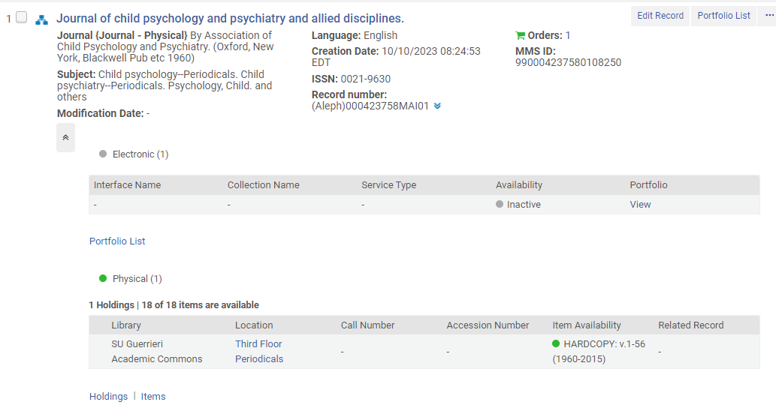
Test Load: Unwanted Electronic Portfolio

Slide 17
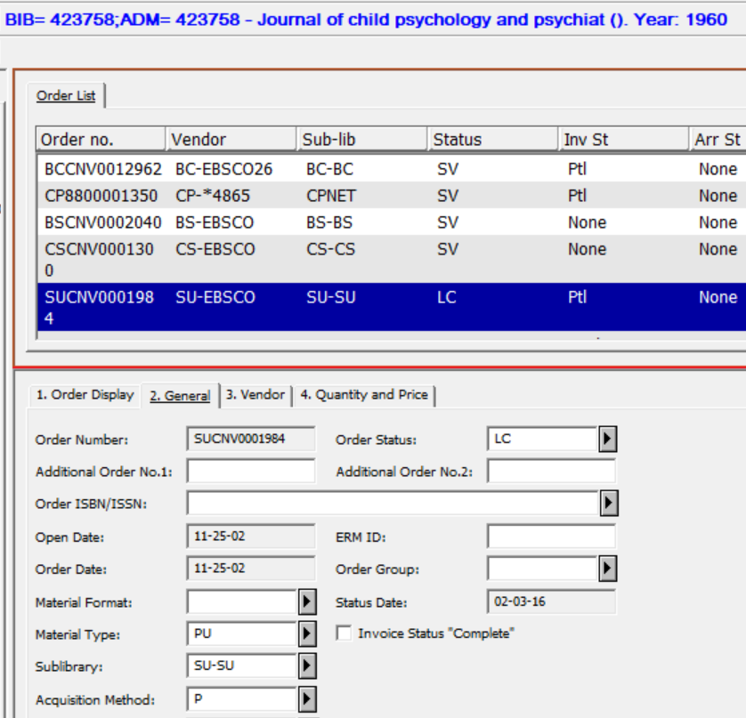
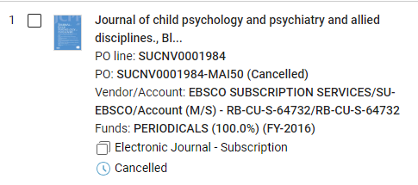
Test Load: Print Order Becomes Electronic Order

Slide 18
What about Clean up in Alma?
Identifying legitimate vs. bogus portfolios was a problem
Absence or presence of a URL was no indication
  URLs mapped from 856 fields in BIB records, because we didn’t have them in holdings
  Some BIB records lacked 856 because link resolver was used for access
No other data is mapped from the holdings/item to the portfolio to serve as a distinguishing feature
At the time of our migration, Alma had no mechanism to change the PO Line Type back from Electronic to Physical

Slide 19
The Solution

Slide 20
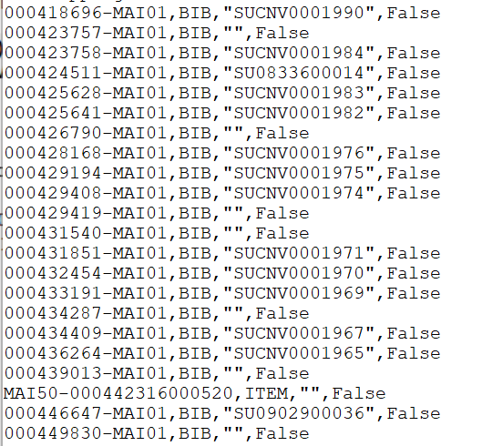
P2E Extract Files on Aleph Server
BIBs are allocated to each IZ’s extract based on existence of linked records (orders, subscriptions, holdings, items) having sublibrary codes as mapped on the Migration Form.
P2E Input File is used to build e_resource.csv files for each IZ. It looks for item(s) in an e-location, then holdings in an e-location, and if none, a BIB.
no e-item or e-holdings found
e-item found

Slide 21
Proposal to Ex Libris
Excerpts from Basecamp, USMAI Alma Primo VE Implementation Project:
USMAI Staff, Aleph data expert - Nov. 15, 2023
In a previous thread, we have established that the lines containing "BIB" in the p2e/e_resource.csv extract files represent BIBs that have no electronic items or holdings for that institution. Couldn't we, then, remove the "BIB" lines from the e_resource.csv files, post-extract and pre-load, to prevent unwanted P2E processing on those records?
Ex Libris, Senior Implementation Consultant - Dec. 4, 2023
Migration has approved a process--to be spelled out here in detail later--that will allow USMAI to alter the p2e inputs for each site.

Slide 22
Steps to Remove BIB Lines from P2E Extract Files
On the Aleph server, extract files were in a “urm” directory, with each IZ having its own subdirectory named with its Institution ID. The e_resource.csv file is found in a “p2e” folder within the IZ subdirectory.
Change the filename of the e_resource.csv file:
mv e_resource.csv e_resource.csv.orig
Output all lines from e_resource.csv.orig that do not contain the “BIB” string to file with original name:
grep -v BIB e_resource.csv.orig > e_resource.csv
Make permissions on the new file match the original file:
chmod 777 e_resource.csv
Move the backup of the original file to a directory outside of the URM directory:
mv e_resource.csv.orig $data_scratch/<Institution ID>_e_resource.csv

Slide 23
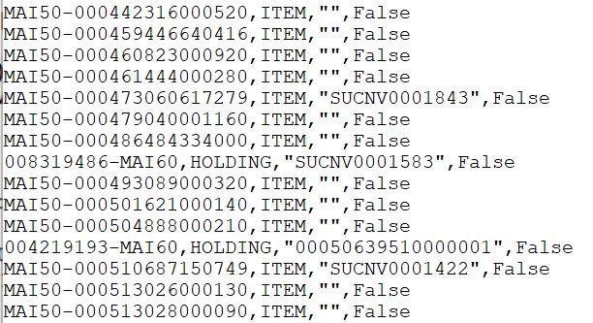
P2E Extract Files (e_resource.csv) Before and After
After BIB lines are removed, only records with e-items or e-holdings in the IZ will undergo P2E processing.

Slide 24
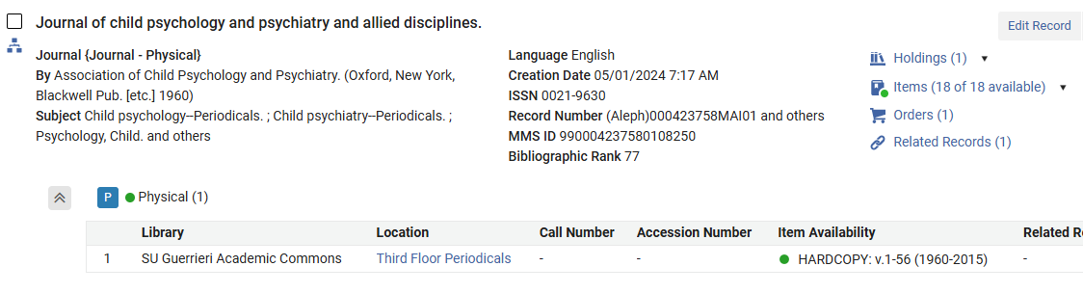
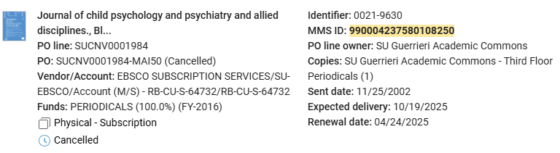
Production Load with Solution Applied
SU print record has only physical holdings, and the PO Line Type is Physical - Subscription

Slide 25
Questions?

