Slide 1
Making Change, Increasing Value: Reorganizing Your Access Services Department
Timothy Hackman, Paula Greenwell, James Spring, and Hilary Thompson
University of Maryland Libraries
Access Services Conference
November 18, 2016

Slide 2
A Quick Poll
https://pollev.com/timhackman369
Notes:
https://www.polleverywhere.com/multiple_choice_polls/ONHzSAA04KAr4oD

Slide 3
Background
Resource Sharing & Access Services
New department head, October 2012
Originally 5 units: Circulation & Reserves, Interlibrary Loan, Stacks, Late Night, Billing
Added 2 units: Information Services, Terrapin Learning Commons
24 x 5 service at 2 desks
31.5 FTE, 100+ students
Lots of new staff & services

Slide 4
Reorganization Goals
General:
Improve efficiency of operations
Increase staff engagement
Improve the user experience
Specific:
Integrate staff and services from TLC and Information Services units
Ensure work is shared equitably and efficiently
Ensure consistent staffing across two service desks
Identify and eliminate redundancies in our work
Assess staffing needs and make the most of existing staff
Allow and encourage staff to learn new tasks and build skills

Slide 5
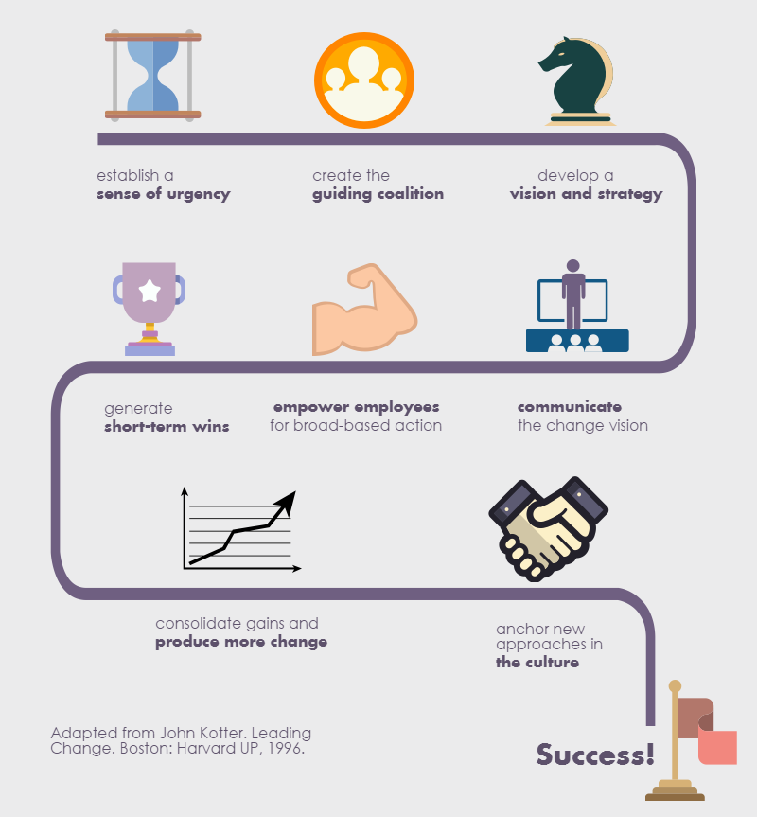
Kotter’s Eight Stage Change Process

Slide 6
Reorganization Process Timeline
Task Groups report to staff
Guiding Coalition Formed
7/30/2015
10/15/2014
Reorganization Effective Date
Kick Off Meeting
Staff Retreat
Card Sorting Exercise
11/12/2014
1/16/2015
4/21/2015
9/20/2015
2014
Oct
Nov
Dec
2015
Feb
Mar
Apr
May
Jun
Jul
Aug
Sep
2015
10 days
Today
Time Logging
11/10/2014
11/21/2014
55 days
1/19/2015
Time Log Analysis
4/3/2015
39 days
Org Chart Drafts & Revisions
4/22/2015
6/15/2015
45 days
6/15/2015
Rewriting Job Descriptions
8/14/2015
33 days
6/15/2015
Task Groups
7/29/2015

Slide 7
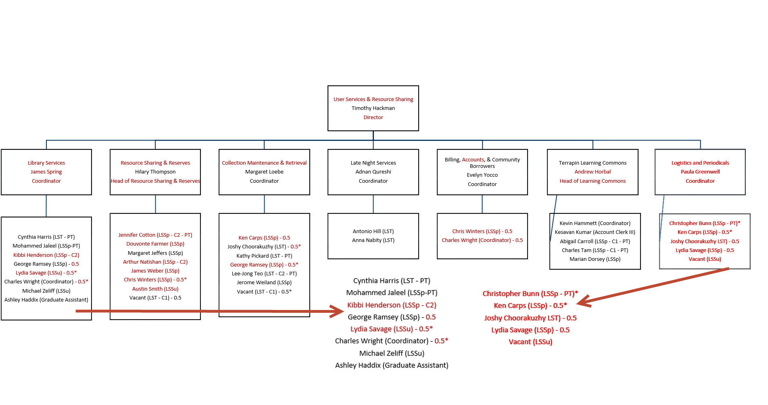

Slide 8
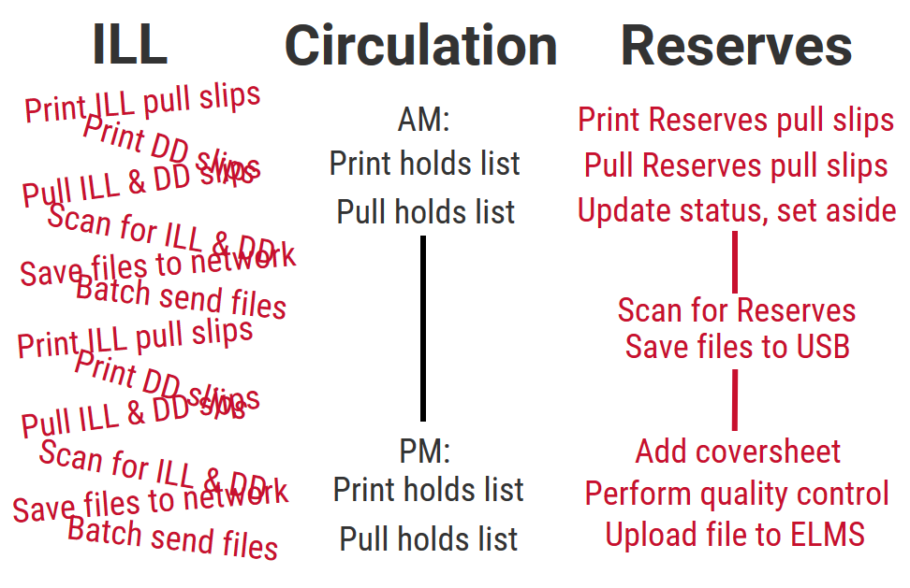
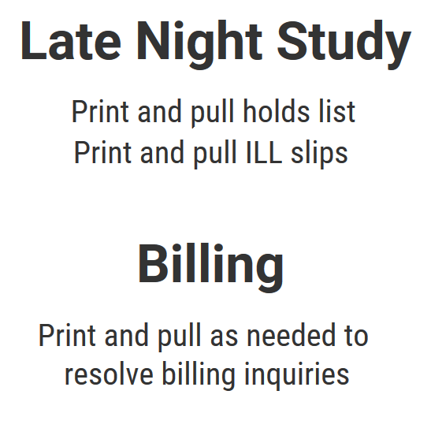
Retrieval and Scanning: Before

Slide 9
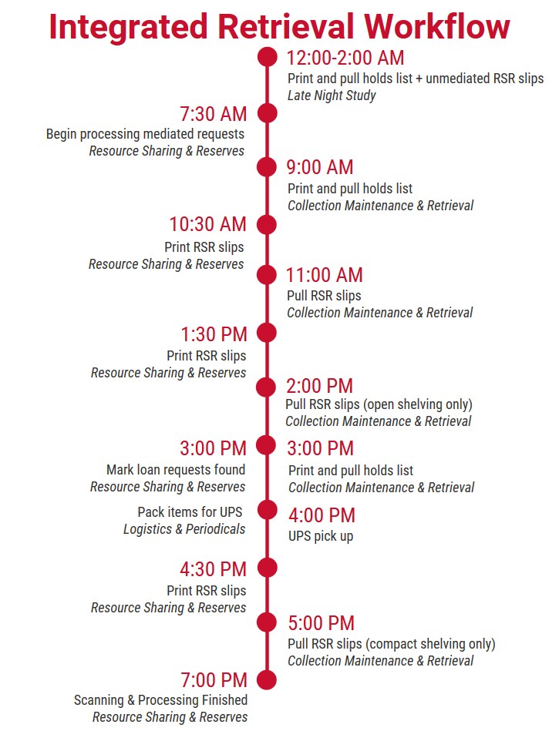
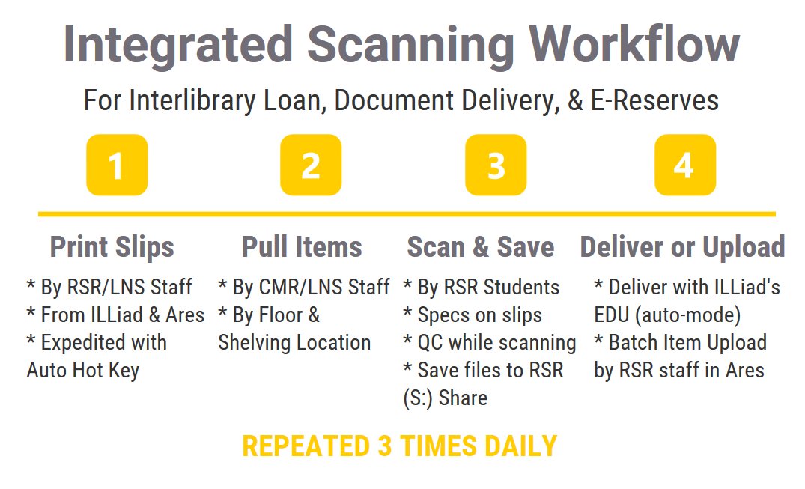
Retrieval and Scanning: After

Slide 10
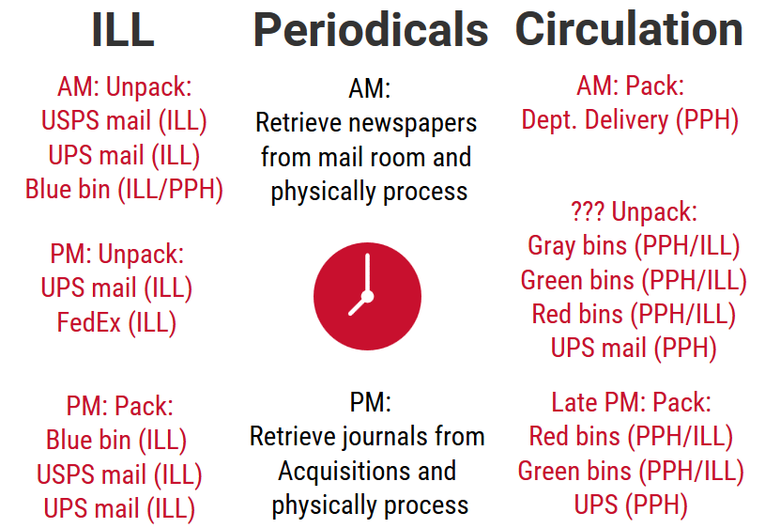
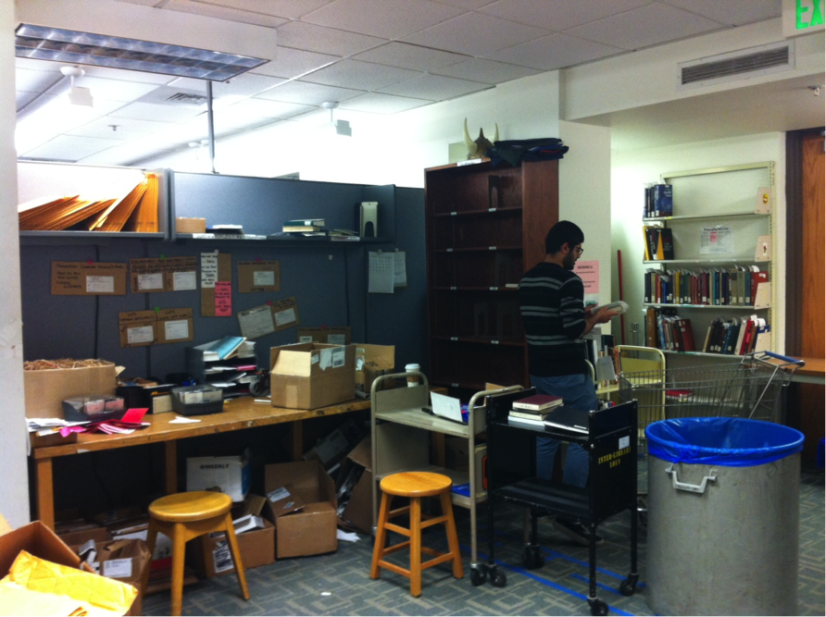
Shipping and Receiving: Before

Slide 11
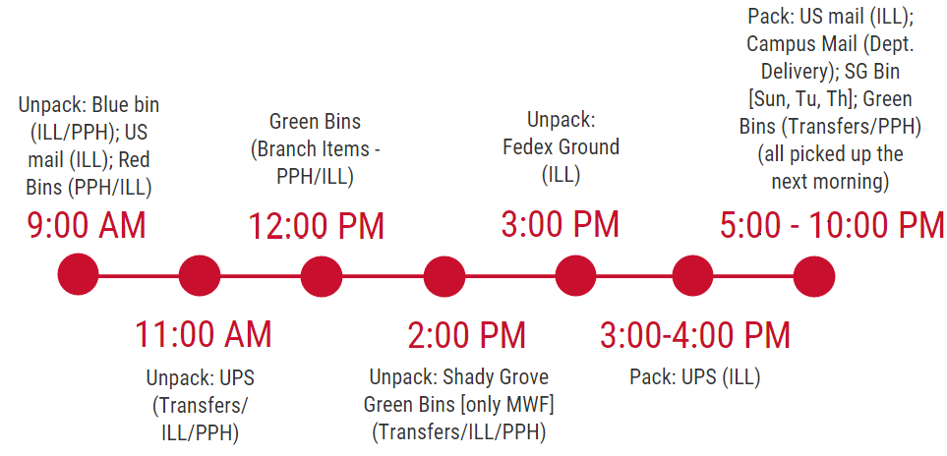
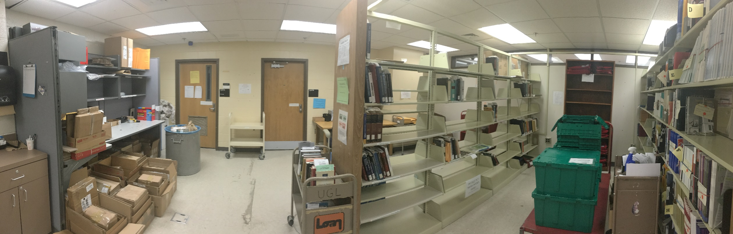
Shipping and Receiving: After

Slide 12
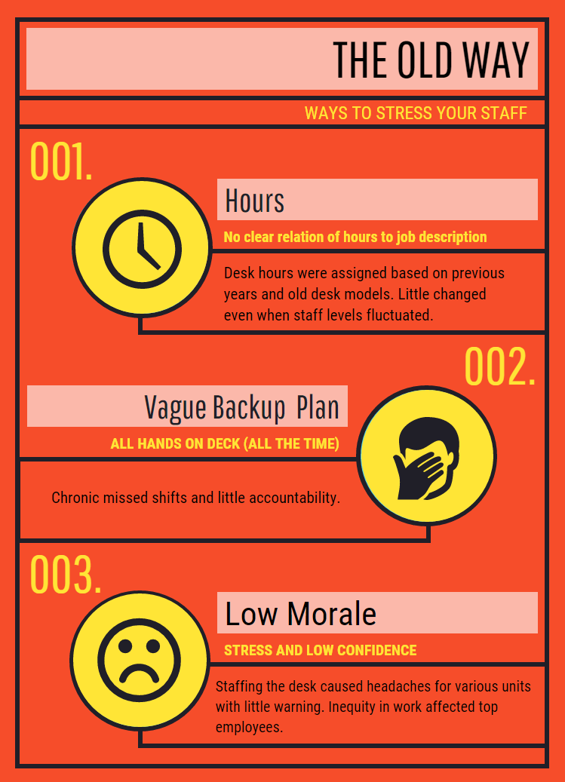
Desk Scheduling: Before
No reliable method for backup and shift coverage
Questions of fairness arose in break room conversation

Slide 13
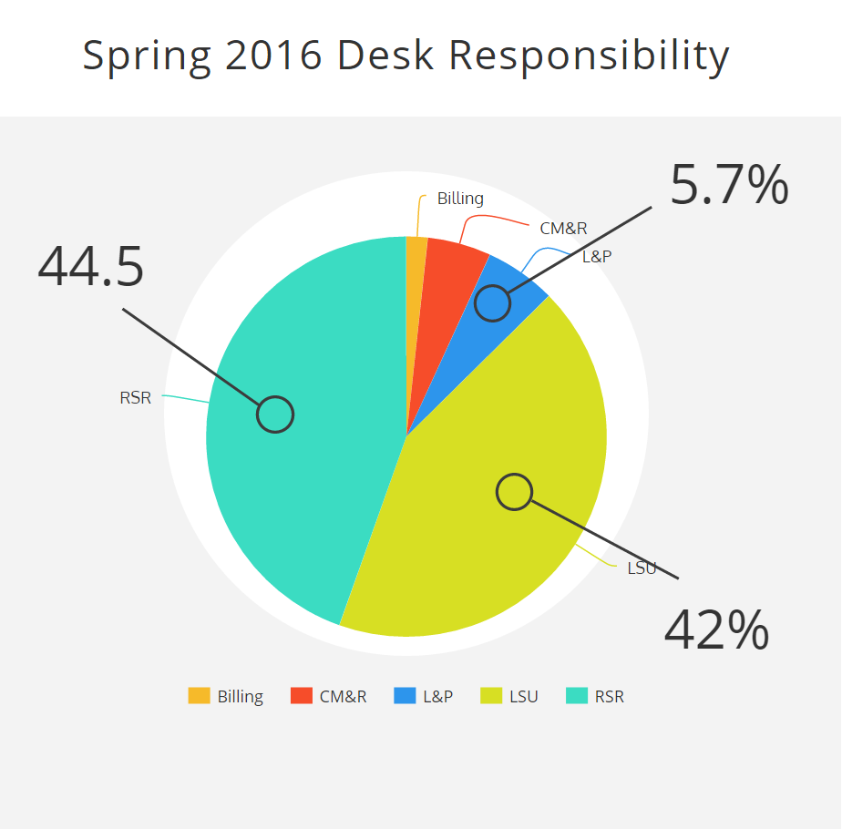
Desk Scheduling: After
3 Tiered backup system
Equitable distribution of Desk Hours based on Job description
Shift trade hierarchy
Unit Supervisors have input for desk schedule

Slide 14
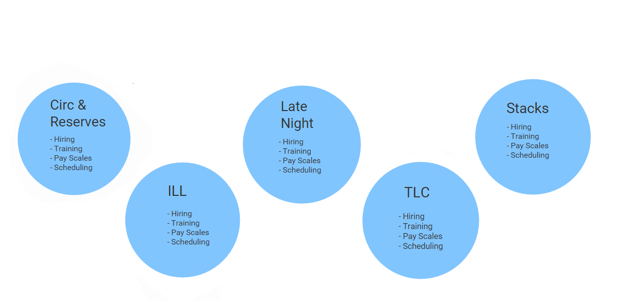
Student Supervision: Before

Slide 15
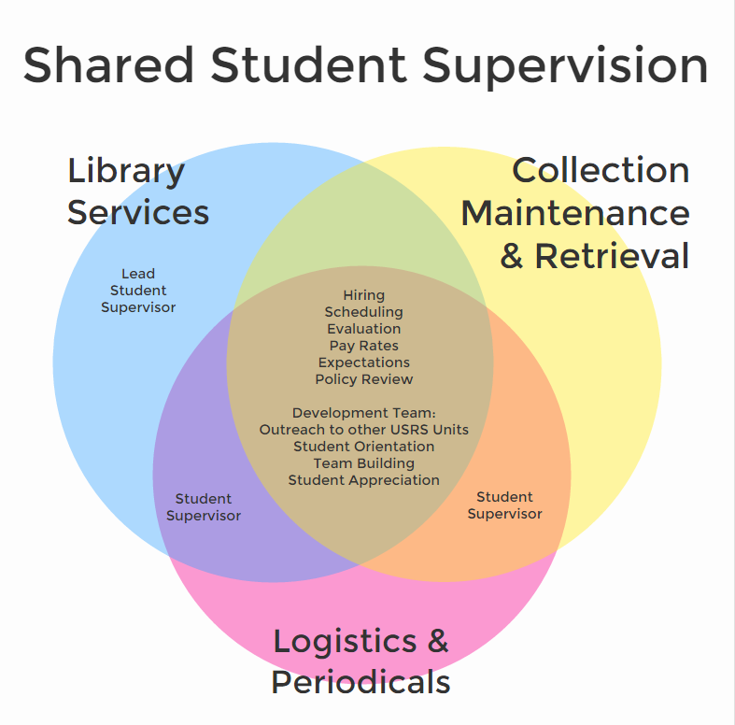
Student Supervision: After

Slide 16
Assessment
3 General Goals:
Improve efficiency of operations
Increase staff engagement
Improve the user experience

Slide 17
Assessment – Goal 1
Labor & Assistance Requests | FY2016 | FY2017 | % Change
Total Funds Requested | $524,462 | $508,414 | - 3.06%
Total Hours Requested | 49,932 | 49,012 | - 1.84%
Learning Commons | 9,984 | 10,780 | + 7.97%
Stacks | 7,050 | 6,240 | - 11.49%
Late Night | 6,336 | 6,840 | + 7.95%
Interlibrary Loan | 9,282 | 9,408 | + 1.36%
Library Services Desk | 17,280 | 15,744 | - 8.89%

Slide 18
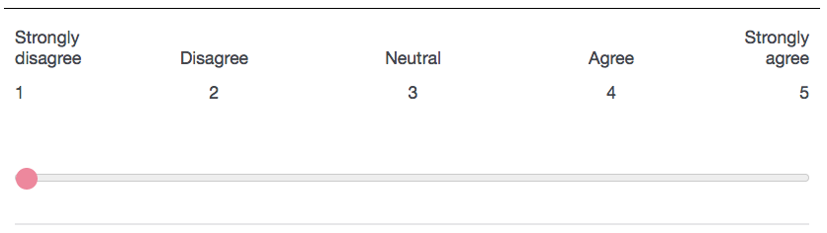
Assessment – Goals 1 - 3
1. I feel that I accomplish more in my workday than I did
before the reorganization.
3. I feel that I am helping the USRS department better accomplish
its strategic goals than before the reorganization.
3.88
3.71
3.4
2. I feel that my ideas have more of an impact on the
USRS department than they did before the reorganization.
4. I feel that library users are generally more satisfied with the services provided by the USRS department than they were
before the reorganization.
3.7
3.56
3.65

Slide 19
Assessment – Goals 1 & 3
12 hours saved
12 hours saved
16 hours saved
5 hours saved

Slide 20
Assessment – Goals 1 & 3

Slide 21
Lessons Learned
Job descriptions matter!
Involve Human Resources early in the process
Provide many and varied opportunities for communication/feedback
It will take longer than you think
Everything will not go as planned
Plan to assess from the start
Use it to your advantage!

Slide 22
Questions?
Contact Us:
Tim Hackman, Director, User Services & Resource Sharing – thackman@umd.edu
Paula Greenwell, Coordinator, Logistics & Periodicals –
pgreenwl@umd.edu
James Spring, Coordinator, Library Services –
jvspring@umd.edu
Hilary Thompson, Head, Resource Sharing & Reserves – hthomps1@umd.edu

