Slide 1

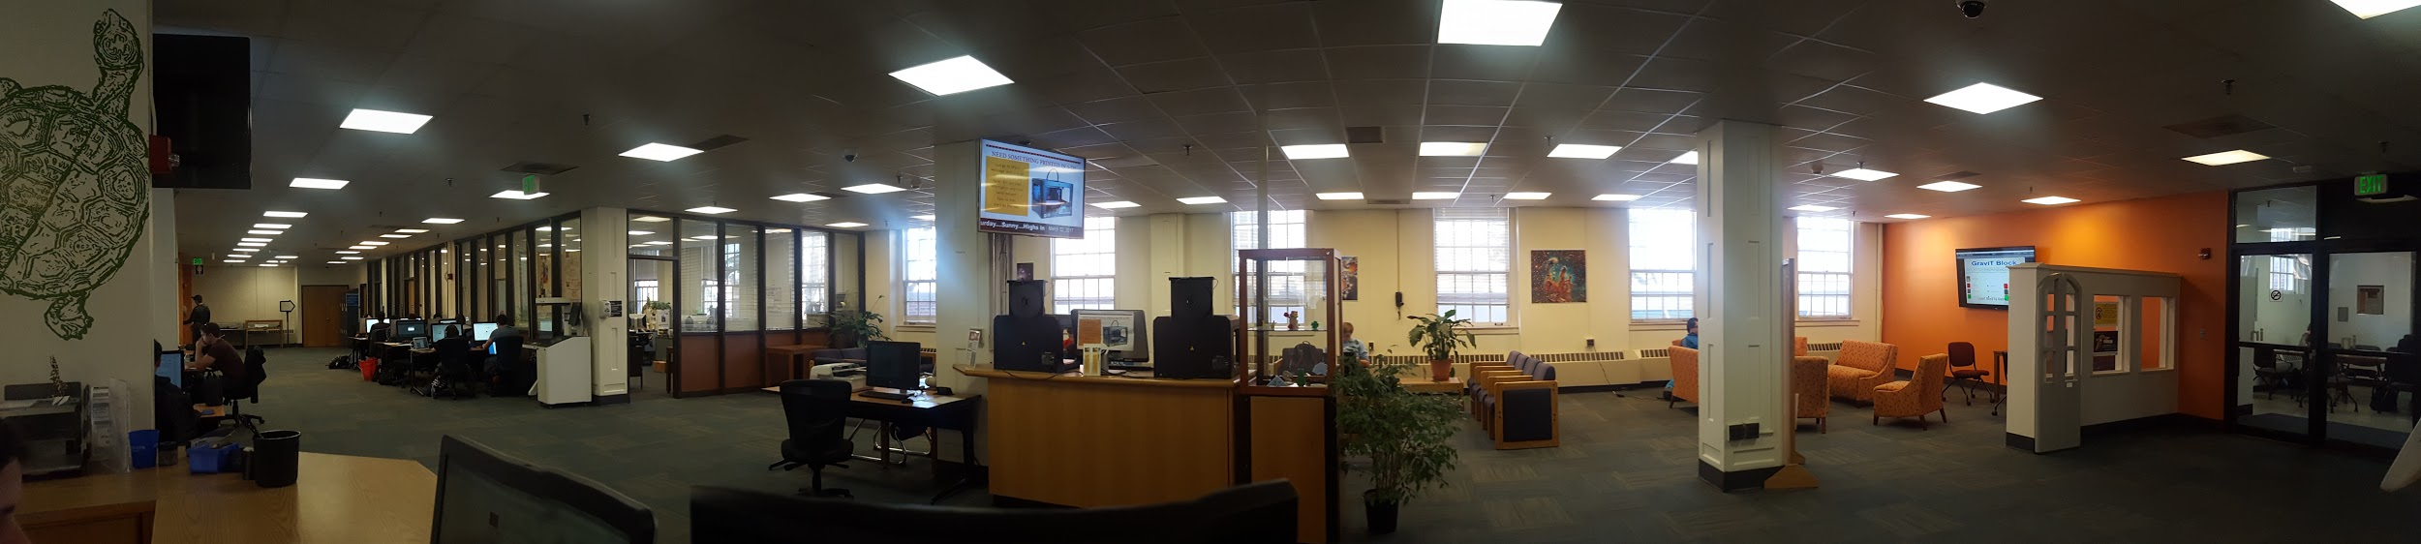
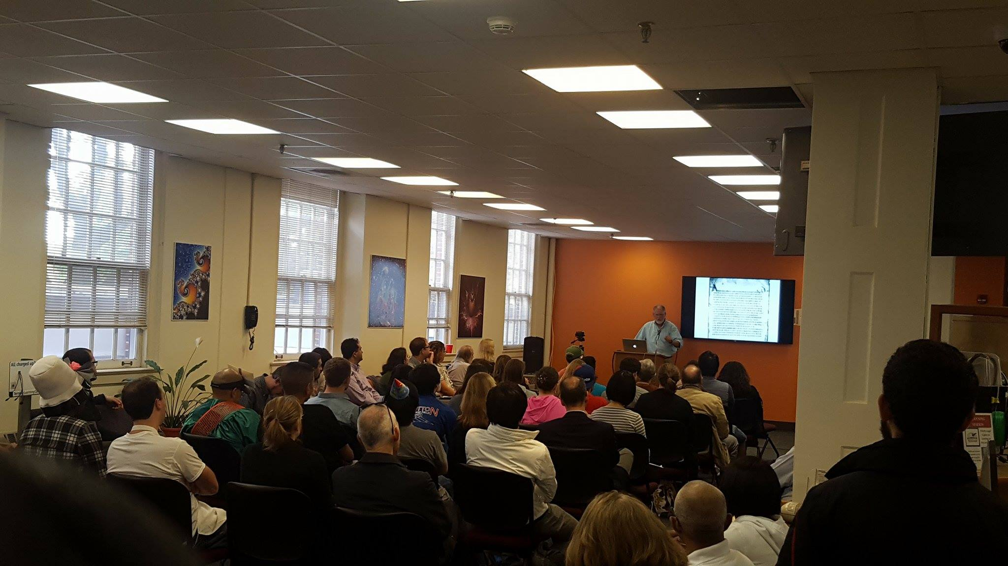
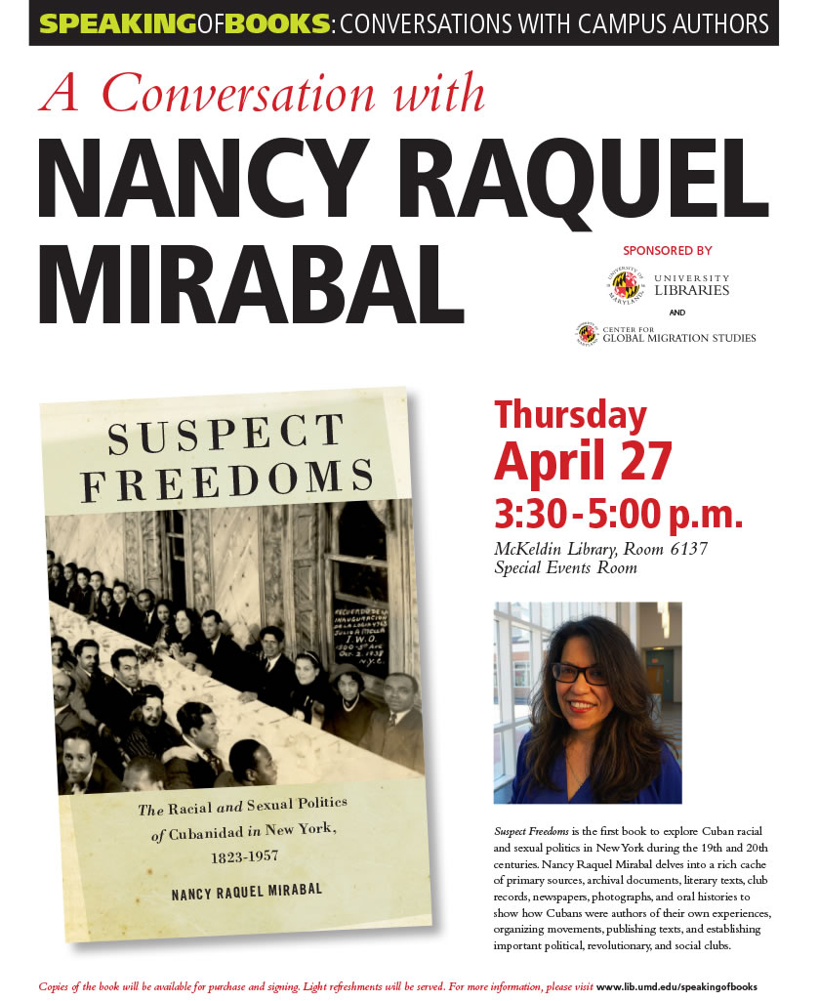


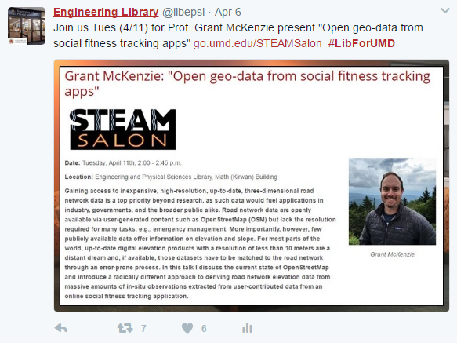
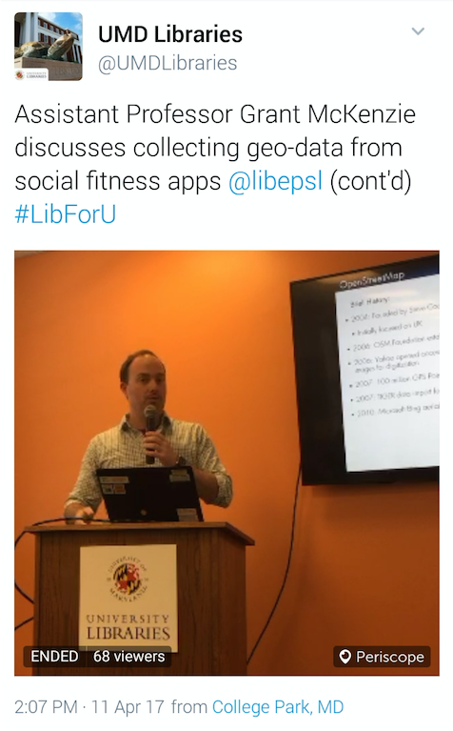
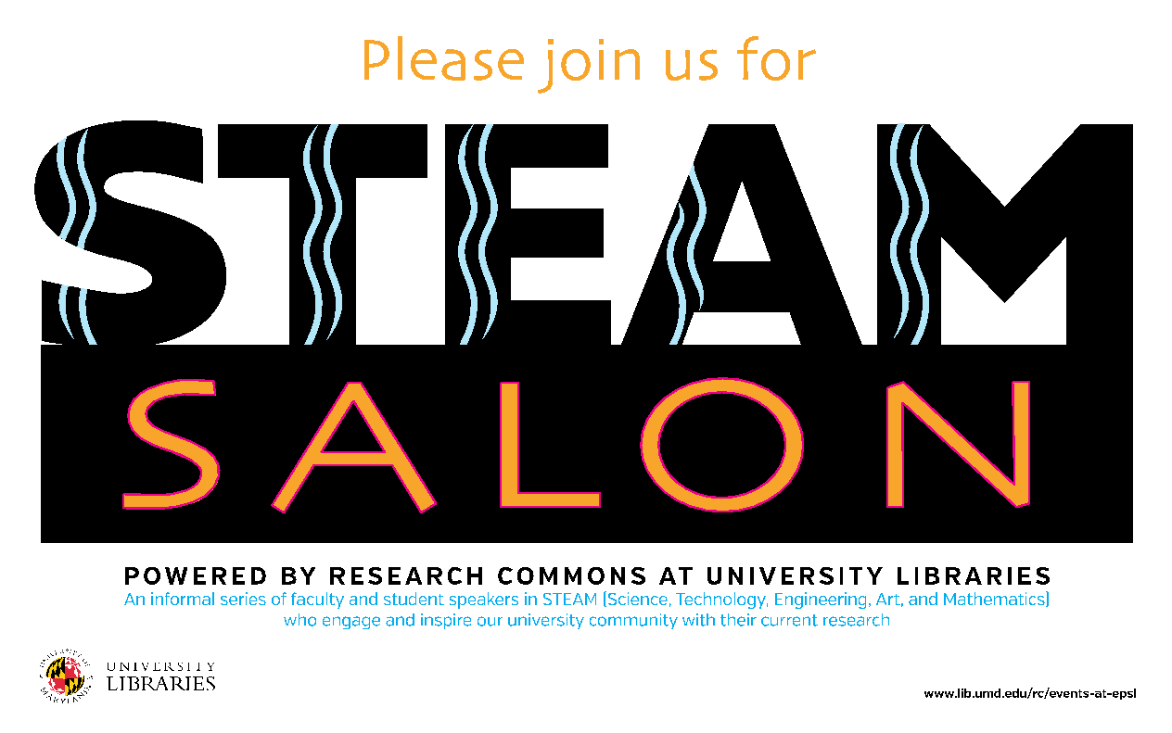
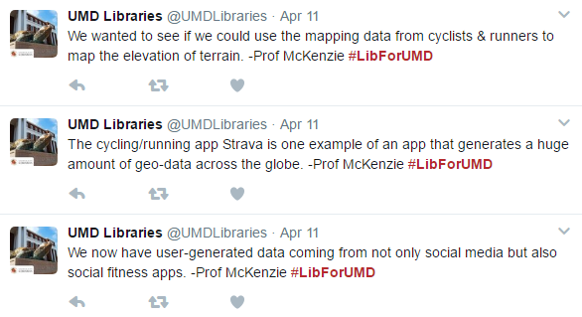
Learning Outside the Classroom:
STEAM Salon Series at EPSL
Kelly Banyas, Graduate Assistant, University Libraries Elizabeth Soergel, STEM Librarian, University Libraries
Abstract
STEAM Salon
Promoting STEAM Salon
Within the past semester, the Engineering and Physical Sciences Library (EPSL) has hosted a speaker series called STEAM Salon. This informal series, organized by the Research Commons at University Libraries, brings in faculty speakers in STEAM (Science, Technology, Engineering, Art, and Mathematics) disciplines at the University of Maryland (UMD) to present on their current research. Topics are from various areas of research and faculty speakers come from all over campus. Students regularly attend these talks, either independently or as part of their coursework. This poster will explore how these talks engage student learning outside of the classroom and create an informal learning environment.
EPSL worked with the Graphics Department in the University Libraries to create promotional materials for each STEAM Salon event. The Social Media Coordinator for the Libraries also worked closely with EPSL to advertise the lectures on social media. EPSL advertised through the following channels:
Social Media - Twitter, Facebook
Emailing departmental contacts
Signs placed in EPSL
Promotional slides on library TV slideshows
A webpage was also created on the Libraries' Research Commons website to solicit presenters and display information about each talk, including links to recordings of previous presentations.
Beginning in Spring 2016, EPSL was renovated to develop more open, group-work space. This area is on the main floor, directly by the entrance, and formerly housed the library’s reference collection. The goal of this new space was to foster student learning and exploration. New space and new technology allowed for multimedia presentations, which have taken the form of the STEAM Salon. The first talk occurred in October 2016 by Google’s Über Tech Lead for Search Quality and User Happiness Dan Russell.
Starting in Spring 2017, faculty from departments across campus have been invited to give short 30-40 minute talks about their current research. Attendees, including students, are encouraged to ask questions and interact with the speaker. Professors from the Department of Computer Science, the iSchool, and the Geographical Sciences Department gave presentations this past spring.
Future Directions
Faculty Lectures in
the Library
Interdisciplinary engagement: soliciting faculty that do work with the sciences and arts to showcase their research
Potential of live-streaming: making events accessible for those that can’t physically come to the space; had some success so far via Twitter
Beyond faculty: working with students and student groups/organizations to develop programming and presentations
Celebrating student work: continuing to display student work and achievements in the space to show the finished products of student learning
Assessing success: developing metrics to measure success and gauge student learning and participation
Targeting interested audiences: getting interested students into the space through targeted outreach
Faculty-led lectures are common programs in the UMD Libraries and at other institutions across the country. At UMD, faculty are invited to give talks and sit on panels at a variety of library events. The Libraries Speaking of Books Series invites authors from around campus present their recent research. The Libraries Interdisciplinary Dialogues series brings faculty to various departments to serve on a panel and talk about a current topic or popular issue, such as the influence of social media or immigration.
Other academic libraries are also engaging faculty and students with lecture series similar to efforts at UMD. In 2007, the Z. Smith Reynold's Library at Wake Forest University established a Library Lecture Series Committee (LLSC) to arrange, advertise, and record lectures in the library (Burris, McCallum & Kenner, 2016). A 2008-09 faculty speaker series at Brock University's James A. Gibson Library helped to emphasize how faculty's research could be applied outside the university (Cotton & Pfaff, 2009).
Cohort 2
Student Engagement and Learning
The STEAM Salon encourages a informal learning environment outside of the classroom. According to Seidman and Brown (2006), "Studies have begun to show that students view their learning experiences outside the classroom as more valuable than their experiences in the classroom" (p. 109-110). The goal of the STEAM Salon is to cultivate valuable learning experiences around current topics that are of interest to many people. To further the learning environment, student projects are displayed in the space when talks are not occurring.
Students in certain classes are encouraged by their professors to attend relevant STEAM Salon lectures. Many of these students come to take notes or have an assignment to complete during the lecture. Students who attend the STEAM Salon talks are engaged in the topic being presented, asking questions and following up with faculty after the lecture has finished.
Cohort 2
Works Consulted
Burris, C., McCallum, C., & Keener, M. (2016). Incorporating Branded Academic Library Programming to Promote and Showcase Campus Research and Artistic Performances. North Carolina Libraries (Online), 74(1), 13–20.
Cotton, J., & Pfaff, H. (2009). The Secret Lives of Professors: Connecting Students with Faculty Research Through a Faculty Lecture Series. Feliciter, 55(6), 254.
Seidman, A., & Brown, S. C. (2006). Integrating Outside Learning with the Classroom Experience: The Student Learning Imperative. Education, 127(1), 109–114.

