Slide 1
Research and Publishing Ethics in the Age of AI
Copyright, community consensus, and the spaces between
Michelle Wilson
Head, Open Scholarship Services
University of Maryland Libraries

Slide 2
Goals:
Explore the current legal landscape around AI and copyright
Understand how AI tools are/can be used in research and scholarly publishing
Highlight ongoing conversations around ethics and developing scholarly norms to help authors make informed decisions about using AI

Slide 3
AI and Copyright

Slide 4
AI and Copyright
Copyright Basics
Copyright is a bundle of exclusive rights to a piece of intangible property
Author is first copyright owner
Copyright expires
Notes:
Michelle

Slide 5
AI and Copyright
Copyright Basics
Works in the public domain are not protected by intellectual property laws. The public owns these works, not an individual author or artist. Works enter into the public domain because:
The artist decided to waive their copyright
The artist died a long time ago and their copyright expired (in the US, more than 70 years ago)
The works were created and published by a government entity
Notes:
Michelle

Slide 6
AI and Copyright
Copyright Basics
Licenses provide a means for copyrighted works to be distributed and reproduced without requiring the creator to give up their copyright ownership.
A License is contract that describes:
A bundle of rights in reproduction and distribution
Purpose of use
Who can be users
A fixed period of time
Where the use can take place
Notes:
Michelle

Slide 7
AI and Copyright
AI Basics
AI systems use algorithms to analyze large datasets, identify patterns, and use those patterns to simulate human reasoning and behavior.
  For example, Large Language Models (LLMs) like Chat GPT predict the word that is most likely to come next in a given sequence of words.
Many AI tools rely on training data that is pulled from the internet. In many cases the data is collected via web scraping, which extracts data and content from websites and databases published online, although datasets can also be built from content that an individual or organization owns or licenses.
Notes:
Michelle

Slide 8
AI and Copyright
Are AI-generated works copyrightable?
Works generated by AI are not copyrightable due to the lack of human authorship. Some parts of works incorporating AI-generated elements may be copyrightable.
Lines around copyrightability are expected to shift based on legal rulemaking and active case law.
https://copyright.gov/ai/
Notes:
Michelle

Slide 9
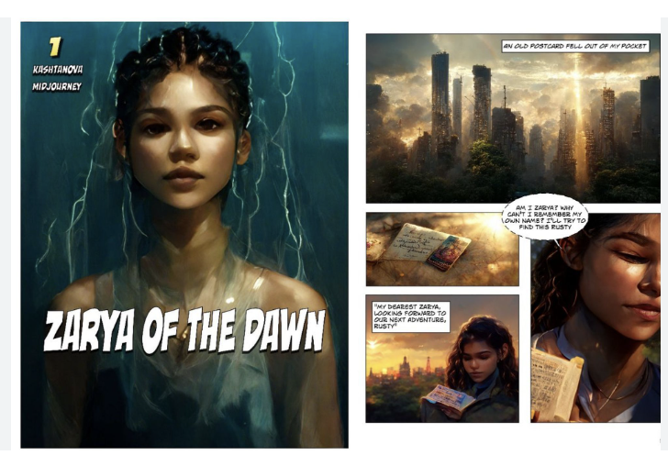

Images from “Zarya of the Dawn” by Kristina Kashtanova
Théâtre d’Opéra Spatial by Jason M. Allen

Slide 10
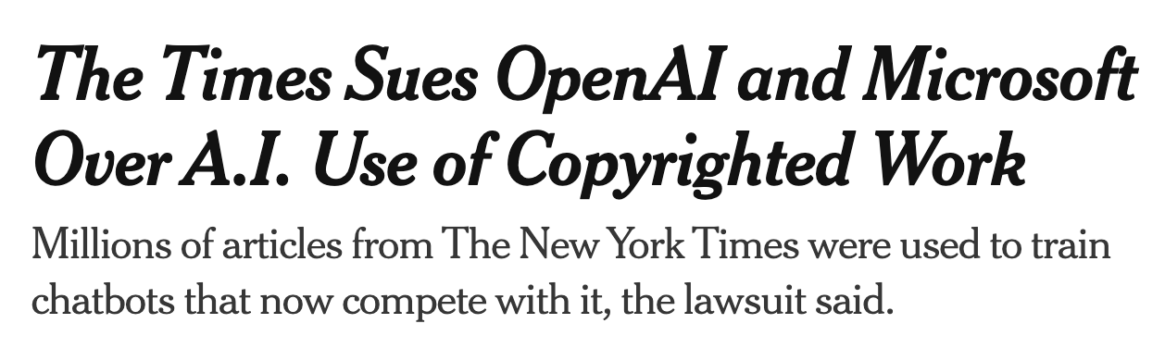
AI and Copyright
Training Data and Fair Use
Is it legal for someone else to put my work into an AI training model?
There is active debate and it is unclear whether training AI models on copyrighted material is infringing.
And it is still debatable whether using someone else’s copyrighted
material falls under the
terms of fair use.
Do I have any recourse if I know or suspect that someone has ingested my work without my permission?
Notes:
Michelle

Slide 11
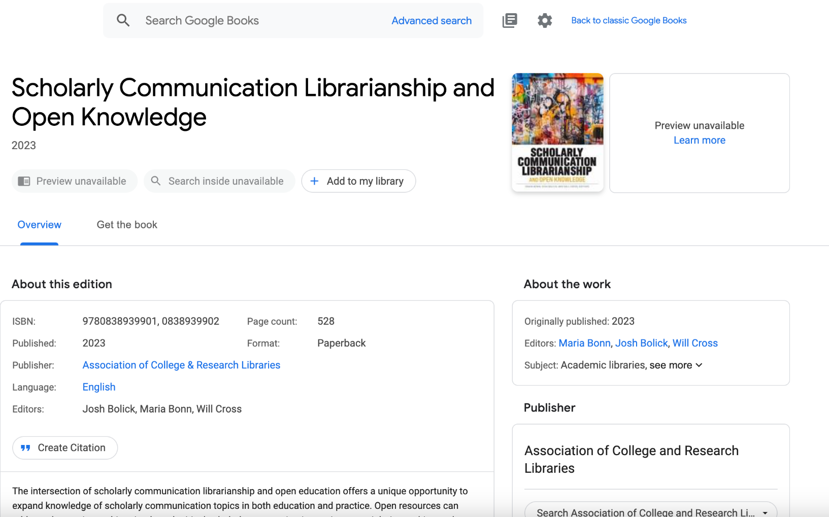


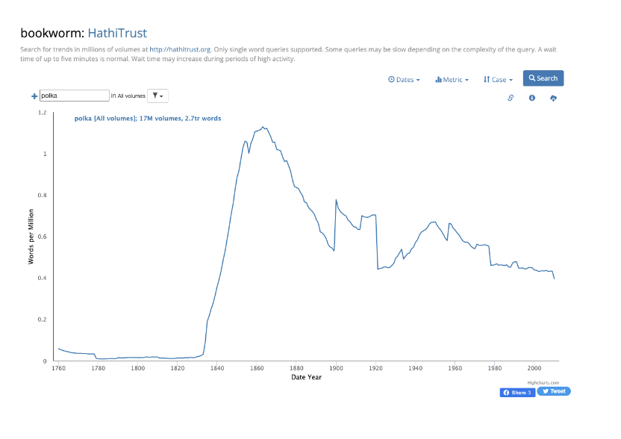


Slide 12
AI and Copyright
Fair use and Output Infringement and Liability
What rights do I have if someone creates something using an AI that I feel is infringing on my copyright?
What if I build an AI tool and someone else creates something that is infringing? Am I liable?
What if I make something that someone claims is infringing on their work using an AI?
Notes:
Michelle

Slide 13

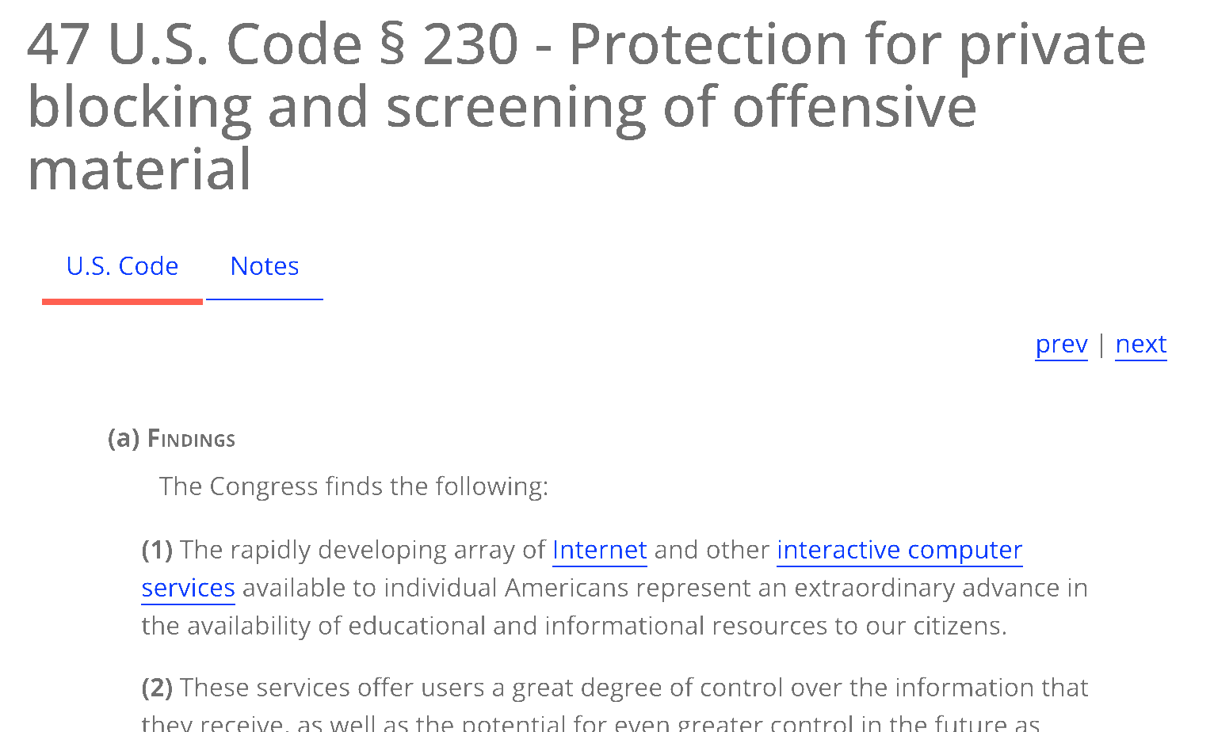
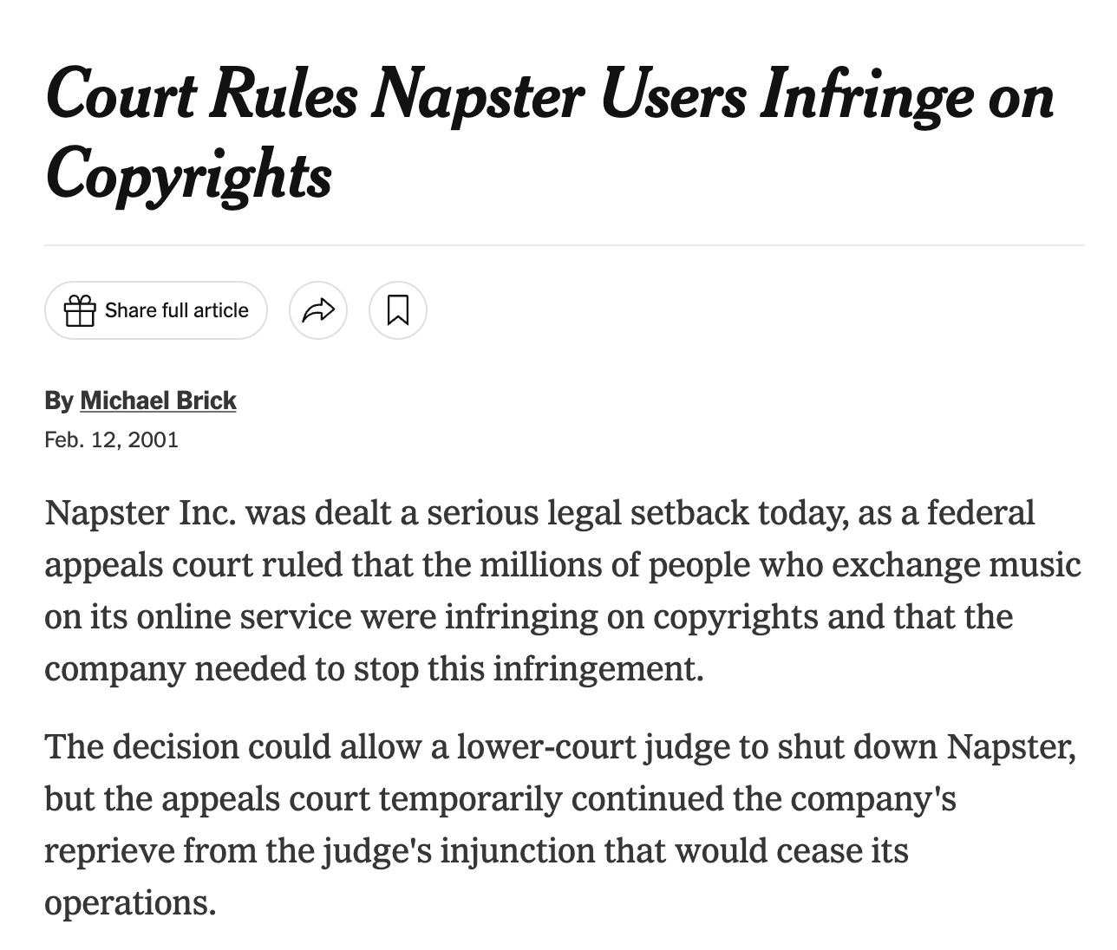
AI and Copyright
Infringement and Output Liability
“No provider of user of an interactive computer service shall be treated as the publisher or speaker of any information provided by another information content provider”
Notes:
Michelle

Slide 14
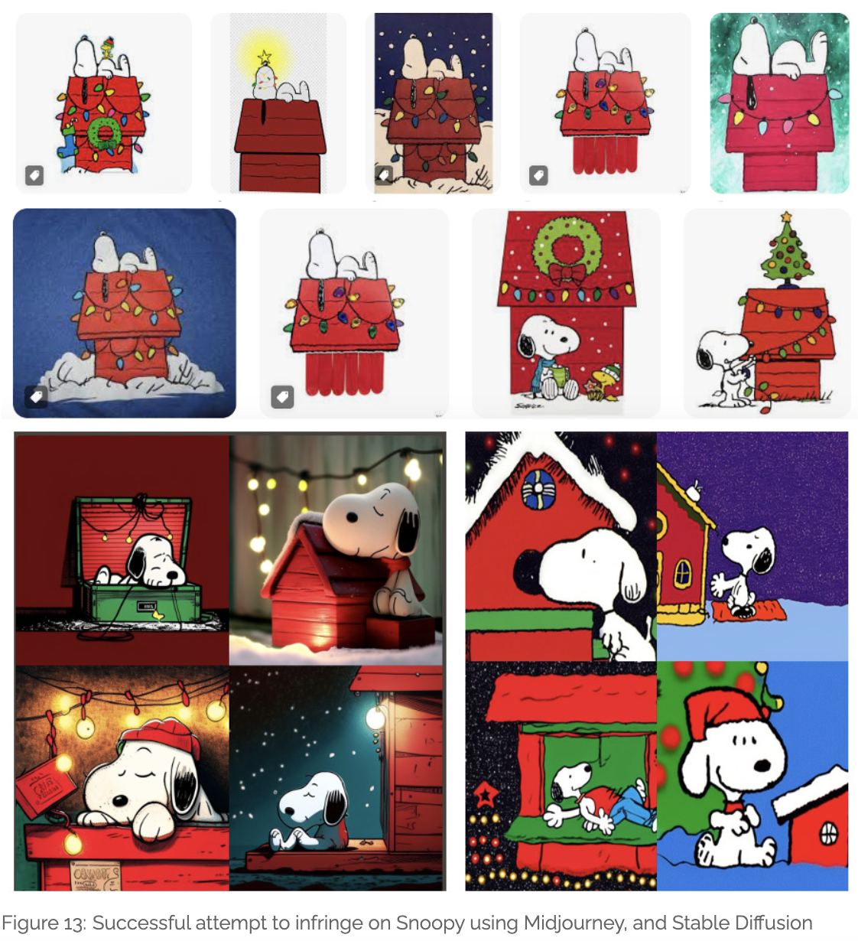
“The Snoopy Problem”
Matthew Sag, Copyright Safety for Generative AI, Houston Law Review, Volume 61, Issue 2 (2023).

Slide 15
The AI Landscape in
Research and Publishing

Slide 16
AI Landscape in Research and Publishing
Generative AI & Publisher Policies
Generative AI tools create new content or media artifacts, such as texts, video, audio, or images.
Many academic publishers and publications have stated policies around the use of generative AI. Professional organizations like the Committee on Publishing Ethics (COPE) and the World Association of Medical Editors (WAME) have also weighed in on the use of AI in academic publishing.

Slide 17
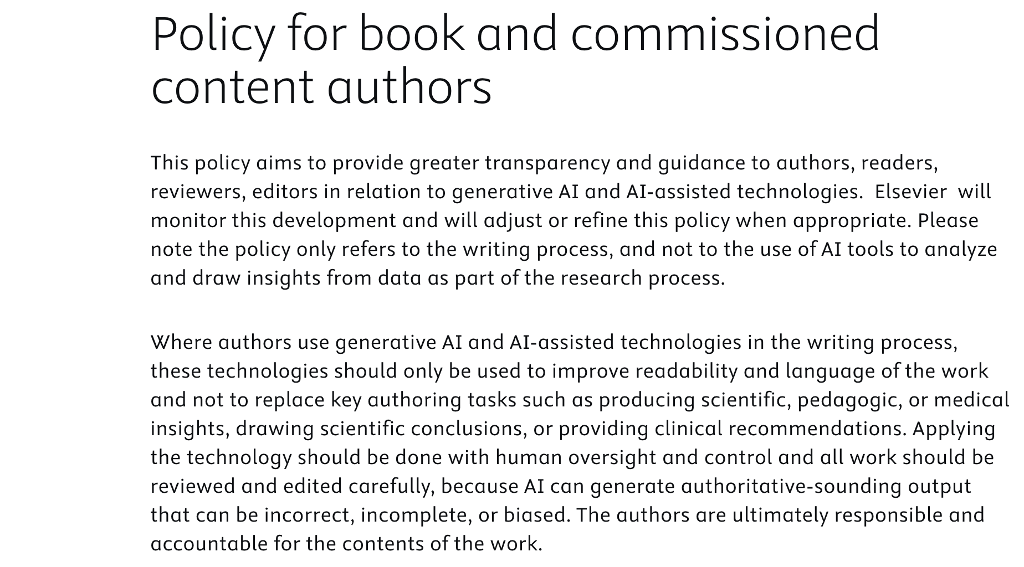


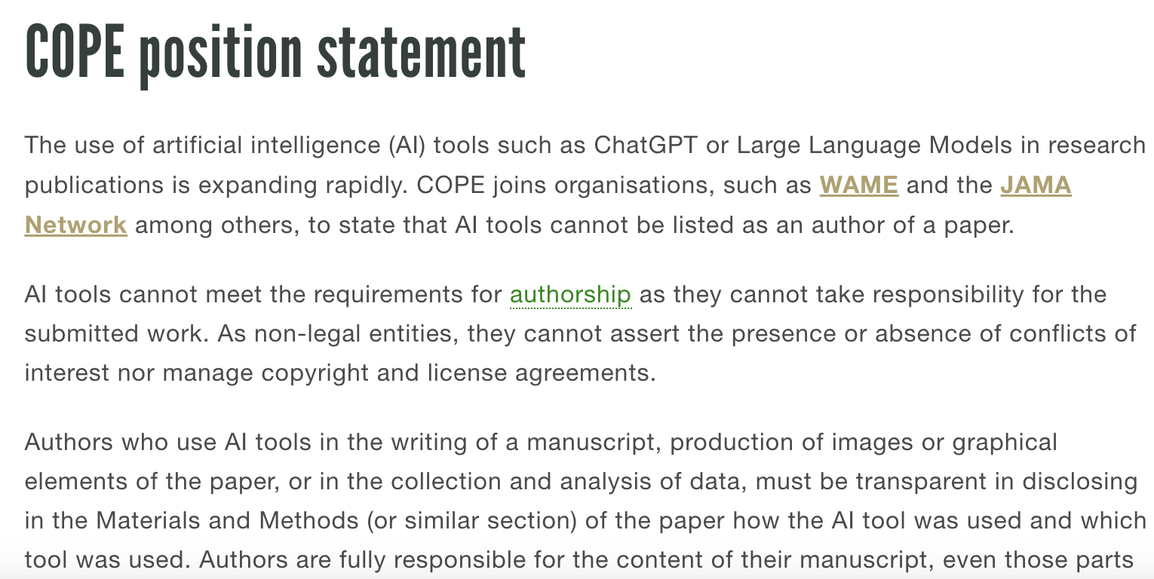


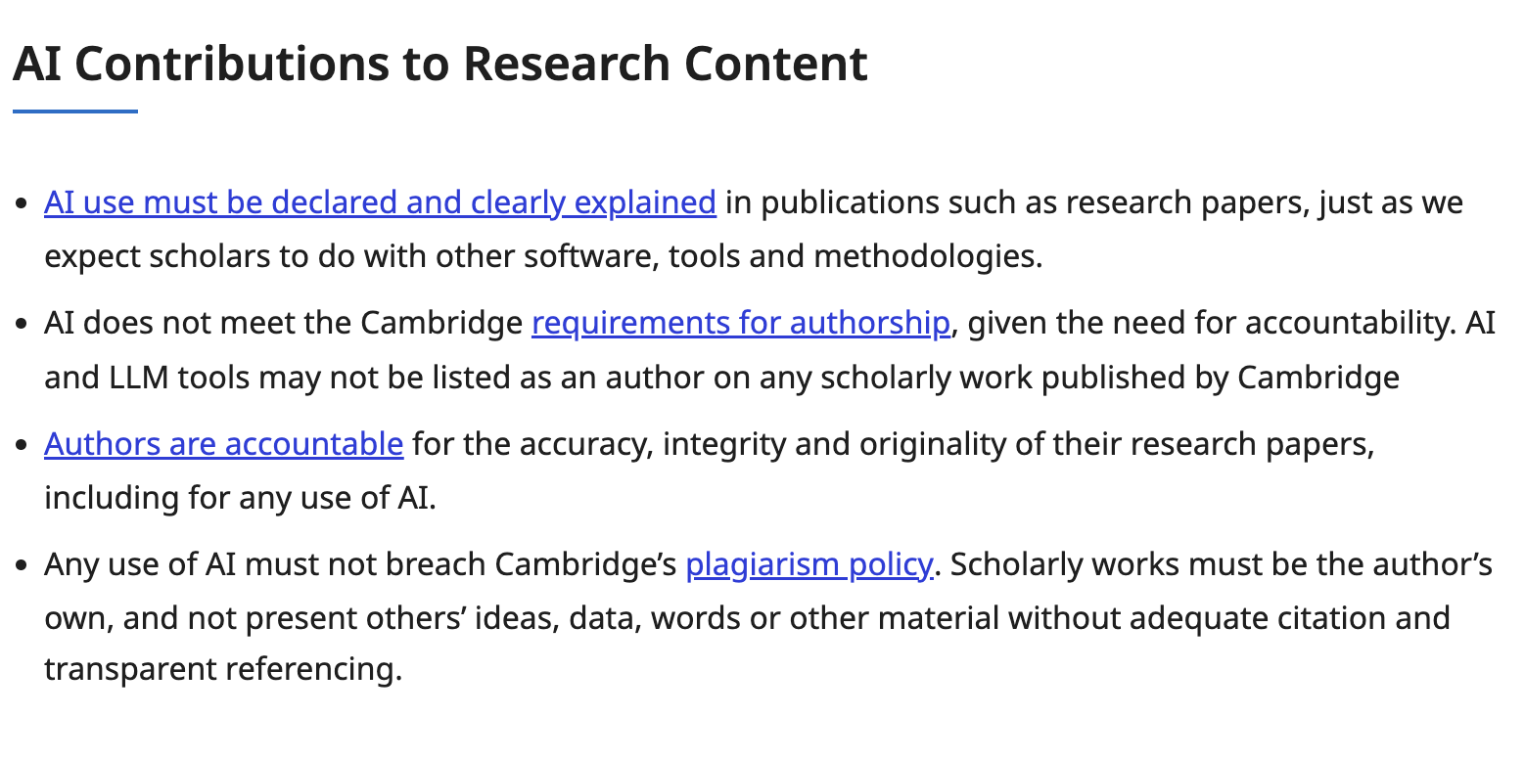
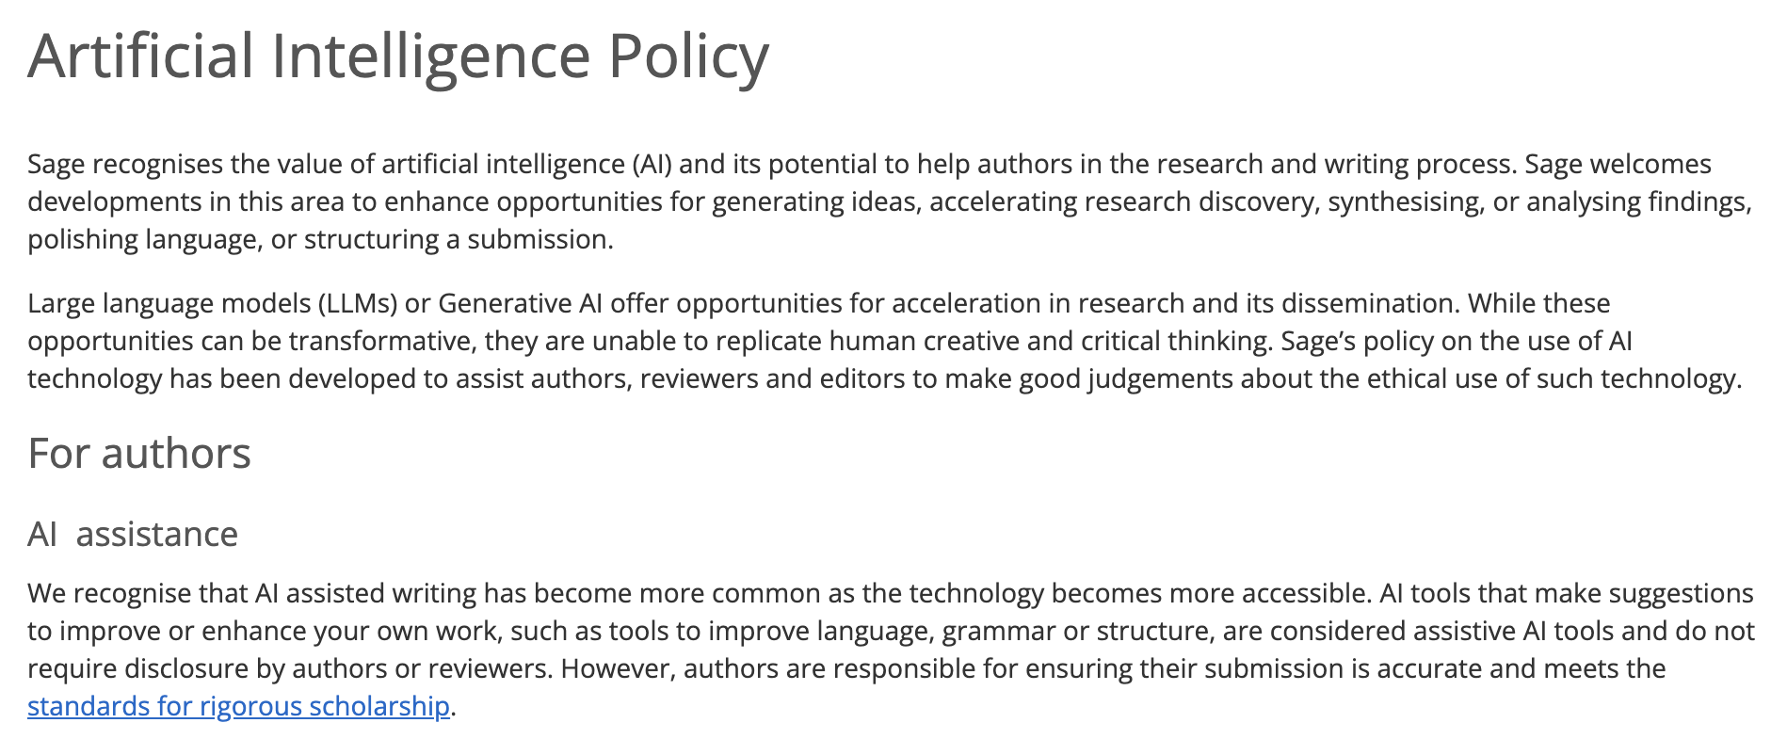

Slide 18
AI Landscape in Research and Publishing
Generative AI & Publisher Policies
Stress the limitations and sometimes restrict the use of AI authorship with regard to copyright, both in written content and other forms of media.
Highlight the importance of transparency and disclosure
Encourage authors to carefully review any work generated or altered by AI to ensure accuracy, validity, and to guard against plagiarism
Make distinctions between “AI assistance” and “Generative AI”

Slide 19
AI Landscape in Research and Publishing
Generative AI & Publisher Policies
Outlining and structuring
Assistance with correcting grammatical errors or writing in a non-native language
Translations
Creating tables, figures, and visualizations
Formatting bibliographies and works cited lists

Slide 20
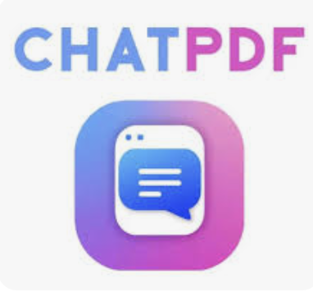






AI Landscape in Research and Publishing
Research Tools
ChatPDF
Query a written
document
Research Rabbit
“Citation-based literature mapping” tool
Elicit
Search for academic papers
ScopusAI
Search, summarize, and map content from the Scopus corpus
Concensus
Search and summarize
academic papers
Scite
Organize and relate citations
Dimensions
Search research papers, analyze data, organize metrics
Notes:
Generative - text
I encourage people to think about AI as a tool. There are lots of aspects of authoring, typesetting, and publishing that are very technical, time consuming, and expensive.
Stuff that’s out of scope for this conversation, but obviously we can use AI tools to do data analysis and Ai can be used as part of your research process and methodology; that’s not really what the focus of this conversation and my expertise is. But there are a variety of tools that can be used throughout the research process and they may offer some value to you.

Slide 21
AI Landscape in Research and Publishing
Using AI Tools
Can I disclose my use and do I feel comfortable doing so?
What are the pitfalls and have I accounted for them?
Unknown data sources
“Hallucinations” and lack of trust in outputs
Potential for plagiarism
Adding my own and others’ data and/or intellectual property to the training data

Slide 22
AI Landscape in Research and Publishing
Generative AI & Research Integrity
ChatGPT and a New Academic Reality: Artificial Intelligence-written Research Papers and the Ethics of the Large Language Models in Scholarly Publishing,” Journal of the Association for Information Science and Technology
Analysis reveals that the potential for bias in the training data and coding process of AI-driven language models such as GPT-3 poses a threat to the integrity of science. Additionally, ethical considerations include issues of copyright, citation practices, and the potential impact on the “Matthew Effect” in scholarly publishing.
The Latest “Crisis” — Is the Research Literature Overrun with ChatGPT- and LLM-generated Articles?
Articles that are written by AI are increasingly appearing in the scholarly literature in reputable scientific journals indexed in mainstream databases.
Papers and Peer Reviews With Evidence of ChatGPT Writing
Retraction Watch list of papers showing evidence that they were written by ChatGPT.

Slide 23
AI Landscape in Research and Publishing
Can AI tools help us to improve research integrity?
AI Beats Human Sleuth in Finding Problematic Images in Research Papers
An algorithm that takes just seconds to scan a paper for duplicated images racks up more suspicious images than a person.
Human Writer or AI? Scholars Build a Detection Tool
A Stanford graduate student has created a tool called DetectGPT that can determine with up to 95% accuracy whether a large language model wrote that essay or social media post.
Can ChatGPT Correctly Identify Predatory Biomedical and Dental Journals? A Cross-Sectional Content Analysis
ChatGPT can accurately distinguish predatory and legitimate journals with a high level of accuracy. While some false positive (29 %) and false negative (7.5 %) results were observed, it may be reasonable to harness ChatGPT to assist with the identification of predatory journals.
Notes:
UMD and other BTAA schools have not turned on the Turnitin tools to detect AI use

Slide 24
AI Landscape in Research and Publishing
Using AI-Powered Research Integrity Tools
Not 100% accurate, but can flag substantial similarity
Flags things that are written by non-native english speakers at a higher rate
Licensed versions of softwares may afford more abilities to control how content is saved, deleted, or reused.
Using these tools actively adds content (often unpublished) into the training and stored data for these models.

Slide 25
Ethical Considerations

Slide 26
…help me write an article?
…create tables, visualizations, illustrations, or other elements for my research works?
Should I use AI tools to..
…proofread or check my own work?
…summarize or create an abstract for my own work?

Slide 27
Ethical Considerations
Should I use AI tools?
Would you feel comfortable disclosing the tool and the manner in which it was employed?
Is there another tool or service that the AI replacing?
  Would you hire a copyeditor or designer to do this work or take it to a service provider on your campus?
  Is this allowing you to contribute something new and valuable to your work - such as providing a transcript or other accessibility element?

Slide 28
Ethical Considerations
Using AI-generated outputs
How much can outputs be trusted? Can you trace where the information came from?
  If citations are provided, are those accurate? Can you check them to verify?
  If you’re using a research tool, what quality of databases is it pulling from?
Are you accounting for bias and inaccuracy?
Notes:
Mona

Slide 29
Ethical Considerations
Should I put my own or others’ work into AI tools?
Did you read the user agreement before signing up or utilizing the tool? Do you trust the tools are you using and are you comfortable putting your work into them?
Assume what you put in is being used to train the machine learning model unless you are explicitly told it is not
Make your own decisions with your creative and scholarly work but use extra caution and deference with others’ intellectual property
Notes:
Mona

Slide 30
Ethical Considerations
Should I put my own or others’ work into AI tools?
Could you create a dataset using public domain or openly licensed materials?
Could you seek permission or license content?
Do not share human subject data or student-identifiable info (even informal data)
Notes:
Mona

Slide 31

Ethical Considerations
Proprietary technologies and sustainability
Using any proprietary tool or platform carries a risk for losing access to that process or methodology. It may not be possible to export your work and exports may not be interoperable with other tools or systems.
Is your research method sustainable if you are utilizing a tool with uncertain longevity?
Notes:
Michelle

Slide 32
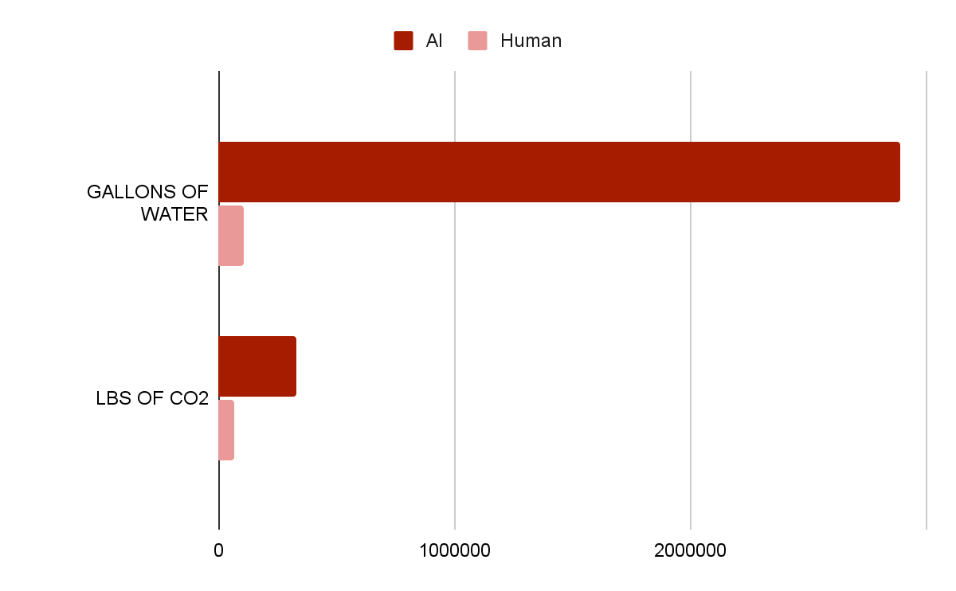

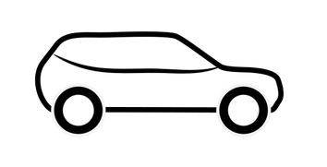
Ethical Considerations
Labor and Environmental Concerns
Labor practices: Data labelling, transcription, and other human-performed tasks are generally outsourced and performed for low wages
Environmental impacts: Training a single AI model can use as much water as an average person uses over 27 years. Training and running AI models can produce carbon dioxide emissions that are more than 5x the amount a car emits over its lifetime.
2,889,000 gal
107,000 gal
330,000 lbs
66,000 lbs
Notes:
Michelle

Slide 33
Ethical Considerations
Disclosures
Intellectual Property Ownership: Generative AI must be to disclosed in order to register copyright for eligible elements of your work.
Funders: Funder requirements are still developing and very individualized at this point. However, it may put you in a difficult position if you utilized tools that were not scoped in the description of your work, including both the research and publication associated with the grant-funded work.
Research Community: It is important to disclose the use of AI, and the methods and extent of your use in order to enhance reproducibility and continue to foster trust among researchers and research users.

Slide 34
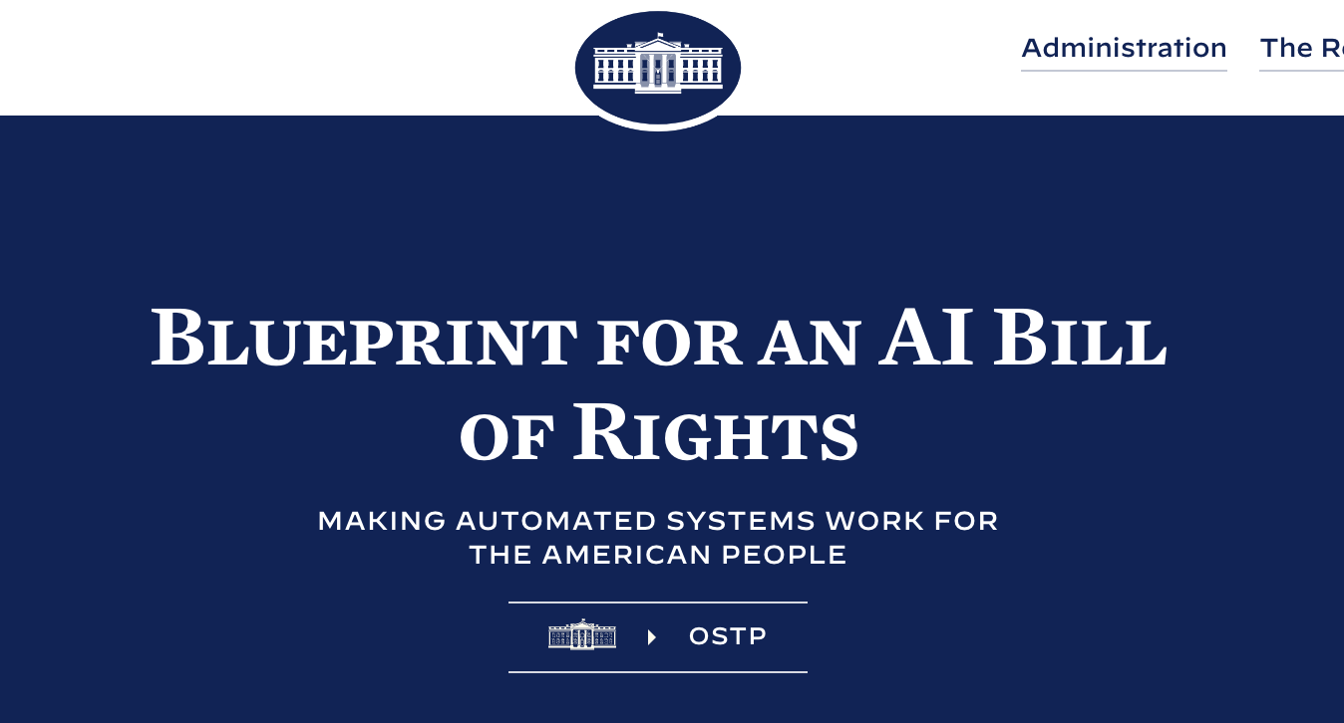
Ethical Considerations
Disclosures
Human Subjects: Your institution may have a stated policy from IRB or another body regarding the use or disclosure of AI. Due to the nature of AI training models and the unpredictability of their outputs, AI should always be disclosed to research subjects.
This is also a question for our campuses regarding the use of human subject data in unregulated tools using AI technologies.
Students: You should disclose to your students when and how you’re using AI on their work and your classes.
White House Blueprint for an AI Bill of Rights

