Slide 1

Dynamic EM Ray Tracing for Complex Outdoor and Indoor Environments with Multiple Receivers
Student: Ruichen Wang
Committee: Prof. Dinesh Mancoha, Chair/Advisor
Prof. Min Wu
Prof. Ramani Duraiswami
Prof. Furong Huang
Prof. Nikhil Chopra
Notes:
Good afternoon, everyone, and thank you for joining us today. I'm Ruichen Wang, and I'll be presenting our work on 'Dynamic EM Ray Tracing for Complex Outdoor and Indoor Environments with Multiple Receivers'. This work has been guided by my advisor, Professor Dinesh Manocha.
I would like to express my very gratitude to the continuous support and guidance from Prof Dinesh, and special thanks to the committee members attending my defense, providing valuable suggestions and comments to my thesis today, and also many thanks and welcome to the audience here.

Slide 2
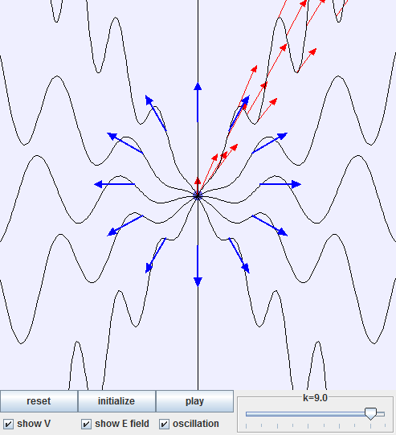
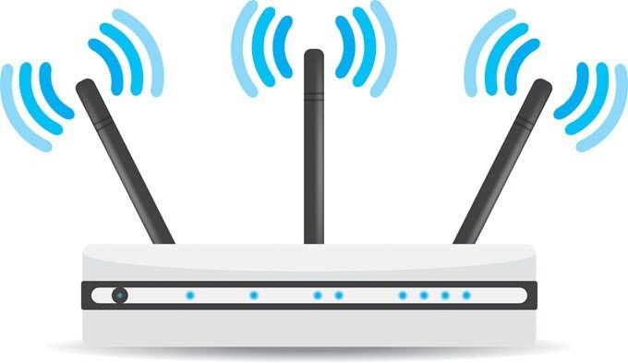

Electromagnetic (EM) simulation
EM wave: energy that travels through space or mediums, defined by oscillating electric and magnetic fields at right angles to each other and the wave's direction [Maxwell, 1873]
EM sources and wireless communication
EM frequency ranges in wireless communication [Ugweje, 2004]: FM Radio (~100MHz), Mobile 2G-4G(700MHz-2.6GHz), 5G/6G (30GHz-3THz), Wi-Fi(2.4GHz, 5GHz), etc.
EM simulation
Notes:
Let’s first introduce what is an electromagnetic wave for short, EM wave: it is a form of energy propagation through space or a medium, characterized by the oscillation of electric and magnetic fields that are perpendicular to each other and to the direction of the wave's propagation.
There are numerous EM waves sources in our daily lives, for example, visible light, microwave ovens, or mobile phones, Wi-Fi signals, etc.
Our research of EM wave focus on wireless communication frequency ranges, which are, for example, 2.4GHz/5GHz for wifi, 30GHz for 5G, …
EM simulations play a vital role in understanding the propagation of EM waves and their interactions with various media, helps designing wireless networks and optimizing their performance.

Slide 3
EM simulation
EM ray tracing: a computational technique modeling electromagnetic wave behavior, analyzing wave interactions in various environments and with objects [McKown et al. 1991]
  Fundamental concept: rays representing narrow beams of EM energy, travel in straight lines until encountering objects
  Powerful insight tool
Other methodologies in EM Simulation
  Wave-Based methods [Taflove et al. 2005] : precise, slow
  Analytical solutions [Amor et al. 2021] : precise, slow
  Stochastic models [Sun et al. 2017] : generic, fast
Notes:
There are several methodologies in EM simulations, the focus of our work is on EM ray tracing: it is based on the concept of rays as narrow beams of EM energy traveling in straight lines, interacting with objects through various means.
Comparing to RT method, the other methods listed below like wave-based method, grounded in in solving Maxwell's equations directly, and analytical solutions, using mathematical and physical principles to solve EM problems, are precise but slow, on the other hand for stochastic models based on measurement data and stochastic fittings, are fast but does not take in 3d environment model information to support site-specific analysis.
Balancing between physical illustrations and working efficiency of EM simulations, we carried out detailed studies in EM ray tracing and efforts to improve its accuracy and efficiency.
Wave-based methods, such as the Finite-Difference Time-Domain and the Finite Element Method , grounded in solving Maxwell's equations directly,
offer a detailed resolution of wave propagation and interaction phenomena
Analysis methods, including the Method of Moments and Green's Function approaches focus on using mathematical and physical principles to analytically or approximately solve electromagnetic problems.
While offering precision, these methods tend to require significant computational resources, even under idealized assumptions as in analytical methods, prompting ongoing efforts to enhance their efficiency and scalability. Solve wave functions and focus on EM wave properties.
On the other hand, stochastic Methods, built upon measurement data and stochastic curve fittings, can provide generic understanding of channels but does not take in 3d environment model information to support site-specific analysis.

Slide 4
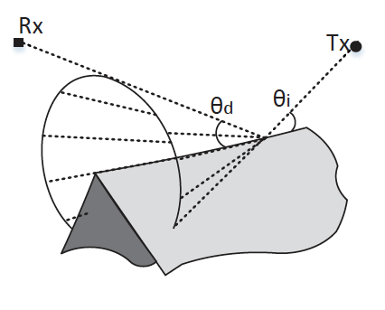
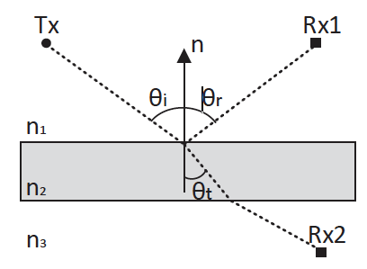
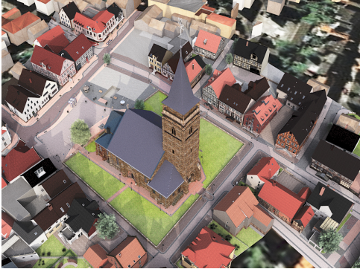
EM ray tracing basics
Ray interactions with environment:
  Transmission: waves travel through obstacles.
  Reflection: waves bounce back when encountering surfaces.
  Diffraction: bending of waves around obstacles or through narrow openings.
Environmental modeling:
  Considers electromagnetic properties of materials for wave interactions.
  Accuracy depends on detailed environmental models.
[Fuschini et al. 2015]
Notes:
Next, We'll look at the basic interactions of rays with the environment, including direct rays, transmission through obstacles, reflection off surfaces, and diffraction around edges or through narrow openings. The accuracy of ray tracing heavily relies on detailed environmental models. (A simulated 3d village model, includes more than 30,000 meshes, implying its computational intensity)

Slide 5
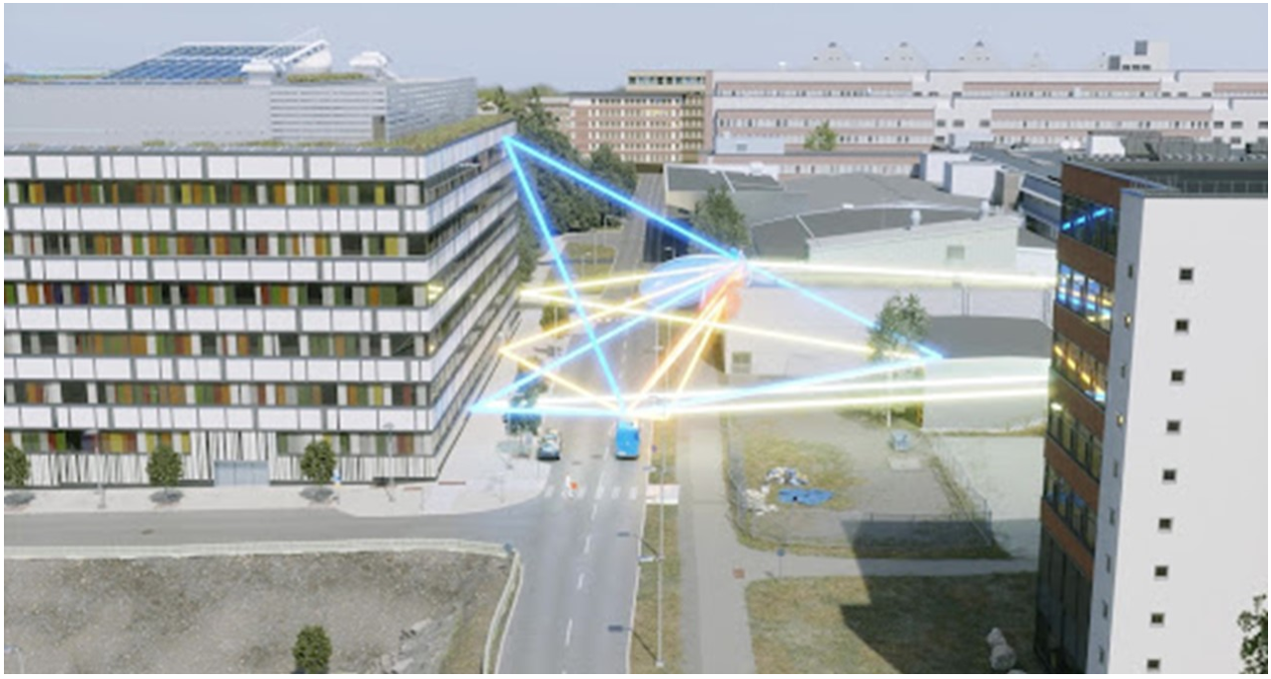
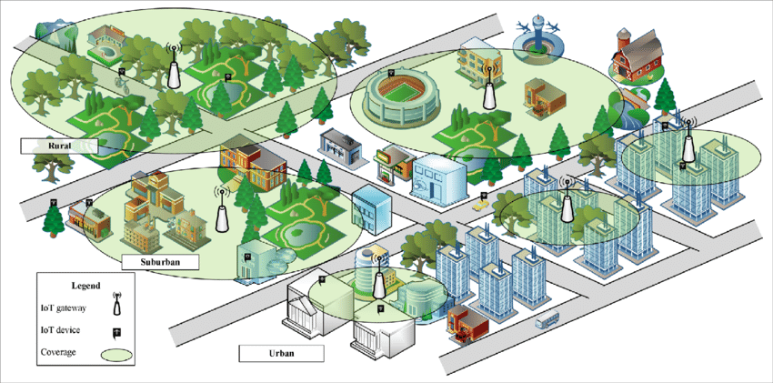
EM ray tracing applications
Aids in understanding and predicting EM wave propagation.
Informs design and optimization of networks for improved coverage and reliability.
Cover page from NVIDIA keynote speech: real-time simulation demo in a digital twin city model. [NVIDIA 2022]
Base station tower coverage illustration: the deployment of base stations in various environments and coverage optimization simulations. [Tao et al. 2018]
Notes:
Ray tracing aids in understanding and predicting EM wave propagation, informing network design and optimization for improved coverage and reliability.
(left: dynamic link simulations in real time, right: base station coverage simulation in nowadays network design)

Slide 6
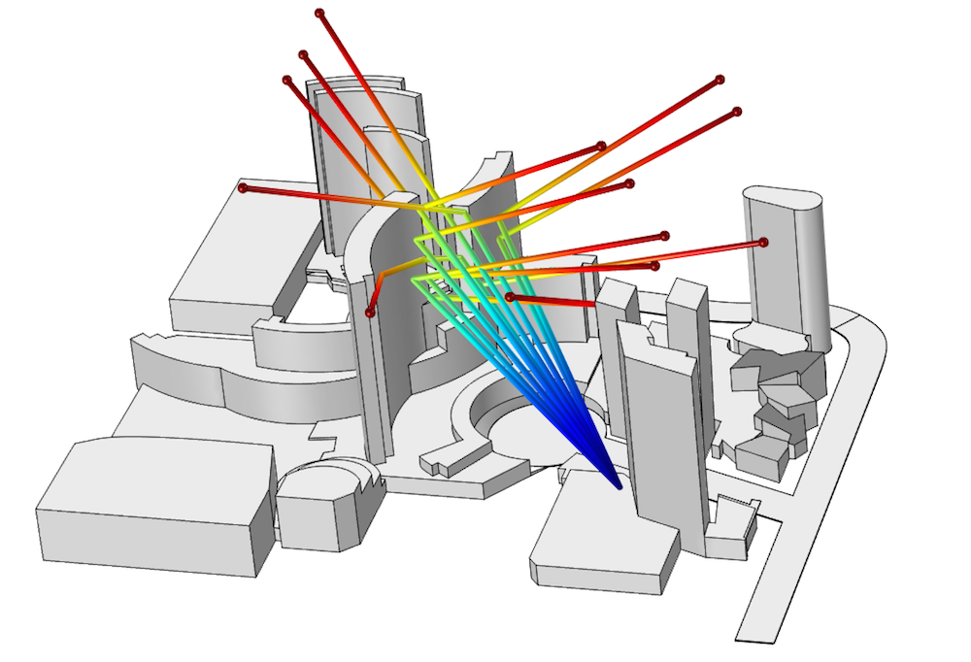
EM ray tracing main challenges
Real-time performance for dynamic scenes
  Real-time: tens of milliseconds for large dynamic scenes [NVIDIA 2022, Yin et al. 2022]
  Dynamic scenes: moving sources or receivers, environment changes
Detailed accuracy in environment modeling
  Environment modeling details: material types and properties, geometry resolutions, air conditions, etc.
Diffraction simulation
Notes:
While the applications are promising, significant hurdles remain. There are three main challenges in EM RT field:
1. Real-time performance: the difficulty behind is to deal with computational intensity of RT: This is particularly evident when simulating complex dynamic scenes or at high frequencies.
2. Detailed modeled environment: those environments with numerous obstacles such as cities with different kinds of buildings and shapes are challenging to model. How well RT simulations work really depends on how good the 3d model data is.
3. Diffraction Simulation: traditional ray tracing methods, which are primarily based on geometric optics, can sometimes struggle to accurately simulate wave phenomena like diffraction. This limitation can be particularly problematic in predicting signal behavior in complex environments or dynamic simulations where diffraction plays a significant role.

Slide 7
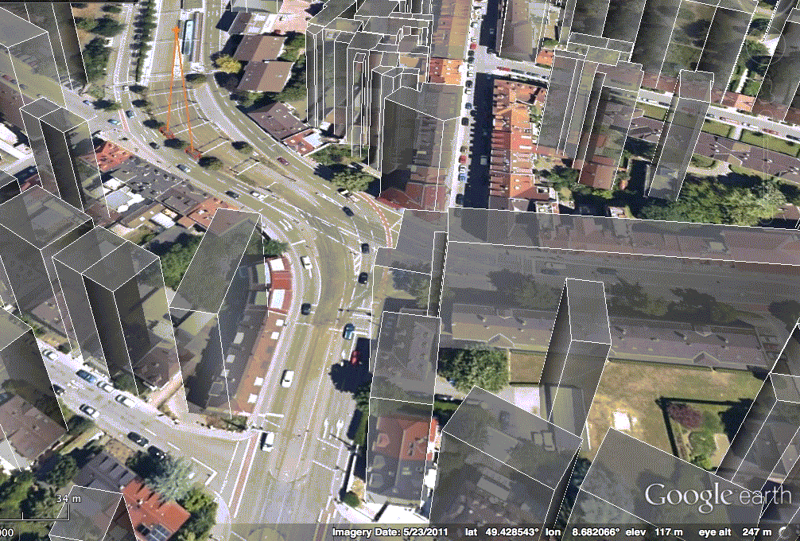
Dynamic EM ray tracing
Consider changes in the environment, such as moving objects, varying material properties, and time-varying channel properties. [Bilibashi et al. 2020]
  Computational complexity
  Accuracy in dynamic and complex environments
  Time-varying channels and ray interactions with
  the environment
Notes:
Besides all the EM ray tracing discussion, dynamic EM ray tracing in addition considers environmental changes such as moving objects and varying material properties. It faces even more challenges in computational complexity and accuracy degradation due to dynamic environments and time varying channel properties.

Slide 8

State-of-art approaches to RT challenges
Parallel computing [Owens et al. 2008, Wald et al. 2014]
Hybrid techniques [Hailu et al. 2011, Tommaso et al. 2021]
Machine learning based acceleration [Jhihoon et al. 2019]
Material libraries [Withayachumnankul et al. 2005, Huangfu et al. 2022]
Notes:
•parallel computing, reduce computation times and enabling complex simulations by efficiently manages the calculations needed for large-scale and dynamic scenarios.
•Hybrid Techniques Combining ray tracing with wave-based methods like Finite-Difference Time-Domain (FDTD) , offer a broader perspective on wave behaviors and electromagnetic interactions [27].
• Machine Learning based acceleration: machine learning to learn propagation patterns from data improving the efficiency of simulations.
• Material Libraries: Developing comprehensive libraries for precise modeling of wave-material interactions supports various applications, from urban radio to radar signature prediction

Slide 9
State-of-art solutions
  Va, Vutha et al. “GEMV^2”,2015
  Aygun et al. “Propagation modeling”, 2016
  Ju, Shihao et al. “NYUSIM”, 2018
Introduced GEMV^2, a hybrid simulator that can deal with dynamic traffic
Introduced channel coherence for channel properties in dynamic environments
Updated NYUSIM for dynamic simulations in stochastic model simulations
These studies introduce key concepts that inspire and lay groundwork to our research
Notes:
Here, we listed some important research that has influenced our work. On a high level, these studies have advanced our understanding of channels properties, propagation modeling, and dynamic simulations in ray tracing, laying the groundwork for the projects we're presenting today.

Slide 10
Related works: widely-used simulators
Industrial simulators: WinProp[WinProp 2022], Wireless Insite…
Academic simulators: NYUSIM, GEMV^2[Mate et al. 2014], CloudRT [Guan et al. 2021], TeraMIMO [Tarboush et al. 2021]…
Simulator | Work Frequency | Environment | Model
WinProp | Up to 100GHz | Outdoor/Indoor | Comprehensive
Wireless Insite | Up to 100GHz | Outdoor/Indoor | Comprehensive
NYUSIM | Up to 100GHz | Outdoor/Indoor | Stochastic
CloudRT | Up to 325GHz | Outdoor | Physical
GEMV^2 | 5.9Ghz | Outdoor | Hybrid
TeraMIMO | Up to 10THz | Outdoor/Indoor | Stochastic
Motivated to build first academic ray tracing-based simulator for both outdoor/indoor environments, that supports mmWave simulations.
Notes:
In this page, we show some other simulators like WinProp, Wireless Insite, NYUSIM, and others that have set benchmarks in EM RT. Each offers unique capabilities, from comprehensive outdoor and indoor modeling to specialized applications at certain frequencies.
After analyzing all the popular simulators, we are motivated to build the first academic dynamic ray tracing simulator for both outdoor/indoor environments, that supports mmWave simulations.

Slide 11
Interactive ray tracing
Faster ray tracing methods
  Visual simulation: image generation [Wald et al. 2001, Wald et al. 2003, Parker et al. 2010]
    Frame-to-frame caching
  Audio simulation: impulse response estimation [Funkhouser et al. 2004, Manocha et al. 2009, Schissler et al. 2018]
    Focus on early reflection and diffraction
    Backward ray tracing and propagation path caching
Notes:
Our work is also inspired by the work on interactive ray tracing for visual rendering and acoustic simulation in the past few years.
A lot of progress has been made in faster ray tracing techniques for visual and audio simulations. We’re working to bring these advancements into EM ray tracing.

Slide 12
Interactive ray tracing
Challenges in ray tracing for adapting faster methods to EM
Aspect | Visual Simulation | Acoustic Simulation | EM Simulation
Transmitted Rays | Modeled as refraction: Relevant for transparent or translucent materials. | Sound transmission through materials: Influenced by material density and thickness. | EM wave transmission through materials: Frequency-dependent attenuation and phase change.
Reflected Rays | Crucial for visual realism: Includes specular and diffuse reflections. | Key for sound behavior in environments: Depends on surface material and texture. | Important for signal behavior around objects: Influenced by material properties and angle of incidence.
Diffracted Rays | Less common due to small light wavelengths: May be considered for fine details. | Significant due to larger sound wavelengths: Sound bending around obstacles. | Crucial for signal behavior around edges and corners: Influential in urban and indoor propagation.
Notes:
There are indeed challenges in such adaptations, A comparison shows the differences in simulated rays across disciplines. So, when adapting interactive ray tracing methods, we need to address these differences.
for example, in EM, diffracted rays are significant to count for shadow region coverage in wireless NLOS communications, but its less common in visual simulations due to small optical wavelength.

Slide 13

Our goals and methods
Reduce computational complexity
  Coherence-based ray tracing
Ensure prediction efficiency and accuracy
  Scalability for large dynamic scenes
  Improved diffraction simulation
Use ML techniques to further improve computation efficiency and prediction accuracy
  Generative Adversarial Networks (GAN)
Notes:
Looking at what others have done, we're now ready to share our goals and methods.
1st We aim to reduce…The coherence concept in our work refers to the consistency and stability of propagation paths across consecutive frames in dynamic environments. It is achieved by efficiently managing these paths through acceleration methods which we will detailed discuss in later talks. (such as backward ray tracing, efficient BVH updates, and path caching and new methods and algorithms such as spatial consistency and channel correlation calculations.)
2nd We want to ensure…in complex and dynamic environment, Develop scalable algorithm for large and dense environment, Include ray interaction models for objects with smooth surfaces to improve diffraction simulations
channel coherence, spatial consistency, efficient measuring doppler shift, UTD,
3rd We use…

Slide 14
Dynamic Coherence-Based EM simulator (DCEM) for Vehicular Environments
Notes:
Now we come to the first work, in which we first developed the Dynamic Coherence-Based EM simulator , for short DCEM, and performed evaluations against other established benchmarks.

Slide 15
Motivation
Develop the first Dynamic Coherence-Based EM simulator with fast and reliable computations
Importance of accurate simulations to ensure reliable vehicular communication
Complexities of vehicular environments for wireless communication
Notes:
So, our first motivation, is to develop the DCEM that offers fast and reliable computations, which is particularly important vehicular scenarios, where there is a fatal cost of minor errors.
Also, we will try to address the complexities and dynamic simulations for vehicular communications.

Slide 16
Method
Utilize the benefits of coherence-based acceleration methods in fast ray tracing simulations including backward ray tracing, efficient Bounding Volume Hierarchy (BVH) updating, and propagation path caching.
Use propagation models for EM simulations with proper physical models and ray interaction parameters.
Notes:
We utilize the strengths of coherence-based ray tracing simulations, adapting acceleration methods like backward ray tracing from acoustic works. We implement propagation models for EM waves, ensuring accurate physical modeling and ray interaction estimations.

Slide 17
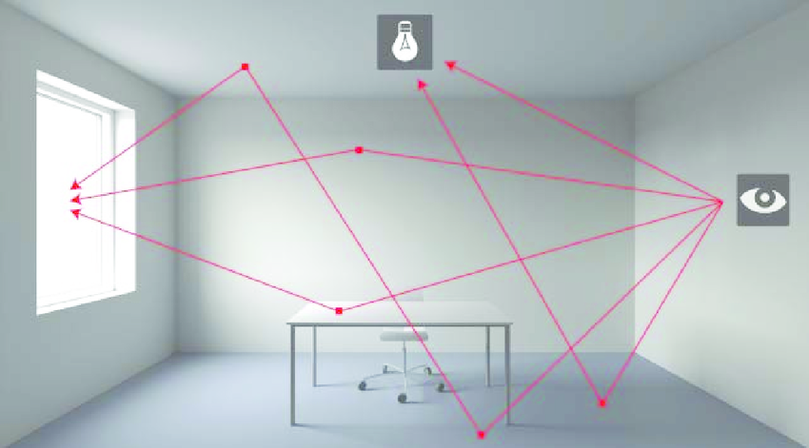
Acceleration methods in DCEM
Backward ray tracing: cast rays from the receiver
  Reflected/diffracted rays coming from geometric primitives in the vicinity of the receiver, contribute more to the total received power.
  The backward RT method can compute all the important paths while shooting fewer rays.
Notes:
In DCEM, we've implemented efficient acceleration methods to enhance the simulation efficiency.

Slide 18
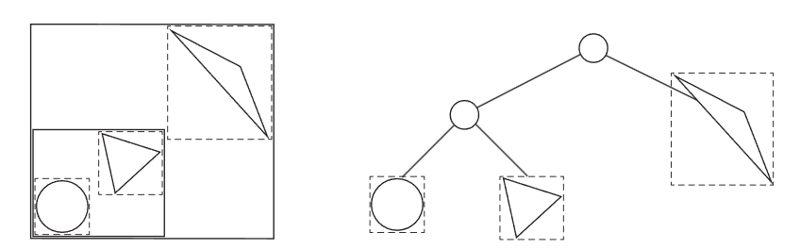
Acceleration methods in DCEM
Efficient BVH update: measuring BVH quality degradation among adjacent time simulation
  Bounding Volume Hierarchy: each node in the hierarchy contains a bounding volume that encapsulates smaller bounding volumes or actual geometric objects.
  Update/rebuild at a time, when necessary, possible to just rebuild subtrees in some cases, minimize cost.
BVH illustration
Notes:
In DCEM, we've implemented efficient acceleration methods to enhance the simulation efficiency.
BVH, without going into too much detail, is a tree structure on a set of geometric objects, where all geometric objects that form the leaf nodes of the tree, are wrapped in bounding volumes; it can support efficient operations on sets of geometric objects in ray tracing.
Hierarchy of Bounding Volumes: BVH is built upon the concept of bounding volumes, which are simple geometric shapes (like spheres, boxes, etc.) that fully contain a group of objects or parts of an object. These bounding volumes form a hierarchy, where each node in the hierarchy contains a bounding volume that encapsulates smaller bounding volumes or actual geometric objects.
Tree Structure: Typically, BVH is structured as a binary tree. Each node in the tree represents a bounding volume, and its children represent smaller volumes within it. The leaves of the tree are the smallest bounding volumes, often directly containing the actual geometric objects (like triangles in a 3D model).
Construction: Building a BVH involves recursively dividing a set of objects into groups, each of which is enclosed in a bounding volume. This division is done based on various heuristics, such as spatial locality or balancing the tree, to ensure efficient queries.
Efficiency in Queries: The primary purpose of a BVH is to speed up operations that require checking many objects. For example, in ray tracing, when a ray is cast into a scene to determine what it intersects, the BVH allows for quickly discarding large sets of objects that the ray cannot possibly intersect, as their bounding volumes do not intersect with the ray. This drastically reduces the number of intersection tests needed.
Dynamic Updates: In dynamic scenes, where objects move or change, the BVH may need to be updated. This can be done either by completely rebuilding the tree or by adjusting the existing hierarchy to accommodate changes.

Slide 19
Acceleration methods in DCEM
Propagation path caching: valid paths are kept and updated until removed
  Visibility hash tables as persistent caches are used to accelerate the path finding process from time to time.
  Lowered the number of visibility rays cast each time, leading to a faster overall computation time.
Notes:
Additionally, our use of propagation path caching optimizes the simulation process, enabling our system to adapt swiftly and efficiently to dynamic environments.

Slide 20
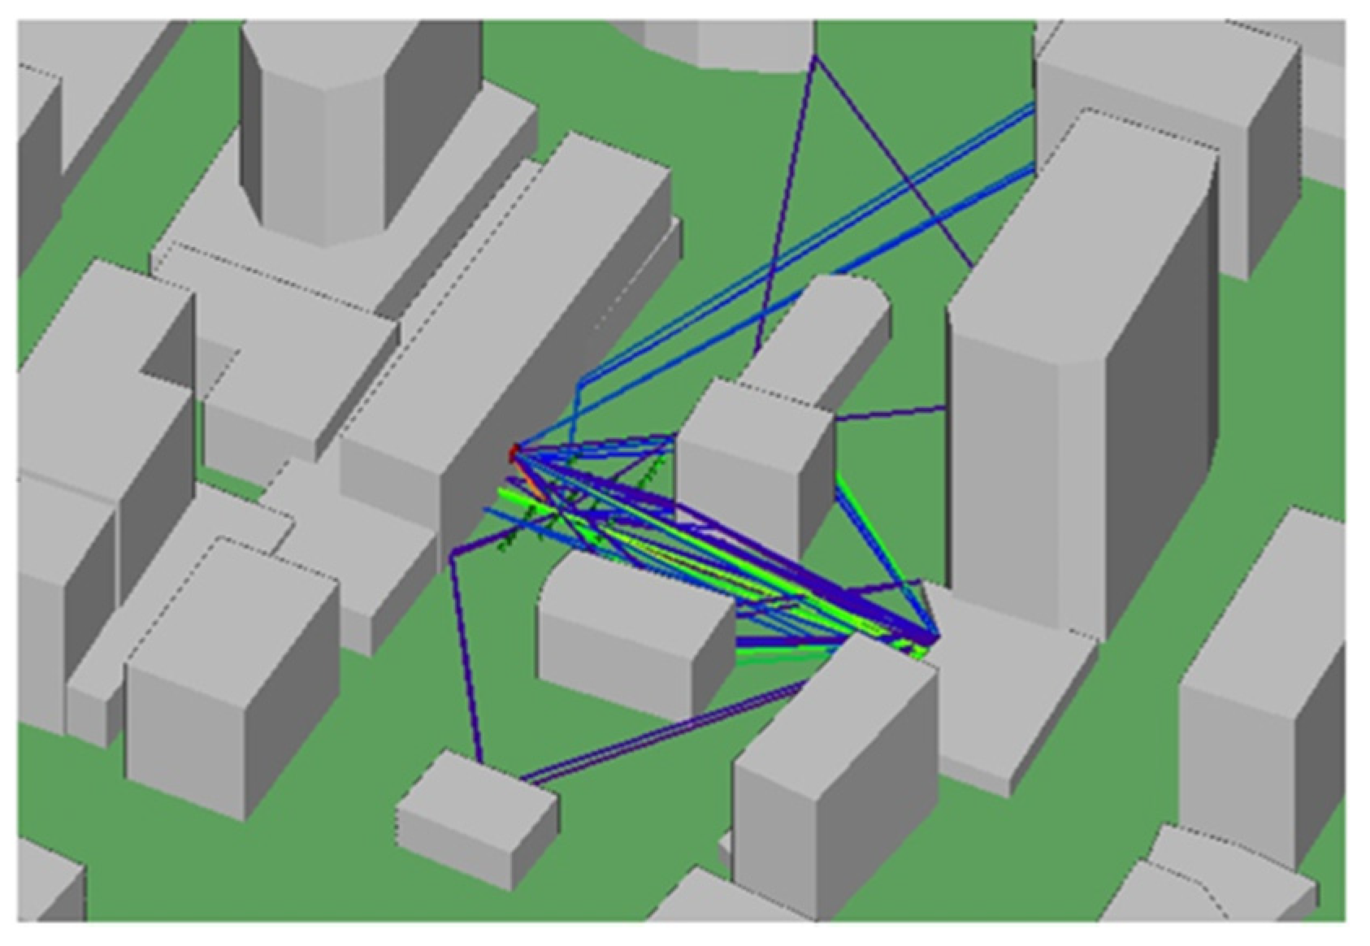
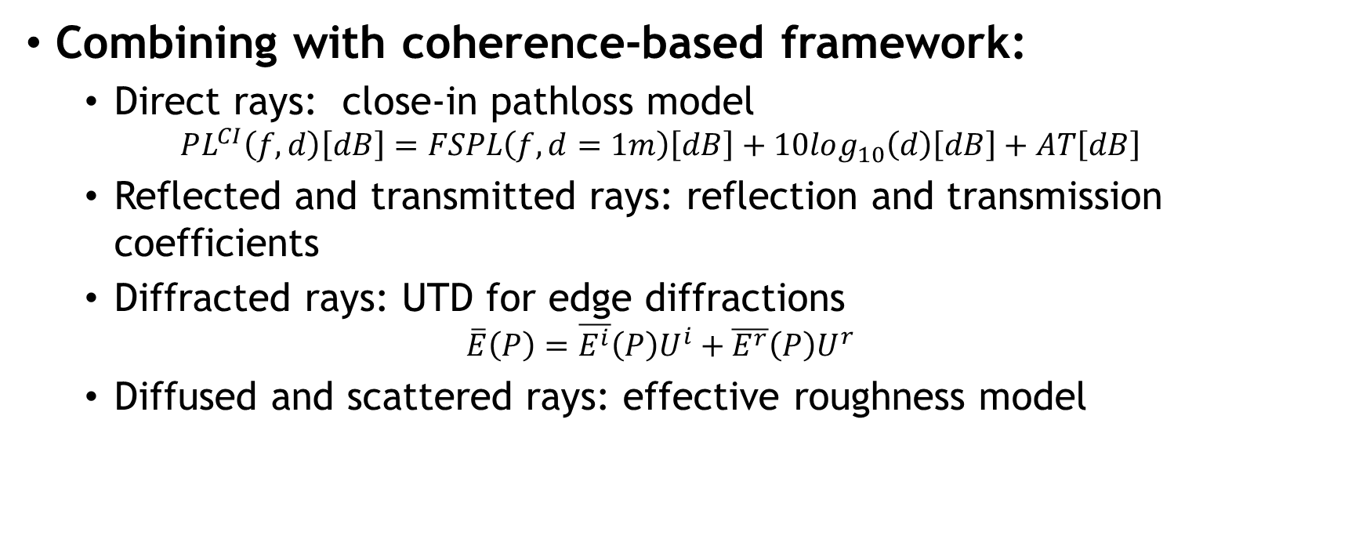
Propagation models in DCEM
Combining with coherence-based framework:
  Direct rays: close-in pathloss model
  $$PL^{CI}\left(f,d\right)\left[dB\right]=FSPL\left(f,d=1m\right)\left[dB\right]+10log_{10}\left(d\right)\left[dB\right]+AT\left[dB\right]$$
  Reflected and transmitted rays: reflection and transmission coefficients
  Diffracted rays: UTD for edge diffractions
  $$\overline{E}\left(P\right)=\overline{E^{i}}\left(P\right)U^{i}+\overline{E^{r}}\left(P\right)U^{r}$$
  Diffused and scattered rays: effective roughness model
Notes:
We build DCEM with the following propagation models. After valid paths are found, the path losses are calculated according to their type of rays along the paths. The received power at certain location will add up all the path contributions. This can be time-varying in dynamic environments.
where f denotes the carrier frequency in GHz, d is the 3D T-R separation distance, n represents the path loss exponent (PLE), and AT is the attenuation term induced by the atmosphere.
UTD can largely be described by two equations: one for the lit region and one for the shadowed region, The Ui and Ur terms represent the Heaviside step function, signifying a direct path visibility for the incident and multipath reflected fields, respectively
E¯I is the incident field directly from a transmitter at a receiver location P while E¯r (P) and E¯d (p) represent the reflected and diffracted fields, respectively.

Slide 21
Main results
Performance evaluation by comparing with GEMV^2 and WinProp in vehicular environments, showing comparable accuracy while reducing 30% computation time under certain settings.
Channel Power Delay Profile (PDP) comparisons under dynamic settings with NYUISIM, showing system capability of dynamic simulations.
Notes:
Our performance evaluations, comparing DCEM with tools like GEMV^2 and WinProp, demonstrate comparable accuracy while reducing computation time by 36% and 30%, respectively, under certain settings. The comparison with NYUSIM results shows our system's capability for dynamic simulations in vehicular environments. The verification metrics are received power heatmaps, and power delay profiles.

Slide 22
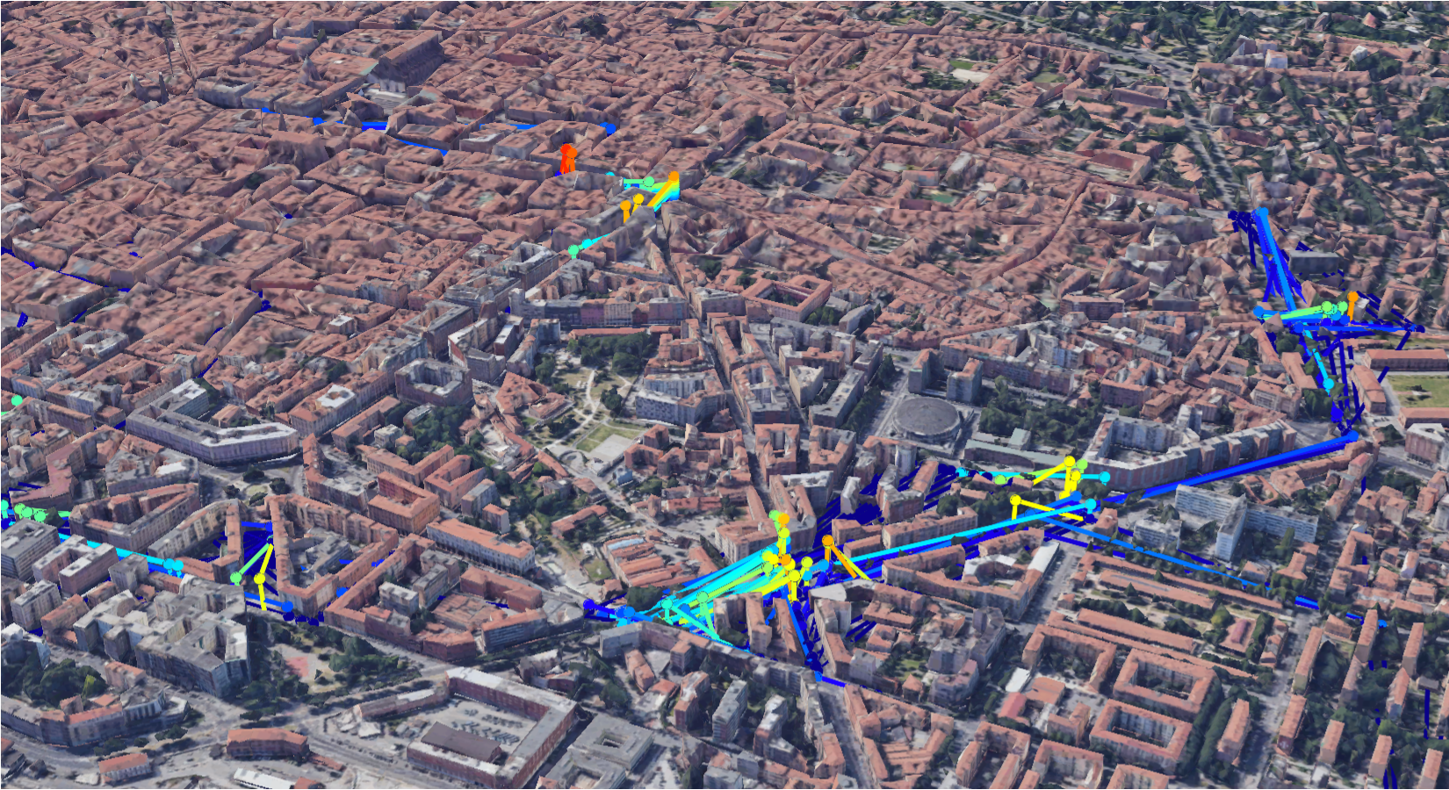
Evaluation details: 3D Environments
Outdoor
3D model of a European urban model
Simulation results of V2V with Google Earth
Notes:
On the left, 3D model of a European urban model. We show that our method works better than other simulators in such urban environment, with high accuracy and fast computation time.
One the right, Simulation results of V2V with Google Earth, GEMV^2 generates V2X simulation output in Keyhole Markup Language (KML) format. We highlight the results in the urban Europe model.

Slide 23
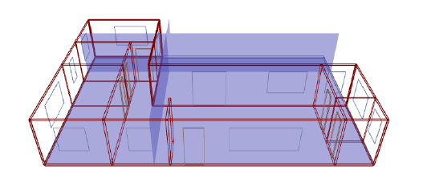
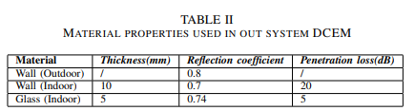
Evaluation details: 3D Environments
Indoor
Material table
Simple indoor office environment
Notes:
Simple indoor office environment: we compare the performances of WinProp and DCEM indoor because WinProp took a very long time to load and convert the modeled village environment shown ealier. This indoor environment with known material information is easy to use for prediction accuracy and performance validation.

Slide 24
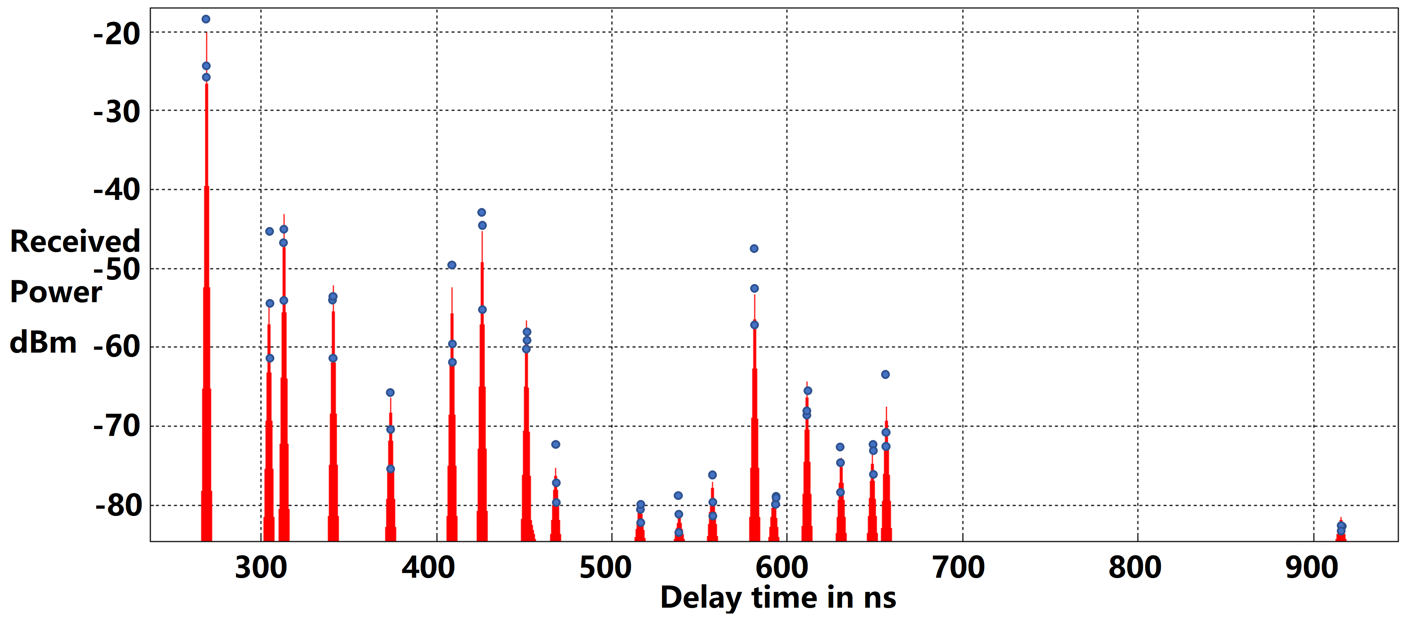
Evaluation details: results comparisons
Outdoor: comparison with GEMV^2
DCEM and GEMV^2 RSP results in V2V comparison
Similar accuracy for outdoor simulations
Notes:
PDP comparison: We observe a good match in the predicted positions in RSP and time delay and the mean of RSP shows an average difference of 1.7 dBm.
DCEM and GEMV^2 RSP results in V2V comparison, the red peaks from DCEM and the blue points from GEMV^2 . Since the GEMV^2 has small scale variation, the simulated result shows a slight variation around the deterministic predictions.

Slide 25
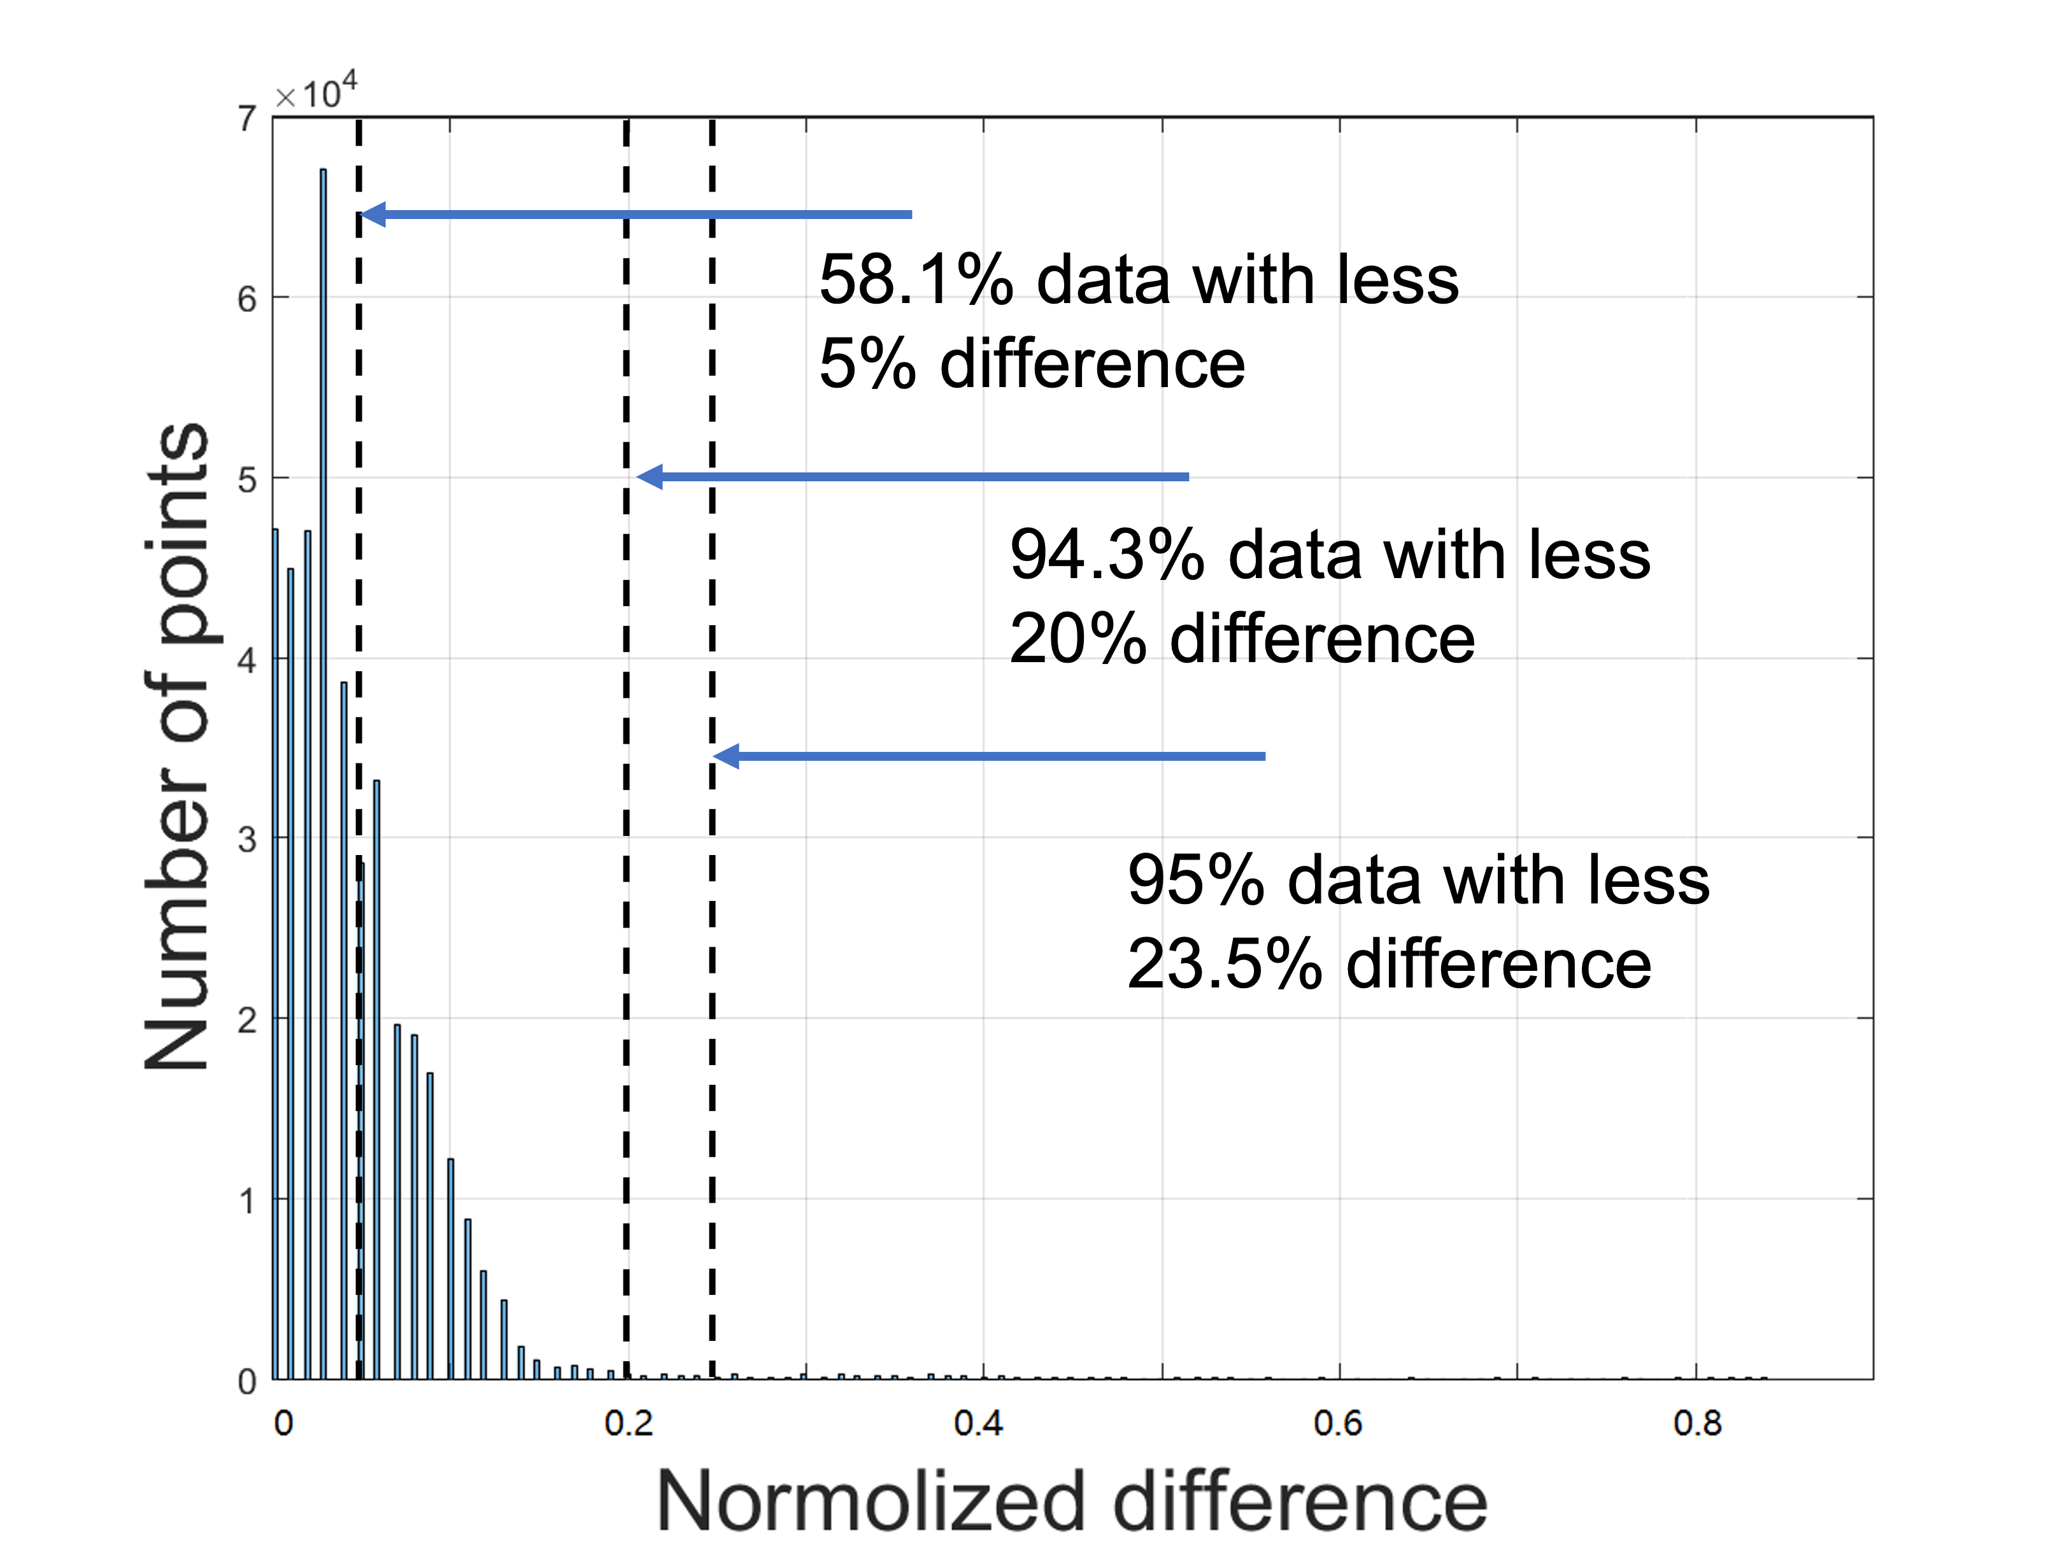
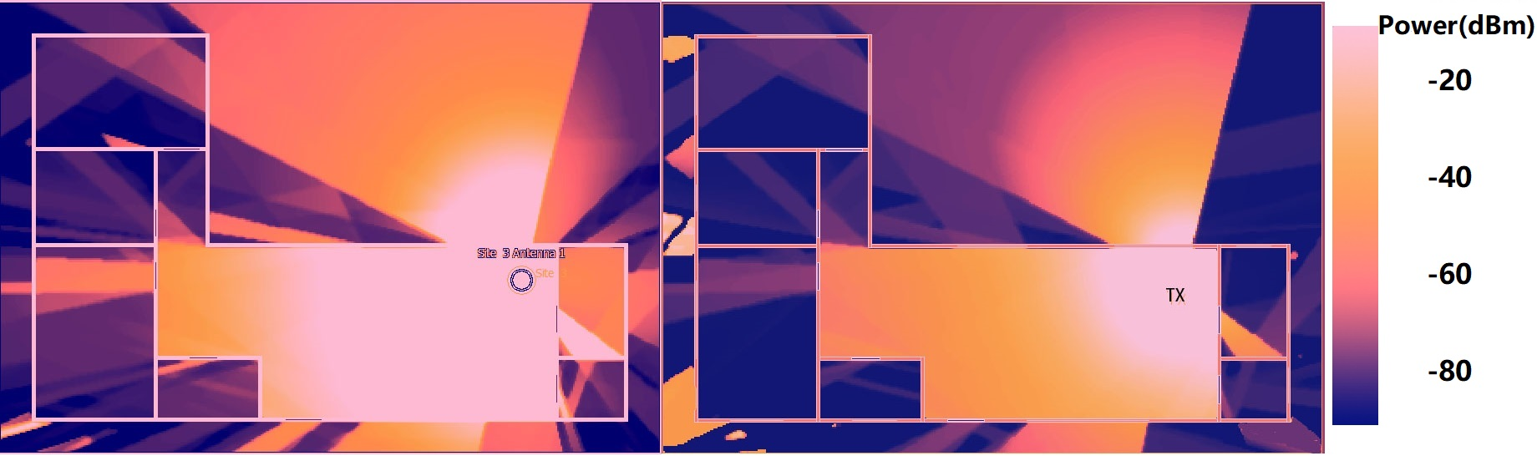
Evaluation details: results comparisons
Indoor: comparison with WinProp
Received power heatmaps by WinProp (left) and DCEM (right) for the indoor environment
Histogram of normalized prediction difference between WinProp and DCEM
Similar accuracy indoor simulations
Notes:
Received power heatmap computed by WinProp (left) using the COST351 model at 30GHz for RT simulation based on balancing the accuracy and running time. The color bar on the right indicates the the strength of received powers. We observe that there are windows or doors in the office, some parts of the rays are limited into a cone shape propagation.
(b) Received power heatmap by DCEM (right), using our model for predictions at 30 GHz. The same environment and material information is considered. We can clearly see the reflection at walls, diffraction at edges, and transmission through windows/walls. Due the differences in two models, we observe some differences between the two heatmaps, while the ray behaviors are similar.
The accuracy comparison is shown by prediction difference histogram.
The normalized difference is calculated by taking the difference between the results from WinProp and DCEM and dividing with the absolute values computed using WinProp. About 58.1% predictions have less 5% difference, and about 94.3% of the data has differences less than 20%.

Slide 26
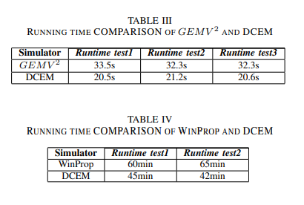
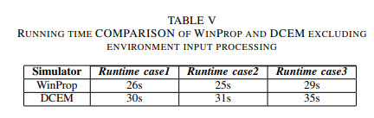
Evaluation details: time comparisons
Comparison with GEMV^2
Comparison with WinProp
Computation time:
36% faster than GEMV^2
30% faster than WinProp
Notes:
Time efficiency is key in dynamic simulations. Our comparisons show that DCEM is 36% faster than GEMV^2 and 30% faster than WinProp, highlighting its efficiency for real-time applications.
(GEMV 2 in MATLAB and DCEM in C++).
Table IV shows the comparison between Winrprop and DCEM with the whole simulation process, including parsing the modeled village file. WinProp takes a longer time.

Slide 27
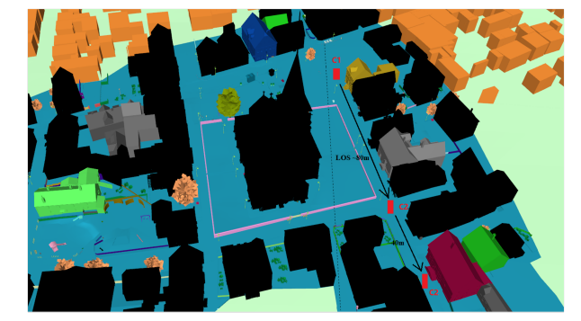
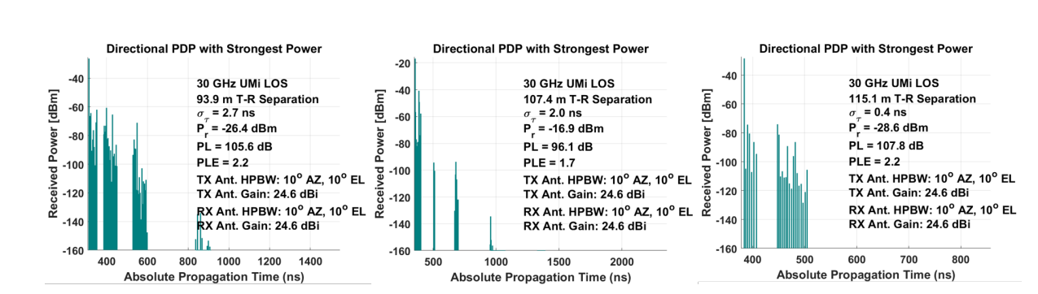
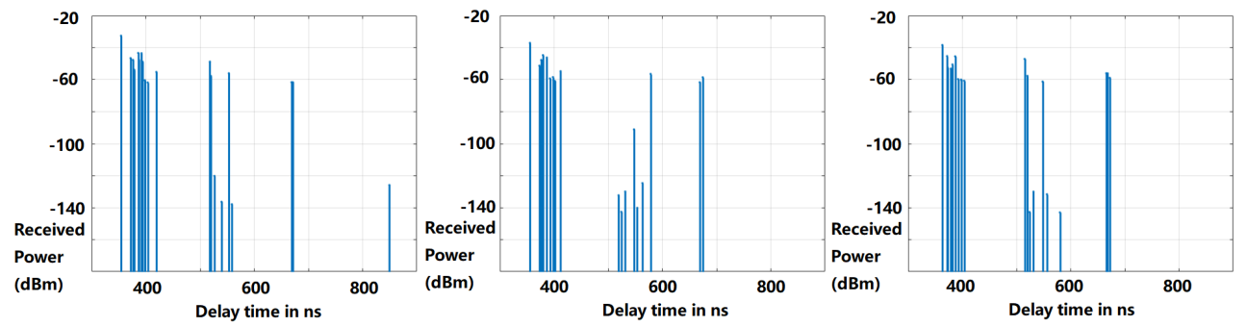
Evaluation details: PDP comparisons
NYUSIM LOS PDP
Compared simulation LOS scene
DCEM LOS PDP
These results showed that the proposed algorithm works well with moving object in urban environment.
Notes:
We compared our Power Delay Profile (PDP) results with NYUSIM in LOS channels, showcasing DCEM's effectiveness in tracking moving vehicles in urban environments and its ability to handle dynamic scenarios
Typical vehicular communication LOS links with extended ranges, approximated distances specified in the figures.
NYUSIM LOS PDP from 93m to 115m, however, since NYUSIM does not take in the environment information, and thus the distance change can not track the moving vehicle.
DCEM LOS PDP from 80m to 100m, we see the decreased direct path received power and longer delay as the car moving away, and the clustering of subpaths changing in a consistent manner.

Slide 28
Summary of DCEM for vehicular environments
DCEM at EM bands for a typical vehicular communication scenario with a dynamic ray tracing algorithm.
Simulation results comparisons with three other well-known RT simulators.
Accuracy maintenance and efficiency boost of RT simulations in vehicular environments.
Notes:
A brief sum of this section, we demonstrated DCEM's application in vehicular environments. We showcased its ability to work in EM bands typical vehicular communication, its efficient simulation capabilities, and its high accuracy and efficiency in these dynamic settings

Slide 29
DCEM for Large Urban Scenes with Multiple Receivers
Notes:
Based on results from vehicular environments, we make one step further for large Urban Scenes with Multiple Receivers.

Slide 30
Motivation
Complexities and challenges of wireless communication in large urban environments, including the presence of multiple structures, diverse materials, and a multitude of signal paths.
Need for advanced simulation techniques to accurately predict signal propagation in these environments, crucial for the development of robust wireless networks.
Notes:
Large urban environments pose significant challenges for wireless communication due to their size and complexity. Our aim is to use advanced simulation techniques for DCEM to accurately predict signal propagation in these environments

Slide 31
Method
Utilize the benefits of DCEM in fast ray tracing simulations
Use channel coherence and spatial consistency for dynamic EM ray tracing
Measuring the Doppler shift effects
Notes:
In these large scenes, we leverage DCEM's fast ray tracing capabilities. We focus on modeling channel coherence and spatial consistency and measure Doppler shift effects to enhance the accuracy of our simulations.

Slide 32
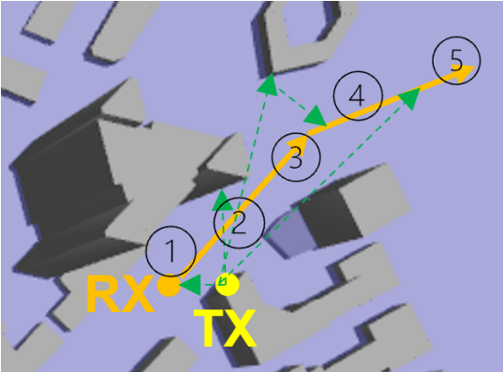
Spatial consistency
Ensure spatial consistency in coherence-based framework
  Calculate the degree of spatial consistency by large-scale parameters and small-scale parameters along the target’s trajectory
    large-scale parameters: distance, channel conditions.
    small-scale parameters: angle of arrivals,
    power, phase, and delay.
  Divide each target’s trajectory into several segments
    Similar channel properties within each segment
    Small changes in BVH, efficient updates
A trajectory is divided into five segments, maintaining spatial consistency
Notes:
spatial consistency: Degree to which the channel characteristics remain consistent over a certain spatial distance.
So, we calculated…
A trajectory used for simulating propagation is divided into five segments based on maintaining spatial consistency. The transmitter is shown in yellow and is at a fixed location. In this case, the moving receiver is along the orange route. The green dashed lines correspond to LoS paths and primary reflection paths, which are used to perform segmentation

Slide 33
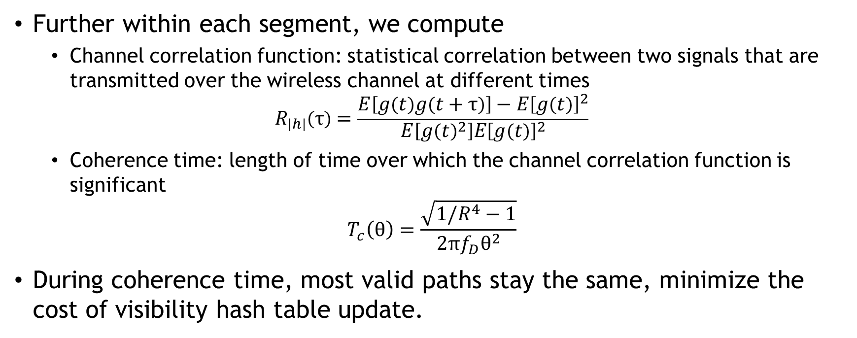
Channel correlation and coherence time
Further within each segment, we compute
  Channel correlation function: statistical correlation between two signals that are transmitted over the wireless channel at different times
$$R_{\left|h\right|}\left(τ\right)=\frac{E\left[g\left(t\right)g\left(t+τ\right)\right]−E{\left[g\left(t\right)\right]}^{2}}{E\left[g{\left(t\right)}^{2}\right]E{\left[g\left(t\right)\right]}^{2}}$$
  Coherence time: length of time over which the channel correlation function is significant
$$T_{c}\left(θ\right)=\frac{\sqrt{1/R^{4}−1}}{2πf_{D}θ^{2}}$$
During coherence time, most valid paths stay the same, minimize the cost of visibility hash table update.
Notes:
We also focus on understanding channel correlation and coherence time, which are key in accelerating simulations in dynamic environments.
where g(t) = |h(t)|, h(t) is the channel coefficient and E denotes the expectation operator.
where R is a predefined threshold value of channel correlation, fD is the maximum Doppler shift frequency, and θ2 can be approximated by the angle of the object’s moving direction and propagation path between transmitter and receiver.
where fc is the central frequency, v is the object’s moving speed, c is the light speed, and θ is the angle between the object’s moving direction and propagation path.

Slide 34
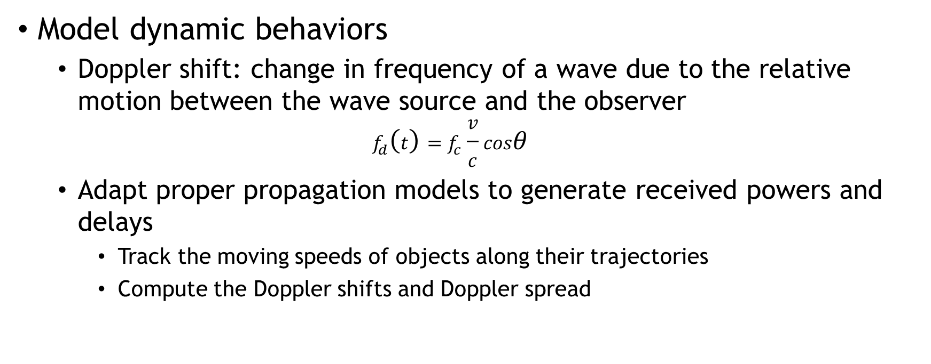
Doppler effects
Model dynamic behaviors
  Doppler shift: change in frequency of a wave due to the relative motion between the wave source and the observer
  $$f_{d}\left(t\right)=f_{c}\frac{v}{c}cosθ$$
  Adapt proper propagation models to generate received powers and delays
    Track the moving speeds of objects along their trajectories
    Compute the Doppler shifts and Doppler spread
Notes:
Our approach includes Doppler effects showing our commitment to comprehensive and accurate modeling.
where fc is the central frequency, v is the object’s moving speed, c is the light speed, and θ is the angle between the object’s moving direction and propagation path.

Slide 35
Main results
With efficient methods to model channel coherence, spatial consistency, and Doppler effects, enables fast dynamic ray tracing simulations with moving objects.
Observe that the running time scales linearly with the area of the scene and the number of receivers, through evaluations of the performance and accuracy of our approach on large dynamic urban environments of size 2 ∗ 2 km^2, where we vary the number of receivers from 1 to 10,000.
Accuracy is comparable to the discrete model simulation results computed using WinProp.
Notes:
Our methods enable fast, dynamic ray tracing simulations with moving objects. We observe that running time scales linearly with the area of the scene and the number of receivers. Our accuracy is comparable to discrete model simulation results computed using WinProp.

Slide 36
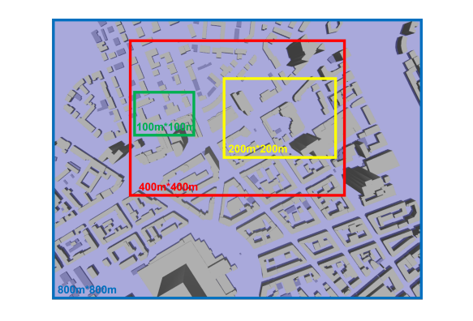
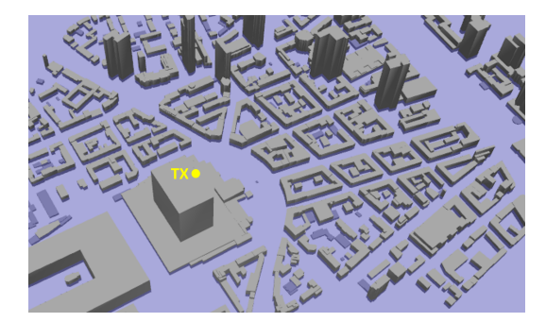
Evaluation details
3D urban city models
A screenshot of the 3D city model
Illustration of simulation environment: varying sizes
Notes:
For validation, we used 3D urban city models and SUMO for trajectory simulation. We illustrated different areas of varying sizes in the modeled environments with a fixed transmitter location and moving receivers with pre-generated trajectories.
A screenshot of the 3D city model: a complex urban scene with many buildings and vehicles.
Illustration of simulation environment: different areas of varying sizes in the modeled environments with a fixed TX location and moving RX with pre-generated trajectories inside.

Slide 37
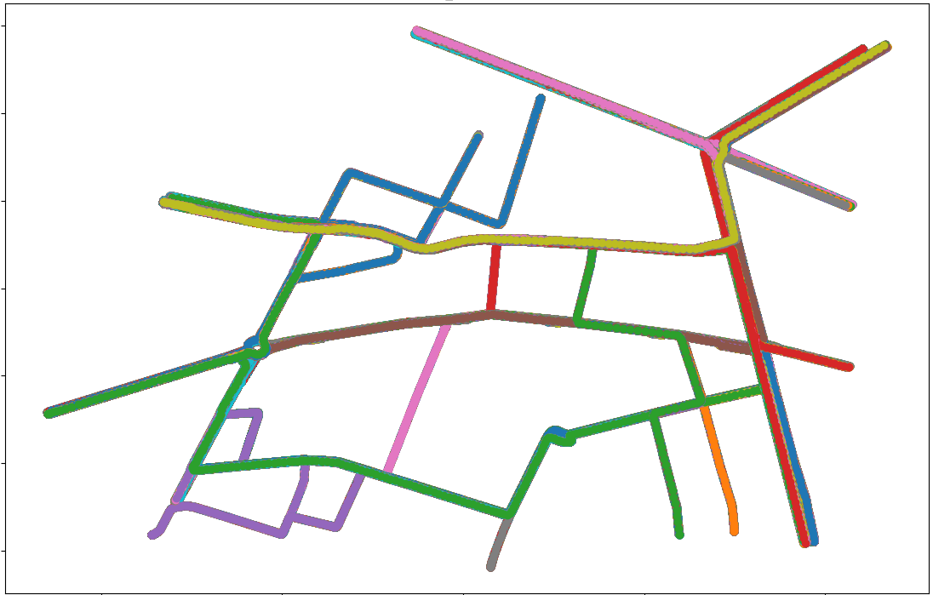
Evaluation details
SUMO for trajectory simulation
SUMO trajectory simulated and visualized in the urban road network
Notes:
SUMO visualization in the urban environment: We export the traffic route information from SUMO and feed it into a dynamic ray tracing simulator. The moving objects, corresponding to yellow cars, are generated in a random and automatic manner. We use the positions of these receivers to compute the signal strength at the corresponding location.

Slide 38
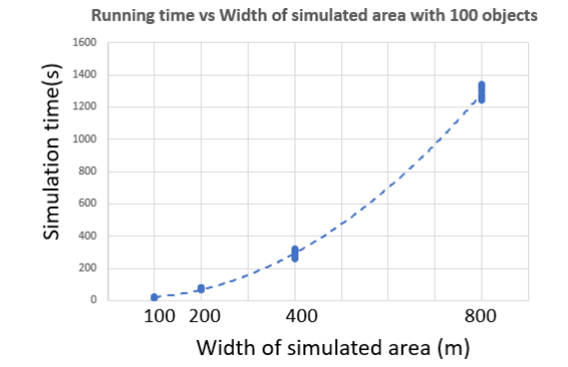
Validation: scalability
Average time of 10 runs with 100 moving objects in different sized areas
Quadratic function of the width and a linear function of the area
Notes:
We evaluated the scalability of our simulator by observing how the simulation time varies with the width of the simulated area and the number of objects. Here, our results indicate a nearly quadratic growth with area widt.
Simulation time vs. width of simulated area with 100 objects: it is observed that, when the area width grows from 100m to 800m, the running time grows from around 20s to 1300s, which is almost a quadratic function of the width and a linear function of the area.
The plot of simulation time vs. width of simulated area with 100 objects. The X-axis represents the width of simulated areas in meters and the Y-axis is the running time in seconds. The simulation areas of different sizes are randomly selected for the position of the objects. The largest area of size 800 ∗ 800m2 is generated and the smaller sized areas are the subsets of the larger areas. We observe that, when the area width grows from 100m to 800m, the running time grows from around 20s to 1300s, which is almost a quadratic function of the width and a linear function of the area.
The plot of simulation time vs. the number of objects. The X-axis represents the number of moving objects in a random 400∗400m2 scene and the Y-axis is the running time in seconds. We chose 10 different regions in the urban environment and compute an average running time over them. It is observed that when the number of moving objects grows from 10 to 10, 000, the running time increases from an average of 270 sec to 600 sec, which is a sub-linear growth. This is due to three factors: (1) the underlying complexity of the modeled 3D environment and our use of a bounding volume hierarchy to accelerate ray tracing computations; (2) the moving objects being modeled as a standard-size box of metal, and our use of a fixed representation for each such object.; (3) the use of acceleration methods such as spatial consistency, coherence time, and coherence-based ray tracing, which significantly reduce the computation complexity.

Slide 39
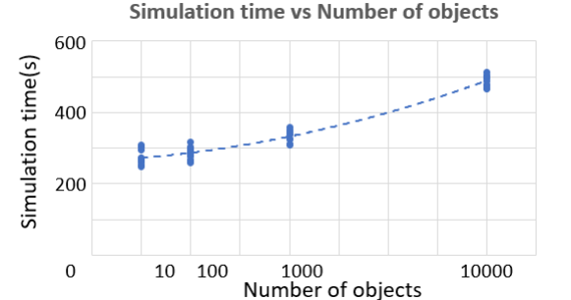
Validation: scalability
Average running time of 10 different regions with same size 400*400 m^2, but different numbers of moving objects
Sub-linear growth with the number of moving objects.
Notes:
Our results indicate a sub-linear growth with the number of moving objects.
The plot of simulation time vs. the number of objects. The X-axis represents the number of moving objects in a random 400∗400m2 scene and the Y-axis is the running time in seconds. We chose 10 different regions in the urban environment and compute an average running time over them. It is observed that when the number of moving objects grows from 10 to 10, 000, the running time increases from an average of 270 sec to 600 sec, which is a sub-linear growth. This is due to three factors: (1) the underlying complexity of the modeled 3D environment and our use of a bounding volume hierarchy to accelerate ray tracing computations; (2) the moving objects being modeled as a standard-size box of metal, and our use of a fixed representation for each such object.; (3) the use of acceleration methods such as spatial consistency, coherence time, and coherence-based ray tracing, which significantly reduce the computation complexity.

Slide 40
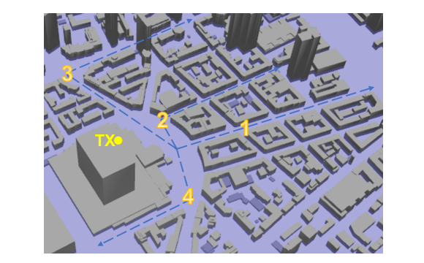
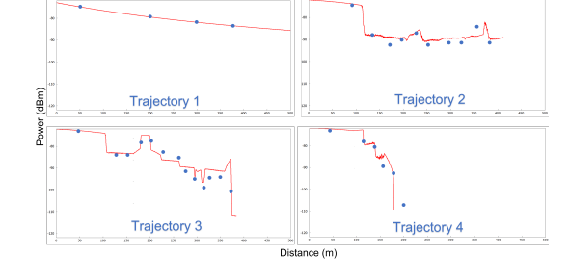
Validation: accuracy
Predicted power at different locations of a given moving object.
Four trajectories
Accuracy Comparisons with WinProp
Accuracy of our dynamic simulator aligns well along all trajectories
Notes:
We assessed the accuracy of our simulator by comparing the predicted power at different locations of a given moving object with WinProp predictions for static scenes.
The trajectories simulated used in our dynamic ray tracing algorithm as well as WinProp in complex urban scenes.
Accuracy Comparisons with WinProp: These plots highlight the received power using our simulator along four routes highlighted in Fig. 8. The plots generated using our dynamic simulator are shown in red, while the static simulations generated using a given configuration of the obstacles and receivers are generated using WinProp are shown with blue dots. This comparison shows that the accuracy of our dynamic simulator aligns well with those computed using WinProp for different trajectories. We see a very high match in Trajectory 1, which corresponds to most LOS computations. We see small differences as we model higher-order reflections and Doppler effects in our formulation.
Static simulation (left) and dynamic results (right). It is observed that the LoS channels (indicated in blue circles) are mostly the same in both simulations, while more variations can be seen around obstacles in dynamic simulations (indicated in yellow circles). This is because when the transmitter (at the same location as in Fig 8, not included in this small area) illuminates the buildings/obstacles from the top, the shadow area caused by building blockages could be characterized into several states, where we apply different propagation models to each state, leading to a clear boundary
between different states.

Slide 41
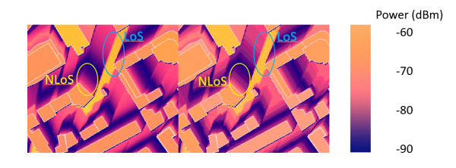
Validation: accuracy
Heatmap catch of Static simulation (left) and dynamic results (right)
Accuracy of our dynamic simulator heatmap similar to WinProp results
Notes:
Static simulation (left) and dynamic results (right). It is observed that the LoS channels (indicated in blue circles) are mostly the same in both simulations, while more variations can be seen around obstacles in dynamic simulations (indicated in yellow circles). This is because when the transmitter (at the same location as in Fig 8, not included in this small area) illuminates the buildings/obstacles from the top, the shadow area caused by building blockages could be characterized into several states, where we apply different propagation models to each state, leading to a clear boundary
between different states.

Slide 42
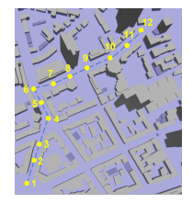
Validation: accuracy along a path
Select a moving path containing different channel conditions
The simulation path involves dynamic channel changes along the path
Notes:
This better illustrates the moving object in a city environment.
The indices beside each small heatmap correspond to the numbered positions The channel conditions change from LoS (1-4) to mixed (5-9) and mostly NLoS (10-12).

Slide 43
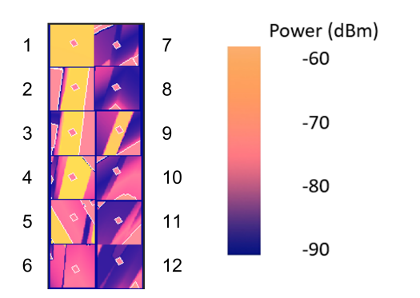
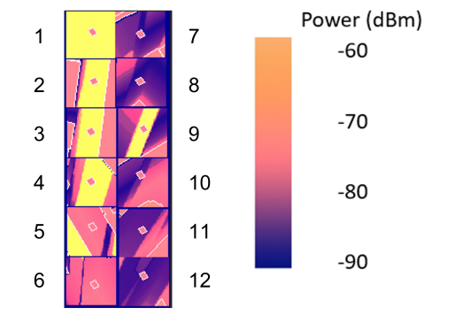
Validation: accuracy along a path
A series of heatmap comparisons along a moving path between static and dynamic simulations from WinProp and DCEM.
Well matched results under various channel conditions
Static results from WinProp
Dynamic results from DCEM
Notes:
Static results from WinProp: We observe the surroundings and power changes at different locations.
Dynamic results from DCEM: Some differences are observed in the heatmaps of positions after 8. Considering their locations, these might be the shadow areas created by building blockages, where different propagation models are applied to each state, leading to clearer boundaries.

Slide 44
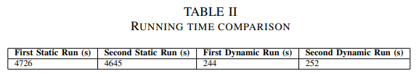
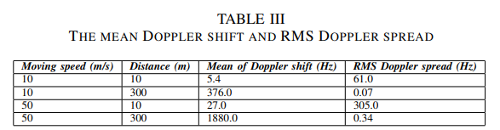
Validation: running time and Doppler shift
The static algorithm runs 40 times to cover the trajectory 2, while the dynamic algorithm is executed just 1 once
Doppler Shift and Doppler Spread at different moving speeds of the objects at 30GHz bands
Notes:
We compared the running times of static and dynamic algorithms and evaluated the Doppler shift and spread at different moving speeds of the objects at 30GHz bands, demonstrating the efficiency and accuracy of our dynamic simulations.
The static algorithm runs 40 times to cover the route while the dynamic algorithm runs just 1 time.
It can be observed that the Doppler shift is low when the LoS path is perpendicular to the moving direction and high when the distance is large. The RMS Doppler spread is associated with the angular spread.

Slide 45
Summary of DCEM for Large Urban Scenes with Multiple Receivers
A fast method for EM ray tracing in dynamic scenes with many receivers.
A coherence-based ray tracer and models spatial consistency, channel correlation, and Doppler effects for large dynamic scenes.
Accuracy evaluation on large urban scenarios and show its scalability with the area of the scene and the number of obstacles.
Notes:
In summary, we've shown that DCEM is a fast method for EM ray tracing in dynamic scenes with many receivers. It models spatial consistency, channel correlation, and Doppler effects, offering scalable and accurate simulations for large urban environments

Slide 46
DCEM for Complex Indoor Scenes with Smooth Surface Diffraction Effects
Notes:
Now we move from outdoor to indoor simulations.

Slide 47
Motivation
Increasing need for advanced simulation tools due to the growing complexity of indoor wireless systems.
Traditional methods, primarily using line-of-sight models, are insufficient for modern requirements that demand the inclusion of multipath bounces and diffraction.
Limitations of ray optical techniques in capturing diffraction effects necessitate more sophisticated approaches like the Uniform Geometrical Theory of Diffraction (UTD).
Notes:
The increasing complexity of indoor wireless systems demands advanced simulation tools. Traditional methods using Shooting and Bouncing RT fall short for modern requirements, prompting us to incorporate diffraction effects more comprehensively.

Slide 48
Method
Augmenting DCEM with UTD to model smooth surface diffraction, previously limited mostly to edge diffraction in indoor simulations.
Modifications to DCEM focus on predicting accurate signal behavior in shadow regions by accounting for the effects of convex surfaces.
Notes:
We've augmented DCEM with the Uniform Geometrical Theory of Diffraction (UTD) to model smooth surface diffraction, previously limited mostly to edge diffraction in indoor simulations. This modification focuses on predicting accurate signal behavior in shadow regions.
Path caching also helps accelerate the simulation process by restoring diffraction paths and reusing them for calculating other diffracted ray paths in the local area (adjacent frames).
For this work, we did not perform dynamic simulations, but we kept the potential for efficient BVH updating in dynamic scenes for future exploration

Slide 49
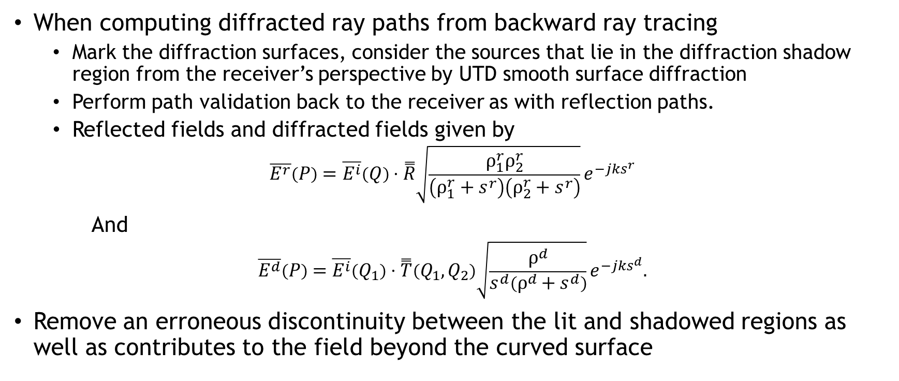
Uniform Geometry Theory of Diffraction (UTD) for smooth surfaces
When computing diffracted ray paths from backward ray tracing
  Mark the diffraction surfaces, consider the sources that lie in the diffraction shadow region from the receiver’s perspective by UTD smooth surface diffraction
  Perform path validation back to the receiver as with reflection paths.
  Reflected fields and diffracted fields given by
$$\overline{E^{r}}\left(P\right)=\overline{E^{i}}\left(Q\right)⋅\overset{̿}{R}\sqrt{\frac{ρ_{1}^{r}ρ_{2}^{r}}{\left(ρ_{1}^{r}+s^{r}\right)\left(ρ_{2}^{r}+s^{r}\right)}}e^{−jks^{r}}$$
And
$$\overline{E^{d}}\left(P\right)=\overline{E^{i}}\left(Q_{1}\right)⋅\overset{̿}{T}\left(Q_{1},Q_{2}\right)\sqrt{\frac{ρ^{d}}{s^{d}\left(ρ^{d}+s^{d}\right)}}e^{−jks^{d}}.$$
Remove an erroneous discontinuity between the lit and shadowed regions as well as contributes to the field beyond the curved surface
Notes:
the Uniform Geometry Theory of Diffraction for smooth surfaces, which marks an advancement in modeling diffraction effects in shadow regions and around shadow boundaries, also enhance the system with the capability of better simulating of objects with smooth/round surfaces.
The ρ terms account for the surface curvature while s represents the distance from a scattering point Q on the surface and the receiver. R ¯¯ is the UTD reflection coefficient accounting for both parallel and perpendicularly polarized field components. T¯¯ is a transfer function that describes the amplitude and phase variation of the ray along geodesic paths from Q1 to Q2 as well as the diffraction at a surface point Q2.

Slide 50
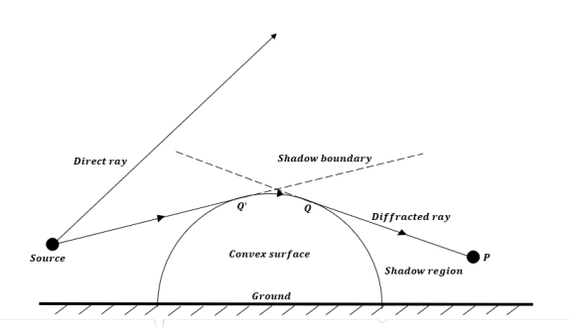
Diffracted ray path in our approach
Diffracted ray path geometry illustration for scattering from a convex surface
Notes:
we show a diffracted ray path geometry, particularly how rays interact with convex surfaces and traverse beyond shadow boundaries
some rays cast from the original source reach the convex surface and travel on the surface to further go beyond shadow boundaries.

Slide 51
Main results
Predictions in and at shadow boundaries improvements, comparing to both DCEM before augmentation and WinProp.
Significant running time boost comparing to WinProp under certain settings, about 60%.
Notes:
We've achieved significant advancements in predictions at shadow boundaries, surpassing the performance of both DCEM before augmentation and WinProp. Additionally, we've managed a remarkable 60% reduction in running time compared to WinProp under certain settings.

Slide 52
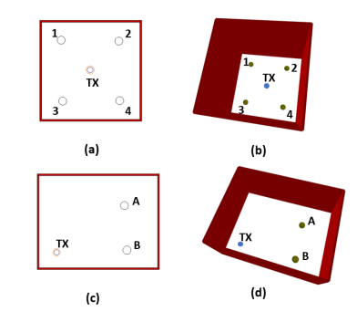
Evaluation: geometry
Comparison indoor environments
Comparison indoor environments: two scenarios, 2d and 3d views
Notes:
In our evaluation setups, we modeled indoor environments. Two scenarios: In the first, the transmitter is centrally located, surrounded by metal balls. In the second scenario, we placed the transmitter in a specific corner, using metal balls to simulate different positions. On the right illustration we show a typical diffracted ray path geometry, particularly how rays interact with convex surfaces and traverse beyond shadow boundaries
In (a), the transmitter is at the bottom left corner and the circles on the right represent metal ball positions. In (b), the positions of transmitters and spheres are displayed. In (c), the transmitter is at the center of the room and the four circles around the transmitter represent metal ball positions. In (d), the positions of transmitters and spheres are displayed. The simulated room has a floor and ceiling that was not shown in the screenshot for better illustration purposes.

Slide 53
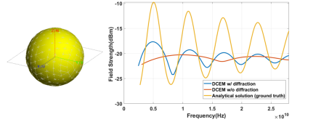
Evaluation: theoretical foundation
Validation results of sphere geometry from Analytical and DCEM solutions
Left: a perfect sphere conductor with a radius of 2 cm
Right: Field strength for the sphere
Notes:
Our theoretical foundation evaluation involved comparing results from Analytical, FEKO, and DCEM solutions. We used two models: a perfect sphere conductor and a teacup-shaped conductor. Right: Field strength for the sphere: the yellow line represents the analytical solution as ground truth, the red line comes from the simulation of DCEM w/o smooth surface diffraction, and the blue line from the simulation of DCEM w/ smooth surface diffraction.
We see significant improvements by introducing smooth surface diffractions to reproduce the response periodicity. However, the amplitudes of peaks still show clear differences which partially result from the proximity of the smooth surface diffraction methods, but they might be aligned better in future improvements by appropriate parameter tweaks.

Slide 54
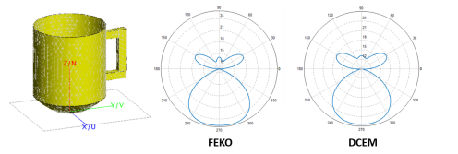
Evaluation: theoretical foundation
Validation results of teacup shaped geometry from FEKO and DCEM solutions
Left: a teacup shaped perfect conductor model with 12.5 cm height and radius of 5 cm.
Middle: polar plot from FEKO.
Right: polar plot from our DCEM-based method.
Demonstrates the effectiveness of DCEM-based method, even with complex shapes
Notes:
Our findings show that while there are minor differences in the upper part of the teacup model, likely due to the handle, the overall field characteristics are accurately captured. This demonstrates the effectiveness of our DCEM-based method, even with complex shapes
Right: polar plot from our DCEM-based method. We observe that the lower part has almost the same results as representing the teacup’s cup part, while some minor differences in the upper part come from the handle part. However, it’s clear that the field characteristics are perfectly identified, and the minor differences might result from simulation precision settings.

Slide 55
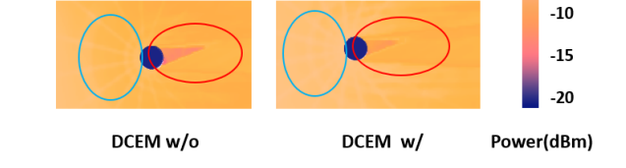
Evaluation: improvements in DCEM with smooth surface diffraction
Heatmap comparison of DCEM without smooth surface diffraction (left) vs. DCEM with smooth surface diffraction (right)
Notes:
This slide highlights the improvements we've achieved with the integration of smooth surface diffraction in DCEM. Through heatmap comparisons, we've observed consistent reflected rays and significant differences in shadow regions. This indicates a marked improvement in field strength at these critical areas.

Slide 56
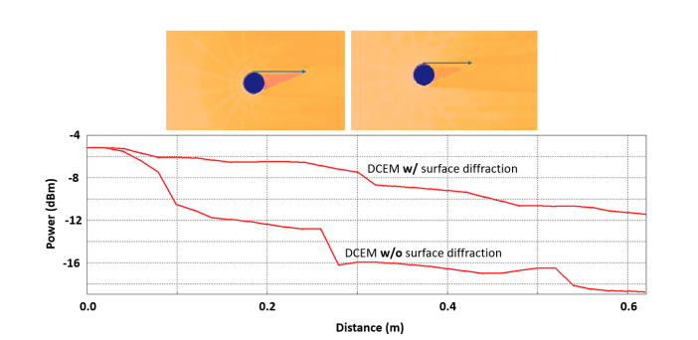
Evaluation: improvements in DCEM with smooth surface diffraction
Received power comparison of DCEM without smooth surface diffraction vs. DCEM with smooth surface diffraction
A marked improvement in field strength in shadow regions
Along a boundary path into a shadow region
Notes:
The received power comparison further supports this, showing a 5dB difference along a specific path, underscoring the impact of smooth surface diffractions

Slide 57
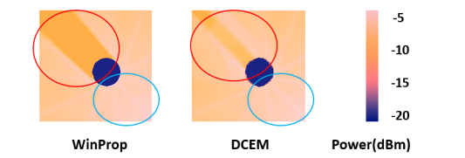
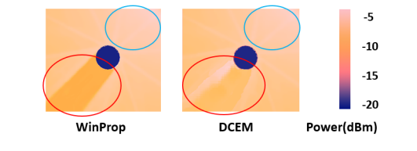
Evaluation: results comparison between WinProp and DCEM
Heatmap comparison of WinProp (left) vs. DCEM (right)
Notes:
We compared the two set of results of WinProp and DCEM. The heatmap

Slide 58
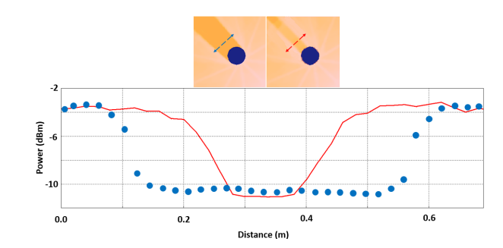
Evaluation: results comparison between WinProp and DCEM
Received power comparison along a line across the shadow region bonds in WinProp (the left), and DCEM (the right)
Thinner shadow regions,
stronger field
Strengths
Received power comparison
Notes:
The received power analysis along specific paths reveal distinct advantages of DCEM. Notably, the shadow regions in DCEM are thinner and demonstrate a stronger field, pointing to a more precise simulation capability
We see the width of the shadow region in WinProp simulations (blue dots) is approximately 0.4m (bottom to bottom) while that of the DCEM results (red lines) is around 0.1m. This is expected because the smooth surface diffraction enables more illuminated areas around the original shadow boundary regions, decaying fast after a wavelength (0.15m in our settings). In addition, we see the powers at the diffraction point and outside of the region align well (shown as the powers at the two sides of this plot). This also means that the surface diffraction shall not distort other propagation path simulations.

Slide 59

Evaluation: running time of WinProp and DCEM
Running time recorded in three test runs under the same setups
Computation time: 60% faster than WinProp
Notes:
This slide focuses on the running times of WinProp and DCEM. [Refer to specific data]. In our 3 test runs under identical setups, DCEM consistently showed superior performance in terms of speed, emphasizing its efficiency in practical applications.
discrepancy could be explained by redundant rays tracing repeated paths resulting in a longer running time.

Slide 60
Summary of DCEM for Complex Indoor Scenes with Smooth Surface Diffraction Effects
The augmented DCEM includes smooth surface diffraction effects, providing a more comprehensive tool for indoor wireless system design and testing.
Rigorous validations against analytical solutions and commercial tools highlights marked improvements in accuracy, performance, runtime, and efficiency.
Notes:
In sum, We've made significant advancements with the augmented DCEM, which now includes smooth surface diffraction effects. This enhancement not only provides a more comprehensive tool for indoor wireless system design but also ensures marked improvements in accuracy, performance, runtime, and efficiency, as validated against analytical solutions and commercial tools

Slide 61
ML-based DCEM Acceleration
Notes:
Finally, let's talk about the ML-based DCEM acceleration.

Slide 62
Motivation
Need for faster and more efficient simulation processes without compromising accuracy.
Integrating ML with traditional EM ray tracing techniques has achieved remarkable results in certain applications [Huang et al. 2021, Yin et al. 2022].
Generative Adversarial Networks (GAN) approach [Ian et al. 2014]:
  High-quality synthetic data generation
  Efficiency in prediction
  Accuracy close to ray tracing simulations
  Overcoming limitations of other ML methods
Notes:
The first motivation of this work is that Along with network growth, there is need for faster or real-time simulations,
Secondly, we have seen remarkable results has been achieved in certain applications: under water simulations, robot navigation,
Thridly, we find The Generative Adversarial Networks (for short GAN) benefits highlight below
• High-Quality Synthetic Data Generation: cGANs are adept at generating synthetic data that closely mirrors the distribution of real data, an essential capability for accurately predicting heatmaps from limited real-world data.
• Efficiency in Prediction: The GAN-based method can produce heat maps for an entire target area in a single inference step, offering a significant efficiency advantage over traditional, computation-intensive methods.
• Accuracy Close to Ray Tracing Simulations: cGANs have the potential to achieve accuracy levels comparable to those of traditional ray tracing simulations by learning to capture the complex variability of path loss across different environments.
• Overcoming Limitations of Other ML Methods: Unlike traditional machine learning methods, cGANs are specifically designed for data generation tasks, making them particularly well-suited for creating heat maps based on complex indoor environment inputs.

Slide 63


GAN workflow
Conditional Generative Adversarial Networks (cGANs):
  Equation: $P_{r}=f_{cGAN}\left(E_{g},L_{tx},z\right)$
    $P_{r}$: received power
    $f_{cGAN}$: GAN function
    $E_{g}$: encoded geometry info
    $L_{tx}$: location of the transmitter
    $z$: noise vector
  Flowchart
Notes:
Conditional Generative Adversarial Networks (cGANs) are an extension of the original Generative Adversarial Networks (GANs), designed to generate data with specific conditions or attributes. A GAN typically consists of two neural networks: a generator that creates samples aiming to mimic the distribution of real data, and a discriminator that tries to differentiate between the generator's fake data and real data from a dataset. The two networks are trained simultaneously in a game-like scenario where the generator tries to fool the discriminator, and the discriminator tries to accurately identify real vs. generated data. Objective function and flowchart is shown.
By conditioning the model on this additional information, cGANs can generate data that is more targeted and relevant to specific applications or requirements.

Slide 64
Method
Prepare training/testing data from DCEM simulations.
Build and train cGAN to generate and distinguish EM heatmaps, ideally, the training process reaches an equilibrium where the generator produces data indistinguishable from real data, and the discriminator guesses at chance level (50% accuracy).
Fuse GAN results with DCEM and optimized against WinProp simulations.
Evaluate against testing data and compute MSE and time for DCEM-GAN, GAN-based predictions, comparing to traditional RT simulations.
Notes:
Here we mention the approach we took, from data preparation, to evaluation analysis. In the end, we will have two different methods, GAN-based predictions, and DCEM-GAN predictions. Details are discussed in the next few minutes.

Slide 65

Data preparation
Generate 2000 indoor scenes through WinProp
~64 million received power points simulated through DCEM
Divided based on 80/20 split into training and testing set
Sample 3D renderings of indoor environments
Notes:
We randomly generated over 2000 indoor scenes with over 64 million simulated received power points to ensure the diversity and richness of the dataset, preparing it for effective ML training. The dataset is parsed into training and testing datasets based on 80/20 split.
Sample 3D renderings of indoor environments used for simulation:
Single-room setup with minimal furniture.
Multi-room configuration with complex wall structures.
Multi-room layout with varied dimensions and partitions.
The red materials represent concert walls, the blue represents glass, and the yellow represents wooden doors

Slide 66

Methodology: overview of GAN
Implementation details
  Data preparation
  Generator
  Discriminator
  Feedback/update
  Testing/verification
  Fusion with DCEM for DCEM-GAN
Notes:
Here we show a more detailed flowchart of the GAN training process and implementation details. After data preparation, we encode geometry info along with transmitter location and a noise vector to feed into the generator networks.
The generator employs a series of convolutional neural network (CNN) layers, designed to capture the intricate spatial relationships within the indoor environments. Special attention is given to geometry information, allowing the model to understand how different materials and layouts affect signal propagation.
The discriminator is also based on CNNs, with the addition of condition layers that incorporate geometry information. This setup ensures that the discrimination process considers not just the realism of the heatmaps but also their consistency with the input geometry.
Loss function as binary cross entropy, The losses are backpropagated through the respective networks to compute the gradient of the loss with respect to the network weights. Gradient descent optimization algorithms such as is used to adjust the weights of the generator and discriminator in the direction that will reduce their respective losses.
The discriminator's loss is calculated by summing up the loss from real maps and the loss from fake maps generated by the generator. For real maps, the loss measures how well the discriminator recognizes them as real. For fake maps, the loss measures how well the discriminator recognizes them as fake.
The generator's loss measures how well it tricks the discriminator. It is computed by using the discriminator's predictions on fake maps and calculating the loss when these fake maps are labeled as real
trained in a min-max game where the generator tries to maximize the loss of the discriminator by generating realistic images, while the discriminator tries to minimize its own loss.

Slide 67

Two methods: GAN-based and DCEM-GAN
Notes:
Here we have a flowchart to show how we define and form the two prediction methods, namely, GAN-based predictions and DCEM-GAN predictions.

Slide 68

Two methods:
GAN-based and DCEM-GAN
After training GAN and verification against testing data, we define current results as GAN-based predictions.
Combining the outputs of DCEM and GAN-based, assigning weights that reflect the confidence of each method for different areas of the simulation space, to get DCEM-GAN predictions:
$$P_{DCEM−ML}=w_{RT}∙P_{RT}+w_{ML}∙P_{ML}$$
The fusion weights are solved as an optimization problem that minimizes the overall error with respect to a set of ground truth data from WinProp.
Notes:
More detailed descriptions of the two methods are shown here

Slide 69
Challenges and solutions
Data adequacy and quality: geometry and power prediction data from WinProp and DCEM simulator
Hyperparameter tuning: start learning from simple models
  Typical hyperparameters: learning rate, batch size, latent space dimensions, etc.
Mode collapse: introduce the noise vector
  Noise vector is a source of randomness, ensuring the generator can produce a diverse set of outputs
  However, finding the right distribution (uniform, Gaussian, etc.) and dimensionality for the noise vector can require a lot of experiment
Notes:
Here we discuss some challenges we encountered during GAN training:
Indoor wireless systems are complex, so our GAN needs a lot of good training data to really understand how different environments affect signal movement. We use data on shapes and signal predictions from two tools, WinProp and the DCEM simulator. This way, we make sure we have enough variety and quality in our data to cover many different situations well
2. CGANs are difficult to train, often sensitive to the choice of hyperparameters, They often need a lot of trial and error to adjust properly. In our work, we start simple, training the CGAN with basic versions of the environment. Then, we gradually make the scenarios more complex. This step-by-step approach helps the CGAN grasp the basics before moving on to tougher situations. By slowly ramping up the difficulty, we manage to keep the model stable and avoid convergence issues, leading to a reliable simulation that closely mirrors of EM ray tracing
3. Another common issue with GANs is where the generator starts producing a limited range of outputs, which in the case of EM ray tracing could lead to underrepresentation of the solution space. In our work, we introduce the noise vector to break the symmetry in the model weights, ensuring that different units learn different features. By introducing variability through noise, the generator is encouraged to learn general patterns rather than memorizing specific training examples, avoiding overfitting issues.
Learning Rate: It determines the step size at each iteration while moving toward a minimum of the loss function. For GANs, sometimes different learning rates are used for the generator and the discriminator.
Batch Size: This is the number of training examples utilized in one iteration. The batch size can affect the stability and performance of the training process.
Latent Space Dimension: This refers to the size of the random noise vector fed into the generator. The dimensionality can impact the diversity and quality of the generated data.
Beta1 and Beta2 in Adam Optimizer: These are hyperparameters of the Adam optimizer that control the decay rates of the moving averages of the gradient and its square, affecting the training stability and speed.

Slide 70
Main results
Accuracy enhancement: the integration of cGAN leads to more accurate predictions of received power distributions across indoor spaces, as evidenced by lower Mean Squared Error (MSE) values when compared to standard simulations.
Efficiency improvement: leveraging ML for simulations drastically reduced computational time, achieving a 5X speedup compared to benchmark simulations.
Notes:
Leveraging ML for RT has leads to accuracy enhancements in terms of MSE and efficiency improvements in terms of computation time. Further details are shown in the following slides.

Slide 71


Evaluation: accuracy enhancement
Comparative heatmaps displaying received powers in indoor environments
WinProp results
DCEM-GAN results
DCEM results
Notes:
we show evaluations of our ML approach. The heatmaps of DCEM-ML exhibit more pronounced areas of both high and low signal strength comparing to DCEM results, closer to the industrial benchmark results (WinProp)
received powers in indoor environments of size 5*5 (left) and 12*12 (right)

Slide 72

Evaluation: accuracy enhancement
MSE of DCEM-GAN and DCEM comparing to WinProp in different testing scenes
Improved accuracy in various layouts, lower MSE ~2.5dBm^2
Notes:
In this page, we show the MSE comparison table of DCEM-GAN and DCEM comparing to WinProp. With DCEM-GAN approach, the results have less MSE in general

Slide 73

Evaluation: accuracy enhancement
Histogram distribution comparison (scene 3) of the normalized difference
Left Histogram: DCEM-GAN vs WinProp results
Right Histogram: DCEM vs WinProp results
Tighter distribution in the left graph, suggesting a closer match to WinProp and higher accuracy
Notes:
Here we compare the histogram comparison of the normalized difference distribution.
Left Histogram: Distribution of the normalized differences in received power levels between the DCEM-ML and WinProp results for Scene 3. The vertical lines represent the 50th (median), 70th, and 90th percentiles, indicating a central tendency and spread of the differences.
Right Histogram: Distribution of the normalized differences in received power levels between the DCEM and WinProp

Slide 74

Evaluation: efficiency improvement
The efficiency of using ML models alone for quick simulations, the computation time was measured and compared between the GAN-based method and the traditional RT approach.
5X speedup comparing to traditional RT simulations
Notes:
To show the efficiency improvement, we compare the computation time between the GAN-based method and the traditional RT approach. 5X speedup

Slide 75


Evaluation: efficiency improvement
Performance preserved shown in heatmap comparisons
First row: DCEM-GAN
Second row: DCEM
Third row: GAN-based
(4c)
(5c)
(6c)
Notes:
In this page, we show that under 5X speedup, the GAN-Based predictions perverse accuracy levels in various layouts.
The DCEM-GAN simulations show a more balanced distribution of power levels, suggesting enhancement of the accuracy of DCEM with the detailed learning capacity of ML and offering improved fidelity. The GAN-Based predictions exhibit more variations and potentially overstate certain features such as shadowing and bright spots, which may be due to the ML model learning complex patterns in the data. Room sizes larger in general to the left scenes.

Slide 76

Evaluation: efficiency improvement
MSE of GAN-based and DCEM comparing to DCEM-GAN in different testing scenes
Preserved accuracy in various layouts for GAN-based simulations, difference in MSE ~1 dBm^2
Notes:
Here, we show the table of MSEs of GAN-based and DCEM comparing to DCEM-GAN. We see preserved accuracy under different testing scenes, as MSE difference less than 1dBm^2.

Slide 77
Summary of ML-based DCEM acceleration
A novel ML-based RT approach to enhance the accuracy and efficiency of simulating wireless communication within 3D indoor environments.
GAN-based method for simulations remarkably reduced computation time, offering a fast alternative for real-time analysis, albeit with a trade-off in accuracy.
Groundwork for future enhancement of RT simulation in dynamic environments with real-time capability.
Notes:
A brief sum of ML-based DCEM acceleration: A novel ML-based RT approach to enhance the accuracy and efficiency of simulating wireless communication within 3D indoor environments, demonstrating significant improvements in simulation accuracy, as indicated by lower MSE values comparing to traditional RT simulations.

Slide 78
Conclusion
Notes:
Here comes the conclusion section with summary and future work directions.

Slide 79
Contributions
We propose the first dynamic coherence-based ray tracing algorithm to enhance the efficiency of EM simulations for dynamic environments. The algorithm shows a significant reduction in computation time by 36% compared to GEMV^2 and 30% compared to WinProp while maintaining prediction accuracy.
We extend DCEM by introducing an enhanced dynamic EM ray tracing algorithm by incorporating channel coherence and spatial consistency, leading to scalable and more accurate simulations across complex cityscapes.
We augment DCEM with smooth surface diffraction effects, demonstrating a 60% faster computation time than WinProp and better capturing the nuances of indoor environments, especially in shadow regions.

Slide 80
Contributions
We conduct extensive validation of our simulation results against large dynamic urban areas and complex indoor settings, comparing them with analytical benchmarks and established simulation tools.
We combine ML techniques, specifically a modified cGAN, with our DCEM framework, improving simulation accuracy (lower MSE) and efficiency (5X speedup) for 3D indoor environments.

Slide 81
Limitations and future work
Real-time simulation capabilities
  Value of Information (VoI) [M. Giordani et al. 2019]
  Data-Driven Network Simulation [Benjamin et al. 2019]
  Beamforming [Degli-Esposti et al. 2014]
Material property variations
  More data from experiments [Rappaport et al. 2017]
  Specific settings for different applications [Philipp et al. 2017]
Validation against measured data [Huangfu et al. 2022]
Notes:
In the last part, We discuss the limitations of our work and survey recent efforts for potential future work directions.
Real-time Simulation Capabilities: DCEM has improved computation speeds significantly, yet optimizing for real-time simulations in dynamic wireless communication environments is an ongoing challenge and development area.
Material Property Variations: Current simulations primarily focus on materials like concrete, wood, and metal; diversifying material range in simulations to reflect real-world environments more accurately depends on acquiring detailed measurement data.
Validation Against Measured Data: There's a need for validating our simulation enhancements against real-world data to ensure model applicability and identify areas for refinement.

Slide 82
Limitations and future work
Adapting to dynamic environments
  Learning-based trajectory generation methods [Liang et al. 2019]
Scalability for large and intricate environments
  Software-defined networking, time-sensitive networking [Ousmane et al. 2020]
Advancements of emerging wireless technologies [Jhihoon et al. 2021]
Generalization across varied environments
  Assessing the impact of realistic simulation environments [Z. H. Mir et al. 2018]
  Comprehensive machine learning approaches [Fengxiao et al. 2021]
Notes:
Adapting to Dynamic Environments: Incorporating UTD and ML has improved simulation capabilities, but accurately modeling the dynamic nature of indoor environments requires more adaptable methods.
Scalability for Large and Intricate Environments: Addressing scalability for simulations in larger and more complex environments is crucial, necessitating methodological advancements for efficiency without losing computational effectiveness.
Advancements of Emerging Wireless Technologies: Integrating simulation tools with emerging technologies like 6G presents new challenges due to higher frequencies and complex propagation scenarios, requiring further adaptation of simulation approaches.
Generalization Across Varied Environments: Efforts to develop models that accurately predict across diverse environments without specific adjustments are underway, potentially involving sophisticated machine learning algorithms for broader application.

Slide 83

Acknowledgement
I would like to take this moment to extend my heartfelt gratitude to the distinguished members of the committee: Dinesh Manocha, Min Wu, Ramani Duraiswami, Furong Huang, Nikhil Chopra.
I am also very grateful to my co-author Samuel Audia
Lastly, I am extremely appreciative of the understanding and encouragement from my family and partner, who have been my strength to keep going.
Notes:
Finally, I would like to take this moment to extend my heartfelt gratitude to the distinguished members of the committee.
To Prof Dinesh, thank you for leading this journey with such wisdom and patience. To Prof Min, your expertise in signal processing provided a solid foundation for my work. To Prof Ramani, I am deeply thankful for your constructive comments. To Prof Furong, I appreciate your willingness to engage with my research and helpful advice. To Prof Nikil, thank you very much for your time and valuable insights, and serving as the dean’s representative in my committee.
I am also very grateful to my co-author Samuel Audia, thanks for your help and support.
Lastly, I am extremely appreciative of the understanding and encouragement from my family and partner, who have been my strength to keep going.
Again, I am profoundly grateful for all your time and support. Thank you for being a part of this significant milestone in my academic career.
Thank you for your attention. I'm open to any questions or discussions regarding our research.

Slide 84
Published works
R. Wang and D. Manocha, "Dynamic Coherence-Based EM Ray Tracing Simulations in Vehicular Environments," 2022 IEEE 95th Vehicular Technology Conference: (VTC2022-Spring), Helsinki, Finland, 2022, pp. 1-7.
R. Wang and D. Manocha, "Dynamic EM Ray Tracing for Large Urban Scenes with Multiple Receivers," 2023 International Wireless Communications and Mobile Computing (IWCMC), Marrakesh, Morocco, 2023.
Wang, Ruichen, Samuel Audia, and Dinesh Manocha. "Indoor Wireless Signal Modeling with Smooth Surface Diffraction Effects." EUCAP2024, Glasgow, Scotland, 2024
R. Wang and D. Manocha, “Enhancing EM Ray Tracing Through Machine Learning: Received Power Generator for 3D Indoor Scenes” (To be submitted soon)

