Slide 1
Scientists Everywhere: Citizen Science & Academic Libraries
Eileen G. Harrington
Health &Life Sciences Librarian
The Universities at Shady Grove

Slide 2

What kind of frog/toad is this?
Green frog (Rana clamitans)
American bullfrog (Lithobates catesbeianus)
Western toad (Anaxyrus boreas)
Notes:
http://www.californiaherps.com/frogs/pages/l.catesbeianus.sounds.html

Slide 3
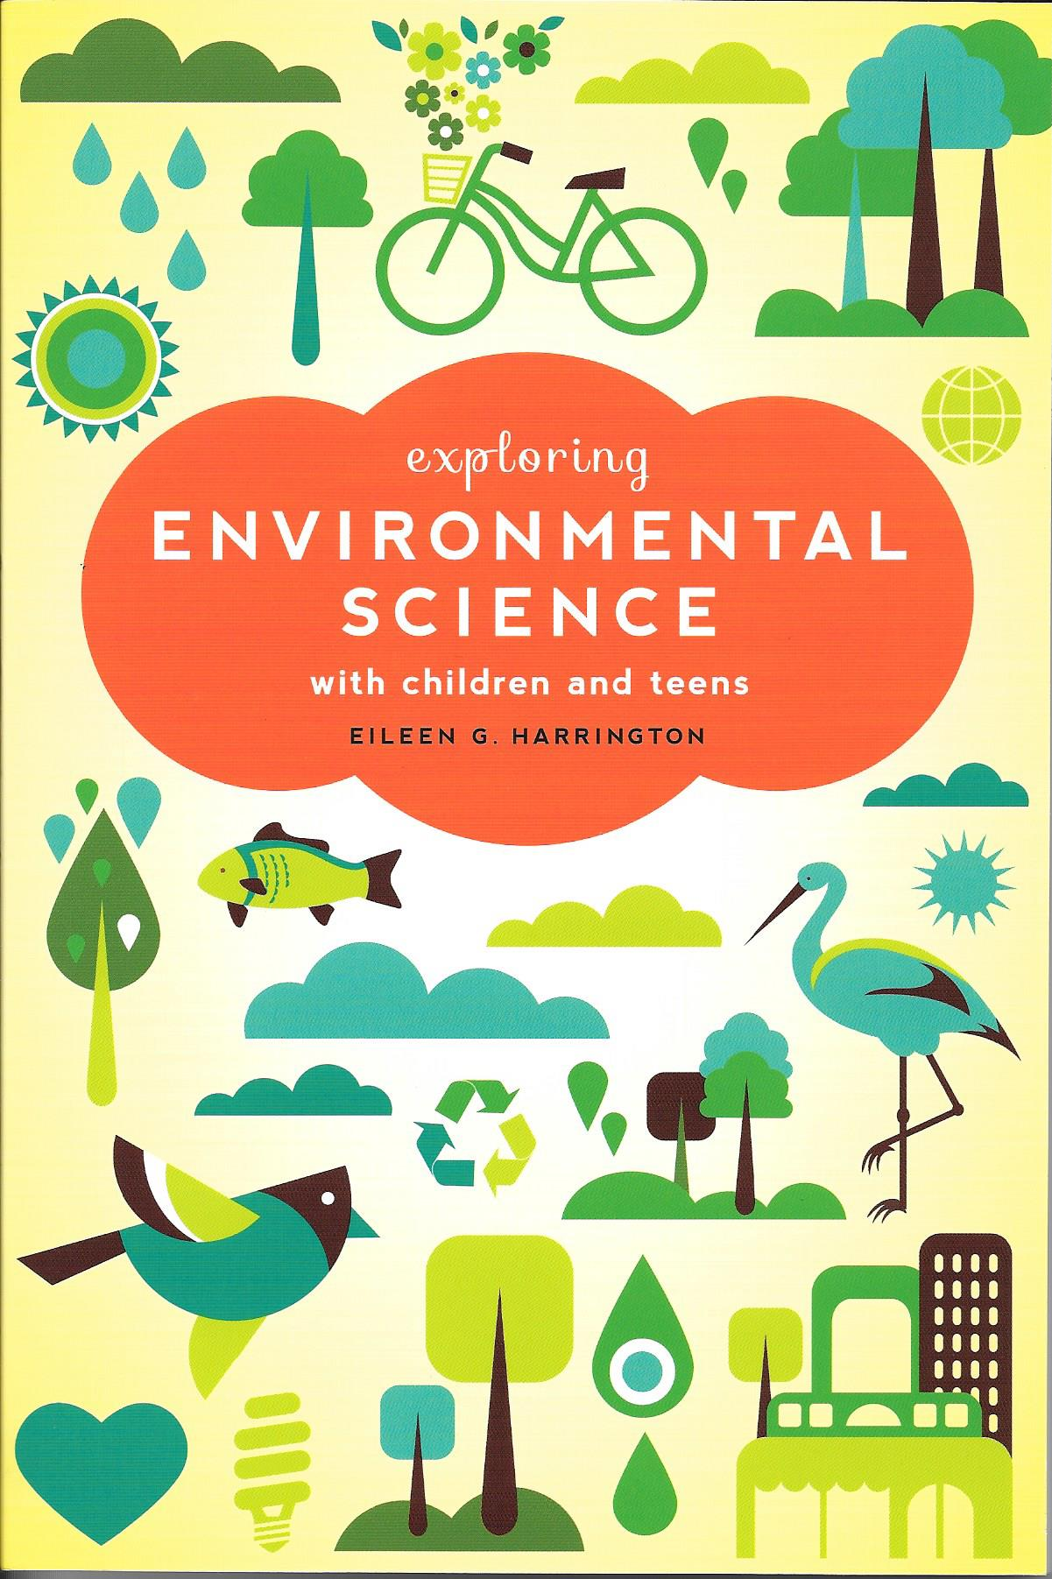
Background
ALA Editions, 2014
Previous position at California Academy of Sciences
Notes:
Presentation drawn from chapter on citizen science in book—although written for school and public librarians and museum/nature center educators, much of what written can be applied to academic libraries
Wrote book while still working at the Academy, which is a natural history museum, aquarium and planetarium here in SF. Manager of a resource center on public floor of the museum and we offered citizen science programs.
Overview of benefits and challenges of implementing citizen science projects. Tips for designing and implementing own citizen science projects. Examples of already existing projects that can tap into and possible avenues of collaboration for academic libraries with citizen science projects.
More detail on all of this in book
Citizen science entails having members of the general public who are not professional scientists work on actual scientific investigations
Depending on project—citizen scientists might get involved in different ways with projects. Some might simply be involved in data collection, while others might be helping with formulating questions and analyzing data. Rise of Internet and new technologies make it easier to connect to projects and people, get involved, upload, access and analyze data.

Slide 4
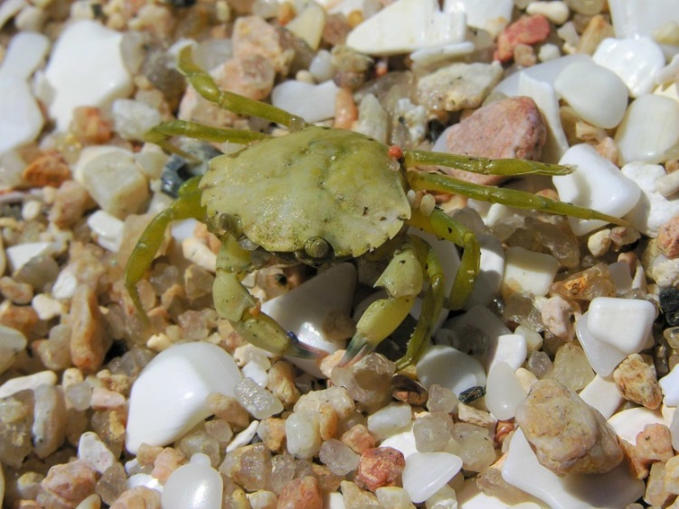
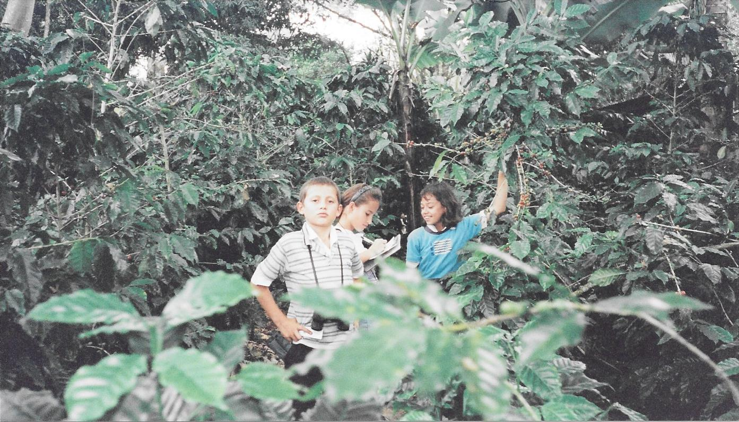
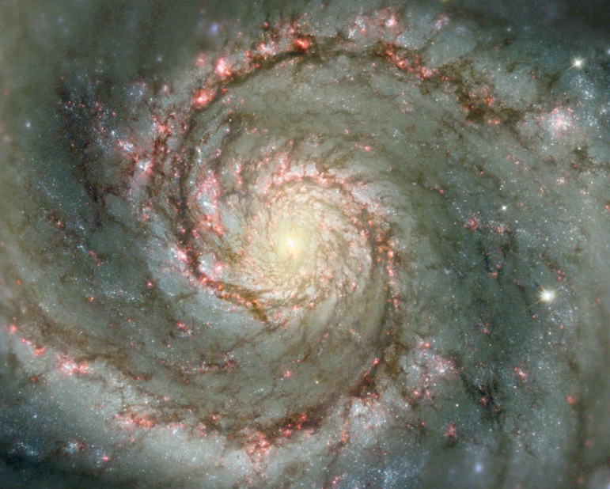
Why Citizen Science?
https://commons.wikimedia.org/wiki/File:Crab_Cangrexo_66eue.jpg
Harrington, 2001
http://apod.nasa.gov/apod/image/1302/m51dust_hubble_960.jpg
Notes:
Benefits to Scientists:
Gather large amounts of data that single scientist or research lab wouldn’t be able to do because of funding & logistical reasons—even more necessary with many funding cuts faced by universities and granting organizations
Provides baseline data which often hard to justify collecting, but useful for conservation managers to react to effects of invasive species and determine best course of action (Crall et al., 2010; Delaney, Sperling, Adams, & Leung, 2008), such as green crab; also help inform studies that investigate effects of climate change on certain species or even entire ecosystems
(Crimmins & Crimmins, 2008; Dickinson, Zuckerberg, & Bonter, 2010)
Analyze large datasets or pick out certain patterns that computers can’t do—still need human touch. Example of GalaxyZoo, which takes data from telescopes (Hubble and Sloan Digital Sky Survey) asks participants to classify images of galaxies by looking at their different features. Help understand how galaxies form
Bring in other viewpoints/perspectives that purely scientific studies might overlook—locals can sometimes have intimate knowledge of natural processes in area that outsider scientist might not have
Help with buy-in with introduction of new environmental policies or management decisions—if citizens involved in helping to shape those decisions (Aceves-Bueno et al., 2015)
New funding sources for research—many grants require broader impacts, including the public and disseminating data

Slide 5
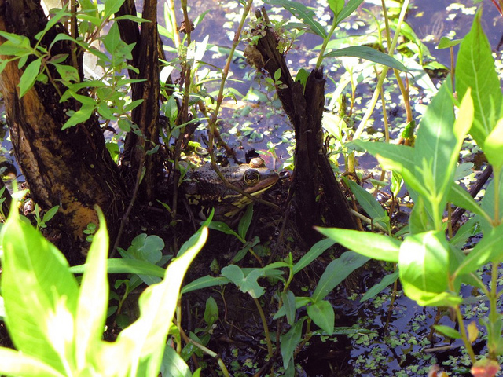
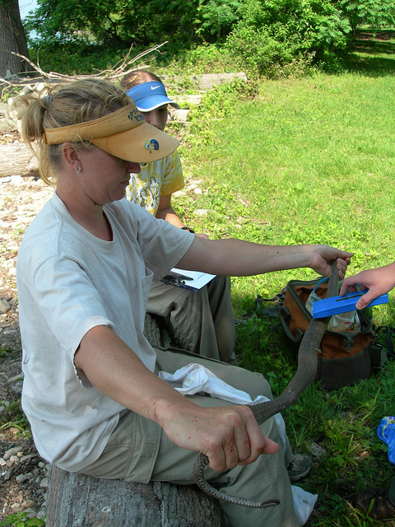
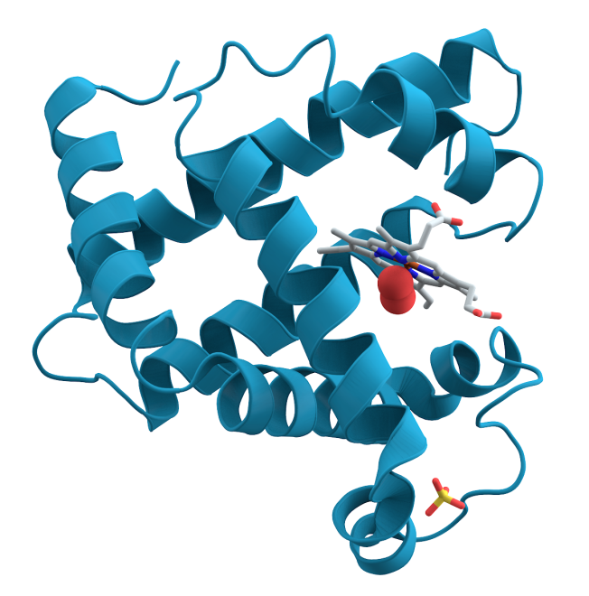
Why Citizen Science?
https://flic.kr/p/cnVydW
https://flic.kr/p/em1wwy
https://commons.wikimedia.org/wiki/File:Myoglobin.png
Notes:
Benefits to Citizens:
Gain first-hand knowledge of scientific process; for undergraduates interested in sciences can give opportunity for lab or field work to hone their skills and help define their interests. For those students not majoring in sciences, but still interested in them can be a more informal way to get involved.
Increase scientific literacy and particularly for environmental/biological-related improve connectedness to the environment around them. Often said that you protect what you love and you can only love what you truly know. Sense of place (Haywood, 2014)
Sense of accomplishment adding to the greater good—example FoldIt which is a game that has players determine folding patterns of various proteins, which can help scientists develop targeted drugs for certain diseases

Slide 6
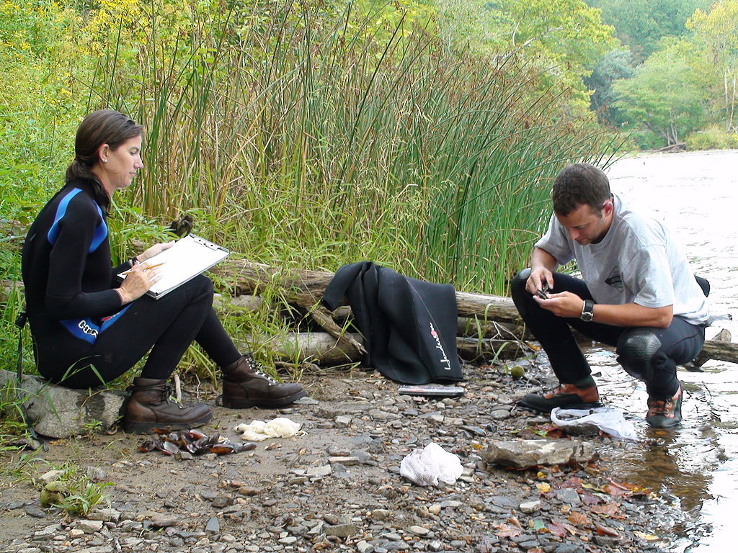
Challenges of Citizen Science: Data Quality?
Simple protocols
Training
Incorporate quality control
Law of Large Numbers
Peer reviewed publications
https://commons.wikimedia.org/wiki/File:Collecting_mussel_data_%285514834987%29.jpg
Notes:
Several challenges associated with citizen science projects—being aware of them can help overcome them
One of the main challenge/critiques: quality of data
Several ways to address this criticism:
--Designing simple protocols –easy to follow and less likely to make errors
--Training—Academy for Roof project held workshops on plant and bird identification prior to starting to collect data; many game-based or online projects have tutorials participants work through before working with actual data
--Quality-control by using online forms/systems and flagging questionable records for review by experts
--Statistics—larger the sample size less likely anomalies will skew overall findings—Law of Large Numbers
--Many projects that have relied on citizen scientists have been published in peer-reviewed journals
Over 60 peer-reviewed articles published based on Zooniverse citizen science projects (astronomy, weather and animal science projects) (https://www.zooniverse.org/publications)
Over 90 peer-reviewed publications either used eBird data or studied the project (Sullivan et al., 2014)

Slide 7

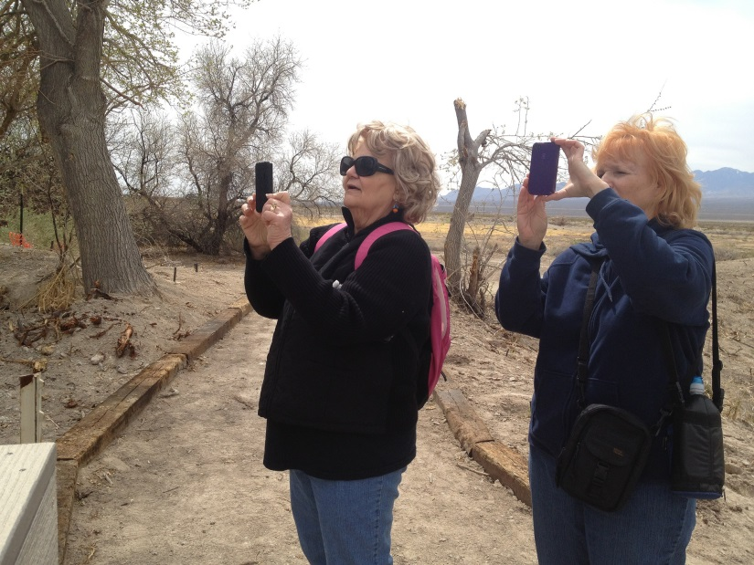
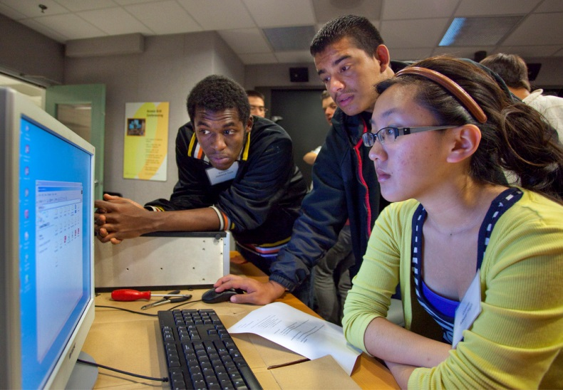
Other Challenges
https://commons.wikimedia.org/wiki/File:Bahnsteiguhr.jpg
https://flic.kr/p/bHb1y8
https://flic.kr/p/8pMJAF
Notes:
Time: scientists might be reluctant to participate b/c afraid have to constantly answer questions from public. In reality can save time, as mentioned previously. Depending on how designed—might be educator or program coordinator who can deal with public
Not really experiencing “real science”, just data collectors. Can design smaller projects where participants involved in all steps or certain steps. Many projects also make data available—educators can use this data to design classes/research projects (Bird Sleuth K-12 curriculum compliments Cornell Lab of Ornithology’s various citizen science projects); Enrichment activities for volunteers, sharing published papers, etc.
Recruiting, training and retaining volunteers—enrichment activities; incorporating ways for volunteers to see their data, explore data, mobile input of data—eBird data—when made modifications to features on website that allowed participants to track their own observations and compare them to others, number of individuals submitting data nearly tripled (Cooper et al., 2009), Newsletters, letting people know when data used.

Slide 8
Creating Your Own
Citizen Science Toolkit--Cornell Lab of Ornithology
http://www.birds.cornell.edu/citscitoolkit/toolkit
CitSci.org—Natural Resources Ecology Lab at Colorado State University
http://www.citsci.org/
Citizen Science Association
http://citizenscienceassociation.org/
Notes:
Several toolkits/resources out there that can help get started if want to partner with faculty member to start up own project
Chapter in book that outlines some things to keep in mind—collated from these different resources
First two represent some key resources
Last is a recently formed organization to better coordinate citizen projects—plethora of new ones popping up so before start own, might be worth it to see if one already exists that could tap into. Also, starting an open access journal Citizen Science: Theory & Practice, “focuses on advancing the field of citizen science by providing a venue for citizen science researchers and practitioners – scientists, information technologists, conservation biologists, community health organizers, educators, evaluators, urban planners, and more – to share best practices in conceiving, developing, implementing, evaluating, and sustaining projects that facilitate public participation in scientific endeavors in any discipline.” (http://citizenscienceassociation.org/journal/)

Slide 9
Tapping Into Already Existing Projects
Citizen Science Central
http://www.birds.cornell.edu/citscitoolkit/projects
SciStarter
http://scistarter.com/
Citizen Science Alliance (Zooniverse)
http://www.citizensciencealliance.org/
Notes:
Clearinghouses of citizen science projects. Can find and add projects to databases. Zooniverse are all Internet-based citizen science projects.

Slide 10
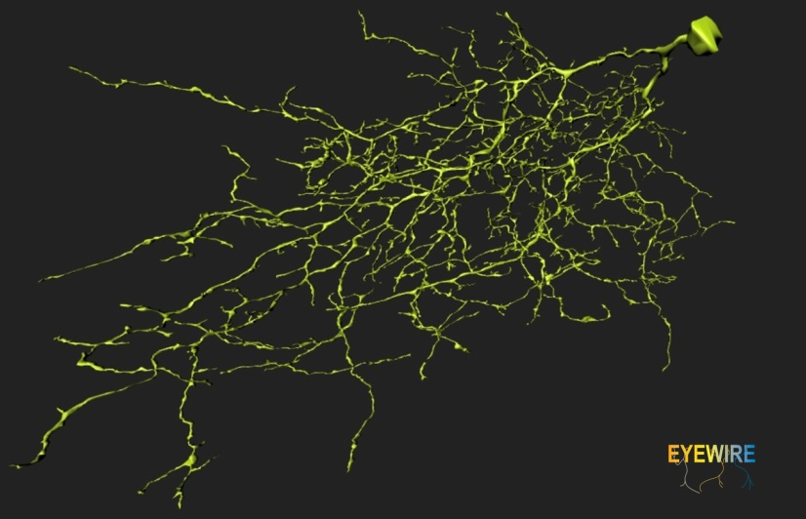
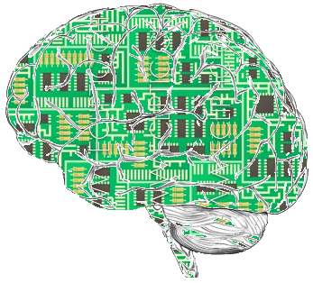
EyeWire
Online game to help map connectome
Human retinal neurons
160,000 participants, 145 countries
Sebastian Seung’s Computational Neuroscience Lab at Princeton
http://blog.eyewire.org/about
"EyeWirers complete J Cell 2" by AmyLeeRobinson https://commons.wikimedia.org/wiki/File:EyeWirers_complete_J_Cell_2.jpg#/media/File:EyeWirers_complete_J_Cell_2.jpg
https://upload.wikimedia.org/wikipedia/commons/1/17/ArtificialFictionBrain.png
Notes:
One of several completely online, game-based citizen science projects
Connectome, like genome, is thought to be unique to each individual. Pathway of connections between billions of different neurons. Hypothesis is that connectome is what underlies our thoughts, memories and actions. Knowing structure of connectome will help us better understand how brain processes and stores information. Mapping 3-D structure of branches of neurons and their connections to branches of other neurons.
Can take 50 hours to map one cell and there are 80 billion neural cells in brain (blog.eyewire.org/about)
Participating helps not only with advances in neuroscience, but also in developing artificial intelligence and computational technologies.

Slide 11

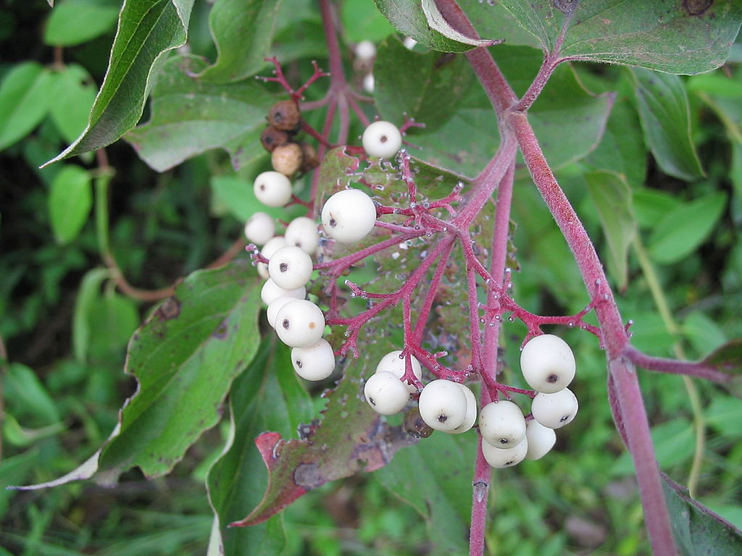
Project BudBurst
Monitoring shifting phenophase of plants
One time or full season observations
Data available on website
Over 15,000 observations in all 50 states
National Ecological Observatory Network (NEON) & Chicago Botanic Garden
http://budburst.org/
https://commons.wikimedia.org/wiki/File:Dogwood_from_below_2.jpg
https://commons.wikimedia.org/wiki/File:Northern_Swamp_Dogwood_
berries.jpg
Notes:
Example of environmental-based projects, requires collection of data in the field
Climate change causing changes in arrival of warmer spring temperatures and cooler fall temperatures and changes in rainfall amounts. This effects phenophases (timing of different life cycle stages of plants). Given interdependence of many animals on plants for nourishment and interplay of flowers and pollinators—need to understand shifts in phenophases to be able to make predictions of future conditions in env and develop management plans
All of data is available for free to scientists, educators and project participants on website. Can use data to compare to historical phenological records

Slide 12
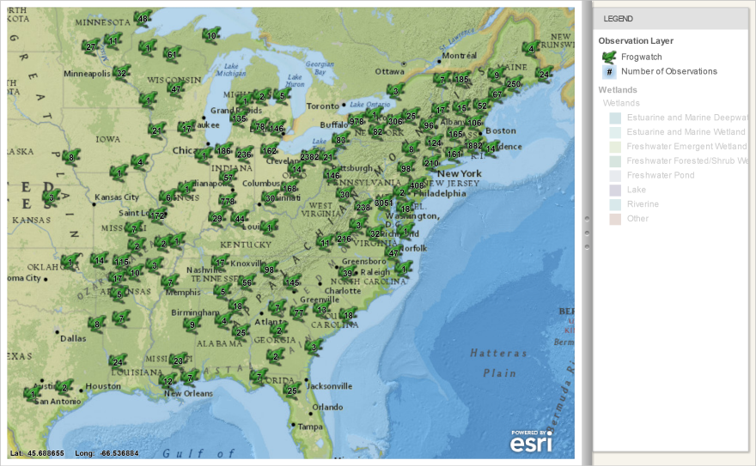

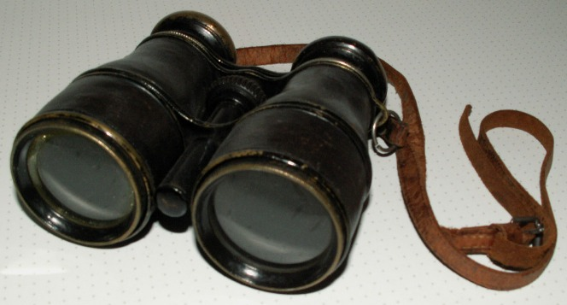
Avenues for Collaboration
Data management services
Visualization labs/GIS labs & Services
Equipment Loans
Scholarly communications & open access
http://frogwatch.fieldscope.org/v3/maps
https://commons.wikimedia.org/wiki/File:DARPA_Big_Data.jpg
https://commons.wikimedia.org/wiki/Binoculars#/media/File:Fernglas%28alt%29.JPG
Notes:
Data management: Many projects want to share data and keep it open, but might not know about data repositories that can accept it. At same time a lot of data is in open data repositories, but people not always aware of where to look. Librarians can help with both of these issues. Can be part of team and help with collecting and archiving data. Don’t always have standardization in how data collected and stored—making it harder to use and access. (Crall et al., 2010)
Visualization & GIS labs: becoming more and more common in academic libraries. Can help people analyze their data and share it with a broader public. Many have large screen display areas—can feature citizen science data on them
Equipment loan: Many academic libraries loan laptops, iPads, digital cameras, all of which might be useful to citizen scientists. Could also look into loaning other items (binoculars, quadrats, tape measures, etc.)
Scholarly communications & open access: Because projects involve public, many want to publish papers associated with project in open access journals, but might not have funds to do so or awareness of open access journals. Some libraries have open access funds that can help with. Can help with advice on where to publish

Slide 13
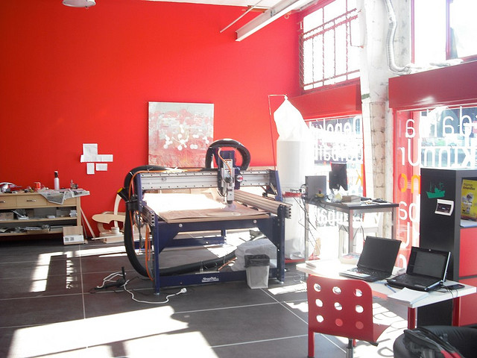
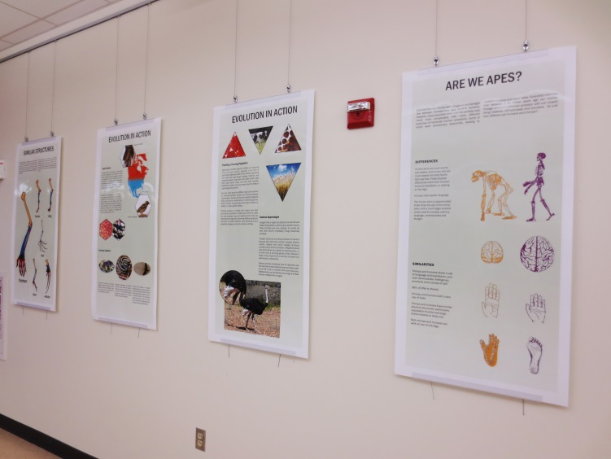
Avenues for Collaboration
Outreach & education
Makerspaces
Exhibit Spaces
Classrooms/Meeting rooms
https://commons.wikimedia.org/wiki/File:Donnonkln_Fab_lab_en_Bermeo.jpg
Harrington, 2015
Notes:
Outreach & education: link to all people on campus and many have programs that reach out to the general public. We can promote already established citizen science programs. We can help with training volunteers on using protocols. We can help distribute data collection tools (Bay Area ant survey at the Academy). Provide access to the literature if people want to delve deeper and learn more about the field or area of study that the project falls under.
Makerspaces: can be used to create tools/equipment for citizen science projects
Exhibit spaces: share research and/or information about citizen science projects
Classroom/meeting rooms: Training volunteers, enrichment activities for volunteers, talks/forums on projects

Slide 14
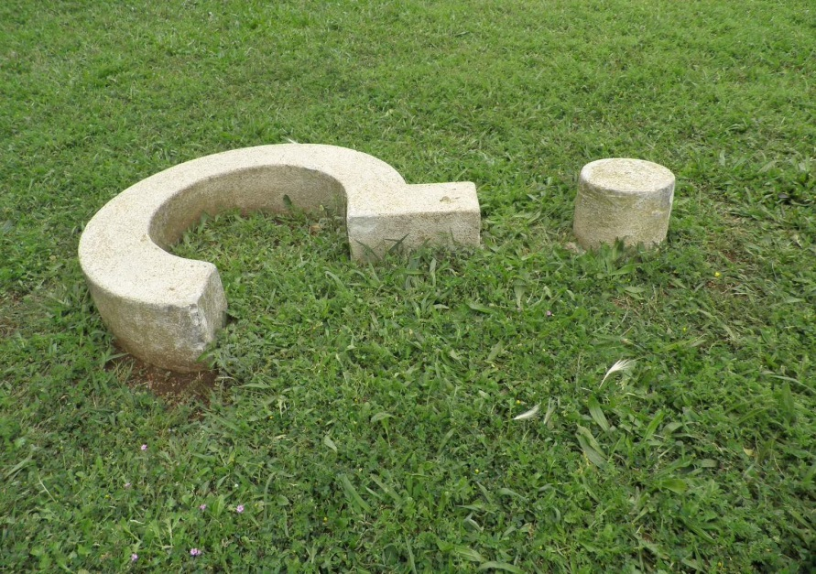
https://commons.wikimedia.org/wiki/File:Joan_Brossa_Vel%C3%B2drom_Cam%C3%AD_obrint_interrogaci%C3%B3.JPG
Eileen G. Harrington
eharring@umd.edu

Slide 15
References
Aceves-Bueno, E., Adeleye, A. S., Bradley, D., Brandt, W. T., Callery, P., Feraud, M., … Tague, C. (2015). Citizen science as an approach for overcoming insufficient monitoring and inadequate stakeholder buy-in in adaptive management: criteria and evidence. Ecosystems, 18(3), 493–506. http://doi.org/10.1007/s10021-015-9842-4
Cooper, C. B., Dickinson, J., Kelling, S., Phillips, T., Rosenberg, K. V., Shirk, J., & Bonney, R. (2009). Citizen science: A developing tool for expanding science knowledge and scientific literacy. BioScience, 59(11), 977–984. http://doi.org/10.1525/bio.2009.59.11.9
Crall, A. W., Newman, G. J., Jarnevich, C. S., Stohlgren, T. J., Waller, D. M., & Graham, J. (2010). Improving and integrating data on invasive species collected by citizen scientists. Biological Invasions, 12(10), 3419–3428. http://doi.org/http://dx.doi.org/10.1007/s10530-010-9740-9
Crimmins, T. M., & Crimmins, M. (2008). The critical role that citizen scientists can play in identifying adaptation strategies to climate change. Arid Lands Newsletter, 60, 25–28.
Delaney, D. G., Sperling, C. D., Adams, C. S., & Leung, B. (2008). Marine invasive species: validation of citizen science and implications for national monitoring networks. Biological Invasions, 10(1), 117–128. http://doi.org/10.1007/s10530-007-9114-0
Dickinson, J., Zuckerberg, B., & Bonter, D. N. (2010). Citizen science as an ecological research tool: challenges and benefits. Annual Review of Ecology, Evolution & Systematics, 41(1), 1. http://doi.org/10.1146/annurev-ecolsys-102209-144636
Haywood, B. K. (2014). A “sense of place” in public participation in scientific research. Science Education, 98(1), 64–83. http://doi.org/10.1002/sce.21087
Sullivan, B. L., Aycrigg, J. L., Barry, J. H., Bonney, R. E., Bruns, N., Cooper, C. B., … Kelling, S. (2014). The eBird enterprise: An integrated approach to development and application of citizen science. Biological Conservation, 169, 31–40. http://doi.org/10.1016/j.biocon.2013.11.003
Zooniverse. (n.d.). Zooniverse - Zooniverse Publications. Retrieved June 24, 2015, from https://www.zooniverse.org/publications

