Slide 1
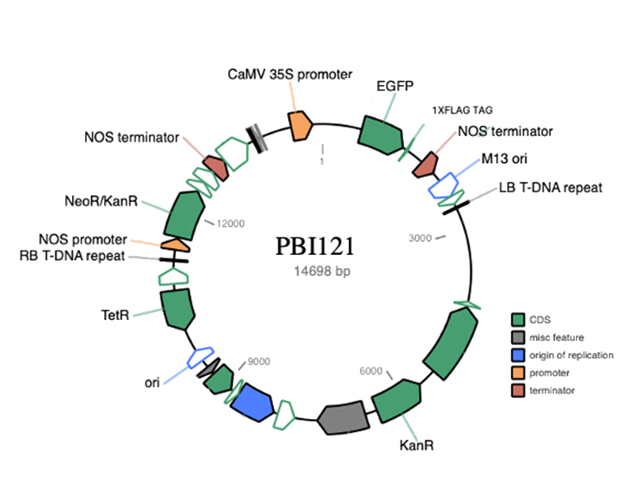
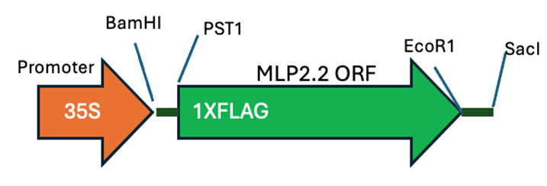
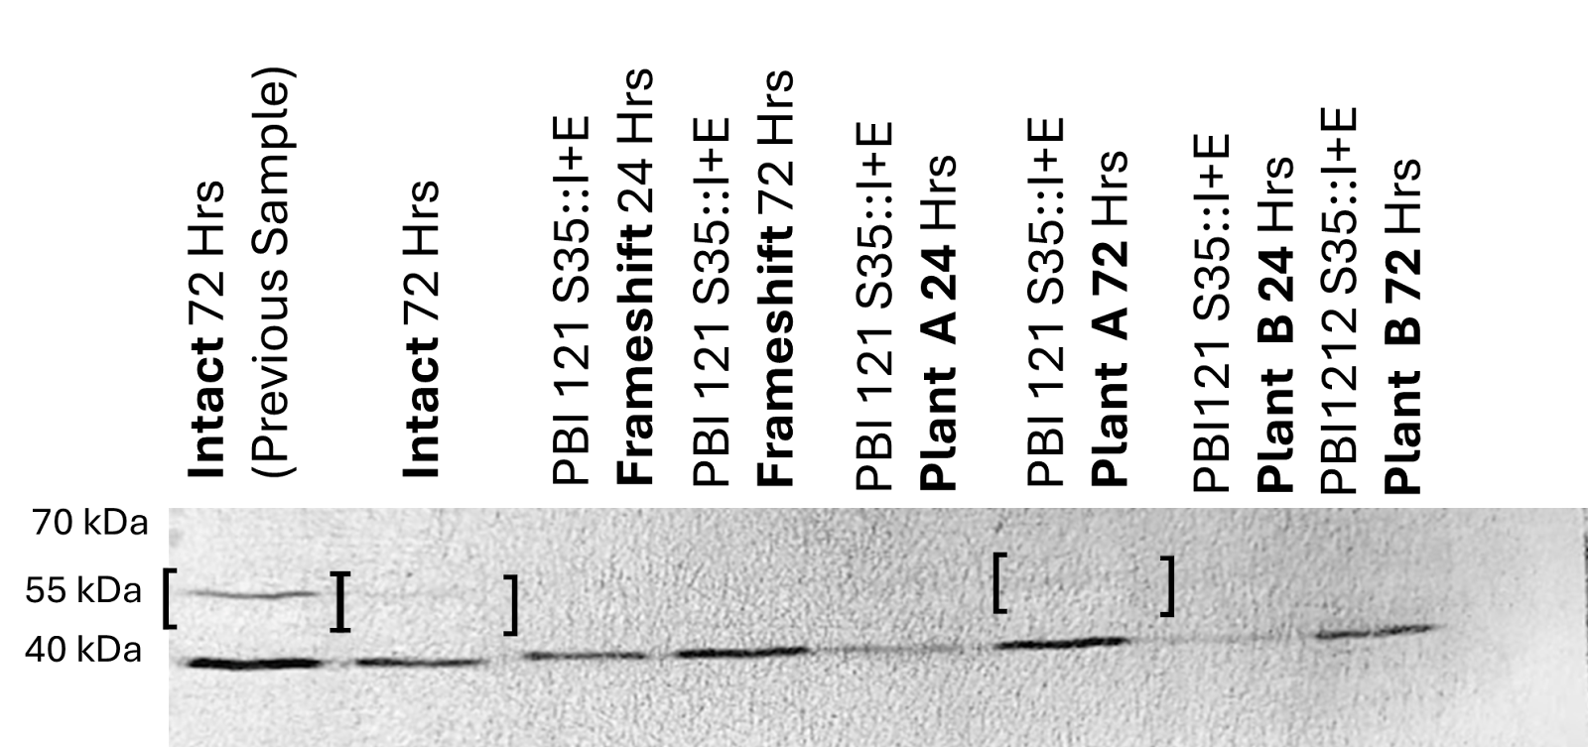
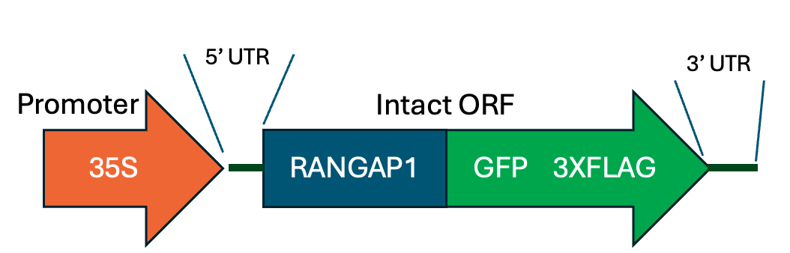
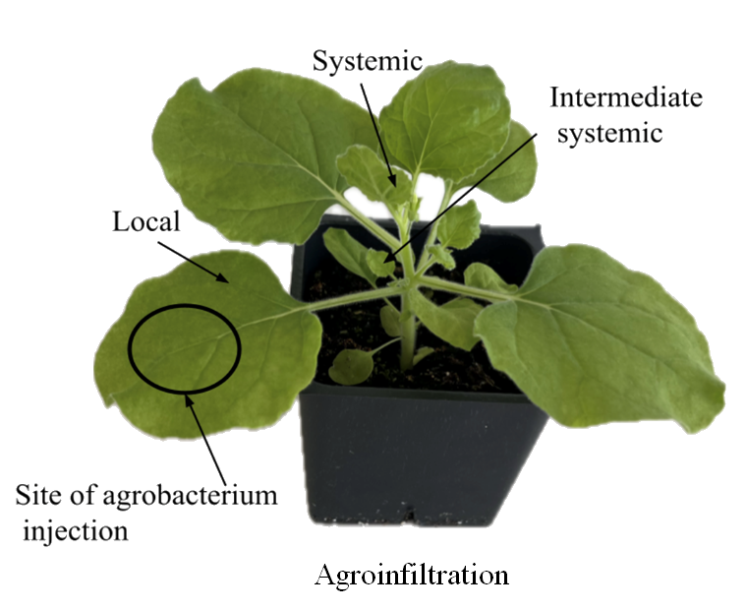
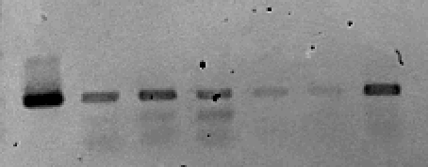
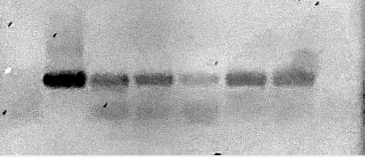
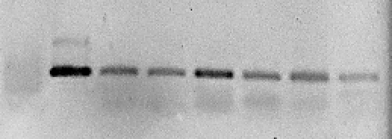
Investigating the Effect of 5’ and 3’ UTRs on mRNA Mobility in Plants
Judith Lin¹, Michael Koretsky¹, James N. Culver^{2,3}
¹Biological Sciences Program, College of Computer, Mathematical, & Natural Sciences, ²Department of Plant Science & Landscape Architecture, ³Institute for Bioscience and Biotechnology Research, University of Maryland, College Park, MD 20742
Abstract
Method
Results Cont.
In tomato rootstock and Nicotiana benthamiana heterografting systems, N. benthamiana scions show stress and defense related transcripts derived from tomato rootstock. tRNA-like and poly-pyrimidine sequences in mRNA untranslated regions (UTRs) may facilitate mRNA mobility. To understand UTR contributions, two transgenes were created using tomato major latex protein (MLP) and green fluorescent protein (GFP) open reading frames (ORFs) flanked by previously identified mobile mRNA UTRs. Agroinfiltration into N. benthamiana was preformed to study mRNA mobility and protein expression. Preliminary results show MLP mRNA is mobile, supporting its role in mRNA mobility. Ongoing research is investigating the mobility and protein expression of both GFP and MLP mRNAs to develop new mRNA expression cassettes capable of moving systemically and expressing proteins of desired functions.
Fig. I: Mobile mRNA Analysis Flowchart
Insert ORF+E
Fig. III: Image of western blot for detection of GFP. Plant samples were taken 24-72 hours post-inoculation of N. benthamiana with PBI 121 S35::I+E. Brackets indicate a positive marker. The bottom row of bands are background.
Ligation of 5’ and 3’ UTRs to ORF
Creation of PBI MLP2.2+E and PBI S35::I+E constructs using restrictive enzymes digestion
Gel Electrophoresis
RT-PCR
Collect local, intermediate systemic, and systemic MLP tissue samples
Conclusion
We cannot conclude that the engineered 5` and 3` UTRs affect the mobility of mRNA. Movement was detected for both the MLP control and MLP with 5’ and 3’ UTRs throughout N. benthamiana. MLP mRNA was detected in local, intermediate systemic, and systemic tissues as shown by Fig. II. The GFP construct shows promising results (Fig. III), however, a more in-depth check is required. Ongoing research is still being conducted to confirm the innate mobility within the sequence of the MLP ORF and the abundance of the GFP transgene. Experimental results collected from the GFP construct will confirm the MLP gene’s innate mobility within its sequence.
Introduction
Western Blot
Collect local and systemic tissue sample for Intact tissue sample
Visualization of I+E movement using fluorescent light microscopy
Grafting is a horticultural technique widely practiced in modern agriculture for developing crops with desirable traits such as enhanced disease resistance. Information sharing in heterograft systems is made possible by mobile mRNA. In a tomato and N. benthamiana heterografting system, mobile transcripts associated with viral resistance were detected in the N. benthamiana scion from the Dro141TX tomato rootstock.¹ Although previous studies suggest the mobility of mRNA in plants, the exact mechanism behind mRNA mobility remains unclear. mRNA are hypothesized to become mobile due to specific RNA-binding proteins recognizing and binding to motifs such as tRNA-like structures and/or poly-pyrimidine sequences in the untranslated regions of the mRNA.² In this study, 5’ and 3’ untranslated regions (UTRs) containing potential motifs that confer mobility were inserted into MLP and GFP constructs to determine if the UTRs are sufficient to promote mRNA mobility. Understanding the transportation mechanism will be important for future use of grafting systems.
Results
Gel image A shows MLP mRNA content collected from local N. benthamiana tissue. The presence of bands for both the MLP2.2 and MLP2.2+E indicates local movement between cell compartments within the same leaf. Images B and C demonstrate MLP mRNA content from intermediate systemic and systemic tissues, respectively. The two gel images show that MLP2.2 and MLP2.2+E were involved in systemic transportation through the vascular tissue. No significant difference between the MLP2.2 control and MLP2.2+E was observed in facilitating mRNA movement.
References
Kappagantu, M., Brandon, M., Tamukong, Y. B., & Culver, J. N. (2023). Rootstock‐induced scion resistance against tobacco mosaic virus is associated with the induction of defence‐related transcripts and graft‐transmissible mRNAs. In Molecular Plant Pathology (Vol. 24, Issue 9, pp. 1184–1191). Wiley. https://doi.org/10.1111/mpp.13353
Xia, C., & Zhang, C. (2020). Long-distance movement of mrnas in plants. Plants, 9(6), 731. https://doi.org/10.3390/plants9060731
WT N. benthamiana
MLP 2.2 Control
MLP 2.2 Control
MLP2.2+E 20 Hrs
MLP2.2 20 Hrs
MLP2.2+E 45 Hrs
MLP2.2 65 Hrs
MLP2.2+E 20 Hrs
WT N. benthamiana
MLP2.2 45 Hrs
MLP2.2+E 65 Hrs
MLP2.2 65 Hrs
MLP 2.2 Control
MLP2.2 20 Hrs
MLP2.2+E 45 Hrs
MLP2.2 45 Hrs
MLP2.2+E 65 Hrs
MLP2.2 20 Hrs
MLP2.2+E 20 Hrs
MLP2.2 65 Hrs
MLP2.2 45 Hrs
MLP2.2+E 45 Hrs
MLP2.2+E 65 Hrs
1000bp
1000bp
1000bp
Acknowledgements
(A) Local
(B) Intermediate Systemic
(C) Systemic
This research was partially funded by the National Science Foundation Division of Integrative Organismal Systems grant ISO-1644713.
Fig. II: Image of gel electrophoresis of RT-PCR products originating from N. benthamiana tissue collected post inoculation with MLP2.2 and MLP2.2+E.

