Slide 1
Pittsburgh and Philadelphia can work together!
Processing the Arlen Specter Collection at the University of Pittsburgh

Slide 2
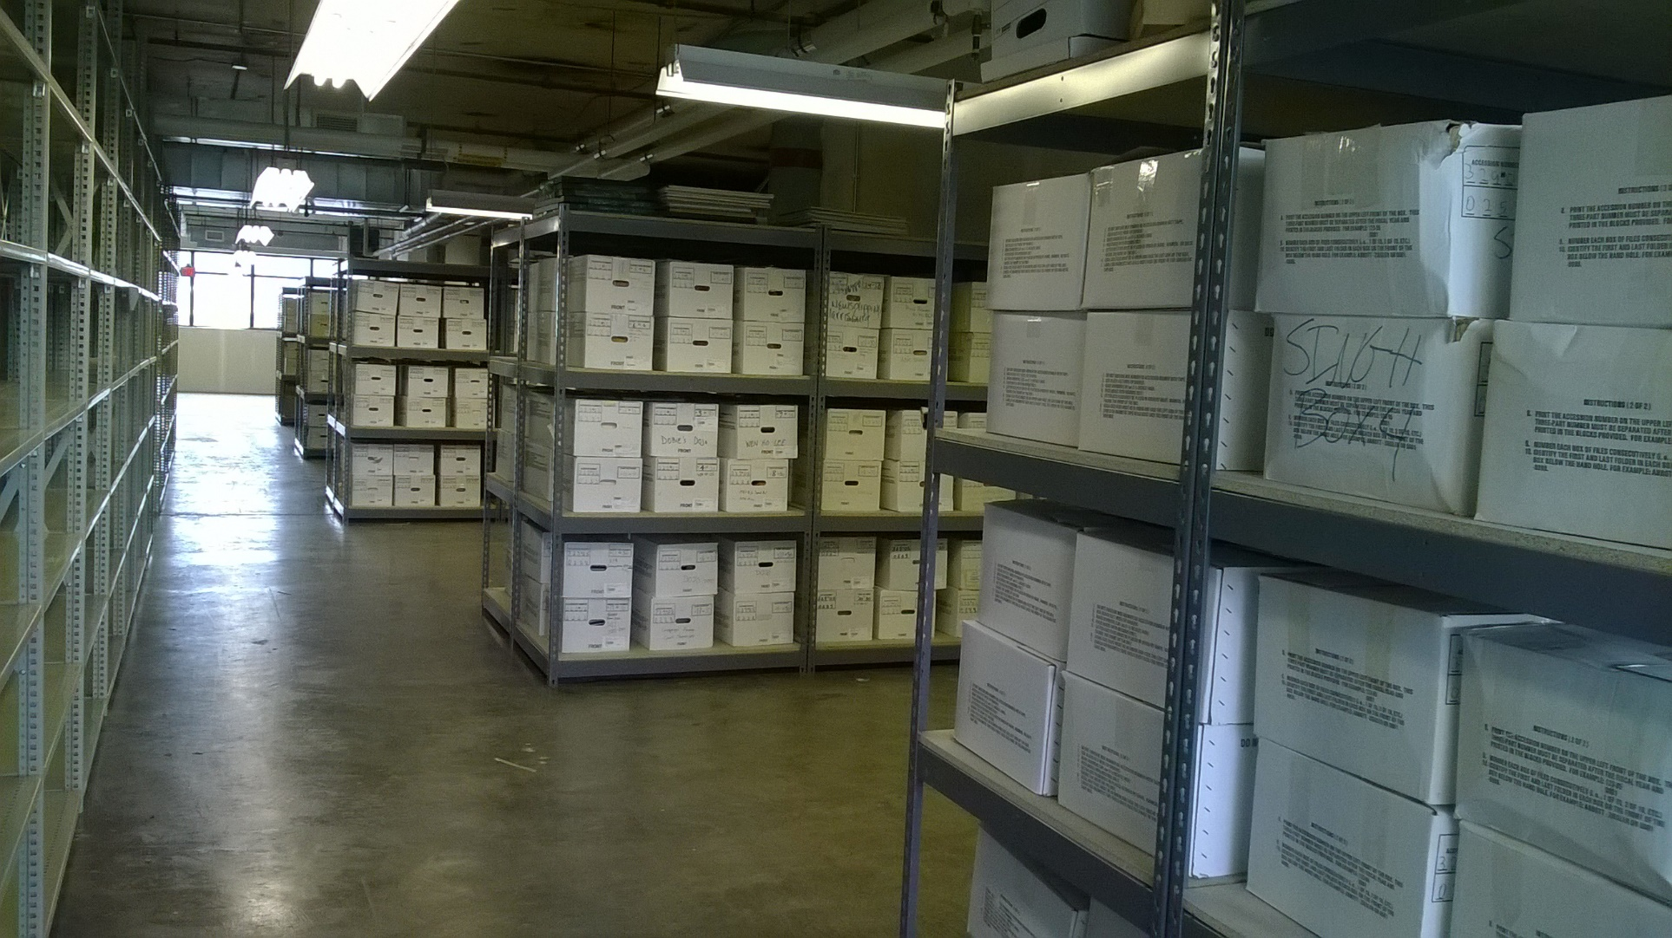
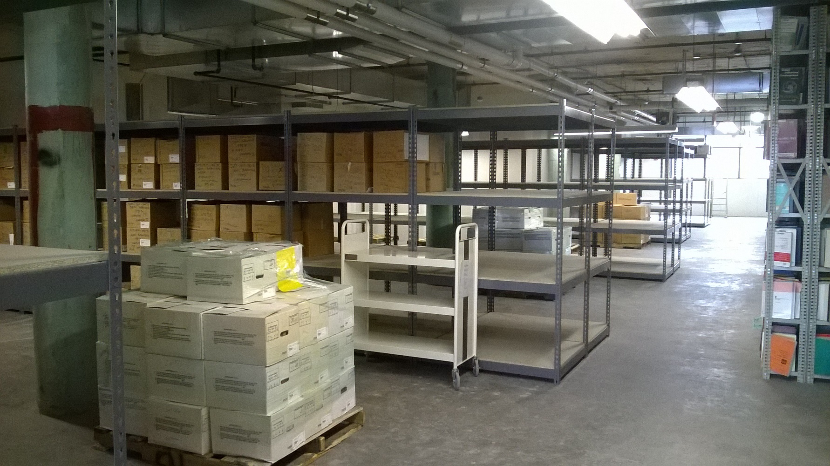
Notes:
New shelving installed for the Specter collection > oversize to accommodate the variety of memorabilia > received material back from BRM over the course of 5 weeks, 2-3 times a week, ten pallets at a time, 91 pallets total

Slide 3
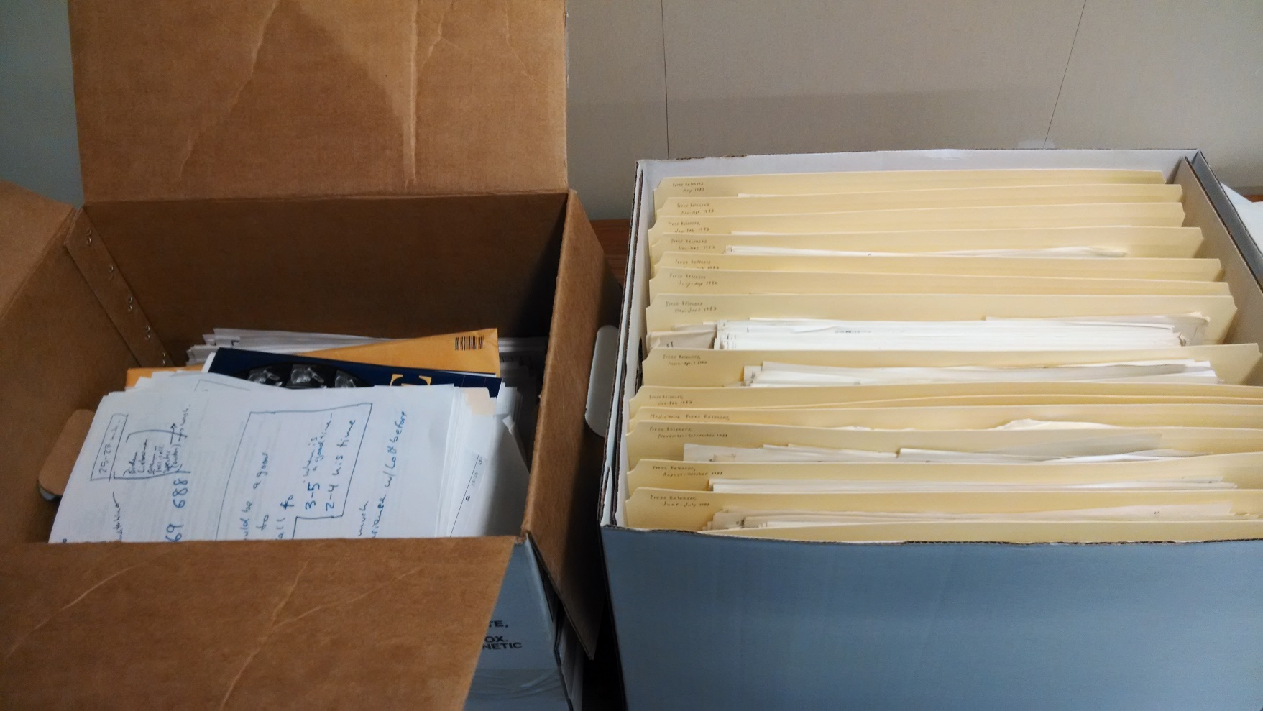
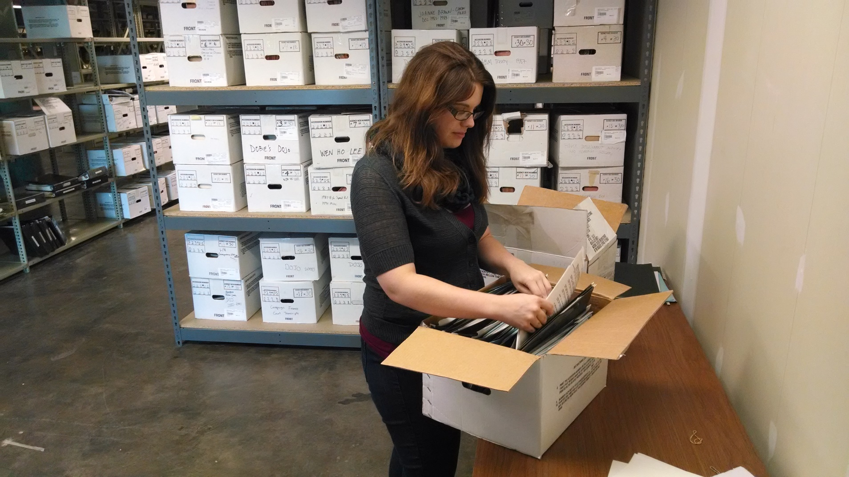
Notes:
Processing > Ashley came up with the arrangement scheme based off of peer reviews and initial box inventories completed by History Associates > some boxes were well-arranged, others were a disaster > managing a project with multiple students, one additional associate archivist > arrangement scheme vetted by PhillaU > appraisal and access decisions as well, with recommendations

Slide 4
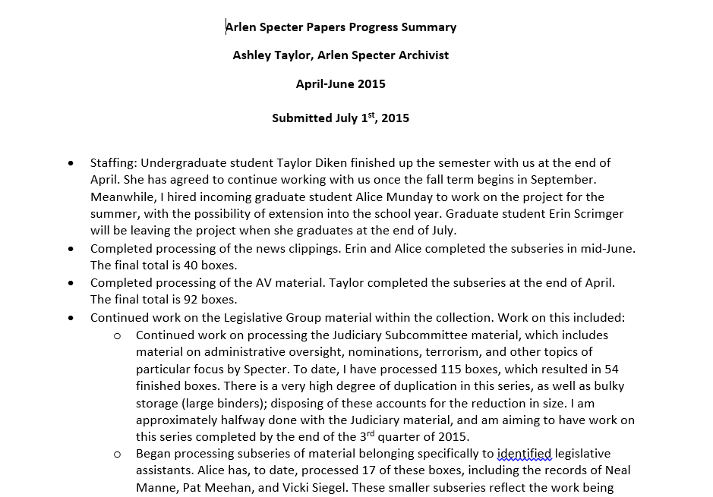
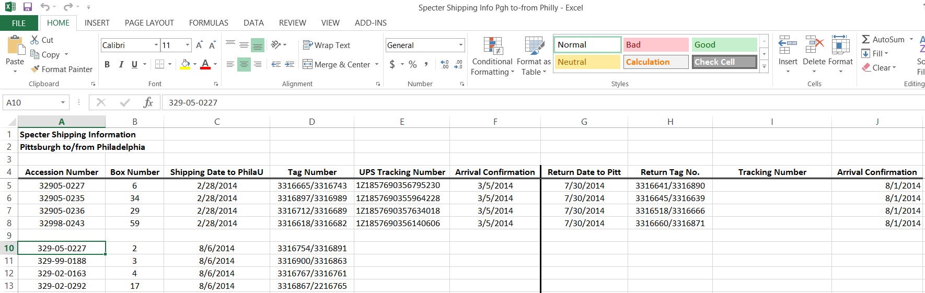
Notes:
Communication is key between the two entities > Quarterly progress reports detailing staffing, amount processed, any outreach done, communication between the two institutions, any reference requests received > Shipping log, keeps track of material going between Pittsburgh and Philadelphia > collection will be available in both locations (via shipping from Pgh)

Slide 5
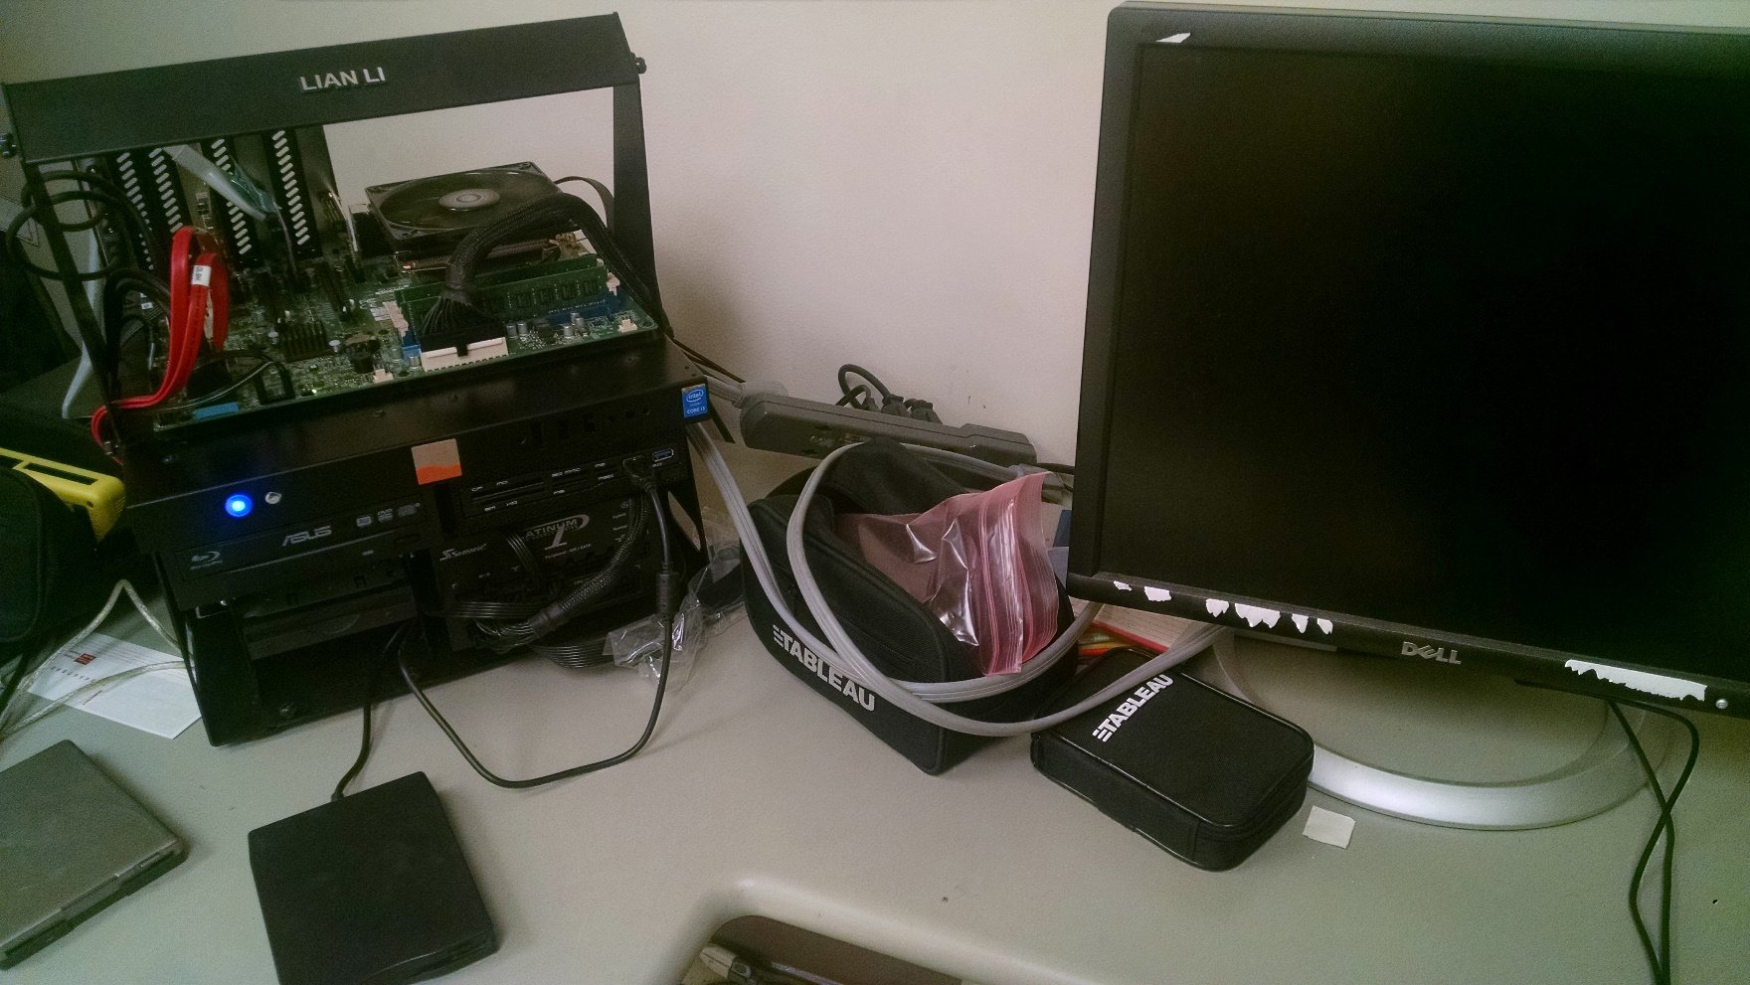
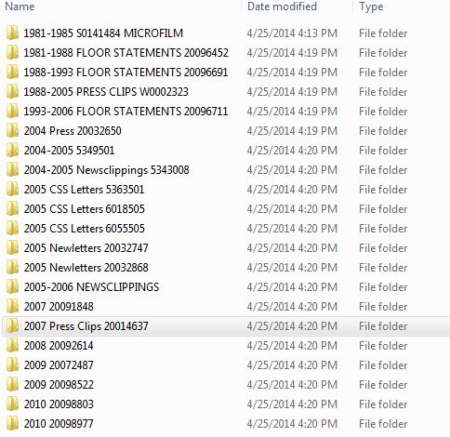
Notes:
Collection is about halfway done > Finished with PR and most of the legislative material > Still to do, Office files, campaign material (relate to material still remaining at Philly) > Electronic material > Website

