Slide 1

The Official RDA Toolkit is Here:
Now What?
Kathy Glennan
Director, Cataloging & Metadata Services
University of Maryland
Connecticut Library Association Technical Services Section
August 26, 2024

Slide 2
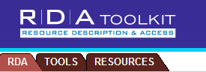
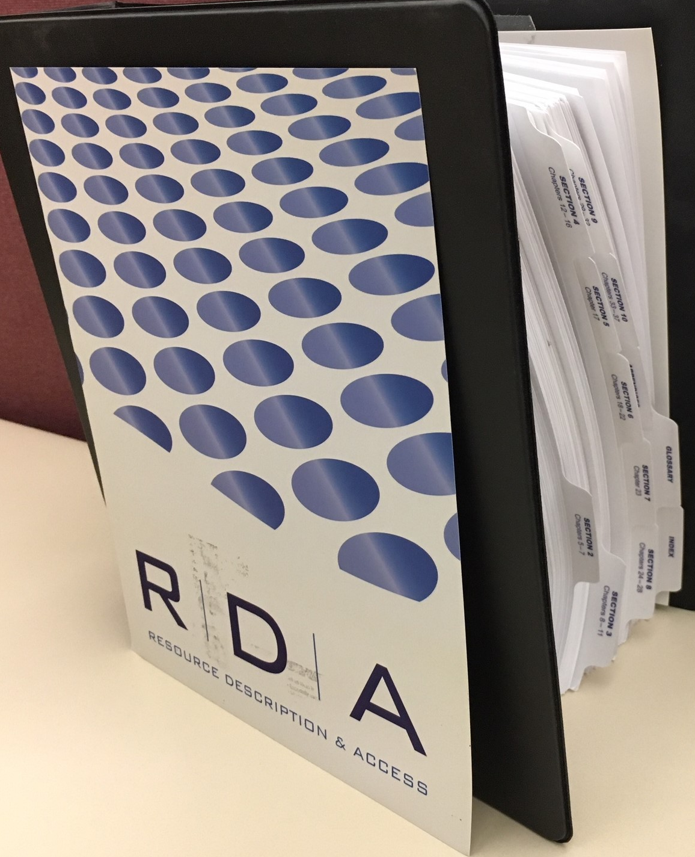
Original RDA Toolkit
Published 2010 – online and in print
Implemented by the Library of Congress (LC) and
the Program for Cooperative Cataloging (PCC) in 2013
Updated regularly through April 2017
  Then “frozen” so a re-imagined Toolkit could be developed (3R Project)
Online version to be retired in May 2027
  PDFs will still be available
Notes:
RDA Toolkit Restructure and Redesign Project

Slide 3
What Led to Developing the New Toolkit?
RDA’s underlying model changed
  From the IFLA Functional Requirements Models (FRBR, FRAD, FRSAD)
  To the IFLA Library Reference Model (LRM)
Need for better alignment with linked data applications
Promote internationalization
  More flexibility in choosing how to record an element
  More generalized instructions
Improve the Toolkit interface
  WCAG 2.0 accessibility rating of AA
Restructure underlying data to support editorial and translation work
Notes:
WCAG= Web Content Accessibility Guidelines

Slide 4

Official RDA Toolkit
Moved from “beta” to “official” status in December 2020
Integrating resource, updated several times a year by the RSC
Available in four languages, with more translations on the way
  Currently: English, Finnish, French, and Norwegian
Supporting policy statements in the Toolkit; more under development
  British Library, Library and Archives Canada, Library of Congress-Program for Cooperative Cataloging (LC-PCC), Music Library Association, National Library of New Zealand
Some communities creating guidance outside of the Toolkit
  LC-PCC Metadata Guidance Documents
  RDA DACH (German speaking world)

Slide 5
Official RDA Implementation Plans
PCC: Rolling Implementation of Official RDA
from May 1, 2024 to April 30, 2027
National Library of New Zealand: August-December 2024
  Started with print monographs (physical and digital)
So, no need to panic, but it is time to start preparing

Slide 6
Key Terminology – Understand the Differences
Entity: An abstract class of conceptual objects, representing the key “things” of interest to users of RDA data
Example: work
  vs.
Element: A specific aspect, characteristic, attribute, or relationship used to describe an RDA entity
Example: preceded by work
Attribute element: An element that is an inherent or externally imputed characteristic of an RDA entity
Example: duration
  vs.
Relationship element: An element that relates two RDA entities
Example: abstract / abstract of

Slide 7
What Changed from Original to Official RDA?
Organizational structure
Terminology
Presentation of options
New entities
  No fictional values for entities
Relationship designators became elements
New concepts
  Diachronic works (intended to be issued over time)
  Aggregates (or compilations)
  Representative expressions
Notes:
New entities: RDA entity, Agent, Collective Agent, Nomen, Place, Timespan

Slide 8
Yikes! What Stayed the Same?
Most instructions are still present, but might be in a new place
  Also might be phrased a little differently or have fewer specifics
General outcome of applying most instructions should still produce the same results
  Especially if you use LC-PCC Policy Statements along with MARC 21
Some Anglo-American specific guidance has moved to the “Community Resources” section, but is still available within the Toolkit
Availability of policy statements within the Toolkit
  New: Can select a default policy statement to display adjacent to the instructions

Slide 9
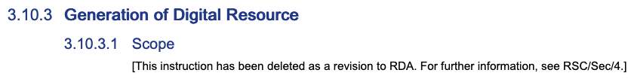
Organizational Structure Changes
No set way to approach the instructions
  More like choose your own adventure!
  Instructions are not numbered, so no workflow implied
  You can refer to specific instructions by citation number or link
No need for the RSC to adjust the numbering of instructions to insert or remove guidance, such as the following in the Original Toolkit
Application profiles can help with determining what your “community” expects
  Example: Draft Music Library Association Application Profile

Slide 10
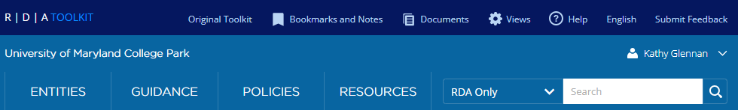
Logging In
https://access.rdatoolkit.org/
Best choice: create a personal profile, rather than relying on just an institutional login
  This provides you with additional settings/content

Slide 11

Toolbar Orientation
Help: Explains Toolkit features
Views: Customize what displays
Entities: Abstract classes of things that are of interest to library users
Guidance: Explains theory; offers “how to” instructions
Policies: Guidance from communities about how to apply RDA
Resources: Includes Glossary, Vocabulary Encoding Schemes,
and Community Resources
Search box: Search Official RDA, policy statements, etc.
2
1
3
4
5
6
7

Slide 12
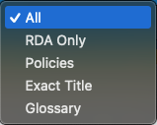
Search Options
All = Everything in the Toolkit
RDA Only = Base RDA
  No policy statements, etc.
Policies = Only policy statements
  Not RDA itself
Exact title = precise name of the element
Glossary = Definitions
Note: Toolkit does not use Boolean operators
  Use quotation marks when searching for an exact phrase
Notes:
Toolkit does not use Boolean operators
“and” is assumed between terms
Searching is not case sensitive or punctuation sensitive
Use quotation marks when searching for an exact phrase
Unless you’re using Exact Title – then omit them
Good way to search for former element names
Use an asterisk (*) as a wildcard for one or more letters
number* retrieves: number, numbers, numbering
Use a percentage sign (%) as wildcard for a single letter
short-cut retrieves: nothing
short*cut retrieves: shortcut

Slide 13

Guidance Chapters
Three main categories
  Explain critical information to help Toolkit users make sense of RDA text
  Provide instructions on how to examine and evaluate resources,
  make decisions about descriptions, and record values
  Explain more complex concepts introduced by LRM or RDA
Contain some instructions that apply to multiple elements
  And the specific information is linked from the element page as needed

Slide 14
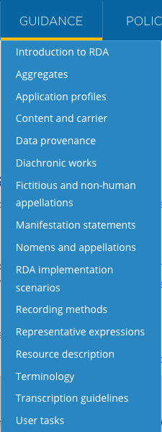
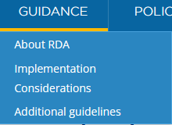
Guidance Chapters: Organization
Can change your display of the
dropdown menu with
these groupings, instead of
the more alphabetical default
Notes:
You can change the menu view via the settings menu

Slide 15
Guidance Chapters: Content
Introductory information
  Objectives and principles
  Terminology
  User tasks
  Well-formed RDA
  Implementation scenarios
  Application profiles
Implementation considerations
  Entity boundaries
  Recording methods
  Transcription guidelines
  Data provenance
  Nomens and appellations
  Resource description
  Content and carrier
  Manifestation statements
Additional guidelines
  Aggregates
  Diachronic works
  Representative expressions
  Fictitious and non-human appellations

Slide 16
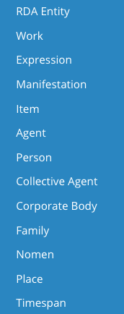
Entities
RDA Definition: An abstract class of key conceptual objects in the universe of human discourse that is a focus of interest to users of RDA metadata in a system for resource discovery
Mutually exclusive
13 established in RDA
  Hierarchical arrangement
    RDA Entity is at the top
    Agent has subtypes, including Collective Agent
    RDA retained Corporate Body and Family as refinements of LRM’s Collective Agent

Slide 17
Organization of an Entity Page
Definition and scope
Prerecording
  Including information about related entities
    Entity supertype = broader entity
    Entity subtype = narrower entity
  Also guidance about Minimum description,
  Effective description, and Entity boundaries
Recording
  Guidance about what data to record
  4 recording methods - always present
Elements
RDA entity
Entity
subtype
Entity
supertype
Agent
Entity
subtype
Entity
supertype
Person
Notes:
Minimum description: which kind of element must be used
Effective description: Record elements that are deemed useful for identification and access
Entity boundary: determined by bibliographic and cultural conventions

Slide 18
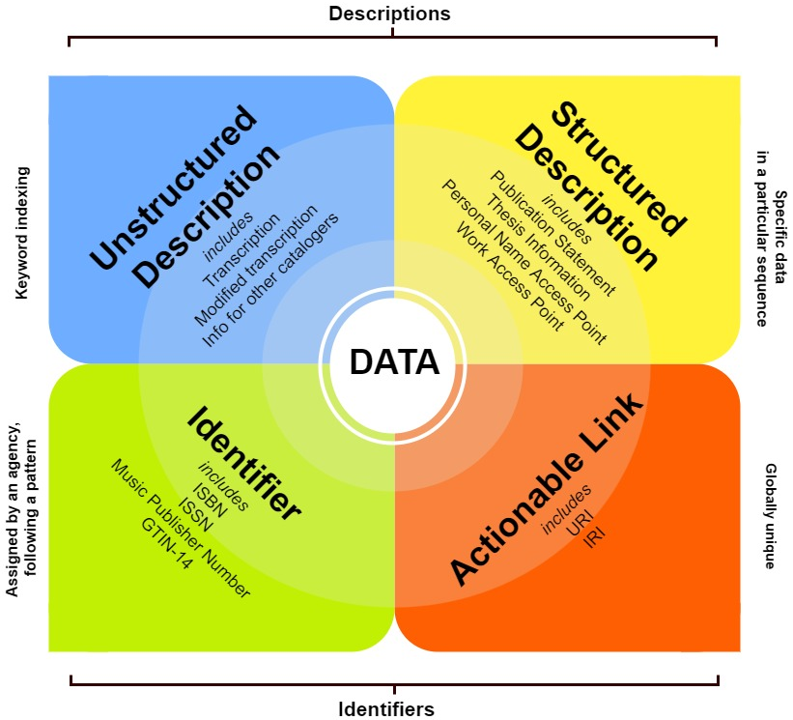
RDA Recording Methods

Slide 19
Elements
RDA definition: A specific aspect, characteristic, attribute, or relationship used to describe an RDA entity
All elements are unique and can only describe one entity
No direct navigation – why?
  Over 3,000 elements!
Explicitly declared for each type of agent as applicable
  Agent, Collective Agent, Corporate body, Family, Person
Some hierarchical relationships
  Author person
    Librettist person, Lyricist person, Rapporteur person,
    Screenwriter person

Slide 20



Finding an Element
Use the search box:
Find the Glossary entry and click on the name
Click on links in an entity page, element page, or guidance chapter
Navigate from an entity page [more info on next slide]
(example from 06.15.43.81)

Slide 21
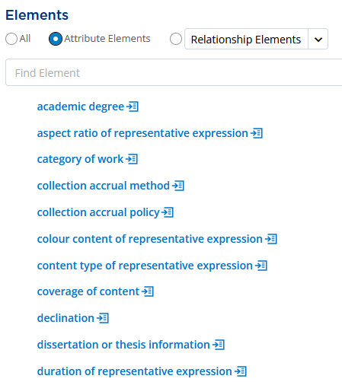
Entities and their Elements
Select an entity, such as work
Scroll to the bottom, to the “Elements”
section
Options
  View all
  View only attribute elements
  View only relationship elements
    Can specify another entity (like person)
Can search any of these lists in the
“Find Element” box

Slide 22
Element Labels
Some unchanged, such as
  title proper
  place of publication
Some with minor changes
  based on (work) → based on work
  place of residence, etc. → place of residence
Not intended for discovery layer data labels
  Terms grounded in linked data principles
  Designed to be meaningful to machines
  Simpler versions can be selected by a cataloging community for display
    But for linked data, reference the precise element
  content type
  date of birth

Slide 23
Completely New Elements Created
Original Toolkit
[no equivalent]
Official Toolkit
appellation of person
transformation by extension plan
identifier for nomen
language of representative expression

Slide 24
A More Drastic Transformation
Original Toolkit
illustrator
Official Toolkit
contributor agent of still image
contributor collective agent of still image
contributor corporate body of still image
contributor family of still image
contributor person of still image
element broken down into separate elements
label modified
relationship moved from expression to manifestation

Slide 25
Organization of an Element Page
Definition and scope
  Element reference
Prerecording
  Is this element appropriate for my resource?
Recording
  Guidance about what data to record
  4 recording methods – always present
Related elements
  Broader and narrower elements
  Inverse (for relationship elements)

Slide 26
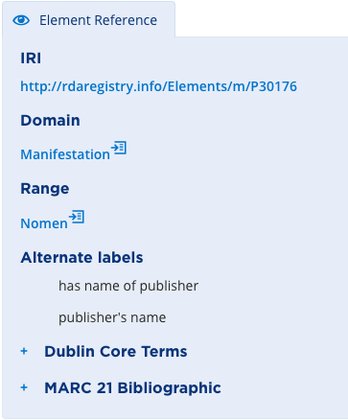
Element Reference
[from name of publisher]
Collapsible box
Contains
  Link to RDA Registry
  (external site; useful for linked data)
  Domain
  Range (for relationship elements)
  Alternate labels
  Mapping to other standards,
  such as MARC 21 (Bib & Auth)
    Expandable by clicking on “+”
Links to entity pages

Slide 27
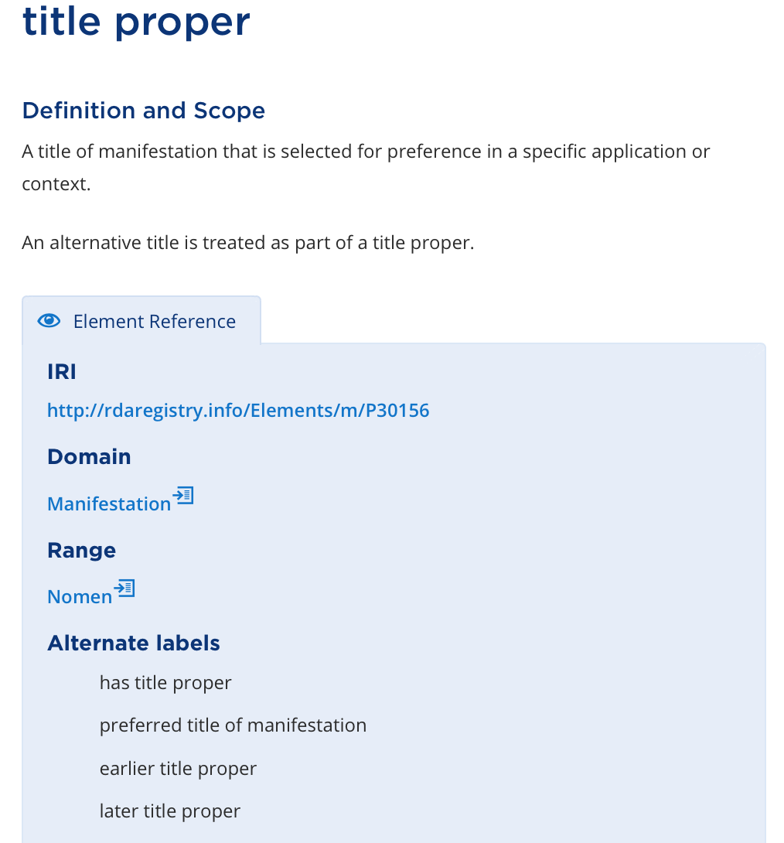
Each Element
Is Unique
unique label
unique definition
unique IRI
unique identifier

Slide 28
Each Element Can
Only Describe
One Entity
The element “title proper” always describes a manifestation

Slide 29
Each Element Has
One or More
Alternate Labels
Verbalized label
(RDA Registry label)
Previous element names
(in Original RDA)

Slide 30
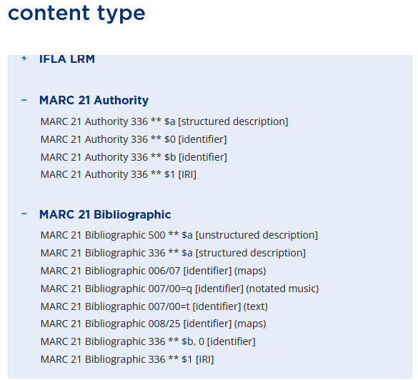

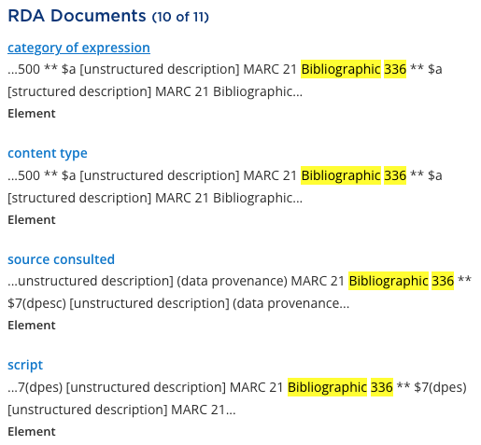
Element Reference – MARC 21 Mapping
Searchable

Slide 31
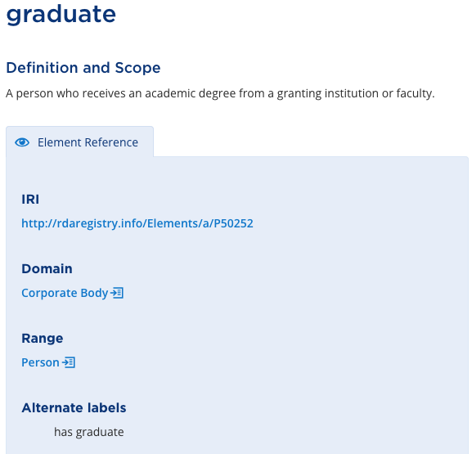
Relationship Elements
Have a domain and a range
RDA Entity that is described by an element
RDA Entity that is the value of a relationship element

Slide 32
Reading an Element Page
The element
relates a
to a
that is

Slide 33
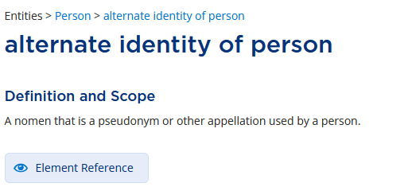
Relationship Designators → Elements
No longer attributes, but elements in and of themselves
Example: alternate identity
  Original RDA K.2.1, Relationship Designators to Relate Persons to Other Persons
    alternate identity: A pseudonymous or other identity assumed by a person.
    Reciprocal relationship: real identity.
  Official RDA

Slide 34
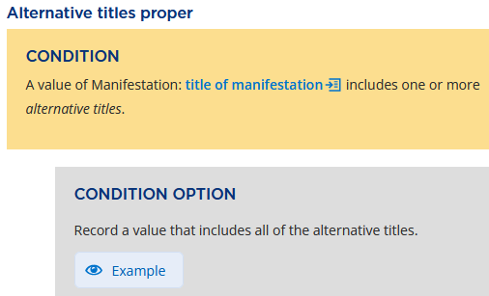
Conditions and Options Boxes
Example from title proper (30.02.03.88)
Replaces the variety of options and
exceptions in the original Toolkit
Condition = situation
  If the box contains multiple
  conditions, they all must apply
Condition options = what to do
  A condition box may or may not have
  multiple separate option boxes, which
  may or may not be mutually exclusive
  Context is everything!

Slide 35
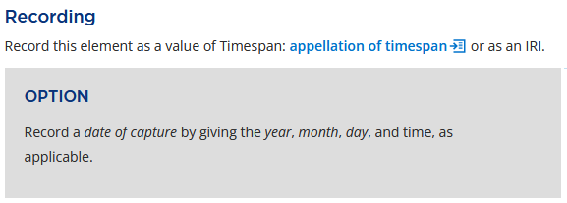
Option Box Alone
Example from date of capture (78.79.00.24)
Option boxes may appear without condition boxes
  To distinguish these, they only use the term “option”

Slide 36
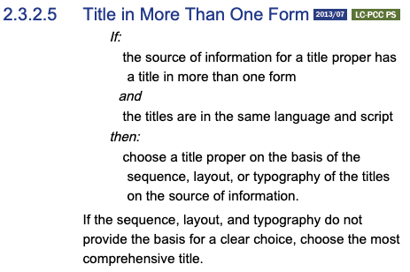
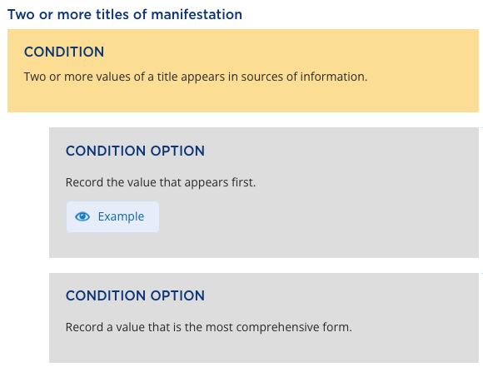
If/Then Instructions → Conditions/Options
  Original Toolkit
Official Toolkit (99.39.48.43)

Slide 37
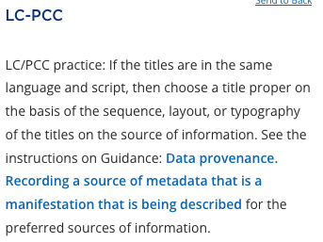
Wait, I Expected to See More Details!
The linked LC-PCC Policy Statements provide additional guidance
  For the first Condition Option

Slide 38
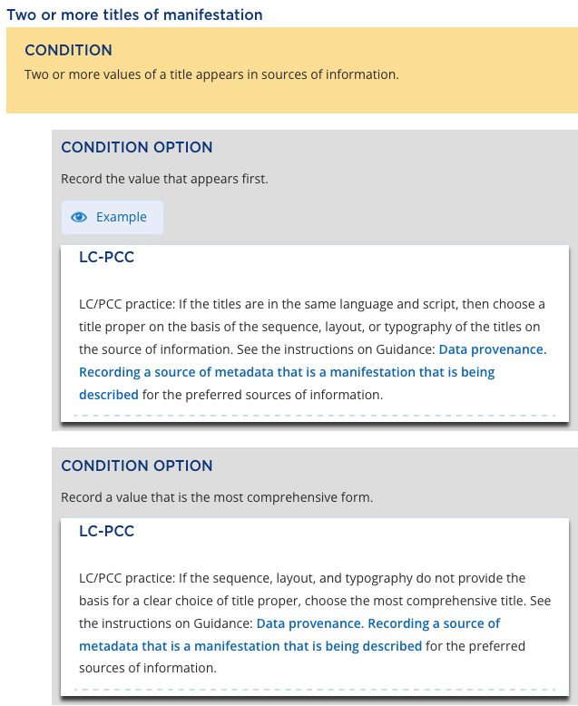
Policy Statement
In Context

Slide 39


Alternatives & Exceptions → Conditions/Options
Original Toolkit
  2.8.2.3 Recording Place of Publication
…
…
Official Toolkit
  place of publication
  Local and larger place names
  … (56.57.03.17)
Notes:
LC-PCC PS on this condition option is Cataloger’s judgment.

Slide 40
Other Kinds of Options
Recording any element is optional, except as specified in
  Coherent description of an information resource (Guidance chapter)
    Must include a description of at least one of the resource’s entities
  Minimum description of a resource entity (Guidance chapter)
    Record a value for at least one appellation element of the entity, using an applicable recording method
    Relate entities by recording a value for a relationship element
  Effective description of an information resource (Guidance chapter)
    Conforms to coherent and minimum descriptions
    Adds other entities and/or elements deemed useful for identification or access
      From application profiles, policy statements, cataloger’s judgment, and/or information availability

Slide 41
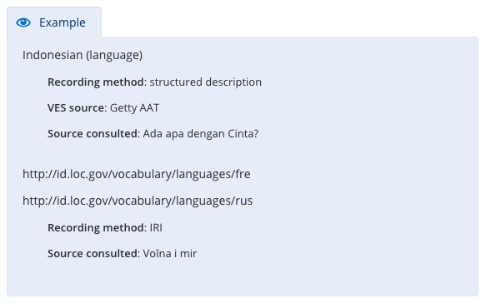
Examples
From language of expression (16.35.97.31)
Collapsible boxes
Instructions may have many
or none
Different types
  With the instruction
  View in context
  [see next slide]
  View as relationship
  [next slide after that]
such as

Slide 42
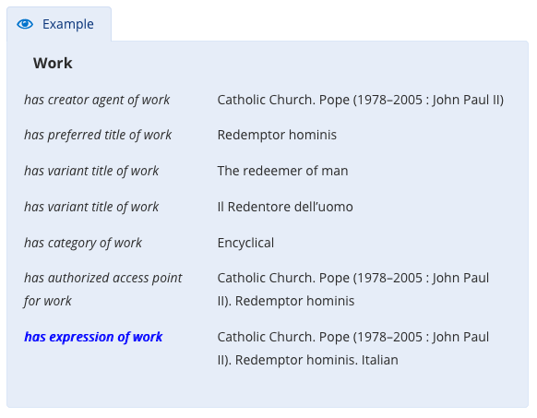
Examples – View in Context
Shows other elements
that could be used in
describing the entity
  The element in focus is
  in blue italics
  (from 57.56.80.15)

Slide 43
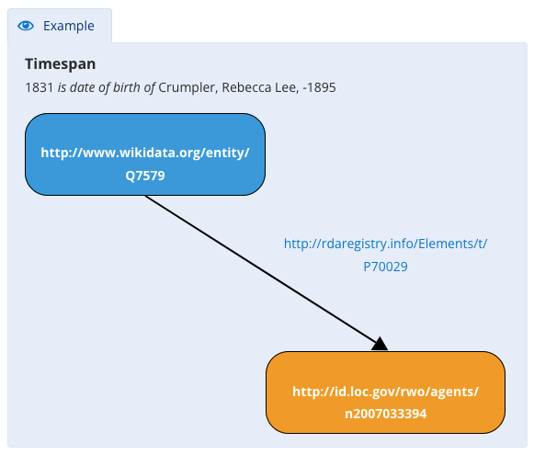
Examples – View as Relationship
A linked data visualization
of the relationship
  From date of birth of
  (24.31.35.50)
  Includes the relevant IRIs

Slide 44
Brief Description of Other Topics

Slide 45
Nomen
A label (or appellation) for any RDA entity (except nomen)
Example: appellation of person
  Definition: A nomen that is used within a given scheme or context to refer to a person
  Domain: Person
  Recording methods
    Unstructured = name of person
    Structured = access point for person
    Identifier = identifier for person
    IRI = not applicable
Range: Nomen
Notes:
An appellation is a string or combination of signs used to refer to an entity

Slide 46
Fictitious & Non-Human Entities
RDA defines “Agent” as:
  An entity who is capable of deliberate actions, of being granted rights, and of being held accountable for its actions. An agent includes a collective agent and a person.
Clearly there is an agent or person behind “authors” such as
  Sherlock Holmes
  Geronimo Stilton
  Newt Scamander
Fictitious authors function as a type of pseudonym
Animals are not considered “agents”

Slide 47
What to do with These Entities?
In bibliographic records
  Per RDA Guidance (Fictitious and non-human appellations), capture this information in a statement of responsibility or other unstructured description
    Do not treat this appellation as relating to any RDA entity
  Per the LC-PCC Metadata Guidance Document (MG: Fictitious and Real Non-Human Entities)
    If you record a fictitious character or a real, non-human entity as a creator, do not code the record as RDA
The LC-PCC MDG also describes what to do with such names in authority records
All of the above has nothing to do with subject treatment

Slide 48
Manifestation Statements
A statement appearing in a manifestation and deemed to be significant for users to understand how the manifestation represents itself
Not implemented by LC/PCC (40.47.54.86)
  LC/PCC practice: The Manifestation statements described in this Guidance are not implemented by LC/PCC. Instead LC/PCC implements the more specific elements covered by these broad category elements. For example, do not implement the Manifestation: manifestation title and responsibility statement, but instead implement the Manifestation: title of manifestation and Manifestation: statement of responsibility elements and subelements.

Slide 49
Representative Expressions
Provides the values of specific elements used to identify a work and distinguish it from other works
Useful to identify characteristics that “live” at the expression level in the LRM model but users associate with the work
  For example, Shakespeare's Hamlet
    Content type: Text
    Language: English
Probably will have the most impact on MARC authority records

Slide 50
Diachronic Works
A work that is planned to be embodied over time, rather than as a single “act of publication”
  Have an extension plan: the content changes over time – by design
  Covers more than just serials
    Includes multipart monographs issued over time
    And integrating resources
  If the plan for the work changes, there’s a new work
    Print vs. online versions of a serial
    Change in scope, audience, genre, etc.

Slide 51
Aggregates
A manifestation that embodies two or more expressions
  Those expressions may realize one or more works
  The manifestation may be issued in one or more units
Three types
  Collection aggregate
    Example: compact disc with more than one musical work
  Augmentation aggregate
    Example: play with critical commentary
  Parallel aggregate
    Example: Canadian government publication in English & French

Slide 52
Many Choices About Describing Aggregates
Record all of the works/expressions embodied in the manifestation
Record some of the works/expressions embodied in the manifestation
  But not all of them; some may not be important enough to mention
Simply relate the aggregate manifestation to the aggregating work/expression
  Encyclopedia
  Shel Silverstein’s Falling up [144 poems!]

Slide 53
You’ve Got This!
You already understand the cataloging rules
  You had to learn specific terminology, practices, etc.
  You had to learn MARC 21
  You know why you want to record a specific piece of information
In spite of the differences, Official RDA is still a descriptive cataloging standard which has roots in the Anglo-American cataloging tradition
  You may need to consult LC-PCC documentation or Community Resources to get the specific guidance you’re looking for, but it hasn’t disappeared
  Ask questions! Don’t be afraid!

Slide 54
For Further Information
ebook: Oliver, Chris. Introducing RDA: A Guide to the Basics After 3R. Chicago: American Library Association, 2021
RDA Toolkit website
  RSC website
    RSC presentations by year
    RDA Teaching and Training Tips (2024)
  RDA Toolkit YouTube channel
PCC Training on Official RDA

Slide 55
Questions?
Ask now, or contact me later: kglennan@umd.edu

