Slide 1
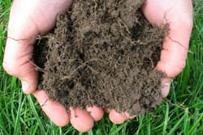
Soil – from Texture to Structure to Sustainability

Slide 2
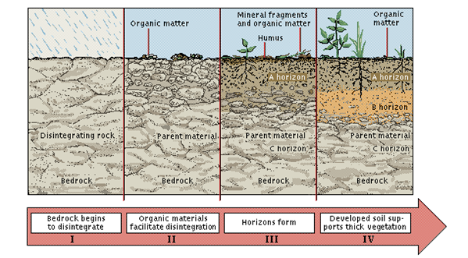
How soil forms

Slide 3
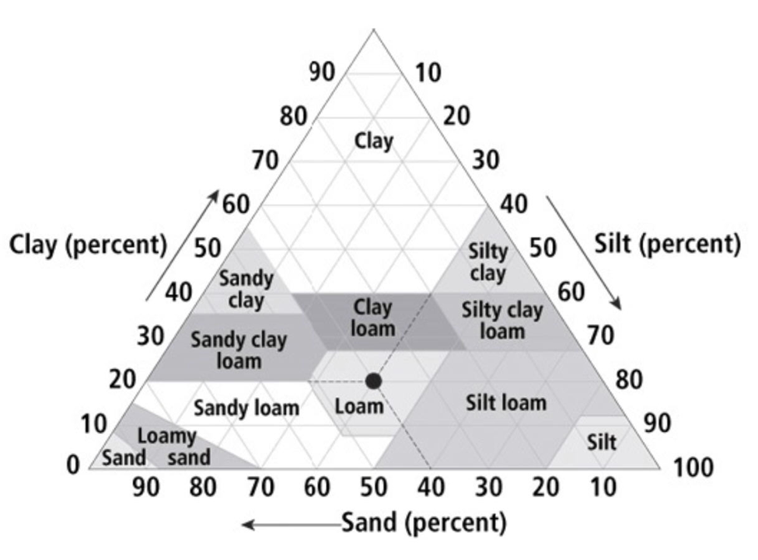
Soil texture SOIL TEXTURE PYRAMID (Source USDA)

Slide 4
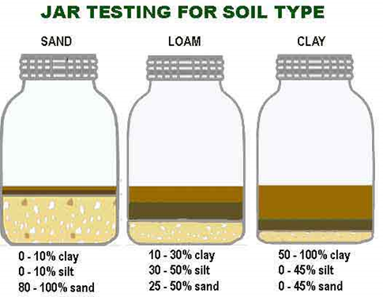
Determining the Soil Type

Slide 5
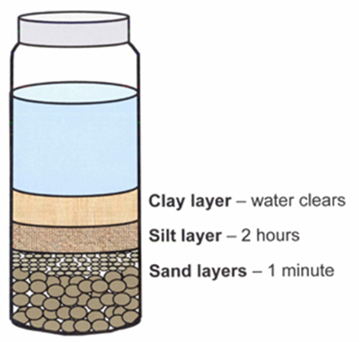

Slide 6
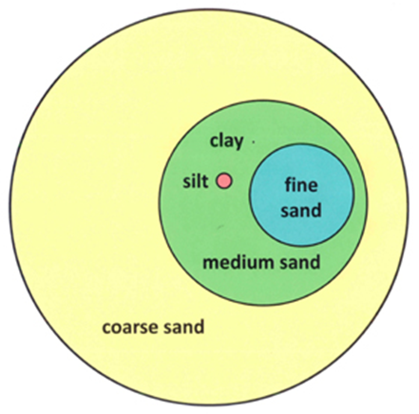
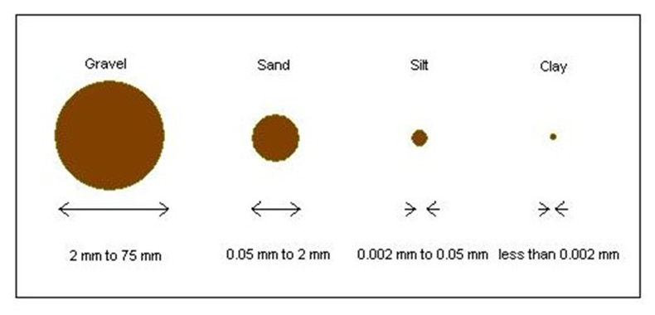
Soil particle size
Notes:
http://www.ext.colostate.edu/mg/gardennotes/214.pdf

Slide 7
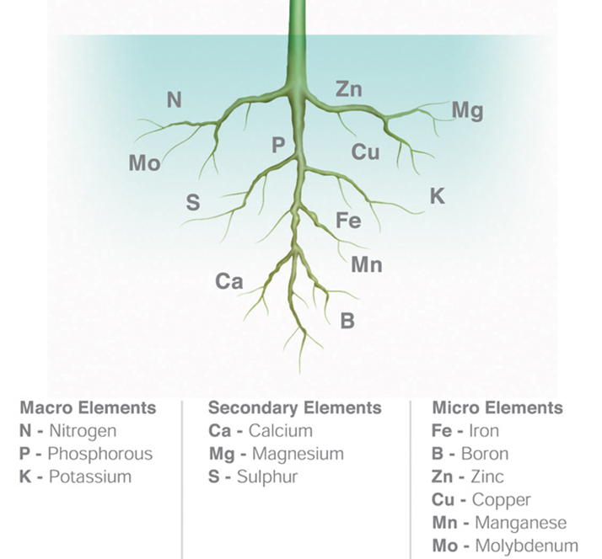
Soil nutrients

Slide 8
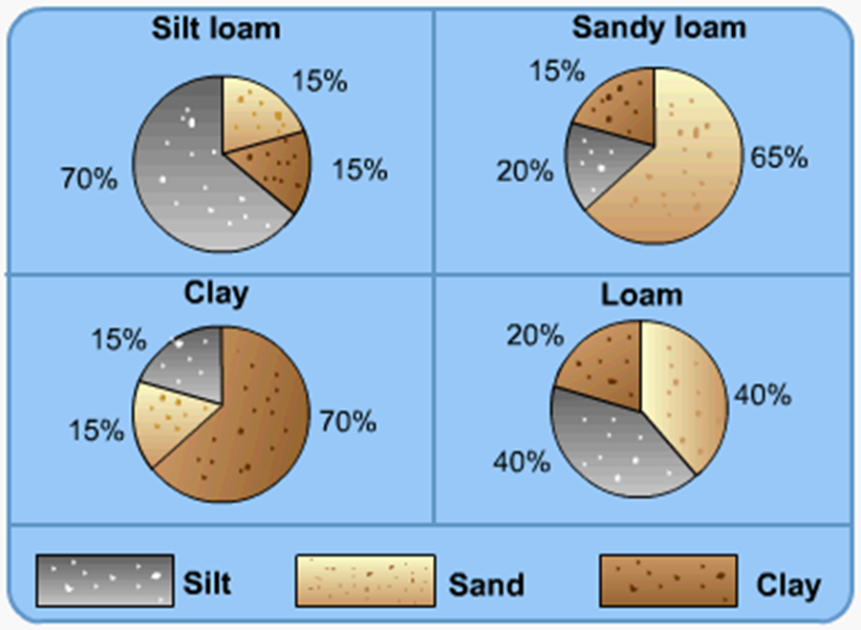
Soil – from texture to structure
http://www.s-cool.co.uk

Slide 9
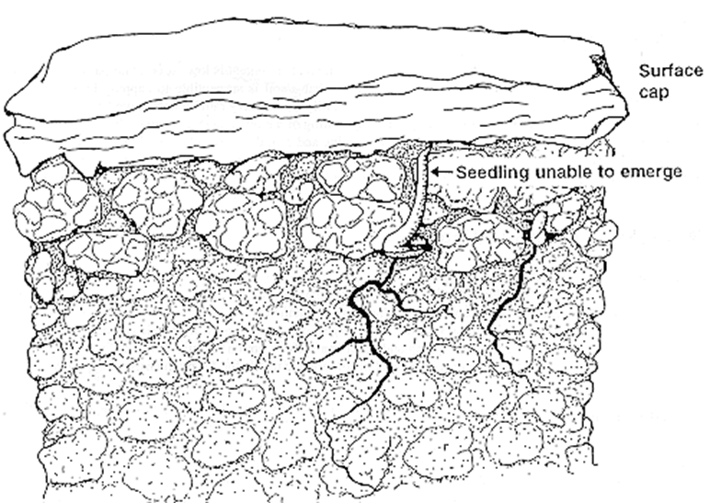
Heavy rainfall following sowing can result in collapse of surface soil structure. Following drying, a hard cap can form that prevents seedling emergence through the surface.
http://maxa.maf.govt.nz Redrawn from Batey (1988).

Slide 10
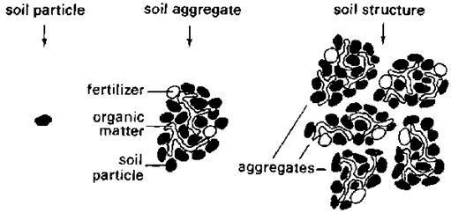
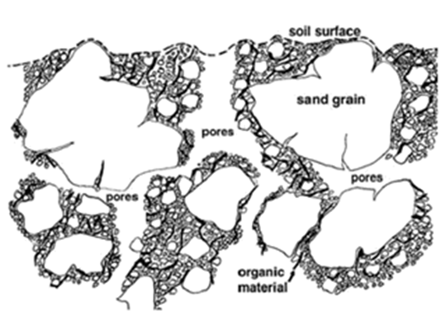
Soil Structure

Slide 12
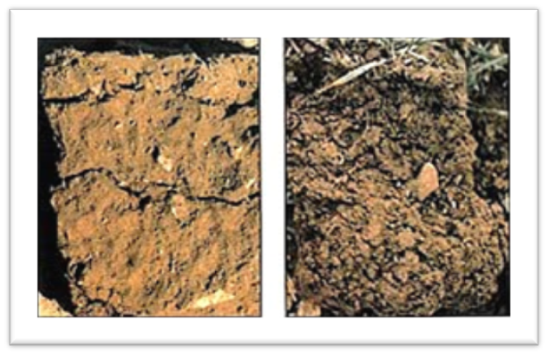

Slide 13
