Slide 1

Universal Design for Learning (UDL) Framework for Accessibility and Inclusivity in Library Instruction
Nedelina Tchangalova
Public Health Librarian
nedelina@umd.edu
Tahirah Akbar-Williams
Education and African American Studies Librarian
takbarwi@umd.edu
Notes:
Presentation at the Big Ten Academic Alliance (BTAA) Library Conference - Equitable Access: Accessibility driving innovation in libraries
May 22-23, 2019
University of Michigan, Ann Arbor, MI
Abstract
Students are diverse not only in terms of age, race, sex, (dis)Ability, ethnicity, religion, political beliefs, but also they are different in the ways of how they learn. As dedicated educators, we strive to ensure that our students have equal opportunities to learn and be fully engaged in instruction. Digital technologies, online resources and mobile devices coupled with the guiding principles of the Universal Design for Learning (UDL) Framework and the University of Maryland (UMD) Web Accessibility Guidelines allowed us to tailor our instruction practices to create an inclusive and accessible learning environment for every student. We incorporated various tools and resources to achieve the learning objectives set up for our library instruction classes. In this presentation, we will highlight some examples of applying the UDL framework and web accessibility principles into our instruction efforts.

Slide 2
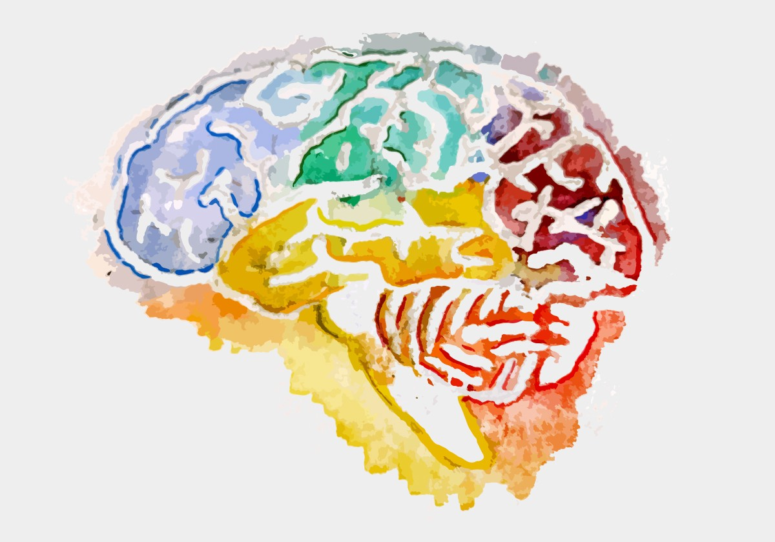
Academic work is all about engaging the brain, right?
Notes:
(Tahirah)
The brain is the processor of our human bodies and while in computers it is processing the programs in an expected way, sometimes errors happen. Therefore, we have computer engineers and programmers to troubleshoot and make the systems work better. The computer experts make changes in the code and in the software programs but we, as educators, can’t change the brains of our students to learn better, right? We can facilitate learning by offering students from all ages and abilities the opportunity to gain knowledge and achieve academic success.
Image: Watercolor painting of a human brain | Graphic by Cassandra Sell, © CAST 2018
https://medium.com/udl-center/udlchat-engage-the-brain-609889fa2f05

Slide 3
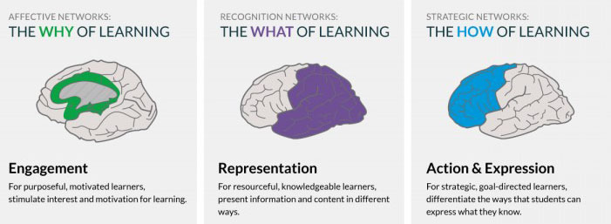
UDL Overview and Framework
Notes:
(Tahirah)
Let’s get started with some definitions and theories. Before we dive deeply in this area, how many of you are familiar with UDL?
UDL is one of the most accepted and applied frameworks for learning, and I would say even for teaching. Teachers with disabilities would benefit from this framework thus making their teaching accessible. For example, a deaf professor may benefit from teaching online courses rather than in-person. Nedelina will speak more about this later.
So, UDL has been first developed in the 90’s at CAST (www.cast.org) and it groups guidelines into three distinct sections, as shown on this slide here:
Emphasis is on multiple means of engagement, representation, and action/expression for all materials that students access.
The guidelines encourage clarity throughout curriculum, promote choice, and set high standards for students of all ages and abilities.
Image: Rethinking Learning (https://barbarabray.net/2017/10/23/udl-and-the-why-of-learning/)

Slide 4
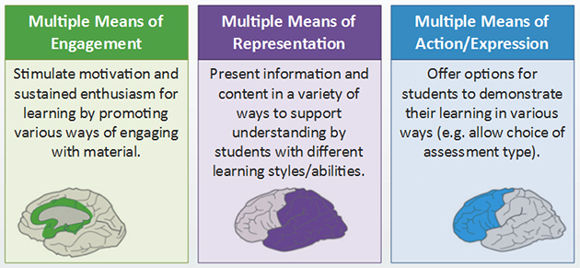
UDL in Action
Notes:
(Tahirah)
Here is a more detailed infographic of the framework. The objective of each section are listed. This allows professors more insight onto how to implement UDL framework in all settings. The framework is based on the fact that there is no “average” student. Every student study and learn differently and educators have to introduce greater flexibility into their teaching practices. Educators should follow these three core principles when designing their lesson plans for in-class instruction or in the online environment to allow for a more inclusive learning environment for all students.
Image: https://ahead.ie/udl-framework

Slide 5


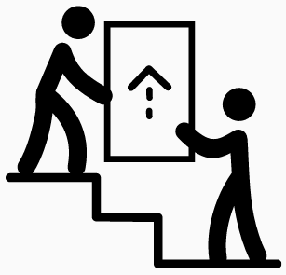
High Standards
Choice
UDL in the UMD Libraries
How does it look like?
Support
Notes:
(Tahirah)
Here at UMD Libraries, we are committed to:
Provide high quality education by setting up high standards. We meet with faculty to set and check in on learning objectives and work collaboratively to design assignments to specifically meet these objectives.
Provide our students choice in selecting the method for learning that they are most comfortable with. We provide multiple options for learning in different formats including text, audio and video format.
Support students to achieve their highest academic potential. We offer students flexible formats for reaching out to us through in-person consultations, phone, chat, video conference call or use technology tools embedded in the Learning Management Systems. We have Canvas at UMD and through this medium we have embedded technology (such as Voice Thread) to provide students opportunity to address their questions right within their own learning environment in Canvas thus building a community of learners.
Image #1: Award by Luc Poupard, CH from Noun Project
Image #2: Choice by Kirby Wu, TW from Noun Project
Image #3: Carry on top by Jenie Tomboc, PH from Noun Project

Slide 6
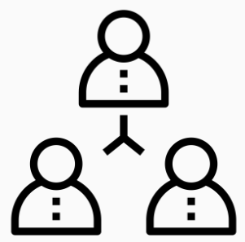
Online Library Modules
Notes:
(Nedelina)
To reach out to students who may not have a one-shot library instruction or to provide an alternative format for learning, I designed library modules that teaching faculty can incorporate into their course spaces. Rather than starting from scratch, I used the modules created by a former colleague. Also, Tahirah introduced me to the Universal Design for Learning (UDL) framework. I think this framework is not just for learning, but is applicable as framework for teaching as well. As a person with a hearing disability, I had to adapt my teaching to various environments. In many cases I will co-teach with a colleague or with a graduate assistant in order to facilitate the classroom discussions. Another adaptive technique is to make sure the videos I use for classroom teaching are closed captioned.
Image: Team building by Becris from Noun Project

Slide 7
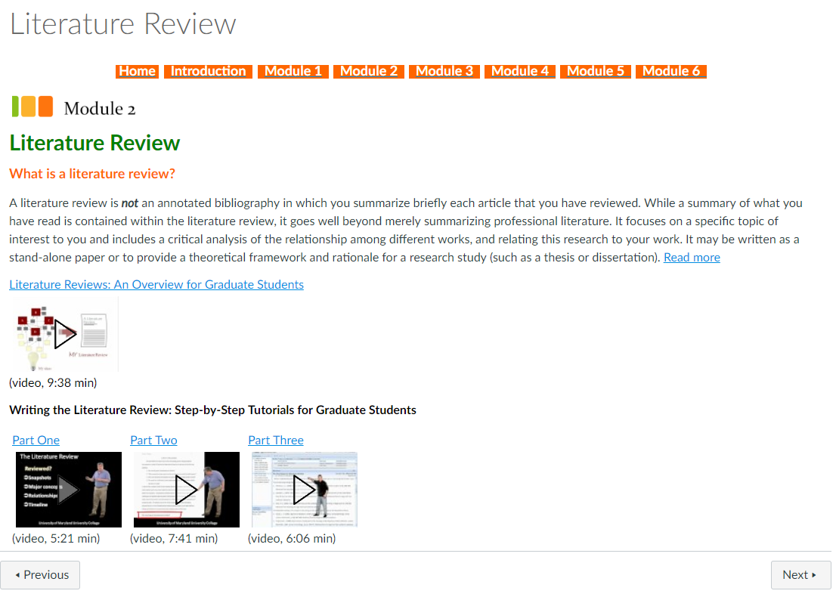
Navigation menu
Link to text
Videos with closed captions
Notes:
(Nedelina)
So, with the accessibility in mind for both students and myself as a teacher, I re-designed the modules in a way to provide more images and videos, and cut off some of the textual information for clarity.

Slide 8

Some Tools for Active Learning
Notes:
(Tahirah)
Building on these modules, I embedded a few tools to facilitate learning.
Image: Man holding tools by Gan Khoon Lay from Noun Project

Slide 9
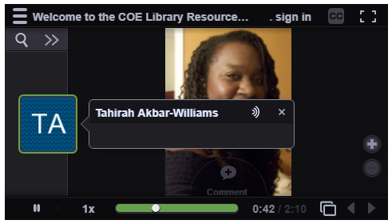
Voice Thread
https://voicethread.com/
Notes:
(Tahirah)
Voice Thread, “is a cloud application, so there is no software to install. The only system requirement is an up-to-date version of Google Chrome or Mozilla Firefox. VoiceThread will run in your web browser and on almost any internet connection. Voice thread can be used in various ways:
Upload, share and discuss documents, presentations, images, audio files and videos. Over 50 different types of media can be used in a VoiceThread.
Commenting - Comment on VoiceThread slides using one of five powerful commenting options: microphone, webcam, text, phone, and audio-file upload.
Sharing - Keep a VoiceThread private, share it with specific people, or open it up to the entire world.”
(https://voicethread.com/about/features/#feature-voicethread)
I used voice thread to communicate with my students. I leave messages for them and ask them to leave me messages about the tutorial or ask questions and/or provide any feedback they would like. However, you can use VoiceThread in so many ways, create assignments for students and have other students comment for presentations. The platform is really good for engaging your students, they seem to like it.

Slide 10
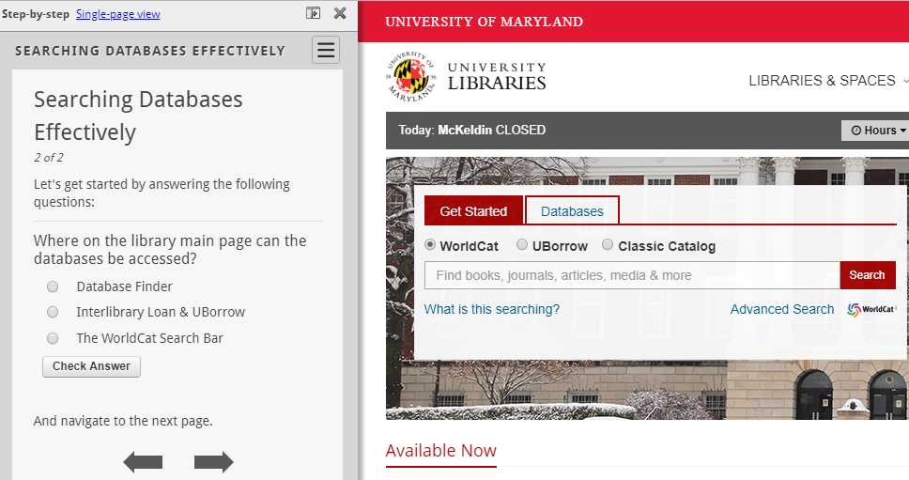
Guide on the Side
https://ualibraries.github.io/Guide-on-the-Side/ Demo
Notes:
(Tahirah)
Guide on the Side “helps you to quickly and easily create online, interactive tutorials based on the principles of authentic and active learning. Know how to use Word? You already know how to use Guide on the Side.” (https://ualibraries.github.io/Guide-on-the-Side/about.html)
This platform gives students practice searches and provide real time answers and interaction. It allows for exploration, mistakes, discovery and learning without being punitive. Students have the freedom to search content, engage subject matter and learn about it in the manner that best fits them.
For example, students can practice searching the catalog, databases and websites to get acclimated to searching and learn search techniques through the prompting and guidance of guides on the side.
Show a demo here: http://tutorials.lib.umd.edu/tutorial/worldcatadvancesearch

Slide 11

Measure of Success
100% responded that all students should take a research skills session
85% said that the tutorial was easy to follow
67% agreed that more students should have access to a tutorial like this
How would you rate your research skills in general?
BEFORE taking the tutorial
57% responded that they have fair research skills
20% responded that they don’t know
AFTER taking the tutorial
50% responded that they have good research skills
33% responded that they have very good research skills
Notes:
(Tahirah)
At the end of the semester, students were asked to answer a few questions related to how confident they felt as researchers before and after taking the online tutorial. I wanted to gauge the success of the online tutorial to see if students believed that they were better researchers after taking it. The feedback was positive, many students believed that taking the tutorial was a valuable use of their time and that more students should have access to it. Also, they felt as if their research skills had improved.
Image: Help by Gregor Cresnar from Noun Project

Slide 12

Accessibility Issues
Notes:
(Nedelina)
Although the tutorial seems valuable to students, more work is needed in order to make these modules even more accessible.
Image: Worklife by ghayn from Noun Project

Slide 13
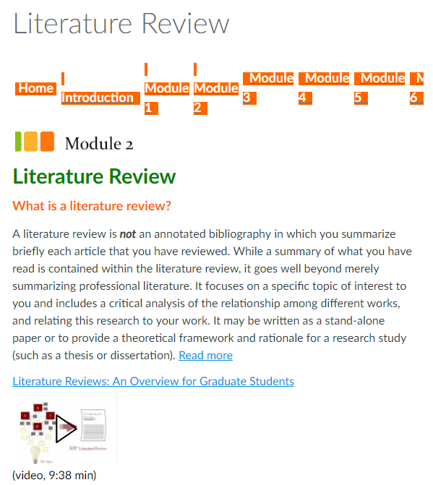
Before
View on a laptop
View on a tablet or phone
Notes:
(Nedelina)
While it is nice to have the navigation menu there, when seen on a mobile device, this table transforms in a difficult to navigate list of tabs. When consulting with an instructional designer, she advised to use the built in tools within the Canvas course page to create a web responsive page.

Slide 14
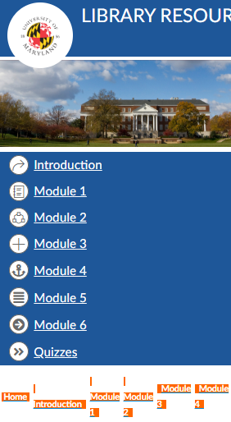
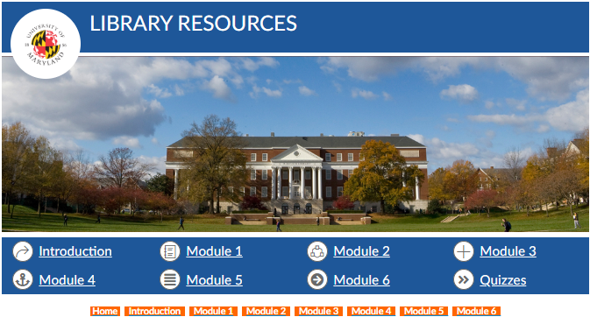
After
Notes:
(Nedelina)
The image on the left shows the navigation bar in orange along with the re-designed navigation bar in blue above. With the responsive design, the course can be viewed on any device such as tablet, iPad, phone, etc.

Slide 15

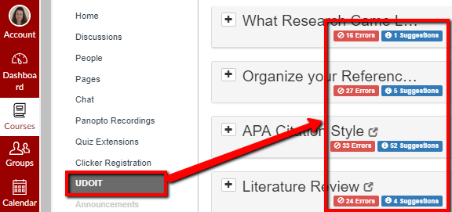
Tool #1:
Notes:
(Nedelina)
This slide shows a layout of the course with UDOIT tool embedded in the Canvas course. When you run it on your course, it will run a report listing the problematic areas with suggestions on how to fix them. You may want to check at your institutions to see if you have it available because it’s a subscription base. These errors, shown in red here, actually can be easily fixed by following the 6 six steps outlined at the next slide.

Slide 16
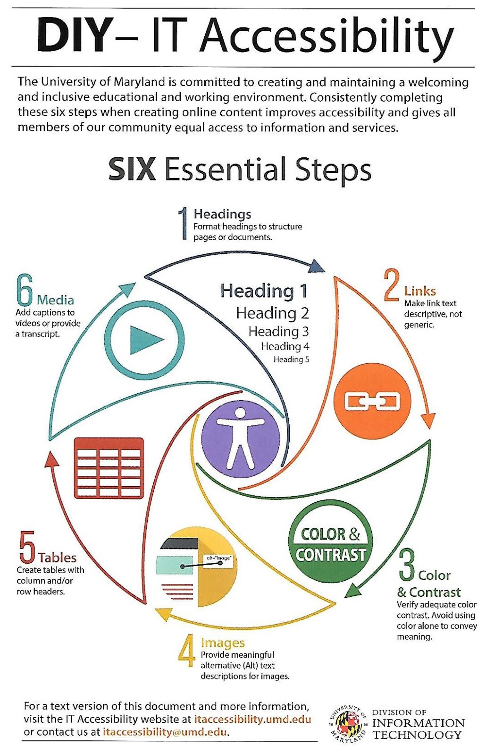
Tool #2: Checklist
Headings
Links
Color & Contrast
Images
Tables
Media
https://itaccessibility.umd.edu/sites/default/files/AccessibilityHandout2-6-19.pdf
Notes:
(Nedelina)
Consider checking checklists and guidelines developed by your institutions. Here is the document at the University of Maryland College park which outlines in a very concise manner the items that one must keep in mind when designing online content.

Slide 17

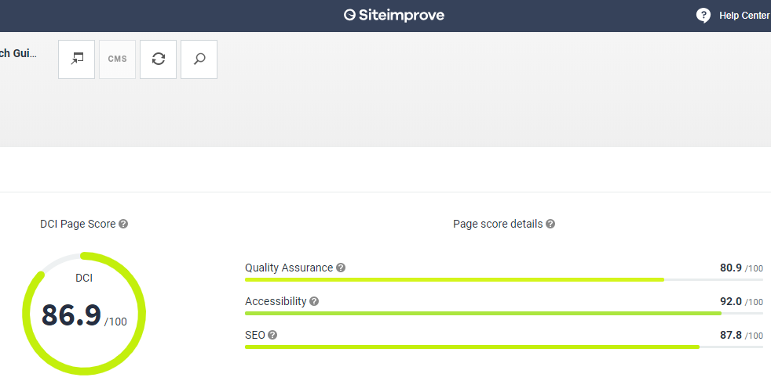
Tool #3:
Notes:
(Nedelina)
Other tools include Siteimprove tool which can help you address issues impacting your site’s accessibility, content quality, and more.

Slide 18
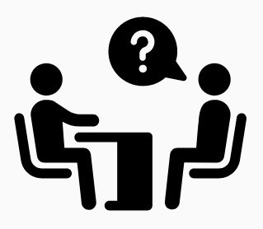
Future collaborations
Notes:
(Nedelina)
You are not alone! Consult the experts and make a positive impact on student’s learning!
Instructional designers have experience in accessible learning and quality assurance.
Image: Consultation by Adrien Coquet, FR from Noun Project

Slide 19
THANK YOU
Nedelina Tchangalova
Public Health Librarian
nedelina@umd.edu
Tahirah Akbar-Williams
Education and African American Studies Librarian
takbarwi@umd.edu
Notes:
Thank you! We would love to hear from you!

