Slide 1
Instructor Use of Educational Streaming Video Resources
Please note that this title, while shorter, is still pretty lame. Suggestions would be greatly appreciated!
Preliminary results From a Qualitative Research Study
Andy Horbal
Library Research & Innovative Practice Forum
University of Maryland
June 8, 2017
Notes:
This study was funded in part by a generous grant from the Library Research Fund. Thanks, LRF!
Franco (2002) defines educational videos as non-fiction titles which “contain information that is important for educators” but are not “of enough interest to consumers to warrant distribution to the home market” and thus are sold at higher prices than most individuals can afford.”

Slide 2
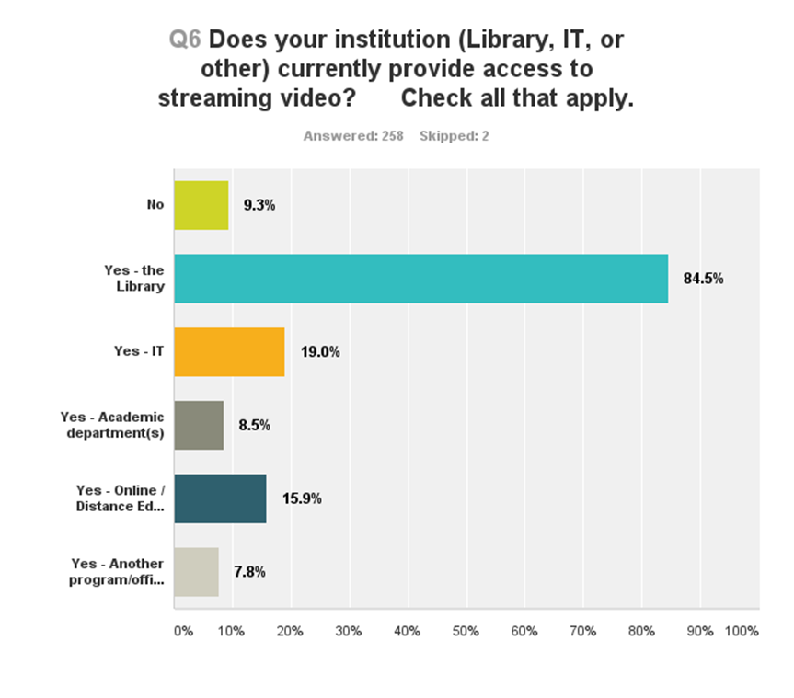
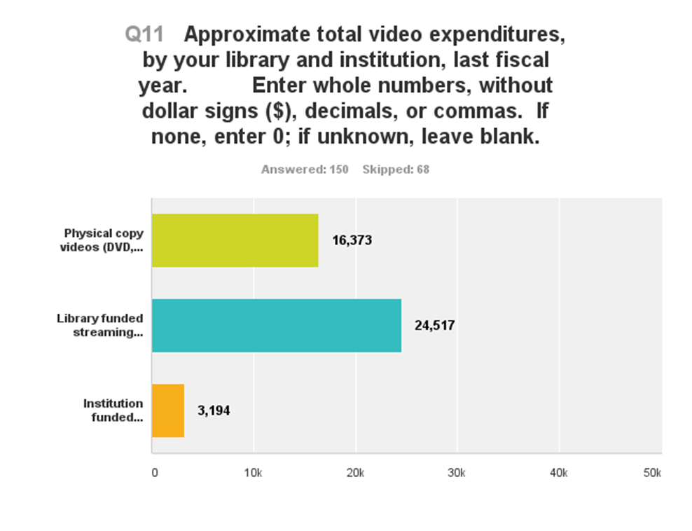
Background
--Farrelly, D., & Hutchinson, J. (2016). Academic library streaming video revisited [PowerPoint
slides]. Retrieved from https://repository.asu.edu/items/39058.
Notes:
So: academic libraries are spending a lot of money on educational streaming video resources!
The literature also contains:
Evidence that for instructors, the library plays a secondary role to reviews and word-of-mouth as a resource for discovering moving images to use, and to online video sites and personal and departmental purchases as a resource for obtaining them.
Evidence that students value streaming video and would like to see its use by instructors become more ubiquitous, but that overall usage is primarily driven by faculty and classes.
Lots of discussion of different options for acquiring educational streaming video resources
What it doesn’t contain is anything about how instructors actually choose which resources to use and what they do with them after they’ve made a selection which would help librarians make informed collection development decisions.

Slide 3
Research Questions
Why and how do instructors use educational streaming video resources?
How do instructors who use educational streaming video resources discover them?
How satisfied are instructors with the educational streaming video resources they use?
How essential do instructors who use educational streaming video resources consider them to be to their work, how interested in/aware of non-library alternatives are they, and what would they do if these resources ceased to be available?

Slide 4
My Project
Conducted in-depth interviews with 19 UMD instructors.
Included a screening questionnaire to filter out users of UMD’s ELMS Course Media Reserves Program.
Recruited from two populations: ELMS Course Media Reserves users referred to Films@UM + instructors who responded to a call for participants distributed by subject librarians.
Ended up w/ 19 interviews, totaling more than 14 ½ audio hours and 386 pages of interview transcripts containing 157,122 words.
Uncoded transcripts, coded transcripts, code frequency spreadsheets, and code book all will be uploaded to DRUM.
Article will be submitted to Journal of Academic Librarianship after I finish writing it, hopefully later this month!
Notes:
Qualitative approach chosen because the main objective of my research was to explore or investigate (see “Ditch the Survey” presentation).
Filtered out ELMS Course Media Reserves users to obtain more generalizable results.
Thanks for your help, subject librarians!
1 interview discarded because subject wasn’t clear on what I was asking

Slide 5
Population
5 interviewees associated themselves with the College of Arts and Humanities; 4 with the College of Behavioral and Social Sciences; 1 with the College of Education; 1 with the Philip Merrill College of Journalism; 1 with the School of Languages, Literatures, and Cultures; 3 with the School of Public Health; and 2 with the School of Theatre, Dance, and Performance Studies.
18/18 interviewees indicated that they use educational streaming video resources at least once/academic year; 17/18 indicated that they use them at least once/semester; 13/18 interviewees indicated that they typically use them multiple times/semester.
All 18 interviewees referenced communicating with a librarian or another member of the library staff either in person or remotely via email, phone, text, or some other means.
All 18 interviewees referenced discussing educational videos with other people.
Notes:
So: my population consisted of “regular customers” of the library from the arts, humanities, and social sciences who were, perhaps, more passionate about educational streaming video resources than most people.

Slide 6
Key Findings
Instructors indicated that in general, they are satisfied with the educational streaming video resources they use, and that they compare favorably to both commercial and non-streaming alternatives.
  Greatest relative strengths compared to commercial alternatives = audio-visual quality (12/15 favorable) and licensing terms/terms of use (12/12 favorable), with the specific reason being the assumption that the library had already taken care of obtaining all necessary rights for them to do whatever they wanted to with the video.
  Most common barrier described by interviewees = need to use a proxy link and/or for UMD users to authenticate themselves through a VPN (7/18 mentions).
13/17 interviewees indicated that they wouldn’t use a non-streaming educational video if it was available in streaming form or that they would do so only under very specific circumstances; none indicated an overall preference for non-streaming video resources.

Slide 7
Key Findings (cont.)
11/18 instructors indicated that they wouldn’t knowingly use a non-library educational streaming video resource for instruction if the same title was available through the library + four indicated they would use both.
Far and away the most common use (18/18) for educational streaming video resources instructors described was teaching, with use in a lecture series and research (2/18 each) trailing far behind.
18/18 instructors indicated that when using educational streaming video resources for teaching, they assign them to their students for outside-of-class viewing. A strong majority (13/18) indicated that they sometimes show videos in class as well, but 2/3 of all interviewees indicated that the primary benefit of these resources was the freedom they afford them to utilize limited class time for other, more important things than watching videos.
Notes:
This indicates a strong preference for educational streaming video resources supplied by the library!

Slide 8
Key Findings (cont.)
Most instructors seemed to regard using videos in their entirety as the default option, but 15/18 indicated that they would consider using portions of videos if the situation seemed to warrant it. The most common reason given for using just portions of videos was concern about limited class time.
17/18 instructors indicated that they use popular (public film screenings, newspapers, etc.) and professional (journals, interactions w/ colleagues, etc.) resources to help them identify educational video resources to use. By contrast, only 4/18 instructors indicated that they rely on the library for this, with five more describing searching within educational streaming video databases provided by the library. However, 16/18 instructors indicated that they have relied on the library to help them acquire or locate the video(s) they have decided to use.
Notes:
This suggests that interviewees see the library’s primary role as being to make the educational streaming video resources available, not to help them figure out what resources might be a good match for what they want to do.

Slide 9
Key Findings (cont.)
10/18 instructors described using or being interested in using technological means to determine whether or not students viewed assigned videos, but no other special feature (including captions/subtitles, transcripts, and clip-making tools) was mentioned by more than 3 instructors.
14/18 instructors discussed how libraries should or shouldn’t market the educational streaming video resources in their collections and related services. The majority (10/14) suggested that emails from a librarian would be an effective form of marketing. No other idea was mentioned by more than three instructors.
Another potential marketing/communication initiative is suggested by the fact that 8/18 instructors indicated that they are willing to “retire” a title that they use if it becomes dated or just as part of a general tendency to cycle things in and out of their teaching.

Slide 10
Recommendations
When reviewing the title list of an educational streaming video resource, the most important consideration isn’t the total number of titles available, it’s the number of titles used by your instructors. Libraries with the means to host their own content may find that this offers them the best value.
From an instructor use standpoint, there is no longer any reason to acquire an educational video in a physical format unless you’re planning on converting it into streaming video form yourself.
Instructors want to be able to determine which of their students have viewed the films they were assigned to watch. Other special features like transcripts, subtitles/captions, and clip-making tools are a nice bonus, but aren’t essential. Please note, though, that there may be legal and ethical reasons not addressed by this study to look for resources with subtitles/captions.

Slide 11
Recommendations (cont.)
The best way to promote individual titles and resources is by emailing faculty. While instructors appreciate being provided with alternatives to these titles, this probably shouldn’t be a focus of marketing and outreaching initiatives. A better option might be partnering with departments and schools to create a syllabus repository, or harvesting video-specific information from such repositories if they already exist at your institution.
If you are interested in a more general campaign to promote the format itself, focus on the main reason instructors use streaming video resources: as a more convenient and pedagogically-sound alternative to screening films in class.
Finally, although instructors don’t look to the library for advice about what titles to use, they are receptive to replacing titles which have become “out of date.”

Slide 12

Notes:
Questions?

