Slide 1
Building Awareness of Archival Value: Working
With Record Creators
Sesily Resch
Karolina Lewandowska
Mid-Atlantic Regional Archives Conference
Spring 2019
Morgantown, WV

Slide 2
Disclaimer
The opinions expressed in this presentation are the authors’ own and do not reflect the view of the Department of the Navy, the Department of Defense, or the United States Government.
Notes:
The opinions expressed in this presentation are the authors’ own and do not reflect the view of the Department of the Navy, the Department of Defense, or the United States Government.

Slide 3
Overview of NHHC
The Naval History and Heritage Command (NHHC) is headquartered in Washington, DC. The history of the NHHC can be traced back to 1800 with the founding of the Navy Department Library.
Mission: To preserve and present an accurate history of the U.S. Navy
Specialties:
  Archives
  Histories
  Navy Department Library
  Navy Art Collection
  Underwater Archeology
  Curator Branch
  Official Navy Museums
  Communications & Outreach (Public Affairs)
Notes:
Sesily
A little about who we are as an organization.
The Naval History and Heritage Command can be traced back to the 1800s with the founding of the Navy Department Library.
Our primary mission is to preserve and present an accurate history of the United States Navy.
As a command we achieve this through the work that our 8 divisions perform on a daily basis.

Slide 4
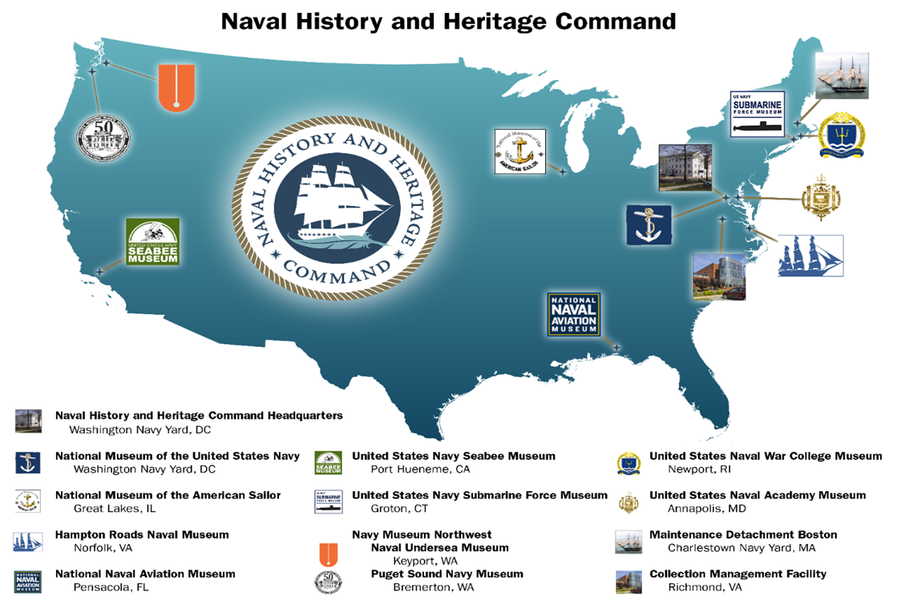
Locations
Notes:
Sesily
We have 13 locations across the country which include 10 naval museums, our collection management facility and maintenance detachment Boston.
Our archive is located at our headquarters on the Washington Navy Yard in Washington, DC.

Slide 5
History, Mission & Staff
History: Traces history back to 1882 with formation of Office of Naval Records and Library within the Office of Naval Intelligence
Mission: Collect, organize, preserve, protect, and make available select permanent official records and other historically significant documents of the Navy such as personal papers, oral histories, and photographs
Staff: 25 archivists and 2 FOIA specialists organized into Processing and Reference/FOIA sections + contractors for special projects
Part of the Histories and Archives Division that includes the Navy Department Library and the Histories Branch
Notes:
Sesily
Our complete mission is to collect, organize, preserve, protect, and make available select permanent official records and other historically significant documents of the Navy such as personal papers, oral histories, and photographs.
We have a staff of 25 archivists and 2 FOIA specialists organized into Processing and Reference/FOIA sections and sometimes contractors for special projects.

Slide 6
Collection Overview
Largest repository of permanent Navy records outside the National Archives
  Almost 40,000 cu. Ft. of textual and special media records and donated archival material
  1 million+ photographs
  4 TB+ of electronic records
Approximately 85% to 90% of textual and electronic holdings are official records
  Transferred to the Navy Archives in accordance with Navy record schedules
  Retained up to 50 years depending on the record series before transfer to National Archives
Collecting Areas
  Operational records
  Ships History Collections
  Aviation History Collections
  Personal Papers
  Office of the Chief of Naval Operations
Notes:
Sesily
We are the largest repository of permanent Navy records outside the National Archives.
Our collection consists of an estimated 40,000 Cubic FT of textual and special media, over 1 million photographs, and over 4 TB of electronic records.
Approximately 85-90% of these records are official and will be transferred to the National Archives depending on the record series.
Our collecting areas range from operational records and histories to personal papers

Slide 7
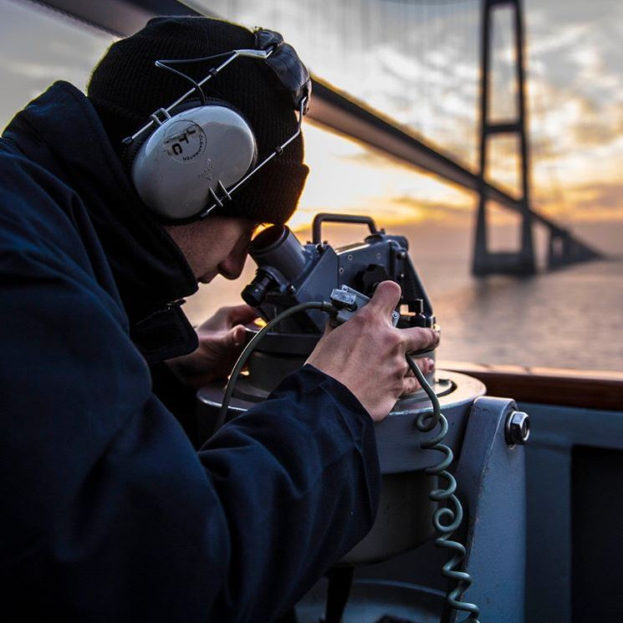
US Navy
NAVY PERSONNEL
Active Duty: 329,867
Officers: 54,621
Enlisted: 270,811
Midshipmen: 4,435
Ready Reserve: 100,495 as of Dec 2018
Selected Reserves: 50,080
Individual Ready Reserve: 42,415
Navy Department Civilian Employees: 274,300
SHIPS AND SUBMARINES
Deployable Battle Force Ships: 288
https://www.navy.mil/navydata/nav_legacy.asp?id=146
https://www.instagram.com/p/BtHTnLzhxRm/
Notes:
Sesily-transition out
A little about the Navy.
We are part of the 274,000+ civilians that work for the Navy.
We happily support the almost 330,000 active duty sailors.
On a regular basis Kay works with the fleet which consist of 288 vessels.
And I work with the roughly 3.500 commands that make up the navy.

Slide 8
Glossary
Archival Value - for our purposes, the record has validity
Validity – accurately represents reality
OPNAVINST - is a formally documented lawful order that is issued by the Chief of Naval Operations. These instructions are typically used to establish United States Navy policy, procedures, and requirements.
Fleet consists of 288 vessels
Naval Commands over 3,000 (land, sea, and reserve units)
History – for our purposes, it’s anything that happened ‘yesterday’.
COR are annual reports submitted by commands
Deck Log monthly reports of Naval commissioned vessels
NCDU- Naval Combat Documentation Unit is a reservist unit which works with commands to document the Navy’s active history
Notes:
Kay –transition
Archival Value - for our purposes, the record has validity
Validity – accurately represents reality
OPNAVINST - is a formally documented lawful order that is issued by the Chief of Naval Operations. These instructions are typically used to establish United States Navy policy, procedures, and requirements.
Fleet consists of 288 vessels
Naval Commands over 3,000 (land, sea, and reserve units)
History – for our purposes, it’s anything that happened ‘yesterday’.
COR are annual reports submitted by commands
Deck Log monthly reports of Naval commissioned vessels
NCDU- Naval Combat Documentation Unit is a reservist unit which works with commands to document the Navy’s active history

Slide 9
COR and Deck Logs
Record Series – document a specific kind of transaction or function
https://commons.lbl.gov/display/aro/Record+Series+Definition
In our case, either monthly or yearly ‘reports’.
Again, these record series are governed by the OPNAVINST
Notes:
Kay
NARAs full: “A group of records arranged according to a filing system or kept together because they relate to a particular subject or function, result from the same activity, document a specific type of transaction, exist in the same media format, or have some other type of relationship.”
COR and Deck Log are record series that we both manage. Take all of the Navy out of it and a deck log is a monthly report and a COR is a yearly report.
We are accessioning the receipt of new collection materials daily and appraising the records as we go. I review roughly 3,000 to 4,000 pages daily, Sesily reviews between 2,500 and 3,500 pages daily during the height of processing. We don’t process and then move onto another collection or record series. Because of this, we have become subject matter experts..
When the record is ‘missing’ pages (usually left on the copier) or vital information to ensure the record is complete, I reach out to the ship to ensure that archive and future users have a complete record to look at.
Similar to Kay, when additional reports listed for submission or vital information is missing, or the OPNAVINST is not followed I will reach out to the command for additional materials. Every command receives a received receipt that acts as our institutions accession record.
But because COR and Deck Logs are programs we are responsible for, we determine what to create and what to include in either their monthly or yearly report. NHHC owns the record series, so we are also the program managers, setting the policy for the CORs or the deck logs via the OPNAVINST. There is a natural reluctance to get involved in the records you get, there is very much a passive nature of archival collection. But during those times, you gotta take off your archivist hat and put on your program manager hat.

Slide 10
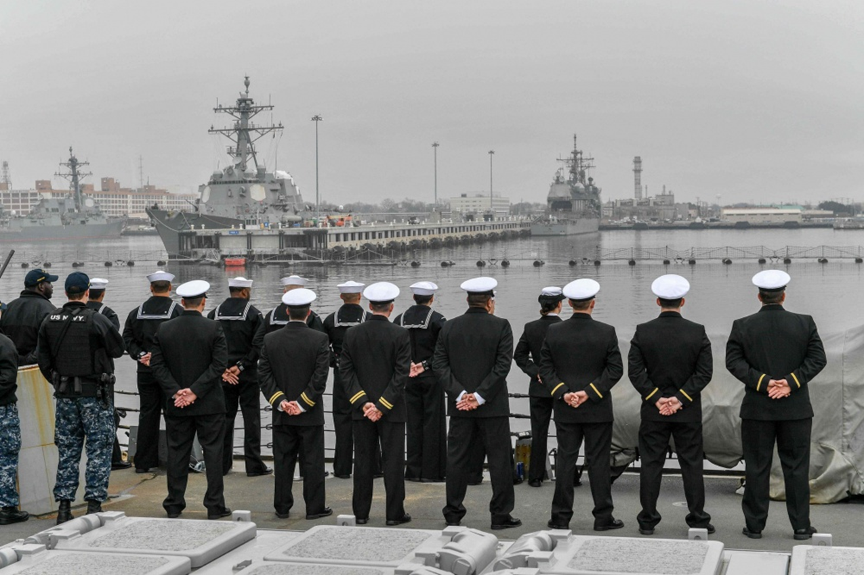
US Navy Sailor
“…I didn’t think anyone really looked at the deck log let alone read any of it once we send it off…”
https://www.navy.mil/view_image.asp?id=231199
Notes:
Kay
An excerpt from a 2018 email that I received. Doesn’t matter the rank, the type of ship, etc. This is how our Sailors feels about the records that they create.
And while a US Sailor feels this way, I am sure that a lot of record creators feel this way across the federal government, across the local government, across industries, etc.
Many record creators don’t understand how their records are used once they reach the archive and either they put no effort into their work or in effort to be helpful they send everything and the kitchen sink but none of it has any archival value.
I always say that our Sailors know sailor ‘stuff’. Archival value is not a skill set taught by the Navy.
The Archivist’s Code is to remain neutral.
And yet, The Archivist in appraising records for retention or disposal acts as the agent of future generations. So why not intervene before creation? We are constantly making decisions when appraising records for retention or disposal that will have implications for many years to come. What’s the difference between retention and please send us this. What’s the difference between disposal and please do not give us 9 million photos of sailors taking a written exam.
This is where our jobs becomes a balancing act. As program managers we need to enforce the rules. We have to work with the fleet/commands to make sure they are following the OPNAVINST. As archivists we want to passive but we want future generations to be able to use the records we have. As records managers, we want to receive the required materials properly the first time, and to assure that the records are properly maintained in our case according to records management issued Standard Subject Identification Codes. Furthermore, as records managers we want the materials properly maintained for the duration of their life cycle or transferred to their final repository. It is important to understand that we live in the gray area where we do not necessarily tell the records creator what to create, rather what they need to include.

Slide 11

Archivist vs Records Manager vs Program Manager
Records Manager
Archivist
An individual responsible for the administration of programs for the efficient and economical handling, protecting, and disposing of records throughout their life cycle.
https://www2.archivists.org/glossary/terms/r/records-manager
1. An individual responsible for appraising, acquiring, arranging, describing, preserving, and providing access to records of enduring value, according to the principles of provenance, original order, and collective control to protect the materials' authenticity and context. - 2. An individual with responsibility for management and oversight of an archival repository or of records of enduring value.
https://www2.archivists.org/glossary/terms/a/archivist
Program Manager
Responsible for planning and governance and for overseeing the successful delivery of the program’s output/product
https://www.pmi.org/learning/library/roles-responsibilities-skills-program-management-6799
Notes:
Kay
Archives generally concern themselves more with the extra work that happens AFTER disposition
Records Managers generally concern themselves more with the before it gets to the archives.
Program Managers generally concern themselves more with the planning, activities, and outputs of a specific program.

Slide 12
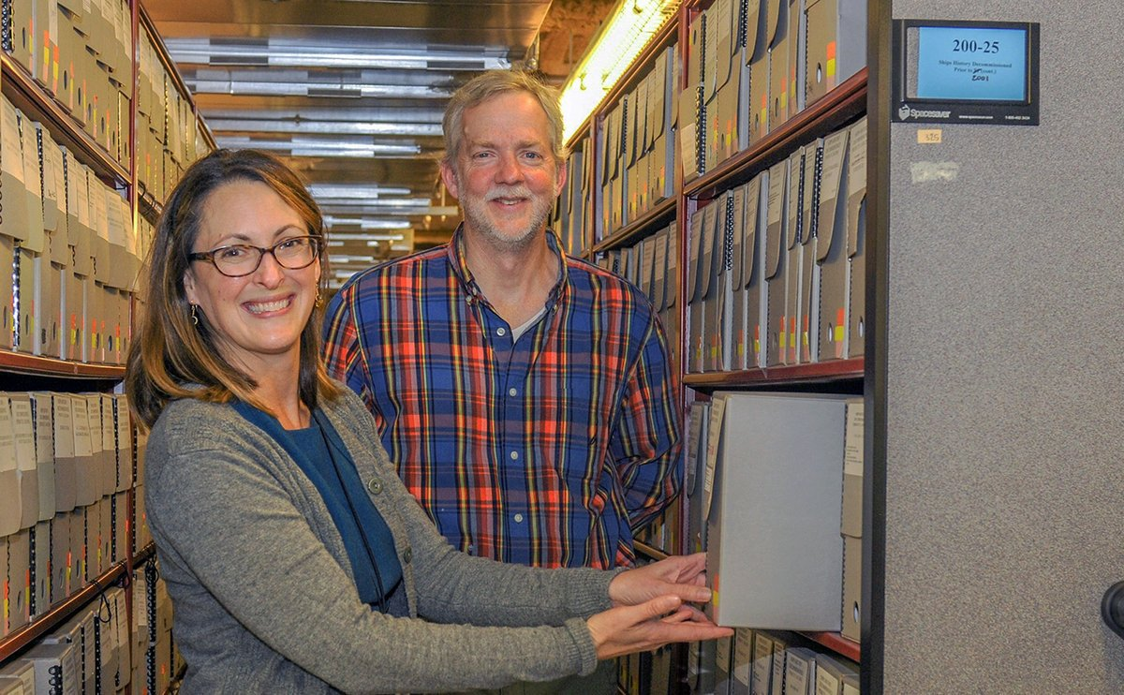
No one knows their collection the way archivists know their collection.
Notes:
Kay
No one knows collections the way archivists know their collections, so who is better qualified to answer questions? Provide support? Explain how the records are used?
All archivist have a spirit of helpfulness to reference requests. It is natural to assume that we would have that same spirit of helpfulness when asked about creation.
Who better to instill a deep learning about archives and the understanding of the needs of future users? We believe that without this knowledge the records creators understanding and interpretation any ‘instruction” may not provide as comprehensive records.

Slide 13
Archivist vs Records Manager
Trepidation about ‘changing’ history
Notes:
Kay-transition out
Trepidation about ‘changing’ history
What about going into someone’s house and saying these 5 boxes are great and we will accept them into the archive but these other 20 boxes are not historical.

Slide 14
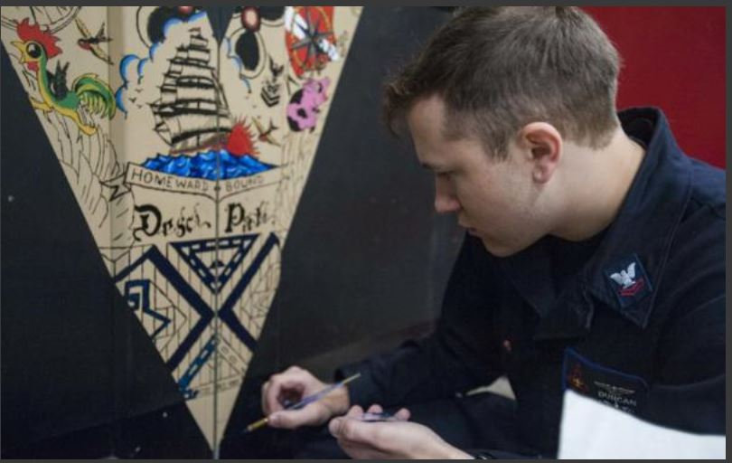
Things don’t have to change the world or the fleet to be important.
Aviation Electronics Technician 2nd Class Jesse Duncan paints a workshop door in the AIMD tunnel aboard the aircraft carrier USS George H.W. Bush (CVN 77). (U.S. Navy photo by Mass Communication Specialist 3rd Class Tristan B. Lotz/Released)
https://www.dvidshub.net/image/3884086/ghwb-flagship-carrier-strike-group-csg-2-which-comprised-staff-csg-2-ghwb
Notes:
Sesily – transition
And while archivist know that things don’t have to change the world to be important, our sailors may not.

Slide 15
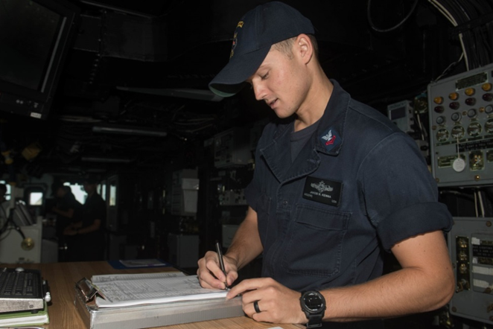
Intervention
Not tampering
Action taken to improve a situation
Aerographer’s Mate 2nd Class Jakob Kenna, a native of Cocoa Beach, Florida, assigned to the navigation department aboard the amphibious dock landing ship USS Pearl Harbor (LSD-52), logs information into the deck log while standing a watch. (U.S. Navy photo by Mass Communication Specialist 3rd Class Logan C. Kellums/Released)
https://www.dvidshub.net/image/3933747/uss-pearl-harbor-sailors-stand-watches
Notes:
Sesily
When working with our records creators, the fleet, intervention may be as simple explaining file name conventions, metadata, and file formats, which may change the way the records are used. Or this intervention may be more complex, such as explaining the importance of documenting their actions and the research value of their records for future generations.
In the case of the NHHC it may be additional information, for example, the future usage of the record, the importance of collecting commands active history, and required documentation.
Typically a command will contact us to figure out what their basic requirements are for a submission. A Sailor may contact us and ask “Should I submit X with my COR?” For my team our intervention is not a yes or no answer. Typically we will ask additional questions "Is this information covered in the body of your COR? Does it further the discussion of this report topic? Is it an important part of your commands mission? Is it invaluable?”
This allows me to perform in my position as an archivist, by allowing the creation of a record to occur with as little interference as possible, as a records manager, by making sure we get the materials submitted correctly the first time, and as a program manager, by promoting critical thinking and assisting the commands in their task of completing their required reports.

Slide 16

The Need for Intervention
Turnover
No Archival Training
No Records Management Training
OPNAVIST = standard guidance
https://www.instagram.com/p/BsB9E4chVIs/
Notes:
Sesily
The average length of a sailors stay on a vessel or a command is anywhere from 24-36 months and the turnover process is not always a smooth one.
The creation of the COR occurs at the end of the calendar year, which for many is during their turnover. If we do not work with the command on a regular basis, new personnel taking over may not realize that, for example, the COR is a part of their duties. It is our job to make sure commands are aware that these reports are required, and that we exist to assist them and collect these records.

Slide 17
Deep Learning
We are thinking about the long term
Teaching
  Value vs non-value
Creating / showing examples
Notes:
Sesily
We want our record creators, in our case sailors, to have a full understanding of concepts and to be able to adapt and apply these concepts to future submissions.
Our emails tend to be books because we want to provide sailors with a full understanding of their requirements. We may or may not ever talk to this sailor again, so we always add please keep in mind x, y, and z. Or also please note this and that. For the most part, they don’t ask for this information but we giving it to them anyway because it benefits everyone involved. In some instances the record creators may not know they had these questions.
While it was work up front to create our standard language templates, now we just have to copy and paste this information into the email. I will also note that sailors talk to each other more often than they talk to us. So what we tell one sailor in terms of CORs or deck logs we can actually be telling 5-10-20 sailors because they share information amongst themselves.
As visual learners, we understand that it is also good to include visuals in our communication. To help create a deeper understanding when necessary, we will include screenshots of what we are talking about in our emails. Again, this is ‘more’ work up front, but once it is created, we can use it over and over again.

Slide 18
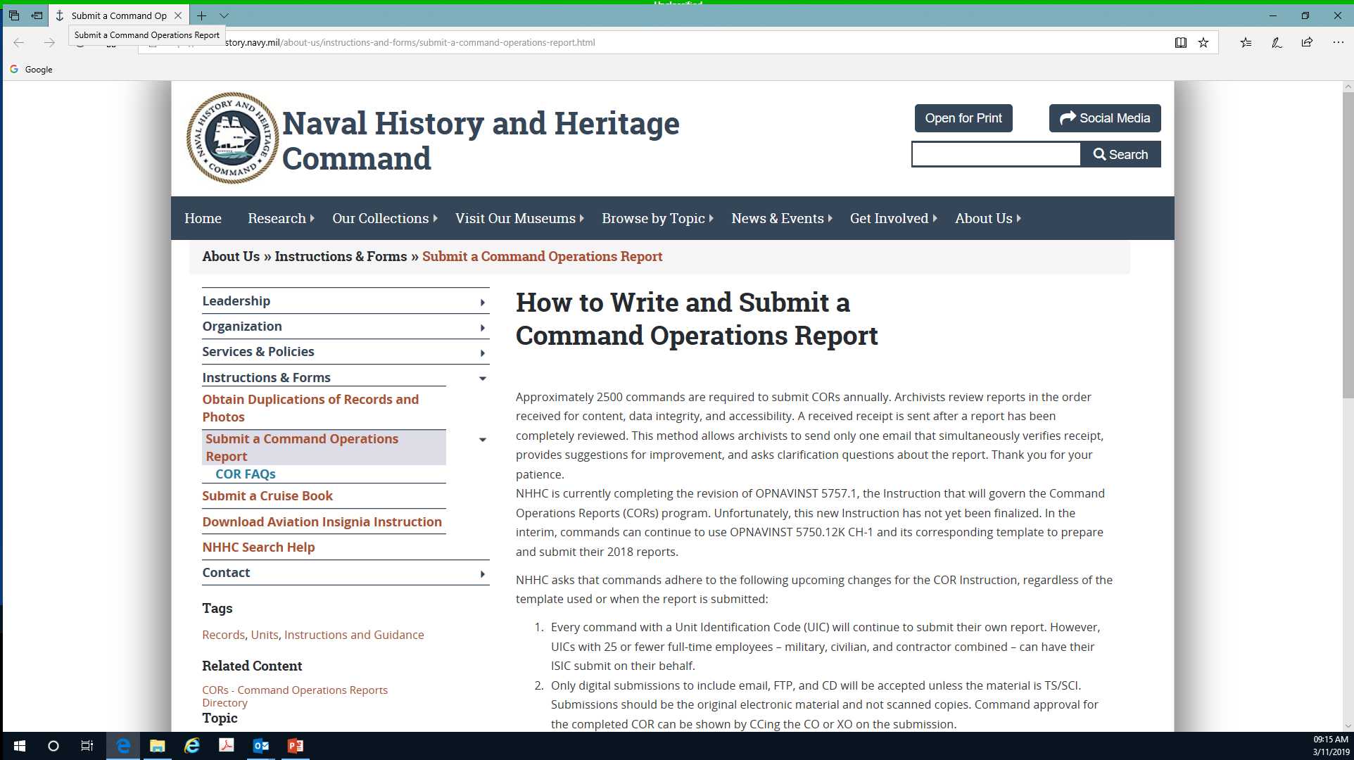
Outreach
Exhibits, audiovisual, presentations, websites are traditional outreach activities
But every phone call or email is also an opportunity of outreach
Notes:
Sesily
As a key part of our outreach, the COR program has a main webpage that explains the guidelines of creating and submitting a command operations report. We also established a COR FAQ page, currently highlighting 27 of the most important information regarding the creation and requirements of the COR, as well as some of the reoccurring questions we receive.
These two webpages have not only helped to provide a 24/7 tool for the fleet to utilize while creating their annual reports but they have also help to promote the COR team’s presence as a tool for the Navy as well.
It is important to also note that every time we answer the phone or answer an email we are given the opportunity to promote outreach or deep learning. We use that opportunity to explain how the reports are utilized to help the Navy as a whole, as an individual command, and at the level of an individual service member. We explain that these records are some of the only reports that do not have an expiration date, but most importantly they are the only official record of the history of a command kept for the life of the republic.

Slide 19
Fleet Historian Training/Outreach
Training reservist who visit with commands throughout the year
  Similar to an appraisal archivist
Two way street
  Learning more about the commands from sailors
Notes:
Sesily
Another form of outreach we provide is training our Naval Combat Documentation Unit. The sailors attached to this unit are reservists and this is not their full time job, but they provide support to our mission by visiting commands throughout the year to provide guidance, training and perform oral histories.
The training we provide the unit is a two day event. Not only do we create presentations for our respective areas but artifact collection, communication and outreach division, archival accession process and oral histories also provide presentations. This is the time where we are able to basically train the trainers. We love our reservists but for most this is entirely new venture. Therefore, we are attempting to cram years of knowledge about the collection, records management, our programs and archival knowledge into 60 minutes.
Our COR and Deck Log presentations are being shared by the Naval Combat Documentation Unit during their visit to our naval commands. The unit is presenting and providing copies of our PowerPoints, which are being utilized across the Navy to help spread an archival, records management and a more conclusive direction of the OPNAVINST requirements for each command.
Learning from the sailors
While working with the NCDU and our sailors I have learned a lot and active listening played a big part in this. The major issue my team faces on an annual basis is turnover. The COR is something that is typically assembled by a new individual annually which can unintentionally delay or eliminate submissions.
I recently spoke with a CAPT who explain to me that commands typically have turnover guidance for special programs, so information is not forgotten during changes in duties. Since this conversation I have worked with several commands to stand up turnover binders and even more to update their turnover guidance with additional materials. This is something that I would have never considered had it not been for these interactions with our service men and women.
Again who knows more about archival requirements than an archivist and who knows more about the navy than a sailor. We want them to actively listen to what we have to say but it’s a two way street. We also need to actively listen to what they have to say.

Slide 20
Outreach
With any outreach, you need to ask:
  Are these activities effective?
  Are they worth my time?
Notes:
Sesily
With any outreach, you need to ask:
Are these activities effective?
Are they worth my time?

Slide 21
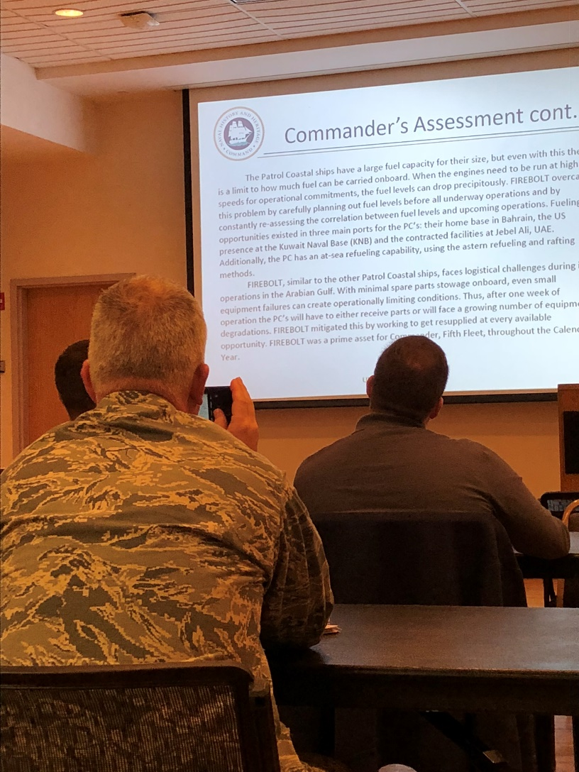
Feedback
Naval Combat Documentation Unit / Fleet Historians
Training
October 2018
Notes:
Sesily-transition out
The COR program has seen an increase in communication with commands across the Navy. We have also seen an 8.5% increase in submission rates over the past two years. This is a great success and 100% worth the efforts that went into it our outreach. Just the fact that commands are reaching out to us and know that we are here to provide them with information as a command is fantastic. As we mentioned, sailors transfer between commands, so reaching one person can do a lot more than some may think. And the feedback we receive from our service men and women helps to teach us more about the commands we work with and how we can better serve them.
Feedback from our Naval Combat Documentation Unit for the Deck log program has also been positive.
During the 2018 Japan embark, the unit provided training on four naval ships to over 40 personal. Both officers and enlisted received the Deck Log presentation and in all cases they requested a copy for use in house.
The 2019 Italy embark provided both COR and Deck Log benefits.
The Deck Log program recieved a request for a site visit from us to conduct deck log training by a CAPT transferring to the Norfolk area.
The COR program saw the submission of 2 additional CORs from a key echelon two command.
So again, is it a lot of work? YES!
Is it worth it? Compelety!

Slide 22
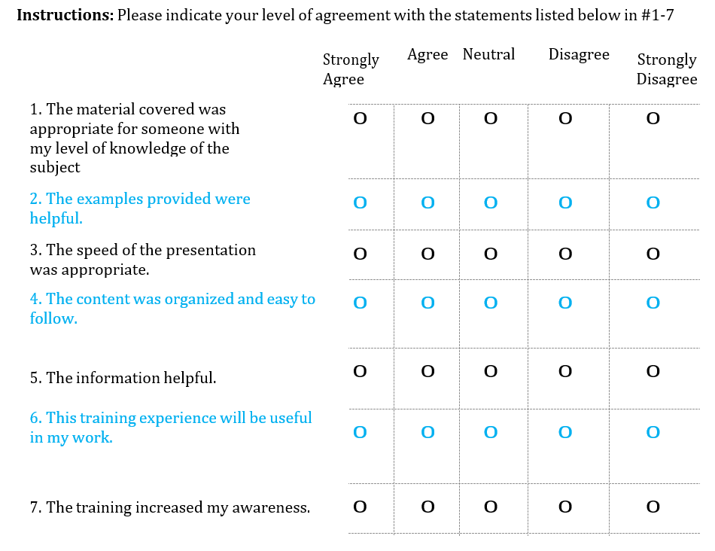
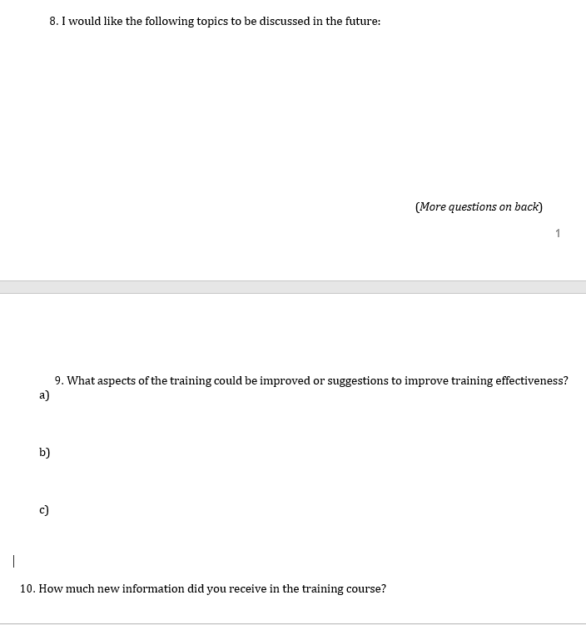
Feedback - Fleet Historian Training
Notes:
Kay-transition
Since Oct 2018, we have trained about 50 Naval Combat Documentation Unit / Fleet Historians.
The overall 2 day training has an evaluation form but we wanted a more in-depth examination of what we were doing. We have never done something like this before and wanted to improve. During my presentation, I actively mention the feedback that other Fleet Historians have proved and how the presentation has changed since the last training. I believe this has helped to encourage the Fleet Historians to give honest feedback.
From about 50 Fleet Historians, we received 21 evaluation questionnaires back. None of them were fully complete. While everyone filled out the closed-ended question, ie filled in the bubbles, not everyone filled in the open-ended questions. Personally the open-ended questions help me the most in terms of how can I make this better, but I can’t force it. The questionnaire has gone through an evaluation too. The original had 15 question and the current version has 10. I had hoped that less questions would lead to every question being filled out but that was not the case.

Slide 23
Feedback - Fleet Historian Training
The Good
95% closed-ended questions were filled out in the Strongly Agree or Agree category
“Training provided a lot of new information and excellent tips for improving the caliber of deck logs received from the fleet by using positive, memorable examples.”
“Wish I knew this as an Ensign on a ship.”
“I never realized how important a deck log is. It really is the history book of the ship.”
Notes:
Kay
20 out of 21 evaluations or 95% of the closed-ended questions were filled out in the Strongly Agree or Agree category.
“Training provided a lot of new information and excellent tips for improving the caliber of deck logs received from the fleet by using positive, memorable examples.”
“Wish I knew this as an Ensign on a ship.”
“I never realized how important a deck log is. It really is the history book of the ship.”

Slide 24
Feedback - Fleet Historian Training
The Bad
“The training was more suitable for civilian or reservist who have never been on a ship and written/signed deck logs. No objection to the training, it just was not as beneficial to a warfare qualified senior officer.”
“A Little Dry.”
“Don’t have prepared jokes in your narrative unless you can deliver it without sounding like you are reading it off the PowerPoint slide.”
“Great script but would be better delivered not reading from notes.”
Notes:
Kay
“The training was more suitable for civilian or reservist who have never been on a ship and written/signed deck logs. No objection to the training, it just was not as beneficial to a warfare qualified senior officer.”
“A Little Dry.”
“Don’t have prepared jokes in your narrative unless you can deliver it without sounding like you are reading it off the PowerPoint slide.”
“Great script but would be better delivered not reading from notes.”

Slide 25
Additional Knowledge and Skills
Public Speaking Skills
Learning the lingo and culture of your organization
Learn to establish rapport with members of diverse groups
Notes:
Kay
what additional knowledge and skills effective archivists working with record creators will need
Being able to give a presentation without notes or reading from slides. I think they more you do this, the better you get at it. I hope.
Learning the lingo and culture of your organization helps you then to explain archival concepts and ideas in terms that the record creator understands. Sending records to the archives is “just something to check off their to do list”. If you try to force them to learn new lingo then they are going to shut down. I find that when you embrace the organizations lingo, it gives off a positive impression. Oh she spent time to learn about us, okay I will give her 2 mins of my time.
Learn to establish rapport with members of diverse groups. You are not only going to be working with archivists.

Slide 26
Traditional Archival Competencies
Ability to write correspondence.
Ability to write recommendations in a clear and concise manner.
Ability to evaluate archival collections.
Ability to accessioned the receipt of new collection materials daily.
Notes:
Kay
Ability to write correspondence. A lot of what we do is in email. And even if we have a phone conversation, they want us to send it in email too.
Ability to write recommendations in a clear and concise manner. Creating templates for commonly asked questions.
Ability to evaluate archival collections.
Ability to accessioned the receipt of new collection materials daily.

Slide 27
Additional Guidance
Google is your friend
Notes:
Kay
I know that we all have a love/hate relationship with Google but Google is your friend. We are all busy and a simple Google search helps to get ideas on how to do things. Don’t try to reinvent the wheel. The questionnaire that I created took a whole 10 minutes. I google post presentation questionnaires and copied and pasted some questions together.

Slide 28
QUESTIONS?
Sesily Resch
sesily.resch@navy.mil
Karolina Lewandowska
Karolina.Lewandowska@navy.mil

