Slide 1
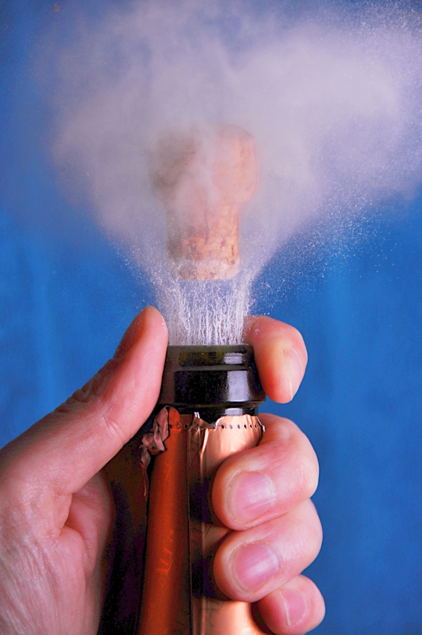
Uncorking Learning
Flipping Library Instruction PechaKucha-Style
Alexander J. Carroll
Nedelina Tchangalova
Eileen G. Harrington
The Innovative Library Classroom (TILC) Radford, VA
May 12, 2015
Notes:
Image:
By Niels Noordhoek (http://commons.wikimedia.org/wiki/File:Champagne_uncorking_photographed_with_a_high_speed_air-gap_flash.jpg)

Slide 2
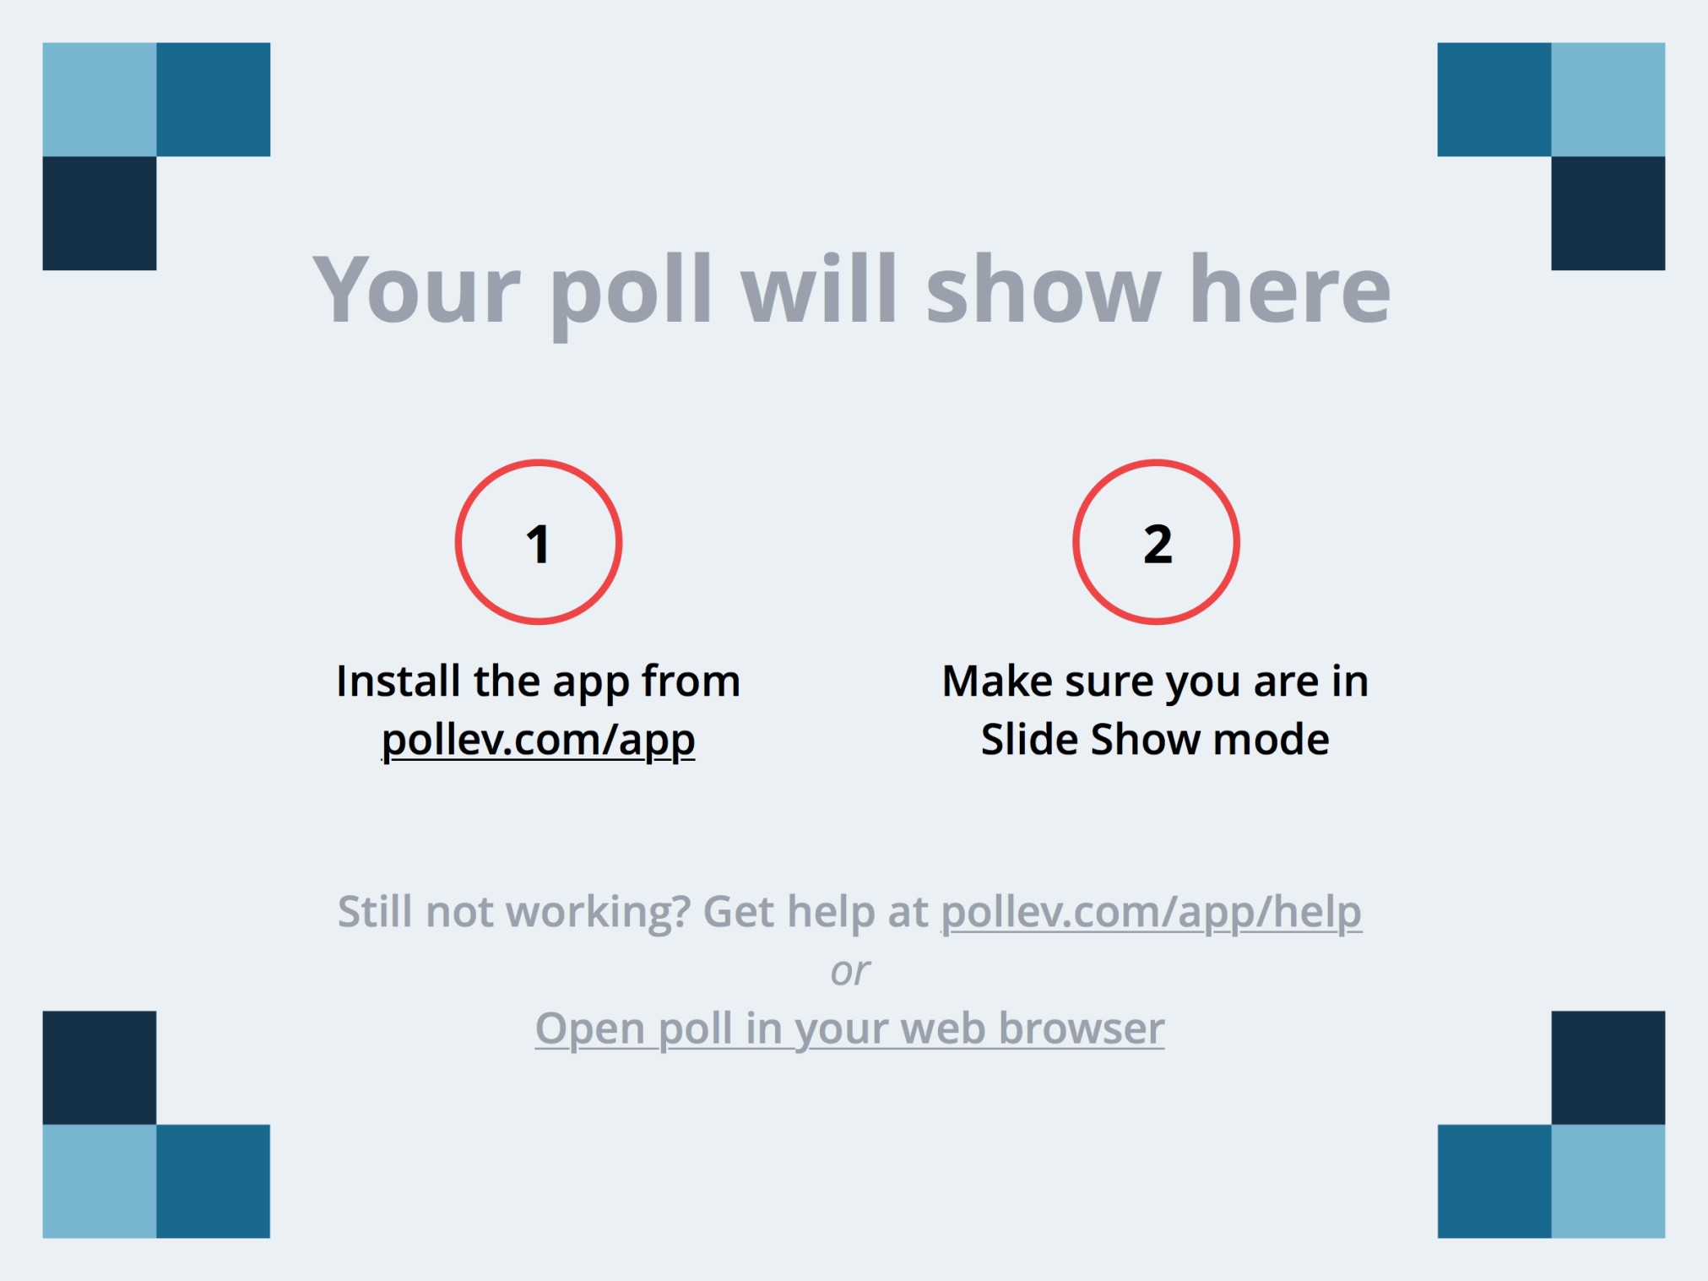
Notes:
Have you ever tried a flipped classroom before?
Yes
No
https://www.polleverywhere.com/multiple_choice_polls/Butz1IXau2zTbro

Slide 3
Notes:
What is PechaKucha?
A music genre
A theater performance
A presentation style
A dog’s name
https://www.polleverywhere.com/multiple_choice_polls/BW2Gkv6Cgc9uiOi

Slide 4
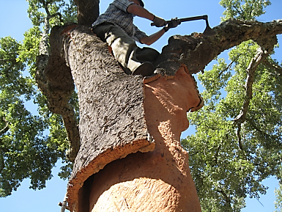
What Inspired Us To Try Flipped Classroom?
Notes:
How cork is made?
It all starts with the cork oaks in the forest. Cork oaks are harvested once they reach maturity, usually every nine-ten years. It doesn’t harm the tree and the cork bark regrows.
How did this project come to be? What inspired us to try flipped classroom?
So, we started uncorking our instruction in the forest of the UMD Libraries building on our strengths, expertise and skills:
Designing a Canvas course for the School of Public Health – there was a need for developing an online information literacy course to accommodate faculty’s distance learning course.
Educational psychology: students need practice to learn, more practice time = more learning
Medical education literature: team based learning, peer evaluation, online learning objects
Bloom’s Taxonomy: what level is our current instruction getting them to? Where do we want our students to be?
Fundamental question: Could the flipped classroom be used to create a student centered classroom that is built around team based learning?
Image: http://justforsybarites.com/2015/02/22/to-cork-or-not-to-cork/

Slide 5
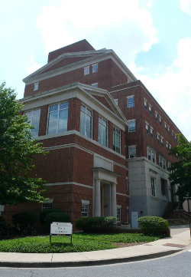
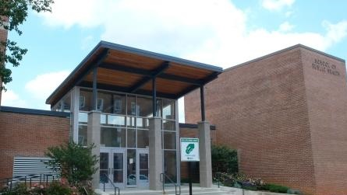

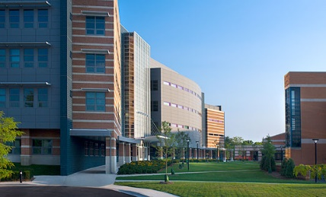
Our Students
College of Agriculture and Natural Resources
About Our Students
Upper level undergraduates
School of Public
Health
Universities at Shady Grove
Notes:
About UMD-CP and Universities at Shady Grove
About AGNR and SPHL
Focus of these school’s undergraduate education programs: human, animal, and environmental health
Similar research assignments, similar information tools, etc.
Clear opportunity for collaboration amongst the three of us
Classes Taught in this Study
3 Animal and Avian Science, upper level undergraduates
2 School of Public Health, upper level undergraduates
Image of college students: http://publicagendaarchives.org/pages/boosting-community-college-success

Slide 6
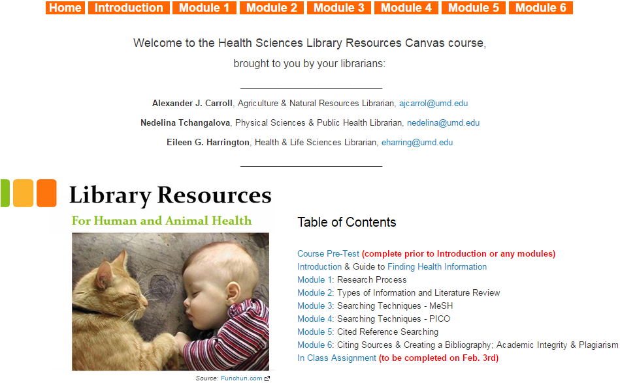
Our Course Content
Notes:
What content we included in the Canvas course?
Justifications for including that content:
Not all students get basic information literacy training in ENGL course
No “gateway” research methods course for these disciplines
No opportunity for us to “catch” all of these students
No way of us knowing at what level of information literacy students will be at

Slide 7



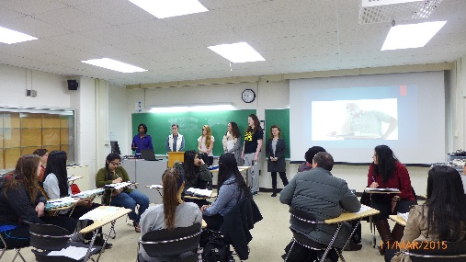
Logistics
Students given access to Canvas course.
Assigned a specific module in advance of class to present on.
Students seated in their teams.
Teams present, while their peers grade their presentation using a rubric.
PechaKucha
Notes:
How we set up and administered the classroom?
Students given access to Canvas course.
Assigned a specific module in advance of class to present on.
Students seated in their teams: given a laptop, USB drive, and ~15 minutes to create a PechaKucha presentation on their assigned topic.
Teams present, while their peers grade their presentation using a rubric: hand out a copy of the rubric to the audience.
What if we distributed the rubric at the beginning of OUR presentation, and asked the audience to evaluate us? We could ask if having the rubric increased their engagement.
Images:
Access (http://liberatedlearning.com/?page_id=2)
Email (http://siliconangle.com/blog/2013/05/23/how-to-switch-email-services-easily-keep-all-your-mails-contacts/)
College students working in a team: http://publicagendaarchives.org/pages/boosting-community-college-success
Students presenting in a class: Courtesy of Nedelina Tchangalova

Slide 8
Why PechaKucha?
Professor:
"Instead of passive listening to somebody talk about a topic that students don’t actually find all that interesting to begin with... knowing that they are on the hook for a presentation to their peers... definitely got them thinking about it. Engagement lasted beyond that because they were immediately asked to use those skills throughout the semester."
Notes:
This teaching pedagogy provides more opportunities for students to be active participants in the learning process.

Slide 9

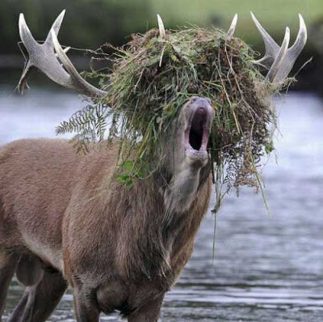


Why PechaKucha?
Researching a topic
Notes:
Students present information literacy concepts in a more fun and memorable way.
Images:
On Being An Older Library School Student: http://hacklibraryschool.com/2012/08/27/on-being-an-older-library-school-student-starter-kit/
Funny Moose Pictures: http://www.afuntab.com/funny-moose-pictures/
Happy: http://sonydj.com/dj-angel-happy-pharrell-williams-remix/

Slide 10

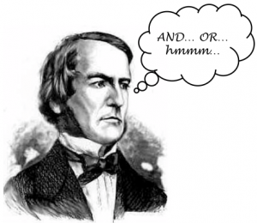

Why PechaKucha?
Searching Strategies
Boolean Operators
PICO Method
Notes:
Images:
George Boole: http://www.sourcecon.com/news/2010/12/07/boolean-search-does-not-internet-search/
Organic Spice Blocks & A Fresh Juice Bar: http://thespicecellar.com.au/2014/02/organic-spice-blocks-a-fresh-juice-bar/
Dog: http://www.royaltreatmentveterinarycenter.com/

Slide 11


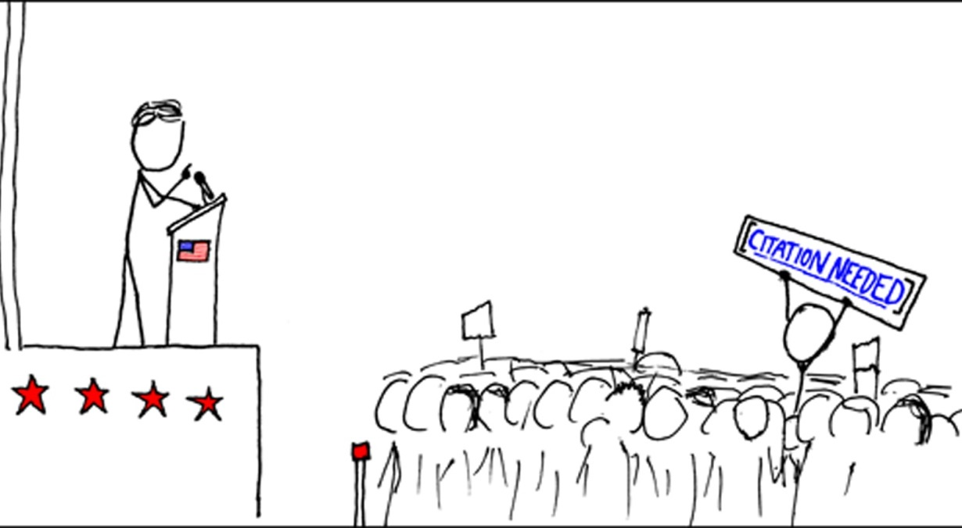
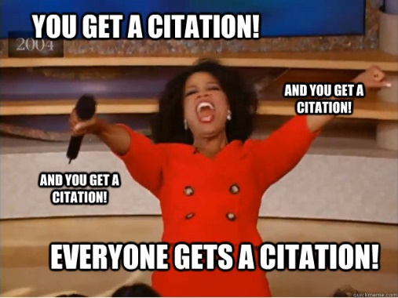
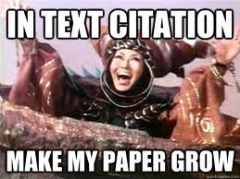
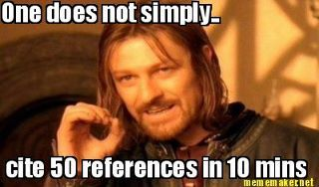
Why PechaKucha?
Academic Integrity
Notes:
Images:
Dr. Evil Air Quotes: http://knowyourmeme.com/photos/594192-dr-evil-air-quotes
Cheating In An On-line Environment: How To Prevent, Detect & Deter Dishonesty: http://www.innovativeeducators.org/product-p/194.htm
In Text Citation Make My Paper Grow: http://www.quickmeme.com/Rita-Repulsa
Everyone Gets a Citation: http://www.quickmeme.com/meme/3tigm2
One Does Not Simply Cite 50 References in 10 Mins: http://www.textalibrarian.com/mobileref/42-library-related-memes/
Citation Needed: http://commons.wikimedia.org/wiki/File:Webcomic_xkcd_-_Wikipedian_protester.png

Slide 12

Our Assessment
Quizzes
Student Presentations
Student Homework
Student Research Assignments
Notecards
Notes:
How are our students doing? How did we assess their learning? And why did we make those decisions?
1. Canvas Quizzes
Open ended response quizzes after each module
Answers the question: how well did students learn the material on their own?
Graded by two different librarians using a rubric, third librarian used as tie breaker
Present audience with student achievement in each module
2. Student presentations
Student presentations assessed by their classmates in the audience
Best student presentations awarded prizes ($30 Amazon for 1st place, $10 Amazon for 2nd place for each student in the team)
Present audience with what module won from each class.
3. Student Deliverables (Library Assignments – pre-class, in-class, post-class)/ Homework
Assigned students homework depending on the class length, professor’s willingness to assign additional work for students to practice information literacy concepts.
4. Student Research Assignments
Provided access to a least one substantive research based assignment that students completed at some point during the semester following the session facilitated by the librarians.
Student assignments evaluated with a rubric by two librarians; third used as tie breaker
5. Note cards
Provided note cards for students to write one thing they have learned from Canvas course/student presentations, and one thing they still have questions about.
Image with letters (http://mryoungberg.weebly.com/proficiency-grading-policy.html)

Slide 13
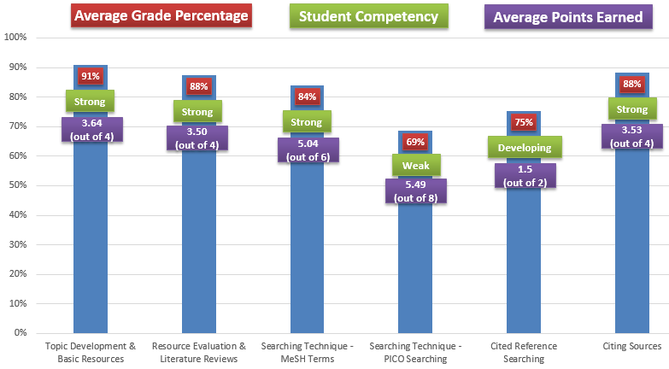
RESULTS: Quizzes
Notes:
RESULTS: Canvas Quizzes
Quiz #1: Topic Development & Basic Resources
Student Competency - Strong
Average Points Earned - 3.64 (out of 4)
Average Grade Percentage - 90.93%
N – 135
Quiz #2: Resource Evaluation Literature Reviews
Student Competency: Strong
Average Points Earned - 3.50 (out of 4)
Average Grade Percentage - 87.50%
N – 134
Quiz #3: Searching Technique - MeSH Terms
Student Competency – Strong
Average Points Earned - 5.04 (out of 6)
Average Grade Percentage - 84.08%
N – 134
Quiz #4: Searching Technique - PICO Searching
Student Competency – Weak
Average Points Earned - 5.49 (out of 8)
Average Grade Percentage - 68.64%
N – 59
Quiz #5: Cited Reference Searching
Student Competency – Developing
Average Points Earned - 1.5 (out of 2)
Average Grade Percentage - 75.38%
N – 132
Quiz #6: Citing Sources
Student Competency – Strong
Average Points Earned - 3.53 (out of 4)
Average Grade Percentage - 88.17%
N - 131

Slide 14
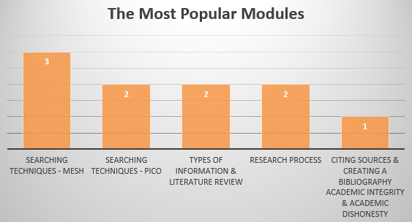
RESULTS: Student Presentations
Notes:
RESULTS: Student Presentations
The most popular modules are:
Searching Techniques - MeSH (3 teams)
Searching Techniques – PICO (2 teams)
Types of Information & Literature Review (2 teams)
Research Process (2 teams)
Citing Sources & Creating a Bibliography - Academic Integrity & Academic Dishonesty (1 team)

Slide 15
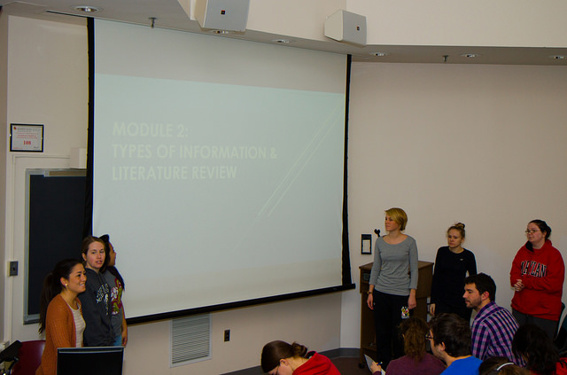
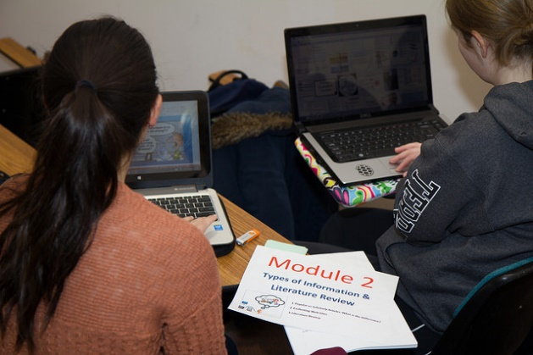
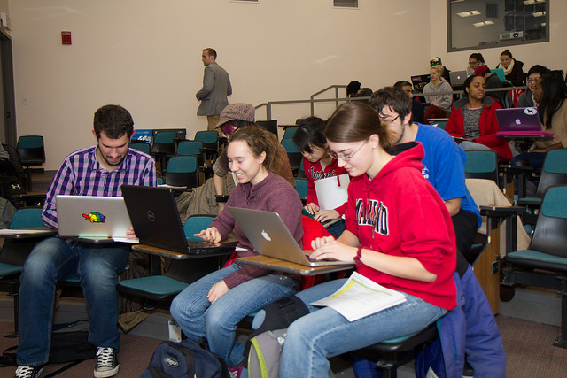
Case Study
ANSC275 Introduction to Veterinary Medical Science and Practice
Notes:
Mix of forty undergraduate students at almost every academic level (Sophomore – Senior). We met them during the first week of class for a 50 min class.
Images from ANSC275 class: https://www.flickr.com/photos/sabanimals/sets/72157650212318839/

Slide 16
RESULTS: Notecards
Notes:
RESULTS: Notecards
Notecards were a useful tool in a 50 minute class like this, where we did not have the opportunity to clarify issues that were still unclear or to conduct an in-class assignment to test student’s competencies immediately following the PechaKucha’s presentations.
Students reported learning about:
New Searching Techniques
New databases to search: Google Scholar, PubMed, Scopus, Web of Science
MeSH Terms, PICO Searching, Booleans and other search operators
Citation Management Tools
Cited Reference Searching
Literature Reviews and Annotated Bibliographies
But: our data suggests students might have benefited from even more training. Students know about MeSH and Zotero, but how do the students actually use them?
Students suggested they were still unclear on a number of topics:
Searching Techniques
Citing Sources in APA Style
Citation Management Tools
Cited Reference Searching

Slide 17
RESULTS: Student Homework
Information Literacy Skill | Performance Level
Finding Background Information | Strong
Search Strategies | Developing
Citing Sources in APA style | Developing
Cited Reference Searching | Developing
Evaluating Sources | Strong
Research as Conversation/Ethics | Weak
Notes:
RESULTS: Student Homework (Library Assignments – pre-class, in-class, post-class)/ Homework?
Notecards were great, but evidence pretty strongly shows that students aren’t always the best judges of what they learned. Designed a follow up homework assignment that would evaluate a number of the same skills introduced through the modules.
We were hoping to learn: Would the student presentations and extra practice lead to better student performance?
Results still pending, but coding done from early classes shows:
Students able to find background info and mentioned on notecards that learned new search strategies, but not really implementing them in their searches.
Notecards several said still unclear about citing using APA style and using citation managers—reflected in homework. Although some did a good job with this, others struggled.
Said had learned about cited reference searching, but clear don’t fully understand the concept. Many searched the references of original paper rather than searching for more current research.
Asked question about why cite sources, and clearly understand importance of academic integrity and avoiding plagiarism, but fuzzy on how they are building on the research of others and adding their own interpretations/discoveries.

Slide 18
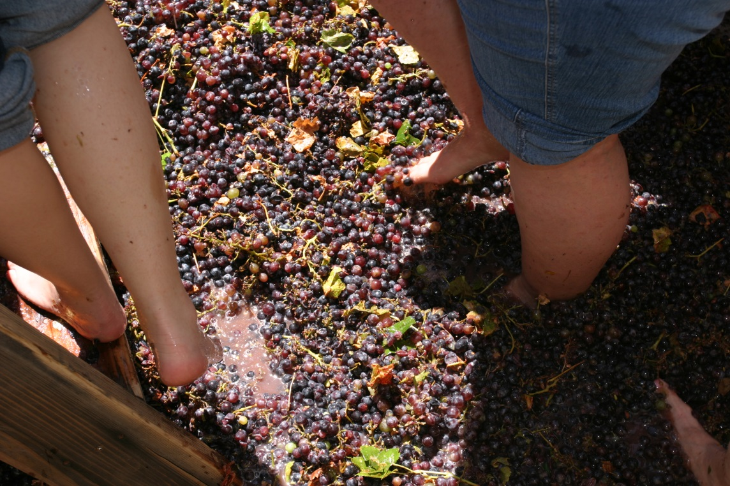
RESULTS: Student Research Assignments
Annotated Bibliographies
Notes:
RESULTS: Student Research Assignments
Professor assigned students to write an annotated bibliography for their resources chosen. We assessed students’ annotated bibliographies using an adapted version of the Association of American College & Universities’ (AACU) Information Literacy VALUE Rubric (https://www.aacu.org/value/rubrics/information-literacy).
CONCLUSION: Students searched literature and able to extract the useful resources for their assignment, much as one might extract the juices from grapes to make wine. Student overwhelmingly performed at the capstone level, defined by us as students evaluating sources “on the basis of relevance to the research question, currency, authority, study design, and sample size.” The level of sophistication demonstrated in the annotations was remarkable for undergraduate scholarship. However, considering that our instruction did not touch on considerations such as study design and sample size, the opportunity for confounding variables when evaluating these assignments is significant. Clearly, the students received significant further instruction from their faculty member over the course of the semester on resource evaluation.
Despite these facts, the sources selected and the number of sources cited in these bibliographies leads to two definite conclusions:
Students were able to successfully search for and find high quality, scholarly articles.
Whether they used a citation manager or not, students were able to cite these articles consistently using APA style.
Image: https://commons.wikimedia.org/wiki/File:Grape_Stomping_-_Pigeage.jpg

Slide 19
RESULTS: Student Research Assignments
Power Point Slides or Prezi
Notes:
RESULTS: Student Research Assignments
Professor assigned students a research project to present in class, using the sources they included in their annotated bibliographies. We assessed students’ PowerPoint/Prezi slides and the references they have used, again using an adapted version of the Association of American College & Universities’ (AACU) Information Literacy VALUE Rubric (https://www.aacu.org/value/rubrics/information-literacy).
CONCLUSION:
Each student group achieved the capstone level of “Use Information Effectively to Accomplish a Specific Purpose.” Student groups critically evaluated the resources they found, used mostly recent peer-reviewed journal articles, and synthesized the information they found with clarity and purpose.
Students also consistently performed well in the criteria of “Access and Use Information Ethically and Legally.” Students consistently cited the images they were using on their slides. The majority of student groups achieved capstone level competency by supporting claims with appropriate APA style parenthetical citations and a references slide at the end. The rest of the groups reached at least milestone 3 (images cited, and reference lists included, but failure to consistently use APA style parenthetical citations).

Slide 20

Faculty Interviews:
Perceptions of Our Impact on Students’ Learning
Professor:
"Many [students] have referenced that class. ‘It was a great start, I never learned how to research before’."
Notes:
We conducted post session interviews with faculty members to collect their assessment of the flipped classroom.
General Themes from Interviews
Project good for strengthening authentic collaboration between librarian(s) and instructors/professors. Working together on curriculum development, structuring assignments, strategies for inserting information literacy into courses in thoughtful way.
Students think know more than do about research. Different expectations between what a freshman/sophomore should know/be able to do vs. junior/senior, but often juniors/seniors don’t really have skills one would expect, and might not have had opportunity to do real research.
Flipping classroom, working in groups and requiring that students create a “product” as part of session, all beneficial to students’ learning.
Challenges with this flipped classroom approach:
Figuring out the best timing for doing this class during the semester
Some students still had trouble searching literature
Repeat students
Incorporating it into grading system so that students take it more seriously.
Image: http://www.enjoywine.bg

Slide 21
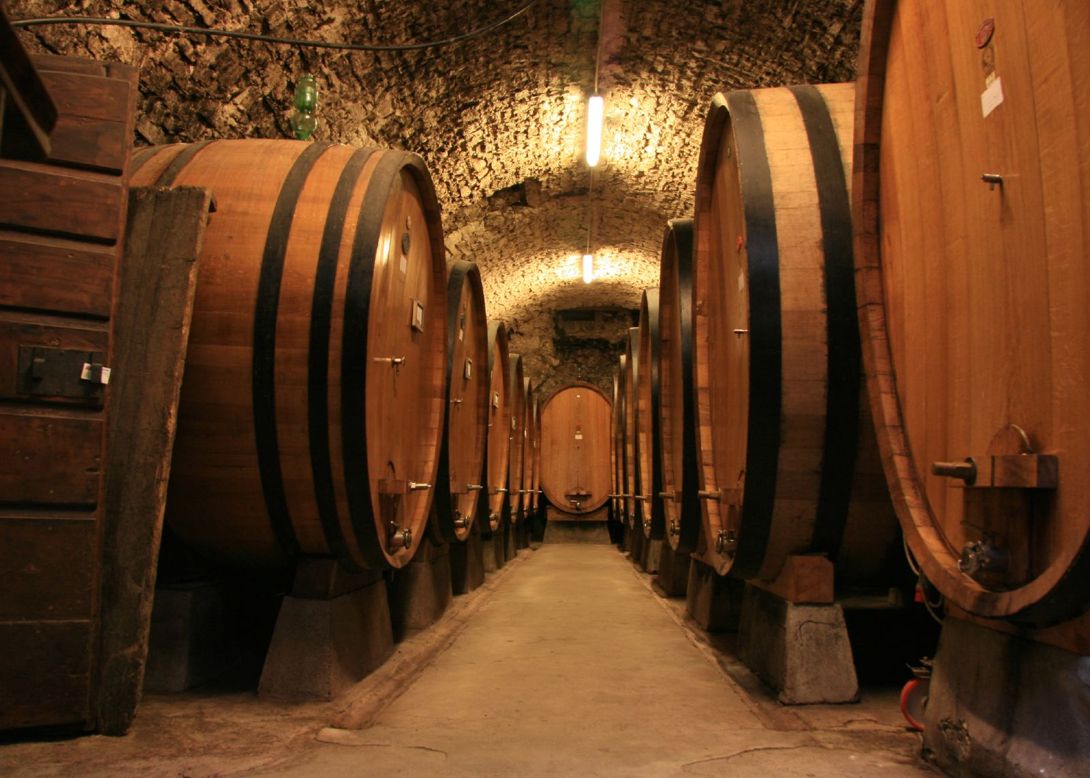
Perceived Benefits
Notes:
As oak is used in winemaking to vary the color, flavor, tannin profile and texture of wine, we used the flipped classroom model to provide various learning experience to our students and to accommodate professors’ various teaching pedagogies.
Data analysis still on going, but here’s our preliminary findings:
Benefits for Students
Flipping classroom allows us to cover more content than traditionally possible in a 50-75 minute class
Flipping classroom creates more opportunities to engage students in hands on practice time with these concepts
By having students deliver a presentation on one of the topics to their peers:
Content is presented jargon free, using authentic language that resonates
Creates a more inclusive classroom: allows for a diversity of voices that matches the diversity in the classroom demographics
Students are creating a “product” that can be assessed in real time
Aligns with how classroom instruction is being taught to students by disciplinary faculty
Image: http://bg.wikipedia.org/wiki/%D0%91%D1%8A%D1%87%D0%B2%D0%B0

Slide 22
Professor:
“When I get to the point of building the syllabus for it you know in August or whenever it is, I'll send you an e-mail and say 'Hey, I'm working on the syllabus. How can we encapsulate this experience into the grading scheme?”
Perceived Benefits
Notes:
Benefits for Discipline and Library Faculty:
Creates an opportunity to work extensively with a faculty member on authentically integrating information literacy instruction and assessment into the course
No more one shots!
AGNR: Student overlap has led to discussion of embedding research methods into the introductory lab for Animal and Avian Sciences
SPHL: working with faculty to revamp syllabus – moving away from traditional paper assignments and using librarian to help develop
Extensively collaborative partnerships with library faculty colleagues
One shots you’re working alone – building on each other’s strengths
Image: http://bg.wikipedia.org/wiki/%D0%91%D1%8A%D1%87%D0%B2%D0%B0

Slide 23
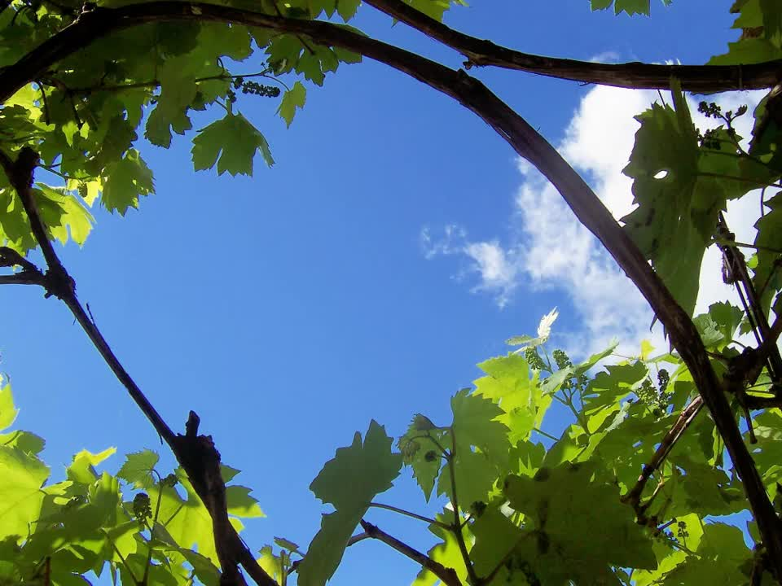
Challenges
Remaining Questions
Future Directions
Notes:
Funding - Gift cards
For students really increased student buy in and excitement – can this be sustained without prizes? Perhaps more sustainable if it’s included into the grading of the course – need for more integration into the class
For faculty - Gift cards don’t work for enticing uninterested faculty – all faculty partners recruited from pre-existing relationships and/or already appreciated the importance of teaching research skills
No magic bullets – have to build relationships with faculty
Canvas Course
How do you keep this up to date? How does it not become just a “new LibGuide”?
Would a “shared” course amongst subject specialists work as well in less related fields?
Are students referring back to it throughout course to help with their research assignment(s) or just for the in-class session?
Scalability and Feasibility
Development, administration, and assessment are a huge time investment – how can this be dealt with when you don’t have three FTEs collaborating on a project like this?
Potential Solutions:
Pre-testing prior to session: does this class actually need further instruction to accomplish the research assignment the faculty member has designed?
Train the trainer with faculty or TAs: the librarian doesn’t necessarily need to be in the room for this sort of instruction to occur
Representative assessment: don’t have to assess every session, just a representative sample to ensure that the content is still achieving the learning outcomes you established
Future Direction
Continue assessing student assignments to determine whether this was leading to student learning / application.
Image: http://i49.vbox7.com/o/0da/0da5f0e98e0.jpg

Slide 24

Acknowledgments
Our Faculty Partners
Our Funders
MAC-MLA Research & Assessment Grant ($1,000)
UMD Libraries Faculty Research Fund ($500)
Our Bosses
For the freedom to research this!
Notes:
Image: http://interestingthings.info/food-and-beverages/10-interesting-facts-wine-know.html

Slide 25



Alexander J. Carroll
ajcarrol@umd.edu
Nedelina Tchangalova
nedelina@umd.edu
Eileen G. Harrington
eharring@umd.edu
Notes:
Thank you for your interest in our presentation! Please email us – we would love to hear from you!

