Slide 1
LIFE AFTER MPLP
Identifying Underrepresented Voices in Collections through a Repository-Wide Collections Survey

Slide 2
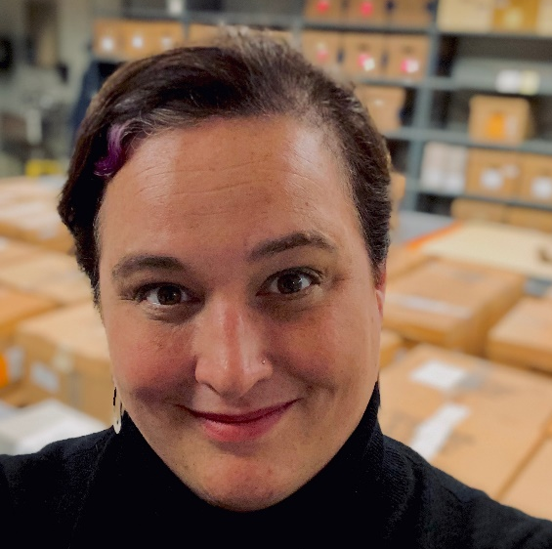


WHO WE ARE:
Elizabeth Parker,
Technical services archivist,
eep63@cornell.edu
Ben Wrubel,
Processing Archivist,
baw242@cornell.edu
Claire Deng
Collections Survey Assistant,
cwd62@cornell.edu

Slide 3
HOUSEKEEPING AND OTHER ERRATA:
Structure of the presentation:
History and scope of project
Designing the survey, instrument, and workflows
Conducting survey work and broader impacts
Survey working meetings and “inclusive” work
Project poll:
How many attendees today have embarked on (or even completed) a repository wide survey of their collections?
For those who answered “No,” how many of you are thinking of attempting a project like this?

Slide 4
THE KHEEL CENTER FOR LABOR-MANAGEMENT DOCUMENTATION & ARCHIVES
History of Kheel Center
Overview of our collections
Previous practices
MPLP under previous technical services staff
No “backlog” but minimally processed and under-described
Arrival of ATHM library and archives (8 tractor trailers of materials)

Slide 5
IDENTIFYING, SCOPING, ADVOCATING
Identify the problems/unintended consequences of MPLP
Scoping the depth of the issues to present data driven justifications
Advocating to supervisors, directors, and administration
CUL is currently creating a new strategic plan, one area of import has been identified as “sustainable stewardship” and the ethos of this survey aligns with this

Slide 6
INSTITUTIONAL INERTIA & INSTITUTIONAL INITIATIVE
Potential for new position after retirement
advocated for processing archivist position
New UL supportive of this work
Drafting new strategic plan that includes emphasis on sustainable stewardship
Hiring of new AUL for Special Collections
Job description specifically call out the need for retrospective work on our collections
Library Director support of project
Funds allocated to hire processing assistant

Slide 7
REPARATIVE DESCRIPTION
Accuracy of description
Usefulness of description
Problematic language
Standardizing description
Evaluating access points
Missing descriptive fields
Identifying metadata drift

Slide 8
SUSTAINABLE STEWARDSHIP
Cornell is drafting a new strategic plan, and sustainable stewardship has been identified as one of the areas that CUL needs to include in its future planning
What does this mean in terms of acquisitions and collection building strategies?
What are our responsibilities to our collections?
What does sustainable mean in terms of the labor of library and archive workers?
How can we justify continuously bringing in new collections if we are not doing our best by the collections we already have?

Slide 9
SURVEY, FIRST STEPS
Hiring processing archivist
Identifying the scope of the project
Identifying the appropriate tools
Identifying the appropriate collections
Kheel Center has traditionally separated out collections by genre type, i.e. manuscript, AV, graphics, photographs
Goals
Prioritized processing plan
Increased discoverability
Improved descriptions

Slide 10
Literature Review
CLIR “Cataloging Hidden Special Collections and Archives Program” (2008)
Secondary sources
Hackbart-Dean and Slomba – How to Manage Archival Processing in Special Collections (2012)
O’Hara Conway – “The Practice, Power, and Promise of Archival Collections Assessment” (2012)
Primary sources
PACSCL Hidden Collections Processing Project (2009-2012)
University of California, Berkeley, Bancroft Library Manuscripts Survey Project (2008- 2011)

Slide 11
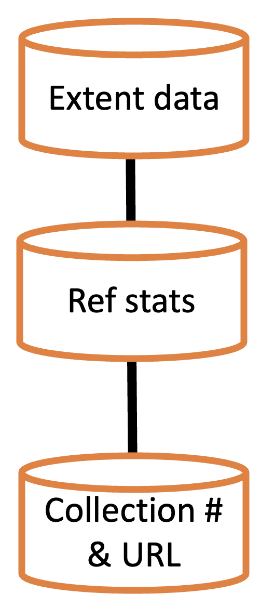
Leveraging Technical Context
Early prototype in Excel
Existing Library support for Airtable
Pre-accession database
Accessibility
ArchivesSpace migration
Populating the empty database

Slide 12
Designing the Survey
Setting goals and priorities
Prioritized processing list
Marginalized groups
Conservation
Responsive to researcher interest
Identify materials of anticipated interest

Slide 13
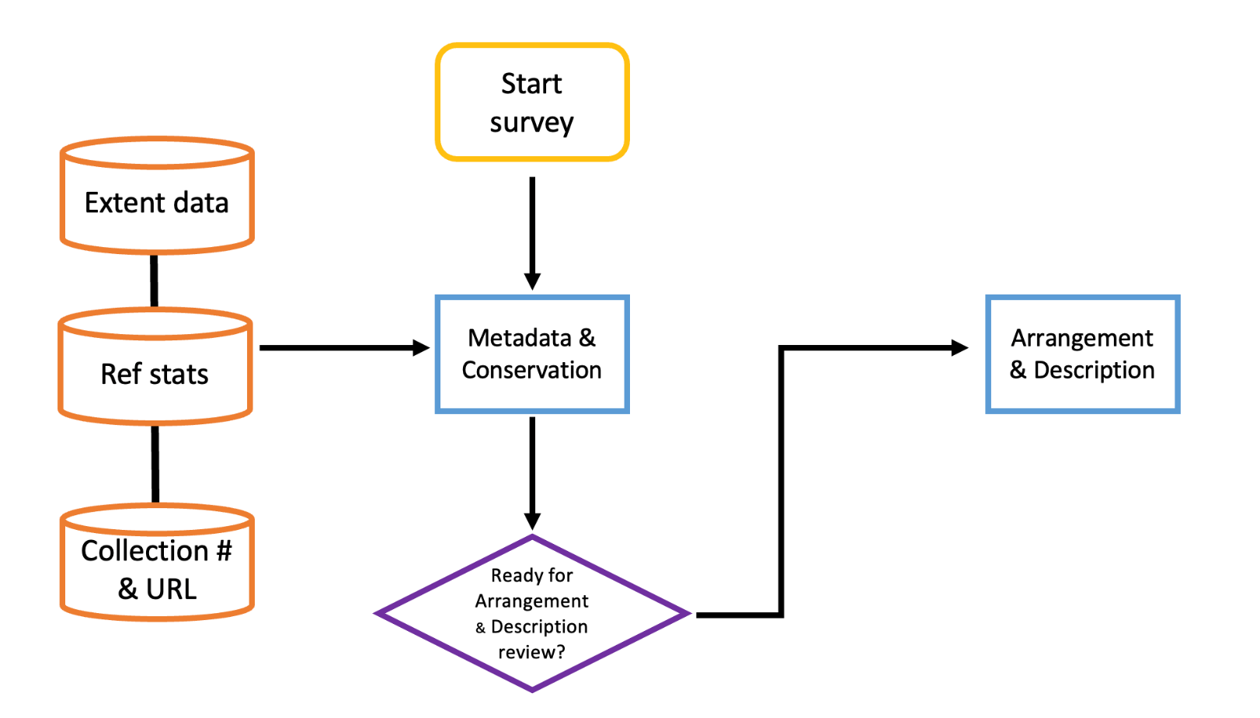
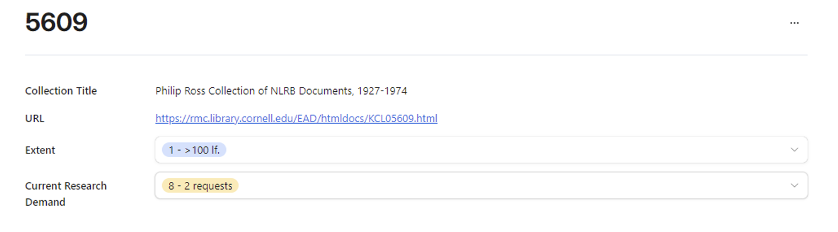
Designing the Instrument
2 Step Process:
Metadata/Conservation
Arrangement/Description

Slide 14
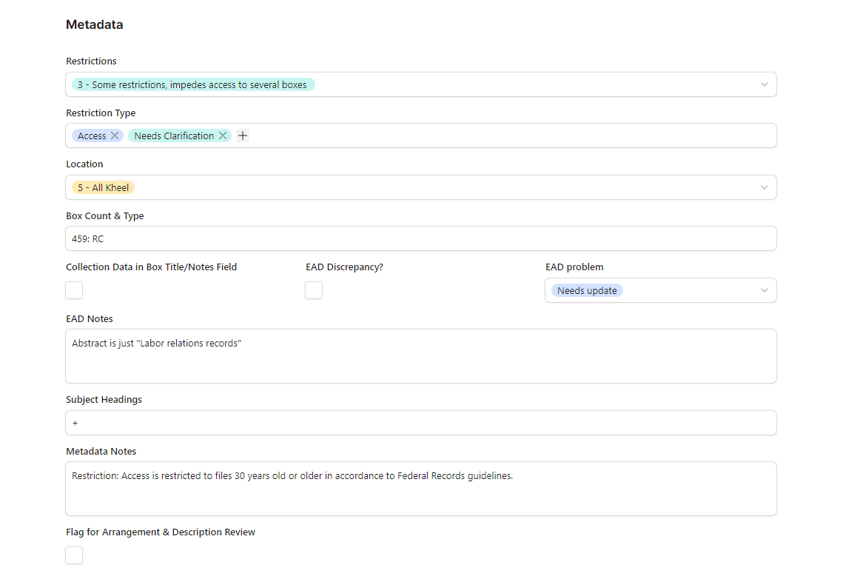

Slide 15
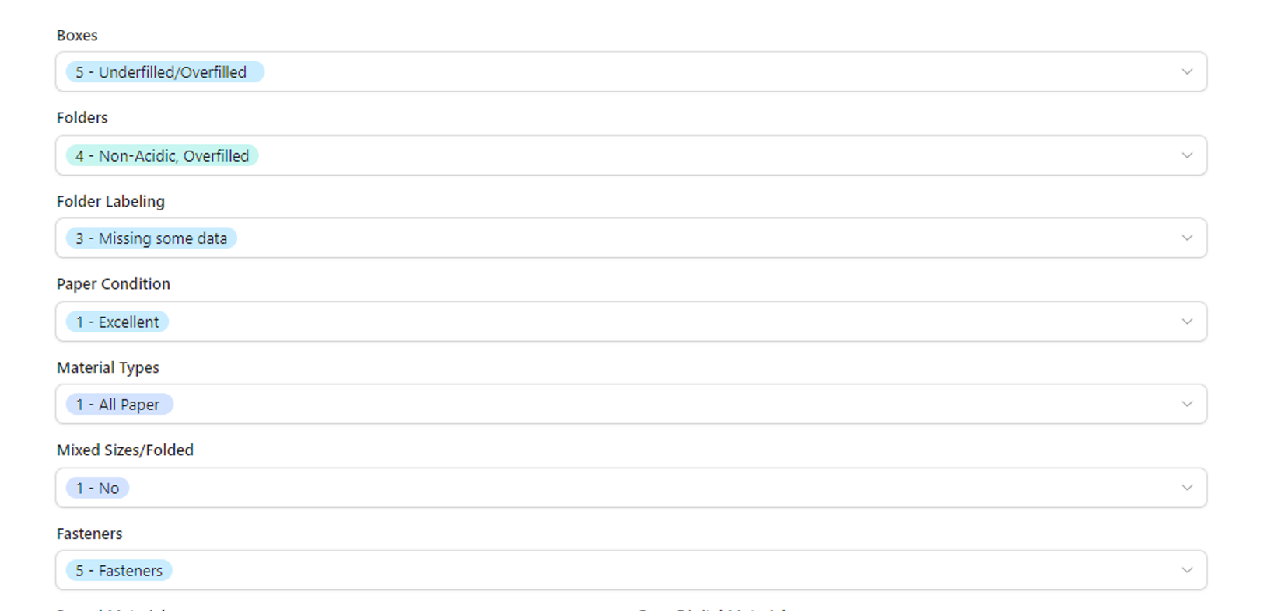

Slide 16
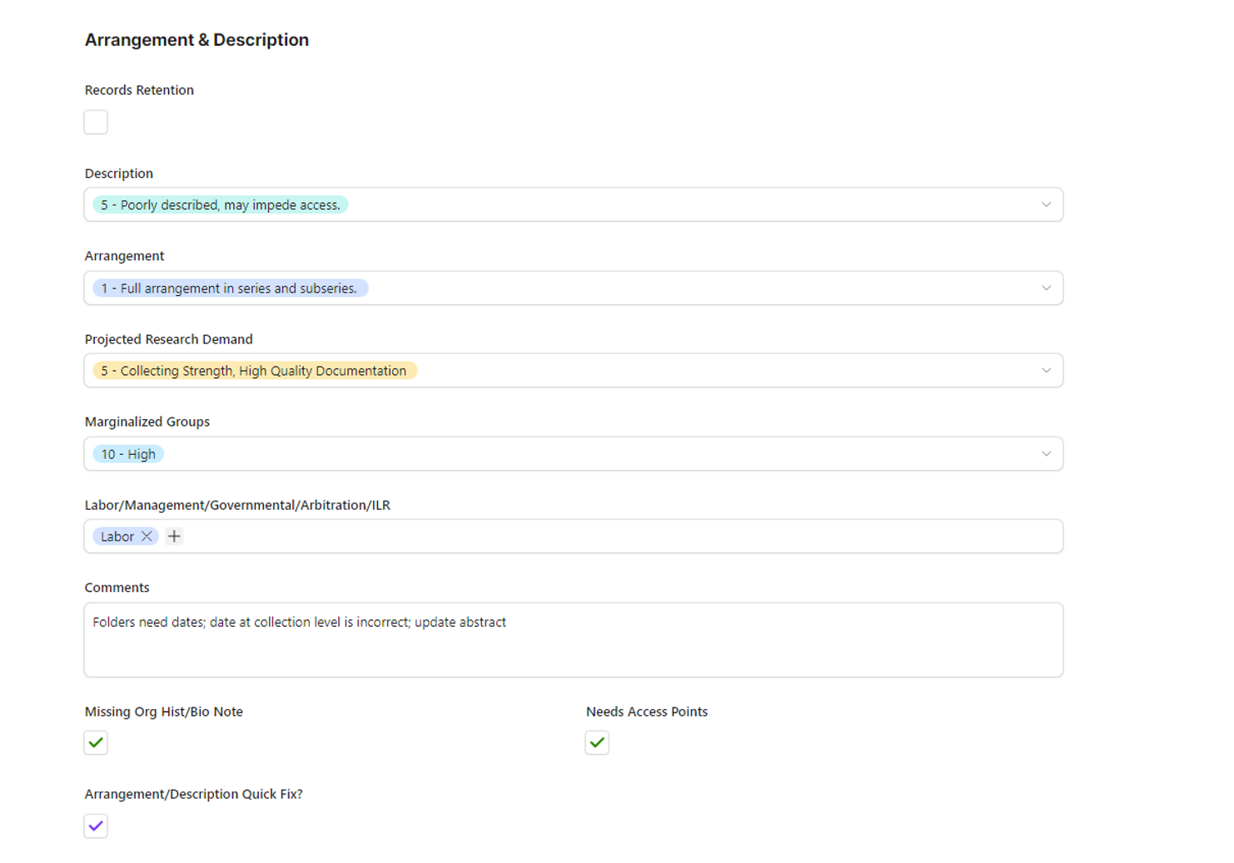

Slide 17
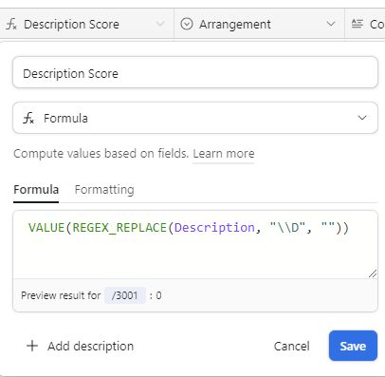
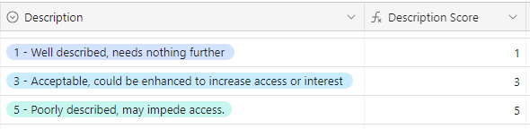
Creating the Scores

Slide 18
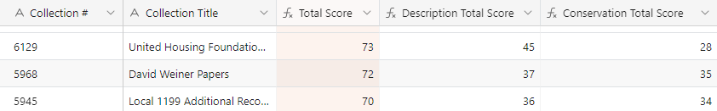
Weighing the scores
Each step = 50 points
Ratings disbursed based on priorities
High scores = high and realistic processing priority
Formulas convert text fields into numbers

Slide 19
Pilot Project
30 collections, representing different collecting areas, condition, eras
Refinement of instrument
Proof of concept and administrative support
Administrative support = funding, staffing, overhaul
Survey 2.0
Designed for 2 full time staff
Work queues
Survey manual

Slide 20
Start survey
Review: Metadata/
conservation
Extent data
Ref stats
Metadata & Conservation
Collection # & URL
Ready for Arrangement & Description review?
Yes
Survey scores tallied
Prioritized Processing List
Arrangement & Description
Repeat!
Review: Arrangement/description
Legend:
Start/end
Interface
Data store
User input
Decision
File
Data flow:
Parallel flow:

Slide 21
Start survey
Review: Metadata/
conservation
Extent data
Quick Fix Queue
Ref stats
Metadata & Conservation
Approved: Staff
Approved: Student
Conservation Quick Fix?
Collection # & URL
Ready for Arrangement & Description review?
Yes
Survey scores tallied
Prioritized Processing List
Arrangement & Description
Repeat!
Review: Arrangement/description
Legend:
Start/end
Interface
Data store
User input
Decision
File
Data flow:
Parallel flow:

Slide 22
Start survey
Review: Metadata/
conservation
Extent data
Quick Fix Queue
Student Work Queue
Ref stats
Metadata & Conservation
Approved: Staff
Approved: Student
Conservation Quick Fix?
Collection # & URL
Ready for Arrangement & Description review?
Yes
Survey scores tallied
Prioritized Processing List
Arrangement & Description
Repeat!
Review: Arrangement/description
Legend:
Start/end
Interface
Data store
User input
Decision
File
Data flow:
Parallel flow:

Slide 23
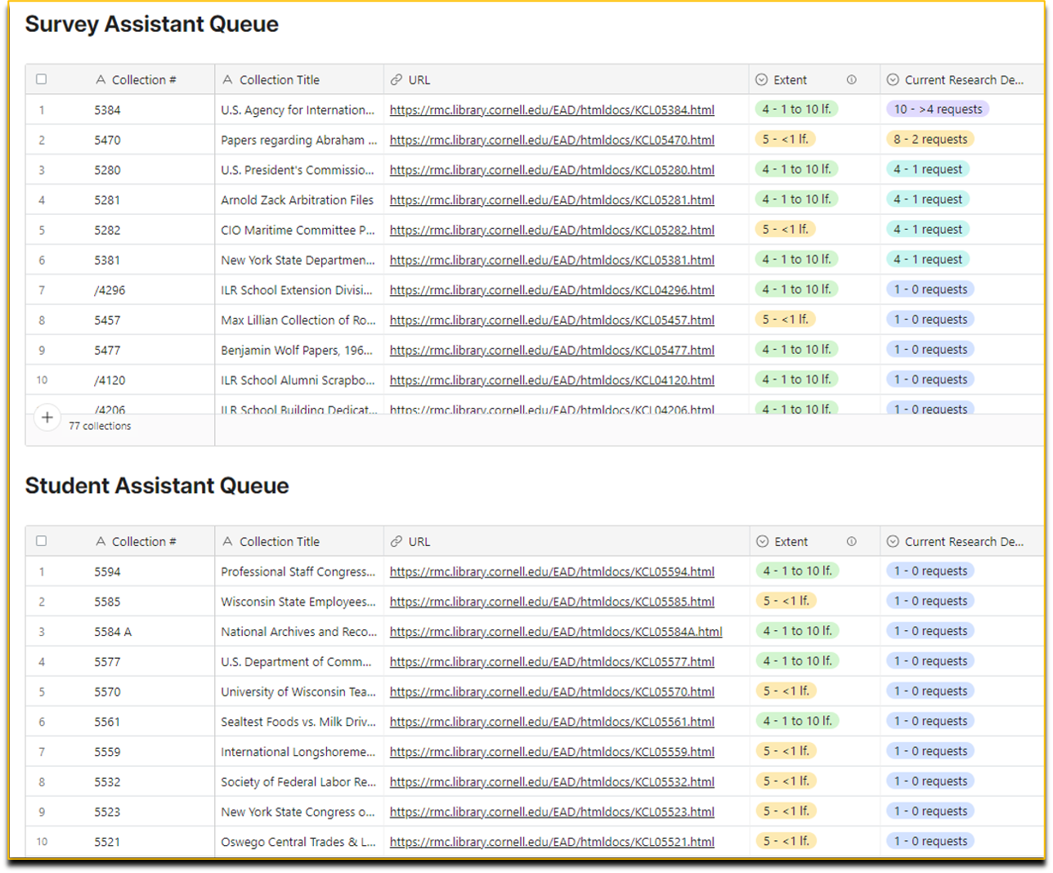

Slide 24
Start survey
Review: Metadata/
conservation
Extent data
Quick Fix Queue
Student Work Queue
Ref stats
Metadata & Conservation
Approved: Staff
Approved: Student
Conservation Quick Fix?
Collection # & URL
Ready for Arrangement & Description review?
Yes
Survey scores tallied
Prioritized Processing List
Arrangement & Description
Repeat!
Review: Arrangement/description
Legend:
Start/end
Interface
Data store
User input
Decision
File
Data flow:
Parallel flow:

Slide 25
Start survey
Review: Metadata/
conservation
Extent data
Quick Fix Queue
Student Work Queue
Ref stats
Metadata & Conservation
Approved: Staff
Approved: Student
Conservation Quick Fix?
Collection # & URL
Ready for Arrangement & Description review?
Yes
Survey scores tallied
Prioritized Processing List
Arrangement & Description
Flag for Arrangement & Description
Flagged Collections
Repeat!
Review: Arrangement/description
Legend:
Start/end
Interface
Data store
User input
Decision
File
Data flow:
Parallel flow:

Slide 26
Start survey
Review: Metadata/
conservation
Extent data
Quick Fix Queue
Student Work Queue
Ref stats
Metadata & Conservation
Approved: Staff
Approved: Student
Conservation Quick Fix?
Collection # & URL
Ready for Arrangement & Description review?
Yes
Survey scores tallied
Prioritized Processing List
Arrangement & Description
Records Retention
Flag for Arrangement & Description
Flagged Collections
Repeat!
Review: Arrangement/description
Legend:
Start/end
Interface
Data store
User input
Decision
File
Data flow:
Parallel flow:

Slide 27

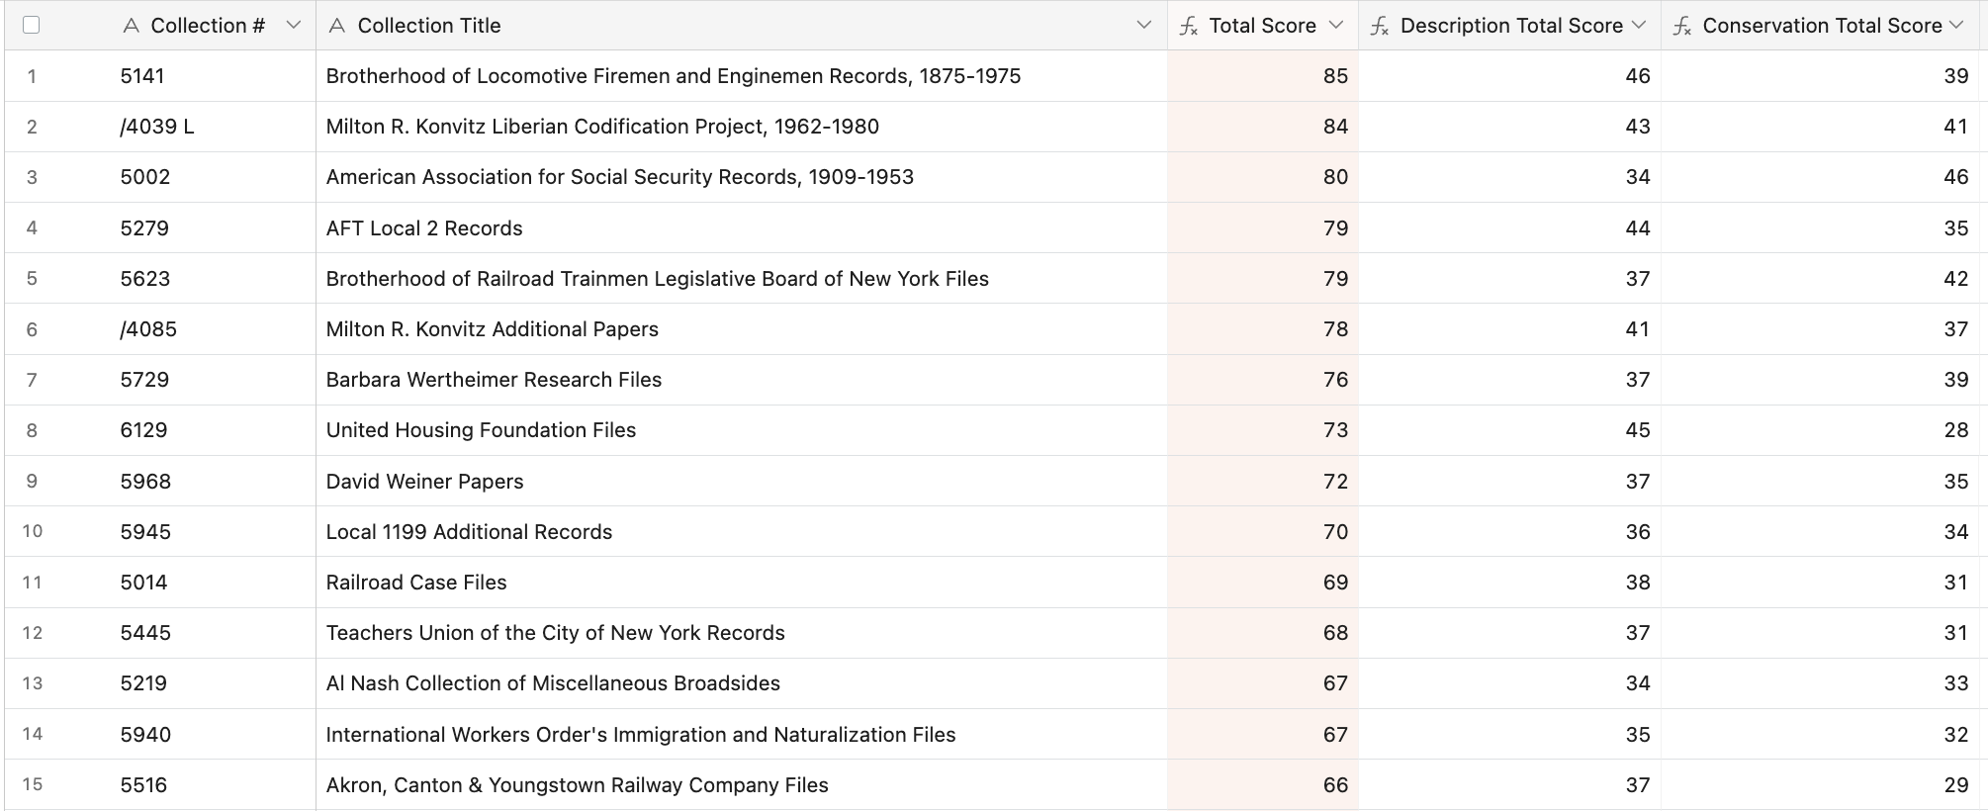

Slide 28
Metadata/Conservation Interface
Metadata: crosschecking finding aids and collections database for restrictions and inconsistencies
Conservation: inspecting the physical condition of collections
Collections >10 boxes: check 10 + 20% of remaining boxes, sampling across entire collection
Ex: for a 100 box collection, check 10 + (0.2*90) = 28 boxes
Evaluated in survey with rating scales, multiple choice, checkboxes, free text fields

Slide 29
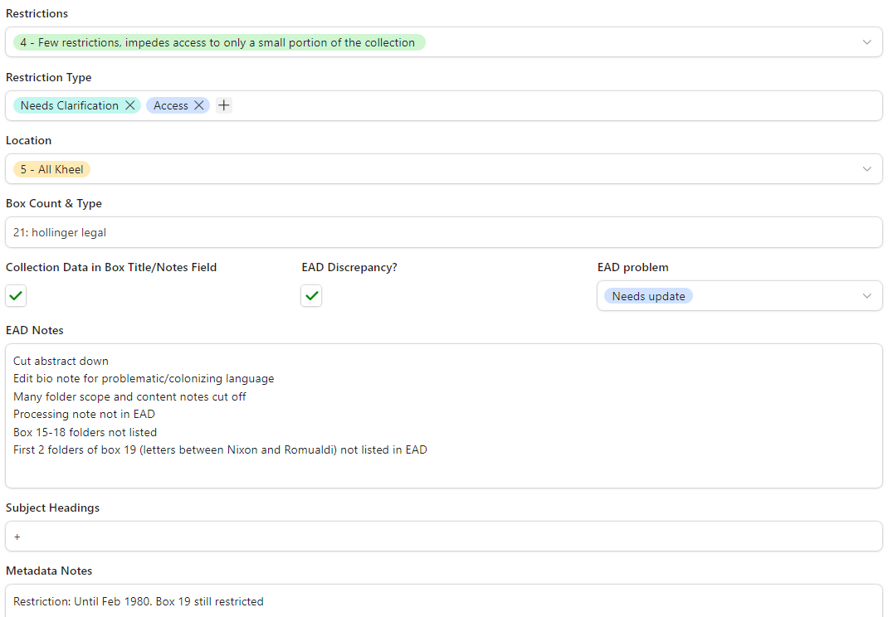
Metadata Example: "Serafino Romualdi Papers"

Slide 30
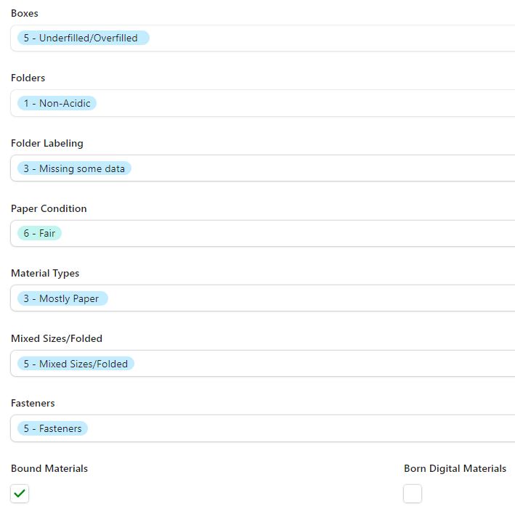
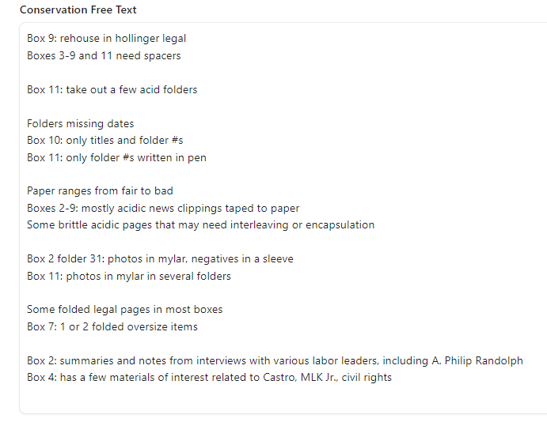
Conservation Example: "Edwin S. Smith Papers"

Slide 31
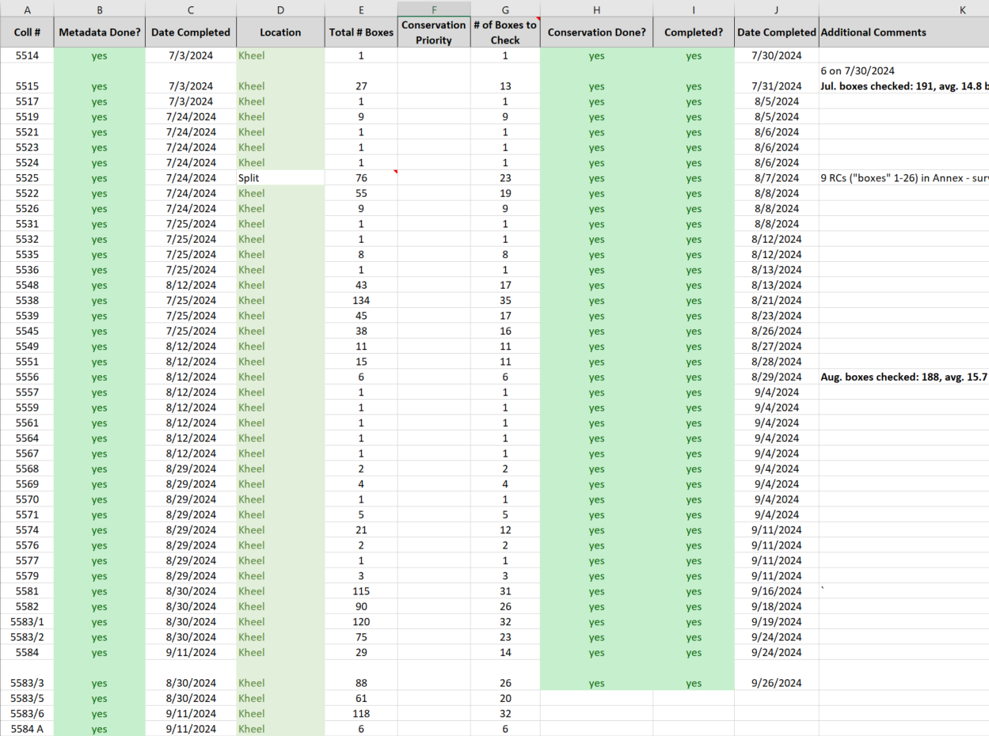
Tracking Survey Progress
Tracks # of boxes checked per day and month
Automates formula for how many boxes to check for larger collections

Slide 32
Refining the Survey
Setting reasonable goals
# of boxes to check in larger collections > 6,000 boxes!
Added "de-prioritize" check box and reduced # by ~1,000 boxes
Unexpected complications
Collections split between different repositories 🡪 added a “split” rating
Needed more precise measure of collection size for quick fix evaluation 🡪 added a “box count and type” field

Slide 33
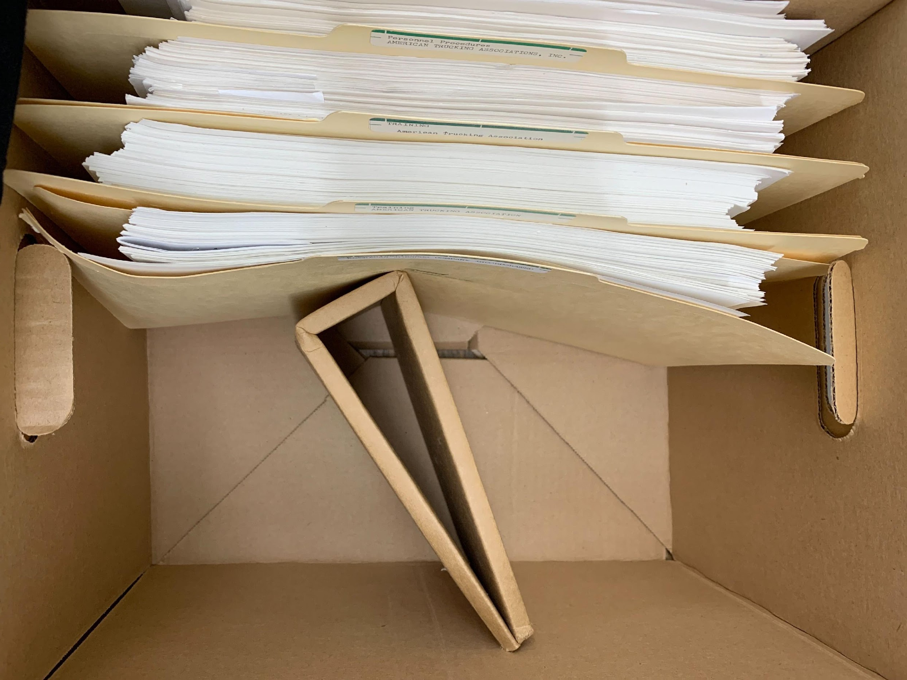
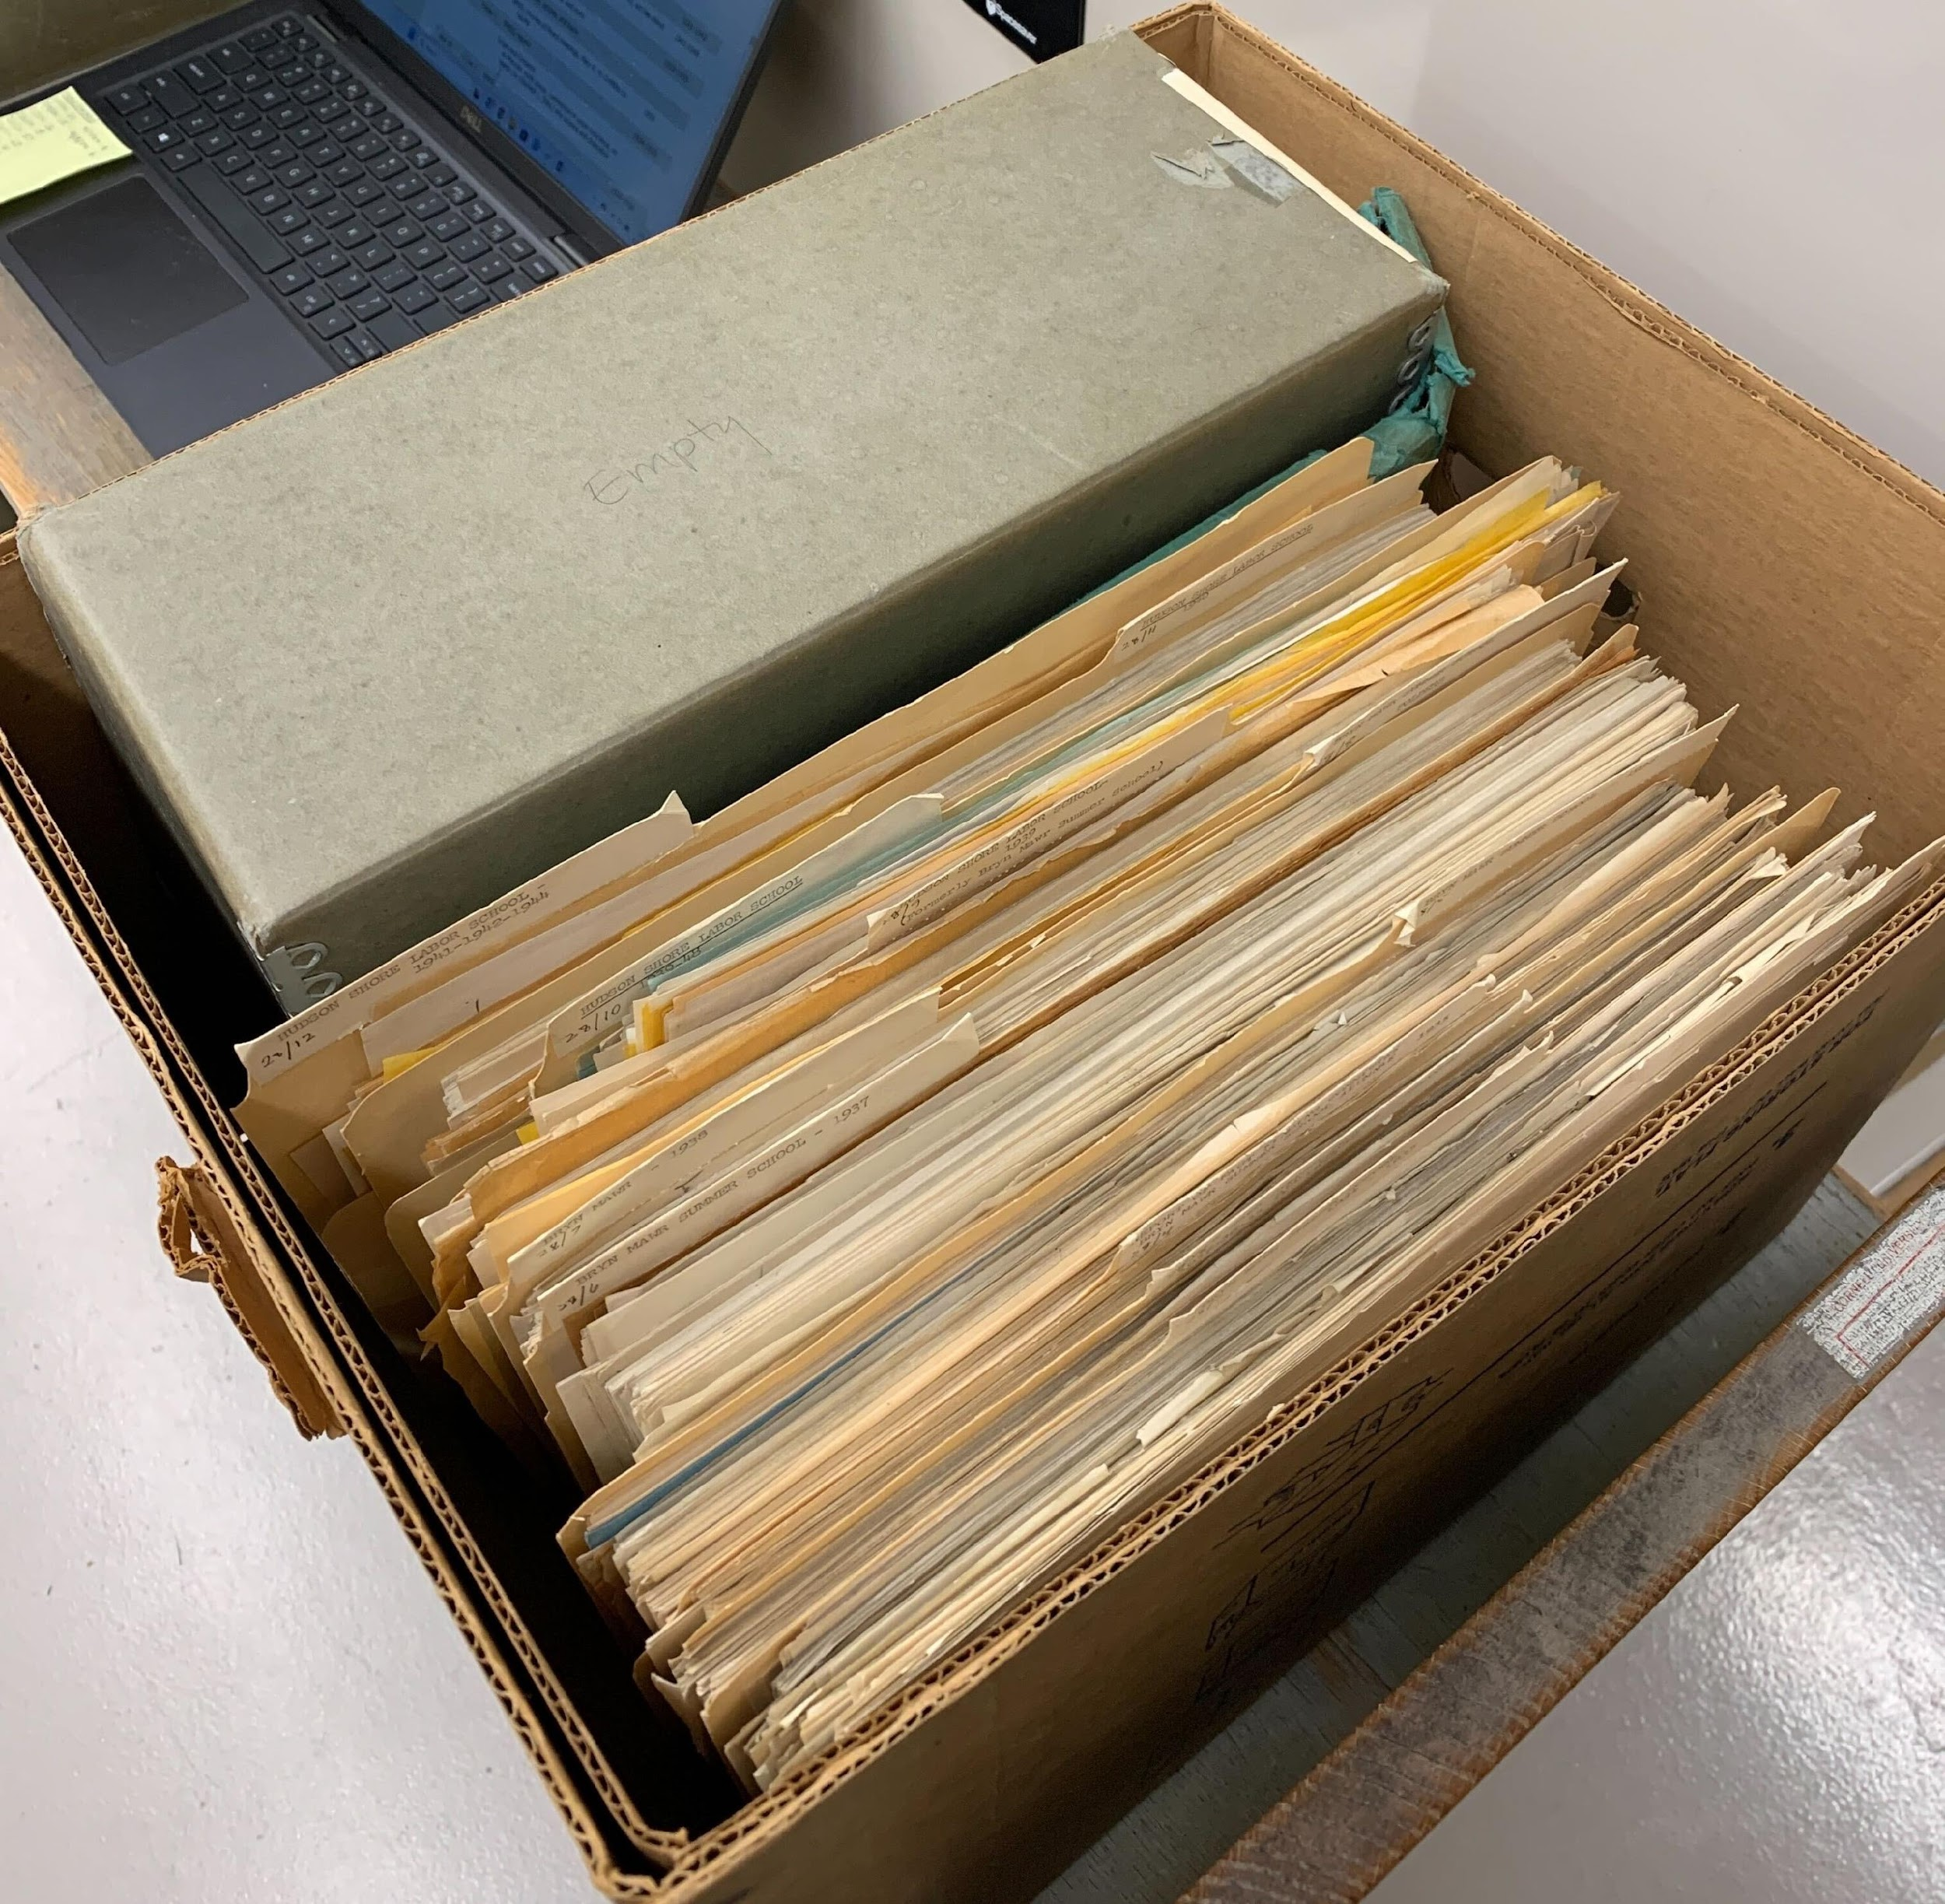

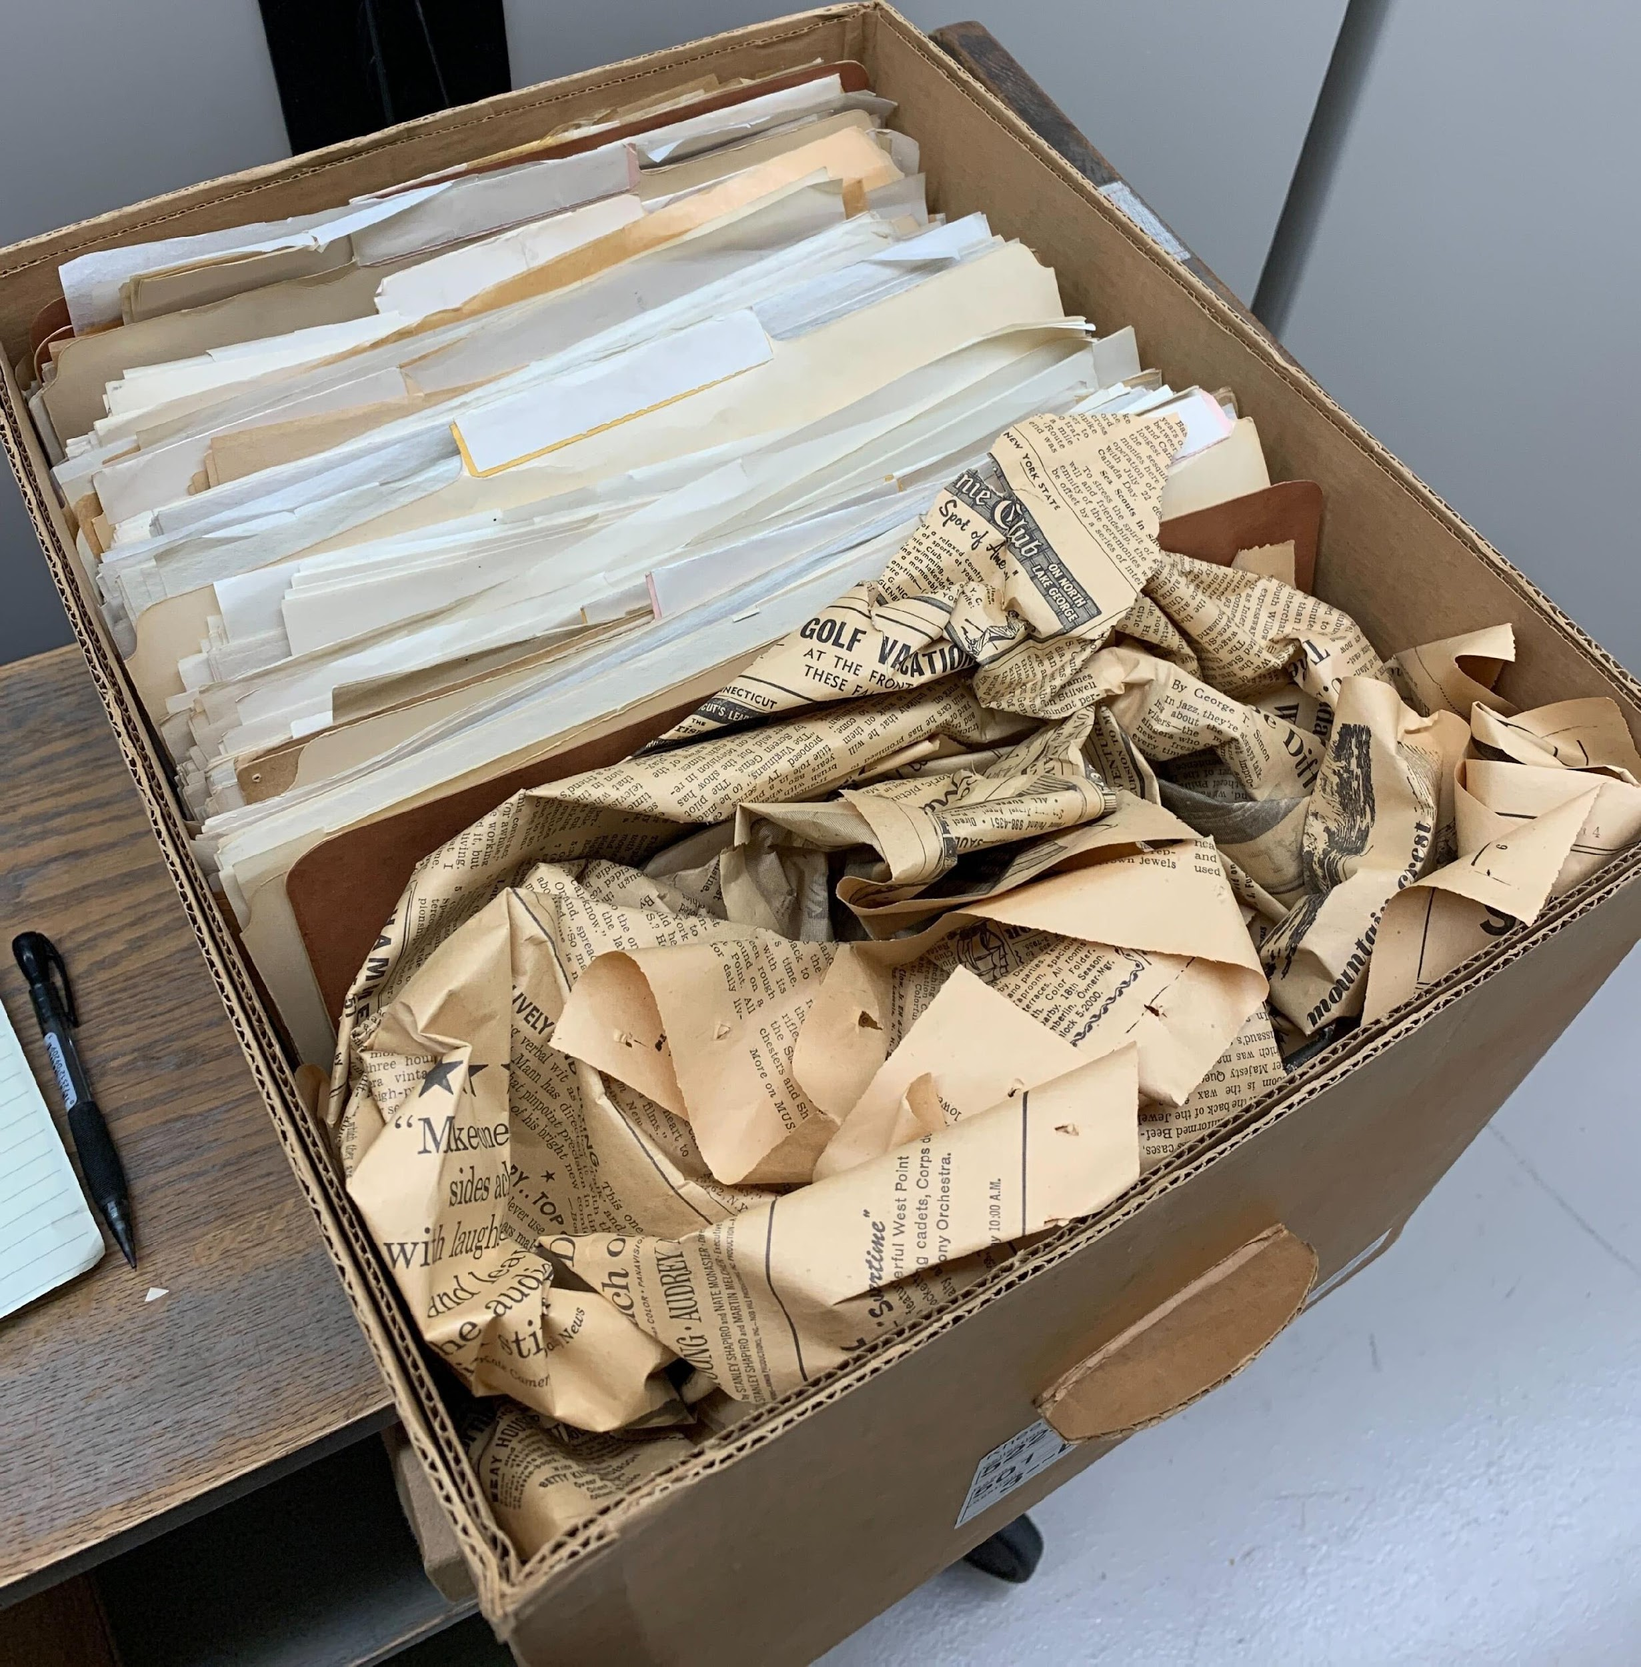
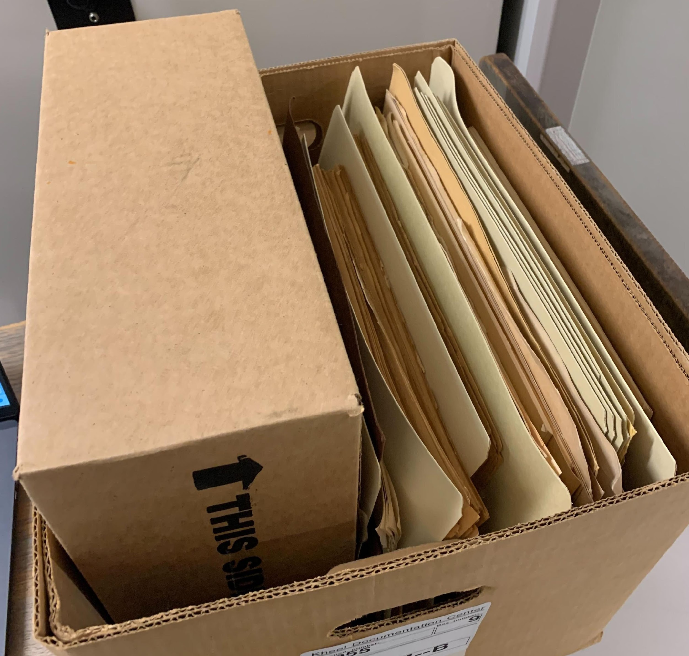

Found in the Archives: Weird Spacers…

Slide 34
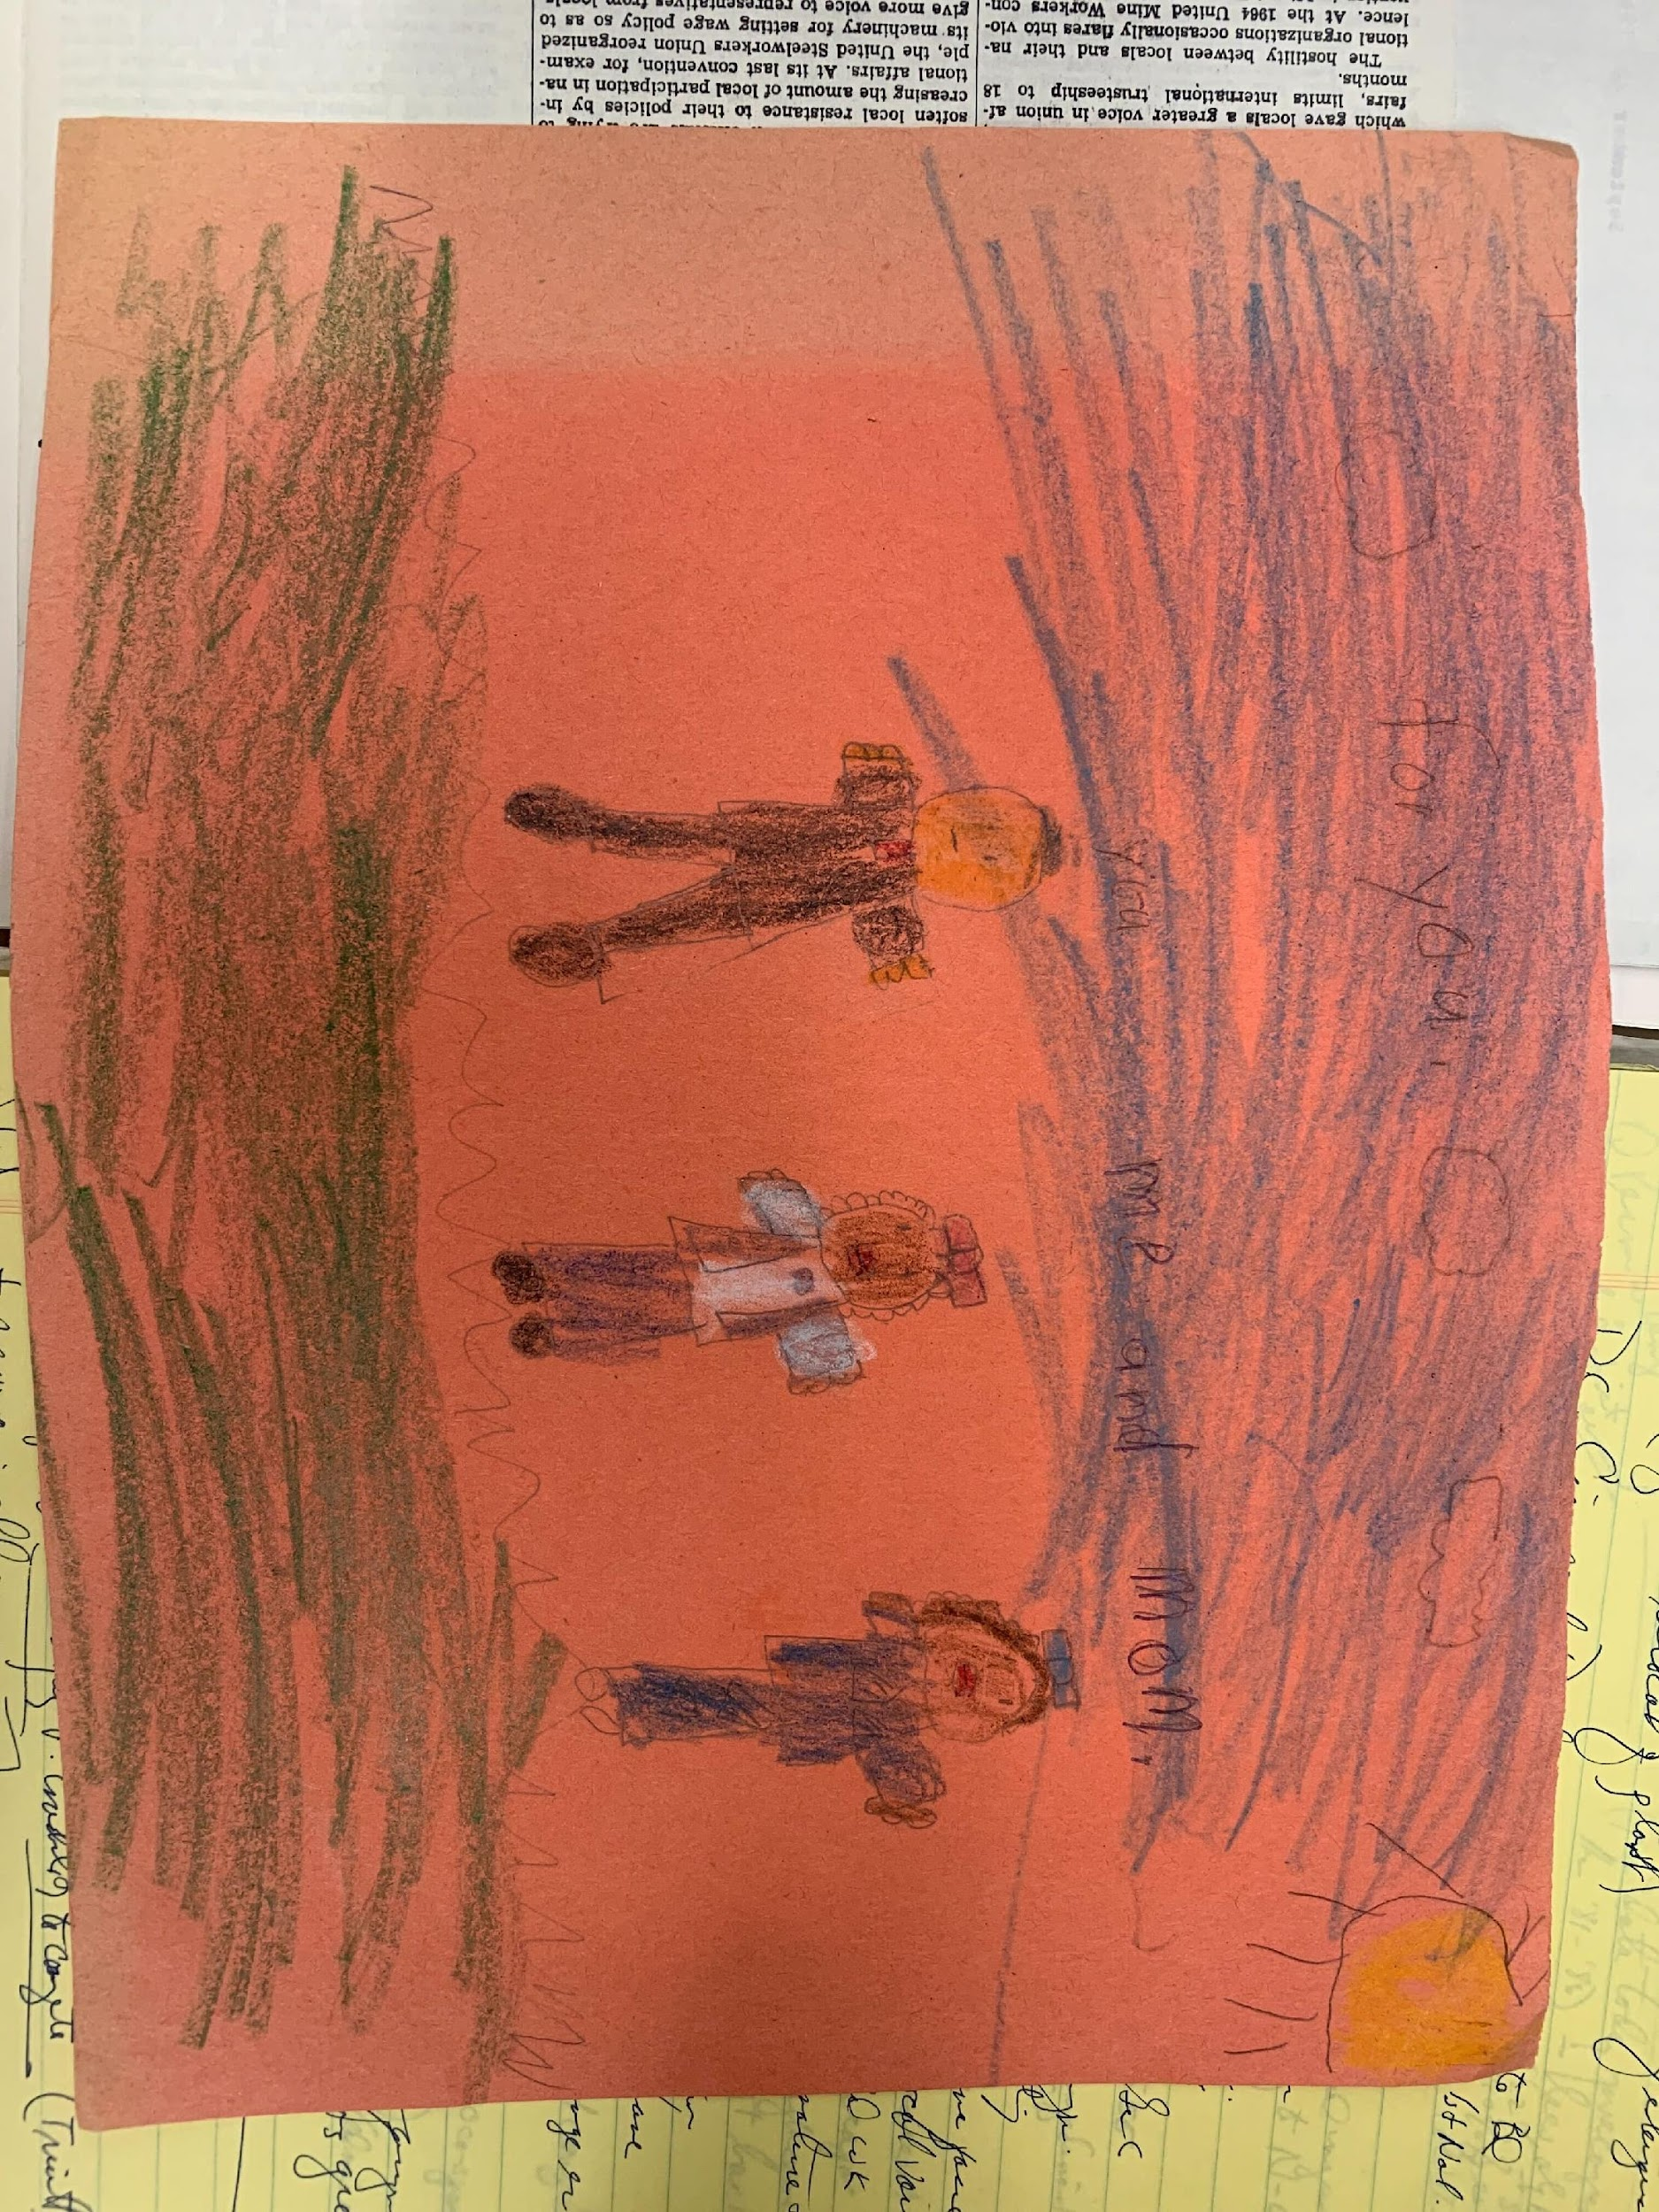
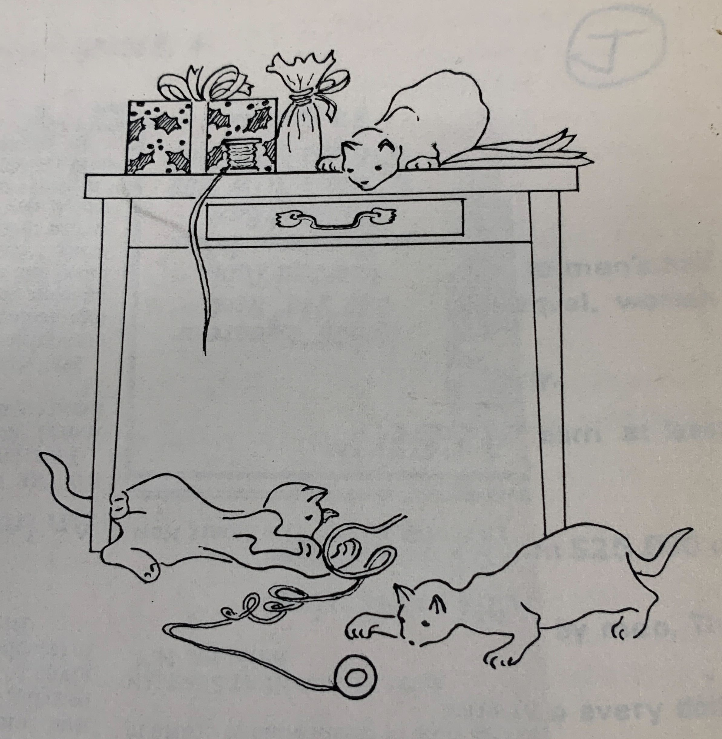
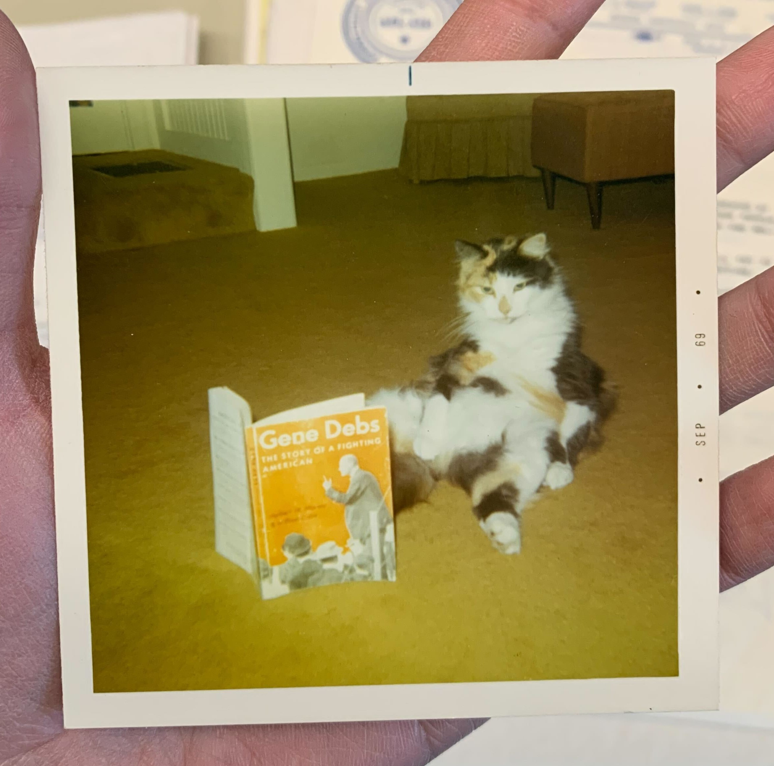
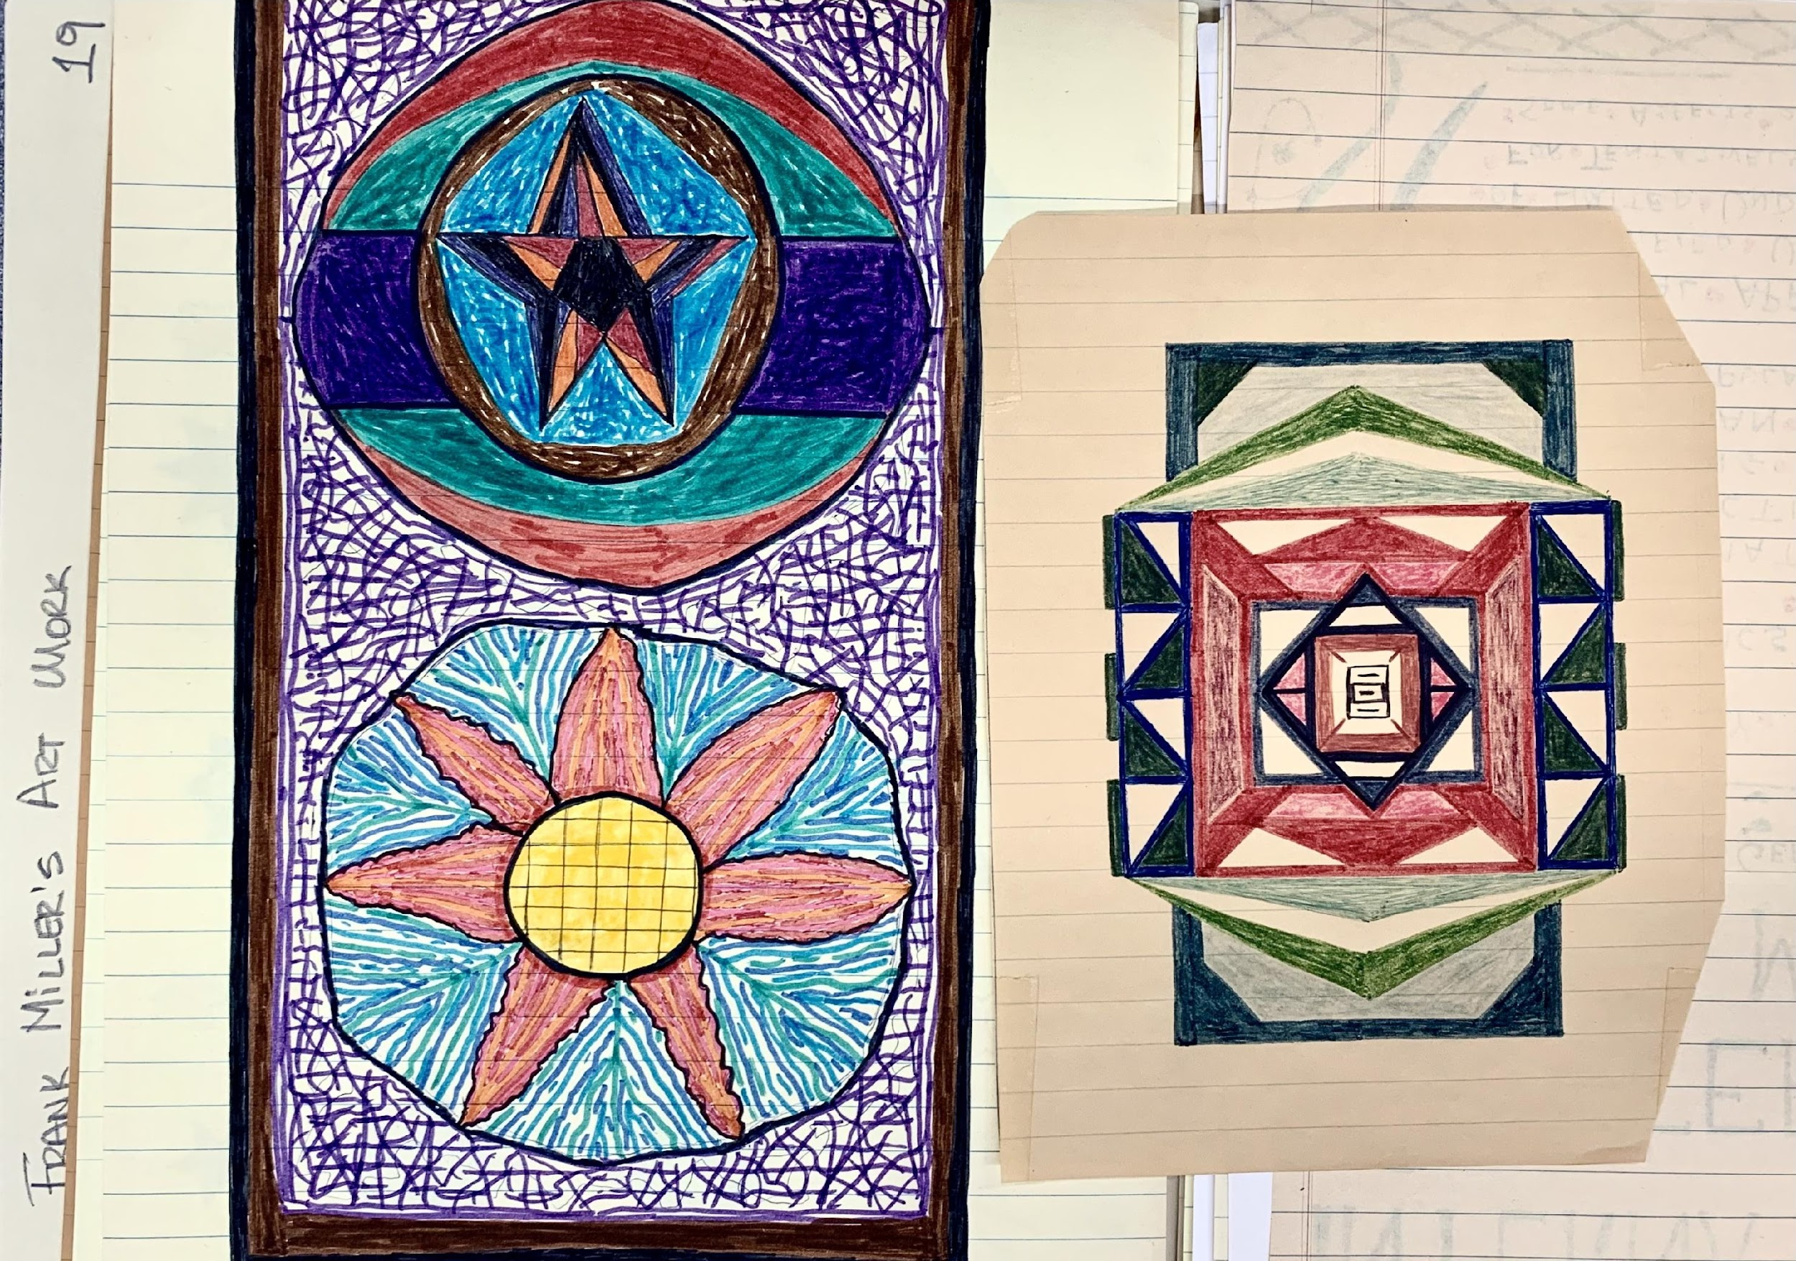
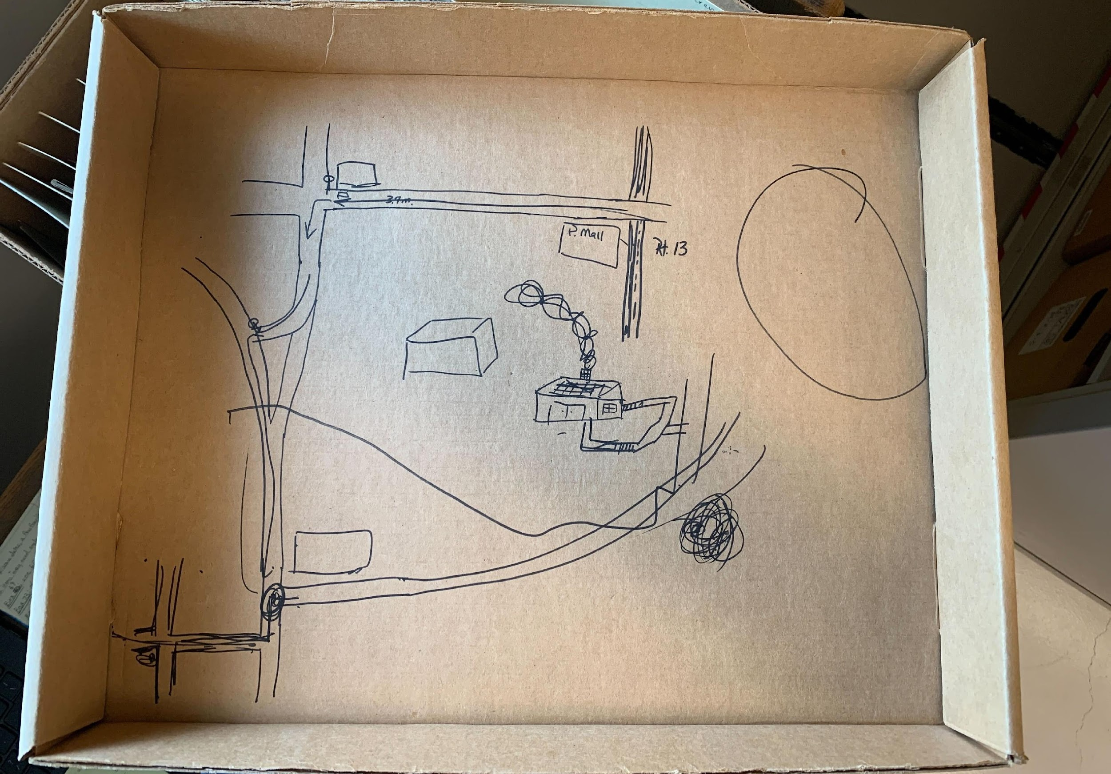
Found in the Archives: Fun Finds!

Slide 35
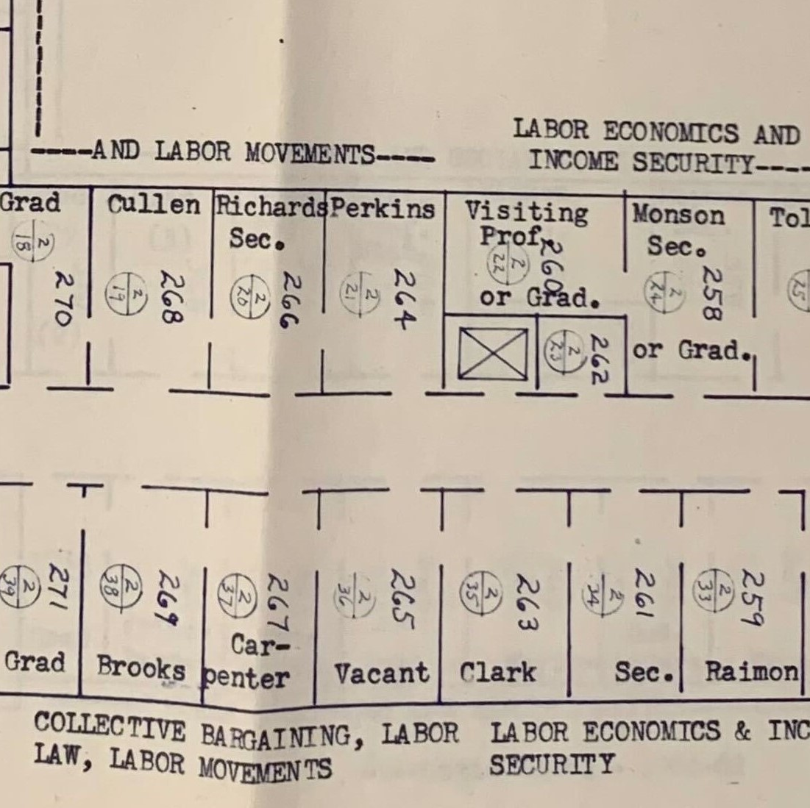
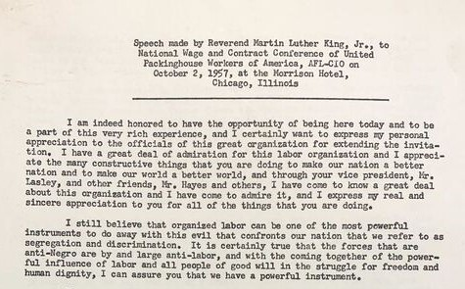
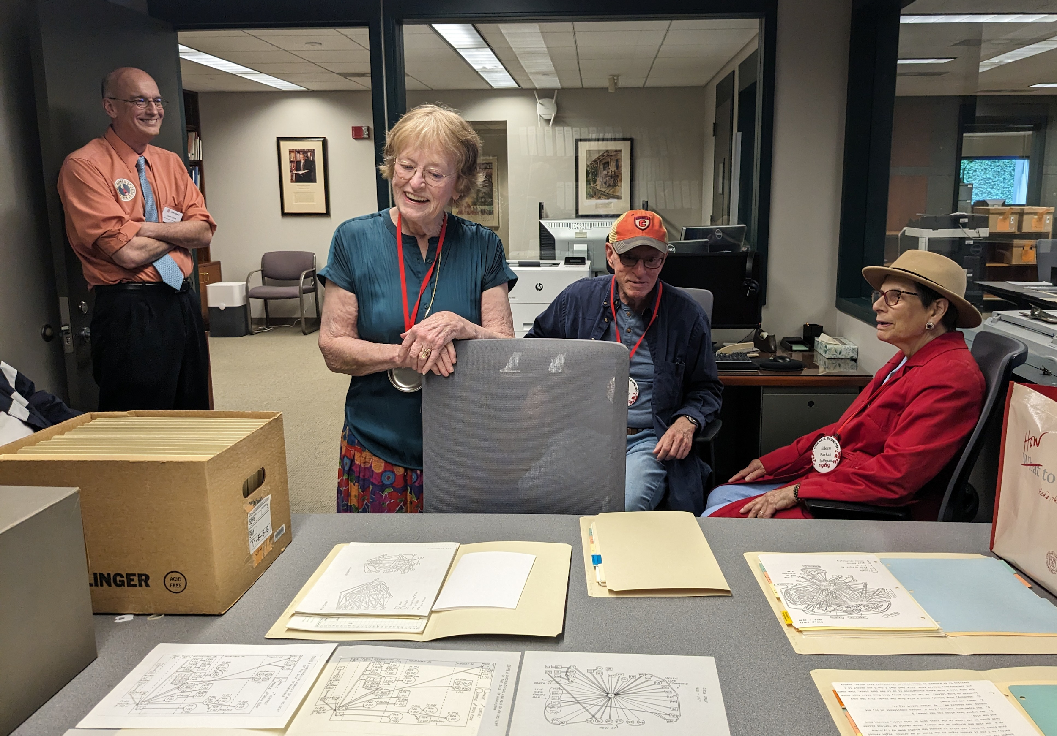
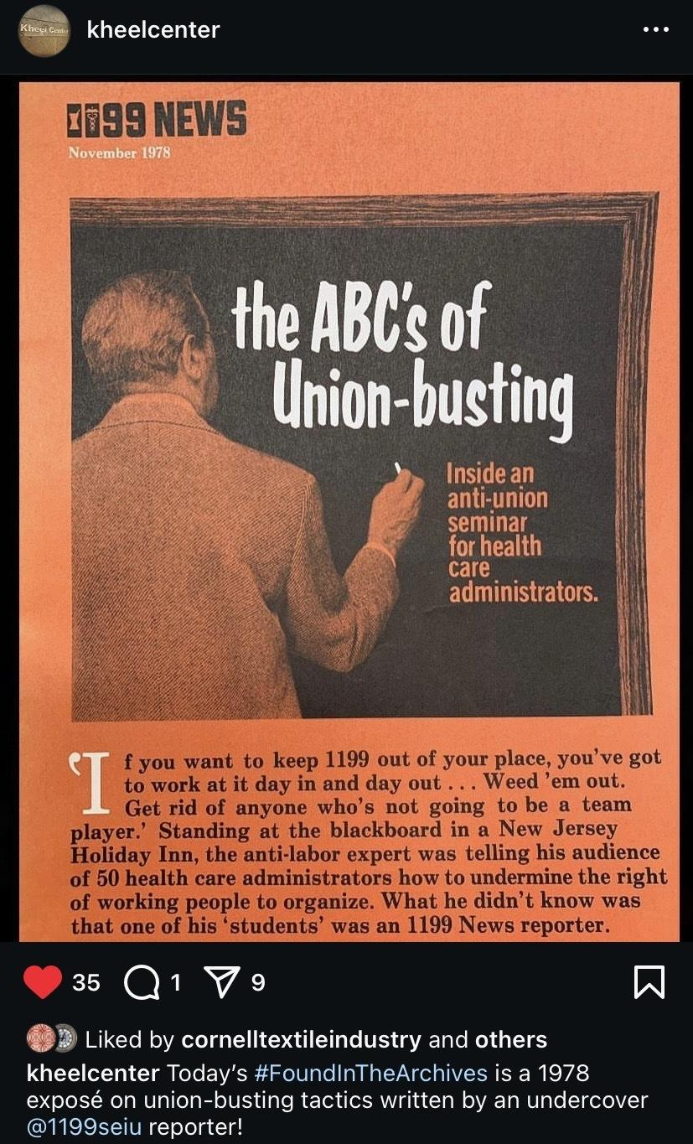
Immediate Impacts: Enhancing Public Services
ILR history exhibit for Alumni Reunion 2024
Social media posts
Reference questions
Greater knowledge of our collections!

Slide 36
Survey Progress: 1 Year In
747 collections reviewed for Conservation/Metadata
2900+ boxes checked, monthly avg. 15-20 boxes/day
269 collections fully surveyed
110 collections "quick fixed" for metadata/conservation issues

Slide 37
MANY HANDS MAKE LIGHT (SURVEY) WORK
Weekly meetings of technical services team
Review quick fixes
Refine survey instrument
Assign tasks
Talk through notes fields and add to them with additional observations
Group discussion benefits
Leverage everyone’s specific knowledge
Ask Claire to clarify notes
Correct for each other’s biases
Reach consensus on priorities

Slide 38
ILR WORKING WOMEN’S INSTITUTE(S)
Collections /3099, 3099m, and /4354/003
Institute for Education and Research on Women and Work records, 1961 – 1983
ILR School Proposal for a Working Women's Institute for Research and Education, 1977
ILR School Extension Division Metropolitan District Office (New York, N.Y.), Working Women United Institute Records, 1975 – 1986
/3099 - This collection was re-processed and re-named in March 2024. The original title of the collection was "ILR School Working Women's Institute Files." The new title better reflects the content and creators of the collection.
/4354/003 - This collection was originally located at the Barnard Center for Research on Women (or earlier, the Women's Center). The records were donated by KC Wagner, Cornell faculty and member of the Working Women's Institute. The Barnard Center for Research on Women maintained a large feminist ephemera collection, a collection of periodicals, parts of their own institutional records, and some additional special research collections in their office. After its closing, the majority of their materials were transferred to the Barnard Archives. The Working Women's Institute Records were one of these collections. They were held by the Barnard Archives, but never accessioned into their collection. The records were returned to KC Wagner at her request for deposit at the Kheel Center in November 2018.

Slide 39
FINAL THOUGHTS ~OR~ QUESTIONS THAT NEED ANSWERS
Questions of provenance
Whose stories are in these records? Are they ours to tell? Is there informed consent?
What about the right to be forgotten?
How are we capturing our decisions? How are we communicating them?

