Slide 1

What’s Wrong with this Picture?
How Format and Issue Identification Tools Can Help You
Robin C. Pike
Manager, Digital Conversion and Media Reformatting
University of Maryland Libraries
rpike@umd.edu
@AVArchivist
Notes:
I’m Robin Pike and I’m the Manager of Digital Conversion and Media Reformatting at the University of Maryland Libraries. I’ve used many different tools throughout my career as a cataloger, processor, preserver, reference provider, and digitizer to make different tasks easier, and I will discuss several of them today.

Slide 2
Helpful Tools
Still Image
  IPI Graphic Atlas
Video
  Texas Commission on the Arts: Videotape Identification and Assessment Guide
Audio
  IUB: Field Audio Collection Evaluation Tool (FACET)
A/V Issues
  AVAA: A/V Artifact Atlas
http://www.arts.texas.gov/wp-content/uploads/2012/04/video.pdf, page 10
Notes:
The IPI Graphic Atlas and A/V Artifact Atlas are both online tools, while the Videotape Identification and Assessment Guide and FACET are downloadable resources. These tools should be used in addition to the publications typically found in a library’s or archive’s reference collection.

Slide 3

What’s that?
Planning
Description
  Help Identify
  Help Date
Resources
Preservation
Digitization
Notes:
Determining what formats are in your collections is important for resource allocation. The following resources can assist with format identification, and possibly determine when it was created, how to best store the object, what preservation steps you may need to take, and what precautions or requirements you may need to keep in mind while you create products, such as digital surrogates.

Slide 4
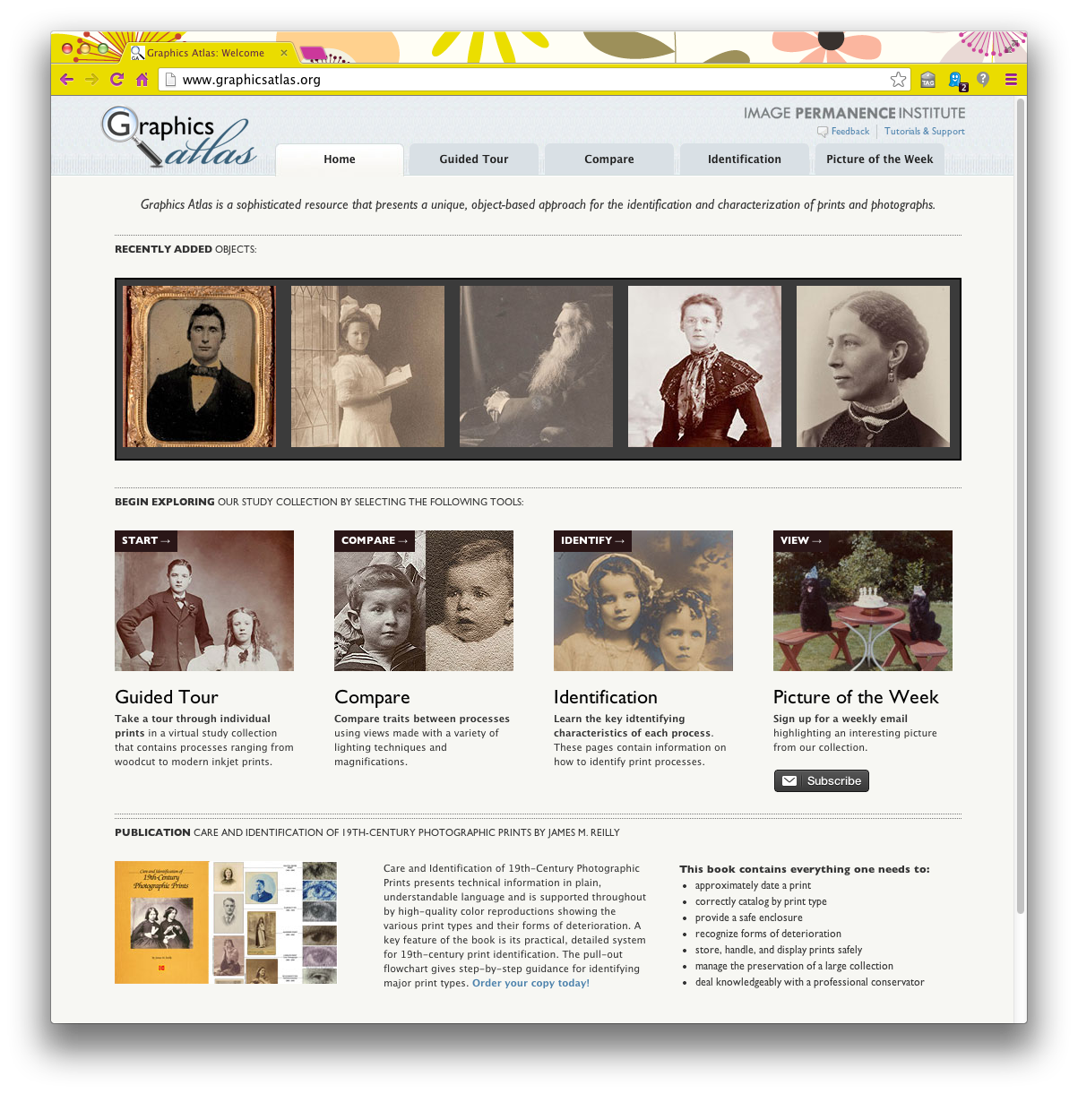
Still Image: IPI Graphic Atlas http://www.graphicsatlas.org/
Notes:
The Image Permanence Institute launched the Graphic Atlas in early 2010, the result of several years of research on photographic and pre-photographic processes. IPI received a grant in 2012 to continue development and research for this project.

Slide 5
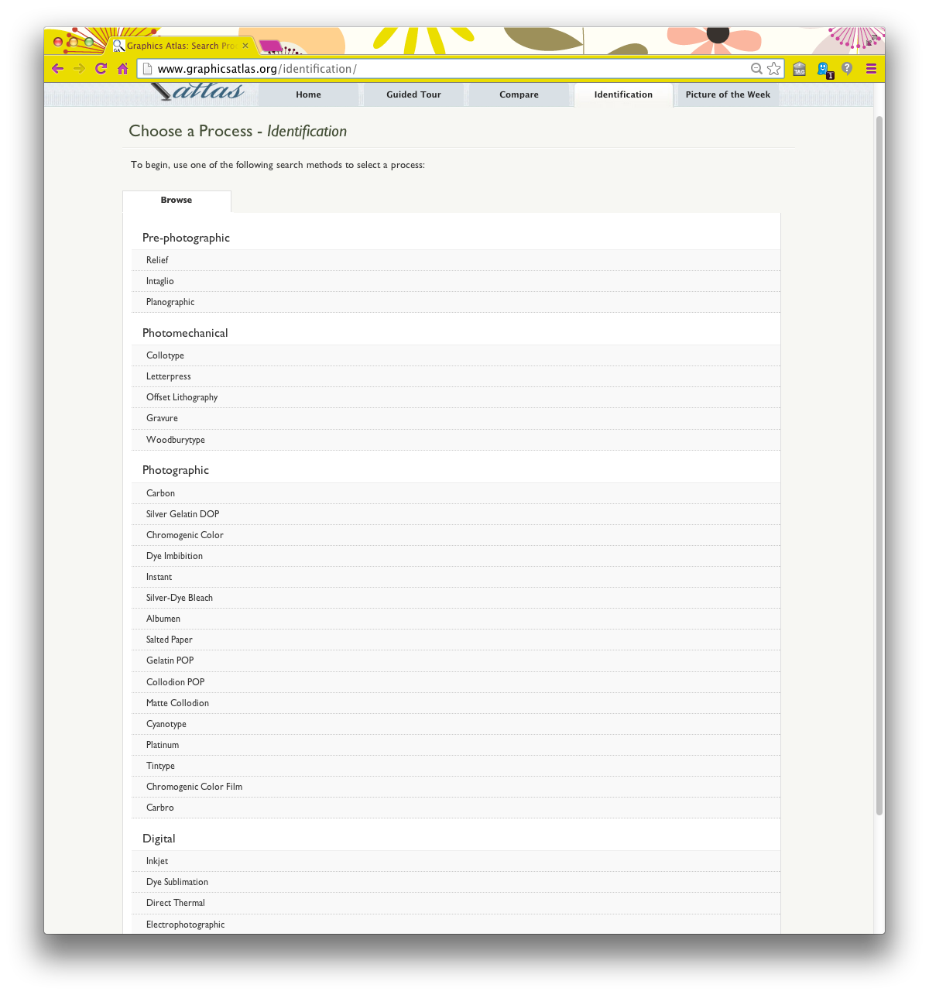
Comprehensive Still Image Formats
Notes:
The Graphic Atlas can be used to identify or compare a comprehensive list of still image formats. While this list is not exhaustive, and the information about each format is not exhaustive, the Image Permanence Institute is using the second grant to add more formats and information to this resource.

Slide 6
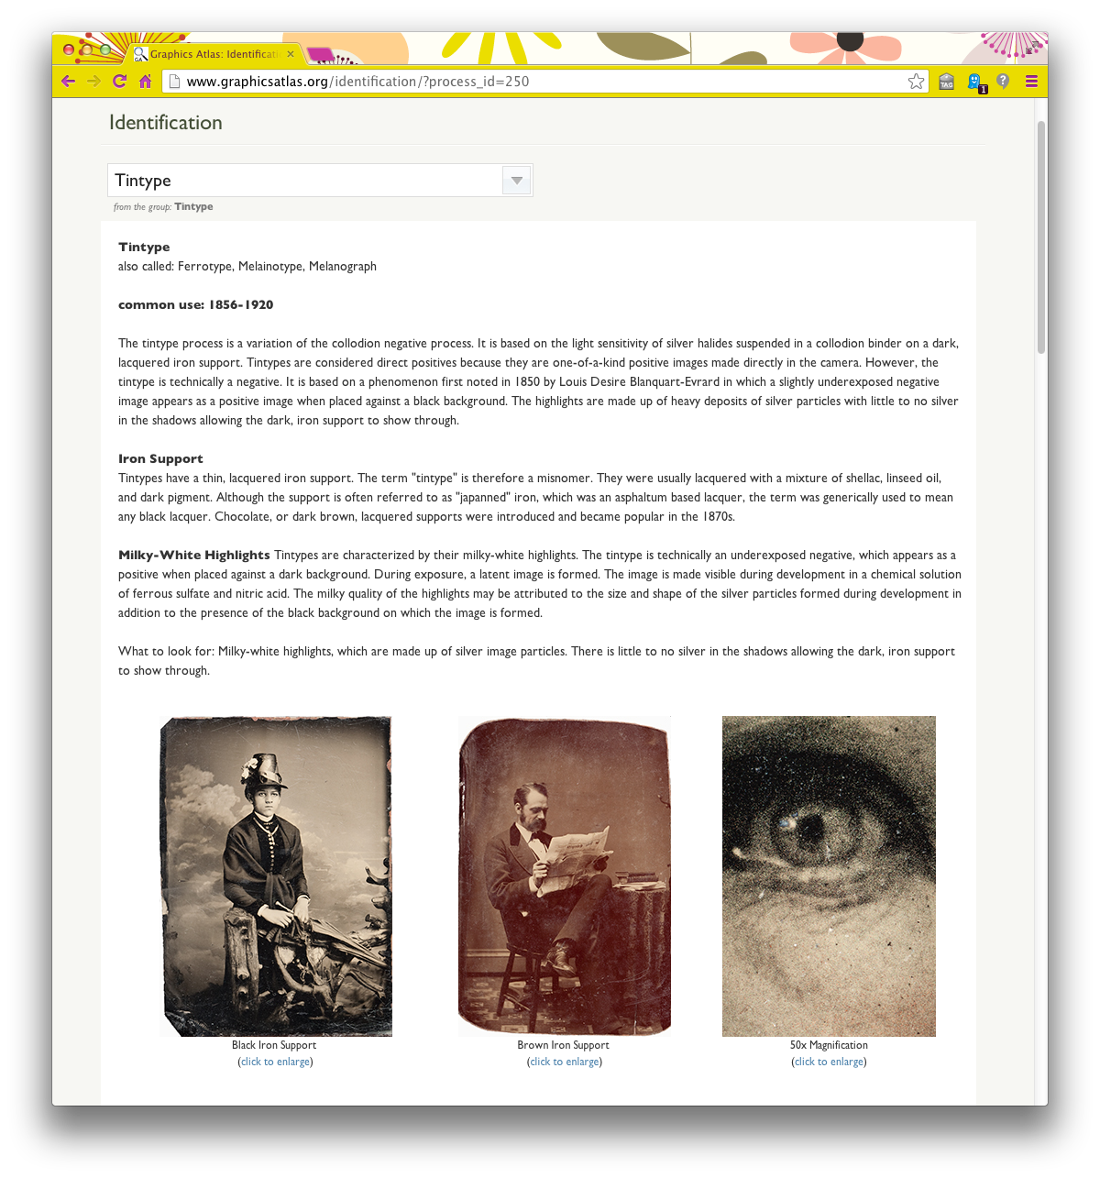
Identify
Notes:
The two features I have used the most frequently are “Identify” and “Compare.” “Identify” provides the various names of the same process, its common uses and period of use, information on the substrate and processing method, general identifying characteristics and other traits, any artifacts from the process, and condition issues.

Slide 7
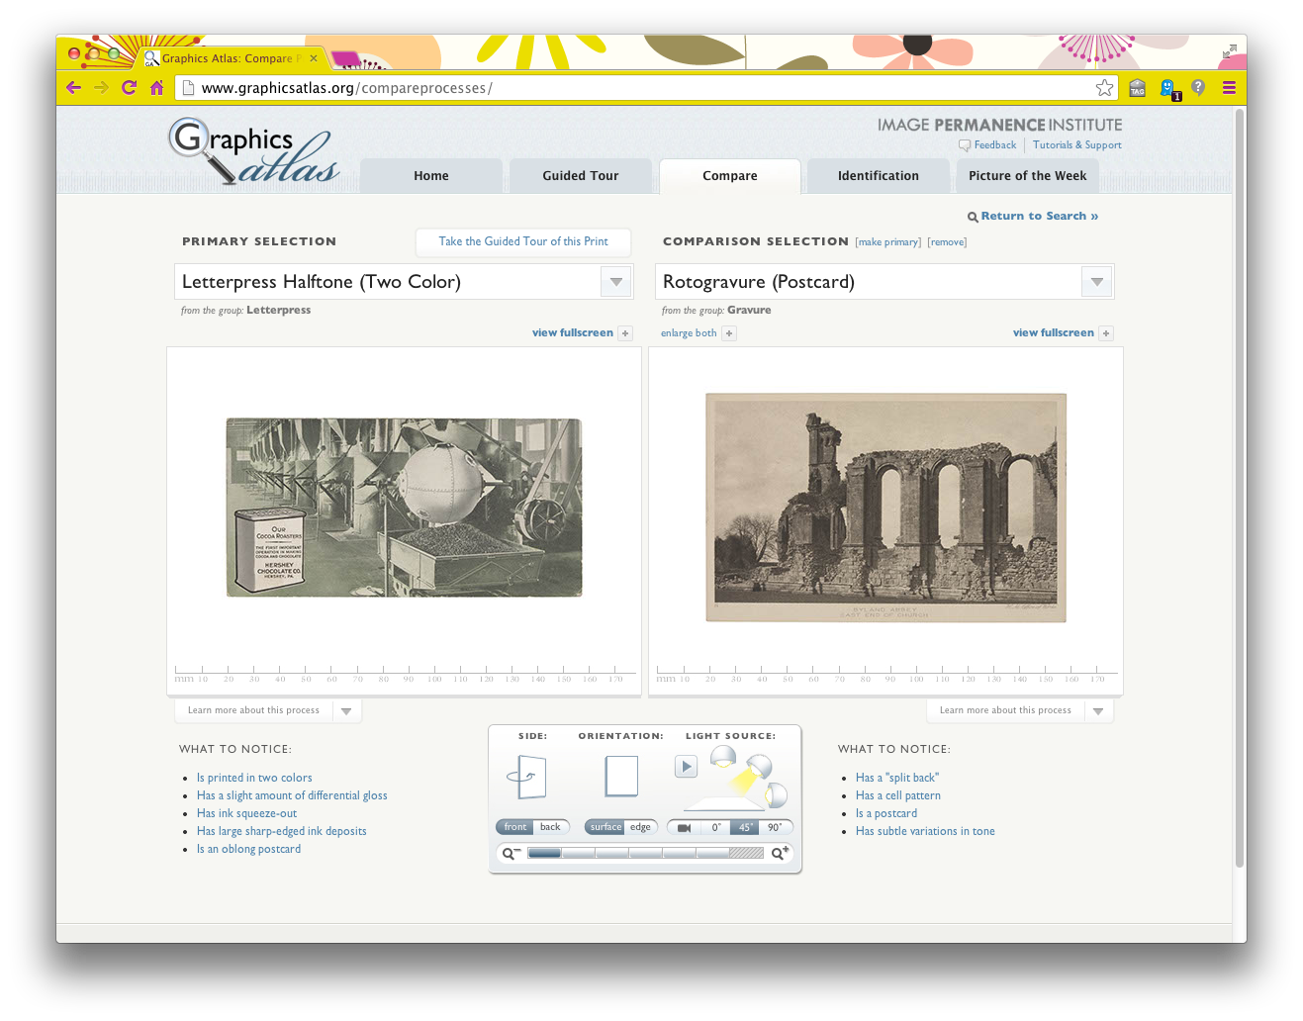
Compare
Notes:
“Compare” is useful when you need to compare two similar processes. “What to notice” points out the major characteristics of the object. This view also allows you to “move” the light source and orientation of the image so you can better detect texture, to also better identify the process.

Slide 8
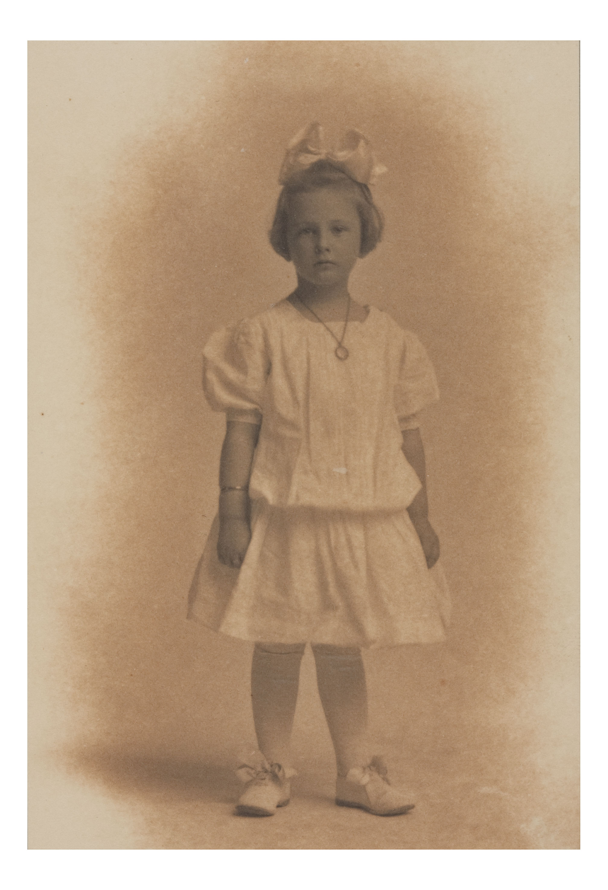
Uses
Enclosure
Description
Dating
Identify deterioration
Plan digitization
Personal archiving
http://www.graphicsatlas.org/media/images/Platinotype_ID_Stability1_Fullscreen.jpg
Notes:
The IPI Graphic Atlas can help identify the print so you can determine what type of enclosure to use, to help circa date a photo, and to better understand deterioration effects like silvering, that can impact the resulting digital surrogate produced by a scanner or a camera using a flash instead of a static light source. It’s also a good tool to refer patrons to so they can learn more about their personal collections.

Slide 9
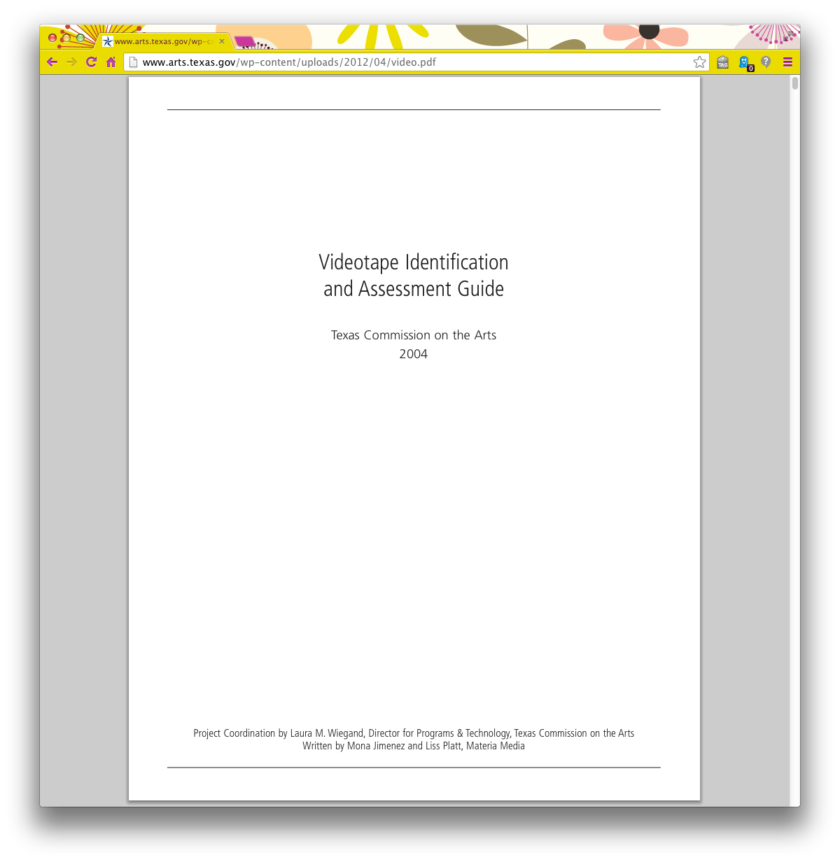
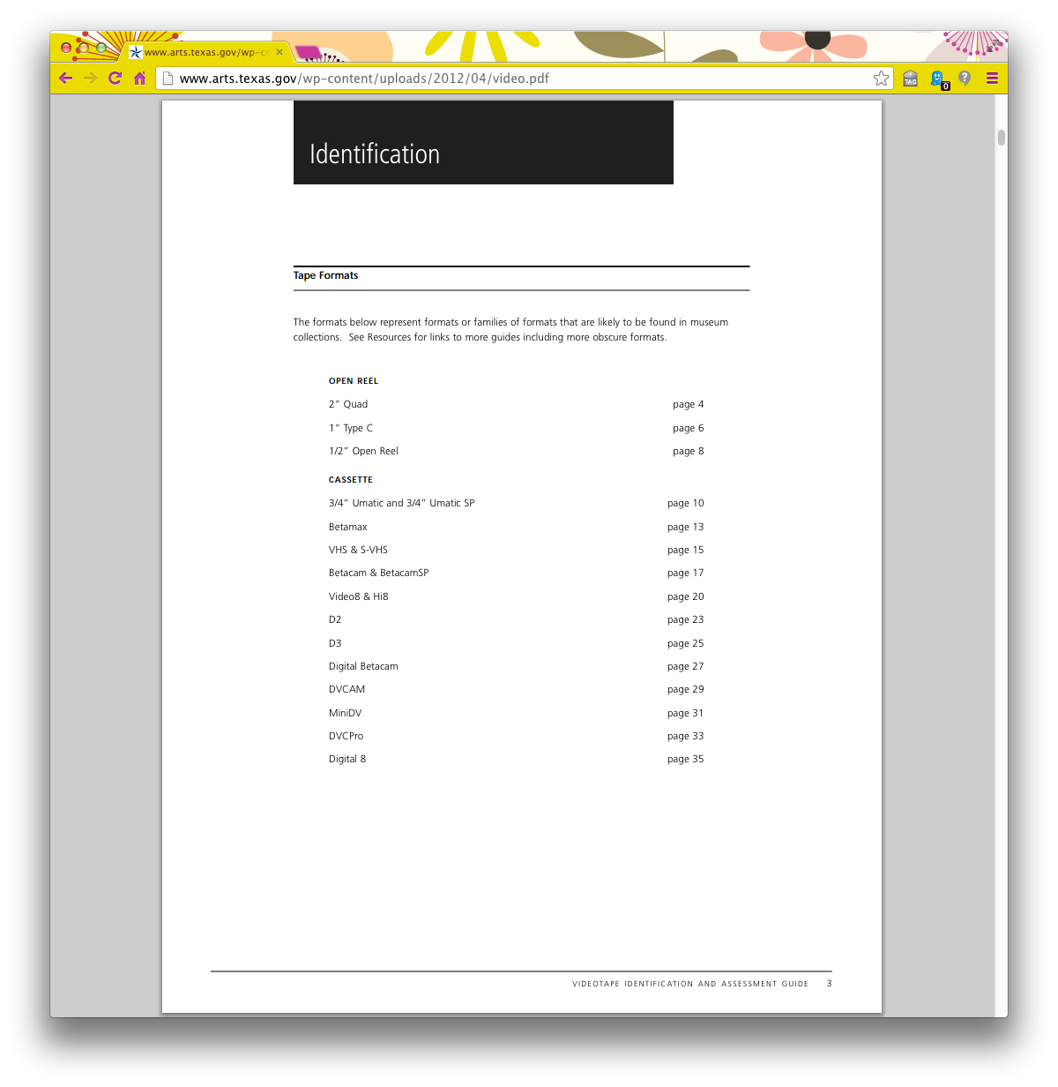
Moving Image: Videotape Identification and Assessment Guide http://www.arts.texas.gov/wp-content/uploads/2012/04/video.pdf
Notes:
The Videotape Identification and Assessment Guide was released by the Texas Commission on the Arts in 2004 as an interactive website. It was rebranded as a downloadable PDF a few years ago. Its contents feature many common types of video formats.

Slide 10
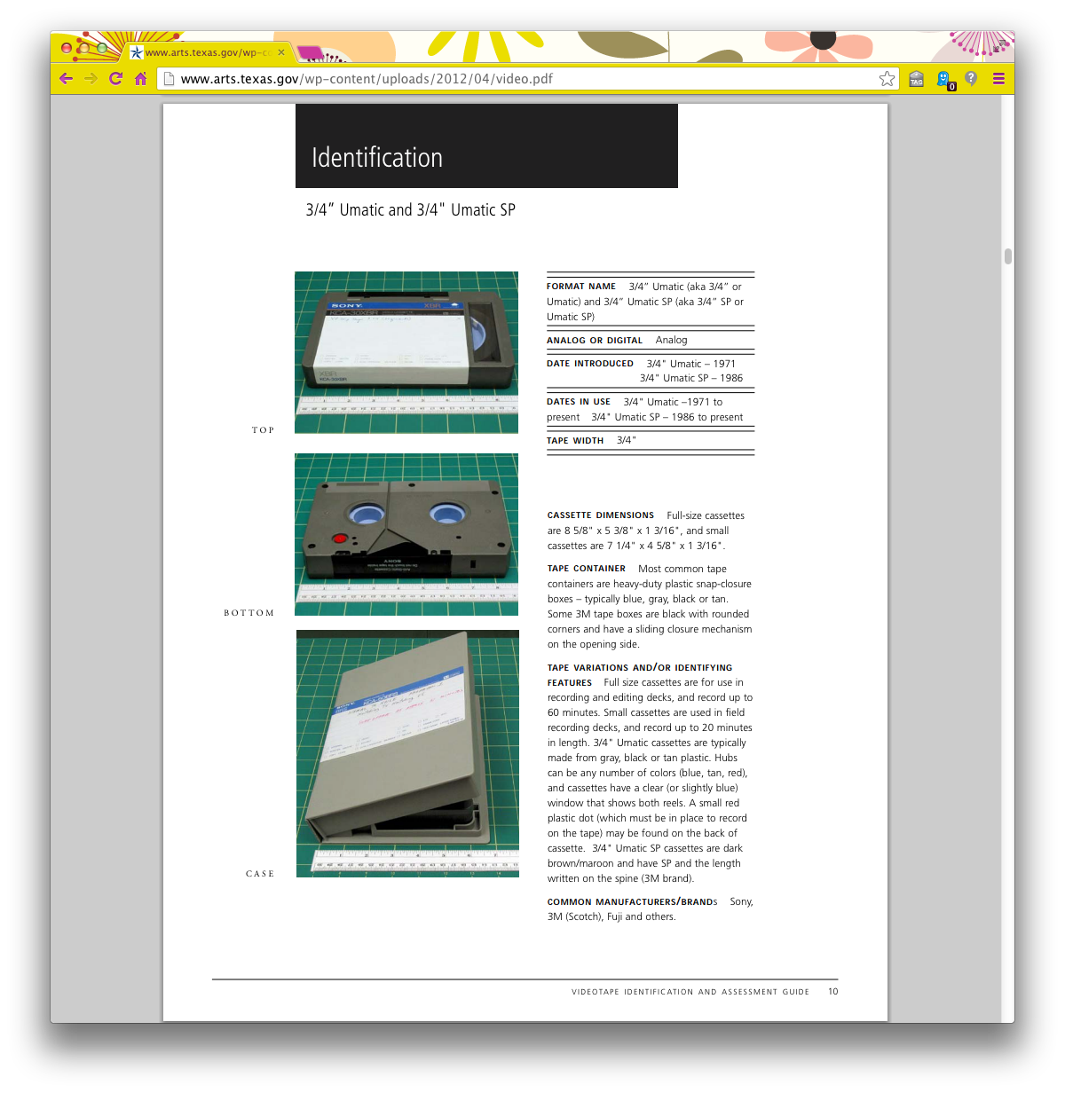
Identify
Notes:
The Identification and Assessment Guide lists the major characteristics of the formats, such as dimensions of the carrier and container, dates produced, manufacturers and brands, players or recorders, and whether the format is analog or digital…

Slide 11
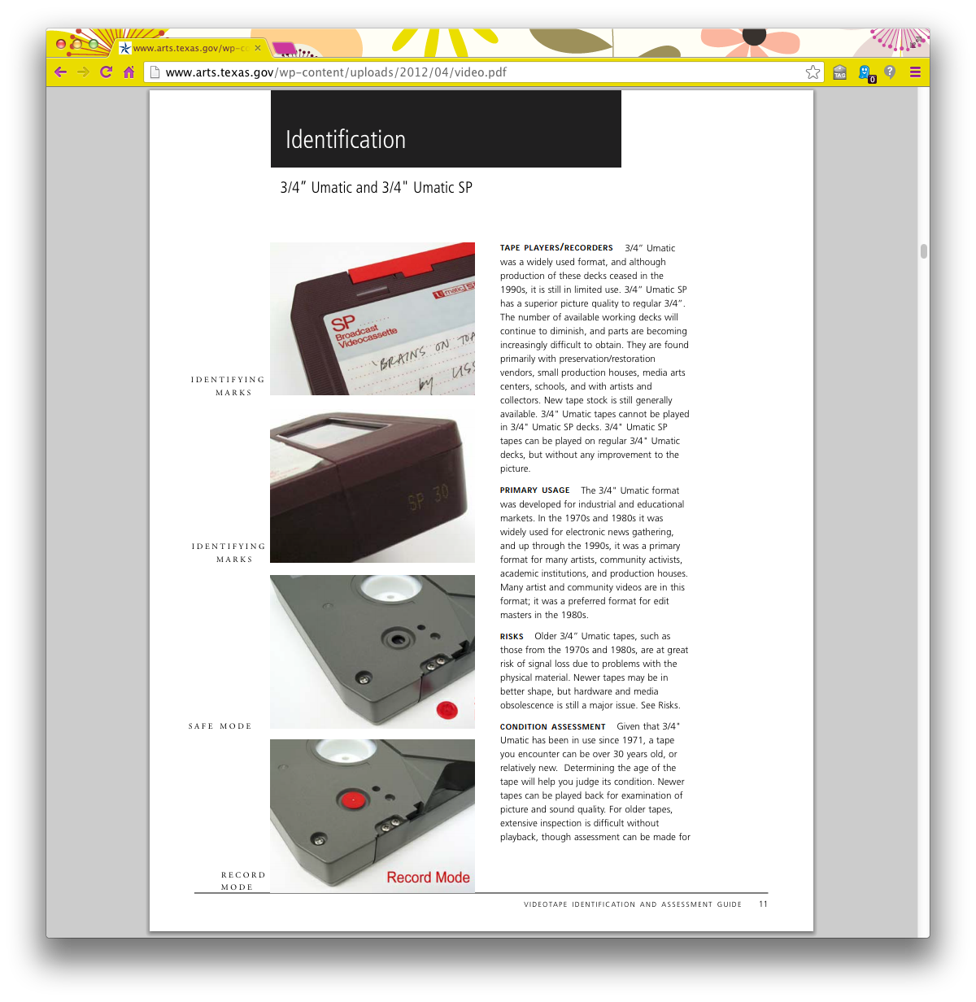
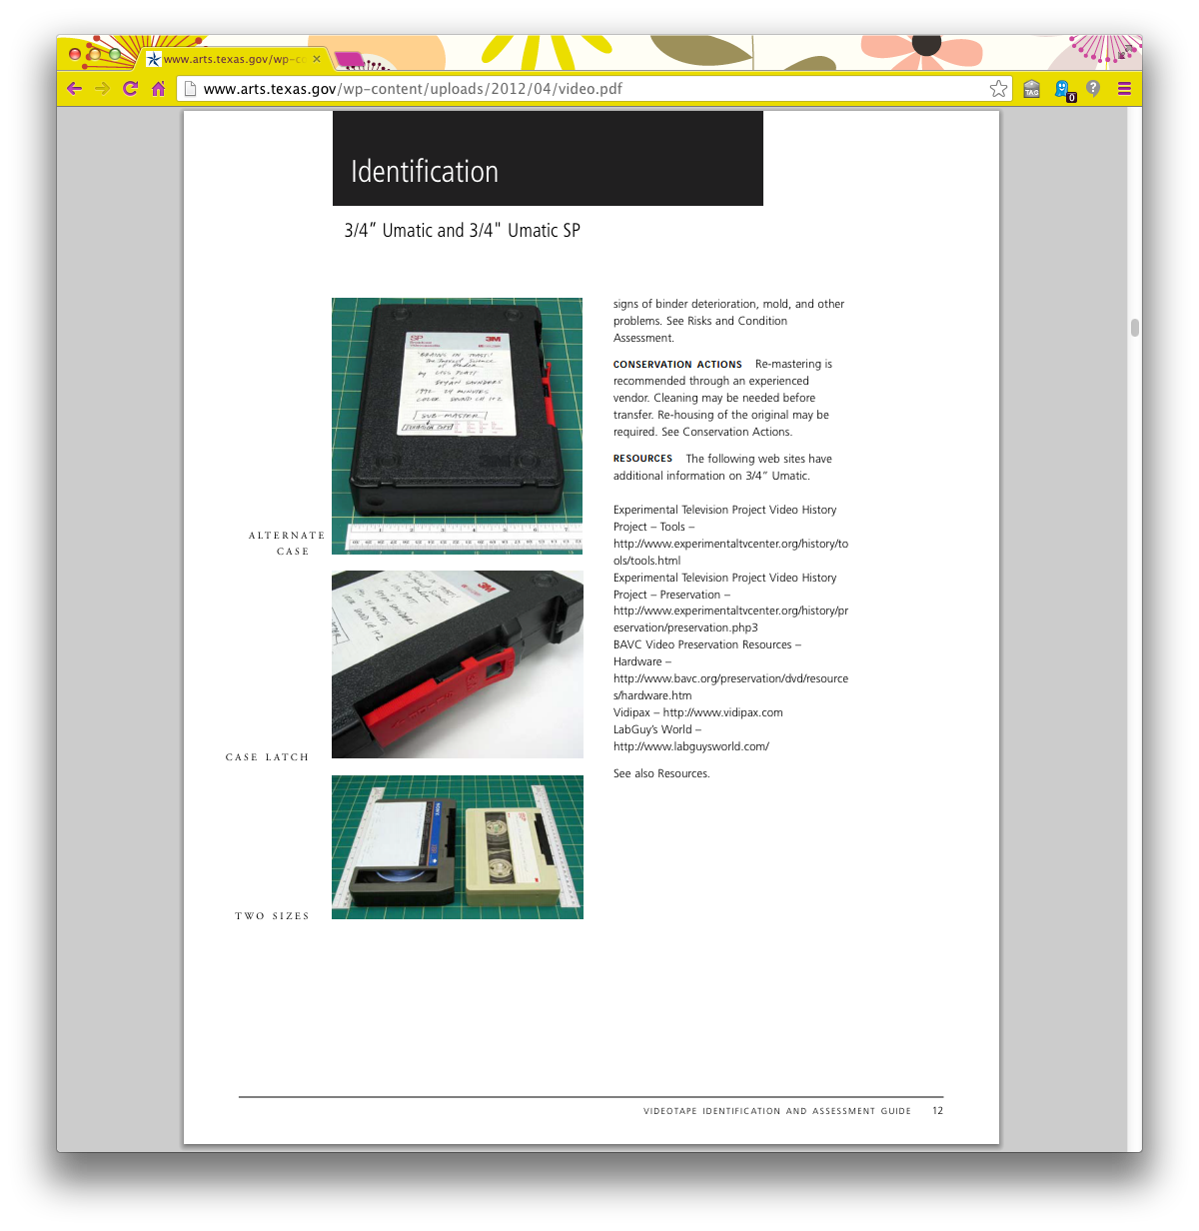
Identify
Notes:
It also lists usages, risks, and common preservation actions that should be taken on the media, such as removing the tabs or dots to prevent re-recording on the media, or how to store the media (film—flat, video—vertical).

Slide 12
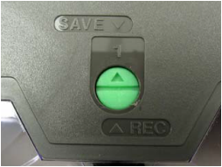
Uses
Description
Dating
Identify deterioration
Help preservation
Plan digitization
Plan equipment and other resources
http://www.arts.texas.gov/wp-content/uploads/2012/04/video.pdf, page 24
Notes:
Again, this resource can help to date or describe media, as well as help to plan and mitigate collection preservation risks and reformatting plans. This Guide is also a good resource to help identify playback machines for your collections, and it links to other useful resources.

Slide 13
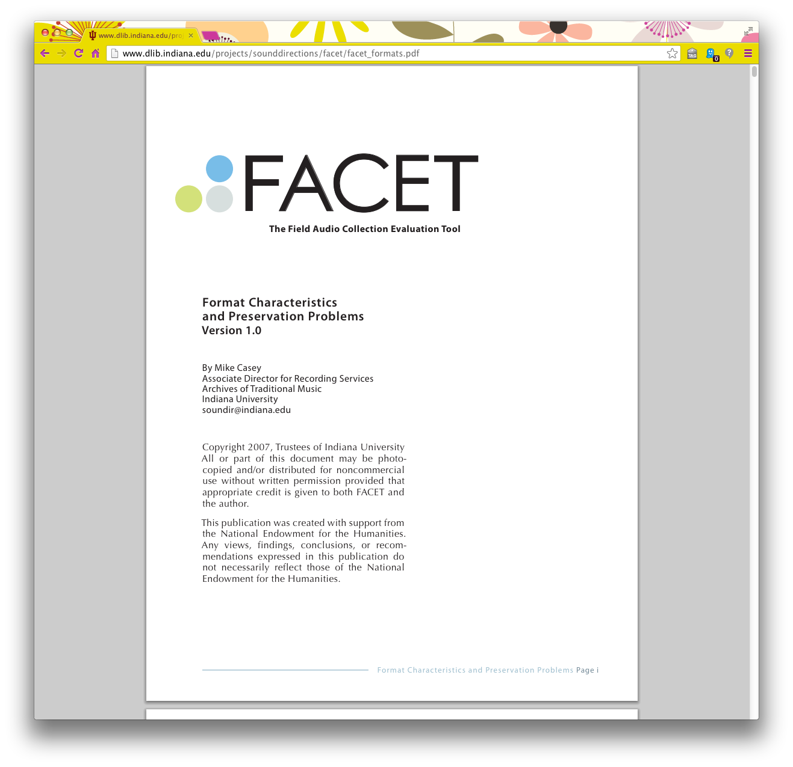
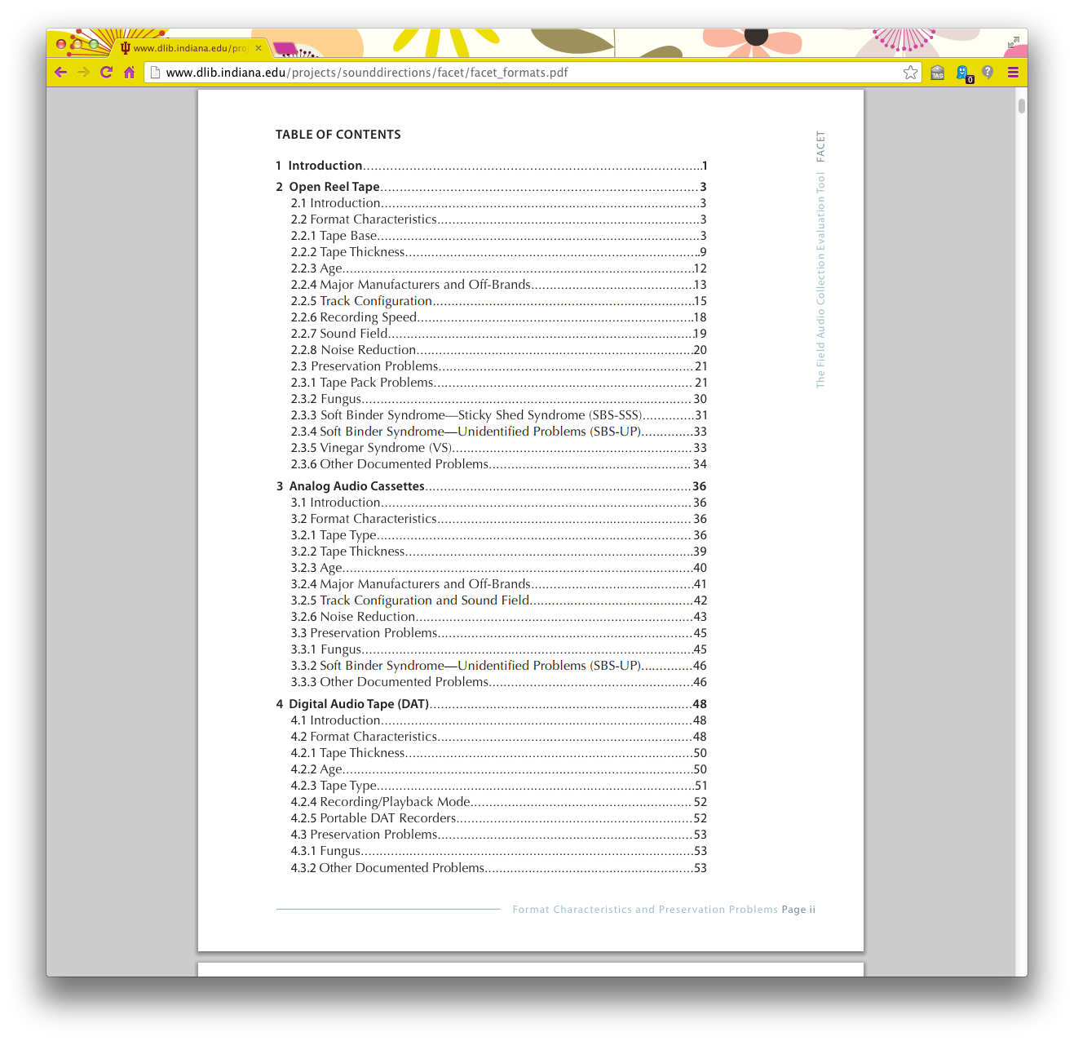
Audio: FACET http://www.dlib.indiana.edu/projects/sounddirections/facet/facet_formats.pdf
Notes:
In 2007, Indiana University Bloomington released the Field Audio Collection Evaluation Tool or FACET. FACET provides much more detail than the aforementioned resources because it was intended as a collection survey analysis tool. However, the comprehensive information about common analog and digital audio formats is helpful for many other functions.

Slide 14
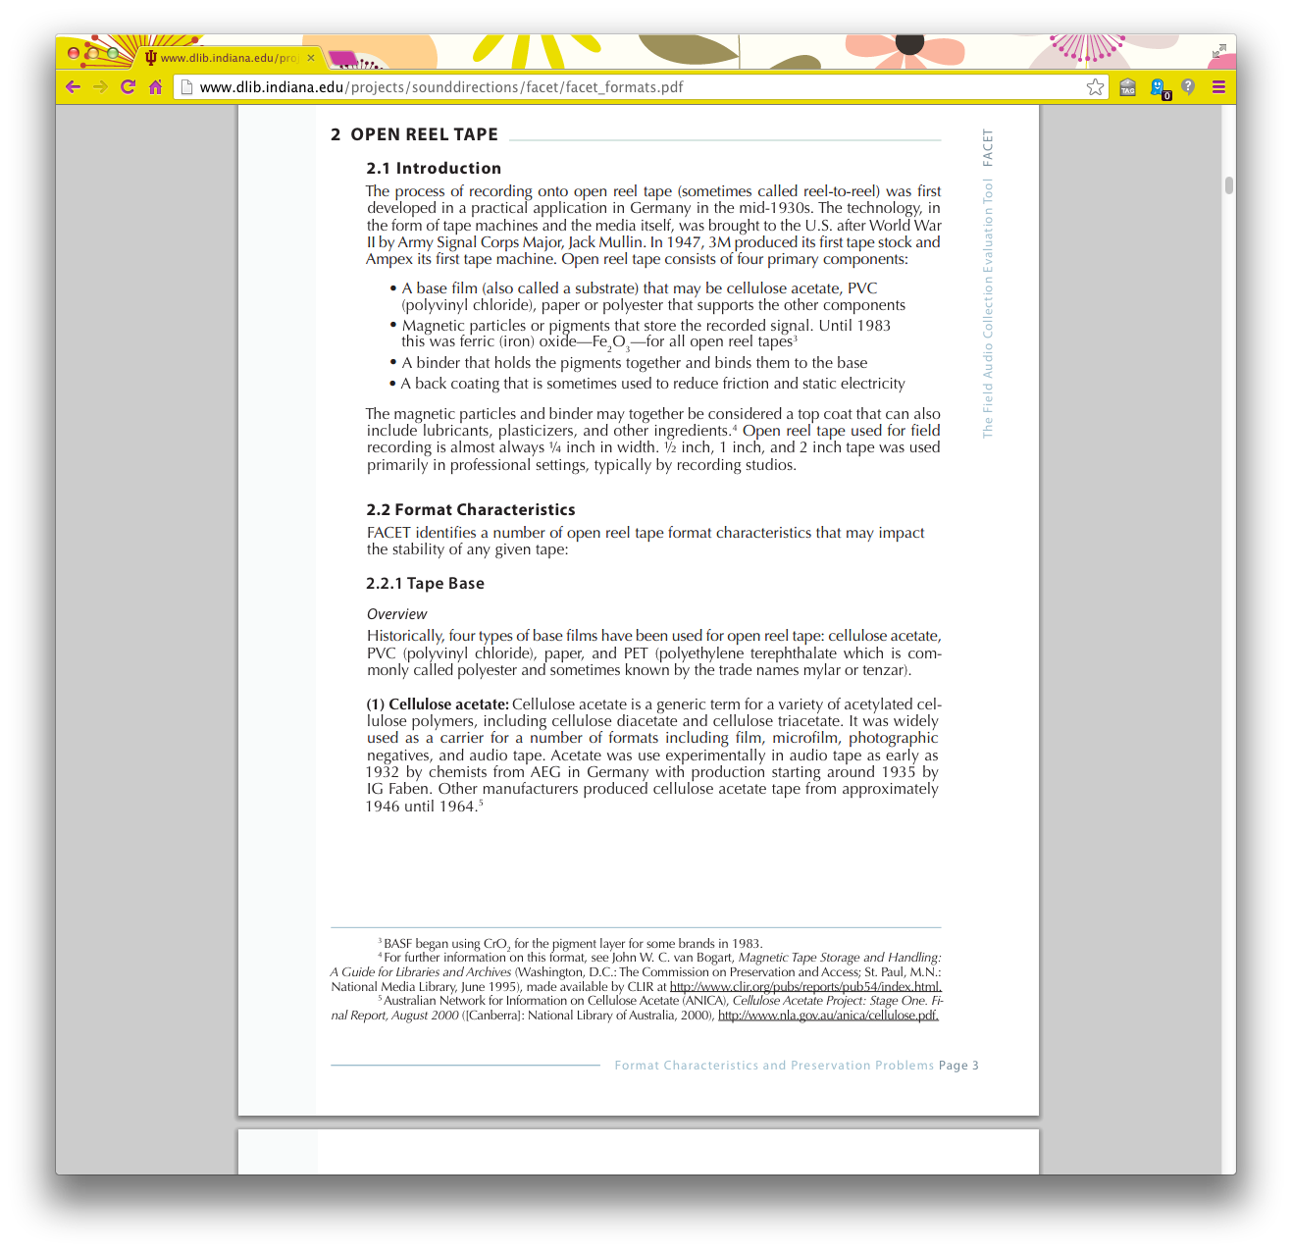
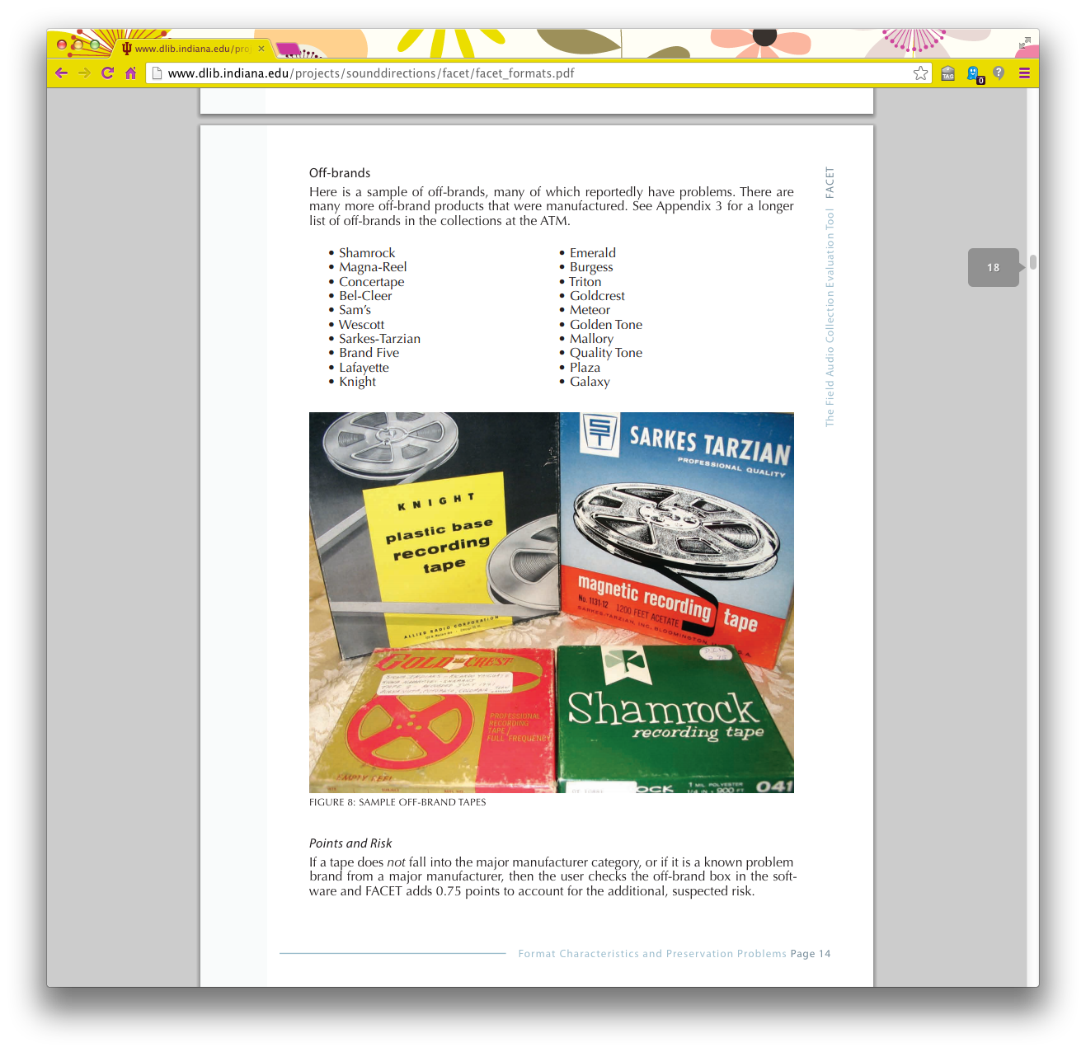
Identify
Notes:
Each section of FACET provides key characteristics about each format including the base material, thickness, and manufacturers, which is helpful in identification. Understanding the tape base, the emulsion thickness, and whether or not the tape has a backing, can also predict potential preservation issues.

Slide 15
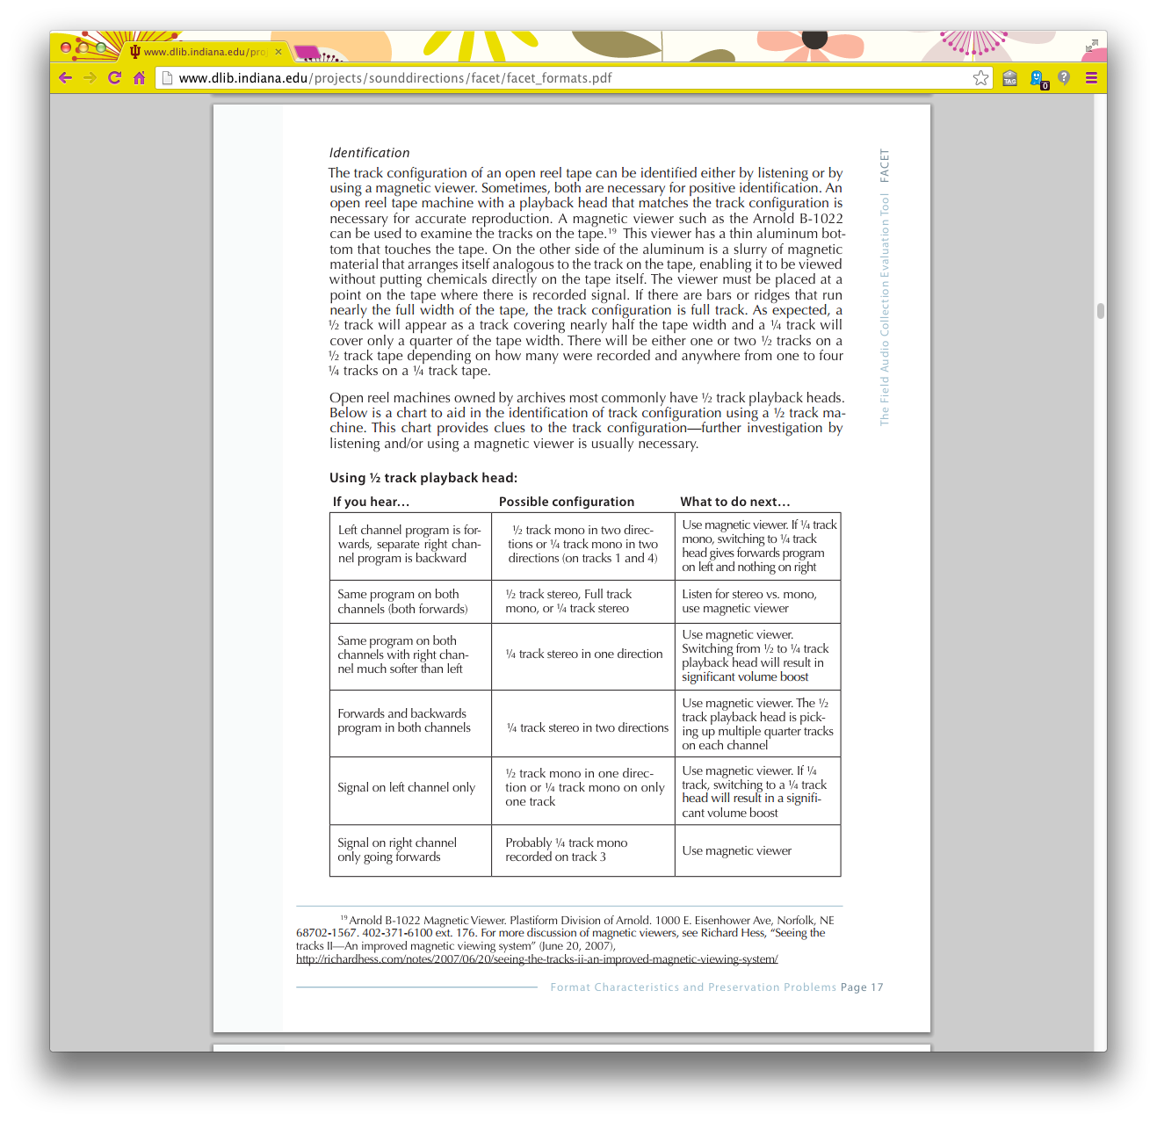
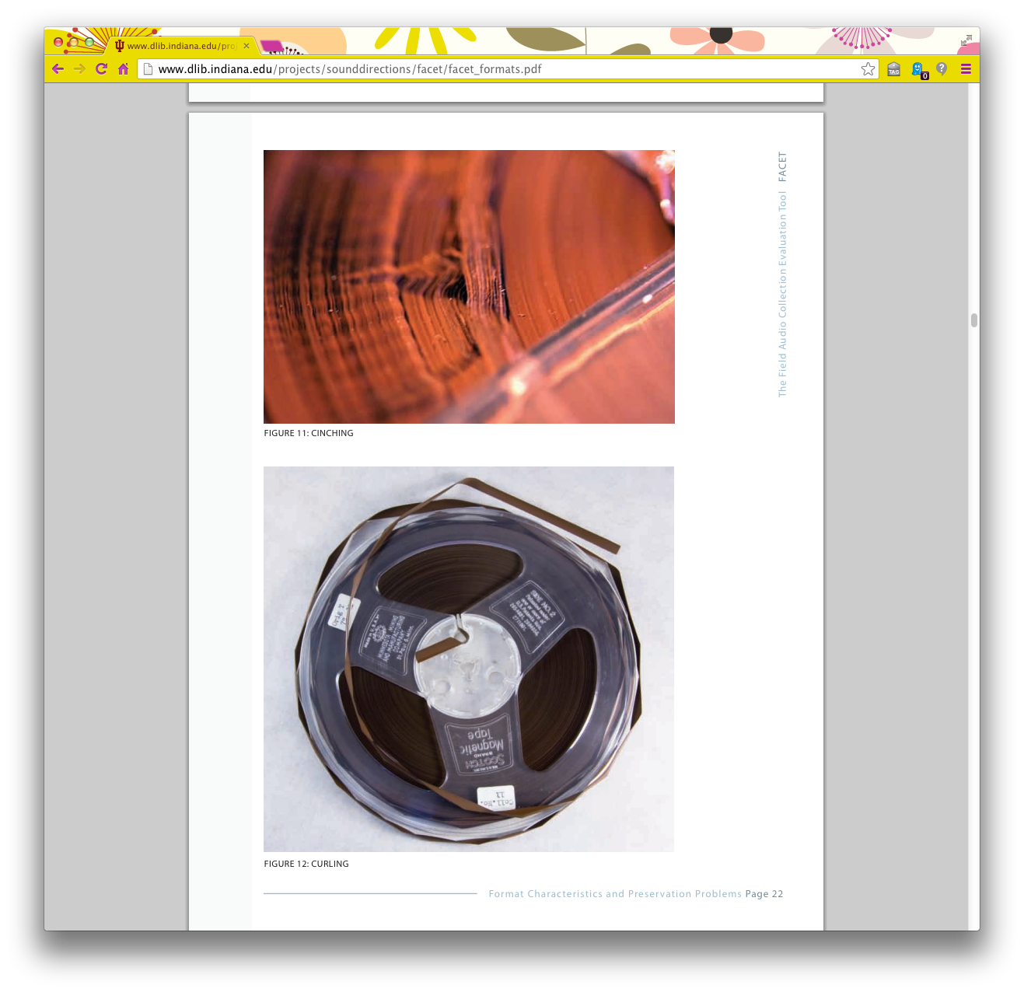
Preservation
Notes:
FACET also provides detailed information about track configuration, recording speed and what to listen for, noise, playback problems, storage issues, common preservation threats, and other associated risks. They have included many images of common preservation problems.

Slide 16
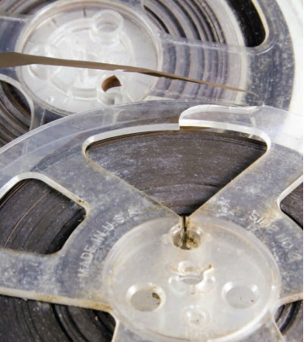
Uses
Description
Dating
Identify deterioration
Plan digitization
Plan equipment and other resources
http://www.dlib.indiana.edu/projects/sounddirections/facet/facet_formats.pdf, page 30
Notes:
Much like the Videotape Guide, this resource can help to date or describe a resource through identification, as well as help to plan collection preservation risks and reformatting plans. Its bibliography is extensive and can lead to other useful resources.

Slide 17
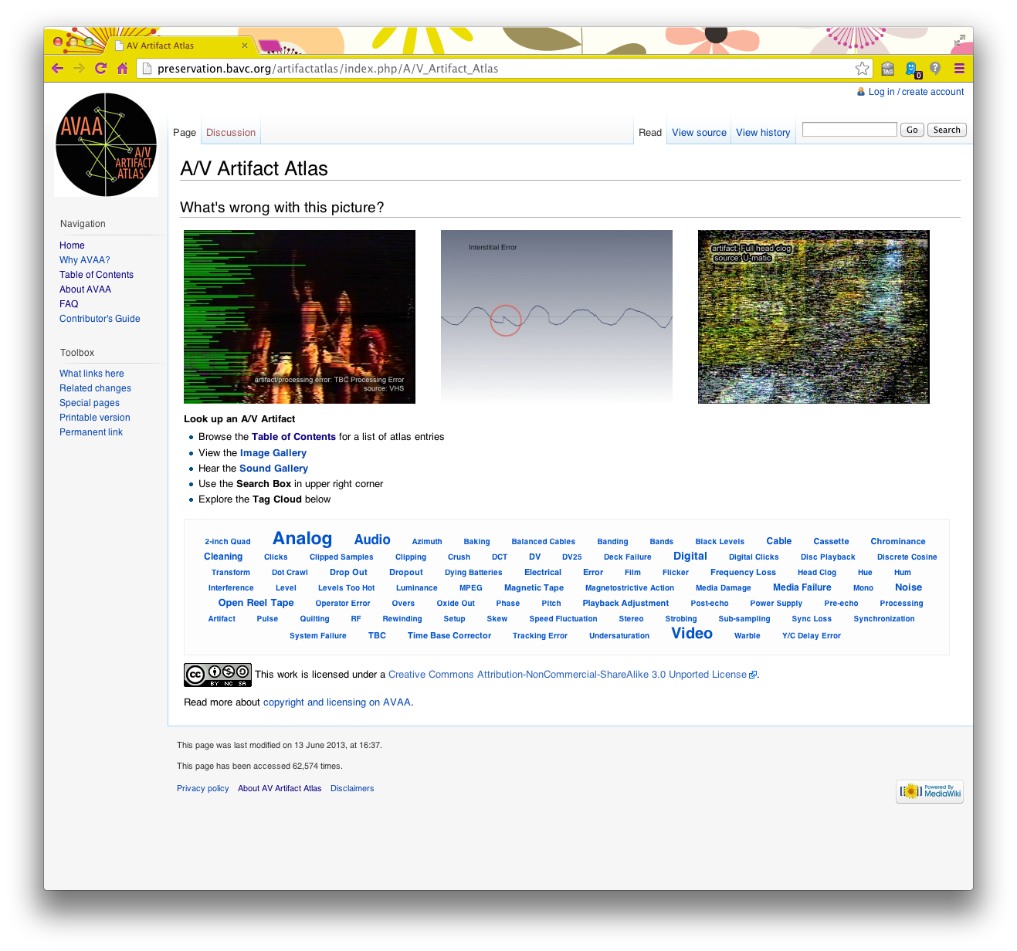
A/V Issues: A/V Artifact Atlas http://preservation.bavc.org/artifactatlas/index.php/A/V_Artifact_Atlas
Notes:
Finally, the A/V Artifact Atlas was produced by the Stanford Media Preservation Lab and New York University, to assist with their digitization work. It is currently hosted by the Bay Area Video Coalition, and anyone can become a contributor to the wiki resource.

Slide 18
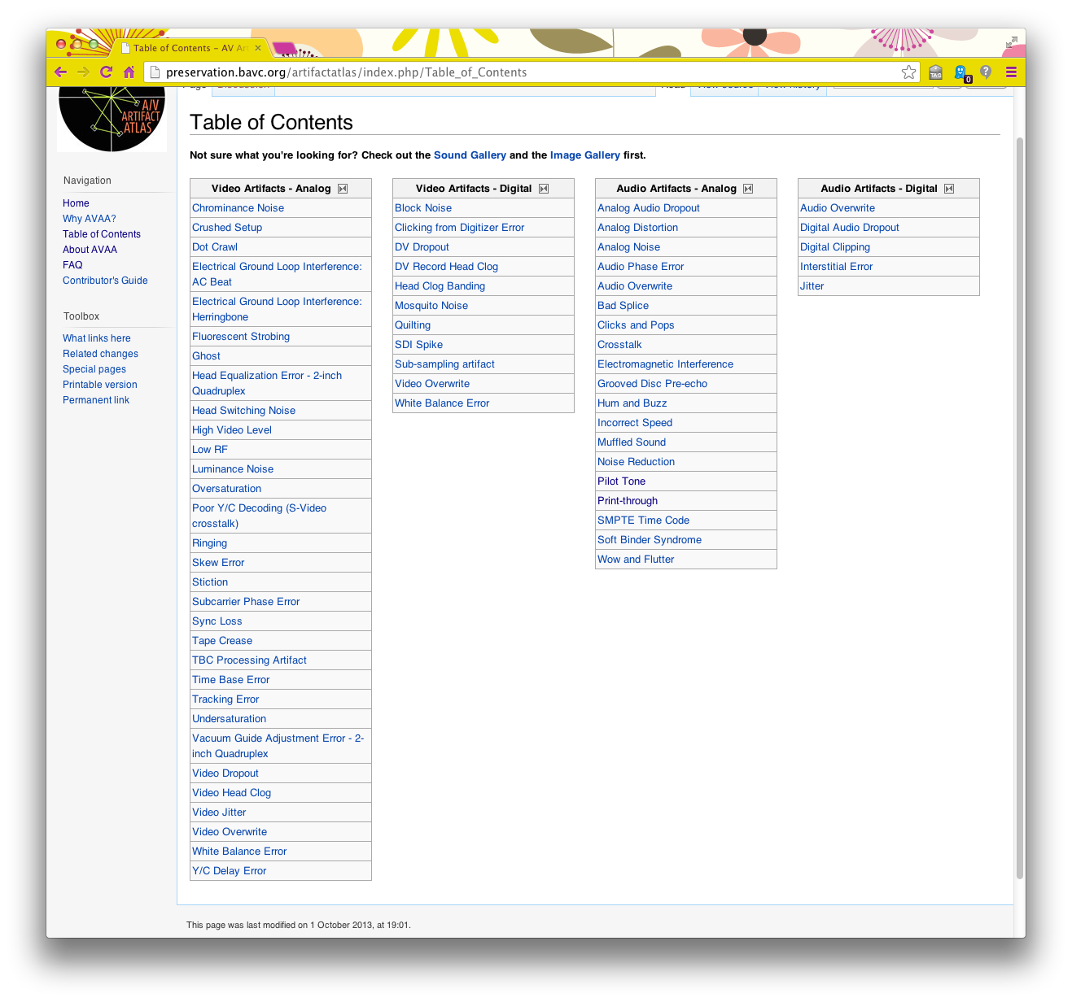
Identify
Notes:
The Atlas is intended to identify common playback and digitization issues through verbal description and audio and video examples. During playback and digitization of legacy audiovisual materials, it is necessary to determine what sound or video issues are caused by deterioration of the material vs. the machine or calibration settings.

Slide 19
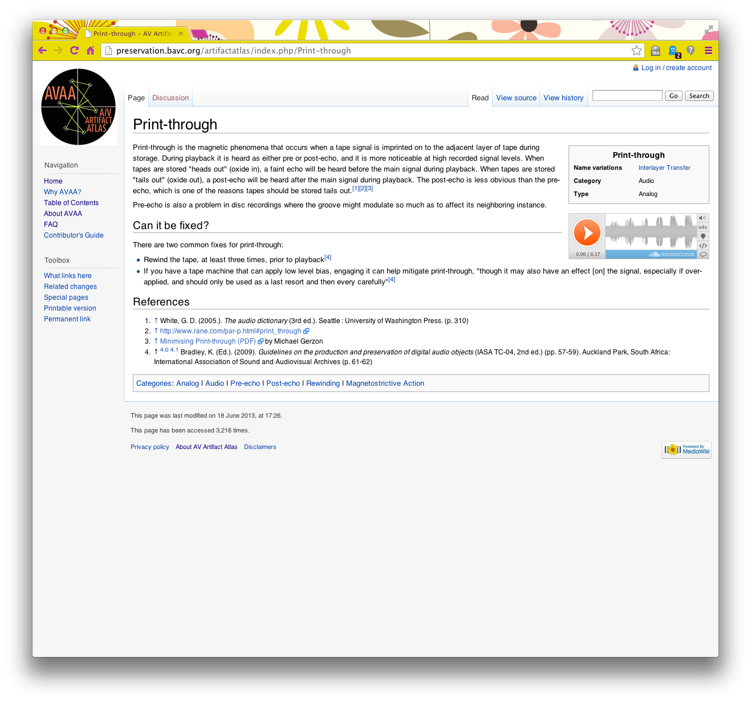

Identify
Notes:
For example, the Atlas can help you determine that this echo is print-through.

Slide 20
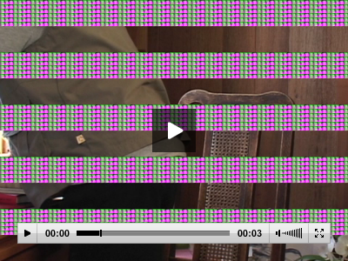
Uses
Description
Digitization
Quality assurance
THANK YOU!
http://preservation.bavc.org/artifactatlas/index.php/Head_Clog_Banding
Notes:
At UMD Libraries, we’ve primarily used the A/V Artifact in our Digitization Center to confirm issues with the media and note this in the metadata during quality assurance work on vendor-based projects. We may also make a decision to fix some issues such as hiss or pops, and leave others that can provide more information to researchers. Thank you!

