Slide 1
In Media Res: Transitioning Streaming Media Reserves Without a Succession Plan
Brynne Norton
Head Resource Sharing & Reserves
Jenny Cotton
Course Reserves Coordinator
MLA DLA Virtual Conference
May 3-7, 2021

Slide 2
Presentation Outline
Case study
Succession Planning
Discussion: What are your experiences, and what questions do you have?

Slide 3
What is your supervisory level?
Please visit:
www.menti.com
And use the code: 6398 3859

Slide 4
Overview - UMD Libraries
University of Maryland, College Park
40,700+ students in 102 undergrad majors, 115 master's programs and 84 doctoral programs
8 Library branches

Slide 5
Overview - Course Reserves
Part of Resource Sharing & Reserves unit, 4 FTE staff
Serves 300 classes per semester (avg.)
Includes:
Hardcopy and textbook reserves
Electronic reserves (text-based)
Streaming media reserves

Slide 6
Resource Sharing & Reserves (RSR)
Integrated team of Course Reserves and Interlibrary Loan staff
Areas of specialization, but general shared knowledge (on call hours)
Cross-training and backups
Extensive documentation (Confluence)

Slide 7
Saga of Streaming Media Reserves (1)
Library Media Services (LMS)
Housed in Hornbake Library, along with most of the UMD Libraries’ media collection
Handled both hardcopy and streaming media reserves
Had different customer service practices and workflows from the Course Reserves unit

Slide 8
Saga of Streaming Media Reserves (2)
Transition to McKeldin Library
Summer 2019, LMS was removed from Hornbake
Media collection moved into McKeldin
Streaming Media Reserves moved into Course Reserves

Slide 9
Saga of Streaming Media Reserves (3)
Further changes
Late Fall 2019, long-time SMR staff member departed the Libraries, leaving minimal documentation
Integration into Course Reserves
Alignment with policies and procedures
Integrated requesting

Slide 10
Saga of Streaming Media Reserves (4)
Pandemic
Sudden shift to entirely remote work, followed by partially in-person
Limited/delayed access to the collection, limited ability to request purchases
Hiring freeze

Slide 11
Succession Planning Status Poll
Please visit:
www.menti.com
And use the code: 6398 3859

Slide 12
What is succession planning?
“the right people in the right place
at the right time for the right job.”
Hawthorne, P. (2011). Succession planning and management: A key leadership responsibility emerges. Texas Library Journal, 87(1), 8.

Slide 13
What is technical succession planning?
“In technical SPM [succession planning and management], the ultimate goal is to isolate, distill, transmit the right information to people at the right time to ensure continuity of operations and provide foundation for future improvements.”
Hawthorne, P. (2011). Succession planning and management: A key leadership responsibility emerges. Texas Library Journal, 87(1), 9.

Slide 14
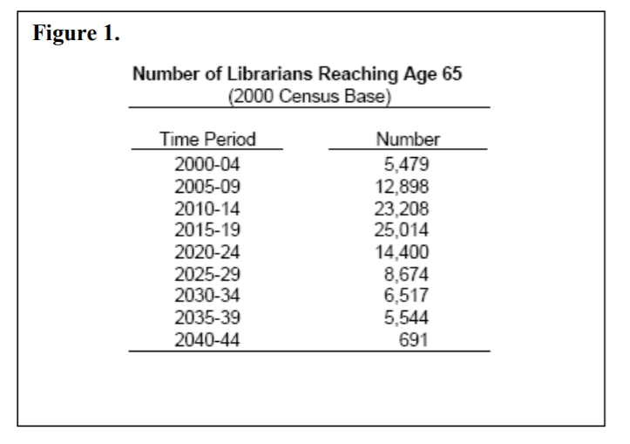
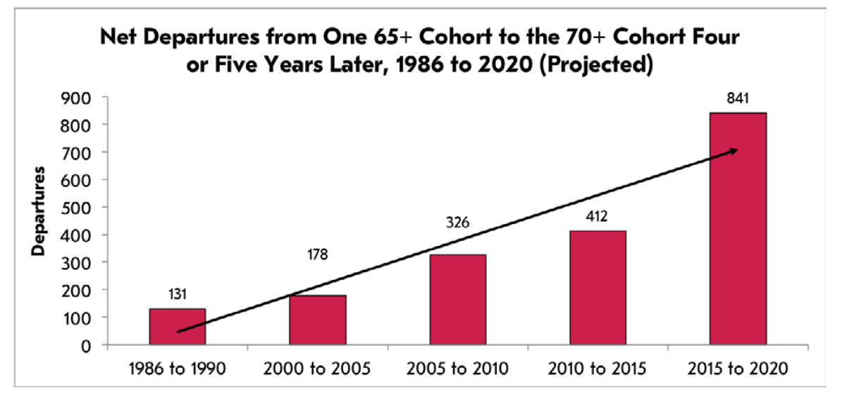
Why is this important for libraries?
Library employees are a graying profession
From: Davis, Denise M. “Library Retirements – What we can expect” Office for Research & Statistics American Library Association (2004)
From: Wilder, Stanley. “Hiring and Staffing Trends in ARL Libraries.” ARL (2018)

Slide 15

Why is this important for libraries?
Lottery-proofing

Slide 16

Why is this important for libraries?
Capturing institutional knowledge / the single expert

Slide 17
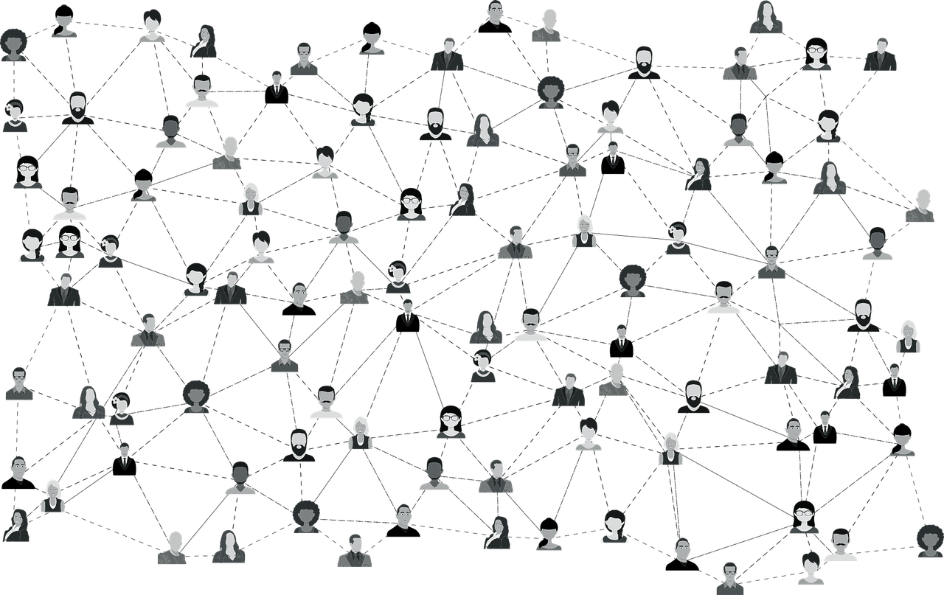
Parts of planning
Identifying Competencies

Slide 18

Parts of planning
Documentation

Slide 19

Parts of planning
Working with long term employees

Slide 20

Parts of planning
Cross training

Slide 21

Job Descriptions
Promoting from within / Skill scaffolding

Slide 22

Job Descriptions
Dangers of out of scope work

Slide 23
Lessons Learned/Best Practices
Decide if and what type of succession planning is right for you
Evaluate services for “single expert” bottlenecks
Create and maintain documentation
Cross-train
Evaluate job descriptions
Handout (https://bit.ly/3vCW3V9)

Slide 24
Resources Consulted
Bridgland, A. (1999). To fill, or how to fill—that is the question succession planning and leadership development in academic libraries. Australian Academic & Research Libraries, 30(1), 20–29. https://doi.org/10.1080/00048623.1999.10755074
Hall-Ellis, S. D., & Grealy, D. S. (2013). The dreyfus model of skill acquisition: a career development framework for succession planning and management in academic libraries. College & Research Libraries, 74(6), 587–603.
Hawthorne, P. (2011). Succession planning and management: A key leadership responsibility emerges. Texas Library Journal, 87(1), 8–12.
Siewert, K. G., & Louderback, P. (2019). The “bus proof” library: technical succession planning, knowledge transfer, and institutional memory. Journal of Library Administration, 59(4), 455–474. https://doi.org/10.1080/01930826.2019.1593716

Slide 25
Which part of succession planning will be the most challenging for you?
Getting buy in from your institution
Creating documentation
Working with long term employees
Cross training
Evaluating job descriptions
Other
*Please feel free to answer in chat or unmute

Slide 26
Questions?
Please feel free to share your succession planning experiences whether they are successes or failures.
Brynne Norton
Head, Resource Sharing & Reserves
bnorton1@umd.edu
Jenny Cotton
Course Reserves Coordinator
jecotton@umd.edu

Slide 27
Brynne Norton
Head, Resource Sharing & Reserves
bnorton1@umd.edu
Jenny Cotton
Course Reserves Coordinator
jecotton@umd.edu

