Slide 1

Combining ALEPH and GreenGlass Data
Stephanie Ritchie
University of Maryland, College Park
STEM Library
May 2019

Slide 2
Project Background
Started with a Challenge!
Merge the White Memorial Chemistry Library collection with the Engineering and Physical Sciences Library (EPSL)
  Chemistry Collections prior to merge included thousands of books and serials
  Most materials in the QD (Chemistry) call number
  Many items in Q-Z ranges,
  Very few in A-P ranges
Approximately 6 months - 1 year to complete project

Slide 3
Project Background
Q-Z Call Number materials housed in multiple locations across UMCP Libraries:
Chemistry Library
STEM Library
McKeldin (main library)
Severn (off-site storage facility)
Decision needed for each item:
Keep in stacks and move
Transfer to storage
Withdraw

Slide 4
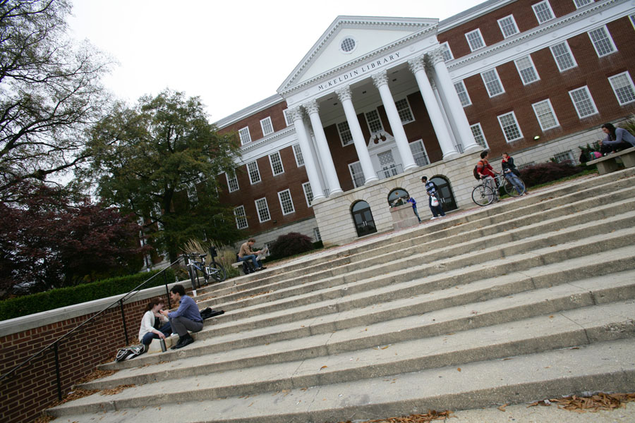
How make a decision for thousands of items in short amount of time?
Use data to determine which items needed librarian review

Slide 5
What data?
For books we used ALEPH bibliographic and holdings data as a starting point to estimate materials in collection:
Item Identification Information
Bib ID
Title
Pub Year
Barcode
Material Type
Location Information
Sublibrary
Collection
Call Number
Description
  Includes volume/series
  numbering
IPS
  Can indicate if item is
  Not On Shelf

Slide 6
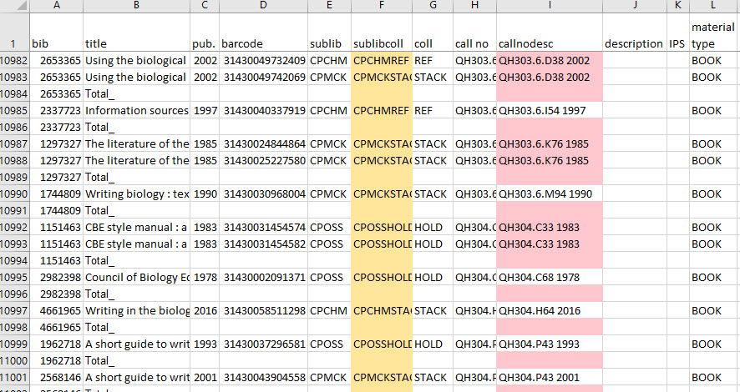
Sublibcoll = Concatenate sublibrary and collection for shelf locations
Callnodesc = Concatenate callno and description for call number with volume number

Slide 7
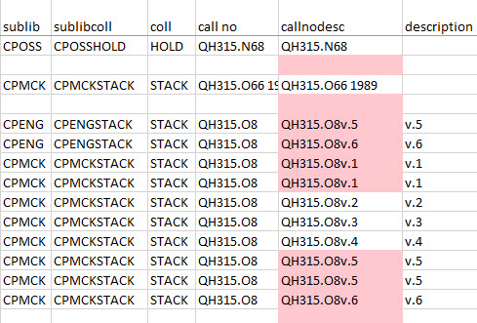
Example where sublibcoll and callnodesc are important for deduplication decisions

Slide 8
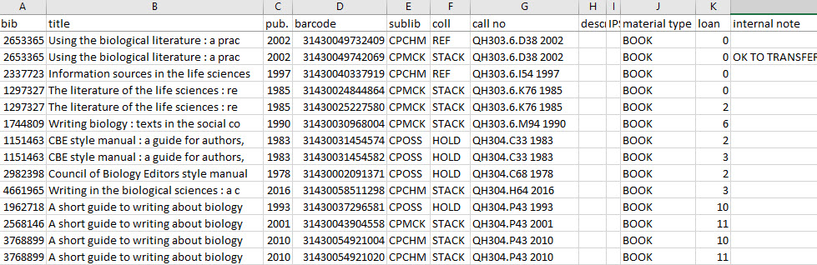
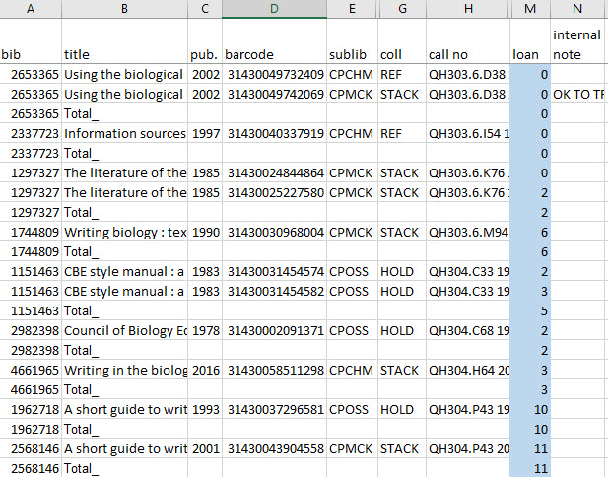
What data?
Loan Count
Use ALEPH Circulation data and Subtotal function to determine use across all copies
Raw ALEPH Data
Subtotaled Data

Slide 9
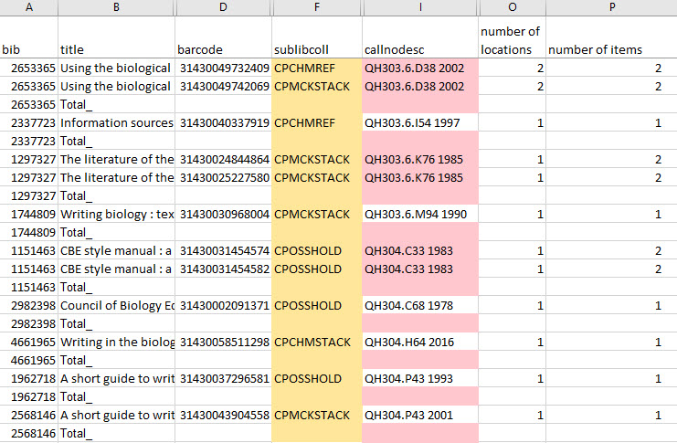
Transform Data
Using Pivot Tables, find count of items and locations for each bibliographic item
Number of Locations
Shared bibliographic ID,
different bardcode #s
BY sublibcoll
Pivot tallies
each barcode
by sublibcoll
in bib set
Number of Items
Shared bibliographic ID, different barcode #s
Pivot counts # of unique barcodes in bib set

Slide 10
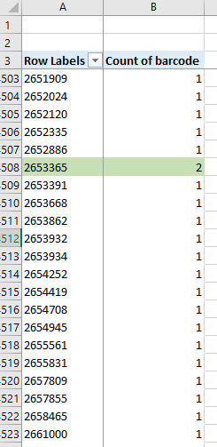
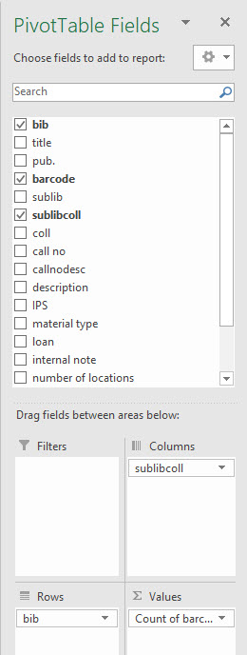
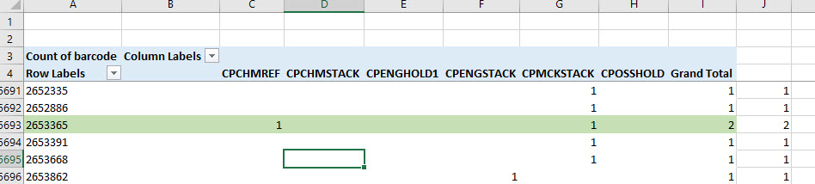
Transform Data
Pivot Tables
Count of items for each Bib ID number
Then organize by sublibrary collection

Slide 11
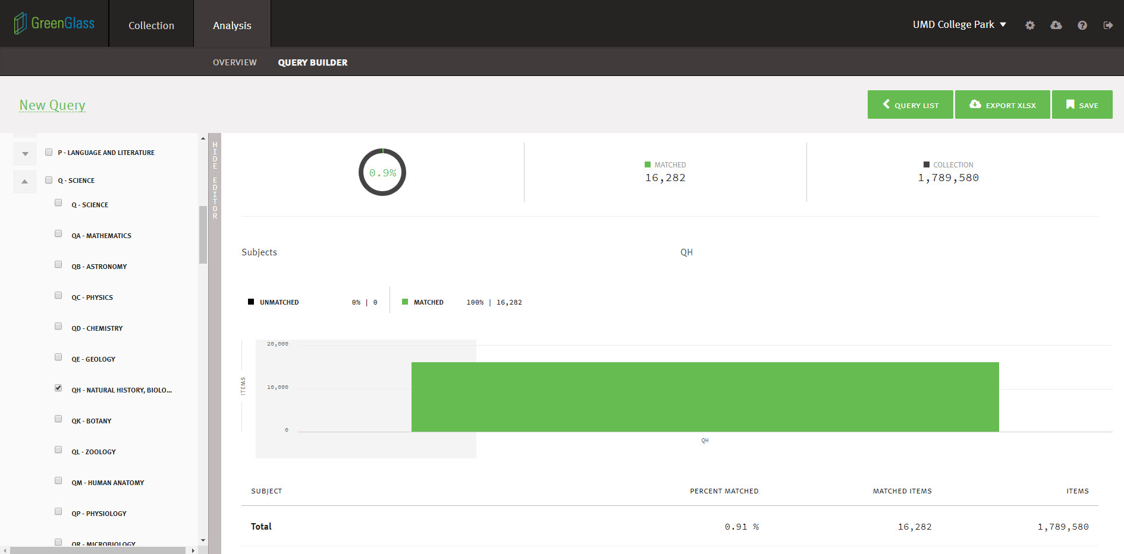
Import Data
GreenGlass
Build Query by Subject, Location, Formats, Circulation History, Publication/ Acquisition Dates, WorldCat Holdings, Group Attributes (overlap, retention), Hathi

Slide 12
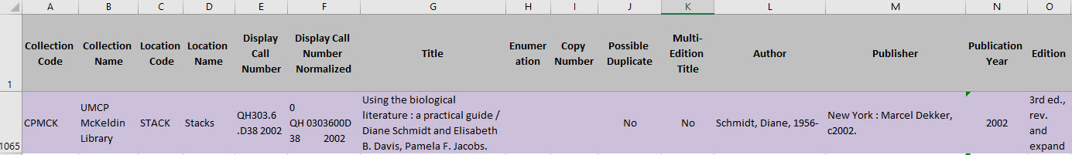
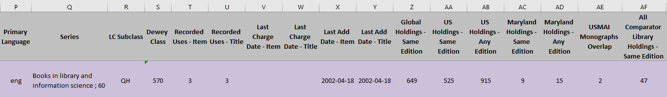
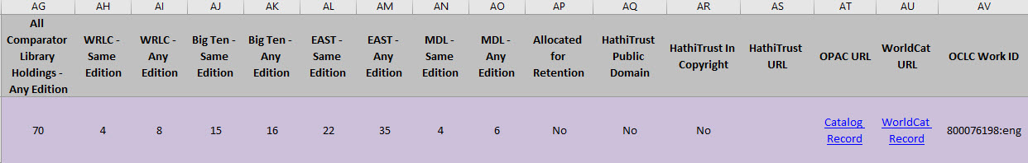
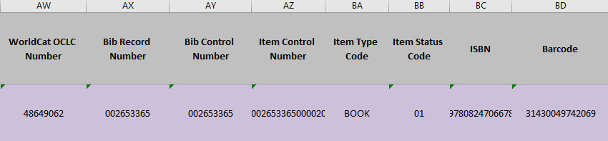
Import Data
GreenGlass
Export Data to XLSX file – 56 files of data for each item
Might have to wait for download to finish due to large file sizes

Slide 13
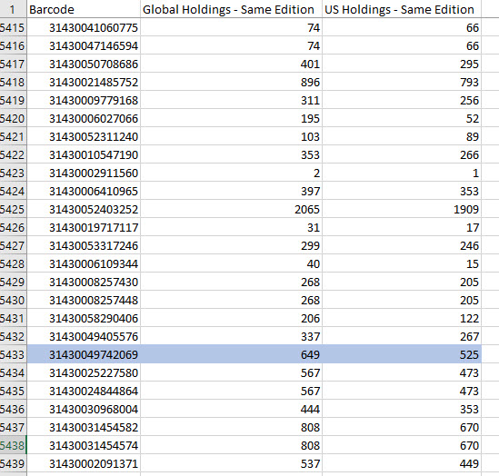
Import Data
GreenGlass
Copy item barcode with holdings comparison fields of interest into a new worksheet in same workbook as ALPEH data
Why barcode and not Bib ID?
So you can match data for each item in the lookup

Slide 14
Integrate Data
GreenGlass
Rename the worksheet tab “greenglass”
Return to working worksheet tab
Create greenglass column at the end of the worksheet columns
In the first cell of the greenglass column, type “=vlook..” and double clink the formula as it is autosuggested and type your elements:
=VLOOKUP(D2, greenglass!A:C,3,FALSE)
In the bib column, press control+down to get to the bottom of the column, then key over to the greenglass column. Now press control+shift+up to get to the top of the column, then control+D to fill down.
Remove all filters. Copy the greenglass column and paste as values only to replace formula.

Slide 15
Integrate Data
=VLOOKUP(D2, greenglass!A:C, 3, FALSE)
Lookup_value = barcode number
Select D2 (first barcode cell) in the working tab and the first value of the formula
table_array= range where the lookup value is located
The lookup value should always be in the first column in the range for VLOOKUP to work correctly. For example, if your lookup value is in cell A2 then your range should start with A.
col_index_number = number of columns counted from left and ending with the direction column
range_lookup = FALSE (exact match)

Slide 16
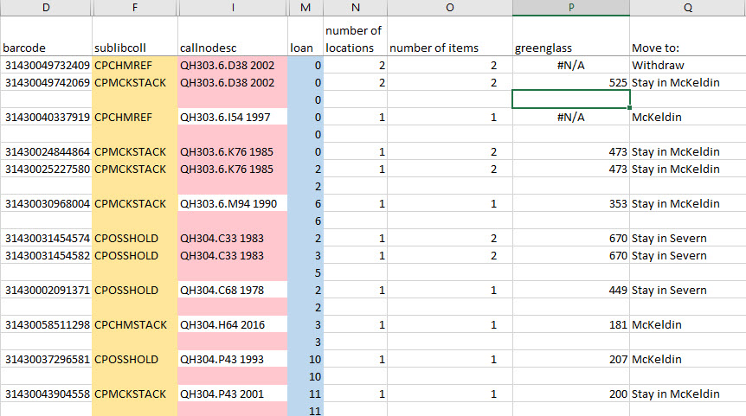
Integrate Data
Barcodes not matched will appear as #N/A error and
can occur when items were not in GreenGlass data

Slide 17
Thank you!
Feel free to contact me!
Stephanie Ritchie
sritchie@umd.edu

