Slide 1
Champagne Information Literacy Workshops on a Beer Budget
Alexander Carroll
Kelsey Corlett-Rivera
Linda Macri

Slide 2
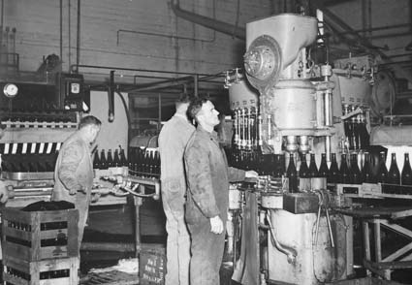
Brief history
Notes:
Half day long boot camps – generally poorly attended
Specific targeted programs (such as citation management workshops, also poorly attended)
Marketing was the primary means of improving attendance (as opposed to content/partnerships changes)

Slide 3
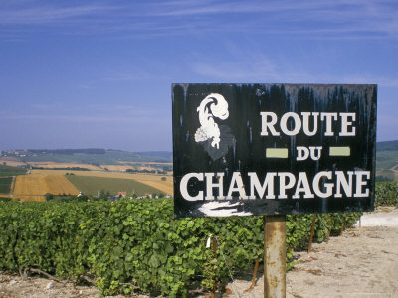
Change in direction
Notes:
· New writing center director to work with
· Writing center moved into the library
· Lack of staff time on both sides
· Graduate students demonstrated a need for this kind of content in research consultations with librarians

Slide 4

Workshop content
Notes:
Workshop is a crash course on:
o how to find sources (discovery layer, subject index databases, citation chasing)
o how to get access to sources (access services, resource sharing)
o how to store and organize the sources you find (citation management options)
o what it looks like to write well with sources (stasis theory)
Mention that when we debuted new content, we got 160 registrants in 24 hours with very limited advertising.

Slide 5
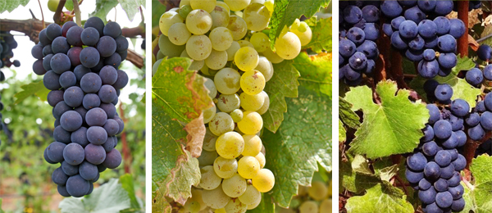
Why this content?
Notes:
Scholarly discourse and stasis theory of composition
o How they teach writing overlaps with new directions in ACRL Info Lit Framework (scholarship is a conversation, etc.)
o we’re speaking the same language – why wouldn't we work together?
Explaining to students the dual purpose of literature reviews
o to immerse yourself into the literature for your own benefit (being able to respond to criticisms of your work)
o to demonstrate to your audience that you know what you’re talking about

Slide 6
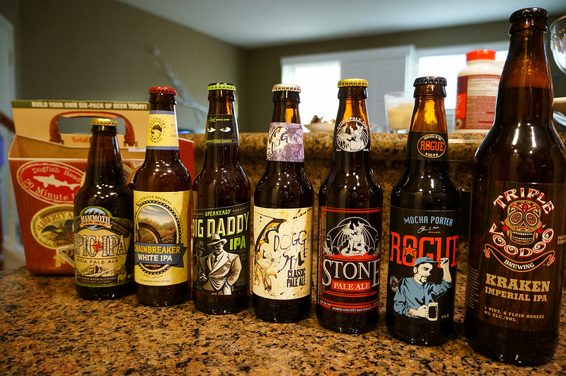
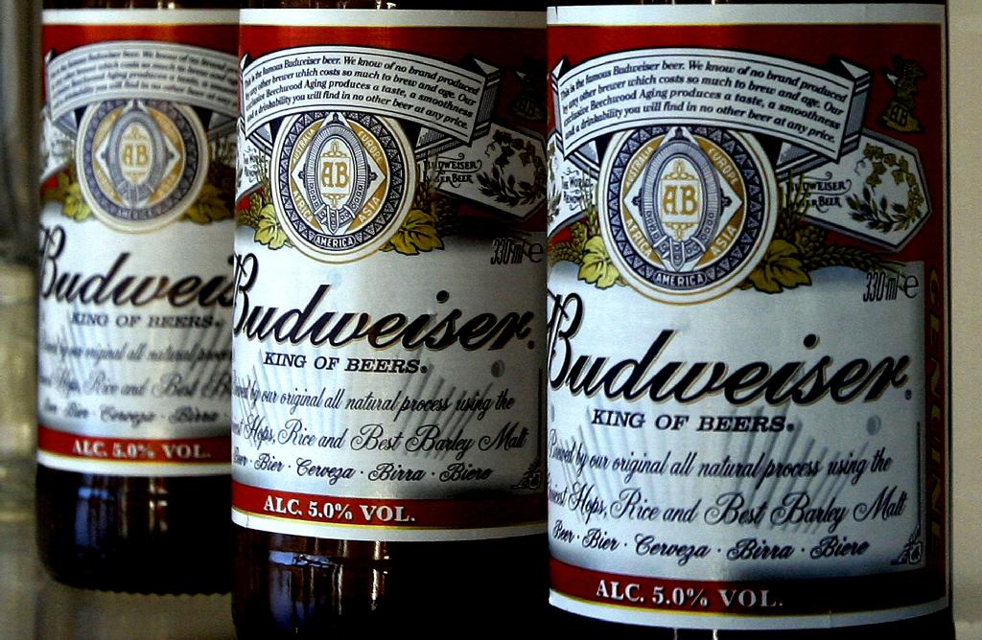
Lessons learned
content
marketing
Notes:
Content matters more than marketing
If you have tried serious marketing and your workshops are still poorly attended, it may not be your marketing.
Content adjustments and strategic partnerships can make a huge difference, but also consider:
timing
location (too far from lunch options)
duration
things out of your control (sometimes it’s 9 degrees and snowing and no one in their right mind is going to trek to the library for any workshop)

Slide 7
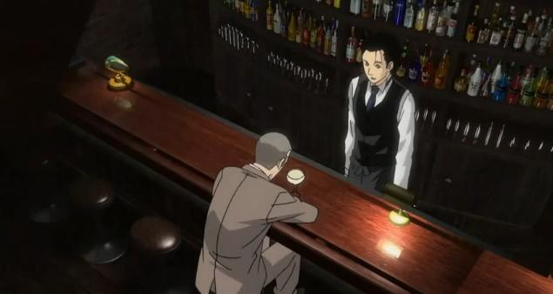
Lessons learned
Listen & talk
Notes:
Listen TO your students but talk LIKE your students!
What aren’t your students getting from advisors, instructors, info lit sessions in their classes, etc.? How can you address those needs?
Based on those needs, identify partners on campus that make sense and build programs that integrate your expertise
Avoid library jargon – speak the language of your students
They know what a lit review is, they don’t necessarily know what citation management software is

Slide 8

Why should you care?
Notes:
More parallels to first year undergraduates then you might think…
o Student familiarity with the types of resources available at an R1 is very uneven
o Student preparedness for this level of scholarship is very uneven depending on previous institution (analogous with K12 training)
o Student support from department, advisor varies greatly (analogous to quality of instruction for ENGL adjuncts, grad instructors)

Slide 9



Questions?
Alexander Carroll
ajcarrol@umd.edu
  Agriculture and Natural Resources Librarian
Kelsey Corlett-Rivera
  kcr1@umd.edu
  Head, Research Commons
Linda Macri
lmacri@umd.edu
  Director of Writing Initiatives, the Graduate School

