Slide 1
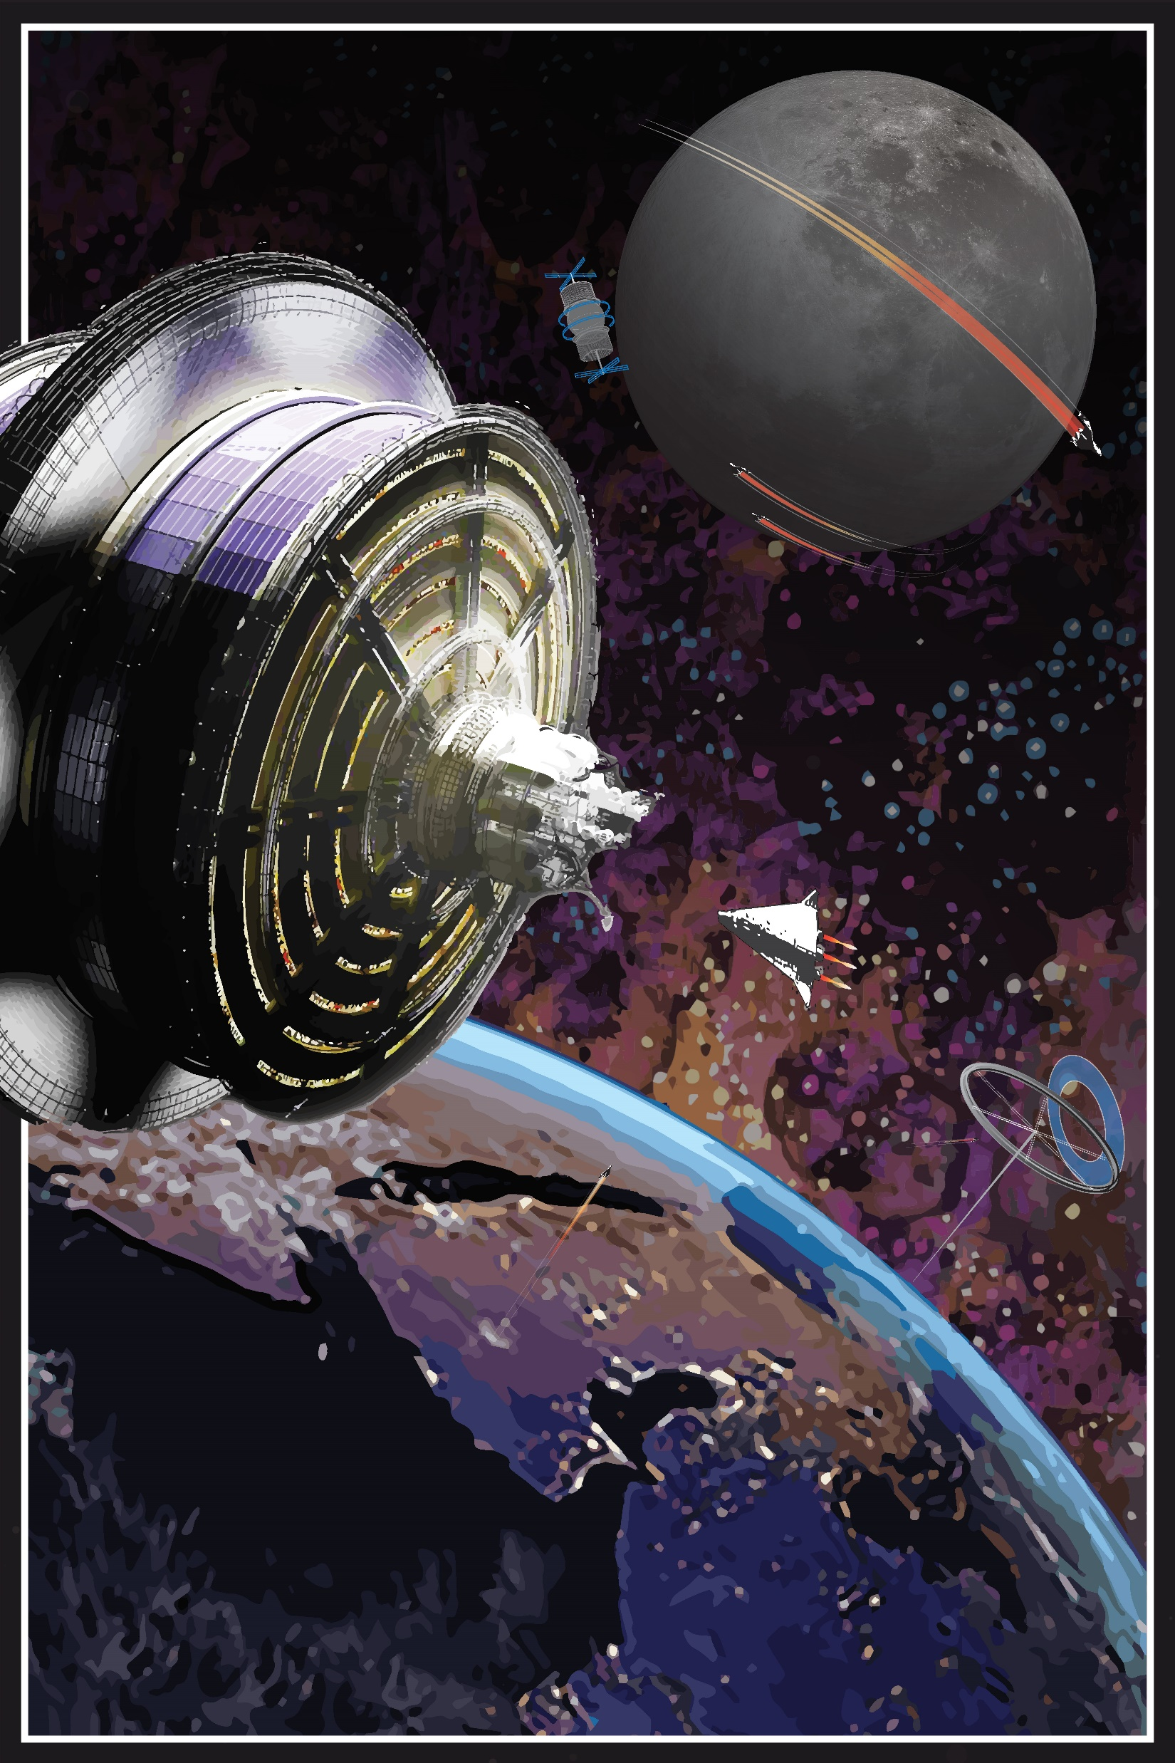
FREE SPACE:
ENVISIONING THE L.E.O. METROPOLIS
Andrew J. Mazer
amazer@spacearchitecture.org
Notes:
Hello, this thesis is entitled Free Space: Envisioning the Low Earth Orbit Metropolis.
The thesis posits a permanent free space settlement as part of a space-based regional plan in the first steps in sustainable and ethical development beyond Earth.
A systems-based strategy in Low Earth Orbit envisions an architectural stepping-stone for humans to realize themselves as a multi-planetary species.
Space hosts untapped resources and un-realized potential and with increased interest in space exploration, it is imperative to plan for the consequences of what permanent settlement in outer space could mean for life on Earth.
This thesis sets forth a strategy to ensure outer space and its resources are used fairly, responsibly, and justly, and access is promoted equitably, ethically, and morally to all who hold a stake in a collaborative human agenda.

Slide 2
Presentation Agenda:
PART I: Inevitable Progress & the Architecture Continuum
PART II: The Free Space Metropolis
PART III: Construction Components
PART IV: The Free Space Neighborhood
Notes:
This presentation is divided into four pieces :
First, I will define what a space settlement is, the foundational principles with which a space settlement could be built upon, and an ideal location for the first space settlement to be built.
Part 2 will discuss the Free Space Metropolis. The Metropolis was fashioned in order to provide context for the space architecture interventions to take place at an urban scale and allows us to understand how Earthly practices translate into outer space.
Part 3 will cover the construction components used in the space architecture designs.
And lastly, I will describe the free space neighborhood module, and its amenities for the free space citizens. I will also highlight the design of human-scaled habitats and show a glimpse into some day-in-the-life events while living permanently in outer space.

Slide 3
PART I:
INEVITABLE PROGRESS & THE ARCHITECTURE CONTINUUM
Notes:
First, why investigate architecture in space?

Slide 4
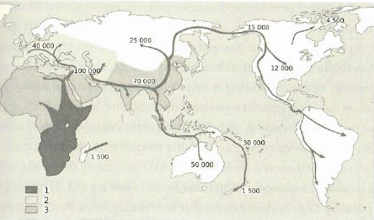
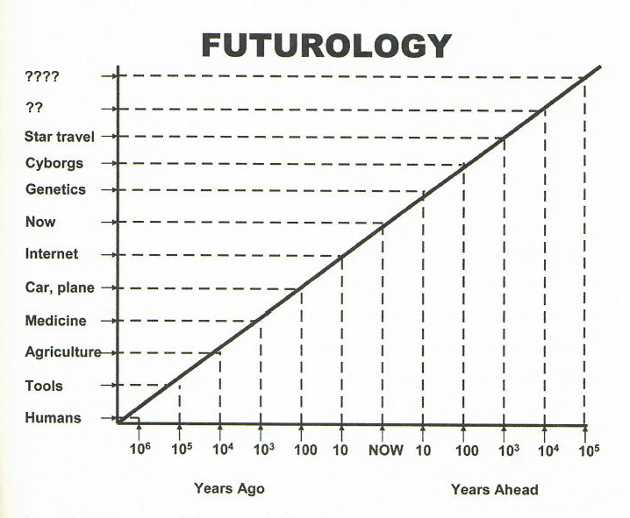
Inevitability of Exploration & Progress:
HISTORY OF GLOBAL EXPLORATION
EXPONENTIAL TREND OF PROGRESS
Impey, Chris. Beyond. 2015.
Impey, Chris. Beyond. 2015.
Notes:
Humans have always lived on the edge of a frontier that continues to be pushed further ahead by our explorative genes. Exploration and progress have been exponentially propelling civilization forward.
These two points raise urgency among the stewards of the built environment to begin thinking about what the impacts of overcoming our current frontier will have on ourselves and our future endeavors.
Is there a space crisis? Are there too few built environment stewards discussing the future of the built environment in locations other than Earth? Is it problematic that private wealth is setting the stage for the rest of the world to follow?
This thesis makes a case for why developing a responsible approach for our use of outer space is important for everyone. This thesis posits a solution along this new space architecture paradigm to positively impact life on Earth.

Slide 5
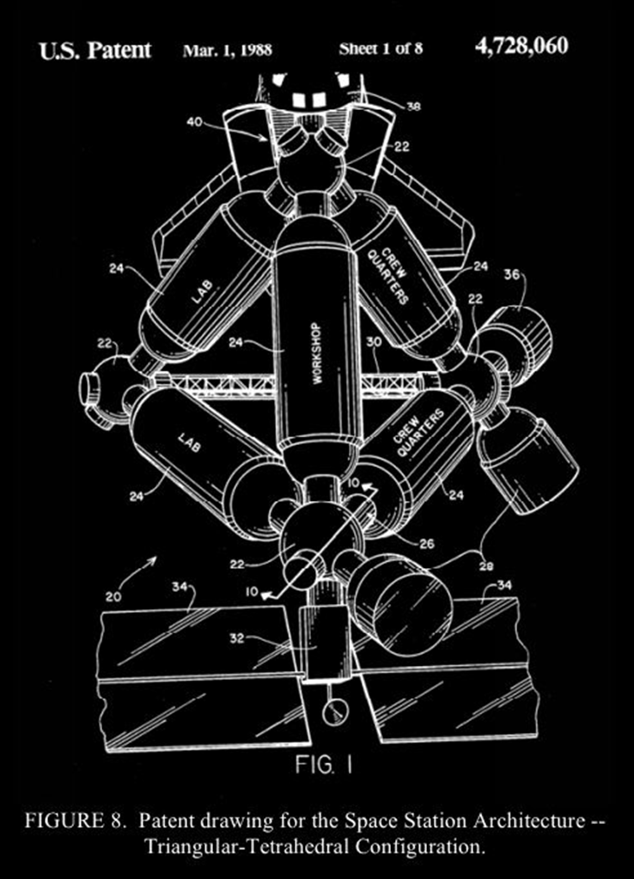
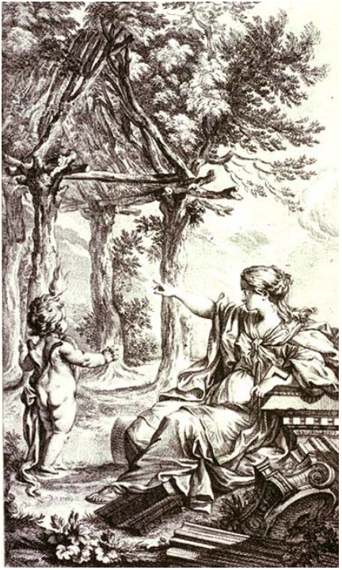
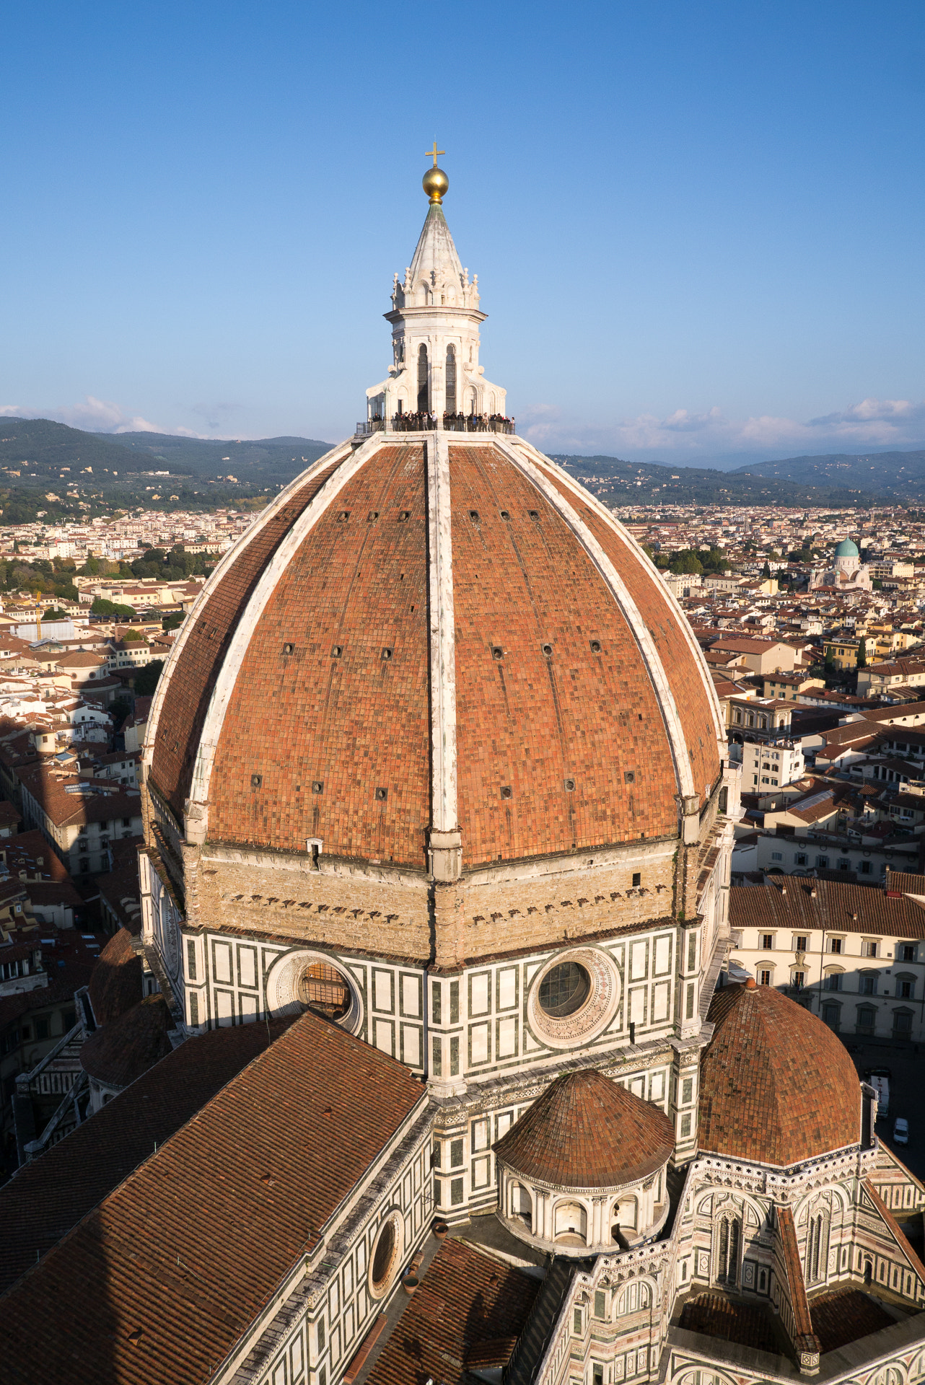
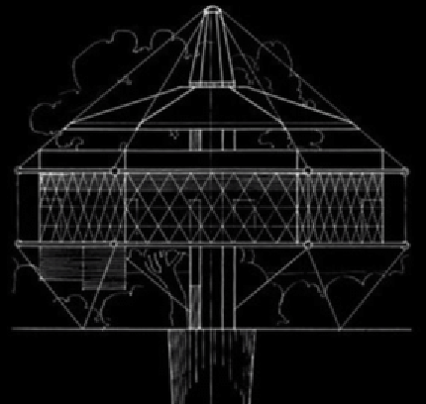
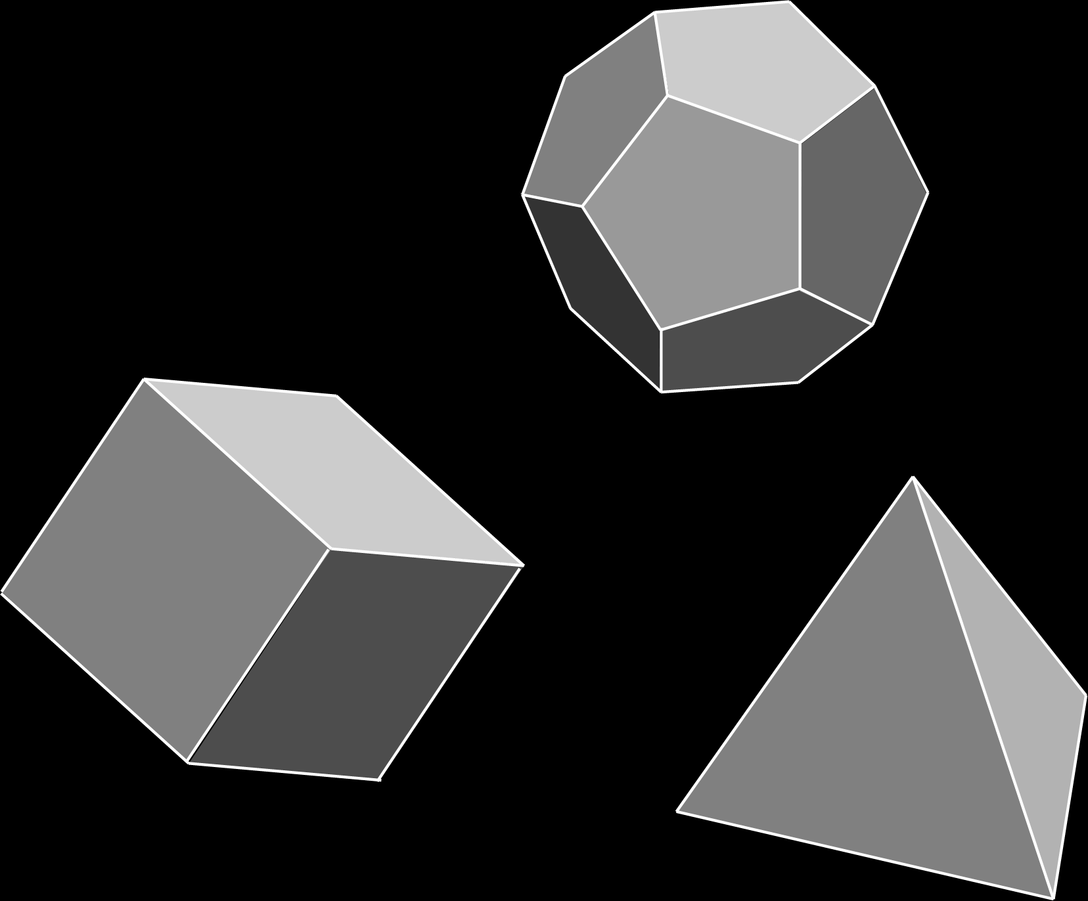
Habitat Continuum:
Primitive Hut.
Florence Duomo.
Patent drawing for the Space Station Architectural-Tetrahedral Configuration.
Cohen, Marc. The Continuum of Space Architecture: From Earth to Orbit. 2012.
Platonic Volumes.
Dymaxion House, Buckminster Fuller.
Adapted from:
Cohen, Marc. The Continuum of Space Architecture: From Earth to Orbit. 2012.
Notes:
CITATIONS
How does architecture fit into this trajectory of progress?
It begins with our ability to realize habitat.
The primitive hut illustrates the beginning – this is humans’ natural reaction to constructing habitat in the effect of gravity.
then, Platonic forms are derived and push architecture innovation to …..
……to express great structures like the dome and the arch – aiding the progress of civilization.
Buckminster Fuller explores the application of these Platonic forms in the absence of gravity. He gives us tensegrity and hyper-efficient architecture like the Dymaxion House.
Then we can realize architecture’s existence in outer space and designing architecture solutions in zero-gravity environments.
This is the grammar of form and tectonics for space architecture throughout this thesis.

Slide 6
What is a Space Settlement?
SPACE STATION
SPACE HOTEL
SPACE SETTLEMENT
=
=
=
WORK HABITAT
WORK + PLAY HABITAT
LIFE-CYCLE HABITAT
Adapted From:
Globus, Al. Interview (2020).
Notes:
The space metropolis is a compilation of space habitats which in this case amount to a Space settlement -
(walk through slide)
Where one lives and dies.

Slide 7
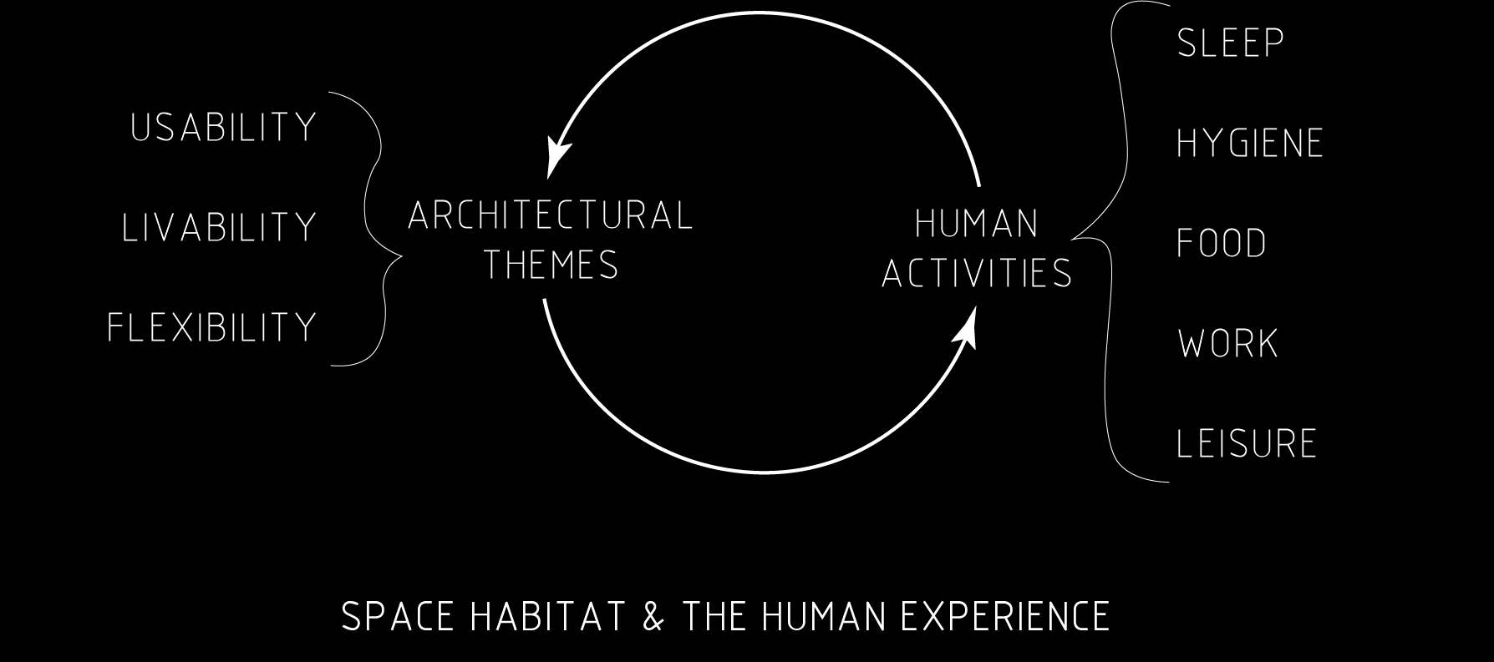
Space Architecture:
Adapted From:
Hauplik-Meusburger, Sandra. Architecture for Astronauts: An Activity-based Approach. (2011).
Notes:
What is space architecture?
Space architecture supports the human experience while protecting them from the hostile environment of outer space and supporting their safety and well-being within the constructed habitat. The habitat is always in constant dialogue with human activities and meeting the high demands of human comfort.

Slide 8
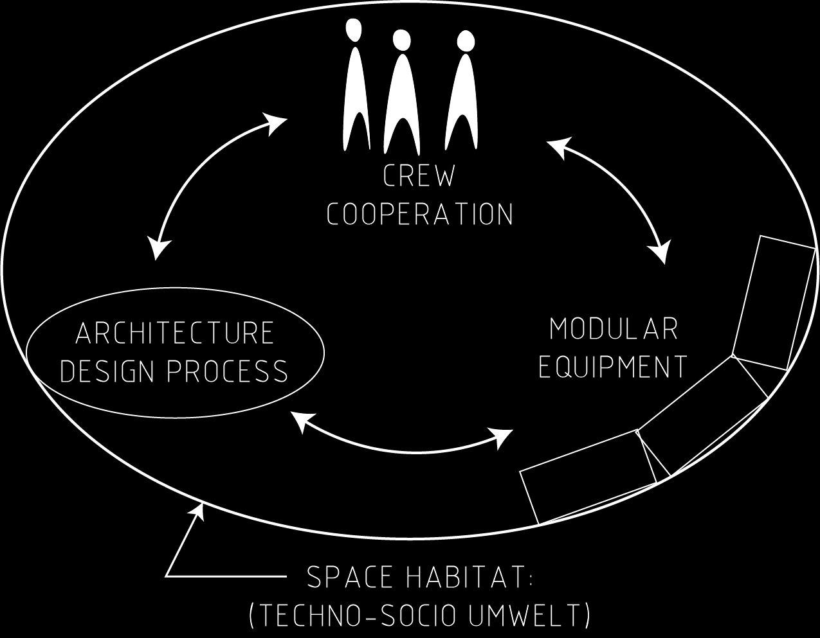
Space Habitat:
Adapted from:
Cohen, Marc. Designing Space Habitats for Human Productivity. (1990).
Scharmen, Fred. Space Settlements. (2019).
Notes:
What is a space habitat?
The inward-focused architecture places emphasis on the user’s interactions within a clearly defined and contained system. Again, the meaningful aspects of function live in constant dialogue between the spatial nature of the architecture, the biology of the users, and modular technology – which is an extension of the space architecture that is used by the inhabitants to maintain productivity.

Slide 9

Foundational Principles of Space Settlement:
Notes:
The Goals of the LEO Metropolis explore architecture, planning, and governmental policy as the built environment migrates to outer space.
1. The principle of Exploration aligns with many of the world’s space programs like NASA.
2. The cooperation principle demands partnerships at the global scale for space planning, space government, and space policy.
3. There will be new resources to be extracted and processed for human use in Space and on Earth.
4. The LEO metropolis will provide a place for new research and educational methods and platforms to propel all fields of study because of the diverse collection of individuals that would be required to maintain a sustainable settlement
5. And lastly, the LEO Metropolis will harbor innovations for living in and exploring space and push human civilization deeper into our current frontier.

Slide 10
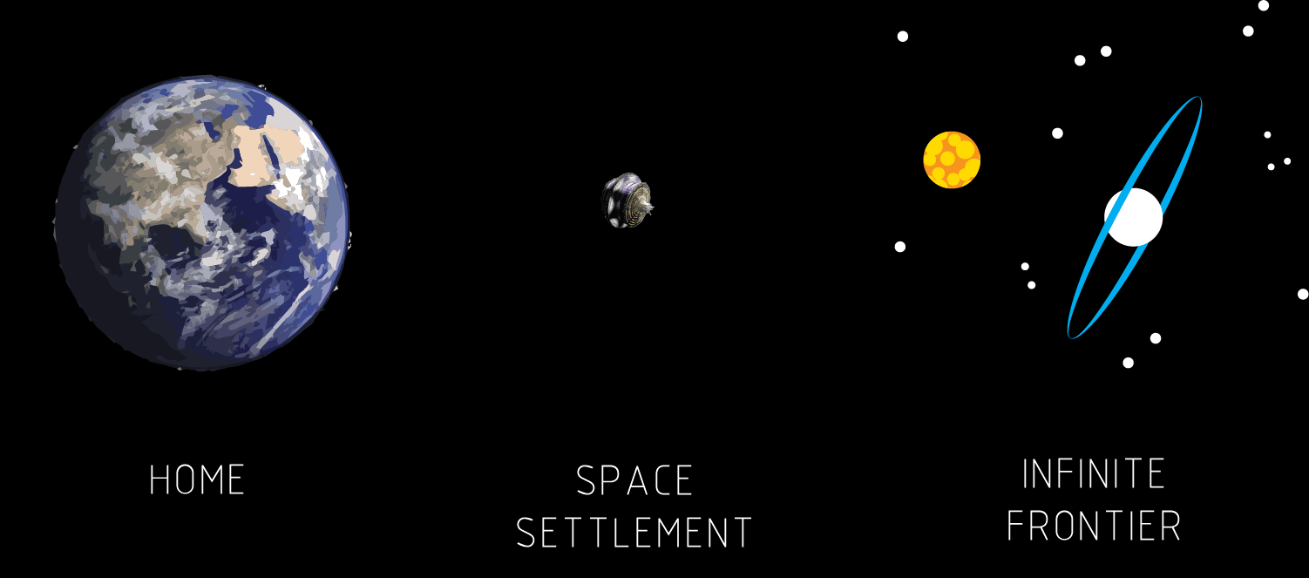
Stepping-Stone To Deep Space:
Notes:
Furthermore, Low Earth Orbit is the only place where humans have built and lived off-earth. The ISS has been consistently inhabited by humans for over the last 20 years. The proposed LEO Metropolis positions itself as a literal and figural steppingstone to bridge humans’ journey into deep space.

Slide 11
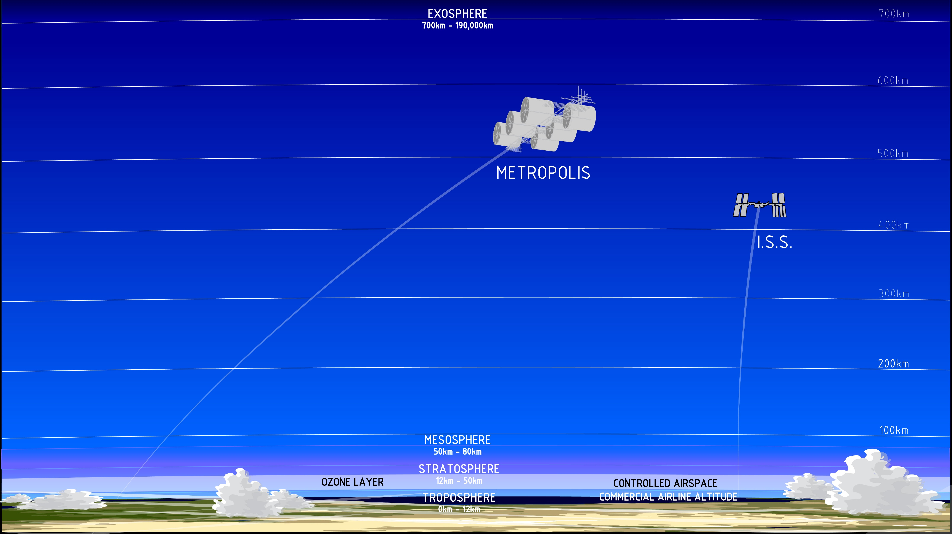
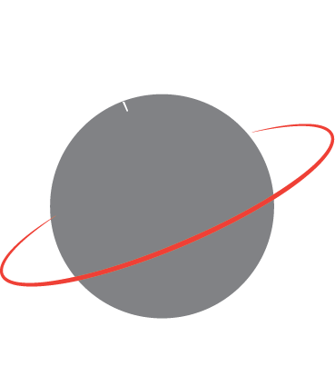
Site Plan:
Low Earth Orbit
Orbital Path Key: Equatorial Earth-Nadir
Notes:
This is the site of the proposed metropolis in Low earth Orbit (free space) – physically untethered to any celestial body. The Free Space Metropolis is located at 500-550 Km altitude. The ISS is located between 400-450Km. Here we are close to home - much closer than Mars or the Moon and we are protected from harmful solar radiation but high enough to maintain orbital velocity. The Metropolis will orbit the Earth along an Earth-Nadir trajectory tracing the equator. This orientation positions the Earth beneath your feet - creating a constant connection to our home planet.

Slide 12
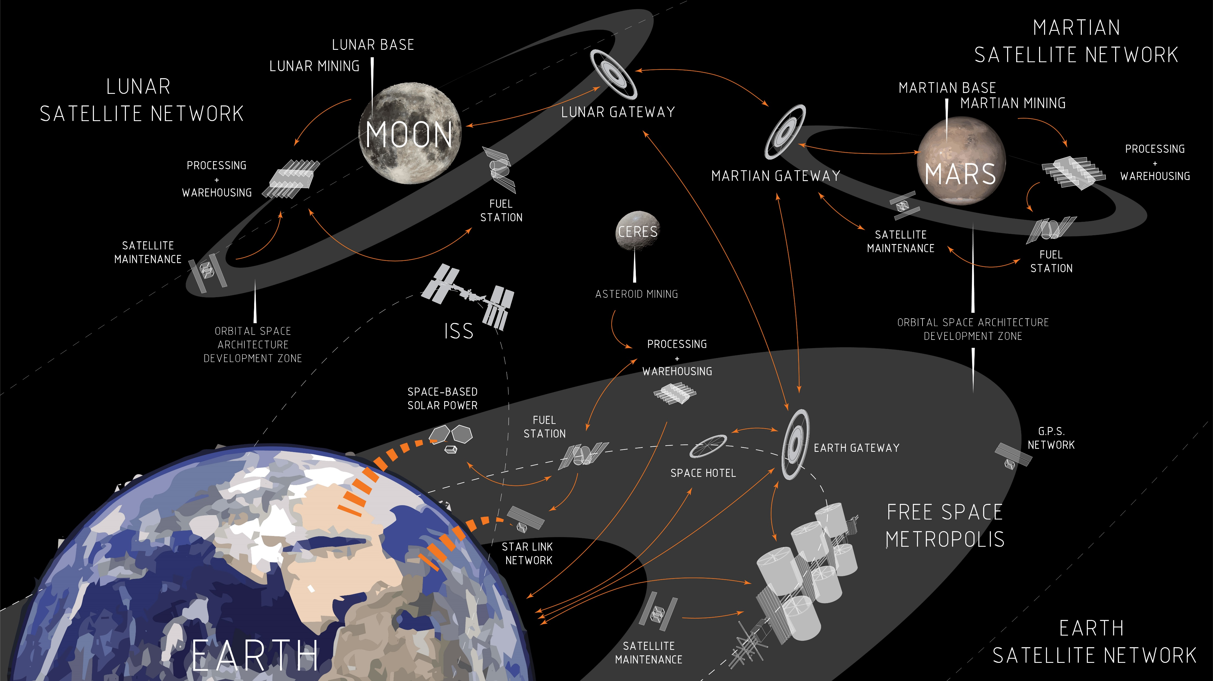
Notes:
Here is the 200-year Earth Network Master Plan
Space has already been populated with satellites and habitats.
The free space metropolis will exist among the current and future space outposts and satellites – building the Earth Satellite Network. By the completion of the metropolis, we could expect networks of space faring outposts among networks of other celestial bodies such as our closest neighbors like the Moon and Mars. These networks allows for the planetary exchange of goods, products, and ideas creating the beginnings of space faring economies.

Slide 13
PART II:
THE FREE SPACE METROPOLIS
Notes:
On to the metropolis

Slide 14
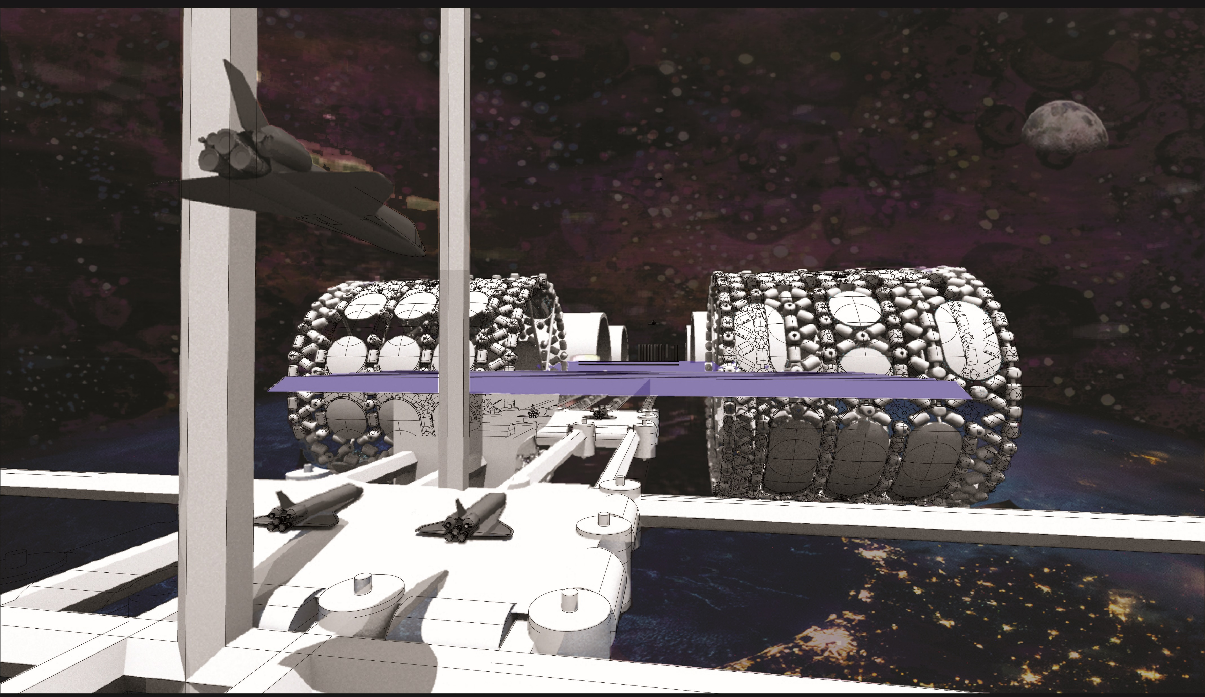
Metropolis Arrival:
Notes:
Welcome!
After your 6~8 hour flight, your commercial spacecraft is ready to land in the metropolis spaceport.
The Spaceport is like an airport for spaceships, where you will be received similarly to arriving at an airport on Earth.

Slide 15
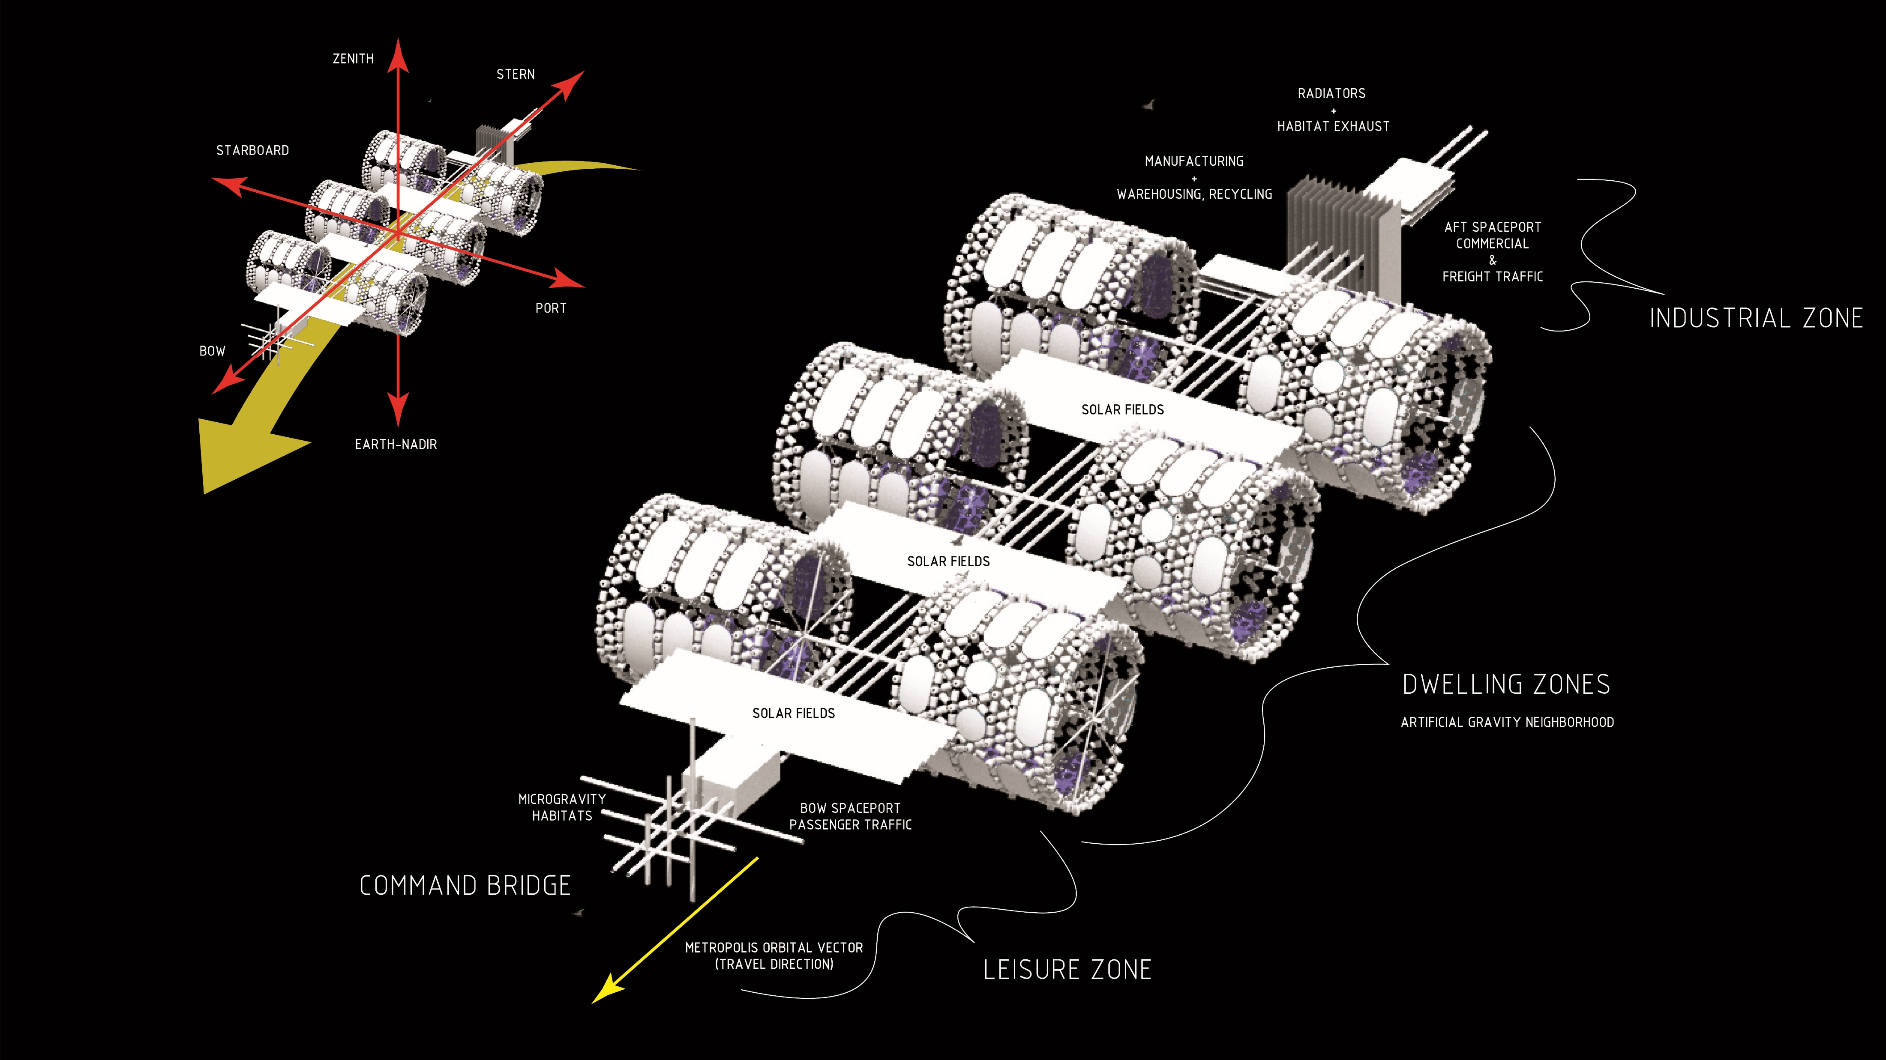
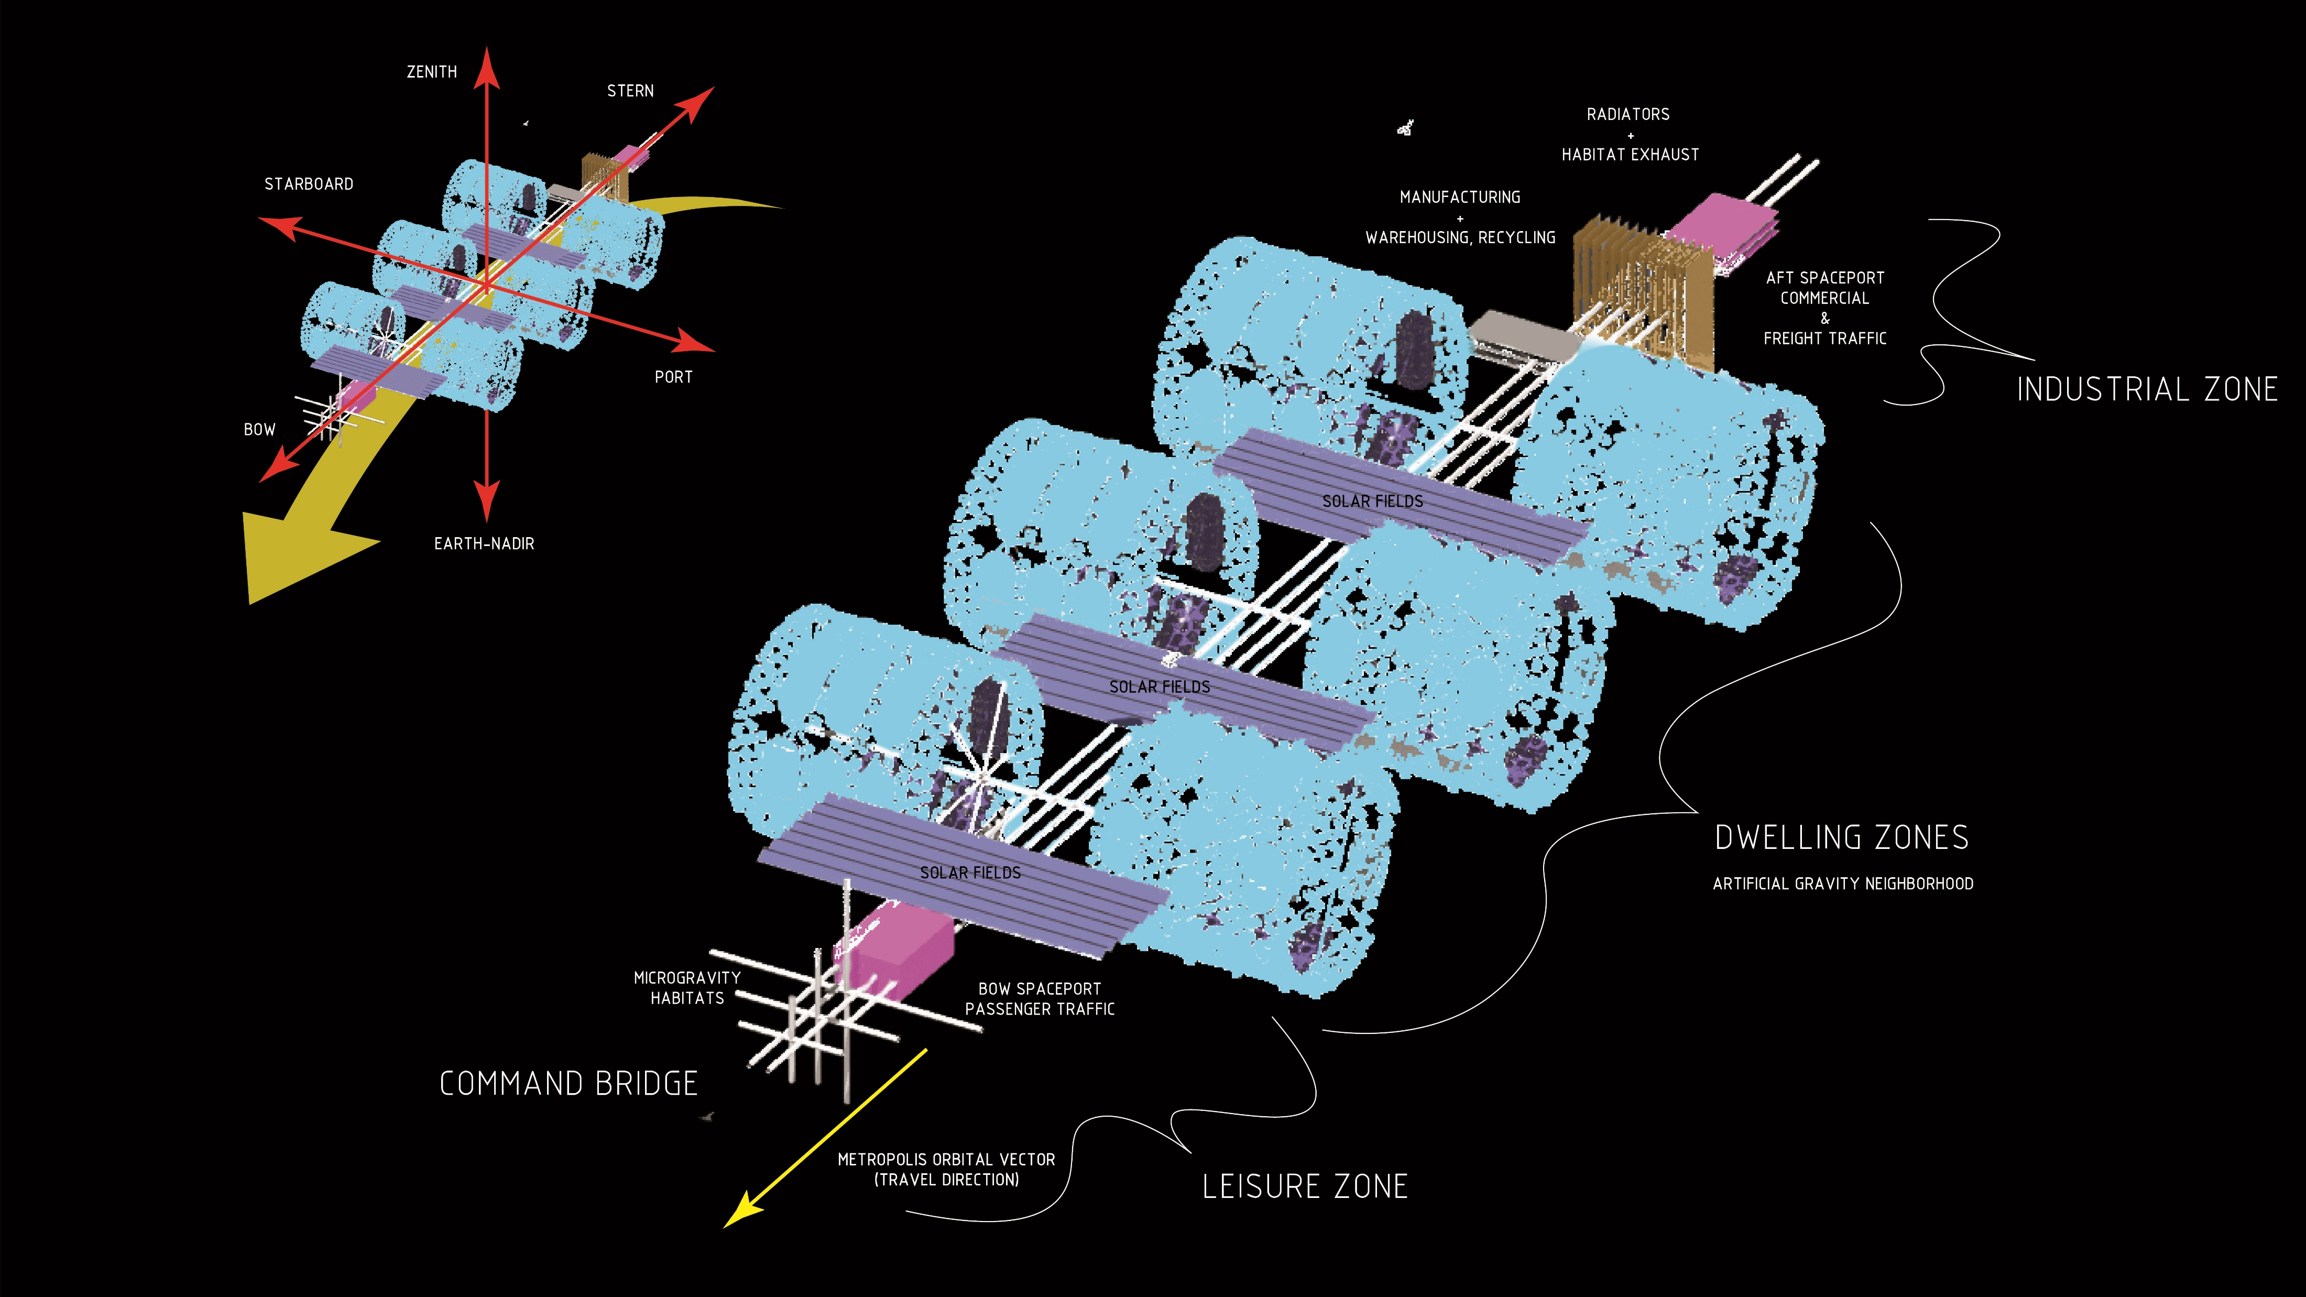
Metropolis
Master Plan:
Metropolis Model Adapted From:
Howe, Sherwood. Out of This World: The New Field of Space Architecture. Ch 13, Orbital Cities. (2009).
Notes:
The metropolis has 2 spaceports. (in pink). They are located at the front and the rear of the metropolis.
Your flight arrives at the foreword spaceport which is reserved for private, commercial, and leisure travel.
The rear spaceport will be used for freight and commercial shipping. These are the gateways on and off the metropolis.
The spaceports are connected along the metro rail and infrastructure spine (in white). Along the spine are PV for power generation (in blue) and radiators (in brown) for habitat exhaust
Flanking the main thoroughfare in pairs are the artificial gravity neighborhoods. We will explore these shortly.

Slide 16
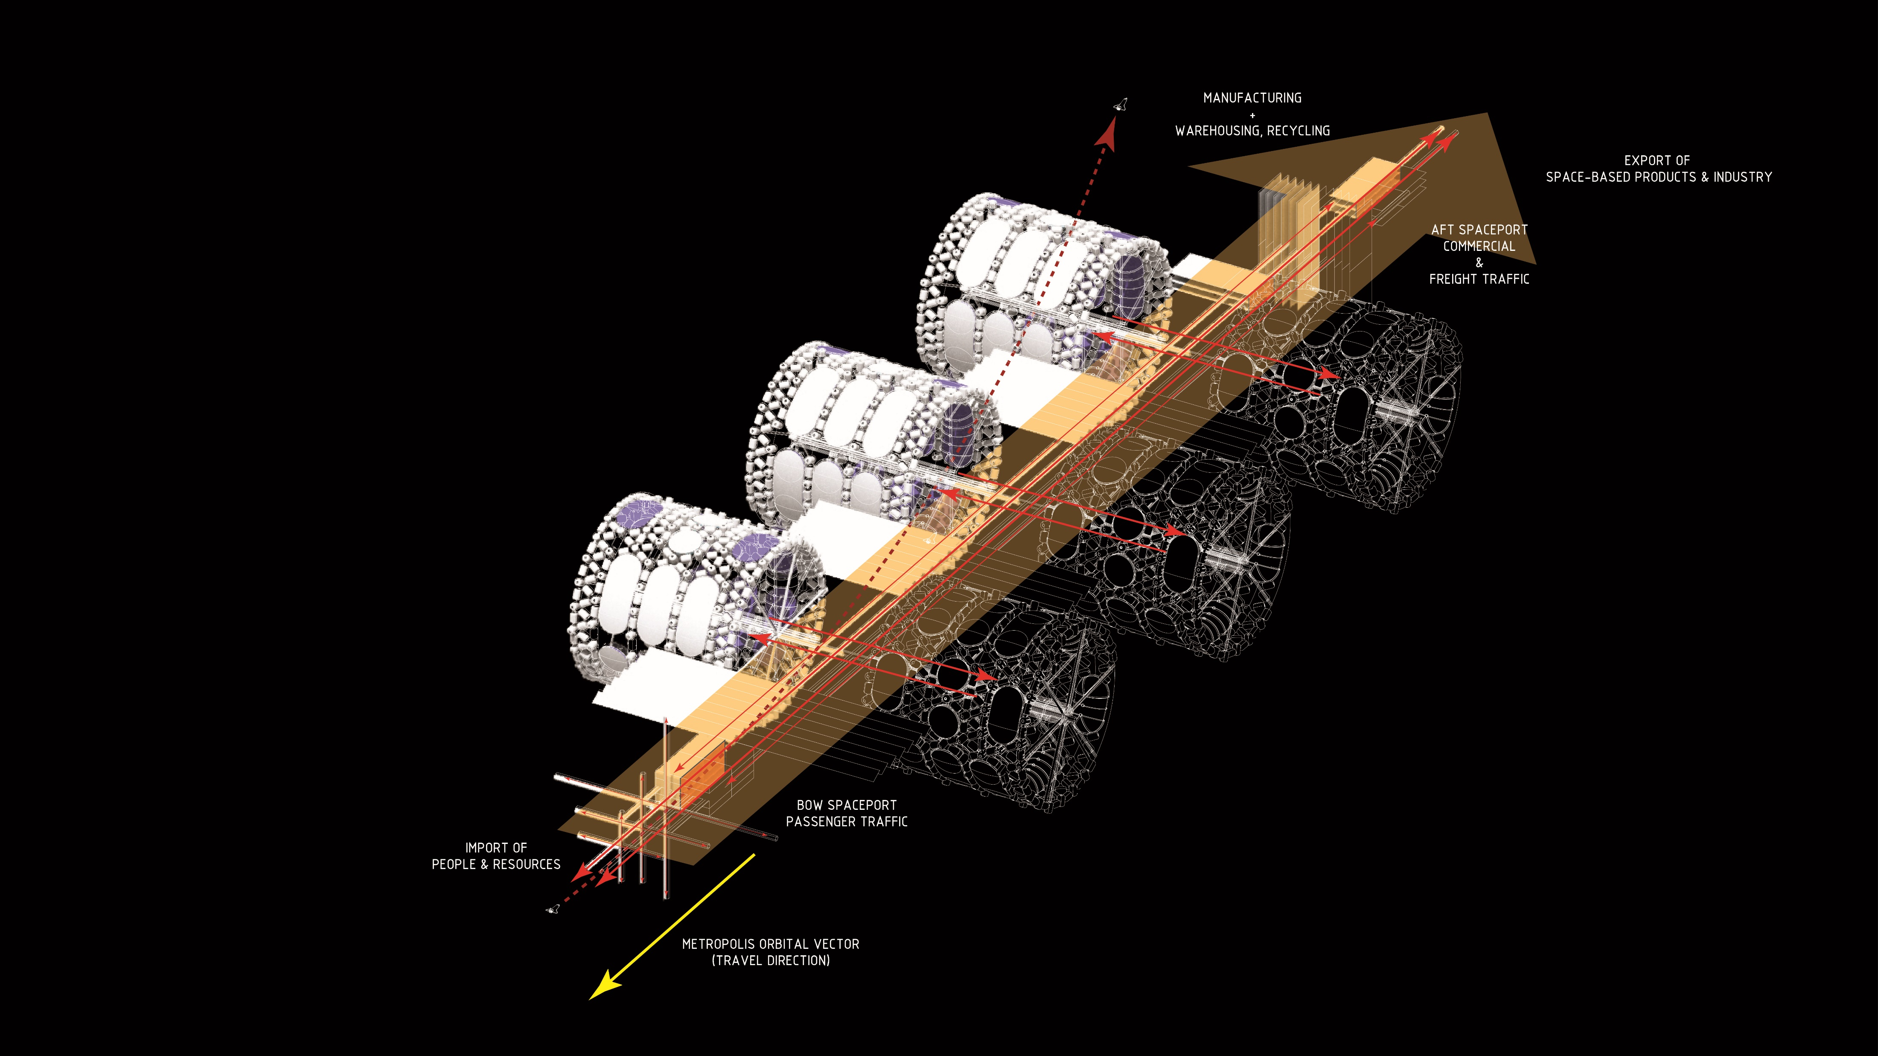
Metropolis
Metabolism:
Metropolis Model Adapted From:
Howe, Sherwood. Out of This World: The New Field of Space Architecture. Ch 13, Orbital Cities. (2009).
Notes:
Like earthly cities, the metropolis has is own metabolism - consuming imports and expelling exported products and goods. The LEO Metropolis has the infrastructure to support an economy to participate in multiplanetary trade.

Slide 17
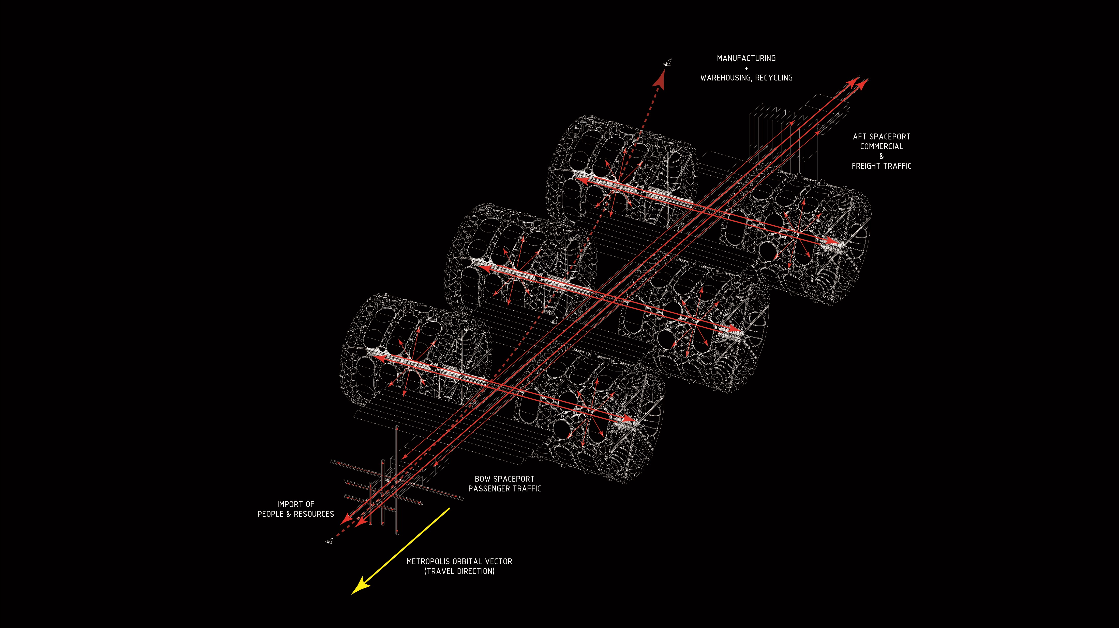
Metropolis
Circulation:
Metropolis Model Adapted From:
Howe, Sherwood. Out of This World: The New Field of Space Architecture. Ch 13, Orbital Cities. (2009).
Notes:
The major street grid of the LEO Metropolis is organized like NYC. Large primary avenues connecting from front to back and secondary cross streets branching out to the neighborhood modules.

Slide 18
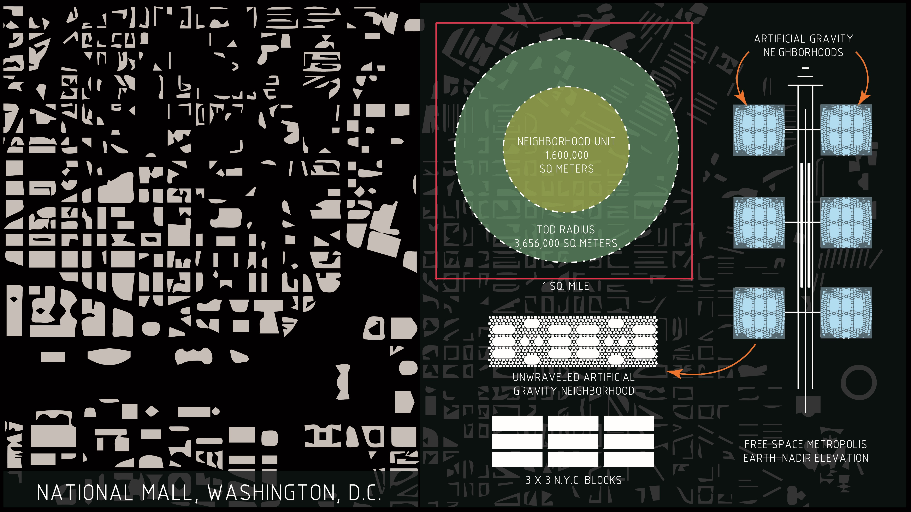
Metropolis Scale Comparisons:
Notes:
The initial metropolis is approximately 1 square mile in size. The Washing D.C. Mall and a 3x3 grid of NYC city blocks are shown for scale reference. The Free Space Neighborhoods fits within a TOD radius of one another and are laid out into units more efficiently than Clarence Perry’s neighborhood unit model.
The initial metropolis will accommodate six neighborhoods in order to achieve a sustainable population of about 10,000 people.

Slide 19
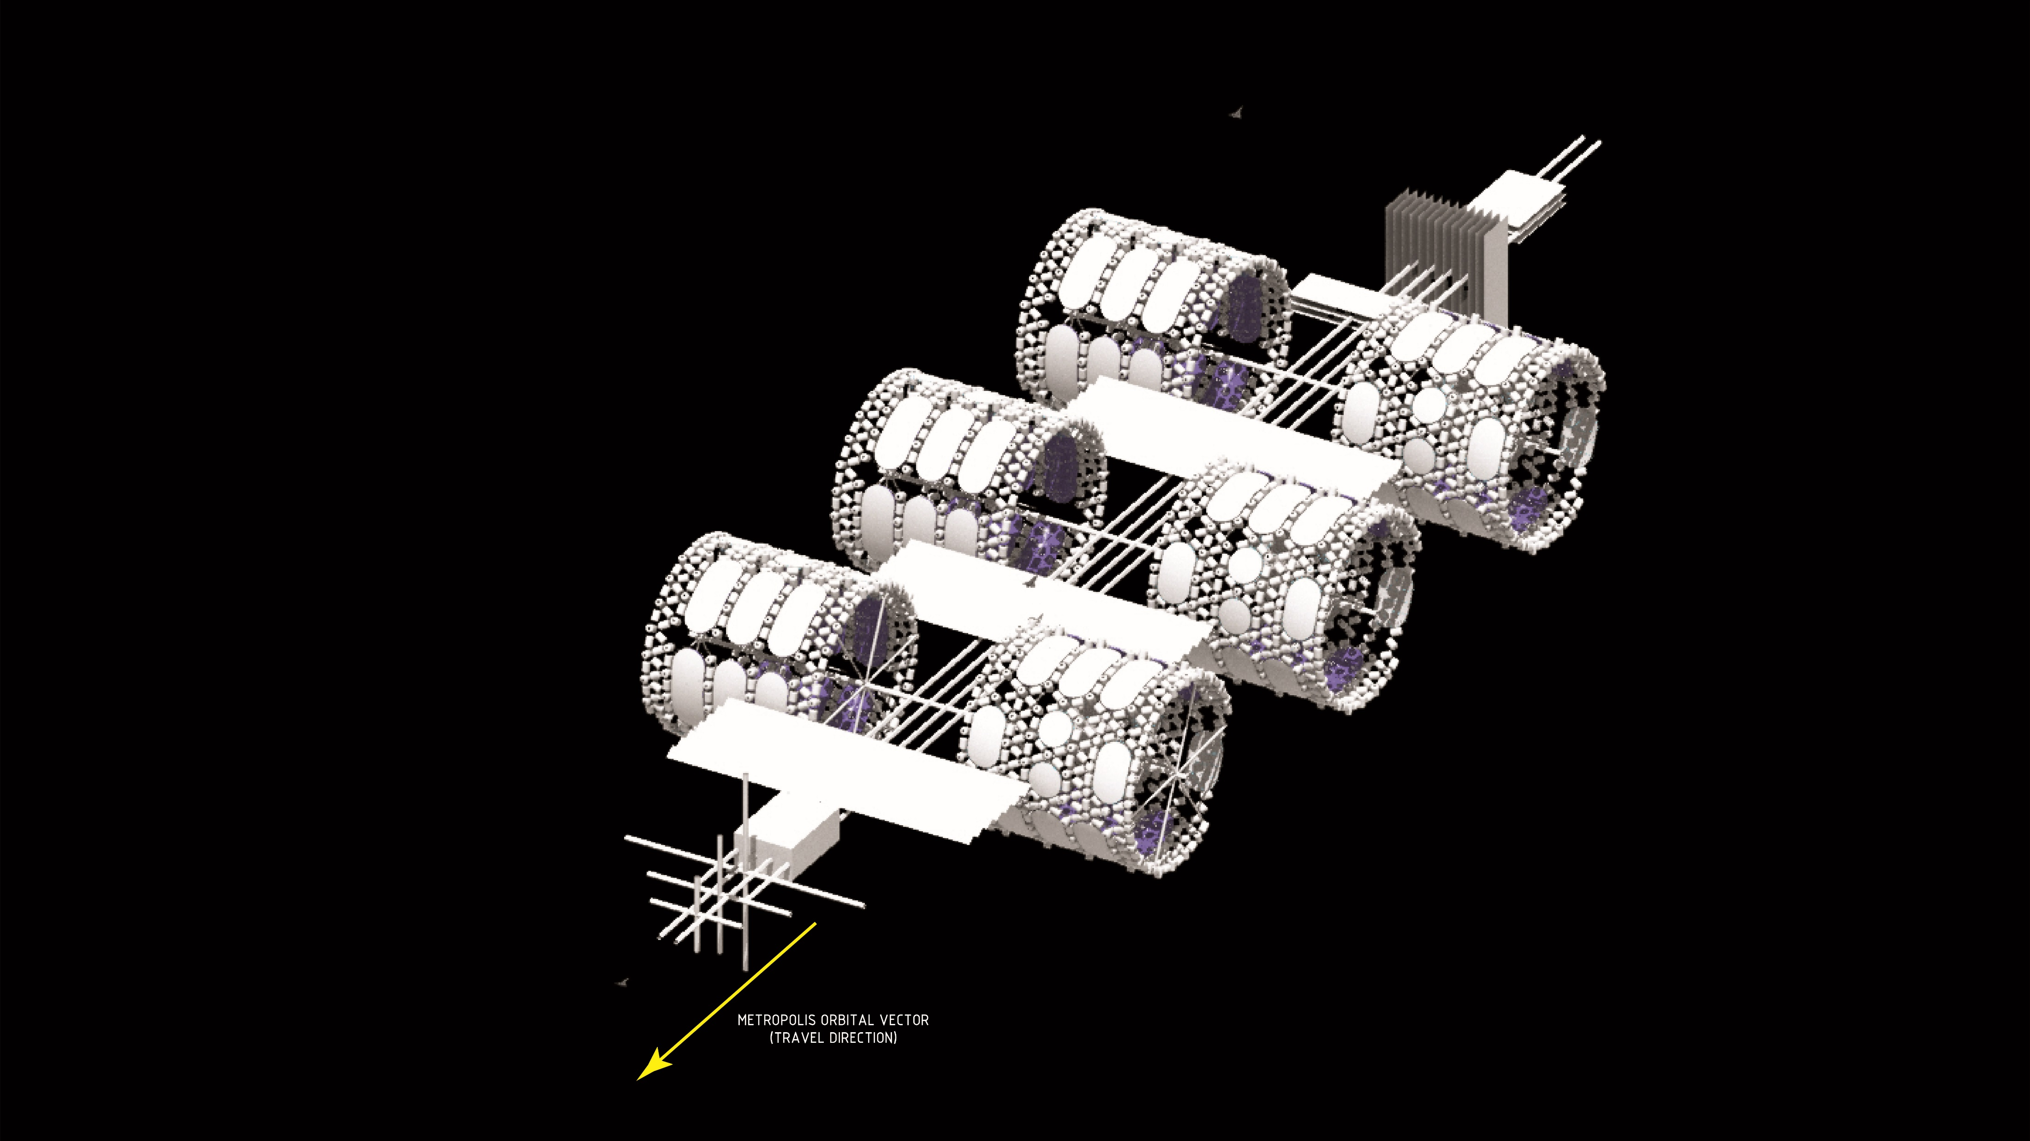
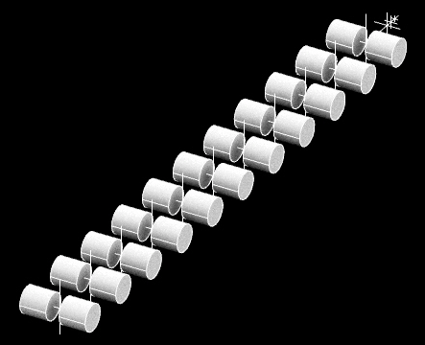
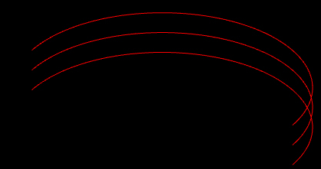
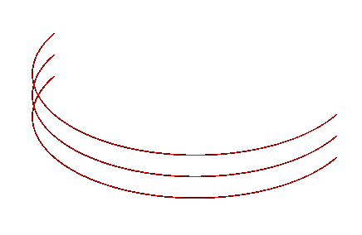
Metropolis
Growth:
INCREMENTAL GROWTH
RING CITY
Metropolis Model Adapted From:
Howe, Sherwood. Out of This World: The New Field of Space Architecture. Ch 13, Orbital Cities. (2009).
Notes:
When it is time for the metropolis to expand, Growth can occur in all directions giving it the ultimate flexibility as it sprawls. It can grow incrementally until it finally encircles the earth and becomes a ring city in its final phase.

Slide 20
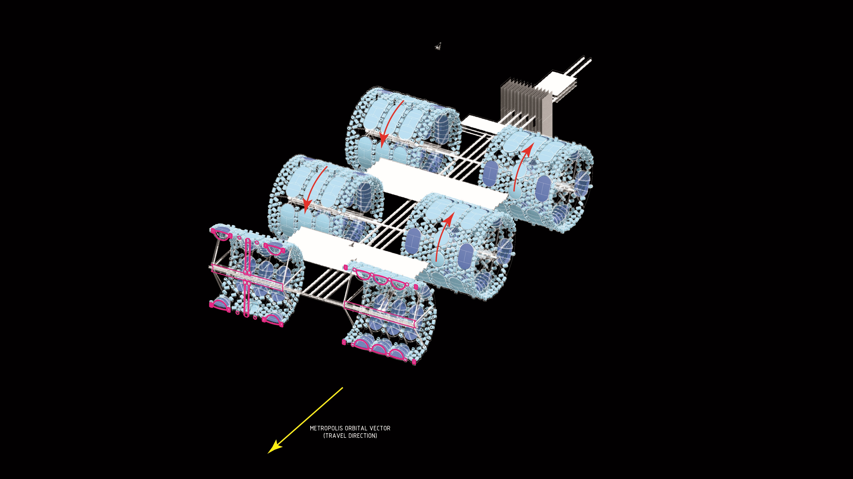
Artificial Gravity
Habitats:
Metropolis Model Adapted From:
Howe, Sherwood. Out of This World: The New Field of Space Architecture. Ch 13, Orbital Cities. (2009).
Notes:
Lastly, These are the artificial gravity neighborhoods that long-term space dwellers will inhabit. These neighborhoods rotate to create artificial gravity environments unlike the rest of the metropolis, where one would experience microgravity: (total weightlessness).
Each neighborhood is 320 meters in diameter by about 300 meters in length and located along the main boulevards that connect to other programs in the metropolis. It is important the neighborhoods rotate in opposite directions for counterbalance.

Slide 21
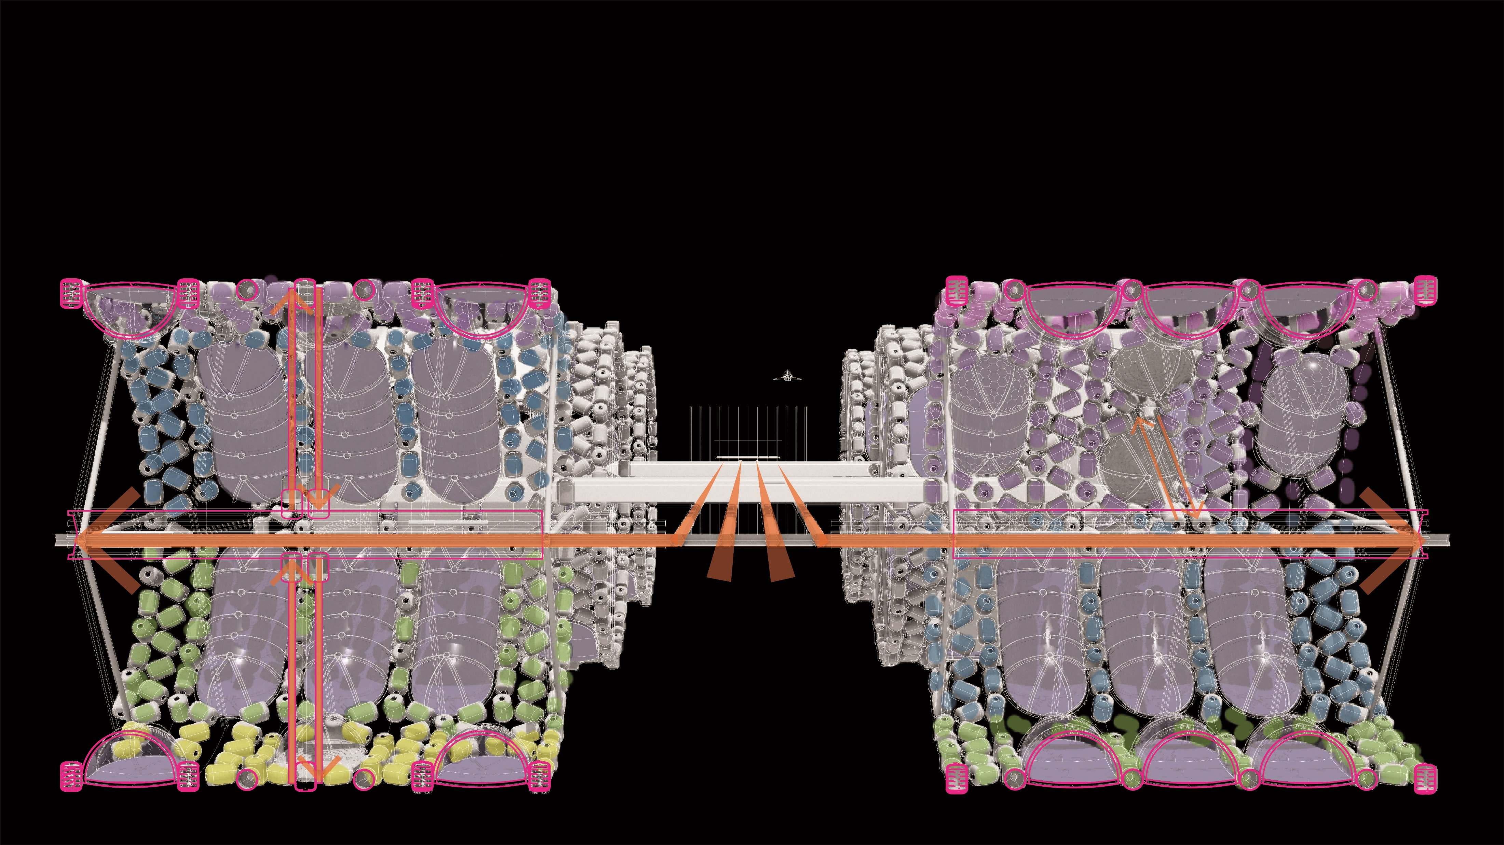
Neighborhood Axle:
Notes:
As we move along the metro rail from the spaceport, we arrive at the neighborhood modules.
The metro rail connects to the radial axis of each neighborhood which supports the structural hub for the neighborhood.
The neighborhoods are comprised of some basic building components…..

Slide 22
PART III:
CONSTRUCTION COMPONENTS
Notes:
How do we build a city in Space? I will break it down into the fundamental building blocks.

Slide 23
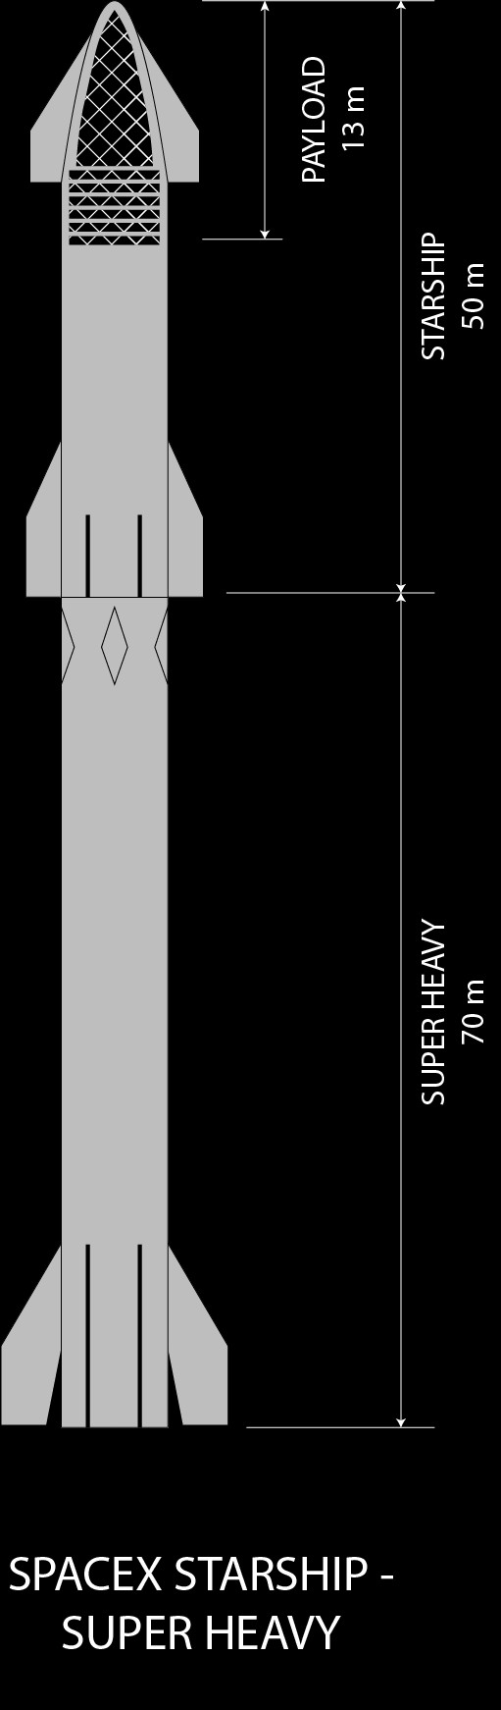
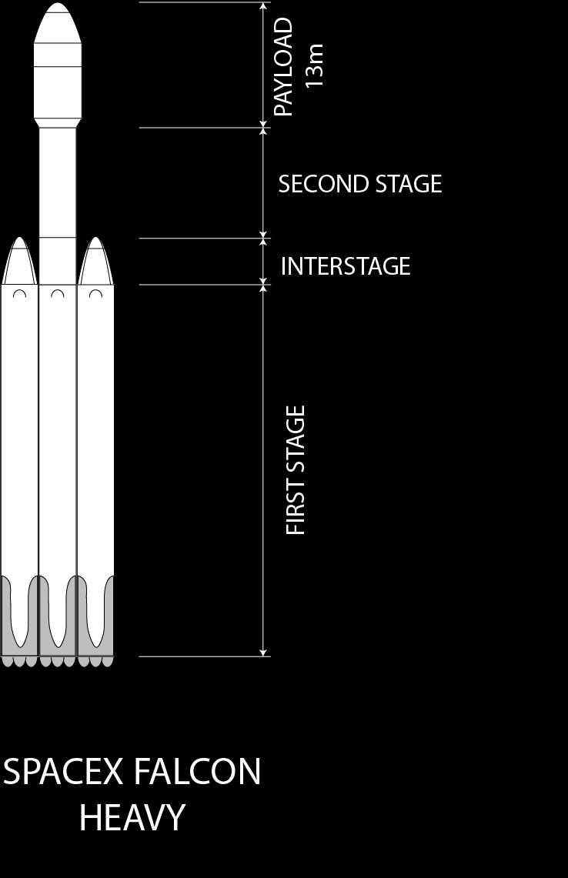
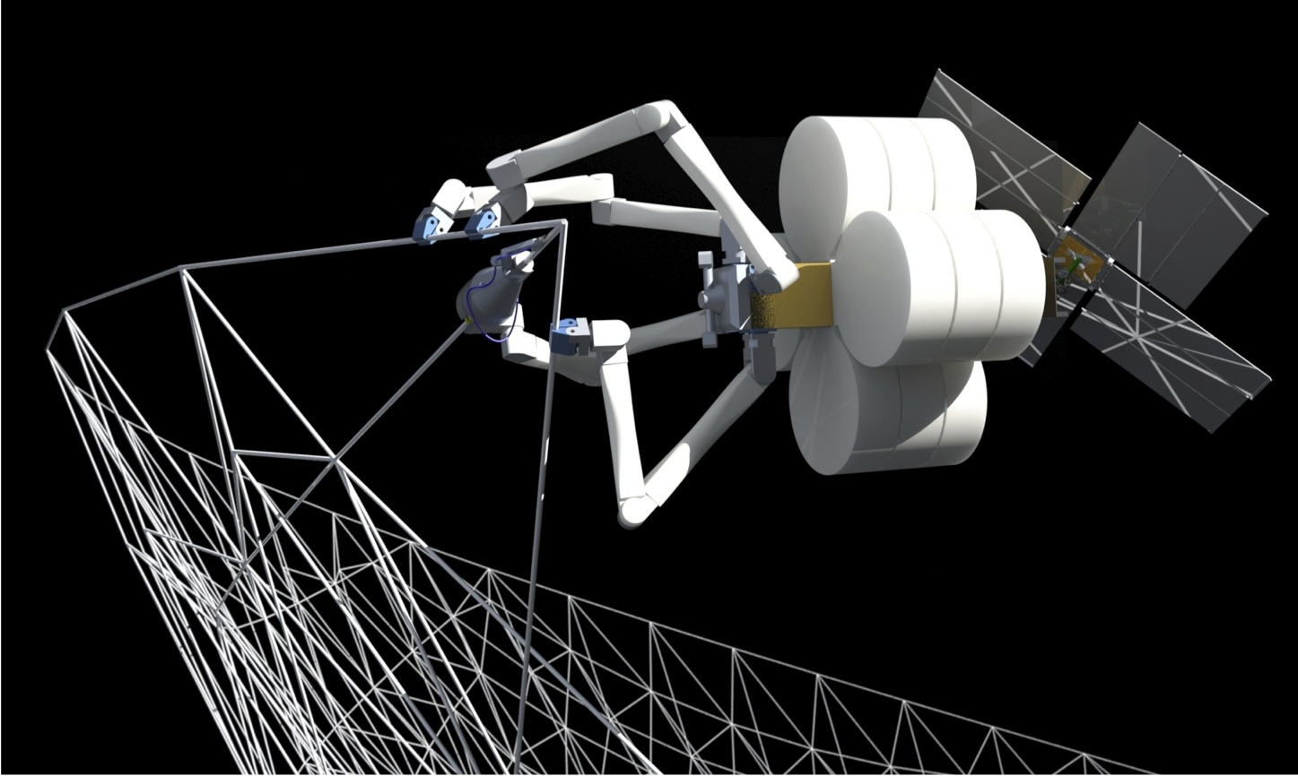
Construction Typologies:
IN-SITU FABRICATION
PRE-FABRICATED CONSTRUCTION
3D Printing Robot Satellite by TransAstra Corp.
Notes:
A combination of two construction methods will be used to construct the LEO Metropolis. In-Situ (or on-site construction) and Pre-fabricated construction.

Slide 24
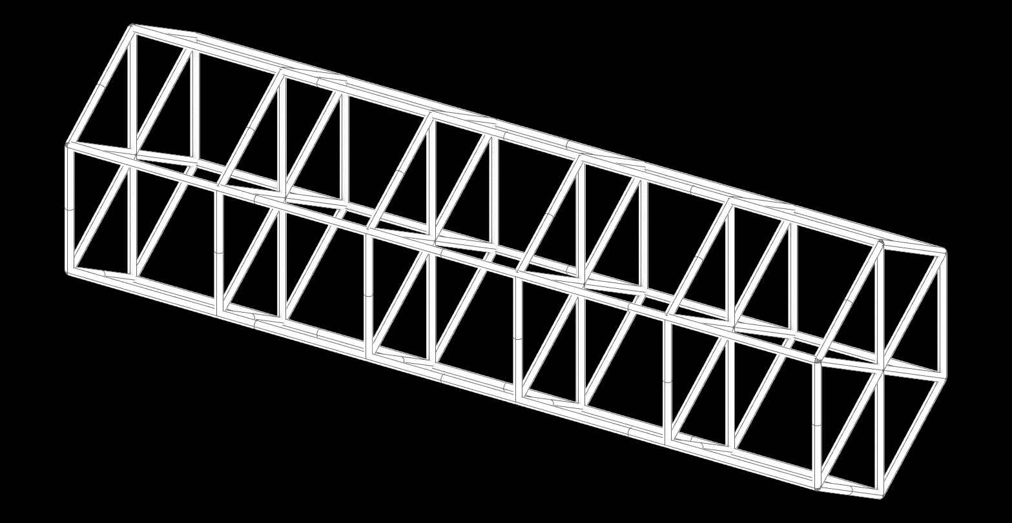
In-Situ Construction:
IN-SITU TRUSS FABRICATION
HEXAGONAL TRUSS SEGMENT
3D Printing Robot Satellite by TransAstra Corp.
Notes:
The Primary Structural armatures of the Metropolis can be 3D printed with the help of TransAstra’s 3D printing satellites. The structural armature will be comprised of metal trusses like that of the ISS. Raw materials for these structural members may be mined and processed from lunar or asteroid regolith making them locally sourced and offering new definitions for sustainable practice and low-embodied energy construction materials.

Slide 25
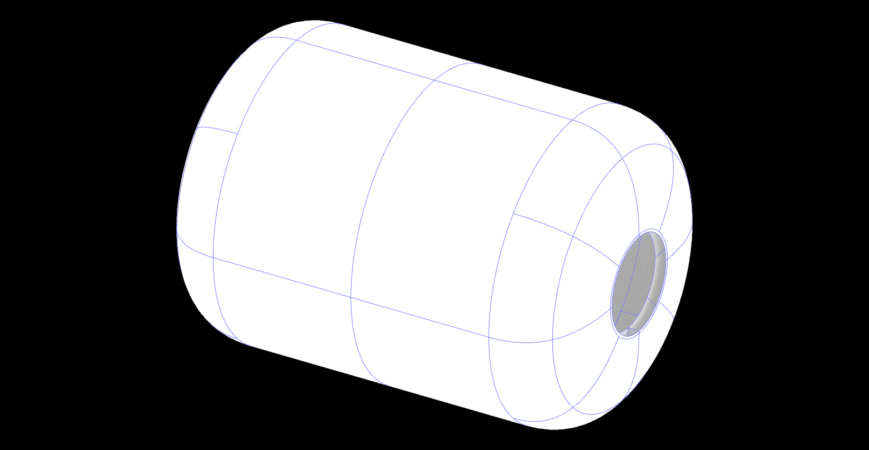
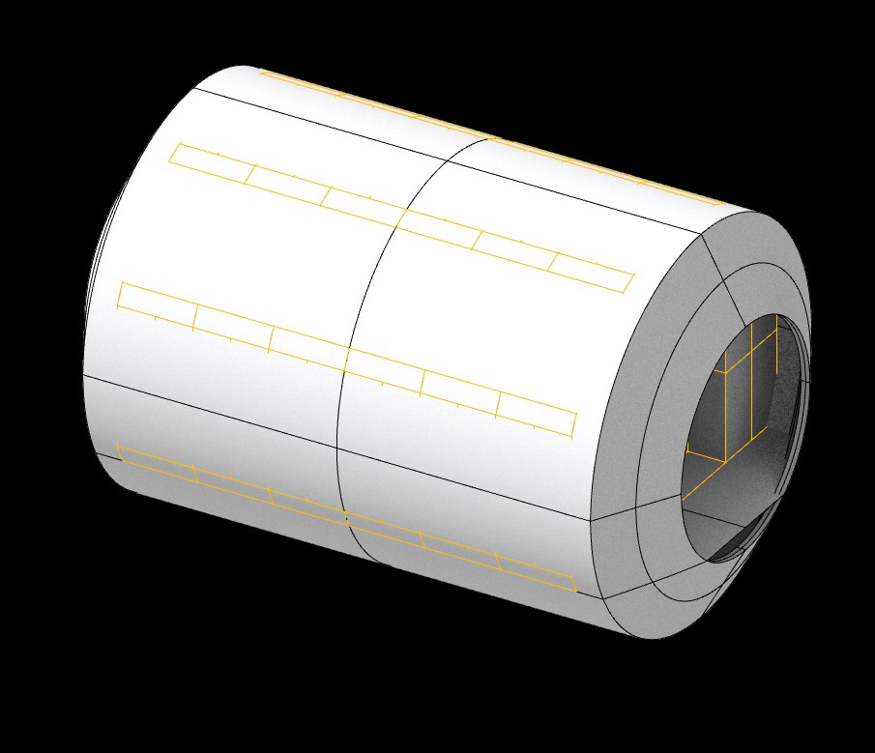
Pre-Fabricated Construction:
BIGELOW 2100 INFLATABLE HABITAT
NASA STANDARD CONNECTOR NODE
EARTH-SPACE TRANSPORTATION
Inflatable Habitat Design adapted from Bigelow Aerospace.
Notes:
Imported construction components arrive via industry standard spacecraft. Currently the largest payloads happens to be SpaceX’s Falcon Heavy and the Starship Super Heavy.
Construction components and crew are packaged within the rocket payloads and then deployed once the payload reaches the construction site.

Slide 26
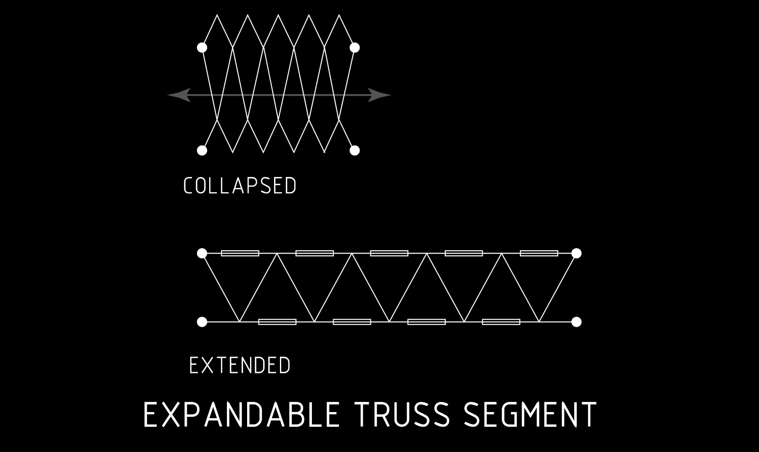
Pre-Fabricated Truss:
HEXAGONAL TRUSS SEGMENT
Notes:
Pre-fabricated trusses can be lightweight and can be collapsed to conserve space for transportation. Their efficient use of material minimizes their weight for transport but would not sacrifice their structural integrity.

Slide 27

Pre-Fabricated Inflatable Habitat:
INFLATABLE HABITAT
Notes:
The collapsible truss armature can be combined with the inflatable habitat to provide it additional structural integrity for mounting floors and walls and carrying equipment. This additional structural design allows modules to gang together to form the neighborhoods.
The inflatable habitat module is adapted from the Bigelow Olympus 2100. It is used to efficiently capture large amounts of habitable volume and is the fundamental building block to accommodate habitable programs within the LEO metropolis. This membrane can be packed up and transported within rocket payloads and then deployed on site for assembly.

Slide 28
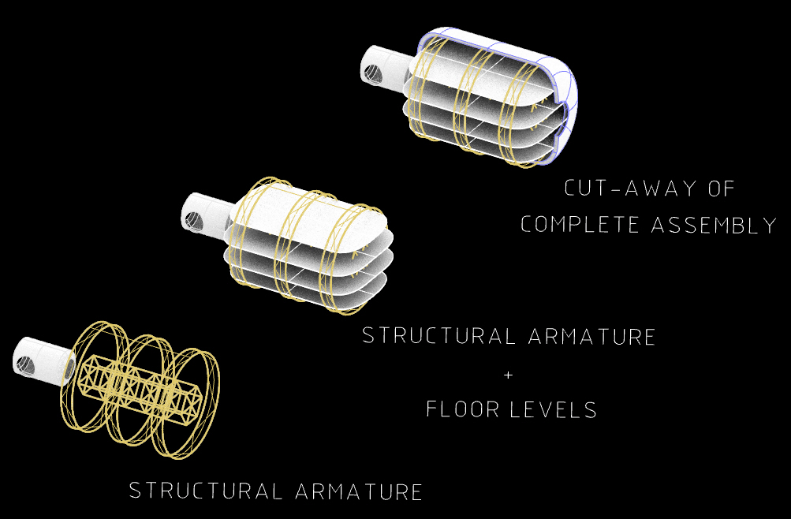
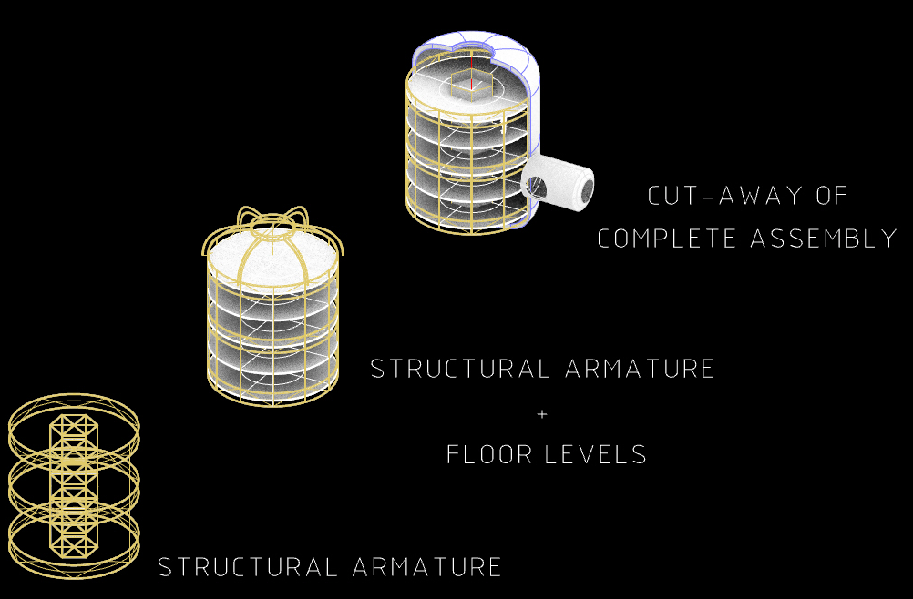
Inflatable Habitat Orientation:
HORIZONTAL MODULE
VERTICAL MODULE
Notes:
Two basic inflatable habitat prototypes were explored. The main difference comes from how they are oriented once installed. The shape of their floor plates and the number of available levels provide flexible design opportunities to address different programmatic challenges in artificial gravity environments. This allows the design to accommodate a variety of human demands to addresses human comfort and productivity.

Slide 29
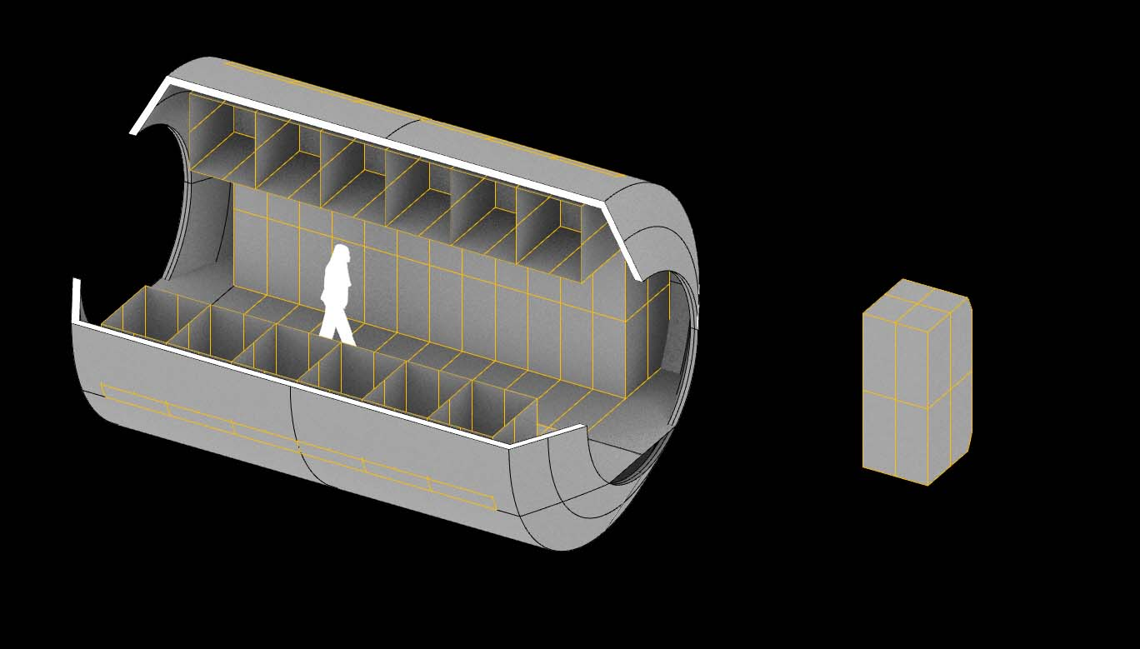
Pre-Fabricated Habitat:
SAFE HAVEN
NASA STANDARD RACK MODULE
Notes:
Lastly, Safe havens are proposed to join the inflatable habitats together. These prefabricated connector nodes are emulated from the ISS connector nodes and laboratory modules. Their interiors come fully outfit with NASA-Standard RACKS and ready for immediate use after installation. These are used in this design proposal as connectors between the inflatable modules and as emergency air-locks between habitats for egress. They also aid in managing and connecting life support systems throughout the neighborhood.

Slide 30
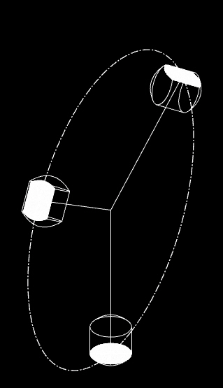
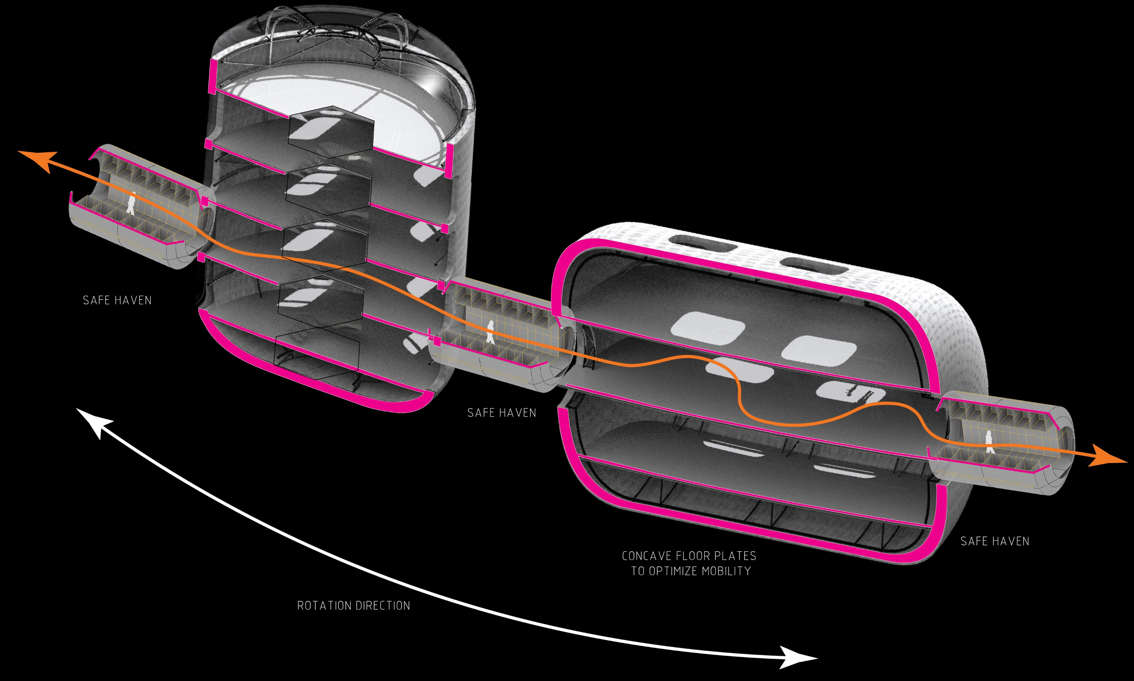
Aggregated Modules:
NEIGHBORHOOD ROTATION
TANGIENTIAL
AXIAL
RADIAL
HABITAT ORIENTATION
Orientation Concepts Derived From:
Howe, Sherwood. Out of This World: The New Field of Space Architecture. Ch 13, Orbital Cities. (2009).
Notes:
Here is what a simple aggregation of these building components might look like along the 1G radius of the rotating neighborhood. The axially oriented module is the most comfortable for human habitation. The radially oriented module is the least comfortable because of the round plan but walls and interior design adjustments can be made to begin to address this.
All floor plates will be contoured to follow the curve of the 1G rotation radius to optimize human comfort as they move about the habitats.
Every habitat module has access to at least 2 other safe havens in the case of an emergency.

Slide 31
IV:
THE FREE SPACE NEIGHBORHOOD
Notes:
The Free Space neighborhood

Slide 32
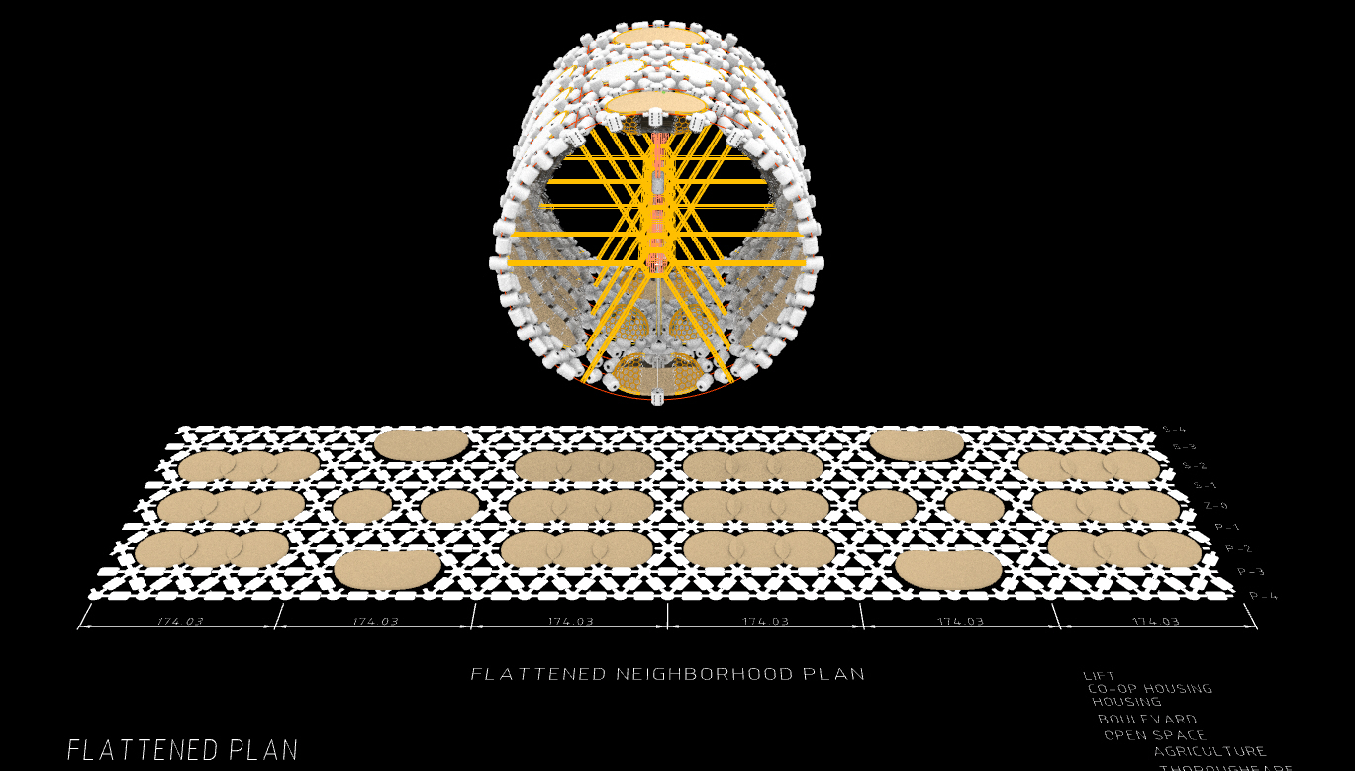
Artificial Gravity
Neighborhood:
Notes:
This is a typical artificial gravity neighborhood module.

Slide 33
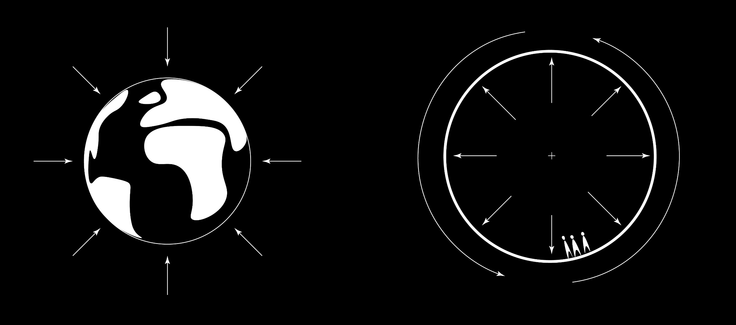
Artificial Gravity:
EARTH GRAVITY
ARTIFICIAL GRAVITY
Notes:
Free space offers an advantage over developing on the Moon or on Mars because there is no gravity. Therefore, artificial gravity is proposed to maintain high levels of human comfort.
As the neighborhood rotates at 2rpms, enough centrifugal force is created to mimic gravitational environments such as on earth.
Therefore, different “floor” levels will experience different gravitational environments because of the relative rate at which you change elevation.
Way-finding techniques will respond to floor levels ascending and descending away from the 1G level which is = to Earth gravity.

Slide 34
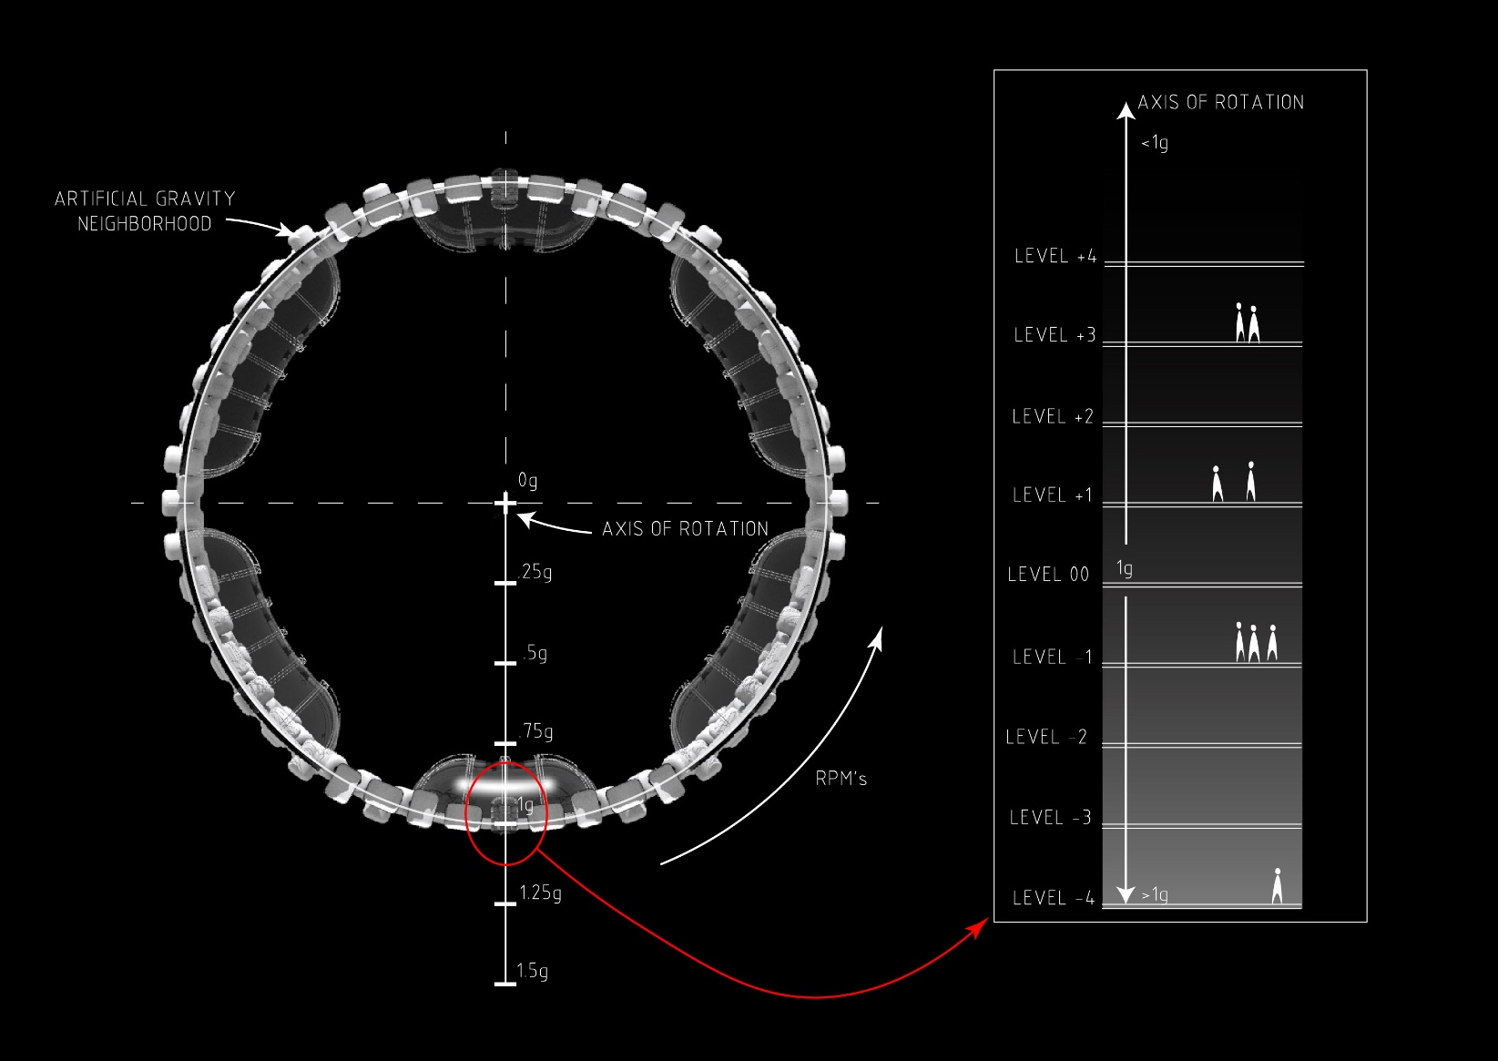
Artificial Gravity:
Notes:
Here is a sample of how gravity changes as one ascends or descends in elevation along the habitable modules. As you ascend from the 1G level, the effects of gravity will decrease making things relatively lighter. As you descend from the 1G level, the effects of gravity will increase making things relatively heavier.

Slide 35
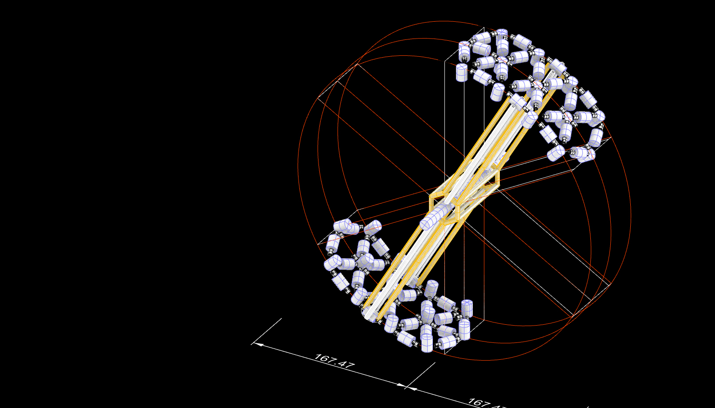
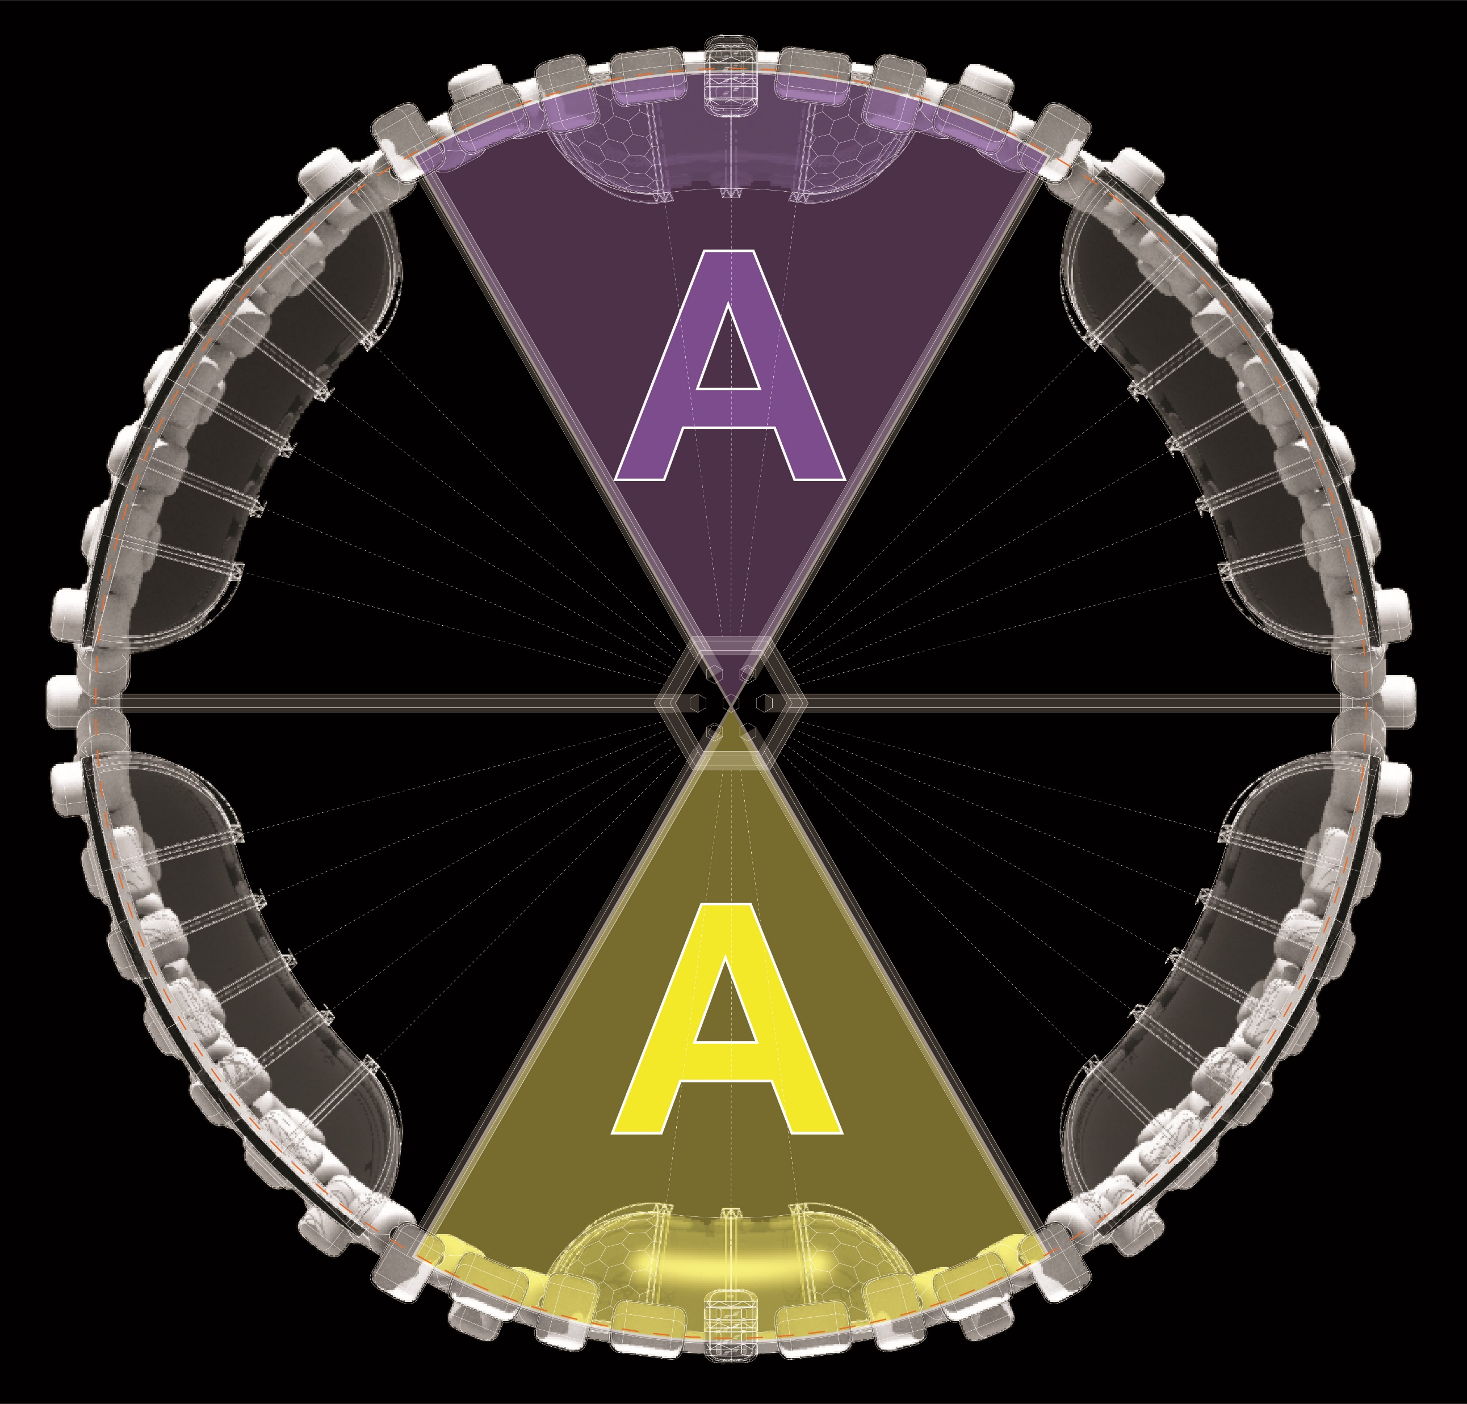
Neighborhood
Growth:
PHASE A-A
Notes:
Here is the first phase in the construction of the neighborhood.
Construction occurs symmetrically to ensure the neighborhood remains in balance as it rotates to create artificial gravity. Wayfinding techniques like color-coding these sectors corresponds with the construction phases. You will see later how these wayfinding techniques are deployed throughout the neighborhood.

Slide 36
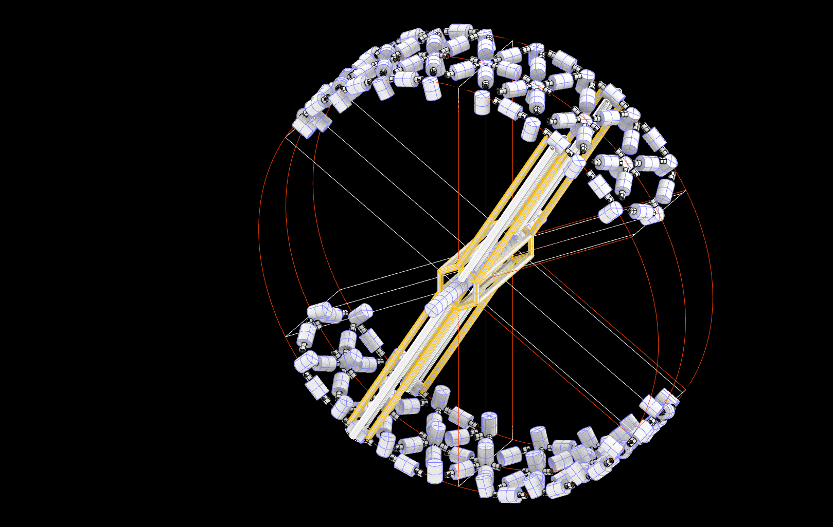
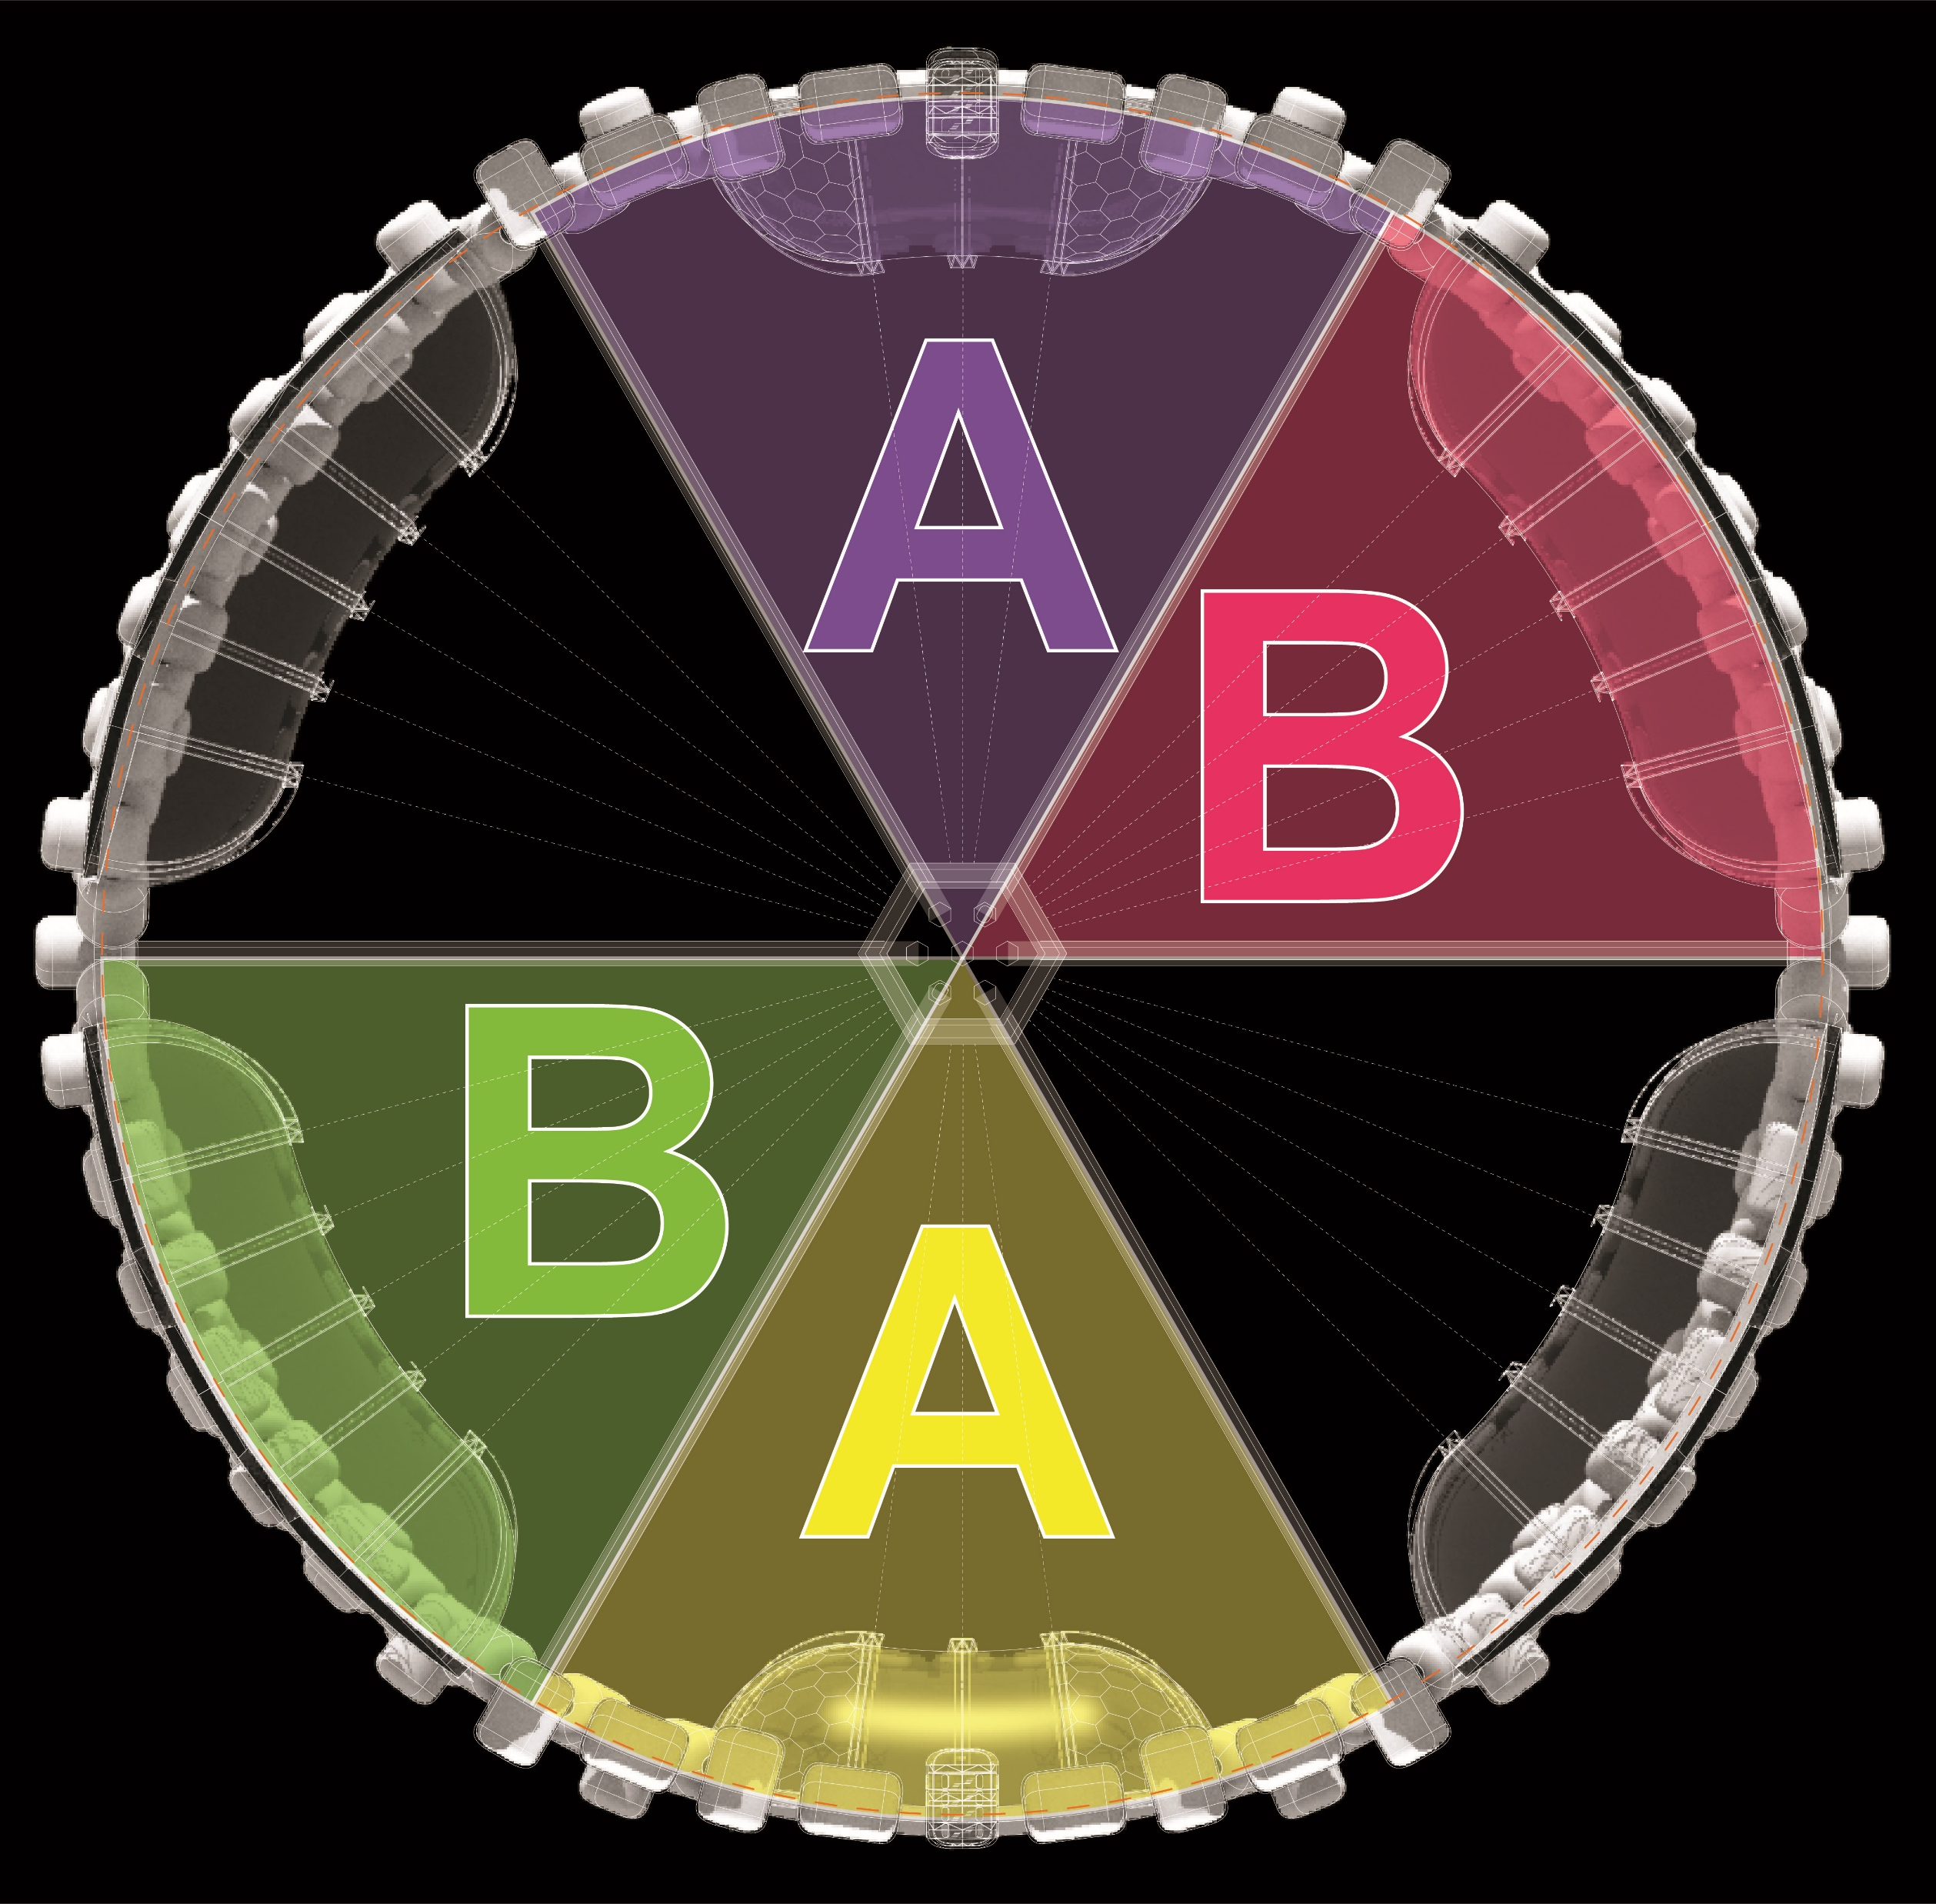
Neighborhood
Growth:
PHASE B-B
Notes:
Each Sector could take about 5-10 years to construct. The more we build in space, the better and faster we will become at it.

Slide 37
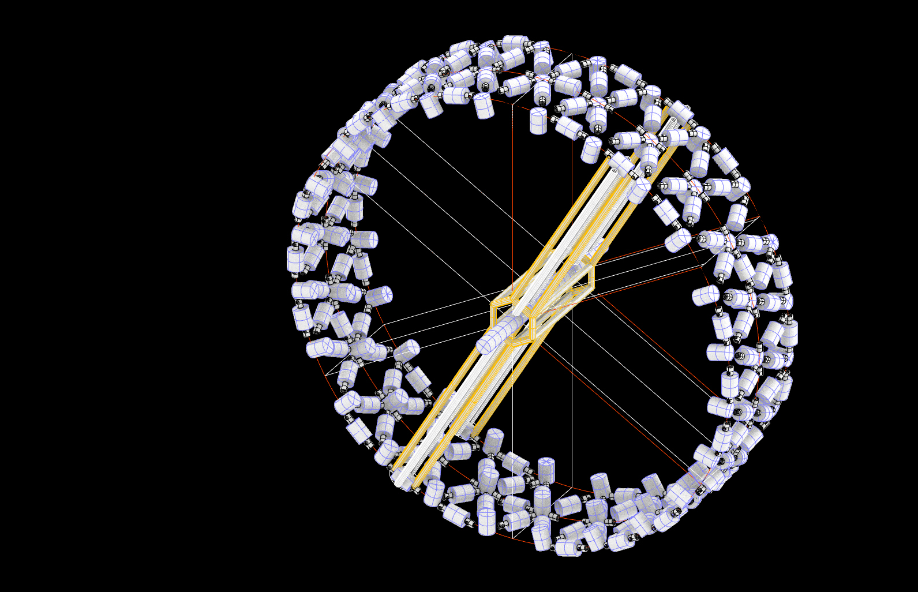
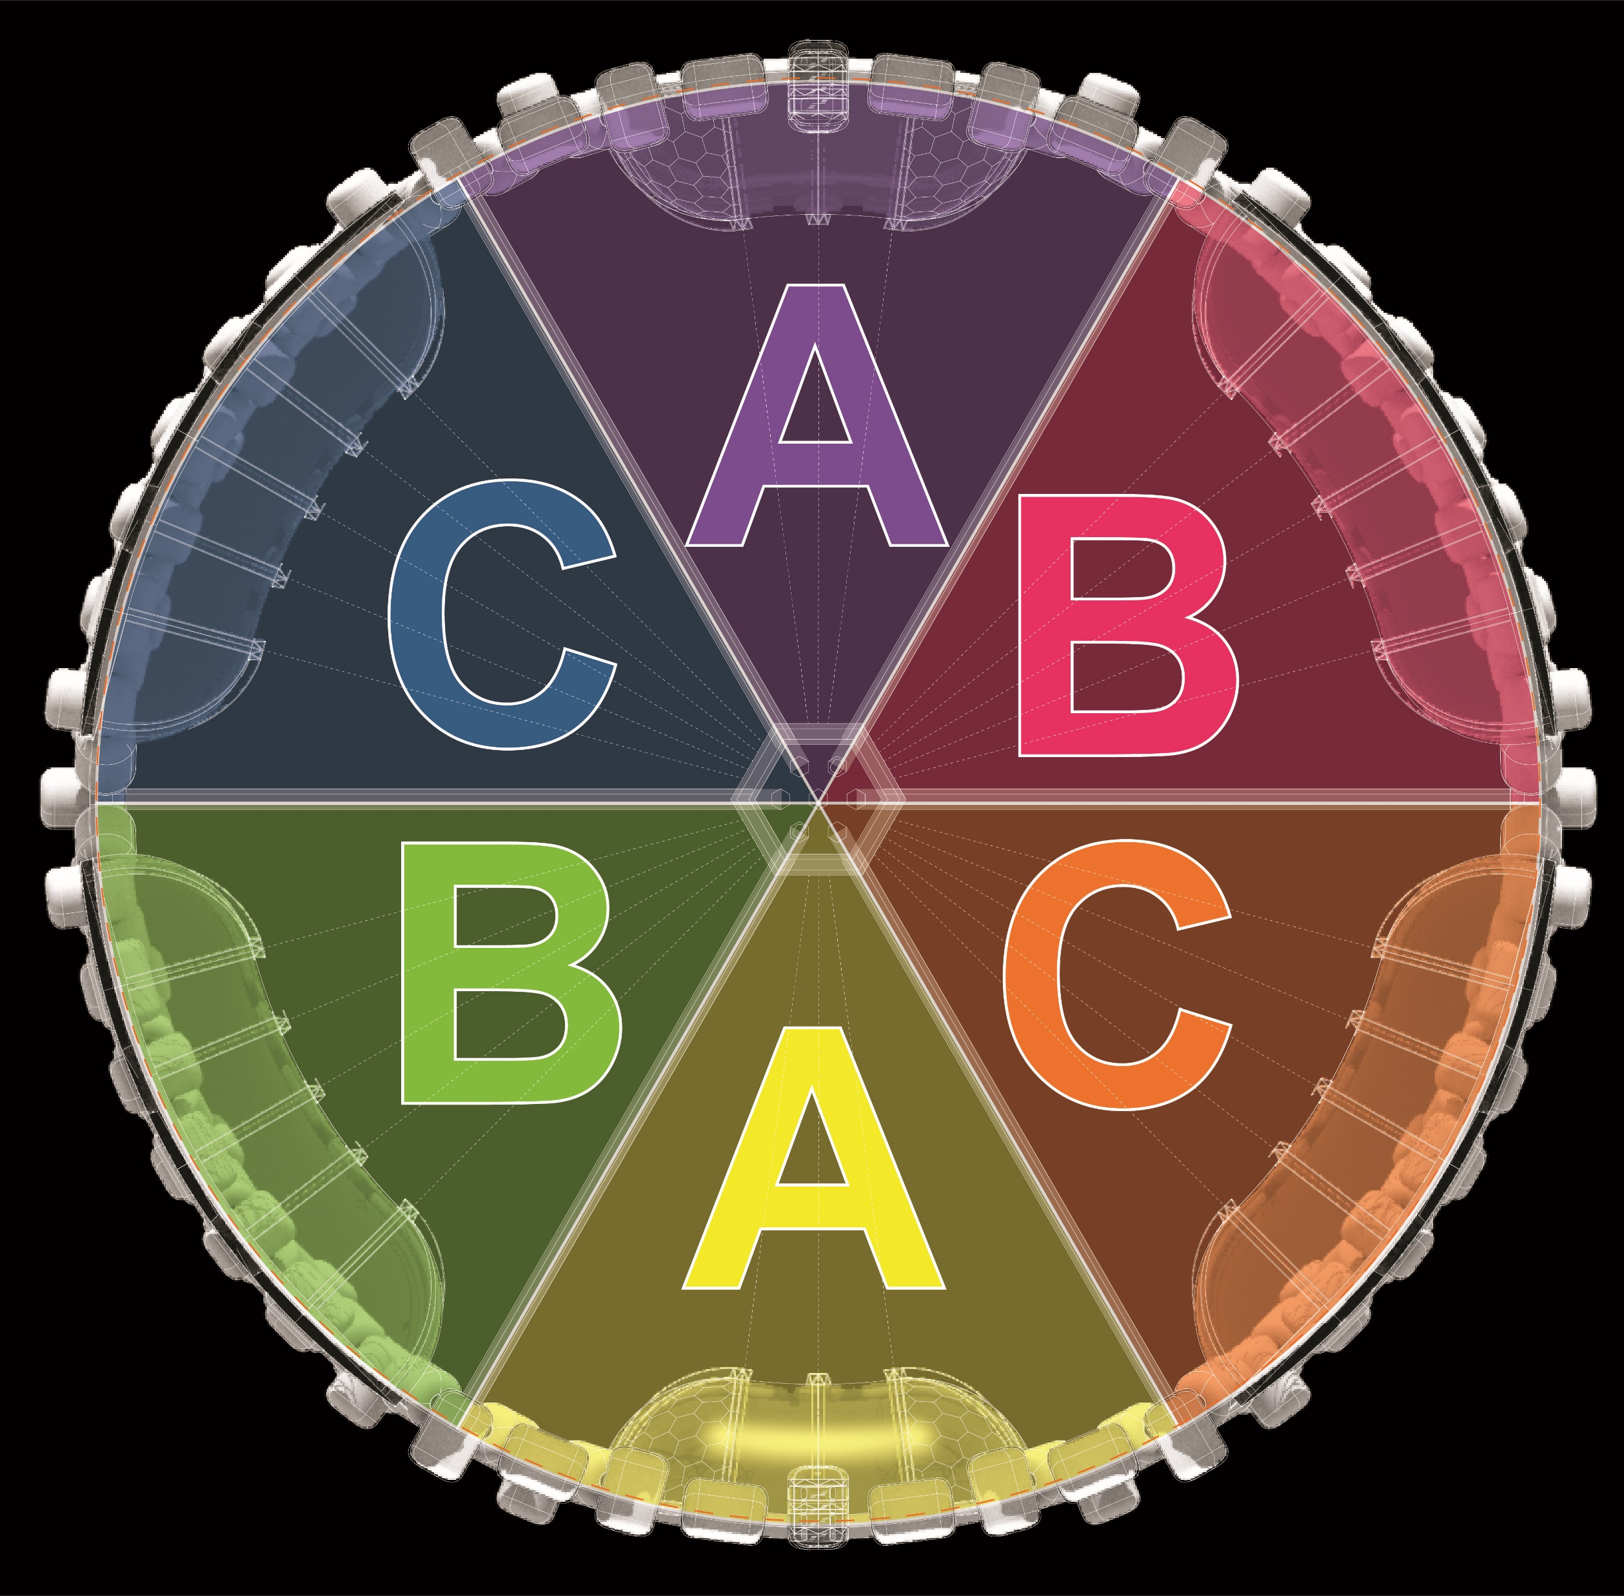
Neighborhood
Growth:
PHASE C-C
Notes:
After about 15 – 20 years, the torus is complete, and the neighborhood can begin to expand outward to create an optimal aspect ratio.

Slide 38
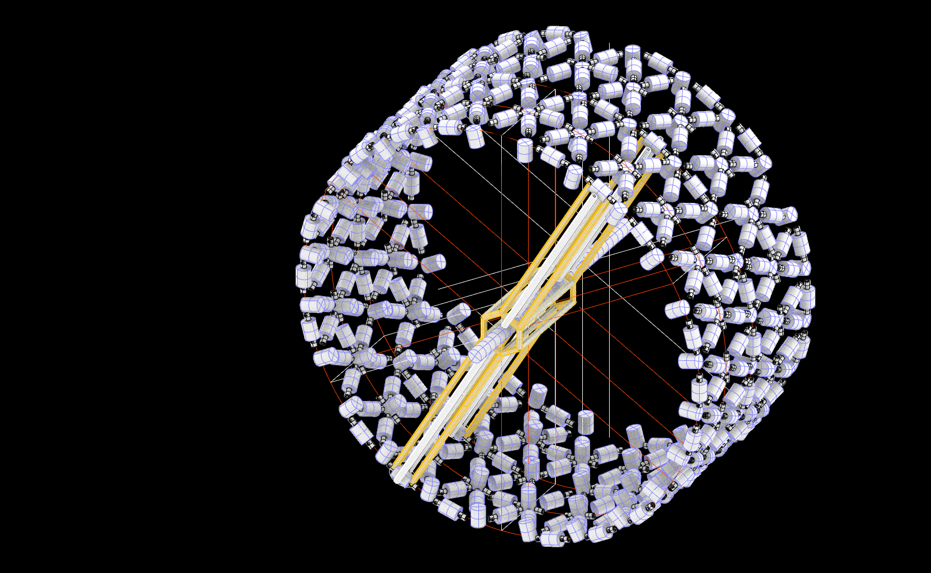
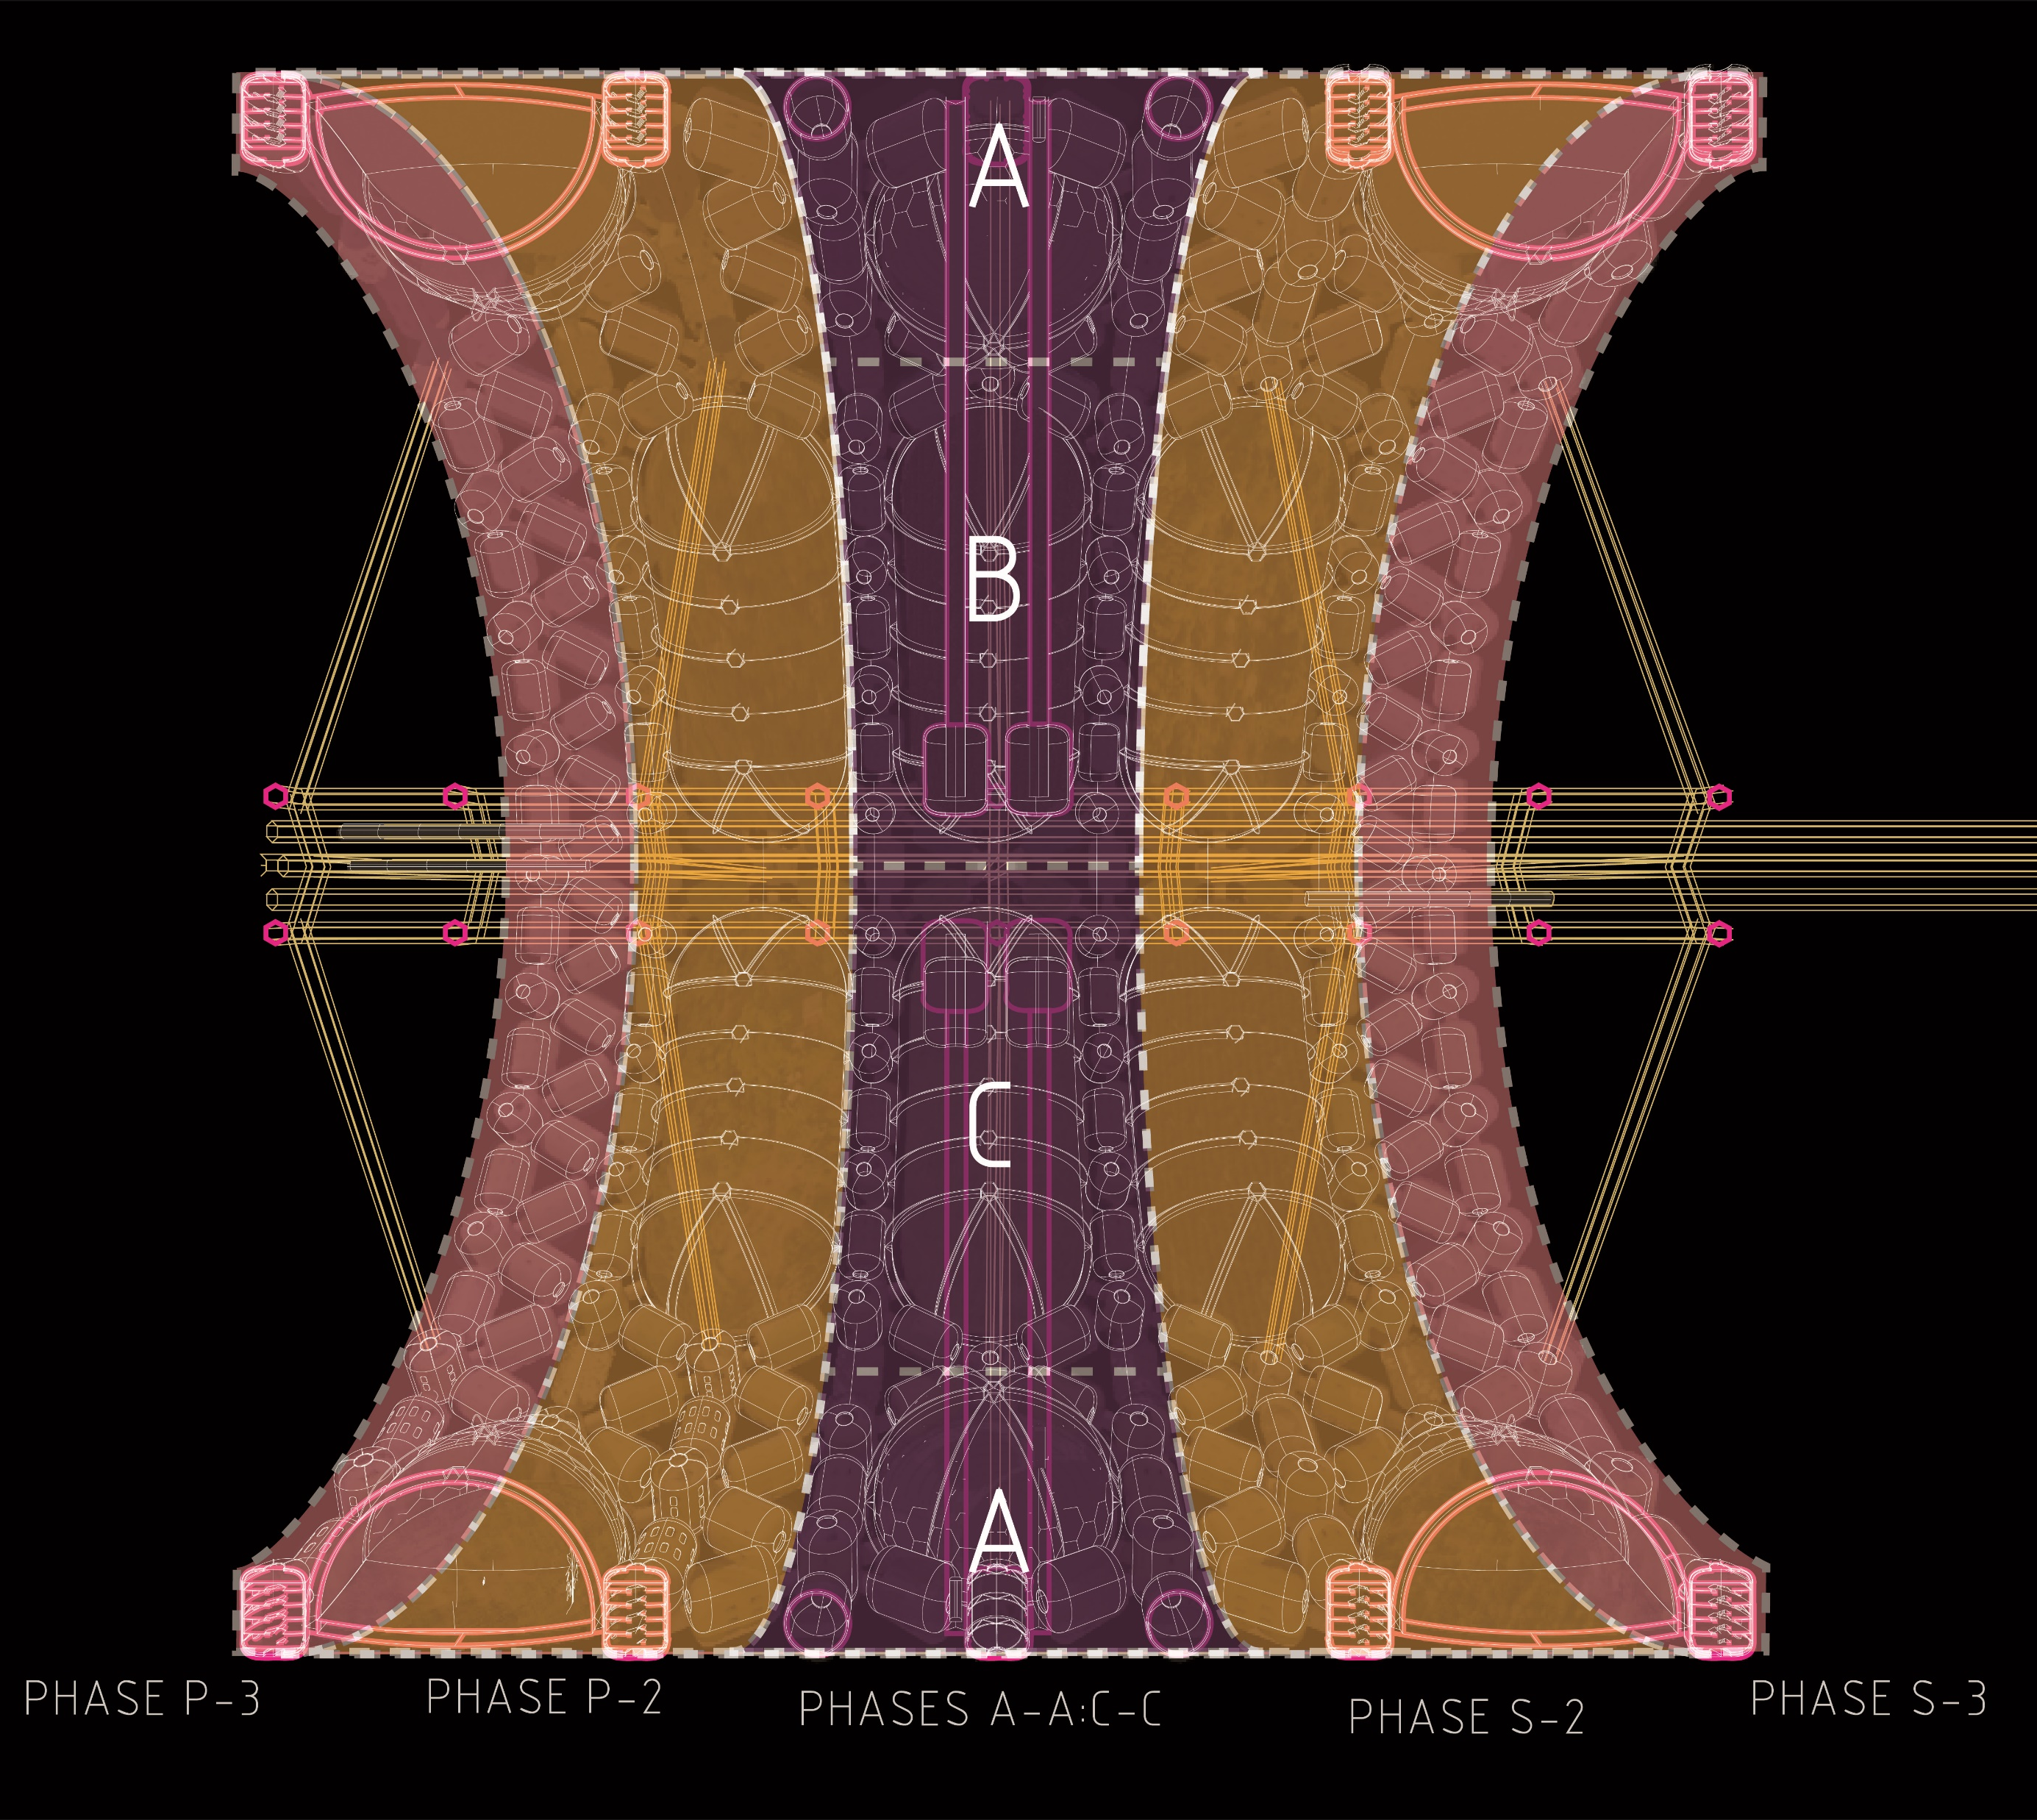
Neighborhood
Growth:
PHASES P/S-2
Notes:
The next phases allow the torus to grow wider.

Slide 39
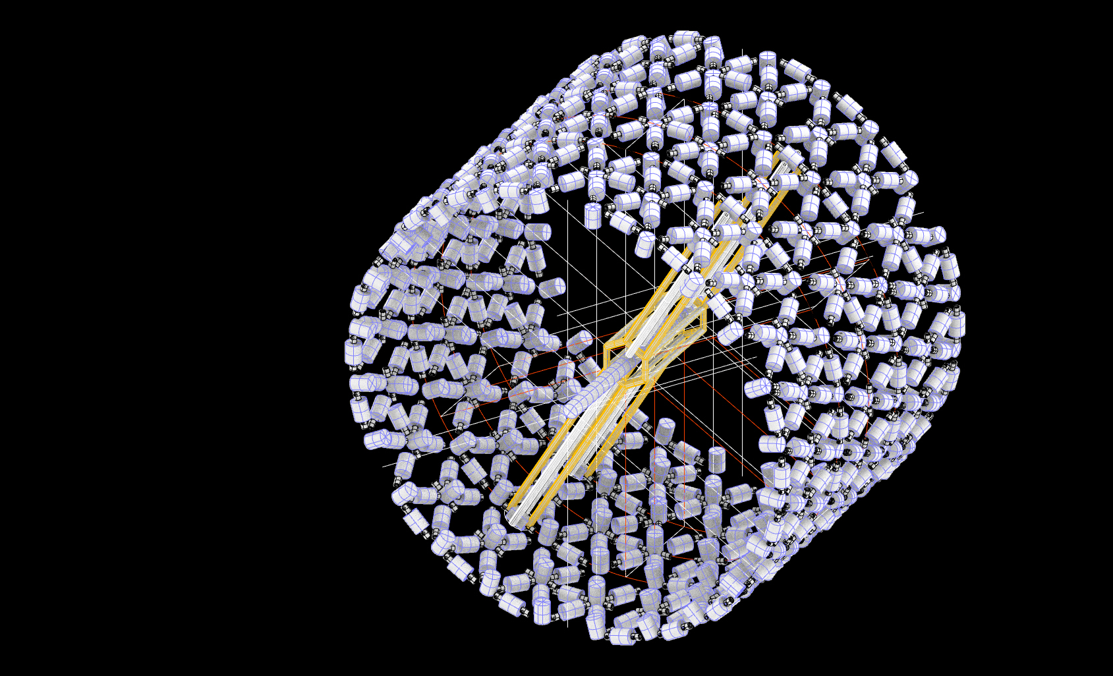
Neighborhood
Growth:
PHASES P/S-3
Notes:
And wider

Slide 40

Neighborhood
Growth:
PHASE P/S-4
Notes:
….until an optimal form is reached over the length of about 100 years.

Slide 41
Neighborhood Axle:
Notes:
Recall the neighborhoods are paired on axis with one another and two will need to be constructed simultaneously….

Slide 42

Metro Rail Station:
Notes:
….and as we ride the metro rail into the neighborhood station, here is what we see…. from the metro rail station platform we can see the incoming and out-going cabs and the exposed view of the ground level of the neighborhood rotating around us.
We are still in a microgravity environment until we use the metro rail lift to descend to the ground level of the neighborhood.

Slide 43

Metro Rail
Station & Lift:
TO/FROM
METROPOLIS
METRO RAIL PLATFORM
METRO LIFT STATION
Notes:
Here is the lift. Integrated into the hub and structural spokes of the neighborhood. Lift cabs will slowly descend to the ground level of the neighborhood. As we descend, we experience the familiar sensation of weight returns to our bodies slowly pulling our feet to the ground.

Slide 44


Metro Rail Lift:
Notes:
Metro mover lift station could look like this
When we exit the lift to the lift station we find ourselves within the central civic junction in the neighborhood. 6 different paths lead us to different civic and publicly programmed modules and thoroughfares within the neighborhood.

Slide 45
Flattened Plan:
Notes:
In order to design and understand the layout of the neighborhood, conventional plans were derived from the flattening of the neighborhood module. A figure ground can be explored to show the connections among different modules and then programming, circulation, and zoning challenges can be addressed.

Slide 46

Neighborhood
Places & Programming:
Notes:
A typical neighborhood plan might look like this:
The lift stations are in bright pink and there are two and they act as the center point for each hemisphere within the neighborhood. The lift stations are surrounded by public and civic programs like the forum, school, and the hospital.
Further out are the neighborhood cooperatives where communal residential housing is closely linked with agriculture and open spaces.

Slide 47

Neighborhood
Zones:
Notes:
And here are those zones shown in the neighborhood plan-section perspective.

Slide 48


Neighborhood
Scale:
Notes:
The neighborhoods are designed to be walkable and provide a comfortable social public experience. Again, the flattened Neighborhood plan fits well within a walkable TOD radius allowing one to walk around the circumference of the neighborhood in less than 10 minutes. The major public thoroughfares are oriented in the direction of the neighborhood’s rotation.

Slide 49


Street Sections:
NEIGHBORHOOD
SECTION KEY
THOROUGHFARE SECTION
Notes:
The main public thoroughfare is positioned along the 1G level (outlined in orange) and moves through various module types.
Habitable modules capture vertical space above or below the datum of the 1G level. These spaces are semi-public and are shared among residential quarters, offices, or co-operative common spaces.

Slide 50


Public Thoroughfare:
Notes:
As we move from the lift station along the public thoroughfare….

Slide 51


Office Module:
Notes:
.. We can note offices within the vertical modules lining the main thoroughfares. The vertical modules are programed like typical vertical apartments, offices, or dormitories on Earth. Circulation and Infrastructure lines the central core while dwellings and office spaces populate the exterior reserving views for the users. These modules have the option to be flexible to accommodate different programs such as offices, laboratories, or luxury apartments.

Slide 52


Forum:
Notes:
Nearby is the public forum.
Here delegates and diplomats from the nations of Earth and other planetary sovereignties can meet. The forum can also be used to organize functions relevant to local matters within the LEO Metropolis.

Slide 53

Thoroughfare Junction:
Notes:
Back out along the thoroughfare we might encounter some astronauts making their way to or from work as we move towards the next large public space.

Slide 54



Sport Stadium:
Notes:
The neighborhood is complete with Entertainment, recreation, and leisure activities.
The exploitation of having control over different gravitational environments can be advantageous to accommodating unique human experiences that are otherwise unavailable or impossible to achieve on Earth.
By creating different gravitational environments, elderly and rehabilitation patients can live comfortably in environments with less gravity and experience less resistance on their bodies while athletes can work out in higher gravitational environments with added resistance.

Slide 55

Wayfinding:
Notes:
Continuing back through the neighborhood, I want to show you …

Slide 56

Co-Operative:
LUNG
TYP NEIGHBORHOOD CO-OPERATIVE
CONTIGUOUS CIRCULATION
Notes:
A typical neighborhood co-operative. Where daily life is supported by and centered around the lung module.

Slide 57







Cooperative Community:
Notes:
Living in space offers a unique cooperative opportunity among the inhabitants.
Among you are your fellow co-op living mates. They range age, household size, and professional expertise. You will be living with folks trained as astronauts and pilots and engineers with the skills to keep the metropolis in working order. You will also be living among teachers and farmers and that are required to maintain a functional society. There will be children playing and running through the open green spaces and retired seniors taking advantage of microgravity therapy for their aged bodies.
There is a unique eclecticism to the intentional social demographic in order to support the sustainability and longevity of a space community.

Slide 58

Cooperative Community:
Notes:
The co-op is designed around the lung module. The lung is a piece of infrastructure as well as a spatial reprieve for relaxation and leisure. A large open green-house like space full of vegetation and daylight. Variations of the LUNG are proposed to maximize biodiversity within the neighborhoods to provide residents with a variety of agricultural options.

Slide 59

LUNG
Section:
Notes:
The LUNG is essential to maintaining sustainable life support systems for the residents. All living things operate within a closed loop system. There is no waste. Waste is the fuel used for growing agriculture and vegetation. Vegetation provides renewable sources of breathable air for human beings living in the metropolis. The oxygen diaphragm circulates air to the nearest habitat modules. PV panels at the base harvest sunlight and convert its energy into power which is then provided to all other modules for use. Black and grey water is also recycled and purified to provide potable drinking water.
The lungs also regulate the humidity and control air flow across the habitat modules. Radiators at the top process excess humidity into energy and exhaust heat.

Slide 60


Co-Op Kitchen:
Notes:
Each co-op has a communal kitchen with views overlooking the lung.
The Kitchen is where community is shared around the food grown and water produced in the lung spaces.

Slide 61


Dwelling Typologies:
HORIZONTAL MODULE:
CONDOS
VERTICAL MODULE:
APARTMENTS
Notes:
There are two different housing configurations based on the orientation of the modules in order to create housing flexibility as families grow and shrink.
Both configurations separate the private dwellings from a centralized circulation core not to inhibit the contiguous circulation network around the co-op and the neighborhood.
The top level of the vertical modules could be reserved for a semi-private garden spaces or roof-top terraces to be shared among those living in this housing module.

Slide 62

Condo Interior:
Notes:
The condos situated within the horizontal modules and are split levels to accommodate the circulation and infrastructure core.

Slide 63


Dormitory Interior:
Notes:
Private apartments like this one could be also be inserted into the vertical module and introducing walls as mentioned earlier can ease some of the negative effects of discomfort that come from the round plan. As many as four dormitories can be fit onto one floor plate.
The interior walls house the utility and plumbing and double as radiation shielding in the event of emergencies.
The apartments are outfit with modern amenity and provide the inhabitants with views of the lung spaces and outer space.

Slide 64

Notes:
Reflect on the thesis question.
In summation, the free space metropolis

