Slide 1

BTAA Liaison Institute
BTAA Liaison Institute
Reference & Instruction
Reference & Instruction

Slide 2

Overview
Focus: What has changed during COVID-19, and what will change when we are able to resume in-person services (hopefully in the fall!)
Agenda:
GIS Virtual Lab (Milan Budhathoki)
Reference (Judy Markowitz)
Virtual Reference & Screen-sharing (Jordan Sly)
Fearless Teaching Institute (Rachel Gammons)
Open discussion

Slide 3

GIS Virtual Lab @ UMD Libraries
Milan Budhathoki, GISP
GIS Librarian
GIS and Spatial Data Center https://www.lib.umd.edu/gis

Slide 4
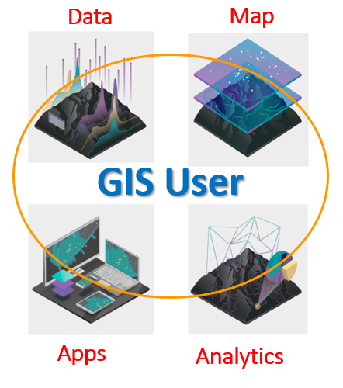

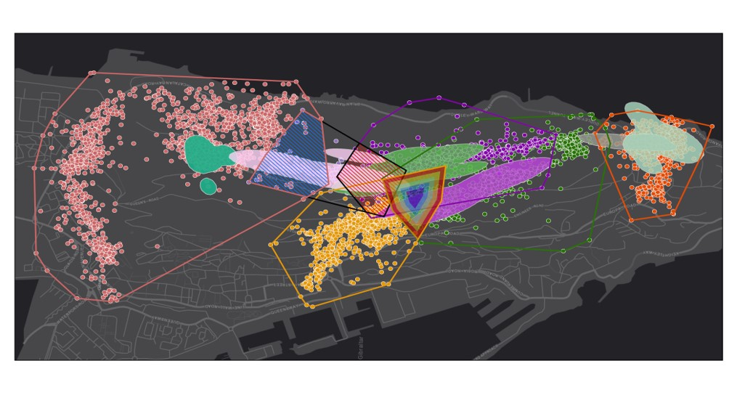
GIS: Geographic Information System/Science
Location based data science
Rooted in the science of geography
A computerized mapping and analysis software
Trajectory of Oil Spill(Gulf of Mexico, 2010)
Barbary Macaques daily home –range (Gibraltar)

Slide 5
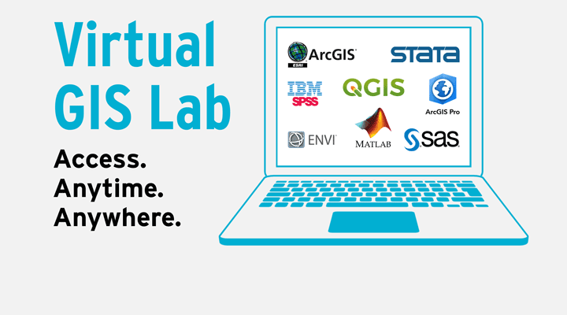
GIS Virtual Lab @ UMD Libraries
Continue to provide computing resoucers to UMD users during the pandemic
First launched on October, 2020
Live 24/7 !
Loaded with more than a dozen of GIS, RS and Statistical software
Check out/dedicated machine to run large job

Slide 6
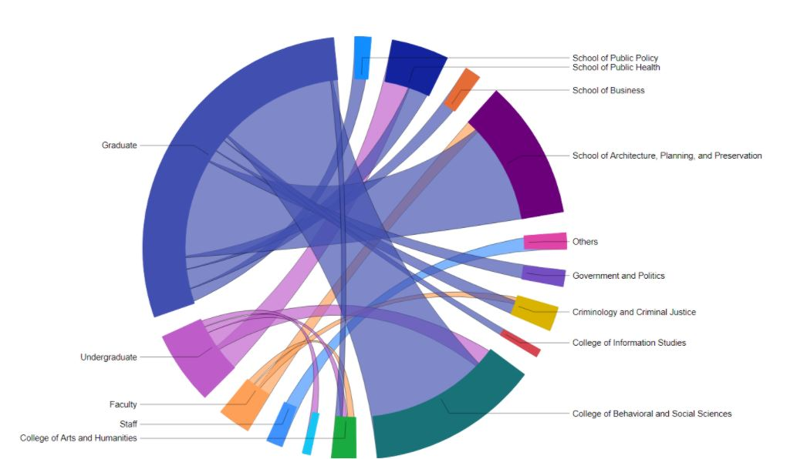
GIS Virtual Lab @ UMD Libraries
Who are using the lab?
School/Colleges
UMD Position

Slide 7
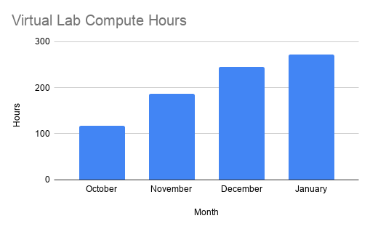
GIS Virtual Lab @ UMD Libraries
Computing hours

Slide 8
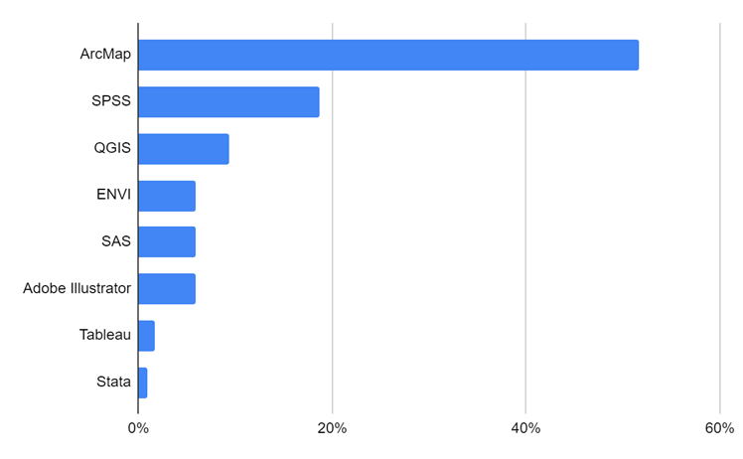
GIS Virtual Lab @ UMD Libraries
Software Request

Slide 9
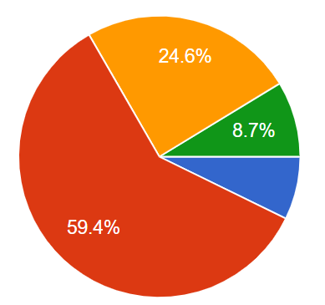
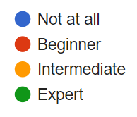
GIS Virtual Lab @ UMD Libraries
Familiarity with GIS
/Statistical software

Slide 10
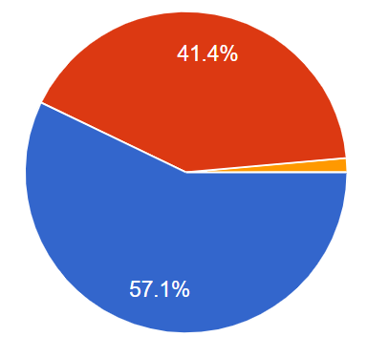
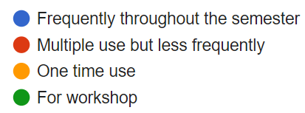
GIS Virtual Lab @ UMD Libraries
Lab use duration

Slide 11
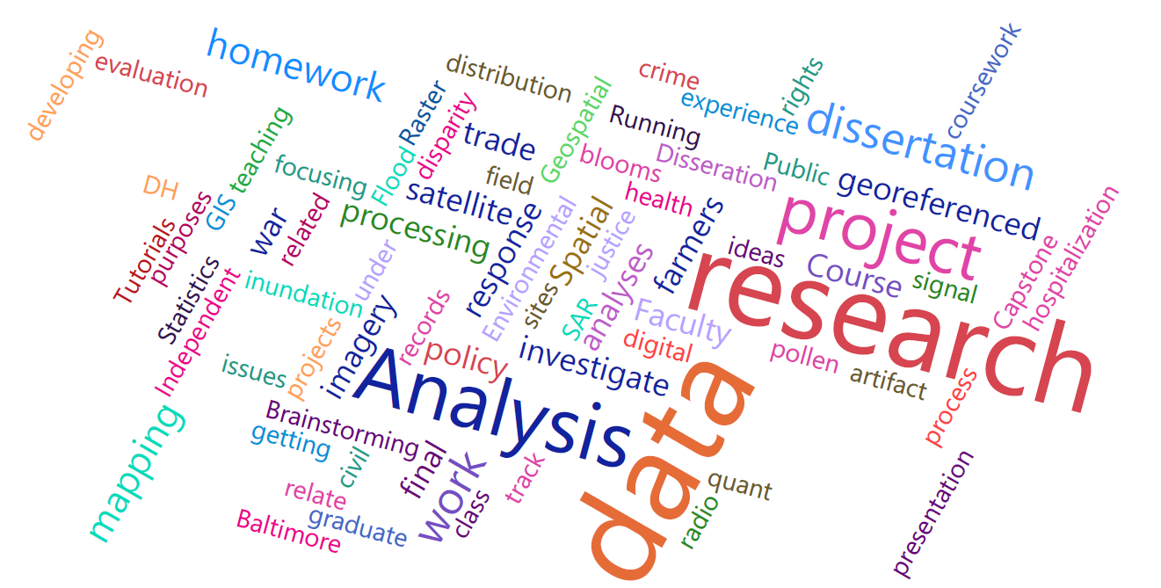
GIS Virtual Lab @ UMD Libraries
How is the lab being used for?

Slide 12
GIS Virtual Lab @ UMD Libraries
Lesson so far …..
Very useful service
Supporting research, teaching and learning needs
Serving beyond GIS users
Demand is growing
Need more outreach
Though the virtual lab is very helpful but can’t wait to provide in-person service soon!
Thank you!

Slide 13
2020 Changes to Chat
Increased hours - added 9am - March 23
Added staff and student assistants to the chat schedule = added training sessions - March 23 (training ongoing)
More canned messages to reflect constantly changing services - March 23 (revised immediately when needed)
Added Screenshare - March 30
Added Chat widget - April 20

Slide 14
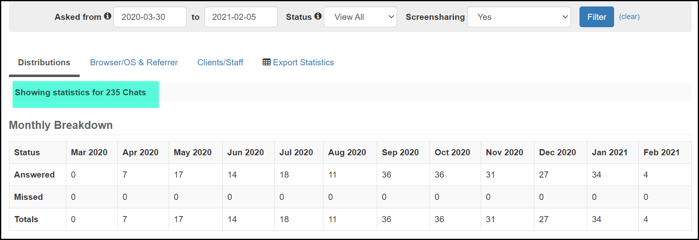
Screenshare Introduced Monday, March 30

Slide 15
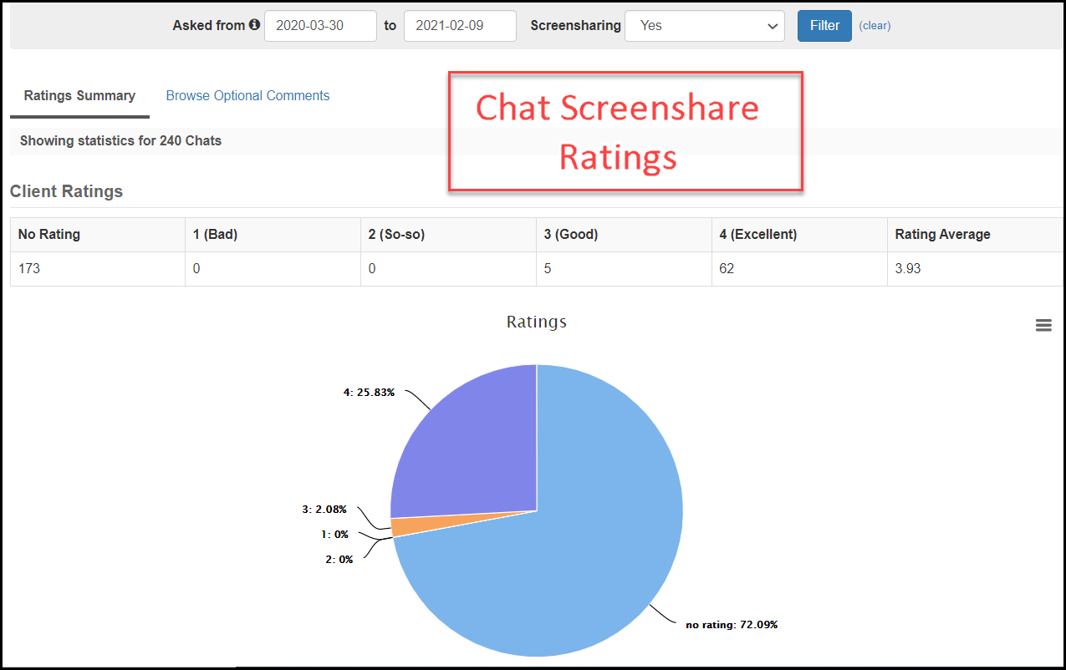

Slide 16
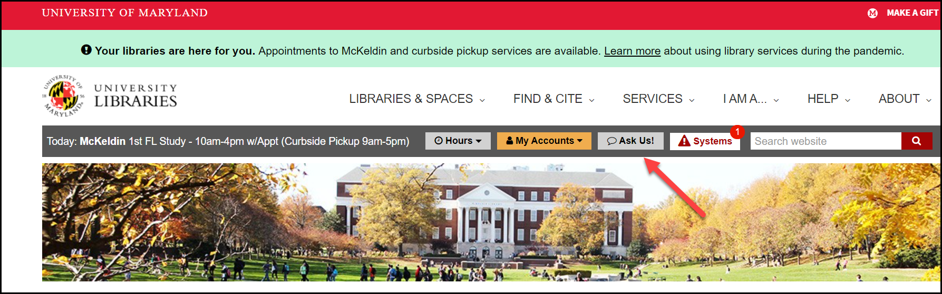
Before the Widget

Slide 17
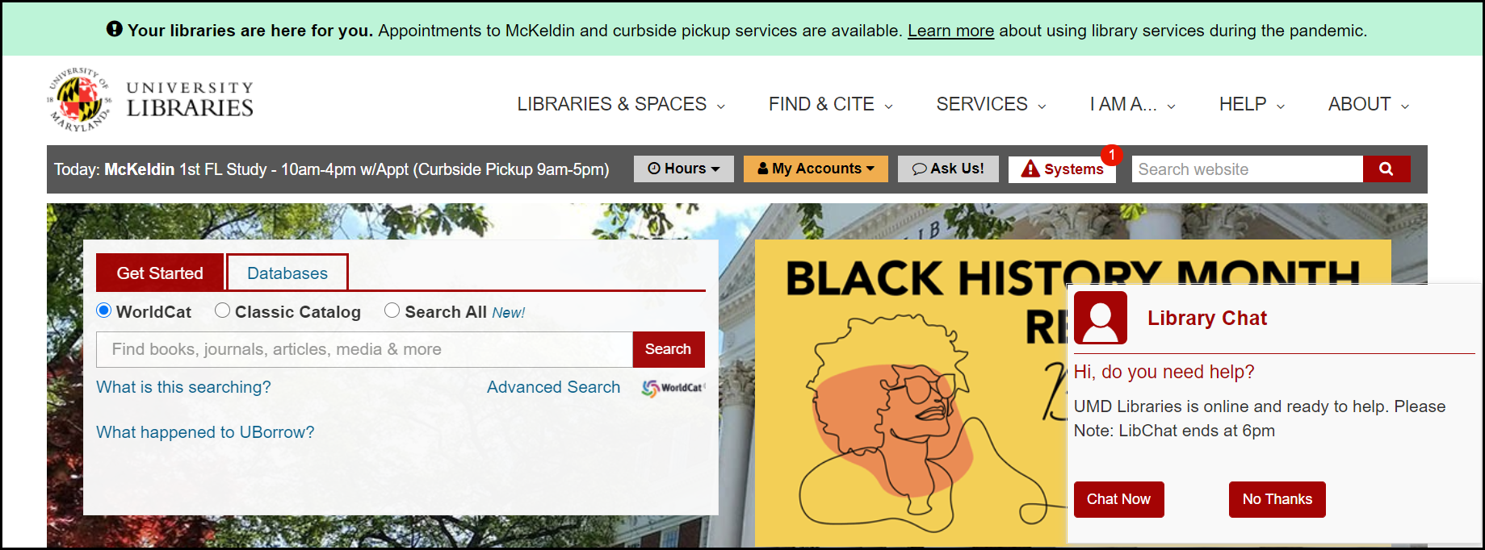
After the Widget

Slide 18
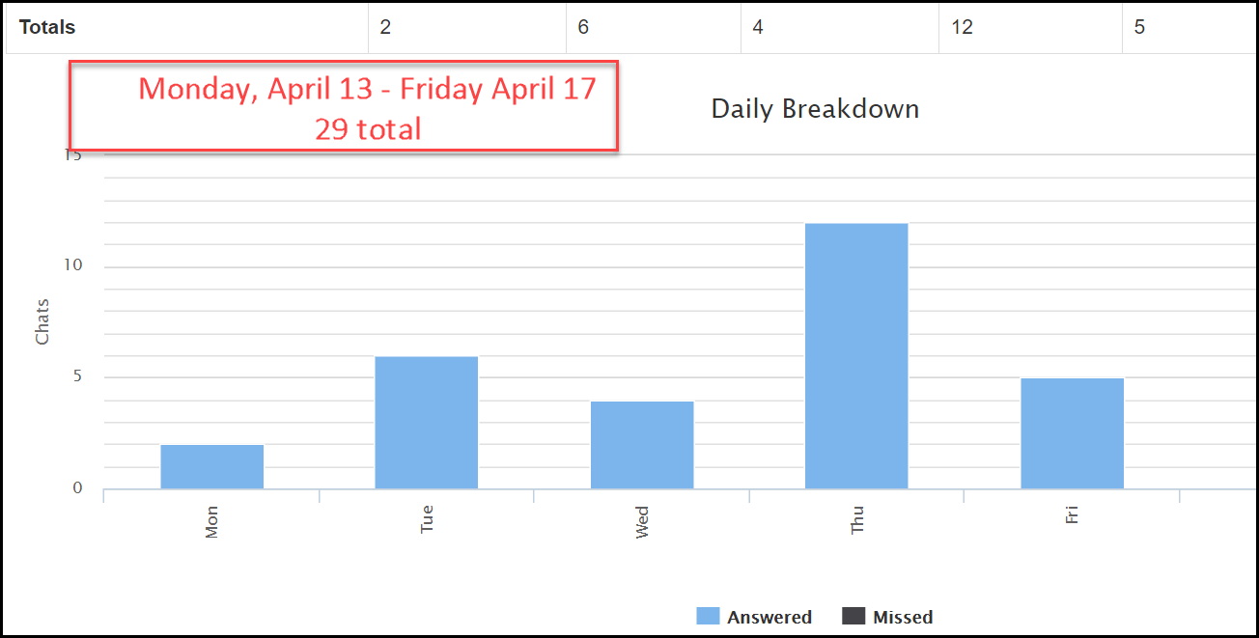
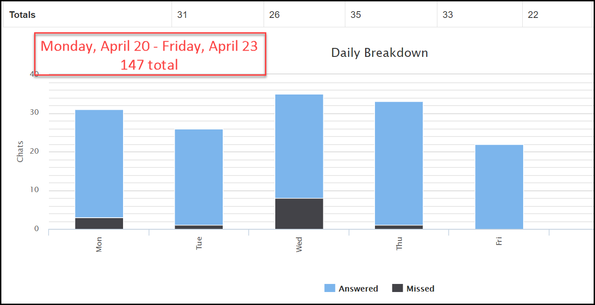
Chat widget added Monday April 20, 2020

Slide 19
Chat Totals
2020
5972
2019
1010

Slide 20
In-Person Reference Moved to Zoom / Google Meet
2019
2020 = 560
810
After Shutdown
346
Before Shutdown
214

Slide 21
The Value of Screensharing
A Brief Testimonial About the Pandemic Stop-Gap that may be a Workable Solution for Chat-Reference’s Shortcomings
Jordan S. Sly, jsly@umd.edu
University of Maryland Libraries
Research & Instruction Librarian for Anthropology, Psychology, Philosophy, French, Italian, German, and Digital Humanities

Slide 22

Fearless Teaching Institute
The Fearless Teaching Institute (FTI) was launched in fall 2018 to provide targeted and well-designed instructional programming for UMD Libraries' faculty and staff. Originally designed as a certificate program - in line with the UMD Teaching and Learning Transformation Center Faculty Launch Program - the FTI has expanded beyond its origins to become an agile arm of our teaching program. Today, the FTI seeks to deepen and strengthen library instruction at all levels from staff training to advanced information literacy instruction through a range of events, programs, and special series.

Slide 23

Tell us about your experience!
https://www.menti.com/o3249628vf
Notes:
https://www.mentimeter.com/s/b5ff6950df91cba780797b19f1f29fc7/c03d551a4182

Slide 24
BACKUP SLIDE (IN CASE MENTI-METER DOESN’T WORK)
What changes has your library made during COVID-19?
Added chat widget
Synchronous online instruction
Asynchronous online instruction
Increased professional development for staff
Added additional operators to chat (student workers, staff, etc)

Slide 25
BACKUP SLIDE (IN CASE MENTI-METER DOESN’T WORK)
What is one thing that changed with reference that you plan to KEEP when you return in-person?

Slide 26
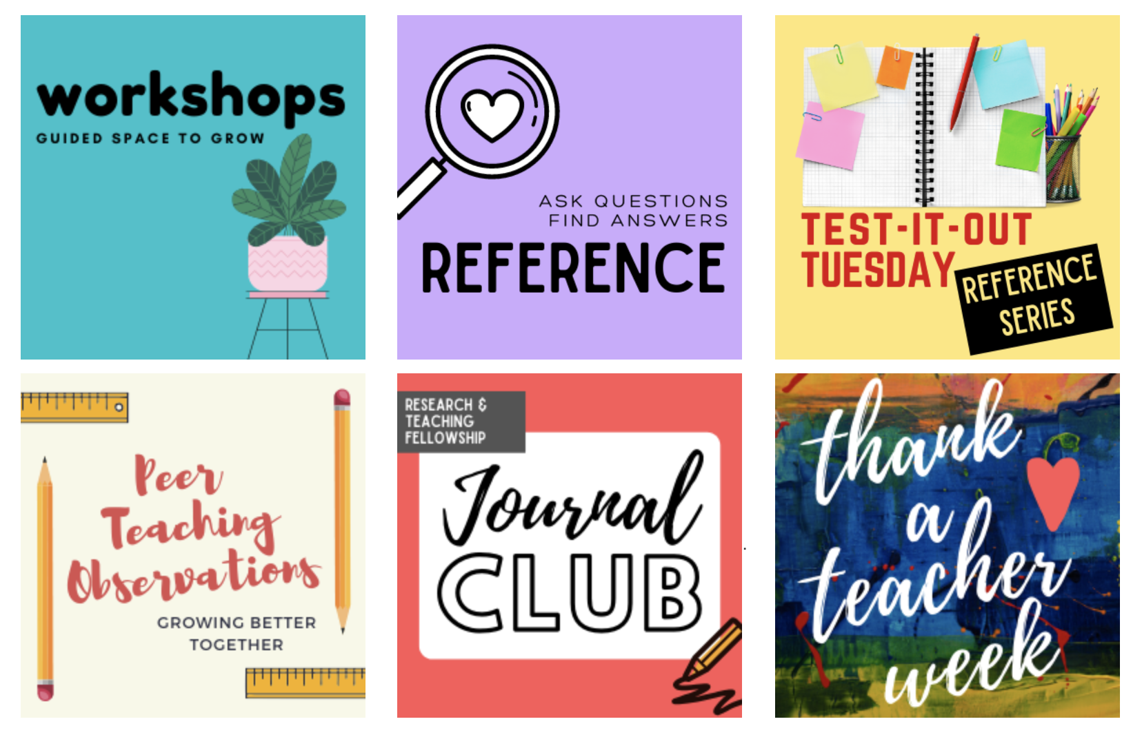
Fearless Teaching Institute
Workshops - guided learning opportunities that are organized and led by a library staff member and focus on a specific concept, idea, or set of skills.
Test It Out Tuesdays - informal gatherings explore new topics, test out new technology, or troubleshoot challenges
Journal Clubs - collaborative learning community to engage trends and issues in the profession.
Peer Teaching Observations - Every three years, we organize a large-scale peer-teaching observation program by pairing up interested library instructors and providing guidance and support for mutual observations

Slide 27

Fearless Teaching Institute
Here at the Fearless Teaching Institute, we know that reference is a form of teaching! To kick off our 2021, we are hosting a semester-long series on reference services, including workshops and guest speakers. Open to all library staff and student workers, our reference series will include tips, techniques, and resources that will be useful for anyone who interfaces regularly in public services. Join us in December / January for Foundations Reference Series workshops (focusing on core concepts such as the Reference Interview) then come back all spring semester as we dive deeper into subject-area resources in our Test-It-Out Tuesday sessions led by subject librarians!

Slide 28
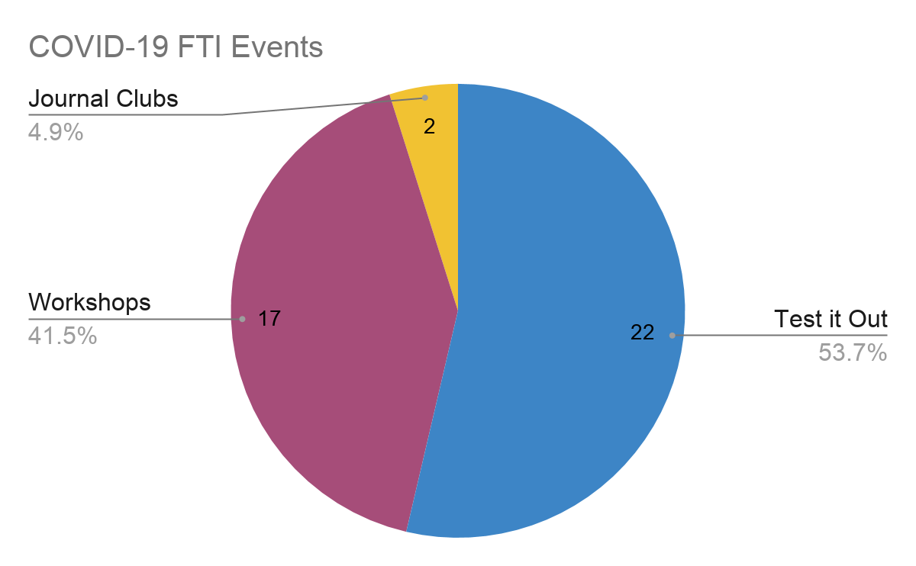
Fearless Teaching Institute

Slide 29
Fearless Teaching Institute
Changes we made:
Consistent branding + consolidation of resources
Updated program guide
Online offerings
Mix of formal, informal, group, and individual learning opportunities
Proactive, rather than reactive
COVID-19 Dashboard
What will we keep when we return in the fall?
All of it!!!

Slide 30
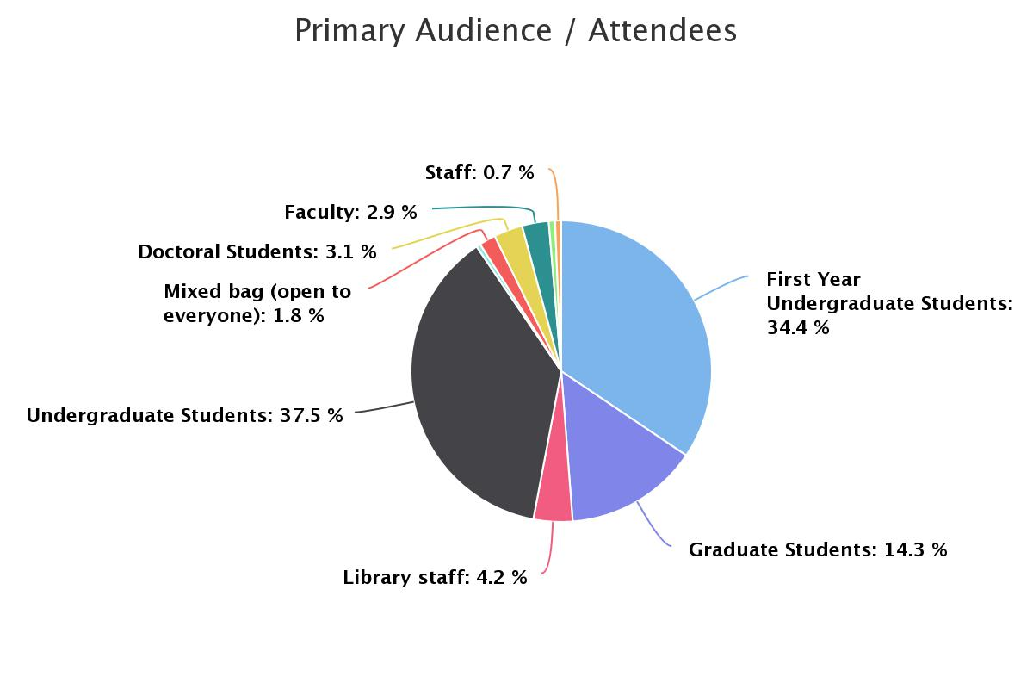
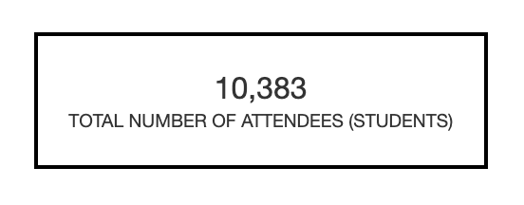
Fearless Teaching Institute

Slide 31
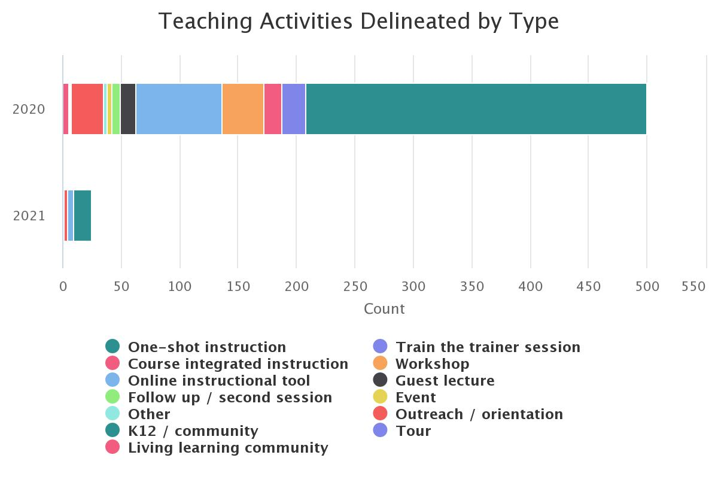
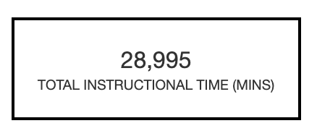
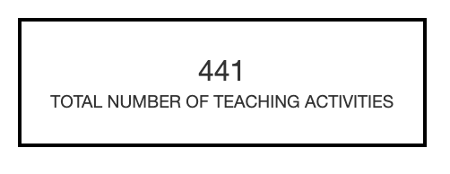
Fearless Teaching Institute

Slide 32

Visit our program guide: https://go.umd.edu/fearlessteaching

Slide 33
Tell us about your experience!
https://www.menti.com/o3249628vf
Notes:
https://www.mentimeter.com/s/b5ff6950df91cba780797b19f1f29fc7/c03d551a4182

Slide 34
BACKUP SLIDE (IN CASE MENTI-METER DOESN’T WORK)
What is one thing that changed with instruction that you plan to KEEP when you return in-person?

