Slide 1
Effects of Model Scaling on
Sediment Transport in Brownout
Mark Glucksman-Glaser
Committee Chair:
Dr. Anya R. Jones
Committee Members:
Dr. J. Gordon Leishman
Dr. James D. Baeder
Department of Aerospace Engineering
University of Maryland
Notes:
Thank you very much. As mentioned, my name is Mark Glucksman-Glaser and I am a graduate student working for Dr. Jones. Before I get started I would like to thank the committee members Dr. Jones, Dr. Leishman and Dr. Baeder for being here today. I would also like to thank the AFOSR for funding my research here at the university. The research I will be presenting today is on the Effects of Model Scaling on Sediment Transport in Brownout.

Slide 2
Outline
Motivation: the brownout problem
Similarity parameters
Objectives / experimental setup
Results
  Experimental
  Similarity parameters
Analysis
  Buckingham-Pi analysis
  New similarity parameters
Conclusions
Suggestions for future work
Notes:
I will begin with the background and motivation of my research, and talk about the brownout problem and how we study it, scaling results found in laboratory environments to full scale results. I will then explain the methodogies for my research, followed by the results obtained and some analysis. I will finish up with some conclusions and suggestions for future work.

Slide 3
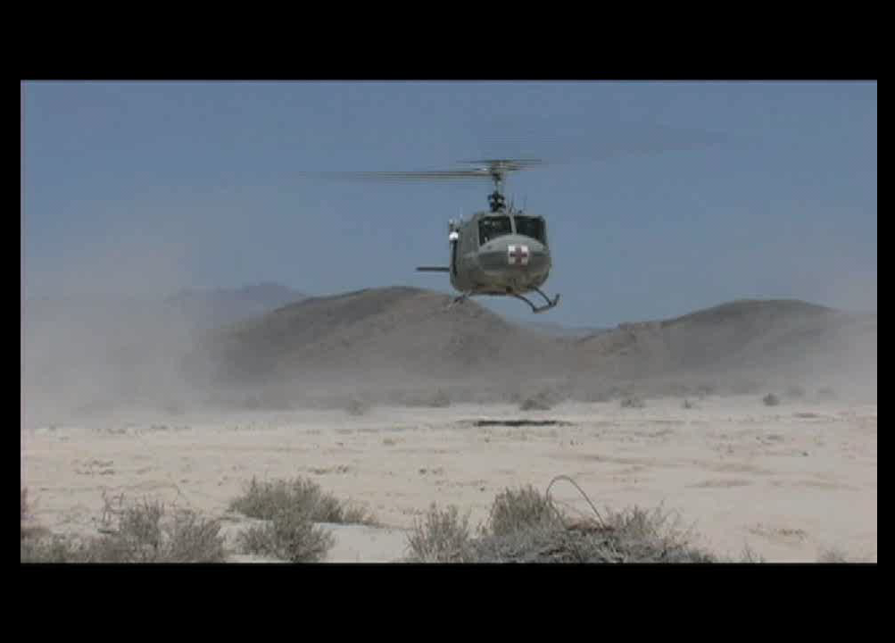
The Brownout Problem
Video courtesy of OADS
Brownout occurs when a rotorcraft lands or takes off in an arid environment above loose, dry sediment
The entrained sediment in the air causes:
  Pilot disorientation
  Aircraft maintenance issues
  Hazardous environment for support personnel
Brownout is the leading cause of human-factor related accidents
Notes:
The phenomena of brownout is characterized by the rapid onset of a blinding dust cloud when rotorcraft try to takeoff or land over loose sediment. The dust cloud created can greatly reduce the pilots ability to distinguish visual cues on the ground. Also, the radially expanding dust cloud can give the pilot the perception of motion, called a vection illusion, which can result in vertigo. In addition to reducing visibility, the dust particles tend to abrade the rotor blades, increase engine wear and create a harsh working environment for ground personnel.

Slide 4
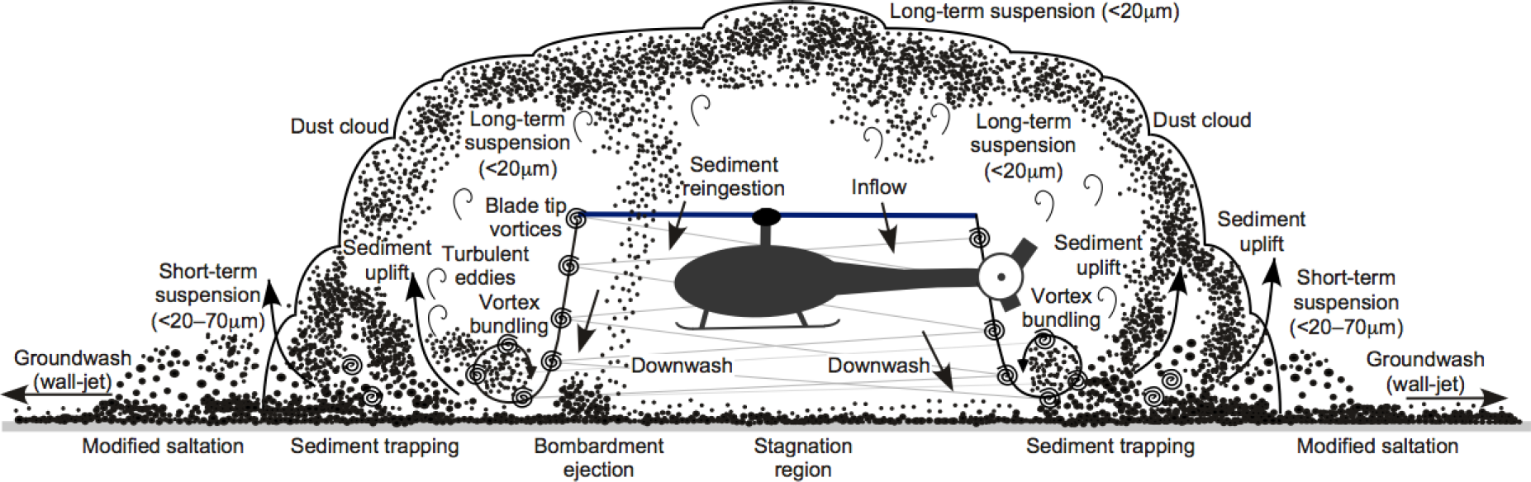
Brownout Fluid Mechanics
A two-phase, three-dimensional, unsteady fluids problem
Dust cloud development is dependent on:
  Rotor parameters (disk loading, blade loading, etc.)
  Operational parameters (including flight path)
  Soil properties (mineralogy, particle size, compactness, etc.)
Notes:
Here is a schematic of a rotorcraft operating in-ground-effect under brownout conditions. Fundamentally brownout is a two phase, unsteady fluid dynamics problem of considerable 3 dimensionality. As the rotor wake impinges on the ground it generates unsteady shearing stresses, vortical structures, turbulence and transient excursions are responsible for mobilization of sediment. Once the sediment begins to move along the ground the tip vortices will tend to trap smaller particles uplifting them to very high heights off the ground. The particles that are to heavy to be uplifted tend to bombard the surface ultimately uplifting more sediment particles. The complexity of the interaction of the wake and ground mean that many factors can affect the development of the dust cloud. These factors deal with the details of the rotor, the operating conditions of the craft, the composition of the sediment, and as this case investigates, the body under the rotor. A better understanding of the aerodynamics of the rotor wake as it interacts with the ground is paramount to understanding the problem of brownout.

Slide 5
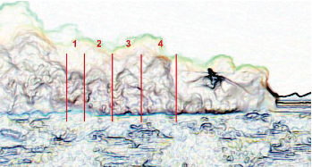
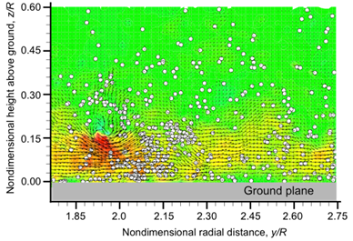
Prior Work on Brownout
Full-scale brownout flight tests:
  DARPA Sandblaster (2007)
  Wong & Tanner (2010)
Sub-scale rotor tests:
  Lee et al. (2008)
  Nathan et al. (2008)
  Haehnel & Dade (2008)
  Johnson et al. (2009)
  Sydney et al. (2011)
  Baharani (2011)
Wong & Tanner (2010)
Baharani (2011)
Notes:
To date there have been several efforts to study the brownout problem from an experimental standpoint.
Most have been done on sub-scale models with only a few tests being done at the full scale.
At the full-scale, flight tests have been conducted through the DARPA sandblaster program to explore sensor technologies, and Wong and Tanner in 2010 obtained photogrammetric measurement to characterize certain features of the dust cloud. However, at the full-scale, there haven’t really been any studies done on the fluid dynamics of brownout due to the relative difficulty in capturing accurate flow field measurments.
In the laboratory environment, Johnson and Sydney have identified and studied some of the mechanisms of sediment entrainment below a rotor.
Recently, Baharani studied the influence of particle characteristics on altering scaling parameters and their effects on sediment mobilization below a hovering rotor.

Slide 6
Options in Experimental Testing
Full-scale tests
  Results immediately applicable
  Flow field measurements require specialized equipment
  Expensive, dangerous, and time consuming
Laboratory-scale measurements
  Precisely controlled conditions
  Off the shelf equipment available
Notes:
The flow found beneath a rotor hovering in ground effect is very complex. While results found in full scale testing are potentially valuable, it is very difficult to study the fundamental fluid dynamics of the problem at large scales.
Flow field measurements require specialized equipment (lasers, high resolution and high speed cameras)
Expensive, potentially dangerous for crew and researchers, and time consuming to gain reliable and repeatable data.
Laboratory scale experiments offer highly controllable conditions, with a high degree of repeatability. Using readily available equipment for measuring flow velocities, the fluid dynamics of the brownout problem can be studied thoroughly & perhaps with more detail
Because of this relative ease of testing, most recent experimental studies on brownout have focused on laboratory-scale rotors.
The problem with lab scale testing is that there is a need for similarity parameters that can quantitatively relate the measurements to the full scale.

Slide 7


Flow Similarity
Aerodynamic scaling
  Governed primarily by:
  Matching just these two is challenging
Sediment scaling
  Based on study of aeolian and marine sediment transport
  Large scale weather systems, tidal events, and river sediment transport
  Governed by at least 15 similarity parameters (Greeley and Iverson 1985)
  These parameters may not be suitable for high speed, unsteady flow
Notes:
There are two areas of scaling for the problem of brownout
Aerodynamic scaling and sediment or aeolian scaling.
Aerodynamic scaling is governed primarily by two similarity parameters: Reynolds number and Mach number which usually for a rotor craft are referenced to the tip speed.
As experimental aerodynamicists would be familiar with, matching these two to full scale is very challenging. In part because of geometric limitations such as the model scale and the size of the testing area, and also because of the interdependency with each other as they are both functions of the velocity. Changing one independently of the other while keeping the same model scale is difficult.
If we look at aeolian scaling however, the problem of scaling becomes even more difficult. Sediment scaling is based on the study of aeolian and marine sediment transport. These fields study large scale weather systems, tidal events, and the transport of sediment in riverine environments. Research by Greeley and Iverson put forward at least least 15 similarity parameters. Scaling this many parameters to lab scale is incredibly difficult, if not impossible. In addition, these scaling parameters are based on steady flow conditions, but the flow found beneath a rotor hovering in ground effect is unsteady and very high speed; therefore it become necessary to examine whether these classicaly derived similarity parameters are suitable for rotor flow.

Slide 8
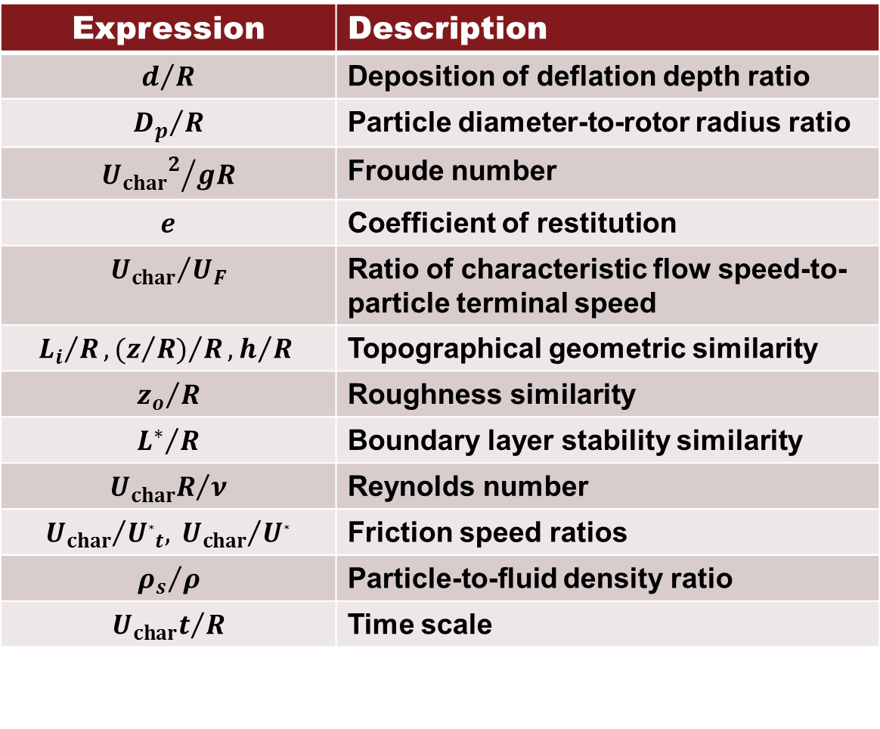
Similarity Parameters
Expression | Description
$$d/R$$ | Deposition of deflation depth ratio
$${D_{p}}/R$$ | Particle diameter-to-rotor radius ratio
$${{U_{char}}_{}^{2}}/{gR}$$ | Froude number
$$e$$ | Coefficient of restitution
$${U_{char}}/{U_{F}}$$ | Ratio of characteristic flow speed-to-particle terminal speed
$${L_{i}}/R, {(z/{R)}}/R, h/R$$ | Topographical geometric similarity
$${z_{o}}/R$$ | Roughness similarity
$${L^{∗}}/R$$ | Boundary layer stability similarity
$${U_{char}R}/ν$$ | Reynolds number
$${U_{char}}/{U_{∗t}, {{ U}_{char}}/{U_{∗}}}$$ | Friction speed ratios
$${ρ_{s}}/ρ$$ | Particle-to-fluid density ratio
$${U_{char}t}/R$$ | Time scale
Source: Greeley and Iverson (1985)
Notes:
So these are the parameters derived by Greeley and Iversen. They identified important variables and conducted a dimensional analysis that resulted in these parameters. They dervied these assuming a uniform flow over a sediment bed.
To match 15 parameters would be impossible. So because we cannot study all of them at once what we need to do is highlight the important parameters for our problem. Of these 15, <CLICK>

Slide 9
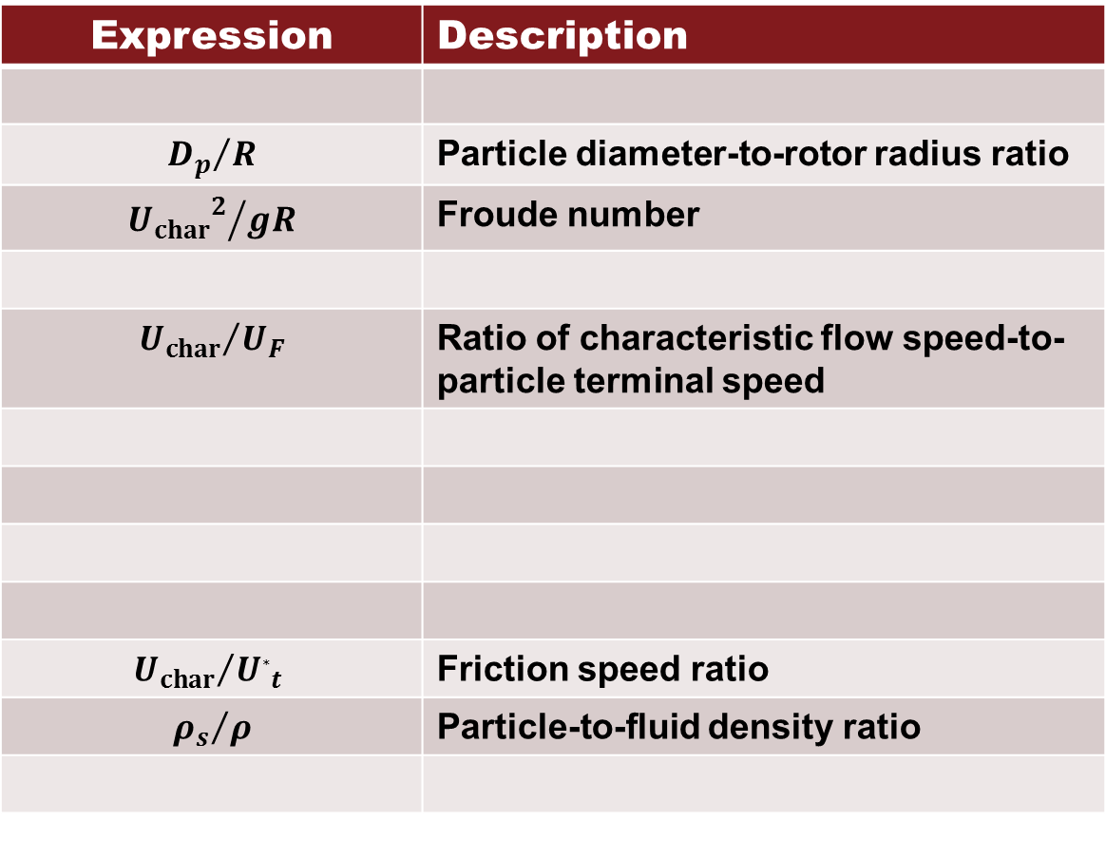
Similarity Parameters
Expression | Description
$${D_{p}}/R$$ | Particle diameter-to-rotor radius ratio
$${{U_{char}}_{}^{2}}/{gR}$$ | Froude number
$${U_{char}}/{U_{F}}$$ | Ratio of characteristic flow speed-to-particle terminal speed
$${U_{char}}/{U_{∗t} }$$ | Friction speed ratio
$${ρ_{s}}/ρ$$ | Particle-to-fluid density ratio
Source: Greeley and Iverson (1985)
Notes:
5 were selected for further study in this work. These parameters were selected on the basis of what parameters could feasably be measured, as well as selecting parameters that had been evaluated in previous work.

Slide 10
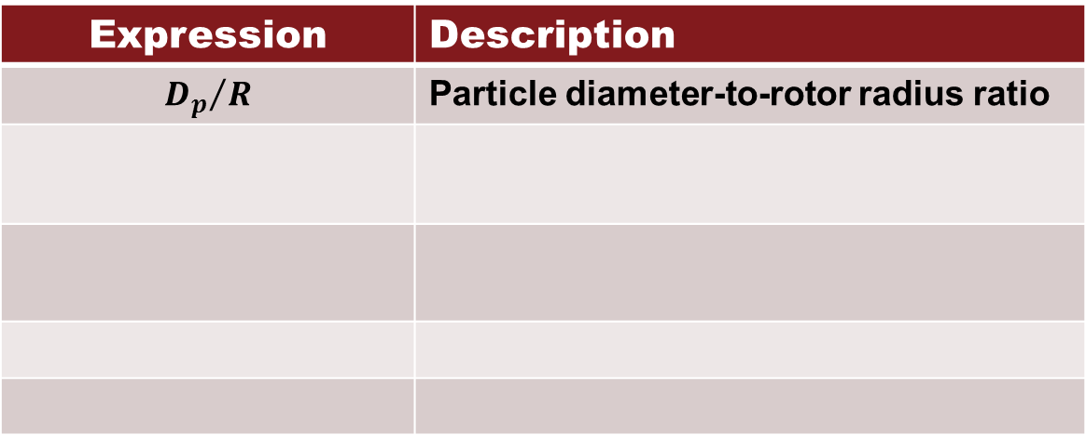
Selected Similarity Parameters
Expression | Description
$${D_{p}}/R$$ | Particle diameter-to-rotor radius ratio
Notes:
The first similarity parameter is the Particle diameter to rotor radius ratio. This parameter gives an idea of how large the sediment is as compared to the rotorcraft size.

Slide 11
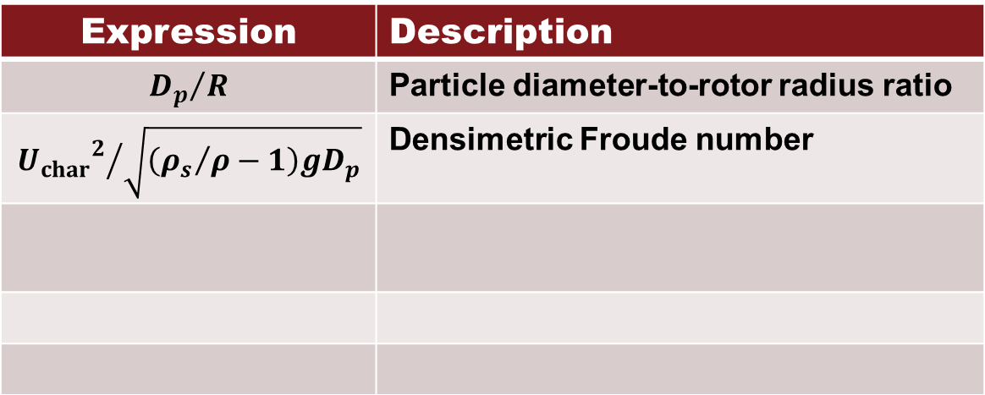
Selected Similarity Parameters
Expression | Description
$${D_{p}}/R$$ | Particle diameter-to-rotor radius ratio
$${{U_{char}}_{}^{2}}/{\sqrt{\left({ρ_{s}}/ρ−1\right)gD_{p}}}$$ | Densimetric Froude number
Notes:
The second parameter selected for study was the Densimetric froude number. You may notice that we’ve substituted densimetric froude number for the Froude number. This number was particle specific. The froude number is used to determine the resistance of an object moving through water. I would like to take a moment to point out the term in the numerator of the parameter, as it is highly important in this and all rotorcraft research. Uchar, the characteristic velocity is a term that describes the fluid flow through the use of a single velocity. The for aeolian sediment transport, the characteristic velocity was calculated from the average wind speed in the flow, and since the flow is steady, this method is fairly well accepted. When examining rotor flows, however, defining a single characteristic velocity becomes difficult. The topic of characteristic velocity will be examined in depth later.

Slide 12
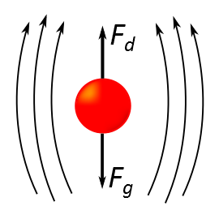
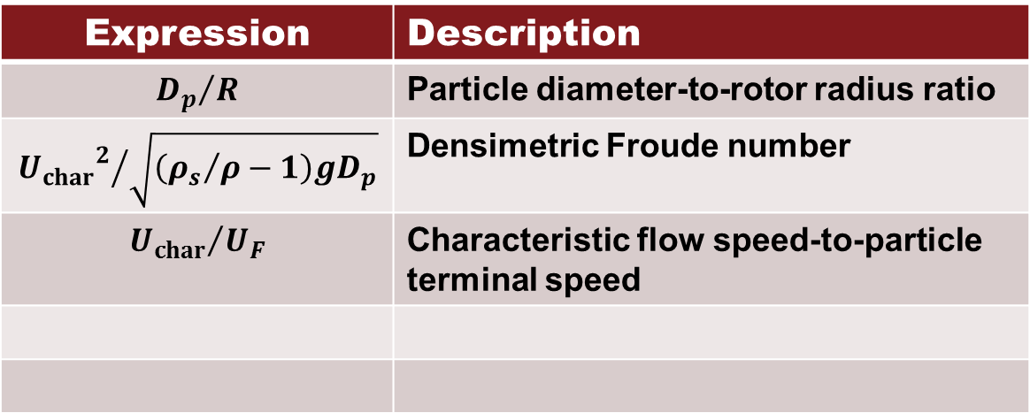
Selected Similarity Parameters
Expression | Description
$${D_{p}}/R$$ | Particle diameter-to-rotor radius ratio
$${{U_{char}}_{}^{2}}/{\sqrt{\left({ρ_{s}}/ρ−1\right)gD_{p}}}$$ | Densimetric Froude number
$${U_{char}}/{U_{F}}$$ | Characteristic flow speed-to-particle terminal speed
U_{F} – Terminal Velocity
Notes:
The third similarity parameter is the characteristic flow speed to particle terminal speed ratio. This parameter relates the characteristic velocity to the terminal velocity of the particle falling through the fluid. The terminal velocity is the speed at which a particle arrives at a balance between the force of gravity and the drag force exerted by the fluid through which it is moving.

Slide 13
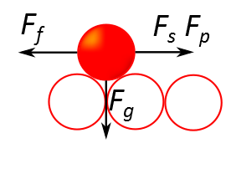
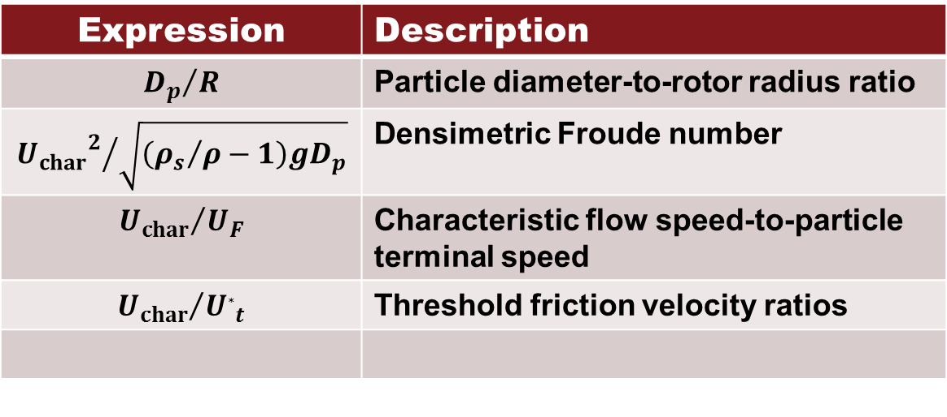
Selected Similarity Parameters
Expression | Description
$${D_{p}}/R$$ | Particle diameter-to-rotor radius ratio
$${{U_{char}}_{}^{2}}/{\sqrt{\left({ρ_{s}}/ρ−1\right)gD_{p}}}$$ | Densimetric Froude number
$${U_{char}}/{U_{F}}$$ | Characteristic flow speed-to-particle terminal speed
$${U_{char}}/{U_{∗t}}$$ | Threshold friction velocity ratios
U_{F} – Terminal Velocity
U*_{t} – Threshold Friction Velocity
Notes:
The Threshold friction velocity ratio examines the relationship between the characteristic velocity and the threshold friction velocity. The Threshold velocity of the sediment is the minimum fluid velocity (not sediment velocity) necessary to initiate motion. Several forces act to keep a sediment particle stationary on a sediment bed, and the threshold velocity accounts for all frictional forces.

Slide 14
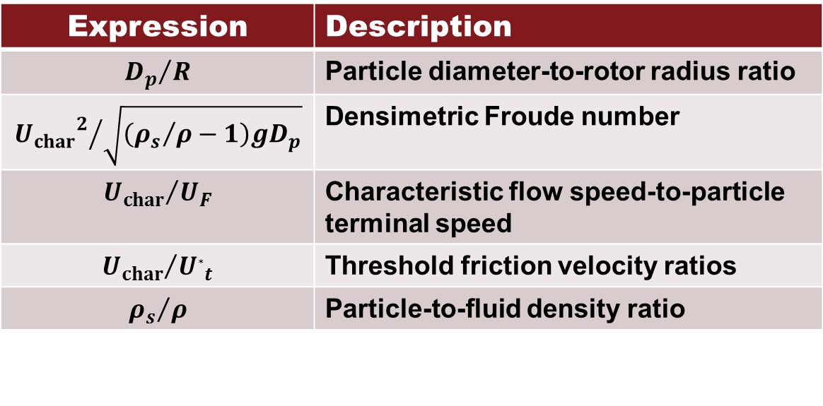
Selected Similarity Parameters
Expression | Description
$${D_{p}}/R$$ | Particle diameter-to-rotor radius ratio
$${{U_{char}}_{}^{2}}/{\sqrt{\left({ρ_{s}}/ρ−1\right)gD_{p}}}$$ | Densimetric Froude number
$${U_{char}}/{U_{F}}$$ | Characteristic flow speed-to-particle terminal speed
$${U_{char}}/{U_{∗t}}$$ | Threshold friction velocity ratios
$${ρ_{s}}/ρ$$ | Particle-to-fluid density ratio
U_{F} – Terminal Velocity
U*_{t} – Threshold Friction Velocity
Notes:
The final similarity parameter is the density ratio. This parameter compares the density of the sediment particulate to the density of the fluid it is submerged in. It is therefore essentially a measure of the specific gravity between the two materials.
As previously mentioned, these similarity parameters were developed for steady flows and large scales of length and time. It is unclear how well these parameters describe the brownout environment.

Slide 15
Research Questions
Which aerodynamic and/or sediment transport similarity parameters best capture the flow physics of brownout, and how should they be measured?
How well do classical similarity parameters predict brownout?
Can new similarity parameters be developed to better describe the brownout problem?
Notes:
For my research then, I asked several questions. Which of the classical aerodynamic and or sediment xport sim params best capture the flow physics of brownout, and how should they be measured?
How well do the classical parameters predict brownout, and can they be used as a means of scaling?
Finally, are there any new similarity parameters that might bettwer descibe the brownout problem?

Slide 16
Experimental Setup
Notes:
In order to explore my proposed questions, several experiments were done.

Slide 17
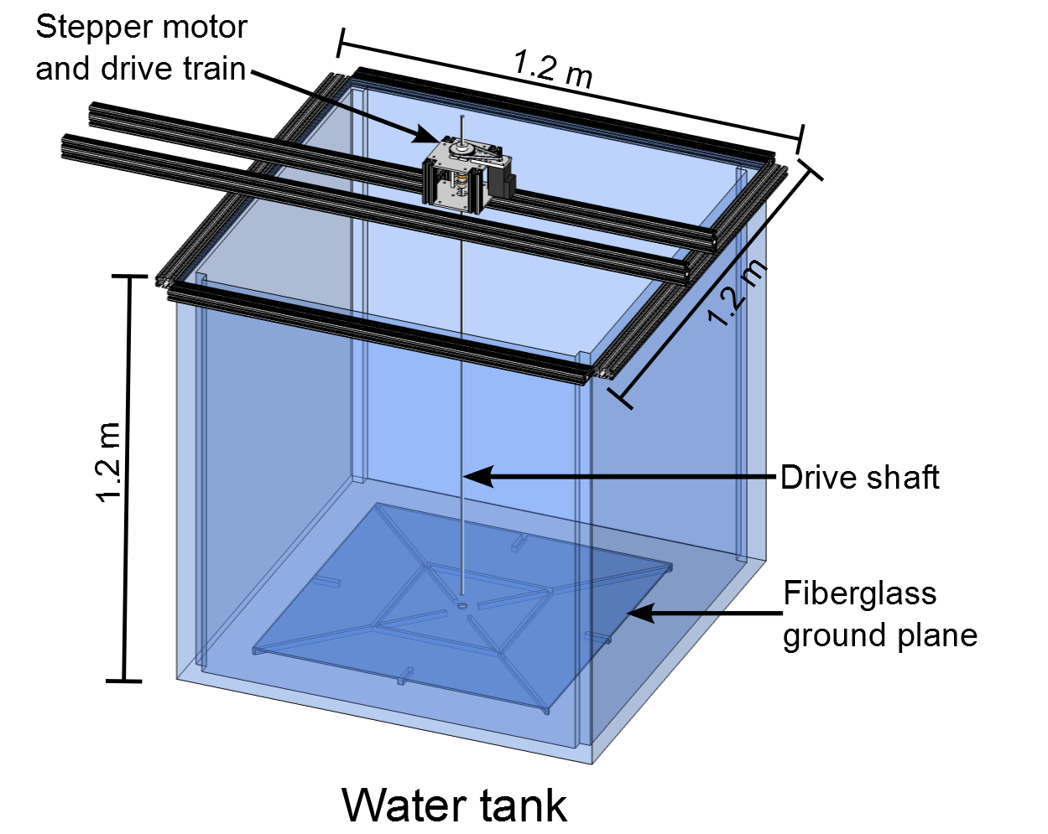
Water Tank
1.2 m x 1.2 m x 1.2 m water tank
System driven by a computer controlled stepper motor
Optical encoder measured rotor position
  Produced trigger signal for PIV system
Removable dye flow needle in ground plane for flow visualization
Notes:
I performed my experiments inside a 900 gallon water tank. The figure on the right shows a schematic of my experimental chamber. All experiments performed were done at the bottom of the tank, above the marked fiberglass ground plane. My experiments were performed in water as opposed to air as water allowed for large variations in similarity parameters, such as density ratio and terminal velocity ratio, while keeping other parameters such as particle size to rotor radius ratio the same as compared to previously done research.

Slide 18
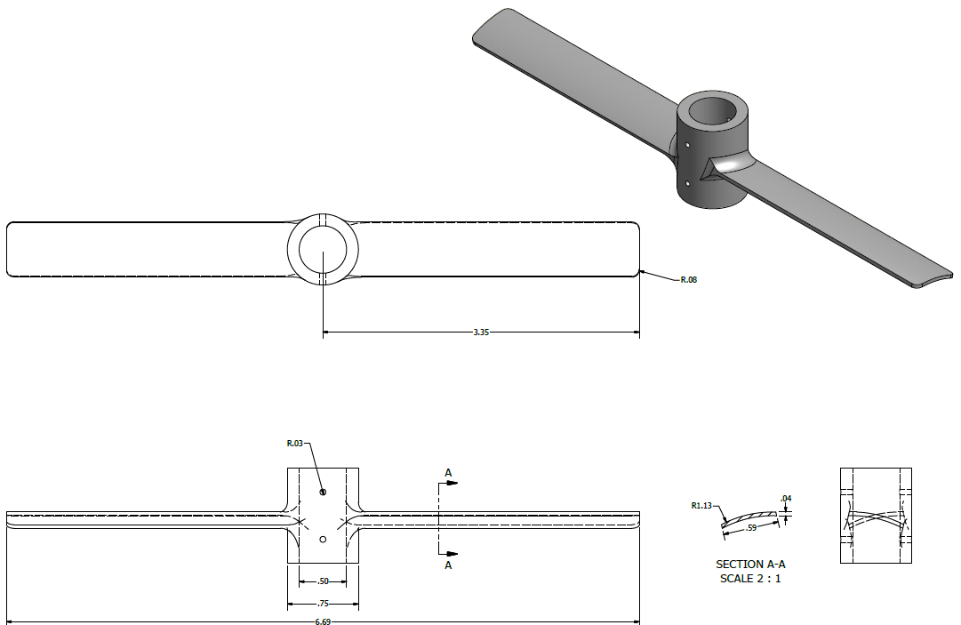
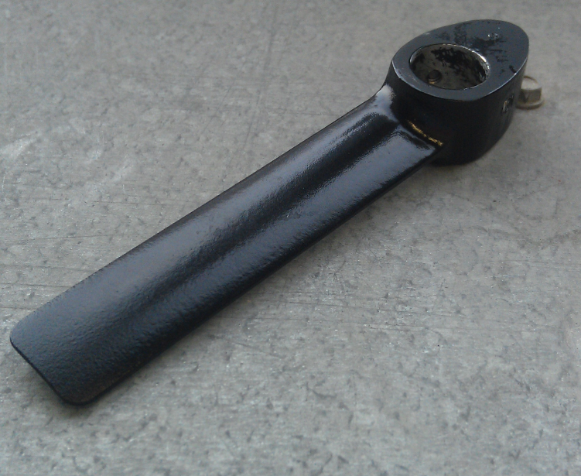
Rotor System
One- and two-bladed rotor:
  Cambered flat plate (t/c = 3%)
  Radius of 85 mm
  Chord of 18 mm
Blade pitch fixed to 12° collective for all test cases
Notes:
Two rotors were used for this research, a one bladed rotor and a two bladed rotor. The two bladed rotor was only used for initial flow visualization research. A mechanical drawing of the two bladed rotor is shown here <POINT> while the one bladed rotor as shown in the bottom right image was used for all other experiments.

Slide 19
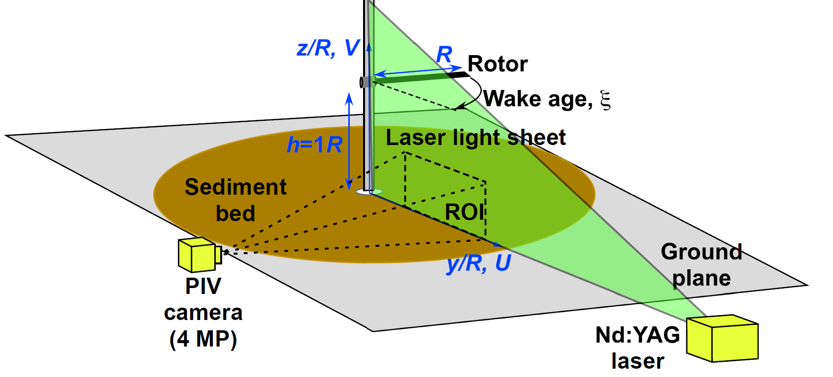
Experimental Setup
Nd:YAG laser – 532 nm light
4 MP CCD camera
Up to 15 Hz repetition rate
Data acquisition could be synched to the optical encoder
Notes:
Shown here is a schematic of the experimental setup used to conduct PIV and flow visualization measurements. The ground plane rested on the bottom of the water tank, while the laser and PIV camera sat outside the tank. The rotor was adjusted to operate in hover above a ground plane. For flow visualization, a needle that injected dye into the rotor wash was built through the ground plane, but was later removed for PIV testing. A laser light sheet was aligned coincident with the rotor shaft to illuminate a region of interest. A PIV Camera was aligned orthogonal to the laser light sheet and focused to the region of interest. For the two-phase tests, a sediment bed of known particles was laid out over the ground plane.

Slide 20
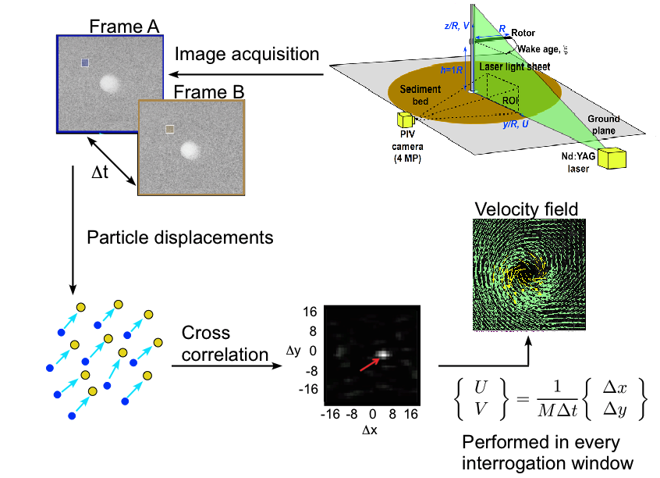
Particle Image Velocimetry (PIV)
Notes:
So I’ll just give a brief overview of the process behind PIV for those who may not know. Regardless of what type of flow diagnostic measurements were taken for this research, the method of PIV is basically the same.
The flow is first seeded with nylon tracer particles that will faithfully follow the flow.
Then data in the form of image pairs are captured and are denoted Frame A and Frame B. These frames are separated by are separated by a small Delta t that is usually on the order of a few hundred microseconds. Each frame is sub-divided into many small interrogation windows
Together, the images contain the distance or particle displacements traveled over the time delta t. The displacements in the interrogation window are then quantified by a cross correlation algorithm which recognizes the unique intensity pattern of the seed particles in both frames.
The velocity is then computed from the displacements of the particles between frames and a velocity field for the flow is calculated.

Slide 21
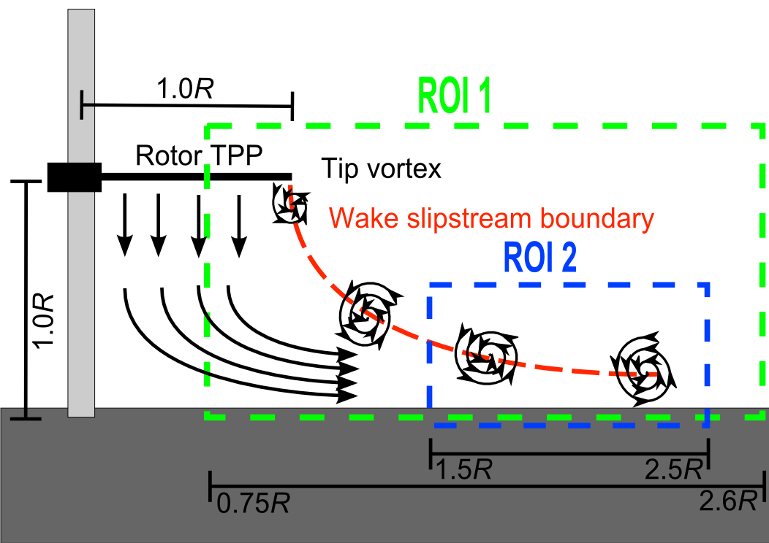
Regions of Interest
ROI 1
  Full view of flow conditions
  Good for gaining insight on overall patterns
  Used for dye flow visualization and PIV
ROI 2
  Tight view near the ground
  Allows for thorough examination of fine detail
  Used with dual-phase flow visualization
Notes:
Two regions of interest were studied. ROI 1 which is given by the green box, imaged the whole flow field to get a global understanding of the problem; while ROI 2, given by the blue box, focused on a near wall region where the most sediment uplift was observed. This smaller region of interest allowed for the study of the dual-phase flow in more detail.

Slide 22
Sediment Surrogates
Glass microspheres
  45 – 63 μm
  SG_{s} = 2.58
Steel microspheres
  44 – 125 μm
  SG_{s} = 7.49
  U_{F} = 2.29x10⁻³ m/s
  U*_{t} = 9.16x10⁻³ m/s
U_{F} – Terminal Velocity
  U_{F} = 2.12x10⁻² m/s
  U*_{t} = 1.09x10⁻² m/s
U*_{t} – Threshold Friction Velocity
Notes:
For dual-phase flow visualization, two different sediment surrogates were used. A glass microsphere was used due to its well characterized nature and its previous use in other brownout experiments. In addition to the glass particulate, steel microspheres were used. (emphasise this) These steel particles were much denser than the glass microspheres, causing them to have a much higher terminal velocity in water than the glass, while still having a relatively similar threshold friction velocity.
Two sediment used, one settles fasgter but has same threhshold

Slide 23
Results
Notes:
I will now move on to the results of my experiments

Slide 24
Results
Dye flow visualization
Particle Image Velocimetry (PIV)
  Time-averaged
  Phase-averaged
  Similarity parameter analysis
Dual-phase flow visualization
Buckingham-Pi analysis
Particle analysis
Notes:
Here is an outline of the results. I will start with dye flow visualization, then move onto quantitative flow field analysis

Slide 25
Dye Flow Visualization
Notes:
Dye flow visualization was performed to gain understanding on the complex fluid dynamics present in a rotor hovering in ground effect.

Slide 26
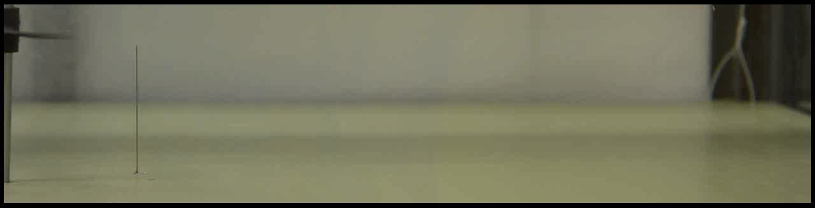
Dye Flow Visualization
Two-bladed rotor
  Re_{tip} = 1.06 x 10⁴
  Steady state operation
Fundamentally much different than a rotor out-of-ground effect
  Vortex stretching
Notes:
In this video, a two-bladed rotor is operating at a tip reynolds number of 10k. We can see the complex flow caused by the tip vortices shed by the rotor. The tip vortices ingest the dye that is injected just below the tip path plane of the rotor and carry it down and out with the downwash of the rotor. As these vortices convect down and out along the ground plane, they strech, intensifying them, which allows them to exist for longer than they would in out of ground effect operation. It can be seen that along the ground plane, especially in the region just outside the dye needle that the flow along the ground is heavily vortex driven.

Slide 27
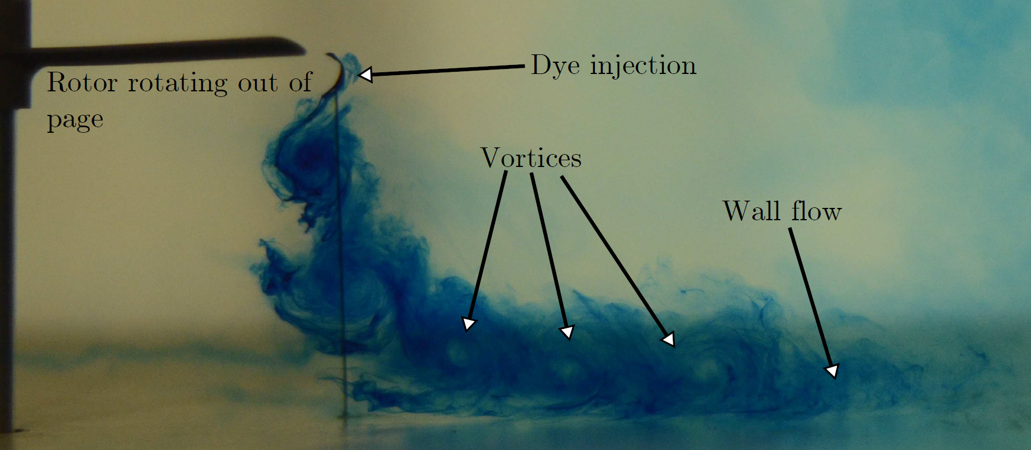
Dye Flow Visualization
Two-bladed rotor
  Re_{tip} = 1.33 x 10⁴
  Steady state operation
Notes:
Here is an image of the same rotor at a slightly higher ReTip. Visible here are the shed vortices convecting with the downwash out along the ground plane. Each vortex represents the passage of the rotor near the dye injection location. With this flow visualization, we gain quite a bit of information about what flow features are present in rotor flows.

Slide 28
Particle Image Velocimetry
Time-Averaged Results
Notes:
Particle image velocimetry allows for quantitative understanding of the flow. By using the PIV techniques mentioned previously, velocity fields were measured in the regions of interest. The following video explains the general time-averaging process used in my research. Because the repetition rate of the PIV system exceeded the rotational rate of the rotor, images were taken at many different blade azimuthal locations. Although the laser system captured images at up to 15Hz, images are displayed at a much lower rate for clarity

Slide 29
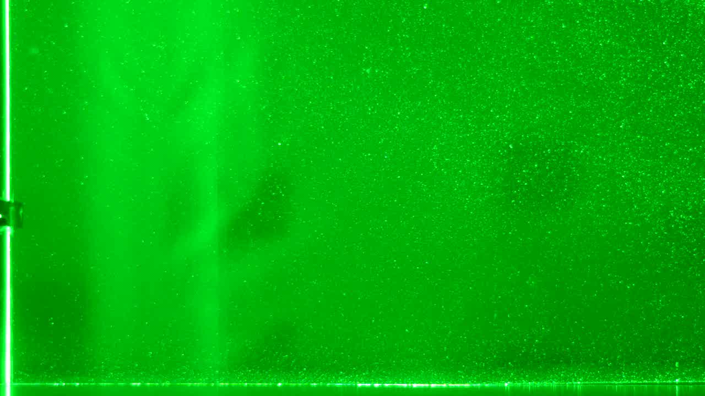
Time-Averaging
Notes:
Once the rotor achives steady state operation, the PIV system is allowed to capture image pairs at its maximum repetition rate as the rotor turned. 500 image pairs were collected for each test case to provide a smooth and significant time-averaged profile. Once the 500 images were collected, all of the velocity profiles were averaged together to finally arrive at the time averaged flow field.

Slide 30
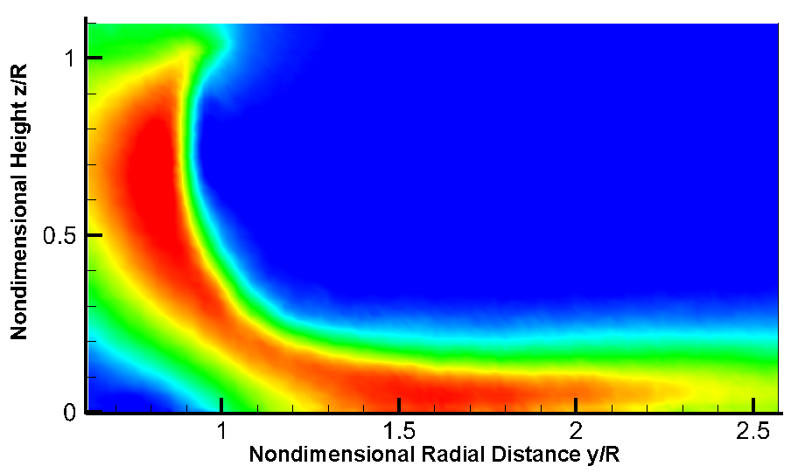
Time-Averaged PIV
Calculation of similarity parameters
  Requires U_{char}
  Time-averaged velocity
Finding the maximum velocities over the region and averaging yields characteristic velocity
Notes:
The time averaged flow field measurements reveal a steady flow at all points in the rotor wash. The image in the upper right shows a smooth total velocity field. The flow travels downwards from the rotor, and then turns outward along the ground plane, however the vortices which were present in the flow visualization are no longer visible. Because PIV images taken at many different blade azimuthal locations and then averaged together, the unsteadyness found in the flow has been averaged out. Despite this problem, previous research has used this averaged profile to calculate the characteristic velocity used in many of the similarity parameters. In order to compare my results to other experiments, this method of finding the char velocity was performed here. The second region of interest <CLICK> was used, and the maximim velocities found in the region were averaged together to calculate the cahricteristic velocity

Slide 31
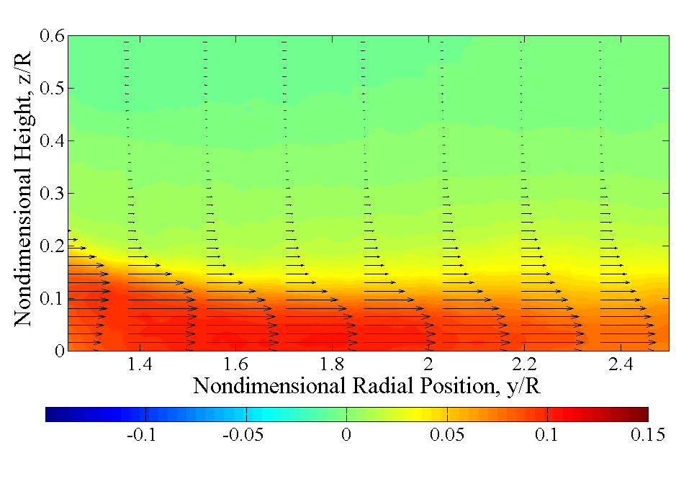
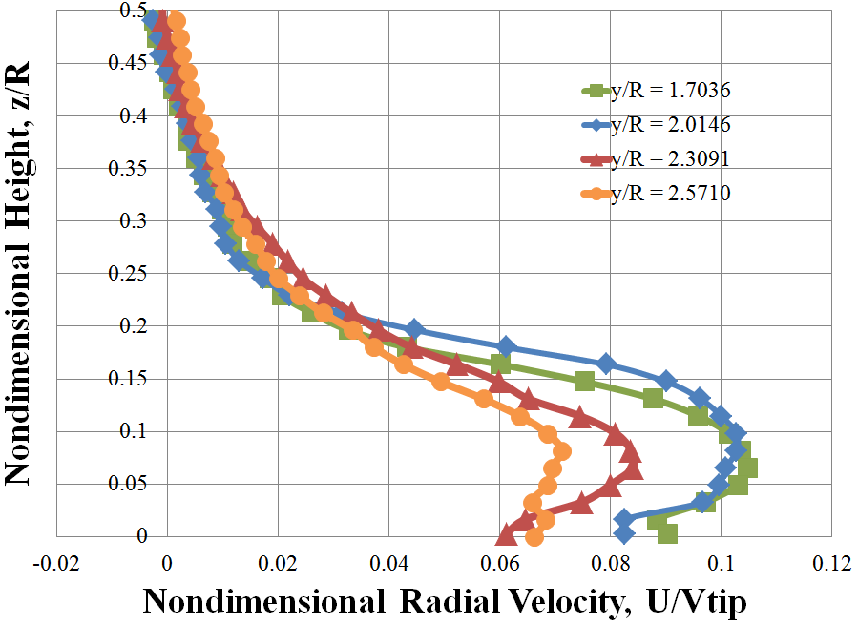
Time-Averaged PIV
Averaging yields a smooth wall-jet like profile that maintains the same shape at all positions
  How does this compare to the actual flow?
Notes:
Presented here again is the second region of interest from the time-averaging presented on the previous slide. The characteristic velocity is calculated by finding the maximum velocity at every nondimensional radial position, as an example <CLICK> here are four horizontal velocity cuts taken along the noted radial locations. As I mentioned, the maximum horizontal velocity at each radial location is taken and averaged together to find the characteristic velocity at each operating condition. As you can see, the time averaging technique yields a smooth wall jet-like profile, completely devoid of the vorticity seen in the flow visualization

Slide 32
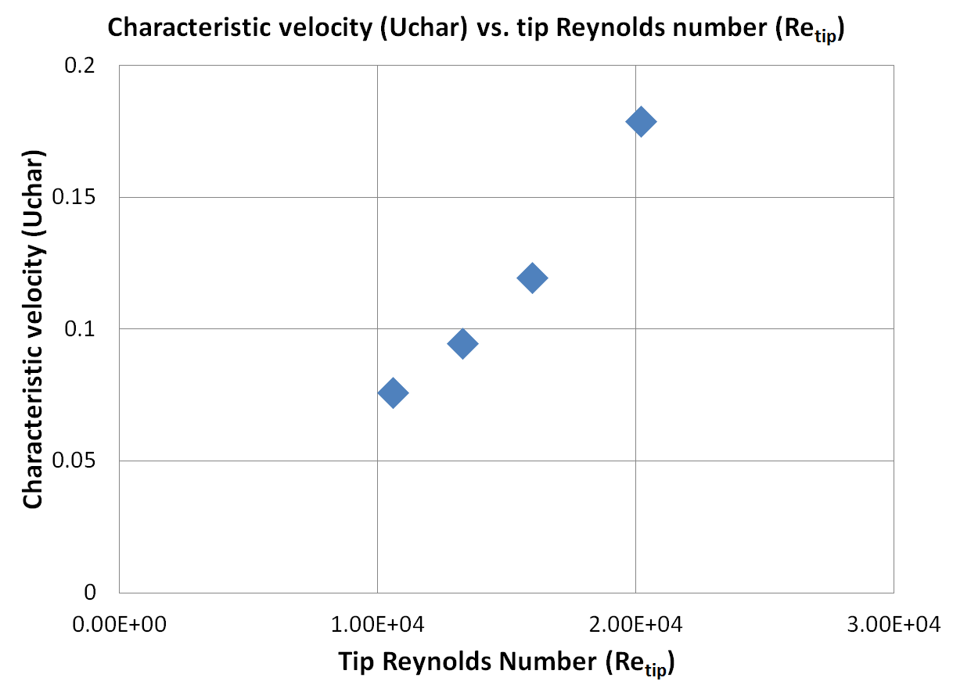
Characteristic Velocity
Notes:
Here is a chart of the measured characteristic velocites at several different tip reynolds numbers.
These velocities, found using the time averaging method, were compared to characteristic velocites found using a different PIV technique, phase averaging

Slide 33
Particle Image Velocimetry
Phase-Averaged Results
Notes:
The Phase average PIV technique is similar to the time averaged one, but for one main difference. In time averaging, the PIV system was allowed to capture images at its maximum repetition rate, in phase averaging however, the PIV system was slaved to an optical encoder mounted to the rotor shaft. The optical encoder measured the rotational position of the rotor, and when it arrived at a specified blade azimuthal location, the PIV system was allowed to capture one image pair. The system then waited for the rotor to complete a full revolution, and when the optical encoder detected that the rotor was in the defined blade azimuthal location, the PIV system captured another image pair.

Slide 34
Phase-Averaging
Notes:
Shown here is a video attempting to explain the Phase averaged technique visually. Instead of displaying one image per revolution, one new image is added approximately once every 10 revolutions. Once a large set of PIV images was collected, the images were averaged together to arrive at a phase-averaged velocity field.

Slide 35
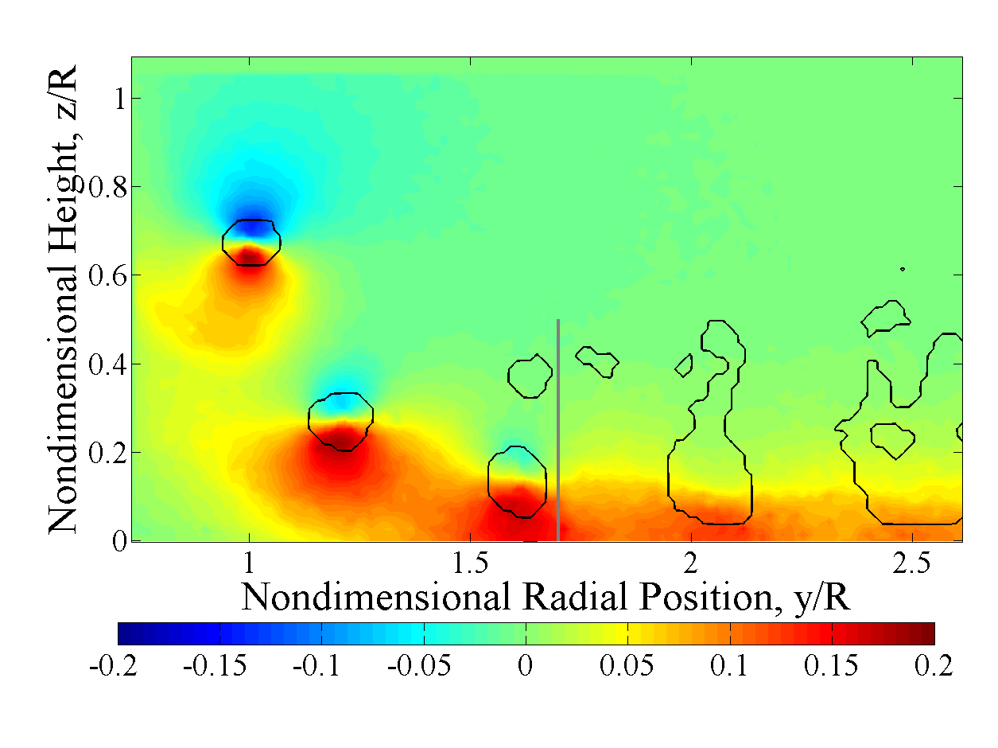
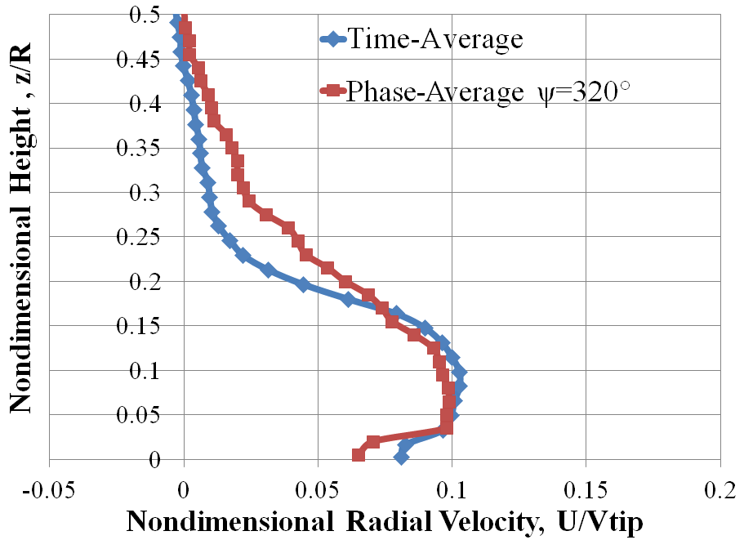
Phase-Averaged PIV
Horizontal Velocity Field
Vortices now visible due to phase-averaging
  Vortex identification algorithms (Γ-method and Q-criterion) confirm vortex location
Before a vortex passes, the time-average and phase-average velocity profiles are similar
Notes:
A difference is immediately noticeable in the phase averaged velocity profiles as compared to the time averaged ones. The vortices which were previously averaged out are now visible. Because PIV images were captured at the same blade azimuthal location, the shed vortices are locacted in similar locations in all images. In the horizontal velocity flow field presented here, the color red denote fluid motion to the right, while blue shows fluid motion to the left. Thus a paired red and blue region denotes the location of a vortex. Several vortex identification algorithms were used to study the size and location of the vortices in the flow. The black outlines show an approximation of the vortex area as measured via the Gamma method.
A velocity profile or cut, taken at <CLICK> <POINT> this location shows how the horizontal velocities in phase averaging compare to the time averaged profile at that location. Before a vortex passes, the time averaged and phase averaged profiles are similar
Q-Criterion defines the center of a vortex where the norm of the vorticity tensor dominates the rate of strain in the fluid
Gamma method uses a proper orthogonal decomposition to separate turbulent fluctuations from unsteady swirling motions

Slide 36
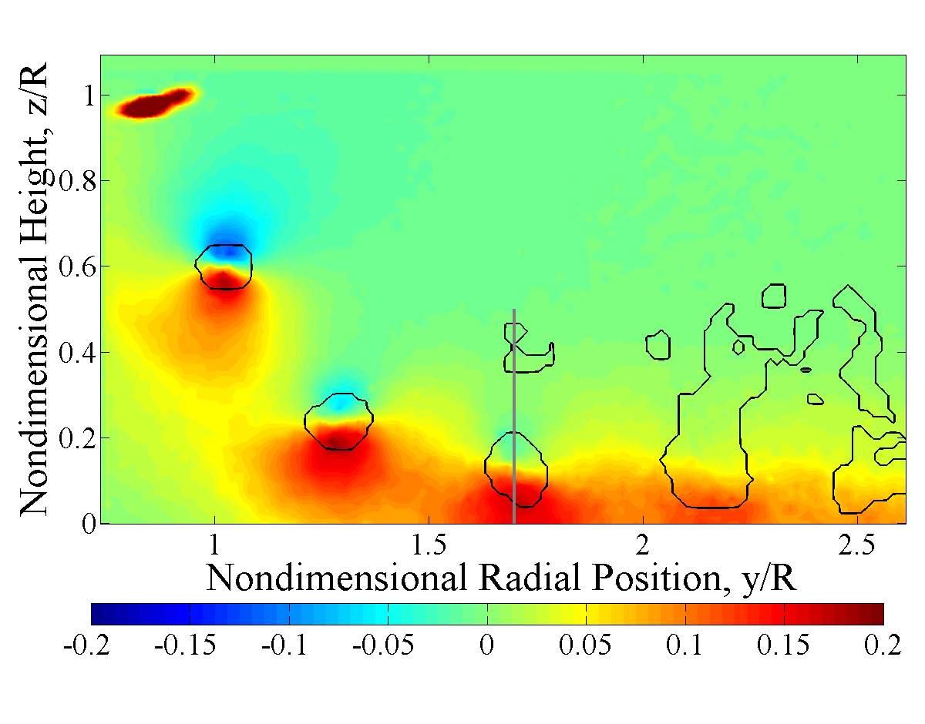
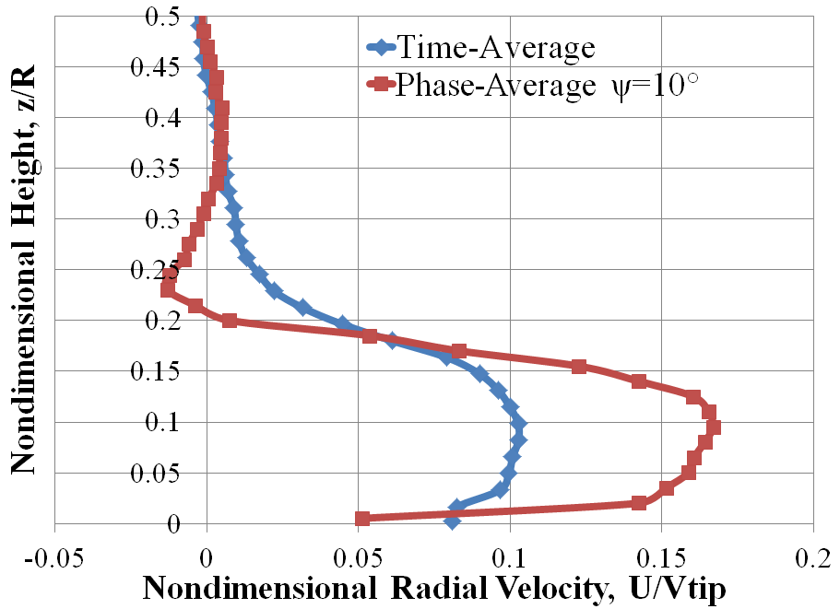
Phase-Averaged PIV
Horizontal Velocity Field
As vortex convects along the ground, large velocity excursion
  More than a 50% increase in velocities
  Onset of higher velocities rapid (1.4 ms)
Notes:
Capturing phase averaged PIV at a blade azimuthal angle 50 degrees greater than in the previous slide shows the progression of the vortices. Looking at the horizontal velocity cut at the same radial position shows a large velocity excursion as compared to the time averaged data. The vortex centered over the measurement location results in a more than 50% increase in the maximum velocity measured. The onset of this higher velocity is extremely rapid, taking less than 2 miliseconds to occur.

Slide 37
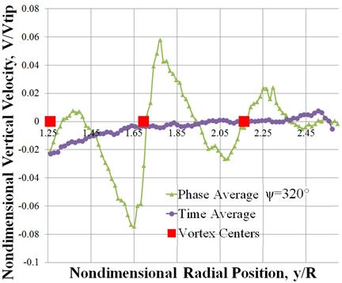
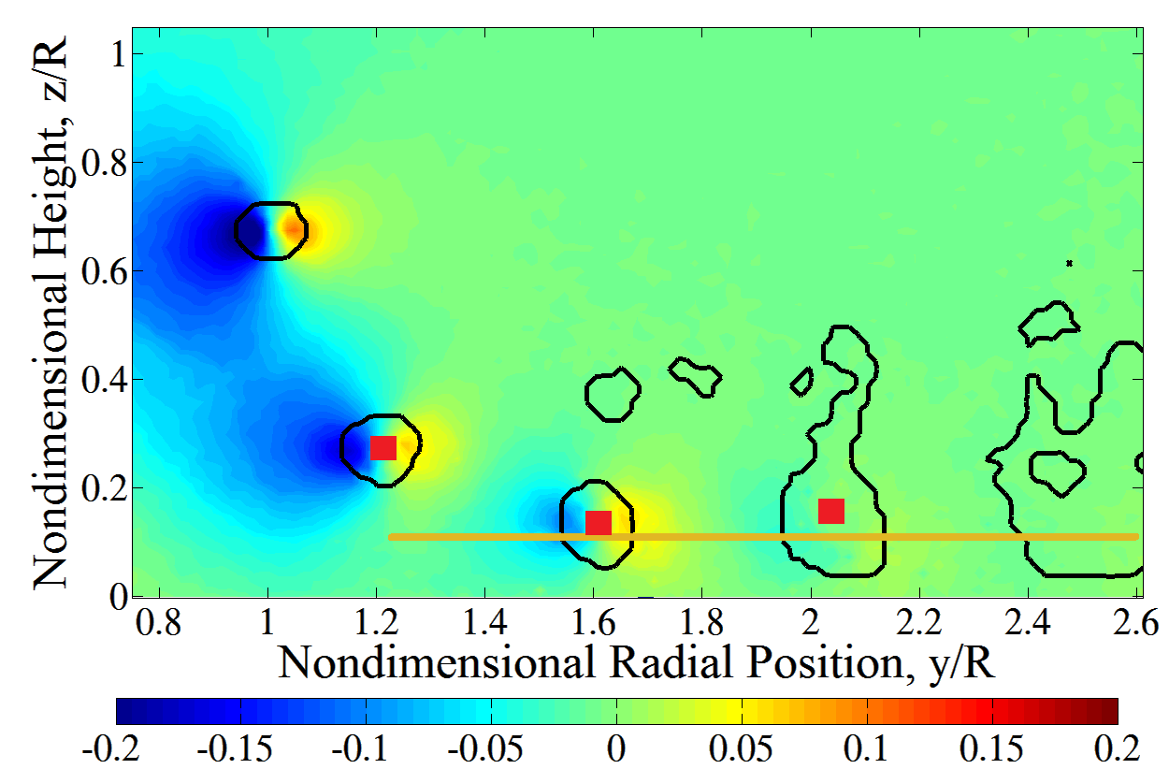
Phase-Averaged PIV
Vertical Velocity Field
Vertical velocities exist as well
  Positive velocities to the right of vortices, negative to the left
  May act to help lift sediment off of the ground and pull it to greater altitudes
Notes:
Presented here is the vertical velocity field, as opposed to the horizontal velocity field presented previously. In this image, the color blue represents downward moving flow, while red/yelllow shows flow moving upwards. Again the black outlines denote vortex sizes, and the red squares show the locations of the vortex centers as identified by the Q criterion.
Taking a vertical velocity cut along <CLICK> this line shows how the vertical velocities fluctuate around the vortex centers. As one might expect, to the right of each vortex exists a region of upward flow, while on the left side of each vortex Is downward moving flow. The time averaged vertical velocity profile on the other hand, has very little vertical velocity due to averaging.
With this and the previous image, the question arises about whether the time-averaging method of determining characteristic velocity is a suitable methodology for rotor flows.
Q-Criterion defines the center of a vortex where the norm of the vorticity tensor dominates the rate of strain in the fluid
Gamma method uses a proper orthogonal decomposition to separate turbulent fluctuations from unsteady swirling motions

Slide 38
Similarity Parameter Analysis
Notes:
In order to determine how much the classical similartiy parametrs as put forward by Greeley and Iverson change depending on PIV techniques, both the time averaged and phase averaged PIV fields were used to calculate the similarity parameters

Slide 39
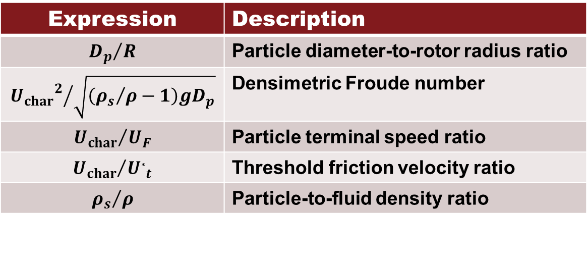
Selected Similarity Parameters
Expression | Description
$${D_{p}}/R$$ | Particle diameter-to-rotor radius ratio
$${{U_{char}}_{}^{2}}/{\sqrt{\left({ρ_{s}}/ρ−1\right)gD_{p}}}$$ | Densimetric Froude number
$${U_{char}}/{U_{F}}$$ | Particle terminal speed ratio
$${U_{char}}/{U_{∗t}}$$ | Threshold friction velocity ratio
$${ρ_{s}}/ρ$$ | Particle-to-fluid density ratio
U_{F} – Terminal Velocity
U*_{t} – Threshold Friction Velocity
Notes:
Just as a quick reminder, here is a list of the 5 similarity parameters examined for this research.

Slide 40
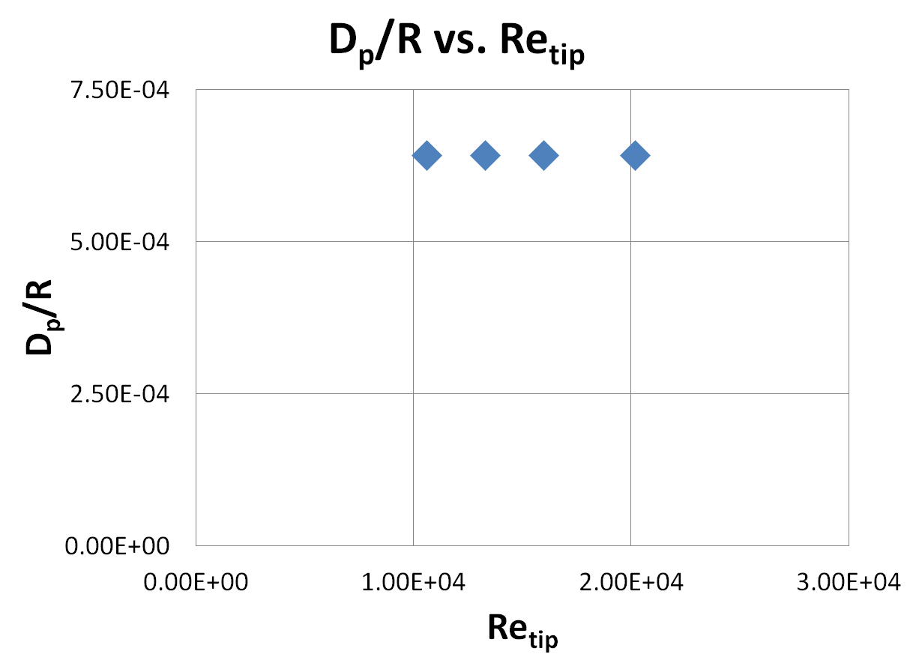
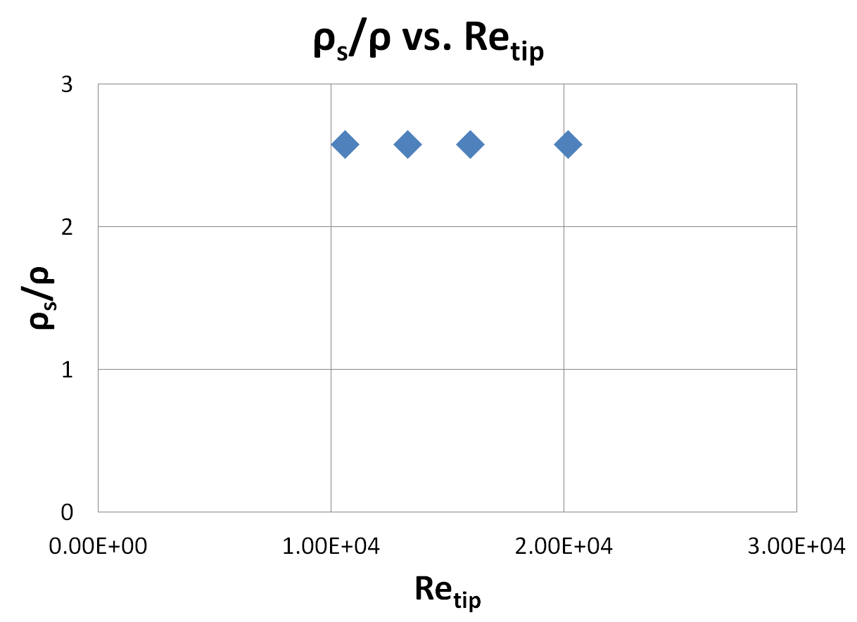
Time-Averaged
Similarity Parameters
Parameters not a function of Reynolds number or any flow condition
  Based solely on geometric characteristics
Geometric parameters
Notes:
Shown here are two of the parameters, particle size ratio and density ratio. It is clear that these two parameters are not functions of the reynolds number or any measured flow conditions. These parameters are only affected by geometric characteristics of the experimental setup, the densities, and sizes of the sediment and rotor. These parameters as well as any parameters that do not use flow conditions are thus classified as geometric similarity parameters.

Slide 41
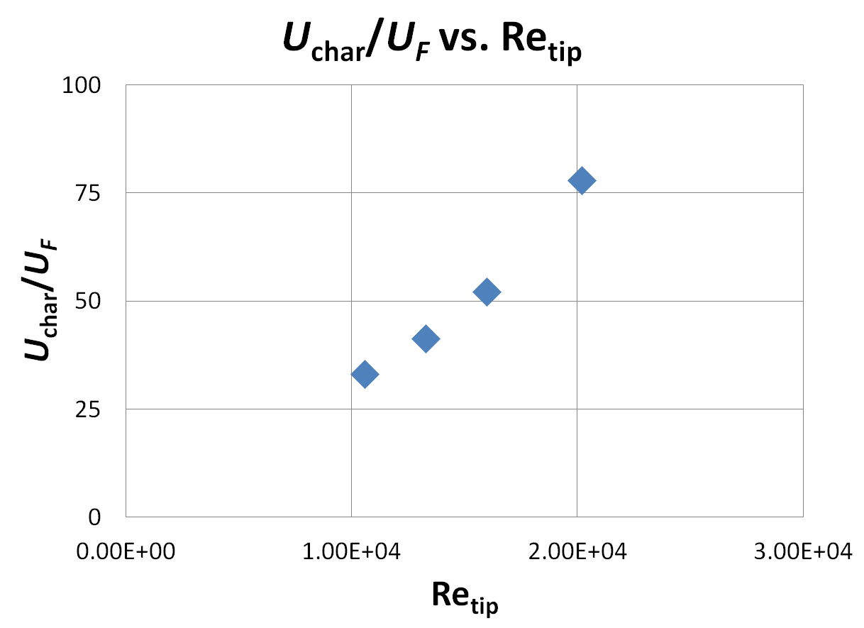
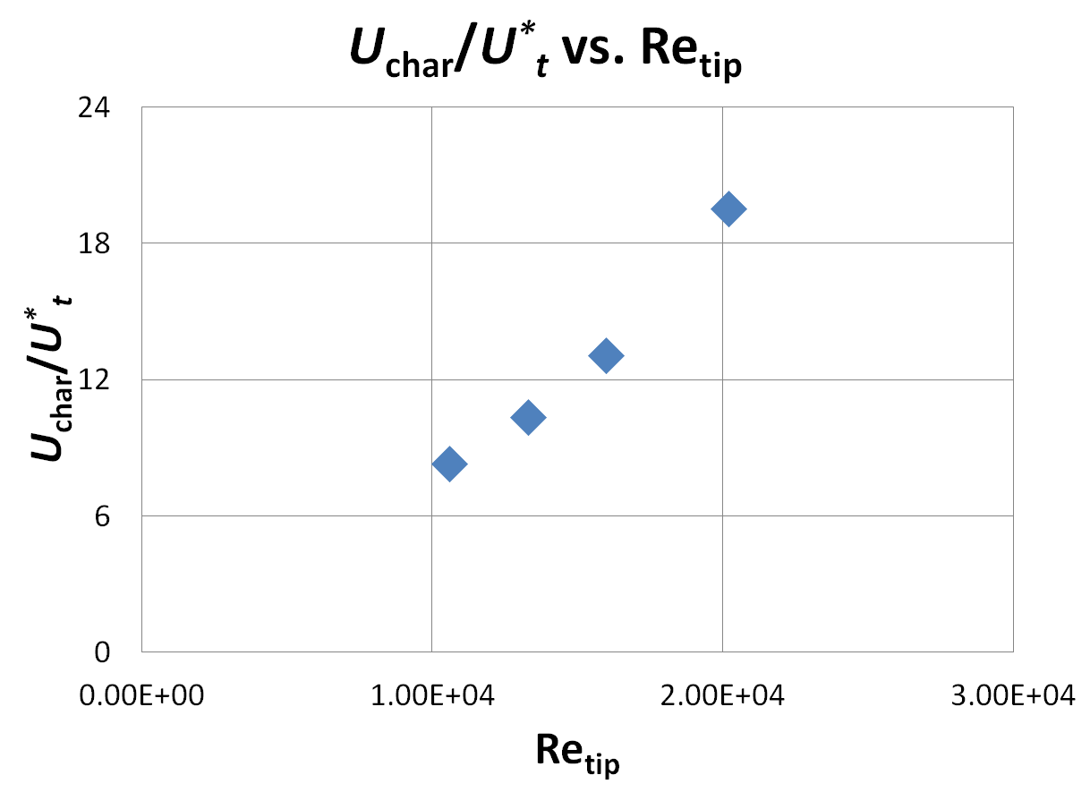
Time-Averaged
Similarity Parameters
Parameters that make use of characteristic velocity are functions of tip Reynolds number and other operating parameters
  Operational parameters incorporate flow velocity measurements
Notes:
The other parameters, terminal speed ratio and threshold friction velocity ratio are affected by flow conditions. These operational similarity parameters use measurements of flow velocity in their calculation. The densimetric froude number is omitted here as it appears qualiatively similar to these plots. As mentioned, these similarity parameters were calculated using the time averaged characteristic velocity, but using the phase averaged data changes the measured operational similarity parameters.

Slide 42
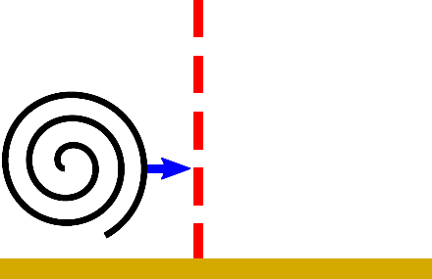
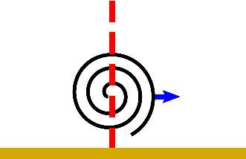
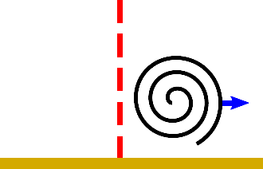
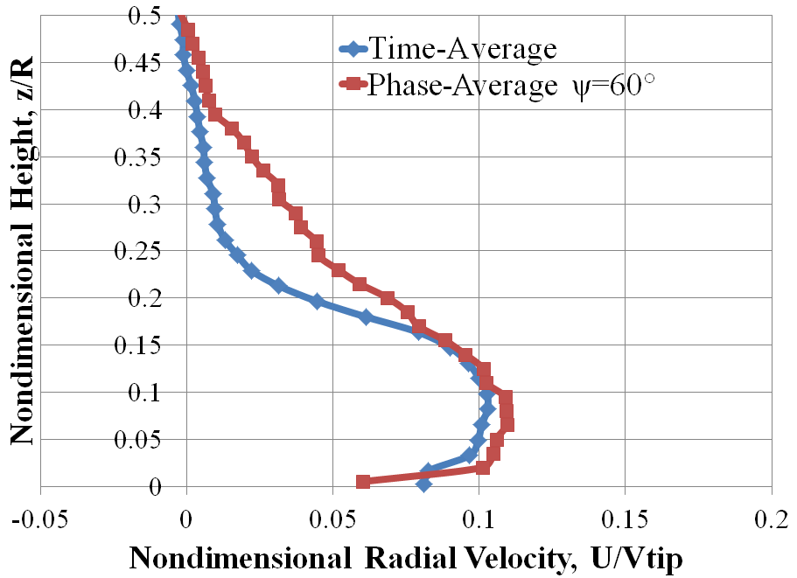
Phase-Averaged
Similarity Parameters
Ψ = 320˚
Ψ = 10˚
Ψ = 60˚
Notes:
In order to define a characteristic velociy for the phase averaged cases, a horizontal velocity cut was taken at a radial location of 1.7. The characteristic velocity for the three different phase averaged cases was then defined as the maximum horizontal velocity measured along the cut location. As seen here, here and here. The images above each velocity cut represent where the vortex is in relation to the measurment location, ahead of, center on, and beyond the measurement location.

Slide 43

PA Similarity Parameters
Time-averaged data
Notes:
Displayed here are the time averaged similarty parameter terminal velocity ratios vs tip reynolds numbers

Slide 44
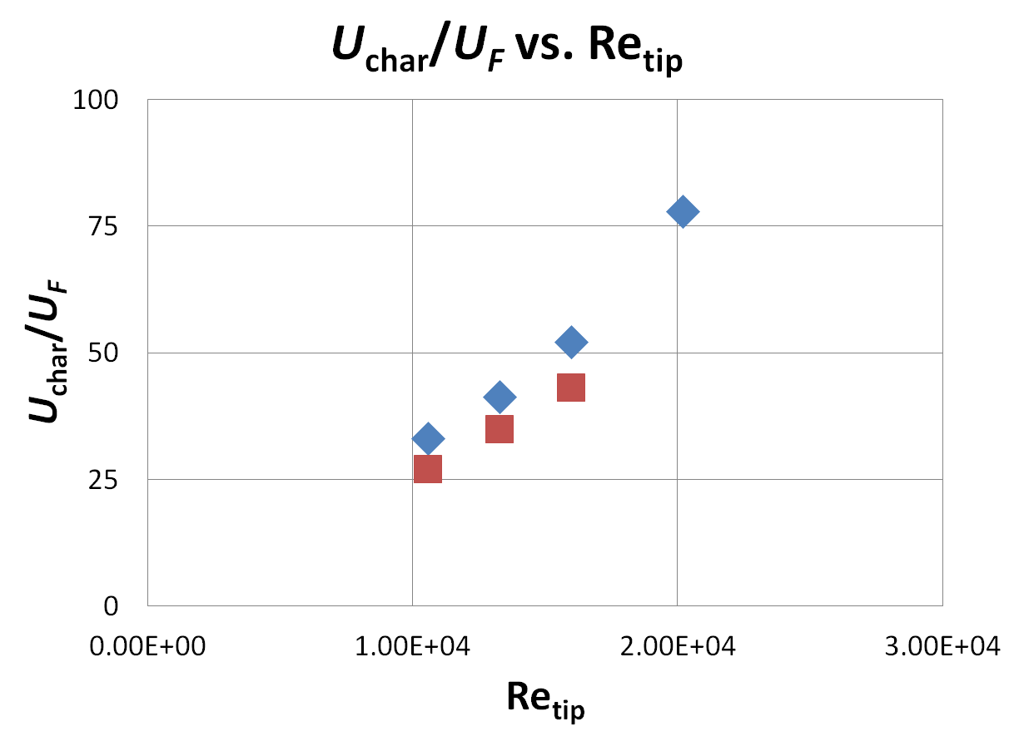

PA Similarity Parameters
Time-averaged data
Notes:
Adding the phase averaged data from before the vortex arrives show somewhat lower similarity parameter values than found in the time averaged data.

Slide 45
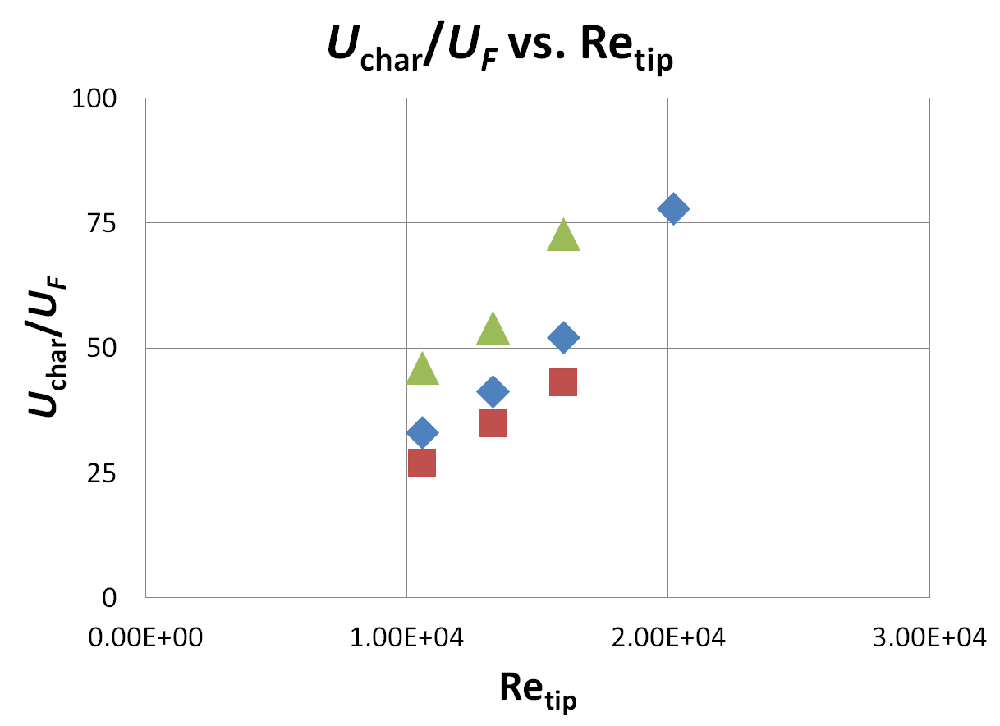

PA Similarity Parameters
Time-averaged data
Notes:
When the vortex is centered over the measurement location, the measured similarity parameter values rise approximately 60% higher than found in the time averaged cases.

Slide 46
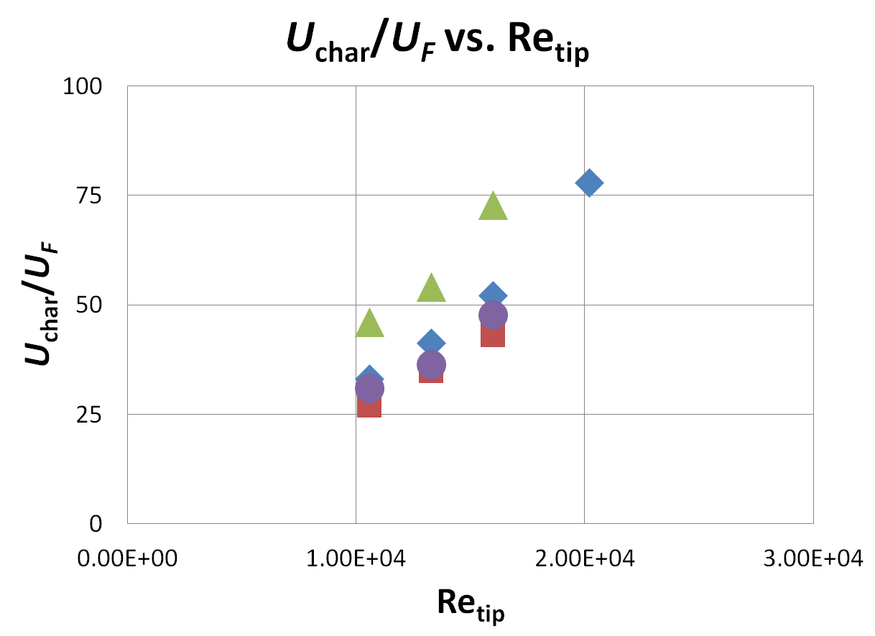

PA Similarity Parameters
Time-averaged data
Notes:
Measurements taken after the vortex passes the cut location show that the similarity parameter values drop back below the time averaged values. This finding is interesting, but not necessarily important. Just because vortices exist in the flow does not mean that they have a large impact on sediment mobilization. The question of whether the vortices have an impact on brownout is thus raised.

Slide 47
Dual-Phase Flow Visualization
Notes:
Dual phase flow visualization was performed in an effort to determine how much of an impact vorticies have on sediment mobilization.

Slide 48
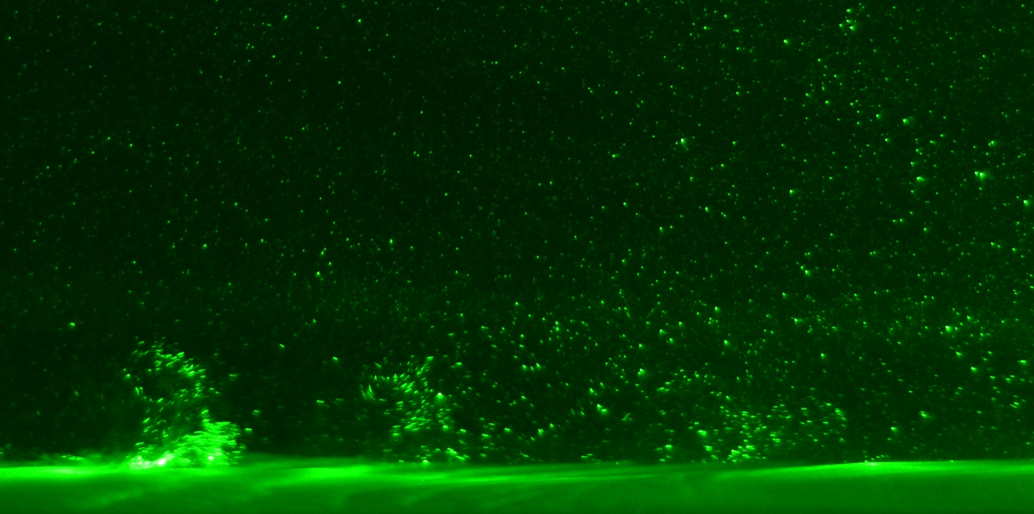
Dual-Phase Results
Re_{tip} = 1.06 x 10⁴
  Single-bladed rotor
45 – 63 μm glass sediment
Notes:
Shown here is the second region of interest with the rotor operating at a tip reynolds number of 10k On the ground are the glass sediment particles. Visible here are small waves of sediment moving along slightly above the ground. It may not be immediately obvious from this image, but a vortex is located here <CLICK>

Slide 49
Dual-Phase Results
Re_{tip} = 1.06 x 10⁴
  Single-bladed rotor
45 – 63 μm glass sediment
Notes:
This vortex seems to be the reason for mobilized sediment directly ahead of it

Slide 50
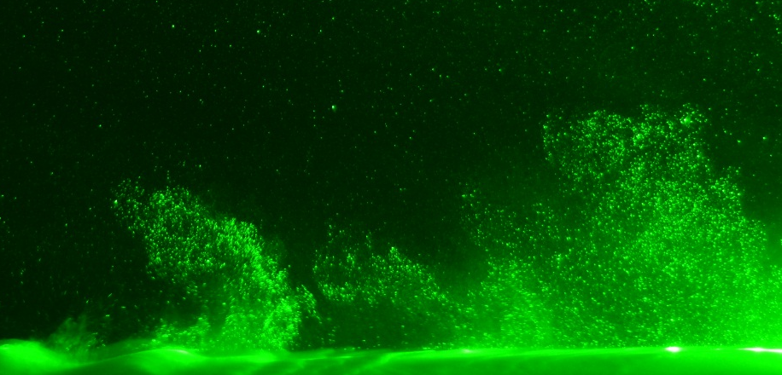
Dual-Phase Results
Re_{tip} = 1.33 x 10⁴
  Single-bladed rotor
45 – 63 μm glass sediment
Notes:
Increasing the tip reynolds number results in a large increase in sediment mobilization, a vortex, located here <CLICK>

Slide 51
Dual-Phase Results
Re_{tip} = 1.33 x 10⁴
  Single-bladed rotor
45 – 63 μm glass sediment
Notes:
Is responsible for large quantities of mobilized sediment. Also important is the general lack of mobilized sediment between vortices, thus reinforcing the importance of vortices on brownout.

Slide 52
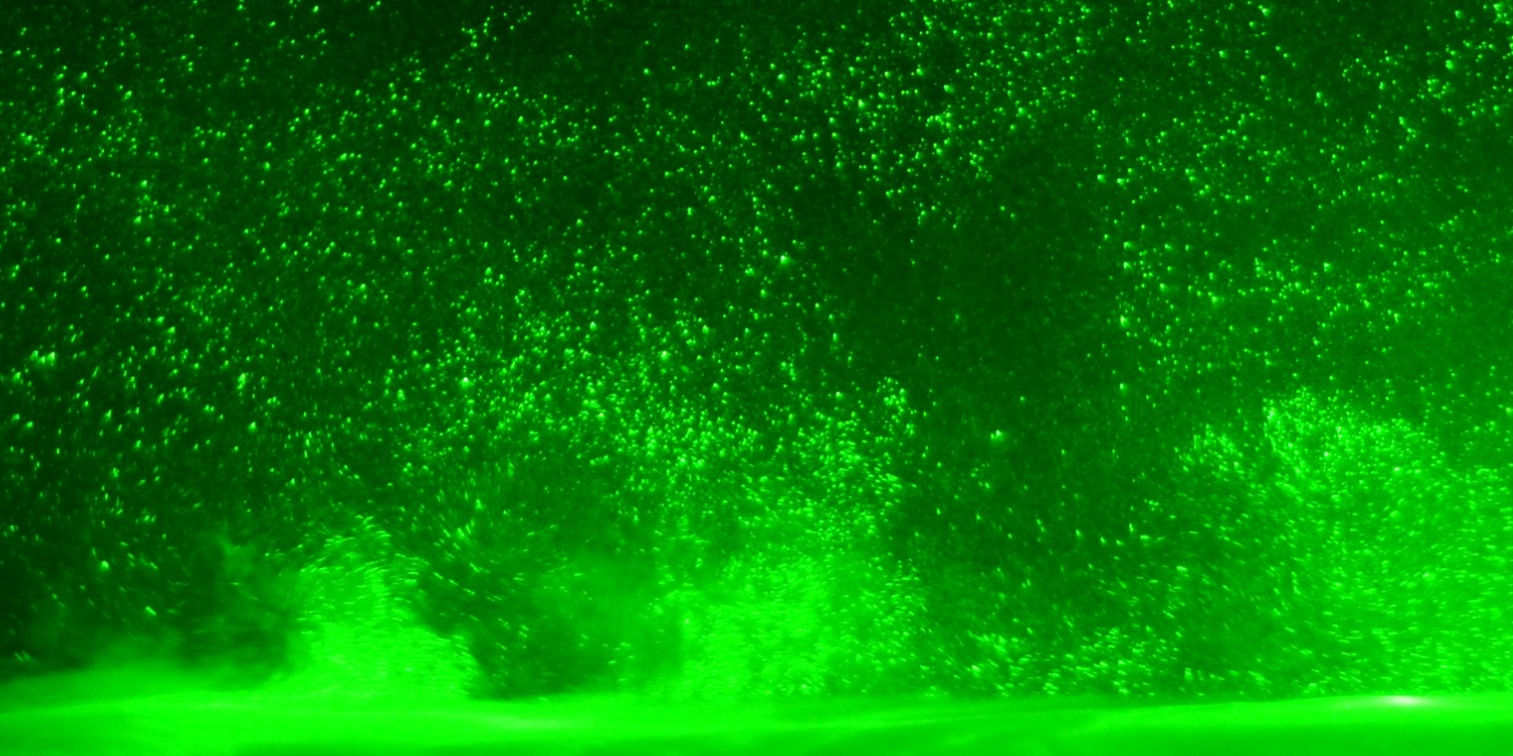
Dual-Phase Results
Re_{tip} = 1.60 x 10⁴
  Single-bladed rotor
45 – 63 μm glass sediment
Notes:
Increasing Retip again shows another increase in mobilized sediment. In this image, large quantites of sediment have been entrained to much higher altitudes off the sedient bed. The vortex locations <CLICK>

Slide 53
Dual-Phase Results
Re_{tip} = 1.60 x 10⁴
  Single-bladed rotor
45 – 63 μm glass sediment
Notes:
Continue to show how vortices drive sediment mobilization

Slide 54
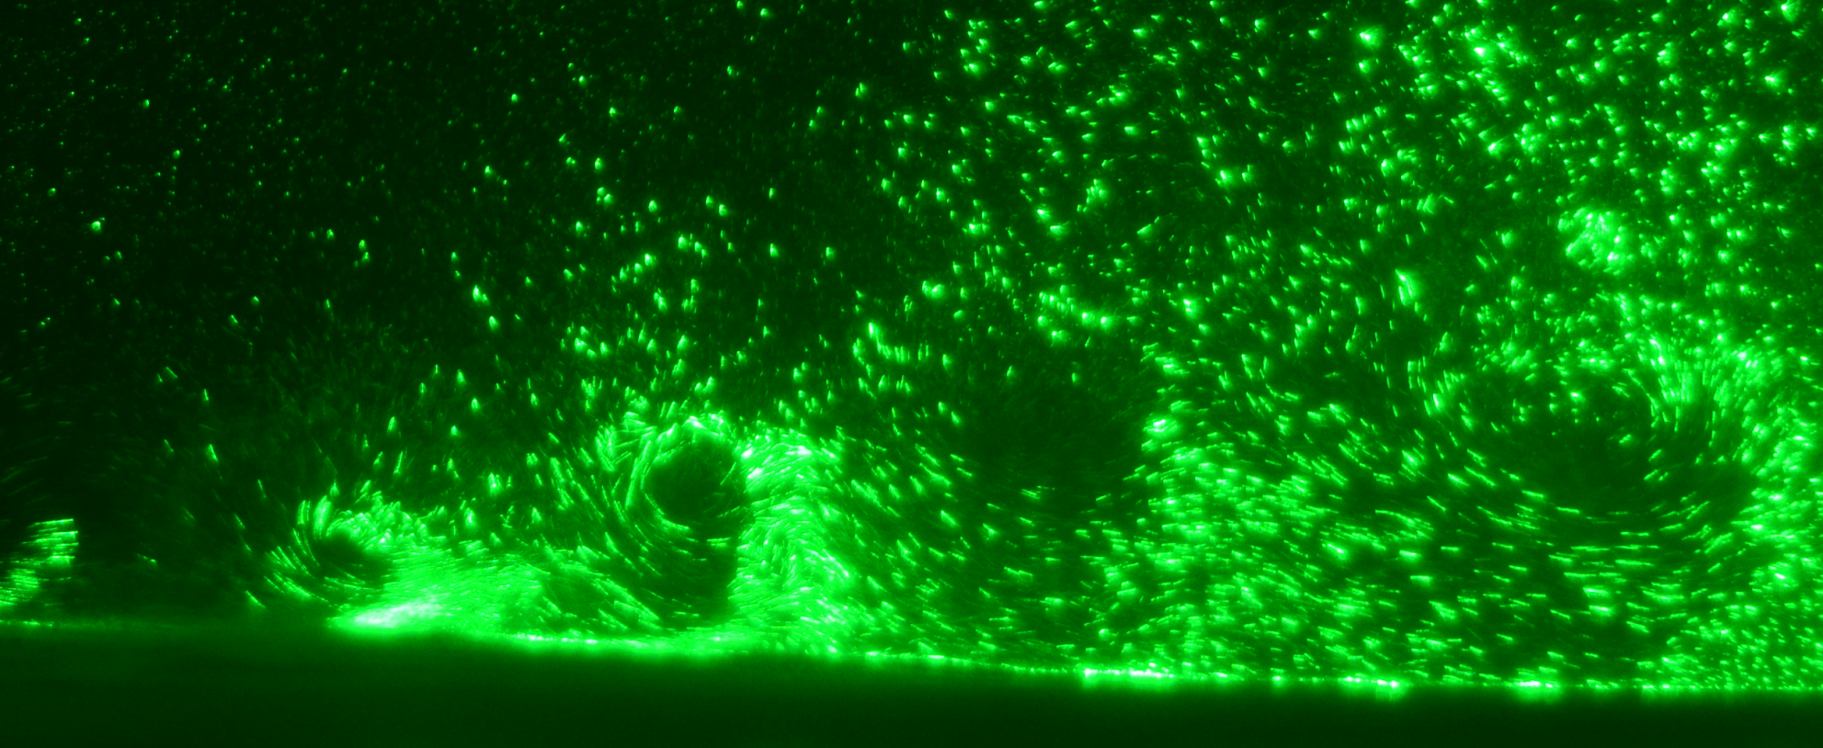
Dual-Phase Results
Re_{tip} = 5.98 x 10⁴
  Single-bladed rotor
44 – 125 μm steel sediment
Notes:
Changing the sediment to the steel particulate and increasing the tip reynolds number 4 times that shown in the previous slide shows how different sediments react differently in the flow. While there is a large amount of sediment entrained in the flow, there appears to be qualitatively less than seen before.
This observation bears out when glass sediment was once again used, but at the same tip reynolds number as shown here.

Slide 55
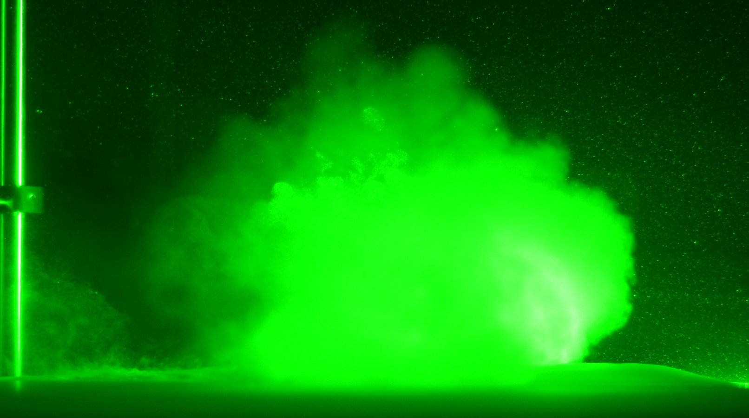
Dual-Phase Results
Re_{tip} = 5.98 x 10⁴
  Single-bladed rotor
45 – 63 μm glass sediment
Notes:
The intense cloud of sediment uplifted during this test case is very remeniscent of a brownout cloud observed at the full scale. During testing the tank became completely opaque for a large period of time. While little data could be gathered from this test case, it is nevertheless important to note that something has happened between this glass test case and the previous test with glass to greatly increase the amount of sediment mobilized. Some threshold has been exceeded that caused an optically impenetrable brownout like cloud to be formed

Slide 56
New Scaling Parameters
Notes:
An objective of this research was to develop new similarity parameters that avoid the issues found with the classical parameters

Slide 57
Buckingham-Pi Analysis
Previous work and flow visualization has shown that vortices affect sediment uplift
Dimensional analysis to find new similarity parameters
Flow/vortex properties
R, D_{p}, U_{char}, U_{F}, …
V_{θmax}, Γ_{ν}, ...
Buckingham-Pi Analysis
New Similarity Parameters
Notes:
The flow in a rotor is unsteady, but classical similarity parameters are based on steady flow assumptions. This is a problem, especially since previous work and the flow visualization presented here show that vortices affect sediment uplift. It was therefore necessary to create new parameters that account for the unsteady characteristics of the flow.
Dimensional analysis is one way of finding new similarity parameters.
To do this, I considered conventional characteristics, such as rotor radius, sediment particle diameter, characteristic velocity and terminal velocity. I also included properties of the vortices found in the flow. Terms such as maximum swirl velocity, and vortex strength were included <CLICK> in a Buckingham-Pi Dimensional Analysis. <CLICK>
This analysis resulted in several new similarity parameters.

Slide 58
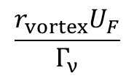















Buckingham-Pi Results
$$\frac{U_{char}}{U_{F}}$$
$$\frac{ρ}{ρ_{s}}$$
$$\frac{V_{tip}}{U_{F}}$$
$$\frac{U_{F}}{V_{θmax}}$$
$$\frac{RU_{F}}{Γ_{ν}}$$
$$\frac{r_{vortex}U_{F}}{Γ_{ν}}$$
$$\frac{r_{vortex}}{D_{p}}$$
$$\frac{r_{vortex}U_{F}}{Γ_{ν}}$$
$$\frac{D_{p}U_{F}}{Γ_{ν}}$$
$$\frac{V_{θmax}}{U_{F}}$$
$$\frac{A_{vortex}}{{D_{p}}^{2}}$$
$$\frac{{U_{t}}_{}^{∗}}{V_{θmax}}$$
$$\frac{{U_{t}}_{}^{∗}}{U_{F}}$$
$$\frac{R}{D_{p}}$$
$$\frac{D_{p}U_{F}}{Γ_{ν}}$$
$$\frac{A_{vortex}t}{Γ_{ν}}$$
Notes:
Presented here is a list of the similarity parameters resulting from the buckingham pi analysis. Note that several <CLICK> classical similarity parameters were output by the dimensional analysis.
The amount of new parameters was narrowed down, first by removing unuseful parameters, and then by selecting parameters that seemed the most appropriate.

Slide 59

Selected New Parameters
$\frac{Γ_{ν}}{D_{p}U_{F}}$ Mobile inertia ratio
$\frac{Γ_{ν}}{D_{p}U_{∗t}}$ Stationary inertia ratio
$\frac{V_{θmax}}{U_{F}}$ Terminal-swirl velocity ratio
$\frac{V_{θmax}}{U_{∗t}}$ Threshold-swirl velocity ratio
$\frac{{V_{θmax}2}_{}^{ }}{{U_{t}}_{}^{∗}U_{F}}$ Terminal/threshold-swirl velocity ratio
Notes:
The first new similarity parameter is the mobile inertia ratio. This ratio describes the vortex strength (Gamma nu) as compared to the sediment particle diameter and the particle terminal velocity. This parameter can be thought of as a measure of how easy or hard it is to keep sediment entrained in the flow compared to how much energy the flow has to keep it entrained.
The second similarity parameter, the stationary inertia ratio replaces the particle terminal velocity with the particle threshold friction velocity. Instead of a measure of how easy or hard it is to keep sediment entrained, this parameter essentialy describes the difficulty in mobilizing stationary sediment, compared to the flows available energy.
The third and fourth parameters mirror the first two, but replace the vortex strength with maximum swirl velocity, a measure of the fastest flow found in a vortex.
The final parameter is a marriage between the previous two, it was theorized that both terminal velocity and threshold velocity have importance in the brownout problem, so a parameter that takes both into account was potentially useful.

Slide 60
Particle Analysis
Notes:
To determine which similarity parameters were useful in describing and scaling brownout, an analysis of the dual-phase flow visualization was necessary. In order to determine a measure of mobilzed sediment a threshold calculation was performed.

Slide 61

Threshold Calculation
Raw Image
Notes:
The process of measuring brownout intensity started with a raw image of the flow visualization.

Slide 62
Threshold Calculation
Reduction to 8-bit Image (Greyscale)
Notes:
The image was reduced to a 8-bit greyscale, and

Slide 63
Threshold Calculation
Background Subtraction
Notes:
Then the background of the image was subtracted, also taking much of the nylon PIV tracer particulate out of the image, what was left was the sediment illuminated by the laser.

Slide 64
Threshold Calculation
Set Image Threshold
Notes:
The sediment was identified by an image threhsolding program

Slide 65

Threshold Calculation
Threshold Calculation
Notes:
The amount of sediment was then calculated by measuring the ratio of threhsolded sediment to the total area. The values of sediment obscuration are described by the percentage of the region covered with thresholded area. Two regions were measured for their quantity of mobilized sediment, a near ground region, which encompassed the area that the vortex traveled, and an upper region, the space going from the tops of the vortices to approximately equal to the tip path plane. The measured percentage of obscured area was plotted agaist the classical parameters, as well as the new similarity parameters.

Slide 66

Particle Size Ratio D_{p}/R
Notes:
Shown here is the sediment obstruction % as a function of the classical similarity parameter particle size ratio. This parameter is a geometric parameter, and does not take into account flow conditions, not to mention vortex characteristics. There appears to be no trend to the data.

Slide 67


Mobile Inertia Ratio $\frac{Γ_{ν}}{D_{p}U_{F}}$
Notes:
Shown here is sediment obstruction % as a function of the new similarity parameter, Mobile inertia ratio. Down in the left hand corner, it can be seen that for increasing similarity parameter value, the amount of sediment obstruction increases. The dual phase flow visualization images presented earlier showed that increases in tip reynolds number resulted in moderate increases in sediment mobilization. In the upper corner here, is the point that represents the highest speed glass sediment case, where the entire image was taken up by sediment, and the image became completely obstructed. The increases in sediment obstruction seem to match increases in similarity parameter values. In this case, while no specific trends are obvious, there is at least order to the data.
This plot shows that while there is more order than seen for the classical parameter value, the data does not show any good trends.

Slide 68


Stationary Inertia Ratio $\frac{Γ_{ν}}{D_{p}U_{∗t}}$
Notes:
The stationary inertia ratio differs slightly from the Mobile inertia ratio, visible here is a point given by the steel particulate. This point lies here because while the steel sediment has a much higher terminal velocity than the glass, it has a relatively similar friction threshold velocity. The dual phase flow visualization showed that despite a very high tip reynolds number, there was not a equally larger amount of sediment uplifted as seen in the glass case, which had the same operating condition. This shows an important point. While sediment may be easy to initialy mobilize, there are other factors that can prevent it from forming a brownout cloud. The higher settling rate of the steel particulate prevented it from forming. The steel particulate has a higher settling rate than the glass sediment, which stops it from forming the same type of brownout cloud as seen from the glass here. This shows the need for multiple similarity parameters that together define the physics of brownout more completely.

Slide 69


Terminal-Swirl velocity ratio $\frac{V_{θmax}}{U_{F}}$
Notes:
Presented here is the terminal-swirl velocity ratio. This parameter is related to the mobile inertia ratio, using the maximum swirl velocity instead of vortex circulation. This substitution has spread out the parameter values along the x axis. There is not enough data to fit a curve, but sediment obscuration does increase with parameter value. Using the swirl velocity in this parameter has allowed for perhaps a more sensitive similarity parameter.

Slide 70


Threshold-Swirl velocity ratio $\frac{V_{θmax}}{U_{∗t}}$
Notes:
The threshold-swirl velocity ratio also has its points spread out like the terminal swirl velocity ratio just examined. Like the stationary inertia ratio, there is a point here, caused by the steel particulate. This similarity parameter may or may not turn out to be a useful parameter, but it does reinforce the importance of taking important characteristics into account.

Slide 71


$$\frac{V_{θmax}2}{{UFU}_{∗t}}$$
Notes:
The final parameter, which takes into account both terminal velocity and threshold friction velocity is shown here. Despite including the threshold friction velocity as in the stationary inerta ratio and the threshold swirl ratio, this parameter does not have the point laying by itself. This parameter is potentially the most useful because it accounts for both sediment mobilization and suspension.

Slide 72
Conclusions
Unique values of similarity parameters were achieved by performing experiments in water
Similarity parameters were classified as geometric or operational parameters
Classical similarity parameters were found to be inadequate for rotor flows because they do not capture unsteady effects
New similarity parameters that include vortex characteristics were found to better characterize the brownout phenomenon
Notes:
So in conclusion, The experiments performed here achieved unique similarity parameter values by performing the experiments in water. These parameters were evaluated, and a classification system was developed to describe geometric and operational similarity parameters.
Analysis showed that the classical similarity parameters are inadequate for rotor flows. The ambiguity of the characteristic velocity term, and the fact that they were developed for steady flows, leads to issues applying them to the unsteady, vortex driven flows encountered in a rotor hovering in ground effect.
Therefore, new similarity parameters were developed to include vortex characteristics. These new parameters were found to better characterize the brownout phenomenon.

Slide 73
Suggestions for Future Work
Gaps in data prevent identification of trends
  Further experimentation in the gap region will show if trends exist
Dual-phase particle image velocimetry
  Gain a better measure of uplifted sediment
?
    Experiments with different sediment materials
    Different rotor operating conditions
    A combination of the two
Notes:
While the new parameters hold much promise in brownout model scaling, there are gaps in the data that need to be explored to determine if solid trends exist. Further experimentation with different sediment materials, as well as different rotor operating conditions will help fill in the gap
While the sediment obscuration analysis used in this research performed admirably in measuring mobilized sediment, it is not a highly accurate quanitative analysis. Dual-phase particle image velocimetry, which can identify, separate, and track sediment particles would help gain a better understanding of the brownout problem and how to best scale experiments for future research.

Slide 74
Effects of Model Scaling on
Sediment Transport in Brownout
Mark Glucksman-Glaser
Committee Chair:
Dr. Anya R. Jones
Committee Members:
Dr. J. Gordon Leishman
Dr. James D. Baeder
Department of Aerospace Engineering
University of Maryland
Notes:
I would again like to thank my committee, chaired by Dr. Jones and including Drs. Leishman and Baeder for agreeing to evaluate my research. I would also like to thank the AFOSR for their generous funding of my research. And finally for all of you for coming here and listening to what I had to say. Are there any questions?

Slide 75




Prior Work
Full-scale brownout flight tests:
  DARPA Sandblaster (2007)
  Wong & Tanner (2010)
Laboratory-scale rotor tests:
  Lee et al. (2008)
  Nathan et al. (2008)
  Haehnel & Dade (2008)
  Johnson et al. (2009)
  Sydney et al. (2011)

Slide 76


Instantaneous PIV

Slide 77

Velocity Excursions

Slide 78

Velocity Excursions

Slide 79

Vorticity Plot
120 RPM ψ = 60˚ (Cutoff at ω = -0.25 s⁻¹)

Slide 80

Q-Criterion
120 RPM ψ = 60˚ (Cutoff at Q = 2)

Slide 81

Gamma Method
120 RPM ψ = 60˚ (Cutoff at Γ = 0.6)
Effective in high areas of shear
Can identify vortices further downfield than Q-Criterion
Useful in determining vortex sizing

Slide 82
Vortex Identification
New scaling parameters to be based on vortex strength
  Circulation
  Swirl velocities
  Core radius
Finding vortex locations vital to finding their properties
  Three methods used
    Vorticity contours
    Q-criterion
    Gamma Method

Slide 83


Vortex Characteristics
Obtaining vortex characteristics
  Vortex Reynolds number ${Re}_{v}= \frac{Γ_{v}}{v}$
    Circulation box method
Swirl Velocity
Vortex Core Size

Slide 84
Buckingham-Pi Analysis
Dimensional analysis to find other possible similarity parameters
Takes into account all known characteristics
Outputs new and previously uncharacterized similarity parameters

Slide 85
Buckingham-Pi Analysis
 | Variable |  | Basic Units
Rotor Radius | R | m | L |  | k=17 | r=3
Rotor Chord | C | m | L
Particle diameter | D_p | m | L |  | k-r
Characteristic velocity (Time Average) | Uchar | m/s | L*T^-1 |  | 14 | π-terms
gravitational Constant | g | m/s^2 | L*T^-2
Particle terminal velocity | Uf | m/s | L*T^-1 |  |  | 3 repeating terms
Boundary layer thickeness | L* | m | L
kinematic viscosity | nu | m^2/s | L^2*T^-1
threshold friction velocity | u* | m/s | L*T^-1
sediment density | rhos | kg/m^3 | M*L^-3
fluid density | rho | kg/m^3 | M*L^-3
Passing Frequency | 1/t | 1/s | T^-1
vortex circulation | gammanu | m^2/s | L^2*T^-1
vortex core size | Rvortex | m | L
maximum swirl velocity | VthetaPeak | m/s | L*T^-1
Vortex Area | Avortex | m^2 | L^2
Tip Speed | Vtip | m/s | L*T^-1

Slide 86
New Similarity Parameters

Slide 87
Results
 | Near Wall | Overall | Upper Region
80 RPM Glass | 3.205% | 1.653% | 0.563%
100 RPM Glass | 8.052% | 4.082% | 0.543%
120 RPM Glass | 14.788% | 8.711% | 2.597%
450 RPM Glass | 97.576% | 98.015% | 98.538%
120 RPM Steel | 0.038% | 0.037% | 0.035%
450 RPM Steel | 7.857% | 3.462% | 0.756%
Values represent area of image obscured by particles
A measure of brownout
Compared against calculated similarity parameters

Slide 88
Future Work
Explore the relationship between scaling parameters and particle uplift
 | Case 1 | Case 2 | Case 3 | Case 4
Desired SP | 7.5e+05 | 1.5e+06 | 2.5e+06 | 3.5e+06
Required RPM (same particles) | 576 | 840 | 1109 | 1332
Required Density (kg/m^3 at 450 RPM) | 1940 (Sand, Glass, Magnesium) | 1463 (Sand, Glass, Aluminum Oxide, Caliche) | 1276 (Sand, Glass, Quartz, Bakelite) | 1196 (Sand, Glass)

